Slide 1
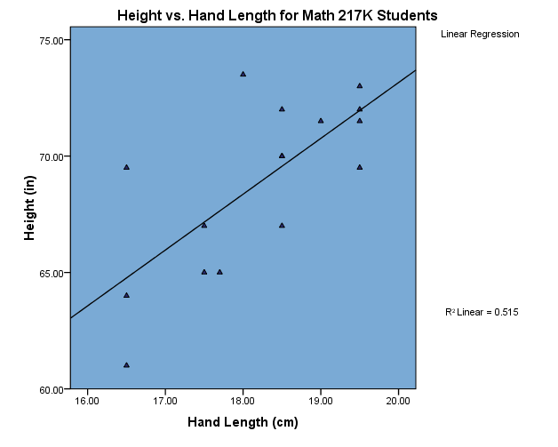

Slide 2
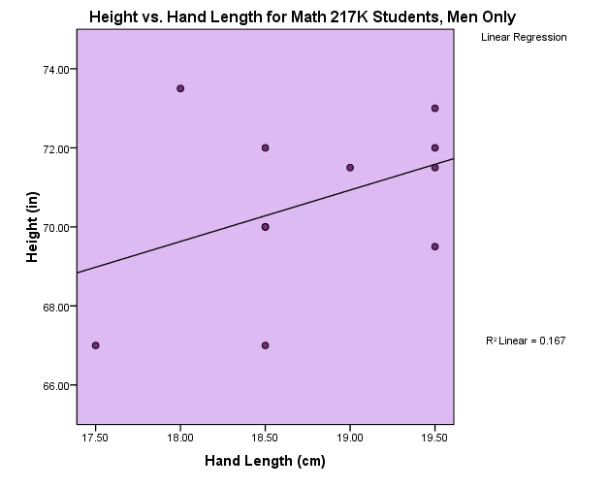

Slide 3
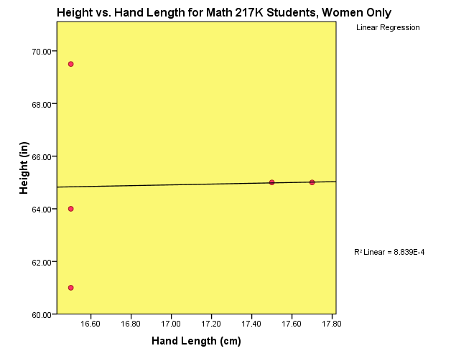

Slide 4
How do you explain that…
Hand length is a moderate predictor of height for Math 217K students, even though:
Hand length is a very weak predictor of height for male students in Math 217K.
Hand length is basically worthless as a predictor of height for female students in Math 217K.

Slide 5
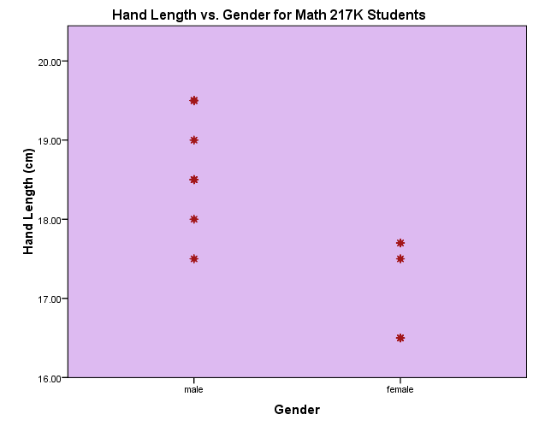

Slide 6
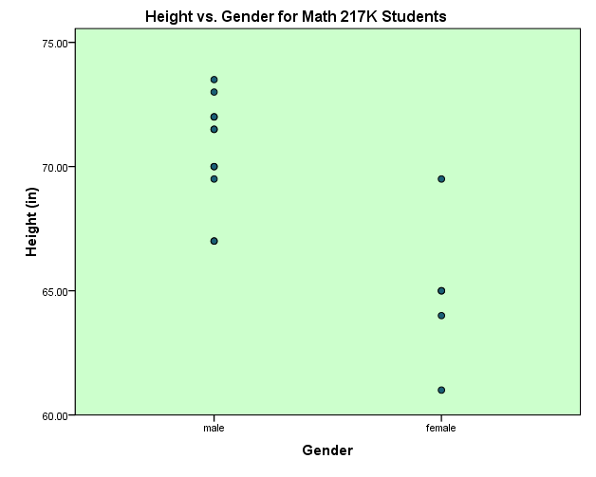

Slide 7
Conclusion
Hand length is a good predictor of gender, and gender is strongly associated with height.
Hand length is moderately good at predicting students’ heights, but only because it gives an indication of their gender.
Bottom line: If the variables in a scatterplot are associated with a third variable, that variable’s effects should also be taken into account.

Slide 8
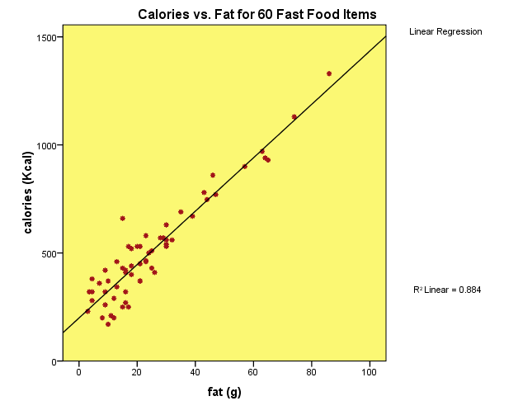
Regression Equation
Use the information on p.137 to find the equation of the regression line for calories vs. fat.
Note: Average fat content is 24.75 grams, with a standard deviation of 18.249 grams.
Average calorie content is 505.23 calories, with a standard deviation of 239.856 calories.

