Slide 1
David S. Moore • George P. McCabe
Introduction to the
Practice of Statistics
Sixth Edition
Chapter 3:
Producing Data
Copyright © 2009 by W. H. Freeman and Company

Slide 2
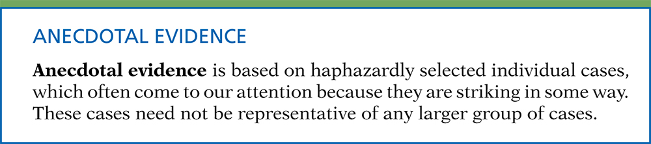
Definition, pg 172
Introduction to the Practice of Statistics, Sixth Edition
© 2009 W.H. Freeman and Company

Slide 3

Definition, pg 172
Introduction to the Practice of Statistics, Sixth Edition
© 2009 W.H. Freeman and Company

Slide 4
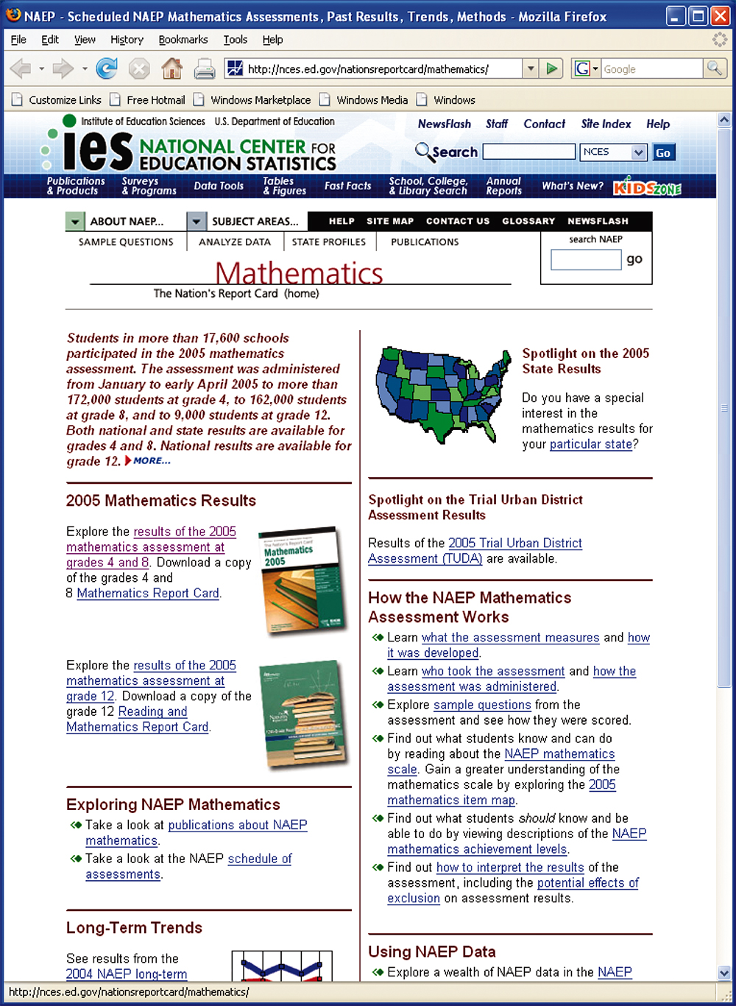
Figure 3.1
Introduction to the Practice of Statistics, Sixth Edition
© 2009 W.H. Freeman and Company

Slide 5
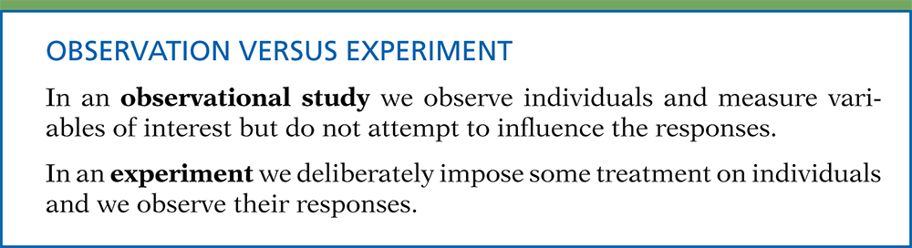
Definition, pg 175
Introduction to the Practice of Statistics, Sixth Edition
© 2009 W.H. Freeman and Company

Slide 6
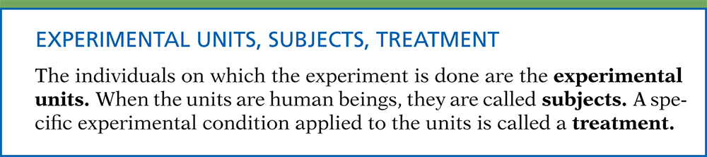
Definition, pg 178
Introduction to the Practice of Statistics, Sixth Edition
© 2009 W.H. Freeman and Company

Slide 7
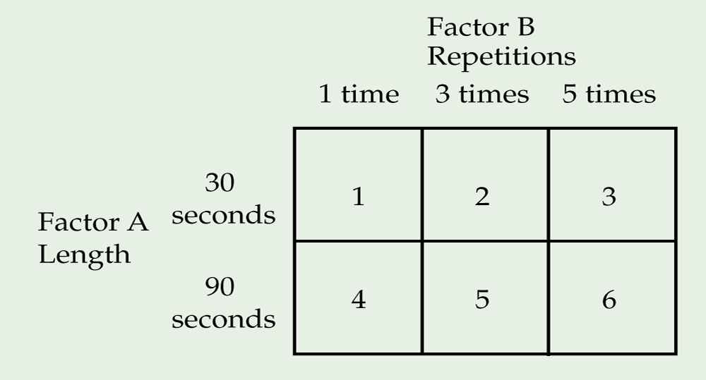
Figure 3.2
Introduction to the Practice of Statistics, Sixth Edition
© 2009 W.H. Freeman and Company

Slide 8

Definition, pg 181
Introduction to the Practice of Statistics, Sixth Edition
© 2009 W.H. Freeman and Company

Slide 9
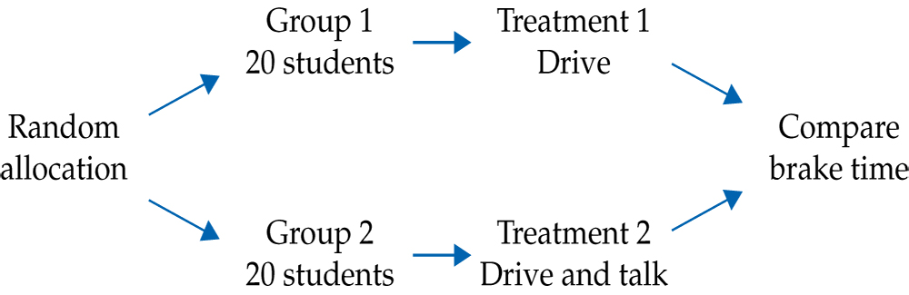
Figure 3.3
Introduction to the Practice of Statistics, Sixth Edition
© 2009 W.H. Freeman and Company

Slide 10
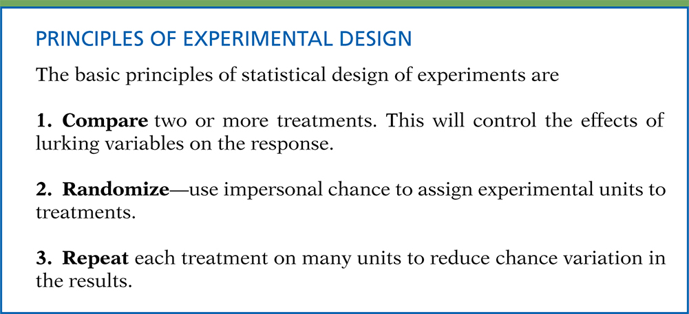
Definition, pg 183–184
Introduction to the Practice of Statistics, Sixth Edition
© 2009 W.H. Freeman and Company

Slide 11
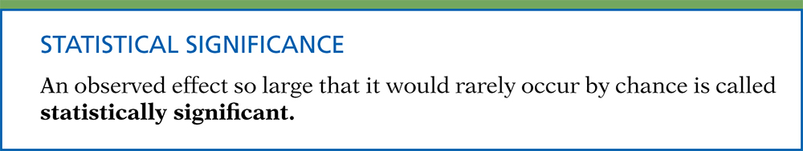
Definition, pg 184
Introduction to the Practice of Statistics, Sixth Edition
© 2009 W.H. Freeman and Company

Slide 12
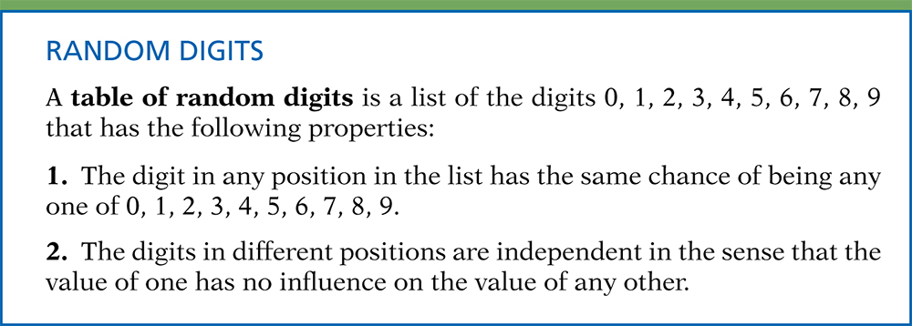
Definition, pg 184
Introduction to the Practice of Statistics, Sixth Edition
© 2009 W.H. Freeman and Company

Slide 13
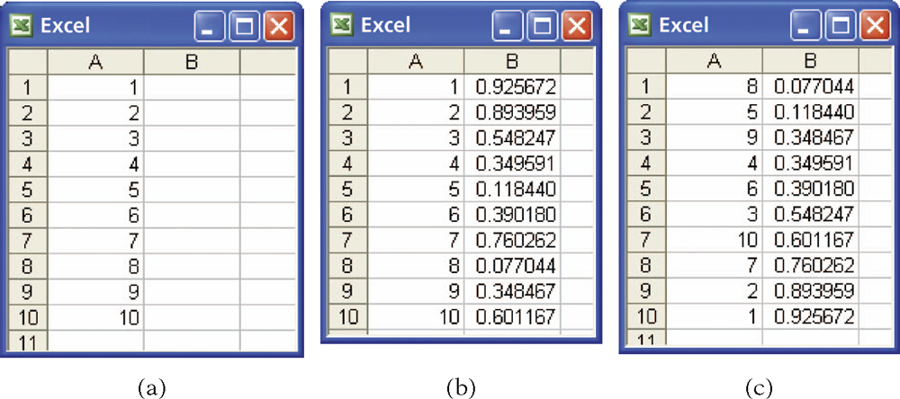
Figure 3.4
Introduction to the Practice of Statistics, Sixth Edition
© 2009 W.H. Freeman and Company

Slide 14
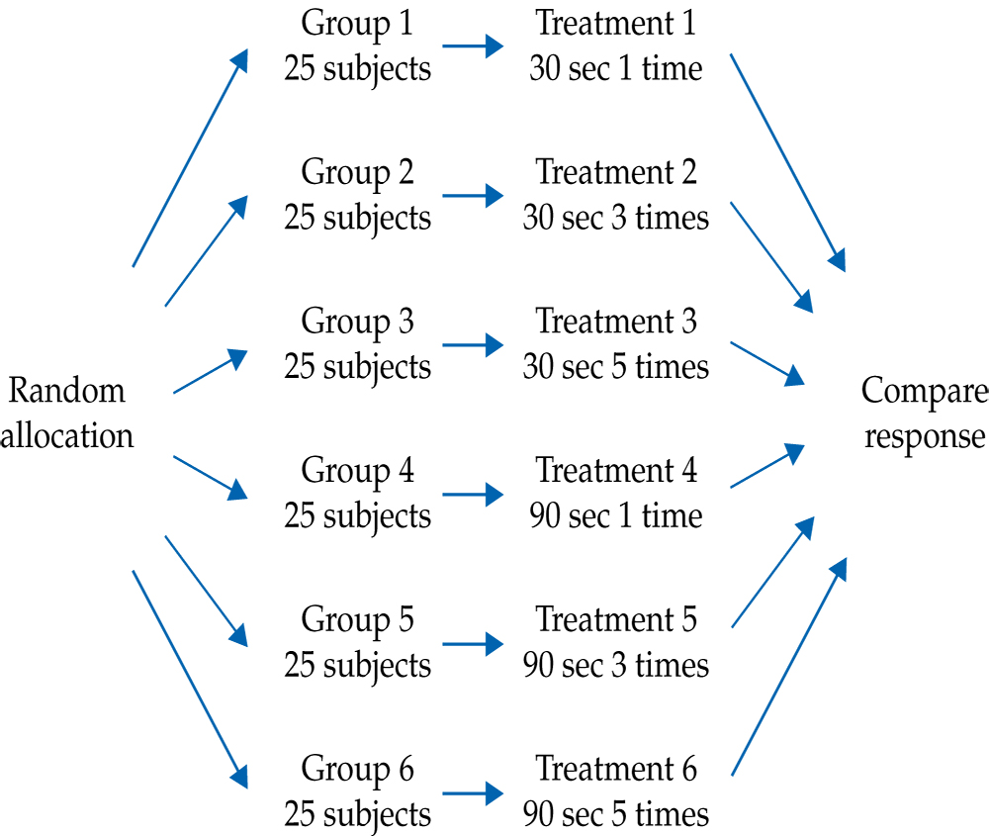
Figure 3.5
Introduction to the Practice of Statistics, Sixth Edition
© 2009 W.H. Freeman and Company

Slide 15
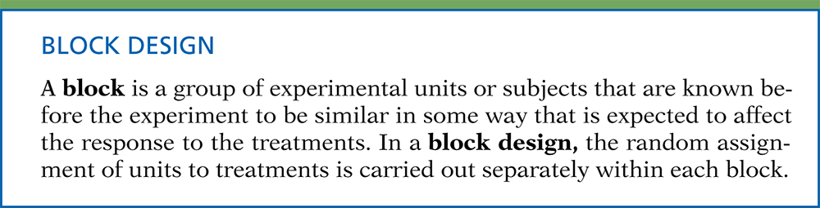
Definition, pg 190
Introduction to the Practice of Statistics, Sixth Edition
© 2009 W.H. Freeman and Company

Slide 16
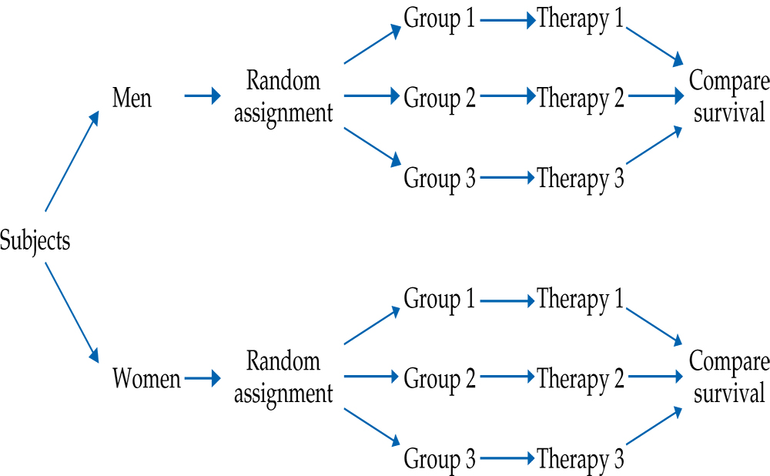
Figure 3.6
Introduction to the Practice of Statistics, Sixth Edition
© 2009 W.H. Freeman and Company

Slide 17
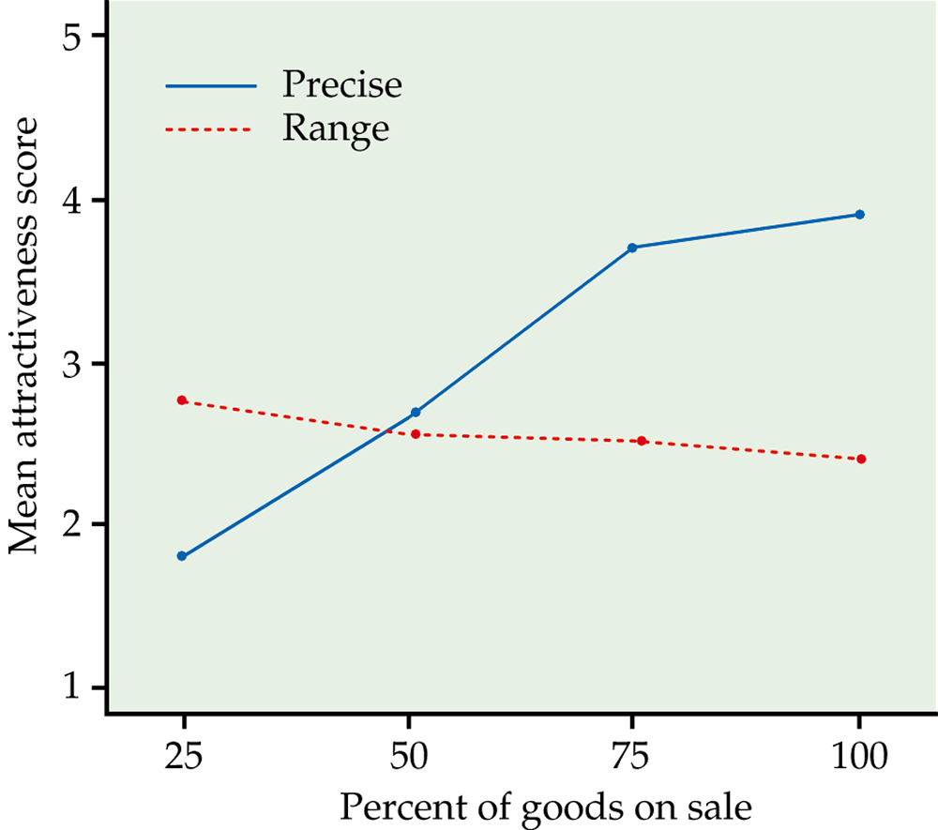
Figure 3.7
Introduction to the Practice of Statistics, Sixth Edition
© 2009 W.H. Freeman and Company

Slide 18
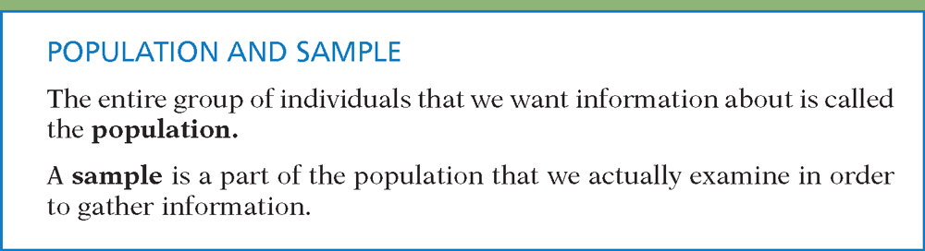
Definition, pg 198
Introduction to the Practice of Statistics, Sixth Edition
© 2009 W.H. Freeman and Company

Slide 19
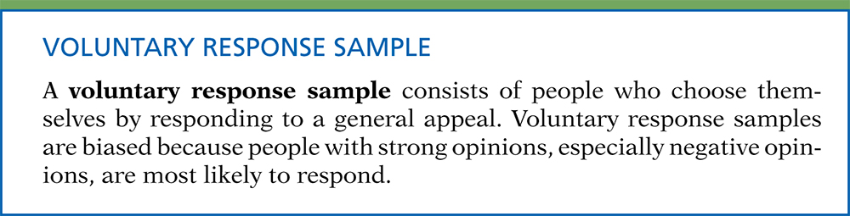
Definition, pg 200
Introduction to the Practice of Statistics, Sixth Edition
© 2009 W.H. Freeman and Company

Slide 20
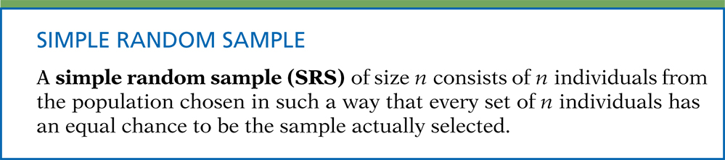
Definition, pg 200
Introduction to the Practice of Statistics, Sixth Edition
© 2009 W.H. Freeman and Company

Slide 21
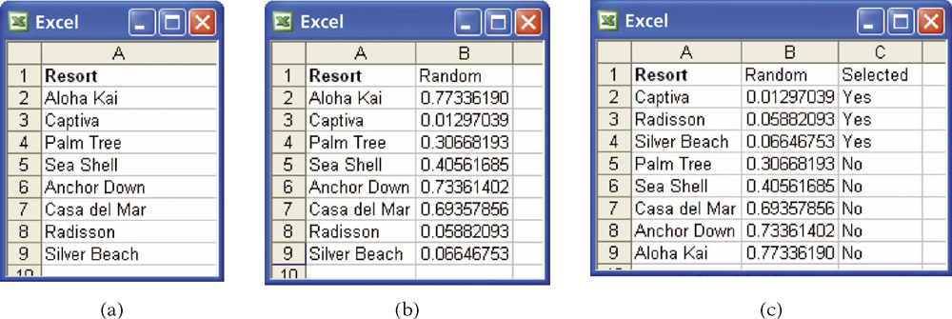
Figure 3.8
Introduction to the Practice of Statistics, Sixth Edition
© 2009 W.H. Freeman and Company

Slide 22
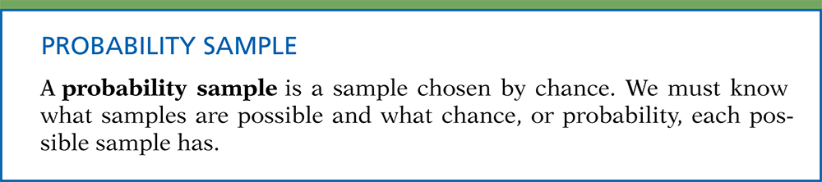
Definition, pg 202
Introduction to the Practice of Statistics, Sixth Edition
© 2009 W.H. Freeman and Company

Slide 23
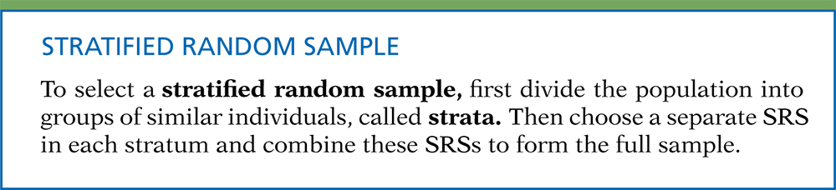
Definition, pg 203
Introduction to the Practice of Statistics, Sixth Edition
© 2009 W.H. Freeman and Company

Slide 24
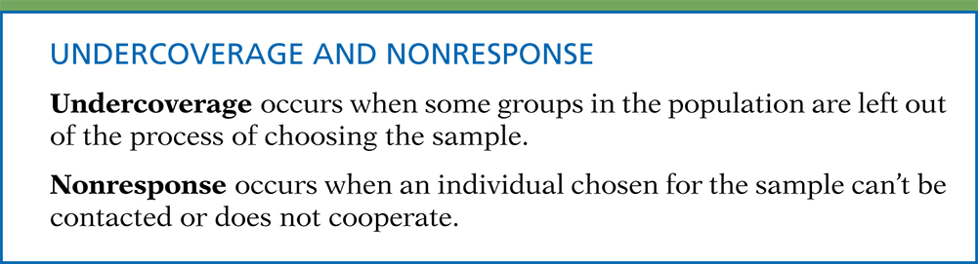
Definition, pg 204
Introduction to the Practice of Statistics, Sixth Edition
© 2009 W.H. Freeman and Company

Slide 25
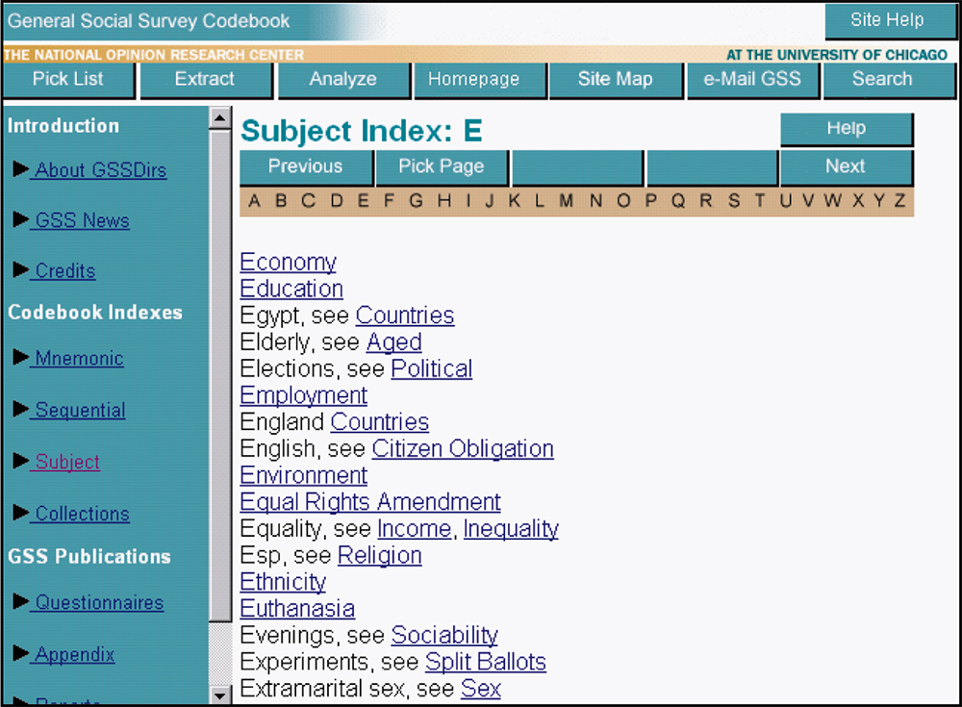
Figure 3.9
Introduction to the Practice of Statistics, Sixth Edition
© 2009 W.H. Freeman and Company

Slide 26
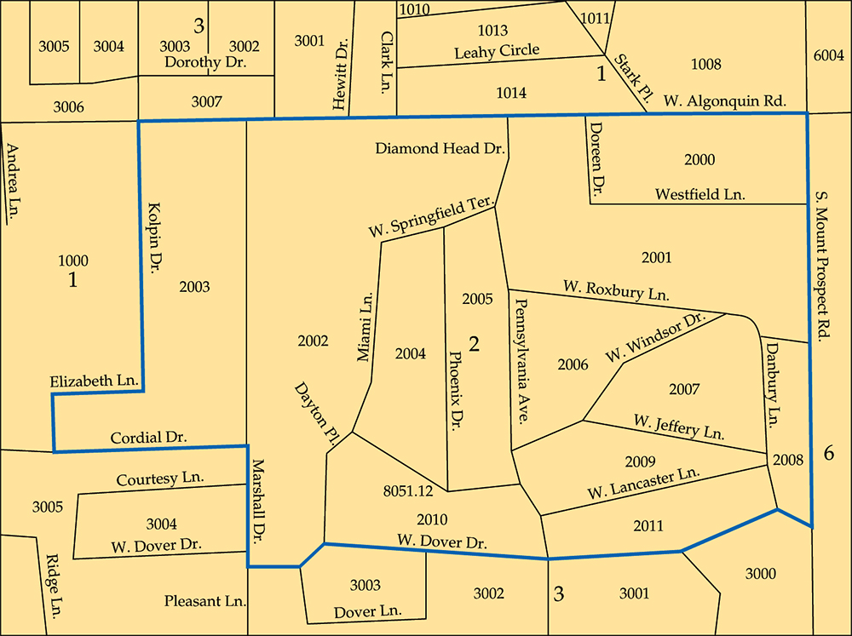
Figure 3.10
Introduction to the Practice of Statistics, Sixth Edition
© 2009 W.H. Freeman and Company

Slide 27
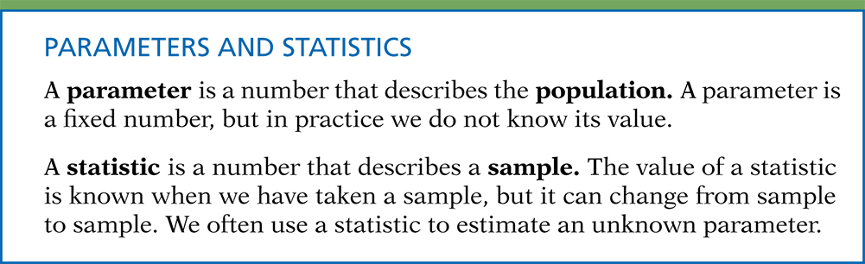
Definition, pg 212
Introduction to the Practice of Statistics, Sixth Edition
© 2009 W.H. Freeman and Company

Slide 28
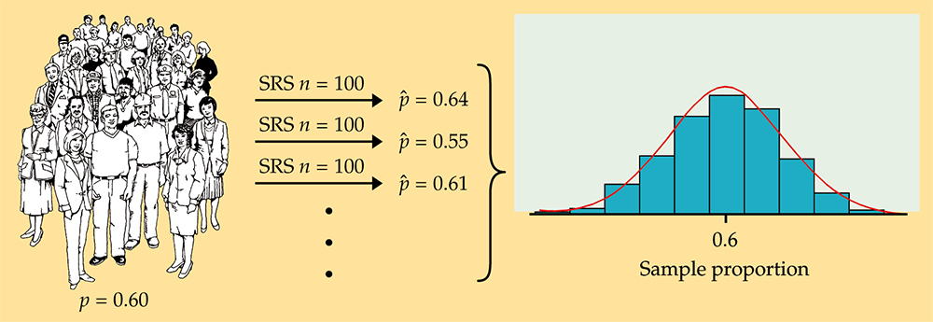
Figure 3.11
Introduction to the Practice of Statistics, Sixth Edition
© 2009 W.H. Freeman and Company

Slide 29
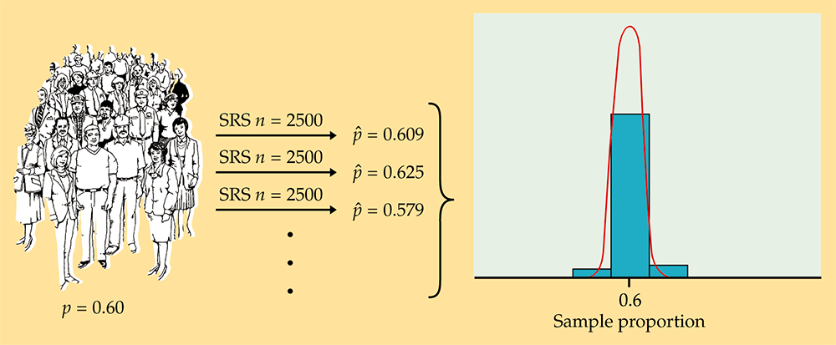
Figure 3.12
Introduction to the Practice of Statistics, Sixth Edition
© 2009 W.H. Freeman and Company

Slide 30
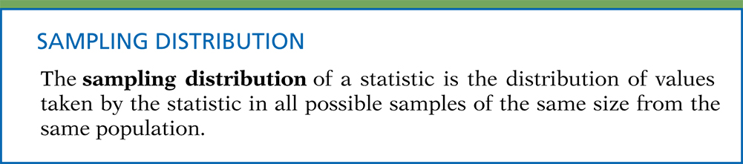
Definition, pg 215
Introduction to the Practice of Statistics, Sixth Edition
© 2009 W.H. Freeman and Company

Slide 31
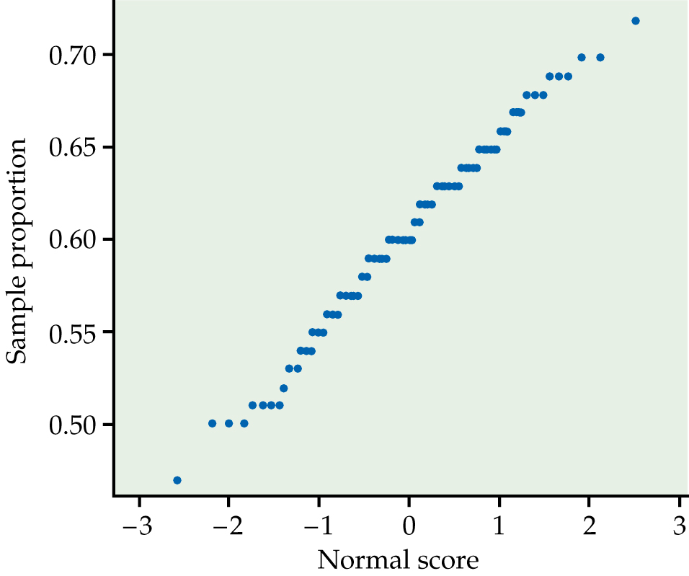
Figure 3.13
Introduction to the Practice of Statistics, Sixth Edition
© 2009 W.H. Freeman and Company

Slide 32
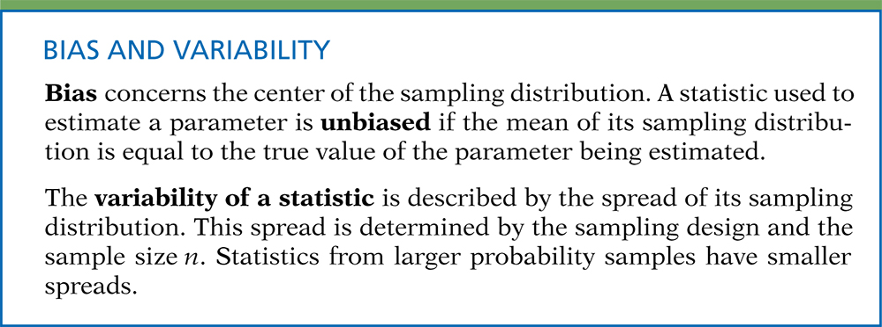
Definition, pg 217
Introduction to the Practice of Statistics, Sixth Edition
© 2009 W.H. Freeman and Company

Slide 33
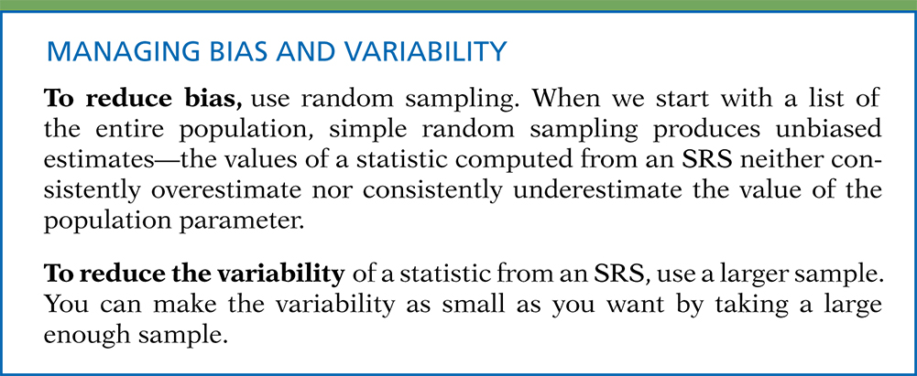
Definition, pg 217–218
Introduction to the Practice of Statistics, Sixth Edition
© 2009 W.H. Freeman and Company

Slide 34
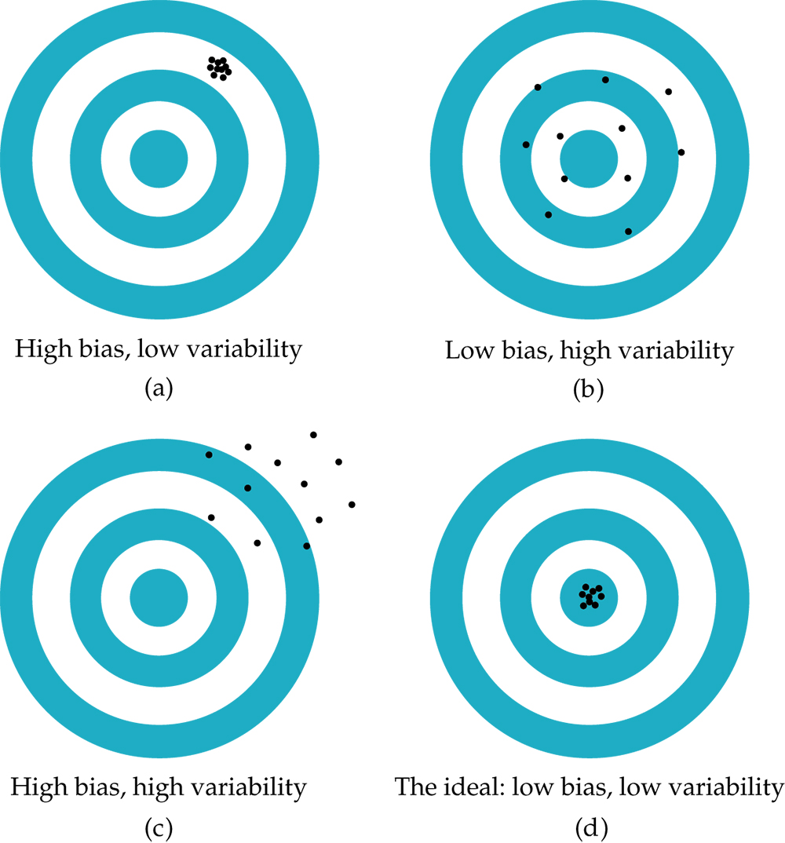
Figure 3.14
Introduction to the Practice of Statistics, Sixth Edition
© 2009 W.H. Freeman and Company

Slide 35
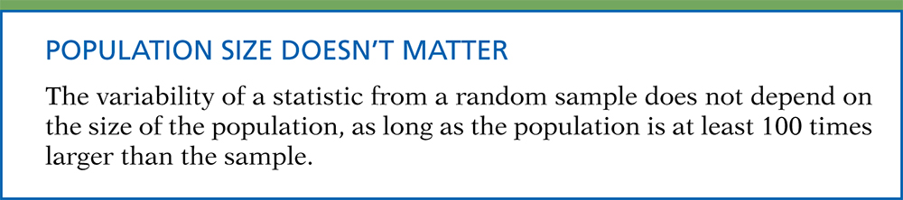
Definition, pg 219
Introduction to the Practice of Statistics, Sixth Edition
© 2009 W.H. Freeman and Company

Slide 36
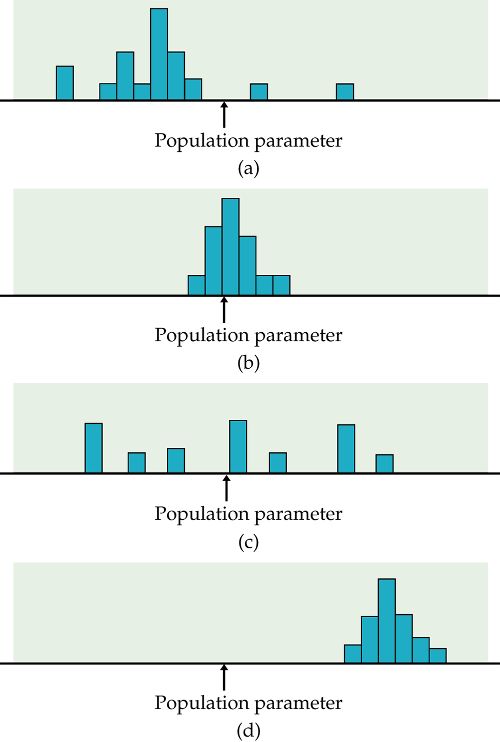
Figure 3.15
Introduction to the Practice of Statistics, Sixth Edition
© 2009 W.H. Freeman and Company

Slide 37
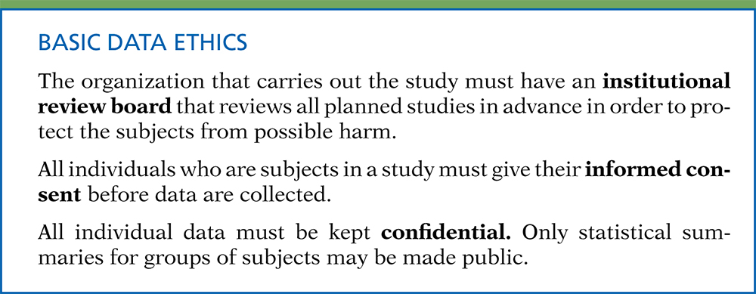
Definition, pg 225
Introduction to the Practice of Statistics, Sixth Edition
© 2009 W.H. Freeman and Company

