Slide 1
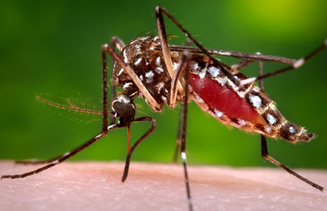
Introduction to Medical Entomology
Hanover College, Health Sciences Summer Academy
June 12, 2018

Slide 2
Agenda
Introductions
Learn about entomology
Explore medical entomology
Learn how biologists trap and identify disease vectors

Slide 3
What is Entomology?

Slide 4
Relative species diversity
How many species of vertebrates are there on Earth?
How many species of mammal are there on Earth?
How many species of insects are there on Earth?
Notes:
66,000 species of vertebrates (5600 or so mammals); 1.3 million invertebrates, 1 million insects; 307, 000 plants

Slide 5
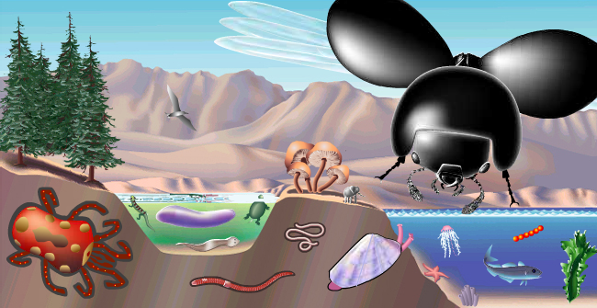
Beetles: >350,000 species
Flies: >150,000 species
Moths, butterflies: 180,000 species
Wasps, bees, ants: >130,000

Slide 6
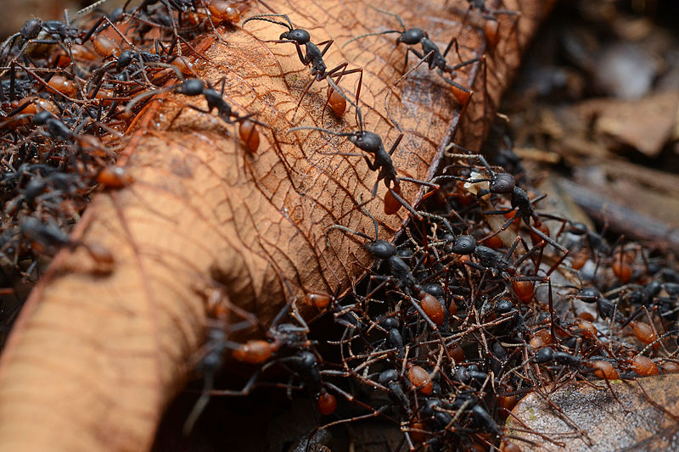
In the Brazilian Amazon rain forest, the dry weight of all the ants is approximately four times that of all the land vertebrates (mammals, birds, reptiles, and amphibians) combined.

Slide 7
Are any insects beneficial or useful to humans?

Slide 8
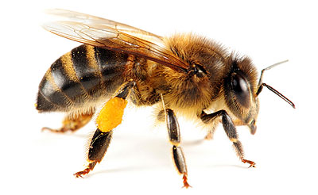
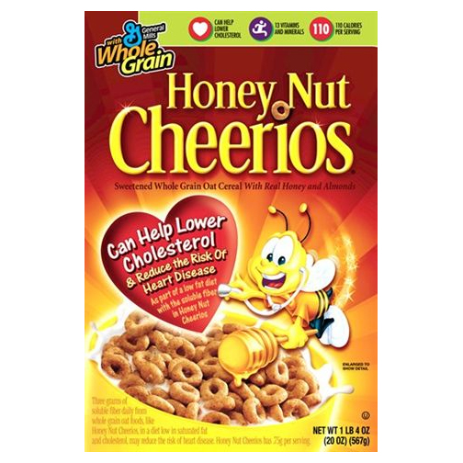
Apis mellifera, the honeybee

Slide 9
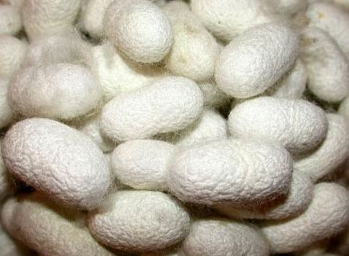
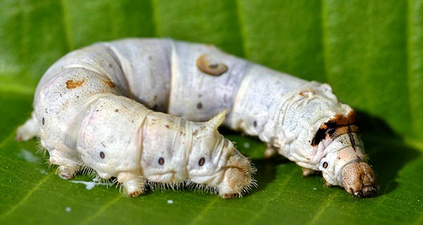
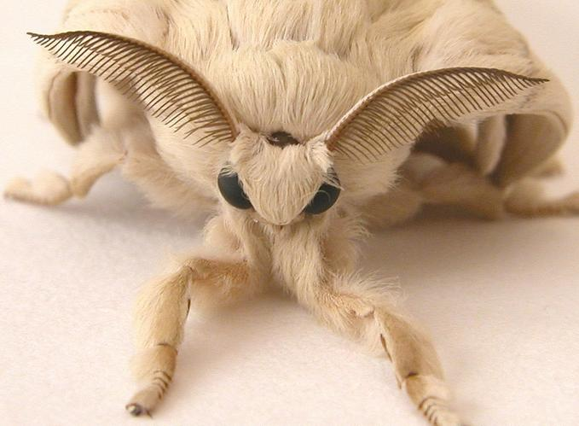
Bombyx mori, the silkworm

Slide 10
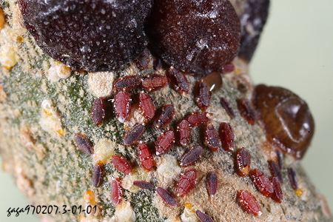
Kerria lacca, the Shellac Bug

Slide 11
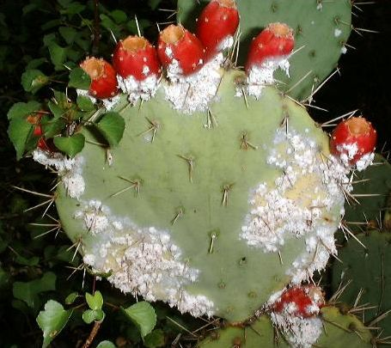
Coccus cacti

Slide 12
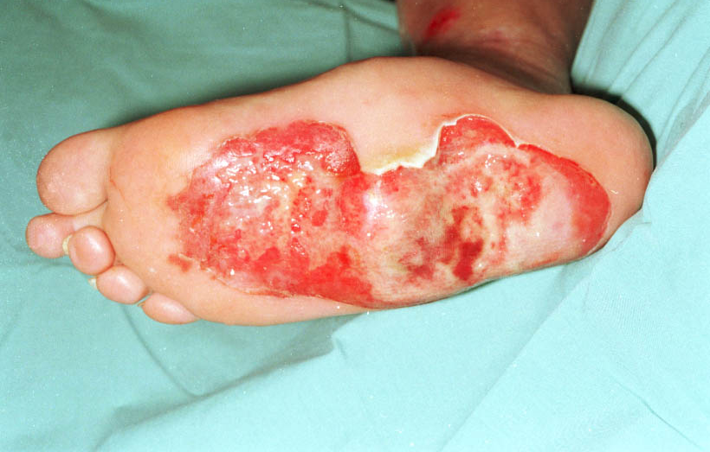
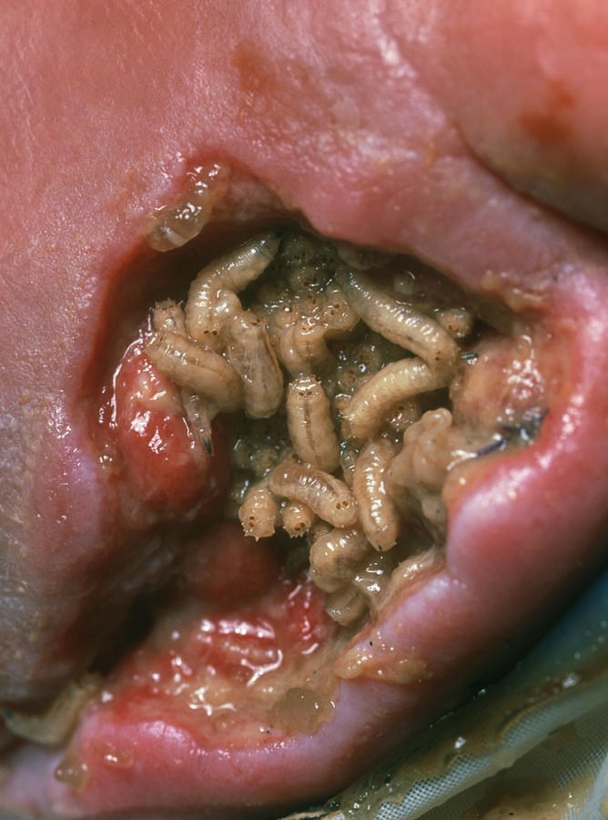
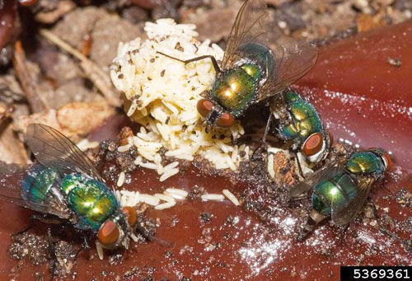
Lucilia sericata, the green bottle fly

Slide 13
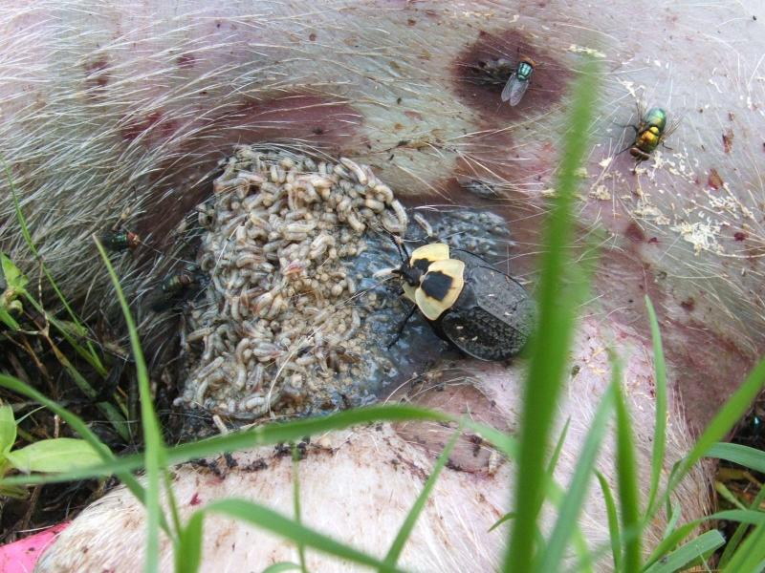
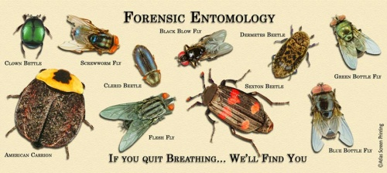

Slide 14
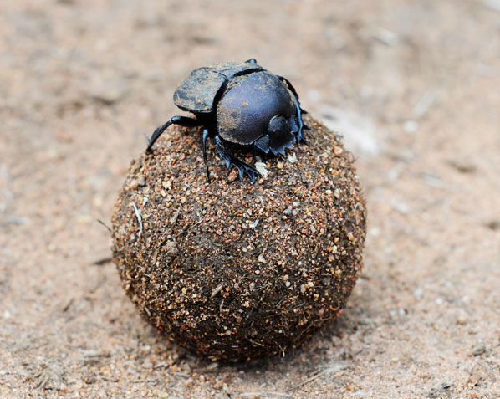
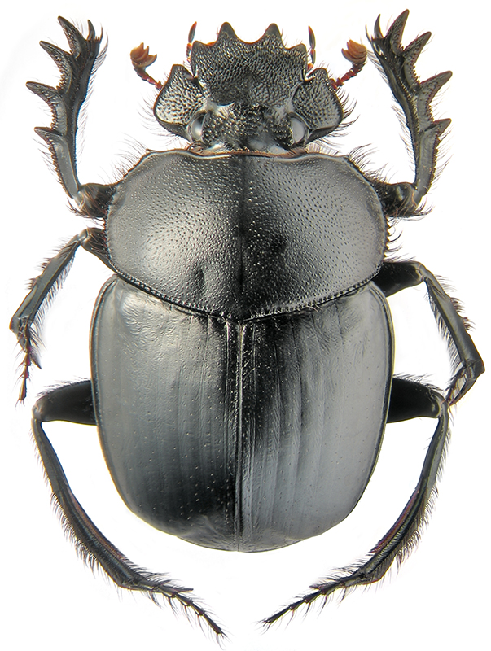
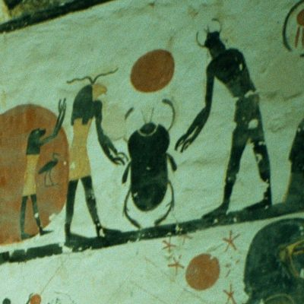
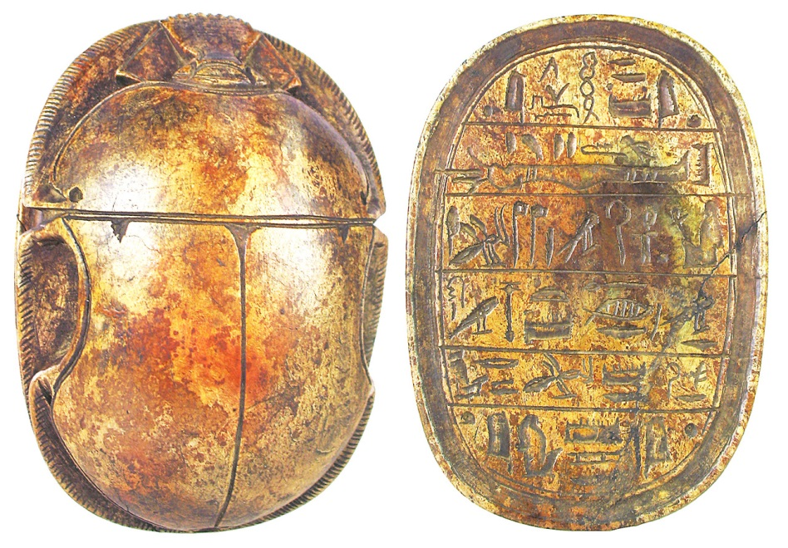
The “Egyptian scarab”

Slide 15
How many insects are harmful to humans?
Medical Entomology

Slide 16
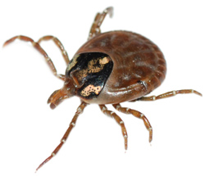
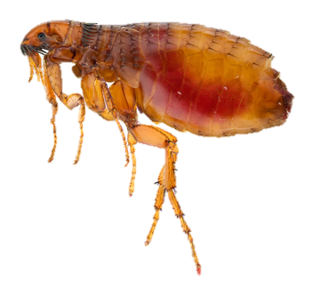
Today’s medically important arthropods
Ticks
Mites
Fleas
Lice
True Bugs
Flies

Slide 17
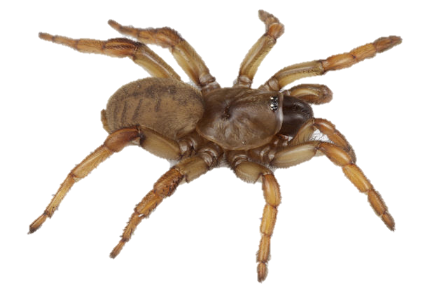
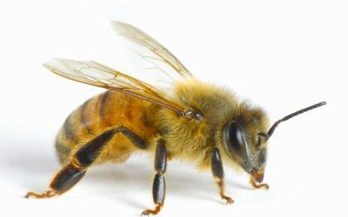
Arthropods: Arachnids vs. insects

Slide 18
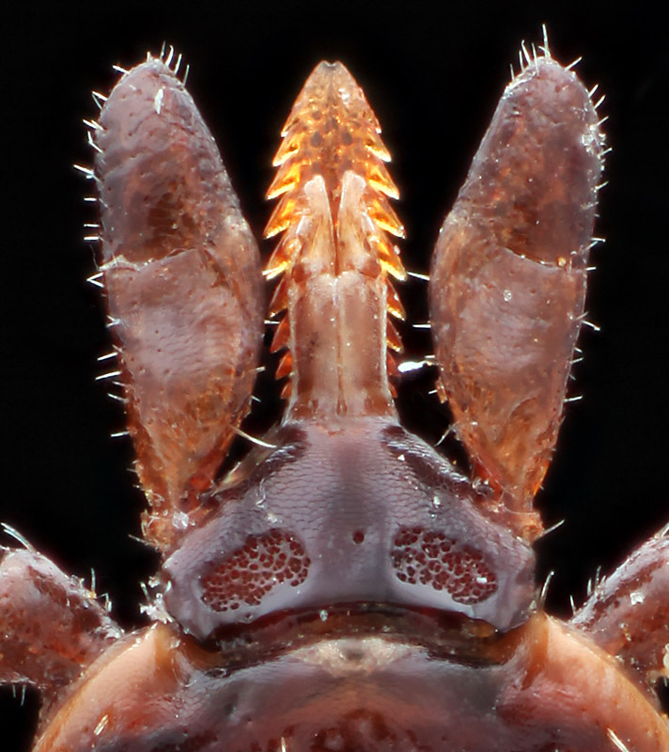
Today’s medically important arthropods
Tick

Slide 19
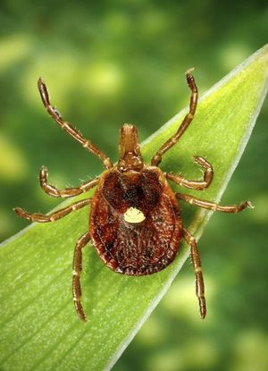
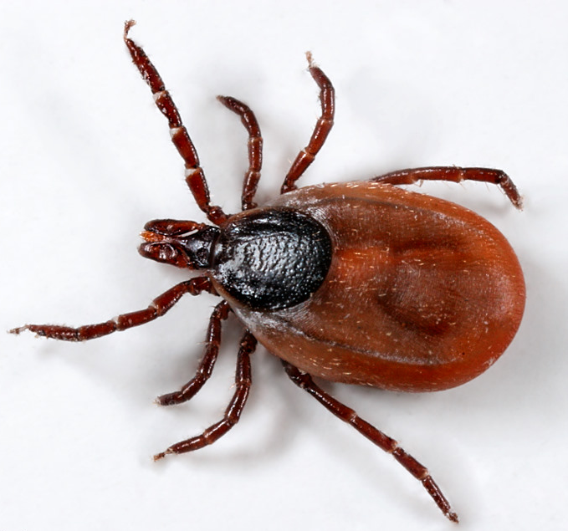
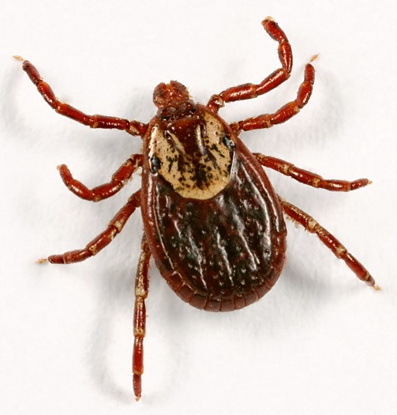
Common Indiana ticks
American dog tick
Lonestar tick
Deer tick

Slide 20
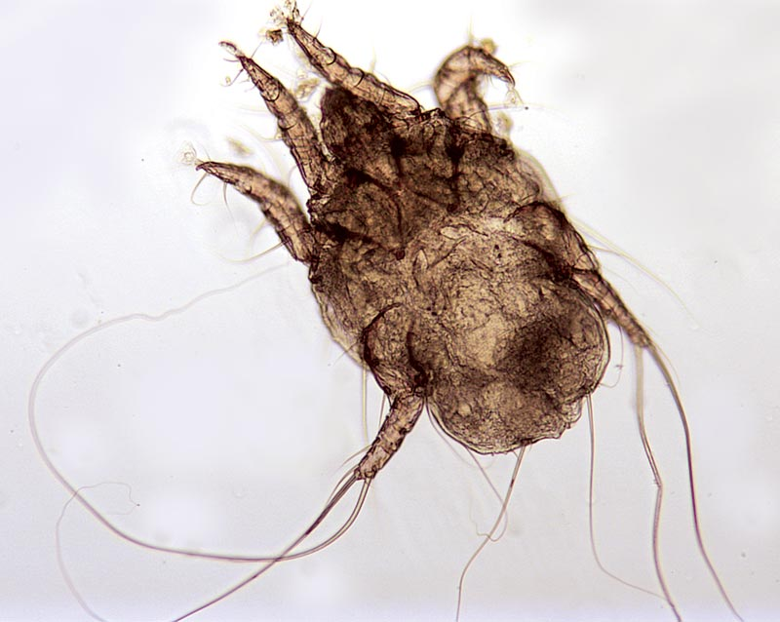
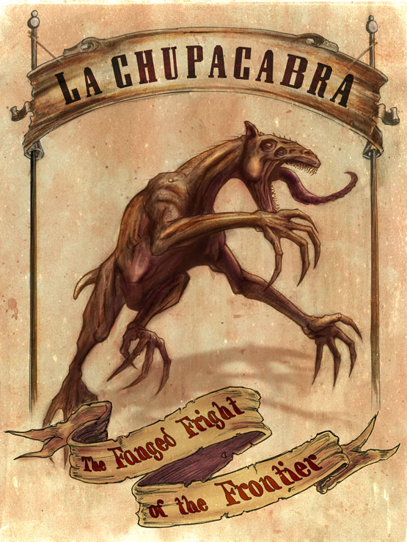
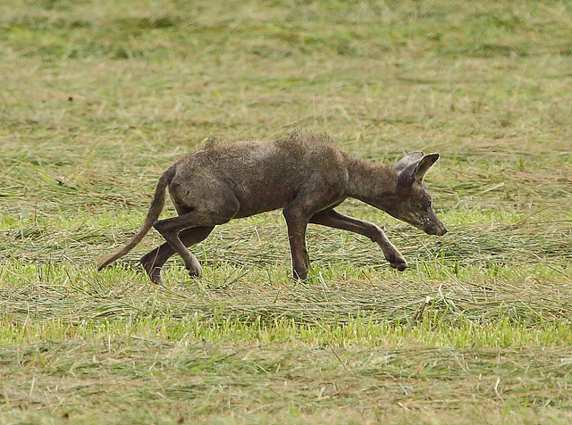
La Chupacabra!

Slide 21
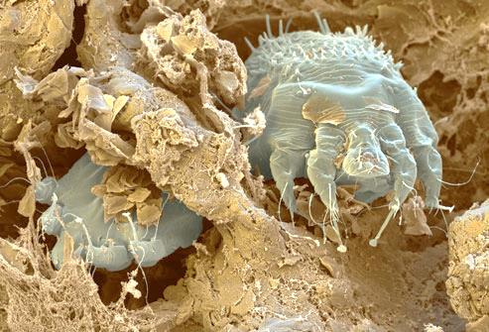
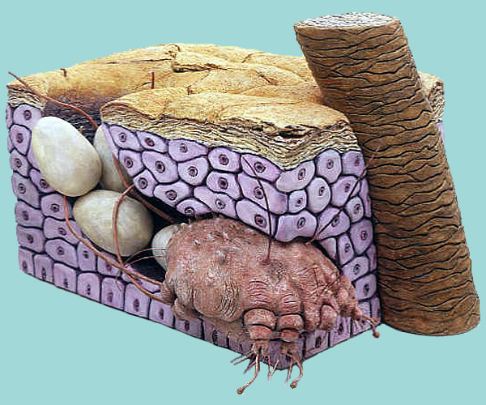
Mites: Scabies mites
Sarcoptes scabiei var. hominis

Slide 22
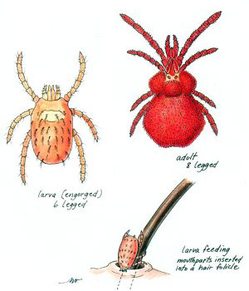
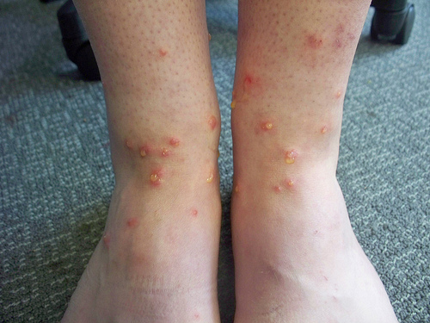
Mites: Chiggers
Trombicula alfreddugesi

Slide 23
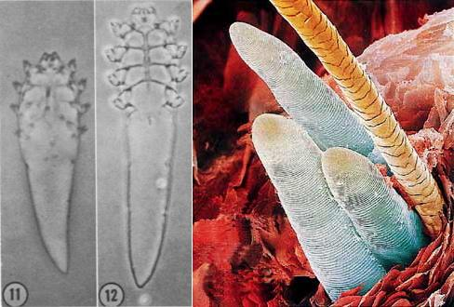
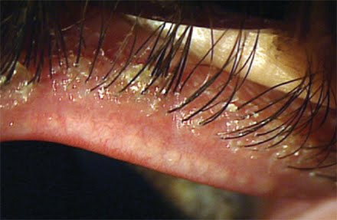
Demodex mites

Slide 24
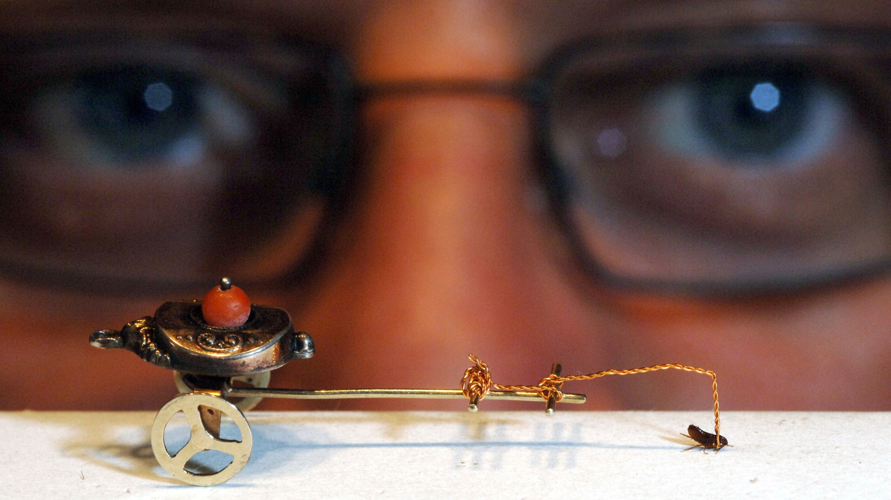
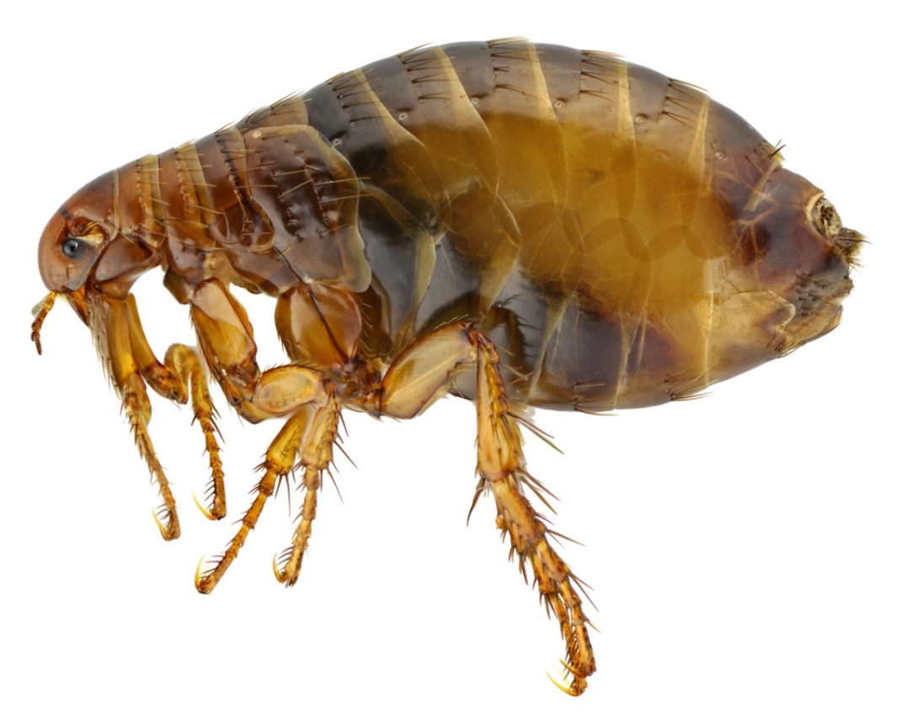
Fleas
Pulex irritans

Slide 25
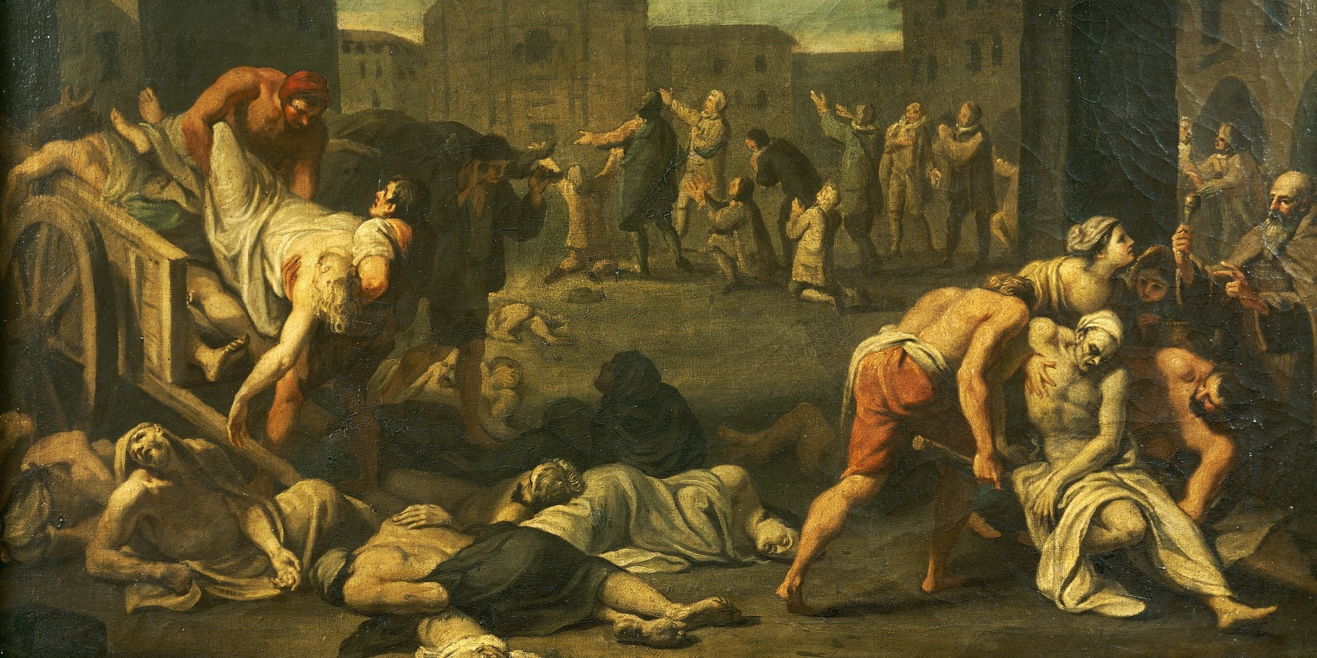
The Plague or Black Death

Slide 26
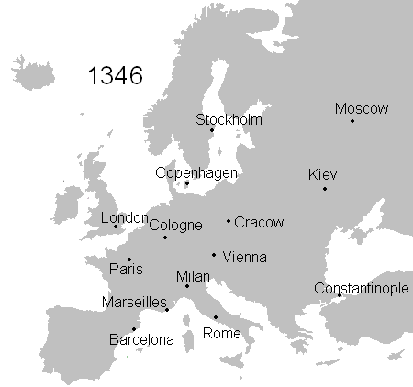
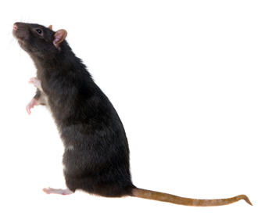
75-200 million deaths

Slide 27
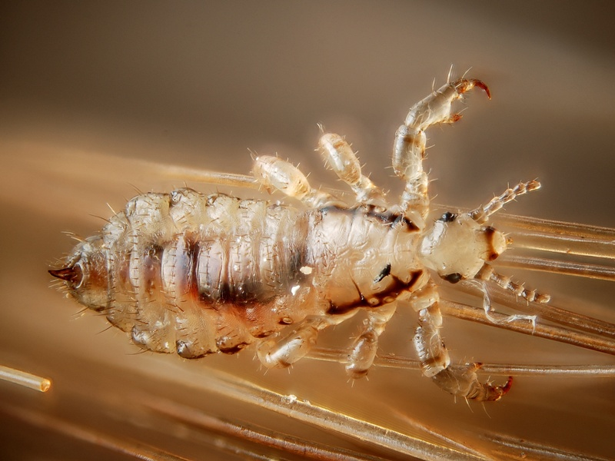

Slide 28
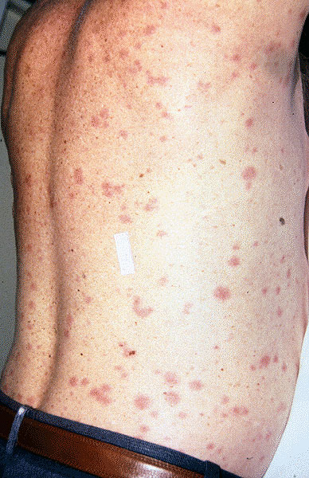
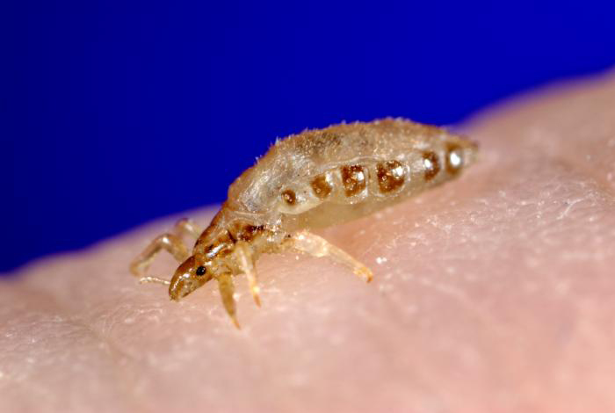
Human body louse
Pediculus humanus humanus

Slide 29
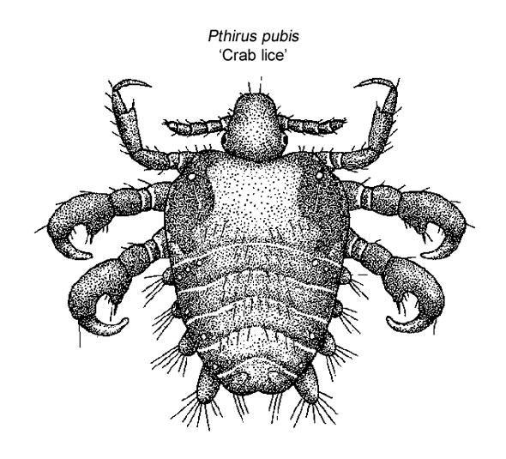
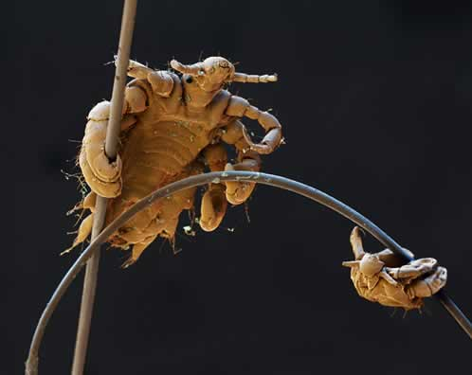
Got crabs?
Pthirus pubis

Slide 30
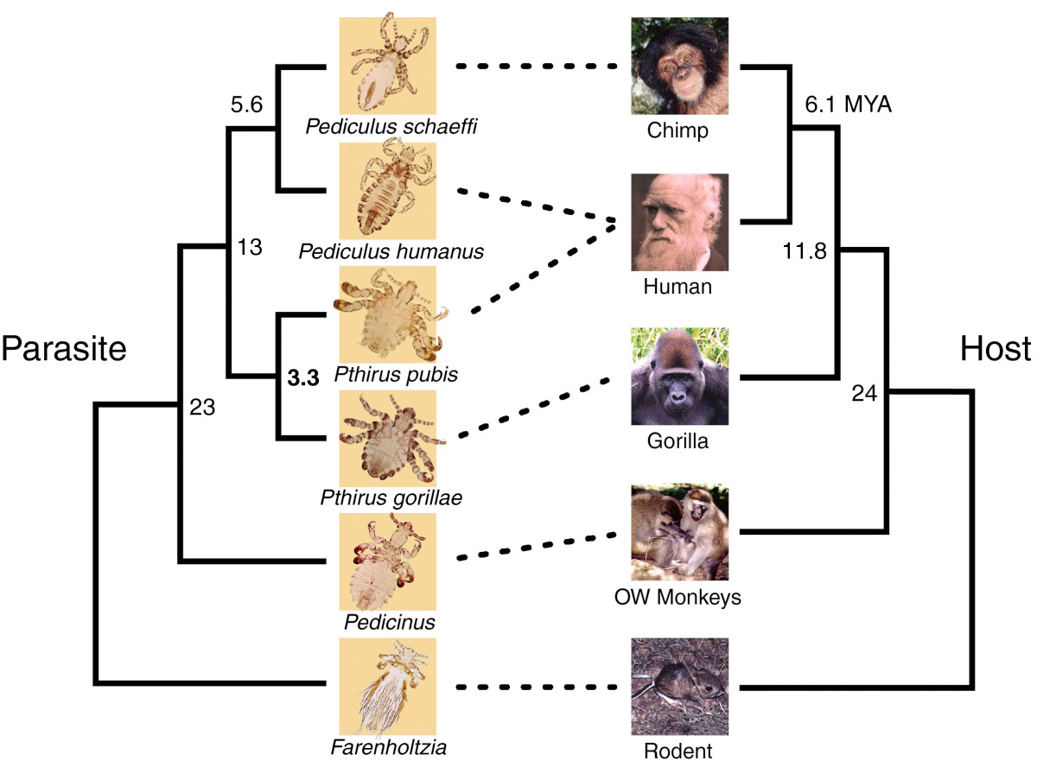
Louse evolution

Slide 31
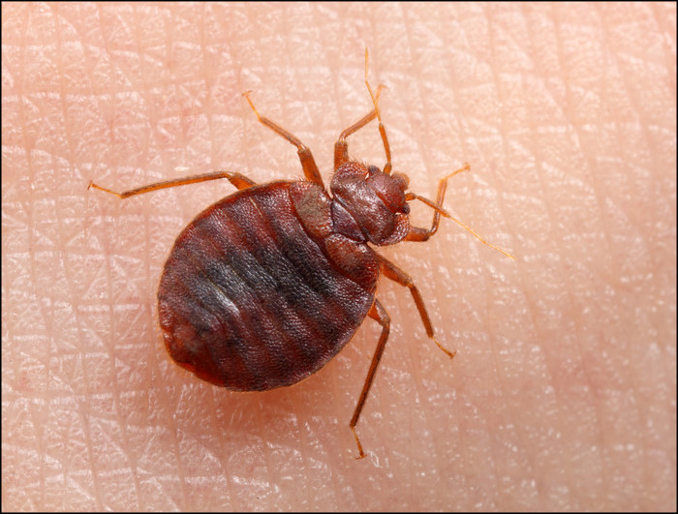
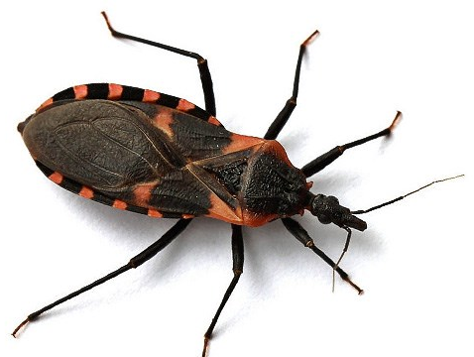
True bugs
Triatoma, Kissing bug
Cimex lectularius, Bed bug

Slide 32
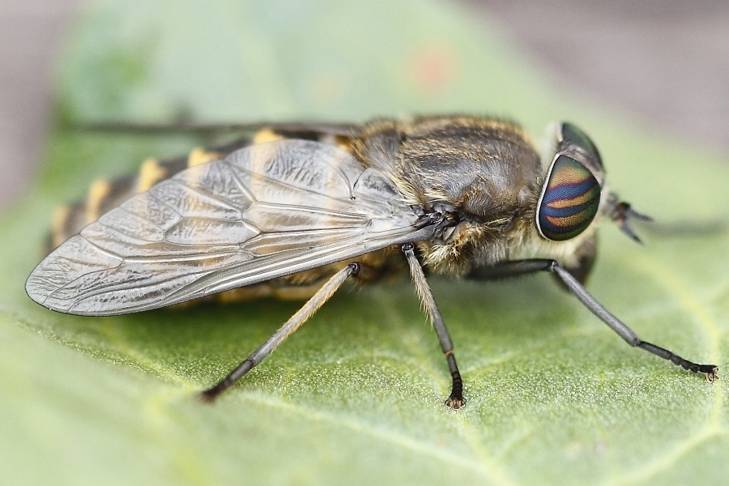
Flies
Notes:
1/6th of the world’s human population is affected by a fly-borne illness at any one time

Slide 33
Mouthparts

Slide 34
Labellum closeup
Pseudotracheae

Slide 35
A different modification

Slide 36
Mosquitoes
3200 species Worldwide
174 species in North America
59 in Indiana
12-15 are medically significant
Culex pipiens

Slide 37
Mosquitoes suck!

Slide 39
Mosquitoes are vectors of disease
Malaria – Plasmodium
Dengue – Virus
Yellow fever – Virus
Chikungunya – Virus
West Nile Virus – Virus
Zika Virus – Virus
Myiasis – Bot fly
Elephantiasis – Filariasis worm

Slide 40
Diseases documented in Indiana
Chikungunya (Aedes)
Dengue fever (Aedes aegypti, major; Ae. albopictus, minor)
West Nile Virus (Culex pipiens)
Zika Virus (Aedes aegypti, Aedes albopictus)

Slide 41
What courses should you take?
Introductory Biology
Cell Biology
Ecology
Entomology
Environmental Science
Evolutionary Biology
Genetics
Immunology
Molecular Biology
Chemistry
Introductory Chemistry
Organic Chemistry
Biochemistry

Slide 42
Related careers
Epidemiologist
Medical Entomologist
United States Army
United States Air Force
United States Navy
Entomologist (Private Sector)
Entomologist (Academia)
Lab Technician/Research Scientist
Molecular Biologist
Pest Management and Control

Slide 43
Questions?

