Slide 1
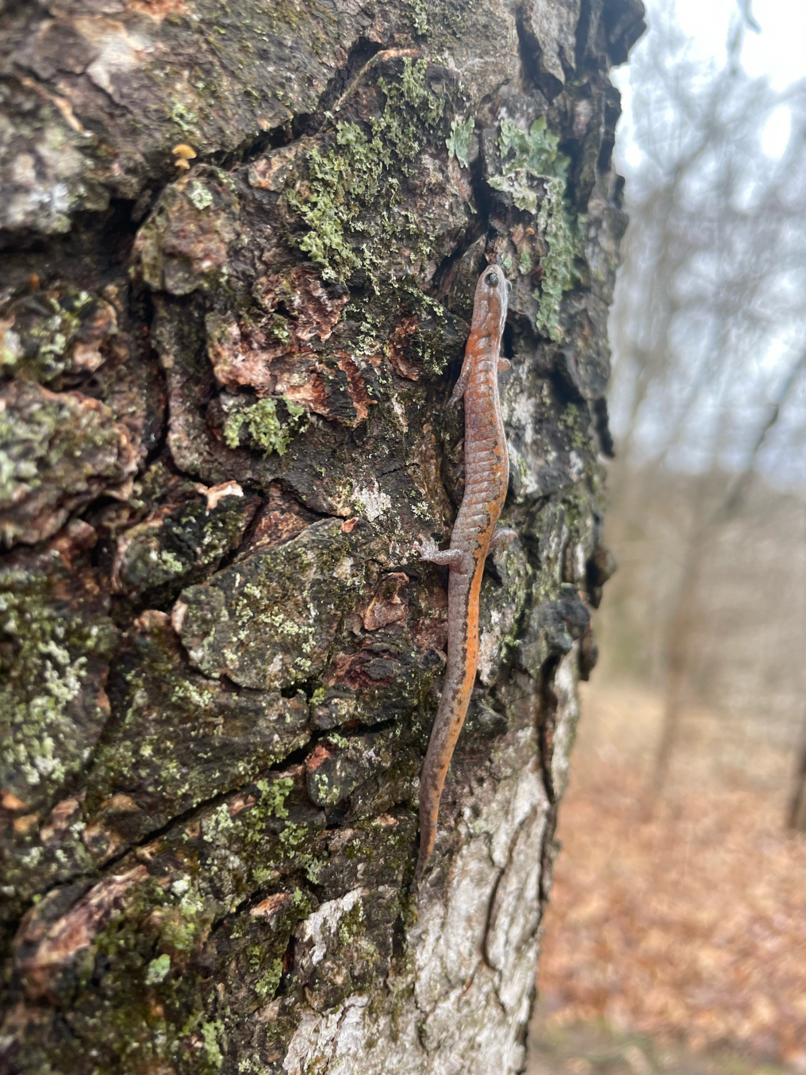

Experimental observations of arboreal behavior in multiple species of fossorial salamanders
Marieke R. Young
Brian G. Gall

Slide 2
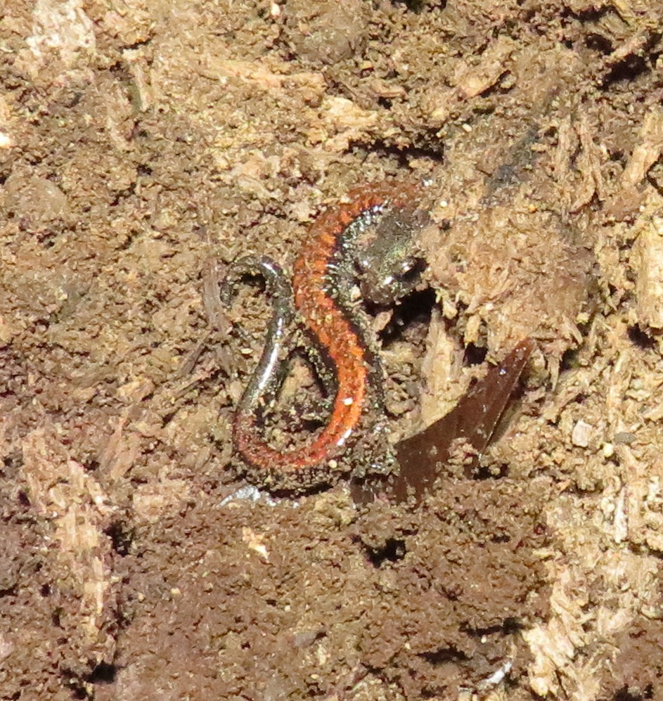
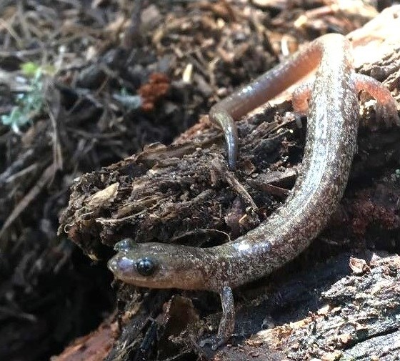
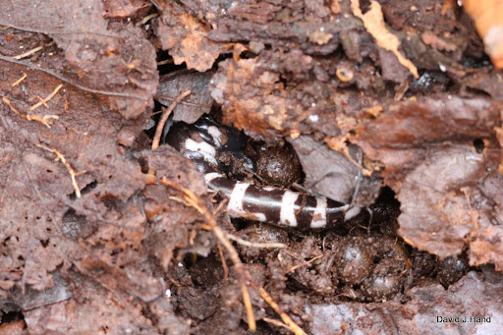
Salamander Ecology
Most abundant vertebrate in forest communities
Terrestrial or fossorial
Found under rocks and logs
Consume leaf litter and soil invertebrates
Important link in food webs
Notes:
Info that’s on poster. Write down on notecard then time yourself!! Don’t use notecard during actual presentation
Salamanders are one of the most abundant vertebrate in forest communities, and are usually found at about 6 salamanders er square meter. Salamanders are considered terrestrial and fossorial, and are commonly found under moist rocks and logs because of the great sources of water, food and protection it offers to salamanders.
Salamanders are also an important link in food webs because of their consumption of leaf litter and soil invertabrates.

Slide 3
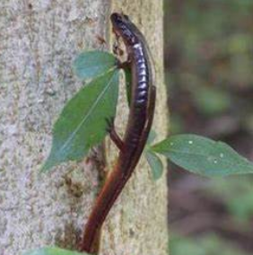
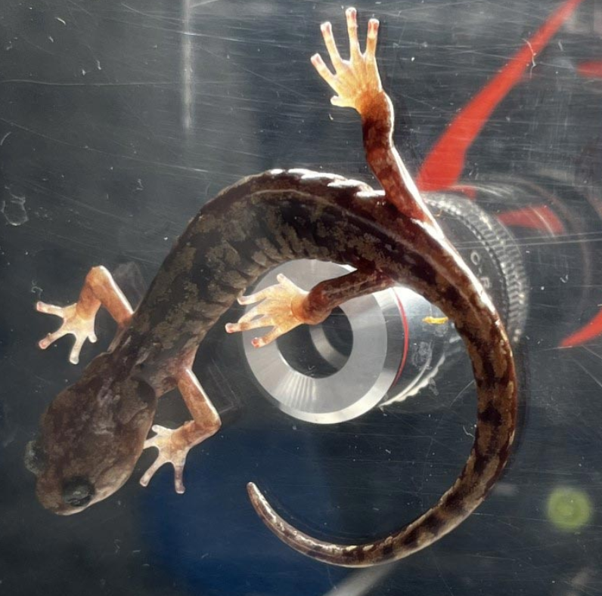
Arboreal behavior in salamanders
Arboreal behavior restricted to few species
These use mucous glands in skin + regulate blood flow to toes
During fieldwork, routine to observe “terrestrial” salamanders climbing
Almost always at night, in the rain
LEFT
Aneides climbing a glass tank
RIGHT
Red-backed salamander climbing a tree trunk
RIGHT
Zigzag salamander climbing a tree
Notes:
Despite their reputation as terrestrial and secretive some species of salamander have gained a reputation of also displaying arboreal activity. Species with confirmed arboreal traits are Aneides vagrans and Plethodon cinerus.
Bodily functions like mucous glands on the skin, which allow salamanders to stick to surfaces, or the ability to regulate blood flow to the toes, which allows salamanders to detatch from surfaces, enhance arboreal behavior in salamander species.
Despite instances of salamander species like the aneides or Plethodon having arboreal traits, it is assumed that other species do not exhibit arboreal behavior.
However, in the past 20 years my advisor has made observations of salamanders climbing up tree trunks, ferns, and rock walls. These examples of arboreal behavior in the have occurred during periods of rainfall and high humidity, particularly in the night time.

Slide 4
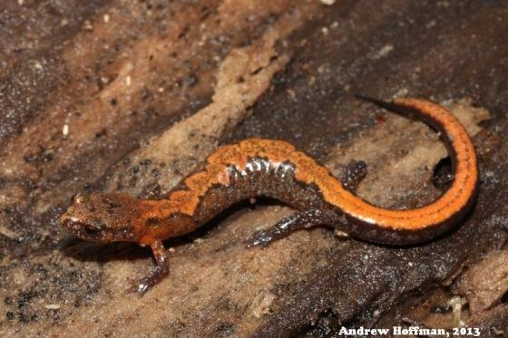
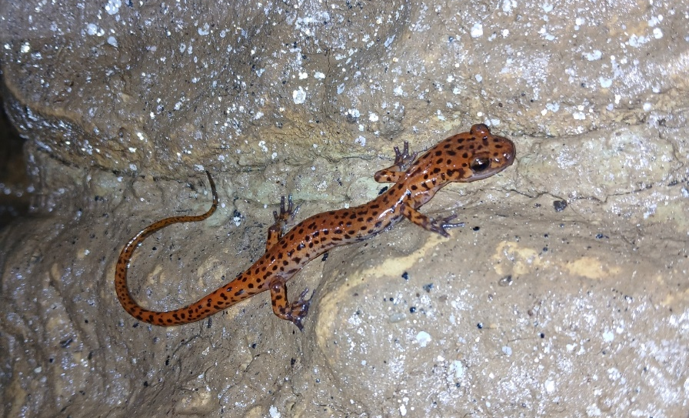
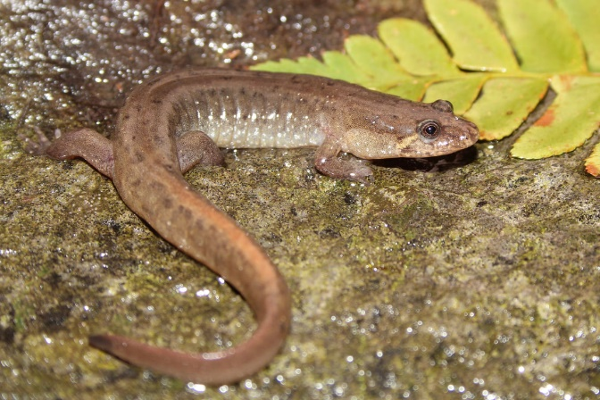
Questions
Do Plethodon, Desmognathus, and Eurycea exhibit arboreal behavior?
Do differences in arboreal behavior differ between species and do they correlate with niche breadth
Are there differences in diurnal and nocturnal arboreal behavior in each species?
Zigzag Salamander
Cave Salamander
Dusky Salamander
Notes:
For my project, I worked with the species Plethodon, Eurycea, and Desmognathus. We chose these species because all three genera are representative of the most abundant salamanders in eastern us. They also provide us with an idea of how salamanders with different ecological traits and niche display arboreal traits.
Second question. Plethodon reside in forested areas with an abundance of moist rocks and logs. The genera Eurycea also live in a wide range of habitats, but the Eurycea we collected live in cave structures. Desmognathus reside in creek beds and streams. All three genera show varied ecological traits and needs, meaning if they display arboreal traits, it will vary.

Slide 5

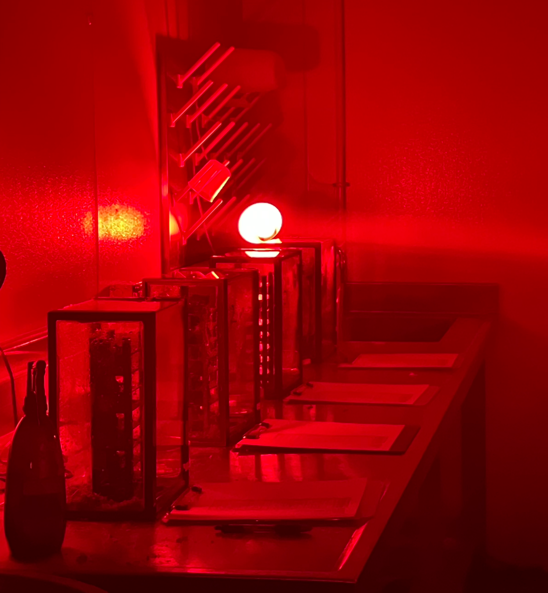
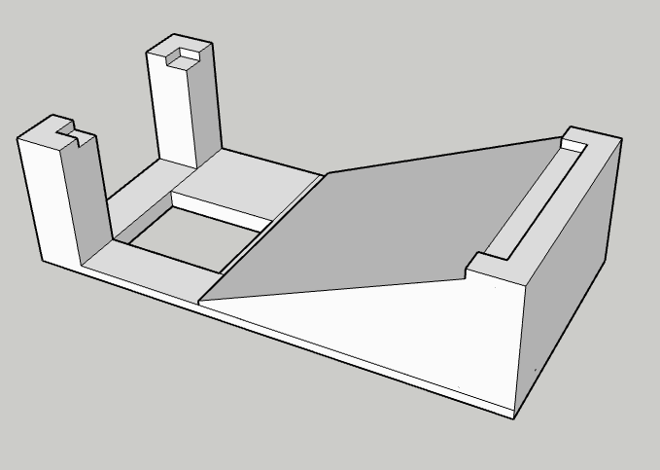
Methods
10 × 5 × 3 cm tall
3D printed stackable ramp
Stacked to create vertical climbing apparatus
10 L tanks (vertically oriented)
Climbing apparatus in center
Bottom lined with damp moss
Environmental chamber at 15°C
Nine ramps stacked in alternating pattern
Ascending structure (27 cm tall)

Slide 6
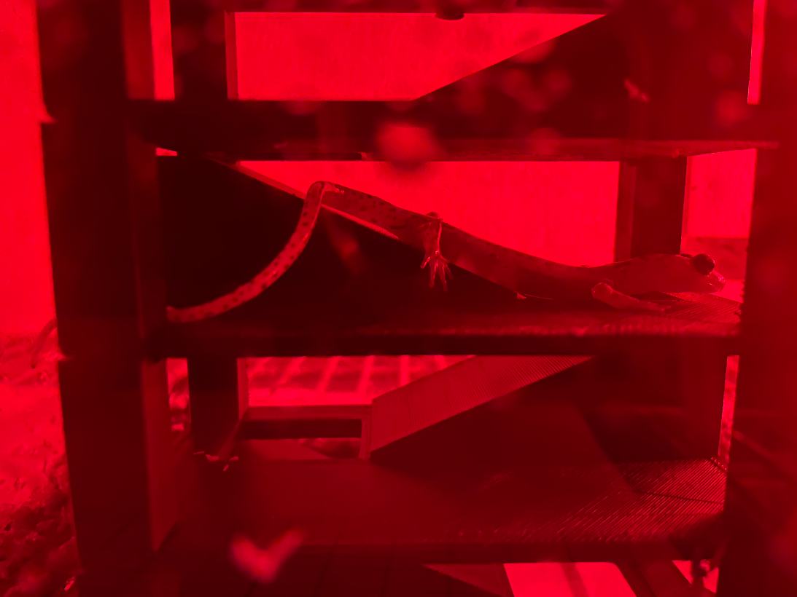
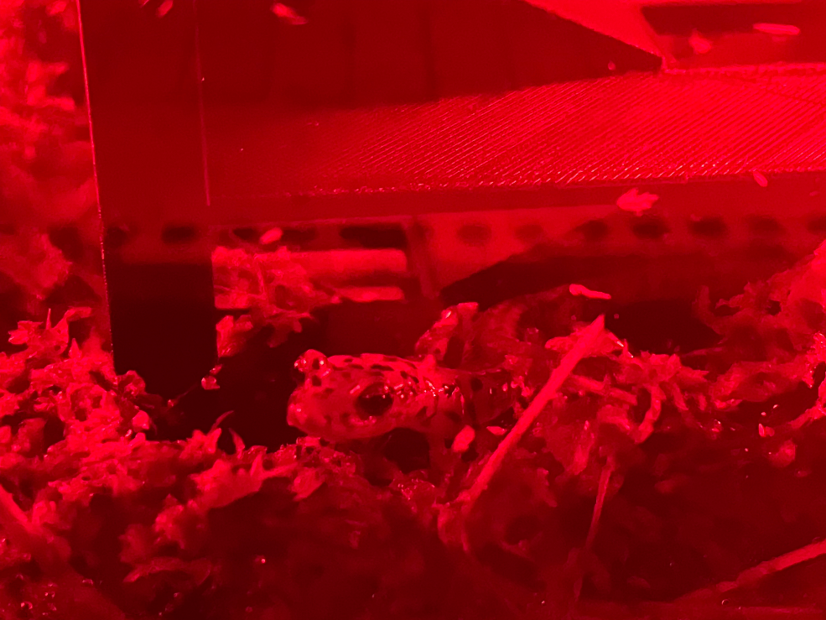
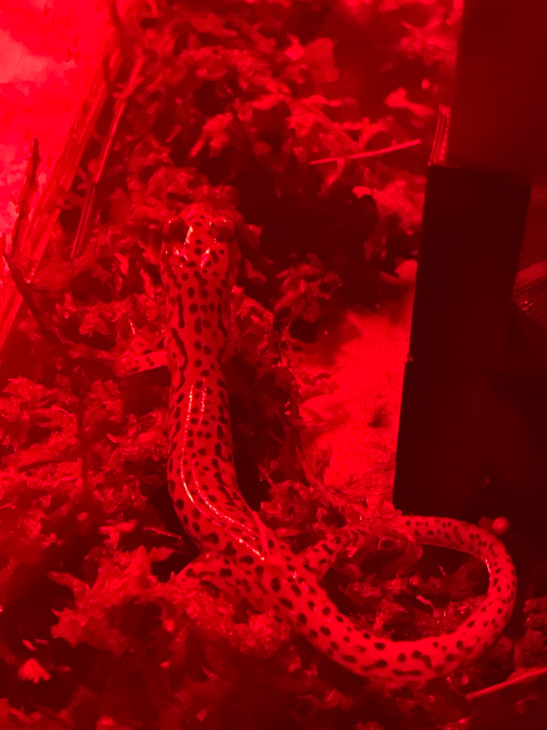
Methods - Observations
  Three species tested
    Zigzag salamanders (N=8)
    Dusky salamanders (N=7)
    Cave salamanders (N=7)
  Individually placed in chamber
  Minimum of 6 hrs prior to observations
  Recorded location every 15 min
  Observations from 10pm – 2am

Slide 7
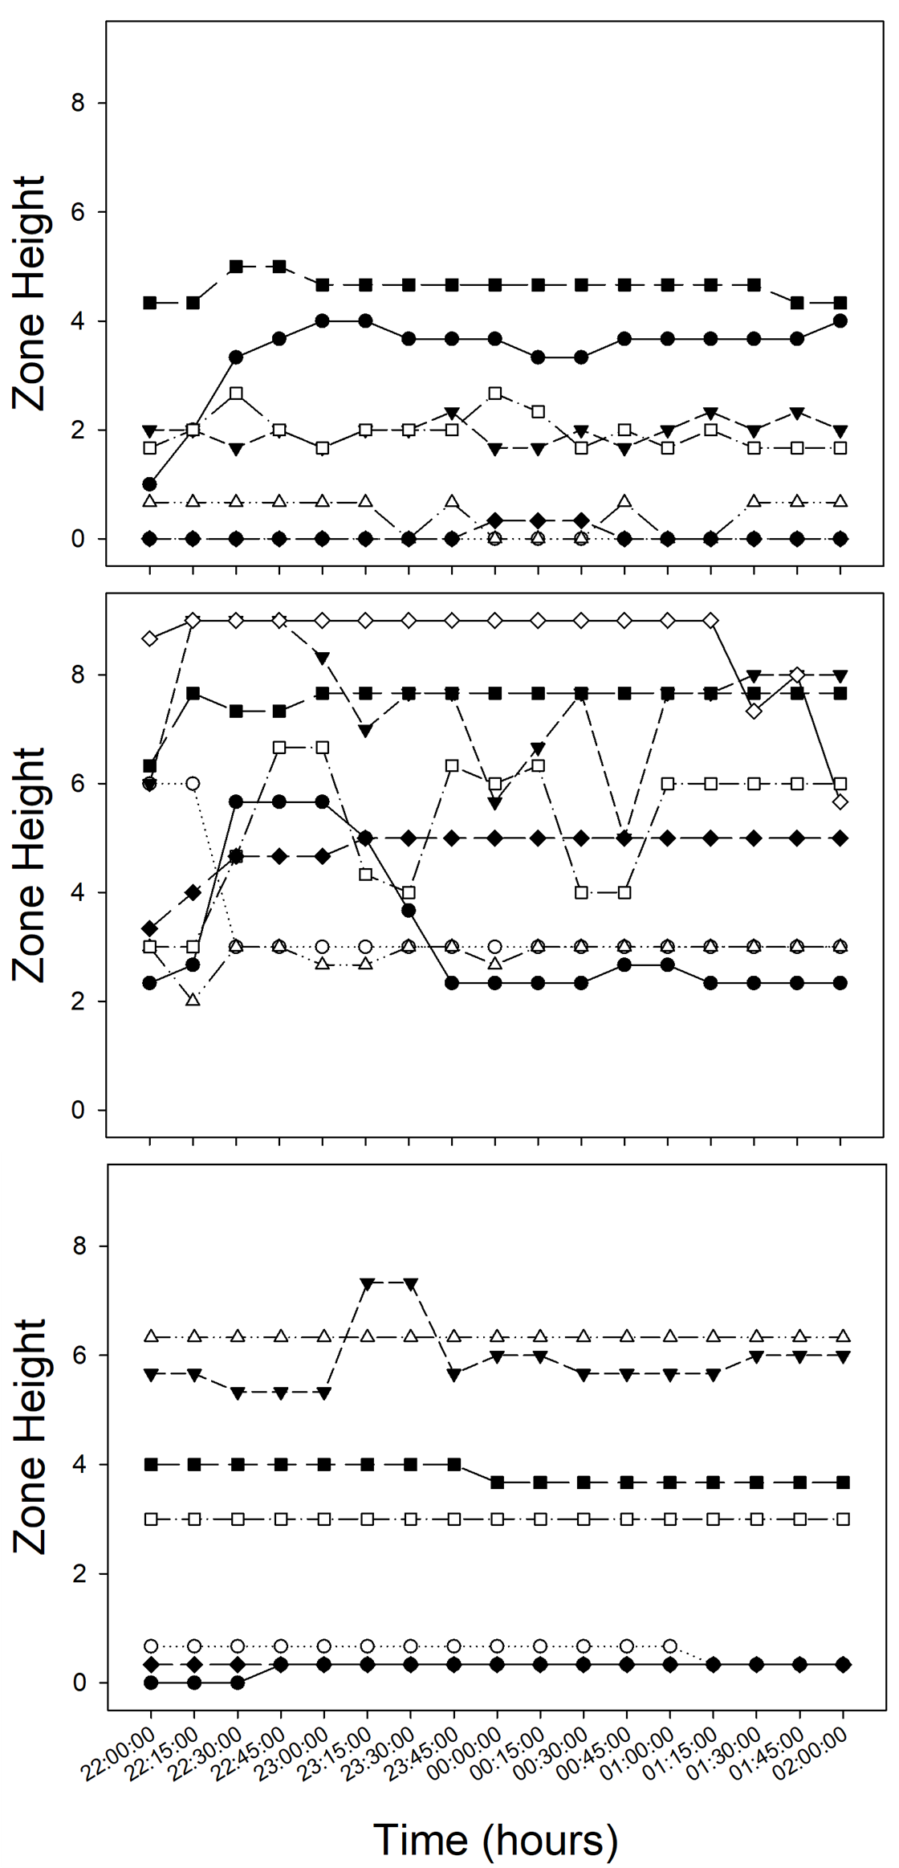
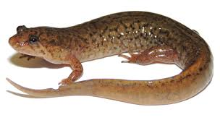
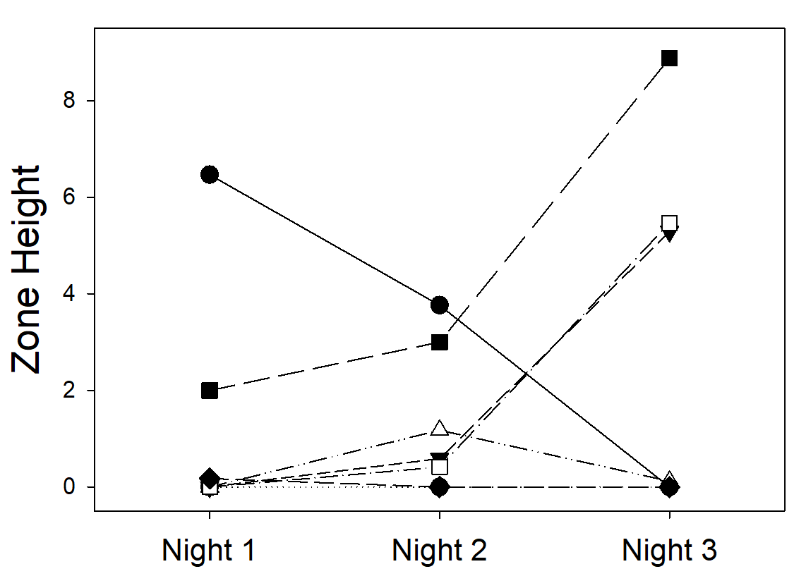
Desmognathus
10pm
12am
2am
Zone 2 or lower (72%)
Little variation on any given night
Large differences between nights
No pattern (high to low or low to high)
Notes:
Each night they pick a zone and stay there
Move to different zones each night

Slide 8
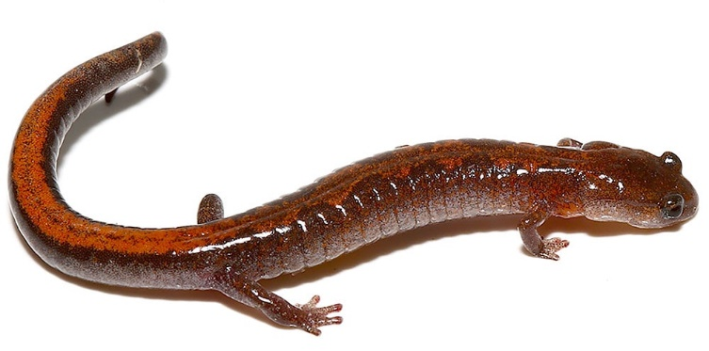
Plethodon
10pm
12am
2am
Highest average of all species
Zone 2 or higher (100%)
Greater movement within a night
All observations initially at top zones
Decline on subsequent days

Slide 9
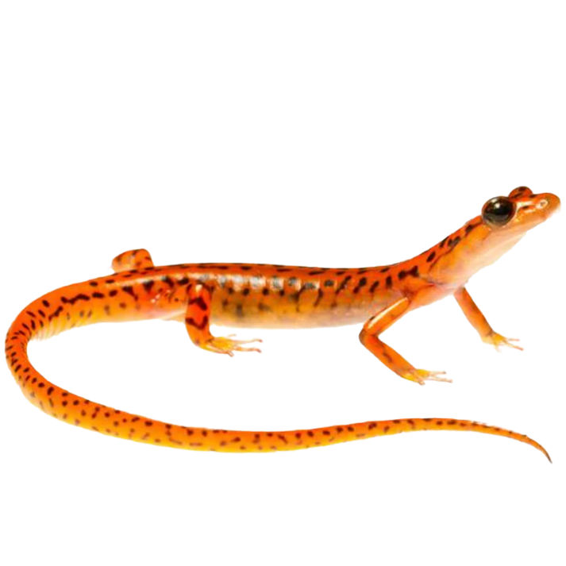
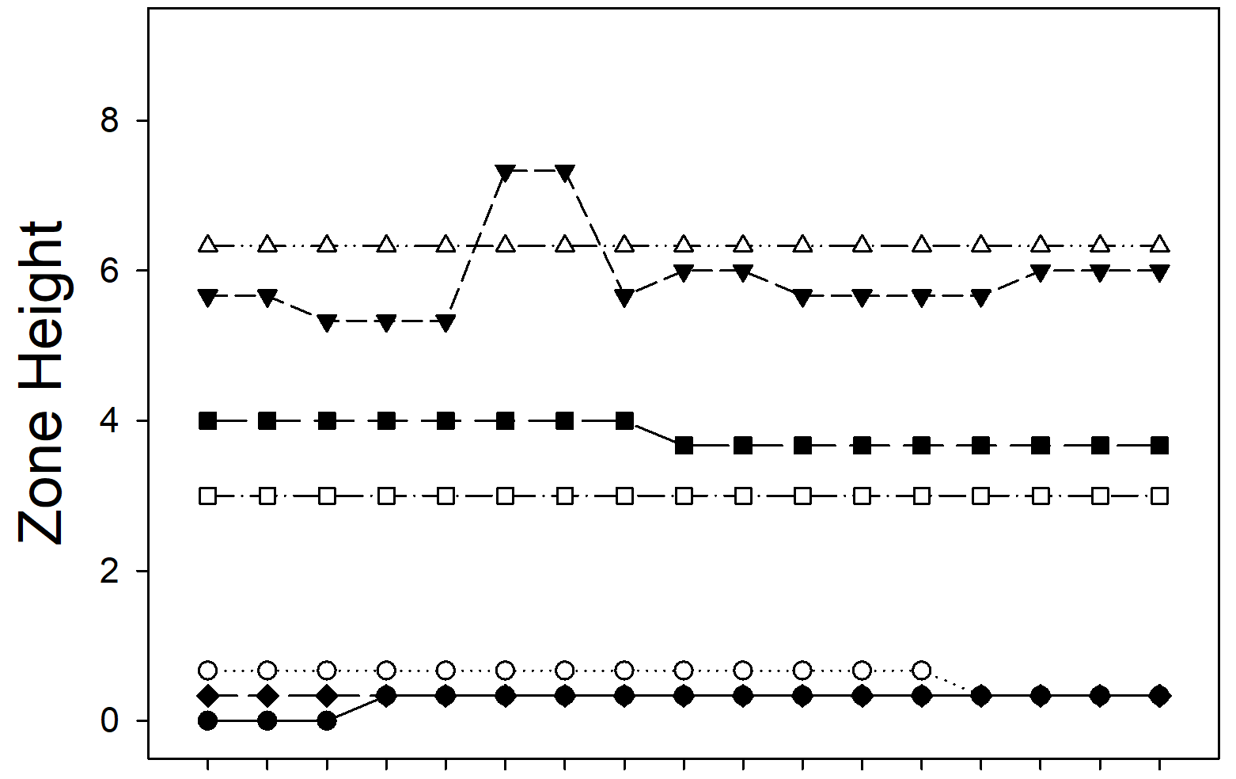
Eurycea
10pm
12am
2am
Considerably higher than Desmognathus
Not as high as Plethodon
Little variation on any given night
Large differences between nights

Slide 10
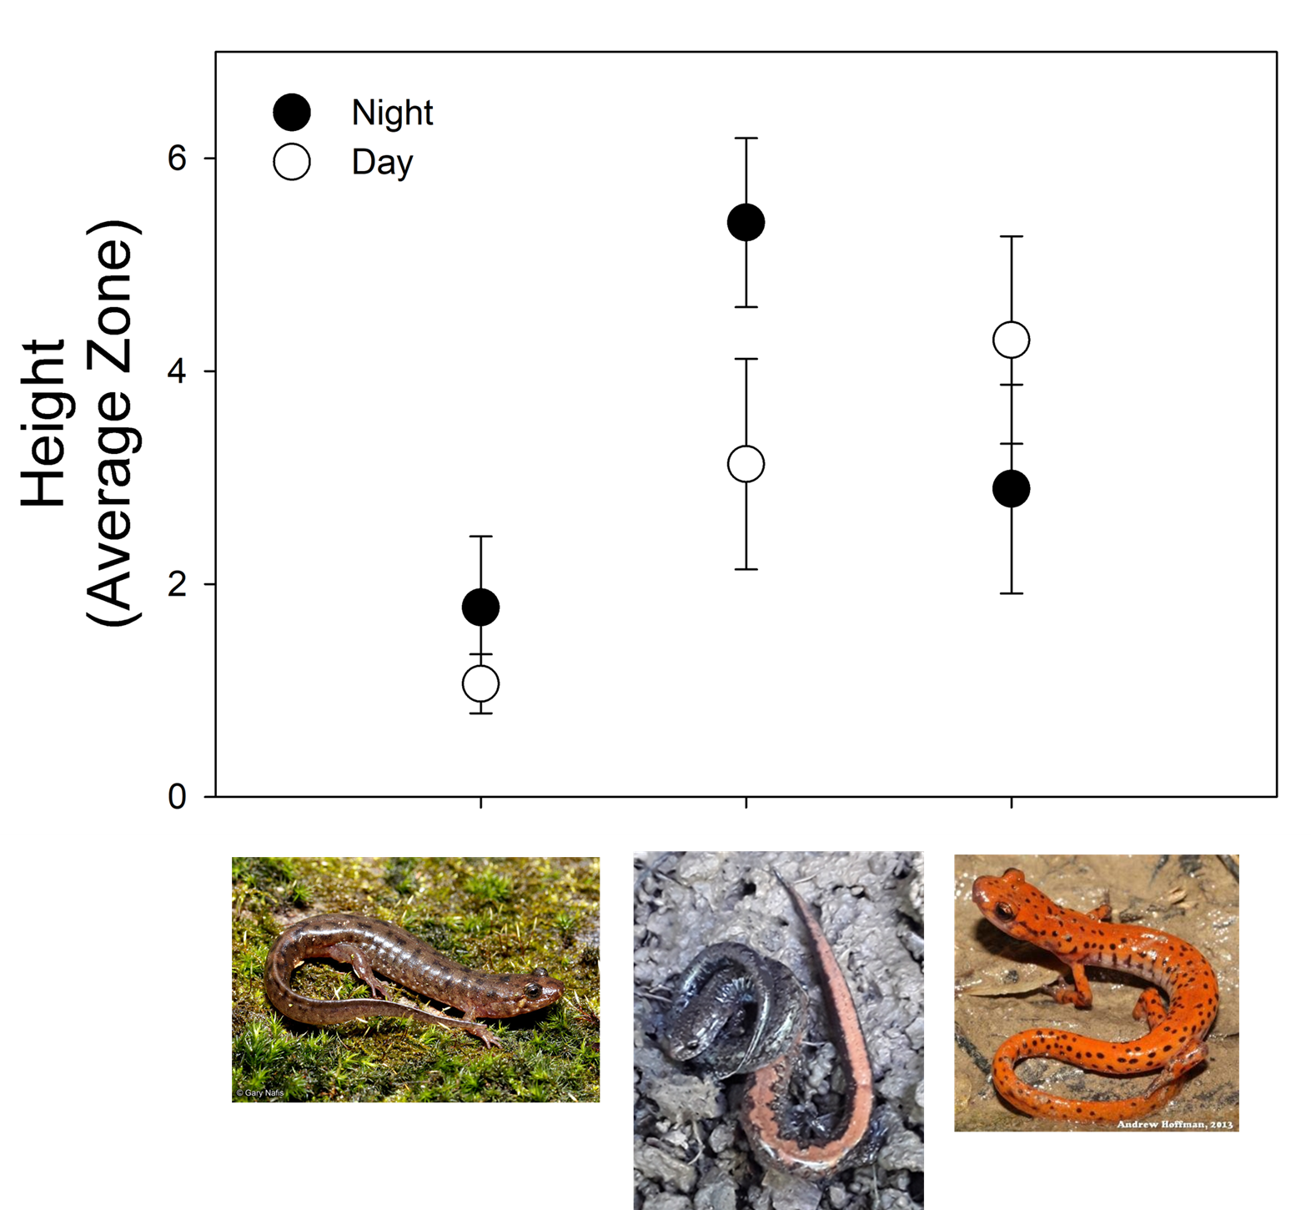
Results
Dusky Salamander
Day v Night (NS)
Low mean Day and Night
Zigzag Salamander
Night higher than day (P=0.02)
Day and night mean higher than Dusky (P<0.04)
Cave Salamander
Day v Night (NS)
Means – intermediate (NS compared to other sp.)
Notes:
Avoid talking about conclusions in results
Plethodon's significantly higher climbing than desmognathus may be due to niche differences. Desmogs reside in creek beds and whatever movement happens is limited to that creek. Plethodons, however, have a wider niche and can live anywhere that has logs and rocks and is moist.
P=.02
Salamanders may be significantly more likely to climb at night due to foraging and anti-predation behavior.
The Eurycea may not have a significant difference in the time that they climb due to living in a cave, which differs to other eurycea species that live near cliffs, which make them more likely to forage.

Slide 11
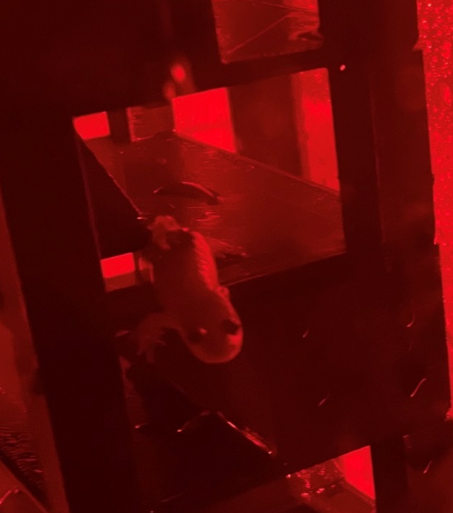
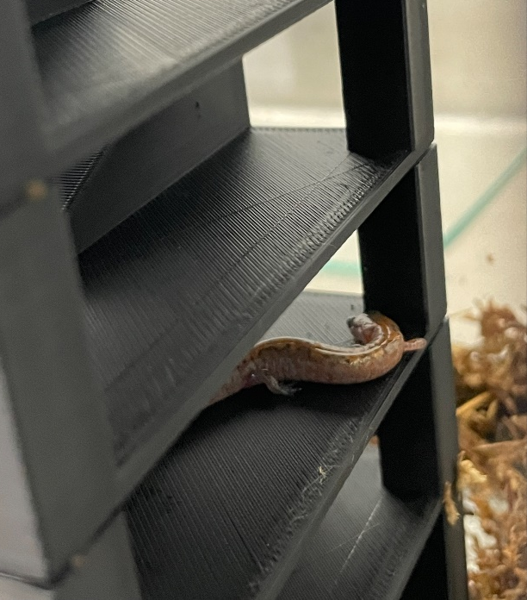

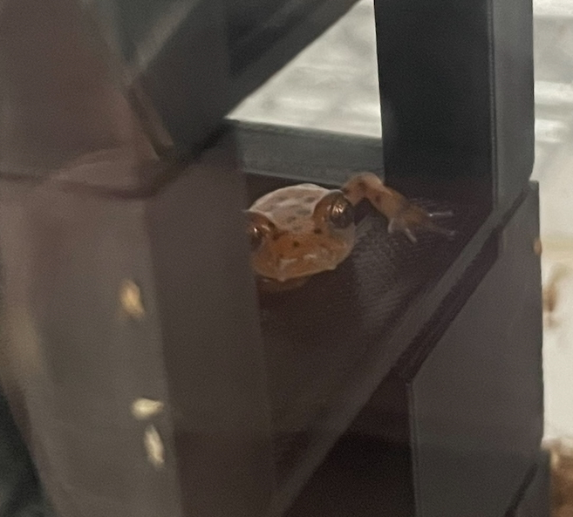
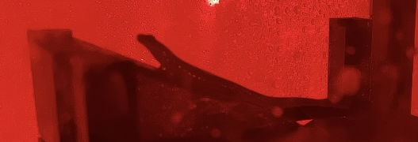
Results Summary
Heights ‒ Desmognathus < Eurycea < Plethodon
Little movement between zones on any given night
Large variation across nights in all species
Diurnal = nocturnal in Desmognathus & Eurycea
Plethodon significant vertical migration at night
Notes:
Avoid talking about conclusions in results
Plethodon's significantly higher climbing than desmognathus may be due to niche differences. Desmogs reside in creek beds and whatever movement happens is limited to that creek. Plethodons, however, have a wider niche and can live anywhere that has logs and rocks and is moist.
P=.02
Salamanders may be significantly more likely to climb at night due to foraging and anti-predation behavior.
The Eurycea may not have a significant difference in the time that they climb due to living in a cave, which differs to other eurycea species that live near cliffs, which make them more likely to forage.

Slide 12
Conclusions
All species exhibited arboreal behavior
Some variation in arboreal behavior may be linked to niche
  Desmognathus – stream margins
Eurycea came from a cave population
  Results surprising – observed on walls and ceiling
  May have influenced temporal behavior patterns
Field observations
  support arboreal behavior in Plethodon and Eurycea
  Routinely observed climbing vegetation and rocks
Artificial lab chambers likely increase diurnal arboreal behavior
Notes:
FOr conclusions answer questions connected to results
Next steps are: create a taller vertical tank to see how high different species are likely to climb and also field observations, that imaging system
Connect some conclustions to the paper you read about cinerus
Overall, All species exhibited arboreal behavior, however depending on the species the variation in climbing differed.
The difference in climbing variation may be due to niche differences. This is supported by Desmognathus inhabiting streams, meaning they do not need to climb around as much due their niche being limited to creeks and streams.
Plethodons, however, have a wider niche and can live anywhere that has logs and rocks and is moist.
The Plethodon were the most likely to climb to higher heights with the most variation, which aligns with their ecology. Since Plethodon live in a wide forest niche, they may climb more at night when predators are not out, and are able to forage and find new rocks to reside in.
Salamanders like the humidity, and since it is more likely to be more humid at night, it makes sense as to why Plethodon and the other species climb more at night.
The Eurycea, like Plethodon, have a larger niche than Desmognathus, but may climb less because they have no differentiation between day in night since they live in caves. However, they have more rocks to climb on than desmognatus so they still have more likelihood to climb around more.
For future observations, I plan to create a taller vertical tank to see if there is a difference in how high different species of salamanders are likely to climb. I also plan on collecting official field observations to support my experimental observations.

Slide 13
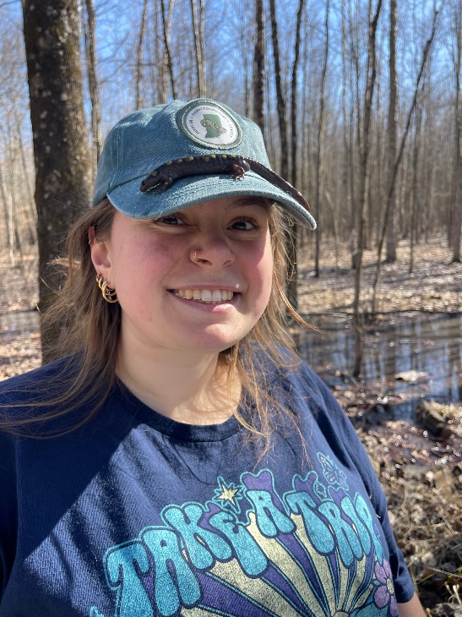

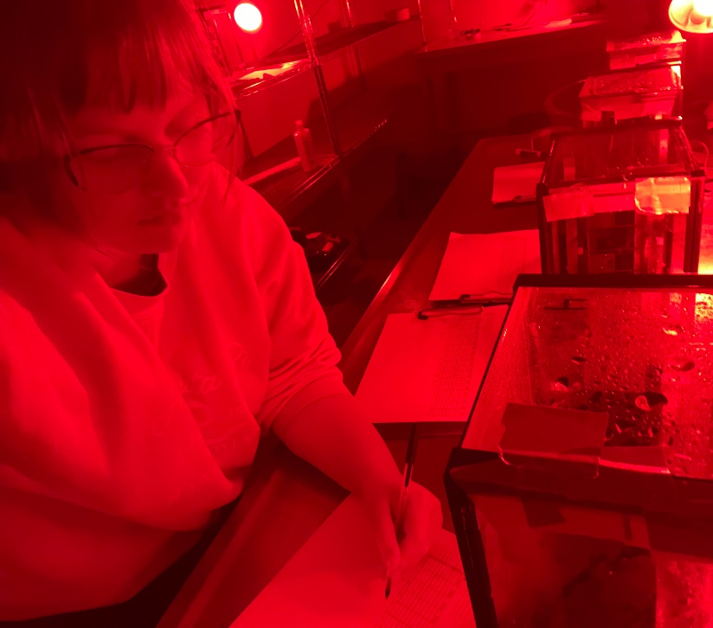
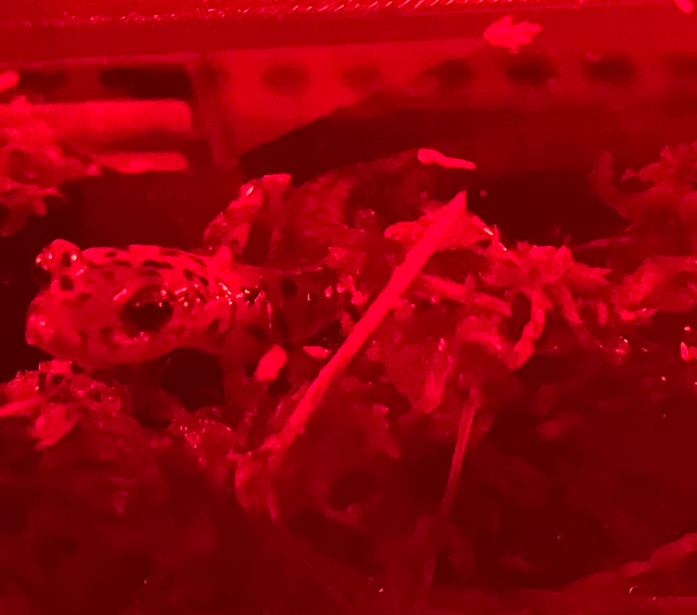
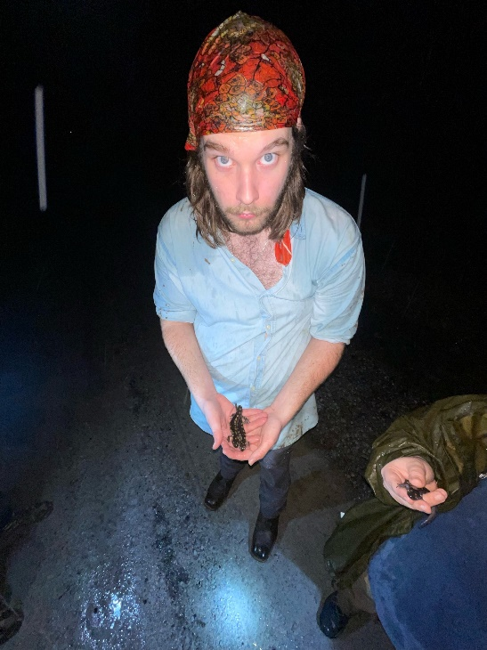

Acknowledgements
Hanover College Biology Department
Dr. Brian Gall
Research lab-mates

