Slide 1
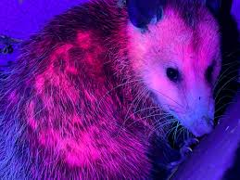

Predatory Behavior by Strigiform Owls in Response to Biofluorescent Skin from the Virginia Opossum (Didelphis virginiana)
Suellen E. Ronk, Katelyn Enginger, Jax D. Betzner, Brian G. Gall

Slide 2
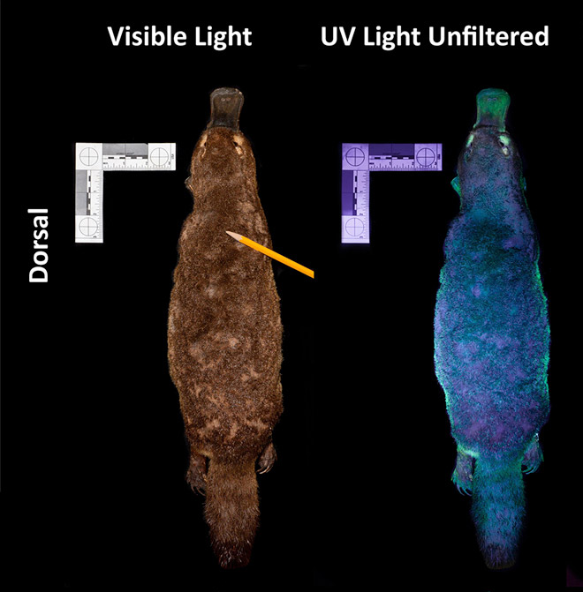
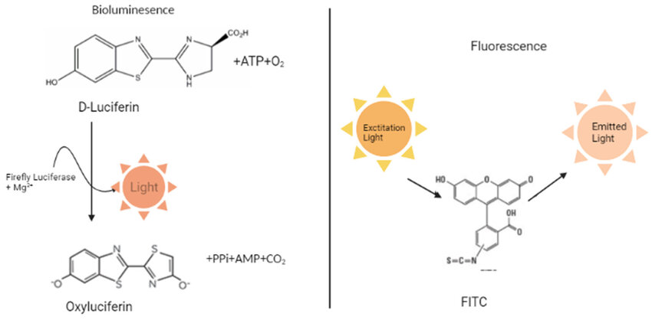
What is Biofluorescence?
**NOT bioluminescence**
Biofluorescence
Organism exposed to a high frequency light (ex: UV light) & reflects a low frequency light (colors visible to the human eye)
Notes:
Explain high freq vs low freq, add pics

Slide 3
Biofluorescence vs. Bioluminescence
Biofluorescence: organism reflects light
Bioluminescence: organisms emit light from their own body
Biofluorescence
Bioluminescence

Slide 4
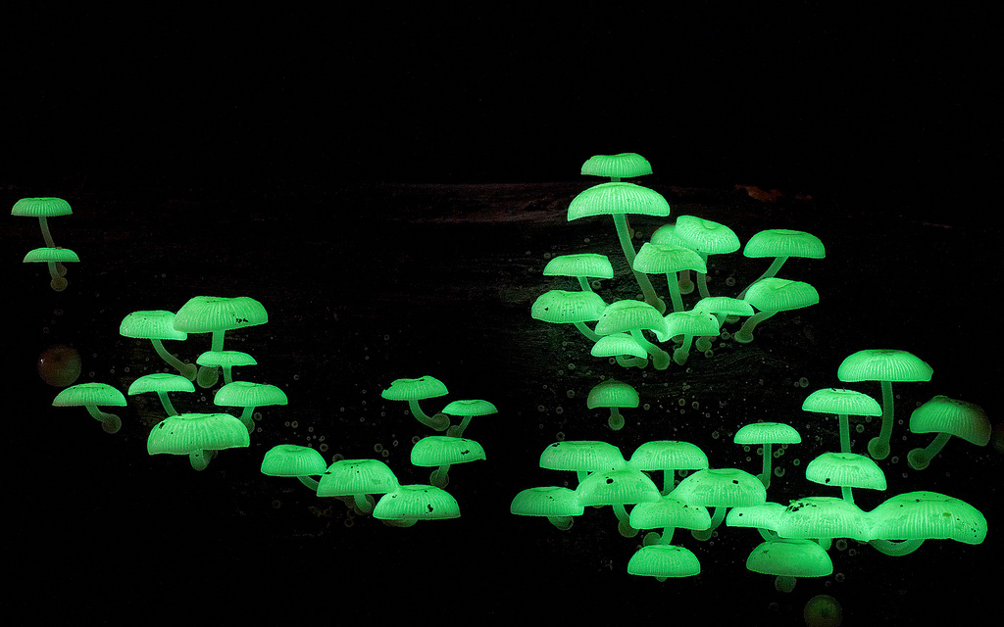
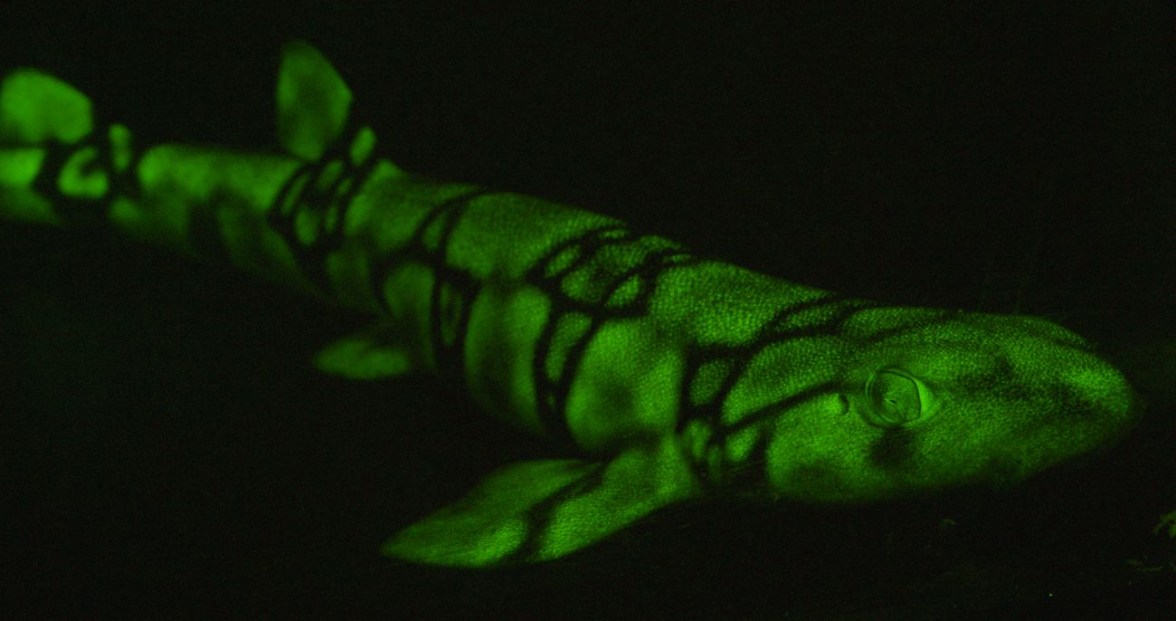
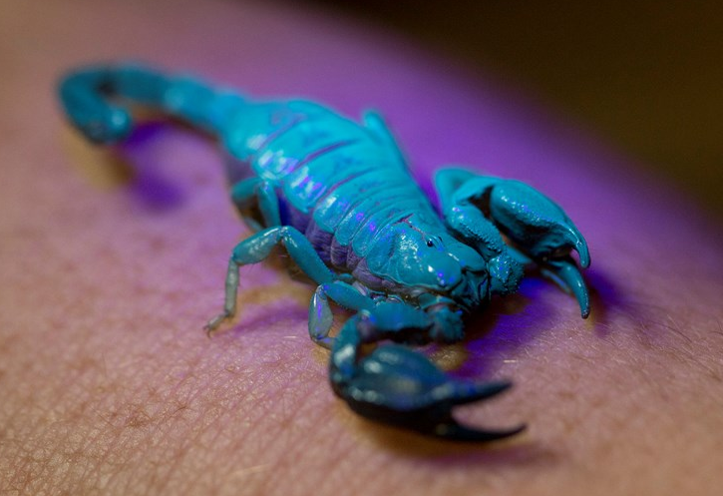
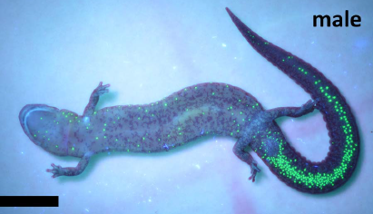
Biofluorescence - Species
Fish
Coral
Jellyfish
Fungi
Invertebrates
Mammals
Amphibians
Notes:
Transition from here to biofluorescence in tree frogs, to opossum study, to discovery

Slide 5
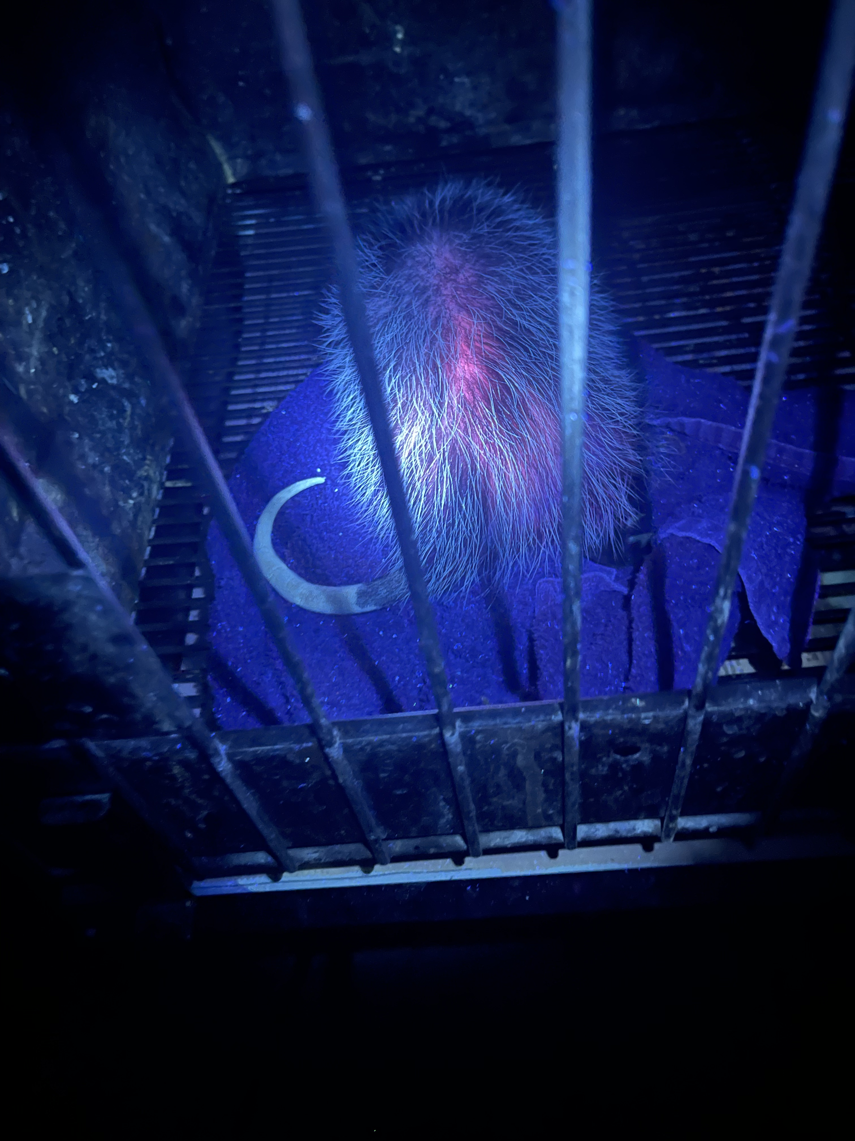

Slide 6
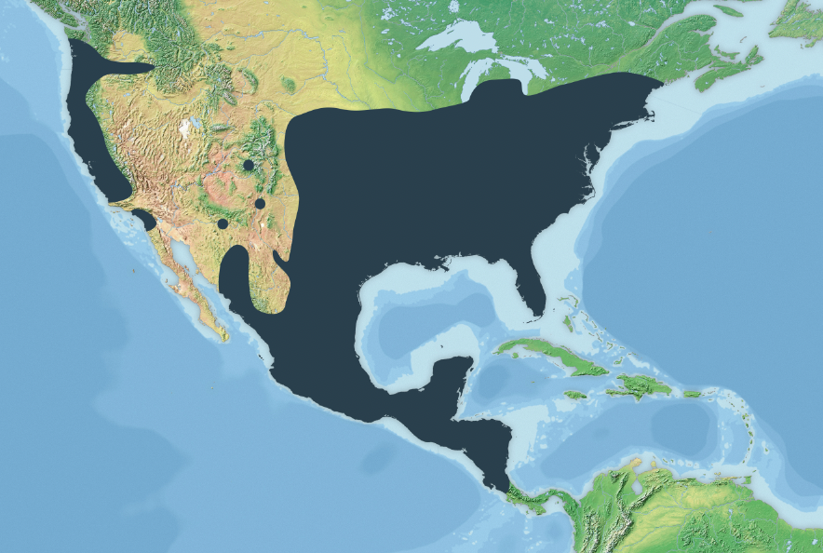
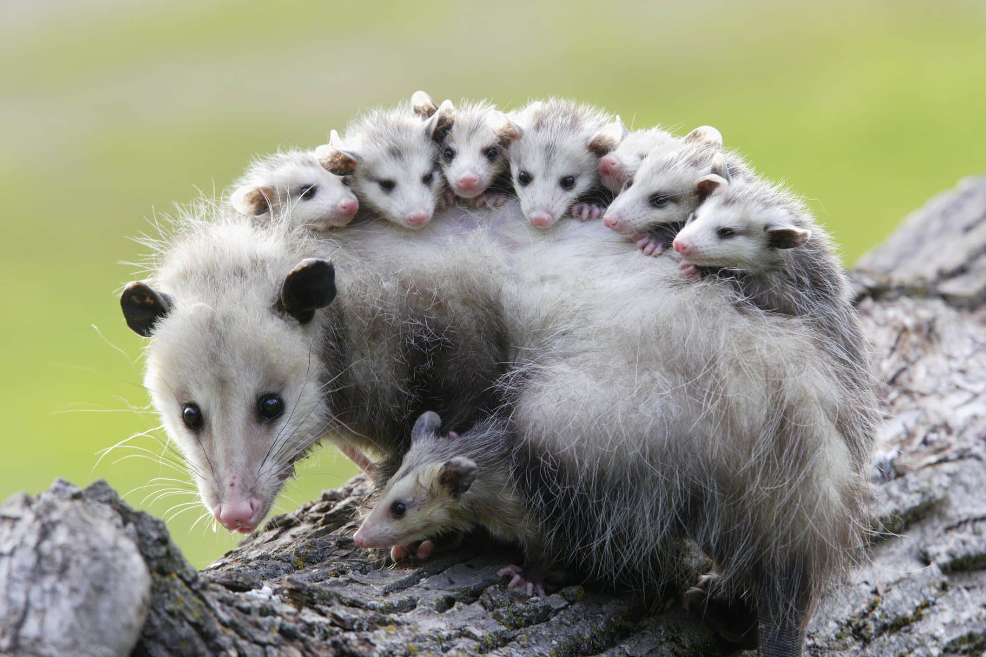
Virginia Opossum (Didelphis virginiana)​
Family Didelphidae
4 recognized subspecies
Live 2 years in the wild
Dry and arid environments, woodlands, thickets, forests, shrublands, and urban areas
Opportunistic omnivores
Nocturnal
Notes:
If need more on this slide
The Virginia opossum is the original animal named opossum, a word which comes from Algonquian wapathemwa, meaning white animal
Colloquially, the Virginia opossum is frequently just called a possum. The possums of Australia, whose name is derived from a similarity to the opossums of the Americas, are also marsupials, but of the order Diprotodontia
https://faunafocus.com/portfolio/virginia-opossum/#:~:text=The%20Virginia%20opossum%20is%20the%20largest%20species%20in%20the%20genus,virginiana%20(Eastern)%2C%20D.

Slide 7
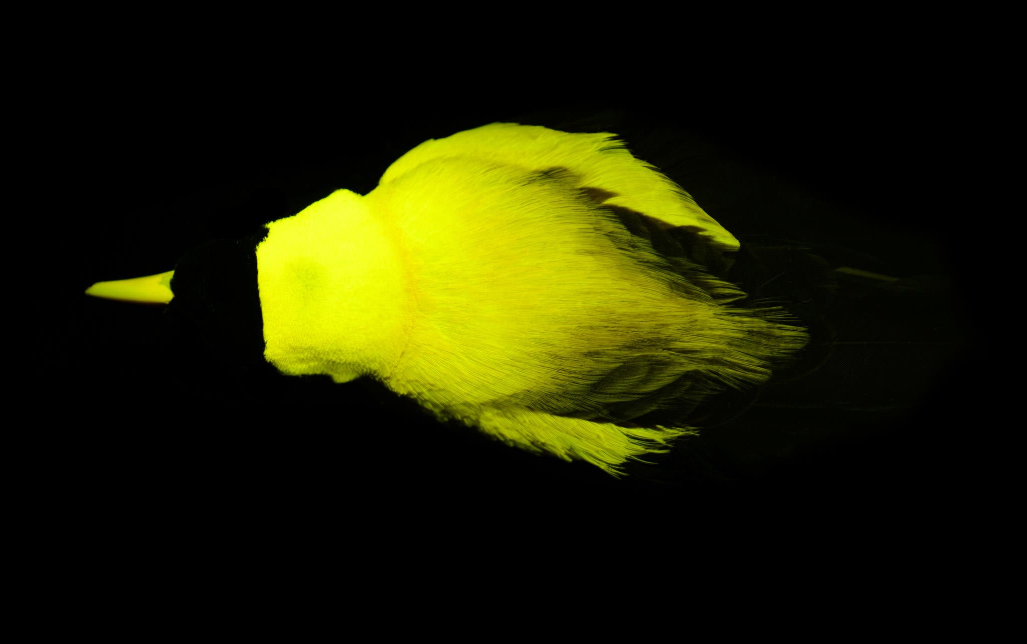
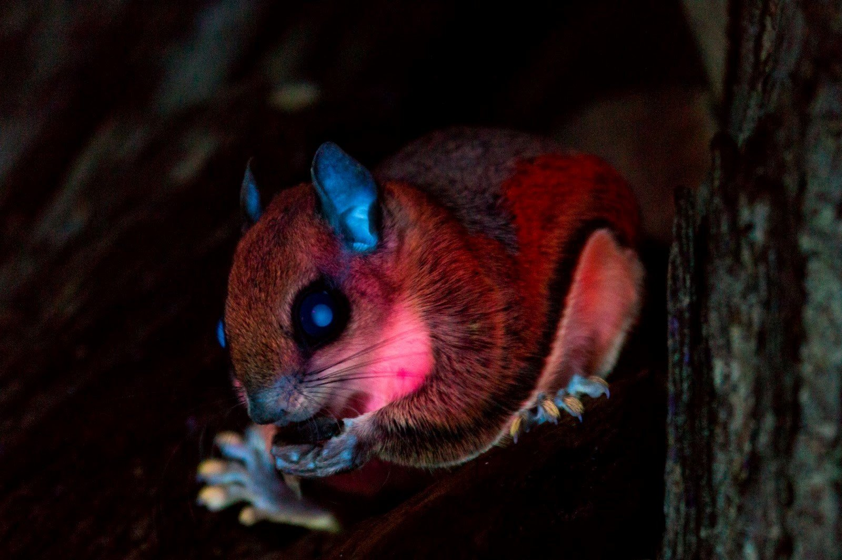
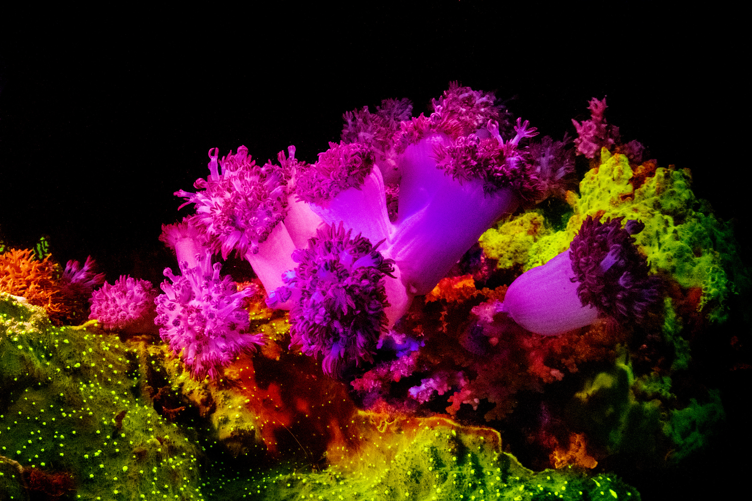
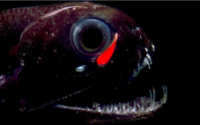
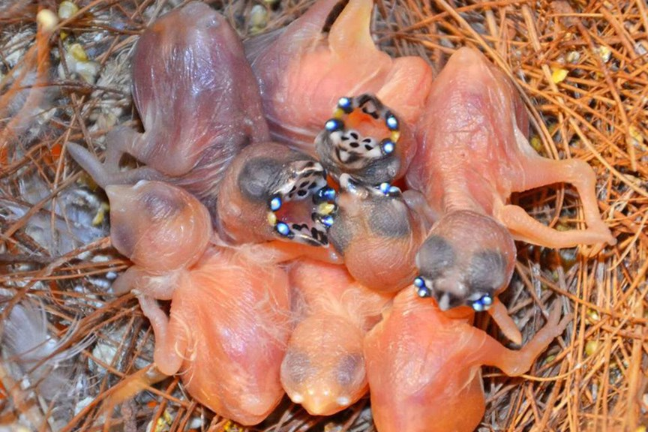
Hypotheses for Biofluorescence
Reproduction
  Birds-of-Paradise
Camouflage
  Flying squirrels
Communication
  Coral
Hunting
  Loosejaw dragonfish
Feeding
  Gouldian Finches
Notes:
Birds of paradise:
37 out of 45 species display
Predominantly in areas that are highlighted during mating rituals
Hypothesized to be to enhance courtship displays
Flying squirrels:
Hypothesized to fluoresce in order to blend in with fluorescent plants and moss
Targeted by owls, which can see fluorescence
Coral
Hypothesized to attract prey such as plankton and other marine organisms
Deep-sea loosejaw dragonfish
Hypothesized to be used to attract prey
Additionally could help make them less visible to potentially prey
Gouldian Finches
Nest in dark caviities, babies have a biofluorescent nodule on their beaks to alert parents where to place food

Slide 8
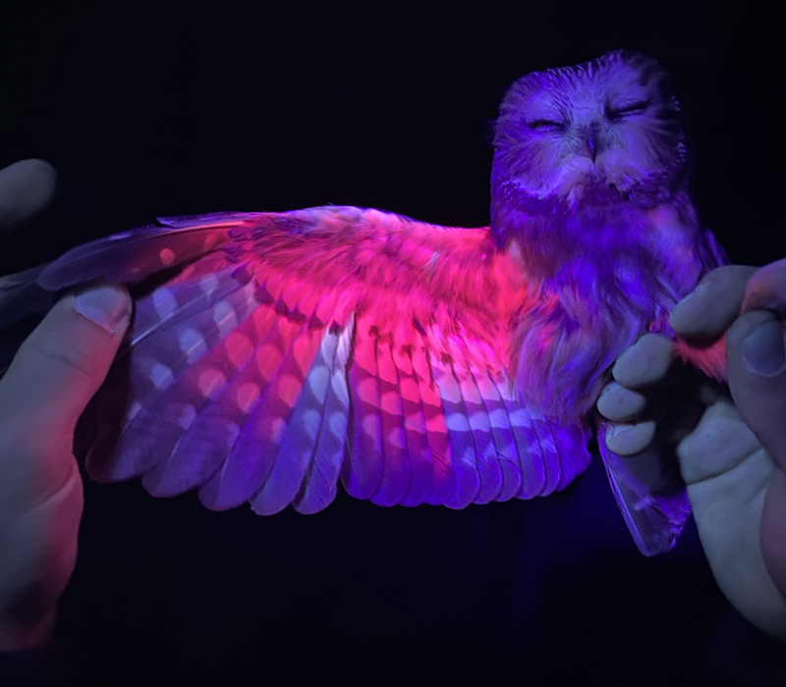
Question – Why are opossums biofluorescent?
Anecdotal – no differences between males and females
Role in predator-prey interactions?
Potential predators:
  Coyotes
  Bobcats
  Foxes
  Hawks
  Owls [nocturnal, biofluorescent, see UV, we have them (sort of)]
Question: Does opossum biofluorescence influence predatory behavior by owls?

Slide 9
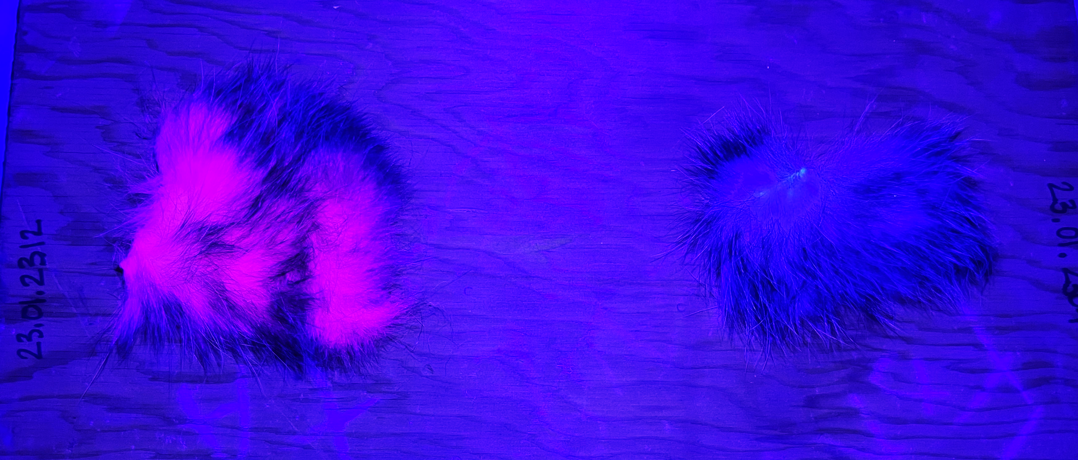
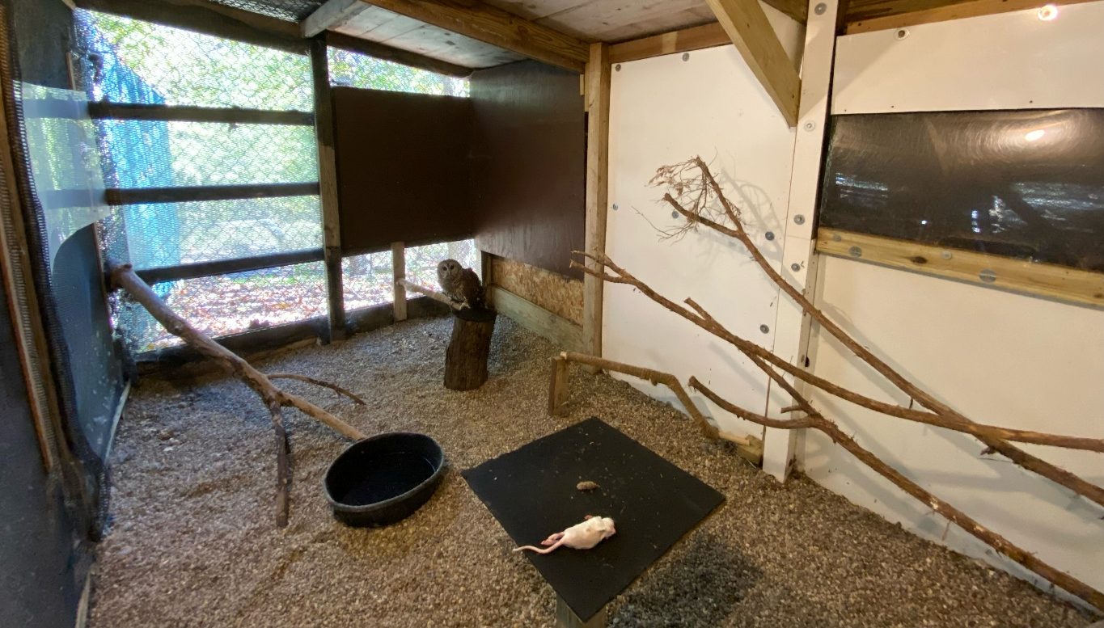
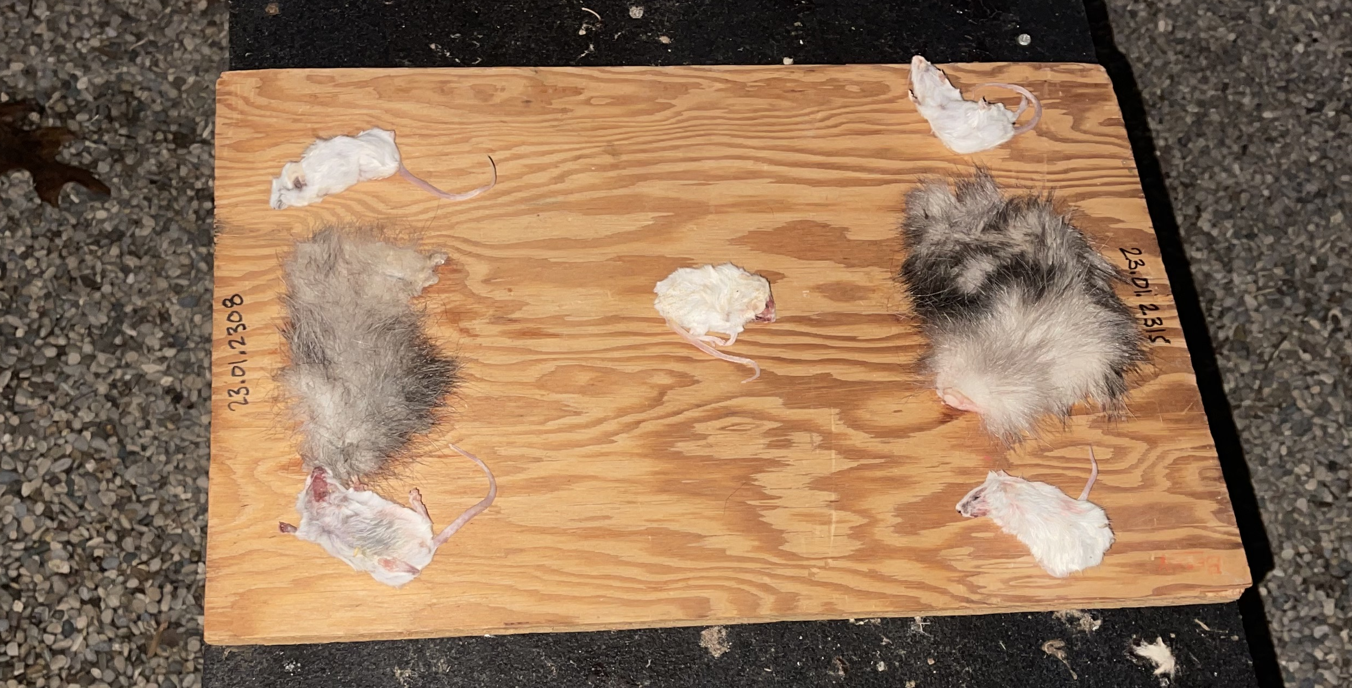
Methods
Fluorescent
Non-Fluorescent
Collected roadkill (head injuries)
Skinned & frozen
Loses fluorescence ~4 mo
Removed, patches (100 cm²), stapled to board
Choice test conducted with live owl
Recorded with trail cameras

Slide 10
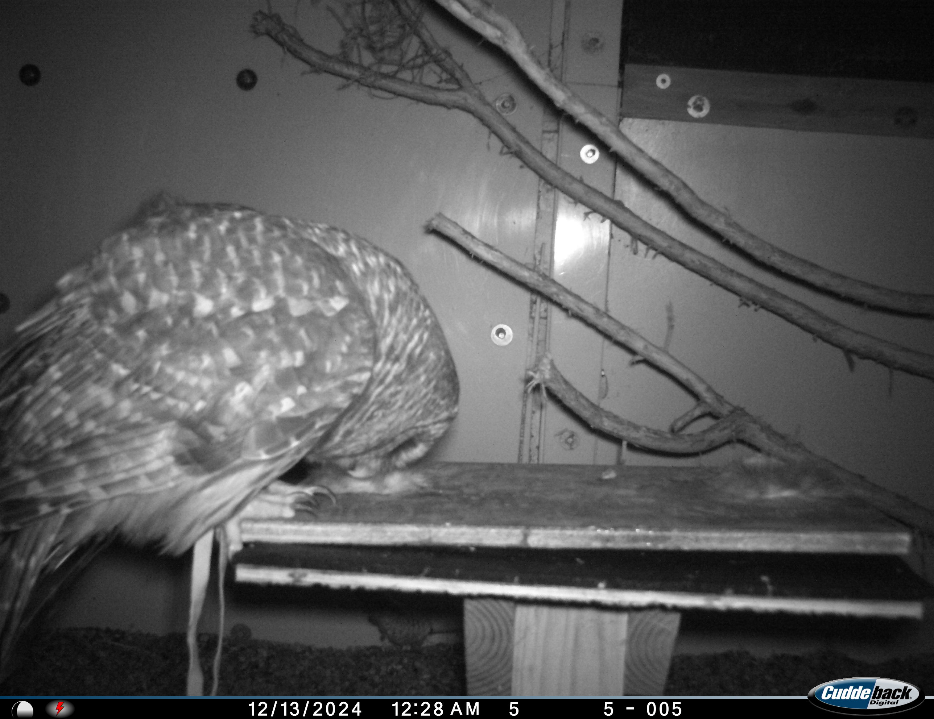
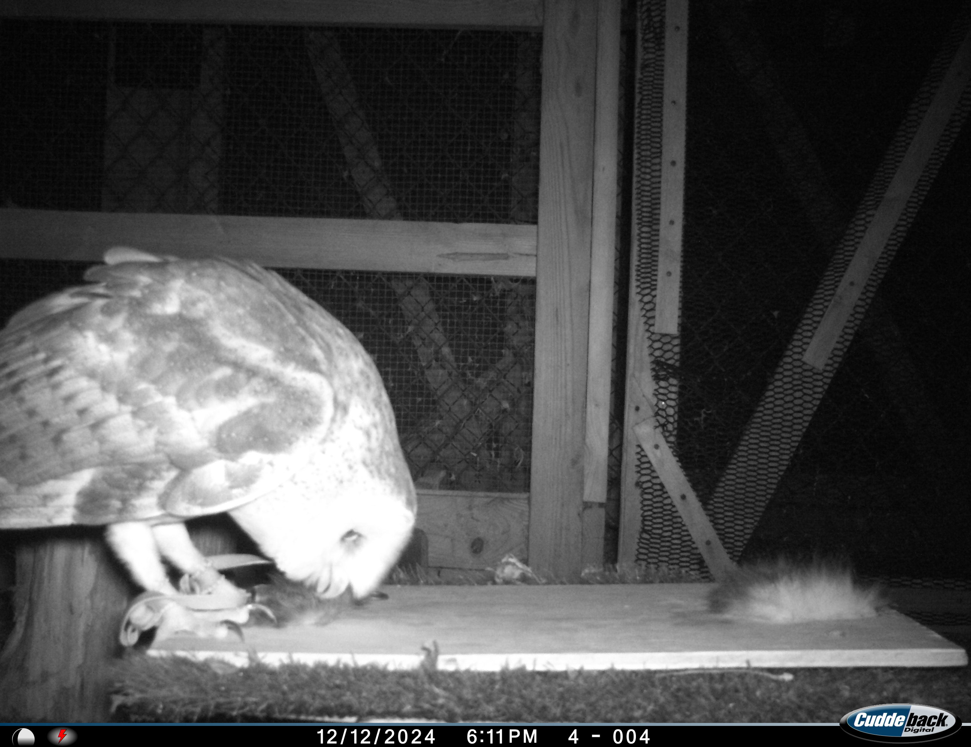
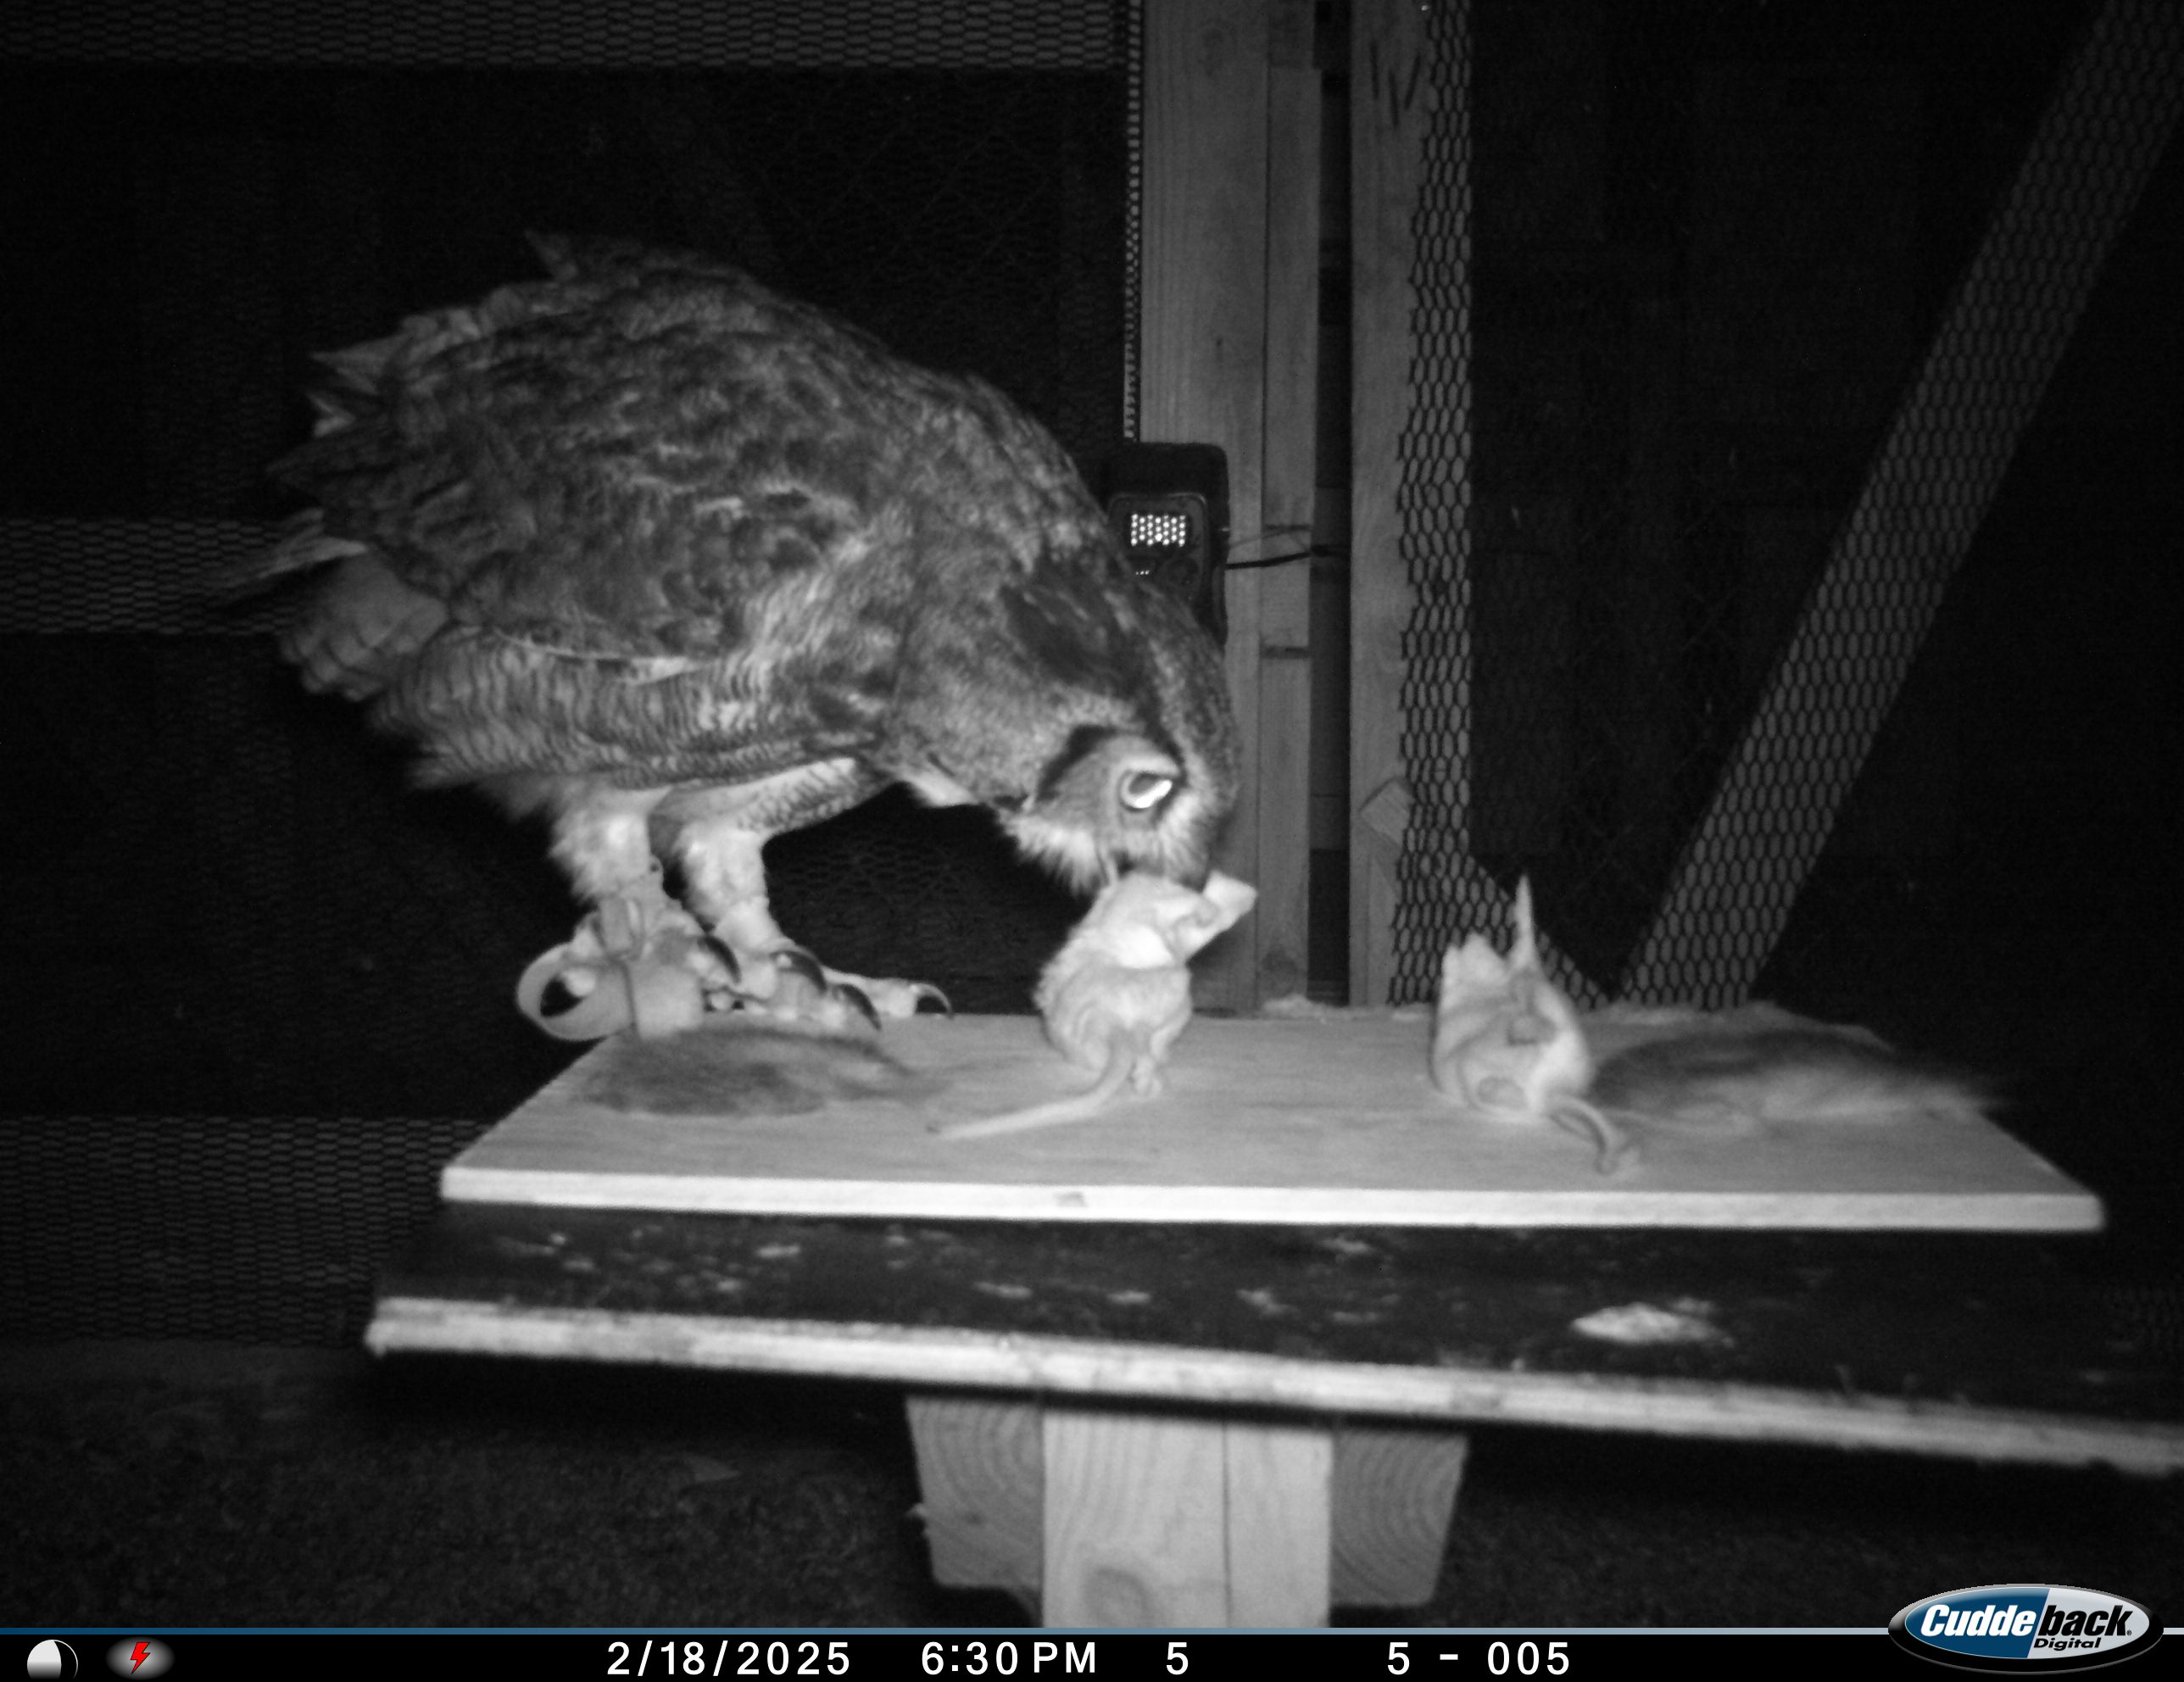
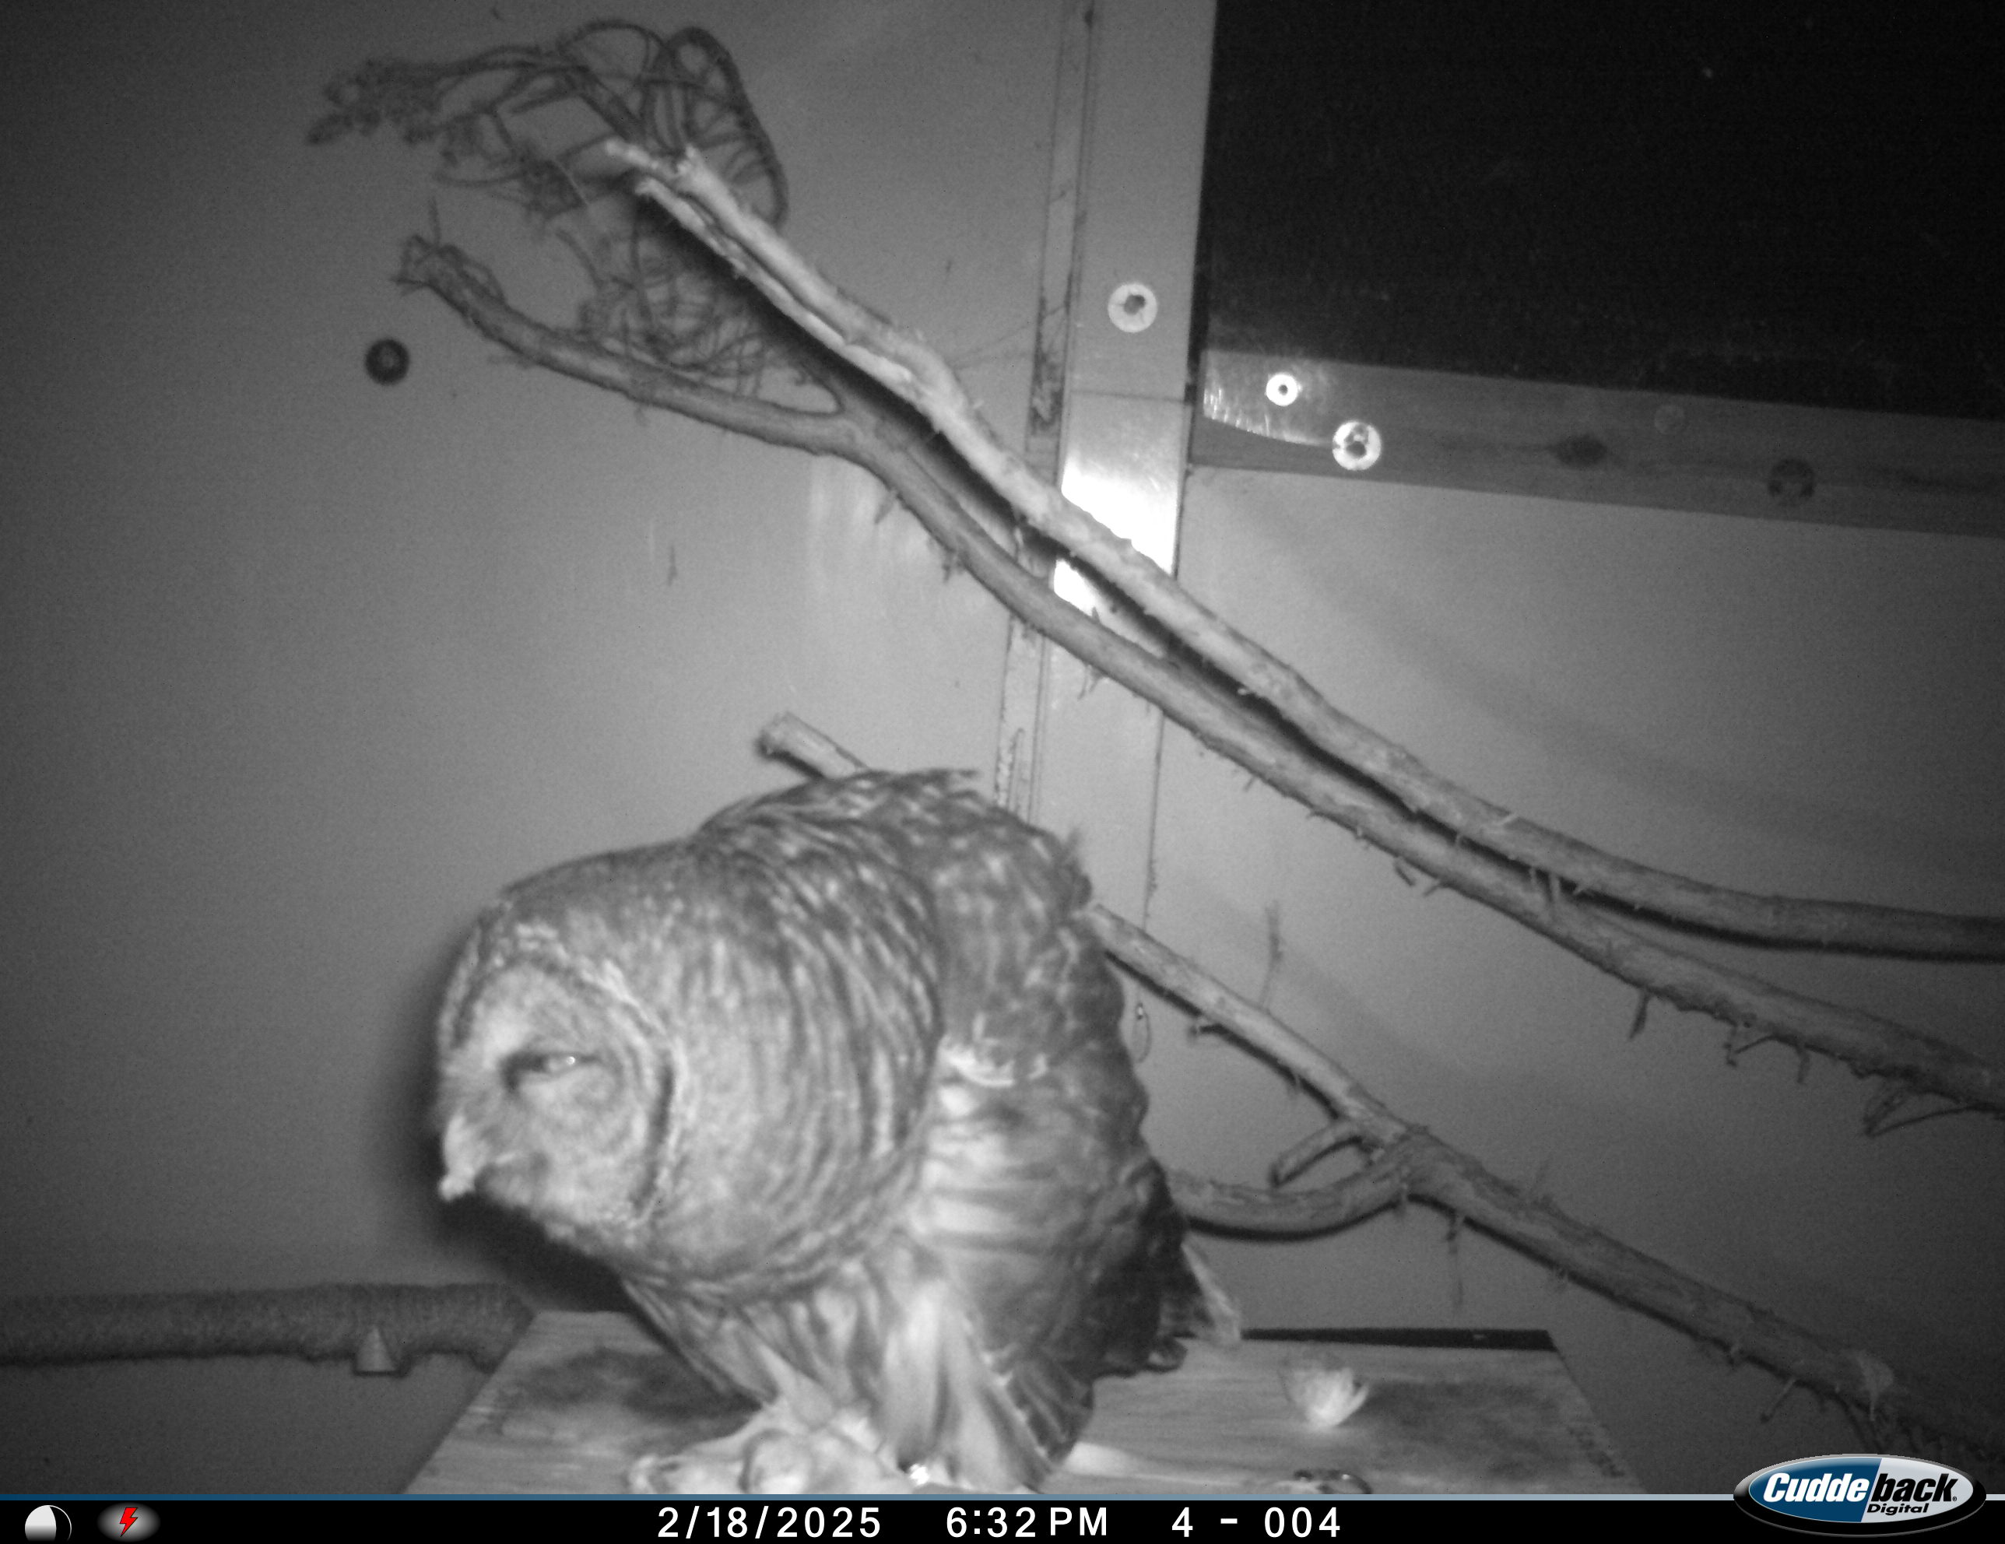
Response Variables
First interaction
Number of Interactions
First consumed
% Observations

Slide 11
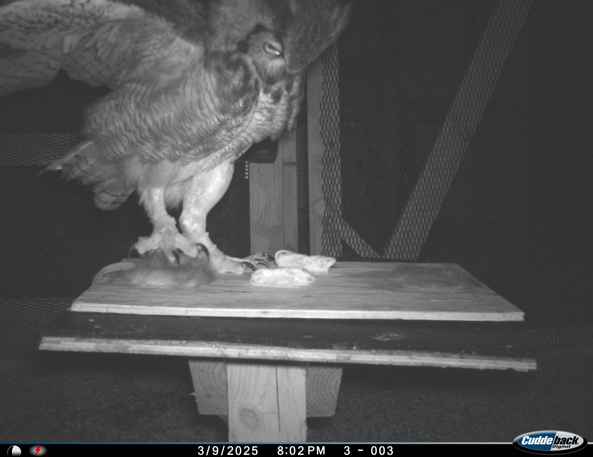
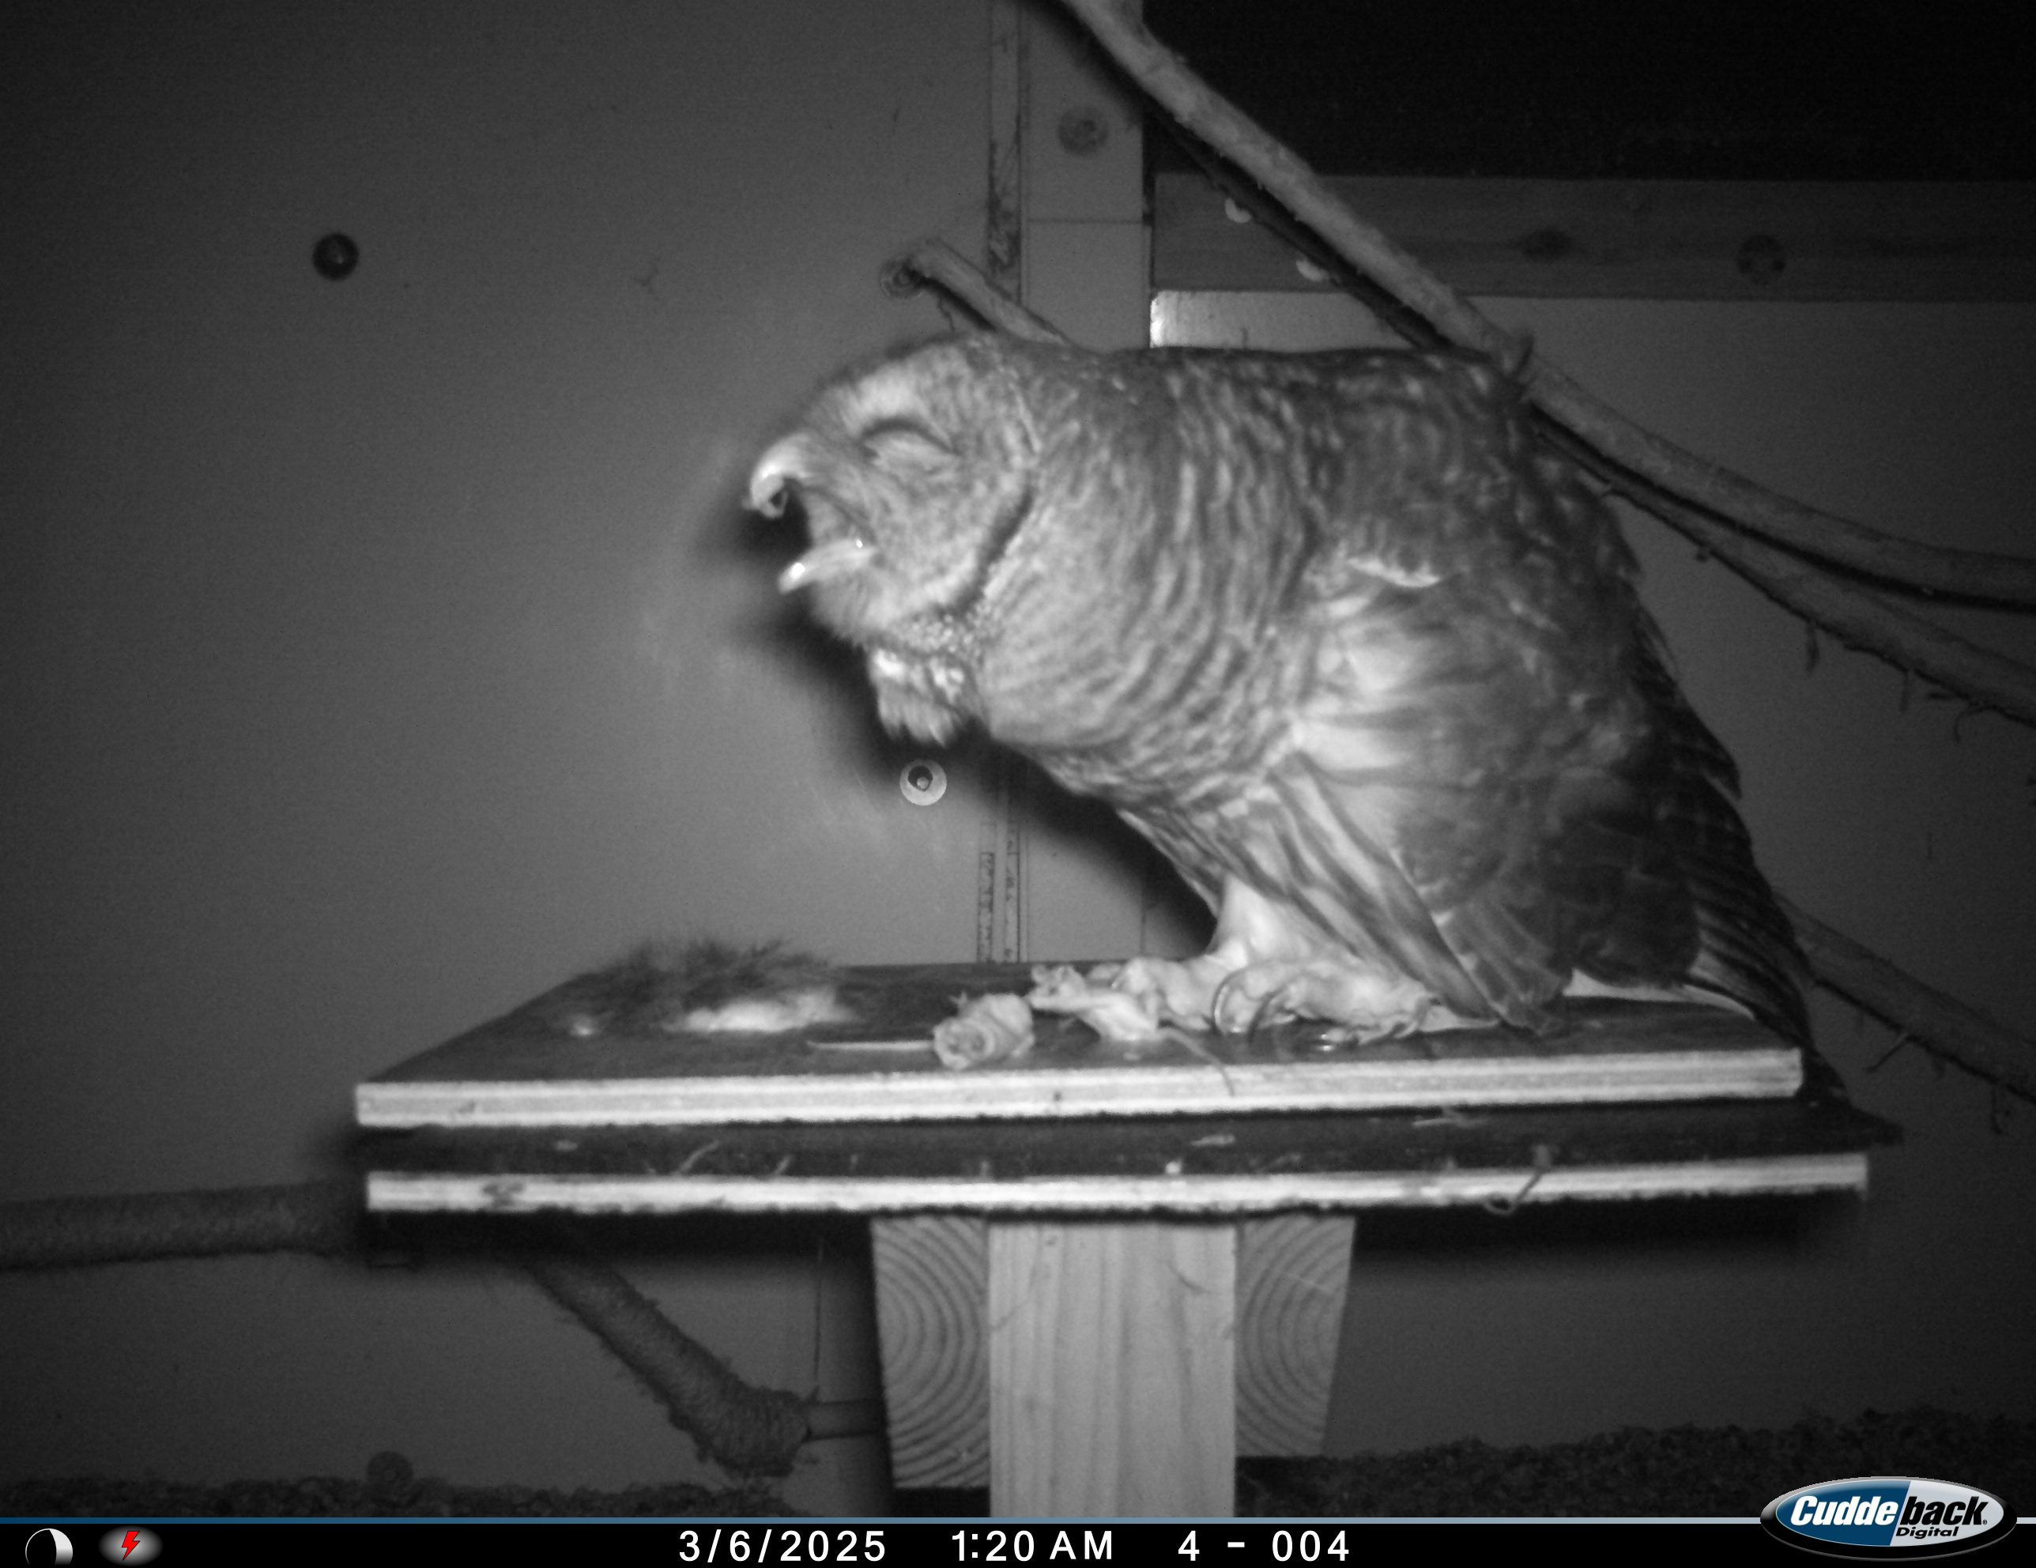
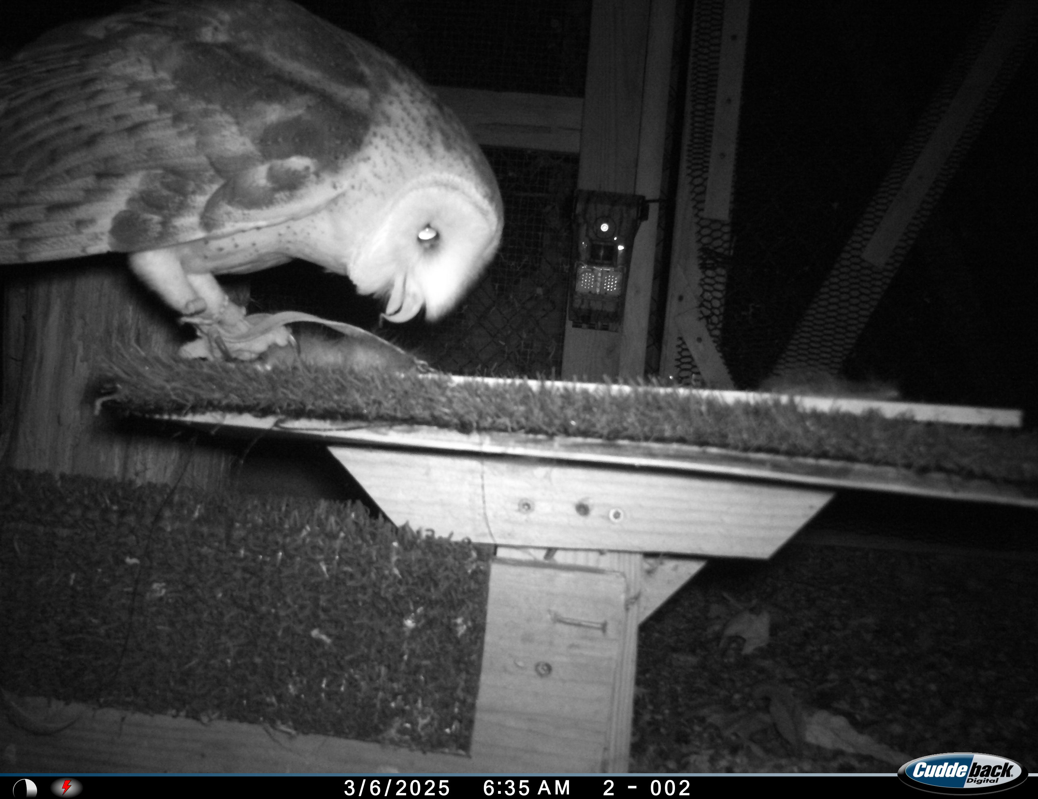
Results
First interaction
2 x 3 contingency table; χ² = 0.21, P = 0.9
First consumed
2 x 3 contingency table; χ² = 2.2, P = 0.33
Notes:
Great-horned eats more birds than barred

Slide 12
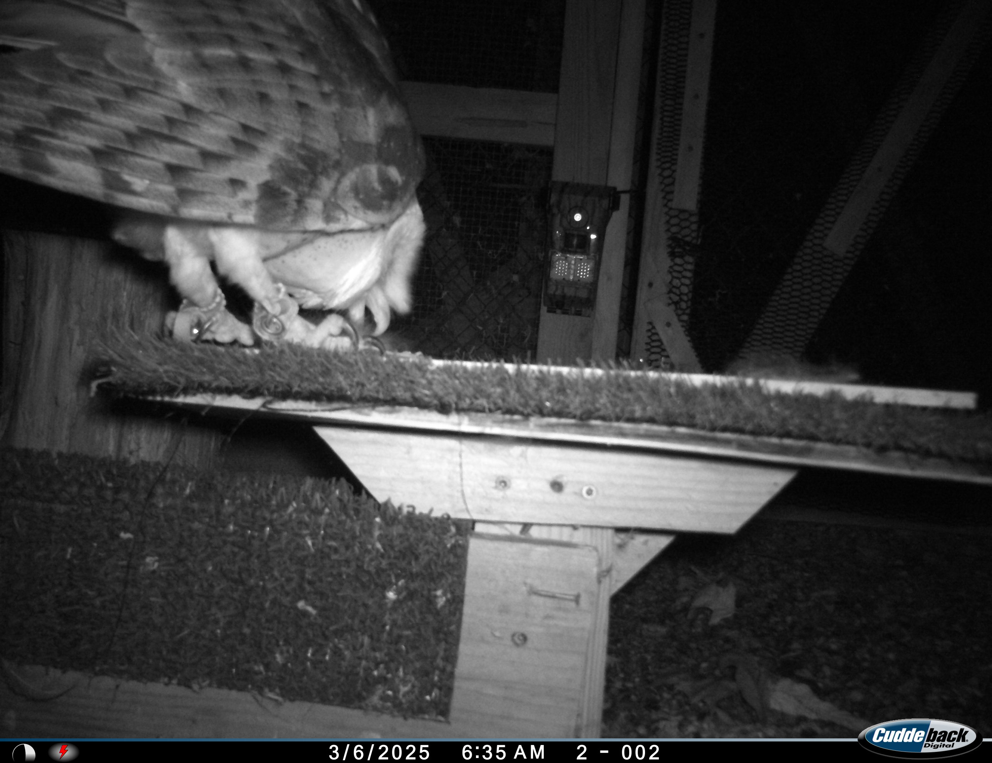
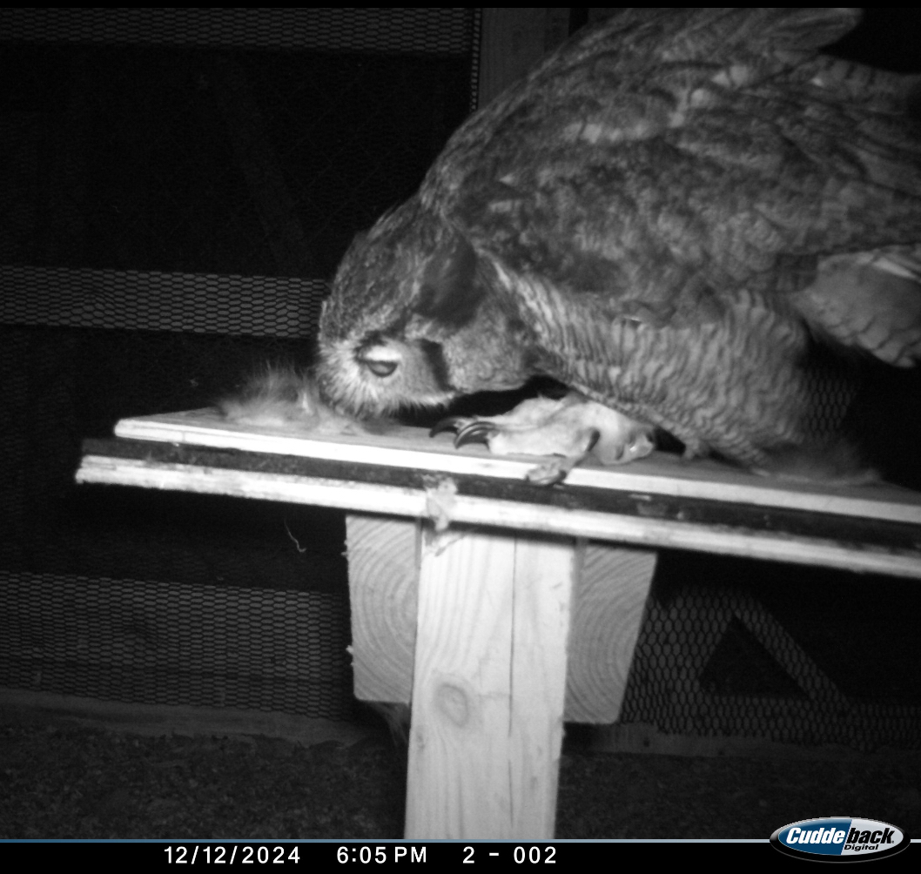
Results
hi
Notes:
Barred owl is older- bad vision? Maybe can see the glowy skin better?
Add note about averages

Slide 13
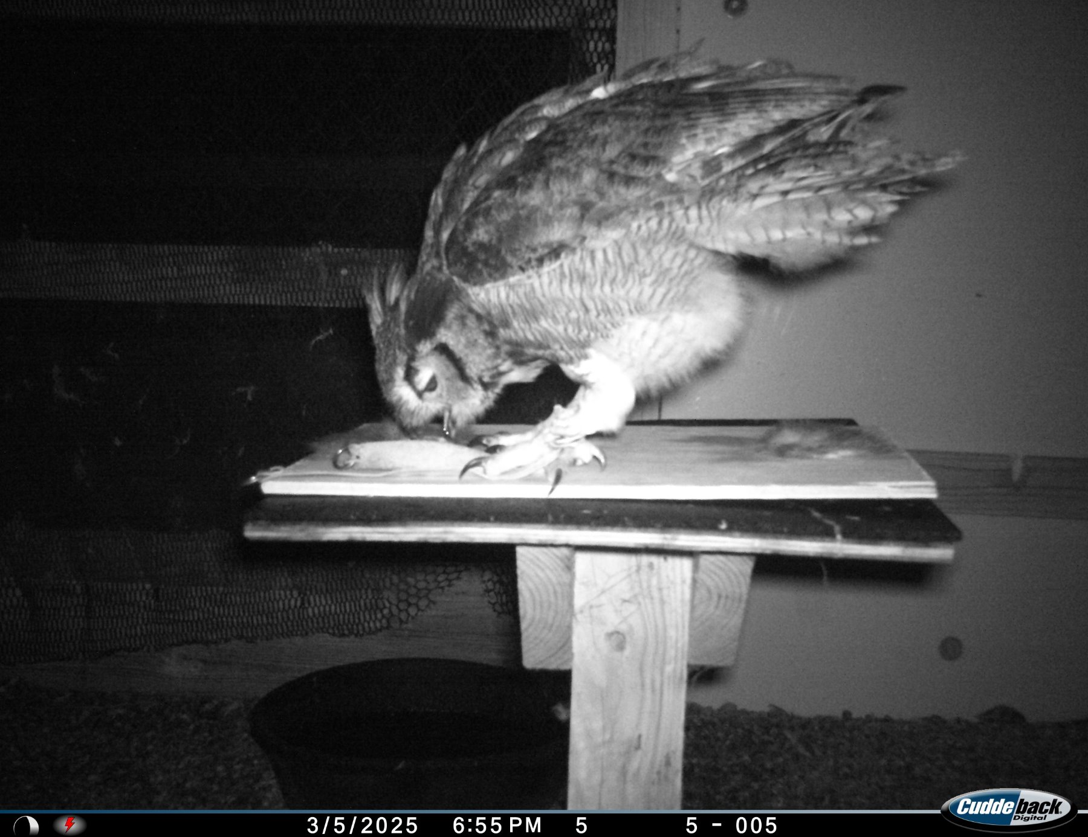
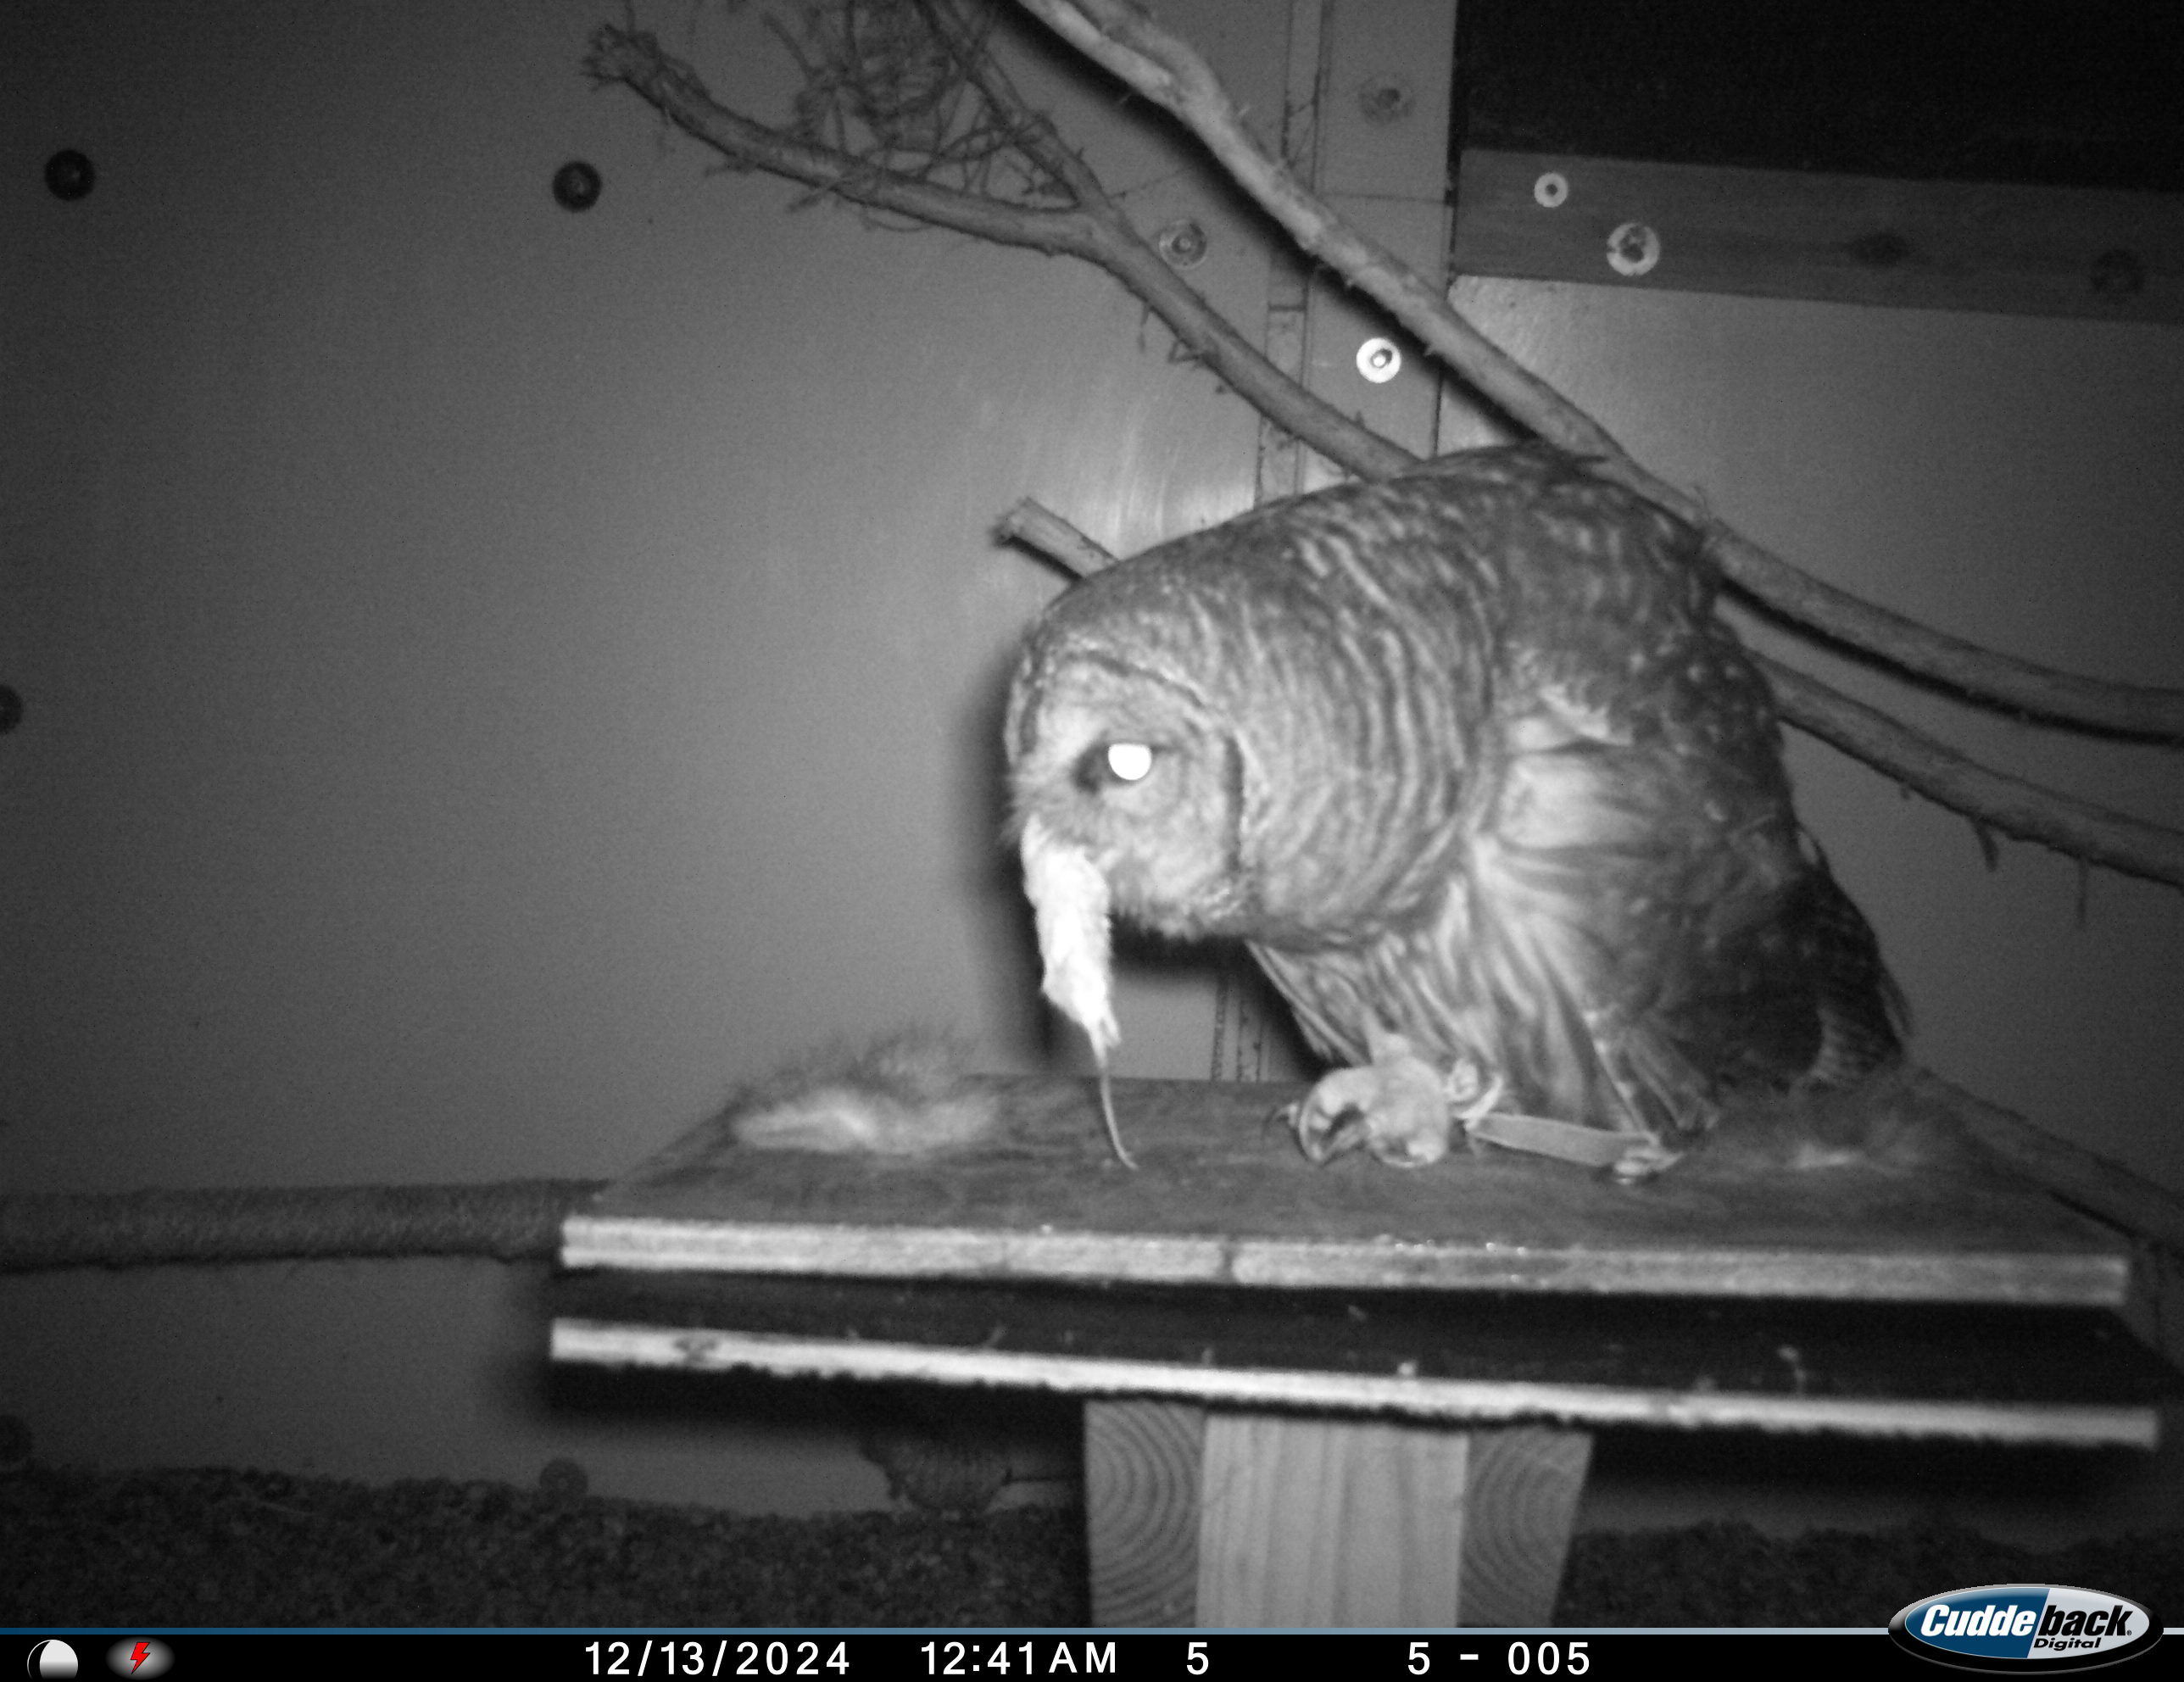
Results
hi
Notes:
CAPTIVITY?

Slide 14
Discussion
Barn owl – no apparent reactions
Barred Owl
  Large # interactions & observations with fluorescent skin
  Suggests some level of interest with the fluorescence
Great horned
  No difference in interactions or observations
  First consumed was always Non-fluorescent
  Suggests some potential aversion?

Slide 15
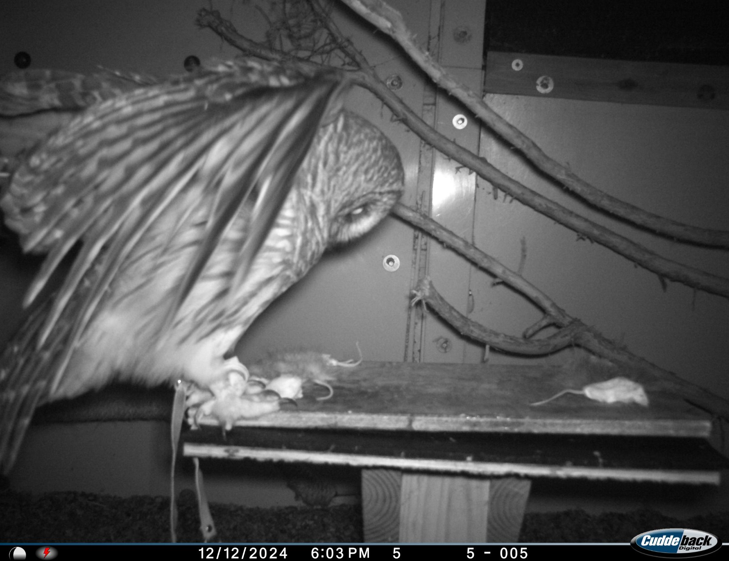
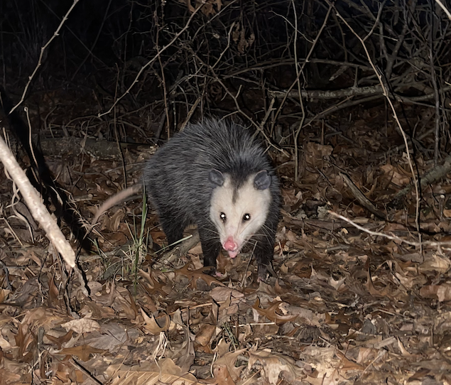
Discussion
Interpret with EXTREME caution (N = 1)!
  Larger sample size – difficult
  Study wild owls
Most owl species are fluorescent
Barred owls
  Diet >70% mammals
  Includes large mammals – rabbits, squirrels, opossums (~7%)
Great horned
  Diet >90% mammals (most small)
  Opossum documented in diet of 1 study
  Feed on wide-range of species
Notes:
Livezey, K. B. (2007). Barred owl habitat and prey: a review and synthesis of the literature. Journal of Raptor Research, 41(3), 177-201.
Cromrich, L. A., Holt, D. W., & Leasure, S. M. (2002). Trophic niche of North American great horned owls. Journal of Raptor Research, 36(1), 10.

Slide 16
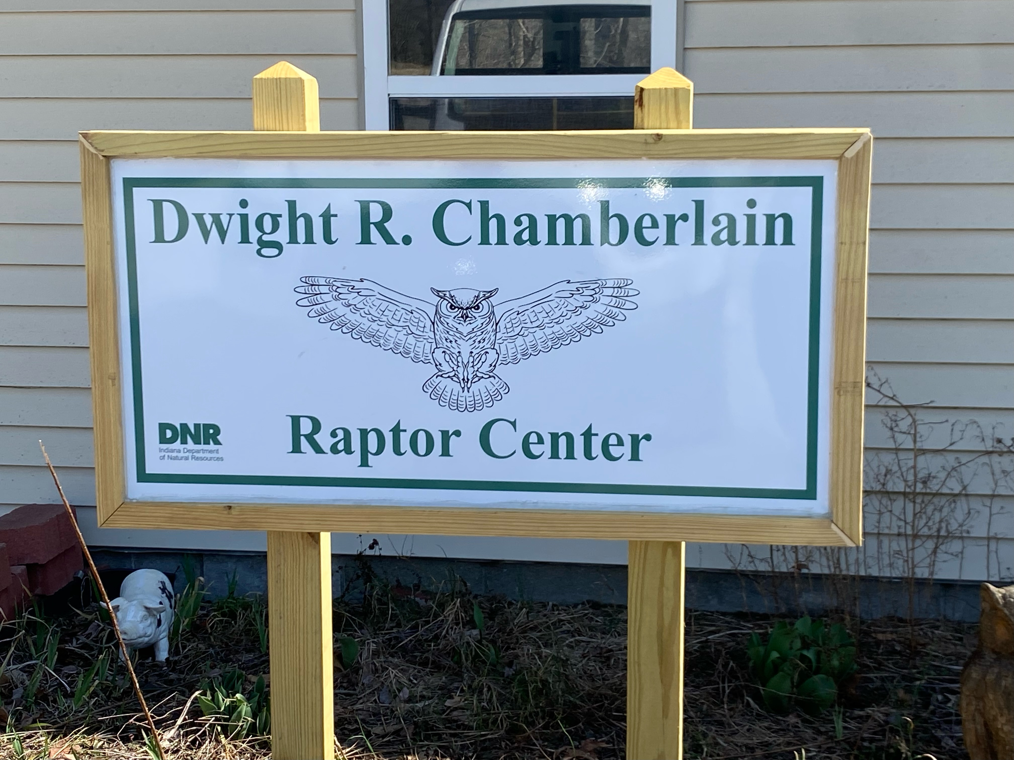
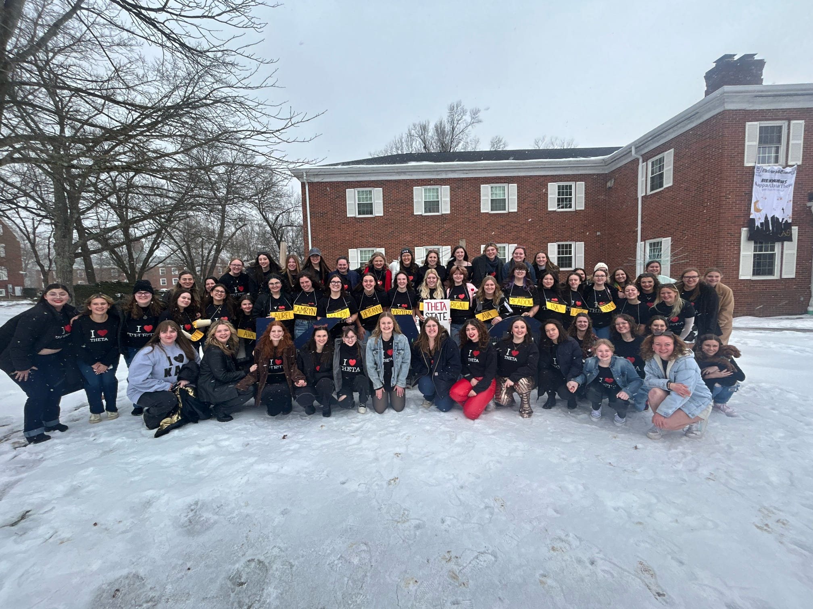
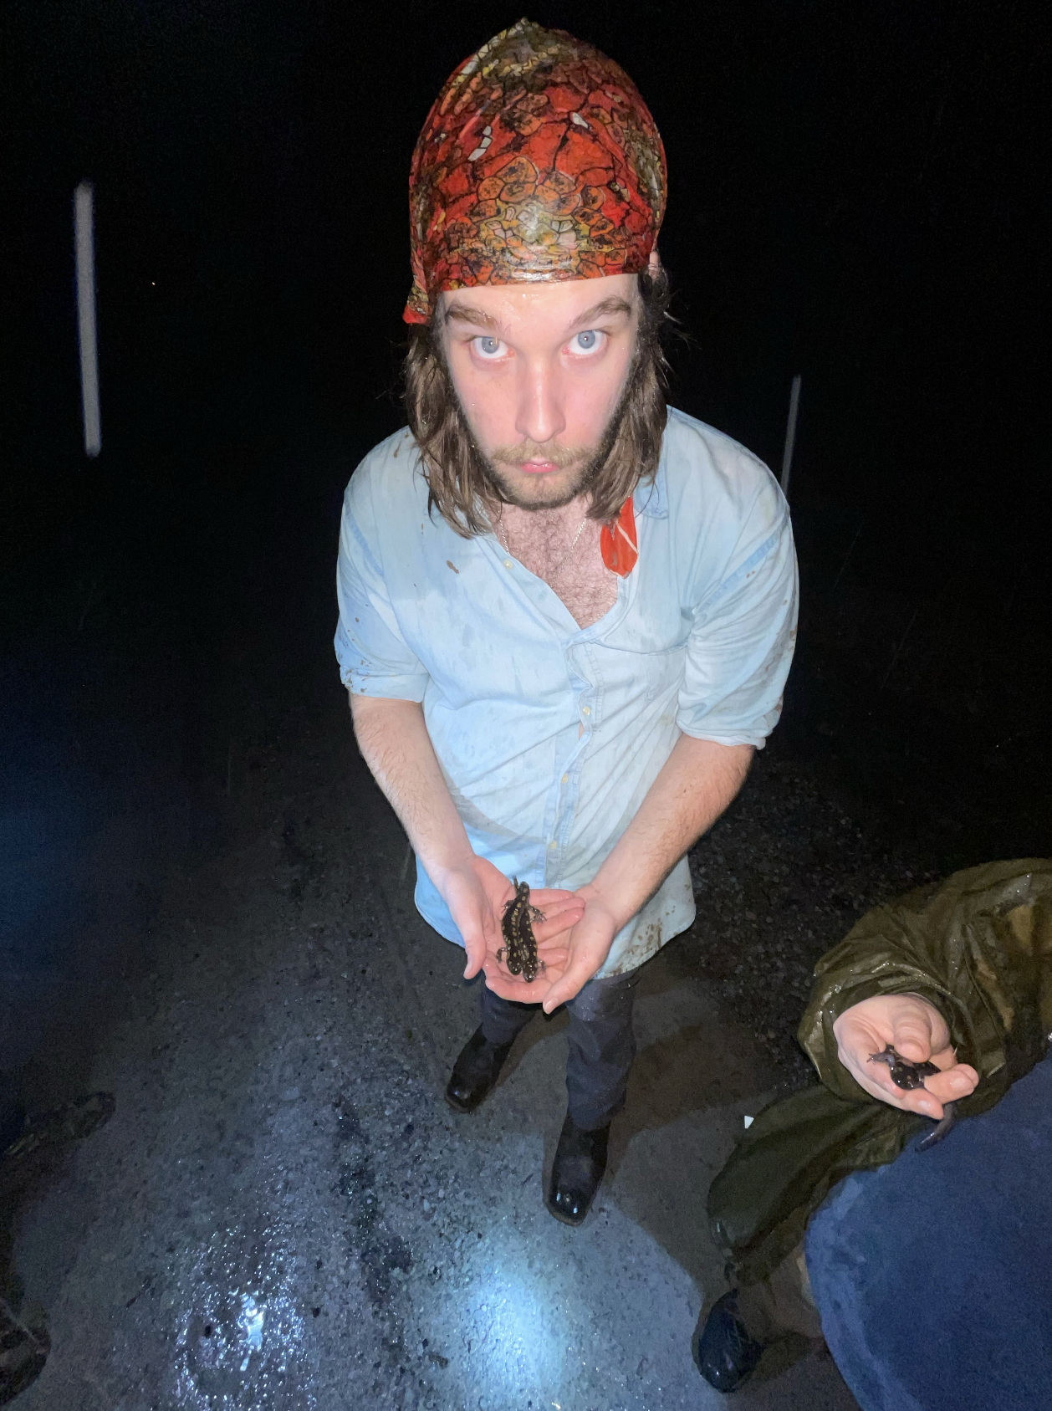





Acknowledgements
Nu Chapter of Kappa Alpha Theta
Jax Betzner
Shane Flick
Abby Badore
Reid Flick​
Katelyn Enginger

