Slide 1
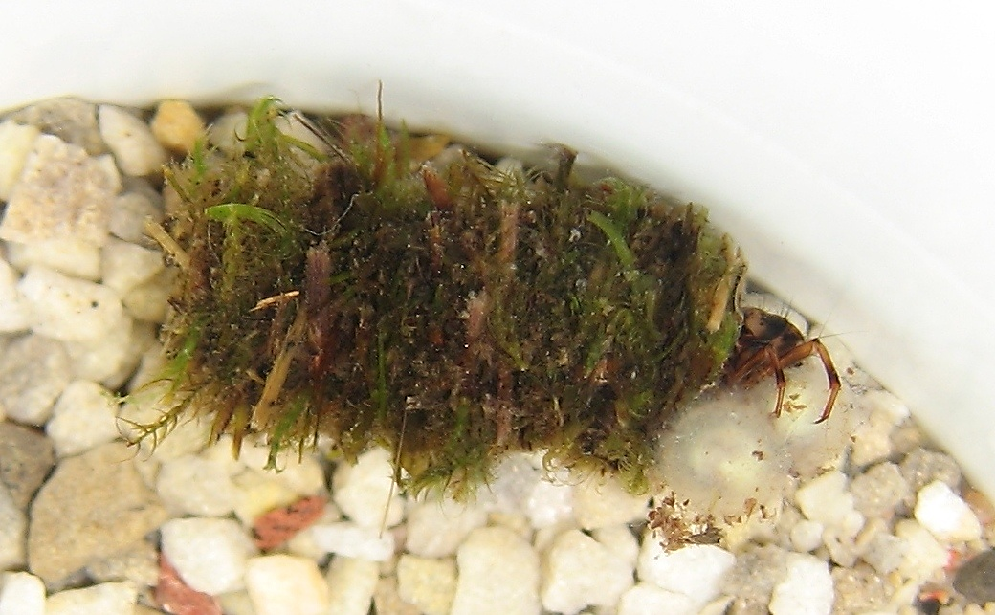

Signature of Selection From a Natural Toxin & Synthetic Pesticide on the Voltage-gated Sodium Channel in a Caddisfly
Brian G. Gall
Michael E. Pfrender
Edmund D. Brodie III
Edmund D. Brodie, Jr.
Notes:
Today I am going to tell a story of death and murder
All of it revolving around a toxin known as tetrodotoxin

Slide 2
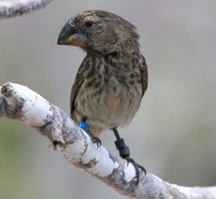
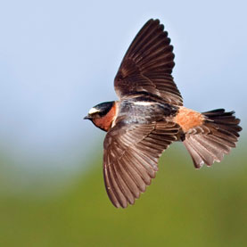
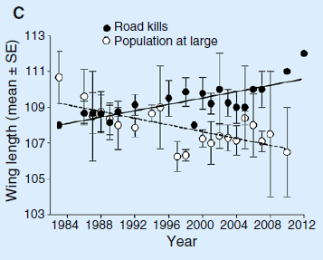
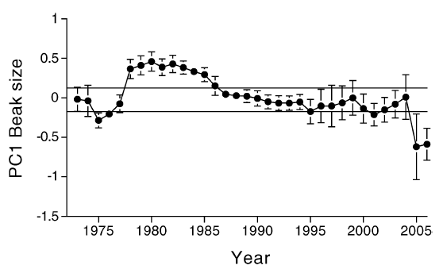
Sources of Selection
Notes:
Natural selection is ubiquitous in nature
Responses to individual selection pressures has been well studied (Natural – Galapagos finches; more recently Anthropogenic – road kills on wing length

Slide 3
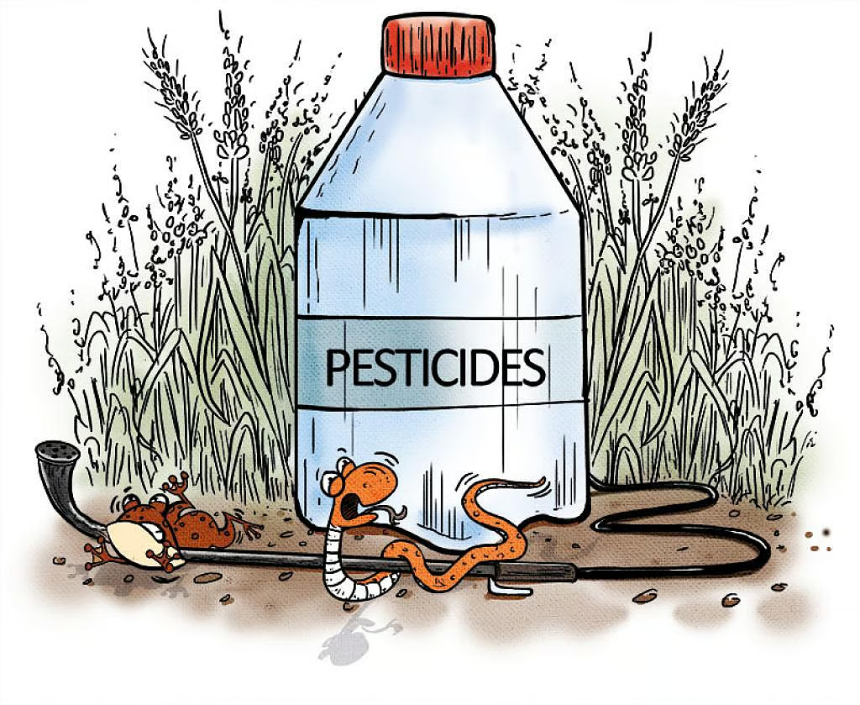
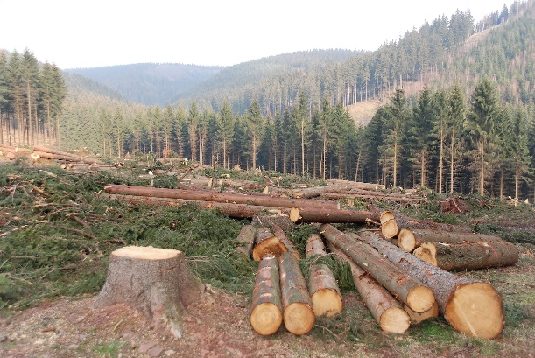

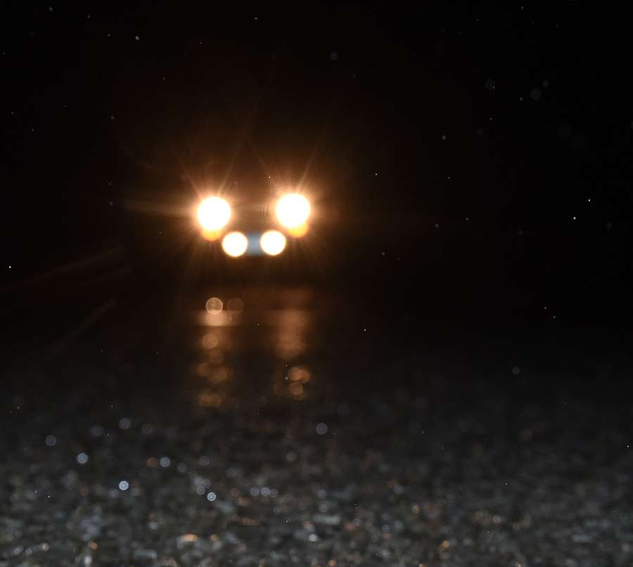
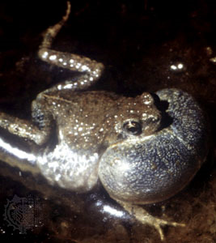
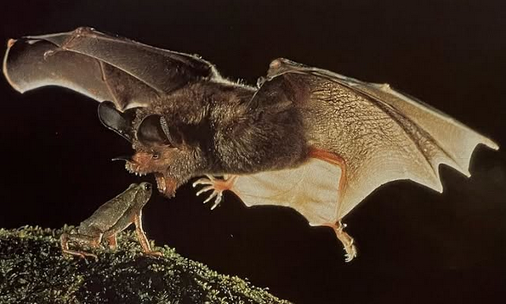
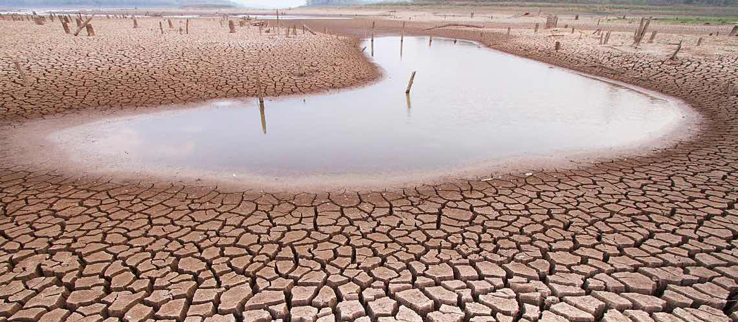
Multidimensional Selection

Slide 4
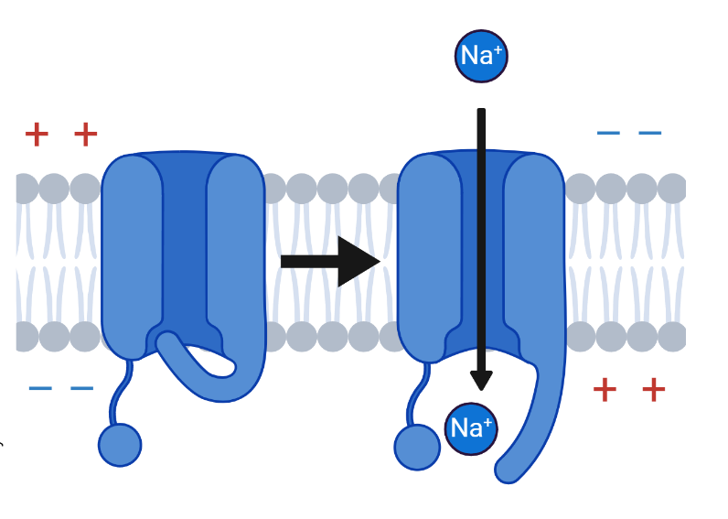
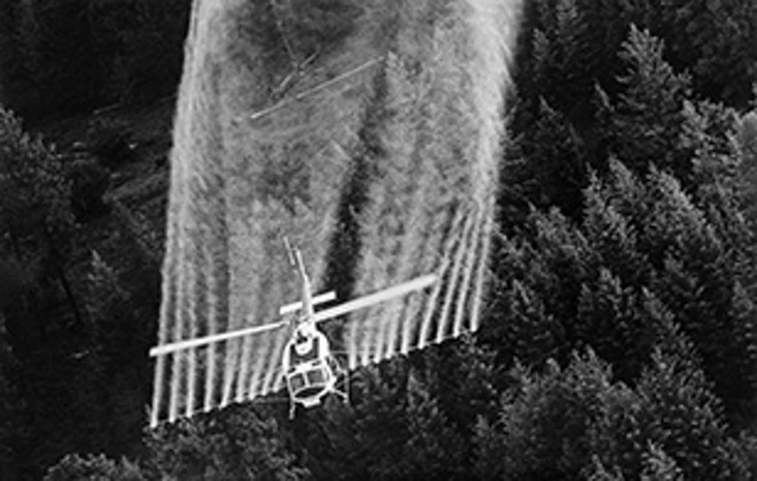
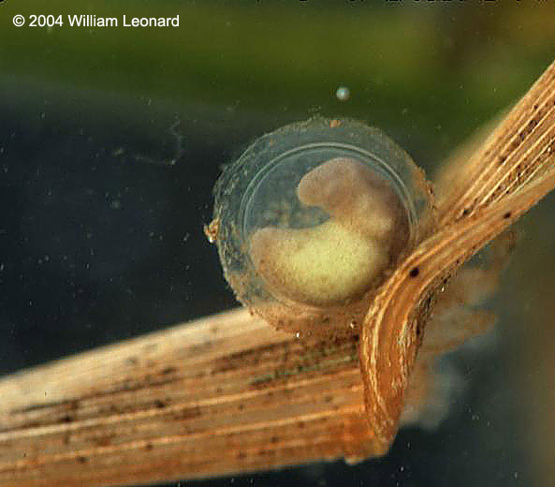
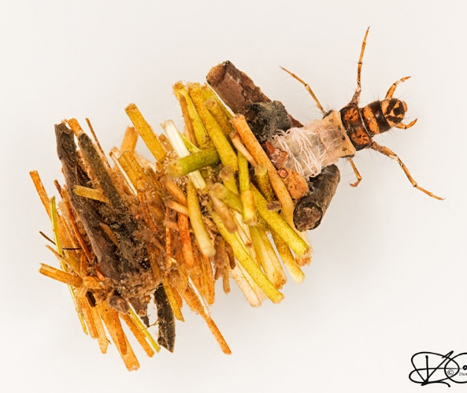
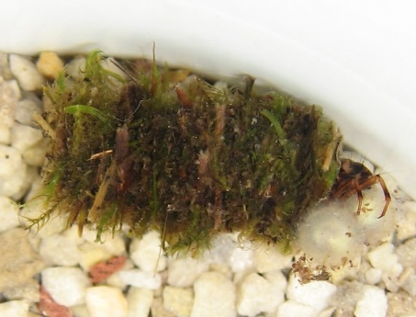
Voltage-gated Sodium Channel
Prominent source of selection → Toxins
  Anthropogenic – Herbicides & Insecticides
  Natural - TTX & STX
Same target → different outcomes
Target site – Voltage-gated sodium channels
Responsible for electrical signaling
Caddisfly from Western Oregon
Aerial application of DDT
Newt egg containing TTX
Notes:
Within the environment – toxins are increasingly a major source of selection
The cell’s work-horse
Critical role to cell physiology
This critical function also makes them an important target for natural and synthetic toxins – and thus a powerful tool to understand how evolution shapes traits in response to multiple sources of competing selection, while simultaneously faced with need for stabilization of protein function
Insights into adaptability and constraints on protein function
One of the most critical proteins for cell physiology is VGSC
Responsible for actional potential generation in nerves and skeletal muscle – thus ALL LIFE’s functions
Responsible for the propagation of action potentials in nerves and muscle and thus all nervous system functioning depends on this critical channel
Resp for electrical signals in nervous system and THUS highly conserved across species
TTX - Occludes
Increase sodium permeability and close slowly - Results in repetitive discharging - muscular convulsions, weakness, paralysis, and death
Increase sodium permeability and close slowly - Results in repetitive discharging - muscular convulsions, weakness, and death
Originally isolated from Chrysanthemum
When the toxin keeps the channels in their open state, the nerves cannot repolarize, leaving the axonal membrane permanently depolarized, thereby paralyzing the organism

Slide 5
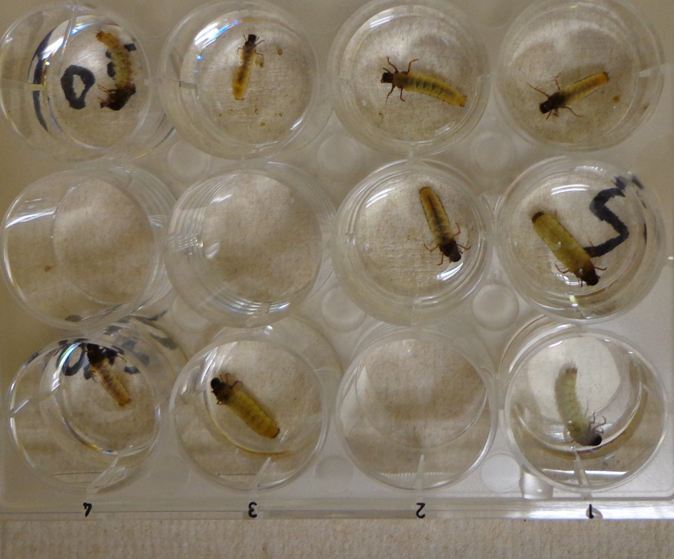
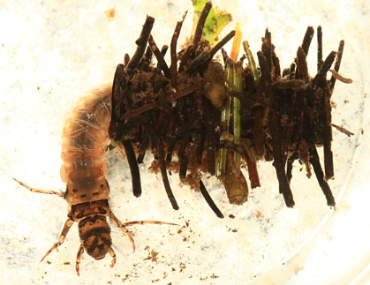
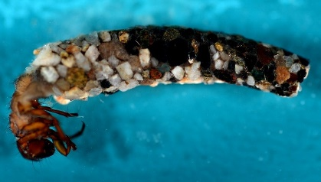
LC50
2 caddis species
  Soap creek, OR
  Cache valley, UT
5 concentrations
  Control
  0.0005 to 0.1 mg TTX/ml

Slide 6
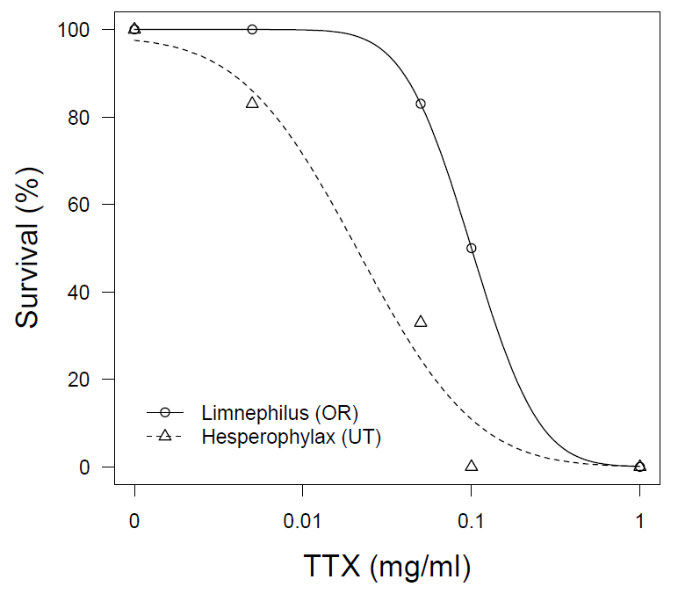

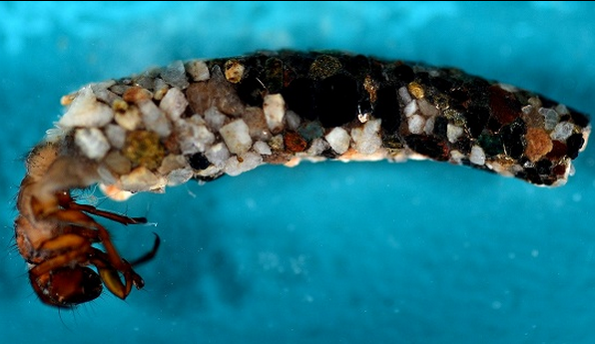
TTX LC50
DRC and Multcomp procedures in R
Evaluates overlap in confidence intervals
Caddisflies sympatric with newts = 5x higher LC50**
LC50: 0.021
LC50: 0.10
Notes:
.1 mg / ml = enough TTX in one well to kill 4-16 people

Slide 7
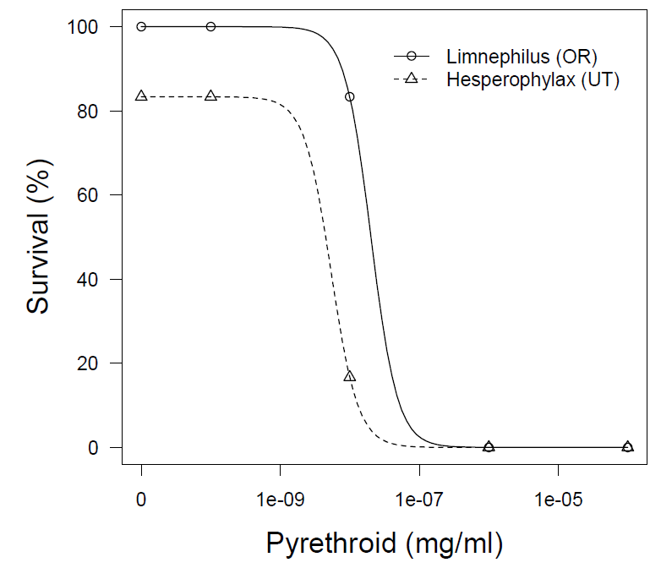

Pyrethroid LC50
95% Confidence intervals surrounding LC50’s do not overlap
Caddisflies from OR 3x higher LC50**
LC50: 5.4e-9
LC50: 2e-8

Slide 8
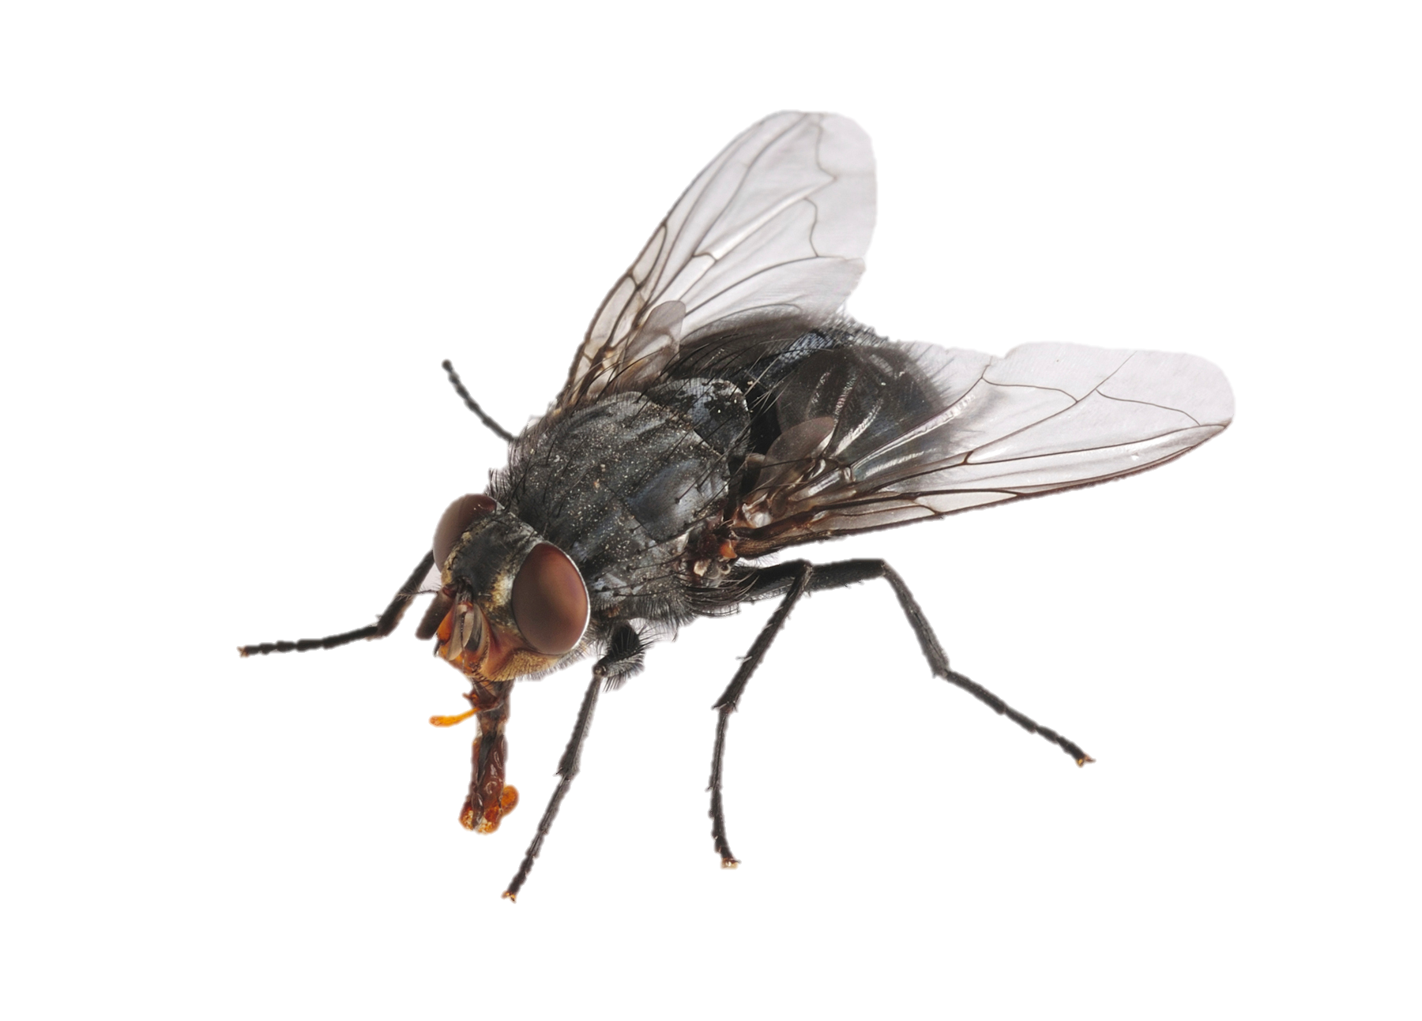
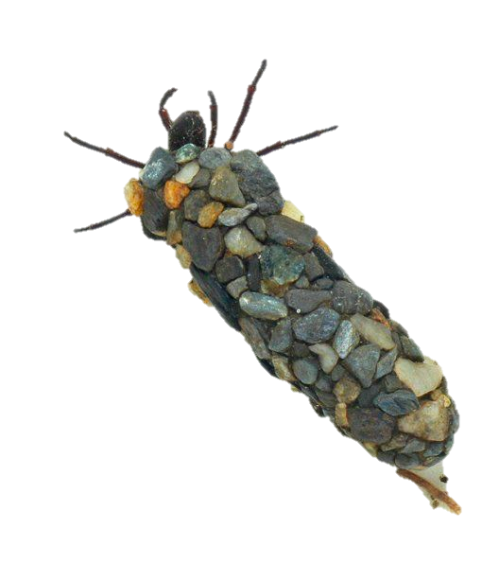
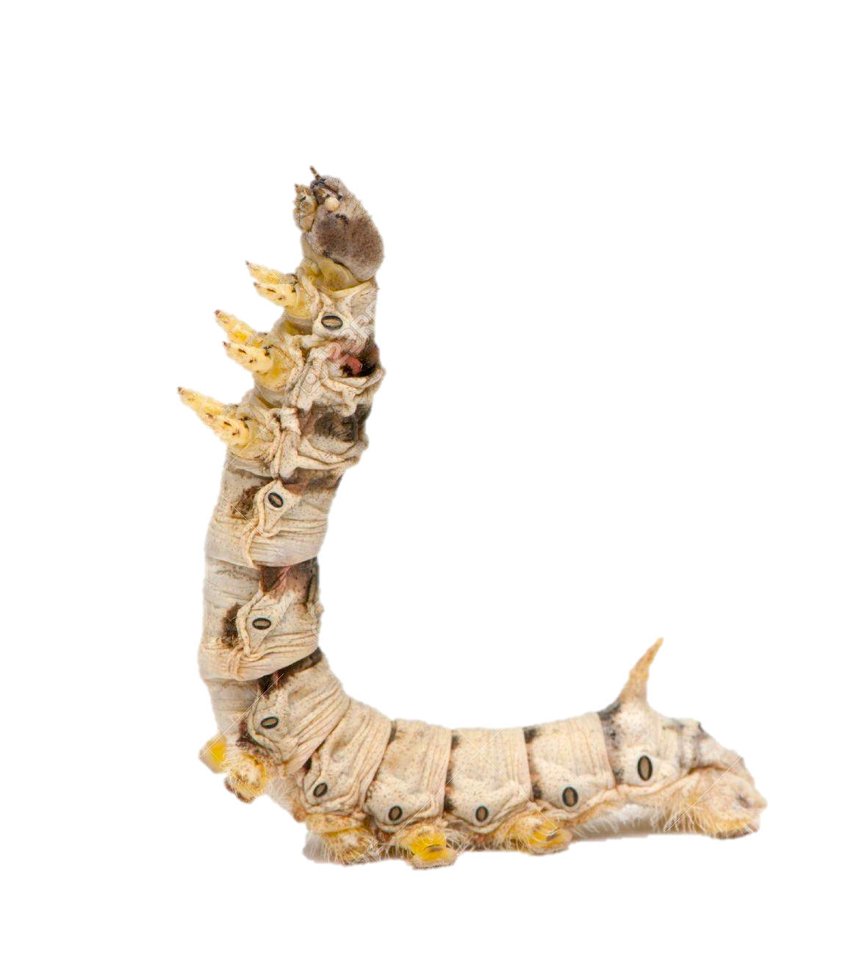
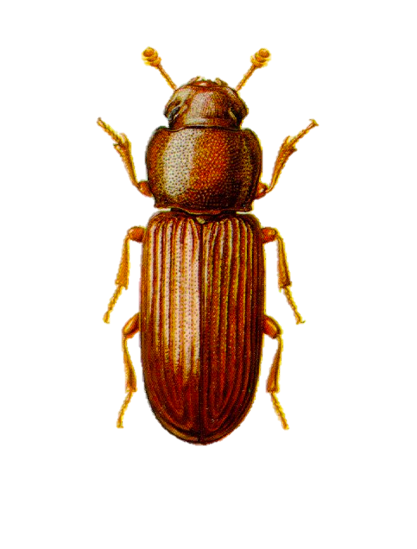
Do TTX resistant caddisflies express mutations in sodium channel gene?
Transcriptome sequence & RNA extraction from 5 individuals (UT & OR)
Trinity assembly & gene annotation (BLASTX and Exonerate)
Reference genomes from 5 other caddisfly species and 5 insect species
Public
Transcriptome data
Genome data
Notes:
4 individuals per specieswere included for comparison, including: fruit fly, housefly, silkworm, red flour beetle, and caddisfly.

Slide 9

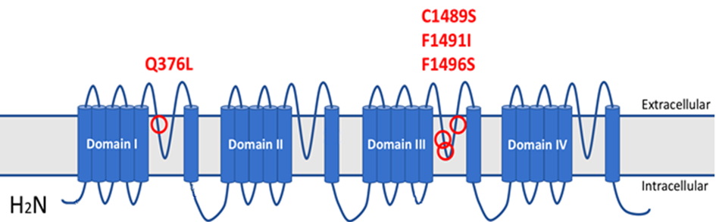

Sodium Channel Mutations?
HIGHLY conserved
1486
1499
Utah
Oregon
69 amino acid replacements
Notes:
4 associated with TTX resistance
15 - 40 fold increase in resistance
P region – virtually identical for all caddis and all insects

Slide 10
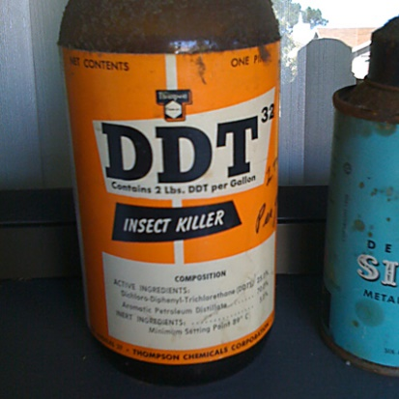
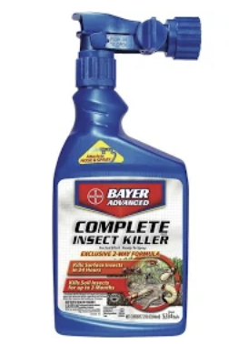
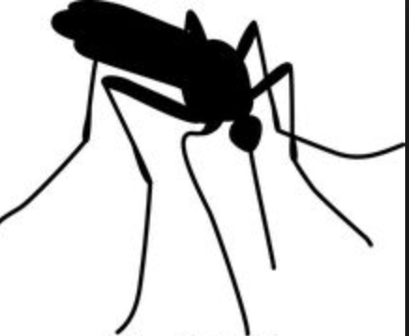
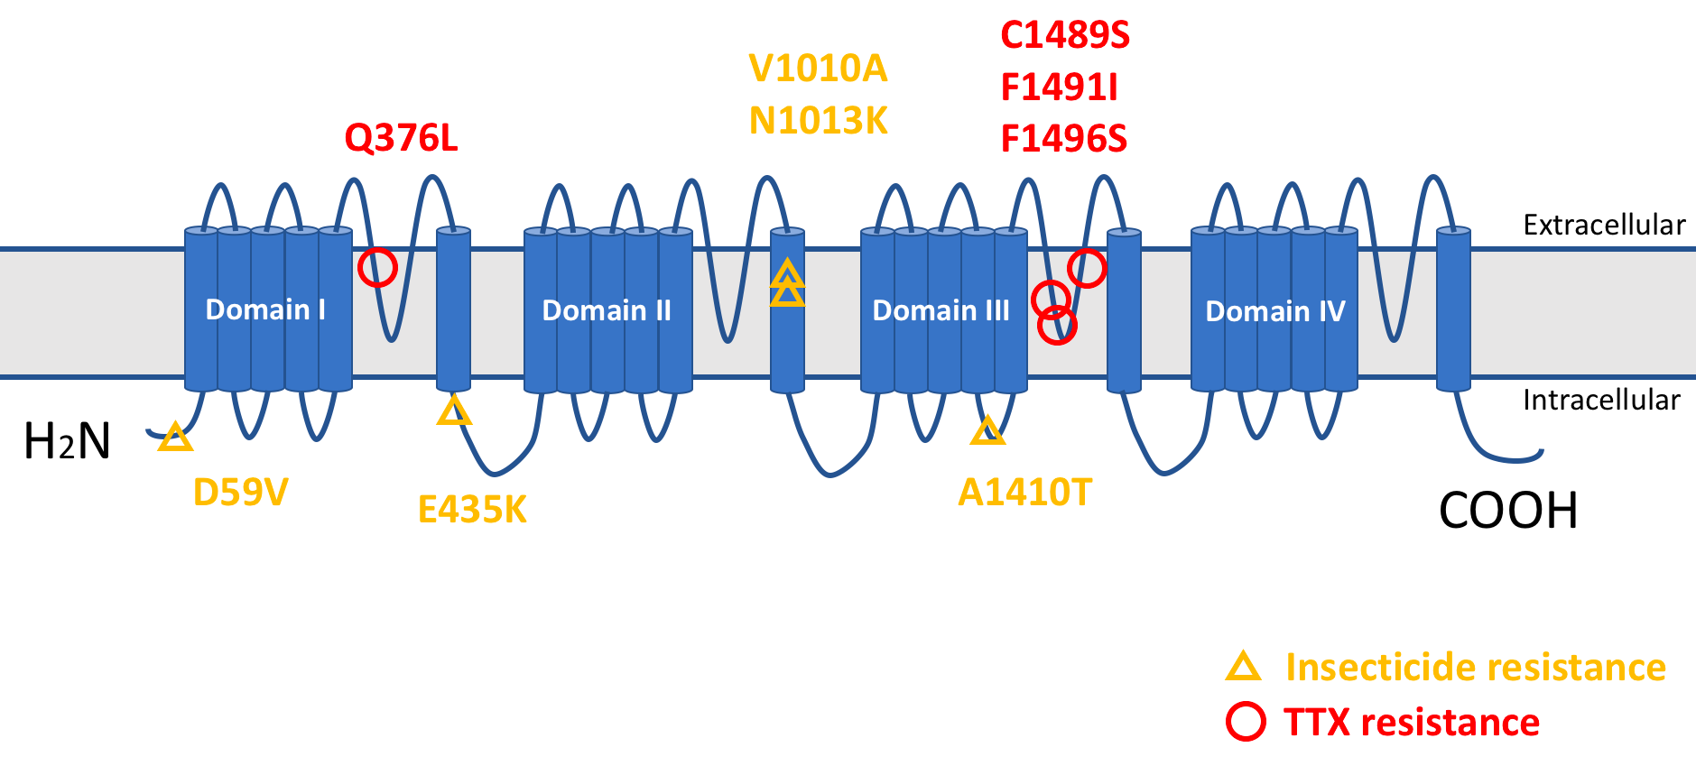
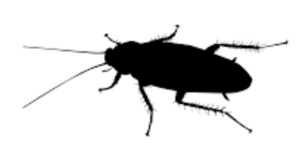
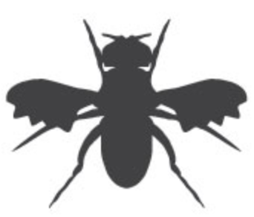
Remaining Mutations?
65 mutations not on P-loop region
5 known to effect channel gating
Toxin effect: increase sodium permeability
Site 1: the linker between S4 and S5 in domain II, S5 in domain II and S6 in domain III
Site 2: linker between S4 and S5 in domain I, S5 in domain I and S6 in domain II
18X DDT
resistance
Notes:
Associated with Linker regions
Increase sodium permeability and close slowly - Results in repetitive discharging - muscular convulsions, weakness, paralysis, and death

Slide 11
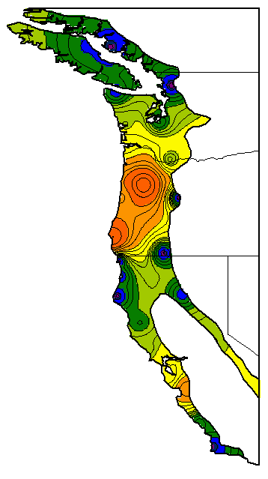
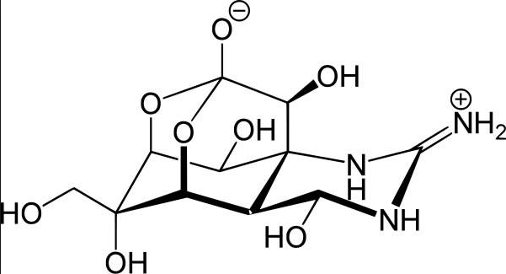
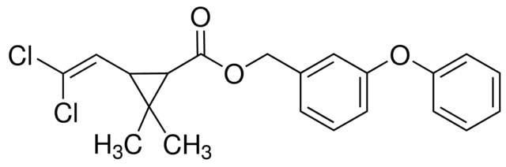
Conclusions
Resistance to natural toxin (TTX)
  Result of selection from eating toxic eggs?
  mutations + physiology = extreme resistance
Resistance to anthropogenic toxin (DDT?)
  Non-target species, aquatics sensitive
  Historic application to control conifer pests (DDT)
  Current application in Willamette valley (PYR)
Tons of unanswered questions
Field site
TTX
Permethrin
Rough-Skinned Newt toxicity
Notes:
Tons of unanswered questions
Relationship between PYR & TTX mutations?
Physiological effects of various mutations?
Unknown mutations (87%)?
Resistance across range of species?

Slide 12
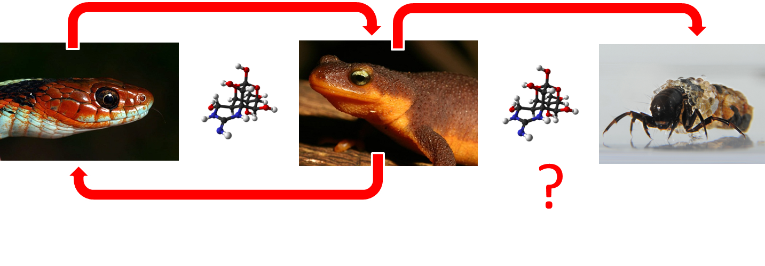
Conclusions
TTX
Permethrin
Evidence of selection from two sources
Opposing forces – different parts of channel
Constraints on protein evolution may be flexible
Challenges assumptions on the limitations of protein evolution
Implications for coevolution
Notes:
Examples of constraints:
Adaptation restricted to stabilize function
Tradeoffs due to limitations on genetic architecture
If caddisflies are coevolving with newts, then one-to-one coevolutionary relationship leading to higher TTX gets more complicated
Caddisfly may be driving newt toxicity
Snake resistance is product of selection from caddisflies
Snakes and newts are not coevolving
Snakes are driving newt toxicity
Caddisfly resistance is product of selection from snakes
Caddisflies and newts are not coevolving
Of course both predators may influence the evolution of toxicity to some degree
Important to remember we are talking about predation on two different life-history stages: eggs and adults
Selection pressure is often assumed to be much stronger during early life-history stages, because by the time the adults interact with a snake they may have reproduced already.

Slide 13
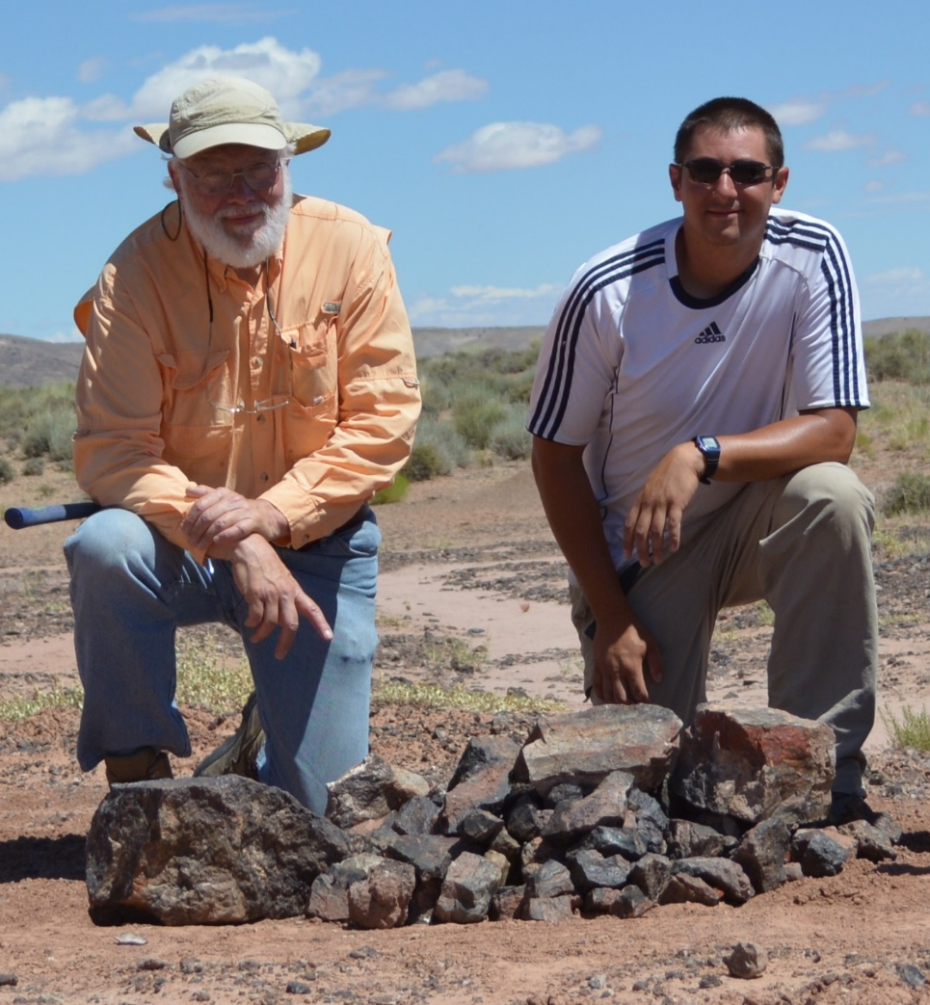






Butch Brodie III.
Trevor Chapman
Mike Pfrender
Yiyuan Li
The “Boneyard”
Joe Beatty
Bill Girth
Edmund Brodie Jr.
Amber Stokes
Notes:
What’s next
Additional verification of the preference for lower toxicity (re-run no-choice trials, choice trials)
Expand this to multiple populations
Find a way to measure resistance (sequence caddisfly sodium channels?)

Slide 14
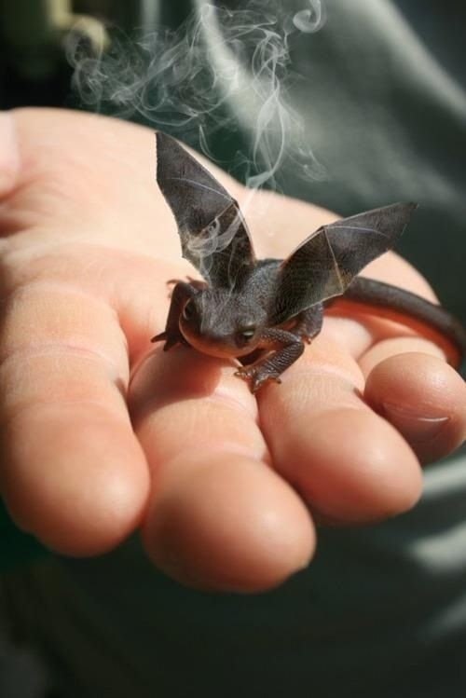
Questions?

