Slide 1
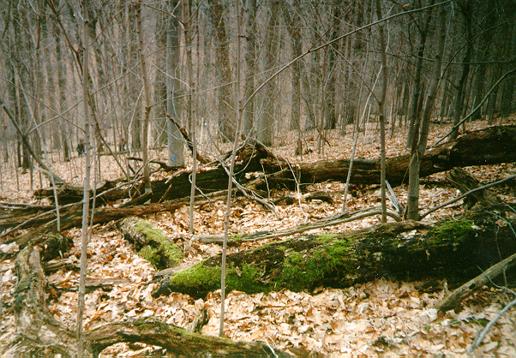
Experimental Evaluation of Woody Debris Decay Dynamics in Central Appalachian Forests

Slide 2
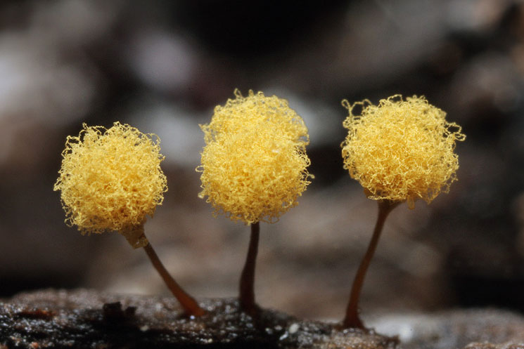
Slime Molds
Slime Molds…Whatever
Brian Gall
Hanover College Biology Department

Slide 3
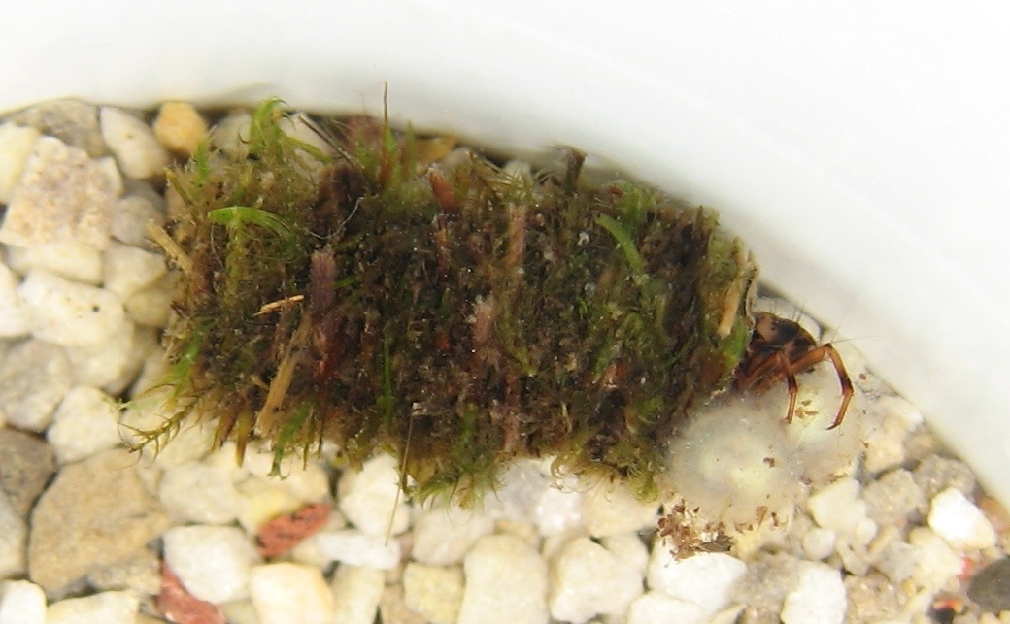

Complex Ecological Interactions between Newts and Aquatic Invertebrates Modulated by Tetrodotoxin
Brian G. Gall
Dept. of Biology
Notes:
Today I am going to tell a story of death and murder
All of it revolving around a toxin known as tetrodotoxin

Slide 4

The origin of a killer: Tetrodotoxin in early life-history stages of newts (Taricha granulosa)
Brian G. Gall, Amber N. Stokes, Susanna S. French, Edmund D. Brodie III, Edmund D. Brodie, Jr.
Notes:
Start with brief intro on what I work on

Slide 5
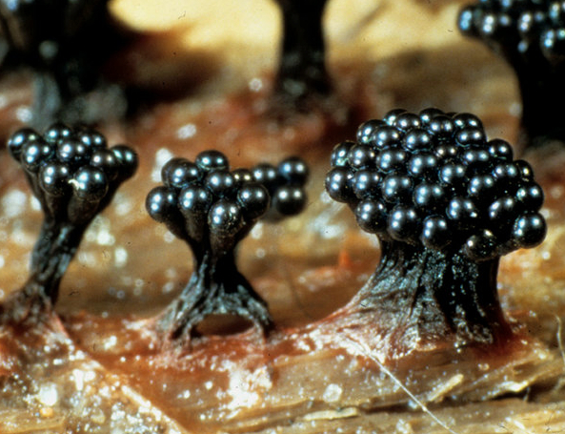
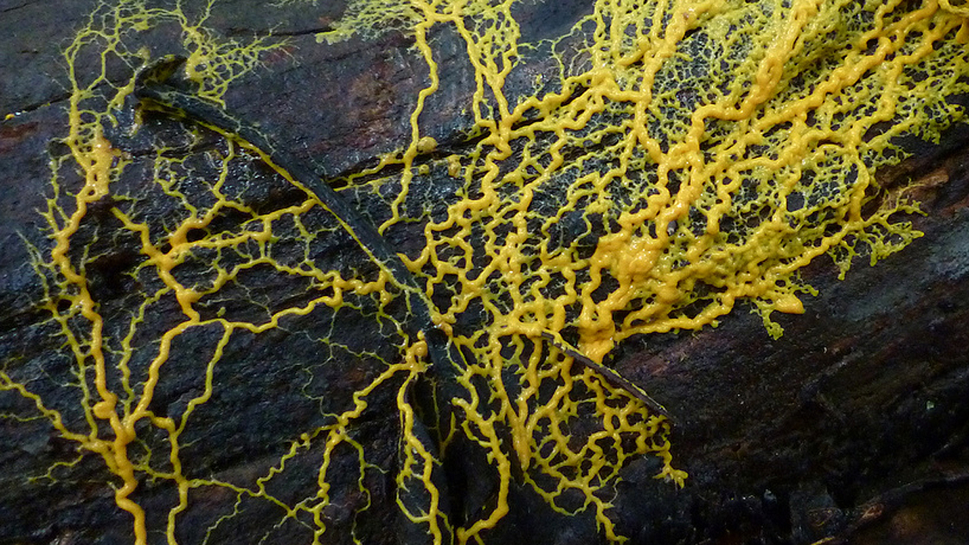
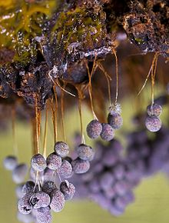
Overview
What they are
What makes them unique
Life History and Ecology
Research
Conclusions

Slide 6
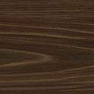
Overview
What they are
What makes them unique
Life History and Ecology
Research
Conclusions

Slide 7
Overview
What they are
What makes them unique
Life History and Ecology
Research
Conclusions

Slide 8

Overview
What they are
What makes them unique
Life History and Ecology
Research
Conclusions

Slide 9
Overview
What are slime molds
What makes them unique
Life History and Ecology
Research
Conclusions

Slide 10
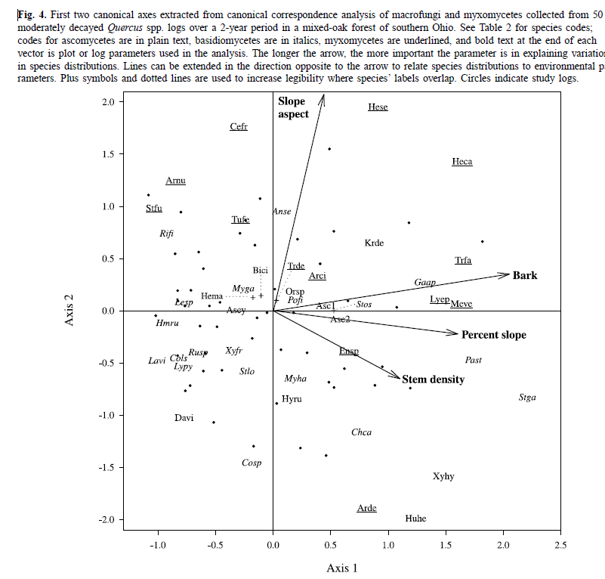

Slide 11
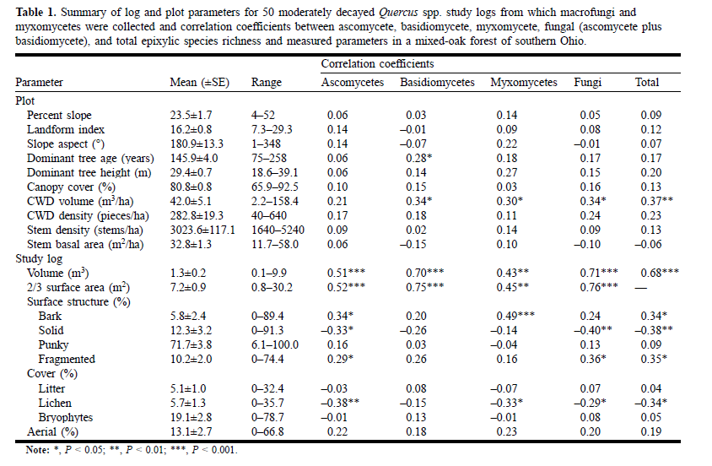

Slide 12
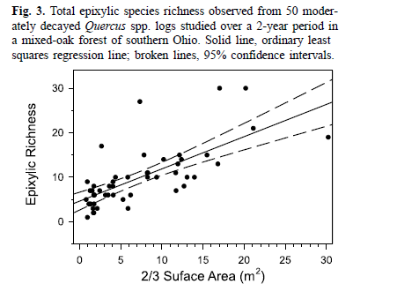

Slide 13
What happens to TTX levels after metamorphosis?
Notes:
We have data from several groups
1 month old metamorphs
6 month old juveniles
1 year old juveniles
juveniles are now 2 yrs old – unfortunately do not have those data yet
also collected data from roughly a dozen wild-caught juveniles
This graph shows the change in mass in our lab animals between 1 month and 2 years
Can see that our masses are within the same range as those from the wild
Some of the animals are now large enough to fall within the range of the adult population
Growing like crazy and doing very well

Slide 14
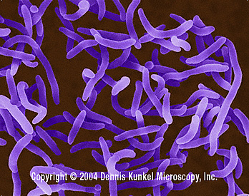
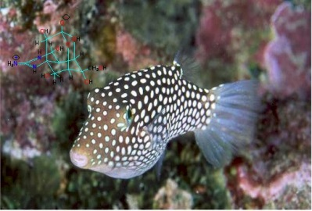
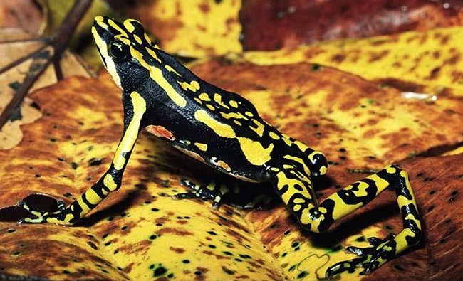
Where does TTX come from?
Well, TTX may come from bacteria that live inside the host as a symbiotic organism. If this is the case then the TTX may be produced passively by the bacteria and is shunted to the host.
TTX could also accumulate inside the organism through bioaccumulation or the ingestion of prey that contain the TTX. The molecule may then be sequestered by the host and used by the host
The last hypothesis for the origin of ttdx is of endogenous production. In other words, the animals may possess the genetics and machinery to produce the compound themselves. In this case, the genes may have originally come from bacteria and then been shunted to the organisms genome at some point in their evolutionary history
Vibrio sp.

Slide 15

Where does it come from?
Vibrio sp.
Symbiotic bacteria
Bioaccumulation
Endogenous production
Atelopus sp.

