Slide 1
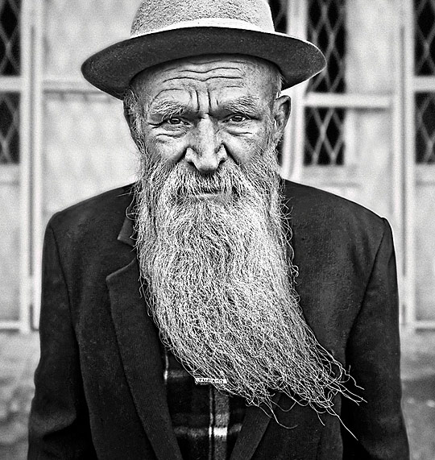
How old is the oldest person you know?
How old is the oldest person you’ve heard about or read about?

Slide 2
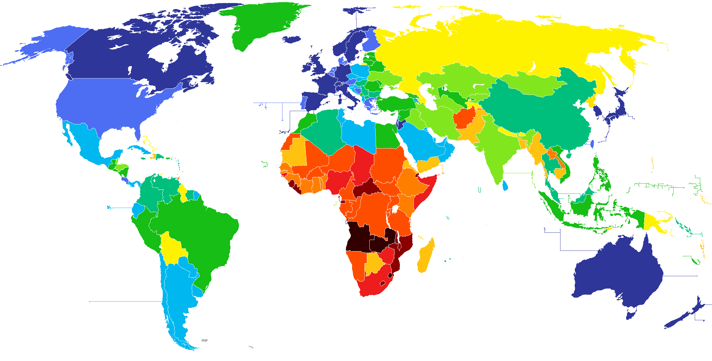
Life Expectancy by Country

Slide 3
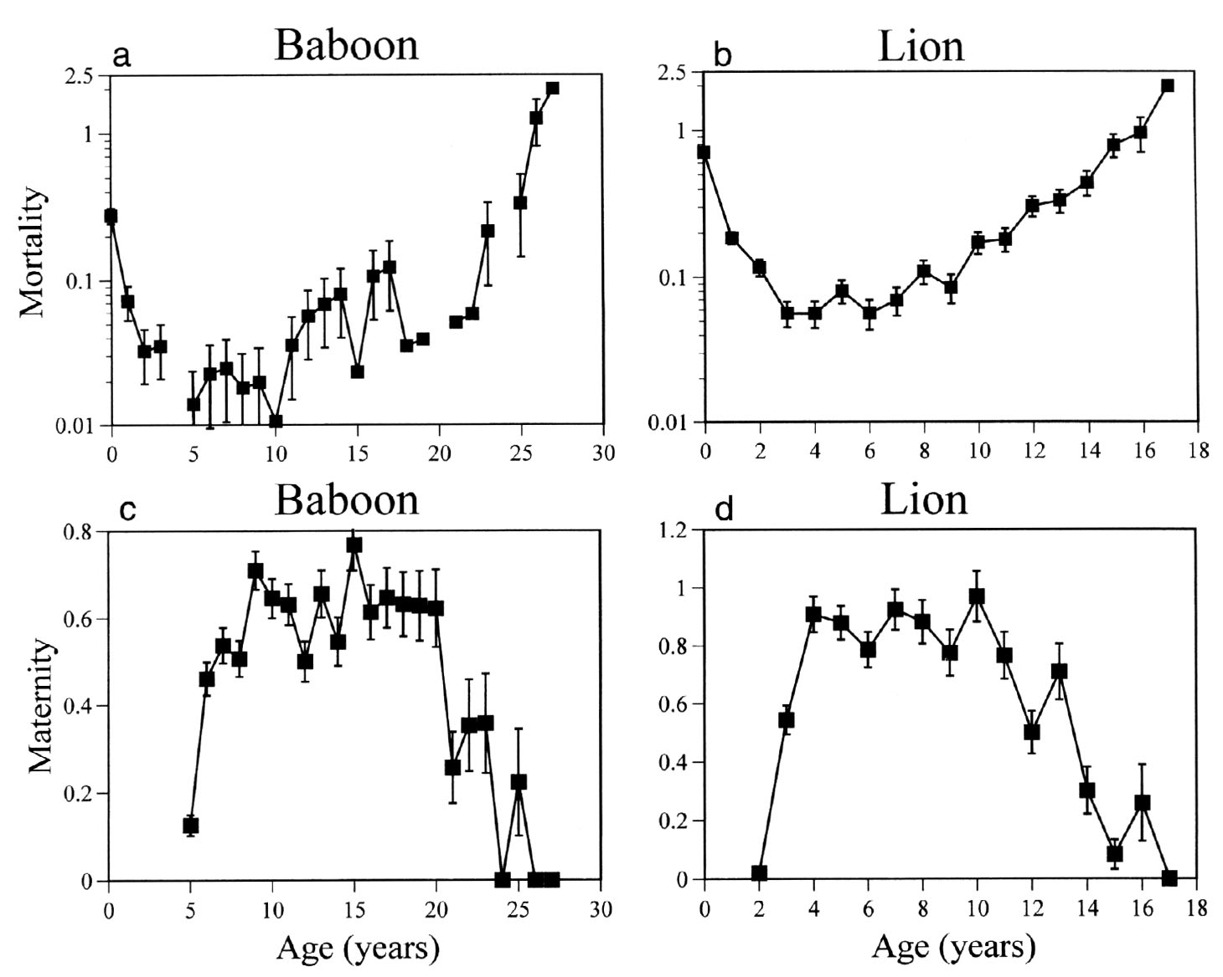
Components of Senescence
Where do animals achieve “peak fitness?”
What do you notice about the relationship between these curves?

Slide 5
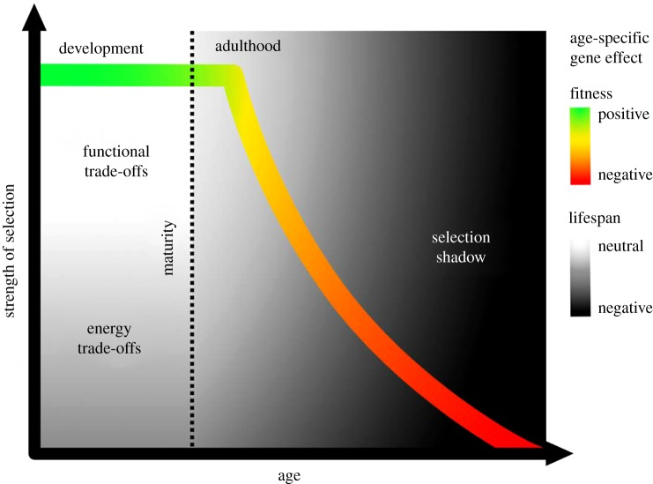
Selection and Aging
Let’s think about the outcome of selection
For selection, aging’s purpose is to do what?
What’s the goal?
Selection maximizes fitness, not lifespan
Does strength of selection change with age?
From: Maklakov and Chapman 2019. Proc. Roy. Soc. B
Notes:
Let’s think about how selection works
For selection, aging is a process to do what? – get organisms to reproductive age
With the goal – maximize fitness
Does selection care about how long an organism lives? – doesn’t really care, but can it influence it? YES, but only to the extent that you achieve reproductive success!

Slide 6
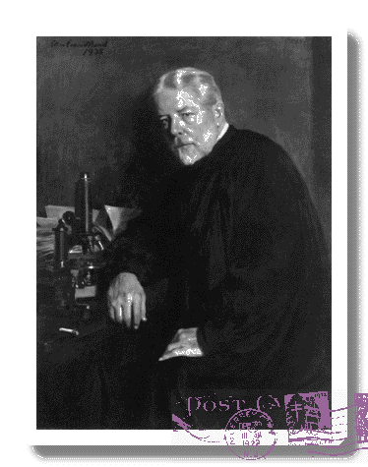
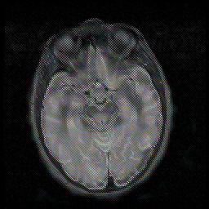
EXAMPLE: Huntington’s disease (chorea)
Late-onset Mutations are not Eliminated by Natural Selection
George Sumner Huntington
If an individual has had children, but dies at age 40, is there an effect on fitness?
Notes:
Causes the breakdown of nerve cells in the brain

Slide 7
Evolutionary Explanations for Senescence
Antagonistic Pleiotropy
Genes often have multiple effects
Some of these effects/consequences are pleiotropic (negative)
Reproduction generally occurs early in life
Can have strong selection for genes that promote reproduction, even if negative effects later

Slide 8
example
Notes:
(a) Origins of the theory
While damage accumulation resulting from energy trade-offs between reproduction and maintenance is generally viewed as the leading physiological/mechanistic explanation for the evolution and expression of ageing via AP, it is interesting that Williams himself used a very different example to illustrate the action of a putative AP allele [10]. He envisioned an allele with a beneficial effect on bone calcification in the developing organism, but that causes calcification of arteries in adulthood. Such an allele could have an overall positive effect on fitness and become established in the population. This is an example of a functional trade-off, where the same physiological process is beneficial for fitness in early-life (e.g. during development), but detrimental for fitness in late life (e.g. post-sexual maturation). Williams suggested that selection could lead to the evolution of a modifier gene to suppress excessive calcification of arteries with age, but noted that such suppression is unlikely ever to be fully effective given weak late-life selection [10].

Slide 9
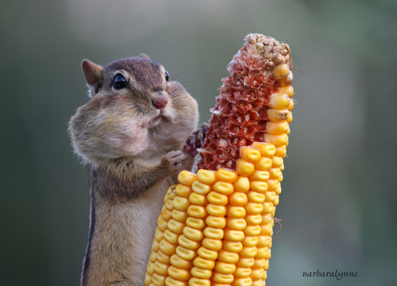
A Physiological / Mechanistic Explanation for the AP
Notes:
The Y model for trade-offs between somatic and reproductive function
Modified from tatar and carey 1995 and de Jong and van Nordwijk 1992

Slide 10
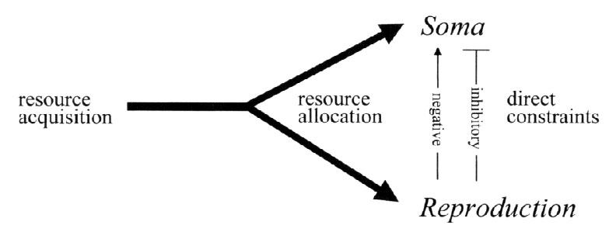
THE PHENOTYPIC MODEL
Notes:
The Y model for trade-offs between somatic and reproductive function
Modified from tatar and carey 1995 and de Jong and van Nordwijk 1992

Slide 11
If the phenotypic model exists, what can we do to extend life-span (delay senescence) in humans?

Slide 12
Does the strength of selection change with the age of the individual?
…the forces of natural selection weakens with increasing age….If a genetical disaster…happens late enough in individual life, its consequences may be completely unimportant. Even in such a crude and unqualified form, this dispensation may have a real bearing on the origin of innate deterioration with increasing age.
Medawar, 1952

Slide 13
Does resource availability taper-off after reproduction?

Slide 14
EVOLUTIONARY EXPLANATIONS FOR SENESCENCE
2. Mutation Accumulation
Selection is weak with increasing age
Mutations accumulate with late-life effects because selection isn’t there to remove them
Senescence is a consequence of the sum of these randomly acquired deleterious effects

Slide 15
Evolutionary Explanations for Aging
Antagonistic Pleiotropy
Genes with strong beneficial effects early in life have negative effects later
Reproduction happens early – leads to strong selection to retain the alleles
Negative trade-off between genes that influence traits early in life vs. longevity later in life
Hypotheses:
  Disposable soma
  Developmental theory

Slide 16
Work with those around you to design an experiment in fruit flies to look for this type of effect.
What traits could we manipulate?
What effect are we looking for?

Slide 17
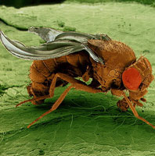
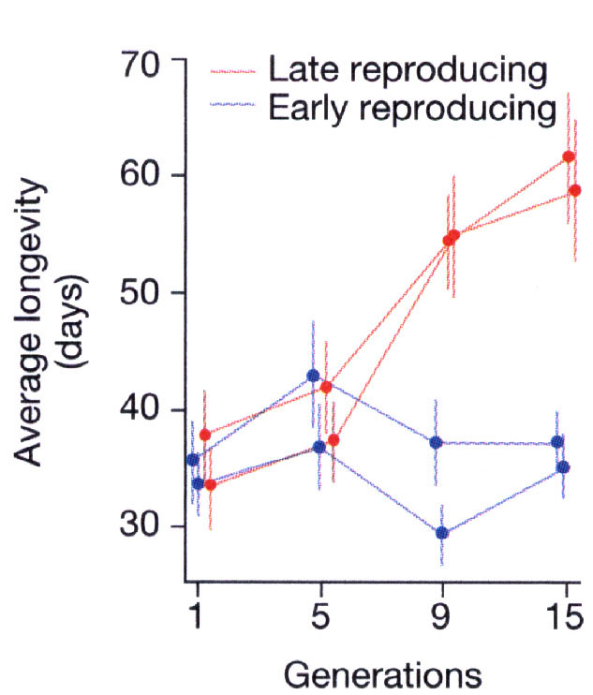
How could we extend lifespan in humans?
Luckinbill et al. 1988. A qualitative analysis of some life-history correlates of longevity in Drosophila melanogaster. Evolution. Ecol. 2:85-94.

Slide 18
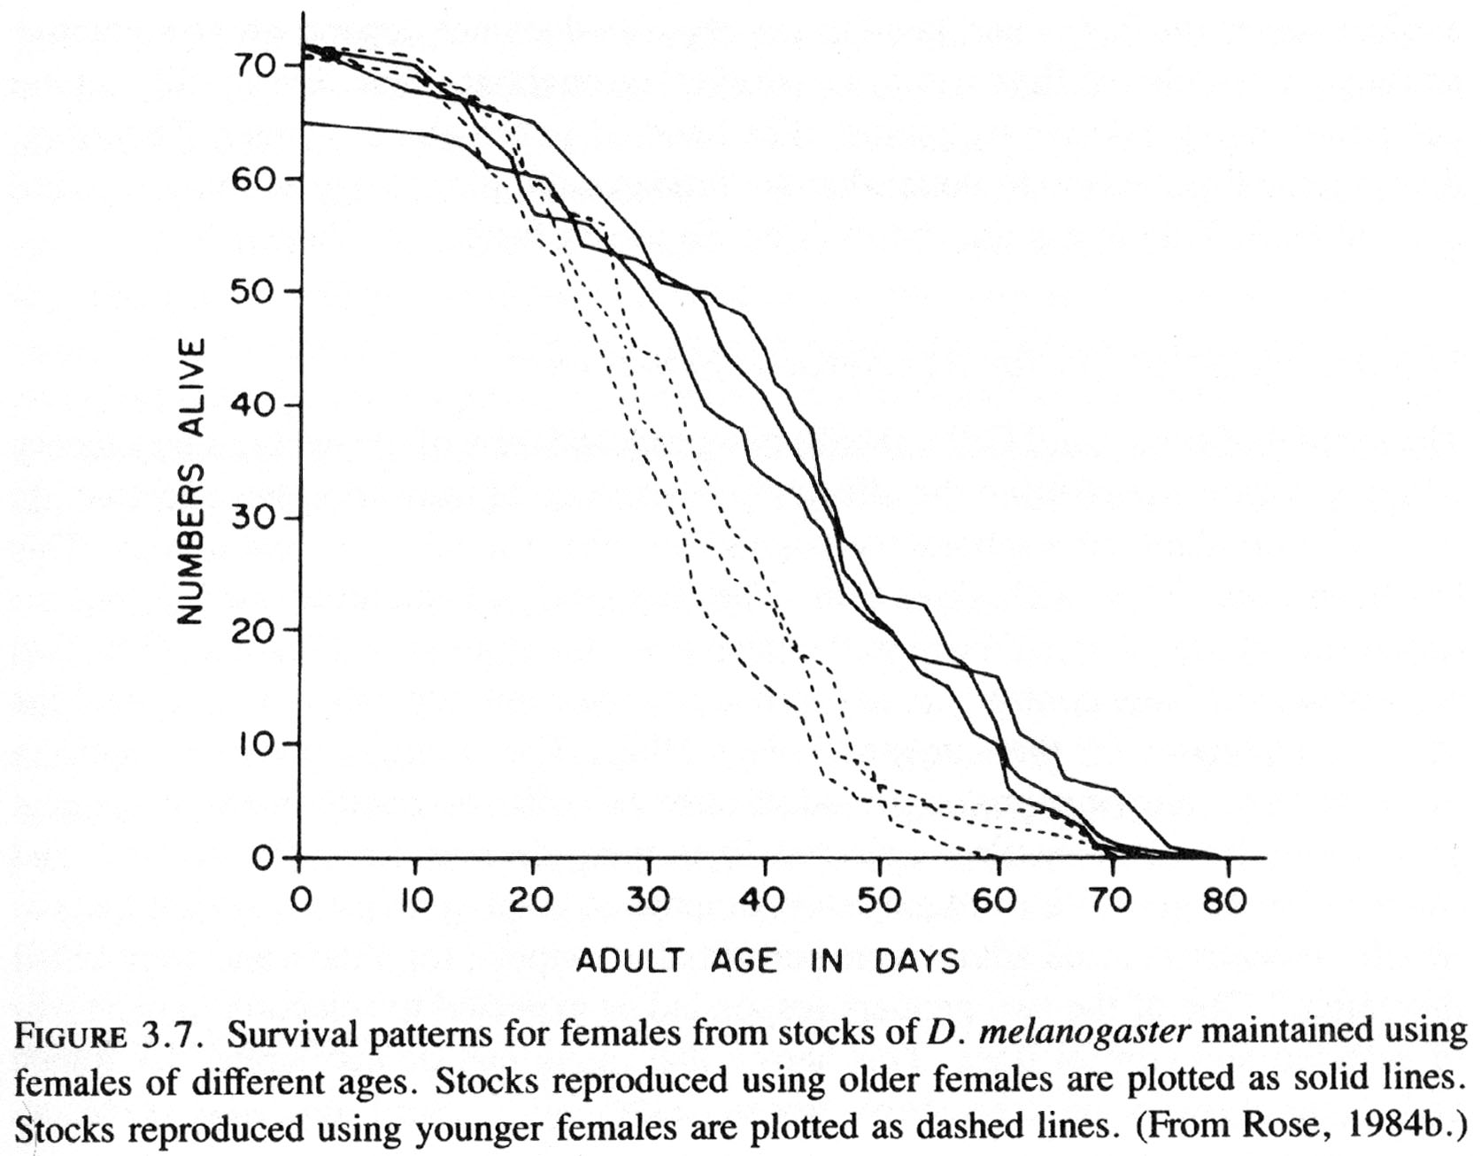
ANTAGONISTIC PLEIOTROPY
LATE REPRODUCTION
EARLY
REPRODUCTION
Several studies have found genes/alleles responsible for AP effects

Slide 19
A Physiological / Mechanistic Explanation for the AP
Can’t allocate resources to both
Cell damage is constant, proteins accumulate that interfere with cell function
Notes:
The Y model for trade-offs between somatic and reproductive function
Modified from tatar and carey 1995 and de Jong and van Nordwijk 1992

Slide 20
Draw a graph of resource availability with age in humans
Does resource availability change at end of reproductive window?
Breakdown of cellular pathways occurs with increasing age, may not be tied to resources

Slide 21
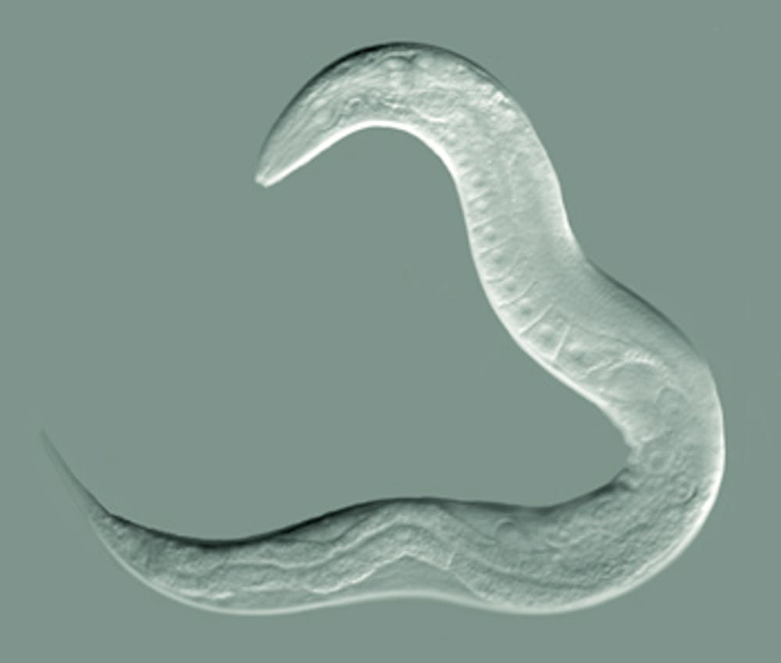
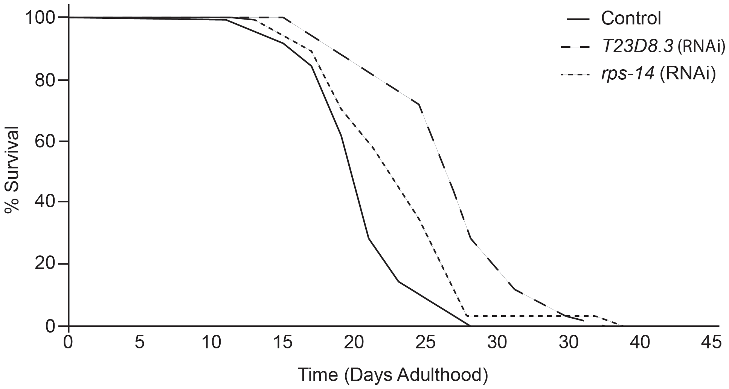
Developmental Theory of Aging
Physiological processes optimized for early repro
Not optimized for late-life function
Leads to slow cell degeneration
Tacutu et al. 2012. PLoS ONE

Slide 22
Evolutionary Explanations for Aging
Mutation Accumulation
Selection weak on older individuals
Organisms senesce because accumulation of mutations that effect older individuals
Selection can’t remove them

Slide 23
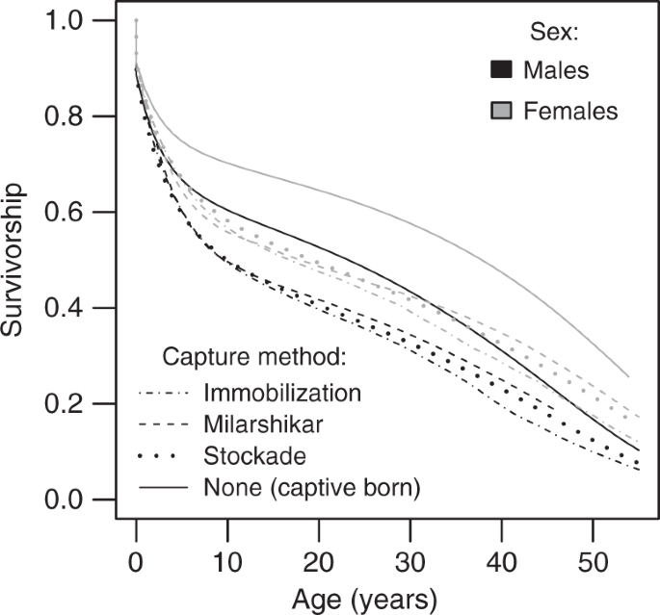
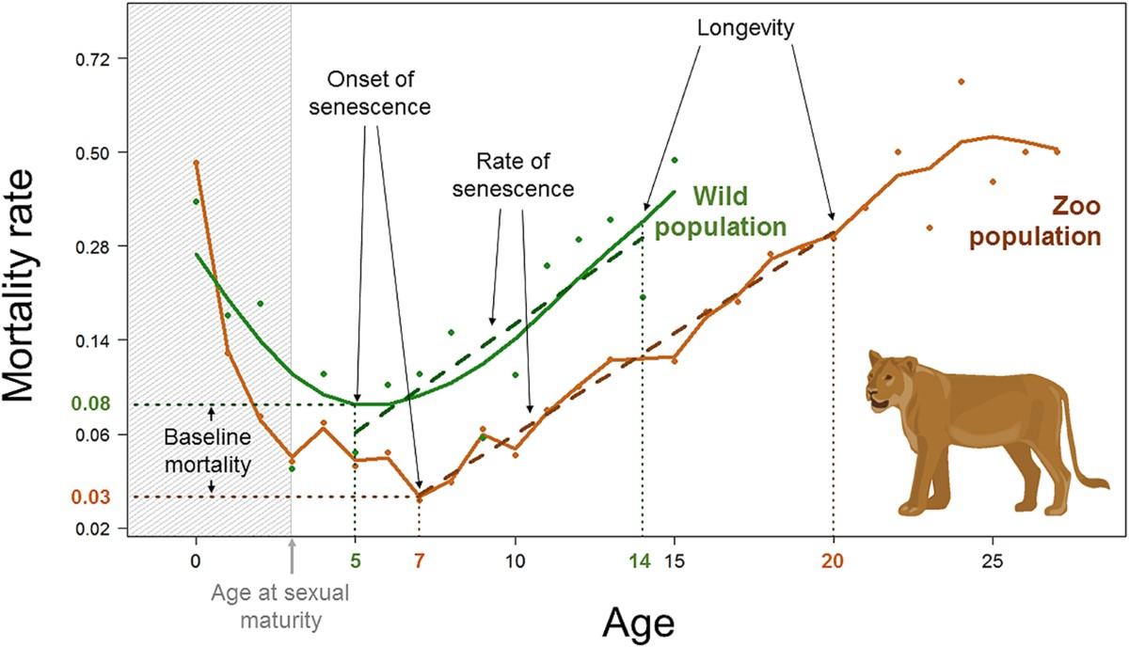
The WALL OF DEATH!
Models predicted rapid increase in mortality
Wall of death
Elephants
WHY?

Slide 24
FUTURE PROSPECTS FOR AGING RESEARCH
“People who think they are going to find a fountain of youth, whether at the molecular level or at any level, are not going to be successful.”
G. C. Williams
Theories of senescence predict that a medical “fountain of youth” is an unlikely
Prospect of a single aging gene impossible

Slide 25
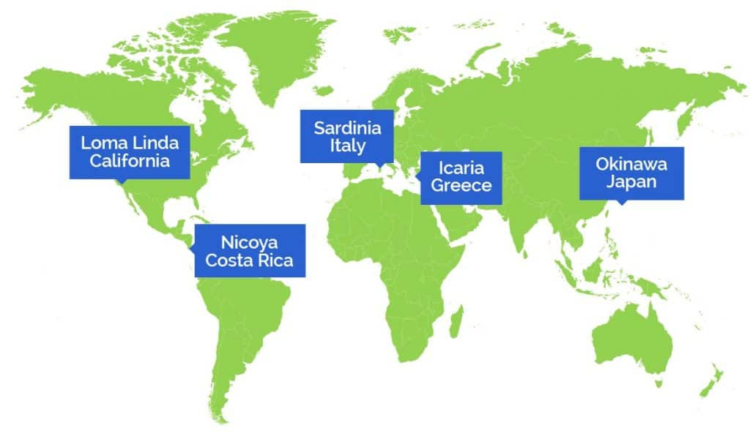
Where can we look to understand ageing?
Blue Zones
Notes:
Close to ocean
Mild to warm temps

Slide 26
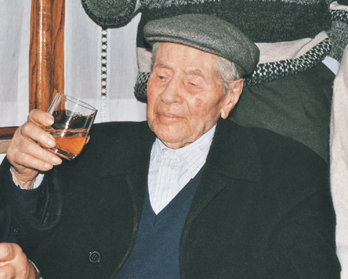
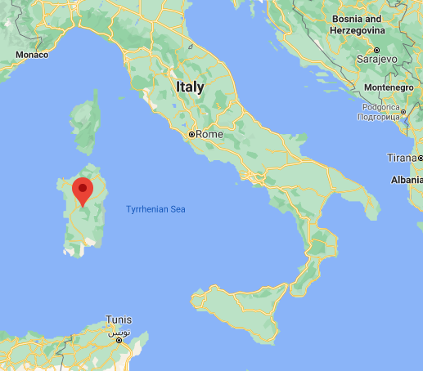
Sardinia's Mysterious Male Methuselahs
Antonio Todde, age 112

Slide 27
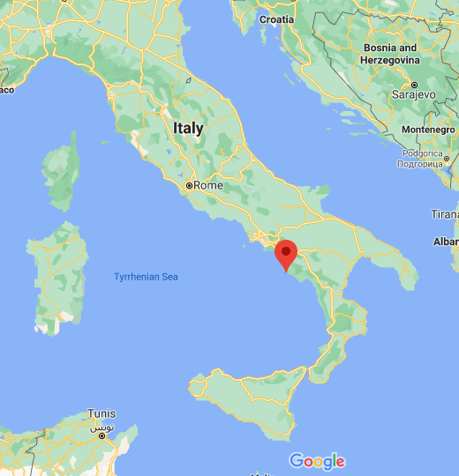

Acciaroli, Italy

Slide 28
What do these populations have in common?
Natural movement
Sense of purpose (friends and family!)
Stress management (nap)
Diet (typically from own garden)
Don’t overeat
Wine or tea
Spirituality
Early to bed, early to rise

Slide 29
Longevity Genes Predict Whether You'll Live Past 100
Scientists sequenced genomes of over 1,000 centurians
150 regions that were common (rare otherwise)
Accurately predict if living past 90 ~80% of time
All fit into one of 19 “genetic groups” (i.e. genetic signature)
  Correspond to extremely old age, late onset of diseases (dementia), etc.
  “bad genes” less important than “good genes”
Notes:
https://www.livescience.com/6665-longevity-genes-predict-ll-live-100.html
Late 2000

Slide 30
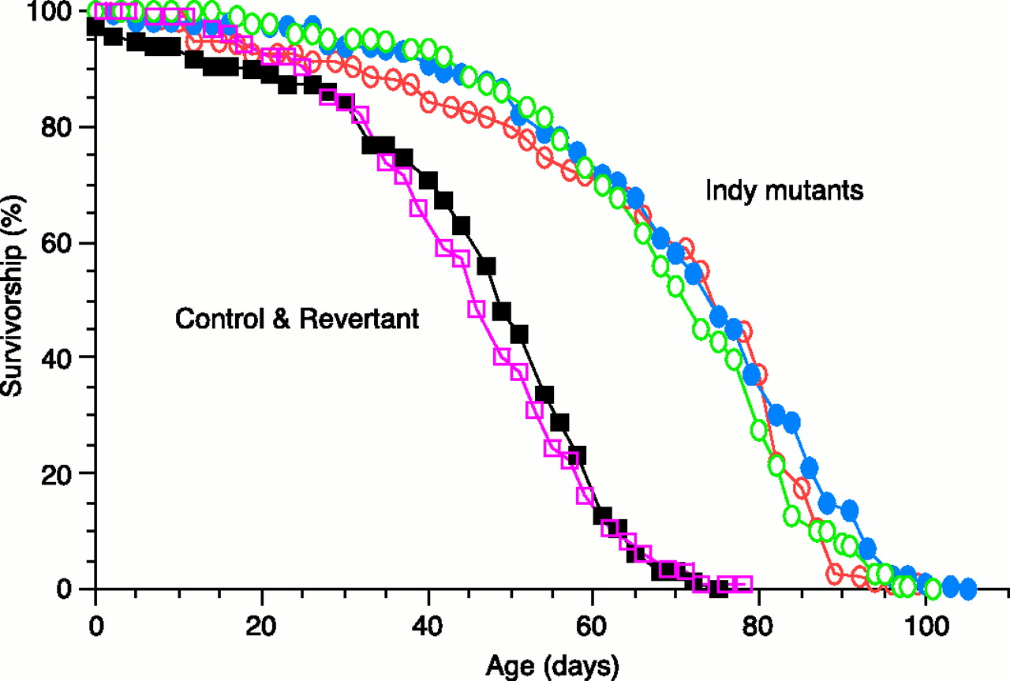
Control of Aging by The INDY (I’m Not Dead Yet) Locus
From: Rogina et al. Science 290:2137.

Slide 31
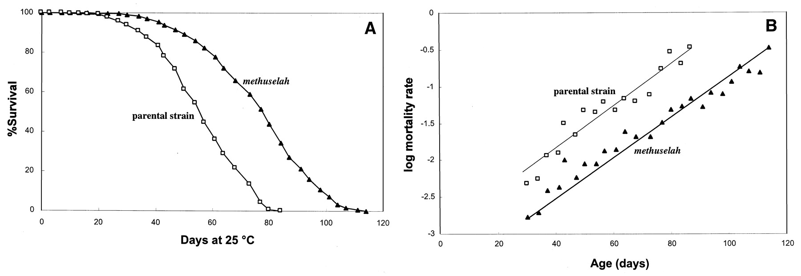
EXTENDED LIFE-SPAN AND STRESS RESISTANCE IN THE DROSOPHILA MUTANT METHUSELAH
Lin et al., Science 1998

Slide 32
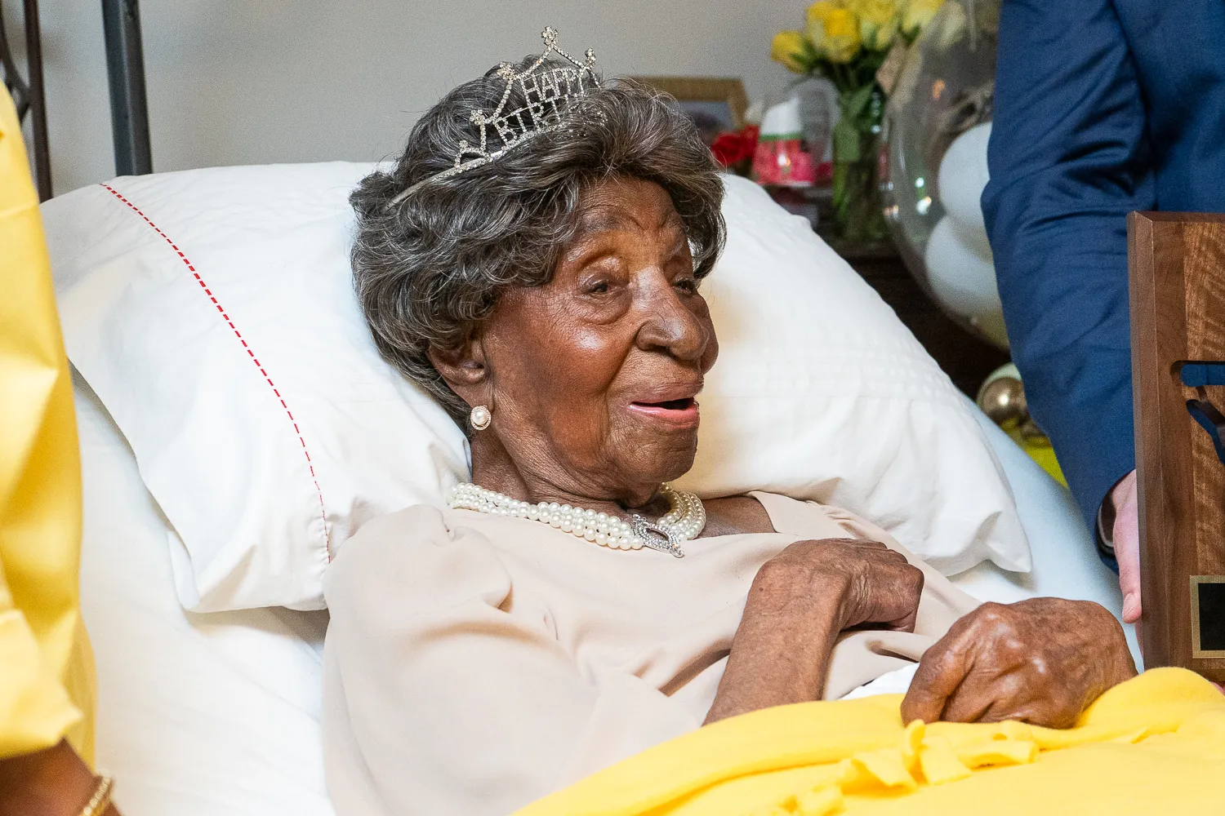
Elizabeth Francis – AGE 115

Slide 33
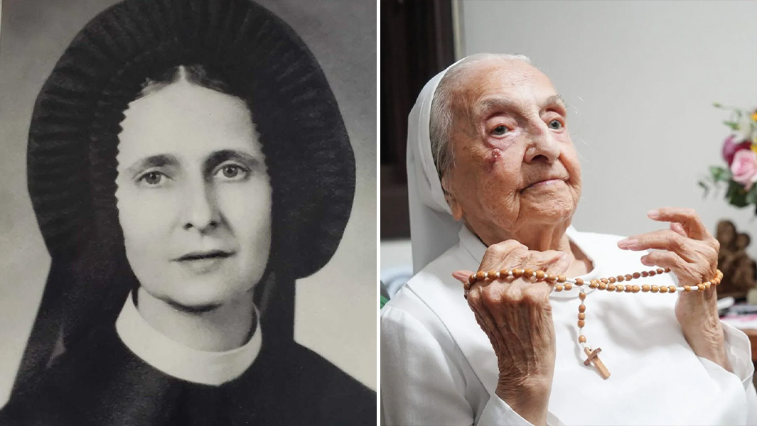
Inah Lucas – Age 116

Slide 34
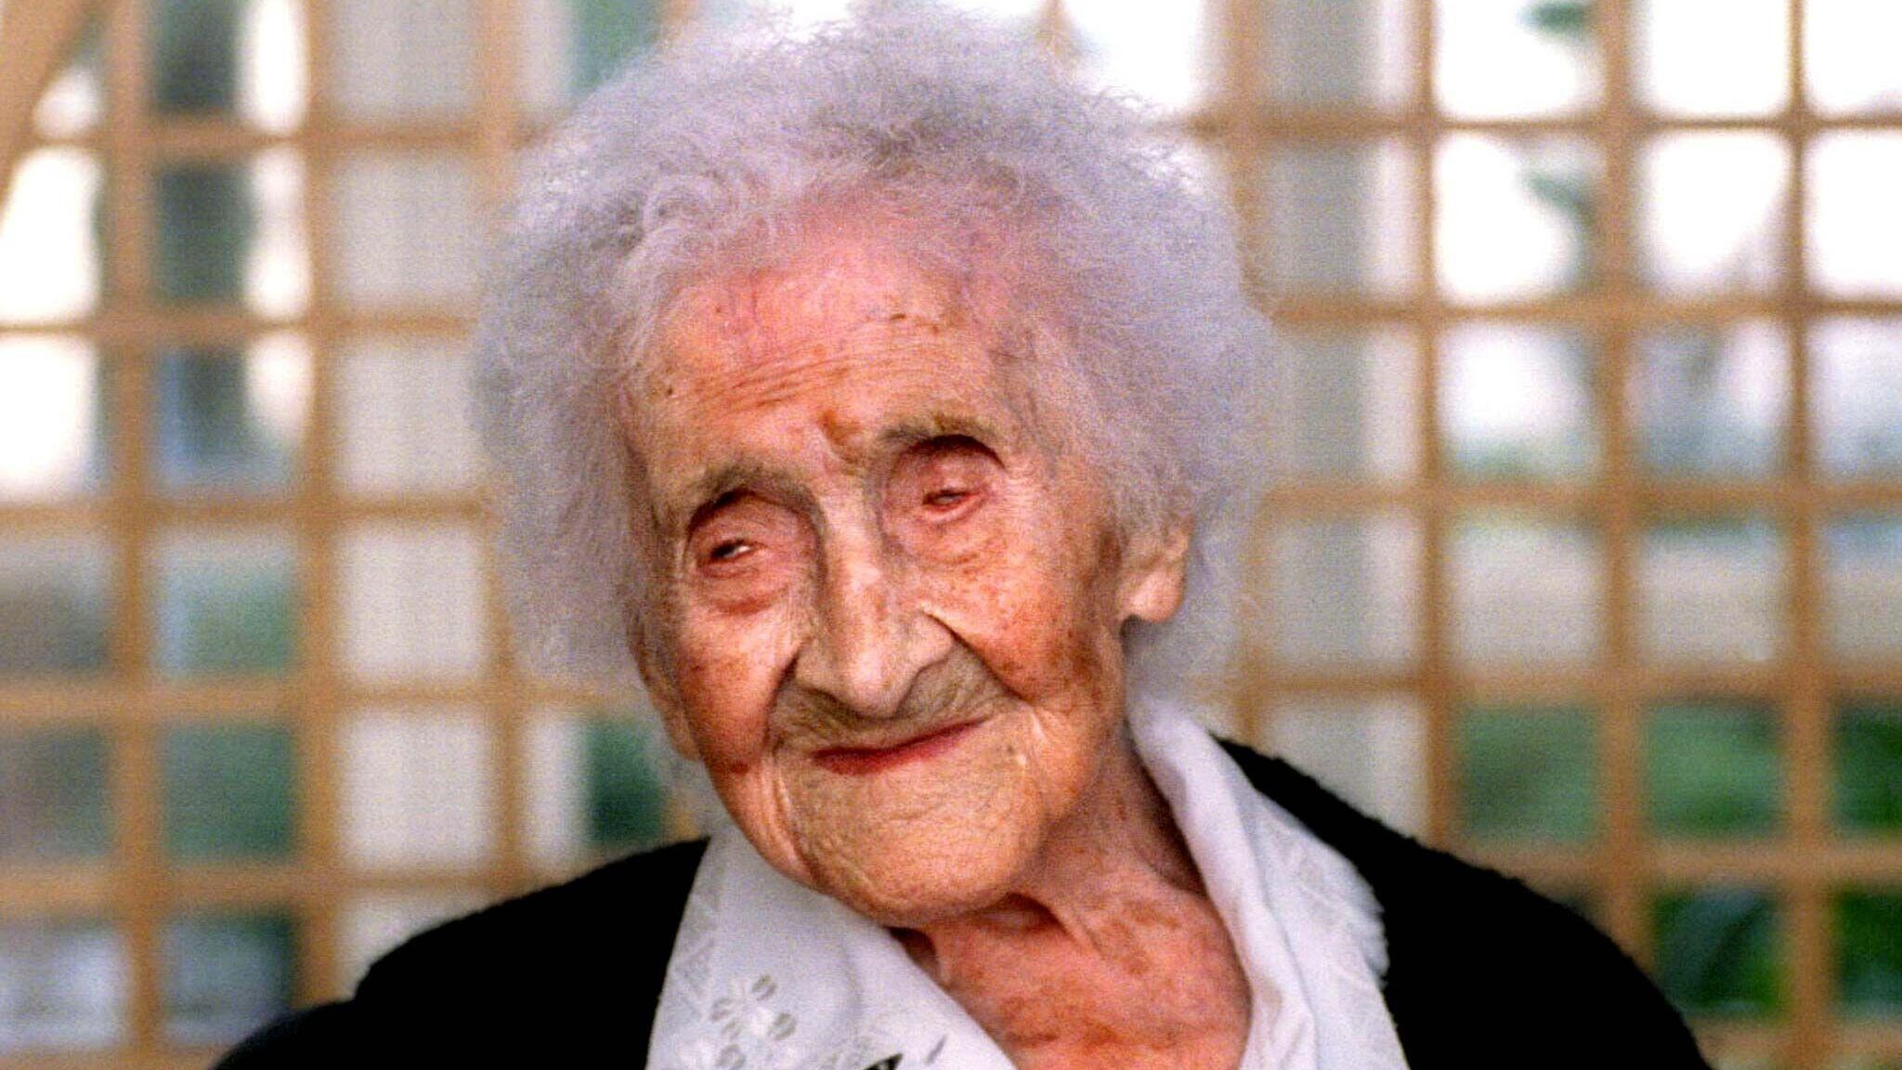
Jeanne Calment – Age 122

Slide 35
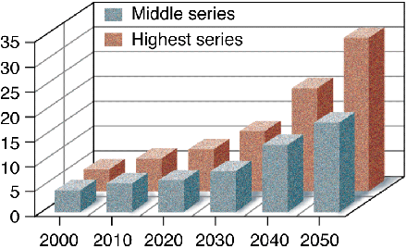
DEMOGRAPHIC PROJECTIONS FOR THE PERCENTAGE OF AMERICANS OVER THE AGE OF 65

Slide 36
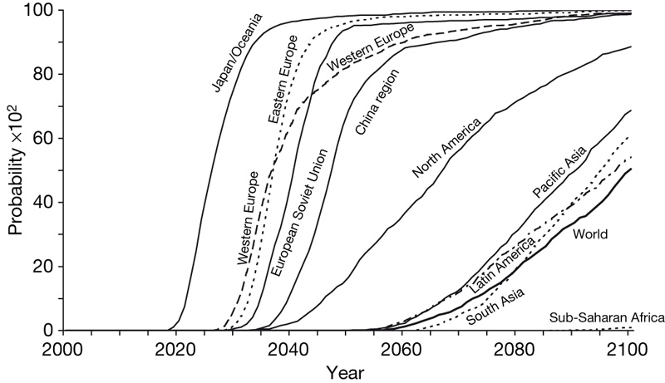
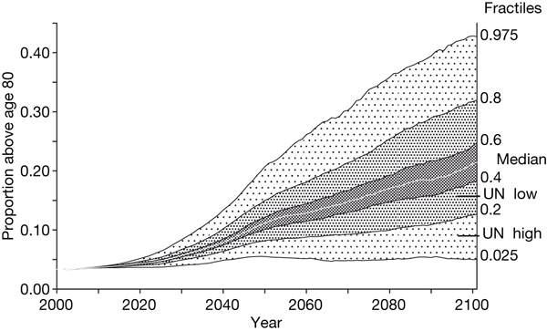
Probability that populations will reach a proportion of 1/3 of individuals > age 60
Fraction of Western European populations > 80 years old
Lutz et al. Nature 2008

Slide 37
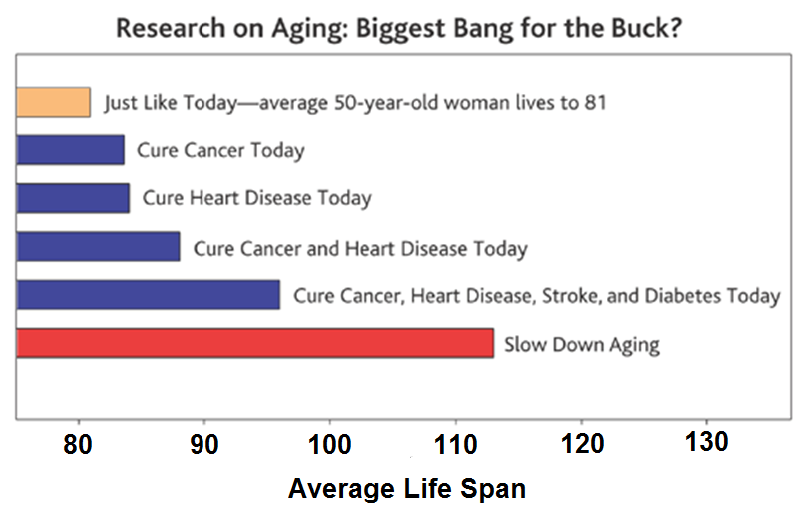
Science: 2003. R.A. Miller

Slide 38
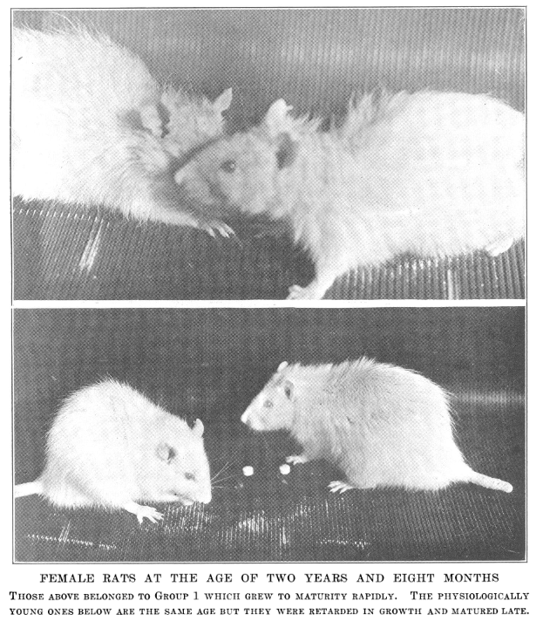
“We designed a diet that was adequate in vitamins, protein, inorganic salts and fats, even when the animal was restricted to a low level of intake each day. Thus for long periods the animals whose growth was retarded could be prevented from growing. At the same time the food ingested each day provided every recognized constituent to insure the health of the animal but not enough calories to permit growth”

Slide 39
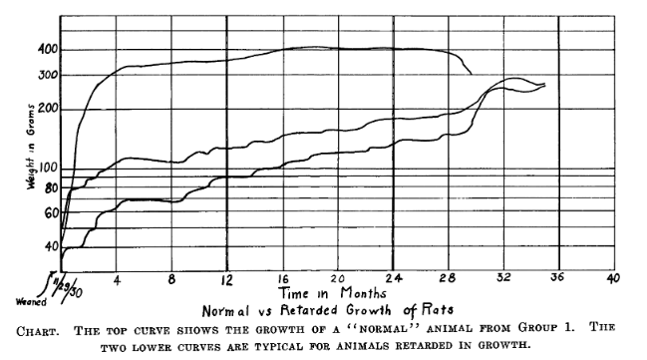

Slide 40
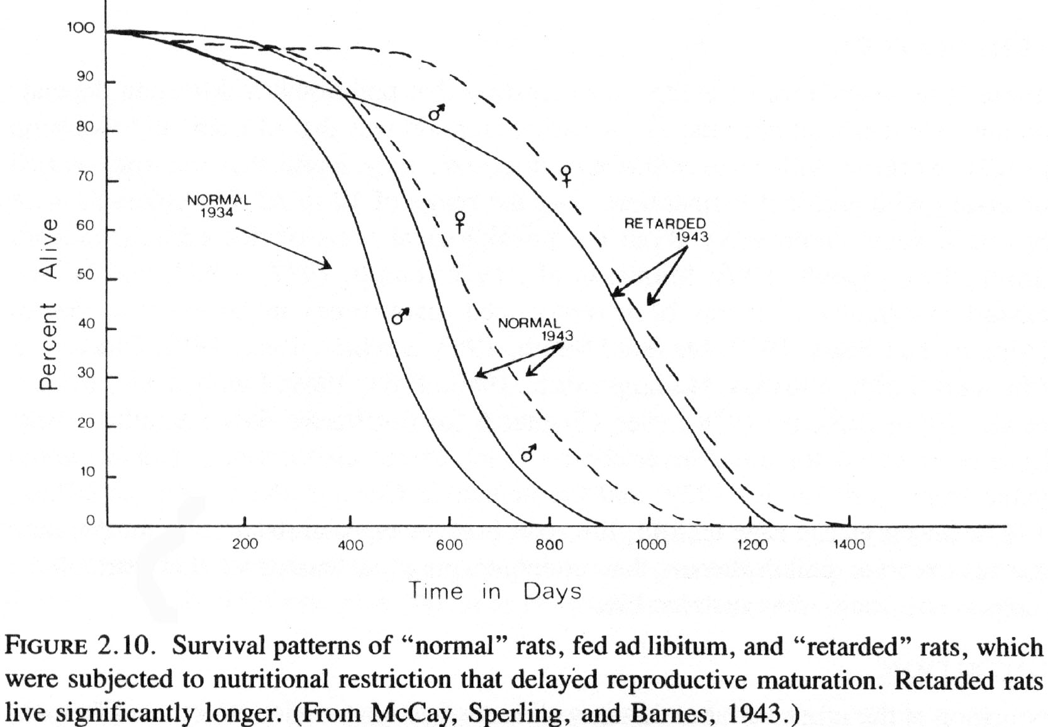

Slide 41
Additional Studies
Similar results with:
  Fruit flies
  Mice
  Rats
  Dogs
  Cows
Not just living longer, also healthier!
  Fewer illnesses
  Less late-onset diseases

Slide 42

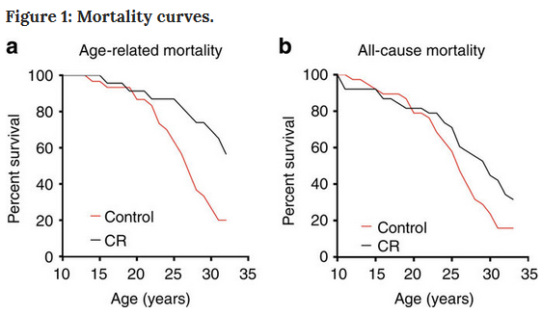
Humans?
Can they be done?
Join the Calorie Restriction Society!!
Results with Monkey’s
Colman et al. 2014. Nature Communications

Slide 43
WHY?!
Lower metabolic rate and oxidative stress
Improves insulin sensitivity
Improves nervous system function

Slide 44
Hypotheses
Excess food leads to free radicals, bond to other compounds causing mutations in cells
Cutting food increases Hormone Fibroblast Growth Factor (HFG), this blocks hormone growth pathway which can cause cancer and other diseases
Lowers core body stress (think ectotherms)
Small stress – body defenses kick in to prevent deleterious effects
Reduces production of Reactive Oxygen Species that damage DNA

Slide 45
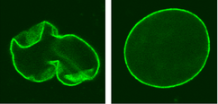
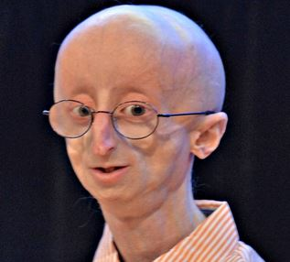
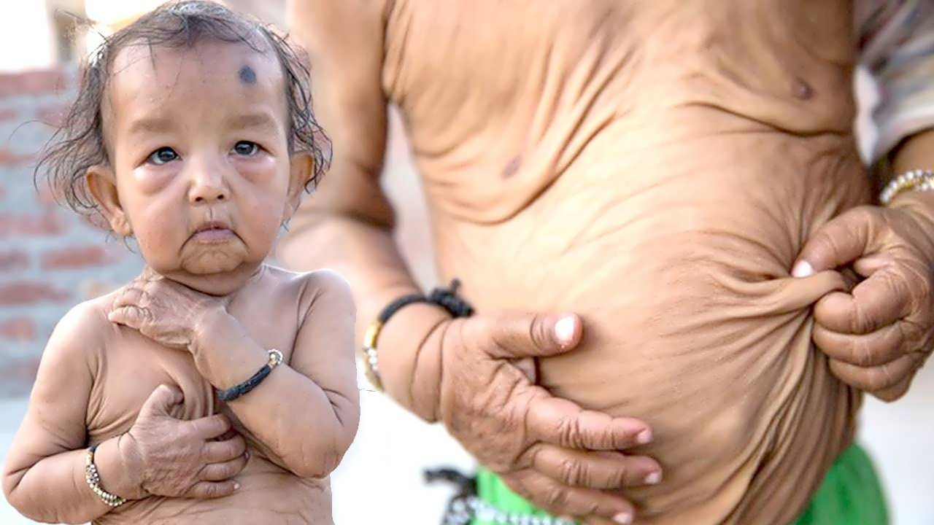
Hey Gene, you don’t look like you’ve aged a day…

Slide 46
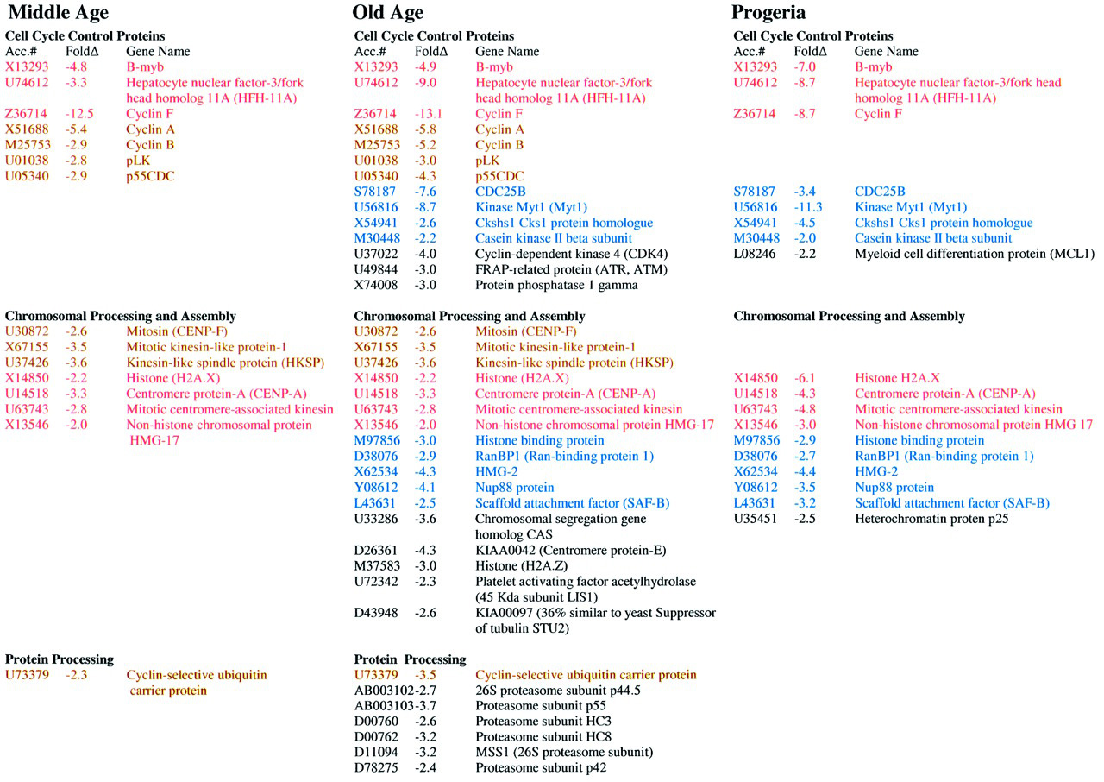

Slide 47
ACCUMULATION OF MUTATIONS IN THE MITOCHONDRIAL GENOME
Mitochondrial DNA:
Mutation rates in mtDNA are 10-20 times that of nuclear genes.
Mitochondria are extremely metabolically active and are a O₂ rich environment.
Leads to free radical damage. Deletion mutations in humans have been shown to increase with age.

Slide 48
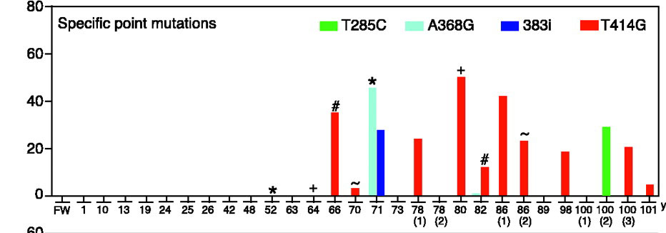
Aging-Dependent Large Accumulation of Point Mutations in the Human mtDNA Control Region for Replication
AGE CLASS
FROM: Michikawa Science 1999

Slide 49
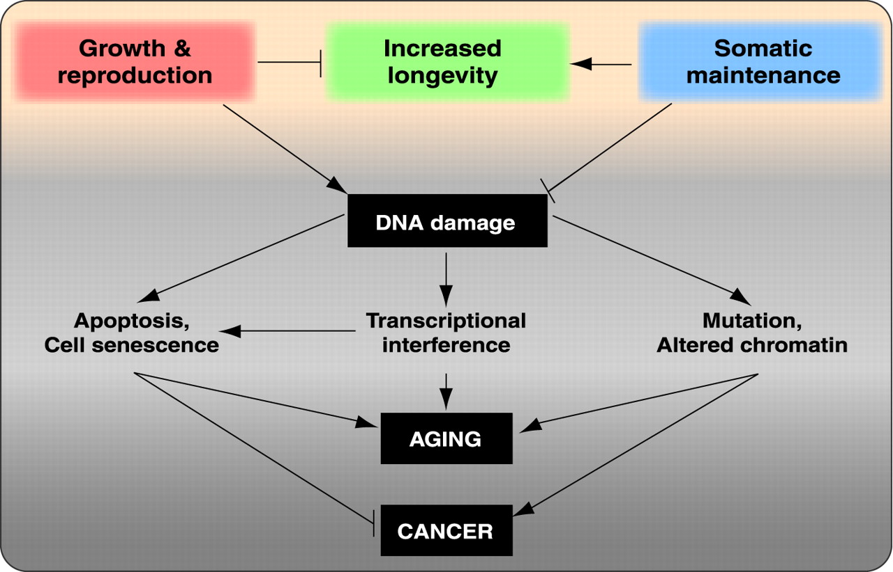
Hasty et al. 2003. Science. 299:1355-1359

Slide 50
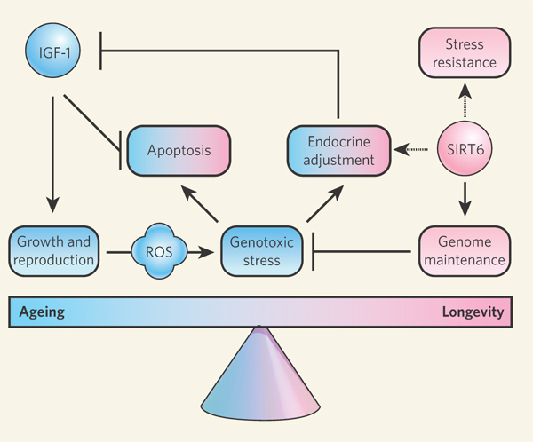
Nature 440, 874-875 (13 April 2006)
Ageing: Chromatin unbound
Jan Vijg and Yousin Suh
Sir2 proteins slow ageing in yeast by locking chromatin — the DNA and proteins in chromosomes — into a stable, silent state. Inactivating a Sir2 family protein in mice causes premature ageing and genome instability.
The possible role of SIRT6 and genome maintenance in balancing ageing (blue) and longevity (pink). Although a mechanism is as yet unclear, SIRT6 may act in its pro-longevity role by promoting DNA repair, increasing stress resistance and maintaining metabolic homeostasis. The genotoxic stress resulting from its absence may cause a compensatory metabolic shift towards reduced insulin-like growth factor (IGF-1) signalling, thereby lowering the production of reactive oxygen species (ROS). The resulting increase in apoptosis could be a cause of the premature ageing symptoms observed by Mostoslavsky et al.1 in mice lacking SIRT6.

Slide 51
INDY gene
https://www.youtube.com/watch?v=dGFXGwHsD_A

Slide 52
WERNER'S SYNDROME
Werner's syndrome (WS) is a rare, autosomal
recessive disease. Its symptoms are:
  Growth is deficient post-puberty
  Predisposition to arteriosclerosis, diabetes, non-epithelial cancers
  Premature ageing - wizened appearance, graying hair, hair loss
Cultured cells from patients show:
  Poor division
  Telomere shortening
  Karyotype changes
  Increased mutation rate
The gene was mapped in Japanese families by looking for regions of the genome that were homozygous in patients (because it is a recessive disease). The gene was isolated in 1996. It codes for a DNA helicase enzyme.

Slide 53
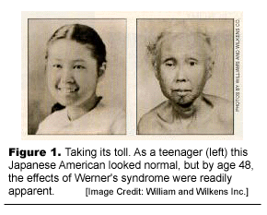

Slide 54
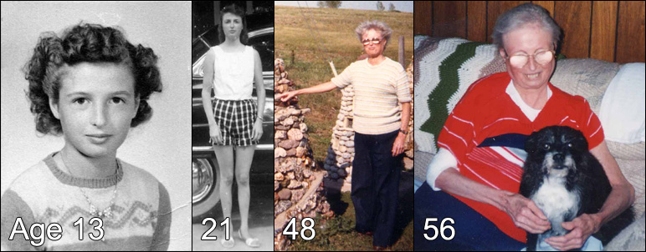

Slide 55
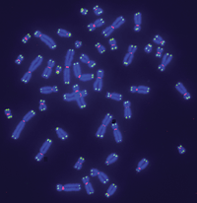
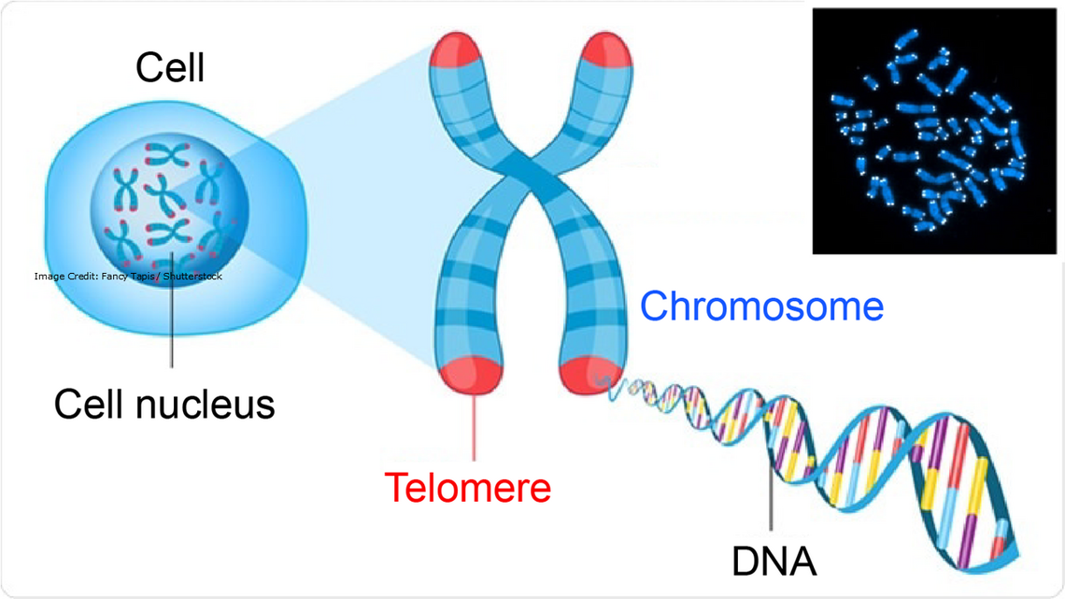
Telomerase research is a hot topic in aging
FROM: Marx, 2002. Science 295:2348-2351
http://joshmitteldorf.scienceblog.com/2015/04/29/large-new-survey-tracks-telomere-length-and-mortality/
Notes:
Tracked 65,000 people over 7 years
Factored in smoking, exercise, cholesterol, body fat, alcohol
Could be a marker or cause aging

Slide 56
FAILURE OF CELL REPLICATION MAY BE DUE TO DAMAGE TO TELOMERES
Telomeres are regions of highly repetitive DNA at the ends of chromosomes.
They prevent the ends of chromosomes from joining together during replication.
DNA polymerases are unable to fully replicate Telomeres.
Telomeres shorten with each cell replication unless they are maintained by telomerase. Eventually the cell is unable to replicate and undergoes “replication senescence”.

Slide 57
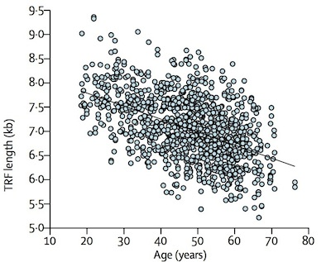
Are they causing aging?
Marx, 2002. Science 295:2348-2351
http://joshmitteldorf.scienceblog.com/2015/04/29/large-new-survey-tracks-telomere-length-and-mortality/
Notes:
Tracked 65,000 people over 7 years
Factored in smoking, exercise, cholesterol, body fat, alcohol
Could be a marker or cause aging

Slide 58
Telomere length is a consequence of protein Telomerase. Evolution should be able to increase telomere length.
Evolution has turned telomerase off such that short telomeres substantially affect our life span. Turning telomerase on would not cost anything, but that is not what evolution has done.
So the theory is wrong that says evolution has already made our life spans as long as possible. Evolution has arranged for us to age and die “on purpose”. Withholding telomerase is part of an evolved death program.
– WHOA, WHY?

