Slide 1
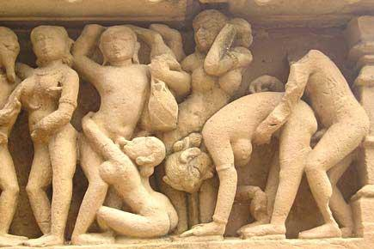
WHY SEX???
What factors favor the evolution and maintenance of sexual reproduction?
Is there an advantage or cost to asexual reproduction?

Slide 2
What is Sexual Reproduction?
Asexual Lineage
Sexual Lineage

Slide 3
What are some costs of sexual reproduction relative to asexual reproduction?
Asexual Lineage
Sexual Lineage

Slide 4
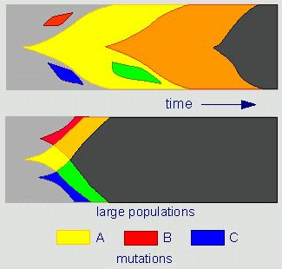
OK, so WHY SEX?
Asexual Population
Sexual Population

Slide 5
What do we know about new mutations?

Slide 6
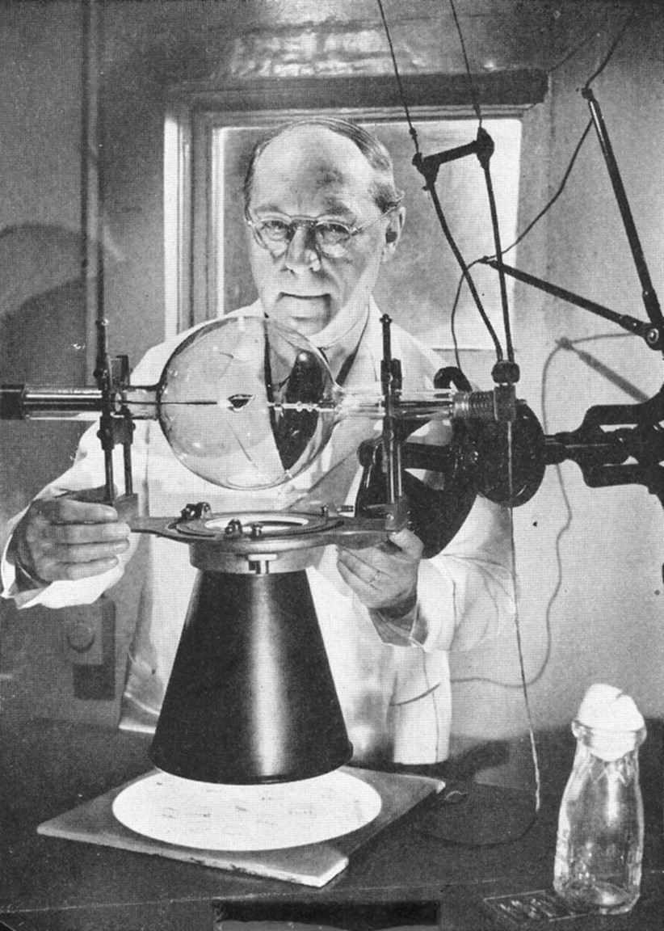
This a major problem for asexual lineages!
H. J. Muller and the X-ray machine with which he did his Nobel Prize-winning experiments at the University of Texas

Slide 7
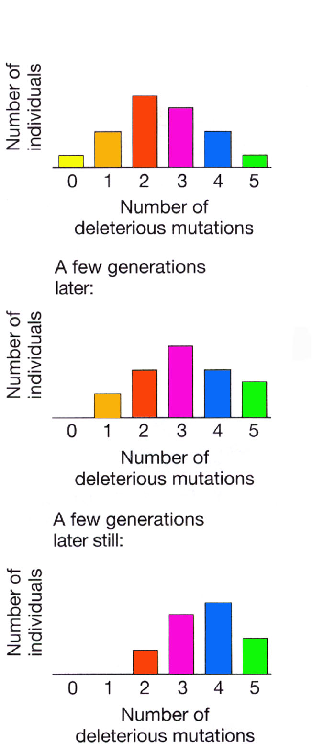
DELETERIOUS MUTATIONS IN ASEXUAL POPULATIONS
H. J. Muller and the X-ray machine with which he did his Nobel Prize-winning experiments at the University of Texas

Slide 8
Meltdown
Ratchet advances slowly
Consequences:
Notes:
Fitness continues to decline
Eventually mutational load is too great

Slide 9
The BIG Benefit of Sex
Mechanism for genomic repair, eliminating deleterious mutations (*)
PARENT GAMETES
A * A A * *
B * B * * B
* C C * C *

Slide 10
Advantages and Disadvantages to ASEXUALITY
What environmental conditions produce advantage for asexual lineages?

Slide 11
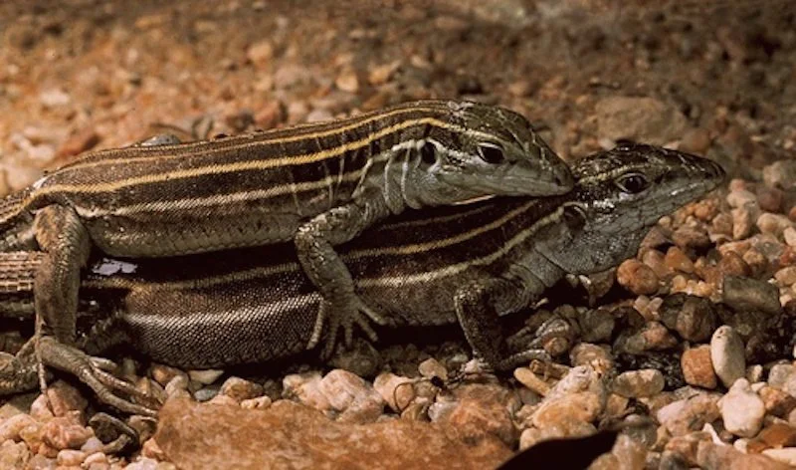
Most Asexual Lineages are Evolutionarily “Young”
SEXUAL
ASEXUAL
Whiptail
Why have prokaryotes been so successful?

Slide 12
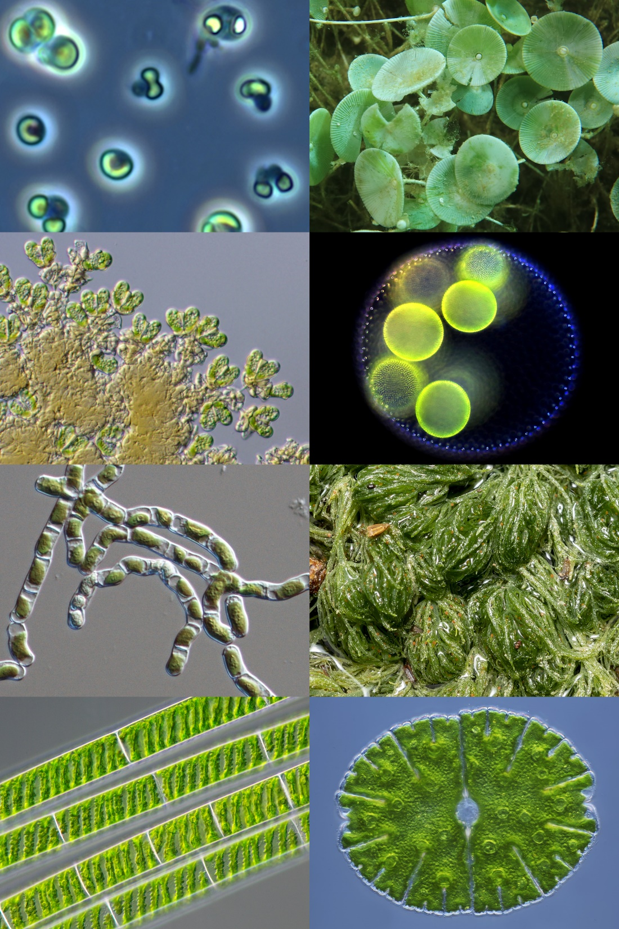
The When, Where, and Who of Sex
Males?? Females??
What are you?
Notes:
Isogamous – same sized gametes

Slide 13

Imagine you are an algae from 1.3 billion years ago
Are you male? Are you female?
What is your “life-goal”?
What can you do to increase reproductive success?
An EXERCISE (see next slide)

Slide 14
Take out a piece of paper and make 10 “gametes”
Put your initials on them
Around the room are 4 reproduction stations – imagine pools of water where breeding is possible
Rules
You may only reproduce in the reproduction stations
You may only mate with one individual at a time per reproduction pool
You may not use a “spray and pray” strategy
Top “reproducer” gets?
Notes:
Do 2 or 3 practice rounds before a final round where extra credit is awarded

Slide 15
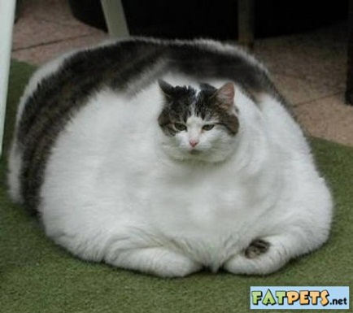
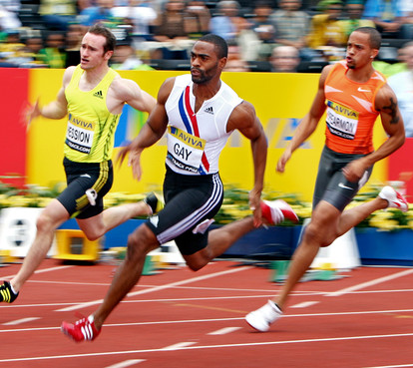
Two Strategies
If gametes are similar size, two ways (hypotheses) for how organisms can increase reproductive success

Slide 16
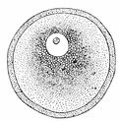

Who makes the little gamete?
Who makes the big gamete?
Egg is 10 million X volume of sperm

Slide 17
What does this mean in terms of investment for the animal with the “big” gamete versus the one with the “little” gamete?

Slide 18
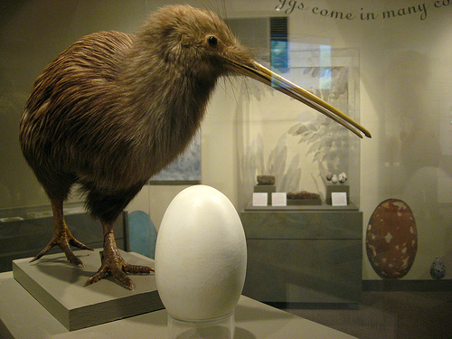
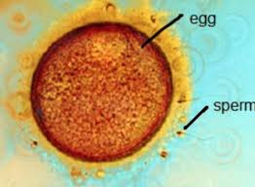
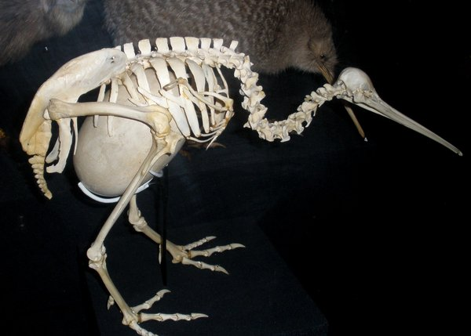
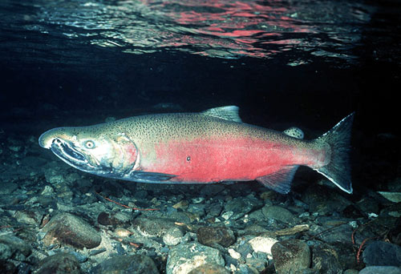
Differential Investment
Sperm are cheap
  Just big enough for DNA and little energy
Single bird egg = 15-30% female mass
Single male may have 8 billion sperm in testes
Coho salmon (100 billion sperm/3500 eggs)
Humans?

Slide 19
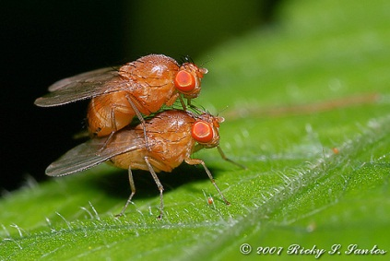
Differences in investment set the stage for competition
    Bateman
    Can we estimate number of offspring as a function of number of mates?
    Do this for both males and females

Slide 20
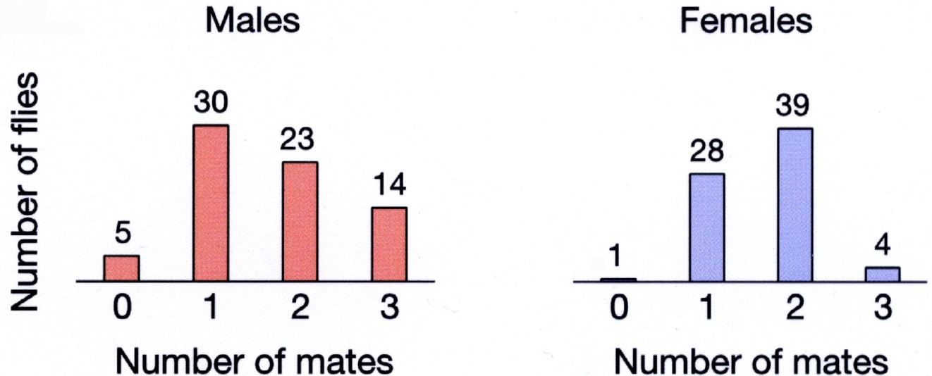
Sets Stage for Competition
    Results:
    Males: some never mated, others 3+ (20%)
    Females: All mated 1-2 times
    Conclusions:
    Sex with little investment will have large variation in reproductive success → COMPETE
    Sex with lots investment will all be successful (no competition)
    How should each sex maximize reproductive success?
27%
6%

Slide 21
Let’s tie it all together!

Slide 22
What is the outcome of sexual selection?

Slide 23


What distinguishes from

Slide 24
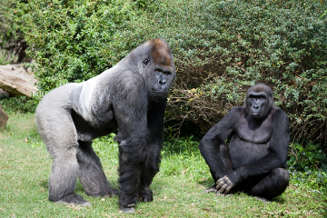
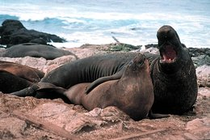
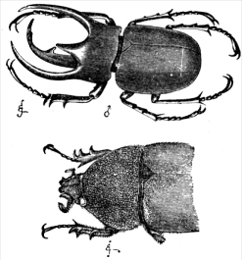
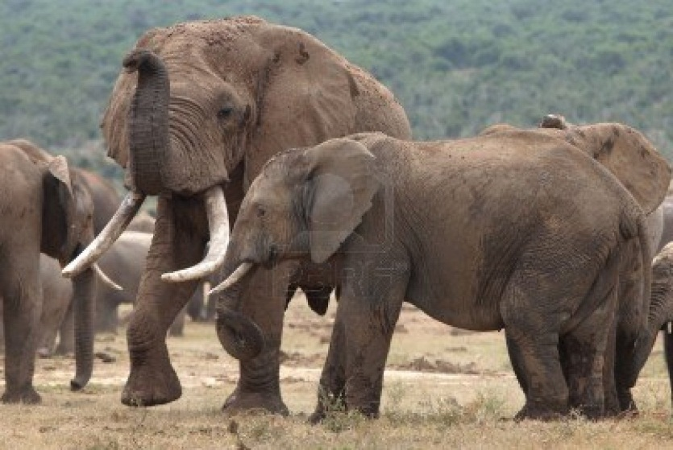
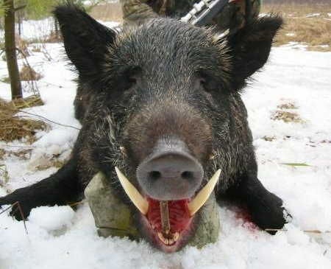
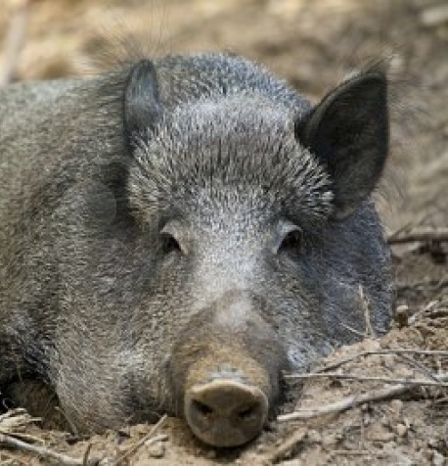
First (of 2) mechanism of sexual selection

Slide 25
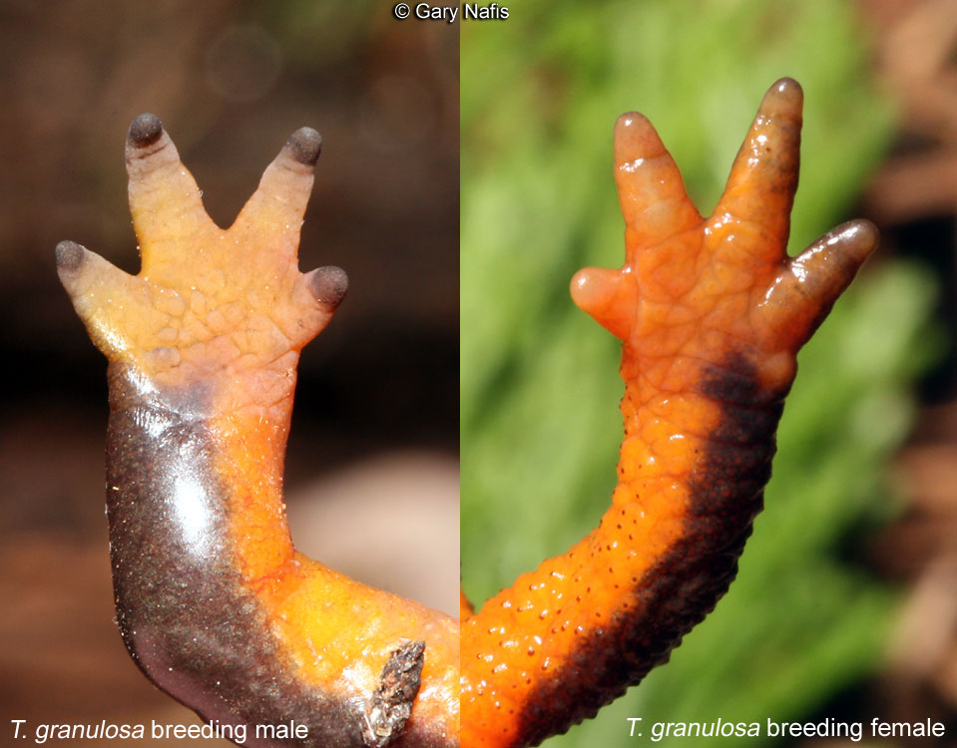
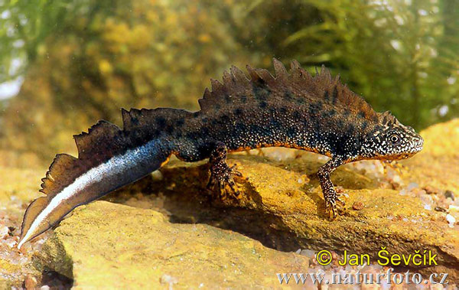
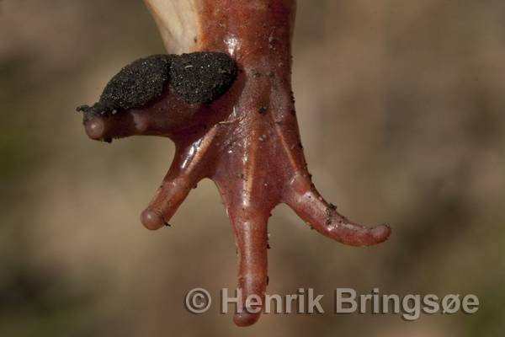
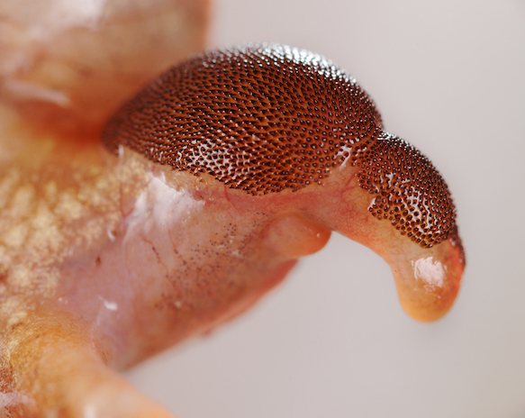
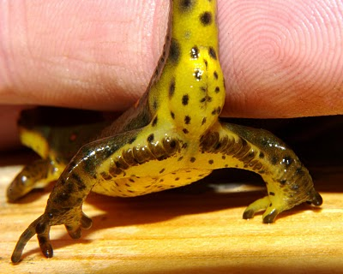
Structures help with “persistence”

Slide 26
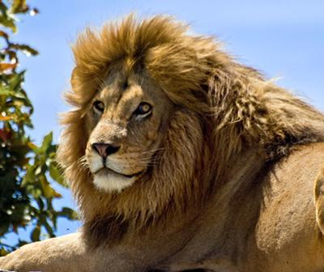
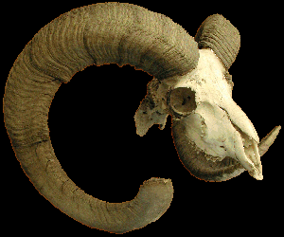
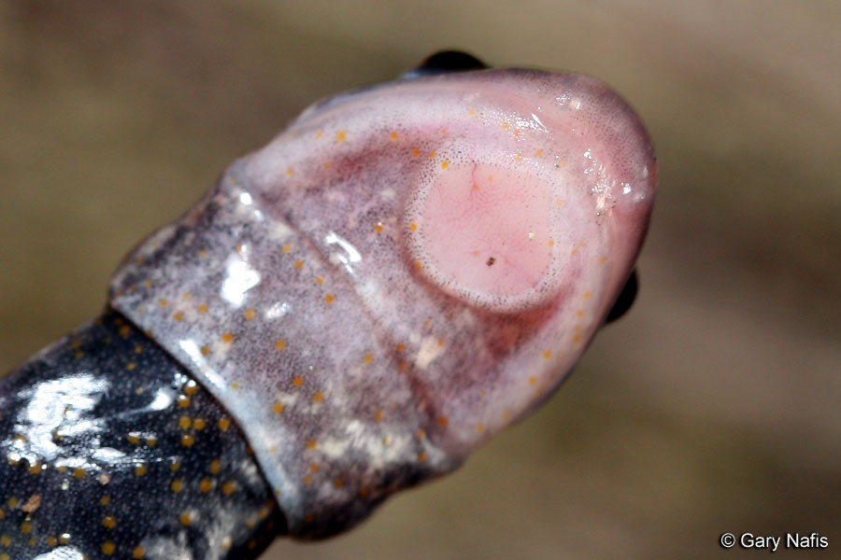
Structures to protect males in combat
Pheromones

Slide 27
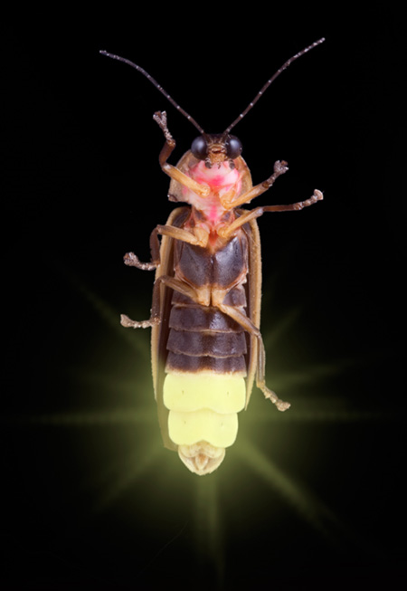
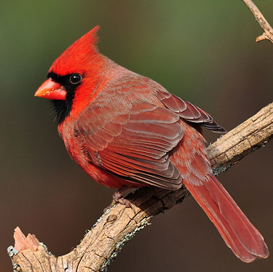
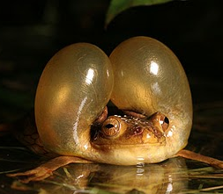
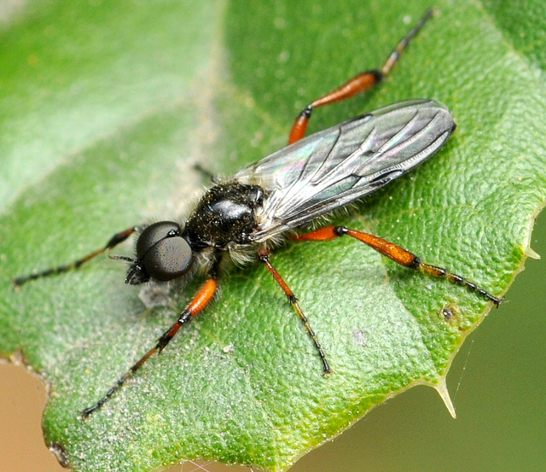
Signals to attract females
Sensory systems to detect females

Slide 28
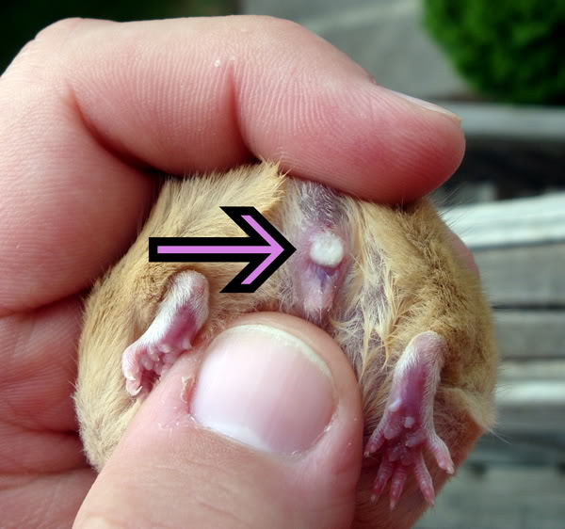
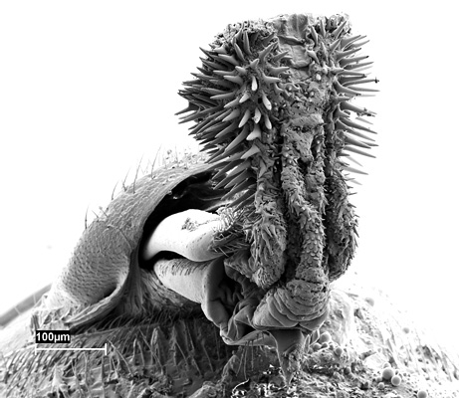
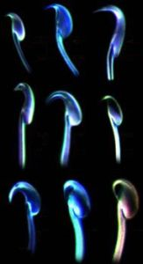
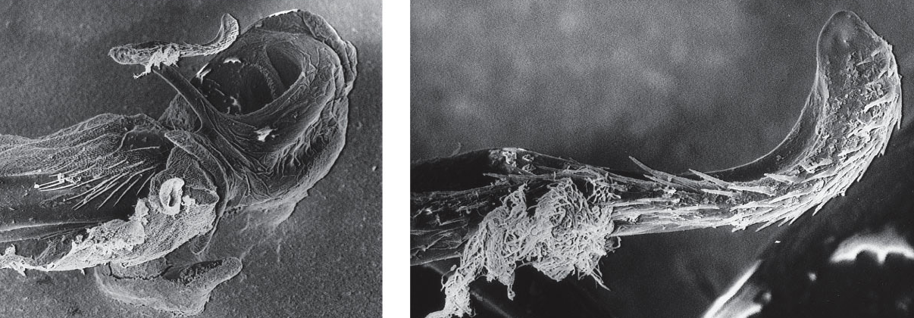
Mechanisms to enhance sperm success
Decrease success of others
Increase success of your own

Slide 29
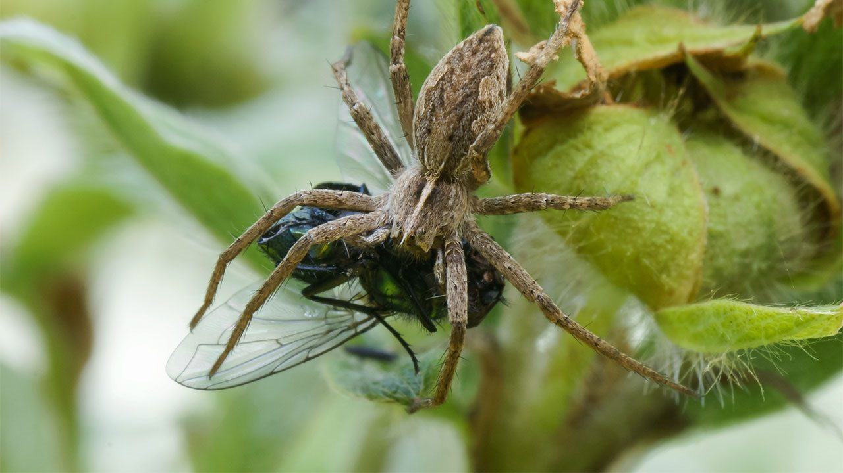
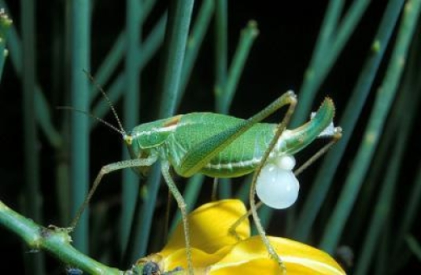
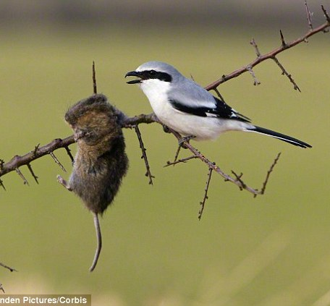
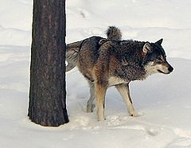
Second (of 2) mechanism of sexual selection
Definition
Two mechanisms

Slide 30
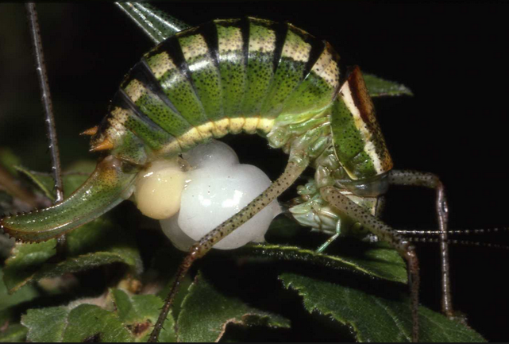
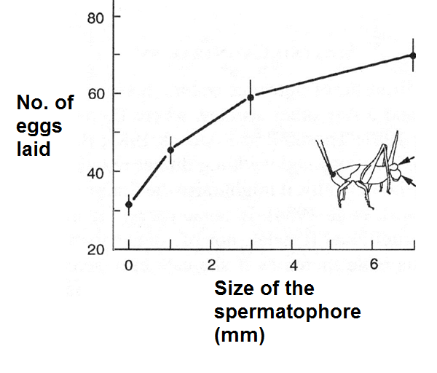
Female Bush Cricket
Example: Direct Benefits

