Slide 1
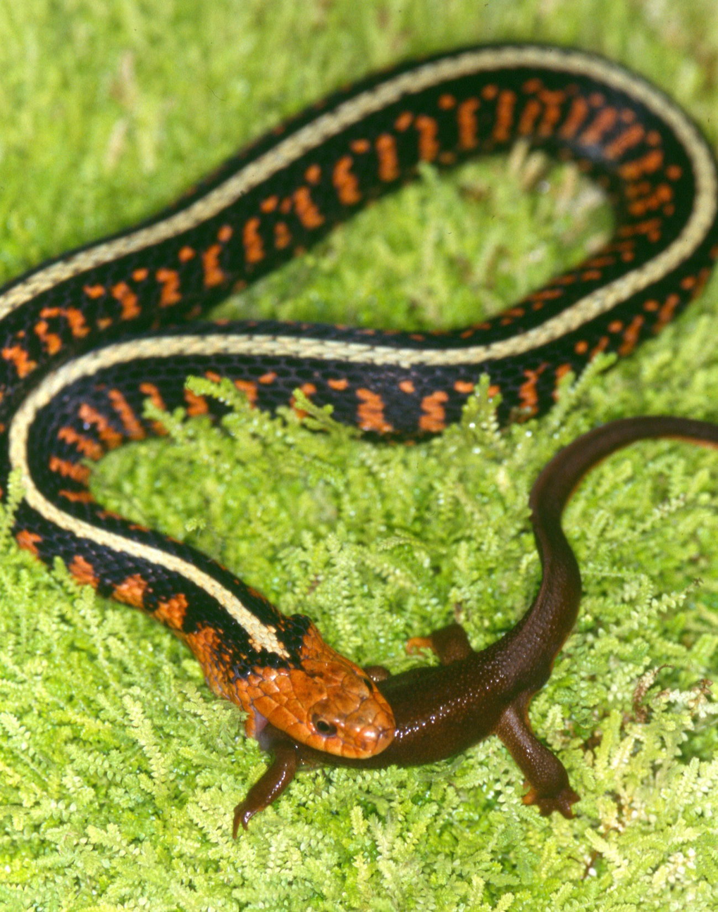
Coevolution

Slide 2
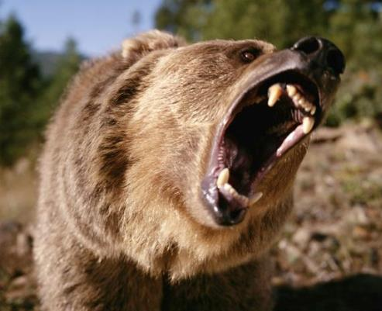

Notes:
Natural Selection is a driving force of adaptation

Slide 3








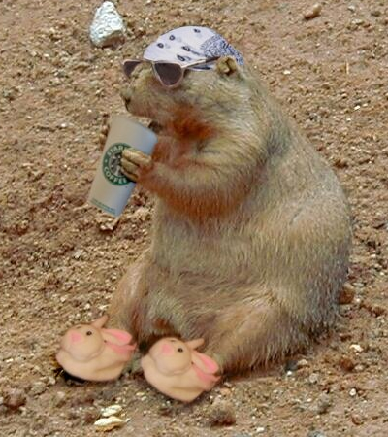

Slide 4
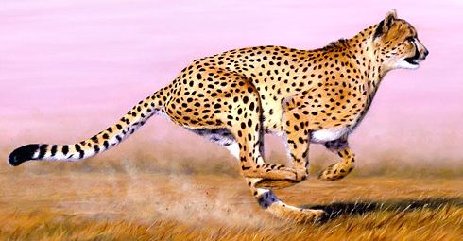
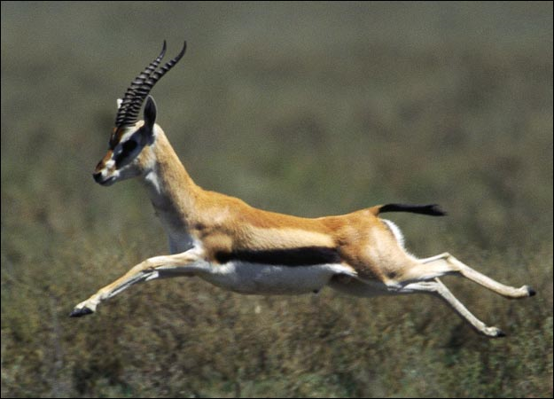
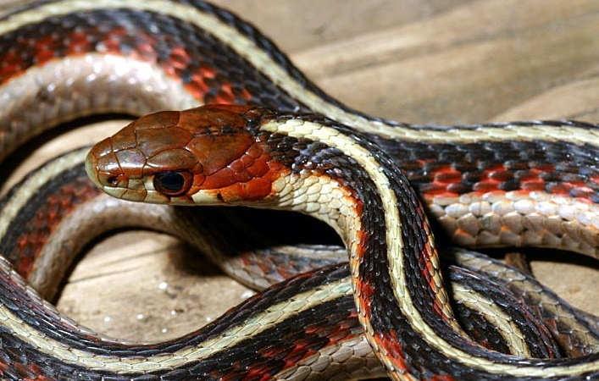
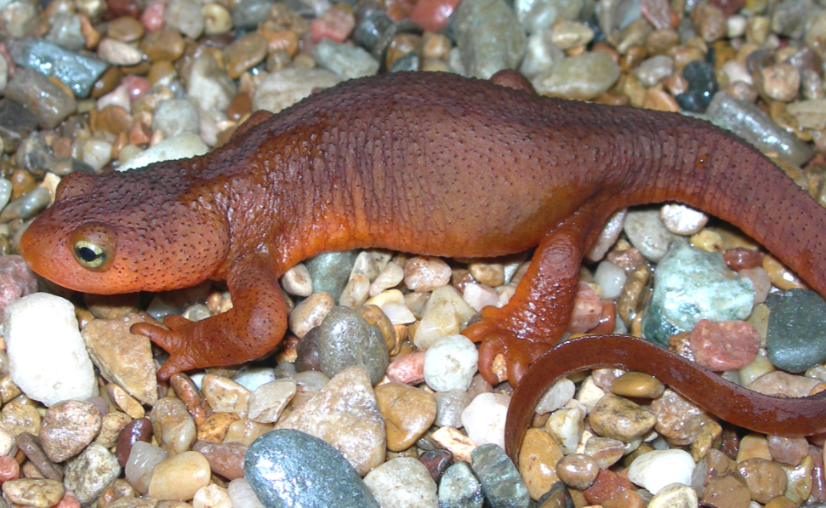
Cheetah
Gazelle
Garter Snake
Newt
Notes:
Talk about the arms race here
Echolocation

Slide 5
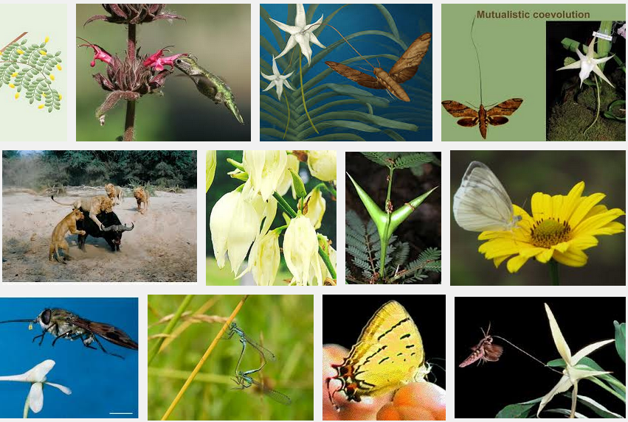
Google image search: coevolution examples

Slide 6
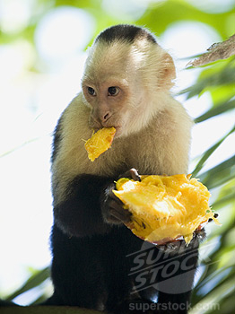
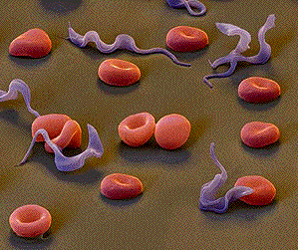
When is it NOT coevolution?
2 misuses of the term
“I plead for the retention of the usefulness of ‘coevoltuion’ by removing it from synonymy of usage with ‘interaction,’ ‘mutualism,’ ‘symbiosis,’ and ‘animal-plant interaction.’”
Janzen 1980. Evolution

Slide 7
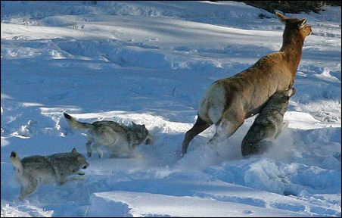
Why are the wolves running?
Why is the elk running?
Notes:
Why the wolves are running (what are they trying to obtain)
Why is the elk running (what is she trying to do)
Life-Dinner Principle
Why co-adaptation may be so common in plant-insect interactions because selection on the prey is not as intense

Slide 8
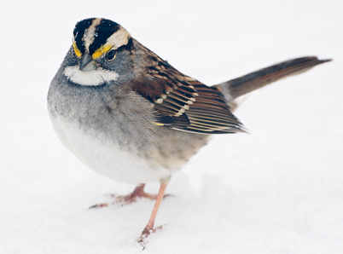
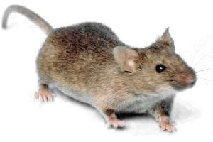
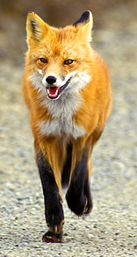
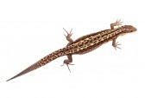
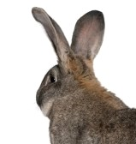
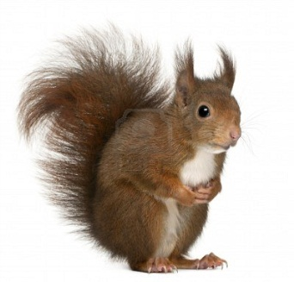
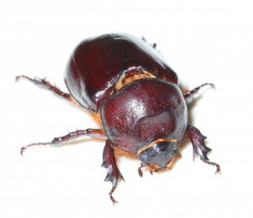
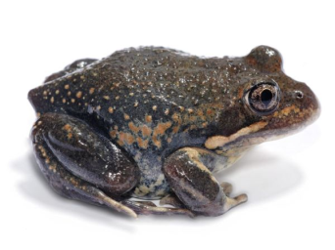
Notes:
Top-down selection
Selection likely to be fairly strong from predator to prey
But for predators with multiple prey, selection in the reverse direction may be relatively week
May select for general speed and swiftness, but for many predators selection from any one prey is unlikely to be driving force
Leads to the conclusion that many adaptations are actually the result of selection from THEIR predators

Slide 9
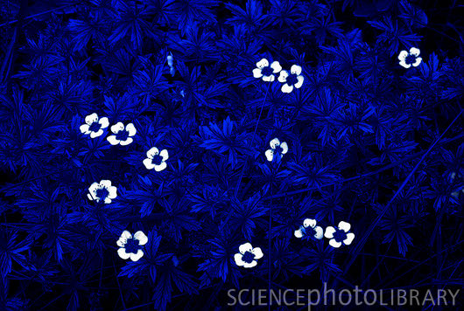
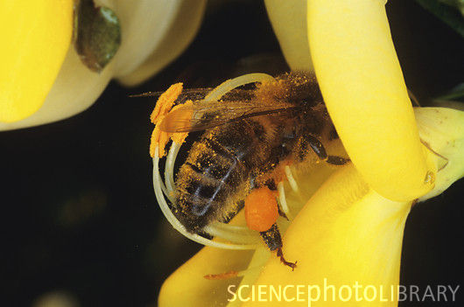
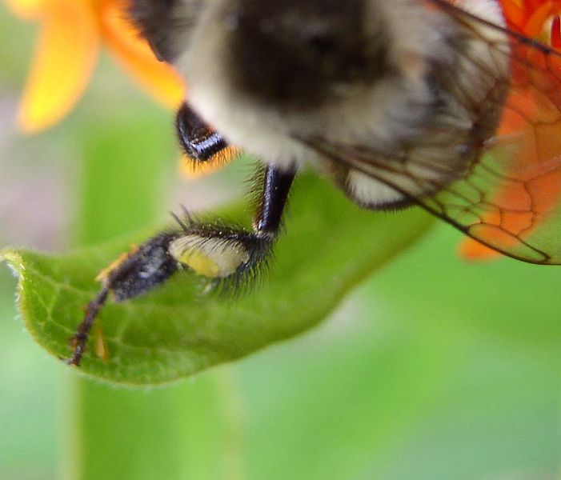
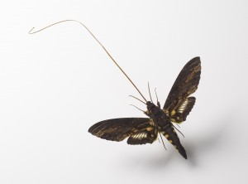
Are plant-pollinator interactions really coevolution?
sphinx moth

Slide 10
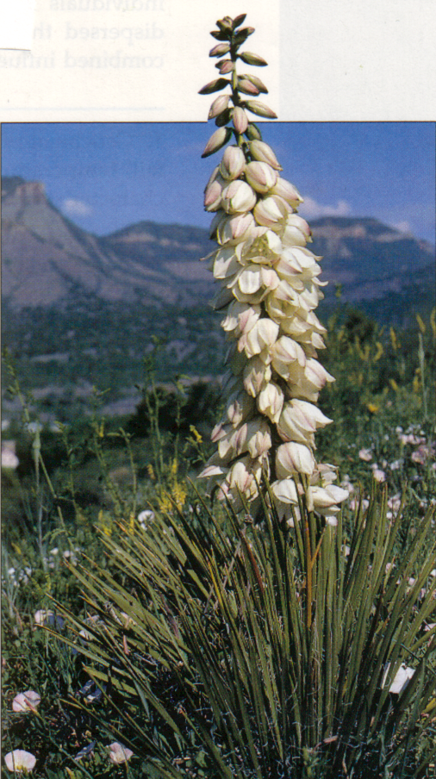
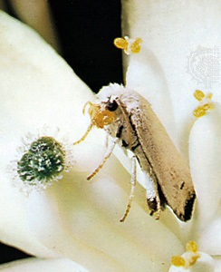
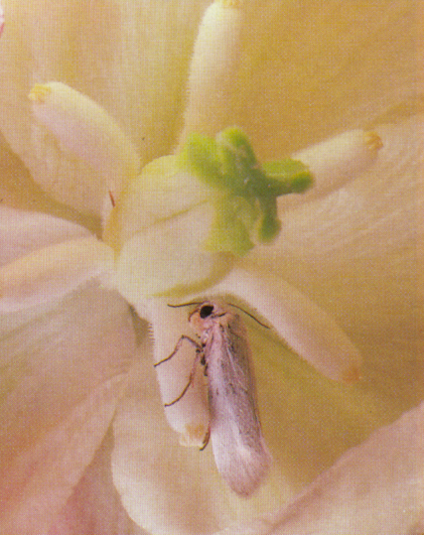
Notes:
Life Cycle of the Yucca Moth. - Most adult moths emerge from the soil from the second week in June through to the second week in July (D. Hurlburt, unpubl. data). Shortly after emergence they gather and mate in freshly opened soapweed flowers (Riley 1892, Baker 1986, Addicott et al. 1990). Adult female yucca moths actively collect pollen from one plant then usually fly to another inflorescence. Upon finding a fresh flower, a female first inserts her ovipositor through the carpel wall and lays an egg next to the developing ovules (Aker and Udovic 1981, Addicott and Tyre 1995). She then climbs to the tip of the style, and using her maxillary tentacles (appendages unique to yucca moths), she actively transfers pollen into the stylar canal. Moths do not feed as adults and die after three to five days. Moth eggs hatch after seven to 10 days (and upon hatching, larvae feed on developing seeds). After approximately 50-60 days, 4th instar larvae chew their way out of the yucca fruit and drop to the ground via a silken thread (Riley 1892). Larvae burrow 5-20 cm into the soil (Fuller 1990), spin a cocoon of silk and sand particles (Davis 1967) and enter a prepupal diapause (dormancy) (Riley 1873, Keeley et al. 1984). After a minimum diapause of 1 year, larvae pupate and emerge from the soil as adults usually coinciding with yucca flowering.
Mutualistic Relationship between Yucca Moth and Soapweed - Of crucial importance to the survival of the yucca moth is the survival and sexual reproduction of its host, the yucca. The plant and moth have an obligate mutualistic relationship and neither species can survive without the other. Obligate mutualistic systems are those relationships in which each partner requires the other to survive or reproduce, and as a result, both species benefit from the interaction (Addicott 1995). This interaction is obligate for both yuccas and yucca moths, because there is no other consistently successful mechanism of pollen transfer for the plants and because yucca moth larvae feed only on yucca seeds.
The maintenance of the mutualism is dependent upon the degree of overlap of appropriate life history stages between the plant and its pollinator. In this case, pollinating moths must be active when flowers are receptive to pollen. Soapweed have developed several unique strategies for dealing with this problem in Alberta. Flowering of soapweed in Alberta is highly asynchronous, having the longest flowering season (approx. 83 days in 1998) of any documented soapweed population or any population of Yucca spp. (D. Hurlburt, unpubl. data). In species of yucca with similar numbers of flowers, flowering typically lasts around 30-35 days (J. Addicott, pers. comm). Further moth density is relatively constant throughout the flowering season; data suggest that flowers have an equal chance of being pollinated at any point during the flowering season (D. Hurlburt, unpubl. data).
In most populations, yuccas are predominantly an outcrossing³ species and selective abscission⁴ (abortion) of flowers occurs in response to self-pollination. However, at the northern edge ofyucca's range, neither the presence of moths, nor the presence of other individual plants in flower is reliable and data suggest that yuccas were selected to be tolerant of a self-pollinating mating system (D. Hurlburt, unpubl. data). In Alberta and parts of Montana, if yuccas have a choice between cross-pollinated and self-pollinated flowers, they will choose to retain cross-pollinated flowers. However, if not given a choice, they will retain self- and cross-pollinated flowers equally with no apparent loss in seed viability (D. Hurlburt, unpubl. data).

Slide 11
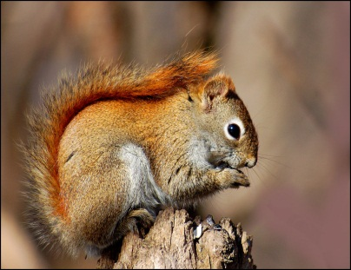
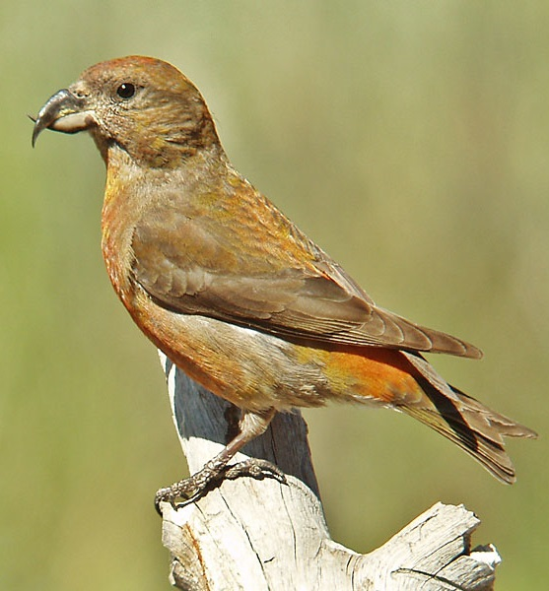
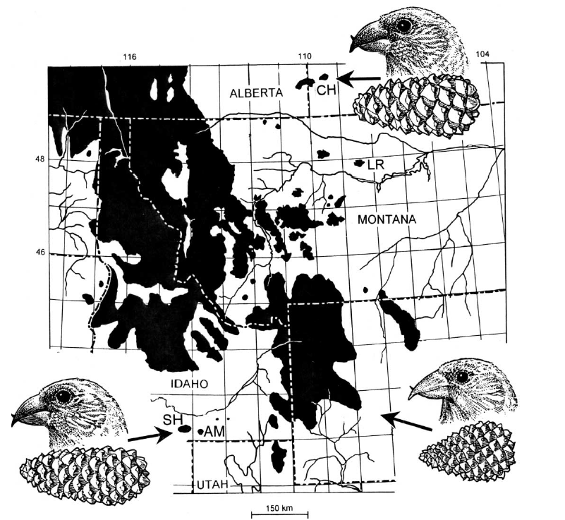
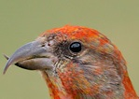
Benkman’s Squirrels
https://www.youtube.com/watch?v=1NvU8WG9bg0

Slide 12

The Coffee Pot Murders
Edmund “Butch” Brodie Jr.
&
Kenneth “Doc” Walker
(Early 1960s)
Notes:
To really tell the TTX story well we really need to start in the beginning
Doc found that his population of newts seemed to have a tremendous amount of toxin and that almost every organism that he injected died
Also observed a snakes eating newts in the pit-traps

Slide 13
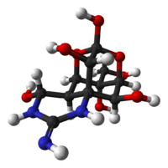
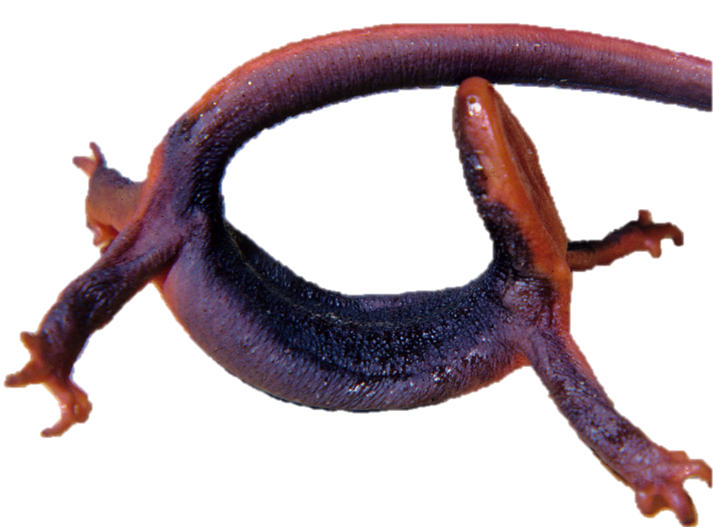
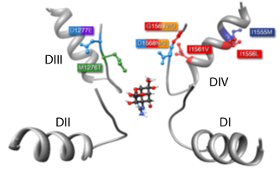
Tetrodotoxin
Set out to answer the question
Results – not PETA approved
What is TTX?
How does it work?
How toxic is it?
Rough-skinned Newt
Sodium Channel Protein (Na_{v}1.4)
Feldman et al. PNAS
Notes:
So here is our culprit, the Rough-skinned newt (Taricha grandulosa)
Doc set out to figure out whether a newt could kill a person
He was given a mortar and a pestle to grind up newt tissue, started setting traps for animals
Over the course of a year, Doc ground up hundreds of newts and injected the concoction into everything he could get his hands on
Killed: hundreds of mice, rats, possum, raccoon, even a bobcat and great blue heron, President's cat?
Absolutely everything died – and died very quickly
Toward the end of his study Mosher published a paper in Science describing the toxin from the newts
Turned out to be Tetrodotoxin:
Non-proteonacious molecule called a guanidinium-ion
Functions by physically blocking the pore of voltage-gated sodium channels in nerve and skeletal muscle
This stops the propogation of action potentials resulting in paralysis
Very potent neurotoxin with only small quantities necessary to induce asphyxiation and death in most organism
Give an example of how potent it is…286 nanograms is enough to kill a mouse in 10 minutes, single newt contains 29 million nanograms - enough toxin to kill more than 100,000 mice or 56+ people

Slide 14


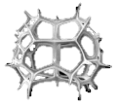



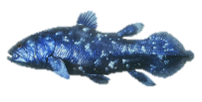
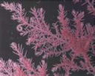



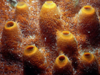
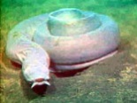

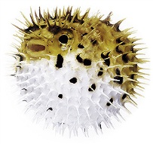
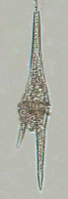
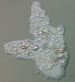


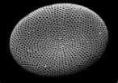
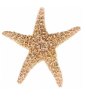

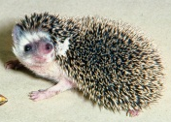

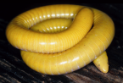
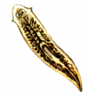


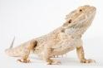
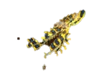




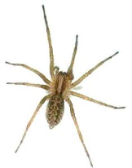

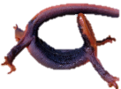








Life
Animals
Plants
Vertebrates
Archaea
Bacteria
Radiolarians/
Foraminiferans
Green
Plants
Corals/
Jellyfish
Chondrichthyes
Sarcopterygiians
Red algae
Fungi
Sponges
Brown
algae
Hagfish/
Lamprey
Tunicates
Ciliates
Slime mold
Comb
Jellies
Amoebas
Ray-finned Fish
Dinoflagellates
Diatoms
Echinoderms
Lancelets
Mammals
Caecilians
Lizards
Turtles
Flatworms
Arrow
Worms
Barnicles
Cephalopods
Insects
Decapods
Annelids
Birds
Salamanders
Snakes
Gastropods
Copepods
Myriapoda
Arachnids
Bivalves
Ribbon Worms
Roundworms
Crocodilians
Frogs
Notes:
TTX is a non-proteonacious molecule called a guanidinium-ion
Functions by physically blocking the pore of voltage-gated sodium channels in nerve and skeletal muscle
This stops the propogation of action potentials resulting in paralysis
It is a very potent neurotoxin with only small quantities necessary to induce asphyxiation and death in most organism
Give an example of how potent it is…286 nanograms is enough to kill a mouse in 10 minutes, single newt contains enough toxin to kill 112,000 mice or 16 people
One of the reasons this makes so little sense for us is that for almost all of these organisms we do not know where they get the toxin

Slide 15





Why are newts so toxic?
Notes:
Story of doc walking up to one of his pit-fall traps and seeing a snake eating a newt

Slide 16


TTX Resistance

Slide 17



TTX Resistance
Baseline speed
Post-injection speed
Resistance = post-injection speed / baseline speed
e.g. Resistance = 35 sec / 55 sec = 0.63

Slide 18
Population differences in TTX resistance
N = 333 families
&
~3,000 individuals
>100 MAMU
35-100
25-35
15-25
10-15
5-10
4-5
<4
Brodie et al. 2002. Evolution 56:2067
Notes:
How can we explain the lack of resistance in so many populations of snakes that co-occurred with Taricha if an arms-race is really taking place

Slide 19
How resistant are snakes?
TTX (mg) to reduce speed to 15 %
Human lethal oral doses
Snake mass (g)
Notes:
Each line is a population of highly resistant Thamnophis sirtalis

Slide 20

The Geographic Mosaic of Coevolution
In the mid 90’s, realized interactions are a landscape
Species and populations are units that evolve, but interactions that drive coevolution occur between individuals
Predictions:
Coevolutionary hotspots and coldspots
Mismatched abilities in some populations
High variation maintained through gene flow
Different evolutionary outcomes or trajectories among populations or lineages
Notes:
World of species interactions is not an even landcape and same for two species wherever they occur together
Crazy quilt of interactions that differs from one spot to the next
Realization that – species and populations are units that evolve, the interactions that drive coevolution occur between individuals and therefore take place on a local scale
Primary consequence (and prediction of GMT) is that across the range of a species interaction there will be hotspots where coevolution between species is active and intense and coldspots where coevolution is inactive or not occuring at all.
Another prediction is the phenotypes in predator and prey should be mismatched in some areas through range – caused by movement of alleles between hotspots and coldspots creating places where either predator or prey may jump way ahead of the other in the arms race. (i.e. if a snake could dispatch any newt in pop, or a newt kill any snake in pop, that’s a mismatch)

Slide 21


Measuring TTX
Notes:
If an arms race were truly driving evolution of TTX resistance, then we would expect resistance to closely match toxicity levels of the local newts
If this is the case than many populations of newts must also lack TTX
Needed a way to quantify the TTX in individual newts

Slide 22


Newt TTX levels
Population averages
Red indicates the highest level of TTX
Purple indicates the lowest
mg TTX
Hanifin et al. 1999 J. Chemical Ecology 26:2161
Hanifin et al. 2008. PLOS

Slide 23
Phenotype Matching
What do you think?
Brodie et al. 2002. Evolution 56:2067
Hanifin et al. 2008. PLOS

Slide 24
What was the first prediction of the GMMC?
Snakes and newts share similar spatial pattern of phenotypic elevation
regions of phenotypic exaggeration ≠ regions of intense reciprocal selection
Brodie et al. 2002. Evolution 56:2067
Hanifin et al. 2008. PLOS
Notes:
One of the predictions of GMT – mismatched abilities
If coevolution is truly happening, should have situations where gene flow causes some populations to out-step the other
Should be populations where snakes have jumped ahead and can consume any newt
Populations where newts have jumped ahead and can kill any snake
These were the criteria for determining whether a populations is matched or unmatched – must hold for every possible pair of individuals at a given locality
Plot these data – see that our ideas of matching and mis-matching are completely wrong
Although similar geographic pattern of elevated phenotypes – functional comparisons were completely different
Most of the areas originally considered hotspots of coevolution are actually coldspots – one of the species has jumped ahead and coevolution can’t happen
Only two really solid hotspots

Slide 25
What was the second prediction of the GMMC?
15%
Newts kill all snakes
85%
Log newt toxicity
Snakes unaffected by any newt
Log snake resistance
Regions of mismatch indicate that no reciprocal selection is possible (true “coldspots”)
Include localities where arms race never started (purple)
And places where snakes have apparently escaped (yellow and green)
Notes:
If we look at the three functional categories
newts have outpaced and can kill/immobilize all potential snakes
Abilities are matched
Snakes have outpaced and can eat any newt
Roughly half of the pops are so mismatched that no coevolution can occur
Also very one-sided with snakes being ahead in all mis-matched cases
No newt can completely immobilize all snakes from a given population

Slide 26
How have snakes managed to escape the arms race?

Slide 27


How have snakes managed to escape the arms race?
Domain IV S5-S6 Linker from tsNa_{V}1.4
Geffeney et al. 2005 Nature 434:759

Slide 28
Why can’t newts escape?
Notes:
Why can’t (or haven’t) newts escaped the arms race
Producing the toxin is expensive – requires too many resources
Manufacturing problem and maybe your restricted in how quickly you can make it
Storage problem and can only hold so much
Maybe requires a precursor that is limited in environment

Slide 29
Mechanisms of Resistance (Why Snakes Can Escape)
Amino Acid Sequence of Na⁺ Channels
THIS…..
DOESN’T EXPLAIN THIS…..
Snake Resistance

Slide 30

McGlothlin et al. 2014. Molecular Biology and Evolution
Fixed across populations
  What does this suggest?
3 channels in central nervous system = no change
  Why?
Notes:
suggesting that the resistant peripheral nerves antedate resistant muscle
protection from toxins by the blood–brain barrier
Still doesn’t explain variation in resistance within a population.
Identify parallel evolution of TTX resistance in Nav1.6 and 1.7, which are expressed in the peripheral nervous system
Each paralog contains at least one TTX-resistant substitution identical to a substitution previously identified in Nav1.4.
These sites are fixed across populations, suggests the resistant peripheral nerves occurred before resistant muscle.
In contrast, three sodium channels in the central nervous system (Nav1.1–1.3) are not TTX resistant, consistent with protection from toxins by the
blood–brain barrier.

Slide 31


A note on when…
Notes:
Common ancestor of all snakes develop changes in domain 3 and 4 of NAv1.7 with TTX resistance in small sensory neurons
Resistance in larger myelinated axons evolved four separate times in dmain 4 of 1.6
Provide baseline resistance to low TTX levels and allow entering arms race in most populations revolving around skeletal muscle
Results show that these early changes at 170 MYA and 38 MYA in NAv1.6 and 1.7 facilitate snakes entering the arms race with newts
Without these pre-adaptations coevolution probably not possible

Slide 32



Coevolution: reciprocal selection
Selection
TTX resistance
TTX production
Thamnophis sirtalis
Taricha
Have we documented reciprocal selection?
Which predictions of GMM are confirmed?
Selection

Slide 33
The Phenotypic Interface of Newt-Snake Interactions
Other Predators
performance
performance
Crawl Speed
SNAKE W
Size, age
TTX
+
Body Size
Reciprocal Selection
Individual Newt Toxicity
Individual TTX Resistance
Skeletal Muscle Physiology
TTX level
Behavioral Prey Rejection
NEWT W
Egg TTX level
Snake
Other Predators
Newt

Slide 34
Conclusions [for now]
TTX resistance is evolutionary labile, with amazingly variability within and among species of garter snakes
Populations of predators and prey are not always well-matched in levels of resistance and toxicity - may be due to large effects of some substitutions
Genetic model of coevolution in this system indicates functional resistance of many genes (and therefore channels)
  not just Nav1.4
  basis of toxicity variation still unknown
Independent evolutionary paths have led to independent (but similar) genetic and physiological answers to the same coevolutionary problem within Thamnophis.
WHAT NEXT?

Slide 35



Why are some populations brightly colored?
Field caught T. sirtalis 108 µg TTX in liver
3 wk after eating single newt, 42 µg in liver
Bird-ingested minimum lethal dose, about 46 µg / kg
Rat - 1/2 life
3-4 hours
absent -- 28 hours
Snake - 1/2 life
9.7 days
absent -- 73 days
FURTHER QUESTIONS
Mechanism for moving and storing TTX?
Only in T. sirtalis?
In all populations?
Williams et al. 2004. J. Chemical Ecology 30:1901
Notes:
Talk about coevolution involving deadly prey

Slide 36


Other species of garter snake do not eat Taricha…
or do they?

Slide 37

A word on coevolution with deadly prey
How can fatal poisons or resistance to them be favored by selection?
http://video.nationalgeographic.com/video/animals/amphibians-animals/salamanders/weirdest-newt/
Notes:
Think about coevolution very careful
Difficult to see how fatal poisons or resistance to them could be favored by selection
Selective advantage to poisons is ability to repel predators – killing the predator has no advantage – killing predator means cant learn
but lets say all the snakes eat newts, selective advantage for avoidance of eating newts
no advantage to toxicity
If prey dies or is injured when poisoning the predator – no advantage to individual with more poison
On other side – if prey so toxic that they kill all the predators then no chance for more-resistant predators to gain slight advantage
Despite inherent advantage of lethal toxins and resistance – selection can only favor coevolution if individuals with more toxin or more resistance gains advantage.
Snakes poisoned slowly and take up to an hour to eat a newt
Mucosal epithelial in mouth absorbs toxin
Snakes can self-assess their own level of resistance and reject snakes that are too toxic
Every newt that is rejected comes away completely unharmed.

Slide 38
What can we say about coevolution in places with extreme traits?

Slide 39







Multidimensional Selection

Slide 40



Skin is the primary source of TTX (0 to 28 mg)
Also deposited in yolk of the eggs (up to 4600 ng)
Notes:
Almost nothing is known about interactions between the eggs and their predators or how these interactions could influence toxicity in newts and the coevolutionary system

Slide 41
Newt egg toxicity and the implications for coevolution
Low variation between eggs within a clutch
High variation between clutches
Correlation between female and egg toxicity
Egg TTX (ng)
Female TTX (mg)
Indirect Selection on Toxicity
Hanifin et al. 2003. J. Chem Ecol. 29:243

Slide 42



Who are the Predators?
Gall et al. 2011. Can J Zoo
Notes:
Aquatic inverts are most likely to be unidentified predators
Tested a large number of invert taxa including hemipterans, odonates, coleopterans, and gastropods
Only caddisflies consumed the eggs

Slide 43


Are Caddisflies a Threat?
Population size / 0.20 hectare pond
Newt eggs produced per year
1,000,000
Caddisflies could eat 1,000,000
eggs in 36 hrs
Population Estimate
Notes:
PUNCH LINE: caddisflies are likely to be a major driving force on the newt population. Natural Selection should select against newts whose eggs are eaten by caddisflies

Slide 44
Are caddisflies resistant to the negative effects of TTX?
Caddisflies are resistant
Movement
Growth
Gall et al. 2011. Can J Zoo
Notes:
Caddisflies will cover more than 21 meters in 1 hr.

Slide 45




LC₅₀
Former Hanover Undergrad Kari Spivey
2 caddis species
  Soap creek, OR
  Cache valley, UT
5 concentrations
  Control
  0.0005 to 0.1 mg TTX/ml

Slide 46



TTX LC₅₀
DRC and Multcomp procedures in R
Evaluates overlap in confidence intervals
Caddisflies sympatric with newts = 5x higher LC50**
LC50: 0.021
LC50: 0.10
Notes:
.1 mg / ml = enough TTX in one well to kill 4-16 people

Slide 47
TTX LC50
Notes:
.1 mg / ml = enough TTX in one well to kill 4-16 people

Slide 48




Do TTX resistant caddisflies express mutations in sodium channel gene?
Transcriptome sequence & RNA extraction from 5 individuals (UT & OR)
Trinity assembly & gene annotation (BLASTX and Exonerate)
Reference genomes from 5 other caddisfly species and 5 insect species
Public
Transcriptome data
Genome data
Notes:
Species exist in a web of interactions. Should experience a web of selection
Diffuse coevolution – see patterns of coevolution between many species across the landscape

Slide 49



Does the sodium channel gene show mutations?
HIGHLY conserved
1486
1499
Utah
Oregon
69 amino acid replacements
Notes:
4 associated with TTX resistance
15 - 40 fold increase in resistance
P region – virtually identical for all caddis and all insects

Slide 50







Channel Results
Remaining mutations not on P-loop region
  Linker btw S4 & S5
  S6 on DII
Lead to Insecticide Resistance
Site 1: the linker between S4 and S5 in domain II, S5 in domain II and S6 in domain III
Site 2: linker between S4 and S5 in domain I, S5 in domain I and S6 in domain II
18X DDT
resistance
Notes:
Associated with Linker regions
Increase sodium permeability and close slowly - Results in repetitive discharging - muscular convulsions, weakness, paralysis, and death

Slide 51



Do caddis exhibit a preference for lower toxicity eggs?
Caddisflies eat more low toxic eggs
Caddis consume more eggs when they have less toxin
Selection leading to higher toxicity
45
13
32
Notes:
Not only do caddisflies exhibit a preference for eggs with less TTX, but there also appears to be variation in this trait as well

Slide 52

Caddisfly Resistance
Actually…
Replicated with
  Higher N
  Greater range of toxicities
  “fresher” caddisflies

Slide 53


Dying eggs
Summer 2013….

Slide 54

Egg Preference Trials
High (dyed) × Low
High × Low (dyed)
High (dyed) × No
High × No (dyed)
Low (dyed) × No
Low × No (dyed)

Slide 55
LD50 test of Resistance….Methods
2 caddis species
  Soap creek
  Cache valley
12-well plate
5 treatments (n=6)
(mg TTX /ml)
  Saline
  0.0005
  0.005
  0.05
  0.1

Slide 56
Methods
Monitored once per hr
5 hr trials
Susceptibility Score
  1: Immediately arch back, legs splayed and moved rapidly, try to grasp objects
  2: weaker arching (less intense or slower to respond), legs move but less rapid
  3: slight abdominal and leg movements, only minor adjustments in body position and shape
  4: very slight abdomen movement, no leg movement (or vice versa)
  5: no movement or response when stimulated

Slide 57
Results
Higher score = less resistance

Slide 58
Survival calculated as % of animals not getting to a susceptibility score of 5 after 5 hrs
Not sure why survival of non-resistant is high at 0.005 – low N?
Even at doses of 0.1 mg/ml
  50% of resistant caddis survived
  The total volume of solution in one well at 0.1 mg/ml would kill a person!!!

Slide 59
Transcriptome sequencing of tetrodotoxin (TTX) resistant caddisfly

Slide 60

Mutations found in caddisflies
E to K
Position 435
Domain I
S6 bridge
Also found in German cockroach
Notes:
This mutation alone did not reduce the sensitivity of the cockroach sodium channel to deltamethrin. However, when either the E435K or C785Rmutationwascombinedwith the L1014F mutation, the channel sensitivity was reduced by 100-fold.

Slide 61

Mutations found in caddisflies
V to L or V to A
Position 1010 & 1014
Domain II
S6 linker
Found in Anopheles culicifacies, Thrips tabaci

Slide 62
Mutations found in caddisflies
N to K
Position 1013
Domain II
S6 linker
Found in Anopheles sinensis

Slide 63

Mutations found in caddisflies
A to T
Position 1410
Domain III
S4/S5 bridge
Also found in Drosophila melanogaster

Slide 64


Slide 65

Pyrethroids
1970’s
30% of global insecticides
Safe to birds and mammals
Extremely toxic to aquatics
Mode of action
Notes:
Increase sodium permeability and close slowly - Results in repetitive discharging - muscular convulsions, weakness, paralysis, and death

Slide 66


Pyrethroid LC50
95% Confidence intervals surrounding LC50’s do not overlap
Caddisflies from OR 3x higher LC50**
LC50: 5.4e-9
LC50: 2e-8

Slide 67



Are Caddisflies and Newts Coevolving?
Variation: in number of eggs consumed, resistance
Heritability: DEFINITELY
Survival: eat more eggs = bigger = more offspring
What are the three “pieces” of Natural Selection?
Selection
Selection
Variation: in egg and adult toxicity
Heritability: egg toxin = adult toxin (toxicity genetics?)
Survival: between eggs of high and low toxicity?
Notes:
eating more eggs = greater growth = more offspring

Slide 68


Thompson’s 5th Prediction
Selection
Selection
Selection
Selection
Which predator is more likely to expose the newts to greater selective pressure?
Notes:
If caddisflies are coevolving with newts, then one-to-one coevolutionary relationship leading to higher TTX gets more complicated
Caddisfly may be driving newt toxicity
Snake resistance is product of selection from caddisflies
Snakes and newts are not coevolving
Snakes are driving newt toxicity
Caddisfly resistance is product of selection from snakes
Caddisflies and newts are not coevolving
Of course both predators may influence the evolution of toxicity to some degree
Important to remember we are talking about predation on two different life-history stages: eggs and adults
Selection pressure is often assumed to be much stronger during early life-history stages, because by the time the adults interact with a snake they may have reproduced already.

Slide 69


Conclusions
TTX
Permethrin
Focus on coevolution narrow
Selection on resistance is not restricted to snakes
What’s the role of caddis in shaping toxicity?
Network of interacting species
?
Notes:
If caddisflies are coevolving with newts, then one-to-one coevolutionary relationship leading to higher TTX gets more complicated
Caddisfly may be driving newt toxicity
Snake resistance is product of selection from caddisflies
Snakes and newts are not coevolving
Snakes are driving newt toxicity
Caddisfly resistance is product of selection from snakes
Caddisflies and newts are not coevolving
Of course both predators may influence the evolution of toxicity to some degree
Important to remember we are talking about predation on two different life-history stages: eggs and adults
Selection pressure is often assumed to be much stronger during early life-history stages, because by the time the adults interact with a snake they may have reproduced already.

Slide 70



Or….

Slide 71



MYA
25
—
—
Are garter snakes resistant to TTX because caddisflies were resistant first?
100
225
—
Notes:
The presence of TTX is an ancestral trait of the modern newts, interaction might date to 100mya…
Definitely raises the possibility that snakes are unlikely to be the only selective force on the newt population
Highlights importance of looking at alternative predators on the evolution of toxicity in newts

Slide 72






Other Tetrodotoxic Amphibians
Cynops, Japan
Amphiesma pryeri
Polypedates, SE Asia
Rhabdophis tigrinus
Liophis epinephalus
Atelopus, C. Am.

Slide 73

Feldman et al.

