Slide 1
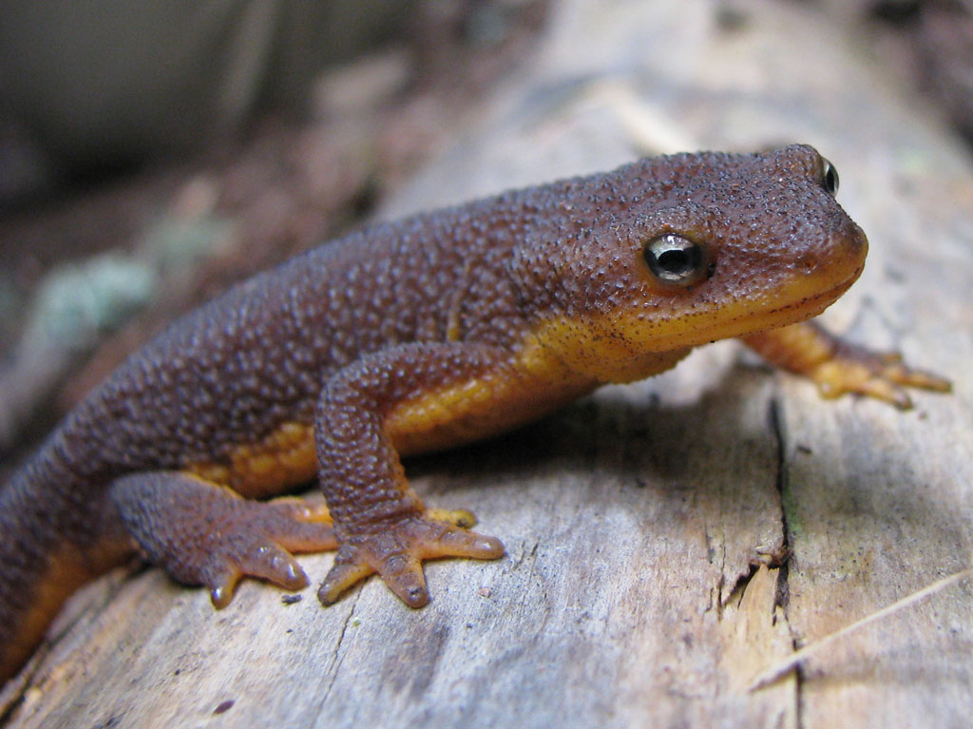
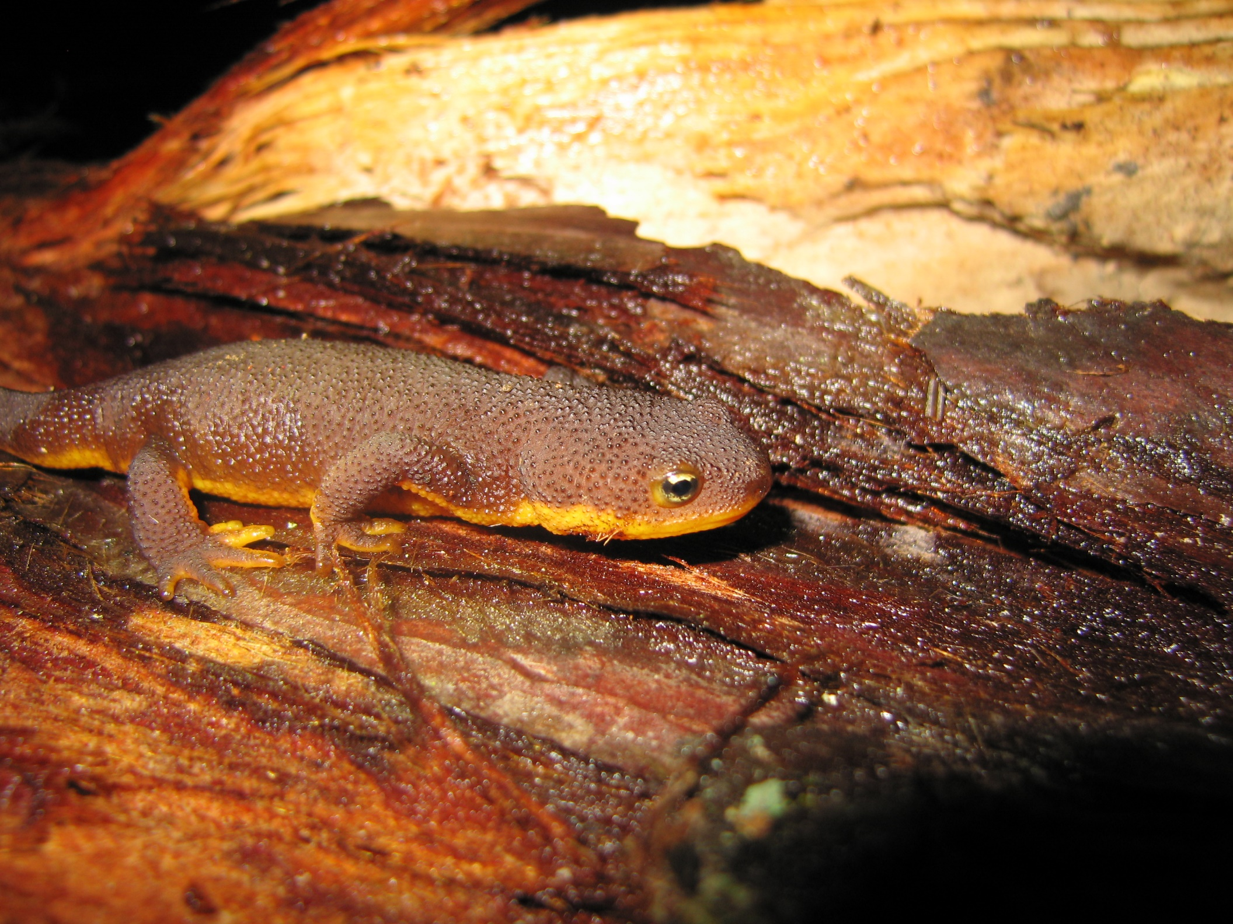

Slide 2
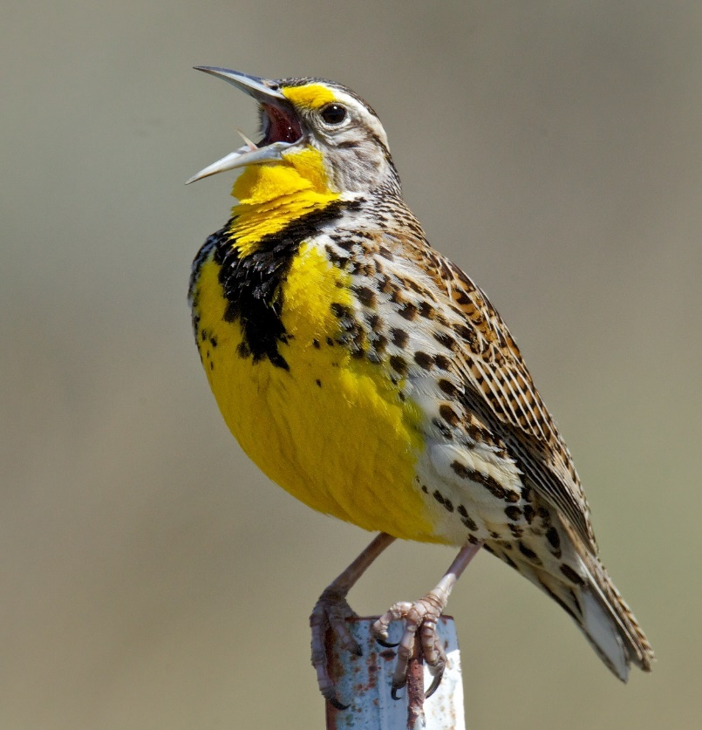
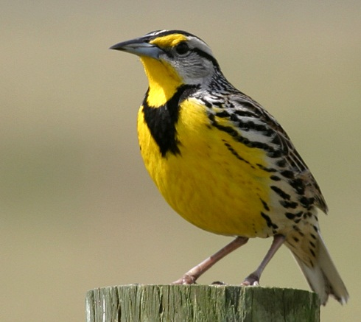

Slide 3
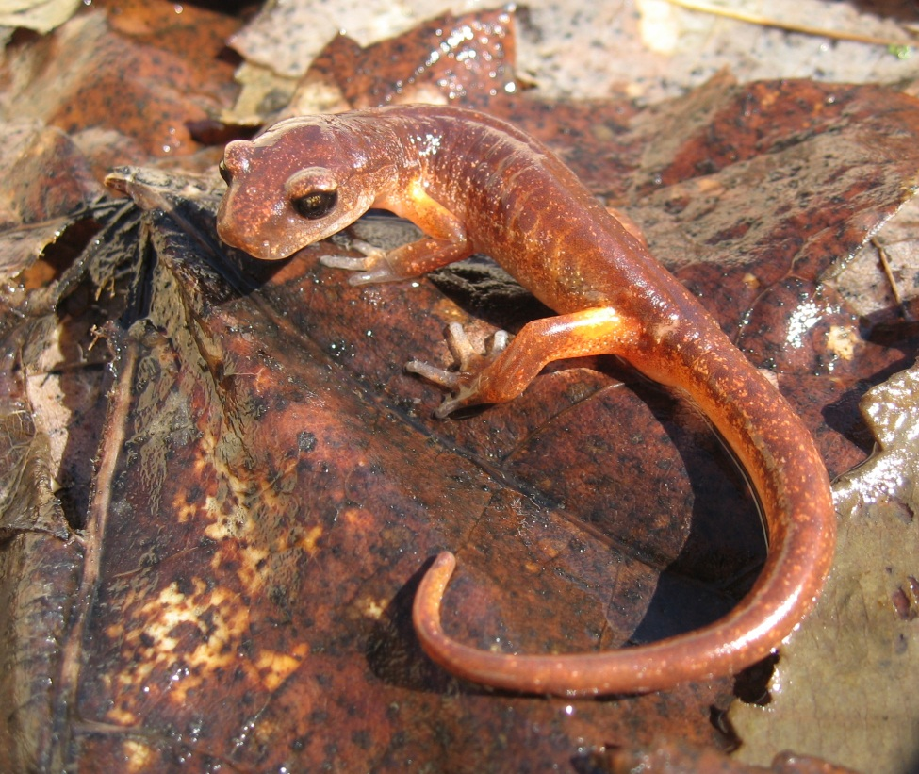
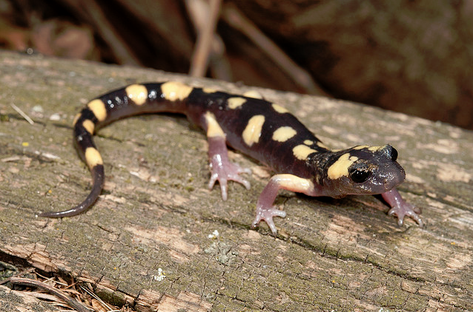

Slide 4
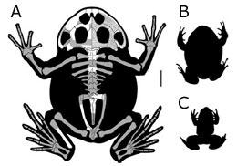
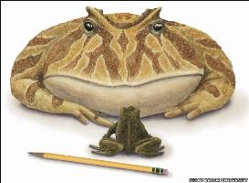
Giant frog found in Madagascar
A giant frog that hopped around Madagascar 65–70 million years ago has been discovered.
Fossil fragments show that the frog, called Beelzebufo ampinga, could have measured 20 centimetres across its squat head, and probably more than 40 centimetres from snout to tail. The researchers nicknamed the monstrous beast ‘the frog from hell’; the official name comes from one of the many names for the devil (Beelzebub) and the Latin for 'toad' (bufo).
Strangely, the frog looks to be more similar to a subfamily of amphibians called the Ceratophryinae, thought to be endemic to South America, than to any of the hundreds of frog species of present-day Madagascar.
It is thought that the supercontinent called Gondwana, made up of Antarctica, South America, Africa, Madagascar, the Indian subcontinent, and Australia and New Zealand, began to split apart some 160 million years ago. But the Beelzebufo fossils support the controversial notion that parts of the supercontinent stayed together until much later than that, says Susan Evans, a vertebrate morphologist and palaeontologist at University College London, UK.
Evans, S. E., Jones, M. E. H. & Krause, D. W. Proc. Natl Acad. Sci. USA, 105, 2951-2956 (2008).

Slide 5
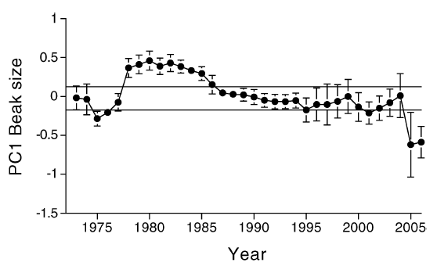
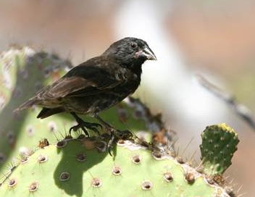
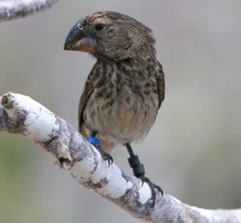
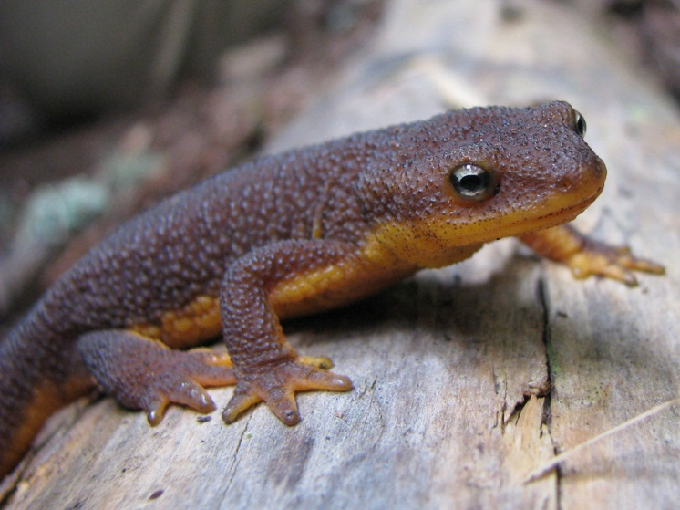
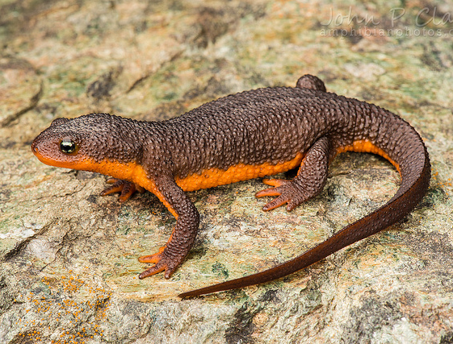
Species and Speciation
Two major categories of evolutionary change:

Slide 6
MAJOR ISSUES IN SPECIATION THEORY
What is a species?
The role of geographic isolation in divergence.
Do population bottlenecks facilitate changes in genetic architecture?
The role of natural selection in speciation.
Prezygotic vs. postzygotic reproductive isolation.
The genetic mechanisms responsible for reproductive isolation.

Slide 7
What is a species???

Slide 8
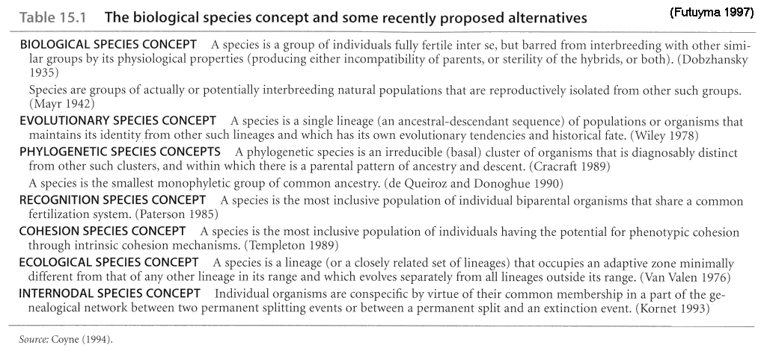

Slide 9
Certainly no clear line of demarcation has yet been drawn between species and sub-species – that is, the forms which…come very near to, but do not quite arrive at, the rank of species. …A well-marked variety may therefore be called an incipient species. …From these remarks it will be seen that I look at the term species as one arbitrarily given.
Darwin, The Origin of Species

Slide 10
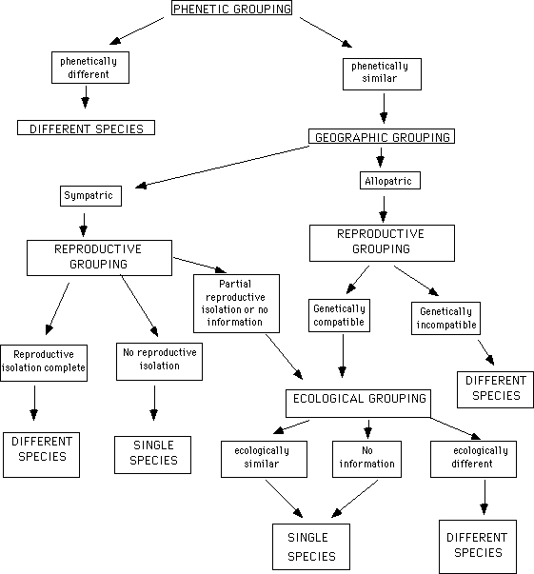
WHAT CONSTITUTES A SPECIES?
From Doyen and Slobodchikoff, 1974, Systematic Zoology 23:239-247

Slide 11
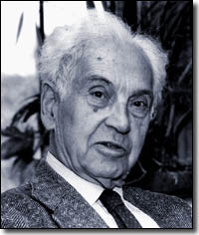
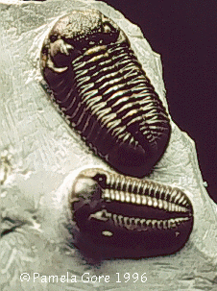
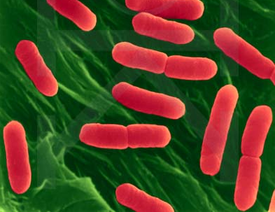
Species Concepts
“Species are groups of actually or potentially interbreeding populations that are reproductively isolated from other such groups.”

Slide 12
PROBLEMS WITH THE BSC

Slide 13
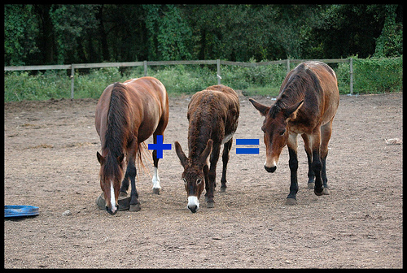
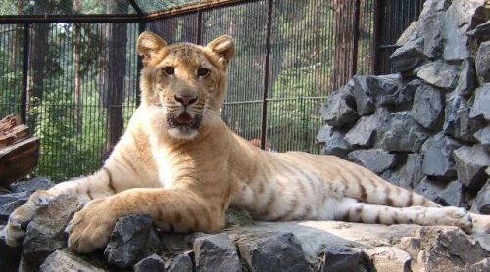
The Difficulty of Recognizing Species
For sympatric species – How can we tell if there is reproductive isolation?
For allopatric populations – How?
What constitutes “reproductive isolation”?

Slide 14
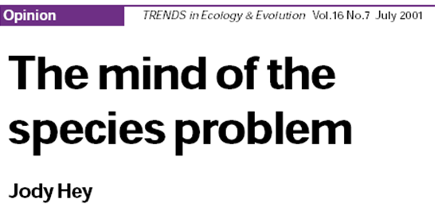
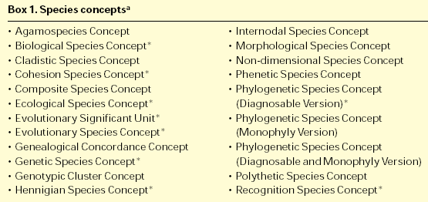


Slide 15
OTHER SPECIES CONCEPTS
An irreducible cluster of organisms that is diagnosably distinct from other such clusters, and within which there is a parental pattern of ancestry and descent.
Single lineage of populations or organisms that maintains its identity from other such lineages and which has its own evolutionary tendencies and historical fate.

Slide 16
PHYLOGENETIC SPECIES CONCEPT
STRENGTHS
Contains a historical component
Provides criteria that can be diagnosed in natural populations
WEAKNESS
Vague
Taken literally, absurd
EVOLUTIONARY SPECIES CONCEPT
STRENGTHS
Describes essence of “species”
Could be used for almost any organismal group
WEAKNESS
Impossible to apply

Slide 17
STRENGTHS AND WEAKNESSES: PHYLOGENETIC SPECIES CONCEPT
STRENGTHS
It contains a historical component.
It provides specific criteria that can be diagnosed in natural populations.
WEAKNESS
It is somewhat vague. What exactly is meant by “irreducible cluster” and “diagnosably different”?
Taken literally and to the extreme, it is absurd.

Slide 18
STRENGTHS AND WEAKNESSES: PHYLOGENETIC SPECIES CONCEPT
RECENT DEBATE:
Pro: Species Concepts and Phylogenetic Theory
by Wheeler and Meier (2000)
Con: “Cladists in wonderland”
by Avise in Evolution 54:1828-1832 (2000).
Bottom line:
The Biological Species concept is the major species concept used by modern biologists in practice.
However, an increasingly large group (of cladists) is applying the phylogenetic species concept (or derivations of it), particularly in regard to conservation genetics.

Slide 19
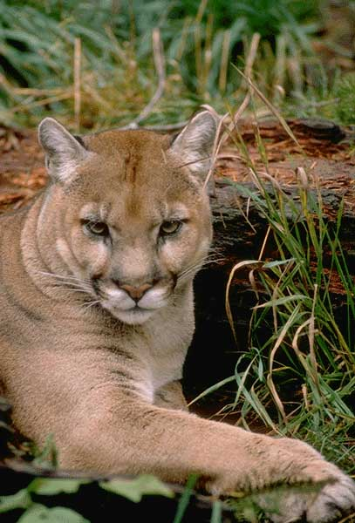
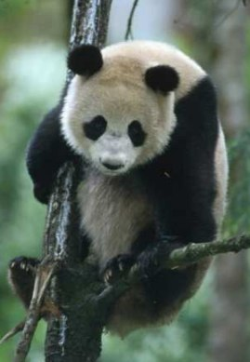

Slide 20
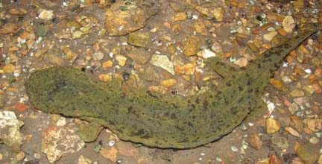
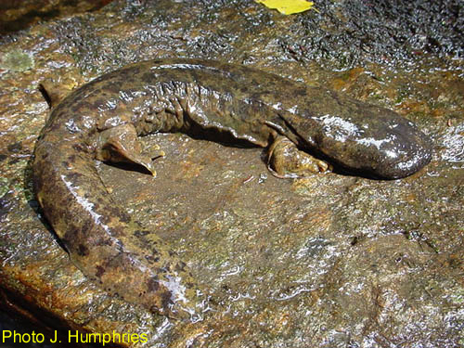
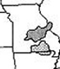
U.S. Endangered Species Act
Legal Definition of Species:
  Species includes: “any subspecies of fish or wildlife or plants, and any distinct population segment of any species of vertebrate fish or wildlife which interbreeds when mature.”

Slide 21
U. S. ENDANGERED SPECIES ACT
Operational Definition: Evolutionary Significant Units (ESU):
“a population (or group of populations) that
  1) is reproductively isolated from other conspecific
  population units, and
  2) represents an important component in the
  evolutionary legacy of the species.”

Slide 22
KEY FEATURES OF OPERATIONAL
SPECIES CONCEPTS
Reproductive cohesion within species.
Reproductive isolation from other such groups.
Recognition that species are dynamic evolutionary lineages, not static “types”.

Slide 23
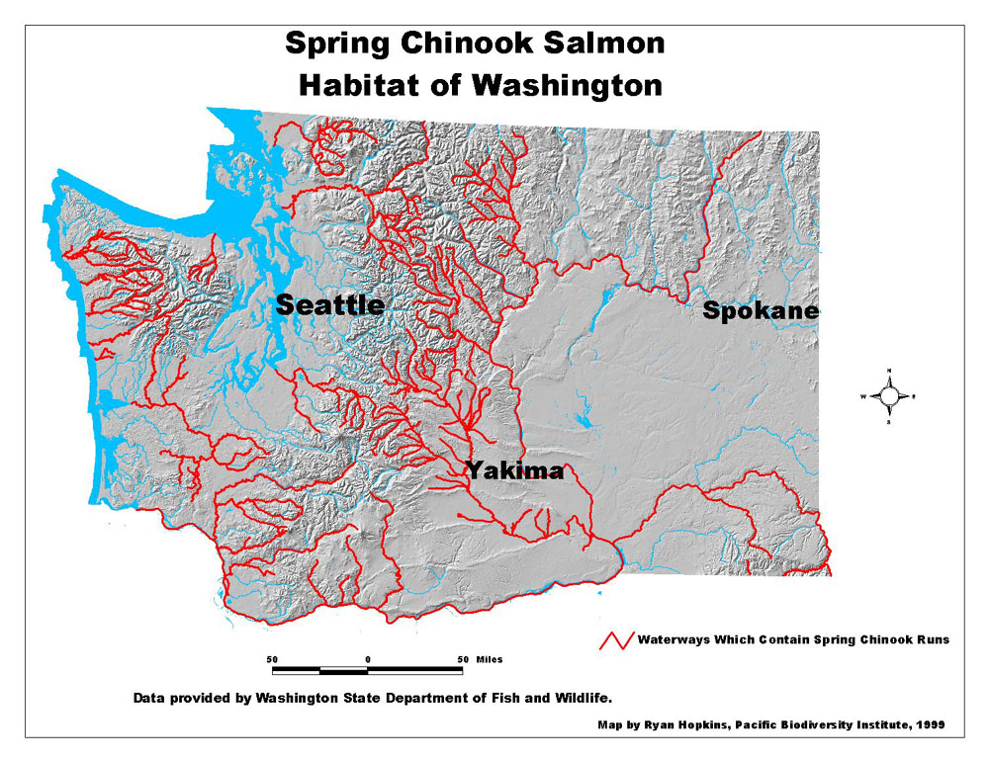
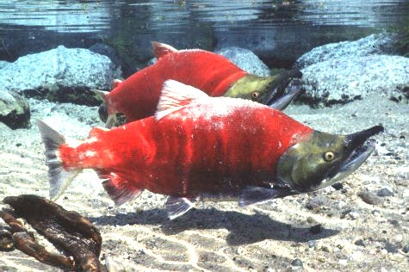

Slide 24
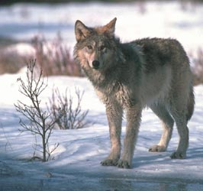
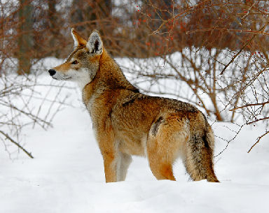
Still problems…
Red Wolf

Slide 25
SPECIATION
Provides the link between evolutionary change within lineages (anagenesis/microevolution) and the macroevolutionary patterns that result from cladogenesis.
Is a process (degree of reproductive isolation varies along a continuum).
Requires the disruption of gene flow and the evolution of reproductive isolating mechanisms (RIMs).

Slide 26
THE CLASSIC VIEW OF SPECIATION
Barrier to gene flow develops
Slow accumulation of genetic differences through mutation, drift, and natural selection
Genetic divergence leads to reproductive isolating mechanisms (RIMs) as a byproduct
Perhaps secondary contact, with some level of hybridization possible

Slide 27
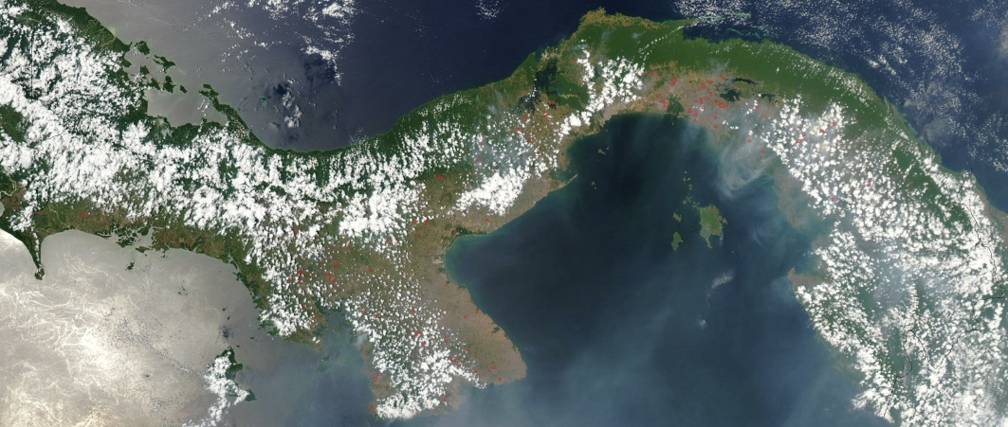
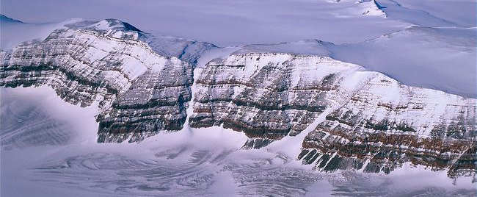
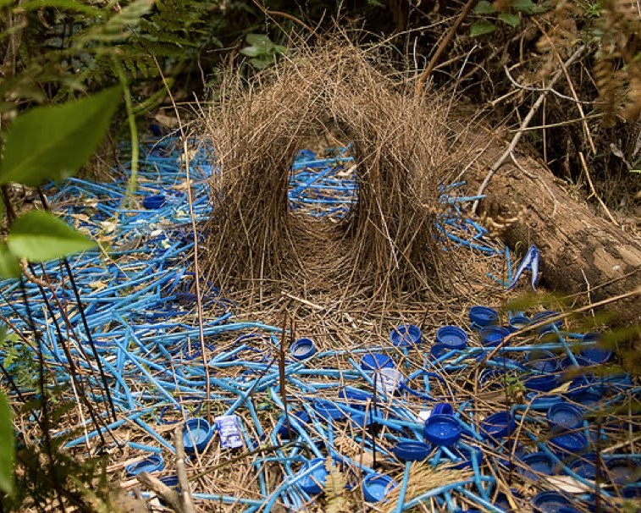
Speciation

Slide 28
The Classic View of Speciation
ANCESTRAL POPULATION

Slide 29
Model of Speciation
ANCESTRAL POPULATION
Must start with what?
Notes:
VICARIANCE EVENT

Slide 30
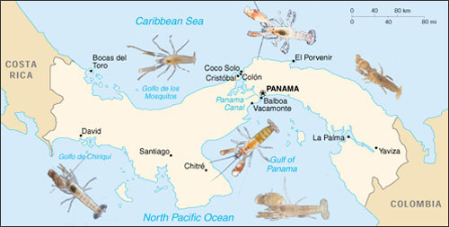
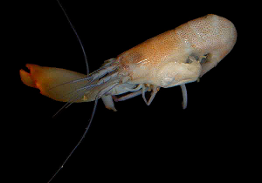
Example of Allopatric Speciation
Snapping shrimp

Slide 31
The marine inhabitants of the eastern and western shores of South America are very distinct, with extremely few shells, crustacea, or echinodermata in common; but Dr. Gunther has recently shown that about thirty per cent of the fishes are the same on the opposite sides of the isthmus of Panama; and this fact has led naturalists to believe that the isthmus was formerly open.
Darwin, The Origin of Species

Slide 32




Consequence Of Secondary Contact
If RIMs not complete → hybrid zone
Strength of RIMs that have developed in allopatry determines the shape of the hybrid zone
4 possibilities after secondary contact
What does the size of the hybrid zone tell us about the strength of RIMS?

Slide 33
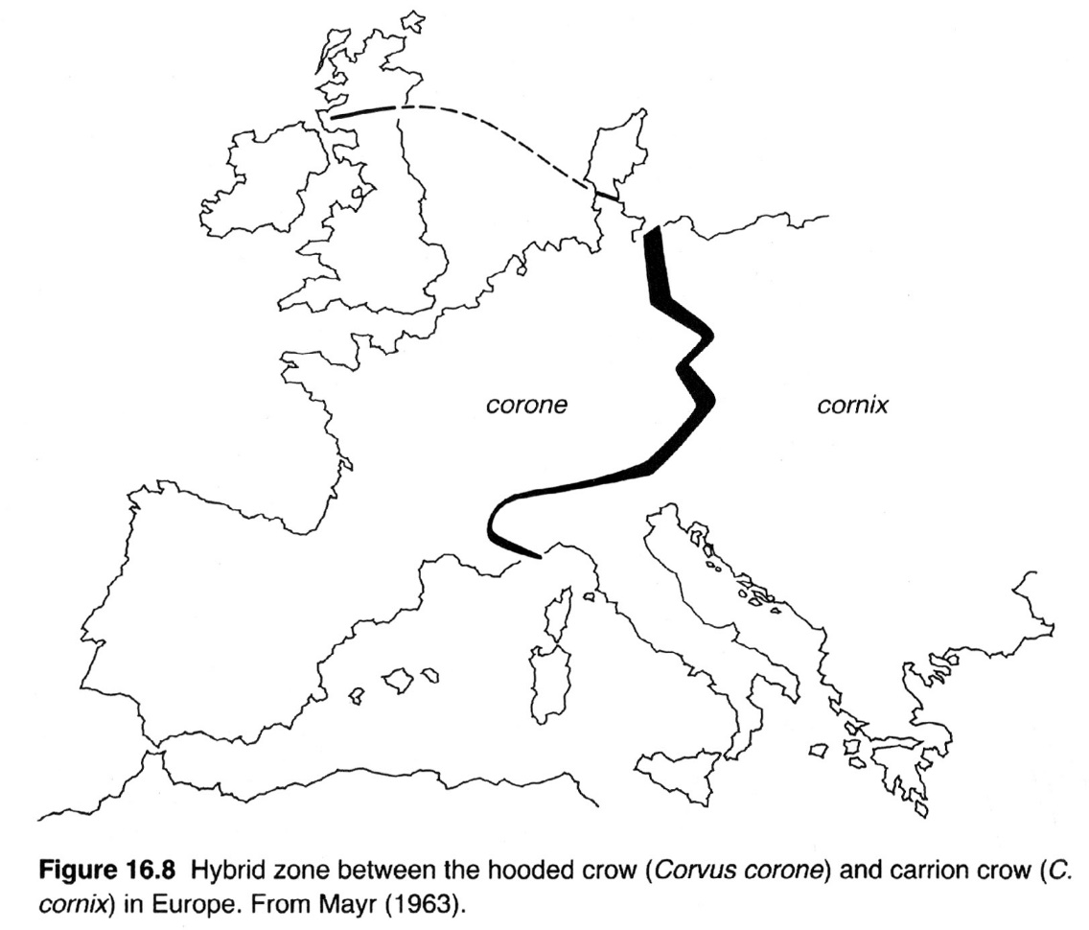
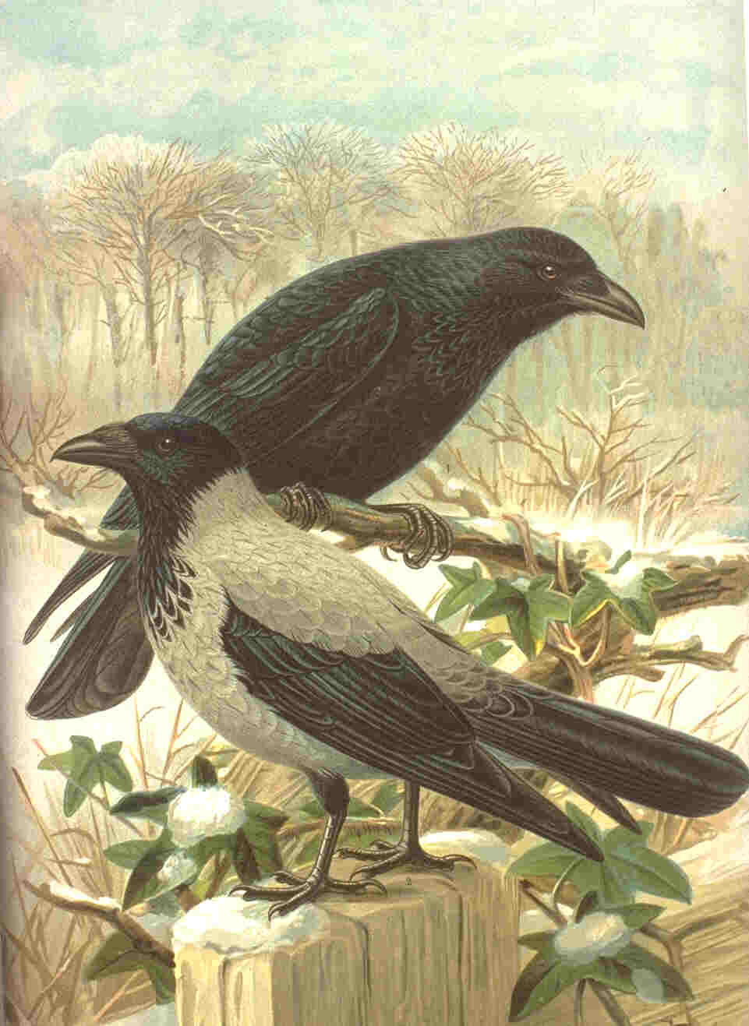
What does this hybrid zone say about the RIMs in these two species?
Corvus cornix
Corvus corone

Slide 34
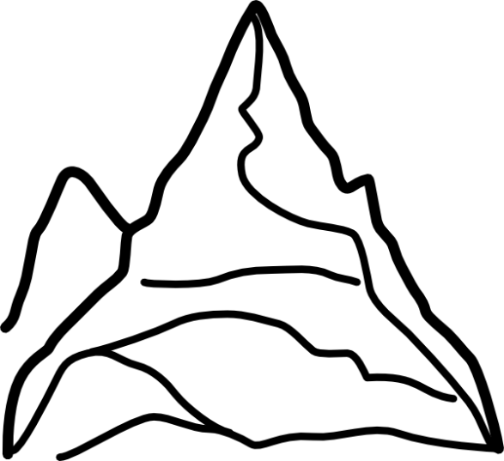
Ring Species

Slide 35
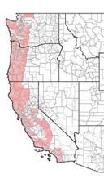
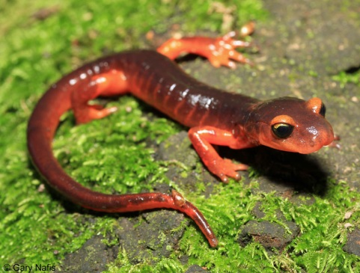
A Ring Species:
Ensatina eschscholtzii
Where has Ensatina experienced a ring?
FROM: Moritz et al. 1992. Sys. Biol. 41:273-292

Slide 36
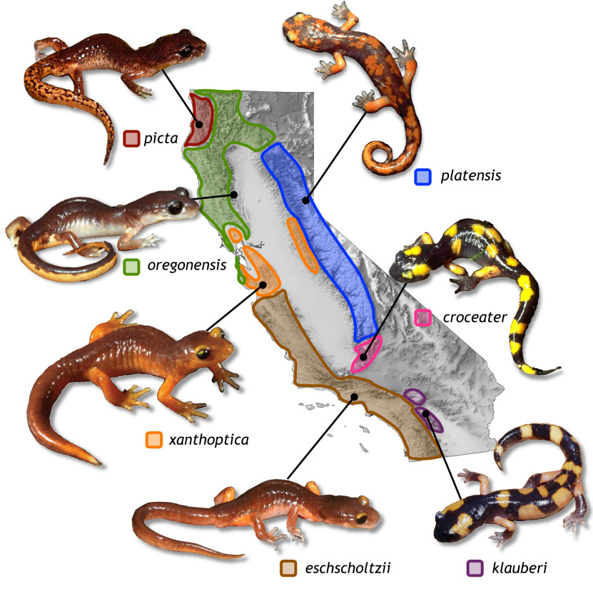
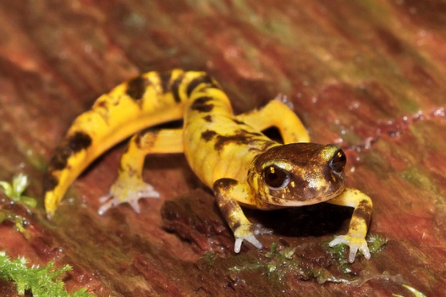
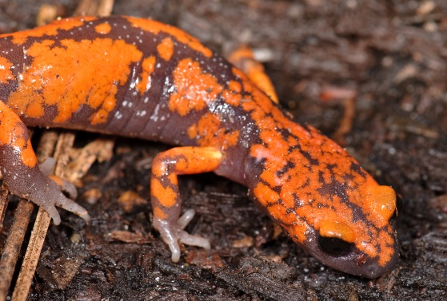
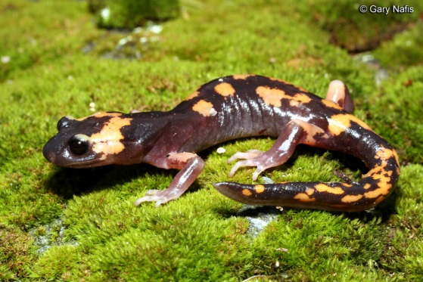
A RING SPECIES:
Ensatina eschscholtzii
Secondary Contact
FROM: Moritz et al. 1992. Sys. Biol. 41:273-292

Slide 37
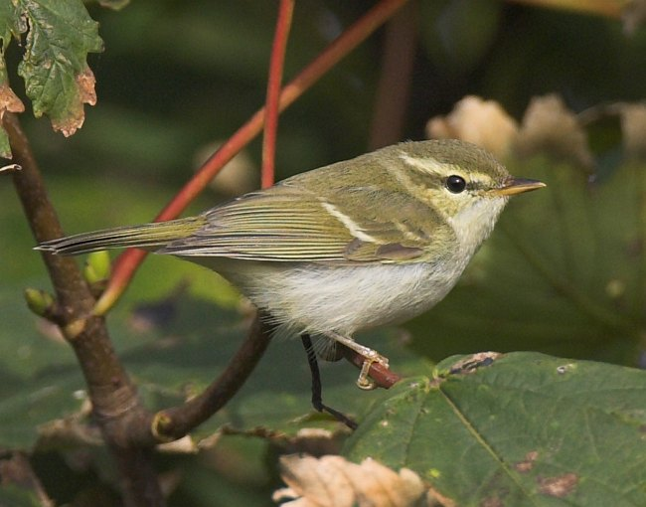
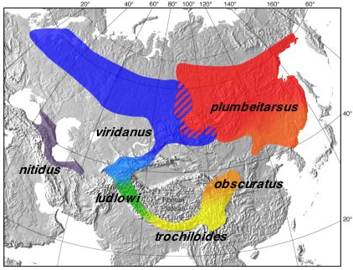
RING SPECIES II:
GREENISH WARBLER COMPLEX
FROM: Irwin et al. 2001. Nature 409:333-337
Notes:
Figure 1 Geographic range of the greenish warbler species complex, along with research sites and representative song spectrograms. Different colours illustrate the ranges of six taxa commonly considered to be subspecies of Phylloscopus trochiloides⁴: purple, nitidus; blue, viridanus; green, ludlowi; yellow, trochiloides; orange, obscuratus; red, plumbeitarsus. Colours grade together in regions where Ticehurst⁴ described gradual change between subspecies. Research sites are indicated by their two-letter designation. Also shown are representative song spectrograms (horizontal axis is time, vertical is frequency, darkness is amplitude) from eight locations ⁷. Letters and brackets below the spectrograms indicate distinct song units. Song structure (for example, length of each unit, repetition of units, frequency range) differs between viridanus and plumbeitarsus, but there is a gradient in song around the southern side of the ring ⁷.

Slide 38
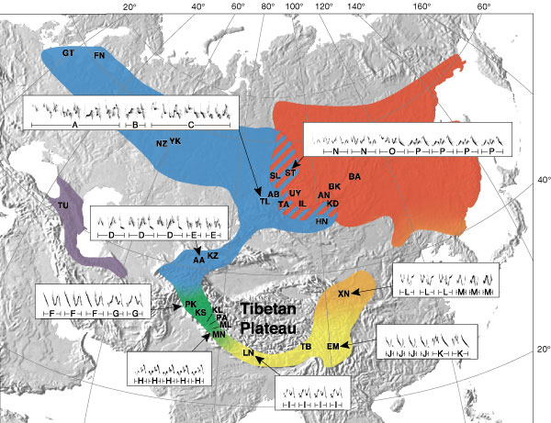
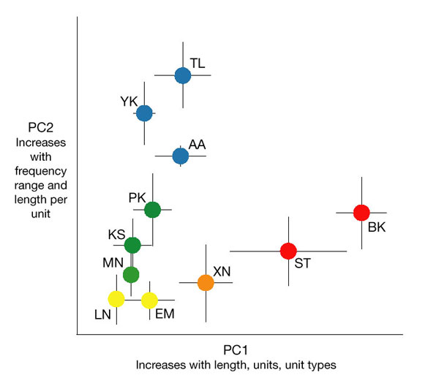
RING SPECIES II:
GREENISH WARBLER COMPLEX
FROM: Irwin et al. 2001. Nature 409:333-337
Notes:
Figure 2 Geographic variation in the song of the greenish warbler as quantified by principal components analysis. Shown are population means and standard deviations, modified from ref. 7 with additional data. Songs distinctly differ between viridanus (blue) and plumbeitarsus (red), but change gradually through populations to the south (in order around the ring: YK-TL-AA-PK-KS-MN-LN-EM-XN-BK-ST ). Both PC1 and PC2 are axes of complexity, and Himalayan populations (yellow and green) have the simplest songs (low PC1 and PC2).

Slide 39
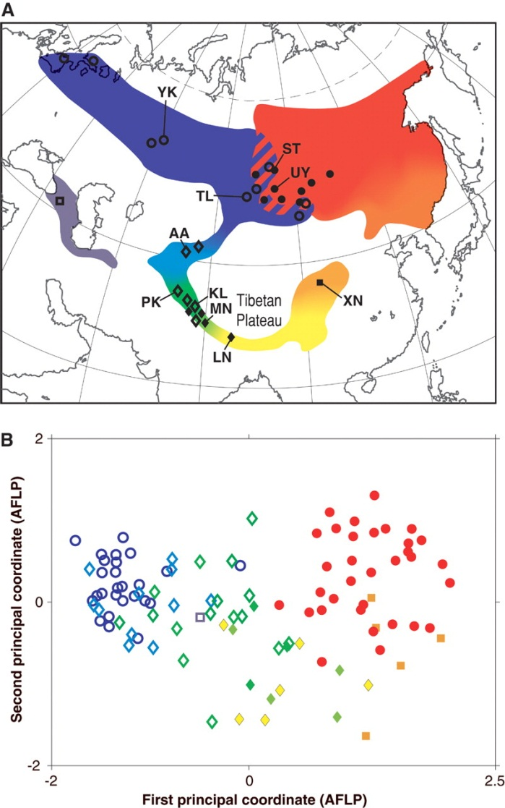

Speciation by Distance in a Ring Species
Darren E. Irwin, Staffan Bensch, Jessica H. Irwin, Trevor D. Price
Science, Vol 307, Issue 5708, 414-416 , 21 January 2005

Slide 40






Prezygotic Isolating Mechanisms

Slide 41
Barriers to Gene Flow II
  Zygote dies
  F₁ hybrid has reduced viability
  F₁ hybrid viable, but has reduced fertility
  Reduced viability or fertility in F₂ or backcross

Slide 42



SEXUAL SELECTION
I think it will be admitted by naturalists… that secondary sexual characters are highly variable. It will also be admitted that species of the same group differ from each other more widely in their secondary sexual characters than in other parts of their organization…
Darwin, The Origin of Species

Slide 43











Slide 44


ORIGIN OF PREMATING ISOLATION AS A PASSIVE RESPONSE TO ECOLOGICAL DIVERGENCE
TWO SPECIES OF DARWIN’S FINCHES
FROM: Podos, J. 2001. Nature 409:185-188.

Slide 45
Post-zygotic Isolating Mechanisms
Postzygotic Barriers
Caused by ?
Genetic developmental incompatibility
        Chromosomal differences
        Chromosomal abnormalities
        Epistatic interactions
Can isolating mechanisms affect sexes differently?

Slide 46

EVIDENCE OF THE CLASSIC VIEW OF SPECIATION:
ACCUMULATION OF SMALL DIFFERENCES OVER TIME

Slide 47




Chromosomal Sterility:
X
Secretariat
Donkey
Sterile Mule
What happens if switch the sexes?

Slide 48

CHROMOSOMAL CHANGES OFTEN LEAD TO
REPRODUCTIVE ISOLATION
Chromosomal Races of the Pocket Mouse:

Slide 49

PARTIAL POST-ZYGOTIC STERILITY
J. B. S. Haldane
Examples:
Hybrid Hybrid
Females Males
Drosophila XX XY, sterile
Aedes mosquito X_{F}X_{F} X_{F}X_{M}, sterile
Mammals XX XY, sterile
Birds ZW, sterile ZZ
Butterflies ZW, sterile ZZ

Slide 50


Slide 51
THE DOMINANCE THEORY FOR HALDANE’S RULE

Slide 52


ALLOPATRIC SPECIATION IN SNAPPING SHRIMP
Vicariant isolation between Pacific and Caribbean populations after the emergence of the Isthmus of Panama.
Snapping shrimp

Slide 53
MODELS OF SPECIATION
Peripatric Speciation:
Speciation in a peripheral isolate.
Due to rare dispersal or colonization events.
Also referred to as Founder Effect speciation.

Slide 54
Another Speciation Model
ANCESTRAL POPULATION
PERIPHERAL ISOLATE
What causes the peripheral population to diverge?

Slide 55





Examples in nature?

Slide 56
GENETIC DIVERSITY
TIME

Slide 57


A Swimming Mammaliaform from the Middle Jurassic and Ecomorphological Diversification of Early Mammals
Qiang Ji, Zhe-Xi Luo, Chong-Xi Yuan, Alan R. Tabrum
Mammals of the Mesozoic era (248 to 65 million years ago) generally are considered to be primitive, shrew-like creatures living in the shadow of the dinosaurs. Pushing back the mammalian conquest of the waters by more than 100 million years, Ji et al. report a Middle Jurassic, 164-million-year-old skeleton with a beaverlike tail and seal-like teeth perfectly adapted for an aquatic lifestyle.
The new Middle Jurassic docodont Castorocauda from Inner Mongolia possesses striking features for an aquatic life-style and combines skeletal, dental, and softpart characters of modern aquatic placentals such as beavers (Castor), river otters (Lutra), and seals (Phoca)
Science 24 February 2006:
Vol. 311. no. 5764, pp. 1123 - 1127

Slide 58
MODELS OF SPECIATION
Sympatric Speciation:
Speciation without restriction to gene flow.
Development of reproductive isolation without geographic barriers.
Requires assortative mating and a stable polymorphism.

Slide 59
A Third Speciation Model
ANCESTRAL POPULATION
Reproductively isolated, geographically sympatric populations

Slide 60



The Apple Maggot: A Case Of Sympatric Speciation?
The Apple Maggot
Hawthorn “apples”

Slide 61


The Apple Maggot: A Case of Sympatric Speciation?
A few ancestral flies migrated to apples
Breed and lay eggs on “your” fruit
Distribution of “races” of R. pomnella

Slide 62




How can reproductive isolation develop when no barrier to gene flow?
Ecologically and temporally isolated
6% migration rate

Slide 63

SYMPATRIC SPECIATION IN CICHLID FISHES FROM NIGARAGUAN LAKES
From: Kirkpatrick. 2000. Nature 408:298-299, Wilson et al., 2000. Proc. R. Soc. Lond. B 267:2133-2141

Slide 64
How can reproductive isolation develop when no barrier to gene flow?

Slide 65
HOW MANY GENES ARE REQUIRED FOR SPECIATION TO OCCUR?

Slide 66
THE PROBLEM WITH A ONE-LOCUS MODEL OF SPECIATION
FITNESS
AA
Aa
aa
In order for a single locus model of speciation to work, populations would have to evolve towards lower fitness.

Slide 67
THE BATESON-MULLER-DOBZHANSKY MODEL FOR THE GENETIC BASIS OF POST-MATING REPRODUCTIVE BARRIERS
AABB
AAbb aaBB
AaBb
This two-locus model relies on epistatic interactions among genes.

Slide 68

4th Speciation Model

Slide 69


Infectious Speciation
Bacteria can infect and change male sperm
Causes cytoplasmic incompatibility
When infected male (W⁺) mate with uninfected females (W⁻)
When both infected (W⁺), viable offspring produced
Different bacteria strains incompatible
Are these compatible?
What’s the consequence?

Slide 70

CONTRASTING THE “CLASSICAL” MODEL OF GENETIC SPECIATION WITH THE ‘INFECTIOUS’ MODEL
The Classical Model
The Infectious Model

Slide 71
EVIDENCE OF THE CLASSIC VIEW OF SPECIATION:
ACCUMULATION OF SMALL DIFFERENCES OVER TIME

Slide 72

If populations are sympatric
And hybrids have reduced fitness
Lead to strong natural selection for assortative mating (?)

Slide 73
REINFORCEMENT
Reinforcement leads to pre-mating isolation.
Hybridization reduces the strength of reinforcement by homogenizing gene pools.
Reinforcement must occur sufficiently fast to counter hybridization and complete the speciation process.

Slide 74

Fill in the graph (relationship between prezygotic mech & genetic differences)
If reinforcement occurs in nature (and it facilitates sympatric speciation), then selection should be stronger for pre-zygotic isolating mechanisms in sympatric species
FROM: Coyne & Orr 1997

Slide 75
Adaptive radiation is the. It involves the differentiation of a single ancestor into an array of species that inhabit a variety of environments and that differ in… traits used to exploit those environments.
…It is regarded as the hallmark of adaptive evolution and may well be the most common syndrome in the origin and proliferation of taxa.
Dolph Schluter, 2000
The Ecology of Adaptive Radiation

Slide 76

…some time after a rather distinctive new adaptive type has developed it often becomes highly diversified. …the same sort of diversification follows, and in this case begins almost immediately, when a group spreads to a new and, for it, ecologically open territory.
- Simpson, 1953

Slide 77

Sometimes speciation events can lead to dramatic increases in diversity
What causes adaptive radiation?

Slide 78

EVIDENCE FOR THE ECOLOGICAL OPPORTUNITY HYPOTHESIS
Fig. 7-7 IN: Schluter 2000. The Ecology of Adaptive Radiation. Oxford Univ. Press. Oxford

Slide 79
Seeing this graduation and diversity of structure in one small, intimately related group of birds, one might really fancy that, from an original paucity of birds in this archipelago, one species has been taken and modified for different ends.
Darwin, 1842

Slide 80

Character Displacement:
Members of one lineage constrain phenotypic evolution in members of other lineages
There are two sides to this coin:
It may promote divergence between closely related species when there are unexploited ecological niches available.
It may constrain divergence when there are no unexploited niches

Slide 81


Examples of Adaptive Radiations:
Hawaiian Honeycreepers

Slide 82


>800 species of Hawaiian drosophila

Slide 83




Hawaiian Silversword
28 species derived from a single ancestor
Occupy habitats ranging from exposed lava to wet forest
Diverse forms:
  Vines
  Trees
  Shrubs
  Rosettes
  Herbaceous mats

Slide 84





Cichlid Fishes In African Rift Valley Lakes:
Lake Tanganyika: 140 Spp.
Lake Malawi: >500 Spp.
Lake Victoria: 250 Spp.

Slide 85


Slide 86


Lake Malawi Cichlids
Photos by Fredrik Hagblom

Slide 87


Slide 88


Slide 89


Slide 90

PARALLEL EVOLUTION IN THE CICHLID RADIATION

Slide 91


Slide 92


Slide 93


Slide 94


Slide 95


Slide 96

Limnetic
Benthic
Limnetic
Benthic
Limnetic
Benthic

Slide 97


Slide 98




Australian Marsupials
Adaptive radiation in the absence of competitive interactions with placental mammals

Slide 99



Can you think of any Key Innovations?
Amniotic Egg
Perhaps one of the greatest key innovations of all time

Slide 100


Adaptive Radiation of Mammals

Slide 101

Diversification of the major Mammalian lineages occurred in a relatively short period of time.

Slide 102



ANOTHER KEY INNOVATION:
Wings

