Slide 1
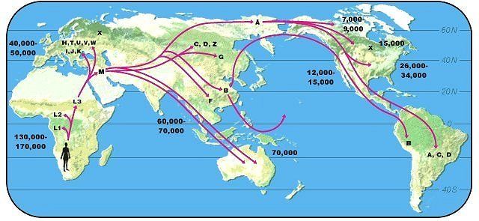
Population Genetics
**I am not a population geneticist**

Slide 2
What are the three components necessary to get evolution by natural selection?
What was the dominant idea of inheritance during Darwin’s time?

Slide 3
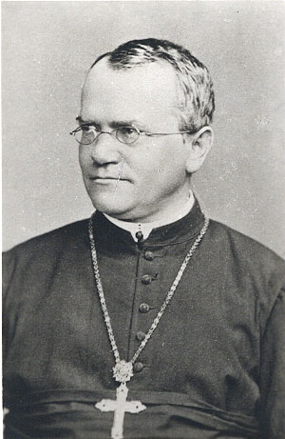
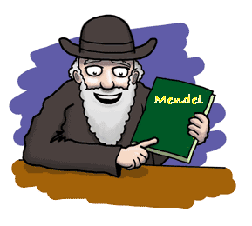
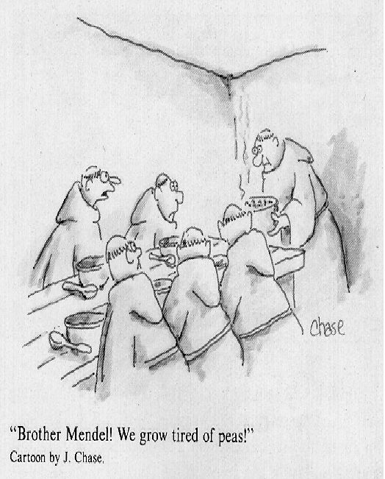
What if Darwin had known about this??!!

Slide 4
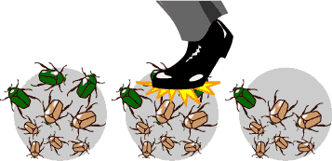
Population Genetics
What was the genetic definition of evolution?
Objective - track the fate of Mendelian genes across generations
Potential results?
Why do this (big picture goal)?

Slide 5
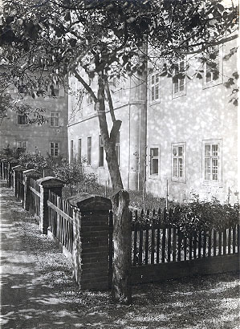
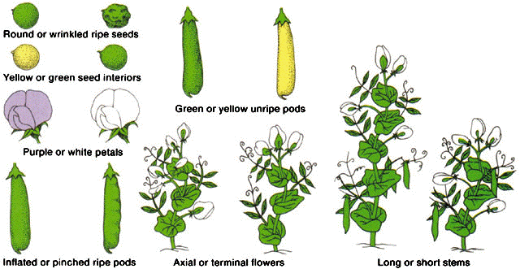
Early Genetics
Father of genetics?
Before Mendel?
Mendel
  Focused on discrete characters
  Findings:

Slide 6
Consequence of Mendel’s Laws
EXAMPLE - 2 diploid individuals with 3 loci and 2 alleles
Parents: aabbcc x AABBCC
F₁ progeny? AaBbCc
F₂ progeny?
AABBCC AABBCc AABBcc
AABbCC AABbCc AABbcc
AAbbCC AAbbCc AAbbcc
AaBBCC AaBBCc AaBBcc
AaBbCC AaBbCc AaBbcc
AabbCC AabbCc Aabbcc
aaBBCC aaBBCc aaBBcc
aaBbCC aaBbCc aaBbcc
aabbCC aabbCc aabbcc
Tremendous variation!
Where did it come from?
Notes:
Lets look at the consequences of mendel’s laws and why this is so important

Slide 7
A few things to keep in mind as we take an excursion into population genetic theory:
“Make things as simple as possible, but no simpler.”
---Einstein
“All models are wrong, some are useful.”
---Box
“No theory should fit all the facts because some of the facts are wrong.”
---Bohr

Slide 8
Some Definitions:
Population: A freely interbreeding group of individuals
Gene Pool: The total of genetic information present in a population at any given point in time
Phenotype: the physical expression of a train in an individual organism
Genotype: The genetic constitution of an individual organism
Locus: A site on a chromosome, or the gene that occupies the site
Gene: A nucleic acid sequence that encodes a product with a distinct function in the organism
Allele: A particular form of a gene
Genotype Frequency: The relative proportion of a particular genotype in a population
Allele Frequency: The relative proportion of a particular allele at a single locus in a population

Slide 9
Assumptions:
Diploid
Autosomal
2 alleles (A and a)
Simple life cycle:
Goal:
Estimate the frequency of (A) and (a)

Slide 10
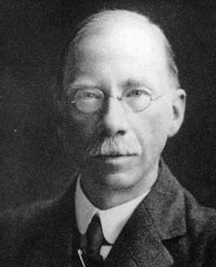
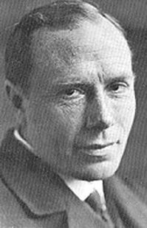
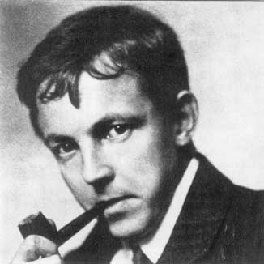
First biologist to track frequency of alleles over time
A little History
Yule
Punnett
Hardy
Hardy (and Weinberg) Proof

Slide 11
If we know genotype frequencies, can use shorthand formula to calculate allele frequencies
  Frequency of the A allele:
  Frequency of the a allele:

Slide 12
Sample Calculation # 1

Slide 13
Sample Calculation # 2

Slide 14
Compare the two populations
What do you notice?

Slide 15
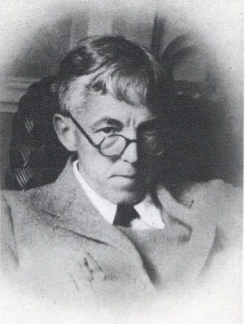
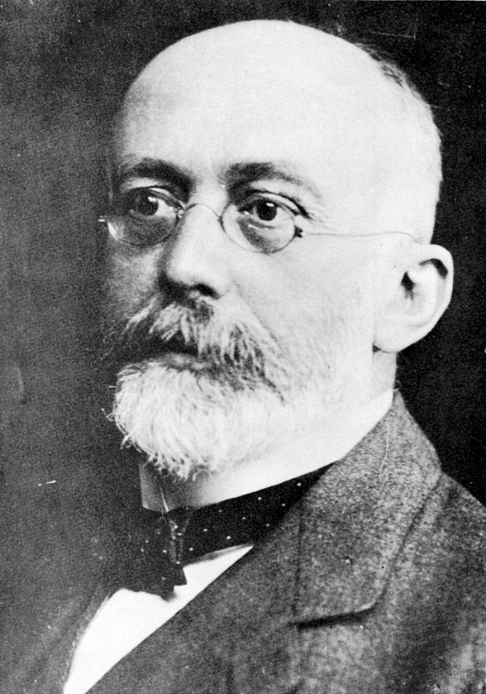
Hardy
The Hardy-Weinberg Equation
Null model – what happens when no outside forces
Results: a single generation - equilibrium reached
How is it used & why important?
Weinberg

Slide 16
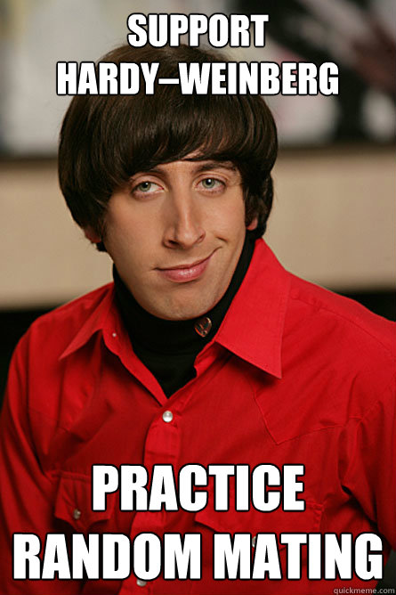
H-W ASSUMPTIONS:

Slide 17
The Speed of Evolution and the Role of Heterozygosity
Heterozygosity maximized when allele frequencies intermediate

Slide 18
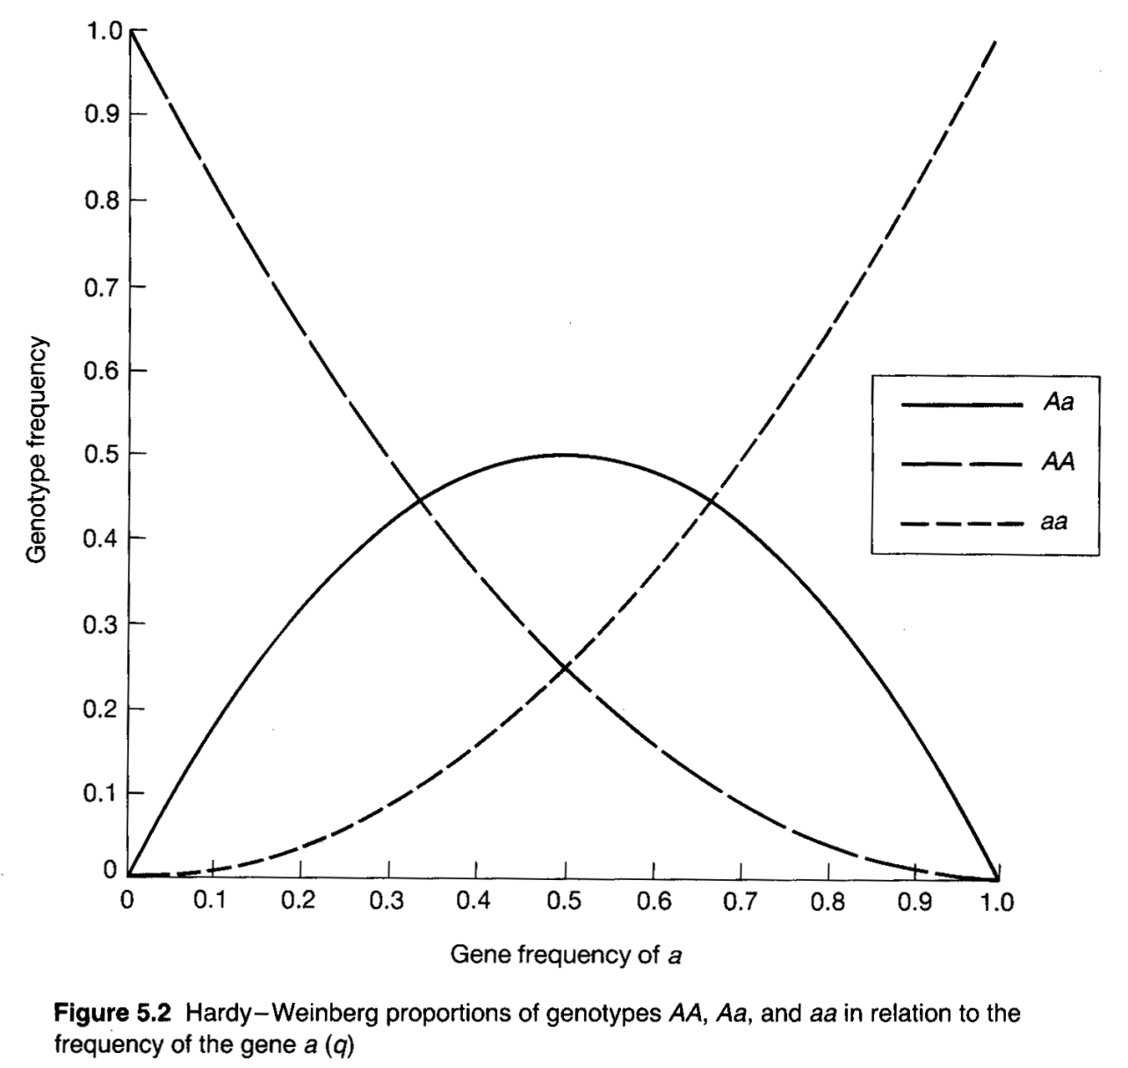
GENOTYPE VERSUS GENE FREQUENCIES
p² (AA)
q² (aa)
2pq (Aa)

Slide 19
FOUR PRIMARY USES OF THE H-W PRINCIPLE:
Track genes
Null model
Forensic analysis
Summarize diversity

Slide 20
Genotype frequencies for Wing-color Polymorphism in a Natural Population of the Moth Panaxia dominula (Fisher & Ford, 1947)
Color Pattern | dominula | medionigra | bimaculata | Total
Genotype | B₁B₁ | B₁B₂ | B₂B₂
Sample Size (N_{ij}) | 905 | 78 | 3 | N = 986
Frequency (P_{ij}) | 0.918 | 0.079 | 0.003 | 1.000
Allele Frequencies:
p₁ = p₁₁ + ½ p₁₂ = 0.918 + ½ (0.079) = 0.958
p₂ = 1 – p₁ = 0.041
Expectations (N_{ij}) | p₁² N | 2p₁p₂ N | p₂² N
 | 905 | 79 | 2

Slide 21
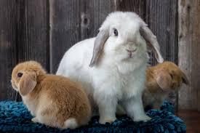
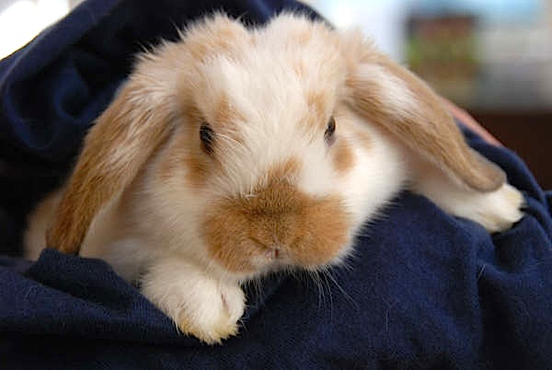
How we use HWE
Step 1?
Step 2:
Step 3: calculate the expected number (not frequency) of individuals with each genotype if population in HWE
What do all these numbers tell us?
Determine allele frequencies
calculate the expected frequency of each genotype if population in HWE
Notes:
A χ²-test (a standard goodness-of-fit test) can be used to detect statistically significant departures from Hardy-Weinberg Equilibrium.

Slide 22
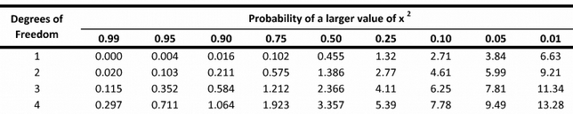
How do we determine if these numbers are “different enough”?
Step 4: Calculate ? test statistic
Step 5: Compare this result to critical value
Step 6: Calculate p-value
What does this mean?

Slide 23
Statistical Departure from HWE
One or more of the assumptions of the H-W principle are not satisfied in this population.
How do we determine which assumption is violated?
Does no difference from HWE mean that the population satisfies all the assumptions?
See Box 5.5 in F&H for more on X² tests.

Slide 24
HWE with Many Alleles
Does HW principle still apply if we have lots of alleles?

Slide 25
EXAMPLE:
APPLICATIONS OF H-W TO FORENSICS
Someone steals the jade head (oh wait!)
Tissue sample found at crime scence (A₁₄A₂₇)
Police catch a suspect!
Questions
  What’s the probability genotype matches by chance?
Given the following frequencies:
What’s the fraction of the population with this genotype?
Did ____ steal the jade head?

Slide 26
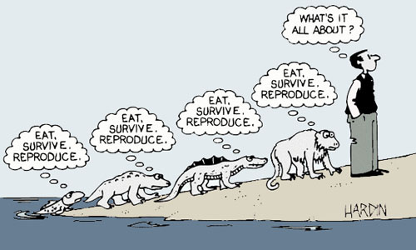
Evolutionary Thought After Darwin
Origin published when?
Evolution accepted by?
Natural selection accepted when?
  Why?

Slide 27
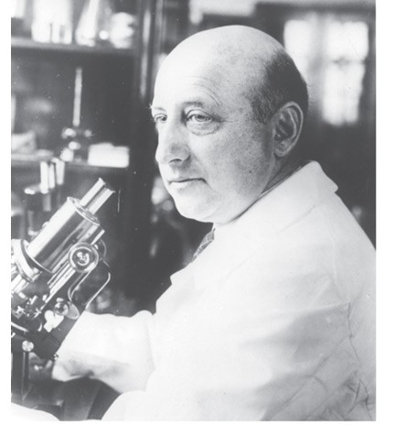
Mendel’s Impact
What did mendelian genetics do to blending inheritance?
What did it do to Lamarckian inheritance?
A third camp
Richard Goldschmidt

Slide 28
Hopeful monsters – new evidence
Richard Lenski
Started experiment 25 yrs ago
  12 populations of e. coli
  Competition for reduced resources
  After few days ~all mutations
  Some increase growth
  Run out of food – go dormant
Pippetted out and started again
Small mutations important (like tortoise)
  Short wait – slow sweep (weeks)
Large mutations (hare)
  Fast sweep – long wait

Slide 29
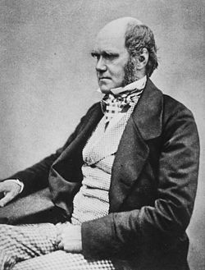
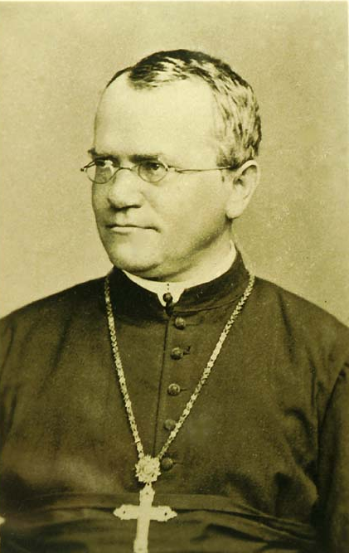
I’m gonna bolo you’re a*&
Bring it!
Natural Selection
Genetics
Notes:
Emphasis on discrete variation caused a rift between genetics and natural selection

Slide 30
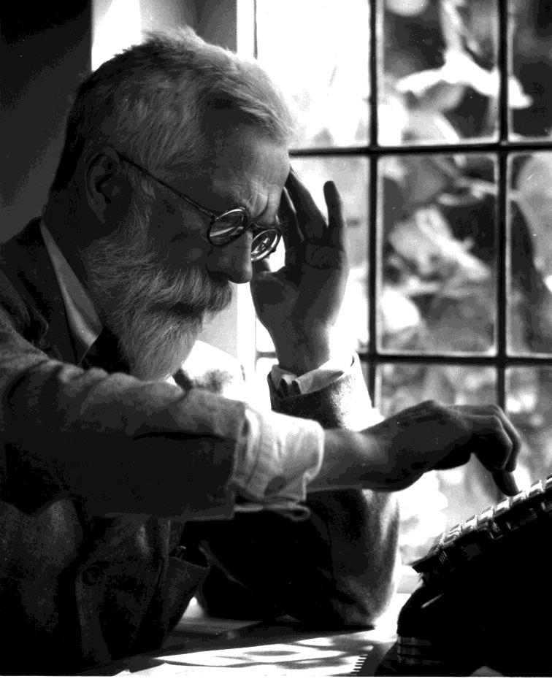
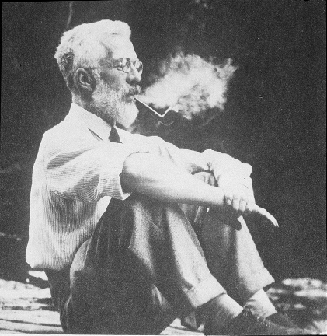
The Modern Synthesis
Mendelian genetics united with the inheritance of continuous traits
Genetically theory of Natural Selection (1930)
  Most traits can be measured on a continuum
  Inheritance of these no different than mendelian
1890-1962

Slide 31
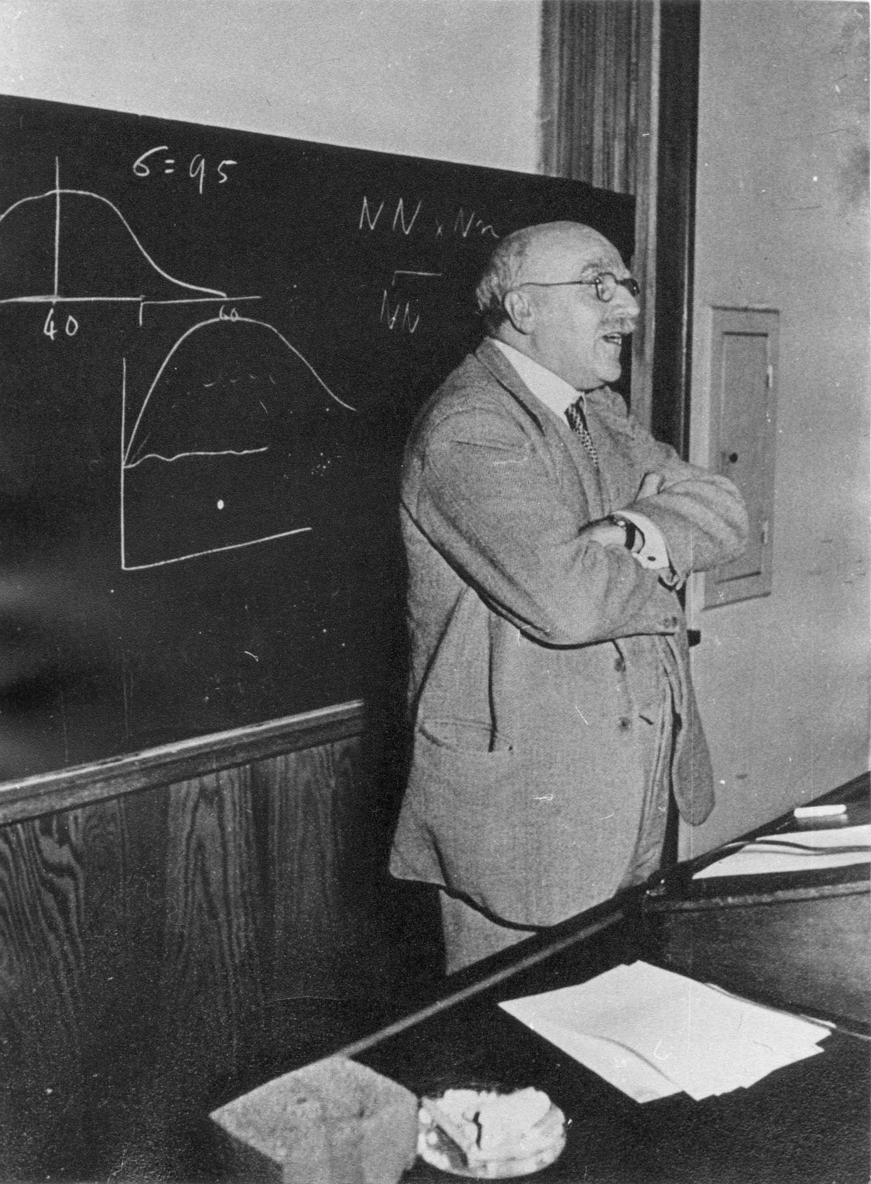
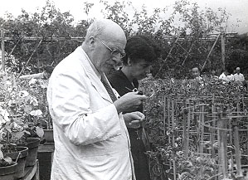
1892-1964
The causes of Evolution (1932)
  Mathematical theory for allele frequency changes under selection

Slide 32
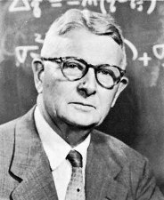
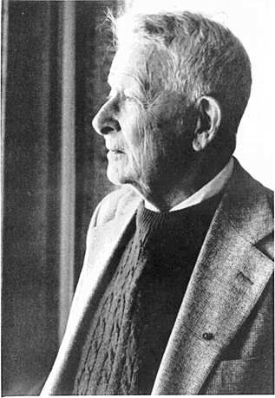
Mathematical framework for:
Migration
Effective population size
Population subdivision
Adaptive landscapes
On his 90th birthday
1889-1988

Slide 33
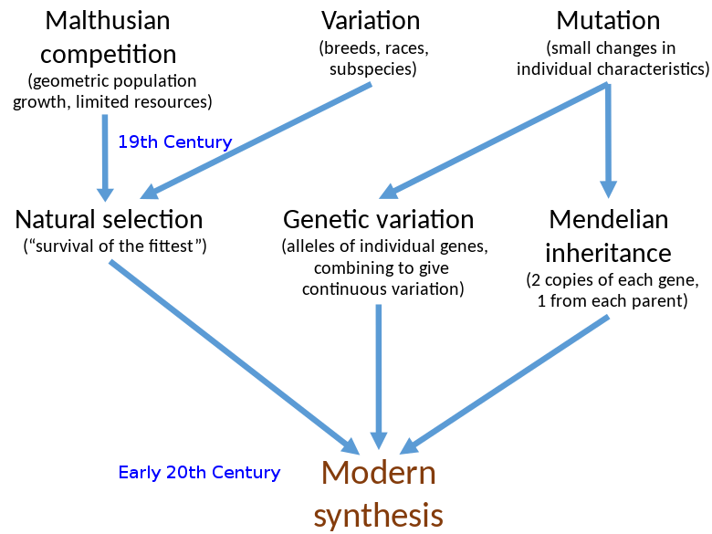
How we got to the “MODERN SYSTHESIS”

Slide 34
Outcomes of the “MODERN SYSTHESIS”

Slide 35
What are the causes of evolution?
How do each of these effect genetic variation (and thus cause evolution)?
Notes:
Main Points:
Since the Modern Synthesis we have a good understanding of the forces that act on populations to cause evolutionary change. These forces are: MUTATION, SELECTION, MIGRATION, and RANDOM GENETIC DRIFT.
It is the interaction of these forces with the GENETIC ARCHITECTURE in natural populations that determines the rate and trajectory of populations evolving in an adaptive landscape.
One pressing challenge for evolutionary biologists is to connect the processes that act on populations and within lineages with patterns of diversity between lineages.
Today I’m going to focus on the GENETIC ARCHITECTURE of natural populations.
In order to make the connection between evolution within lineages and diversity between we need to examine genetic variation at multiple levels……

Slide 36
How Does Mutation Change Allele Frequencies?

Slide 37
Example:
Does mutation change allele frequencies?

Slide 38
Will this continue forever until p=0?
Conclusions:
What are the effects of mutation on allele frequencies?
What are the consequences of mutation on evolution?
Why is mutation important?

Slide 39
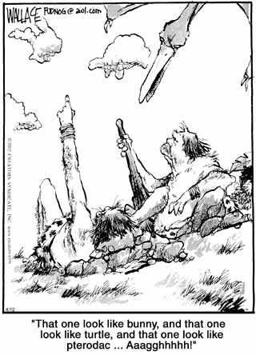
The Law of Natural Selection

Slide 40
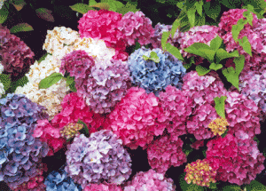

Some Important Points
Notes:
Hydrangea – flowers in acidic soil are blue and those in basic soil are pink or red
Due to how the plant absorbs aluminum ions from the soil – this is influenced by pH

Slide 41
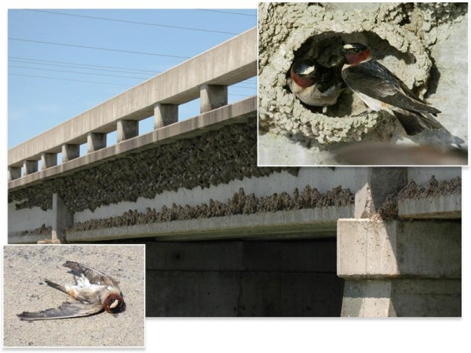
Types of Selection

Slide 42
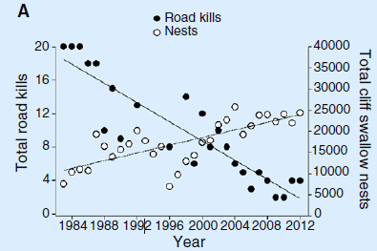
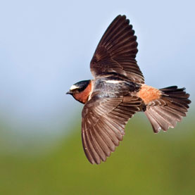
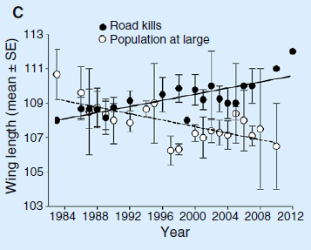
Draw a histogram showing the distribution of the original population
Draw another histogram showing the change
Brown and Brown. 2013. Current Biology

Slide 43
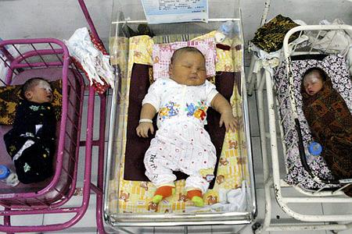
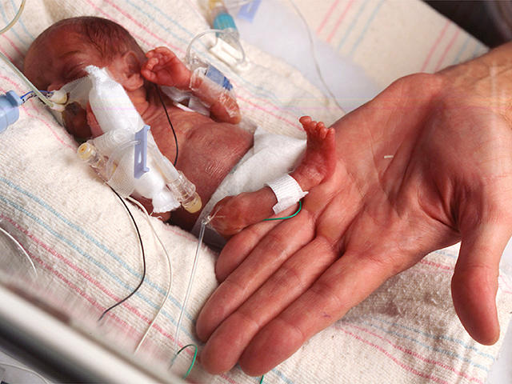
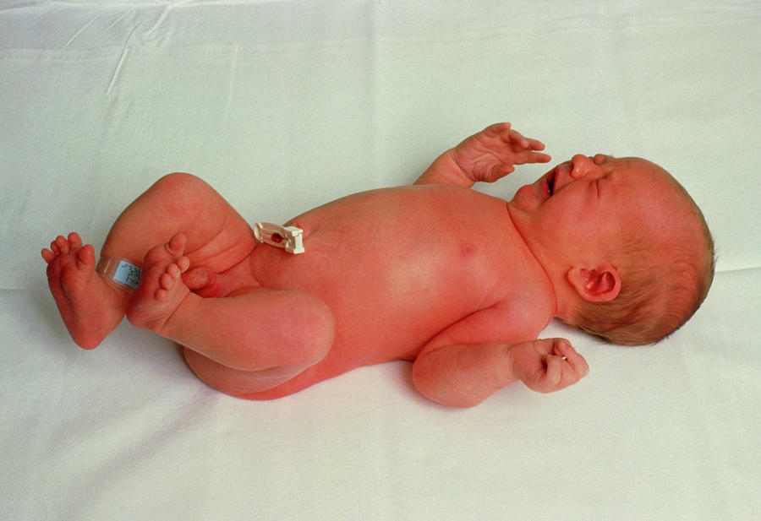
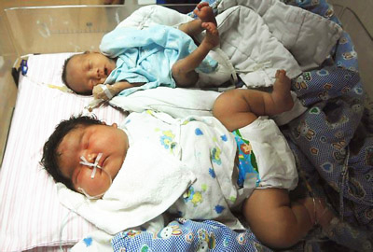
Types of Selection
Draw a histogram showing the distribution of the original population
How is selection influencing birth weight?
Draw another histogram showing the change

Slide 44
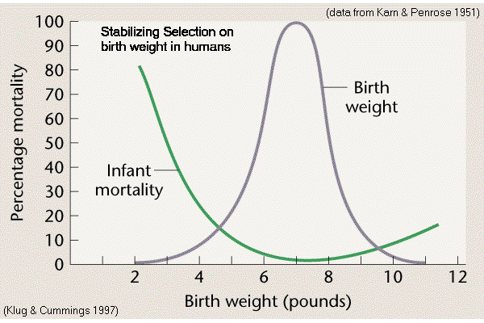

Slide 45
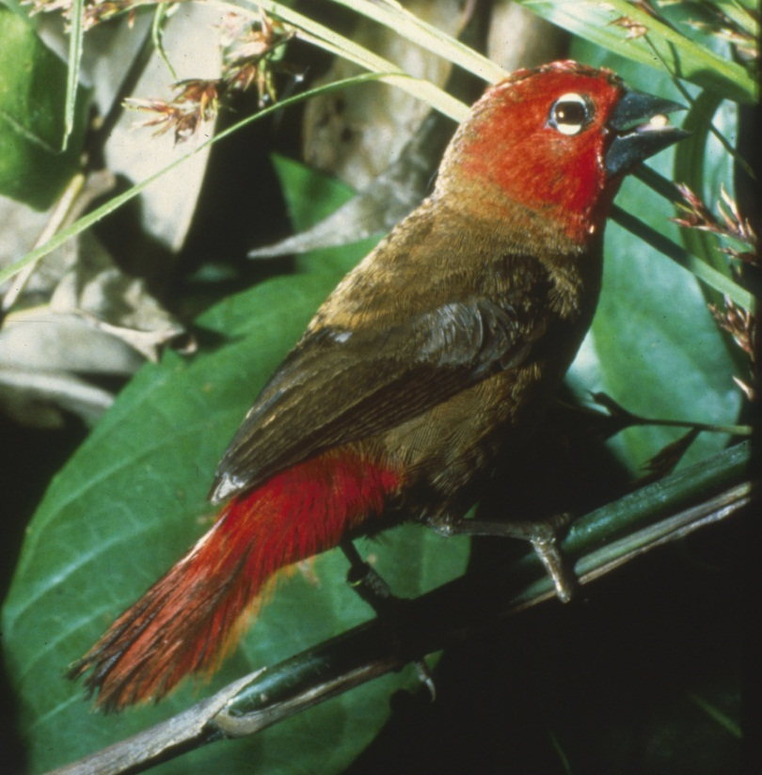
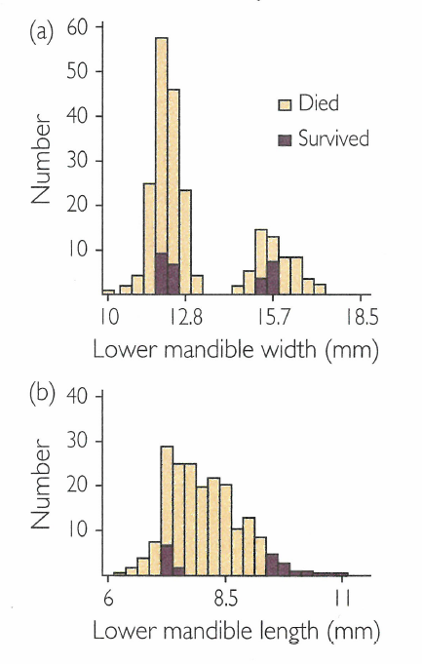
Types of Selection
Draw a histogram showing the distribution of the original population
How is selection influencing beak shape?
Draw another histogram showing the change
What environmental conditions would facilitate this type of selection?
Can you detect any other form of selection at work?
What is the “end” result for the birds?

Slide 46
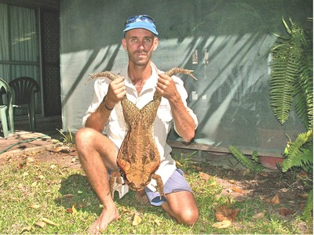
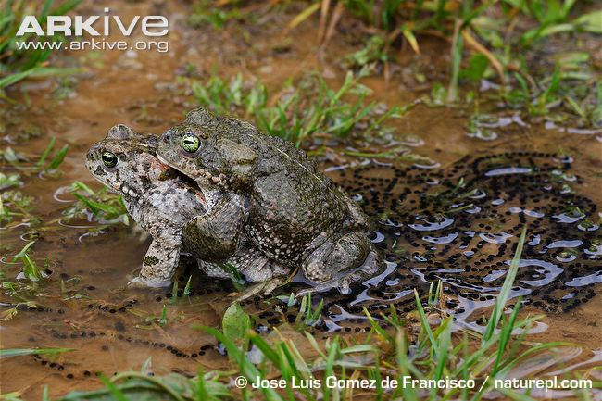
Studying (and measuring) Selection:
Must have a way to measure differences in reproductive success and/or survival
Absolute fitness
Is the total number of offspring produced after fertilization a good estimate of reproductive success?

Slide 47
Studying (and measuring) Selection:
Mean fitness
Relative fitness
Since selection is operating on population, one of these genotypes will be the “worst”
Unless one allele is completely dominant, heterozygous individual will be exposed to some “bad effect”
Notes:
A better way to measure fitness is with mean fitness – accounts for differences in fitness between different genotypes in the population

Slide 48
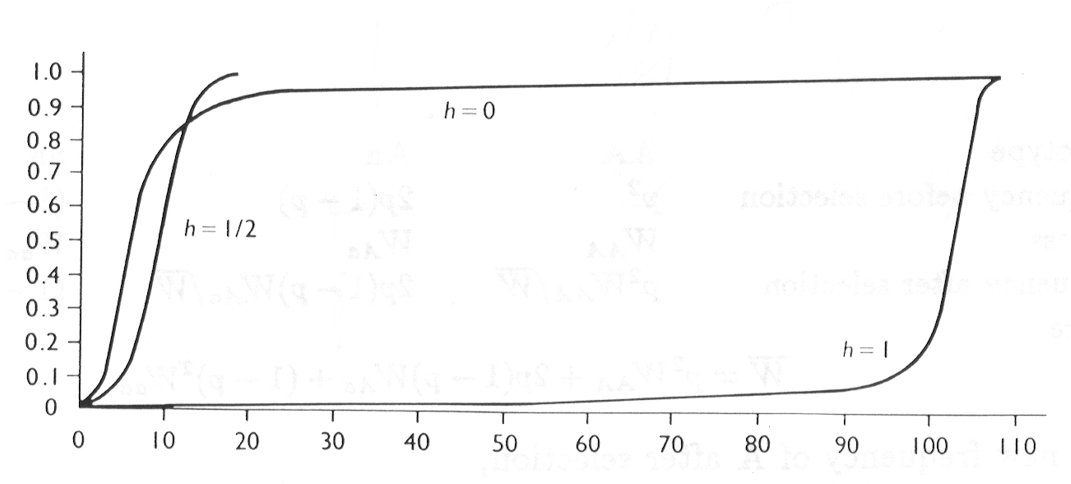
Rate of Spread of favorable alleles
If a favorable (to selection) allele appears in a population, its rate of spread through the population depends on degree of dominance
Thought experiment:
Dominant
Frequency of A allele
Recessive
Generations

Slide 49
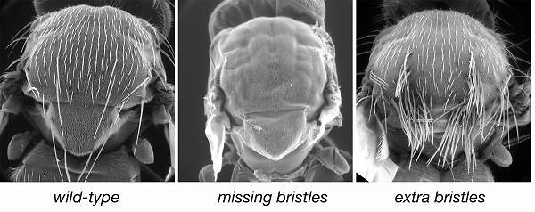
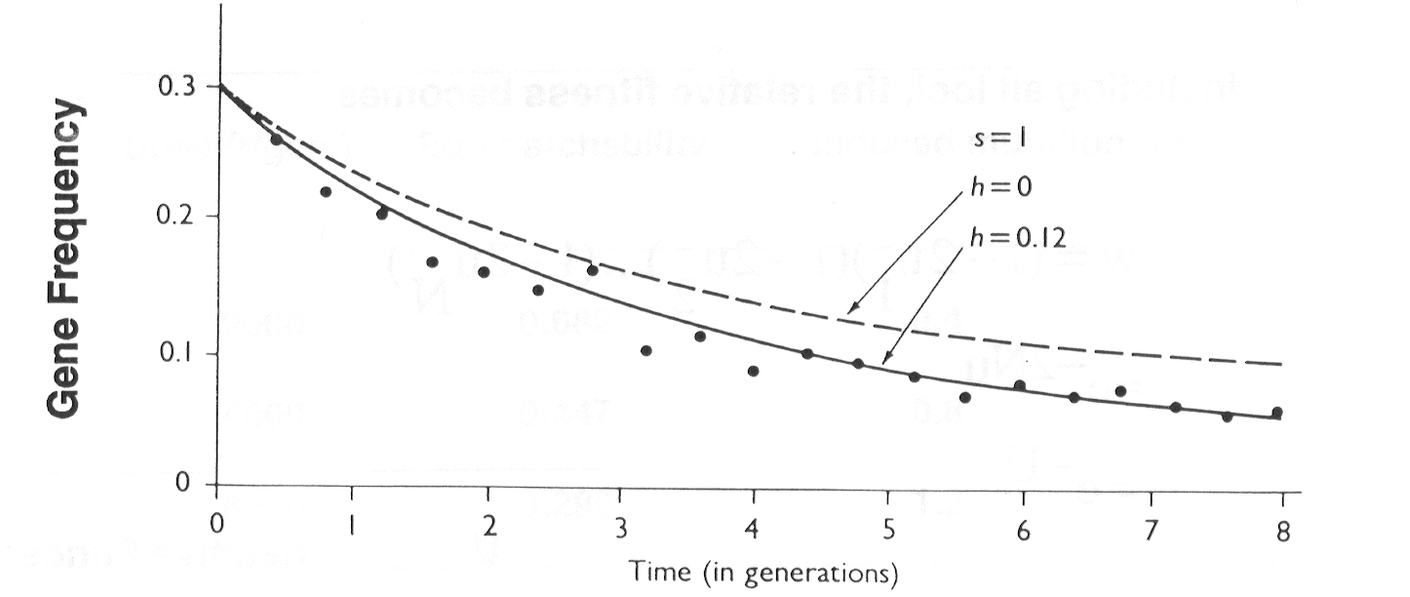
Selection Against a Partially Recessive Lethal
What does s = ?
What does h = ?
If we introduce the stubble allele so that the allele frequency is 30%, what will happen over time?
Dominance masks the effects of the bad allele in the heterozygote

Slide 50
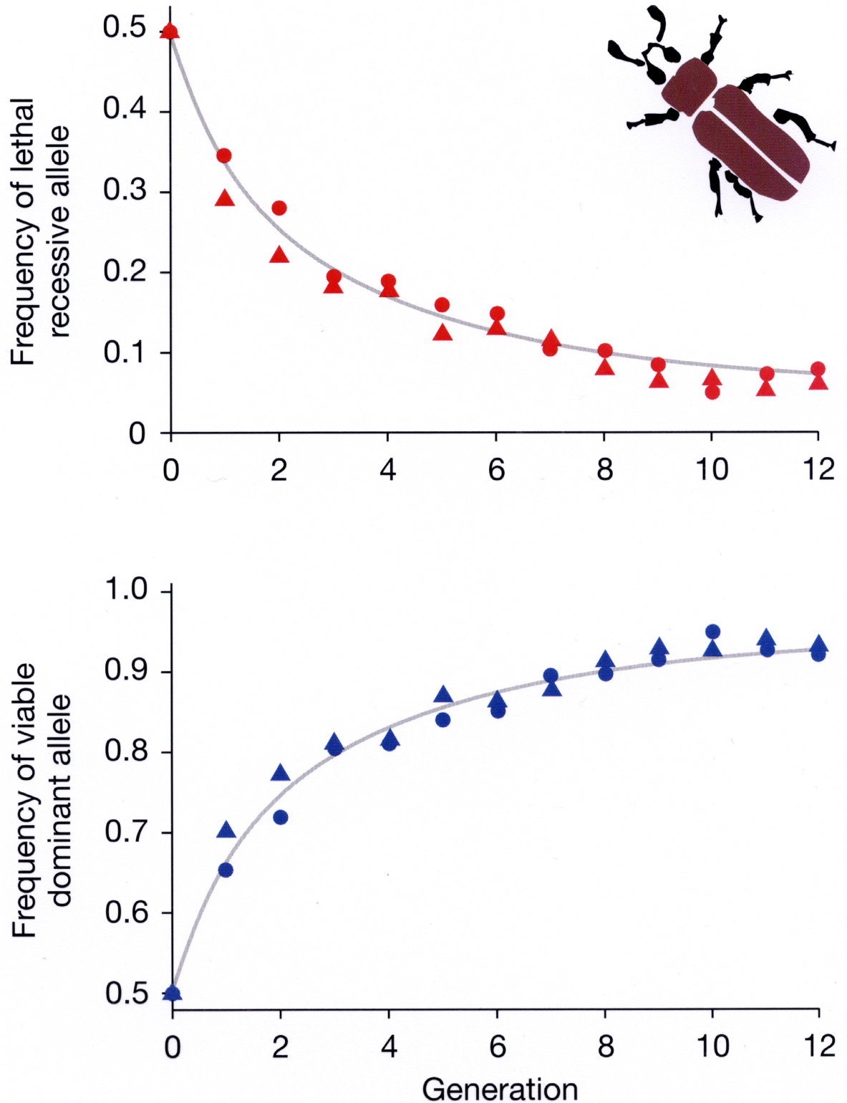
Decline in frequency of a lethal recessive allele
Corresponding increase in frequency of the dominant allele
Dawson (1970)

Slide 51
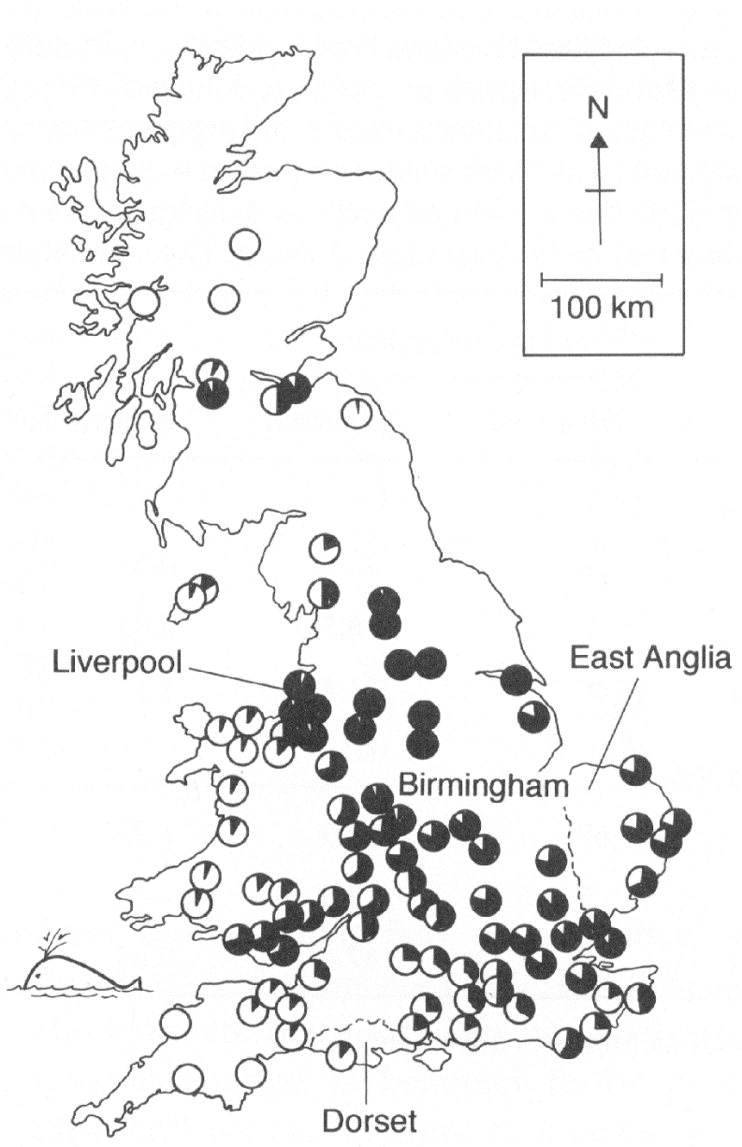
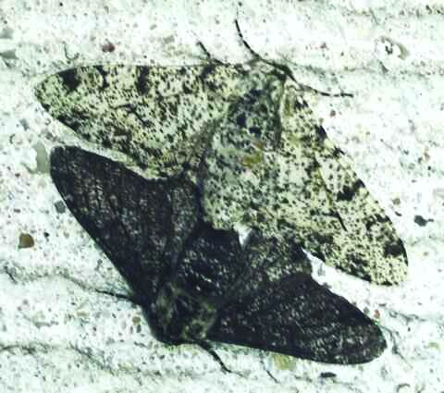
SINGLE LOCUS SELECTION
Case Study: Industrial Melanism
1880’s – early 1900’s
Peppered Moth (Biston betularia)
Less (1971)

Slide 52
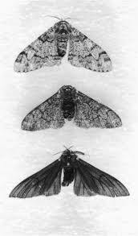
Is the Population Evolving (dataset 1)?
Sampled the population and found the following:
Is our population evolving?
 | Genotype | Observed | Expected Freq (HWE) | Expected # (HWE)
Light morph | cc | 46 | 0.033 | 20.8
Intermediate | Cc | 137 | 0.2975 | 187.4
Dark morph | CC | 447 | 0.6694 | 421.7
630

Slide 53

Estimating Selection: Mark–Recapture Experiment
(dataset 2)
Kettlewell decided to track the fate of known individuals
Designed a mark-recapture experiment
What is the overall survival probability?
 | Genotype | # Released | # Recaught | # Expected? | Survival Rate (recaught/ expected)?
Light morph | cc | 42 | 18 | 36.12 | 0.498
Intermediate | Cc | 10 | 8 | 8.6 | 0.93
Dark morph | CC | 141 | 140 | 121.26 | 1.15
193
166

Slide 54
Calculate Selection and Dominance Coefficients
Actual survival rate is Absolute fitness, need to scale this to the best genotype (i.e. find relative fitness of each genotype)
What’s the best genotype? Set this equal to ?
Now scale other genotypes to this one – how?
Now that we have relative fitness of each genotype, can we calculate selection coefficient (s)? - How?
Now calculate the dominance coefficient (h)

Slide 56
What’s happening?
What type?
What’s causing the selection?

Slide 57

RESPONSE TO A CHANGE IN SELECTION:
FROM: Bishop & Cook 1980

Slide 58
NATURAL SELECTION OPERATING ON A SINGLE LOCUS
Assumptions:
Genotype
Frequency before selection
Fitness
Frequency after selection
The new frequency of A allele after selection

Slide 59
AFTER SOME ALGEBRA…

Slide 60

DIRECTIONAL SELECTION ON A SINGLE LOCUS

Slide 61
SELECTION AND DOMINANCE COEFFICIENTS
Calculate mean fitness
Calculate P’

Slide 62

EVOLUTION OF PESTICIDE RESISTANT SPECIES
Insects
Plants & Weeds

Slide 63

NEW TOOLS – SAME PROBLEMS?

Slide 64

CASE STUDY 2:
Combination of alleles may have advantage
FITNESSES:

Slide 65

HETEROZYGOTE ADVANTAGE IN LAB POPULATIONS
FITNESSES:
VV VL LL
0.735 1.0 0
s = - 0.265
t = - 1.0
Lethal allele
Viable allele
p_{L} = s/ (s + t) = - 0.265 / - 1.265 = 0.209
p_{v} = t / (s + t) = - 1.0 / - 1.265 = 0.791

Slide 66
Genotype frequencies from Yorubas of Ibadan, Nigeria
Genotype | Observed Adult Number (O) | Expected H-W Number (E) | Ratio (O/E) | Fitness (relative to AS)
SS | 29 | 187.4 | 0.155 | 0.155/1.12 = 0.14 = 1-t
SA | 2,993 | 2,672.2 | 1.120 | 1.12/1.12 = 1.00
AA | 9,365 | 9,527.2 | 0.983 | 0.983/1.12 = 0.88 = 1-s
Total | 12,387 | 12,387
Given the following observed values…calculate:
Expected number if in HWE
Survival rate
Relative fitness of each genotype
t & s
FROM: Bodmer & Cavalli-Sforza. 1976

Slide 67

CASE 3: HETEROZYGOTE DISAVANTAGE
FITNESSES:

Slide 68


Slide 69




EFFECT OF SELECTION ON POPULATION MEAN FITNESS:
Populations under selection evolve towards higher population mean fitness
Dominant Beneficial
Overdominance
Recessive Beneficial
Underdominance

Slide 70


What does selection do to variation in a population?
There are situations where selection can maintain variation

Slide 71



Heterozygote advantage
Sickle-cell Anemia

Slide 72
HOW CAN SELECTION MAINTAIN POLYMORPHISM?
Heterozygote advantage – Also known as OVERDOMINANCE or HETEROSIS, results in a stable, polymorphic equilibrium.
Varying selection – If selection varies spatially or temporally, polymorphism may be maintained.
Frequency-dependent selection – the fitness of the genotype depends on its frequency in the population. If common genotypes have low fitness, then the polymorphism will be maintained.

Slide 73



Frequency-Dependent Selection
Lake Tanganyika
Using this information, come up with a scenario that explains how frequency dependent selection maintains this polymorphism
http://www.youtube.com/watch?v=bR5r64lvtMw

Slide 74

Frequency-Dependent Selection
FREQUENCY OF Left-Handed
Hori 1993. Science

Slide 75



Other Forms Of FDS

Slide 76

Fisher argued that 50/50 sex ratio in animals is the result of FDS
How could the stable sex ratio in vertebrates be the result of FDS?

Slide 77

WHY AREN’T WE ALL PERFECT?

Slide 78
SELECTION – MUTATION BALANCE IN
LARGE POPULATIONS
Most new mutations are slightly deleterious.
In large populations the equilibrium frequency of
deleterious mutation is determined by a balance between the input by mutation and removal by selection

Slide 79
WHAT IS THE FREQUENCY OF THE DELETERIOUS MUTANT ALLELE AT EQUILIBRIUM???
Δq = loss due to selection + input by mutation = 0

Slide 80
MUTATION – SELECTION BALANCE
FITNESSES:
W_{AA} = 1 W_{Aa} = 1 W_{aa} = 1 - s
h = 0, and Δq is equal to (-1)*Δp, so

Slide 81
MUTATION – SELECTION BALANCE
At equilibrium, the change in allele frequency due to mutations is exactly equal to the change due to selection, so:
The deleterious allele is rare, so mean population fitness is approximately equal to 1. Thus,
and

Slide 82
Assume q is small, and u >> v :
Selection against a completely recessive allele:
W_{AA} = 1 W_{Aa} = 1 W_{aa} = 1 – s
Selection against a completely dominant allele:
W_{AA} = 1 W_{Aa} = 1– s W_{aa} = 1 – s

Slide 83


Response of a Drosophila melanogaster Population to X-rays
From: K. Sankaranarayanan. 1964. Genetics 50:131-150
CONTROL
RESPONSE TO CESSATION OF RADIATION
EGG HATCHABILITY
IRRADIATED
POPULATION
GENERATIONS

