Slide 1
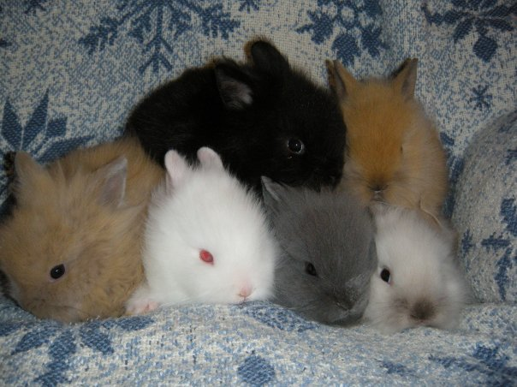
WHERE DOES THE VARIATION COME FROM?

Slide 2
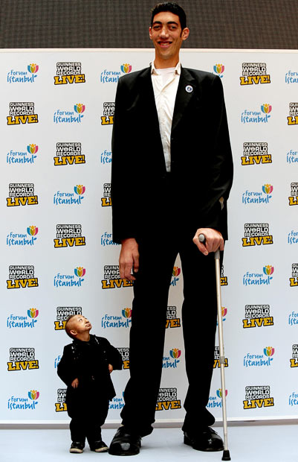
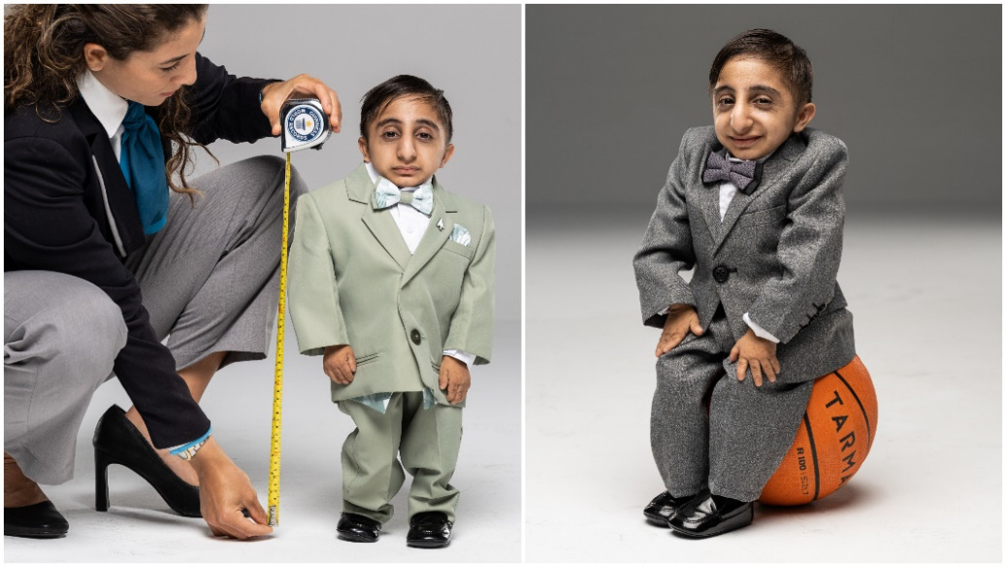
8 ft 2.8 in
World’s tallest and shortest men
2 ft 1.6 in

Slide 3
What initially creates all variation?
What causes mutation?

Slide 4
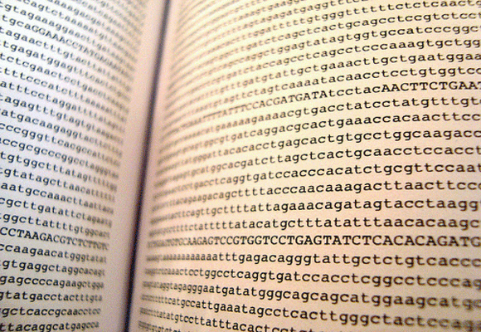
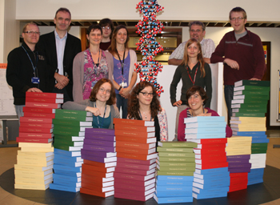
Human Genome
3 billion base pairs
https://www.youtube.com/watch?v=lzhp5NuXo-k

Slide 5
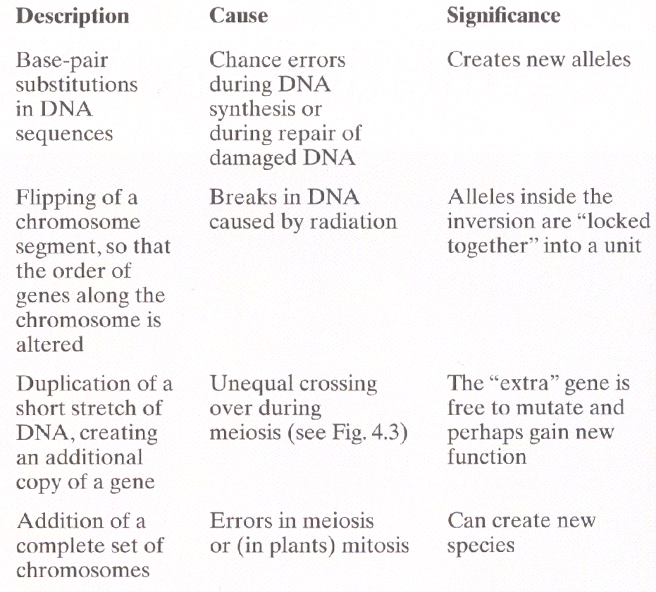
“THE FUEL FOR EVOLUTION”
1)
2)
3)
4)

Slide 6
POINT MUTATIONS:
ACA TTG GTA CGA CAA
ACA TTT GTA CGA CAA
THE DOG AND THE CAT EAT HAM
THE DOT AND THE CAT EAT HAM

Slide 7
POINT MUTATIONS:
THE DOG AND THE CAT EAT HAM
THD OGA NDT HEC ATE ATH AM….
Talk with those around you about the “consequence” of these 3 types of mutations
THE DOG AND THE CAT EAT HAM
THT EDO GAN DTH ECA TEA THA M….

Slide 8
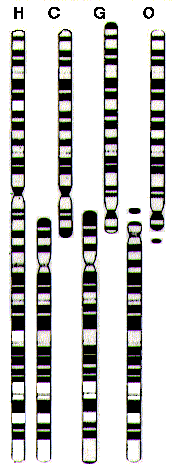
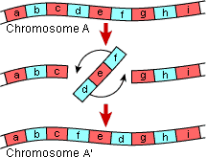
Chromosomal Inversions
Chromosomal Fusions
Guess how many chromosomes modern chimps, gorilla, and orangutan have.

Slide 9
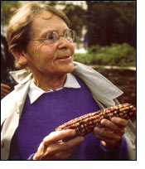
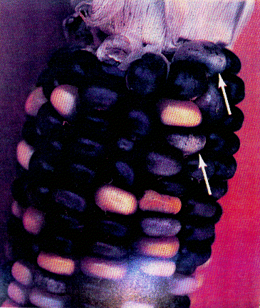
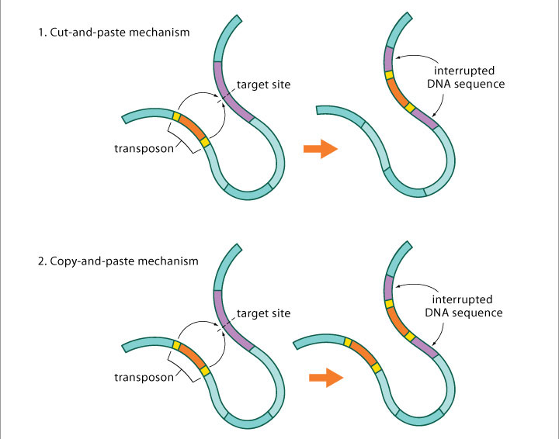
Transposable Elements:
“Jumping Genes”
Notes:
Transposable element actually codes for a reverse transcriptase enzyme that copies itself back into a new position
Very similar to HIV or retroviruses

Slide 10
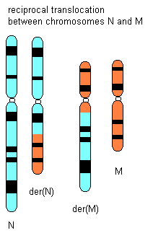
Translocations of Genetic Material Between Chromosomes

Slide 11
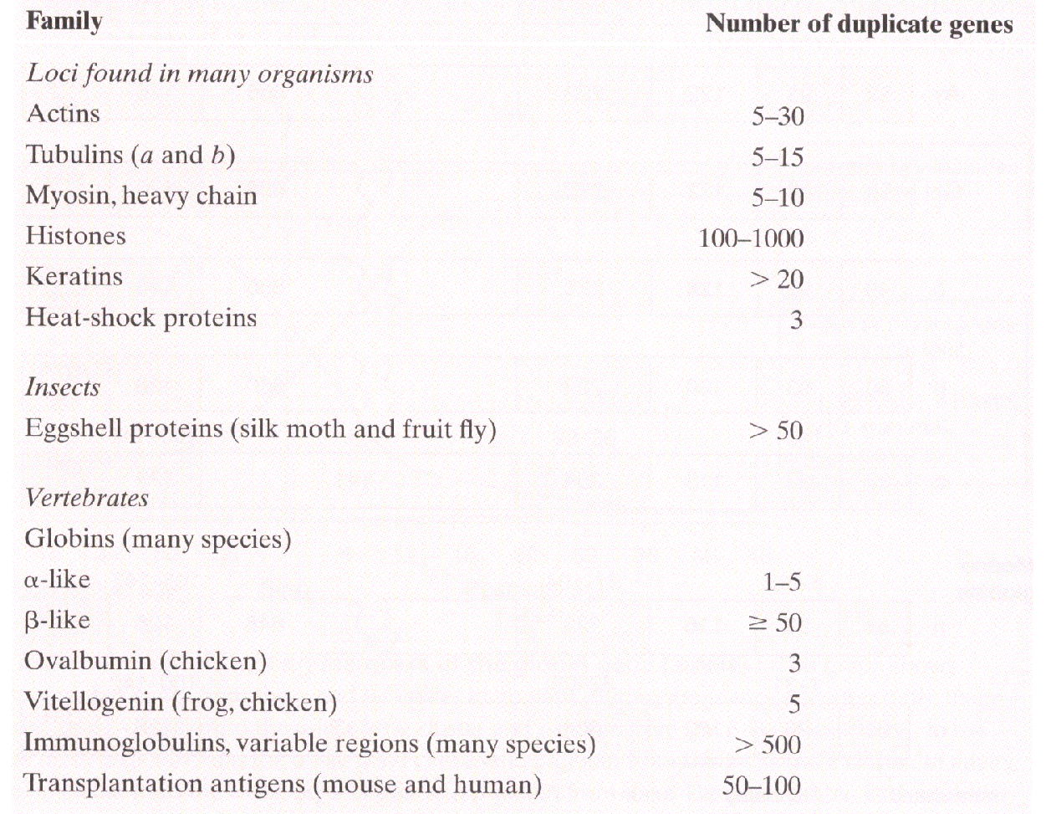
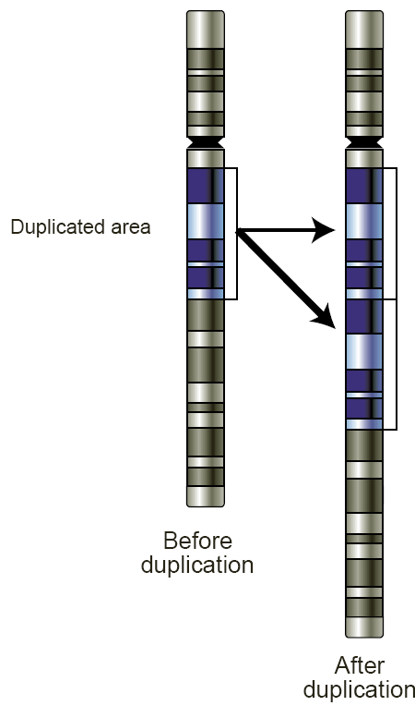
GENE DUPLICATION:

Slide 12
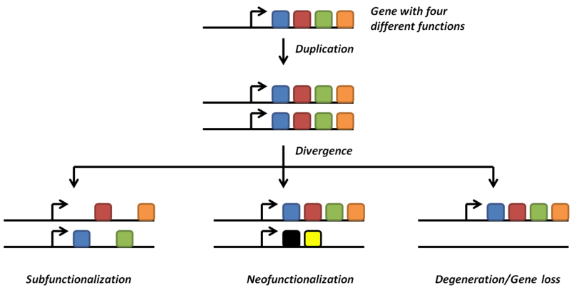
THE FATE OF DUPLICATE GENES
Retain original function and provide additional copy of parent loci
Each gene has partial role in original product
Accumulate point mutation and become functionless
Gain a new function through mutation and selection

Slide 13
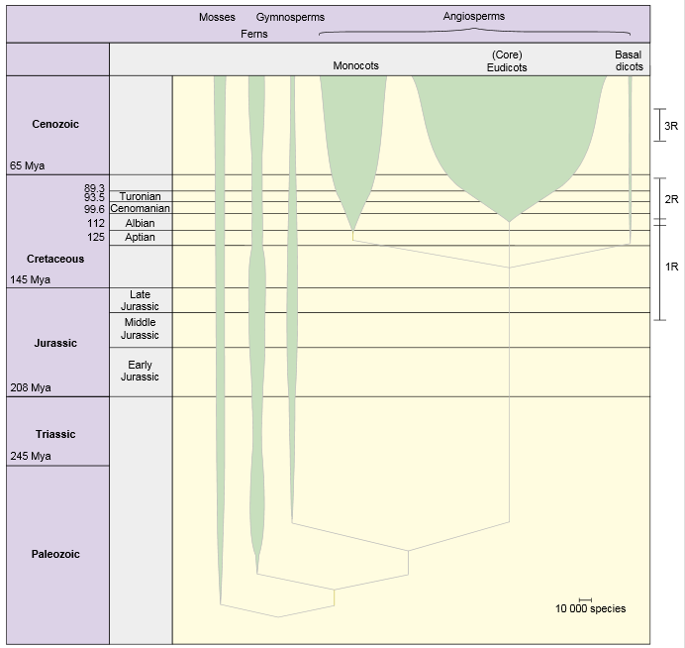
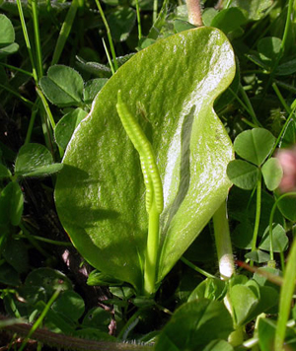
Genome Duplication:
Adders-Tongue
Notes:
https://www.cell.com/trends/ecology-evolution/abstract/S0169-5347(05)00249-1?large_figure=true

Slide 14
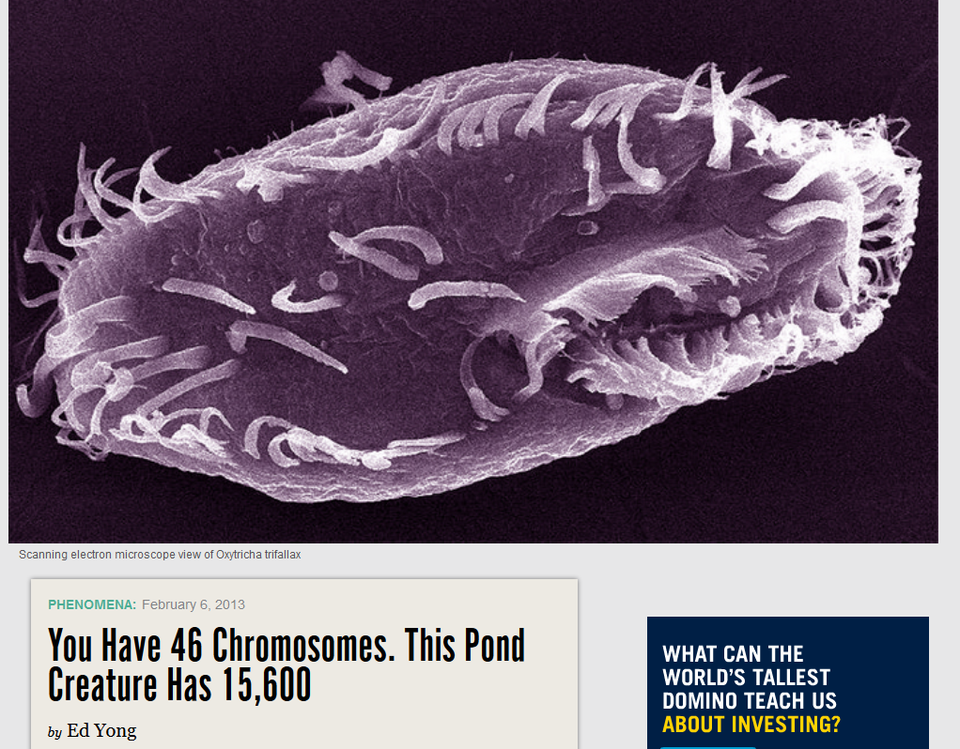
“It’s like someone has taken the encyclopaedias, ripped out all the individual pages, torn some of them, photocopied everything dozens of times, and stuffed the whole lot in a gigantic messy drawer….& It’s like every page in its messy drawer is hard-bound!”

Slide 15
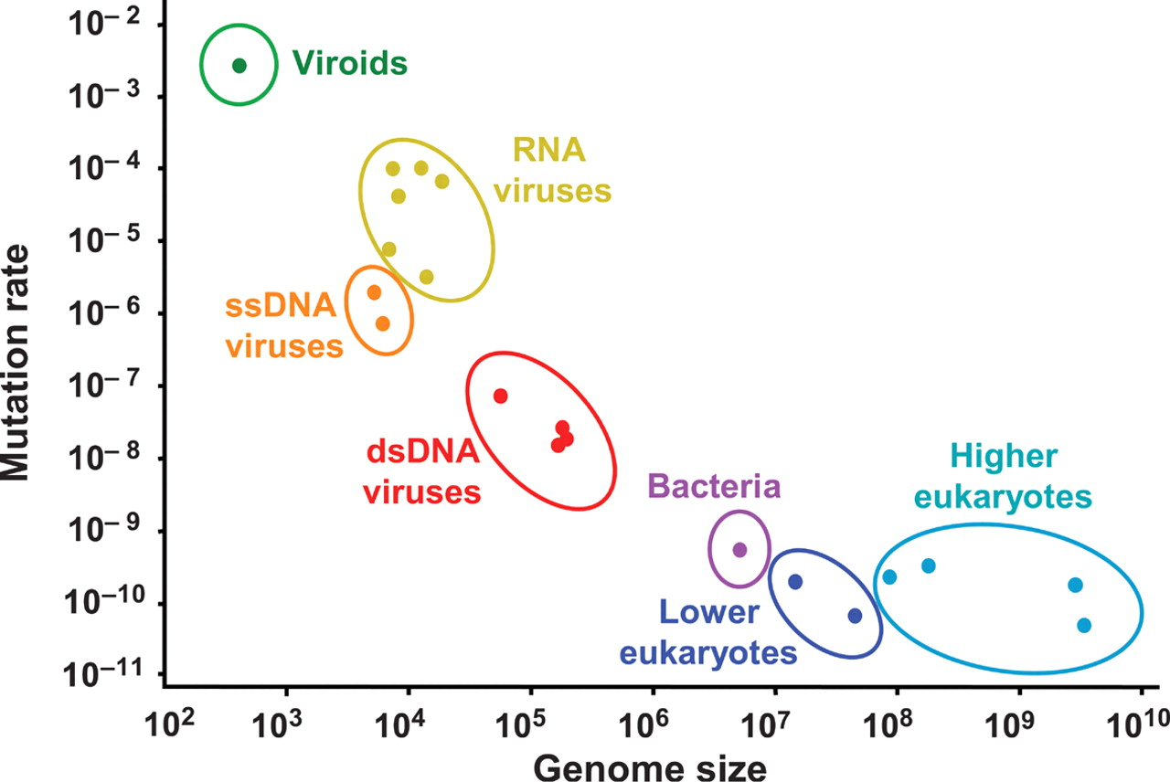
Rate of Mutation
Mutations per unit of time (usually generation)
What do these results suggest?
Gago et al. 2008. Science

Slide 16
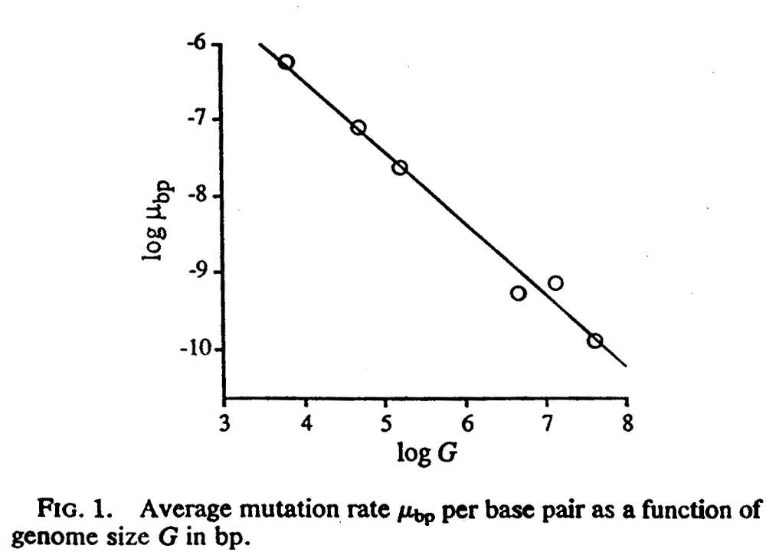
Rate of Mutation
Let’s look at this another way
Scaling mutation rate to genome size
ORGANISM GENOME SIZE PER BASE MUT RATE * GEN SIZE
Phage M13 6.4 x 10³ 7.2 x 10⁻⁷ 0.0046
Phage lambda 4.8 x 10⁴ 7.7 x 10⁻⁸ 0.0038
Phage T2, T4 1.6 x 10⁵ 2.4 x 10⁻⁸ 0.0038
E. coli 4.7 x 10⁶ 5.4 x 10⁻¹⁰ 0.0025
Yeast 1.4 x 10⁷ 2.2 x 10⁻¹⁰ 0.0031
Neurospora 4.2 x 10⁷ 7.2 x 10⁻¹¹ 0.0030
(prob of mut)
Drake 1991

Slide 17
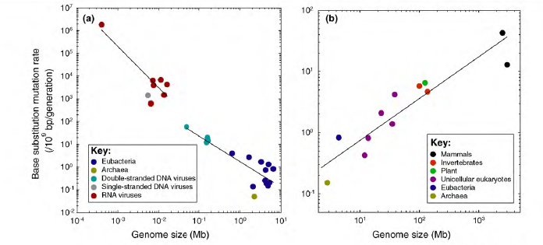
Constant of Mutation Rates?
Most of this work on simple organisms
The genomic deleterious mutation rate:
≈ 0.004/cell division in E. coli
≈ 1.5/generation in D. melanogaster
≈ 12-162 /generation in H. sapiens
High rates in flies and humans suggest Drake’s constancy hypothesis cannot be extended to higher organisms
“Continue” the previous figure with these higher organisms
MUT RATE
(# Mut / base pair)
Why does mutation rate increase with large genomes?
LET’S PLAY A GAME
Lynch 2010

Slide 18
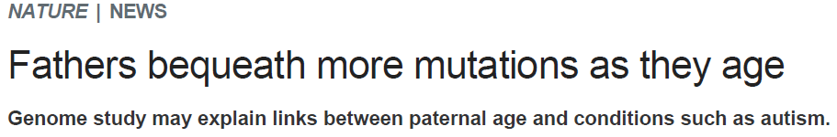
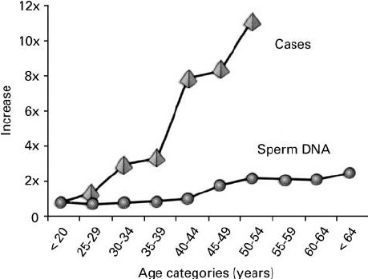

What’s going on?
Haldane, J. B. S. Ann. Eugen. 13, 262–271 (1947).
Notes:
Bone growth disorder that prevents cartilage from changing to bone
Figure 5. Increase of spontaneous cases of achondroplasia with paternal age and frequency of FGFR 3 mutations in sperm. (With permission from Tiemann-Boege et al. , 2002.)
https://www.researchgate.net/publication/8515487_Reproductive_function_of_the_ageing_male/figures?lo=1

Slide 19
THE MUTATION RATE IN HUMANS
Single celled organisms – How many opportunities for mutation between generations?
Multicellular organisms?
  Before gametes form, germ cells undergo multiple divisions
  Female Cell Divisions ≈ 24 (independent of age)
  Male Cell Divisions ≈ 36 + ((Age - 13) x 23)
FROM: J. F. Crow. 1993. Environ. Mol. Mutagenesis 21:122-129 & F. Vogel and R. Rathenberg. 1975. Adv. Human Genetics 5-223-318.

Slide 20
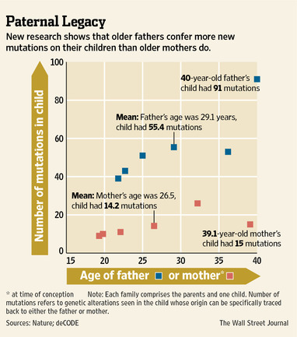
THE MUTATION RATE IN HUMANS continued…
Male mutation rate = 4x10-8
  Probability any nucleotide will mutate in a generation
  Avg total number of mutations?
More than 6% of newly fertilized eggs carry a gross chromosomal abnormality
  5.5% of these terminate
So paternal age is the most important factor when thinking about offspring viability/mutations?
FROM: J. F. Crow. 1993. Environ. Mol. Mutagenesis 21:122-129 & F. Vogel and R. Rathenberg. 1975. Adv. Human Genetics 5-223-318.

Slide 21
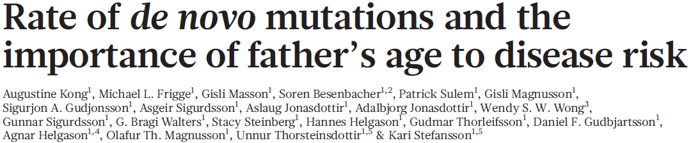
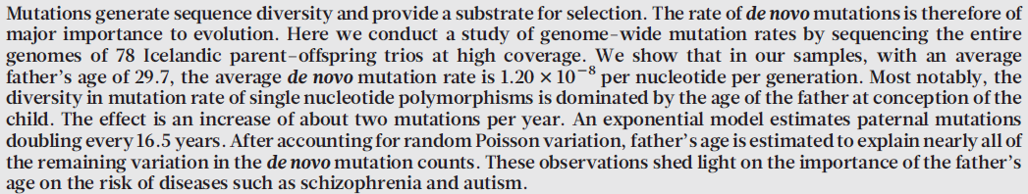
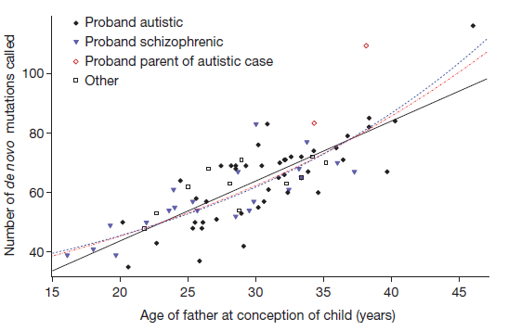
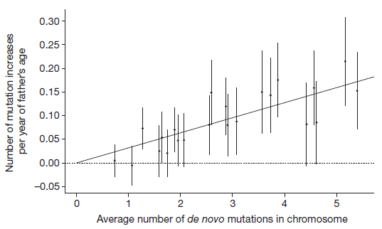

Slide 22
What do we know so far?
What else do we need to know?

Slide 23
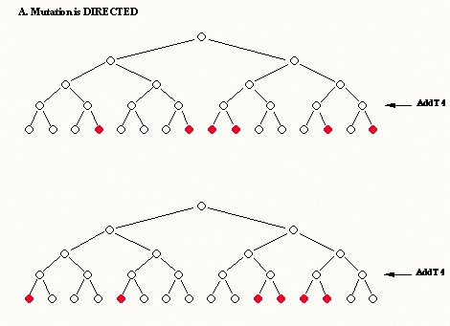
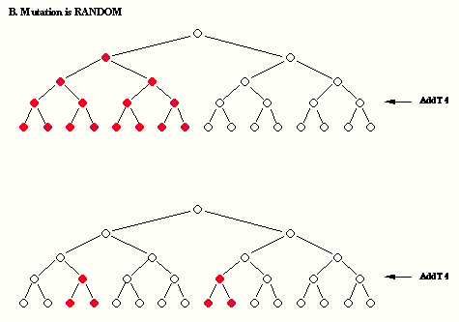
Do mutations arise spontaneously (i.e. randomly) or can they occur due to environmental pressure (i.e. NS)?
Luria-Delbruck Fluctuations Test
Pattern A: Mutation is Directed
Pattern B: Mutation is Random

Slide 24
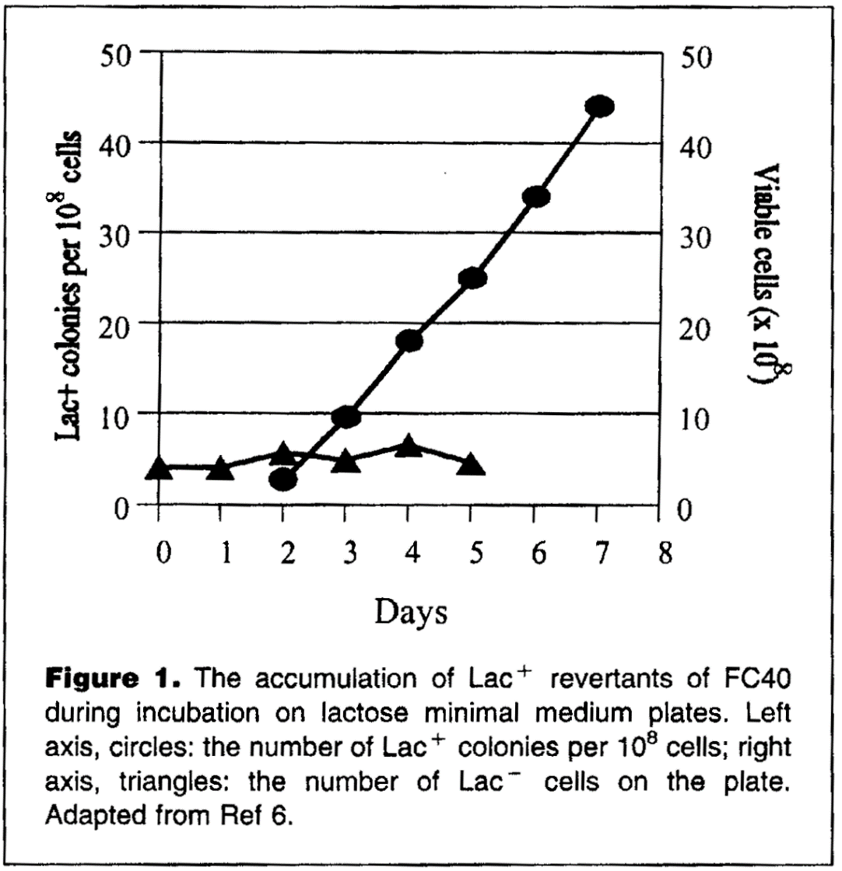
Are Mutations Random?
Lactose – sugar
Some E.coli have lac⁻⁻⁻ mut
lac⁻⁻⁻ to lac⁺ very rare
Adaptive mutation?
What has to exist for this to occur? How would this work?
Pathway responds to selective pressure to produce mutation, confers the correct phenotype, which alleviates pressure
Cairns, J., & P. L. Foster. 1991. Adaptive reversion of a frameshift mutation in Escherichia coli. Genetics 128:695-701

Slide 25
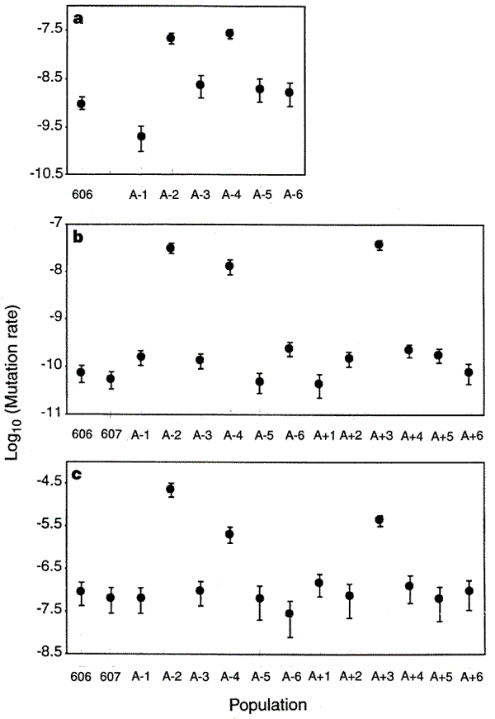
Mutation Rates after 10,000 Generations of Evolution
Ancestral Population High Mutation Lines
Rate of reversion from Ara⁻ to Ara⁺
Rate of mutation to nalidixic-acid resistance
Rate of mutation to bacteriophage T5 resistance
FROM: Sniegowski et al. 1997. Nature 387:703-705

Slide 26
Conclusions from Mutator Strain Experiment
  Mutator strains shut off DNA repair pathways → induces many novel mutations
  Important mutation hitch-hiking in association with all other mutations
  What looks like “adaptive mutation”, really adaptive destruction
  Ones with high mutation rate get a beneficial mutation faster and displace wild – Mutator strains
  Why aren’t all strains mutator?
  Likely in higher organisms?
Notes:
May have a short-term advantage coping with environmental stress but over the long term?

Slide 27
Final thoughts on Adaptive Mutation
Starvation is mutagenic
Rare case where relationship exists between mutation rate and selective environment

Slide 28
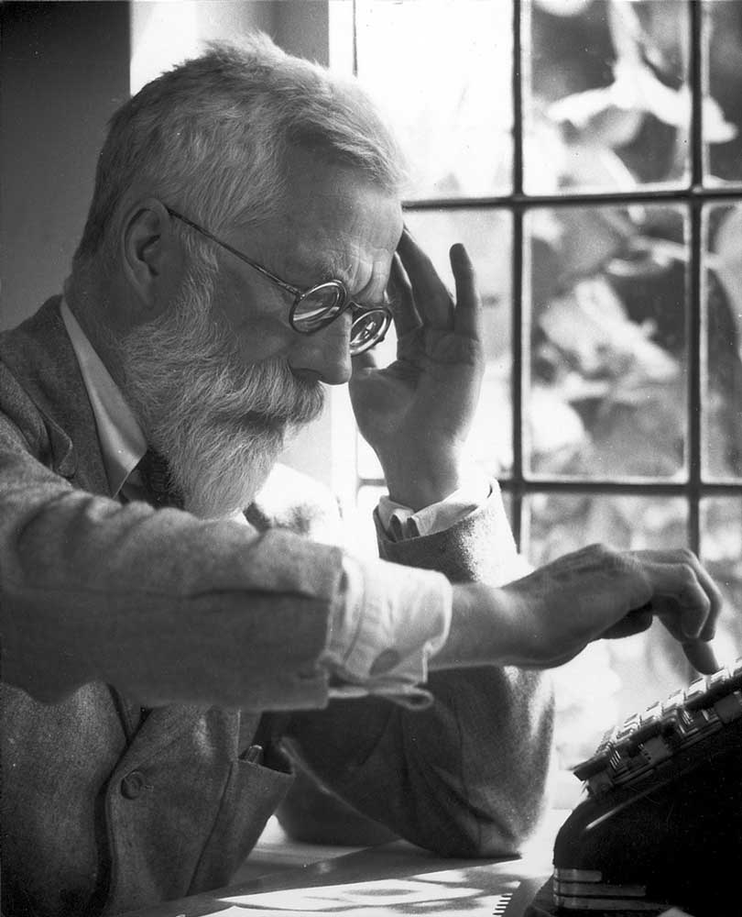
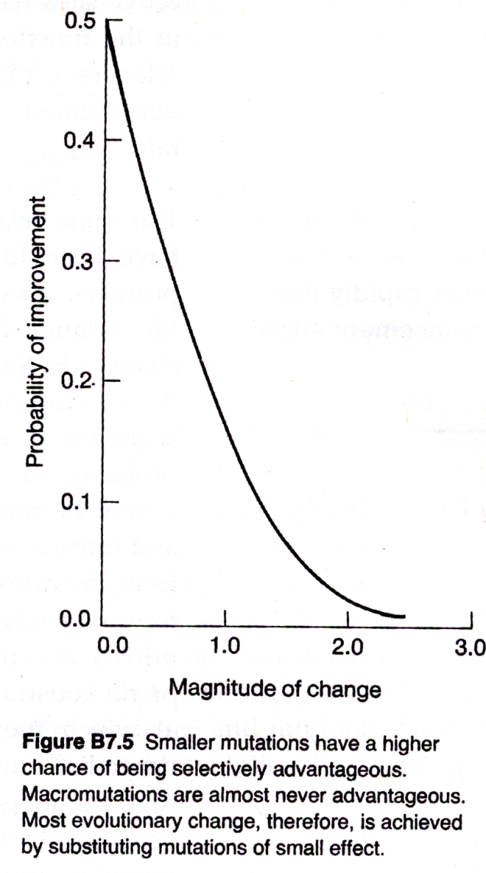
What will be fuel for evolution, large or small mutations?
Mutational Effects: mutations of small effect are more likely the fuel for evolution by natural selection
Notes:
Had very poor eyesight and learned to visualize math problems in head
Before computers so employed hundreds of people to crunch equations
Published the genetical theory of natural selection – important book for the modern synthesis
Major advances in statistics – correlation, ANOVA, founder of population genetics

Slide 29
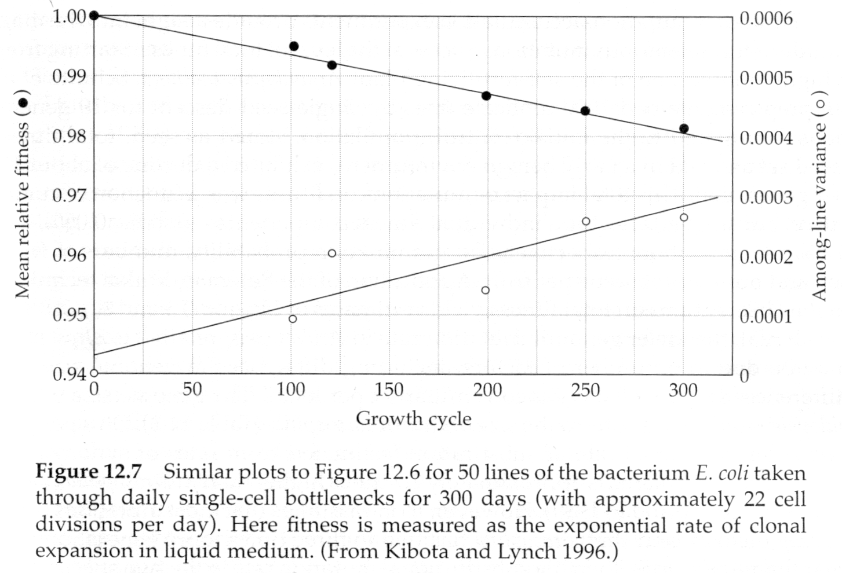
On average, are mutations positive or negative?
FROM: Lynch & Walsh 1998

Slide 30
Conclusions from mutation accumulation studies:
The majority of spontaneous mutations have a slightly deleterious effect on fitness
The average effect of is a 1-2% decrease in fitness (Houle et al. 1997).
Why don’t we see dramatic consequences of mutations in natural populations?
Notes:
Why don’t organisms go extinct because of all the deleterious effects of mutation?!

Slide 31
SUMMARY OF KNOWLEDGE ON MUTATION
The spectrum of mutations is enormous
The mutation rate likely not subject to evolutionary modification
The mutation rate / gen increases with the # cell divisions
Effect of mutations are generally small on phenotype
The vast majority of mutations appear to be deleterious

Slide 32
SUMMARY OF KNOWLEDGE ON MUTATION RATES
The introduction of new variation due to mutation is on the order of 0.1% to 1.0% of the standing variation
The adaptive value of mutations changes with the ecological circumstances
Mutations arise randomly with respect to their utility
RARE - The mutation rate can be modified greatly by the environment (bacteria only?)

