Slide 1
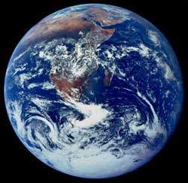
THE HISTORY OF LIFE

Slide 2
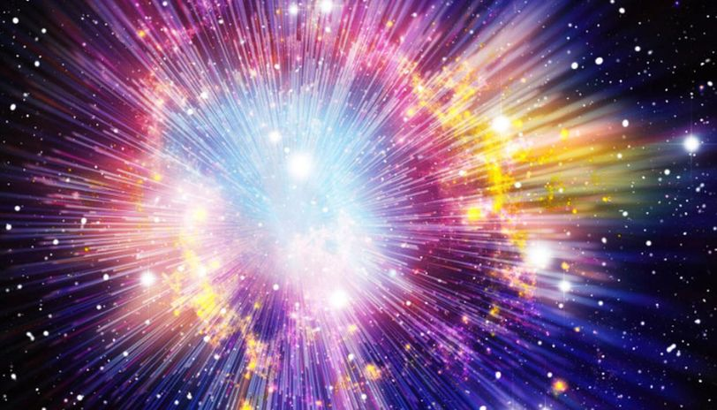

Slide 3
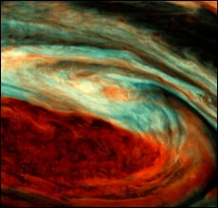
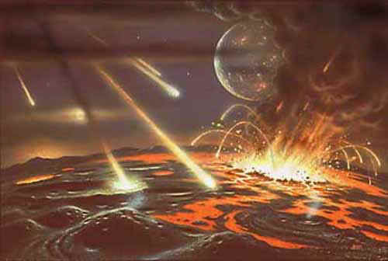
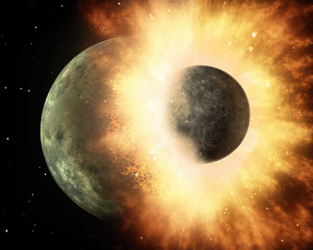
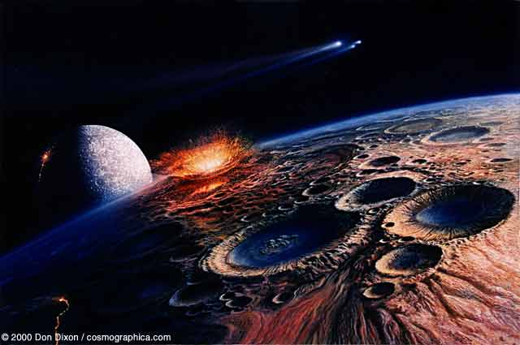
Formation of the Earth

Slide 4
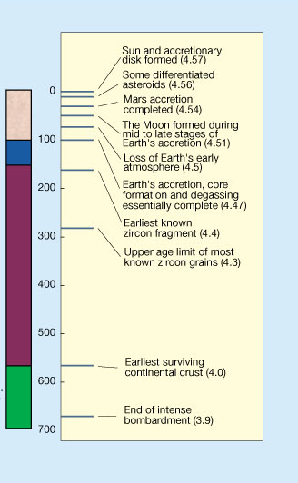
Deciphering the Earliest History of the Earth
Hadean Eon
Hot atmosphere, Magma oceans, No liquid water
Surface cools, loss of atmosphere
Intense BOMBARDMENT
Continental stability
Liquid water
From: Halliday 2001 Nature 409:144-145

Slide 5
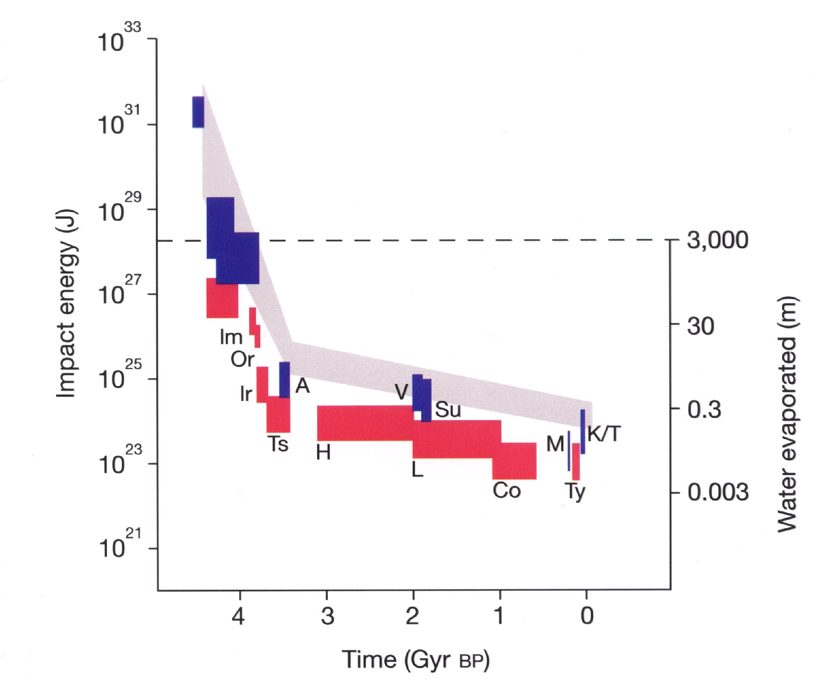
ORIGIN OF THE MOON
No Life
Period of Intense Bombardment
Life
Possible
How much E (J) did the first atomic bomb release?
Notes:
Atomic bomb released 1.5x10^13

Slide 6
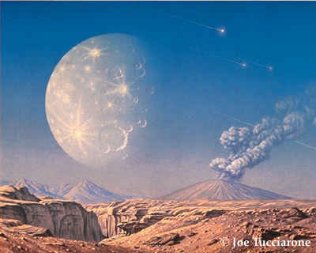
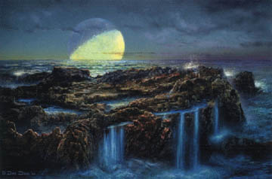
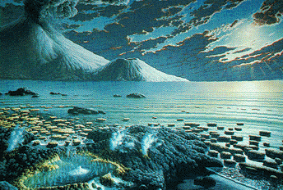
Archaeon Eon
Period of stability
During this eon that life originated (where?)

Slide 7
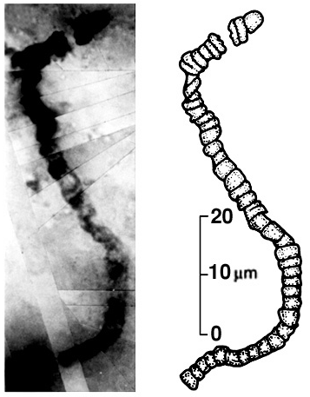
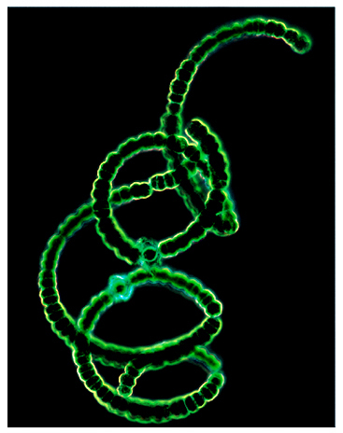
First life-form?
3.8 BYA fossils claimed
Schopf 1993. Science 260: 640-646.
Brasier et al. 2002. Nature 416, 76-81

Slide 8
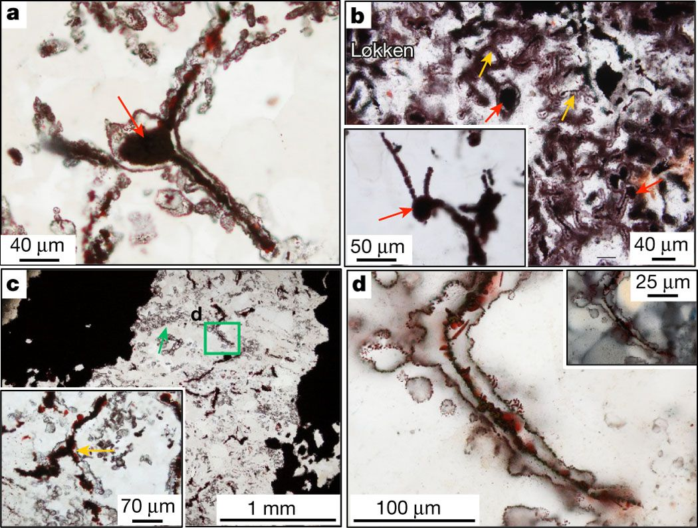
Oldest Fossil Evidence
3.7-4.2 BYA, Greenland
Filamentous “microorganisms”
Large amounts of haematite (iron oxide)
Common around hydrothermal vents
Dodd et al. 2017. Nature
Notes:
Fossils were laid down in a series of hydrothermal vents

Slide 9
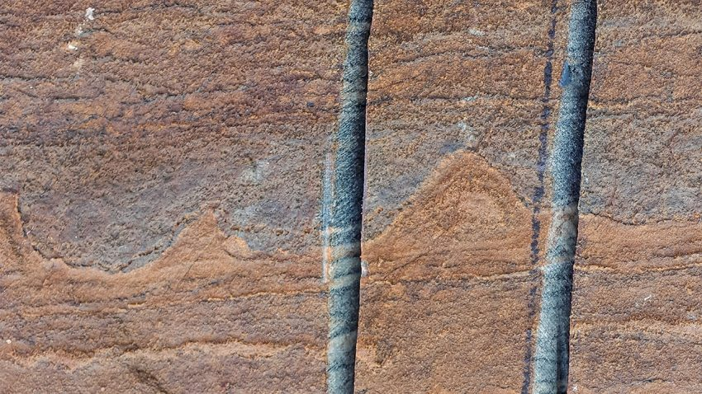
Earliest Fossils
3.7 BYA
Nutman et al. 2016. Nature.

Slide 10
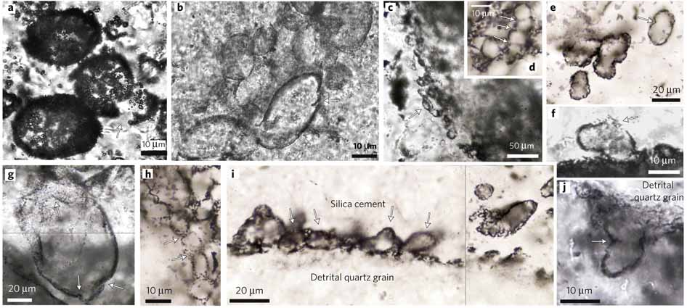
Size and shape
Variation small
Uniform cell walls
Geochemistry
Microfossils - 3.4 BYA
“solid evidence”
Wacey et al. 2011. Nature Geoscience 4:698–702.

Slide 11
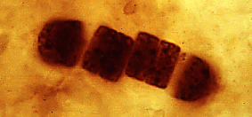
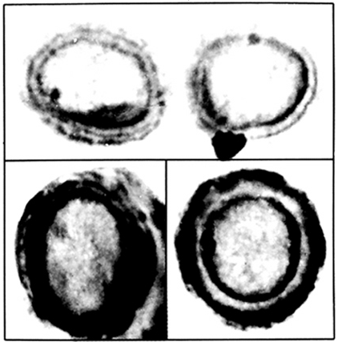
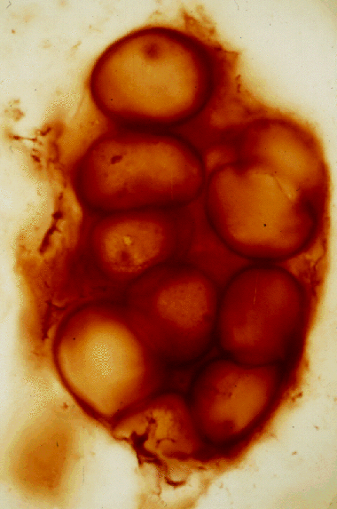
Fossil Cyanobacteria
2.5 BYA
Fossil Bacteria

Slide 12
What date do you believe?
What does the timing between end of the intense bombardment and origin of life suggest?

Slide 13
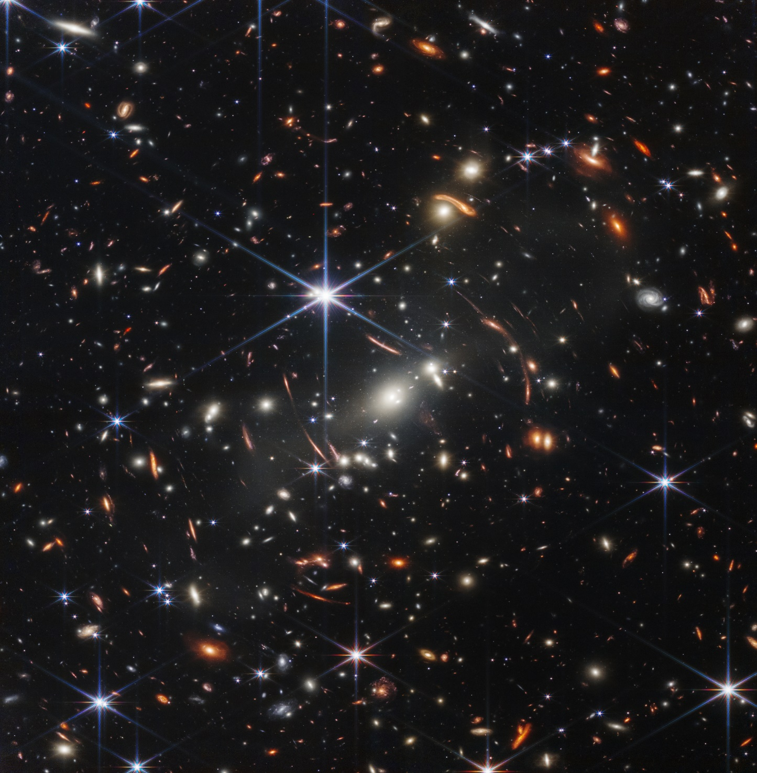
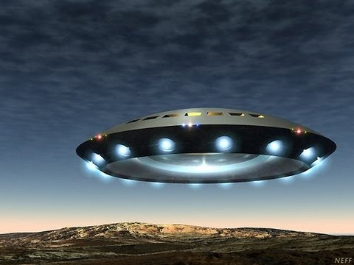
Hypotheses for
the origin of Life:

Slide 14
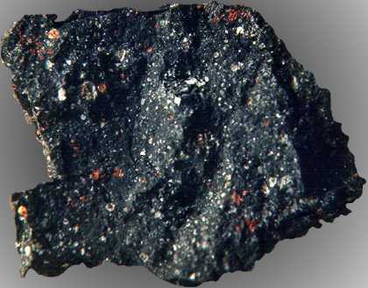
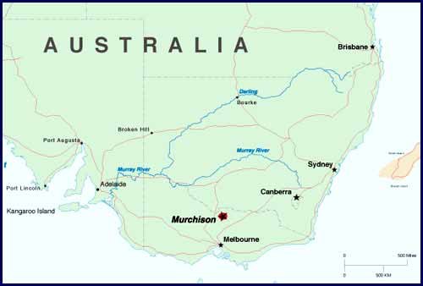
Panspermia
Murchison Meteorite
Cooper et al. 2001 Nature 414:897-883
Notes:
Large (220lbs)
Watched it fall

Slide 15
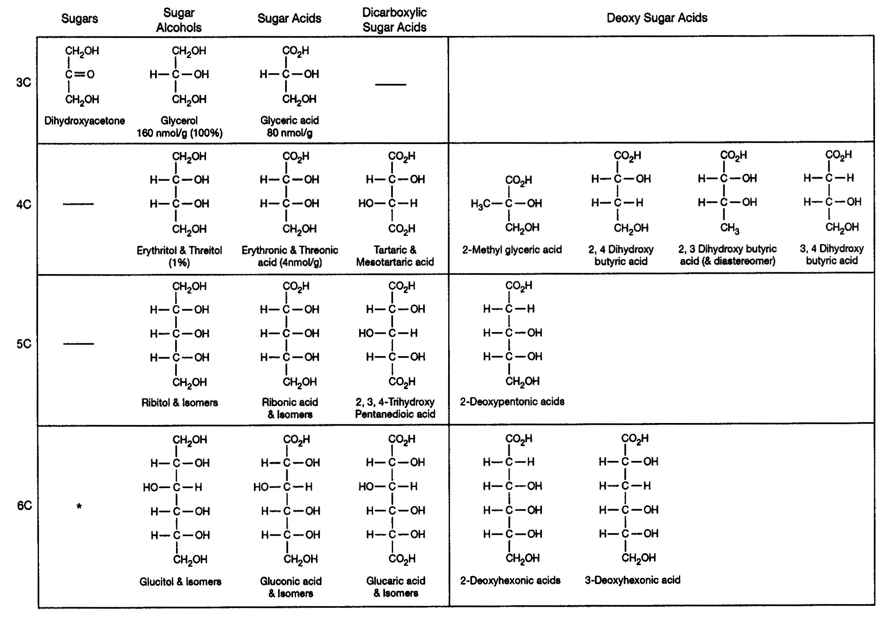
SUGARS FOUND IN THE MURCHISON METEORITE
From: Cooper et al. 2001 Nature 414:897-883

Slide 16
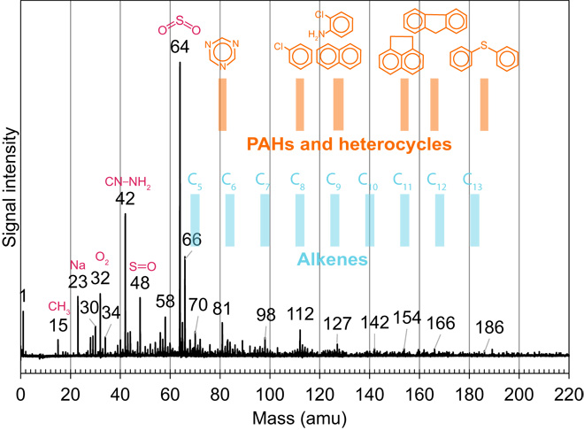
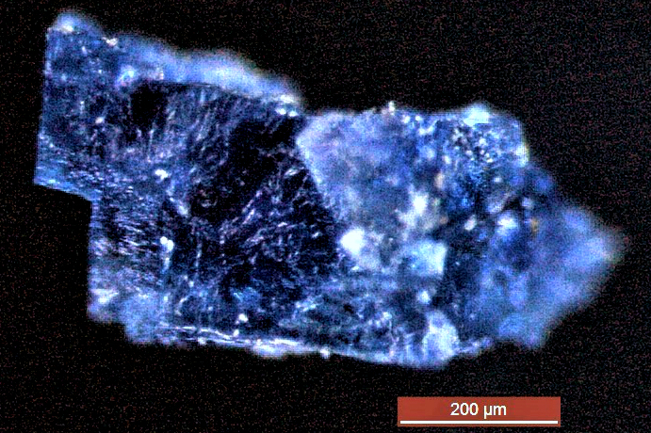
More recent data
“Direct evidence of complex prebiotic chemistry from a water-rich world in the outer solar system is provided by the 4.5-billion-year-old halite crystals from…meteorites…Associated with these trapped brines are organic compounds exhibiting wide chemical variations representing organic precursors, intermediates life’s precursor molecules such as amino acids.”
i.e. Abundant organic matter and evidence of liquid water
Chan et al. 2018. Science Geochemistry
Notes:
https://advances.sciencemag.org/content/4/1/eaao3521
https://newscenter.lbl.gov/2018/01/10/organic-meteorites/

Slide 17
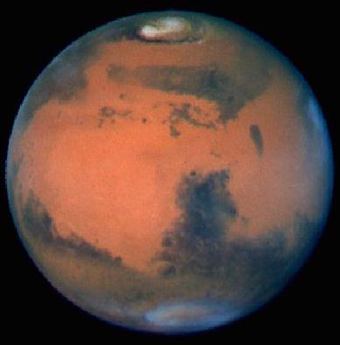
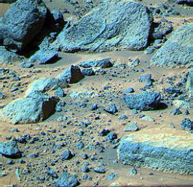
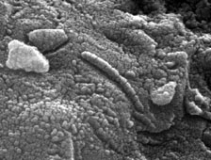
EVIDENCE OF LIFE ON MARS?
Are these biological microfossils?
From: MacKay et al. 1996 Science

Slide 18
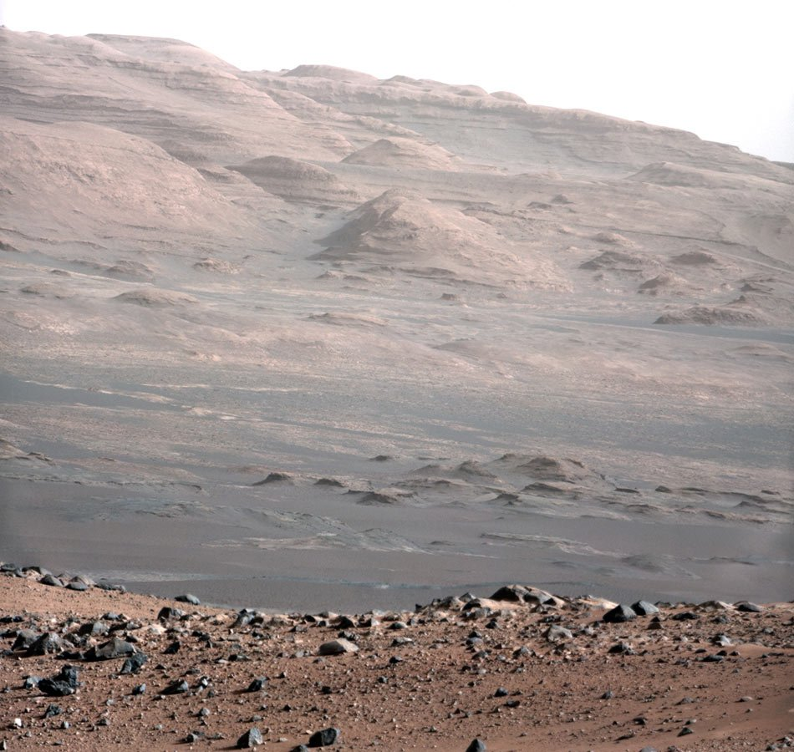
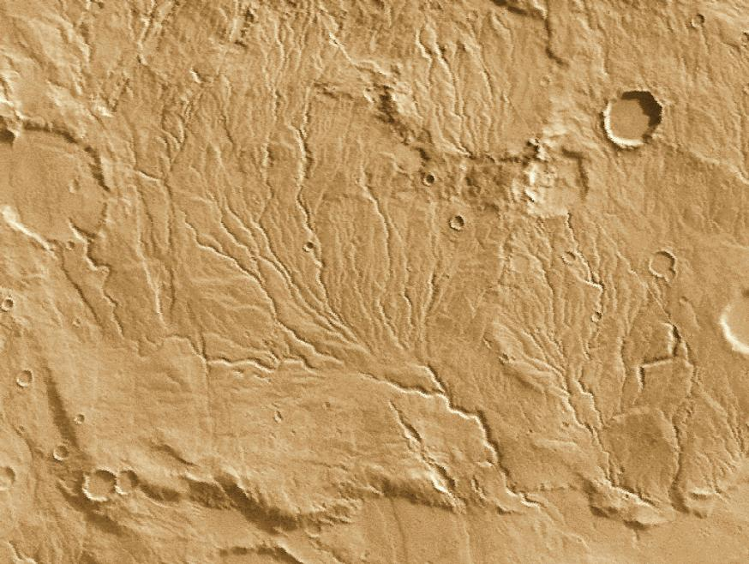

Slide 19
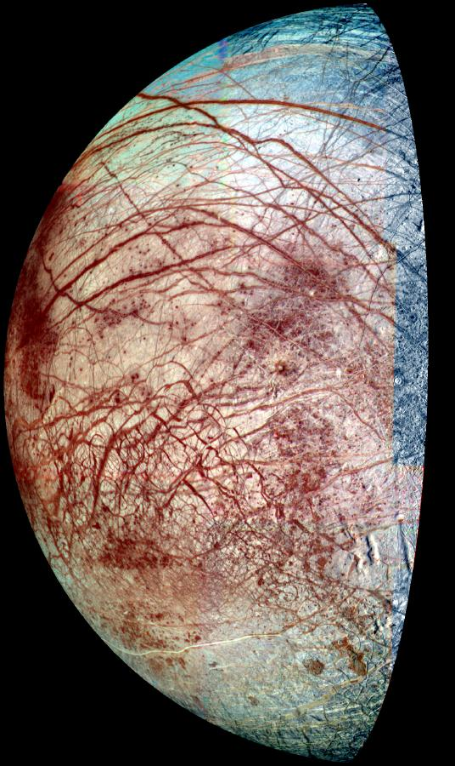
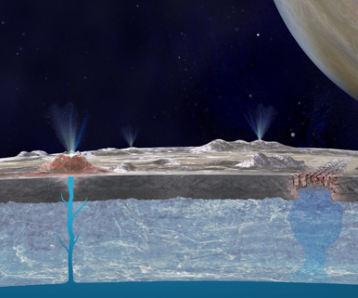
Titan
Life on the moons of Jupiter and Saturn?
Europa

Slide 20
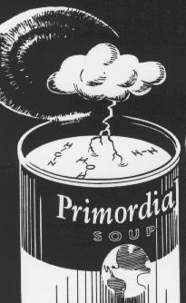
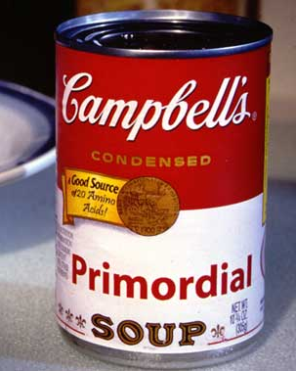
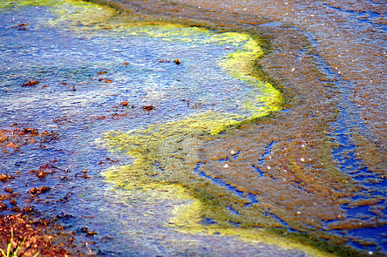
Primordial Soup

Slide 21
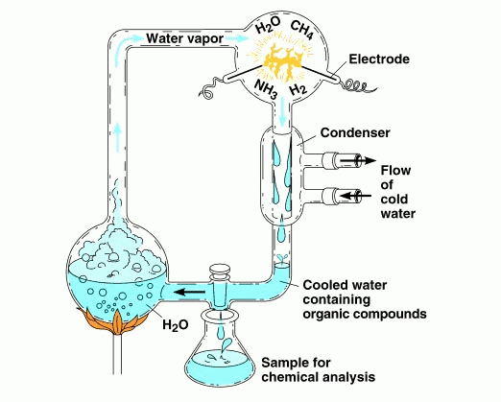
Experiment 1952:
Demonstrated that many of the compounds necessary for life could be produced in a “pre-biotic” atmosphere.
H₂CO - Formaldehyde
HCN – Hydrogen Cyanide
Amino Acids
Urea
NOT LIFE

Slide 22
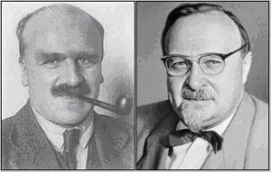
1920’s – Theoretical Advances

Slide 23
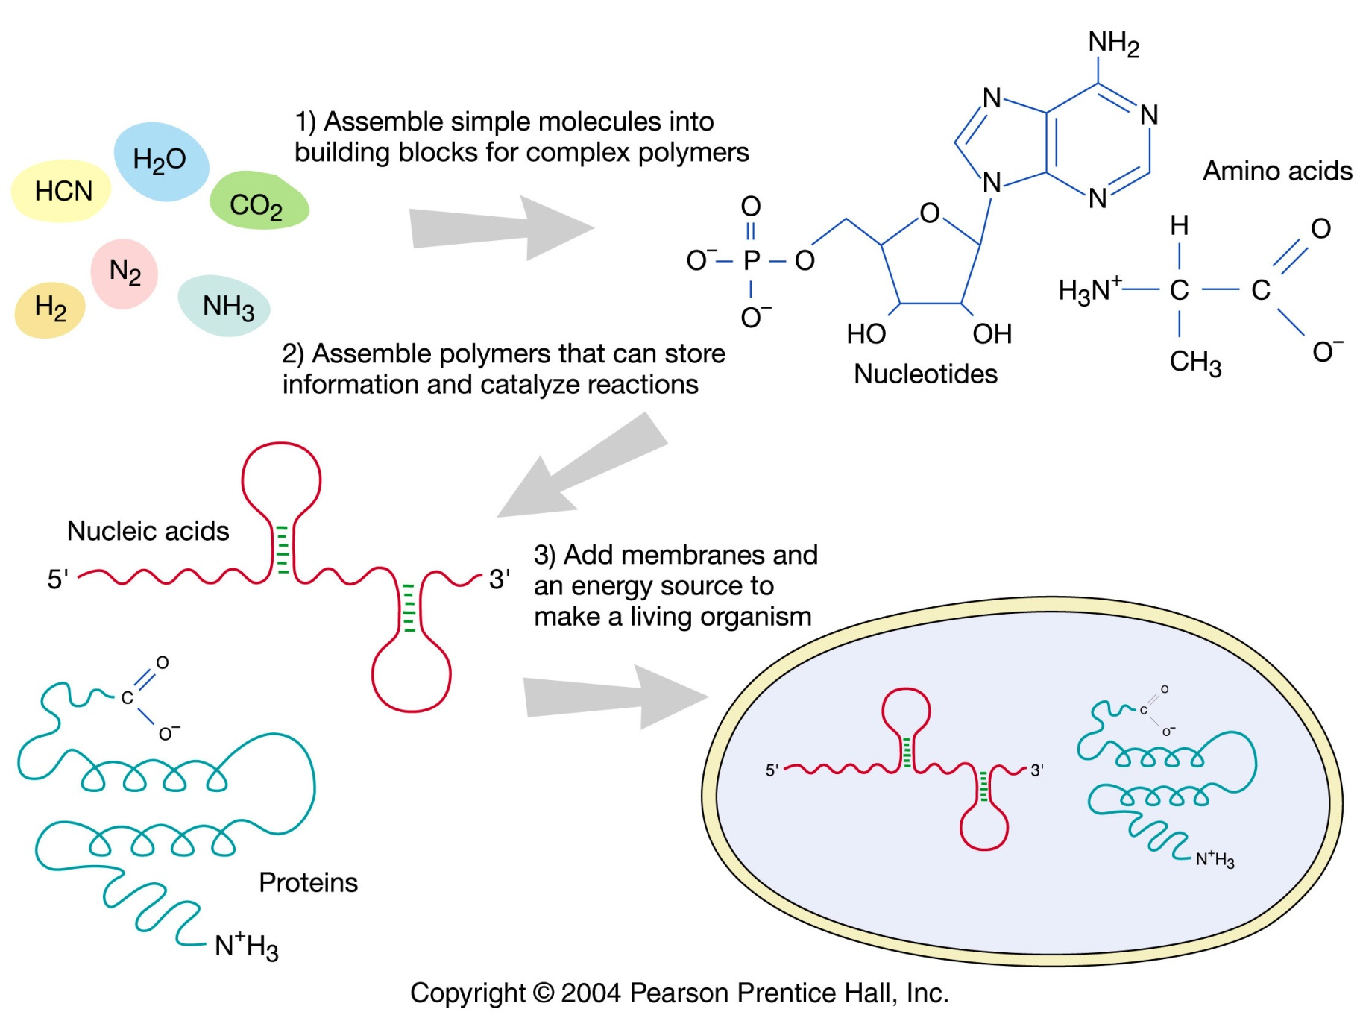
1920’s – theoretical advances

Slide 24
BIG UNANSWERED QUESTIONS IN ORIGIN-OF-LIFE RESEARCH
How did the “primordial soup” acquire the simple monomeric building blocks essential for the production of information bearing polymers?
What conditions are necessary for the initial (pre-biotic) assembly of such polymers?
Can a polymer be produced that is capable of self-replication as well as information storage?
How did compartmentalization, necessary for self-recognition during replication and for the diffusion of gene products, evolve?
Which came first---DNA, RNA, protein, or something else, or did complex systems involving all of these emerge simultaneously?

Slide 25
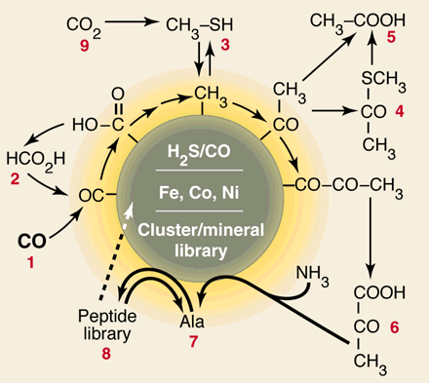
Proposed by
Gunter Wachtershauser

Slide 26
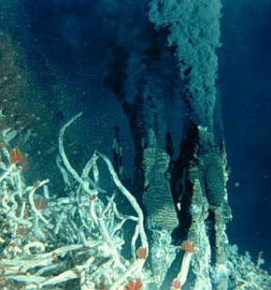
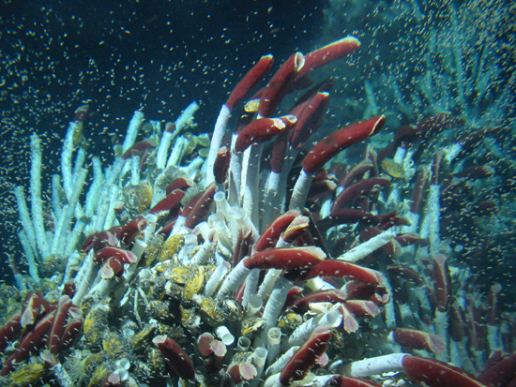
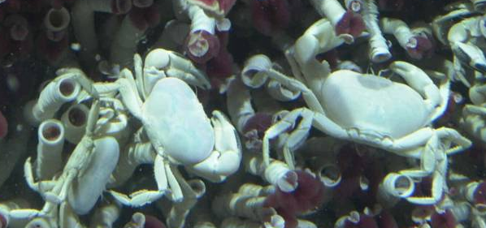
All life depends on _____ for energy.
Deep-sea Thermal
Vents
Support a diverse fauna completely dependent on hydrogen sulfides

Slide 27
What’s the take home message of all these hypotheses and studies?

Slide 28
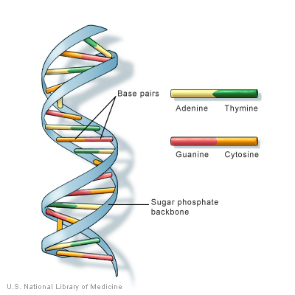
The first “genetic” molecule
Partially answered first question
What is needed next?
Characteristics?
What are the potential molecules?
Teams (Gall assigned)
Goal: determine which molecule most likely the first genetic material

Slide 29
The first “genetic” molecule
Task
  Identify strong and weak points for each molecule regarding their likelihood as the first “molecule”
Questions to consider:
  Entire molecules (or components) in the soup?
  How well do they do each characteristic?
  What shape are they and how will this influence the two characteristics?
  Where can they be found today?
  How well do they replicate?
  How stable is each molecule?
  Where do they fall in the modern replication chain?
  How likely are mistakes?

Slide 30
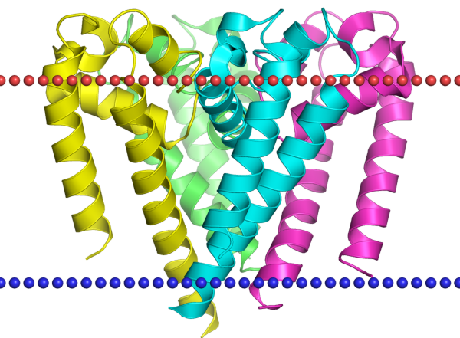
ASSEMBLY OF AN INFORMATION BEARING POLYMER:
PROTEINS FIRST?
Strong points:
AA in soup
All 20 essential AA produced in EXP
Can stick together and make polymer
Snap into shape and catalyze rxn
Weak points:
Don’t find protein outside modern systems
Can’t self replicate (globular)
But see video
https://www.youtube.com/watch?v=dXcLb4oCYfg
Sodium Channel Protein

Slide 31
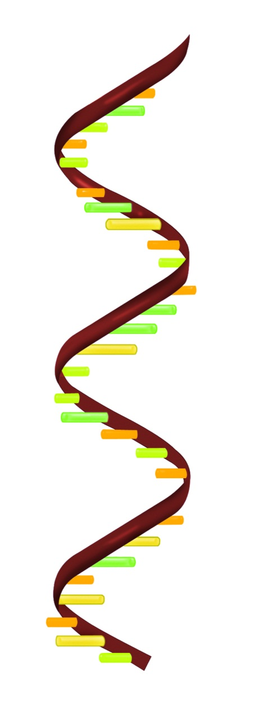
ASSEMBLY OF AN INFORMATION BEARING POLYMER:
AN RNA WORLD?
Strong points:
Obviously can store information
Can make protein
RNA can “snap” into pattern and act like enzyme
Weak points:
Modern systems RNA doesn’t replicate
RNA without DNA?
Not double stranded – probs?
https://www.youtube.com/watch?v=K1xnYFCZ9Yg

Slide 32
ASSEMBLY OF AN INFORMATION BEARING POLYMER:
A DNA WORLD?
Strong Points:
Very good at storing info
Codes for RNA and Protein
Double stranded – backup
Stable
Weak Points
Can not catalyze reactions (ZERO catalytic ability)
Hard to replicate without other molecules

Slide 33
What’s the most likely candidate?
https://www.youtube.com/watch?v=K1xnYFCZ9Yg

Slide 34
RNA World Hypothesis
Nucleotides present in soup
Chains of RNA formed naturally
Some of these “folded” into shapes with catalytic abilities
TONS of free nucleotides
One of these gained replication ability
First proto-life

Slide 35
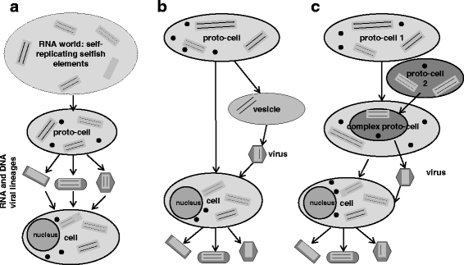
Where do viruses fit in?
Durzynska et al. 2015
Notes:
https://virologyj.biomedcentral.com/articles/10.1186/s12985-015-0400-7
Three major theories of virus origin. Arrows show the direction of evolutionary changes. a. According to the virus-first hypothesis at the dawn of life there were no cellular forms but only first RNA molecules possessing enzymatic activities and capable of self-replication, also called selfish genetic elements. b. According to the escape hypothesis viruses derived from cellular RNA or/and DNA fragments such as plasmids and transpozons. During asymmetrical cell fission a vesicle (smaller cell-like entity) could have formed engulfing a self replicating RNA and a coat encoding RNA segment. c. According to the reduction hypothesis viruses come from small primordial cells (not necessarily primitive), which lost their cellular elements in the course of evolution. They maintained, however, their genetic material and certain elements needed for replication. Proto-cells presented in this picture already contained ribosomes (black small plain circles) and were able to produce proteins/capsids, whereas cells containing a nucleus correspond to modern cells, which descended from LUCA. Eukaryotic cells were used to depict all three hypotheses of virus origin and underline a possible involvement of viruses in eukaryogenesis

Slide 36
Why the transition to DNA?

Slide 37
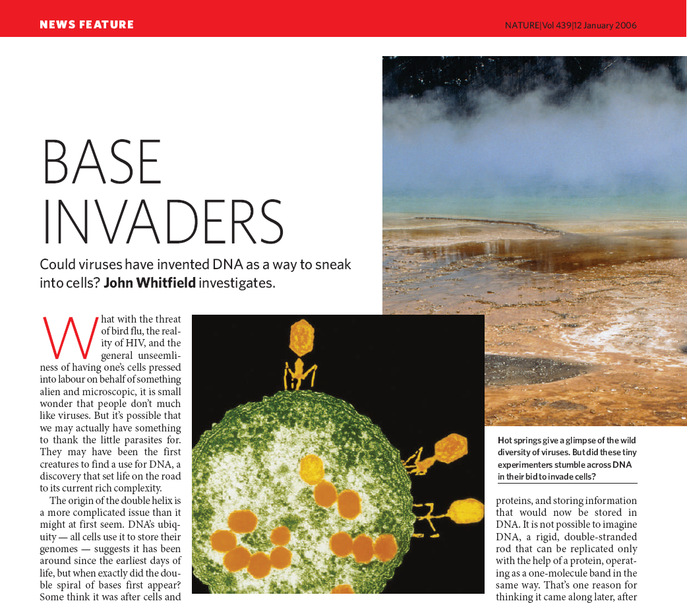

Slide 38
Another hypothesis
Patrick Forterre (2015)
  RNA world
  Viruses already present (virus genetic material?)
  Virus evolved DNA (why?)
  DNA virus coexist in cell
  DNA coopted by host
  What else is possible?
Durzynska et al. 2015
Notes:
https://virologyj.biomedcentral.com/articles/10.1186/s12985-015-0400-7
Three major theories of virus origin. Arrows show the direction of evolutionary changes. a. According to the virus-first hypothesis at the dawn of life there were no cellular forms but only first RNA molecules possessing enzymatic activities and capable of self-replication, also called selfish genetic elements. b. According to the escape hypothesis viruses derived from cellular RNA or/and DNA fragments such as plasmids and transpozons. During asymmetrical cell fission a vesicle (smaller cell-like entity) could have formed engulfing a self replicating RNA and a coat encoding RNA segment. c. According to the reduction hypothesis viruses come from small primordial cells (not necessarily primitive), which lost their cellular elements in the course of evolution. They maintained, however, their genetic material and certain elements needed for replication. Proto-cells presented in this picture already contained ribosomes (black small plain circles) and were able to produce proteins/capsids, whereas cells containing a nucleus correspond to modern cells, which descended from LUCA. Eukaryotic cells were used to depict all three hypotheses of virus origin and underline a possible involvement of viruses in eukaryogenesis

Slide 39
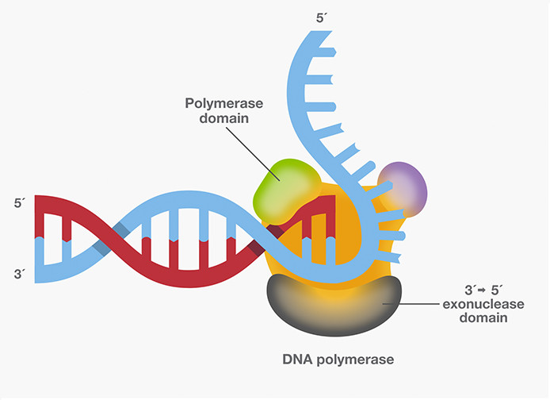
Evolution of Genome Size
Early RNA life small & not complex
  100-300 nucleotides long
  Critical max size – why?
  Paradox – how do cells prevent errors?
To get larger genome
  Reduce error rate OR
  Occupy env where cost of mutation high
Selection removes individuals that can’t repair errors or prevents them from making them
Cost of Mutation Critical Genome Size
1 320
10 7,680
100 15,350
https://journals.plos.org/plosone/article/file?id=10.1371/journal.pone.0021904&type=printable

Slide 40
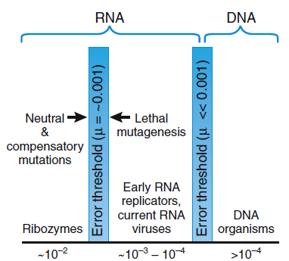


EET assumes can’t increase replication efficiency without repair enzymes
When RNA folds, can buffer negative effects of mutation
Genome size
small
large
Error rate (mut/nucleotide/rep)
Kun et al. 2005. Nature

Slide 41
Genome Size for Single-Stranded RNA viruses

Slide 42


How did Compartmentalization Evolve?
Necessary for self-recognition during replication
3 properties

Slide 43
PNAS 2019
Three components in early “life”
RNA
Protein (amino acids)
Membrane (lipids)
Problem
RNA production – magnesium – breaks down membranes
Salt water – breaks down membranes
Problem
RNA production – magnesium – breaks down membranes
Salt water – breaks down membranes

Slide 44


3 components of life
CELL
Free-floating piece of self-replicating RNA
Accidently encapsulated in fatty acids
Lots of RNA inside vesicle, creates osmotic stress
    Drives uptake of acids from unstressed membranes, relieves the membrane tension
“Cell” splits due to size and agitation
when genome and membrane increase together
COMPETITION!
NEW RESEARCH FROM 2019

Slide 45
CURRENT TIME
Are there multiple origins of life or just one?
ORIGIN OF EARTH

Slide 46

If the theory be true it is indisputable that before the Cambrian stratum was deposited long periods elapsed…and that during these vast periods the world swarmed with living creatures… (However), to the question why we do not find rich fossiliferous deposits belonging to these earliest periods…I can give no satisfactory answer. The case at present must remain inexplicable….
Charles Darwin 1859

Slide 47

Reconstructing Early Life
Extremely long time periods
Early life forms were floozies
60 “universal” genes (what is minimum # for functioning organism?)
Hyperthermophiles at the base (where did life arise?)

Slide 48

Number of Predicted Genes from 244 complete bacterial and archaeal genomes
Contrast and compare the environments for these parasites relative to the molecular soup? –
thoughts?
Smallest free living organism
What are the black dots
Giovannoni et al. 2005 Science 309:1242-1245

Slide 49


Genomes Keep Shrinking!!
Bennett and Moran. 2013. Genome Biology and Evolution

Slide 50

CAPTURE OF ORGANELLE GENOMES

Slide 51


Slide 52

Proterozoic Eon

Slide 53


Sun
Why is Oxygen so important?
Ultraviolet rays
3(O₂)
Upper atmosphere
2(O₃)
Lower atmosphere
Oxygen
Notes:
Figure 21.6: The formation of ozone.
Ozone (O₃) forms in the upper atmosphere when ultraviolet radiation from the sun breaks the double bonds of oxygen molecules.
Glycolysis is the process anaerobic organisms use to make energy – in this 2 atp are input and 4 output, for a net of 2 atp

Slide 54



What caused the change?

Slide 55

The Origin of Eukaryotes
Origin of Eukaryotic cells from prokaryotic ancestors: 2-1.5-1 BYA

Slide 56

Kenzie, Rachel, and Izzy, walk me through the necessary steps to get a primitive eukaryote.
Lynn Margulis
Notes:
Proposed in 1905 by Russian scientist
Expanded and evidence provided in 1960’s by Lynn Margulis

Slide 57




Evolution of Eukaryotes
2 BYA
1.5 BYA
1 BYA
590 MYA

Slide 58


Evidence

Slide 59

A Secondary Symbiosis in Progress?
Noriko Okamoto and Isao Inouye*
Problems with Endosymbiosis
Lateral gene transfer from the symbiont to the host
Establishment of transport machinery back into symbiont
Synchronization of host-symbiont cell cycles
“The symbiont cell retains its nucleus, mitochondria, plastid, and occasionally a vestigial Golgi body, but the flagella, cytoskeleton, and endomembrane system are lost.”
Nature Oct 2005
Notes:
Fig. 1. (A) Hatena (ventral view). All green, symbiont-possessing cells have an eyespot at the cell apex
(arrowhead). Scale bar, 10 mm. (B) A dividing cell (ventral view). The symbiont is always inherited by
only one of the daughter cells. Scale bar, 10 mm. (C) The ultrastructure of eyespot integration
(longitudinal view). E, eyespot granules. Scale bar, 400 nm. Inset: A magnified view of the membranes.
The inner and outer plastid membranes (arrowheads), the single symbiont-enveloping membrane
(double arrow), and the host plasma membrane (arrow) are tightly layered. Scale bar, 50 nm. (D) The
life cycle of Hatena, based on observations of natural populations. Hatena alternates between a host
phase that harbors a green endosymbiont and a predator phase that acquires the endosymbiont after
division. Solid line, observed steps in the process; broken line, hypothetical steps.

Slide 60



4 major evolutionary “advances” follow quickly

Slide 61
Timeline of events

Slide 62
0.002
0.6
CELL-CELL
COMMUNICATION
1.0
Origin of the major
eukaryotic groups
EVOLUTION OF SEX
(Meiosis)
1.5
Eukaryotic cells appear
ORIGIN OF THE
NUCLEUS AND
ORGANELLES
2.5
Atmospheric oxygen plentiful
3.6
Simple cells abundant
ORIGIN OF LIFE
3.8
Stabilization of the earth
4.6
Origin of the earth
BYA

Slide 63

EVOLUTION OF COMPLEX ANIMAL LIFE

Slide 64
THE PROTEROZOIC Eon: 2.5 BYA TO 600 MYA
prokaryotes and eukaryotic algae
multicellular animal life appeared less than 1 BYA
~ 640 MYA

Slide 65




Droser and Gehling 2015. PNAS

Slide 66

Just et al. 2014. PLOS One

Slide 67


PHANEROZOIC EON:
600 MYA - Present
Fossil record scant, until ~550 MYA
550 MYA - EXPLOSION
All modern phyla and classes of hard-bodied marine animals suddenly appear in the fossil record
Only took 5-30 MY
Ended with a mass extinction

Slide 68


Usually Fossils Look Like This
Occasionally,
They Look Like This!
Lenoides serratus

Slide 69




Marrella splendens
Wiwaxia
Waptia

Slide 70


Yunnanozoon lividum
Notochord
Myomeres
Pikaia gracilens

Slide 71

Haikouichthys

Slide 72

Cambrian Assemblage

Slide 73





Origin of Modern Phyla
DIVERSIFICATION DURING THE PRECAMBRIAN PERIOD RESULTED IN THE ORIGIN OF VIRTUALY ALL THE EXTANT MAJOR ANIMAL PHYLA!!

Slide 74



EARLY METAZOAN EMBRYOS
From the Doushantuo
Formation, Southern China
570 MYA
FROM: Xiao et al. 1998 Nature

Slide 75



Slide 76



Science 2011

Slide 77
WHAT PRECIPITATED THE EXPLOSION?
Increasing oxygen levels in the atmosphere
Vacant ecological niches
Key innovations
Evolution of hard parts
Abiotic changes
Nobody knows for sure.

Slide 78

If diverse body plans appear suddenly, genetic architecture must be present

Slide 79


Gives new meaning to butthead

Slide 80

Complexity occurs through HOX duplication
How new structures appear
Expansion of a gene family
Acquisition of novel gene function
Increasing complexity
Assumes morphological complexity correlated with genetic/genomic complexity – does it?

Slide 81


The Enigmatic Phyla
Srivastava et al. 2008. Nature

Slide 82
What Precipitated the Explosion?
Increasing oxygen levels in the atmosphere
Vacant ecological niches
Key innovations
Evolution of hard parts
Abiotic changes
Nobody knows for sure.
What are we basing the existence of an explosion on?
Or maybe there was no such thing…

Slide 83

Molecular Evidence for Deep Precambrian Divergences Among Metazoan Phyla
What conclusions can we draw about the fossil record if this is correct?
Wray et al. 1996 Science
Notes:
One assumption that limits the results is assume rates of change are equal among lineages and across time. Almost certainly not true between lineages.

Slide 84

Molecular Update
Molecular clocks problematic
Lee et al. 2013
  Built phylogentic clocks
  Molecular + Anatomical
Results
  Rates of change dramatically higher during the Cambrian
Conclusions
  Period of rapid diversification (explosion)
  Likely tied to open niches + key innovation
Lee et al. 2013. Current Biology
Notes:
Looked at rates of change among specific lineages
Built phylogenetic clocks – based on anatomical and genetic data for arthropods
Found rates of change in anatomy and genetics were indeed dramatically higher during the cambrian

Slide 85




early jawless fish

Slide 86






1st Terrestrial Life
450 MYA
Why arthropods first on land?
Dunkleosteus

Slide 87






400 MYA

Slide 88

Why seed plants so successful?
Notes:
Very quickly after vascular tissue – get first seed plants

Slide 89


Slide 90

350 MYA
What’s land like?
https://www.youtube.com/watch?v=o5Z4mPQBjqA

Slide 91



1st Amphibians

Slide 92





300 MYA
Amphibians diversify
First amniotes (who?)
(why such a big change?)

Slide 93


Reptile and Mammal ancestors diverge and diversify
Mammal ancestor dominant
Notes:
Probably higher metabolism and endothermic
Probably some hair
Likely still laid eggs

Slide 94

Permian Extinction
https://www.youtube.com/watch?v=xXMoBnuFZ5k

Slide 95

Jurassic and Cretaceous Periods
250 to 65 MYA

Slide 96



An Early Cretaceous Tribosphenic
Mammal and Metatherian Evolution
Zhe-Xi Luo, Qiang Ji, John R. Wible, Chong-Xi Yuan
150 MYA

Slide 97
https://www.youtube.com/watch?v=vq3nWnTkFbk

Slide 98


65 MYA - Present
“Age of Mammals”
66 MYA

Slide 99


Eobasileus
Diatrymiformes
Climate very warm
Many open niches
65-55 MYA

Slide 100




55-30 MYA
Climate cooling
Transitioning from forest to plains
All modern mammal orders appear
Modern birds appear
Indricotherium

Slide 101



30-20 MYA
Much cooler/drier
Ice forming at poles
Grazing mammals dominant

Slide 102

20 MYA – present
Major extinction events
Ancestral humans <6MYA
First modern humans (~200,000 yrs ago)
Modern climate patterns & continent positions
Land bridges connect all major continents

Slide 103
2
Ancestral humans
65
Diversification of mammals
100
Origin of flowering plants
150
Origin of early Mammals
200
Origin of Birds
250
Origin of Reptiles
300
Origin of amniotic egg
325
Origin of amphibians
400
Origin of land plants
550
Origin of the major groups of animals
MYA

Slide 104
Big Patterns in the History of Life
If life originated on earth, the main plan may have been set down in a “relatively” short period of time.
In terms of the appearance of major evolutionary novelties, long periods of stasis appear in the fossil record.
Explosive periods of diversification appear to follow the “invention’ of new genetic mechanisms or ecological changes precipitated by life itself.
Periods of stasis in the complexity of life appear to be getting shorter – suggesting evolution has “autocatalytic” properties.

