Slide 1
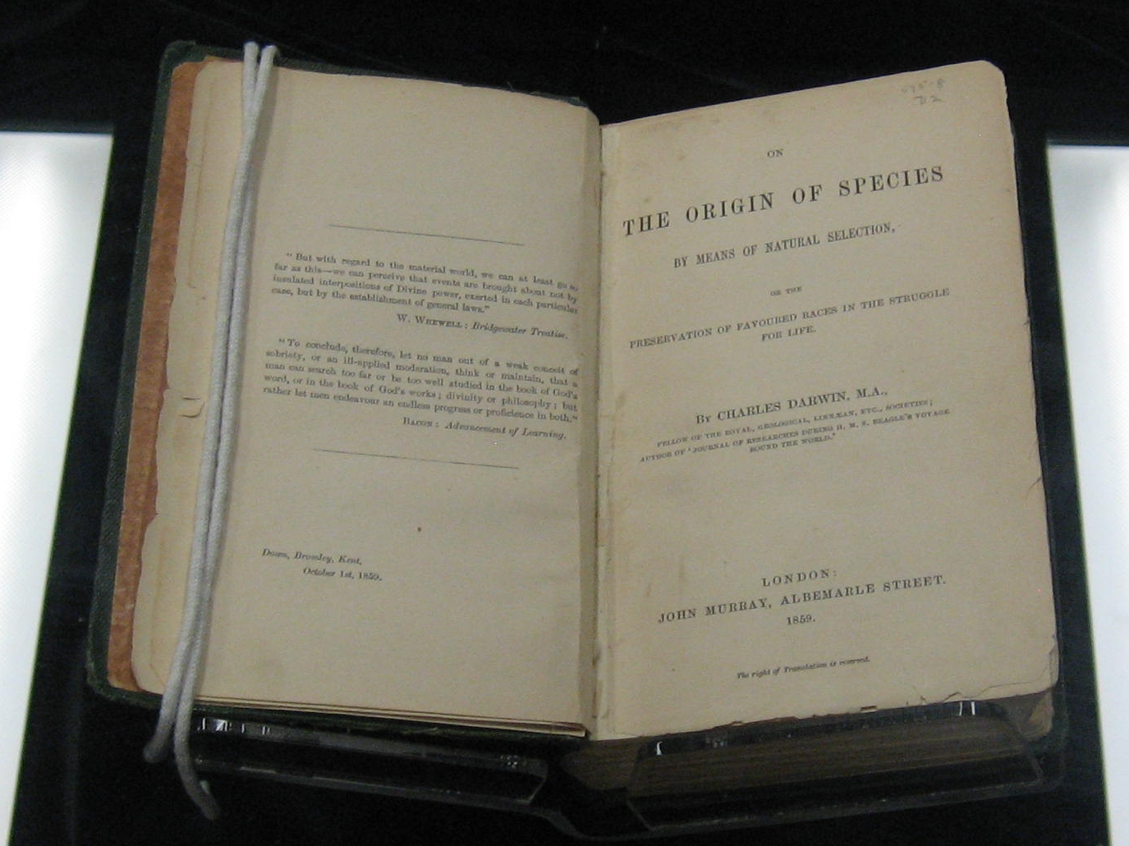
Evolution: A historical introduction

Slide 2
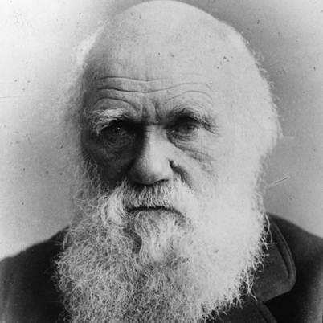
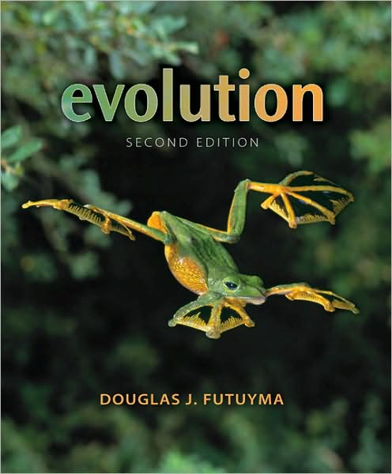
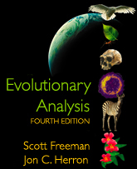
WHAT IS EVOLUTION?
Darwin:
Futuyma:
F & H:
Ours:

Slide 3
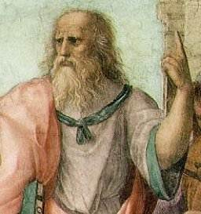
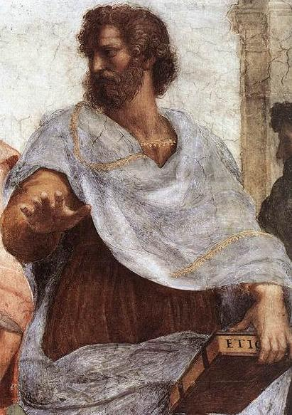
Historical perspectives
Plato (~400BC)
Aristotle (~350 BC)
  “Chain of Being”
Notes:
Complexity = Perfection
Vague…
Not how evolution works

Slide 4
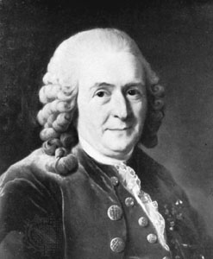
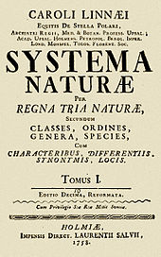
Wanted to discover order in the diversity of life “for the greater glory of God”

Slide 5

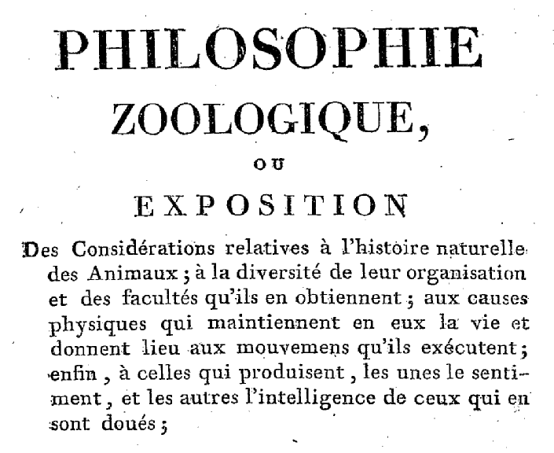
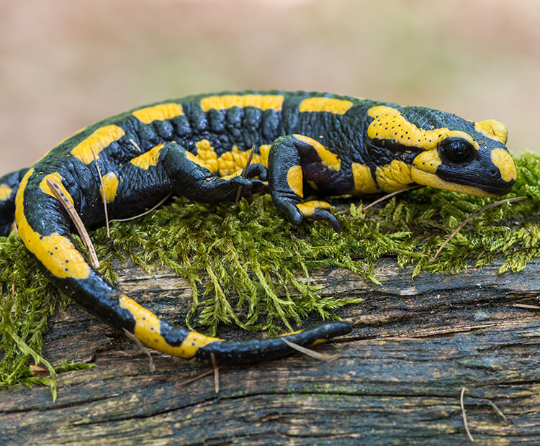
LAMARCKIAN EVOLUTION
“Chain of Being”
SCALE OF ORGANIZATION
TIME

Slide 6
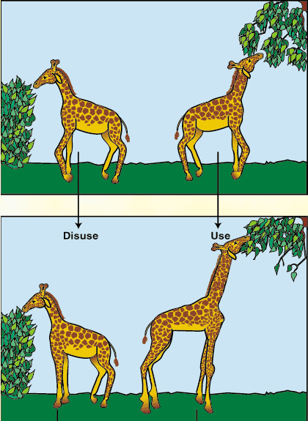
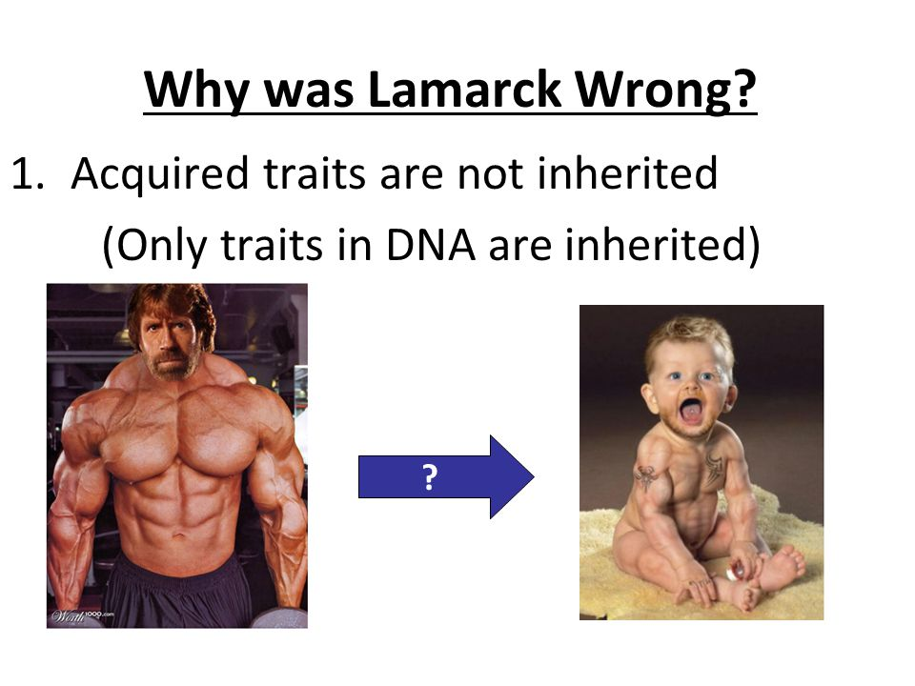
Lamarck’s example: Giraffe
Personal example: What do your parents do for a living?

Slide 7
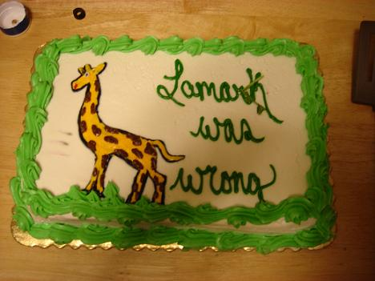
What’s wrong with Lamarck’s theory?
Still a major philosophical transition
Why?

Slide 8
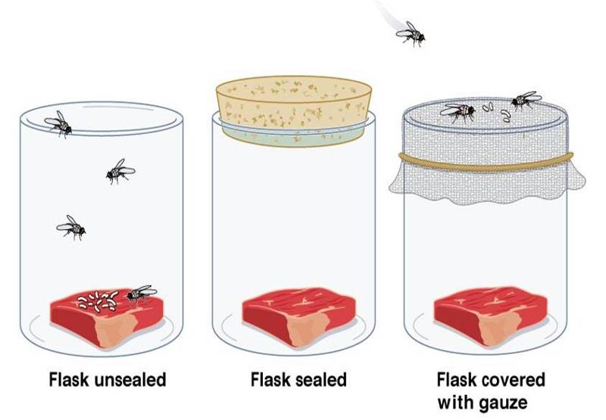
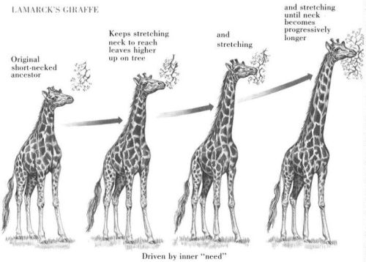
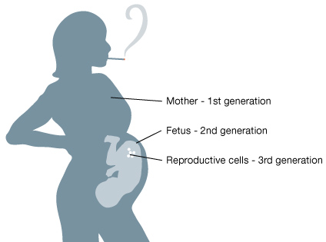
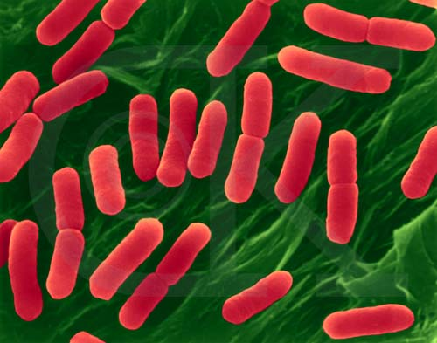
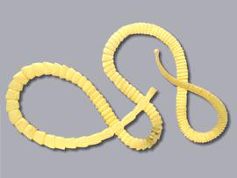
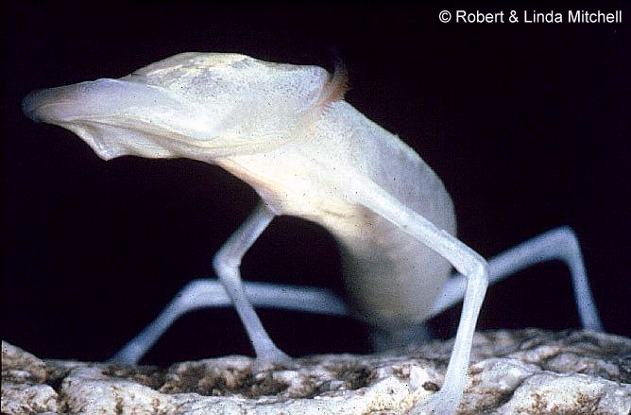
Problems with Lamarck’s ideas:
Francesco Redi

Slide 9
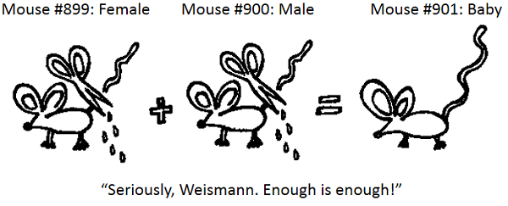

Slide 10
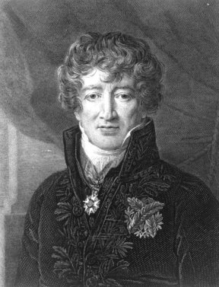
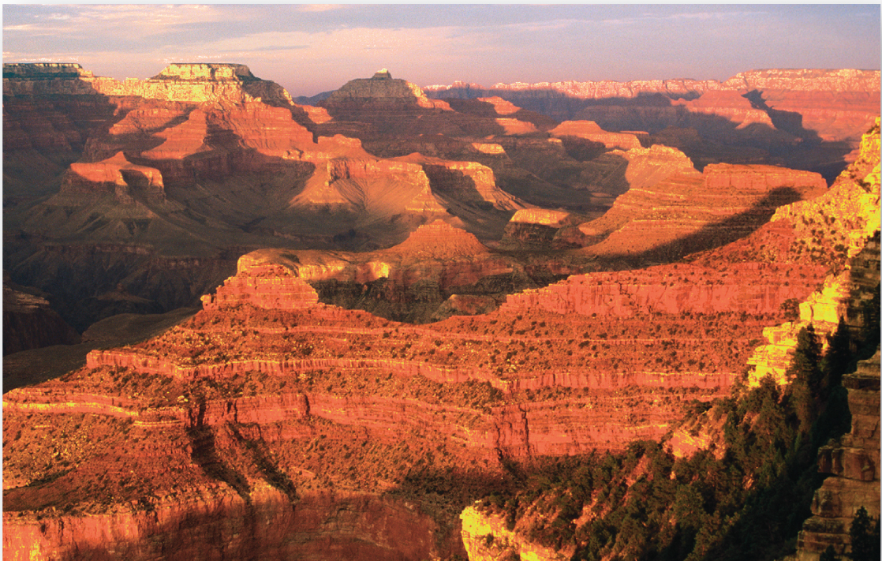

Slide 11
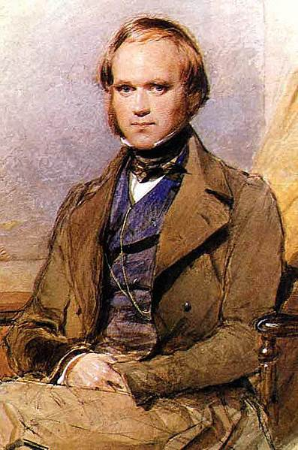
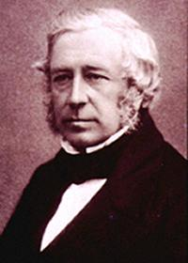
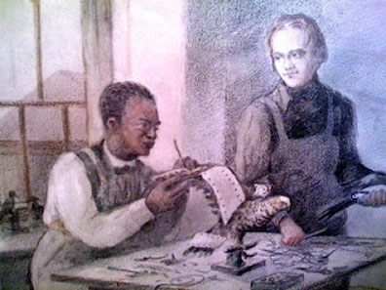
Charles Darwin
Born 1809
Edinburg - ?
Cambridge - ?

Slide 12
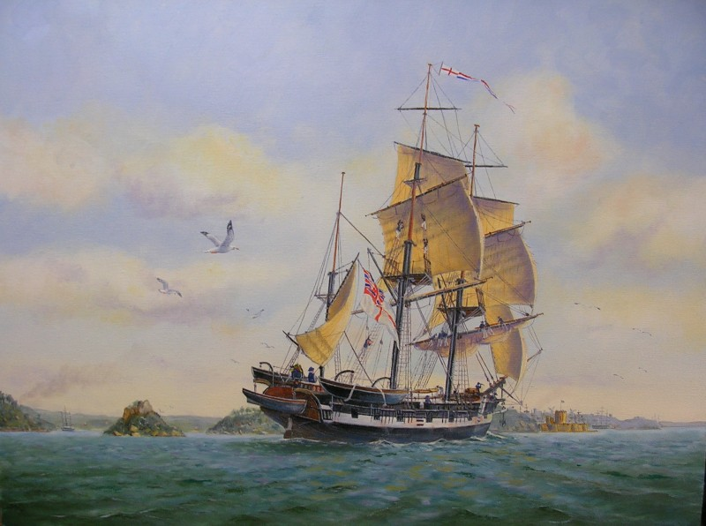
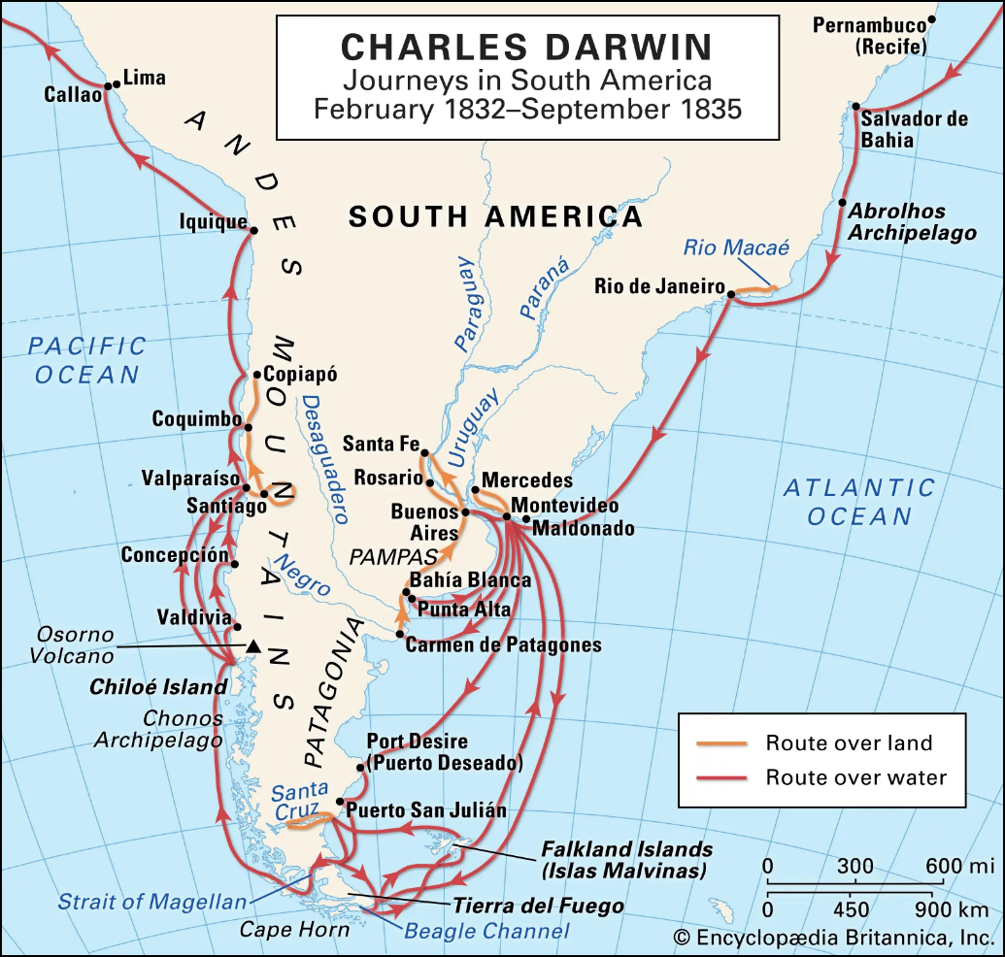
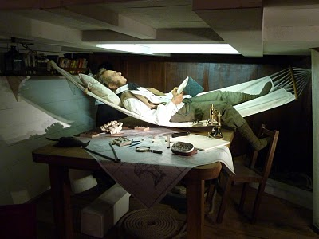
1831 – Henslow gets a letter

Slide 13
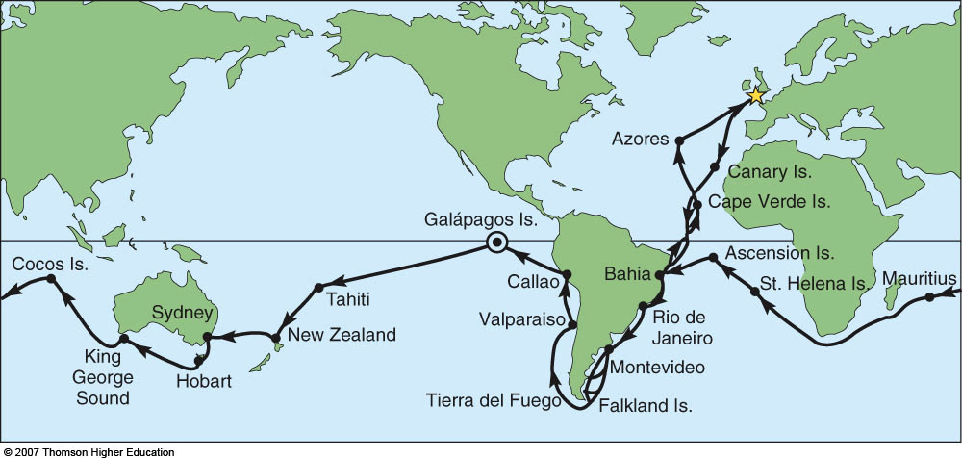
Voyage of HMS Beagle
Set sail from Plymouth, England in 1831 and sailed the
world on a British naval expedition for five years

Slide 14
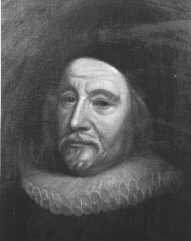
How old is the earth when Darwin left England?
Calculated in 1664 that the Earth
was precisely 5,668 years old.
“Heaven and Earth, Centre and substance were made in the same instant of time and clouds full of water and man were created by the Trinity on the 26th of October 4004 B.C., at 9:00 in the Morning.”

Slide 15
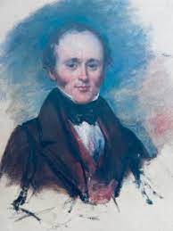
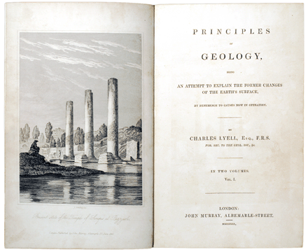
What did Darwin think of himself as?
Biologist
Philanthropist
Chemist
Geologist
Neurologist
What is the conclusion?
Charles Lyell

Slide 16
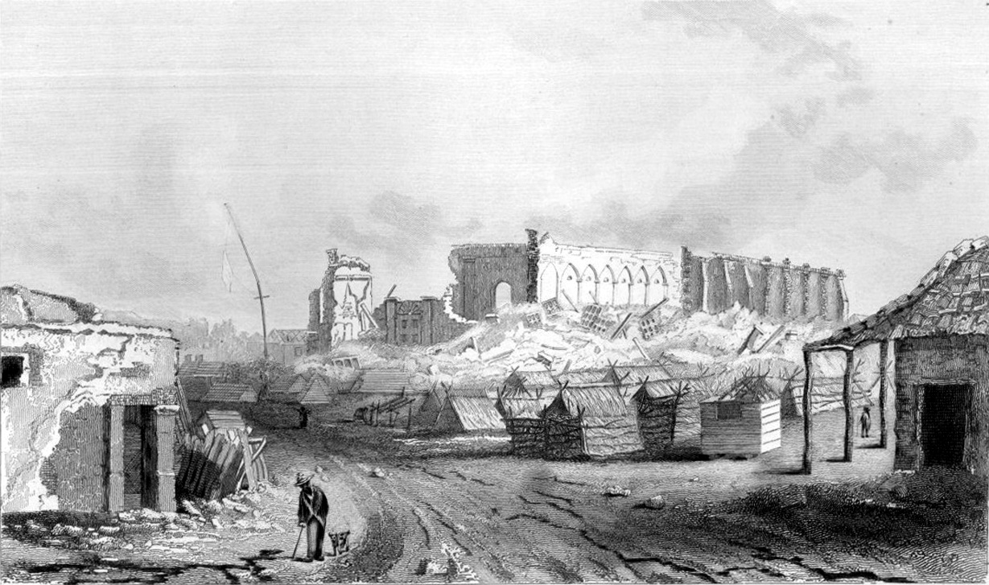
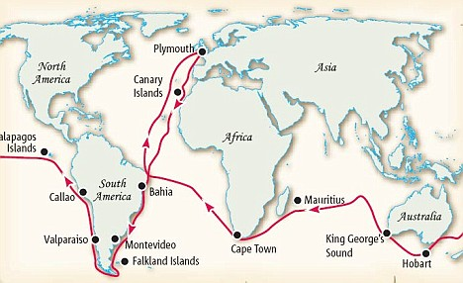

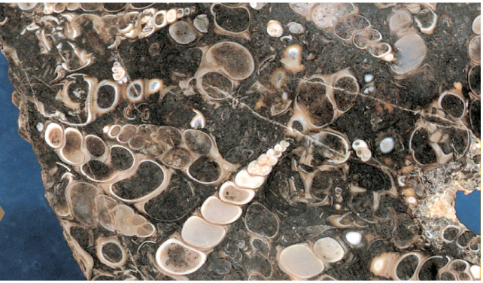
Darwin’s Observations
Darwin’s overland journeys
Cataloged over 10,000 organisms & fossils
Witnessed major geological events
  Earthquakes
  Strata
  Fossils
Began to appreciate long time-scales of earth’s history
“…founds beds of putrid mussel-shells still adhering to the rocks, ten feet above high-water mark: the inhabitants had formerly dived at lower-water spring-tides for these shells”
Fossils preserved in strata

Slide 17
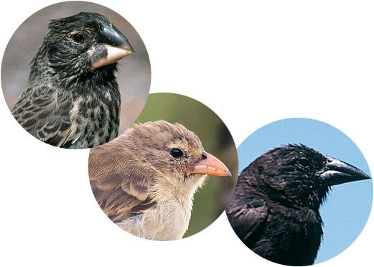
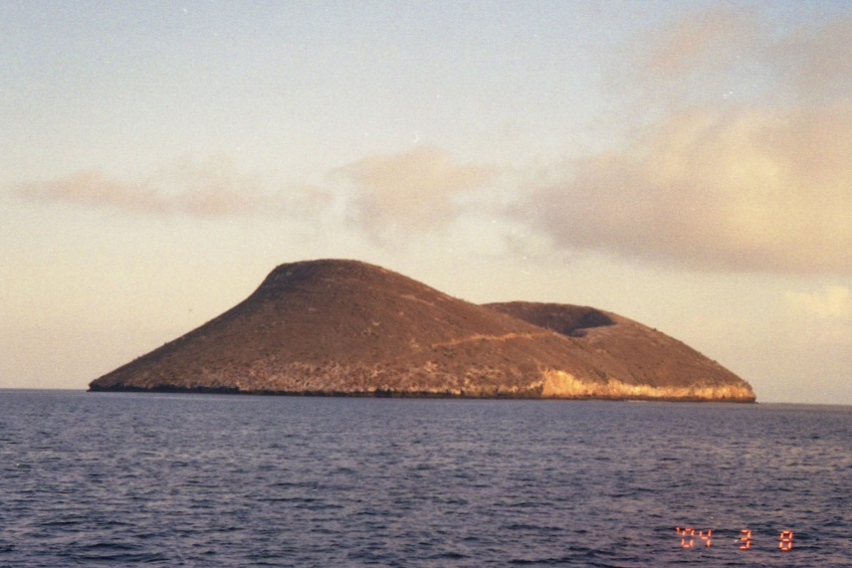
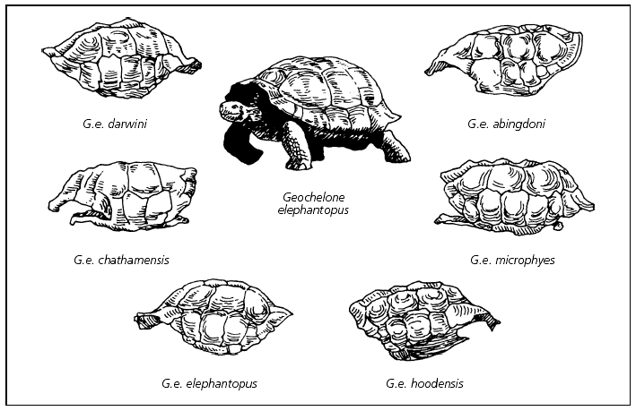
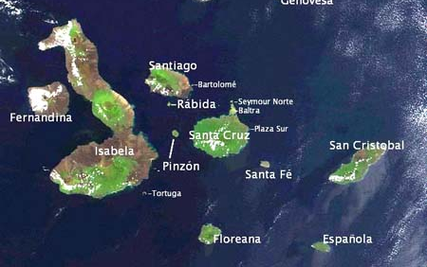
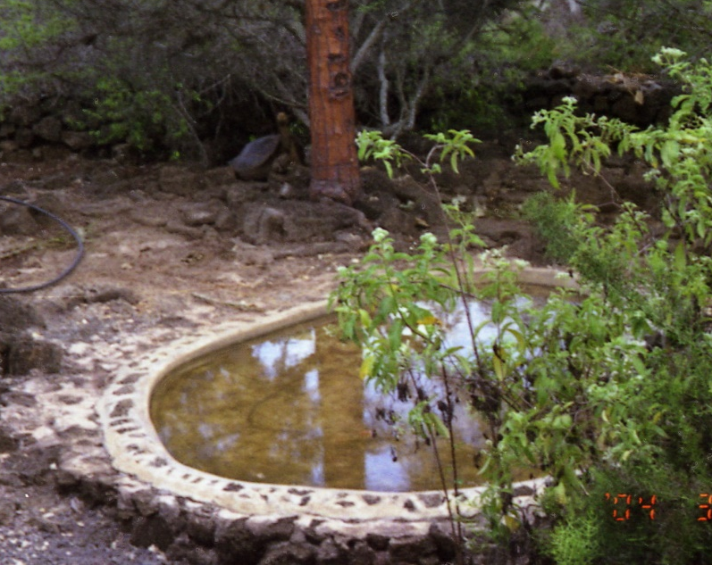
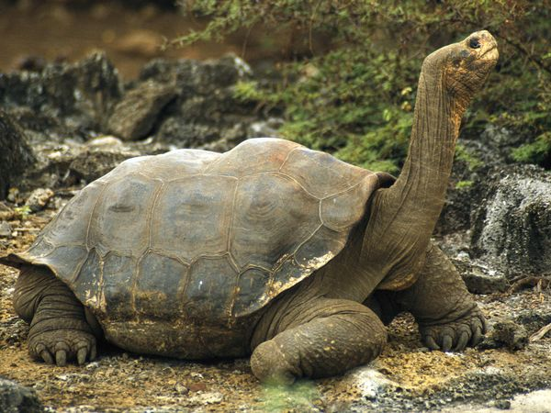
Darwin’s trip through the Galapagos
2 months on Galapagos
Started asking questions…
Why important?
Lonesome George

Slide 18
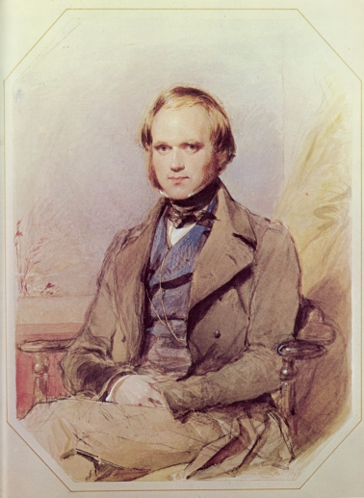
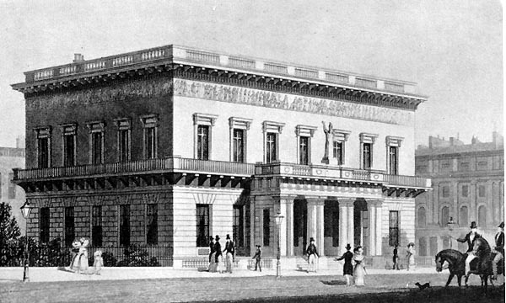
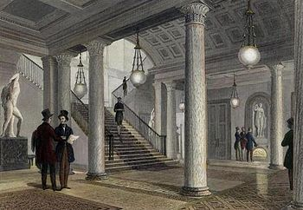
Return Home
Arrives home as a famous naturalist
Publishes Voyage of the Beagle
Most scientists accept evolution happens
Does Darwin accept concept of evolution?
Did he come up with the concept of evolution?

Slide 19
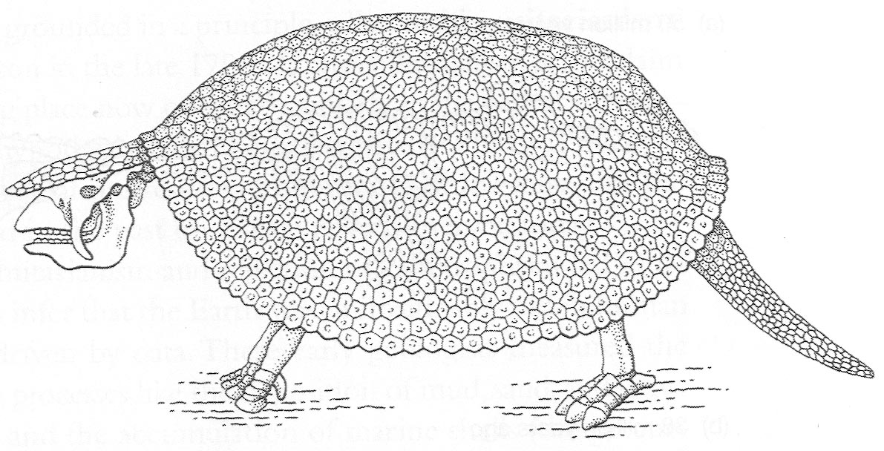
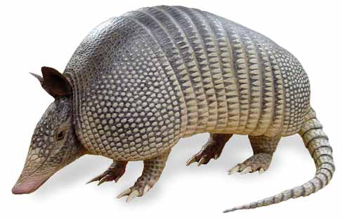
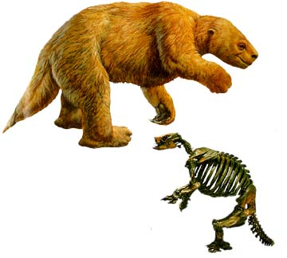
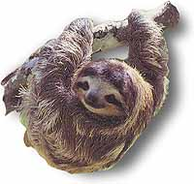
Once home, several observations help guide his ideas about evolution
GLYPTODONTS
ARMADILLO
TREE SLOTHS
GROUND SLOTHS

Slide 20
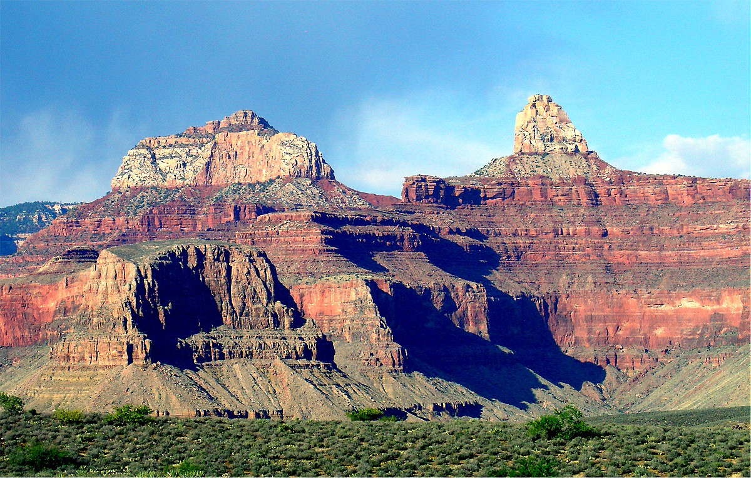
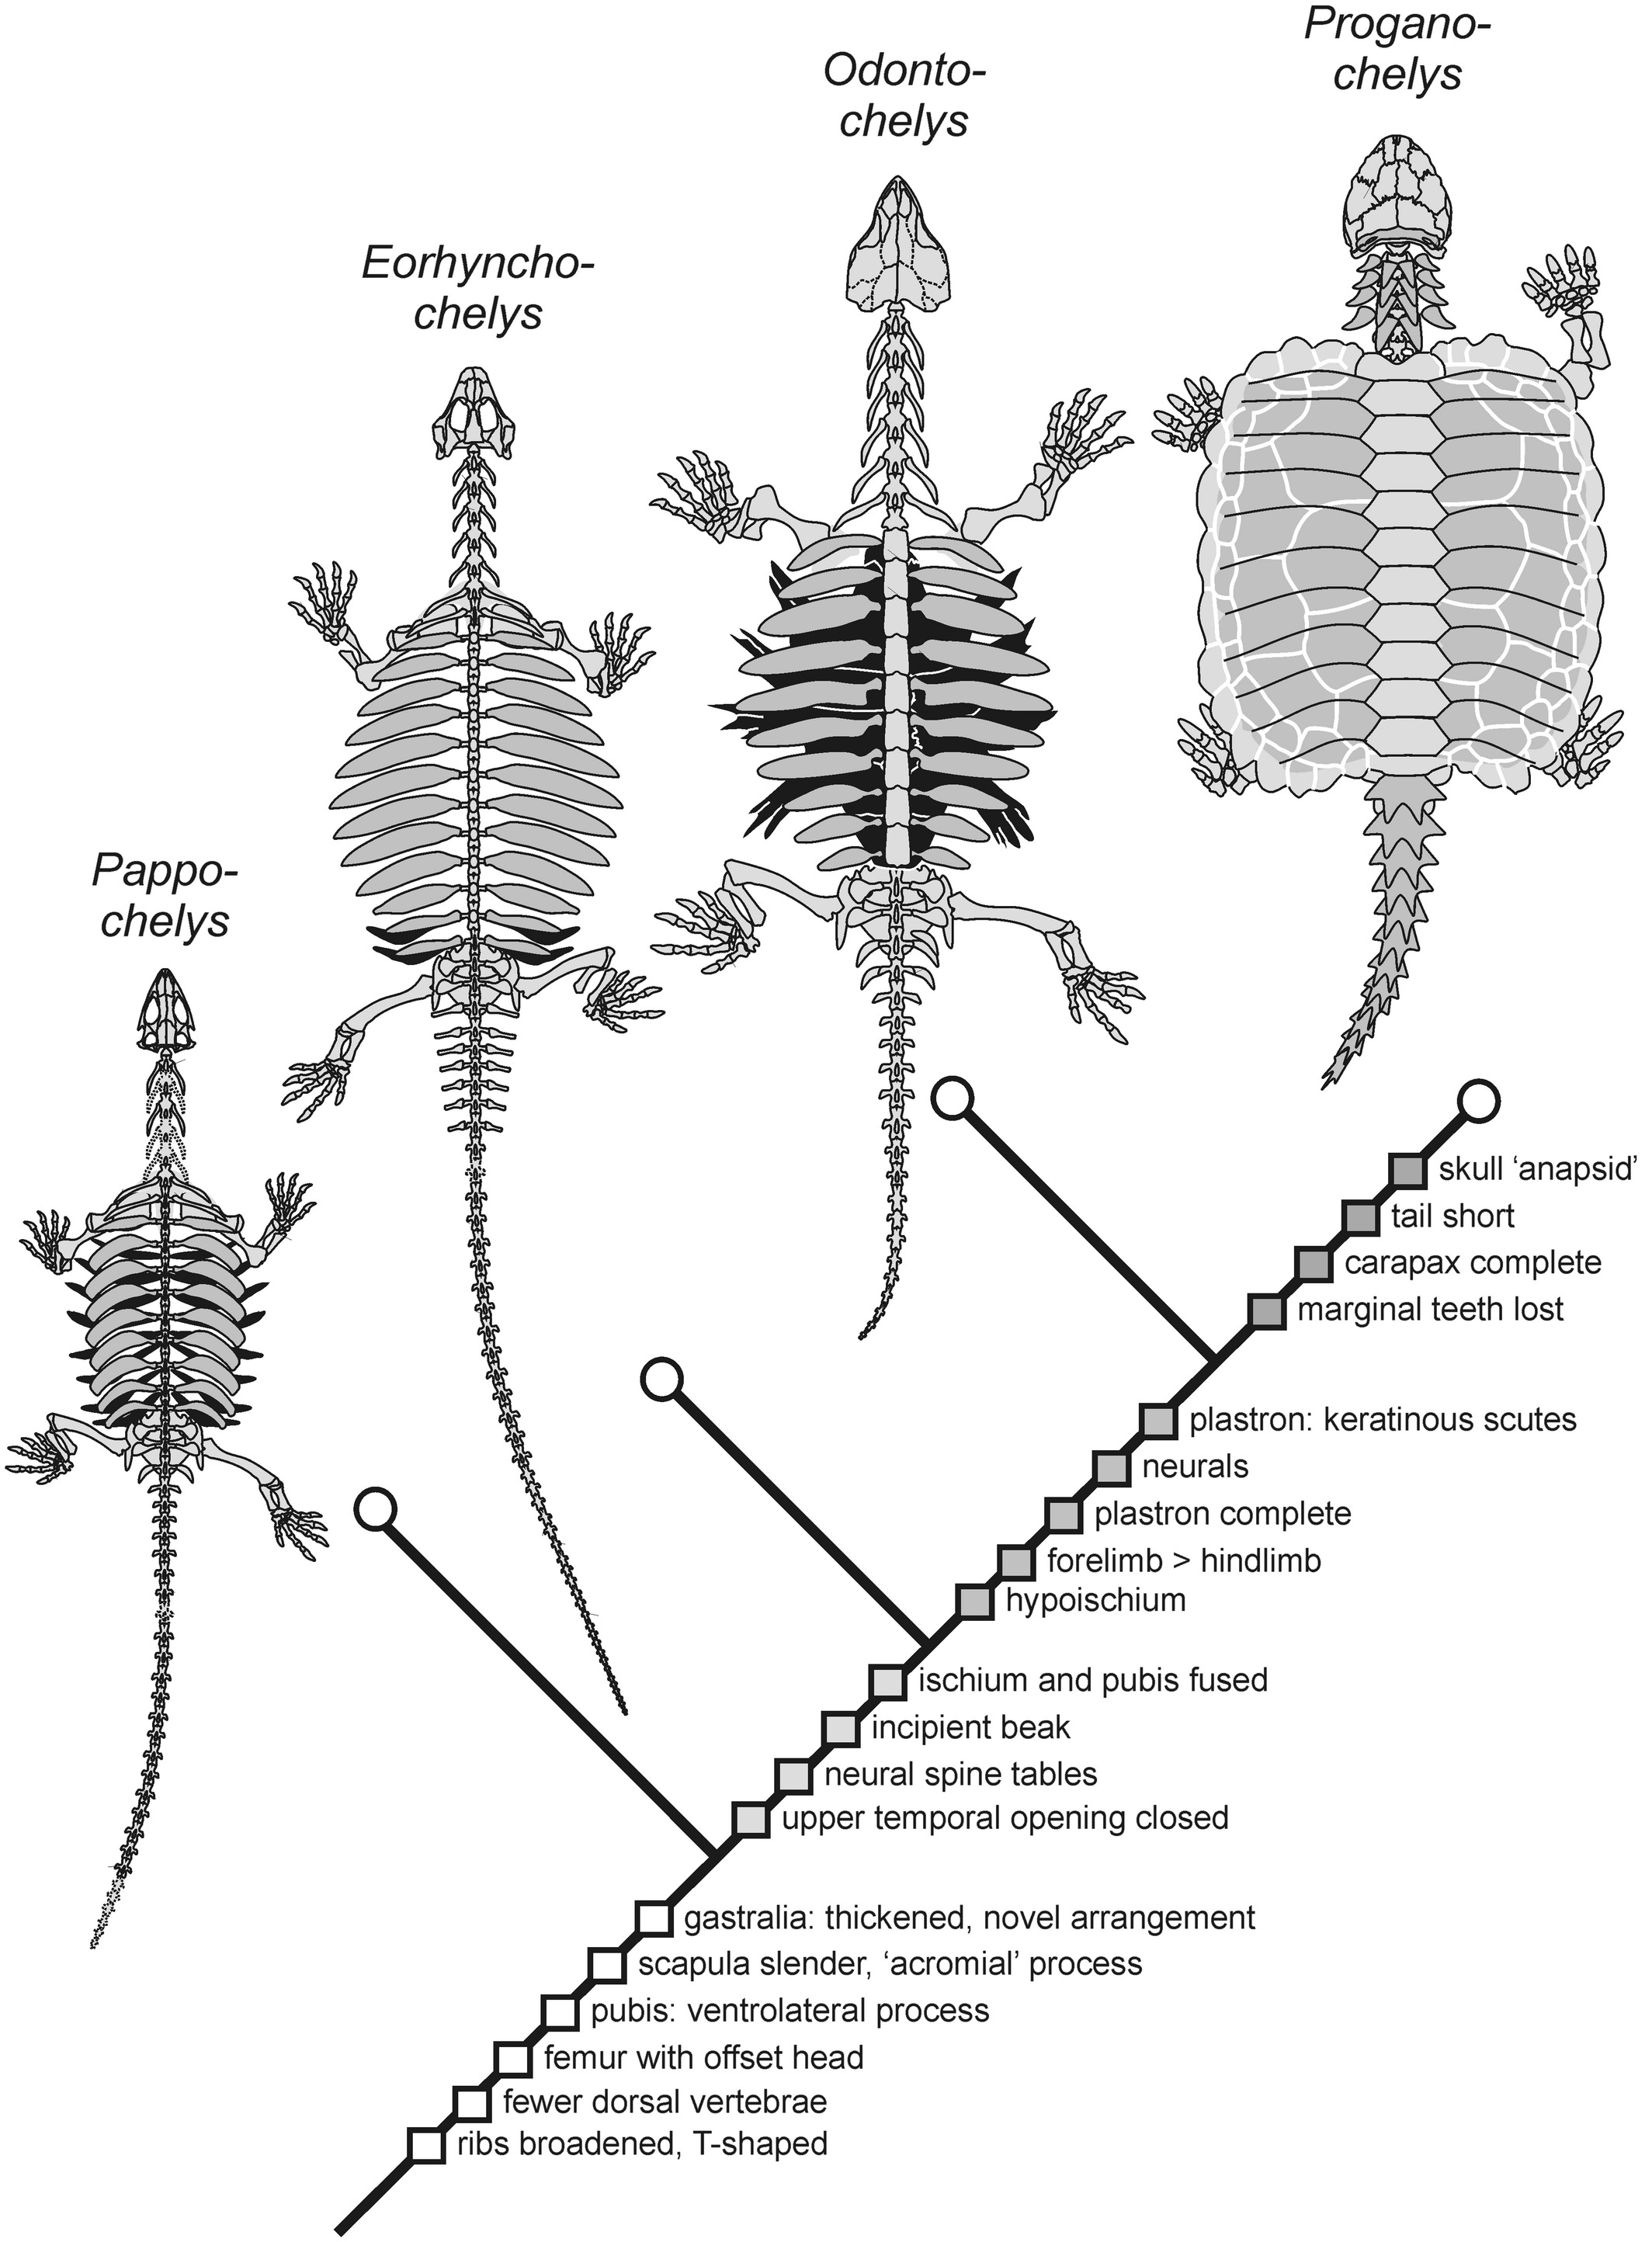

Slide 21




Observations from Domestic Animals:

Slide 22


Thomas Malthus

Slide 23
Premise of natural selection

Slide 24

SEPTEMBER 28, 1838:
“… it at once struck me that under these circumstances favourable variations would tend to be preserved and unfavourable ones to be destroyed. The results of this would be the formation of a new species.”
As more individuals …are born than can possibly survive, and as, consequently, there is a frequently recurring struggle for existence, it follows that any being, if it vary however slightly in a manner profitable to itself, will have a better chance of surviving, and thus be naturally selected. – The Origin of Species 1859
Charles Darwin

Slide 25

1838 What would you do?
What’s the modern equivalent?

Slide 26

1840’s

Slide 27


Almost scooped!
“Then it suddenly flashed upon me that this self-acting process would necessarily improve the race, because in every generation the inferior would inevitably be killed off and the superior would remain – that is, the fittest would survive.”
What does he do?

Slide 28


Linnaen Society
July 1, 1858
Darwin: ‘On the Origin of Species’
Wallace: ‘On the tendency of Varieties to Depart Indefinitely from the Original Type
What happened? What was the reaction?
“The year which has passed… has not, indeed, been marked by any of those striking discoveries which at once revolutionise, so to speak, the department of science on which they bear.”
--year end review, Society President

Slide 29
Linnaen Society
“The year which has passed… has not, indeed, been marked by any of those striking discoveries which at once revolutionise, so to speak, the department of science on which they bear.”
--year end review, Society President

Slide 30


The Origin of Species
"species have changed, and are still slowly changing by the preservation and accumulation of successive slight favorable variations."
Published in 1859
The publication represents greater
than 20 years of thought
Does Darwin describe evolution for the first time in Origin?

Slide 31


Missing information?
Darwin was not able to explain everything
Two major problems
Any guesses?

Slide 32


Darwin’s Four “Theories” of Evolution
Natural Selection – process where organisms better adapted to environment survive/reproduce more

Slide 33


Darwin’s Four “Theories” of Evolution

Slide 34

Post Origin Fall Out
Darwin’s evidence was convincing
Most (scientists) accepted evolution
Natural selection accepted?
What Are The Elements of Evolution by Natural Selection?

Slide 35




The Grants
The Grants

Slide 36


VARIATION

Slide 37

HERITABILITY

Slide 38

COMPETITION
Change in environment
(Resources)
Decline in population
size

Slide 39



Competition must lead to?
seeds from Tribulus cistoides
primary food during drought

Slide 40

Did the population evolve?
Will the population “evolve back?”
Is evolution slow and gradual?
‘77 selection event
https://www.youtube.com/watch?v=mcM23M-CCog

Slide 41
“If I were to give a prize for the single best idea anybody ever had, I’d give it to Darwin for the idea of natural selection. Ahead of Newton, ahead of Einstein, because his idea unites the two most disparate features of our universe: the world of purposeless, meaningless matter in motion on the one side, and the world of meaning and purpose and design on the other. He understood that what he was proposing was a truly revolutionary idea.”
Daniel Dennett, philosopher, 2001

Slide 42
BIOLOGY’S LAW
EVOLUTION BY NATURAL SELECTION – a necessary outcome of differential survival and reproduction, provided the characteristics that caused those differences are heritable.
A mechanism, as mechanical as any physical law
Acts on individuals, but only populations evolve
Opportunistic, not goal seeking – backward-looking, not anticipatory
Not the only mechanism of evolution

