Slide 1
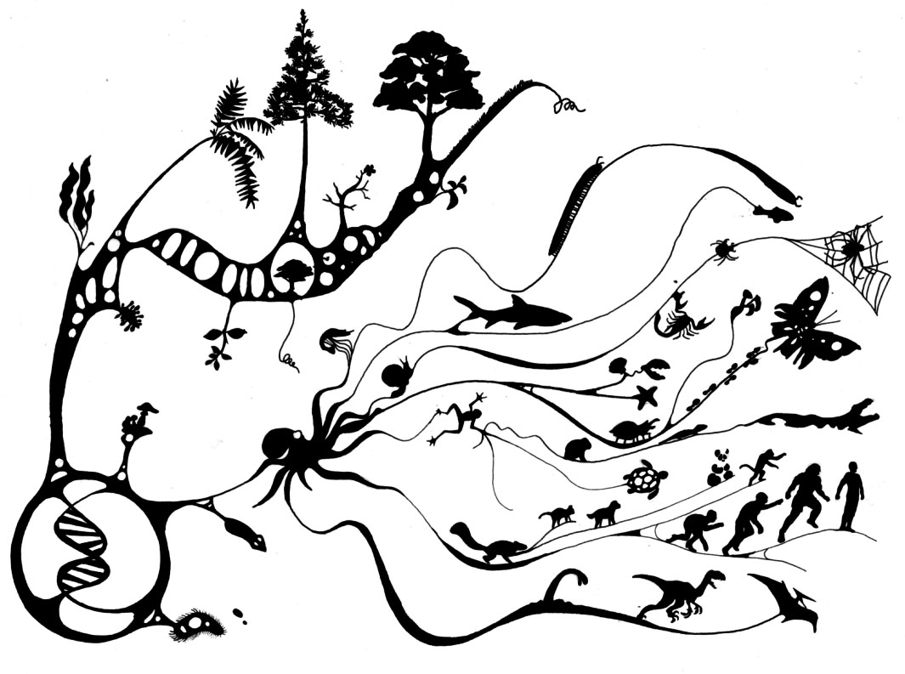
Evolution – Bio 332
FALL 2020

Slide 2
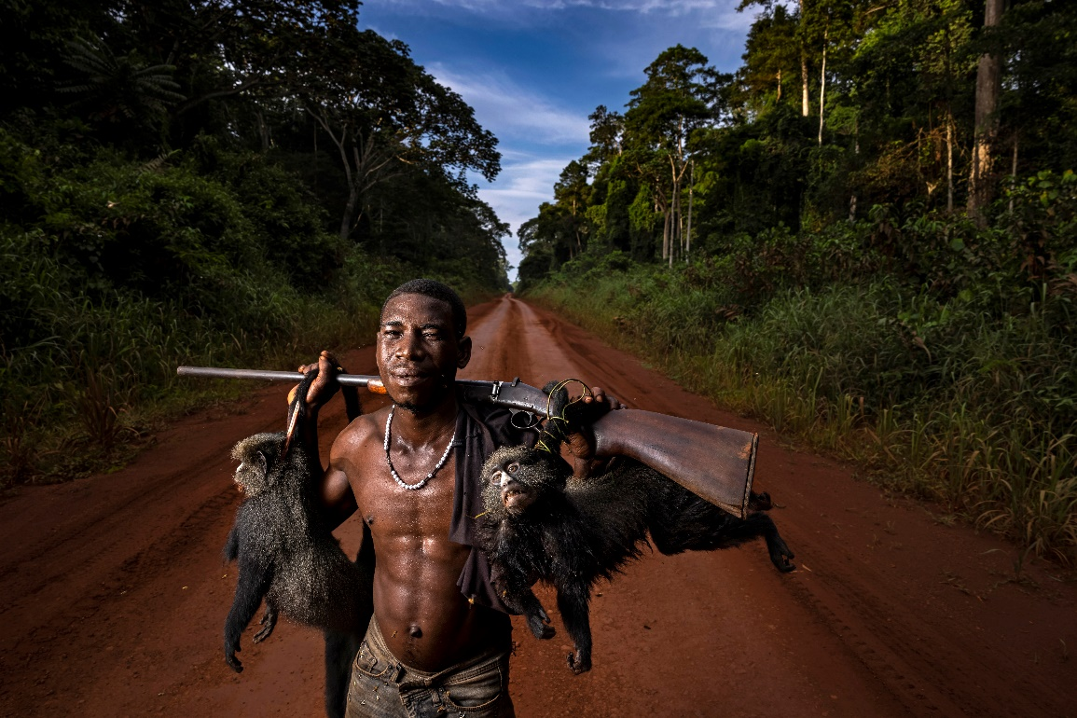
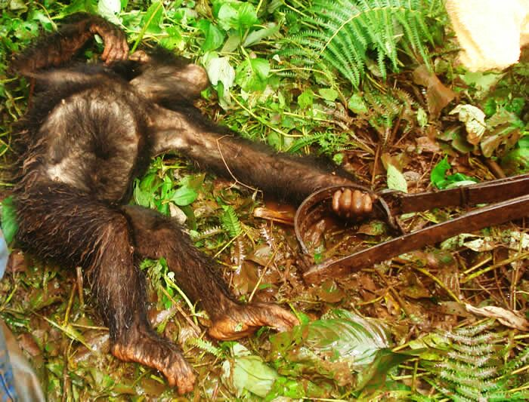
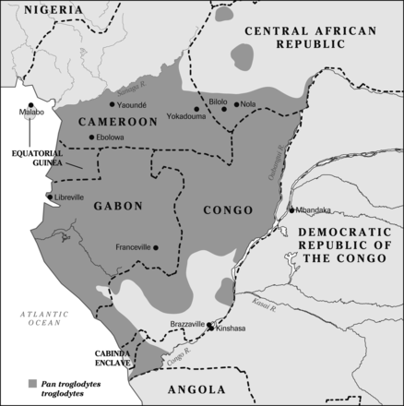

Slide 3
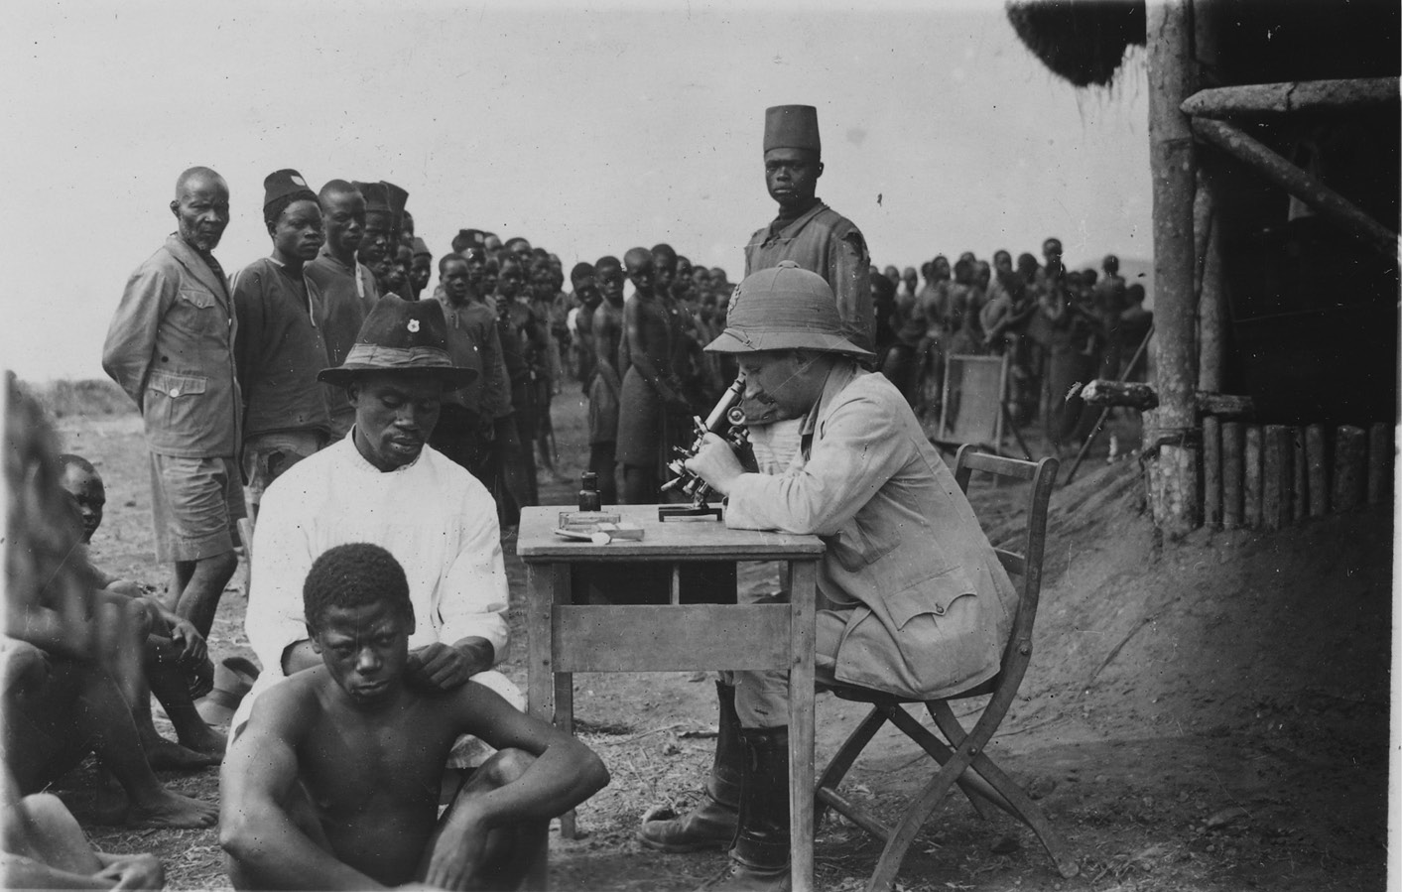

Slide 4
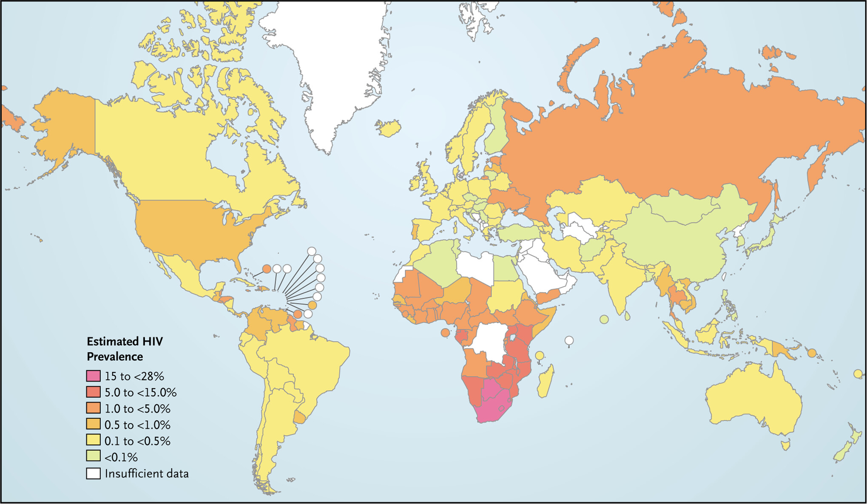

Slide 5
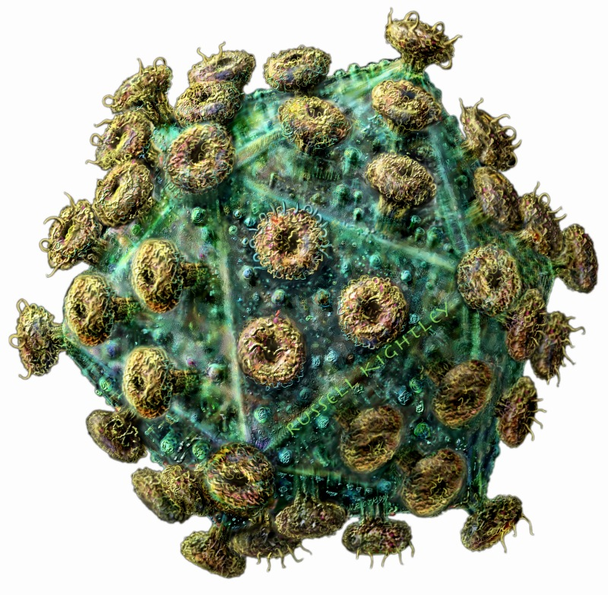

Slide 6
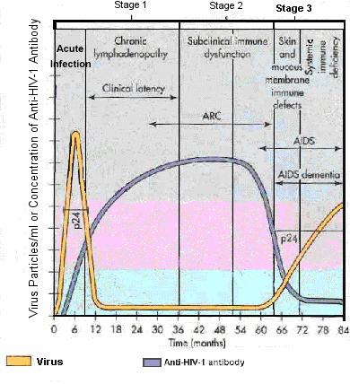

Slide 7
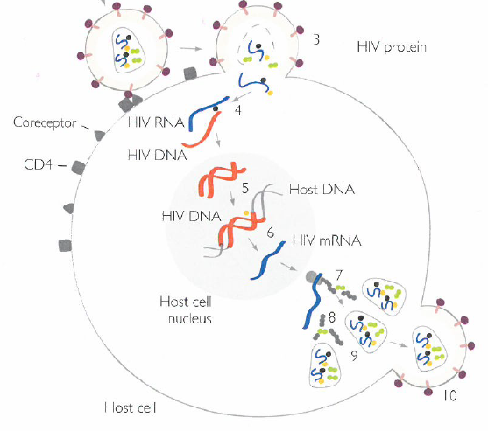
What are the steps in the progression of HIVs life cycle?
How could we stop HIV?

Slide 8
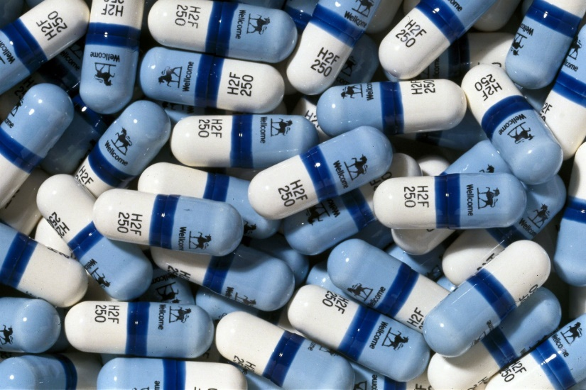
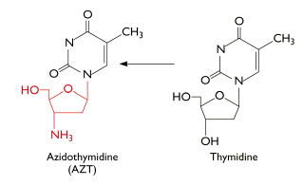
1983 – HIV discovered
First treatment?
Work in your groups and try to figure out how AZT will stop HIV
Things to consider:
Why NH3 important?
Where will it work in cycle?
Look familiar?
Recognize this?

Slide 9
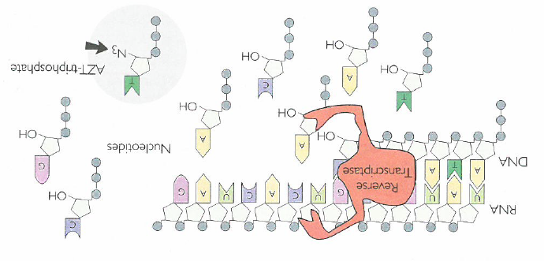
What will AZT do and how does it stop HIV?
Why is this NH group important?

Slide 10
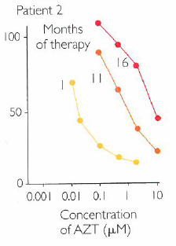
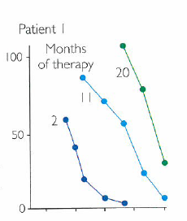
How effective?
Larder et al. Science
% virons
% virons
AZT concentration
What’s happening (groups)?
Nasty side-effects…why?

Slide 11
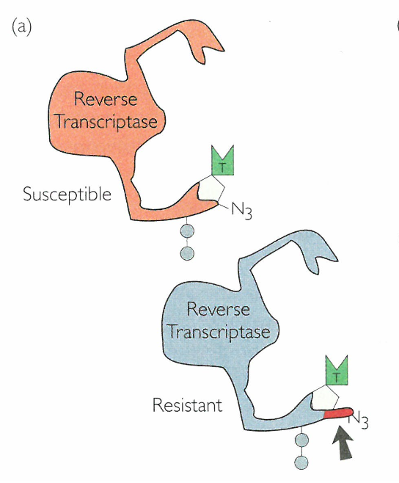
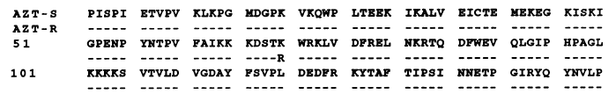
HIV evolved over time
Modified from Mohri et al. 1993

Slide 12


Why?

Slide 13
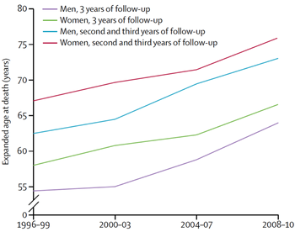
HIV patients live relatively long lives today
Why?

Slide 14
Why does dosing with a drug cocktail prevent patients from developing AIDS?

Slide 15
What happens to the virus if a patient stops taking AZT?

Slide 16
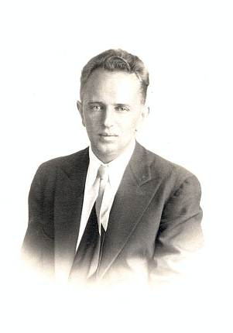
Theodosius Dobzhansky 1973

Slide 17
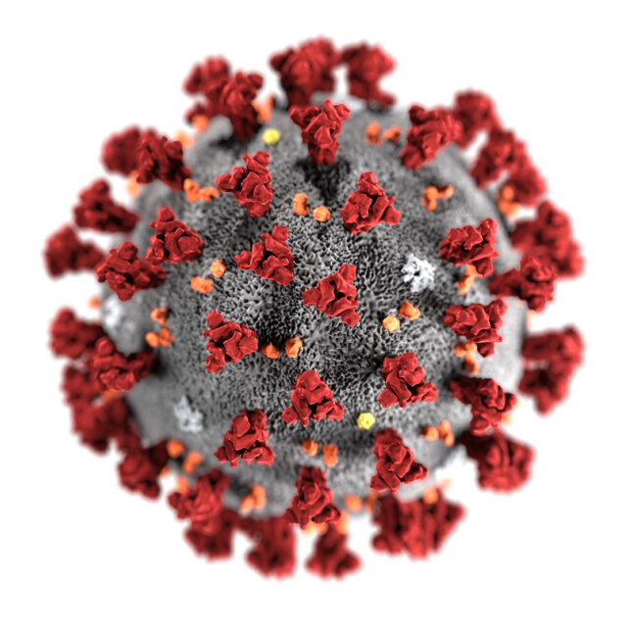
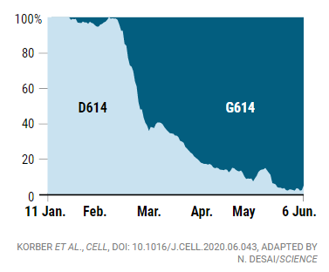
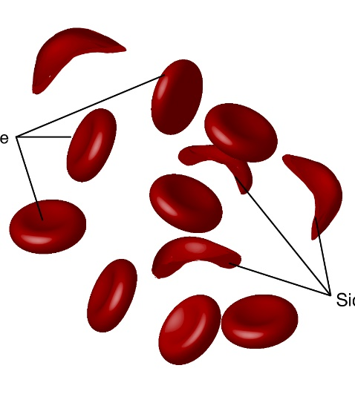
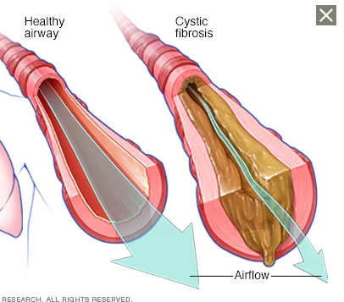
Practical Applications of Evolutionary Biology:
Human Health cont.
Tracing origin and spread of infectious diseases
  Covid – 30,000bp
  Gazzilions of mutations
  What happens to these mutations?
  2 “successful” mutations / month
  D to G – spike protein change
Nucleotide changes responsible for disorders
Long-term consequences of medical intervention

Slide 18
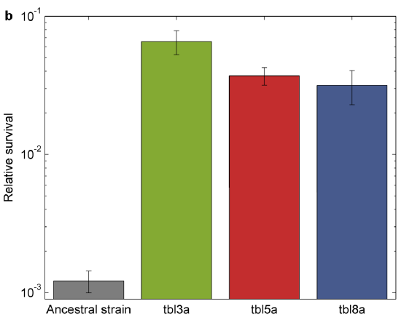
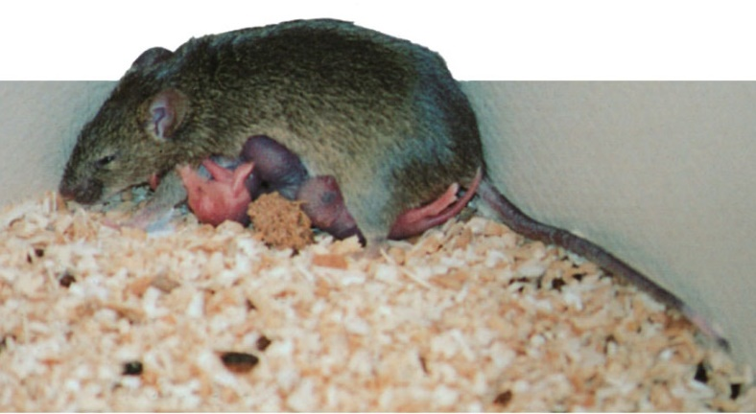
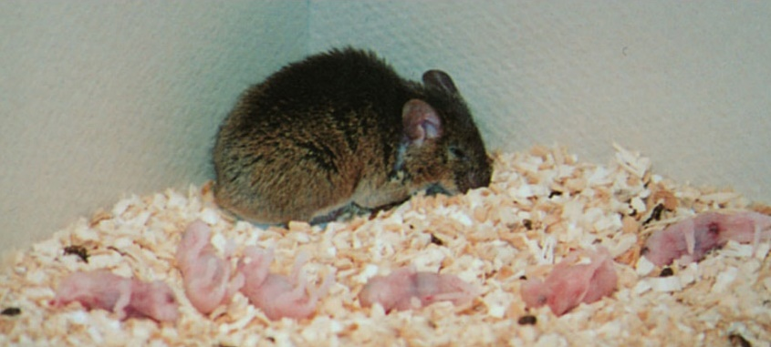
Survival after 8 hrs
Practical Applications of Evolutionary Biology
Evolution of antibiotic resistance/tolerance
Gene function through comparative study
Fridman et al. 2014. Nature

Slide 19
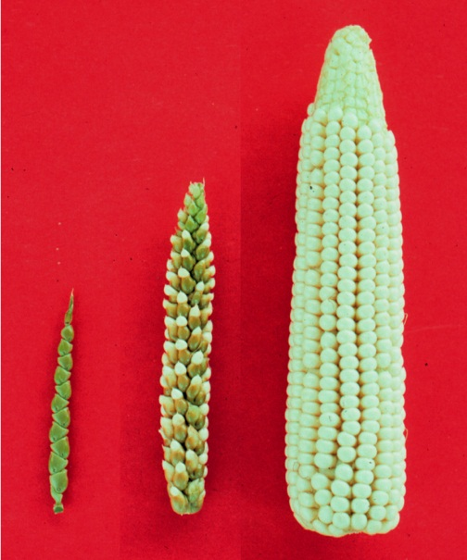
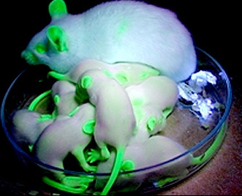
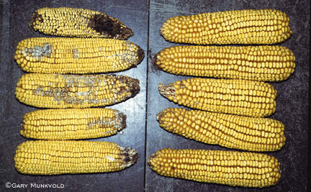
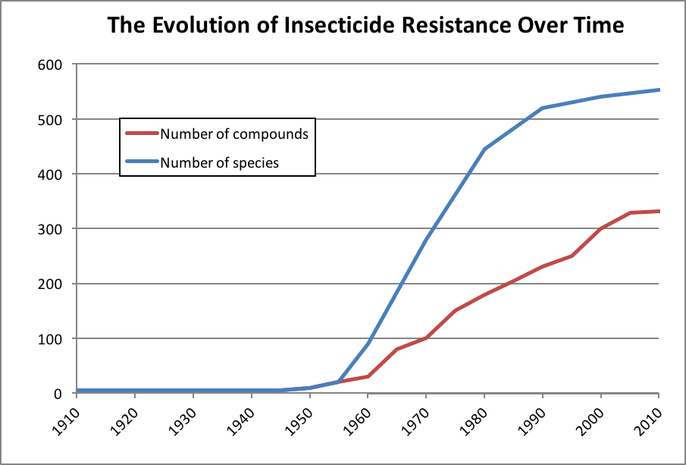
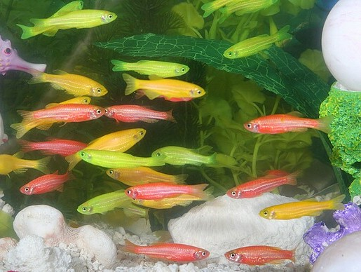
Some Practical Applications of Evolutionary Biology:
Agriculture:
Crop improvement by selective breeding
Evolution of pesticide resistance
Transgenic organisms – advantages and risks

Slide 20
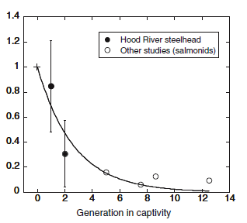
Practical Applications of Evolutionary Biology:
Fisheries Biology:
Genetic consequences of selective harvesting?
Evolutionary consequences of stocking?

Slide 21
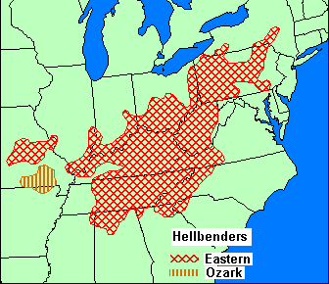
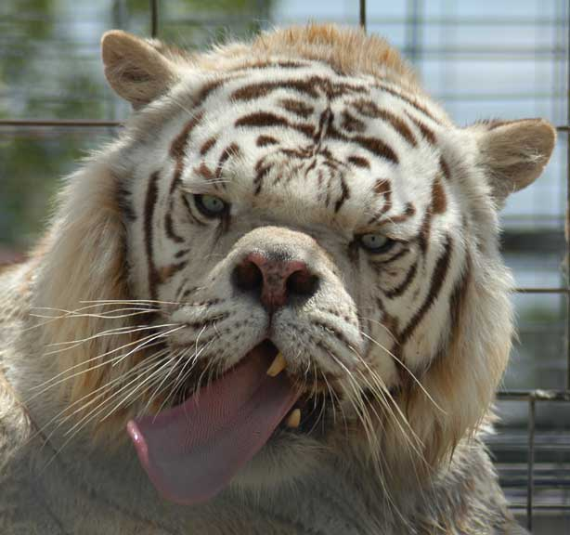
Practical Applications of Evolutionary Biology
Conservation Biology:
Identification of evolutionary significant units
Avoidance of inbreeding depression in captivity
Identification of minimal population size for viability
Adaptive response to introduced species

