Slide 1

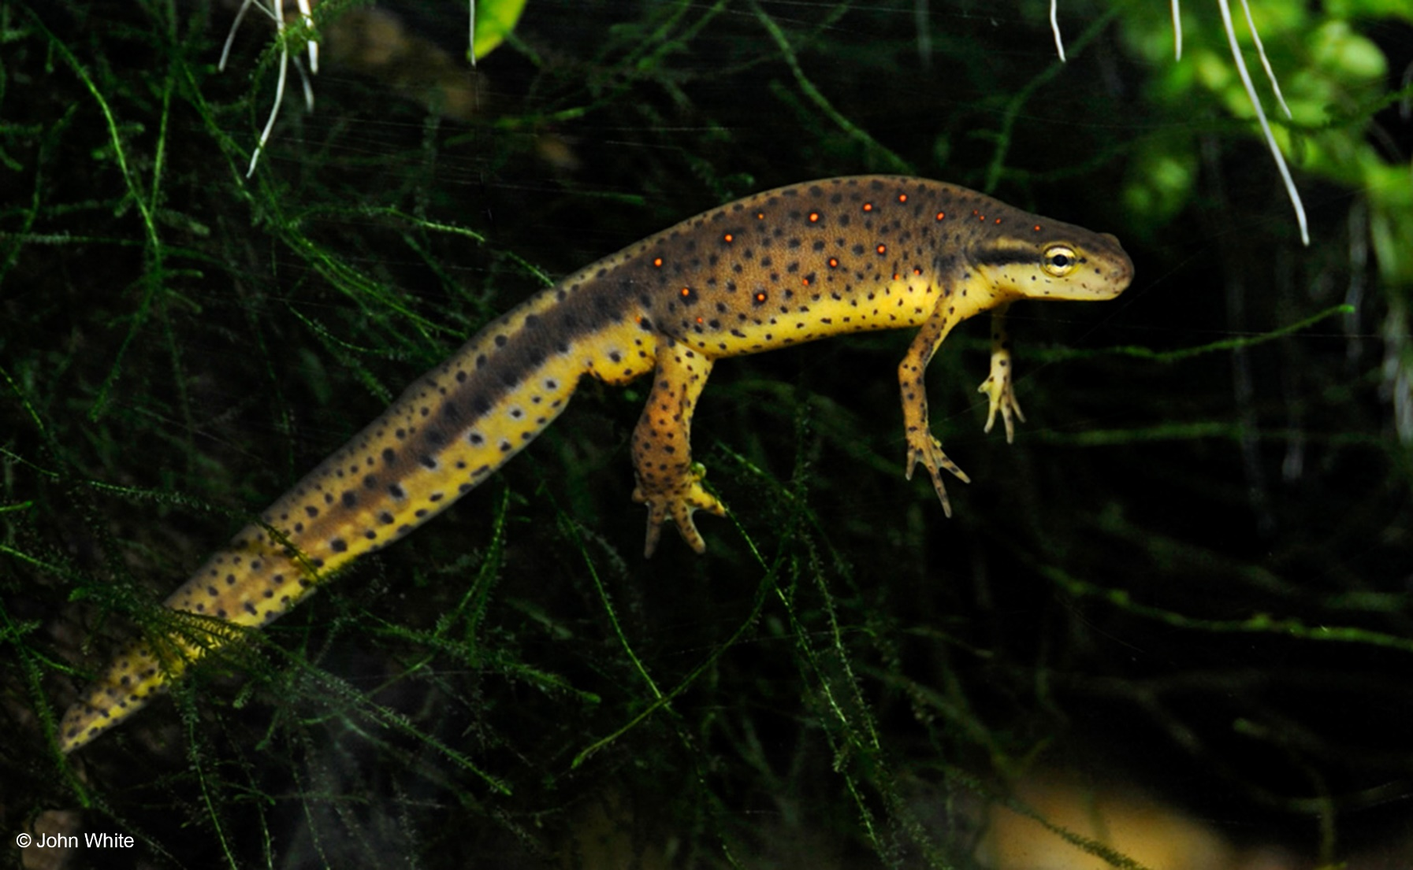
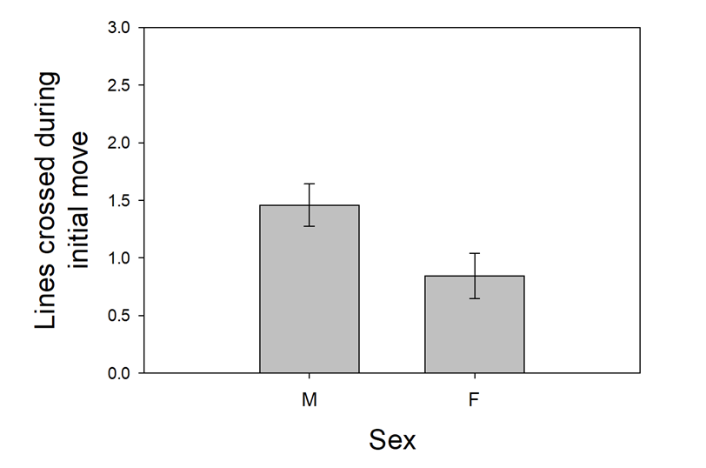

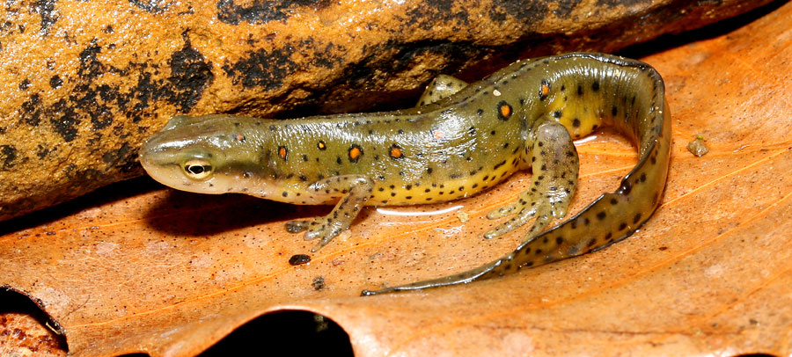
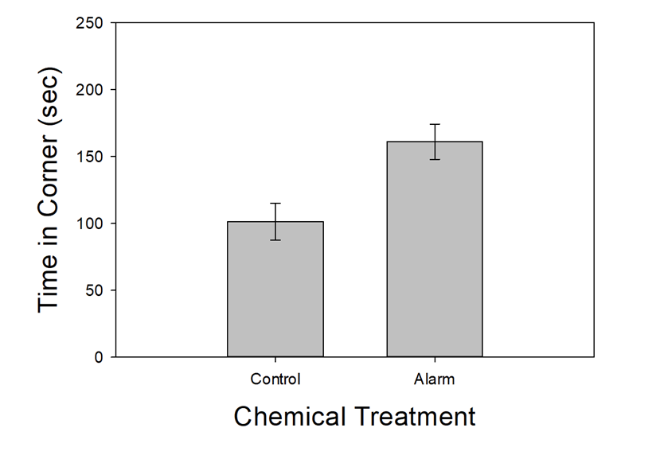
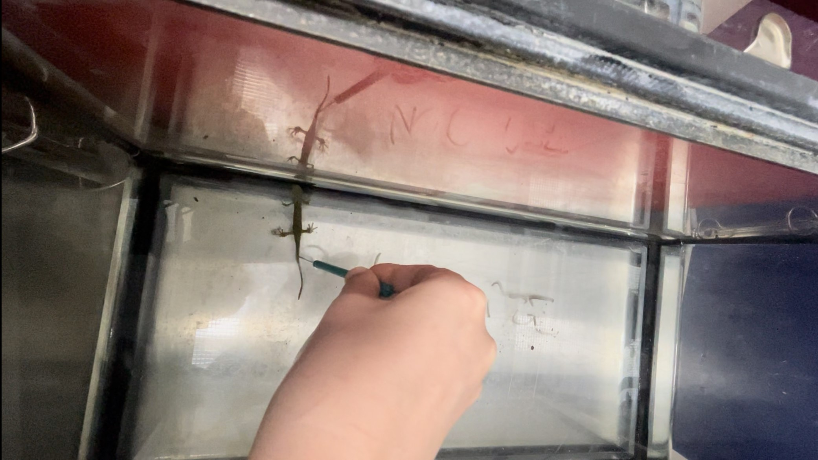
Evidence of Coevolution in Plant-Pollinator Interactions
Brian G. Gall
Department of Biology, Hanover College, Hanover, IN
INTRODUCTION
SYSTEM OVERVIEW
CONCLUSIONS
Communication in aquatic environment is often difficult due to sedimentation or dense vegetation
To ensure a signal is received, aquatic animals often communicate using chemicals
Alarm cues are a chemical released from damaged skin during a predation event, and signal danger to conspecifics
Eastern newts (Notopthalmus viridescens) use chemicals, including alarm cues, to communicate
Newts respond to alarm cues with antipredator behavior – including reduced activity & avoidance
Adult newts are aquatic, but their responses to alarm cues have only been tested under terrestrial conditions
Sex-based differences in communication often exist, but these differences in newts remain unknown
Animal Collection and Housing
Newts collected from fishless ponds in Jefferson Co., IN using a seine and dip nets
Housed in groups of ~10 in 38L tanks
Housed with plant material from site & fed blackworms
Experimental Arena
38 L tank surrounded with newspaper
6 lines drawn on bottom creating following zones:
  4 corners
  3 activity lines
Number of Lines Crossed (initial move)
P = 0.0023
Males crossed more lines than females immediately after the simulated predation event
Right: Experimental arena and simulated predation event
Time Spent in Corner (sec)
P = 0.004
Experimental Procedure
Newt selected and placed into the test arena
20 min acclimation period
15mL of alarm cue or control solution added to tank
Newts exposed to simulated predation event (poked with a probe)
5 min test period began
  Increased antipredator behavior in response to alarm cues
  Confirms newts in the aquatic phase respond to alarm cues from damaged conspecifics
  Reduced activity may be less important than seeking shelter
Sex-based difference in antipredator behavior, with males showing a stronger flight response
  Female newts may reduce mobility to conserve energy that will be used for future reproductive events OR may correspond with higher levels of neurotoxin tetrodotoxin
  Male flight behavior could also be tied to increased activity as part of normal mate-searching behavior (patrolling)
Response Variables
# of lines crossed during initial move
Total time (sec) spent in corners
Two-way ANOVA’s – Alarm treatment and Sex as fixed factors
Questions:
Do eastern newts respond to alarm cues with antipredator behavior in an aquatic setting?
Do males and females respond differently to alarm cues?

