Slide 1
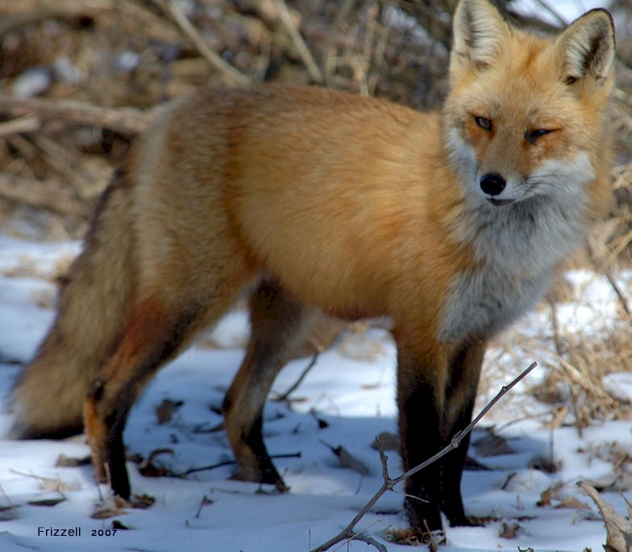

Slide 2
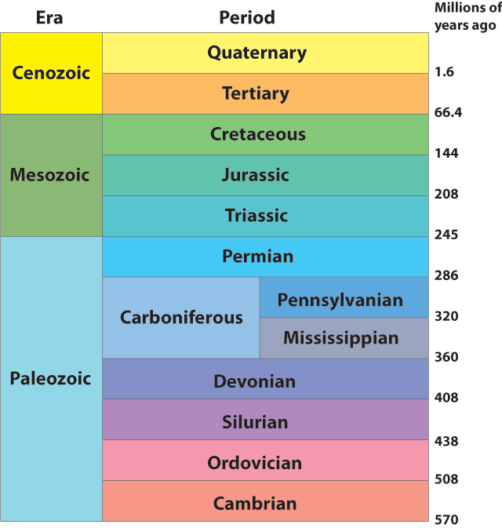
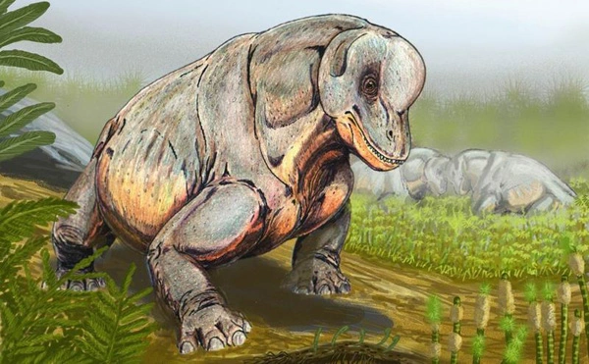
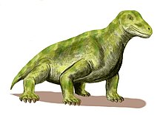
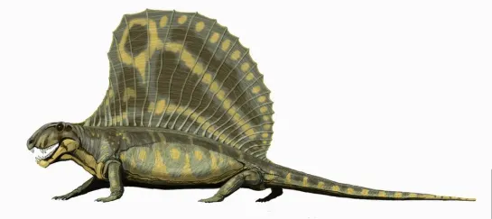
Mammal Evolutionary History

Slide 3
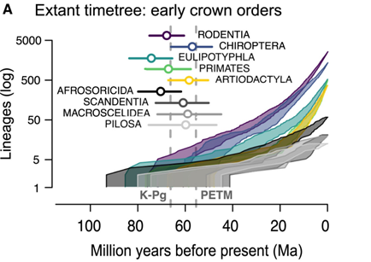

Slide 4
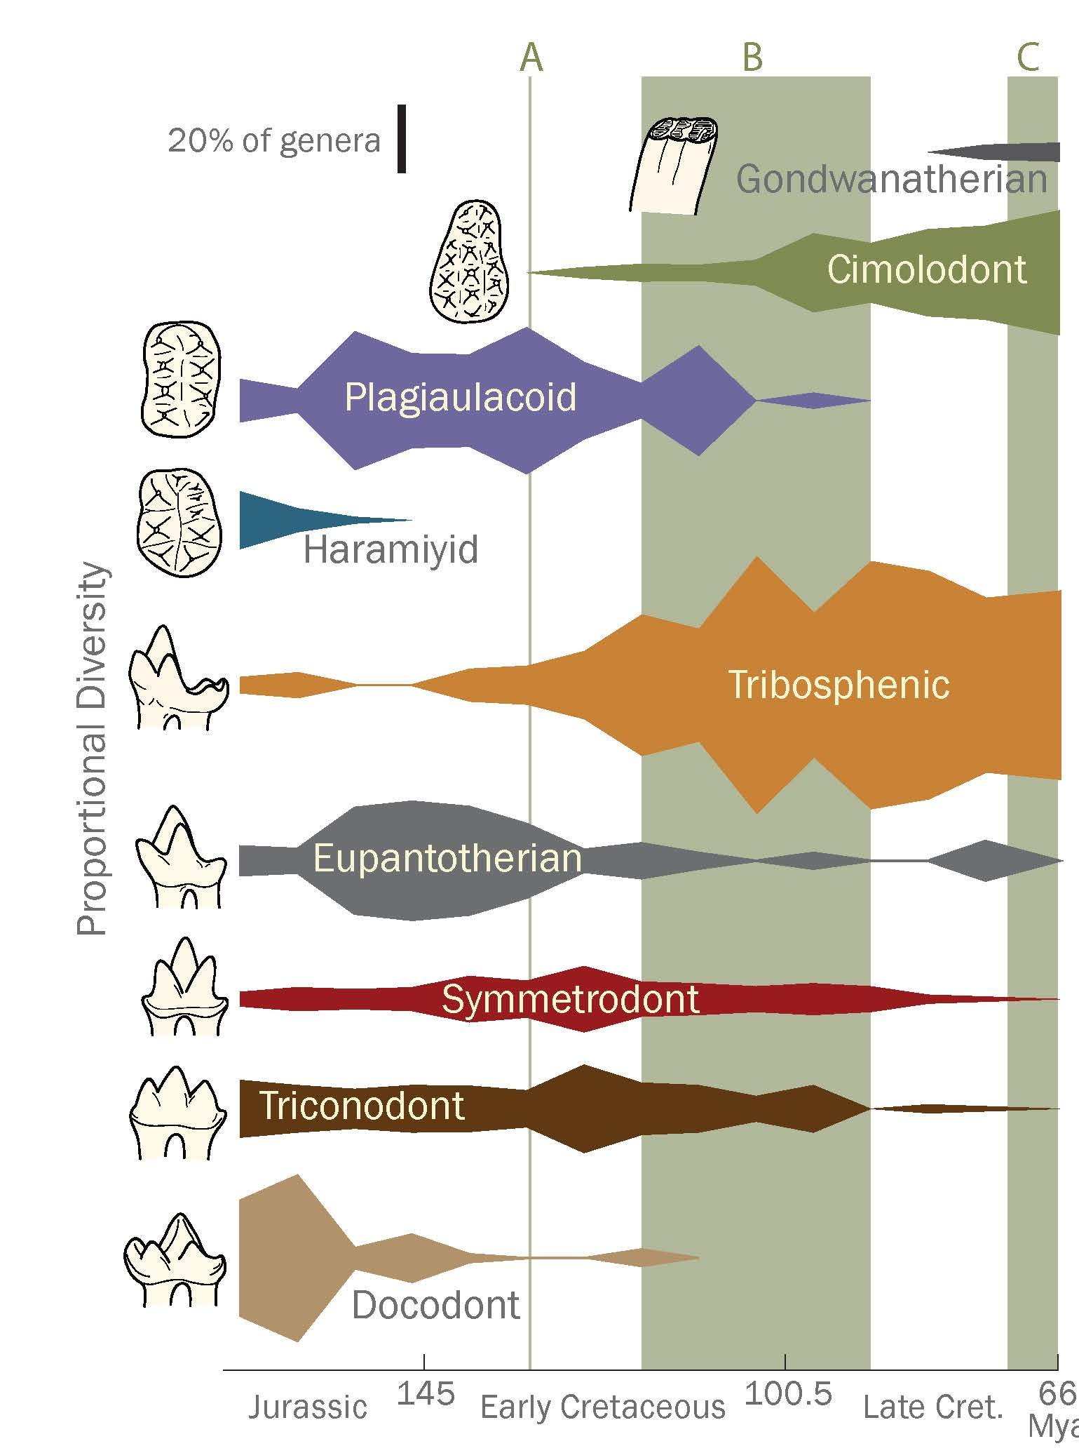
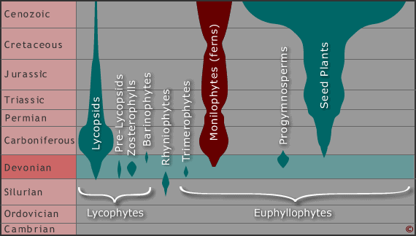
Why mammals diversify at this time?
100 MYA
250 MYA
400 MYA
How could we assess this hypothesis?

Slide 5
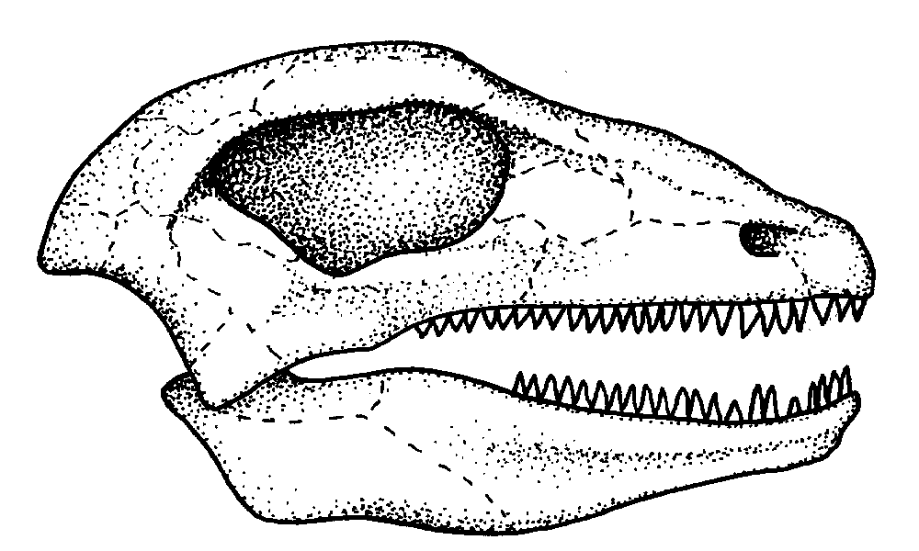
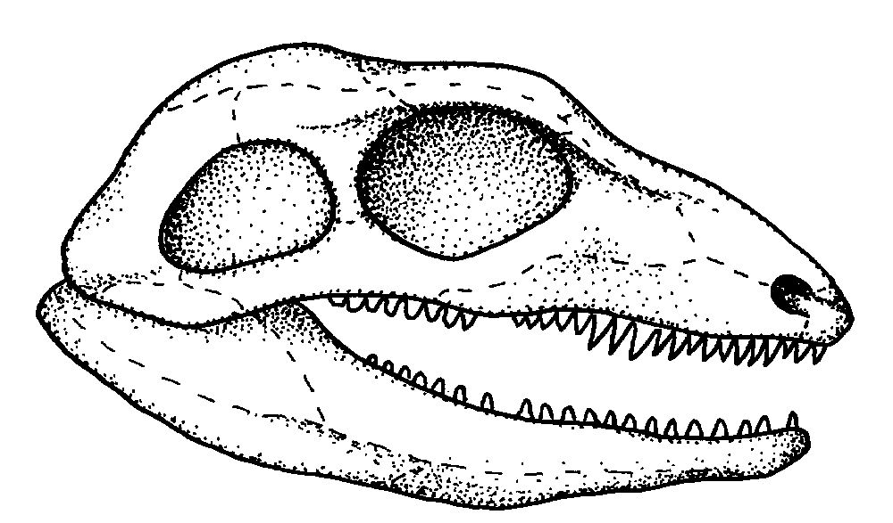
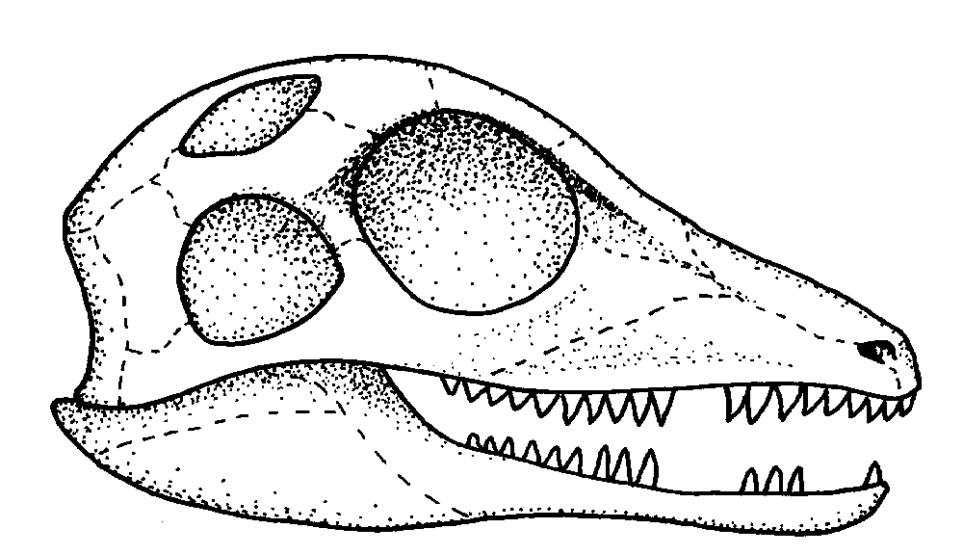
Non-mammalian synapsids
Two groups
Recognized based on skull morphology
These are not reptiles!

Slide 6
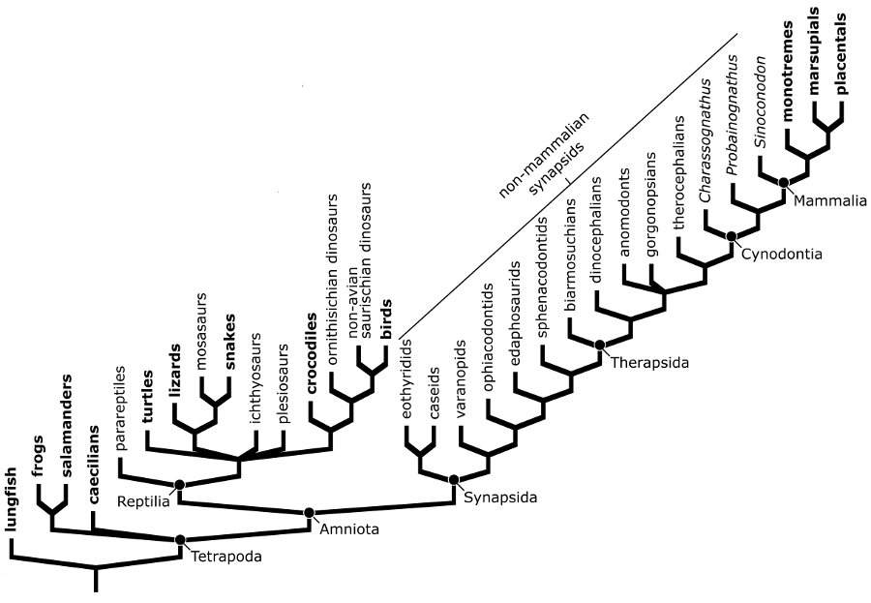
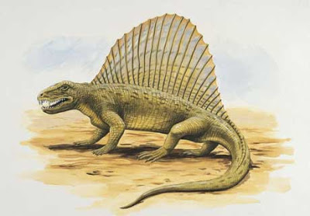
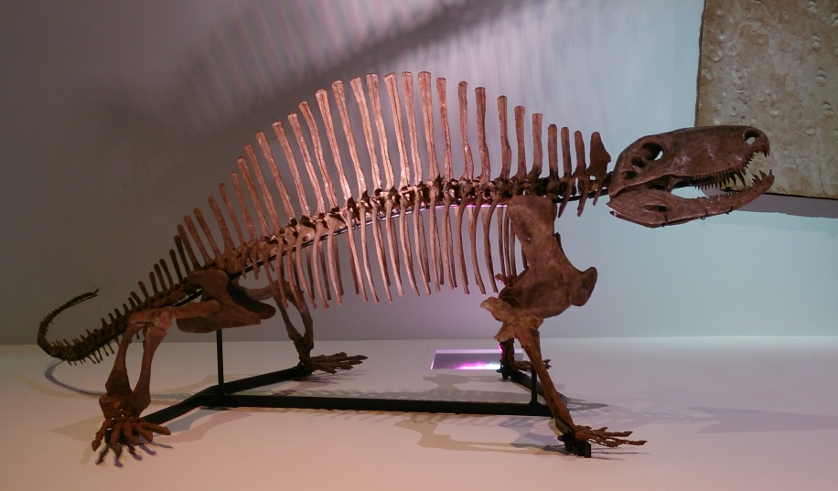
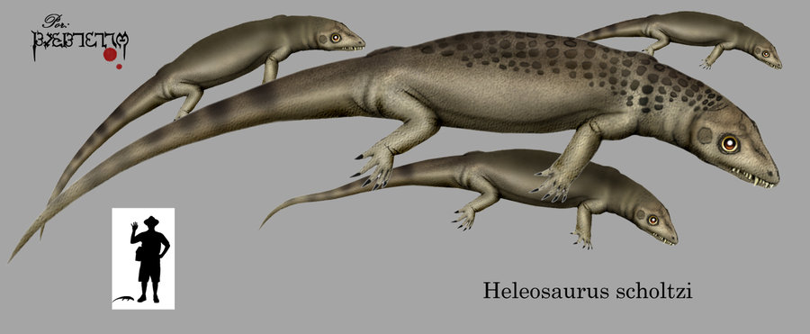
Pelycosaurs (sail-backs)
Most basil
Tropical N. hemisphere
Abundant 300-260 MYA
Specializations
Carnivorous (many fish)
Long snout/jaws
Simple pointed teeth

Slide 7
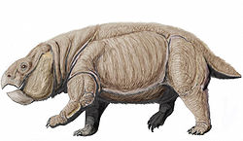
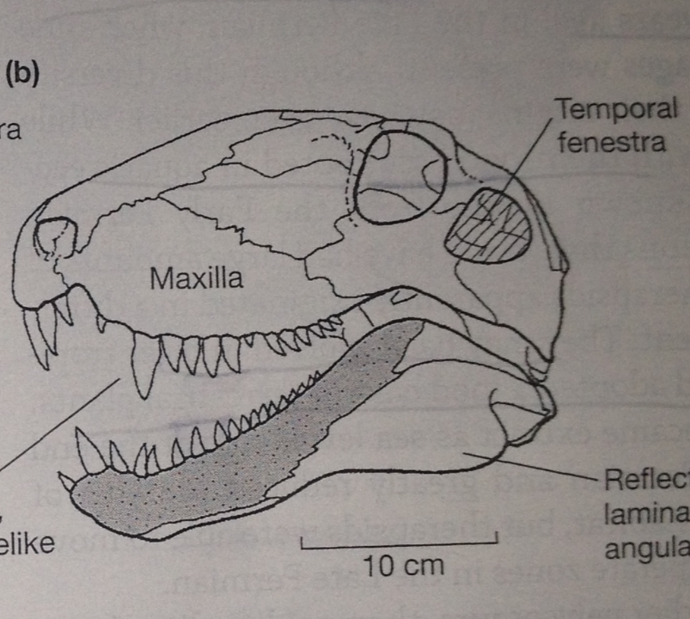
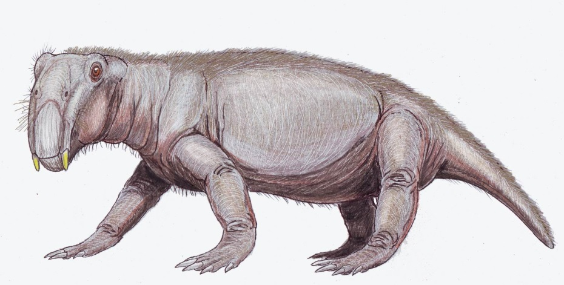

Therapsids
Temperate S. hemisphere
Direct ancestor of mammals
Abundant 280-200 MYA
Specializations
Heavy body
Stumpy legs
Shorter snout
Terrestrial
9 lineages
Therapsid
Pelycosaur

Slide 8
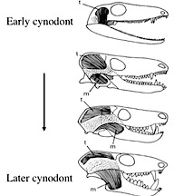
Major Evolutionary Trends
Can we directly tell metabolic rate from fossils?
Indirectly?
Work with your class to examine the skulls on the table. What traits might change if metabolism is changing (how is changing over evolutionary time?). Think whole body as well.

Slide 9
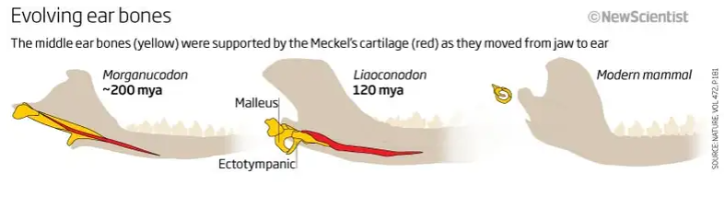
Nature 2011
Notes:
https://www.nature.com/articles/nature09921
Yellow are the post secondary bones
Red is a supporting cartilage

Slide 10
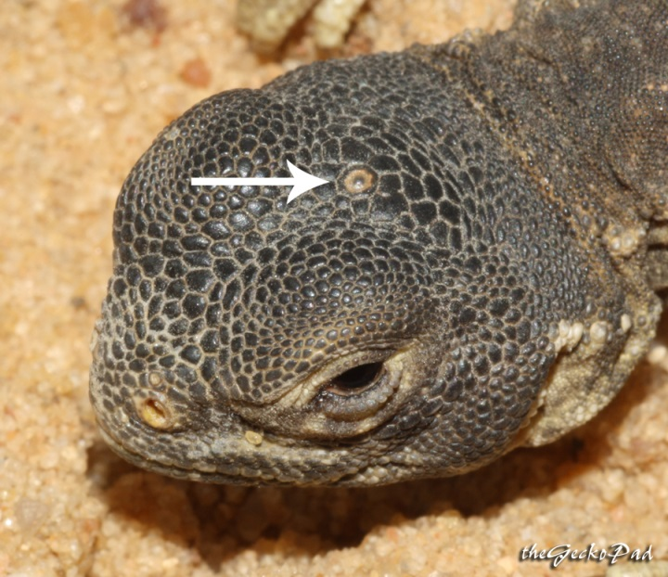
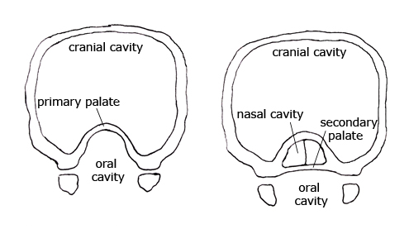
Major Evolutionary Trends

Slide 11
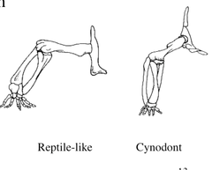
Major Evolutionary Trends

Slide 12
What do you notice about toes?

Slide 13
Combine all of these characteristics
What does it indicate?

Slide 14
Synapomorphies of Mammals?

Slide 15
Lactation
Synapomorphies of Mammals
What is the function of milk in mammals?
Could this have been the function when it evolved?
What are other functions of milk?

Slide 16
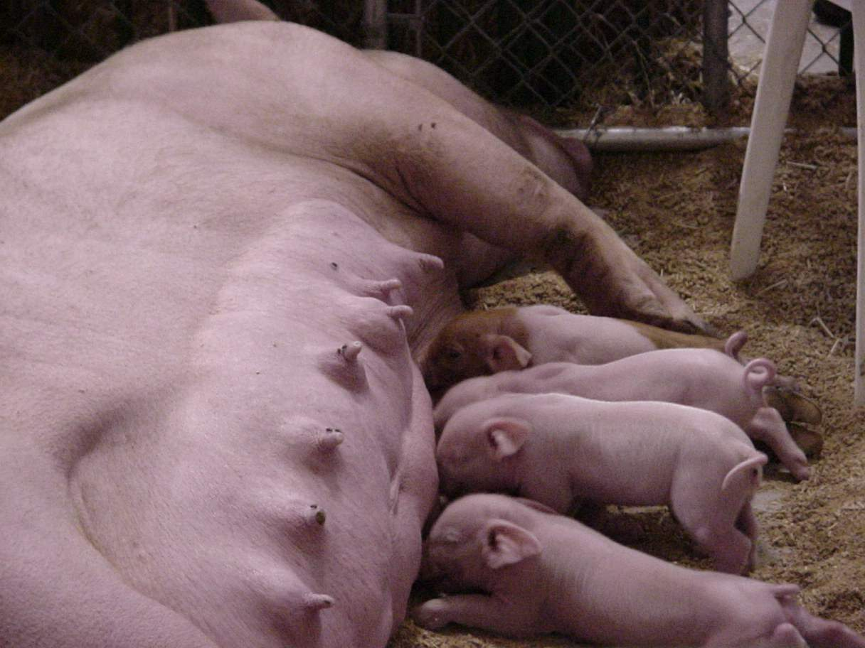
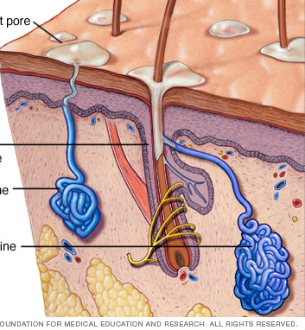
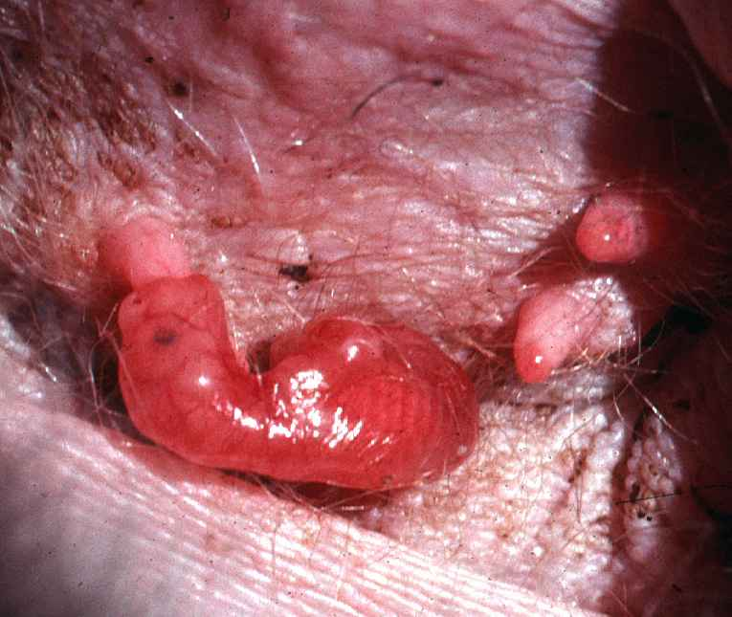
Mammary Glands
What did mammary glands evolve from?

Slide 17
Lactation
All female mammals possess mammary glands, lactate and feed young milk
Do male mammals have mammary glands?
Are these glands functional in males?
Do all mammals have nipples?

Slide 18
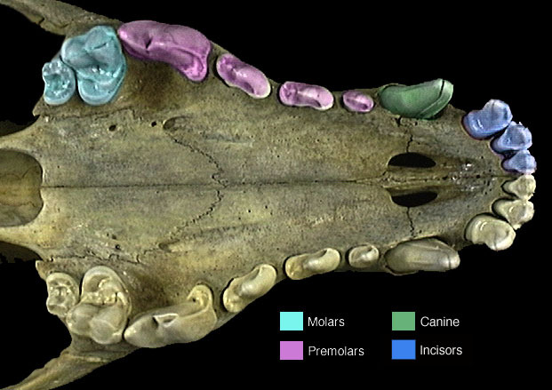
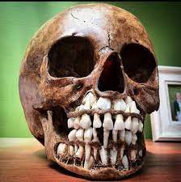
Cranial Morphology

Slide 19
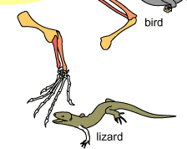
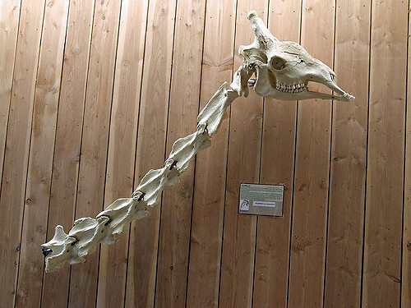
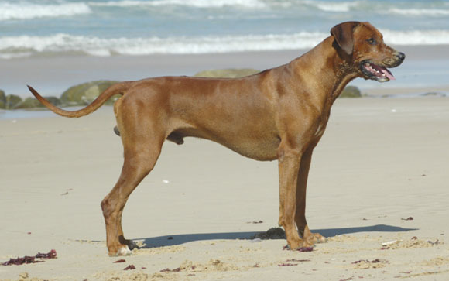

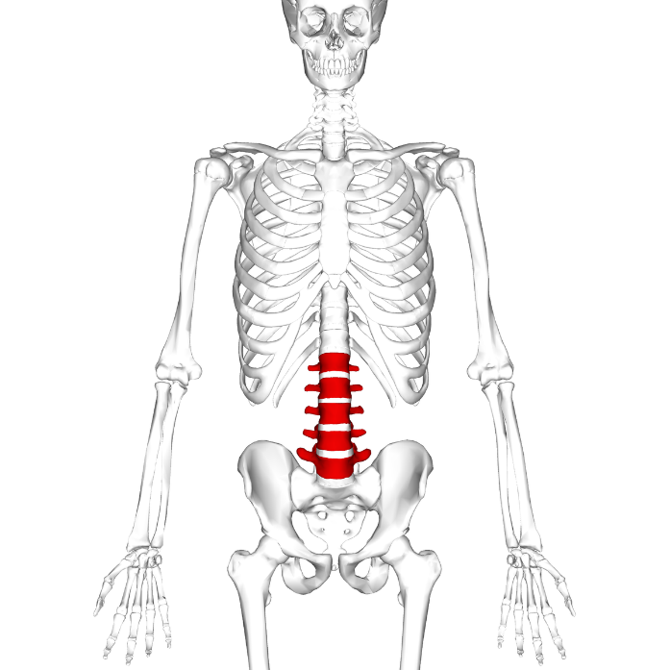
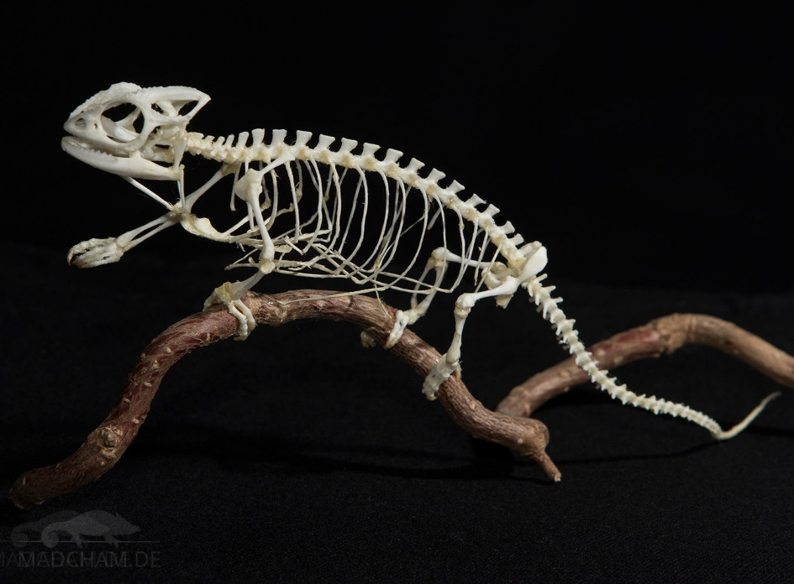
Post-Cranial Morphology

Slide 20
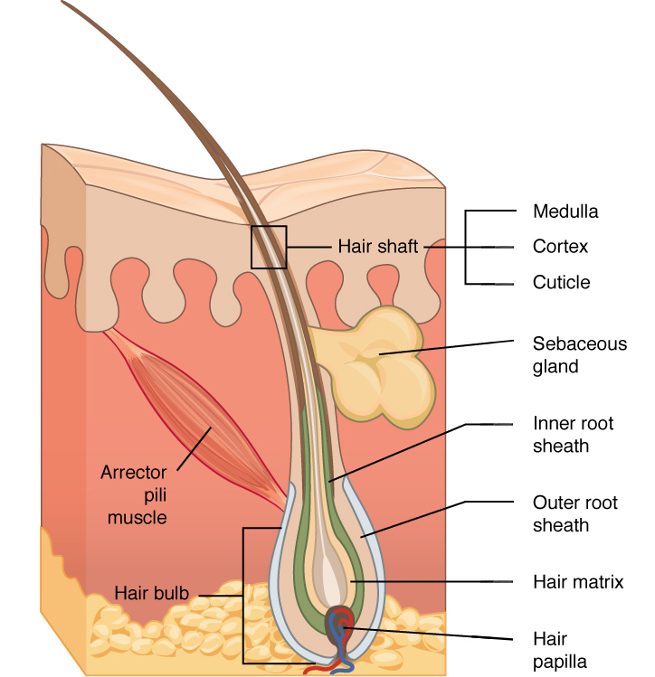
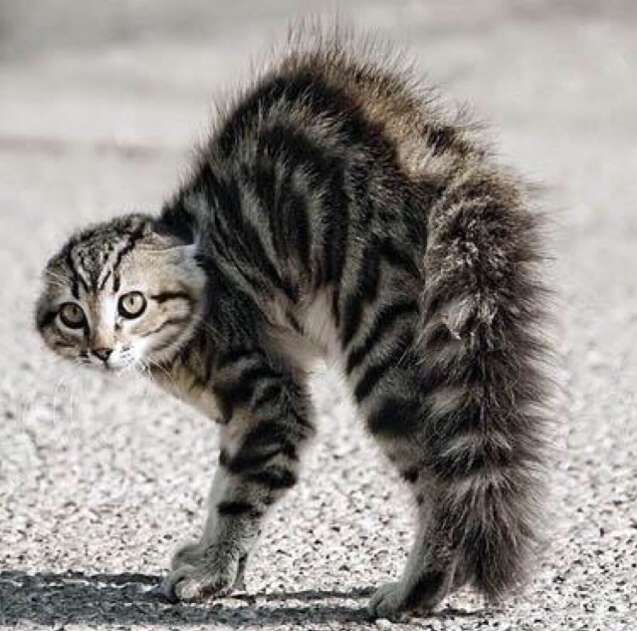
Skin Synapomorphies
Function of hair?

Slide 21
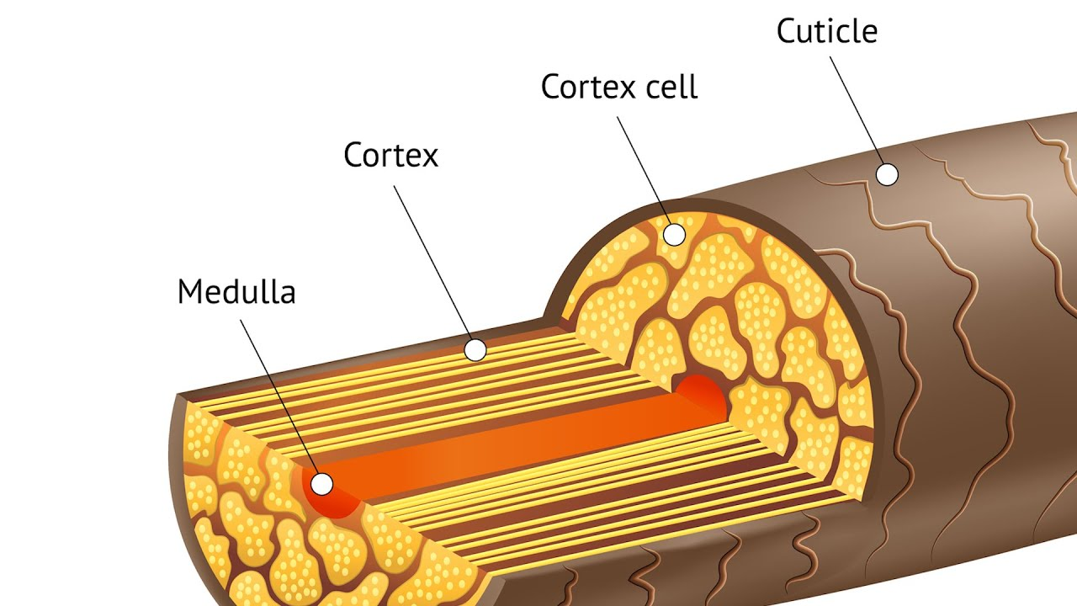

Slide 22
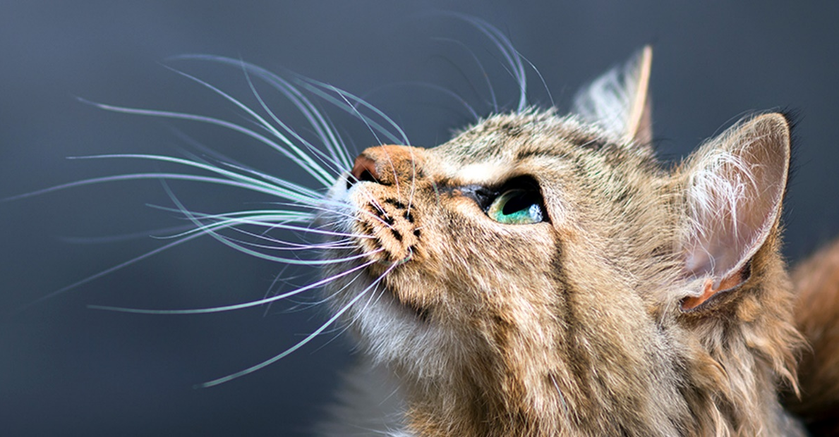
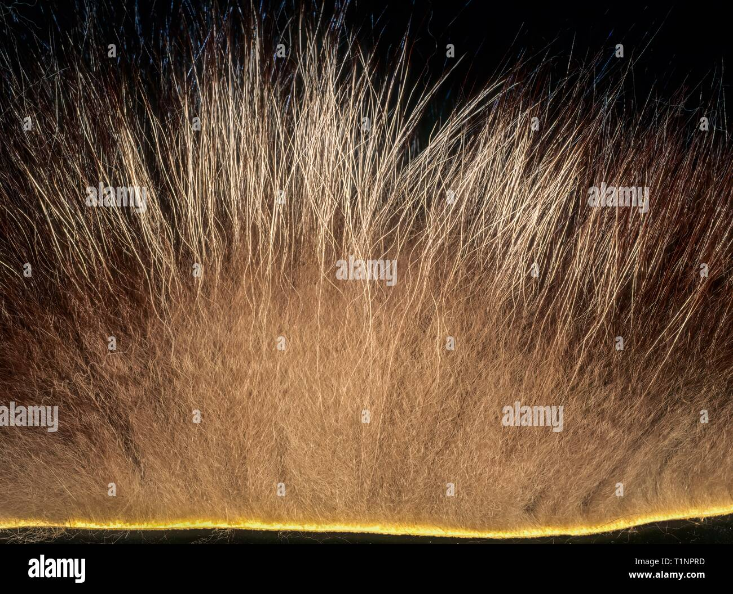
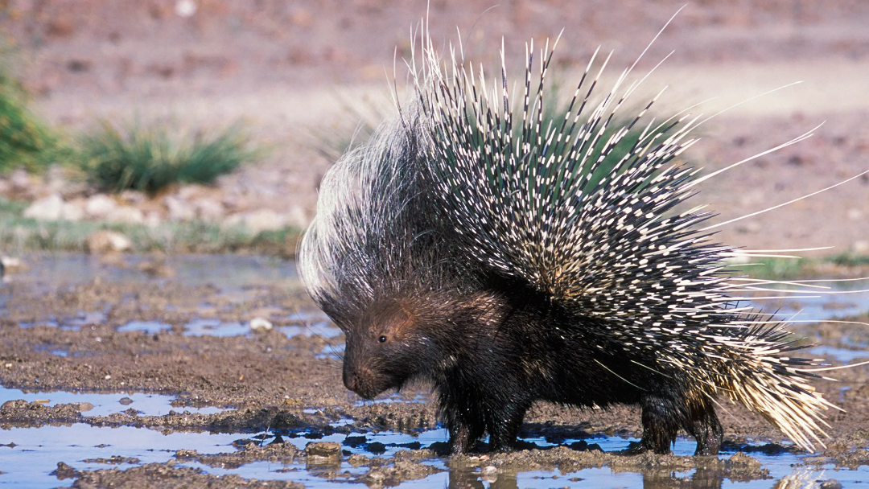
Types of Hair

Slide 23
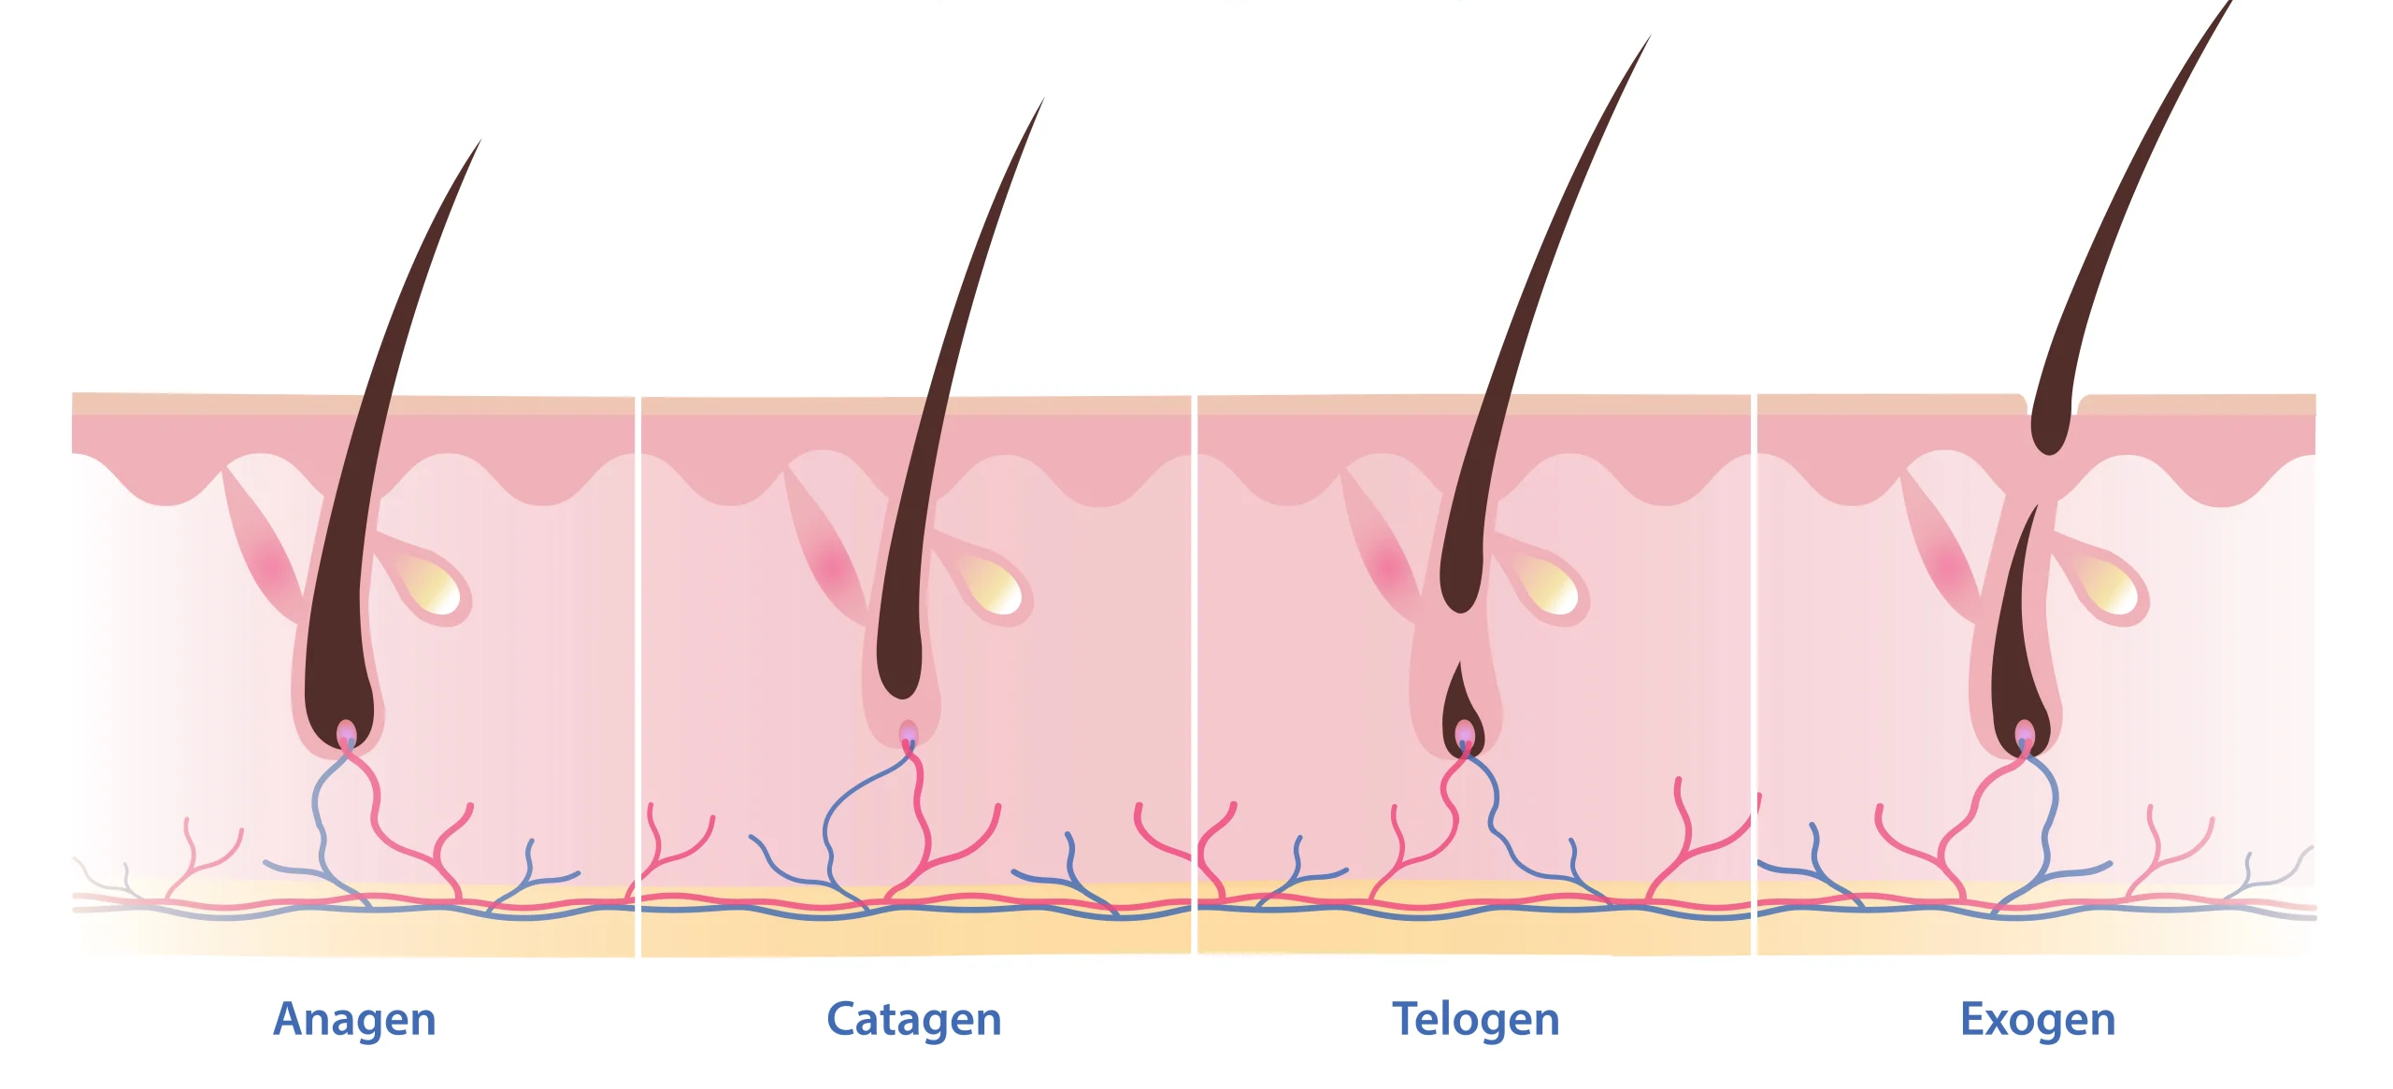
Hair Growth
Does hair grow in continuously or in cycles or?
Notes:
Anagen (growth phase): 2–7 years in human scalp; matrix cells divide rapidly.
Catagen (transition): ~2–3 weeks; follicle shrinks, papilla detaches.
Telogen (resting): ~3 months; old hair is anchored but no longer growing.
Exogen (shedding): Old hair falls out; new anagen begins.
At any time ~85–90% of human scalp hairs are in anagen, ~1% catagen, ~10–15% telogen.

Slide 24
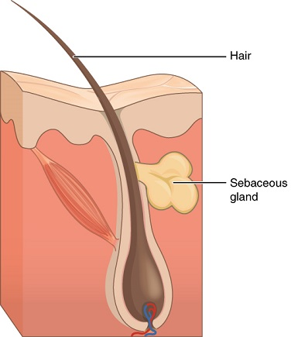
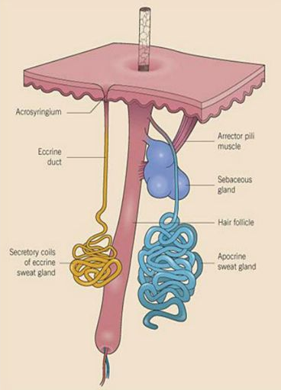
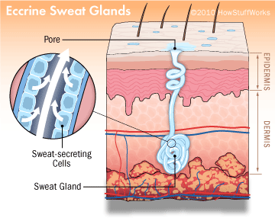

Slide 25
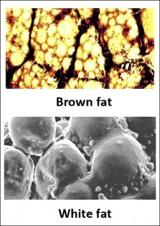
White fat
Found in all vertebrates
Subcutaneous
Large cell with no mitochondria
Associated with organs
Associated with joints
Functions?
Brown fat
Many small cells, lots of mito
Generates heat (10x)
What specific “groups” of mammals is it likely important?
Where is it found?
Notes:
amount and exact distribution of brown fat vary by species, age, body size, and environmental adaptation (e.g., hibernators vs. non-hibernators, cold-adapted vs. tropical species).
Brown fat is concentrated in the upper body, around vital organs, and along major blood vessels—exactly where it can warm circulating blood and protect core temperature.

Slide 26
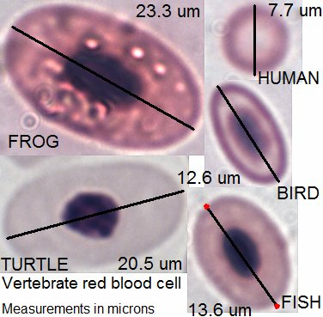
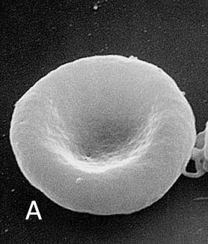
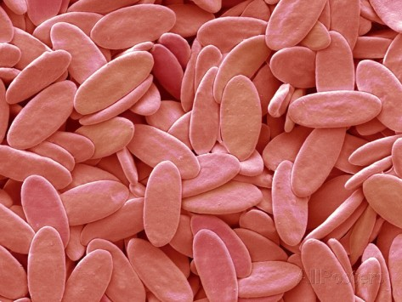
Red Blood Cells
Non-mammal vertebrate red-blood cell

Slide 27
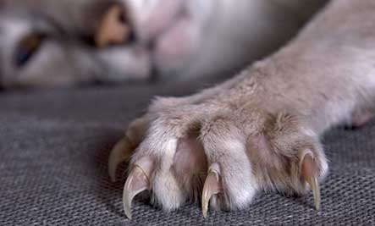
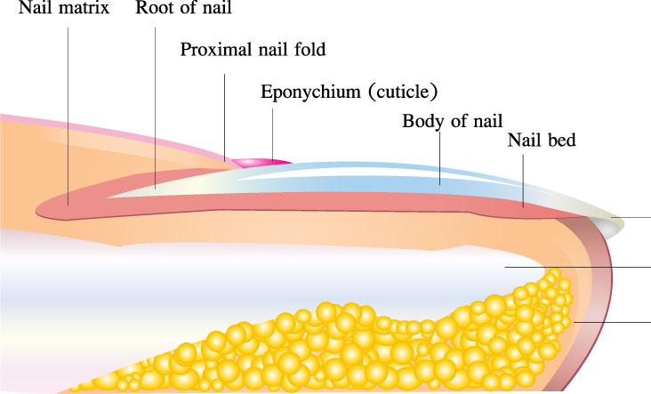
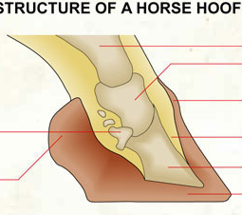



Mammal digits have evolved special structures at tip
Made of?
Aid in?

Slide 28



https://www.youtube.com/watch?v=MqLrY1rmUUE

Slide 29



Why is poaching such a big deal? Can they live without the horn?

Slide 30




Urogenital System
Cloaca – ancestral opening for ?
Mammals – replaced by separate openings

Slide 31


Slide 32



Mammal Diversity
Functionally we recognize three groups of mammals?

Slide 33



Multituberculates (subclass Allotheria)
Why extinct?

Slide 34


Monotremes (subclass Prototheria)

Slide 35




Ornithorhynchidae (Platypus)
Single species
Aquatic
Feeds on?
Males have spur on hind leg
Thought to be hoax in 1800’s
Females lay 2 egg in leaf-lined burrow
https://www.youtube.com/watch?v=QNoQvjlmGdk

Slide 36




Tachyglossidae (Echidna)
4 species
Australia, Tasmania, New Guinea
Covered with spines
Strong arms with long claws
Feeds on?
4-headed penis?
Sperm swim cooperatively
https://www.youtube.com/watch?v=yHjdIXN9v2g
Notes:
The Cooperative Sperm Trick
When an echidna ejaculates, the sperm don’t swim individually at first. Instead, around 10–100 sperm heads snap together in a very precise way—side-by-side, aligned perfectly like a rowing team—to form a streamlined bundle (sometimes described as a "sperm train" or "sperm raft").
Each sperm in the bundle still beats its own flagellum (tail). Because they’re physically stuck together and perfectly synchronized, the bundle swims much faster—up to 2–3 times the speed of a lone echidna sperm. The bundle can travel in a straighter line toward the egg.
What Happens When They Get Close to the Egg?
Once the bundle reaches the vicinity of the egg (or senses chemical signals from it), the sperm suddenly disassemble. They break apart and then compete individually to penetrate the egg. Only one sperm ultimately fertilizes it.
Why Do They Do This?
It’s a clever evolutionary compromise: Bundling gives that male’s sperm a huge speed advantage over sperm from rival males (which may also be in bundles, but the fastest bundle wins the race up the female reproductive tract). Once near the egg, switching back to individual competition ensures the single fastest or strongest sperm from that bundle fertilizes the egg.

Slide 37

Marsupials (subclass Theria, infraclass Metatheria)

Slide 38


Synapomorphies

Slide 39

Only 50% of marsupials have a “pouch”
Early birth and pouch development

Slide 40




Slide 41



Why were these not out-competed by placental shrews?

Slide 42



All rest are Australidelphia
https://www.youtube.com/watch?v=6qWH5b7h_i0

Slide 43






Quoll
https://www.youtube.com/watch?v=9wsmW07dZGk
Numbat
Numbat range
Black current
Colors correspond with extirpations
https://www.youtube.com/watch?v=zXx-g31J22c

Slide 44

Notorychtemorphia

Slide 45





Slide 46

Diprotodontia
Largest group of marsupials
One synapomorphy
3 major radiations

Slide 47





Slide 48



https://www.youtube.com/watch?v=06BfyKUYjbc

Slide 49




What ecological role do they fill?

Slide 50

Placentals!
How many?
Most of these?

Slide 51

Characteristics

Slide 52

Other traits

Slide 53


Notes:
Placentals have lost the epipubic bone (muscle attachment for hips)
Placentals possess a bony patella (kneecap). In marsupials it’s cartilage. Functions as a pulley for knee muscles.

Slide 54

Mammals evolved very rapidly after dino extinction
What happens anytime we have rapid divergence?
4 major clades

Slide 55



Tropical Africa/Madagascar
Basal mammals
Originally Insectovora
Tenrecs
Small shrew/hedgehog like
Noctural, poor eyesight
Insect eaters
https://www.youtube.com/watch?v=yXSmo24ut-8
https://www.youtube.com/watch?v=W9kJKu4cpXM
Golden moles
Convergent with moles

Slide 56

https://www.youtube.com/watch?v=BgI8gZIJZjQ

Slide 57




https://www.youtube.com/watch?v=7bf-AIhVk3A

Slide 58





Slide 59





Slide 60






Slide 61


Mammoth vs. Mastodon exercise

Slide 62



https://www.youtube.com/watch?v=jolihXTbNXI
https://www.youtube.com/watch?v=110iUX1Ursk

Slide 63





10 sp.
S & C. America
Sloths
Arboreal
Fur unique
Long arms and claws ?
Multi-chambered stomachs
Anteaters
Elongated snout and tongue
Lack teeth
Gizzard-like organ
Prehensile tail

Slide 64





Lagomorpha
https://www.youtube.com/watch?v=e8pCXwWWNE0
100 sp.
Global (except?)
Closely related to rodents
Synapomorphies:
Teeth arrangement
Enamel
Jaw motion
Caecum
Natural History
https://www.youtube.com/watch?v=erOPkaVjTIE

Slide 65

Rodentia
2500 sp.
33 families
Global
S. Am. has highest diversity
Synapomorphies:
Teeth arrangement
Enamel
No canines
Jaw motion
Every type of ecology and NH

Slide 66





300 sp.
Diurnal and resilient
Herbivorous w occasional insects
Synapomorphies
Skull structure
Bushy tail as long as body
Cheek pouches

Slide 67





Muridae & Cricetidae
700 & 600 sp.
All small (<3”) or small/med
Tair lacks hair or hairless/sparse hair

Slide 68




New world porcupines
Arboreal
Nocturnal (mostly)
Hair modified into quills
Herbivores

Slide 69


https://www.youtube.com/watch?v=eDXPmrs8t6o
Large burrowing rodents
Herbivores (fruit and nuts)
Forests of C. and S. America
Synapomorphies
Short tail
Toe arrangement

Slide 70


Western S. America
Common in pet trade (extinct)
Colonial with similar ecology as Pika
Synapomorphies
Molars grow continuously
Greatly enlarged auditory bullae
Long bushy tail
4 front toes, 3 rear

Slide 71



S. American rodents
All habitat types
Heaby bodied with short legs, no tail
Herbivores (grass/leaves)
Largest living rodent
Synamphorphy
Cheek pouch, fur lined, extends into neck

Slide 72


African mole rats
24 species (2 social)
Reduced eyes/ears
Build extensive burrows
Herbivorous

Slide 73

Suborder
Prosimii
Suborder Tarsiiformes
Hominoidea Hominids
Gibbons
Gorillas
Humans
Lemurs
Tarsiers
New World monkeys
Old World monkeys
Orangutans
Chimpanzees
3
2
1
Common hominoid ancestor
Common anthropoid ancestor
Common primate ancestor
Notes:
Figure 22.2: Primate evolution.
This branching diagram, called a cladogram, shows evolutionary relationships among living primates, based on current scientific evidence. The nodes (circles) represent branch points where a species splits into two or more lineages. ●1 The divergence of orangutans from the ape/hominid line occurred some 12 mya to 16 mya. ●2 Gorillas separated from the chimpanzee/hominid line an estimated 8 mya, and ●3 the hominid (human) lineage diverged from that of chimpanzees about 6 mya. (Figures not drawn to scale.)

Slide 74




Lemurs
2 families, 100 species
Rafted from Africa ~60MYA
Nostril “comma” shaped
Small body
Small brain
20% extinct since humans colonized

Slide 75




Tarsiers
~14 species
Southeast Asia
Huge eyes
Nocturnal
Insectivorous
Elongated tarsal bones
Head has wide range of motion

Slide 76





Old World Monkeys
80 species
Africa and SE Asia
Tail but not prehensile
Female dominated groups
Prefer plants but omnivores

Slide 77





New World Monkeys
100 species
Americas
Small to medium
Flat face and nose
Lateral nostrils
What differentiates from OW?

Slide 78





Family Hominoidea

Slide 79

Gibbon
~20 sp.
Tropical India and SE Asia
Smallest apes
Elongated arms and fingers
Territorial and highly social
Diet?
Most sp. endangered

Slide 80


https://www.youtube.com/watch?v=MwNWRizCBtM
Orangutan
3(?) species
Arboreal
Solitary
Forests of SE Asia
Males vs females?
Diet?

Slide 81



Gorilla
Terrestrial
Forests of central Africa
Knuckle walking
Diet?
Major sexual dimorphism

Slide 82


Chimpanzees
2 species
Congo of Africa
Highly social
Diet?
Most intelligent of apes
Closest relative to humans
https://www.youtube.com/watch?v=a7XuXi3mqYM

Slide 83




Lipotyphla
500 sp.
Global except Australia
All insectivorous
3 lineages
Hedgehogs
Moles
Shrews

Slide 84





Chiroptera
1200 sp.
Global
2 major clades
Synapomorphies:
Powered flight
Long thin arms
Membranes between
Echolocation (most)
Many social
Hibernate or migrate
https://www.youtube.com/watch?v=9tEpQMjvUAY

Slide 85


Carnivora
~300 sp.
Global
Two paraphyletic lineages:
Synapomorphies:
Ecology: predators and scavengers (exceptions)

Slide 86

Pinnipedia
Seals, sea lions, walrus
Global
Synapomorphies
Carnivorous and predatory
Natural history

Slide 87


Canidae
Dog-like carnivores
Global, role of humans
Synapomorphies
Long snout
Teeth morphology
Upright ears
Long legs
Bushy tail
Highly social
Notes:
Loss of crushing molars, carnassial is extremely long and straight

Slide 88

Ursidae
Bears (8 sp.)
Mostly Northern Hemisphere
Synapomorphies
Large bodies
Short fat legs
Re-evolved crushing teeth
Rounded ears
Short tail
Omnivorous (most)

Slide 89

Procyonidae
Raccoons, ringtails, coati, kinkajous (~18 sp.)
Medium to small
Synapomorphies
Slender (most)
Long bushy tail
Re-evolved omnivorous teeth
Face mask and ringed tail
Omnivorous (most)

Slide 90

Mustelidae
Weasels, ferrets, skunk, badger, otters (~65 sp.)
Generally small/medium (except otter)
Synapomorphies
Elongate body
Short legs
Short ears
Plastic reproduction (diapause)
Solitary
Active predators
Notes:
having one of the most extreme forms of embryonic diapause (also called obligate delayed implantation) in mammals. This is a reproductive strategy where the fertilized egg (blastocyst) reaches the uterus, but then stops developing completely (approx. 100-300 cells) for months before implanting and resuming pregnancy. Floats freely in the uterus and doesn’t implant. Almost all mustelids except river otters (Lontra) and sea otters (Enhydra) show this trait.

Slide 91


Felidae
Cats (~40 sp.)
Small to large obligate carnivores
Synapomorphies
Retractable claws
Short skull with large eyes
Slender body and muscular limbs
Tongue papillae
Generally thin fur (contrast bears)
Plastic reproduction (diapause)
Solitary
Nocturnal (most)

Slide 92


Slide 93





Perissodactyla
Odd-toed ungulates
Horses, tapiers, Rhino (17 sp.)
Global (many extinct)
Synapomorphies
Unguligrades (walk on toe bones)
Toenails enlarged forming hoof (3 or 1)
All risk of extinction
white

Slide 94

Artiodactyla
250 sp.
Pigs, hippo, camel, deer, giraffe, antelope, sheep, cow
Global (except)
Synapomorphies
Digitigrade
Even toed (2) – cloven hoof
Two major groups

Slide 95




Slide 96




Cetacea
Porpoises, dolphins, toothed and baleen whales
~80 sp.
Global marine and some fresh
Synapomorphies
Streamlined body
Dorsal fin and flippers
Horizontal tailfin
Skull elongated
Lack hindlimbs
External nares
Many at risk of extinction

Slide 97


Odontoceti (~infraorder)
Dolphins, beluga, narwhal, killer whale, sperm whale, beaked whales
Peg-like teeth
Echolocation
Carnivorous and predatory
22 sp. – DEEP sea

Slide 98


Baleen Whales (Mysticeti)
Blue, right, humpback, minke, gray, fin whales (16 sp.)
Entirely lack teeth
Feed by straining water using baleen plates
Generally prefer colder waters
No echolocation
22 sp. – DEEP sea

