Slide 1
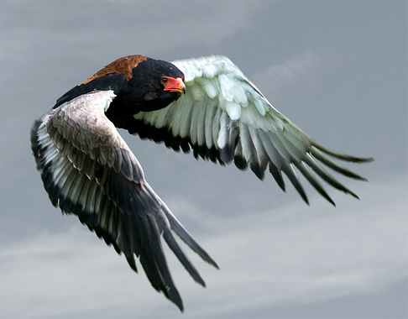

Slide 2
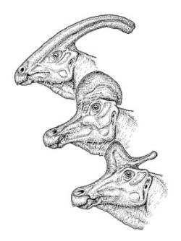
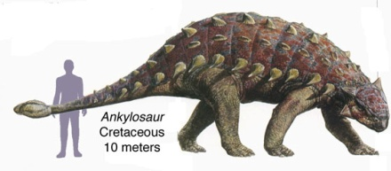
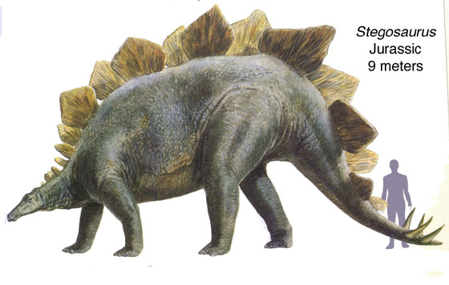
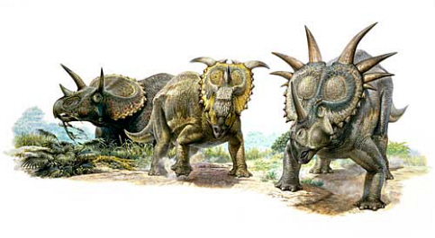
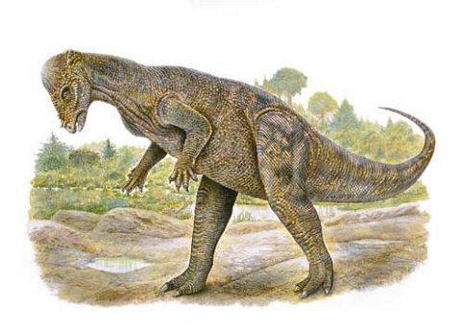
Dinosaur Groups

Slide 3
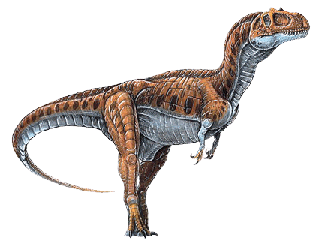
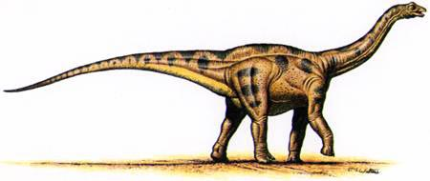
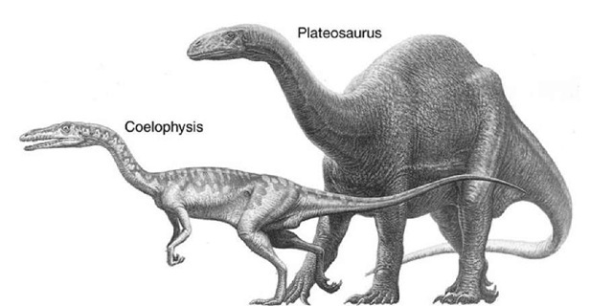
Dinosaur Groups

Slide 4
Who did birds descend from?
In groups of 2
FORGET WHAT YOU THINK YOU KNOW
Take a pigeon skeleton and find the 3 bones
Compare with your notes
Compare with Tinker
Who did birds descend from?

Slide 5
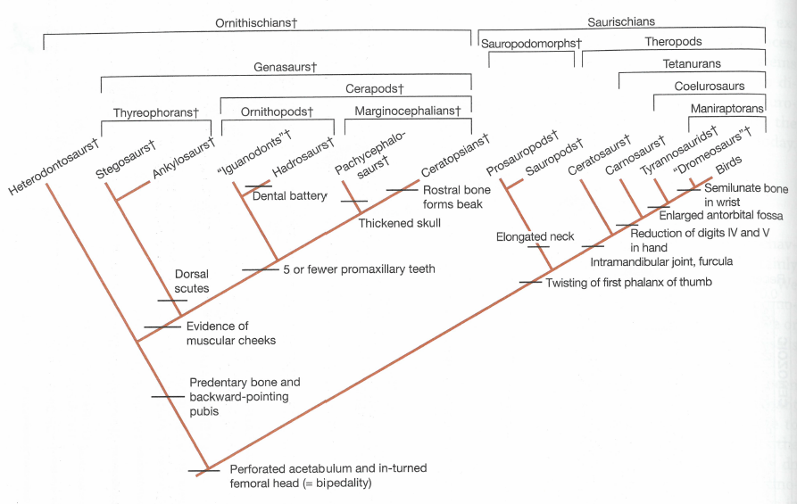
Dinosaur Cladogram

Slide 6
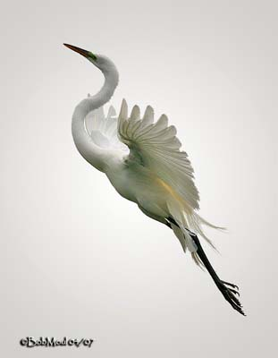
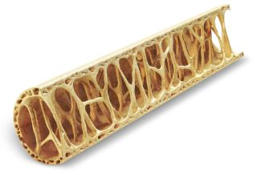
Synapomorphies

Slide 7
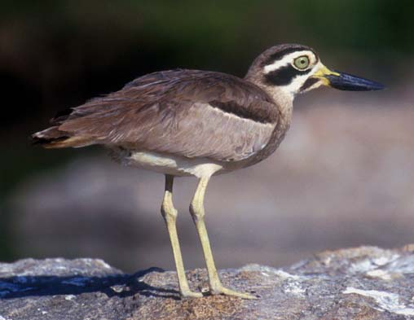
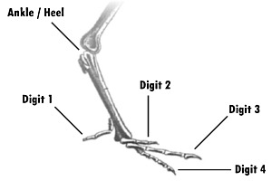
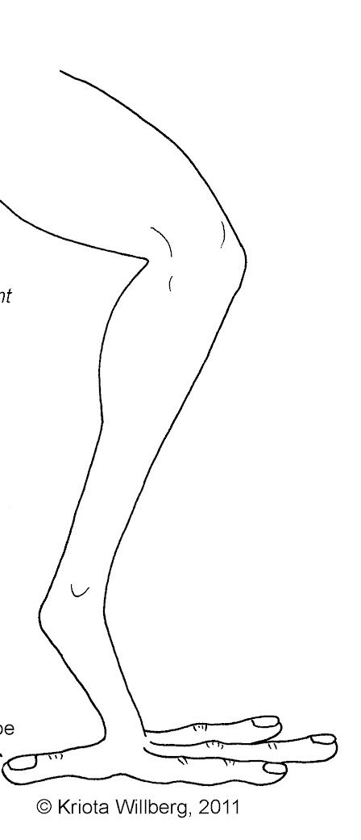
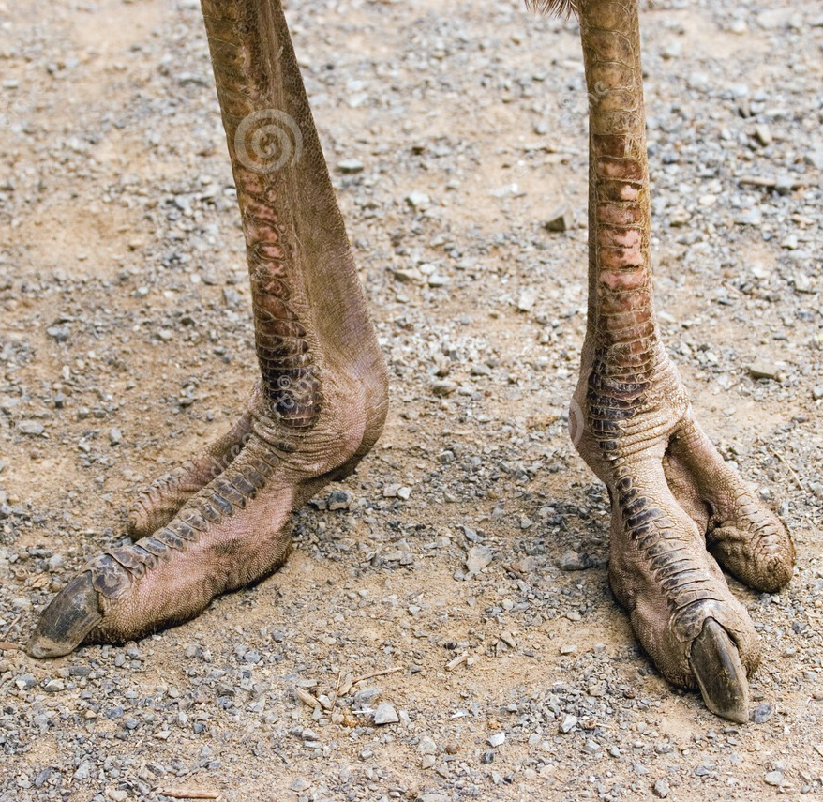
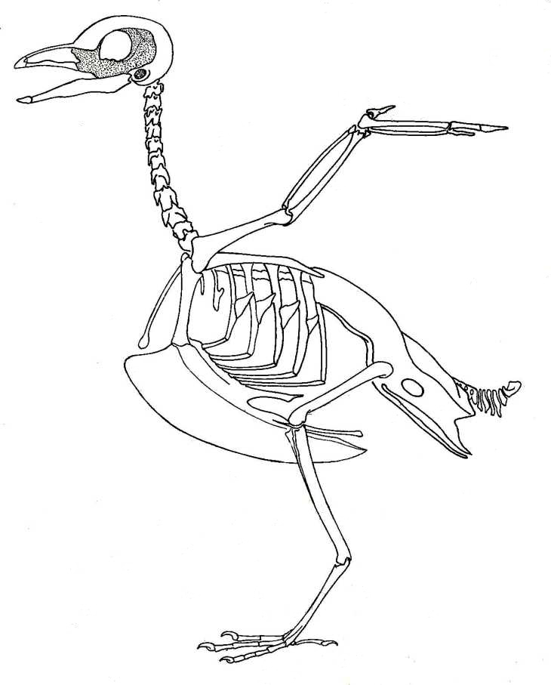

Slide 8
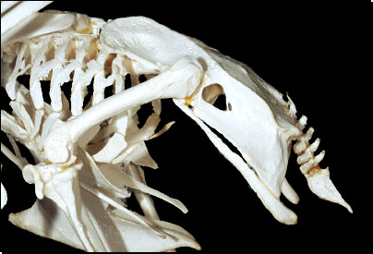
Why re-evolve an ornithischian pelvis?
Notes:
Bipedalism and Balance
Birds (and their theropod dinosaur ancestors like Velociraptor) are bipedal, walking upright on two legs.
A forward-pointing pubis (as in lizards or early reptiles) shifts the center of mass forward, making balance harder.
Rotating the pubis backward (parallel to the ischium) moves the gut and abdominal organs posteriorly, shifting the center of gravity over the hips and feet. This improves stability during walking, running, and landing.
2. Space for the Gizzard and Digestive Efficiency
Many birds have a muscular gizzard (for grinding food, especially in seed-eaters).
A backward pubis creates more abdominal space beneath the ribcage, accommodating a larger gizzard and longer intestines—crucial for processing tough plant material without teeth.
3. Respiratory Optimization (Air Sac System)
Birds have a unique respiratory system with air sacs that extend into the abdomen and even bones.
The backward pubis frees up space in the body cavity, preventing the lungs and air sacs from being compressed by the gut.
This allows continuous airflow (inhale and exhale both deliver oxygen), far more efficient than mammalian lungs—essential for the high metabolic demands of flight.
4. Flight and Lightweight Skeleton
The open, retroverted pelvis (with pubis pointing back) reduces overlap between pelvic bones, making the structure lighter and more flexible.
It also integrates better with the synsacrum (fused sacral vertebrae), creating a rigid frame to support wing-generated lift and thrust during flight.

Slide 9
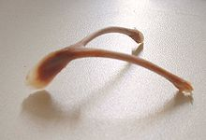
Skeleton Continued

Slide 10
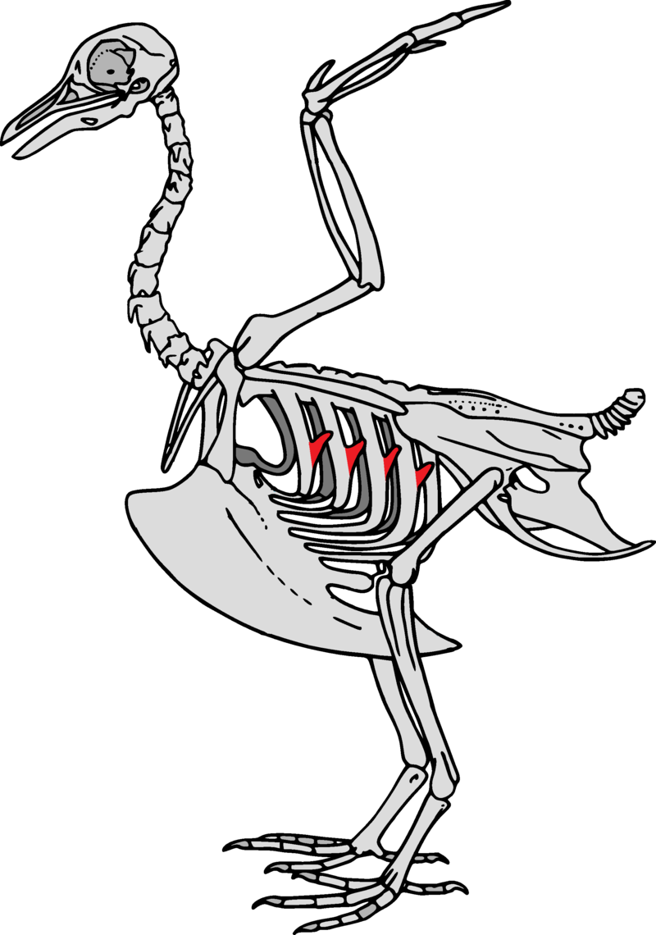

Slide 11
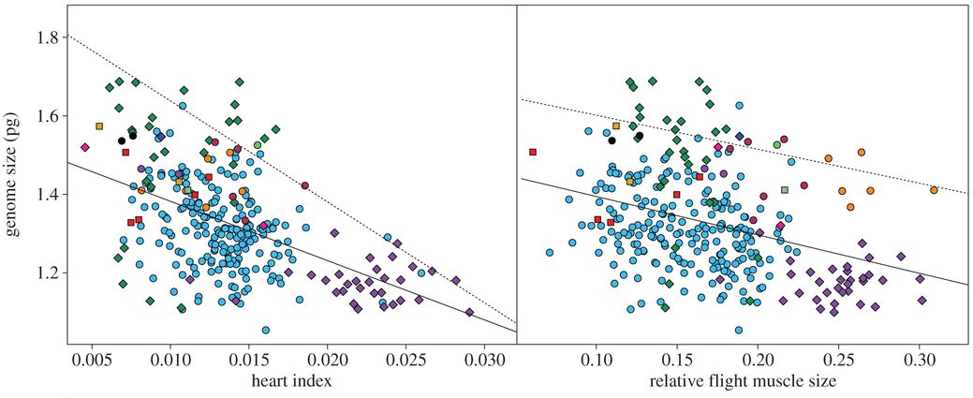
Flight and genomes
Different colored dots are various bird orders (e.g. blue Passeriformes)
Wright et al. 2013. Proc. Roy. Soc. B

Slide 12
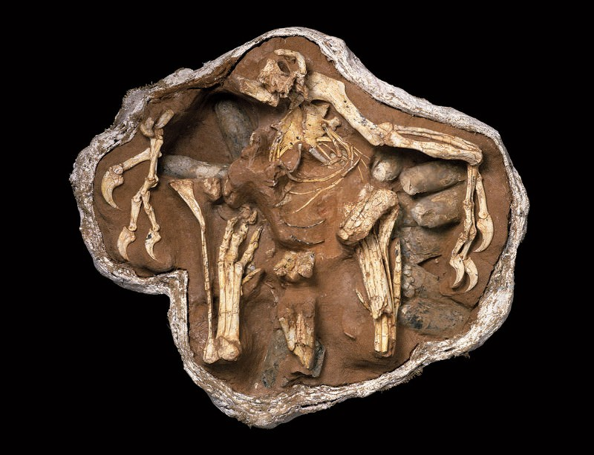
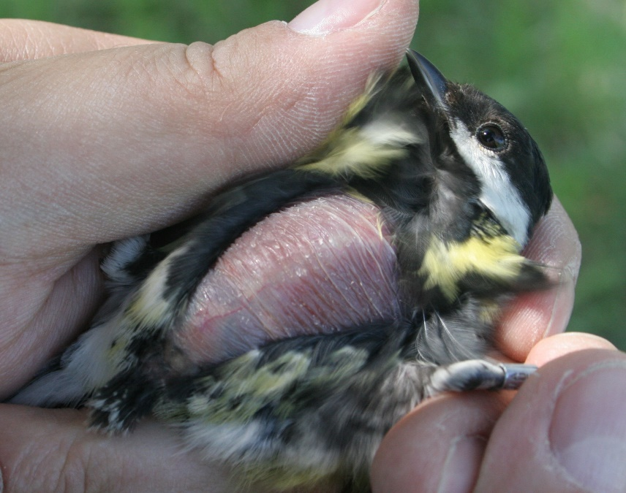
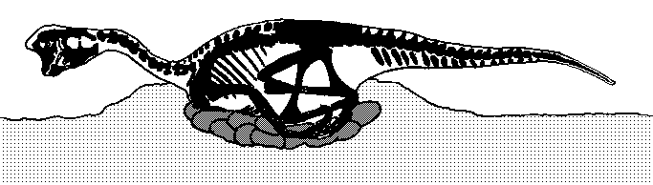
Oviraptosaur “egg thief lizard”
June 2017 – Temp of eggs determined!

Slide 13
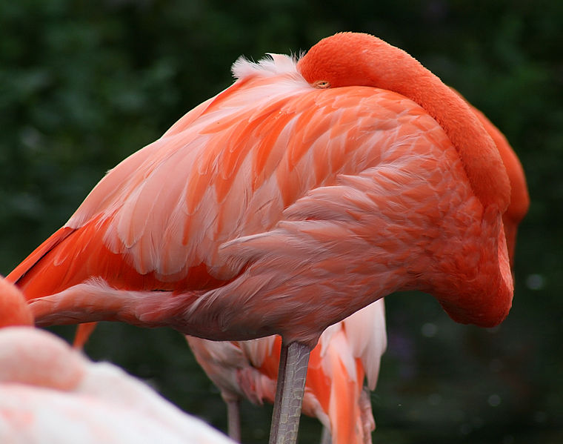
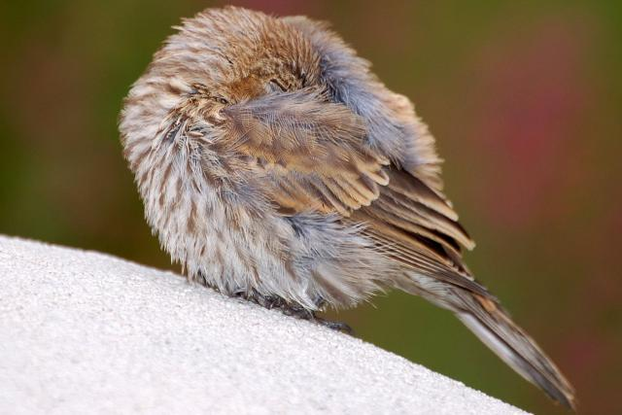

Slide 14
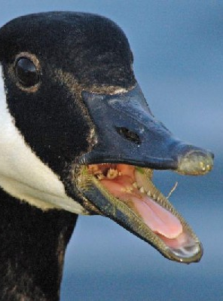
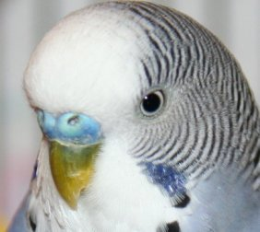
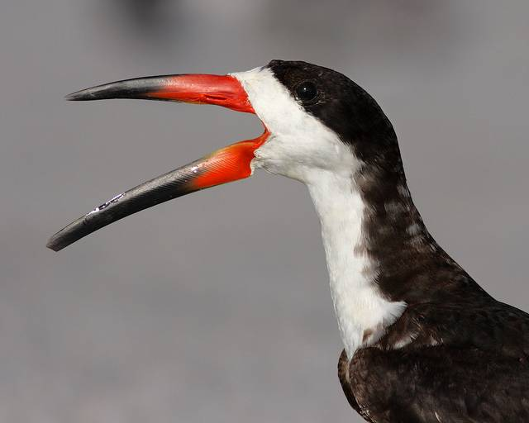

Slide 15
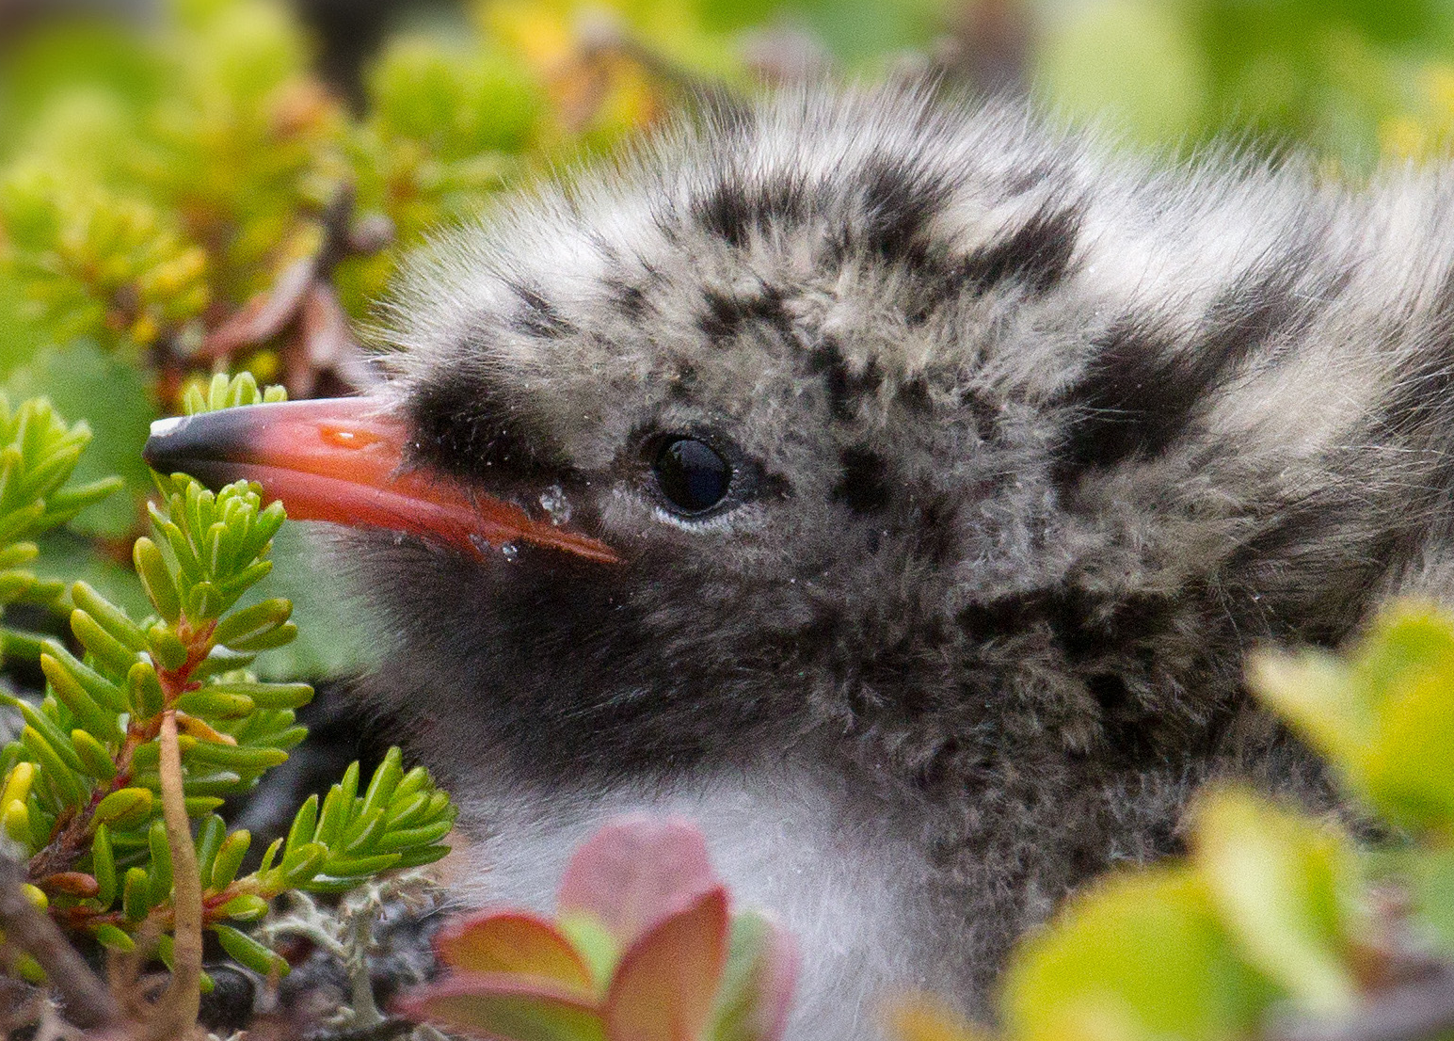
https://www.youtube.com/watch?v=EUEKIQCUJlM

Slide 16
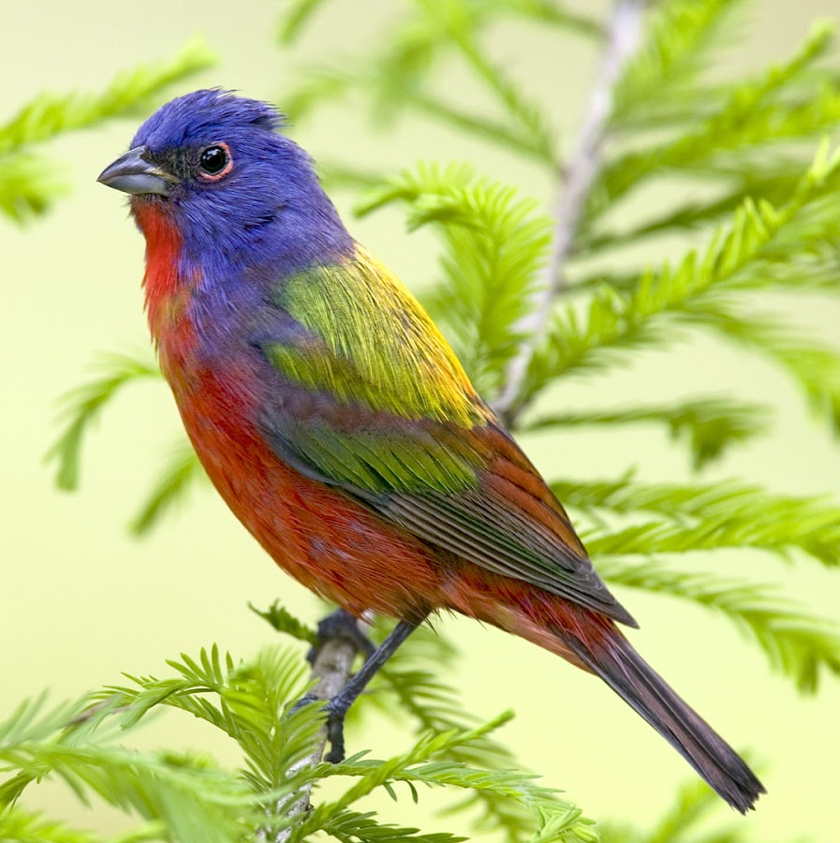

Slide 17
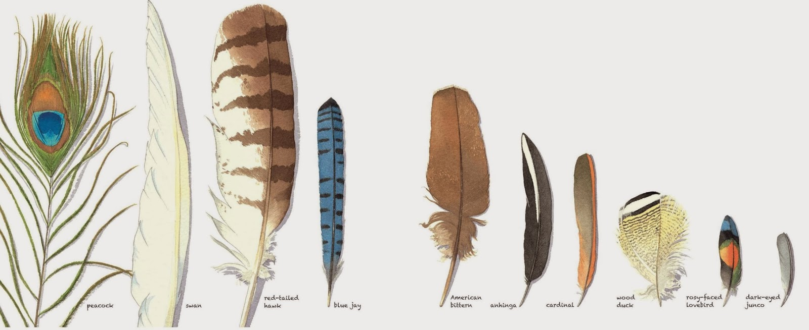
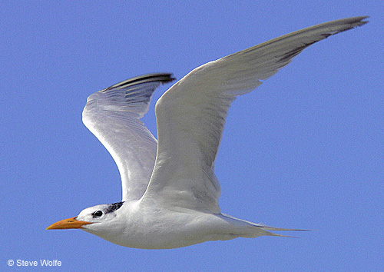
Modern Birds

Slide 18
Evolution of Feathers
“The sight of a feather in a peacock’s tail, whenever I gaze at it, makes me sick!”
Charles Darwin, 1860

Slide 19
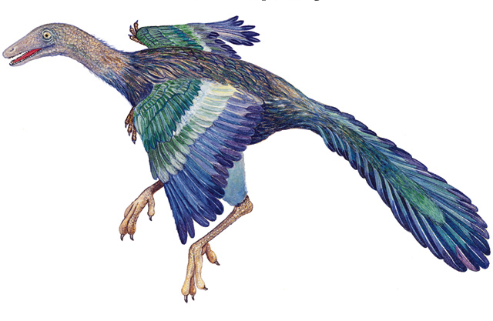
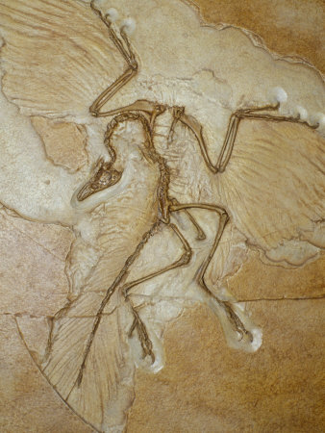
Archaeopteryx
"That strange bird, Archaeopteryx, with a long lizard-like tail, bearing a pair of feathers on each joint, and with its wings furnished with two free claws... scarcely any discovery has been made showing more plainly than this the close affinity between birds and reptiles.”
Mix of reptile and bird-like traits. What are they?

Slide 20
Problems:
What about the pelvis?
How did feathers arise?
What was the function of feathers?
Could these early “birds” fly?
How did flight arise?

Slide 21
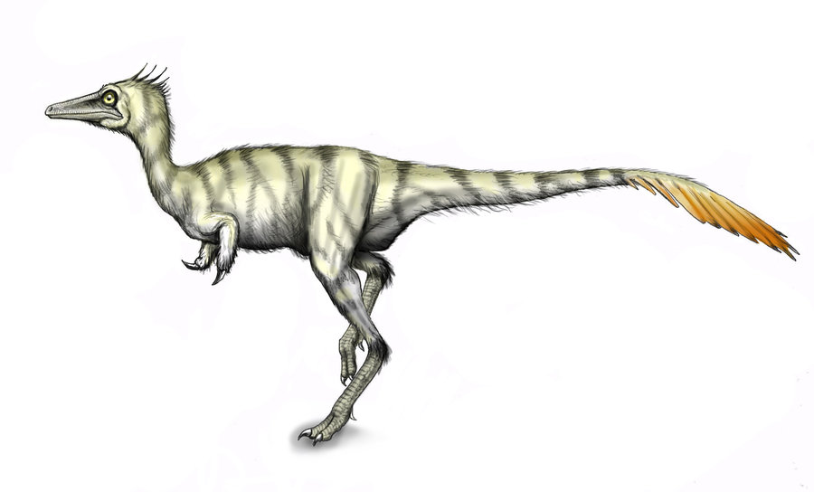
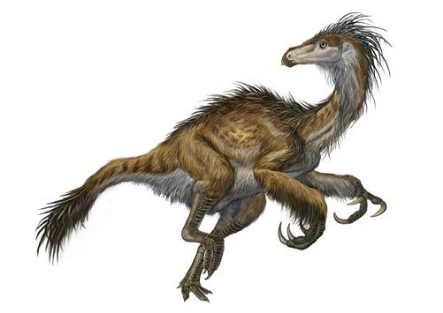
Beipiaosaurus

Slide 22
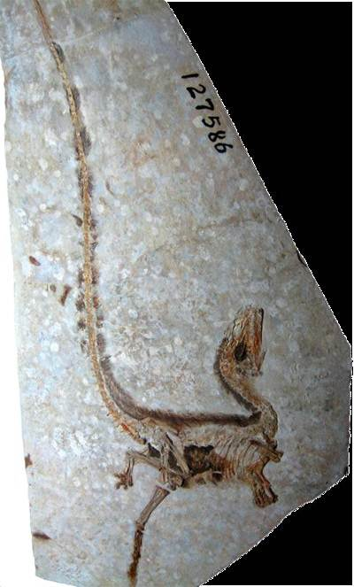
Sinosauropteryx

Slide 23
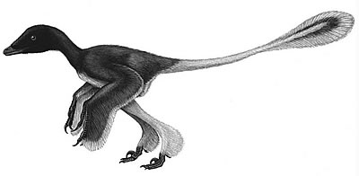
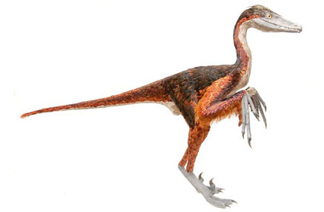
Sinornithosaurus

Slide 24
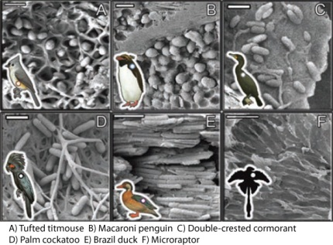
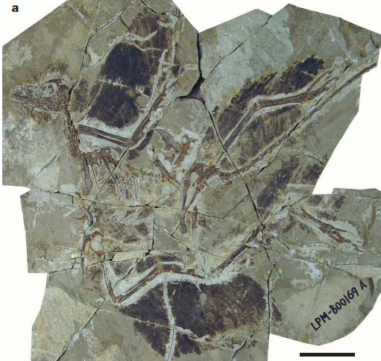
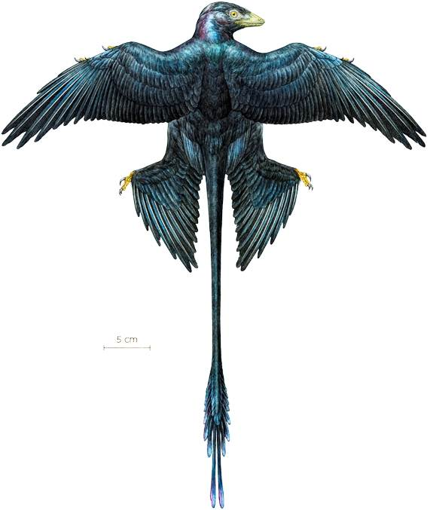
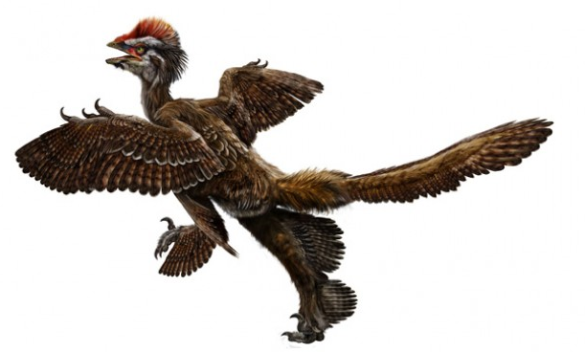
Sinosauropteryx
Microraptor
Li et al. 2012. Science

Slide 25
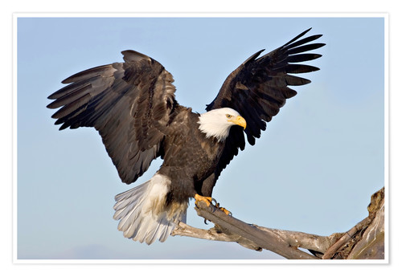

Slide 26
Why Feathers?

Slide 27
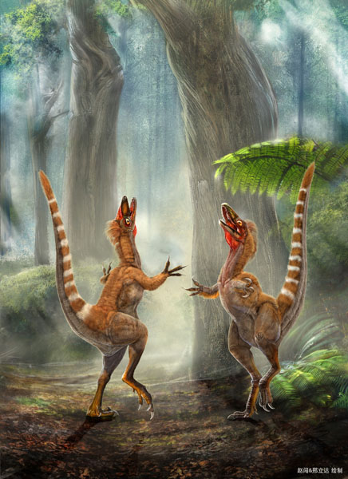
Sinosauropteryx
Dinosaur Coloration?
Zhang et al. 2010. Nature

Slide 28
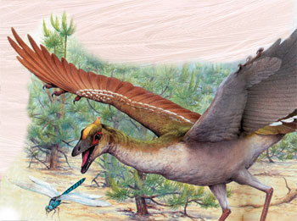
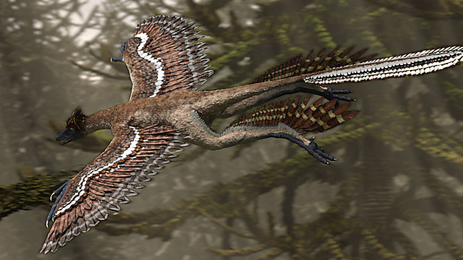
Why Flight?

Slide 29
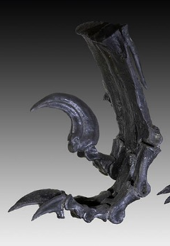
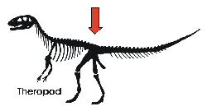



Body Changes in Modern Birds

Slide 30

The prevailing explanation is that theropods lost their fourth and fifth digits, then birds lost their first digits and regrew their fourth digits

Slide 31


Hesperornis
Notes:
Hesperornis – flightless bird from late cretaceous that had tiny row of teeth on the jawbones for holding fish
Moa – New Zealand

Slide 32



Slide 33


Slide 34



Body Size
Relatively uniform
Flight imposes maximum body size
  Flight is SOOO energetically expensive
  Metabolic demand vs mass
  Muscles of big bird work harder
Liz Bradford

Slide 35


Feather Structure
Develop from follicles in skin
Homologous to scales?
Arranged in tracts
Made of ?

Slide 36



Feather Structure

Slide 37




Feather Types

Slide 38





Speed & Weight Reduction
Notes:
http://platospond.com/WatsonsBlog/wp-content/uploads/2009/02/image_sci_animal0291.jpg
Bird bone photo

Slide 39

Muscles
Reducing weight only half the equation
Can make up 35% mass
Power output 10-20x mammal
Heart is huge
Notes:
Heart can be 50-100% larger relative to a mammal of the same size

Slide 40

Gavrilov et al. 2022.
Notes:
Basal metabolic rate (BMR) is the minimum number of calories your body needs to perform essential functions, like breathing, circulation, and cell production, while at rest

Slide 41
Think about the “percent” muscle mass of flight muscles and leg muscles in different “groups” of birds.
Can you link this to ecological context (google it if needed)?
Examples: swifts, eagles, geese, hawks, albatross, rails, ducks, owls

Slide 42



The Wing and Flight
What does airplane wing do?
Bird wing?
https://www.youtube.com/watch?v=B1uY7_wdYOA

Slide 43

Precision Control
Have extreme control of wing
Can rapidly change velocity and lift
Reducing drag and turbulence

Slide 44


Vortices
https://www.youtube.com/watch?v=2sh8_3-R90I

Slide 45


Role of the Tail?

Slide 46




Flight
Unlearned
  Babies develop confined
  Big birds “practice”
  Do improve with practice
Downward stroke
Upward stroke
Larger species too slow
https://www.youtube.com/watch?v=2H9PQ6jt9us
https://www.youtube.com/watch?v=thEkFMaB5CA

Slide 47
Because that last video pissed me off: https://www.youtube.com/watch?v=CEmYEQ78zS0

Slide 48


Wings TYPES
https://www.youtube.com/watch?v=uMX2wCJga8g
https://www.youtube.com/watch?v=Ma0oRdNovOw

Slide 49




The Hindlimbs

Slide 50




The Hindlimbs

Slide 51

Diving vs. Surface Swimming
Swimming
Webbed feet
Dense plumage
Big preening gland
Diving
Webbed feet
Narrow body
Wings into flippers

Slide 52

Feather Maintenance
https://www.youtube.com/watch?v=hVk1-iHtLe4

Slide 53



Reproduction
Breeding Season – cloaca swells
Elaborate courtship
Copulation
No penis (most)
http://www.10000birds.com/do-birds-have-penises.htm

Slide 54







Feeding
Forelimbs are wings – selection on?
Several broad categories

Slide 55





https://www.youtube.com/watch?v=1NvU8WG9bg0

Slide 56






Slide 57


Skull/Jaw Articulation

Slide 58




Tongues
https://www.youtube.com/watch?v=qfGXkNUIocc

Slide 59

Rico-Guevara, Fan, and Rubega 2015. Proc. Roy. Soc. B
https://www.youtube.com/watch?v=QYoYQAbPXbU

Slide 60


Digestive System
https://www.youtube.com/watch?v=wSutYGurh1I

Slide 61

Digestion
Digestion is fast
  Carnivorous?
  Fruit eaters?
  Herbivores?
Small intestine
Ceca
Cloaca

Slide 62

Bird Lungs

Slide 63



Parental Care - variable

Slide 64

Bird Orders!
Class Aves
10,000 sp.
28 orders
A cluster &*#!
Why?

Slide 65


Kuhl et al. 2021
Sequenced 1+ sp. from each family (90%)
429 species
7 major lineages
Couple surprising findings
Notes:
An Unbiased Molecular Approach Using 30-UTRs Resolves the
Avian Family-Level Tree of Life
Hummingbirds and albatrosses are part of a new group: The study revealed that hummingbirds and albatrosses belong to an entirely new, higher-level group of birds.
Eagles and owls are closest relatives: Contrary to previous studies, the research showed that eagles and owls are each other's closest relatives.
Magpie-geese and screamers are sister groups: Despite evidence from other studies suggesting a different relationship, genetic data from control-region sequences strongly support a sister-group relationship between the magpie-goose (Australia+New Guinea) and the screamer families (South American).

Slide 66




Struthioniformes
Emu, Kiwi, Rhea, Ostrich
All flightless
Lack what bony element?
Eat?
Notes:
Top left = ostrich
Top right = kiwi
Bottom left = rhea
Bottom right = emu

Slide 67



Do they have wings?
Notes:
Top left = ostrich
Top right = kiwi
Bottom left = rhea
Bottom right = emu

Slide 68



Anseriformes
Ducks, geese, swans, screamers
180 species
All aquatic
Large, bright, domesticated
Socially monogamous
Habitat?
Eat?

Slide 69

https://www.youtube.com/watch?v=SeaByXgH7nU

Slide 70




Galliformes
Pheasants, quail, turkey, guinea, partridge
200 sp.
Open and forested habitats
Stocky body, small head
Explosive take-off, fly low
Prefer to run
Most important bird

Slide 71



Piciformes
https://www.youtube.com/watch?v=RNni2QLdLJo
400 sp.
All arboreal
Zygodactylous feet
Eat?
Nest?
https://www.youtube.com/watch?v=hGC4nG0RqYI
https://www.youtube.com/watch?v=bqBxbMWd8O0

Slide 72





Slide 73



https://www.youtube.com/watch?v=Q0OCd6b1aXU

Slide 74


Ramphastidae (family)
Toucans
Tropical new world
Massive bill – why?
Bright plumage – no sexual dimorphism
Eat?
Notes:
Thermoregulation – acts as a radiator, can control bloodflow, capillaries close to surface
Feeding – honecomb internal structure makes it strong and light
Sexual selection – bright colors and sizes signal quality and dominance

Slide 75




Bucerotiformes
Hornbills
Africa and Asia
Long down-curved bill
Casque on upper bill (function?)
Vertebrate at skull base fused to skull
Omnivores

Slide 76



Trogoniformes
Trogons
All tropics (not Australia)
Bright colored with elaborate plumage
Most famous bird for birders?
Quetzal

Slide 77



Coraciiformes
Bee eaters, kingfishers, motmots
Old world (most)
200 species
Small with big head and small feet
Associated with water
https://www.youtube.com/watch?v=veQ2ilQrzMU
https://www.youtube.com/watch?v=lNcpMauEzMU

Slide 78


Cuculiformes
Cuckoo
  Brood parasites
  Eat catepillars
Roadrunners
  Ground dwellers
  SW US
  Omnivores
https://www.youtube.com/watch?v=SO1WccH2_YM

Slide 79



Opisthocomiformes
Hoatzin
  Enigmatic for decades
  Rainforests and swamps of SA
  2 claws on wings
  Herbivore
https://www.youtube.com/watch?v=87_shPJxdns
Notes:
Sister group to shorebirds/gulls and cranes – not close to Galliformes (like prev thought)
Deep within bird branch (75MYA)
Claws disappear after fledging

Slide 80



Psittaciformes
360 species
Very intelligent
Traits
  Zygodactylous feet
  Down-curved bill
  Strong tongue
  Bill-tip organ
Feed on?
Carolina parakeet

Slide 81



Trochiliformes
320 species
Americas only
Reduced leg and wing bones
Do not walk or hop
8-70 beats per second
Body temp 105 deg
Eat?
https://www.youtube.com/watch?v=mGUt4EdudBM
Notes:
Eat nectar but also a lot of insects, their body weight in a day

Slide 82



Gruiformes
Cranes, coots, rails (most)
190 sp.
Ground and water feeding
Hold all the records
~11-14 species extinct because flightless
Notes:
Tallest, heaviest, longest, widest birds
Huge proportion endangered due to dependence on wetlands which have been drained

Slide 83

Notes:
Some of the other bird species that are flightless and have gone extinct
Some of these went extinct tens of thousands of years ago. Others – Dodo, were recent
Not all of these are Gruiformes, just highlighting the many extinct big flightless birds

Slide 84




Apodiformes
Swifts
Aerial foragers
Convergent with?
Swooped wing shape and short forked tail
One synapomorphy
Notes:
Convergent with swallows – not closely related
Synapomorphy is a modification to the finger bones – see the diagram. Loss of two digits and extension of carpels allows for greater banking and manuverability.

Slide 85


Caprimulgiformes
Nighthawks & nightjars
90 species
Long wings, short legs, super short bill
Nocturnal
Aerial insect feeders
Nest on ground
Bill bristles
https://www.youtube.com/watch?v=7kJXiFPnlIE
Notes:
Insect feeders and have bristles around mouth to help catch bugs

Slide 86


Strigiformes
200 species (2 families)
Globally distributed
Huge body size variation
Facial disk
Nocturnal hunters
Prey swallowed whole
Flight?
No nests
Territorial and don’t migrate
https://www.youtube.com/watch?v=d_FEaFgJyfA
Notes:
Sparrow to eagle sized
Circle or heart-shaped facial disk – rachis’ are large and insert behind the ear, funnel sound to ear, feathers have open vanes that forms a trough, increase sound 10x
Large eyes with many rods
Fly silently – see next page
Babies in tree cavities or nest of other birds

Slide 87


https://www.youtube.com/watch?v=PTLaxqmcYeY

Slide 88


Notes:
Owl wings/flight is ultra quiet compared to other birds due to adapations that minimize drag/turbulance as the air goes around the wing/feather
Comb-like fringes on primaries
Secondaries have soft fringes to reduce turbulence

Slide 89




Columbiformes
Pigeons, doves, dodo
300 species
Short neck, bill, and legs
Large wing/flight muscles
Eat?
Synapomorphy
https://www.youtube.com/watch?v=YXVLPqY1FrY
Notes:
Seeds and fruit, occasionally insects
Synap – bare patch of skin around eyes
Includes passenger pigeon (middle picture) – most abundant bird on earth at one point. One flock estimated to have 2 billion birds – extinct due to habitat loss and hunting
Dodo – evolved on ocean island with no predators (Mauritius, near Madagascar) – extinct due to hunting and invasive animals in 1600’s

Slide 90





Ciconiiformes
https://www.youtube.com/watch?v=1-p2AI9uTs0
https://www.youtube.com/watch?v=QLV_K7DVeyU
Herons, Ibis, Stork, Bittern
Tall, long-legged wading bird
Eat?
6th Vertebrae modified to form hinge
Notes:
Consists of huge number of birds
Albertrosses, Anhingas, Auks, Avocets, Bitterns, Boobies, Caracaras, Cormorants, Crab-plovers, Curlews, Darters, Divers, Eagles, Egrets, Falcons, Flamingos, Frigatebirds, Gannets, Grebes, Gulls, Hammerkops, Hawks, Herons, Ibises, Jacanas, Kites, Lapwings,Loons, Oystercatchers, Paintedsnipe, Pelecans, Penguins, Petrels, Phalaropes, Plains-wanderers, Plovers, Pratincoles, Puffins, Sandgrouse, Sandpipers, Secretarybirds, Seedsnipes, Shags, Shearwaters, Sheathbills, Shoebills, Skuas, Snipe, Spoonbills, Stilts, Storks, Thick-knees, Tropicbirds
Vertebrae in neck modified to form a hinge – see next slide

Slide 91



Slide 92

Phoenicopteriformes
Flamingos
4 species
Closest relative is the grebe
Americas and Africa/Europe
Colonial
Filter feed on?
Pink from?
Notes:
Consists of huge number of birds
Albertrosses, Anhingas, Auks, Avocets, Bitterns, Boobies, Caracaras, Cormorants, Crab-plovers, Curlews, Darters, Divers, Eagles, Egrets, Falcons, Flamingos, Frigatebirds, Gannets, Grebes, Gulls, Hammerkops, Hawks, Herons, Ibises, Jacanas, Kites, Lapwings,Loons, Oystercatchers, Paintedsnipe, Pelecans, Penguins, Petrels, Phalaropes, Plains-wanderers, Plovers, Pratincoles, Puffins, Sandgrouse, Sandpipers, Secretarybirds, Seedsnipes, Shags, Shearwaters, Sheathbills, Shoebills, Skuas, Snipe, Spoonbills, Stilts, Storks, Thick-knees, Tropicbirds and Vultures,

Slide 93


Accipitriformes
Diurnal birds of prey
Synapomorphies
  Hooked beak
  Large soft cere
  Long broad wings (type?)
  Strong legs and feet
  Eat?
4 families

Slide 94



Cathartidae
Notes:
7 species
Convergent with old world vultures
Scavengers
Very good sense of smell
Bald head to help keep clean when buried in a dead organism

Slide 95


Pandionidae
https://www.youtube.com/watch?v=nMw-PspfdkQ
Notes:
Osprey
Dirunal and global
Fish eater – always near water
Can rotate 3rd toe back to be zygodactylous to help hold fish

Slide 96


Sagittaridae
https://www.youtube.com/watch?v=H9-6n72UTQg
Notes:
Terrestrial bird of prey from Africa
Large body and super long legs
Hunts small animals (mice, lizards, etc.) while walking around

Slide 97




Accipitridae
https://www.youtube.com/watch?v=kbLE1-nOlSs
Notes:
Hawks, Eagles, Old world vultures
Huge size range
Hawks split into Accipiter and Buteo groups
Accipiter hunt birds and life in forest or forest edges
Buteo – watch for prey from a perch and are generalist feeders

Slide 98



Falconiformes
60 sp.
Diurnal birds of prey
Not related to acciptriformes
Slender wings
Strong hooked bill
Kill with?
https://www.youtube.com/watch?v=ovocT91G1ww
https://youtu.be/uapP1yldldk
Notes:
Kill with beak instead of talons - use beak tooth on side of beak

Slide 99


Charadriiformes
Seabirds and waterbirds
60+ species
Medium size gray or white
Opportunistic
Webbed feet and strong fliers
Colonial nesters

Slide 100



Passeriformes
Songbirds or perching birds
Half of all bird species
Most small (but raven)
Anisodactyl feet
One synapomorphy - Preglossale
Omnivorous or insectivorous (but shrikes)
3 suborders
Notes:
Preglossale – bone in the tongue – stiffens the tong when holding seeds
A lot are seed eaters
Suborders
Tyranni (South American)
Passeri – strong control of syrinx and lots of songs
Aconthisitti – New Zealand wrens

Slide 101

List of families haha

Slide 102
Bird Presentations
3 min each family (6 min total)
Powerpoint with 4-6 slides per family
Family name and common names of various species
Any pertinent information about the family that helps put the bird in context (e.g. synapomorphies)
Natural History Details
  Distribution
  Typical habitat and activity patterns
  Food preferences
  Link morphology with the two above
  Nesting sites and parental care behavior
  Mating season and reproductive behavior
  Additional unique features
https://nhpbs.org/wild/Passeriformes.asp

Slide 103
Bird Presentations
Pick families
Presentation order will be randomly chosen (start Friday)
Presentations should mimic one of mine (meaning?)
https://nhpbs.org/wild/Passeriformes.asp

Slide 104



Passeridae/Emberizidae (family)

