Slide 1
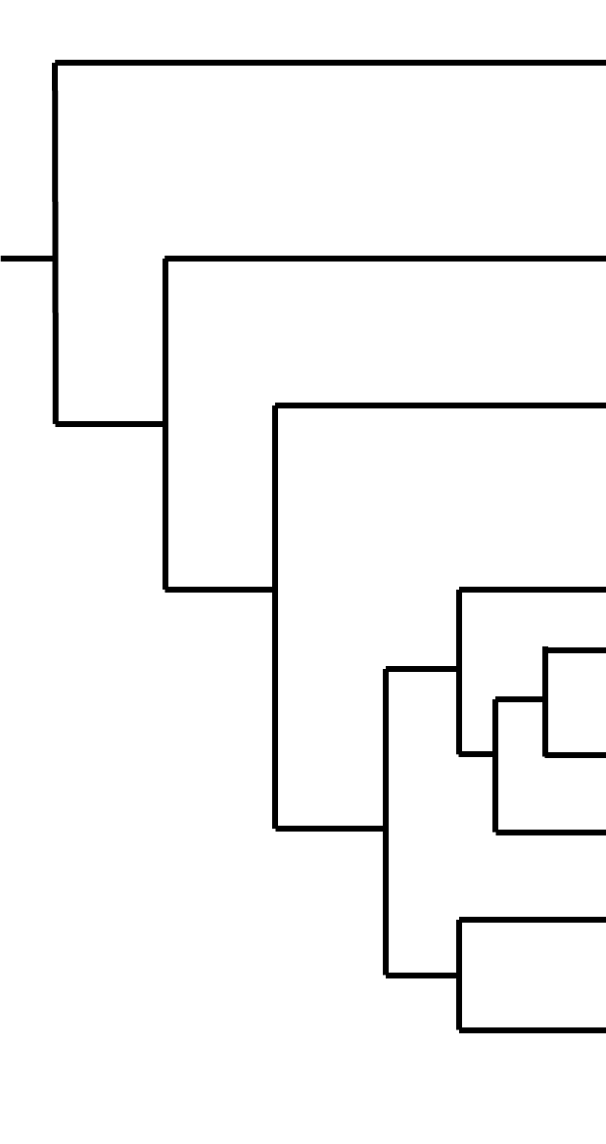
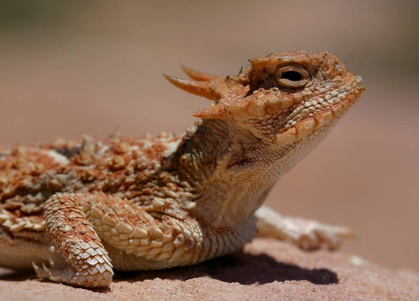
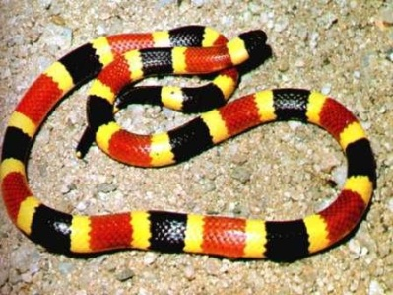
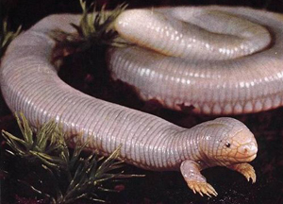
Squamata
Fish
Lissamphibia
Mammalia
Testudines
Lacertilia
Serpentes
Rhyncocephalia
Crocodylia
3 Major orders/suborders
Aves

Slide 2
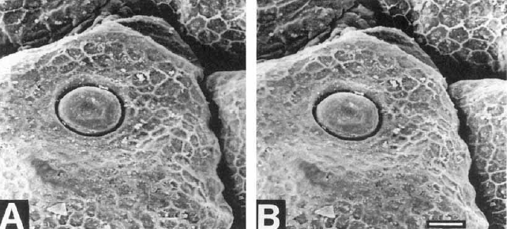
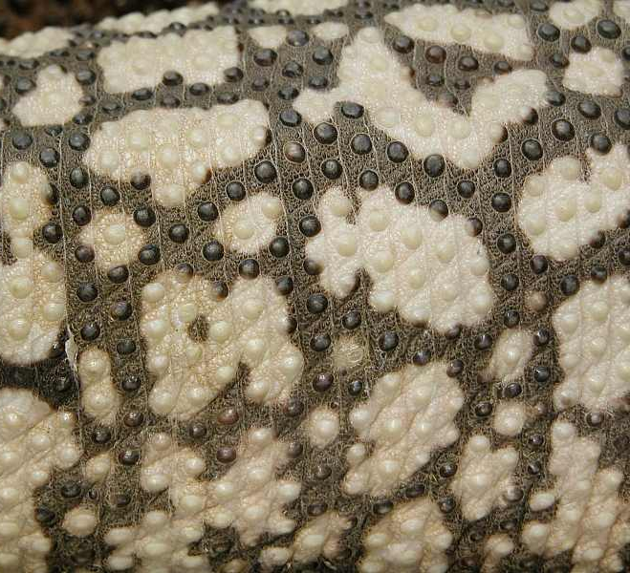
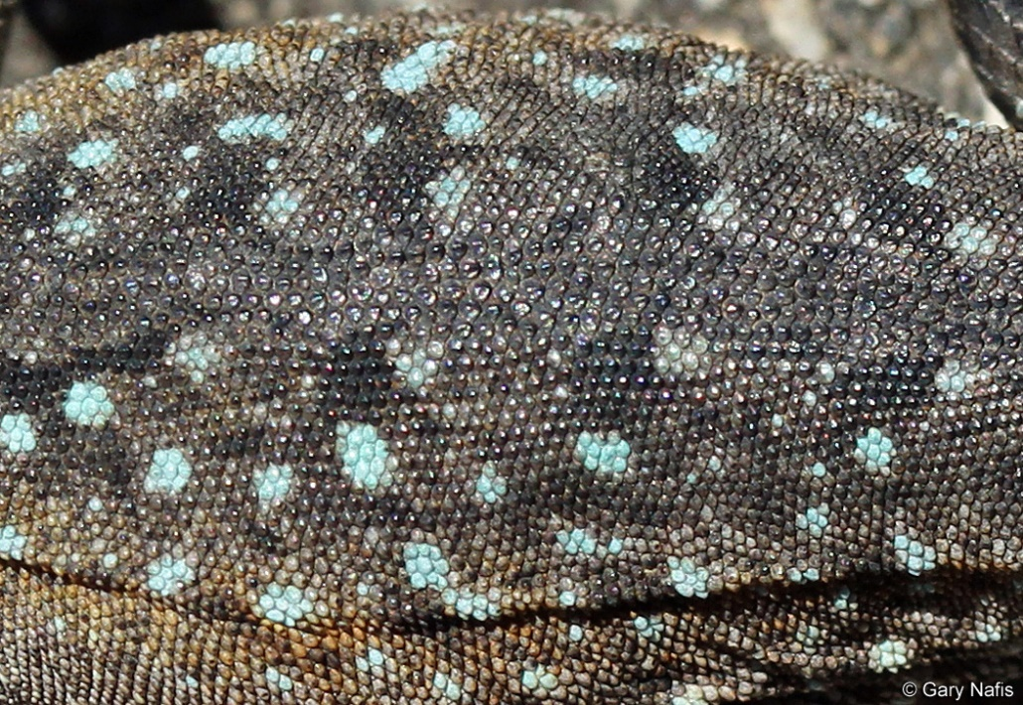
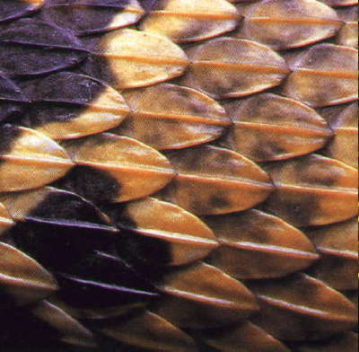
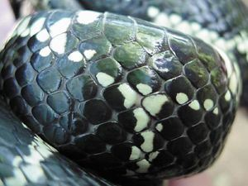
Scale Types
From: Sherbrooke & Nagle 1996. Journal of Morphology

Slide 3
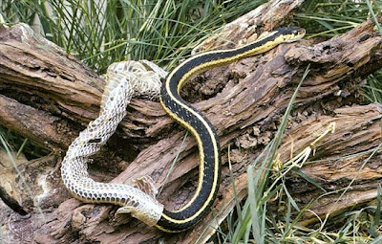
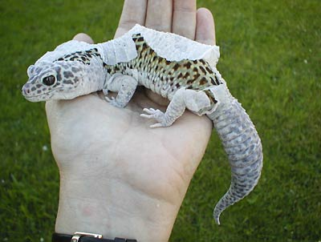
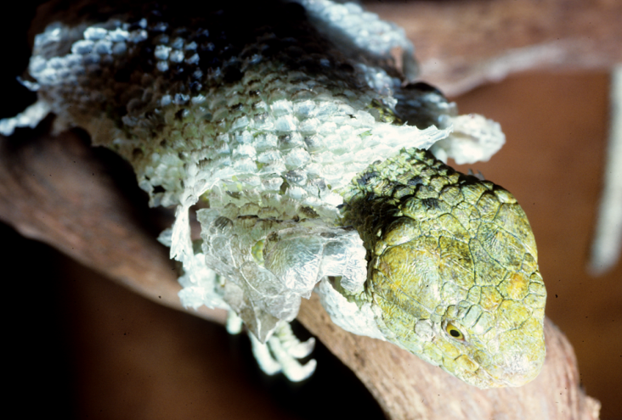
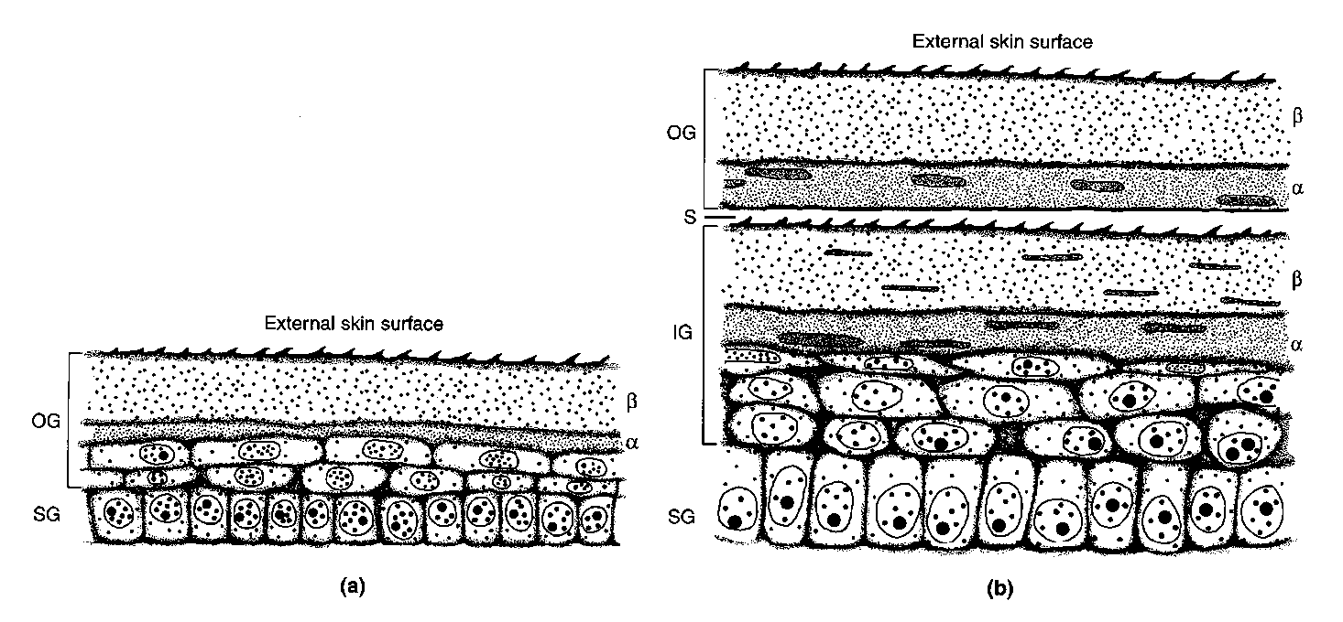
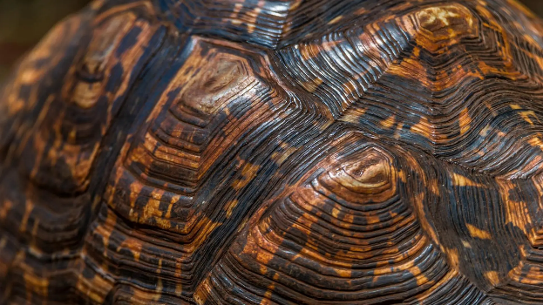
Scales & Skin Shedding
Shedding Skin
(during shedding)
Normal Skin Structure
(after shedding)

Slide 4
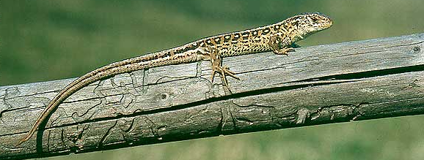
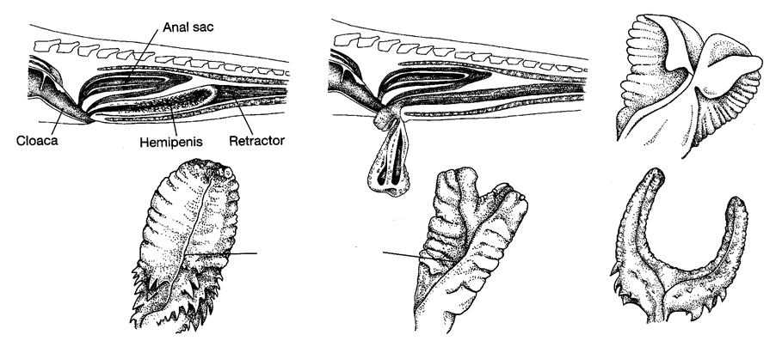
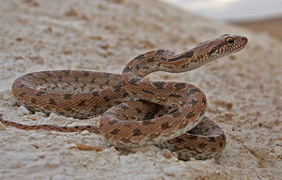
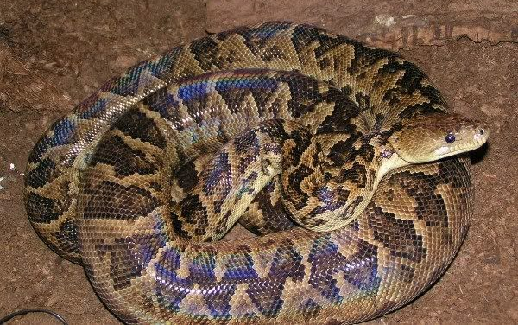
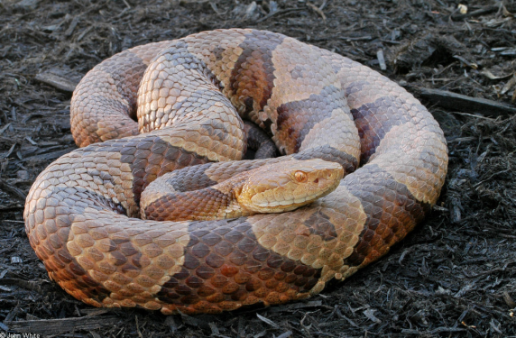
Hemipenes
Lacertidae
Colubridae
Boidae
Viperidae

Slide 5
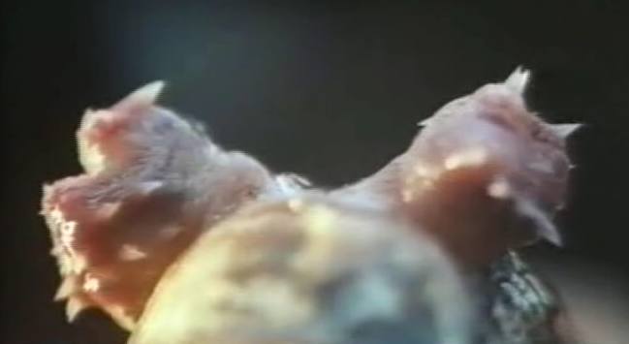
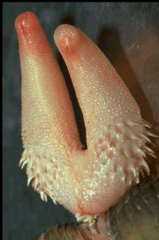
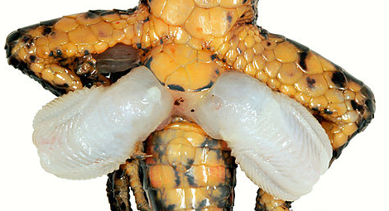
Hemipenes

Slide 6
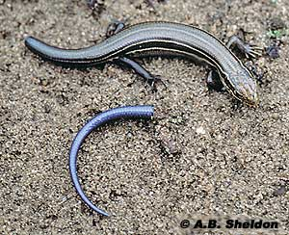
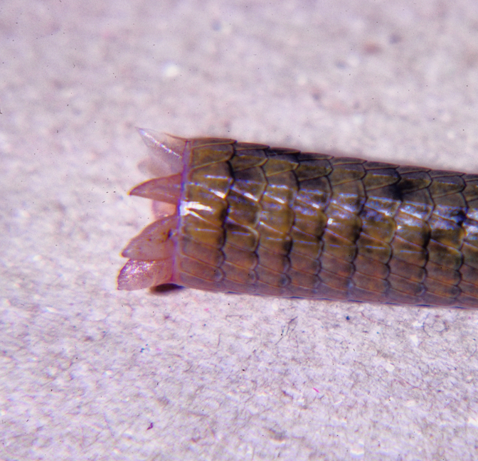
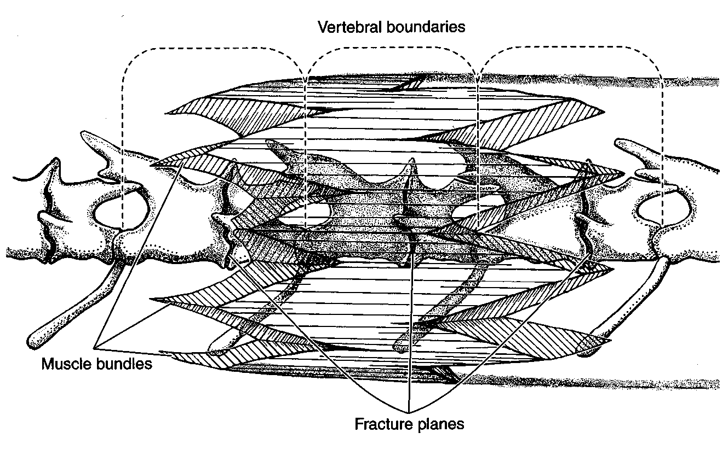
Tail Autotomy

Slide 7
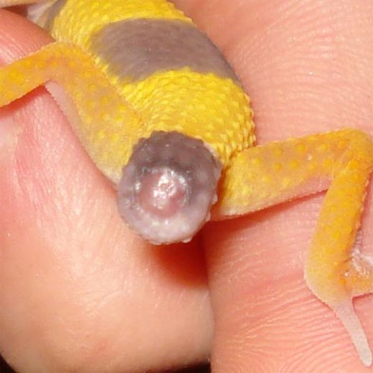
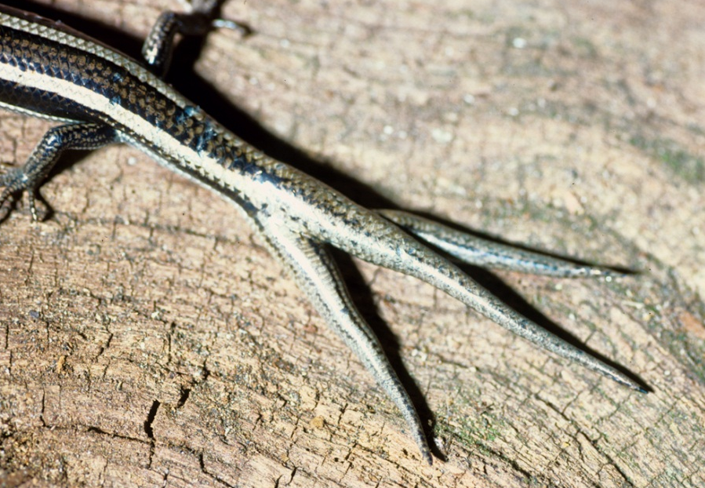
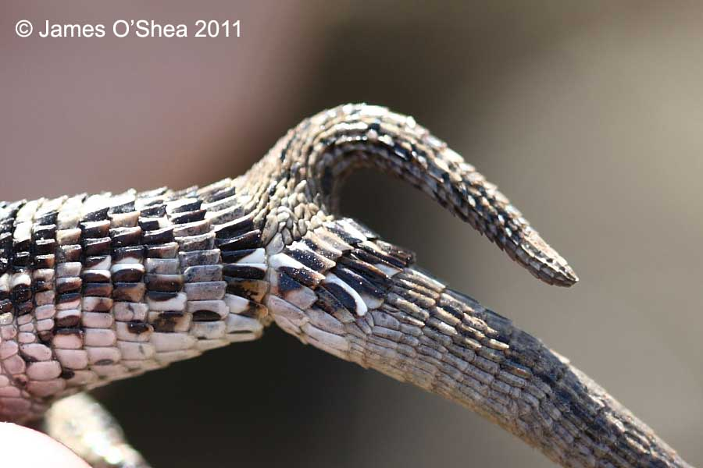
Tail Autotomy

Slide 8
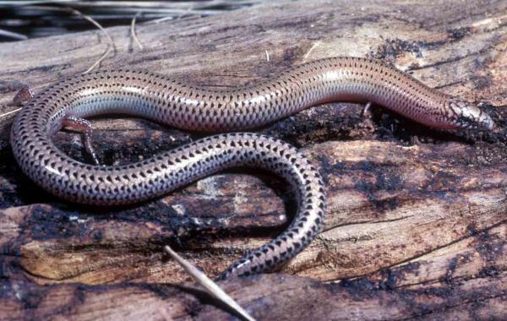
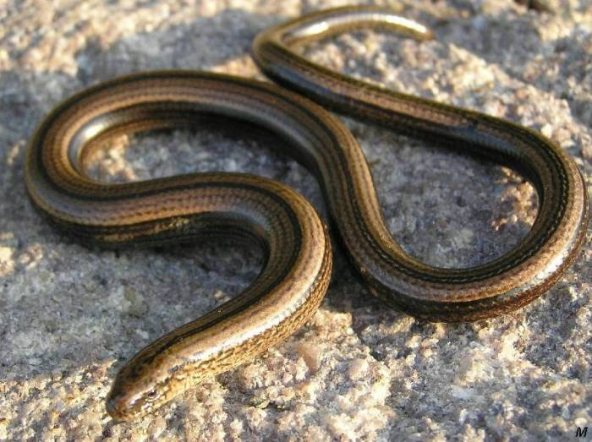
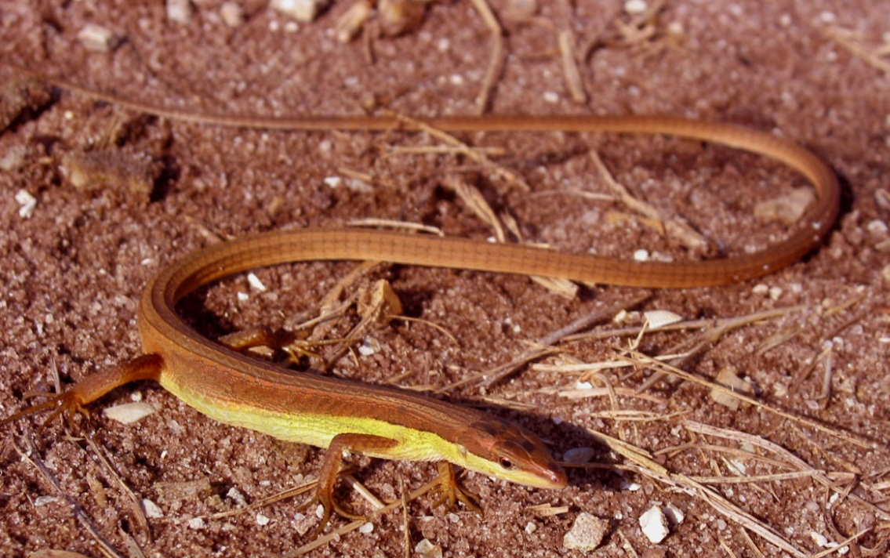
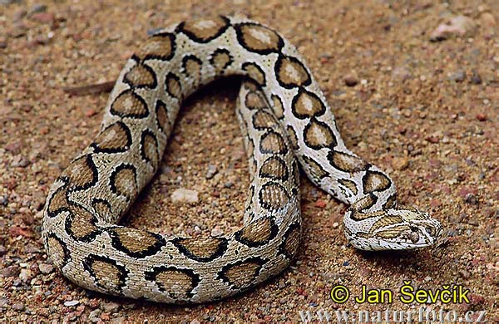
Limb Reduction and Loss

Slide 9
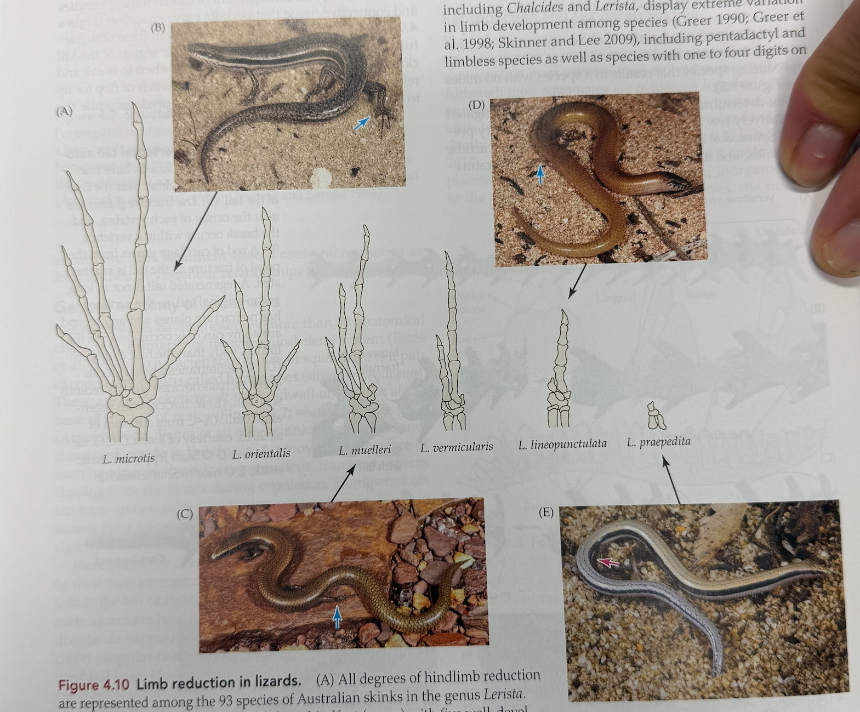
Notes:
Complete limb loss has occurred 25 times

Slide 10
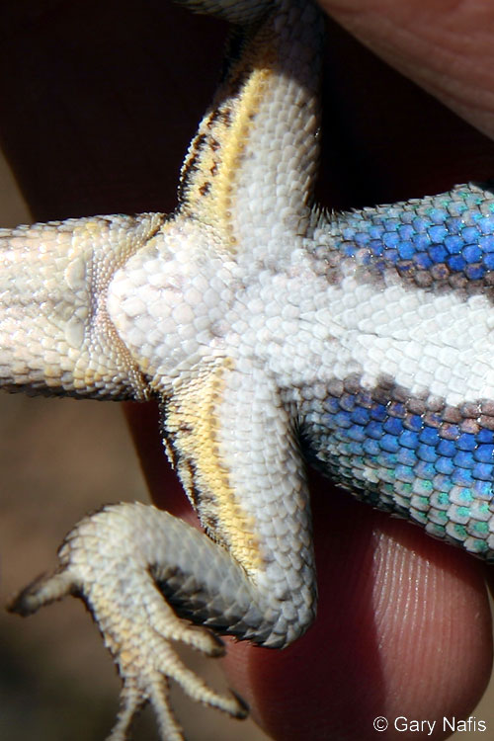
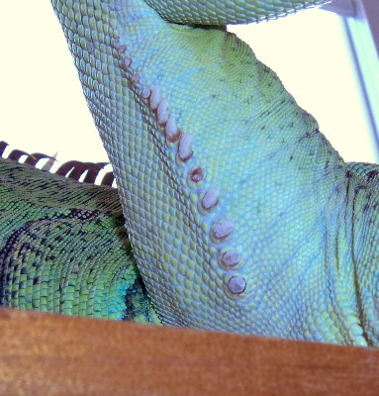
Skin Glands
Sceloporus
Iguana

Slide 11
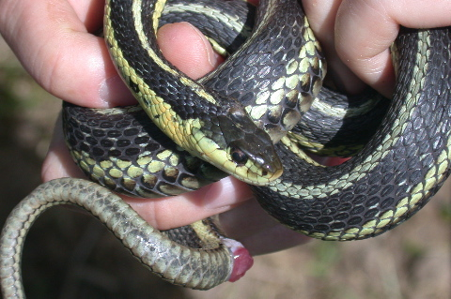

Slide 12
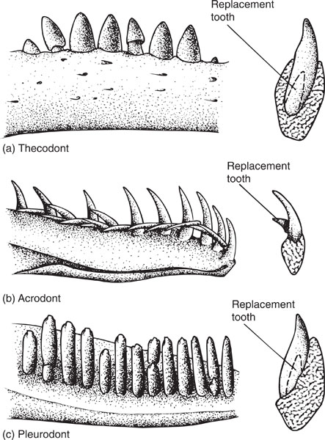
Thecodont
Acrodont
Pleurodont

Slide 13
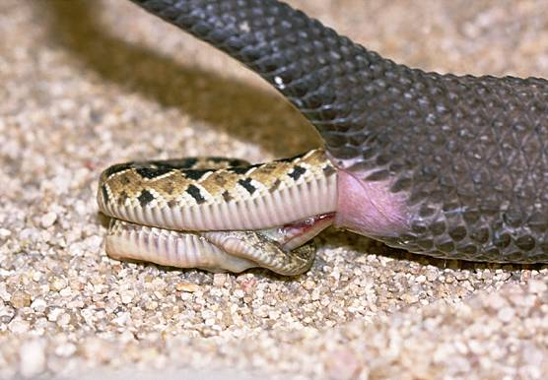
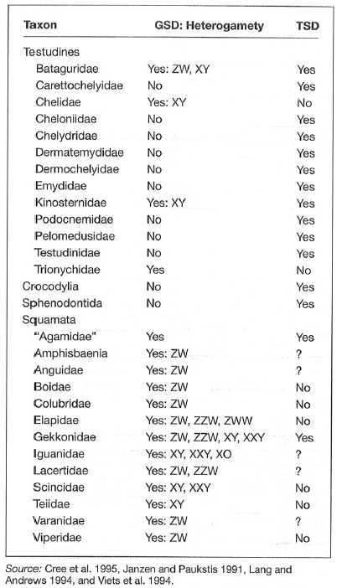
Squamate Reproduction
Most oviparous/viviparous
Few ovoviviparous
Almost all have GSD

Slide 14
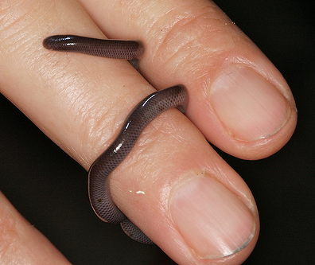
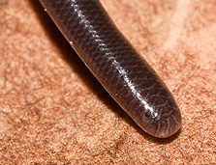
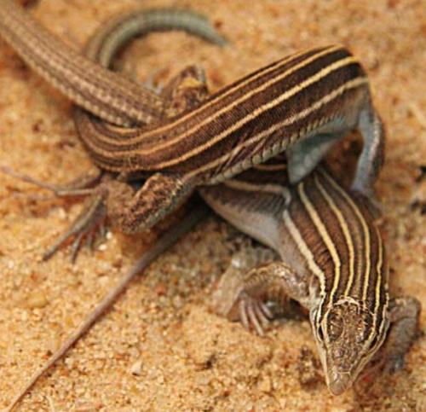
Parthenogensis
All female pops
Produce diploid eggs
Formed by hybridization

Slide 15
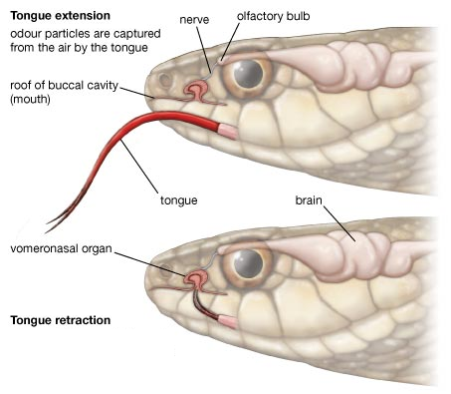
Chemical Communication

Slide 16
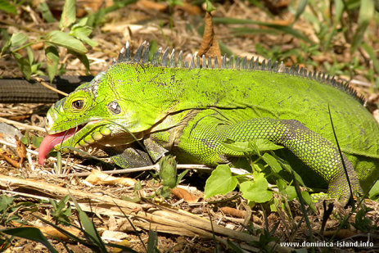
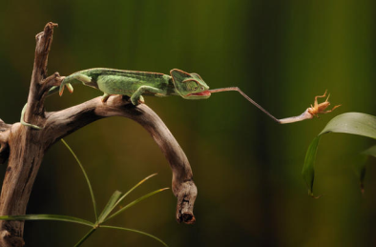
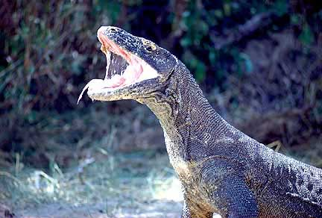
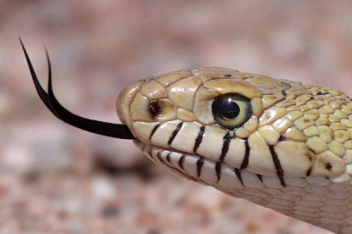
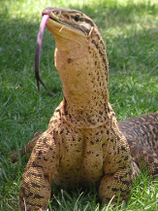
Traditional Division within Squamata

Slide 17
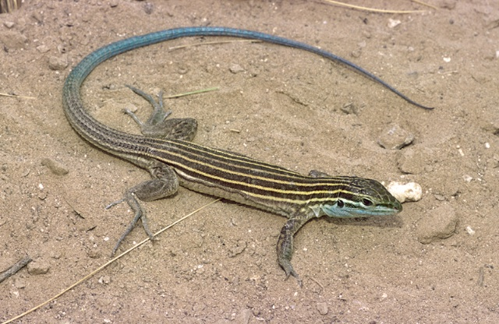
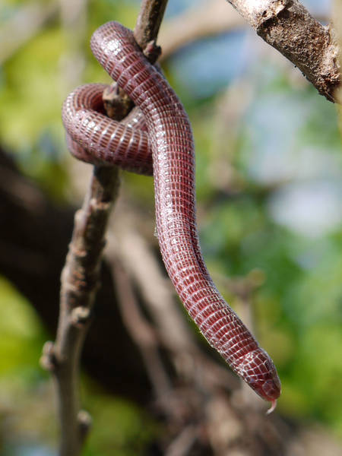

Squamate Systematics
Two major clades of Squamata:
  Iguania
  Scleroglossa

Slide 18
Squamate Phylogeny
Not monophyletic
Morphology disagrees with molecular data
Lots of controversy
  Snakes position?
  Amphisbaenia position (resolved)?
What we know
  Squamata diverged 200MYA
  Never will be consensus (certainly between morphology and DNA)
Iguanomorpha
~170MYA
Gekkonomorpha
Cordyloidea
Lacertoidea
Scincomorpha
Scincoidea
?
Amphisbaenia
?
Serpentes
~100MYA
Carusioidea
Anguidae
Anguimorpha
Platynota

Slide 19
Families of Iguania
What characteristic differentiates these families from other squamates?

Slide 20



Agamidae
Chlamydosaurus kingii
(Frilled Lizard)
Moloch horridus (Thorny Devil)

Slide 21



Agamidae
Pogona vitticeps
Bearded Dragon
Draco volans
Flying Dragon
http://www.youtube.com/watch?v=RLbkVanjHVU

Slide 22







Chamaeleonidae
200 sp.
Laterally compressed
Zygodactylous
Prehensile tail
Projectile tongue
Turreted eyes
Insectivorous
Chromatophores
Notes:
22

Slide 23





Adaptations for Arboreality

Slide 24


Adaptations for Arboreality
Harkness Nature 1977

Slide 25



Dwarf Chameleons
(Bradypodion and Rhampholeon)

Slide 26






Iguanidae
N & S. America
40 sp.
Herbivorous
Colon has partitions

Slide 27



Conolophus subcristatus
Land iguana

Slide 28



Amblyrhynchus cristatus
(Marine Iguana)
Wikelski & Thom, 2000. Nature

Slide 29

Iguaninae
Sauromalus ater
Dipsosaurus dorsalis

Slide 30

Iguana iguana

Slide 31



Basiliscus

Slide 32


Crptaphytidae
Crotaphytus collaris
Gambelia wislizenii
Notes:
32

Slide 33


Gambelia wislizenii
Notes:
33

Slide 34





Phrynosomatidae
110 sp.
Most US species
Small and spiny
Stout body and short tail

Slide 35
Sceloporus serrifer
Phrynosoma cornutum
Sceloporus occidentalis

Slide 36

http://www.youtube.com/watch?v=gEl6TXrkZnk

Slide 37



Young & Brodie, 2004. Science
Evolution of Horn Length
  Phrynosoma macalli

Slide 38




Phrynosomatinae
Urosaurus graciosus
Urosaurus graciosus
Uma notata
Uma notata

Slide 39
Uta stansburiana

Slide 40




Dactyloidae
400 sp.
Dewlap
Setae on toes
Diurnal and arboreal

Slide 41





Gekkonidae
1000+ sp.
Toe pads with extensive setae
Small clutches
Lost eyelid (clear scale)

Slide 42




Gekkonidae
Gecko gecko
Ptychozoon kuhli
Teratoscincus scincus
Ptychozoon kuhli

Slide 43


Setae
Scansors
Spatulae

Slide 44




Scincidae
1600 sp.
Diurnal
45% viviparous with complex placenta
Smooth shiny cycloid scales
Limb reduction common

Slide 45


Broad headed skink
(Plestiodon laticeps)
Five lined skink
(Plestiodon faciatus)

Slide 46





Helodermatidae
Heloderma suspectum
2 species
SW US & Mexico
Dermal osteoderms
Mandibular venom gland
Predators on?
Heloderma horridum

Slide 47




Slide 48






Varanidae
Varanus komodoensis
Long forked tongue
Characteristic body shape
Active diurnal predators
How kill prey?
Largest living species (3m)
Varanus giganteus
Fry et al. PNAS

Slide 49




Amphisbaenia
206 species
Fossorial
Tropics
Limbless or back missing
Heavily annulated
Reduced eyes
Skull shape unique
6 families
Notes:
The genus name Amphisbaena comes from Greek: amphis (both ways) + bainein (to go) — referring to the animal’s ability to move forward or backward with equal ease (head and tail look similar). – can actually crawl either direction in burrows.

Slide 50

Extremely unique skulls

Slide 51



Rhineuridae
Notes:
Single species from central florida
Pine flatwoods and scrub habitat
Insectivorous and common

Slide 52


Amphisbaenidae
Bipes biporus
Notes:
Amphisbaenidae – largest family with most species (~187), restricted to south America, Caribbean, Africa

Slide 53


Bipedidae
Bipes biporus
Notes:
Amphisbaenidae – largest family with most species (~187), restricted to south America, Caribbean, Africa
Bipedidae – reduced teeth, and fused to jaw bone

Slide 54

Evolution and Diversity of Serpentes
“Life is short, but snakes are long.”
David Quammen
Notes:
Write on board? Order Squamata, suborder Ophidia (Gr.)/Serpentes (L.), also colub(e)r- = L.

Slide 55


Evolutionary origin of snakes
Fossorial lizard ancestor
historical/majority view
Limblessness
Not refuted by DNA
Mosasaur ancestor
minority view (Cope)
Sister clades are varanids
Not refuted by some DNA
Very little fossil evidence – WHY?
Notes:
~160 mya

Slide 56

Phylogenetic position of snakes
Greene 1997

Slide 57

Synapomorphies of snakes
Lack limbs & appendicular skeleton
Lack of mandibular symphysis
Obligate carnivory
Cloacal scent glands
Ecdysis in a single step
No eye lids
Long slender forked tongue
Left lung reduced
Porthidium nasutum
Notes:
2 and 5 not in all Scolecophidia

Slide 58






Snake anatomy: external

Slide 59



Snake anatomy: internal

Slide 60



Trends in snake evolution
Why all flexibility?

Slide 61


Slide 62




Trends in snake evolution
Light
Type I
Type IV
Prey mass
Prey girth
Elongate
Bulky
Type II
Type III
Heavy
Notes:
http://www.vidjin.com/snake-vs-centipede.html

Slide 63


Prey Capture Methods?
Notes:
Eaten alive
Constriction
Venom
Snakes that eat living prey often use the body to pin the prey to the substrate – may have been a precursor to constriction
Death is rapid – stops blood flow and cardiac function (less than a min, many less than 30 sec, 2 min max (anaconda)

Slide 64




Venom Function?
Procuring food
  Rapid immobilization and killing of prey
  Facilitation of prey relocation
  Acceleration of prey digestion
Defense against predators and antagonists
Notes:
Proteinacious and enzymatic properties to all snake venoms
Variation in venom composition within and between species in part due to dietary differences
Derived products used to treat hypertension and coagulation disorders

Slide 65


Venom Characteristics
Two types of glands
Proteinaceous
  Energetically expensive
  Variable based on diet
Types:
Products from venom?
Notes:
Proteinacious and enzymatic properties to all snake venoms
Variation in venom composition within and between species in part due to dietary differences
Derived products used to treat hypertension and coagulation disorders

Slide 66

Snake Fangs

Slide 67

Heterodon platirhinos

Slide 68

Dendroaspis angusticeps

Slide 69
Porthidium nasutum

Slide 70

Notes:
In the old days, this was snake taxonomy

Slide 71

Snake Locomotion
https://www.youtube.com/watch?v=B3NbPUTD5qA

Slide 72

Phylogenetic relationships among snakes
Can’t agree where snakes go
Can’t agree on positions within snakes
Molecular vs morphological data conflict
2 or 3 major groups
Notes:
Scolocophidia
Macrostomata
Caenophidia

Slide 73




Scolecophidia – Blind snakes
Global except NA
Short tail (often with spine)
No teeth on dentary
No enlarged ventral scales
Vestigial pelvic elements
Eyes vestigial
Very different diet patterns
5 families
Typhlops elegans
Rhinotyphlops
Typhlops elegans
Typhlops tenuis
Notes:
Many prey on ant and termite nests, single individual may consume 1500 individuals in single feeding

Slide 74



Pythonidae
Africa, Asia, Australia,
Central America
Eat mostly vertebrates
2 rows of teeth
Constrictors
Oviparous
Most have heat-sensing pits
Diverged ~85 mya

Slide 75




Boidae
Neotropics, Madagascar, western NA
Pelvic girdle, spurs
Few - Infrared sensitive pits on labials
Living to 9 meters
Viviparous
Boa constrictor
Corallus caninus

Slide 76




Boidae
Charina bottae
Lichanura trivirgata
Charina bottae
Charina bottae

Slide 77


Titanoboa
12-15 m
Titanoboa cerrejonensis

Slide 78




Colubridae
~ 300 genera, 2400 sp.
Worldwide
No unique traits
Supported by molecular data
NA = non-dangerous
Most oviparous
Many NA sp. aquatic
Dasypeltis fasciata
Coluber constrictor

Slide 79



Colubridae-IV
Lampropeltis getulus
Opheodrys vernalis
Lampropeltis zonata

Slide 80




Colubridae
Thamnophis sirtalis
Thamnophis sirtalis
Thamnophis ordinoides
Thamnophis elegans

Slide 81




Thamnophis sauritus
Regina rigida
Nerodia fasciata
Storeria occipitomaculata

Slide 82




Viperidae
Not Australia
Front erectile fangs
Lost all other teeth
Some w/ infrared sensitive pits
Live birth
Sistrurus miliarius
https://www.youtube.com/watch?v=IPfG4OdGEyI
Agkistrodon contortrix
Agkistrodon piscivorus
Crotalus horridus

Slide 83

Crotalus viridus

Slide 84




Elapidae
Not Europe
Fixed front fangs
Most have teeth behind the fangs
Most oviparous
Cobras, Sea snakes, coral snakes
Pelamis platurus
Ophiophagus hannah

