Slide 1
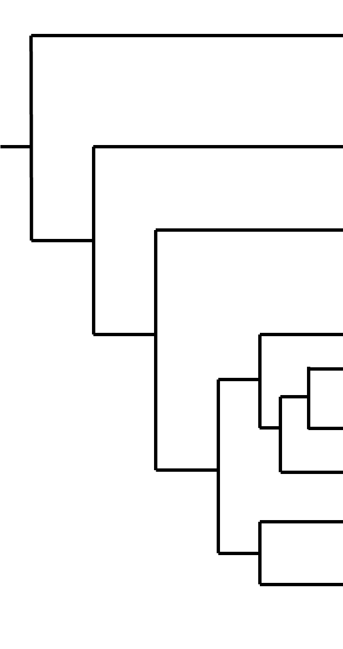
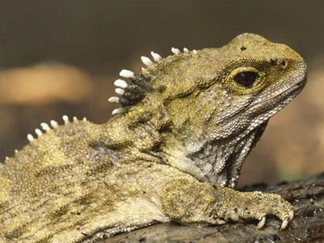
Rhyncocephalia
Fish
Lissamphibia
Mammalia
Testudines
Lacertilia
Serpentes
Rhyncocephalia
Crocodylia
Aves

Slide 2
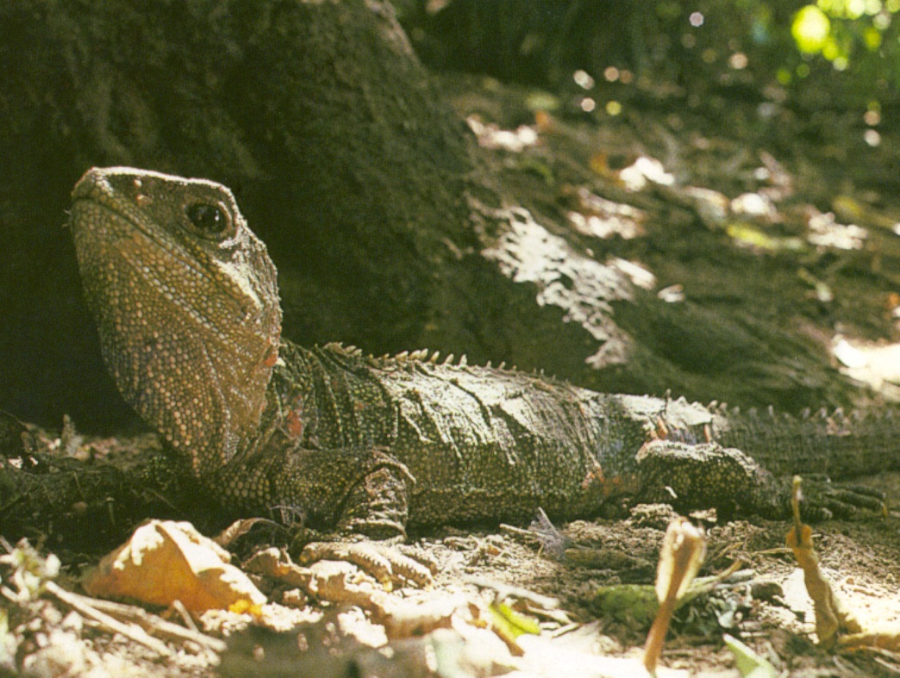
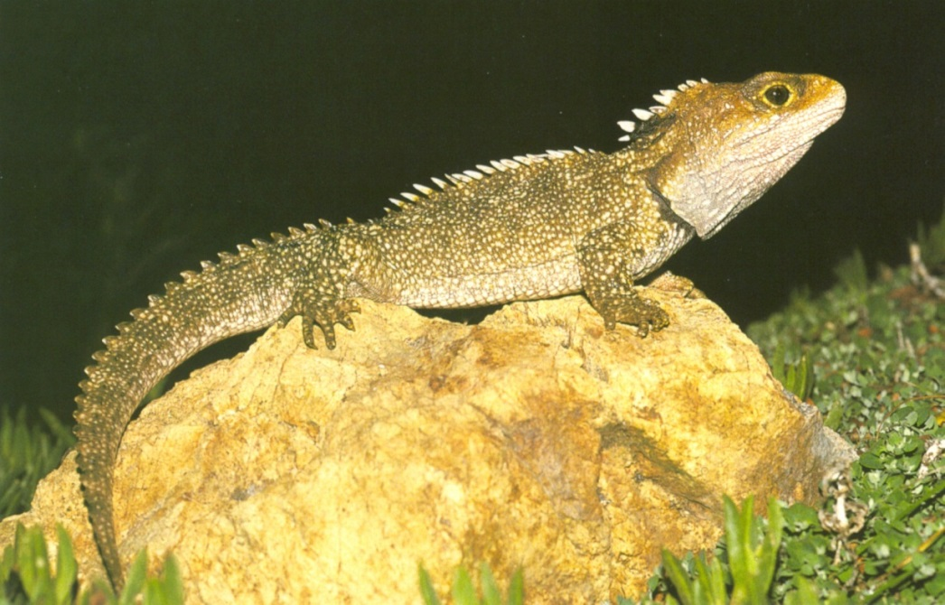
Sphenodon guentheri
Sphenodon punctatus

Slide 3
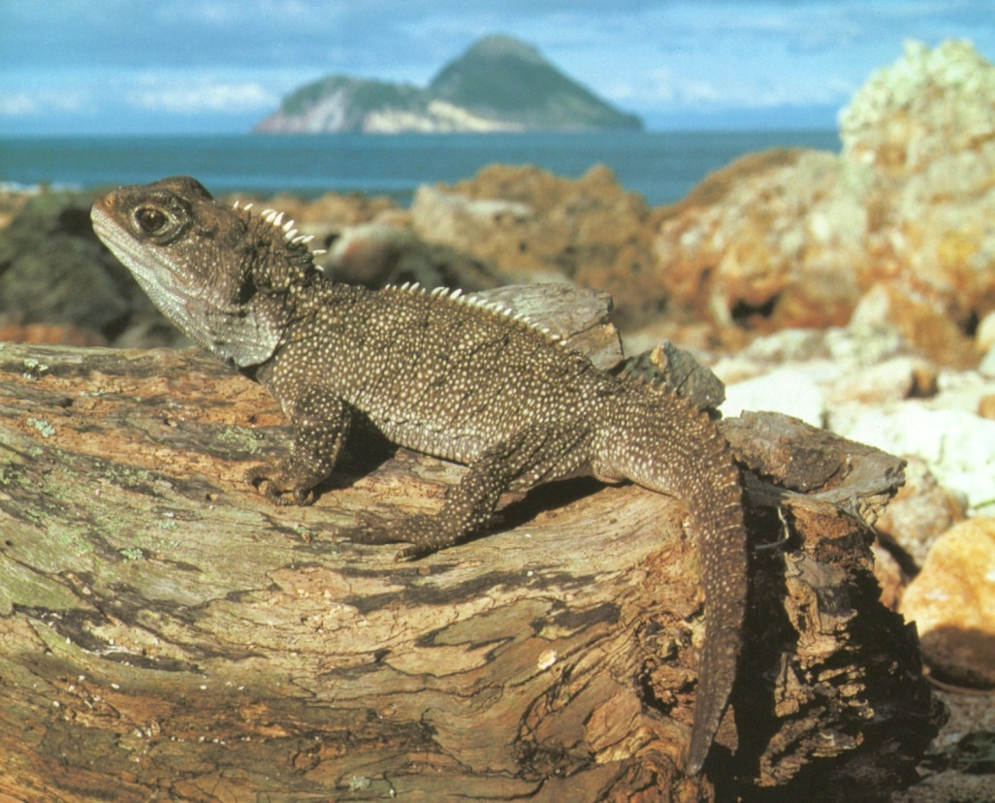
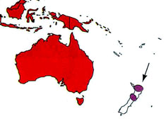

Rhynchocephalia
Historically abundant
Spiny crest down the back
NO PENIS(ES)
Teeth are unique (rows and type)
Extension of jaw bone
Notes:
Two rows teeth on upper jaw, one below
Acrodont dentition - teeth fused to the crest of the jaw bone, with no sockets

Slide 4
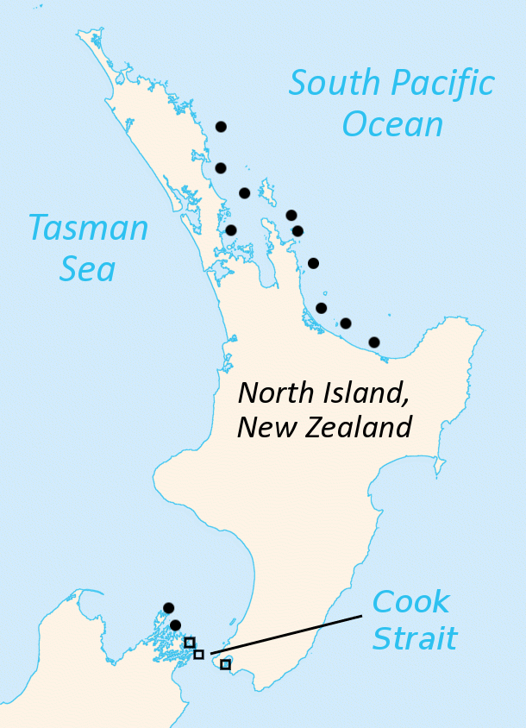
Rhynchocephalia
Sphenodon punctatus: ~30 offshore islands
Sphenodon guntheri:
found naturally on only one island

Slide 5
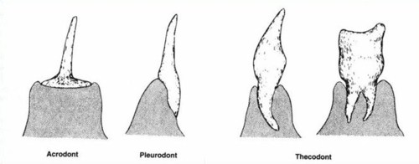
Sphenodon (“wedge tooth”)

Slide 6
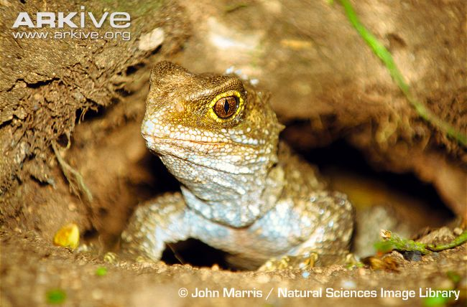
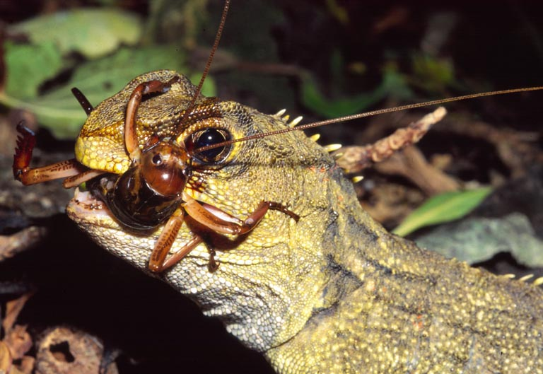
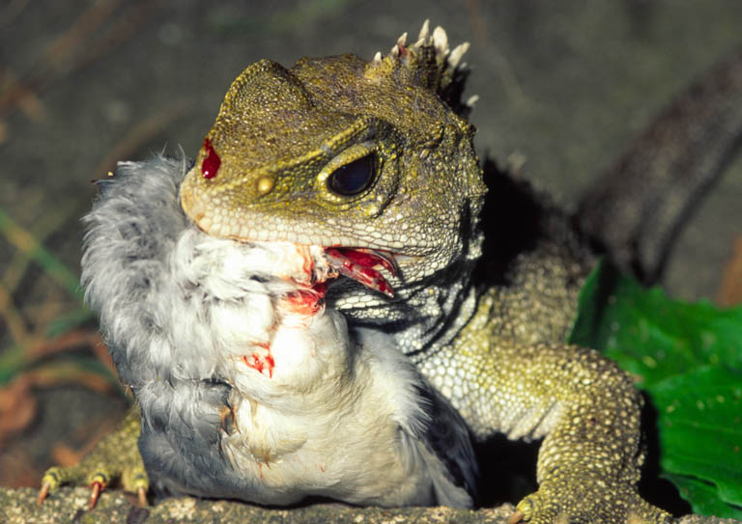
Tuatara Natural History

Slide 7
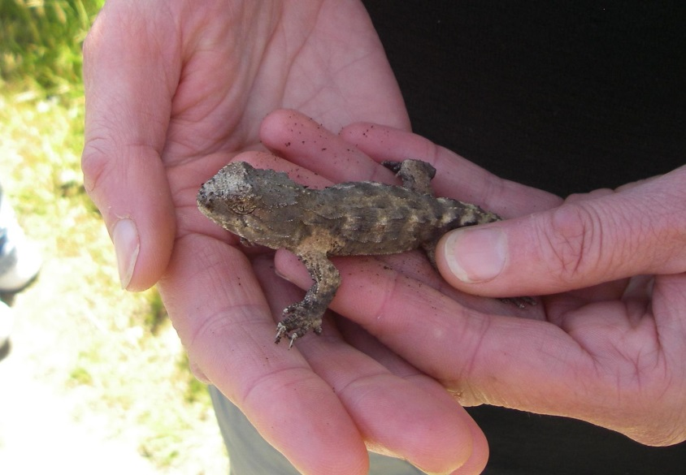
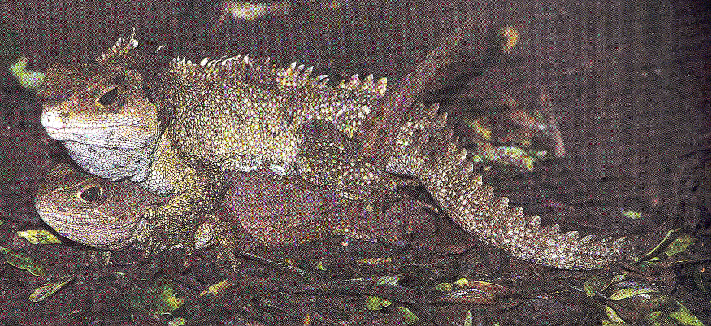
Reproductive Biology

Slide 8
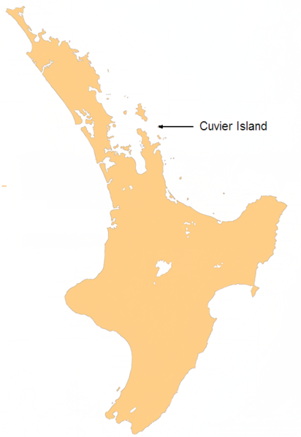
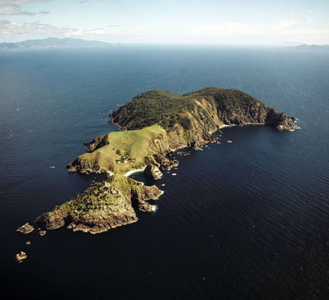
Threats to the Tuatara
Vulnerable to extinction
  Small clutches
  Long incubation
  Slow to mature
  Infrequent reproduction
Introduced animals
New Zealand Department of Conservation

