Slide 1
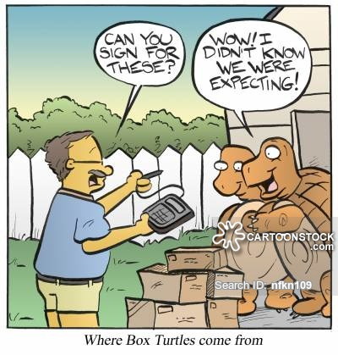
Testudines
315 species
Oviparous
TSD in most
Synapomorphies?

Slide 2
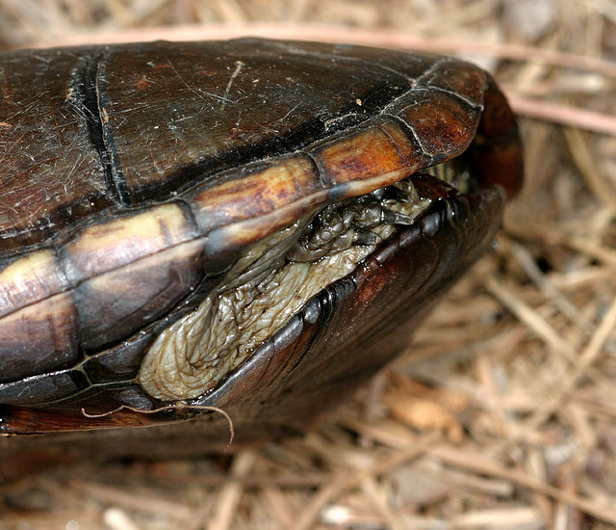
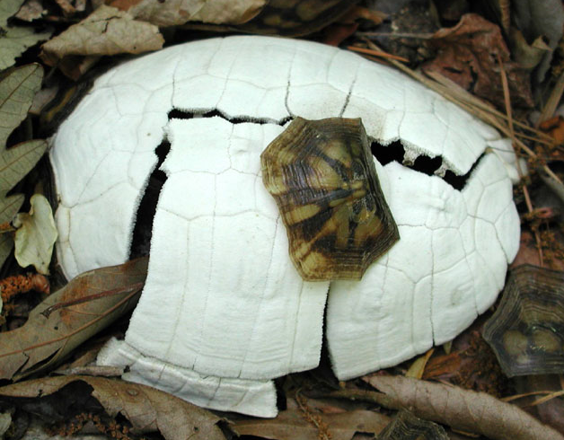
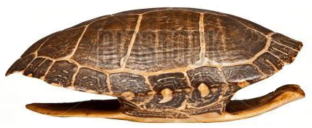
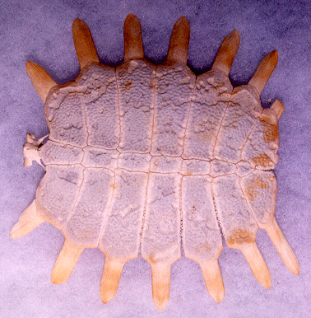
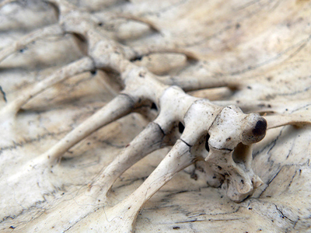
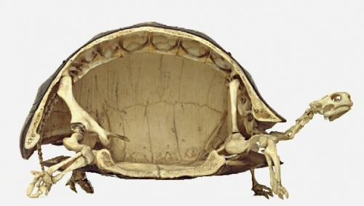
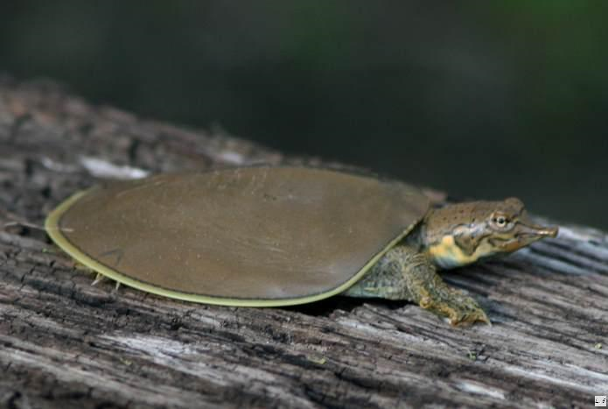
The Shell

Slide 3
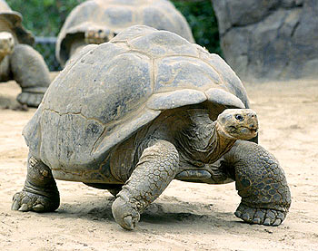
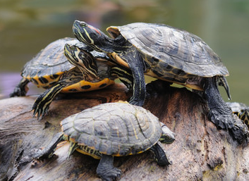
Shell Shape

Slide 4
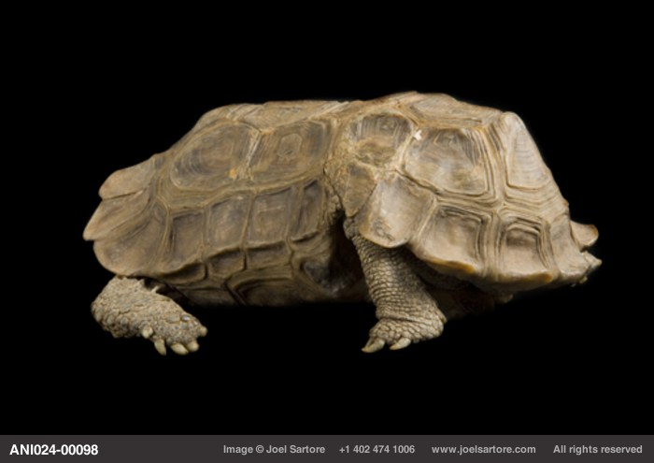
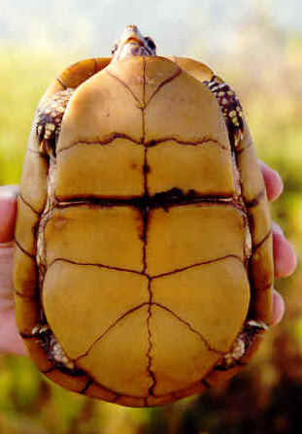
The Shell
Kinixys homeana (Hingeback tortoise)

Slide 5
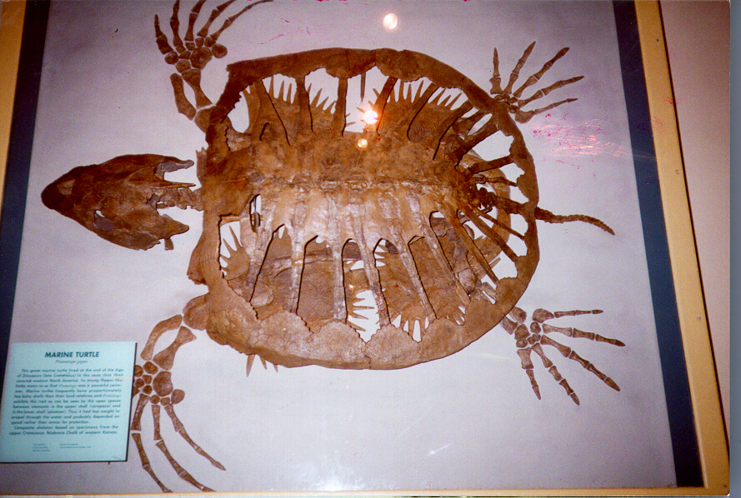
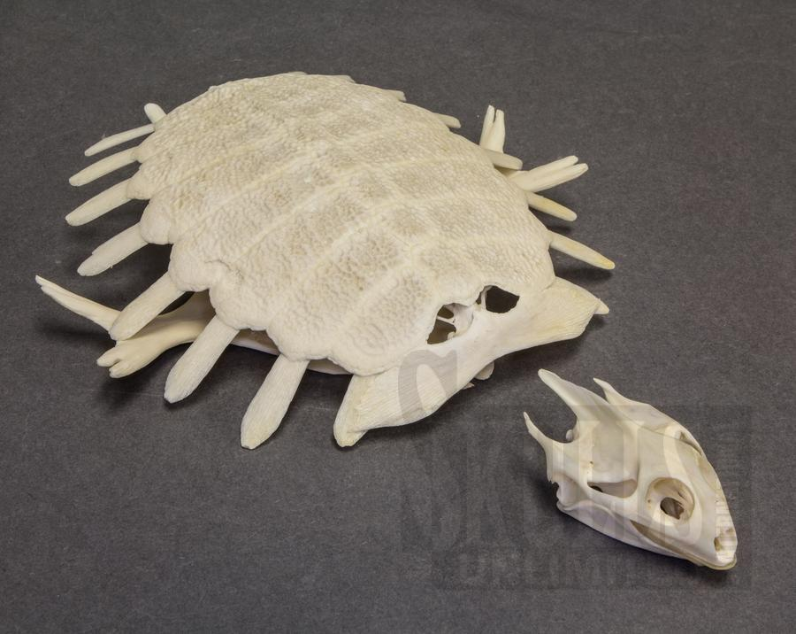
The Shell
The ancient marine turtle Protostega
Trionyx

Slide 6
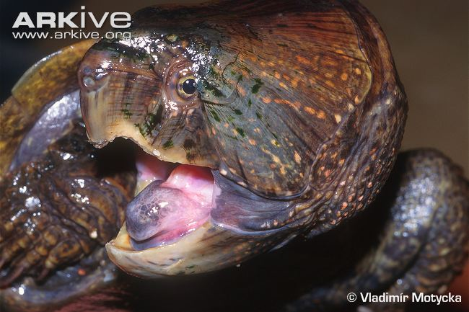
Teeth

Slide 7
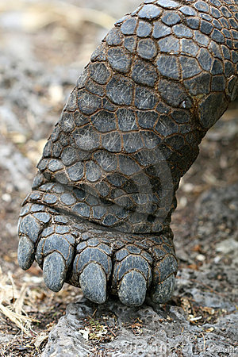
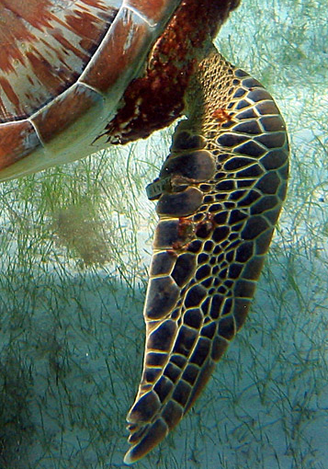
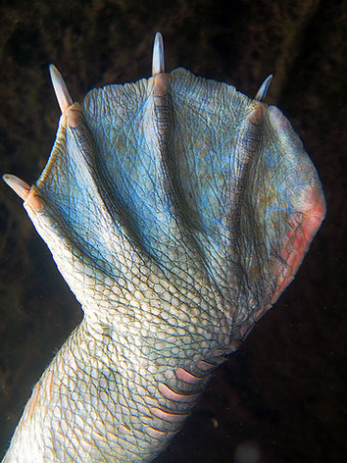
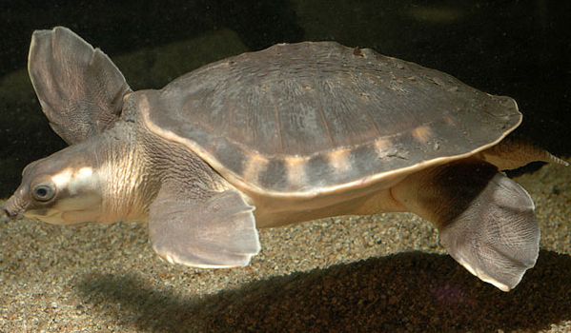
Limbs

Slide 8
How do tetrapods ventilate the lungs?

Slide 9
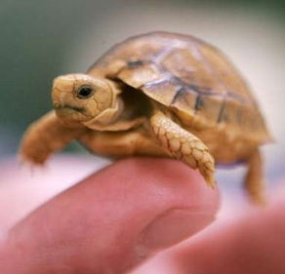
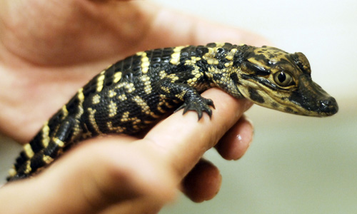
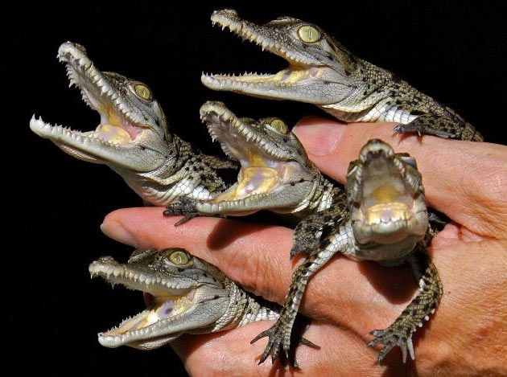
TSD Patterns
Type 1a
Type 2
Type 1b

Slide 10
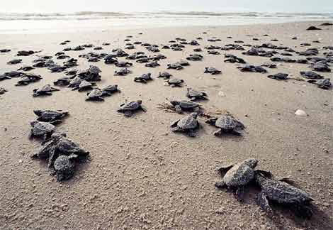
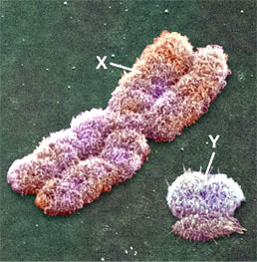
TSD Evolution
Ancestral
Skewed sex ratios
Precise pivotal temperature
Benefits?
  More space?
  Higher fitness with delayed sex determination?
  Differential fitness between sexes?

Slide 11
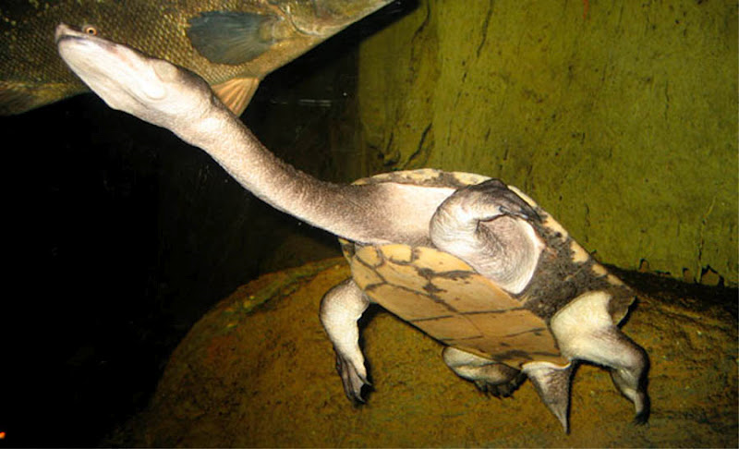
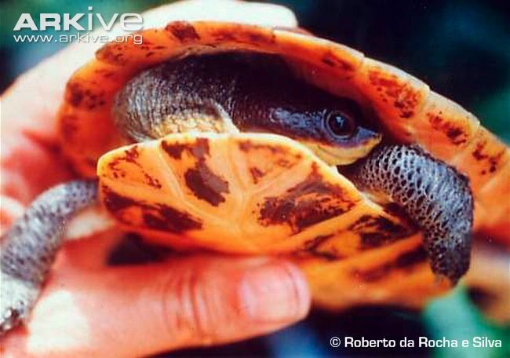
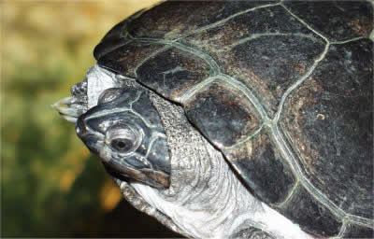
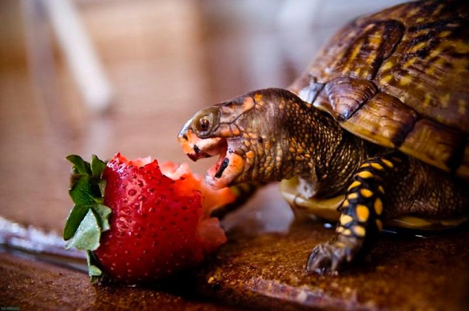
Extant Turtles
Two suborder

Slide 12
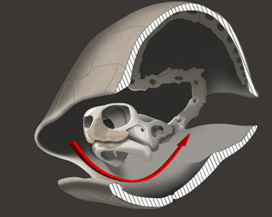
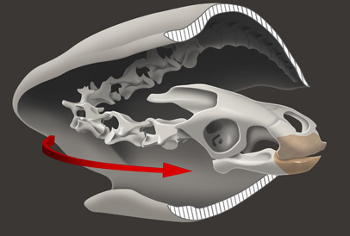
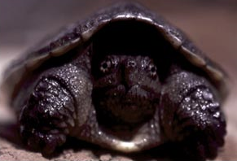
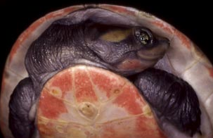
Cryptodira
Pleurodira

Slide 13
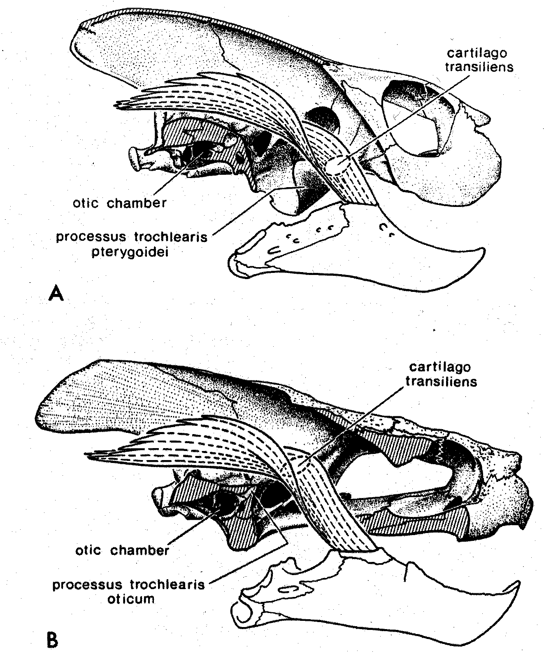
Trochlear Processes of Testudines
Pleurodira
Cryptodira
from Pough et al., 1998

Slide 14
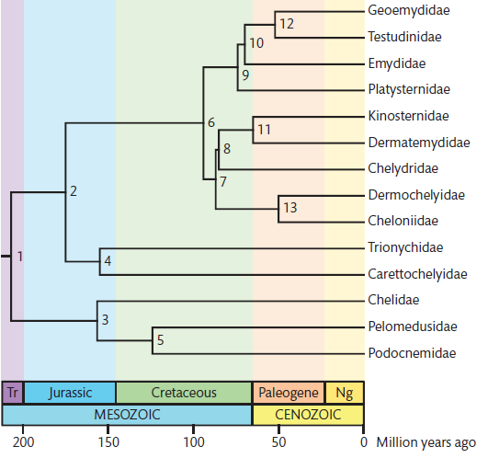
The Timetree of Life, Hedges and Kumar. 2009
(Eurasian pond turtles)
(tortoises)
(pond turtles)
(big-headed turtle)
(mud & musk turtles) - GSD
(river turtles)
(snapping turtles)
Cryptodira
(leatherback turtles)
(sea turtles)
(softshell turtles) - GSD
(pignosed turtle)
(Austro-American sideneck) - GSD
Pluerodira
(African sidenecks)
(American sideneck river turtles)

Slide 15
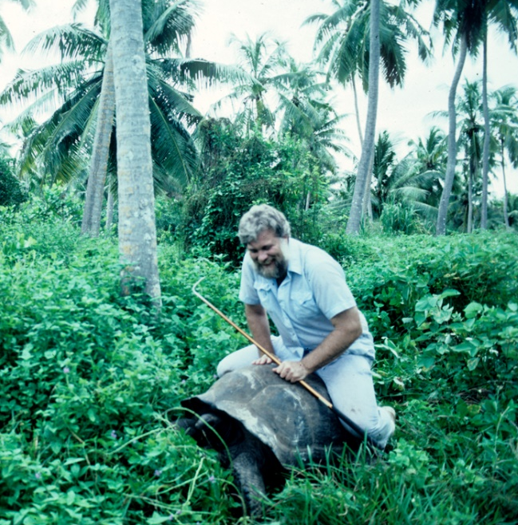
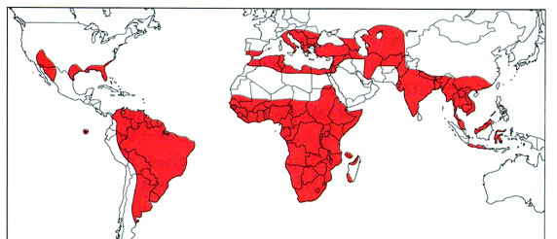
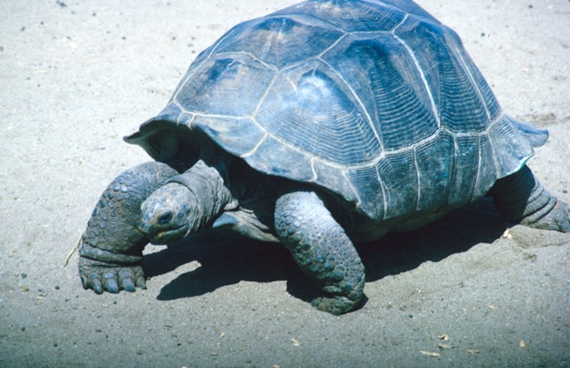
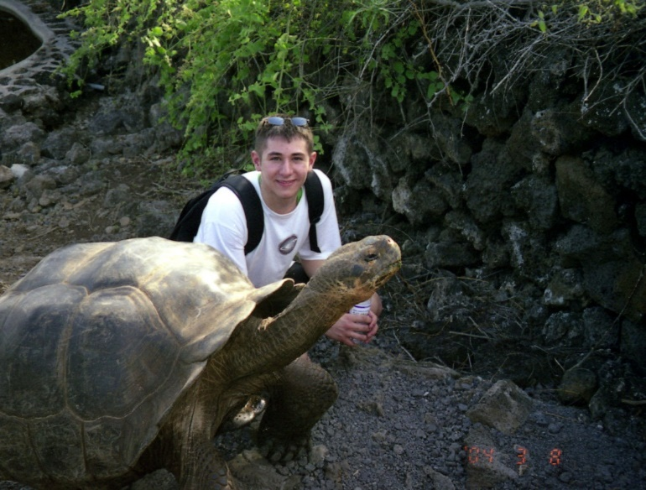
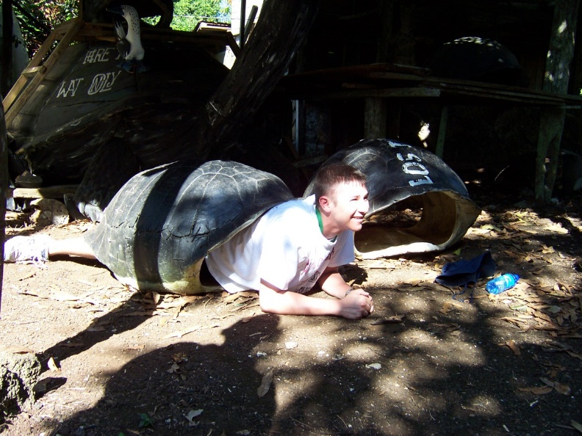
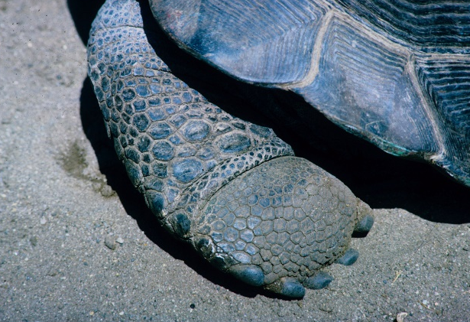
Testudinidae
Fully terrestrial
Long lived
Domed carapace
Scaled limbs and feet

Slide 16


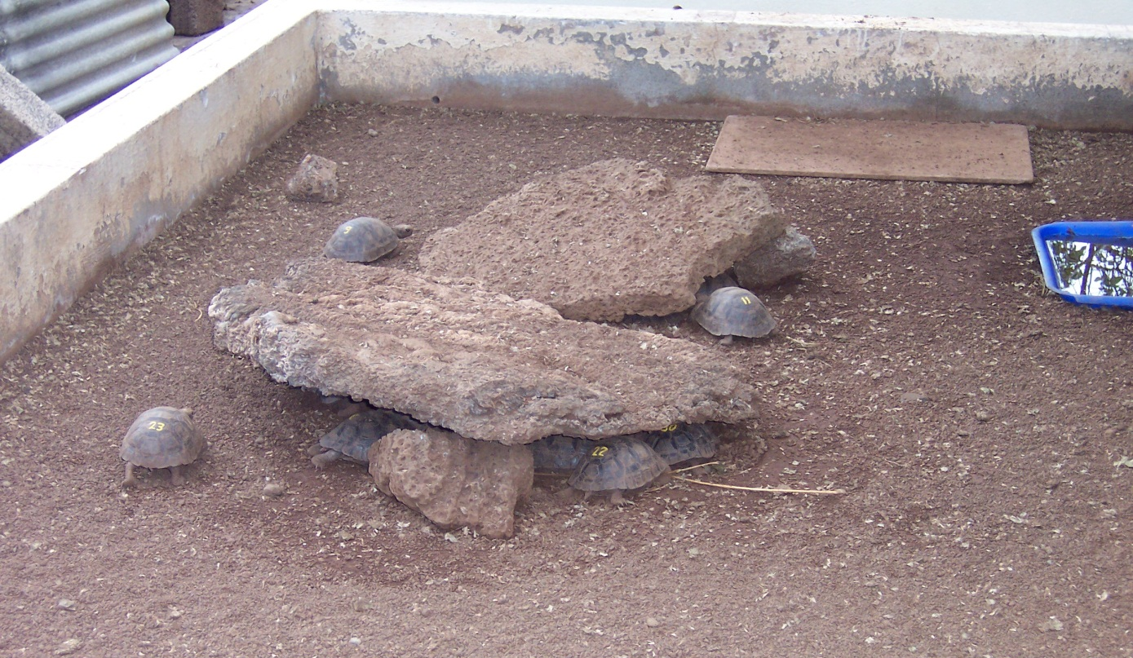
Chelonoidis nigra
formerly Geochelone

Slide 17
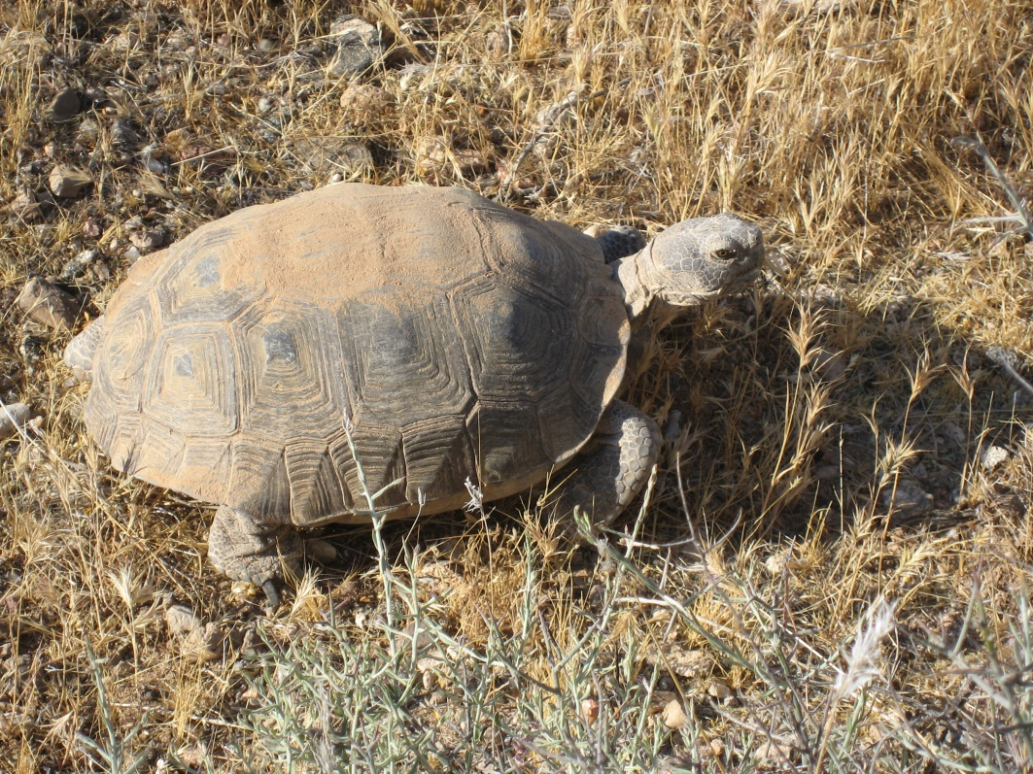
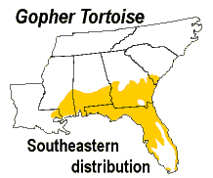
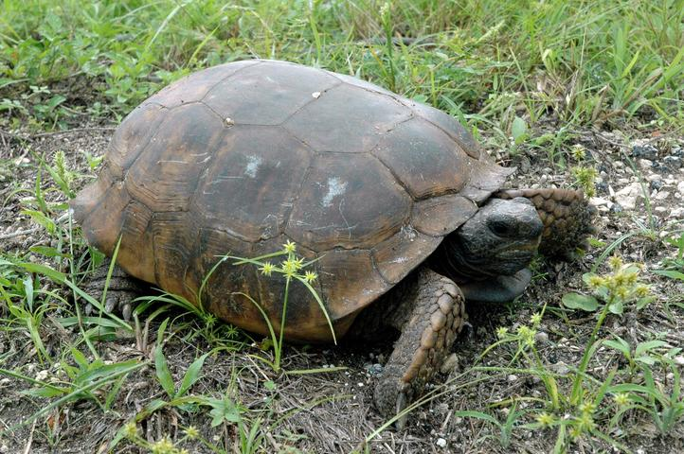
Gopherus polyphemus
Gopherus agassizii

Slide 18
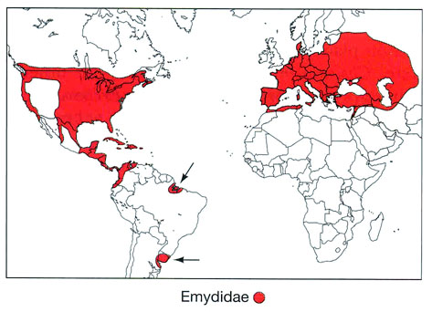
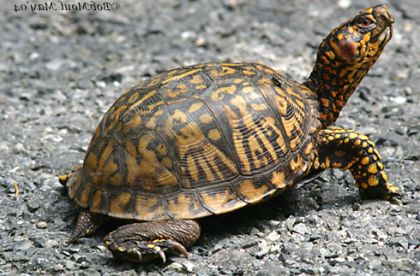
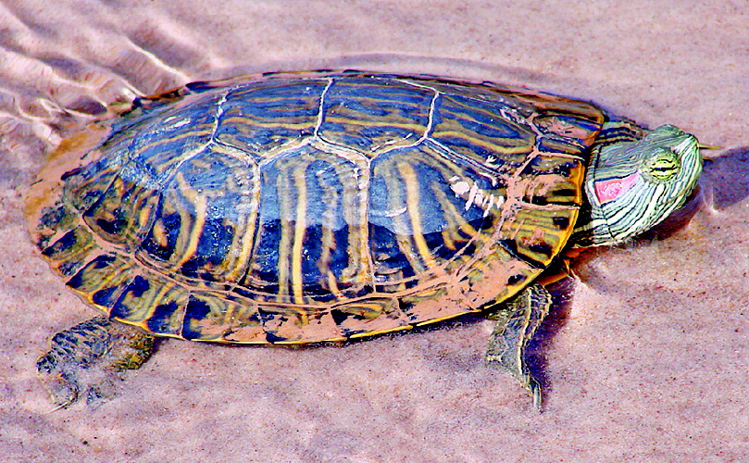
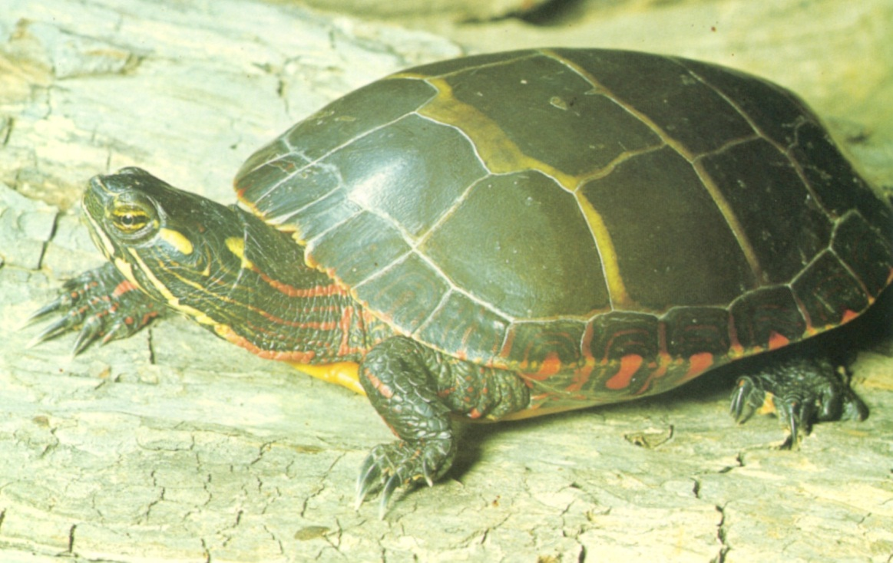
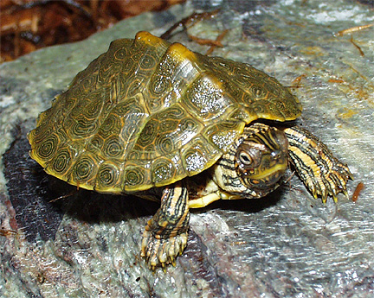
Emydidae
Terrapene carolina
Trachemys scripta
Graptemys
Pond and box
Large plastron
Skeletal elements in skull unite
Chrysemys picta

Slide 19
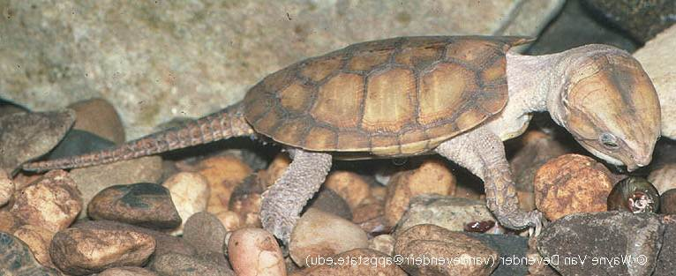


Platysternidae: Platysternon megacephalum

Slide 20


Platysternon megacephalum

Slide 21


Kinosternidae

Slide 22




Chelydridae
Large head, can’t withdraw
Reduced plastron
Large body size
Long-lived
Chelydra serpentina
Macrochelys temminckii

Slide 23






Cheloniidae and Dermochelyidae
Green
Loggerhead
Kemps Ridley
Hawksbill
Flatback
Olive ridley

Slide 24

Cheloniidae
Carreta carrea
Loggerhead sea turtle
Green
Loggerhead
Kemps Ridley
Hawksbill
Flatback
Olive ridley
Eretmochelys imbricata
Hawksbill sea turtle

Slide 25
Dermochelyidae: Dermochelys coriacea
(Leatherback)
Vulnerable

Slide 26



Slide 27



Trionychidae
Carapace reduced
Covered with leathery skin
Fleshy proboscis
Do not bask

Slide 28

Distribution of Carettochelyidae
(from Pough, et al., 2004)

Slide 29

Carettochelyidae: Carettochelys insculpta

Slide 30
Families of Pleurodira
Chelidae
Pelomedusida
Podocnemidae

Slide 31

Distribution of Chelidae

Slide 32



Chelidae
Chelus fimbriatus
Chelodina longicollis

Slide 33



Chelidae: Rheodytes leukops

Slide 34




Pelomedusidae
Pelusios broadleyi

Slide 35




Podocnemididae
Podocnemis expansa
Podocnemis unifilis

