Slide 1
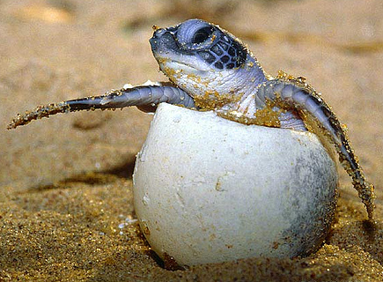
Amniote Evolution

Slide 2
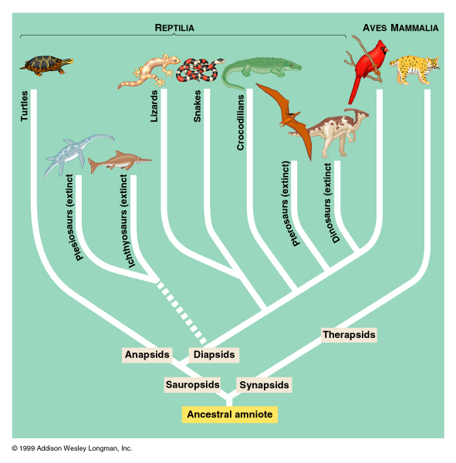
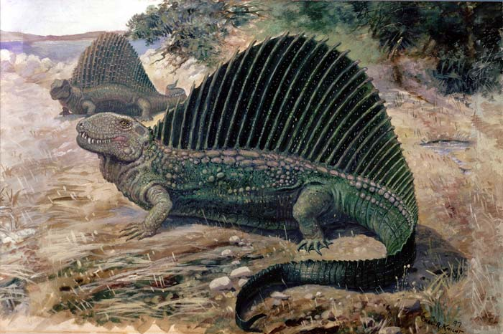
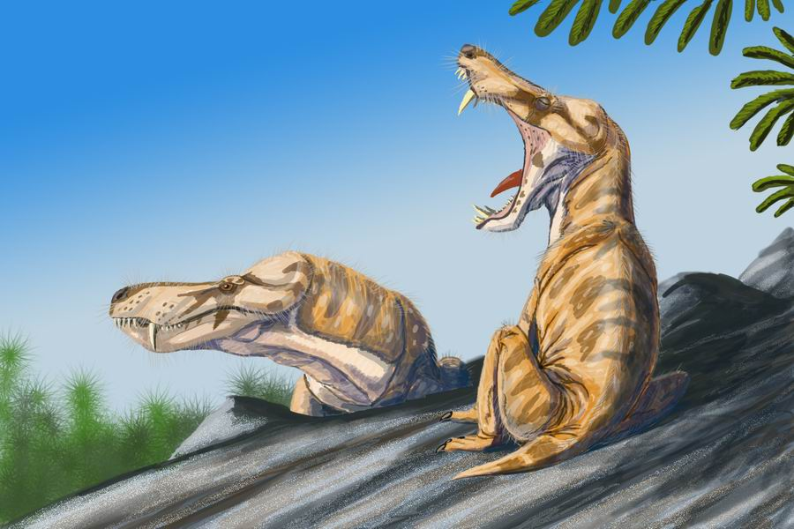
Divergence among Amniotes

Slide 3
Evolutionary Trends
Conservation of water
Terrestrial locomotion systems
Powered flight
Endothermy
Parental care
Complex social behavior

Slide 4
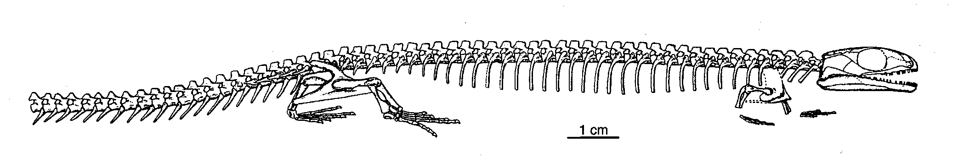
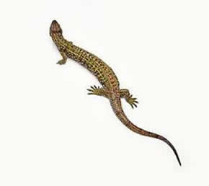
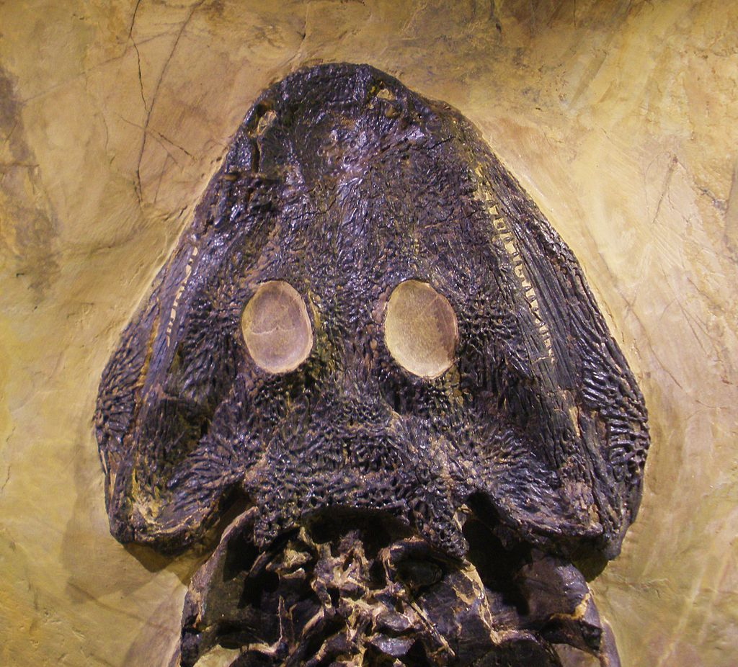
Amniote Fossils
Westlothiana sp.

Slide 5
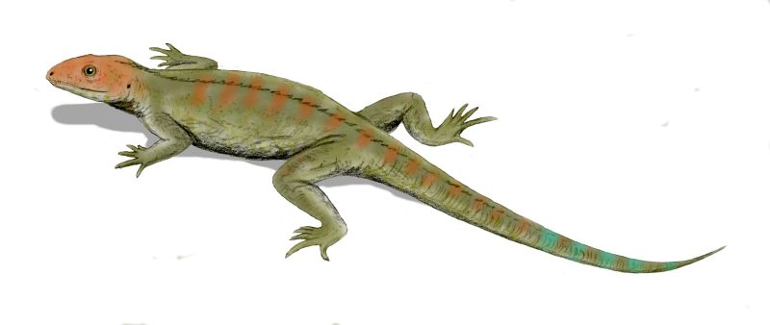
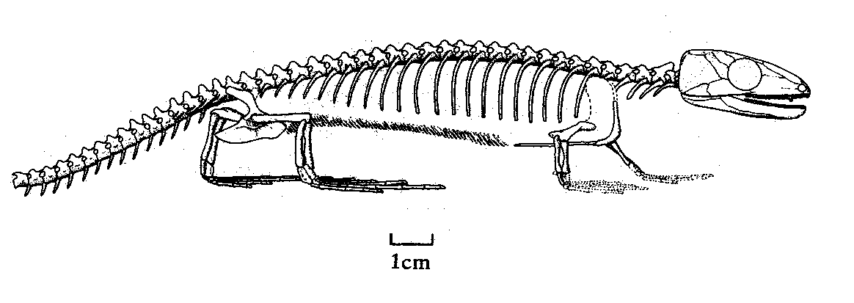
Amniote Fossils
Hylonomus lyelli

Slide 6
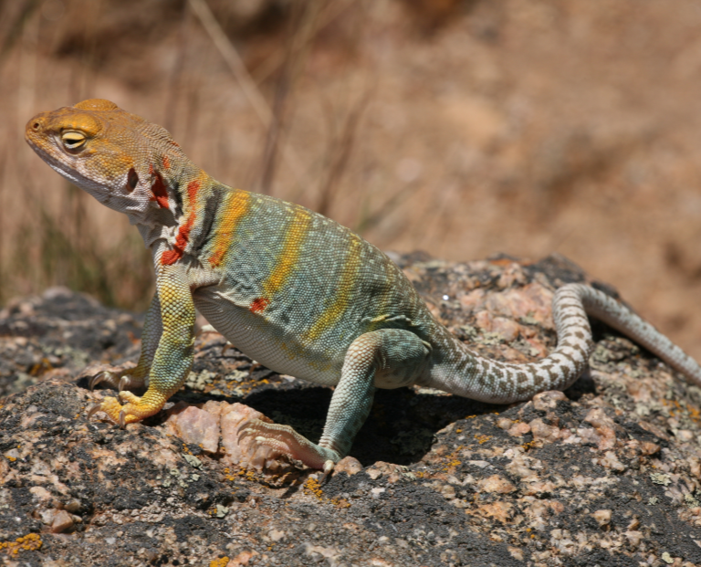
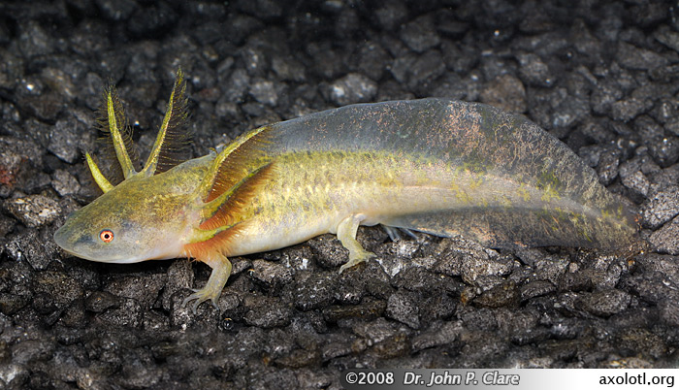
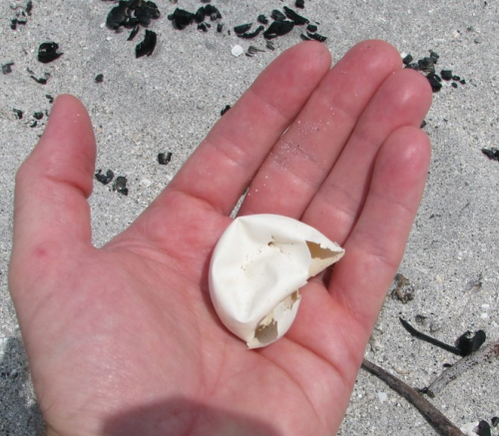
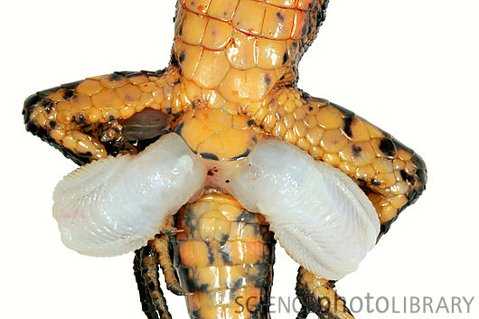
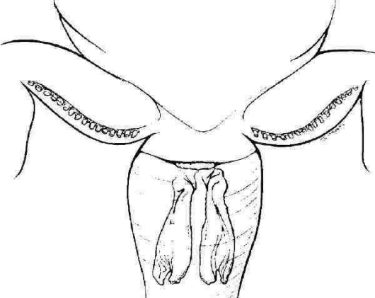
Adaptations for Life on Land

Slide 7
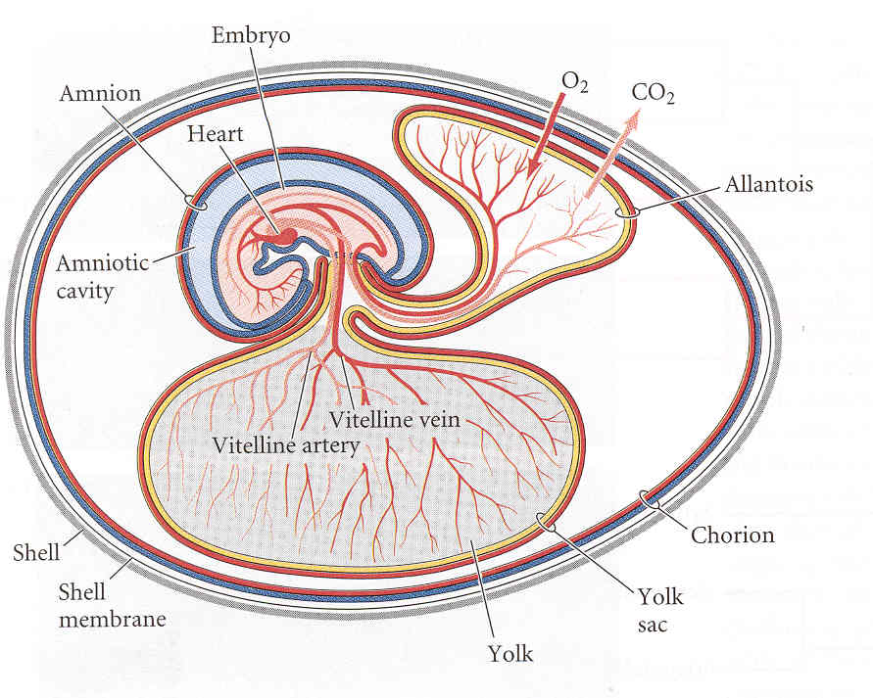

Slide 8
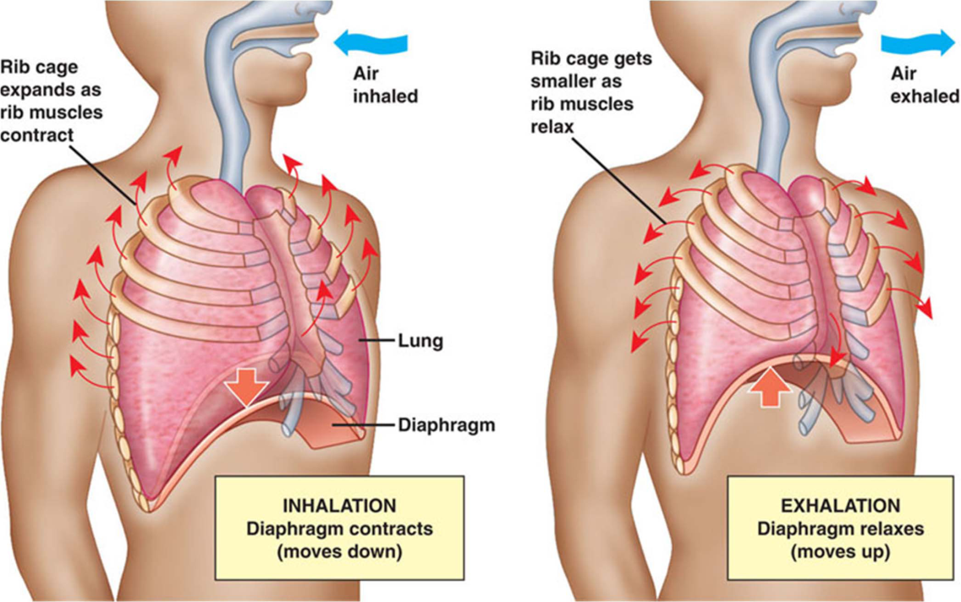
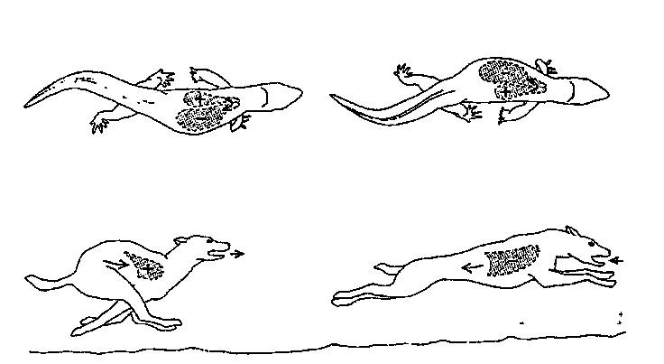
Locomotion
Ancestral
  Lateral undulation
  https://www.youtube.com/watch?v=Mu5WgpZcReg
  Limbs lateral, alternate
  Power: axial muscles
  Conflict
Synapsids
  Upright
  https://www.youtube.com/watch?v=CoL8Gtvxfl0
  Diaphragm
Sauropsids
  Lateral undulation
  Bipedal
  Gastralia

Slide 9
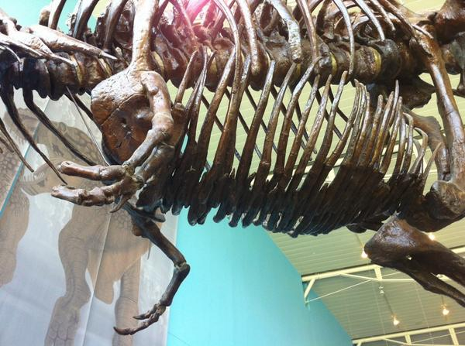
Locomotion

Slide 10
Greater locomotor activity requires more ________?
What do we need to do to increase O₂?
Without changing the heart, how could we achieve this?
Problems?
How do tetrapods solve this problem?
Notes:
Oxygen to muscles was needed to sustain metabolism and locomotion
Occurred more than once in sauropsids and independently of each other.
Derived heart= right vs. left arch
Varanids, crocs, turtles = celiac artery from bird lost left aortic arch.
Single arch better than two= less friction and turbulence

Slide 11
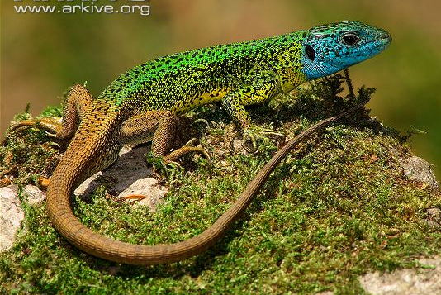
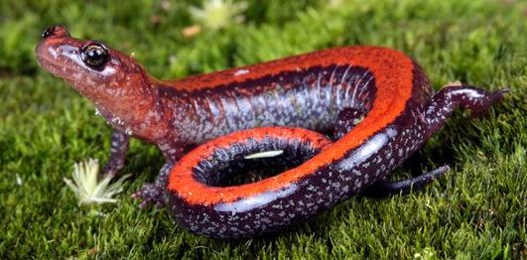
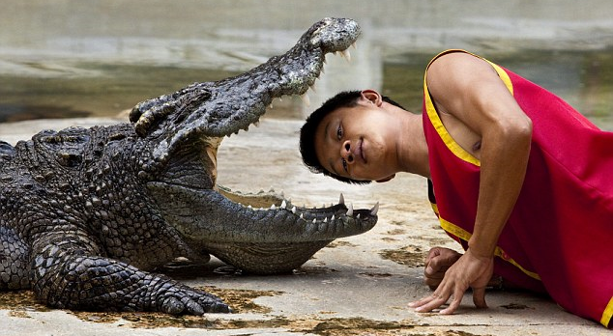
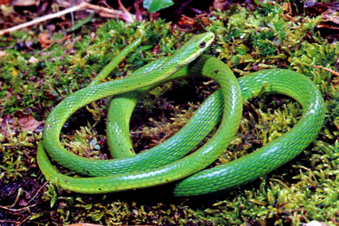
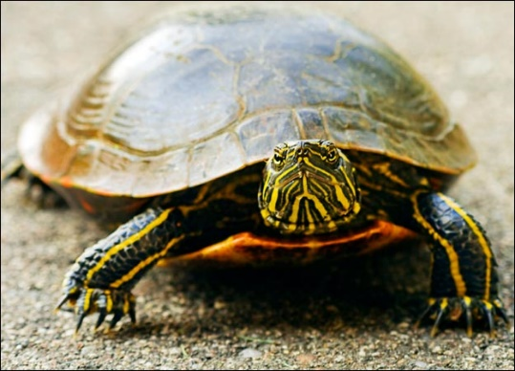
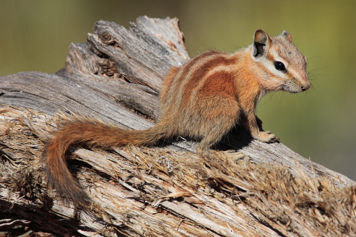
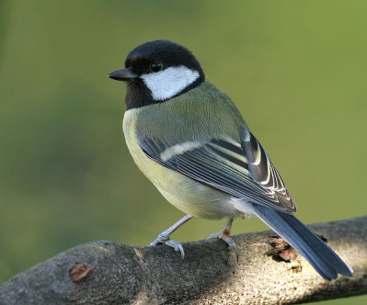
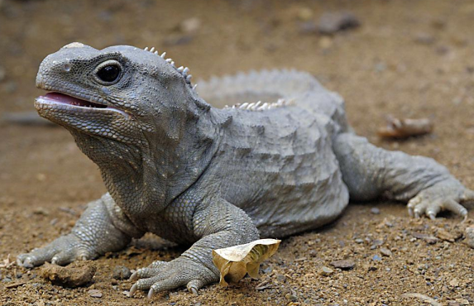
Sex Determination in Amniotes
Two mechanism?
Who has what?

Slide 12
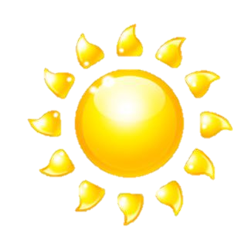
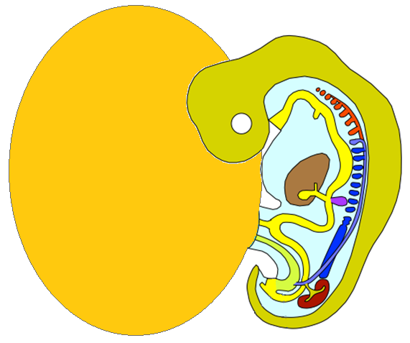
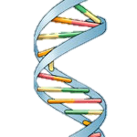
Female temps
TSD
Mechanism
aromatase
estradiol
Undifferentiated
gonads
Estradiol
Cascade of differentiation
Ovaries

Slide 13
Male temps
testosterone
TSD
Mechanism
5α reductase
Dihydro-
testosterone
Undifferentiated
gonads
Androgens
Cascade of differentiation
Testes

Slide 14
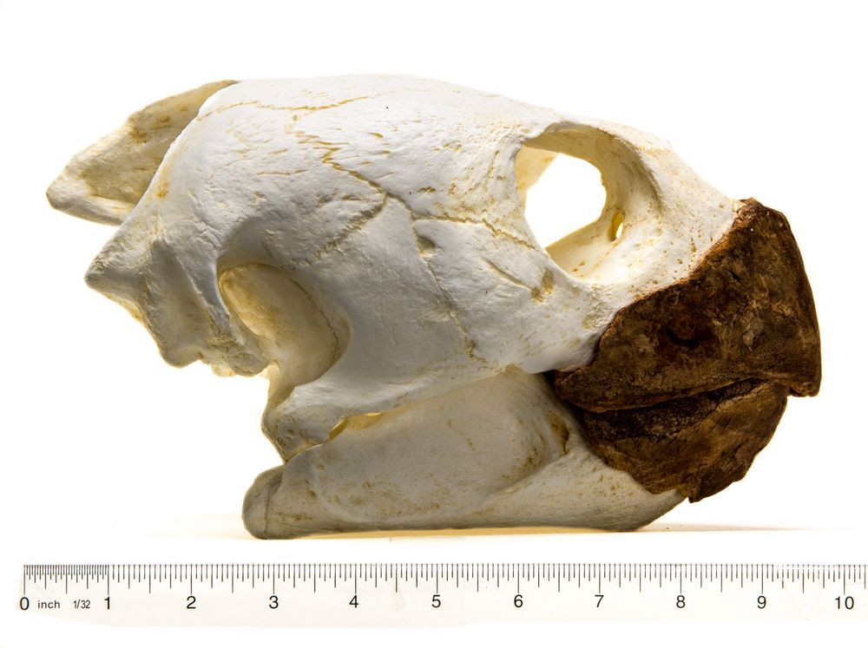
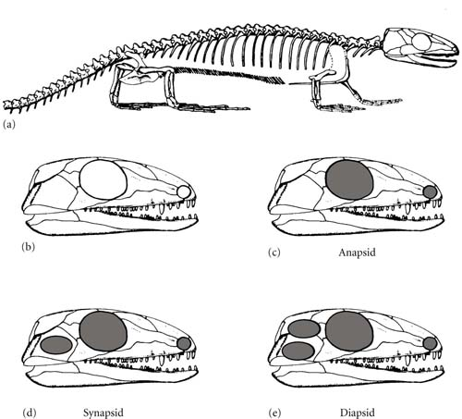
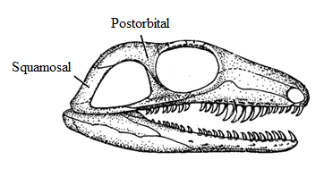
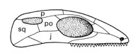
Amniote Skulls
Notes:
Modern turtles are anapsid, most lack a temporal fenestra. Some have re-evolved an opening for a shallower skull and stronger jaw muscles (such as the softshell in the collection)

Slide 15
Draw a phylogeny of extant tetrapods based on the pattern of temporal fenestra

Slide 16
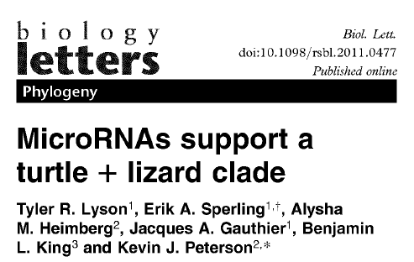
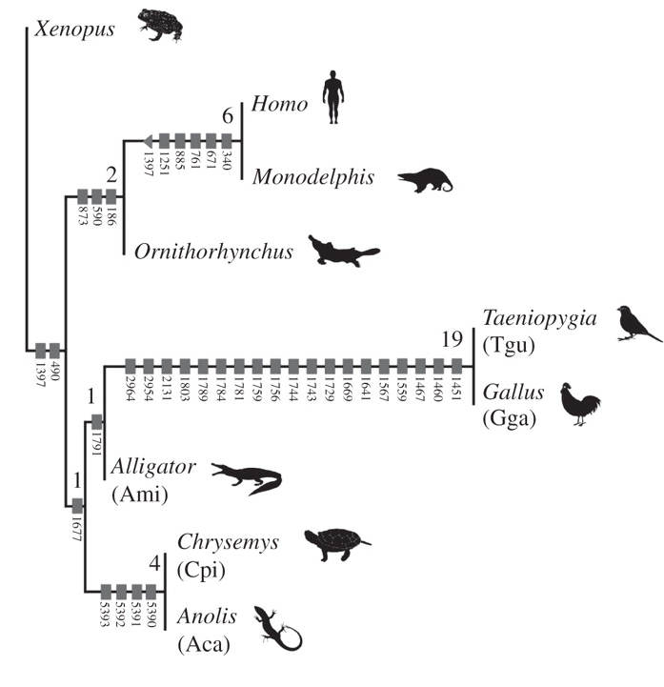
Major Radiations of Tetrapods
Share 4 groups of genes
But see Hedges and Poling 1999….

Slide 17
Linnean Ranks

