Slide 1
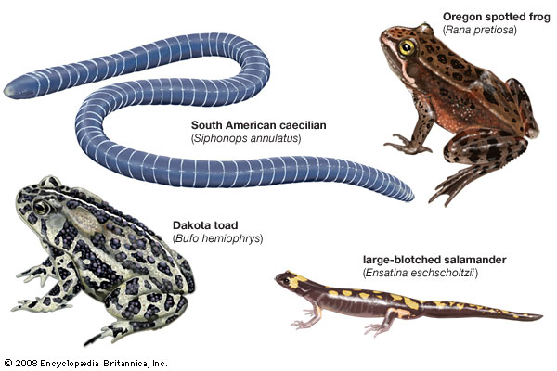
Amphibia (class)
Three Orders of Living Amphibians

Slide 2
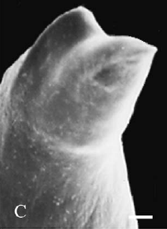
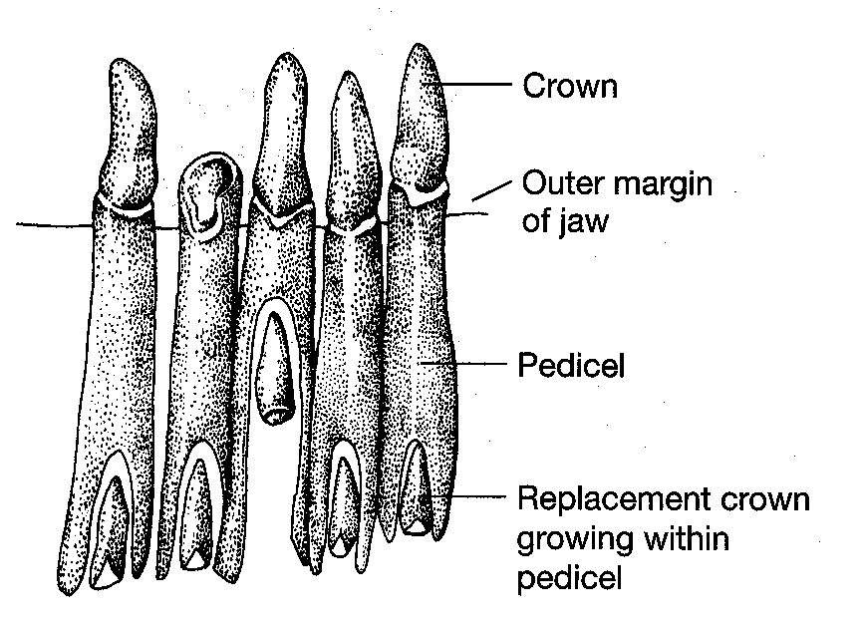
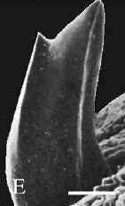
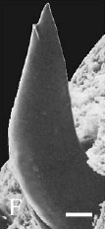
Lissamphibia Synapomorphies

Slide 3
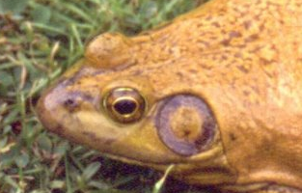
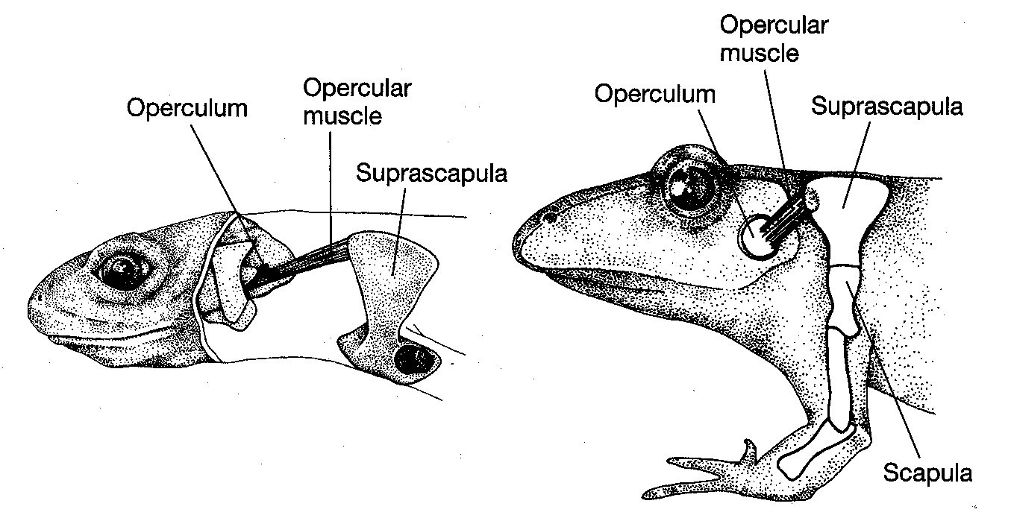

Slide 4
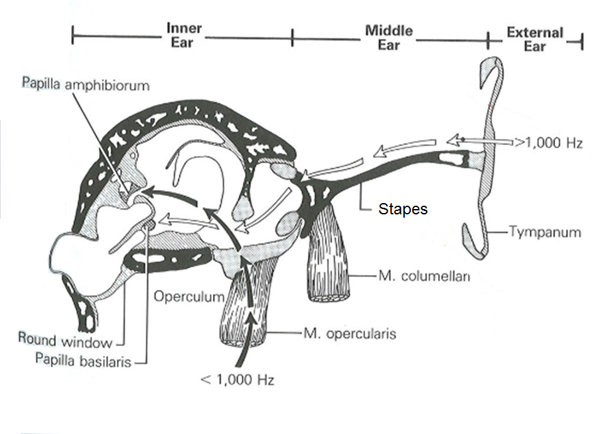

Slide 5
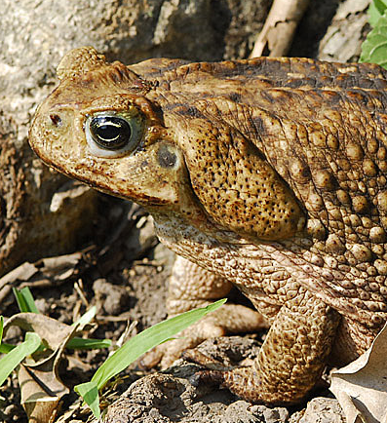
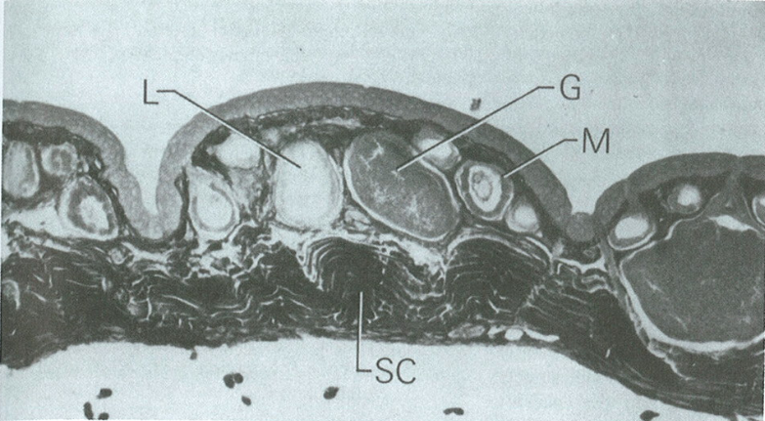
Lissamphibia Synapomorphies
3.
Fat bodies develop from germinal ridge (gonad cells)
4.
Two types of glands

Slide 6
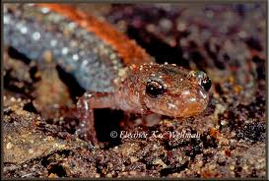
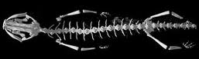
Lissamphibia Synapomorphies
5.
Green rods in the retina
6.
Levator bulbi muscle
7.
Unique respiration
8.
Short straight ribs

Slide 7
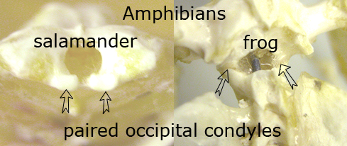
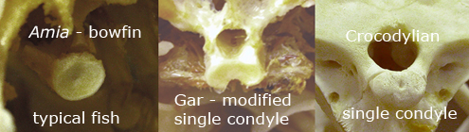
Lissamphibia Synapomorphies
9.
Two occipital condyles

Slide 8
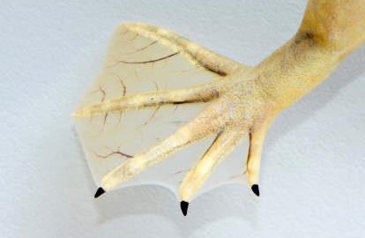
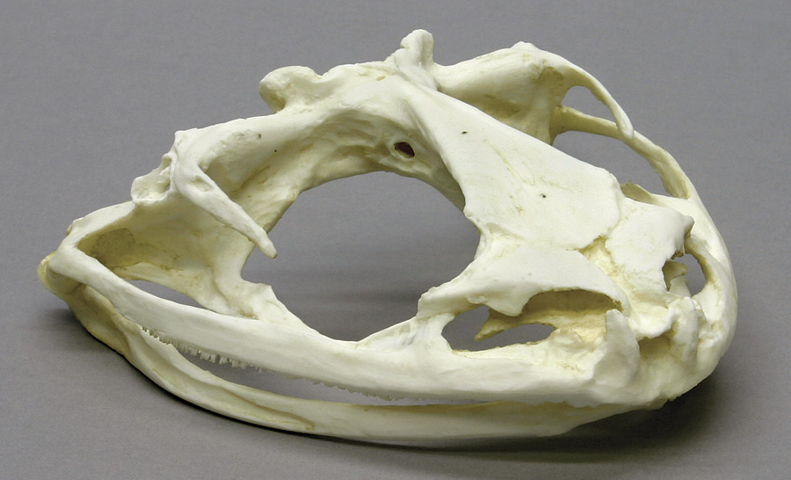
Lissamphibia Synapomorphies
10.
Reduction in skull bones
11.
No true nails or claws

Slide 9
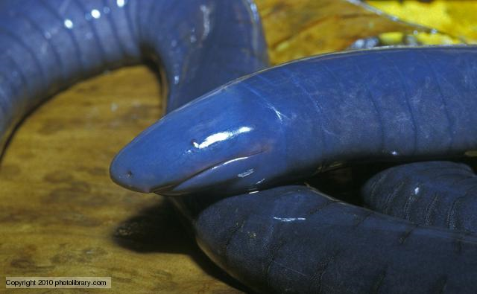
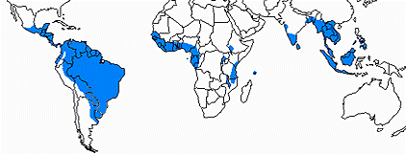
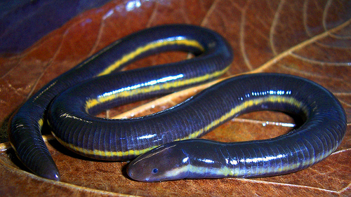
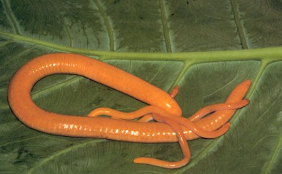
Gymnophiona Caecilians
Split ~200MYA
Fossorial or aquatic
Pantropical distribution
Body size varies
Diverse reproductive modes

Slide 10
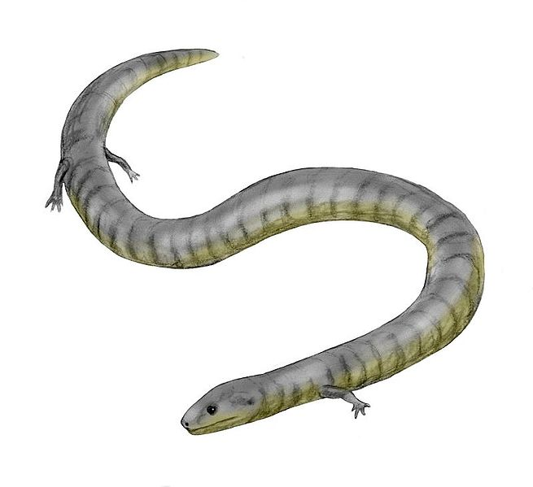
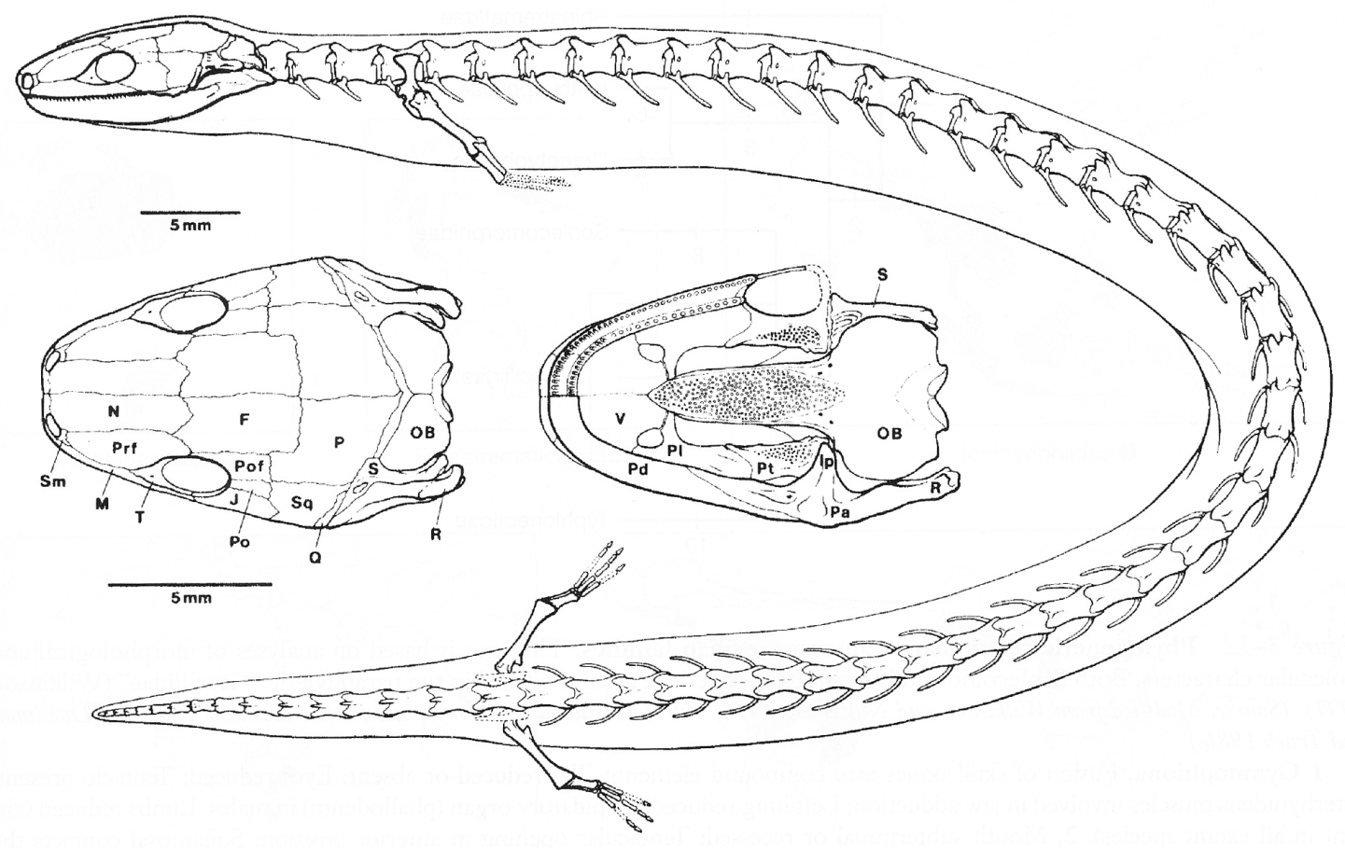
Fossil Evidence
From ~190 MYA
Skull identifies it as caecilian
Girdles and limbs present
Jenkins and Walsh, 1993. Nature
Eocaecilia micropoda

Slide 11
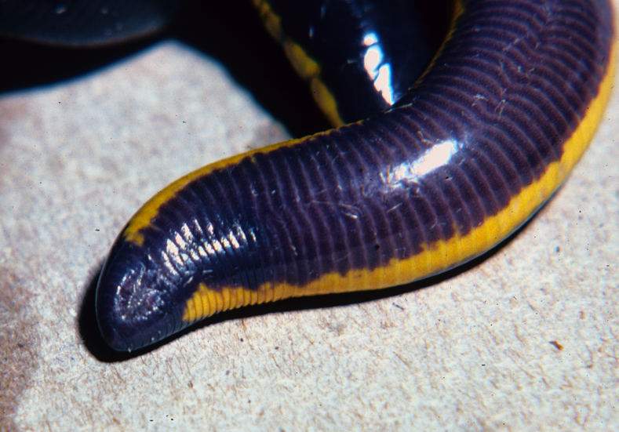
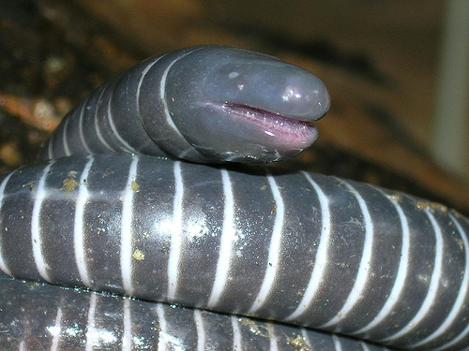
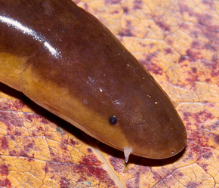
Gymnophiona Synapomorphies
Long annulated body – why?
Reduced/absent tail – define tail?
Limbless (no girdles)
Left lung reduced
Eyes reduced
Dermal scales
Phallodeum
Tentacle

Slide 12
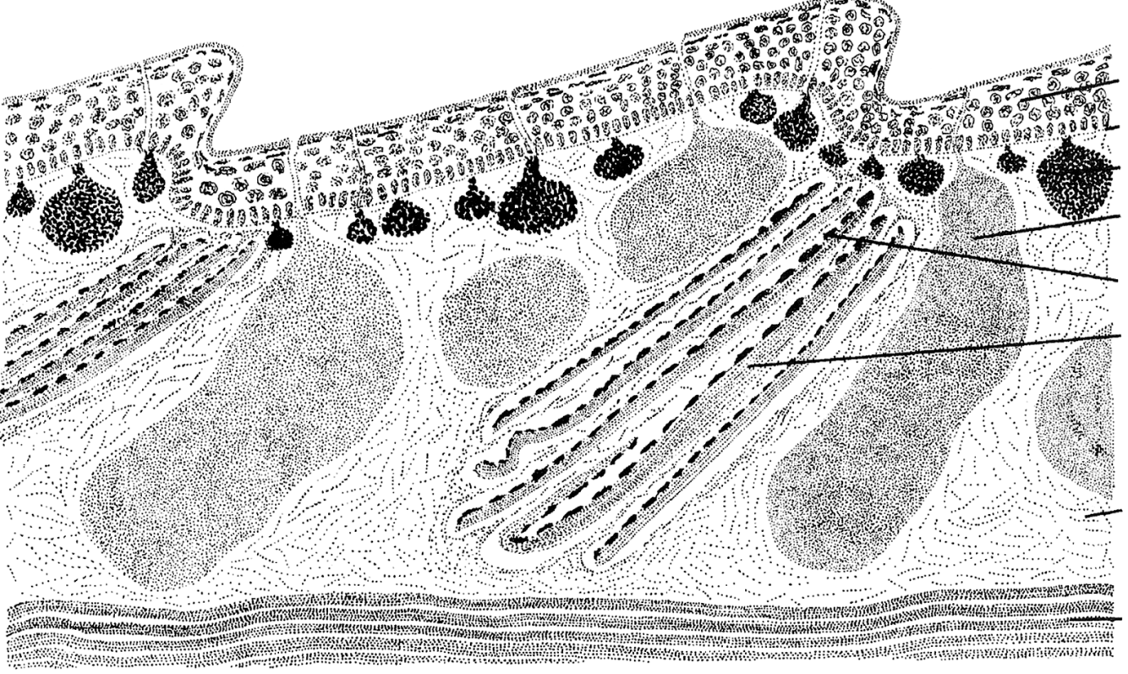
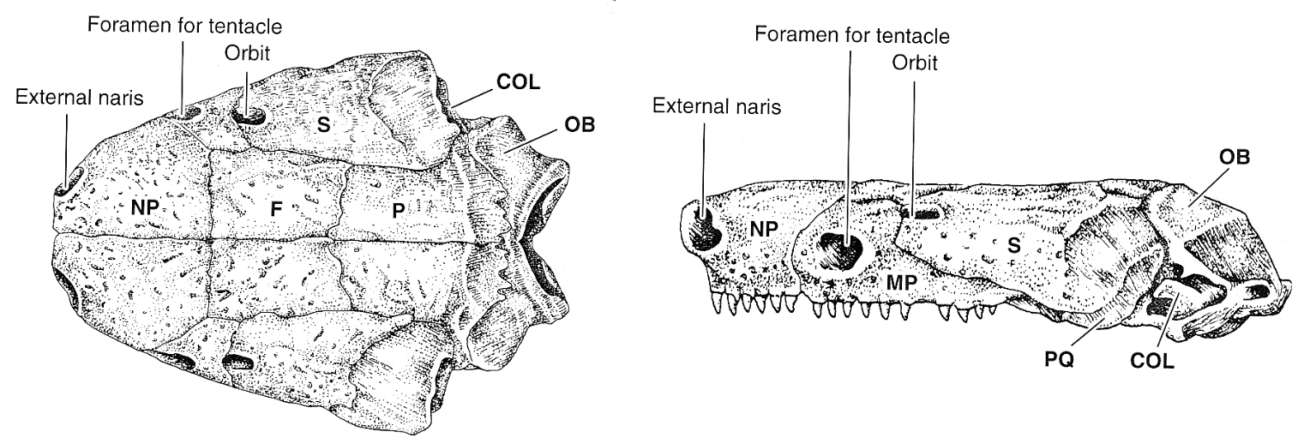
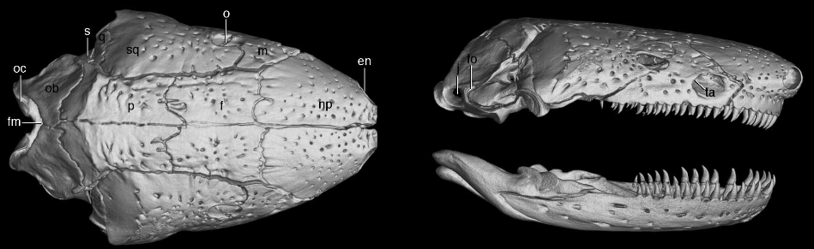
Caecilian Traits
Skin, longitudinal section
Dermophis skull

Slide 13
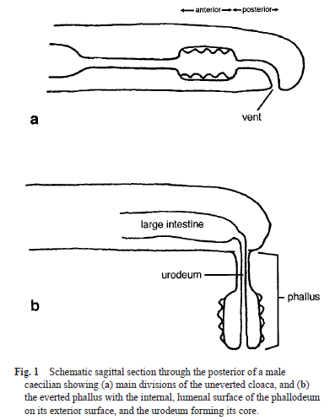
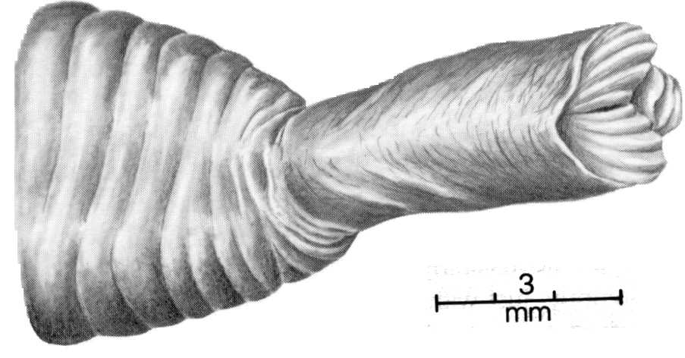
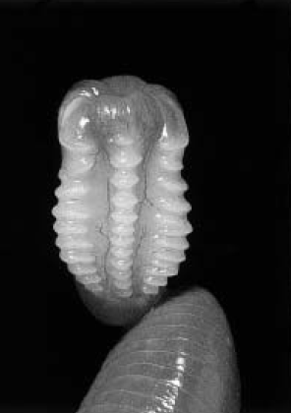
Phallodeum of a Geotrypetes seraphini
From: Gower and Wilkinson 2002.
(from Duellman & Trueb, 1986)
Notes:
Geotrypetes is found in western Africa

Slide 14
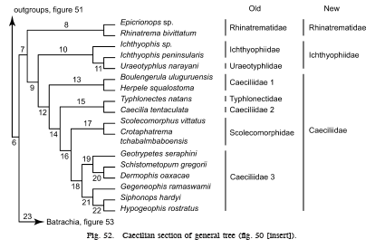
Caecilian Phylogeny
Family assignments based on genetic data
From: Frost et al. 2006. The Amphibian Tree of Life

Slide 15
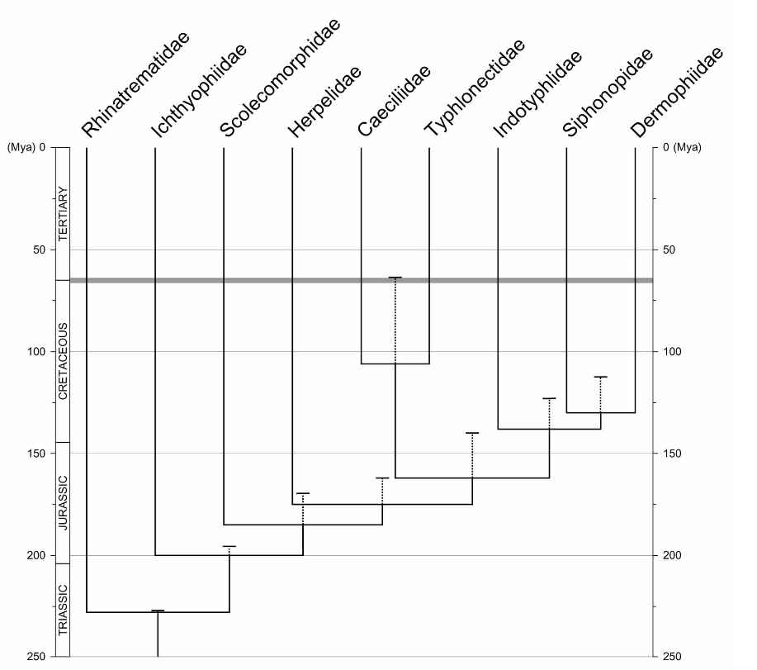
Caecilian Phylogeny
Family assignments based on genetic data
Wilkinson et al. 2011. Zootaxa

Slide 16
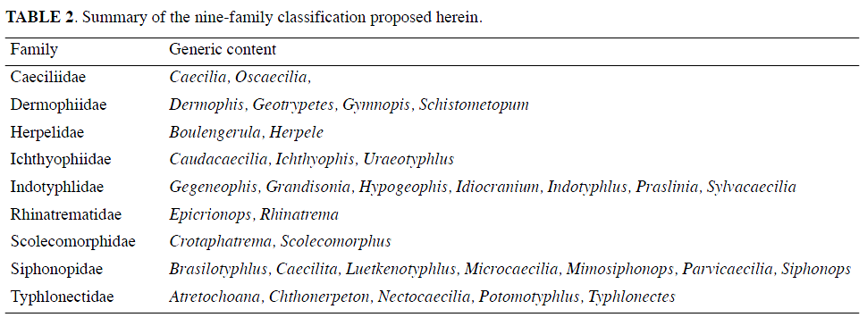
Summary of caecilian families and associated genera

Slide 17
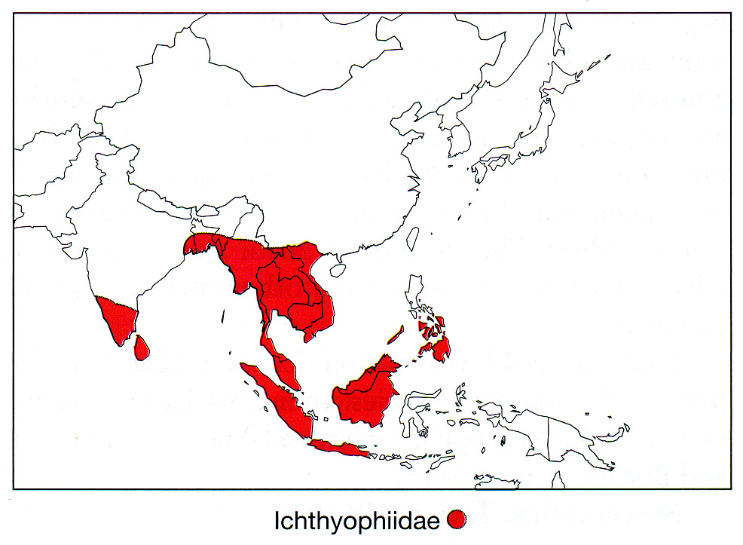
Distribution of Ichthyophiidae
(from Pough, et al., 2004)

Slide 18
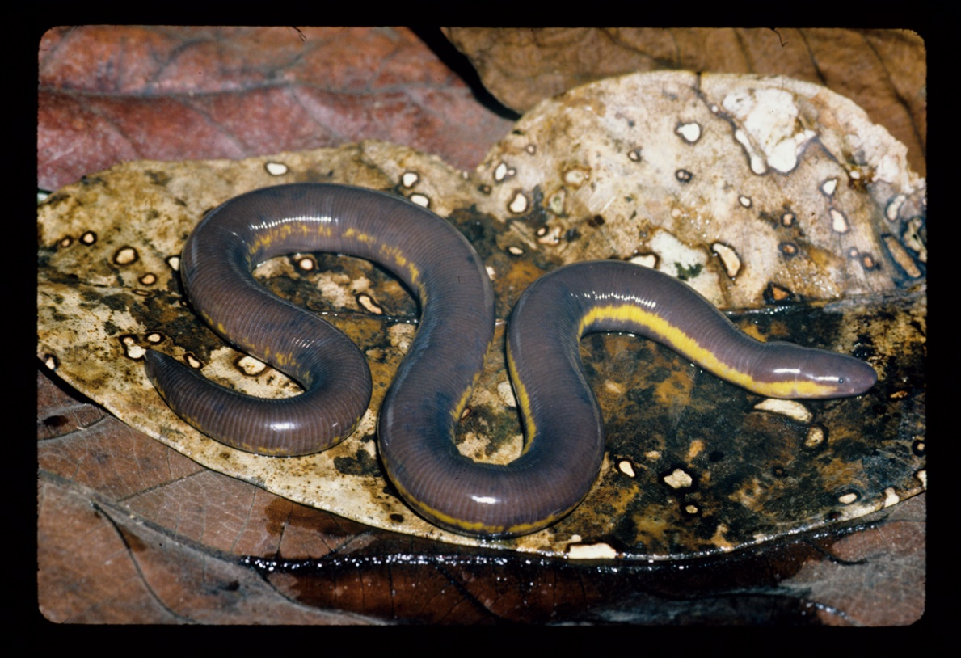
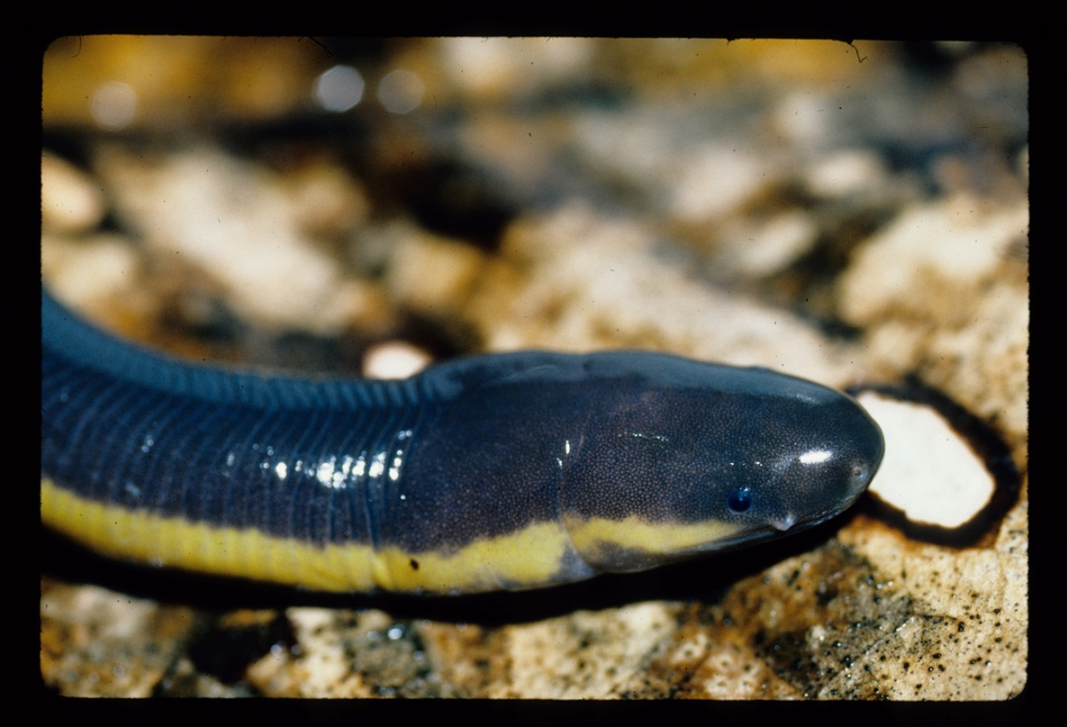
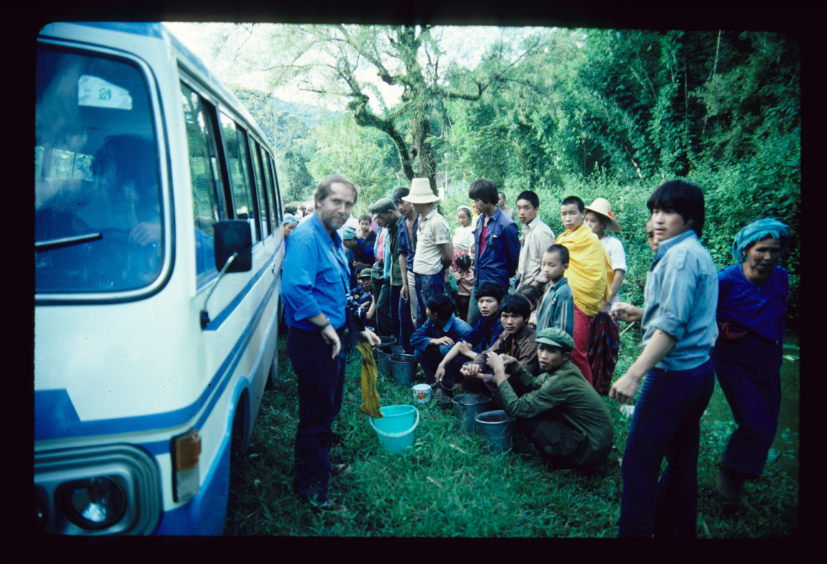
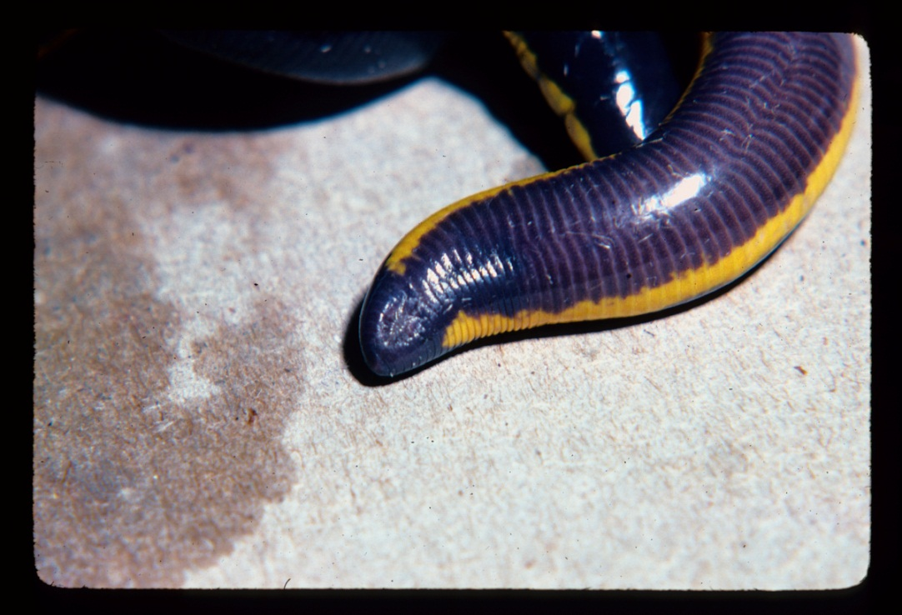
Ichthyophiidea
Ichthyophis bannanicus

Slide 19
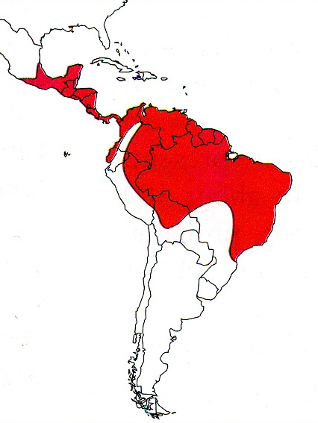
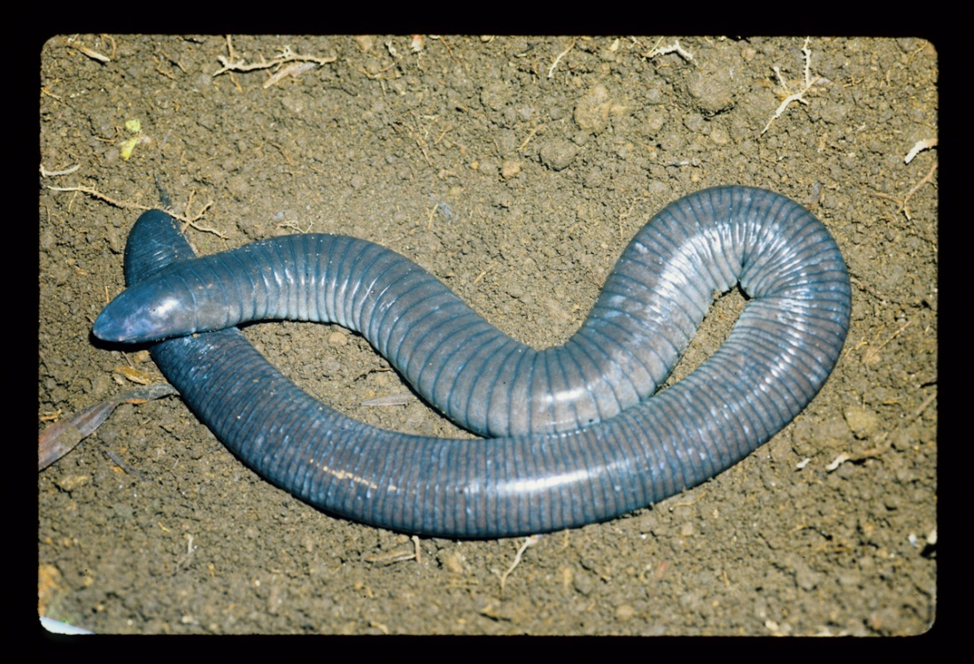
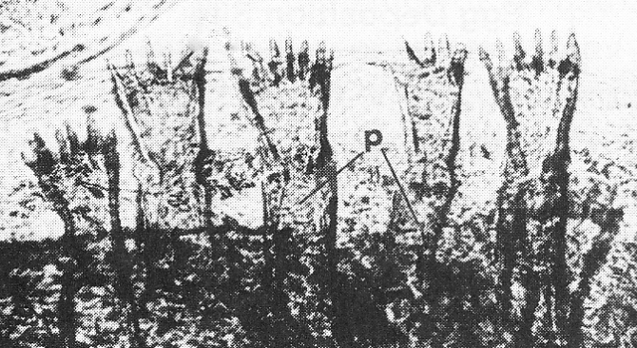
Distribution of Caeciliidae
(from Pough, et al., 2004)

Slide 20
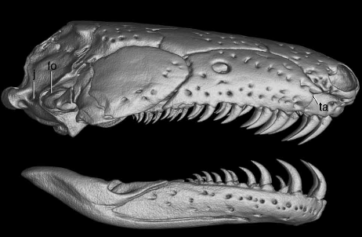
Caeciliidae
Dermophis mexicana
Fetal Teeth

Slide 21
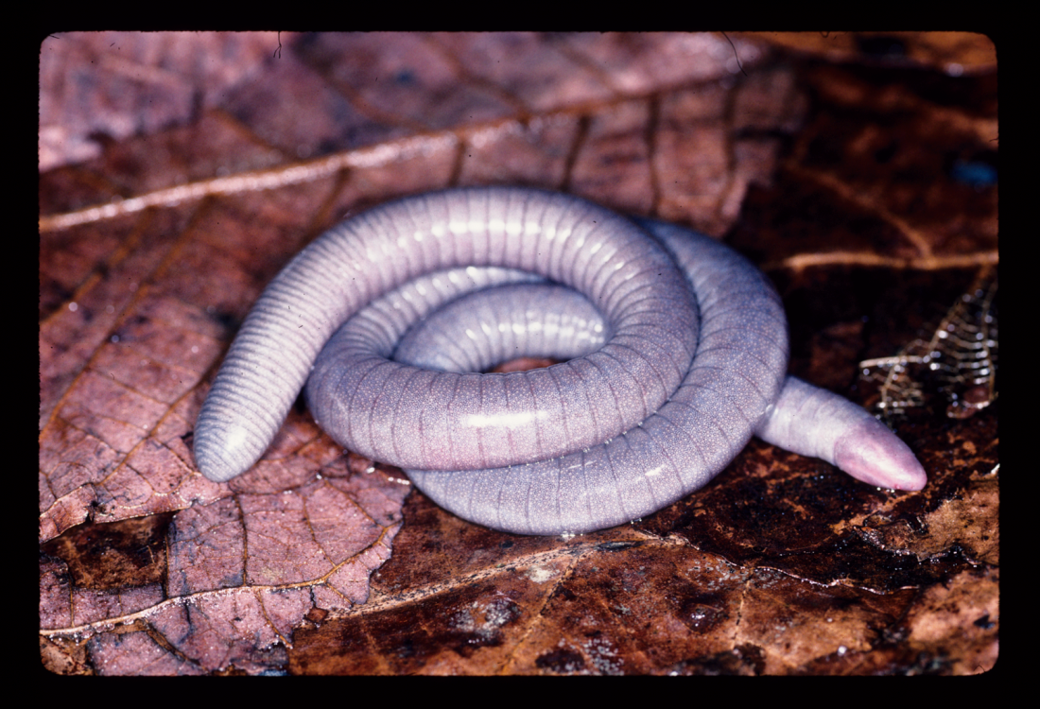
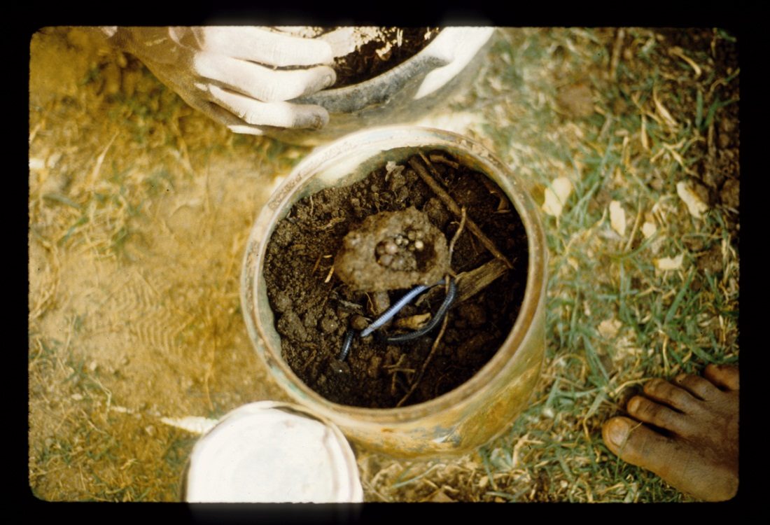
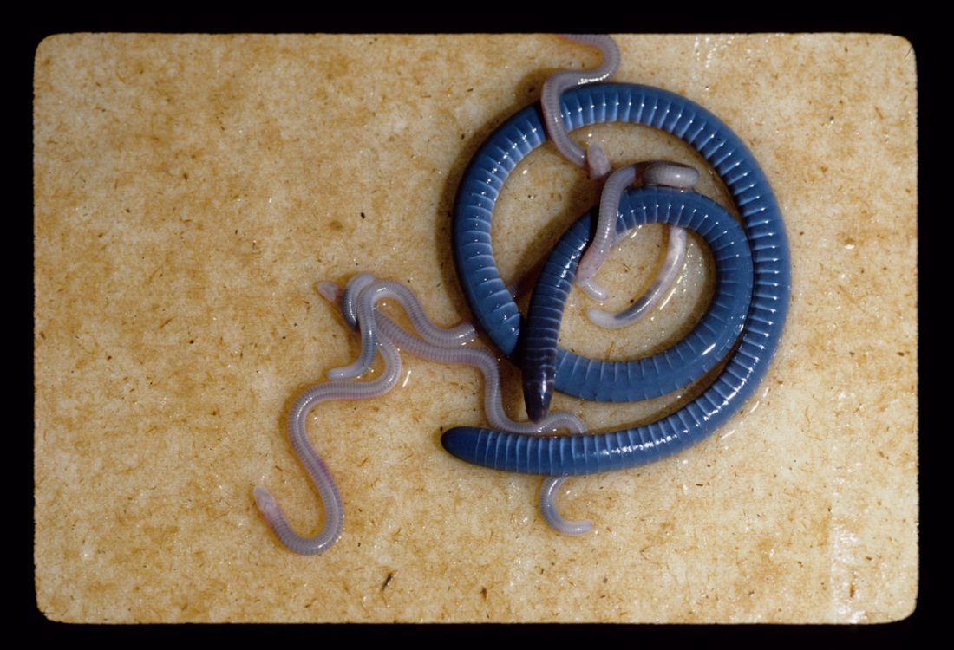
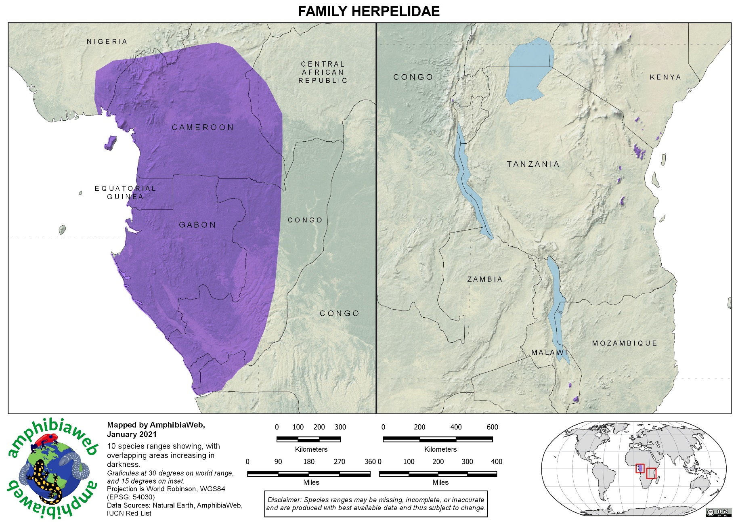
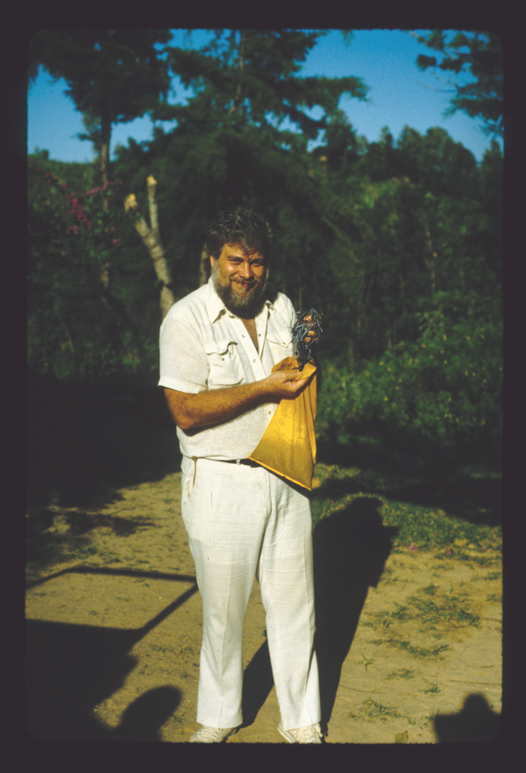
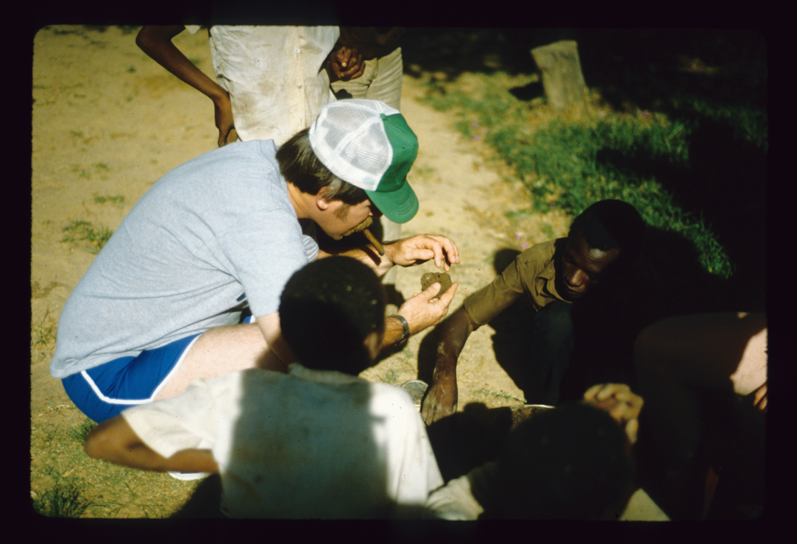
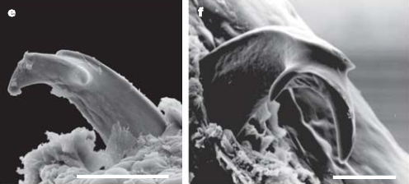
Herpelidae
http://www.youtube.com/watch?v=DMvL4zOLSeM
Kupfer et al. 2006. Nature
Boulengerula taitana
Herpele
Boulengerula boulengerula

Slide 22
Herpele

Slide 23



Typhlonectidae
http://www.youtube.com/watch?v=1lAfOTR9tY4
(from Pough, et al., 2004)

Slide 24

Typhlonectidae
http://www.youtube.com/watch?v=1lAfOTR9tY4
Typhlonectes compressicauda

Slide 25




Indotyphlidae
Hypogeophis rostratus

Slide 26





Dermophiidae
Shistometopum thomense
Male
Female

Slide 27


A new family of Caecilians from India
Chikilidae
Kamei et al. 2012. Proceedings of the Royal Society B

Slide 28




Slide 29



Urodela (salamanders)
© John White
Any thoughts on Salamander distribution?

Slide 30



Urodela Synapomorphies
Limbs =
Tail
Distinct head, neck, body
Distinct costal grooves
External gills in larvae
Reduced but ossified skull
No middle ear!
Fertilization
Many retain larval traits

Slide 31


Costal Grooves
Do they have a function?
Ambystoma gracile
(from: Lopez and Brodie 1977)

Slide 32



Spermatophores
https://www.youtube.com/watch?v=GNDDXKmXlM8
(from Duellman & Trueb, 1986)

Slide 33



Sperm Storage
(from Duellman & Trueb, 1986)

Slide 34


Paedomorphosis
Ambystoma mexicanum (Axolotl)
Retain gill slits or gills
No eyelids
Larval teeth
Stay aquatic

Slide 35

Latest Phylogeny Based on Complete Mitochondrial Genomes Zhang & Wake. 2009. Molec. Phylog. & Evol., 53:492-508.

Slide 36



Slide 37
Salamander Families
GYMNOPHIONA
Sirenidae
Cryptobranchidae
Hynobiidae
Dicamptodontidae
Ambystomatidae
Salamandridae
Proteidae
Rhyacotritonidae
Amphiumidae
Plethodontidae
ANURA

Slide 38



Sirenidae
(from Pough, et al., 2004)

Slide 39




Cryptobranchidae
Two genera
Fully aquatic
Lack gills?
Synapomorphies
1 gill slit
External fertilization
Lateral skin folds
No eyelids

Slide 40





Hynobiidae
Hynobius dunni
Onycodactylus japonicus
Ranodon sibiricus
Ambystoma of Asia
External fertilization
Hynobius leechi

Slide 41






Dicamptodontidae
Pacific NW
Large (up to 30 cm)
Startles predators
2-4 species

Slide 42





Ambystomatidae
Ambystoma tigrinum
Spermatophores
Ambystoma opacum

Slide 43



Salamandridae
Major radiations in US, Europe, Asia
Includes some “true” salamanders, as well as “newts”
Origin of “newt”
What is a newt?
Lyciasalamandra luschani

Slide 44



Salamandridae
Notophthalmus viridescens
Taricha granulosa

Slide 45

Salamandridae: “Modern European Newts”
Triturus cristatus

Slide 46



Proteidae
Synapomorphies:
Gills
Aquatic
Large caudal fin
Maxillary bones (part of upper jaw) absent
(from Pough, et al., 2004)
Necturus lewisi
Necturus maculosus

Slide 47


Rhyacotritonidae
Rhyacotriton olympicus

Slide 48


Amphiumidae
Amphiuma means

Slide 49
Salamander Families
GYMNOPHIONA
Sirenidae
Cryptobranchidae
Hynobiidae
Dicamptodontidae
Ambystomatidae
Salamandridae
Proteidae
Rhyacotritonidae
Amphiumidae
Plethodontidae
ANURA

Slide 50


Synapomorphies
From: Duellman and Trueb, 1986

Slide 51


Tongue Projection

Slide 52

Distribution of
Plethodontidae
Thoughts?
Thought to originate from Appalachian mountains (stream)
Age of clades suggested disbursed from E to W US
Major radiations in central and South America & western US – How?
How do we explain the population in Europe?
(from Pough, et al., 2004)

Slide 53



Plethodon Biogeography

Slide 54


New Species from Korea
Karsenia koreana
Min et al. 2005. Nature

Slide 55

Anura
What do you think about frog distribution compared to salamanders?
Gymnophiona
Urodela
Anura

Slide 56


Slide 57




Synapomorphies
Lithobates palustris
No tail
Head and trunk fused
Caudal vertebrae fused into urostyle
9 or less vertebrae (most 8)
Hind limbs longer than fore
Fused limb bones
Functional middle ear
True larynx
Tongue attached anteriorly
External fertilization
No teeth on lower jaw
Tadpoles
?

Slide 58

Anuran Skeleton
Notes:
58
58
58

Slide 59



Tadpoles - goal?
Megophrys nasuta
Ascaphus truei

Slide 60




Tadpoles
Spiracle
Dendrobates tinctorius
(cobalt poison dart frog)
Differences between tadpoles and salamander larvae?
Notes:
60
60
60

Slide 61






Slide 62






Components of Amphibian Reproduction
Clutch Structure: masses, single eggs, strings,
Deposition site: aquatic, terrestrial, arboreal, cutaneous
Larval Development: free-living, direct development
Parental Care: none, nest construction, egg attendance, carry eggs/larvae, feeding larvae

Slide 63

Stem Batrachian Fossil from the Early Permian of Texas (Anderson et al. 2008. Nature)
Gerobatrachus hottoni
How many vertebrae?

Slide 64

Fossil Frog
Triadobatrachus
Notes:
Extinct sister taxon of Anura
Frog-like, but with many ancestral features
>9 vertebrae; no fusion of caudal vertebrae
Distinct tail
Free ribs
U-shaped pelvic girdle with slightly elongated ilia
Relatively complete fossil from Lower (early) Triassic (230 MYA) in Madagascar
Anura + Triadobatrachus = Salientia

Slide 65

Anuran Phylogeny (complete)
Frost et al. 2006. The Amphibian Tree of Life. Bull. Amer. Mus. Nat. Hist.

Slide 66






Hylidae
Hyla versicolor
Hyla chrysoscelis
Notes:
66
66
66

Slide 67





Bufonidae
Synapomorphies
Most terrestrial (dryer skin)
Clutch size varies
Couple genera viviparous
Tadpole aggregations
Notes:
67
67
67

Slide 68






Atelopus sp.
Most critically endangered
Notes:
68
68
68

Slide 69





Ranidae
400 sp.
No real synapomorphies
“pond” dwellers
Notes:
69
69
69

