Slide 1
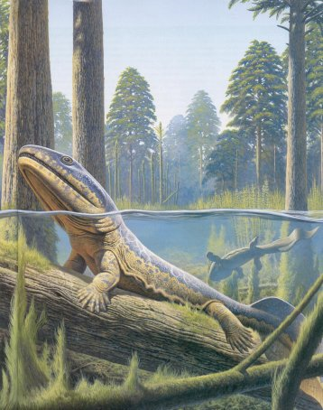
Tetrapod Origins

Slide 2
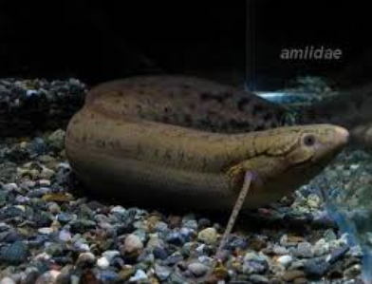
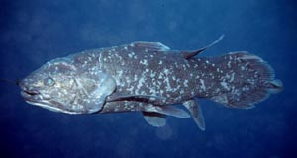
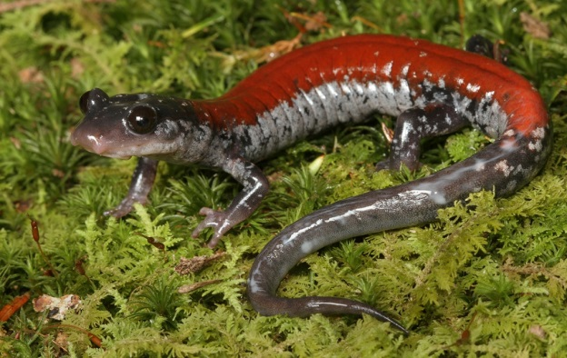
Which Sarcopterygian?
?
Work with a partner to build two potential cladograms that highlight the possible relationship between sarcopterygians and tetropods

Slide 3
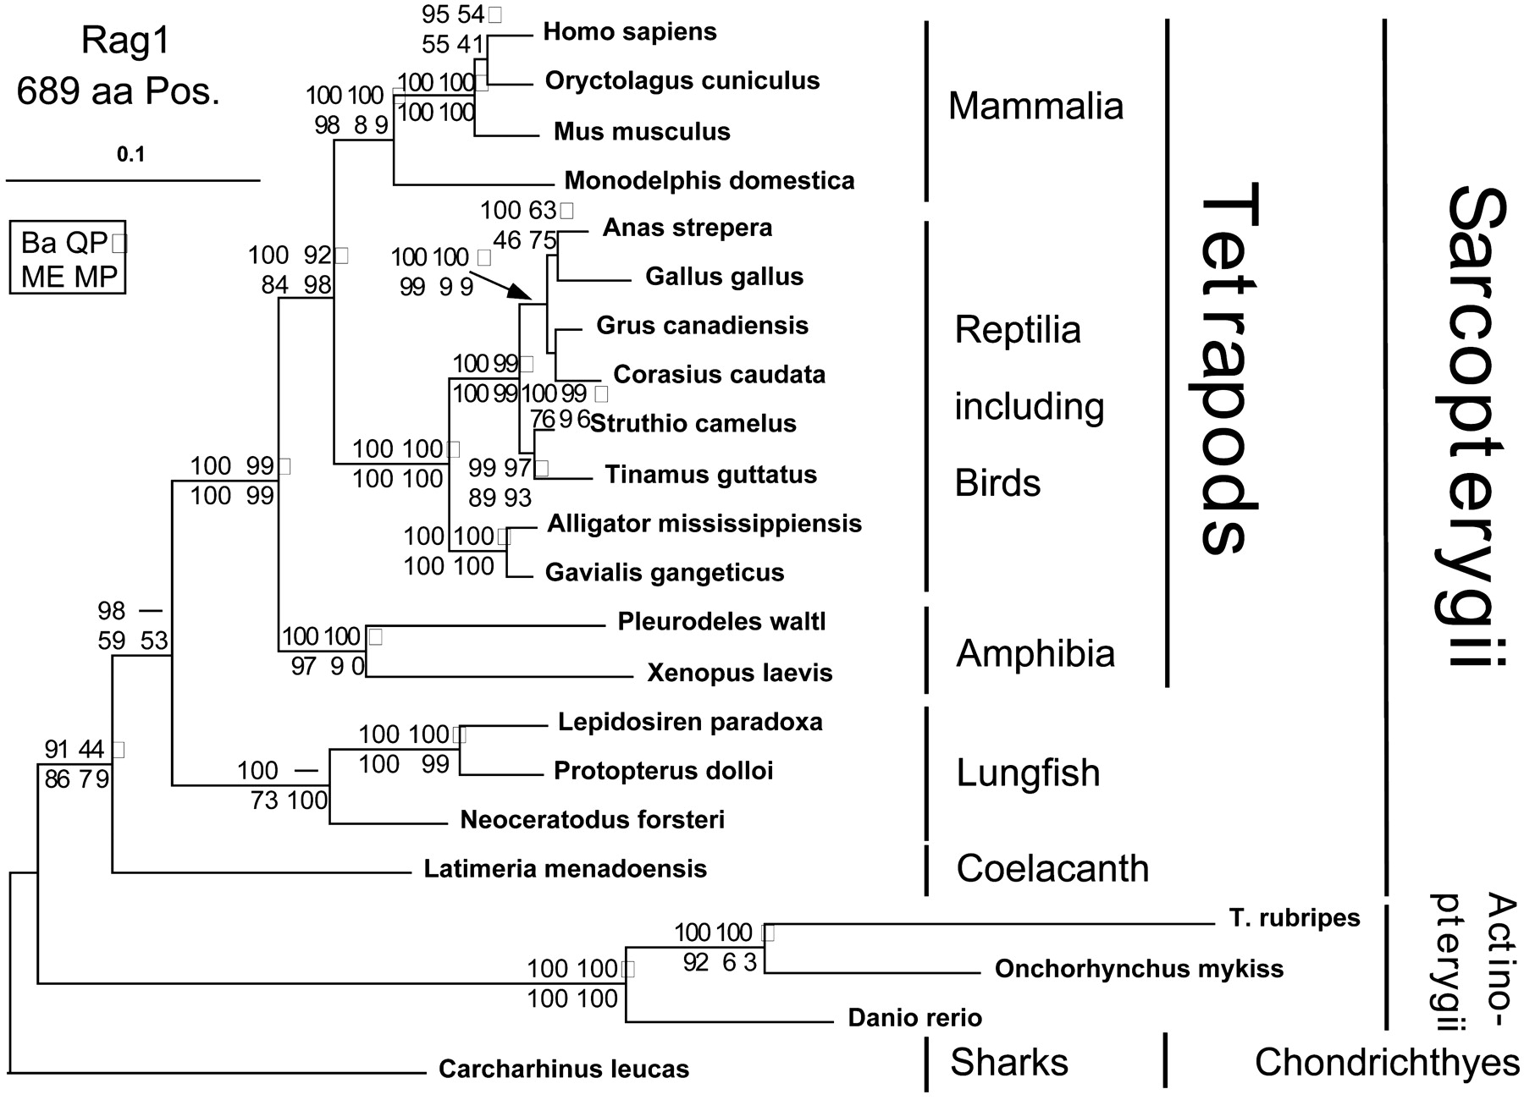
So which is it?
Brinkmann et al. 2004
Morphology → Dipnoi
Functional lung
Single basal bone in limb
Skull morphology matches
Dentition matches
Vertebrae similar to tetrapods
Genetic?
Original → Actinistia
Modern → Dipnoi
Notes:
Some of the first genetic studies on Coelacanth 90’s suggested Actinistia as the ancestor
Morphological evidence suggested Dipnoi (functional lung that is structurally closer to tetrapods, single basal bone in the limbs, skull morphology matches, vertebrae are more similar to tetrapods)
Modern genetic studies all support Dipnoi as the ancestor – strong support
Lung and Air-Breathing: Lungfishes possess a functional lung homologous to tetrapod lungs, enabling air-breathing. This is a critical adaptation for the fish-tetrapod transition in Devonian environments with fluctuating oxygen levels. Coelacanths lack functional lungs, relying on gills, with their "lung" reduced to a vestigial fatty organ.
Studies (e.g., Long & Clement, 2020) highlight lungfish lung morphology (e.g., Neoceratodus paired lungs) as structurally closer to early tetrapodomorph fossils like Tiktaalik than coelacanth anatomy.
Fin-to-Limb Transition: Lungfish paired fins (pectoral and pelvic) contain a single basal bone (humerus/femur homolog) articulating with the girdle, mirroring tetrapod limb structure more closely than coelacanth fins, which have simpler, less robust skeletal supports.
Fossil lungfishes (e.g., Gogonasus, ~380 Mya) show fin endoskeletons with elements analogous to tetrapod limb bones, supporting homology (Clack, 2012).
Cranial and Dental Features: Lungfishes share with early tetrapods a palate structure (e.g., autostyly, where the palatoquadrate fuses to the skull) and tooth plates suited for crushing, resembling early tetrapodomorphs (Eusthenopteron). Coelacanths have a more divergent intracranial joint and simpler dentition.
Studies of Devonian fossils (e.g., Ahlberg & Johanson, 1998) note lungfish-like cranial kinesis in stem-tetrapods, suggesting shared ancestry.
Vertebral and Axial Skeleton: Lungfishes exhibit a notochord with rudimentary centra, akin to early tetrapodomorphs, whereas coelacanths have a persistent, less ossified notochord. Fossil lungfishes (Griphognathus) show vertebral patterns closer to tetrapods than coelacanths (Long, 2010).

Slide 4
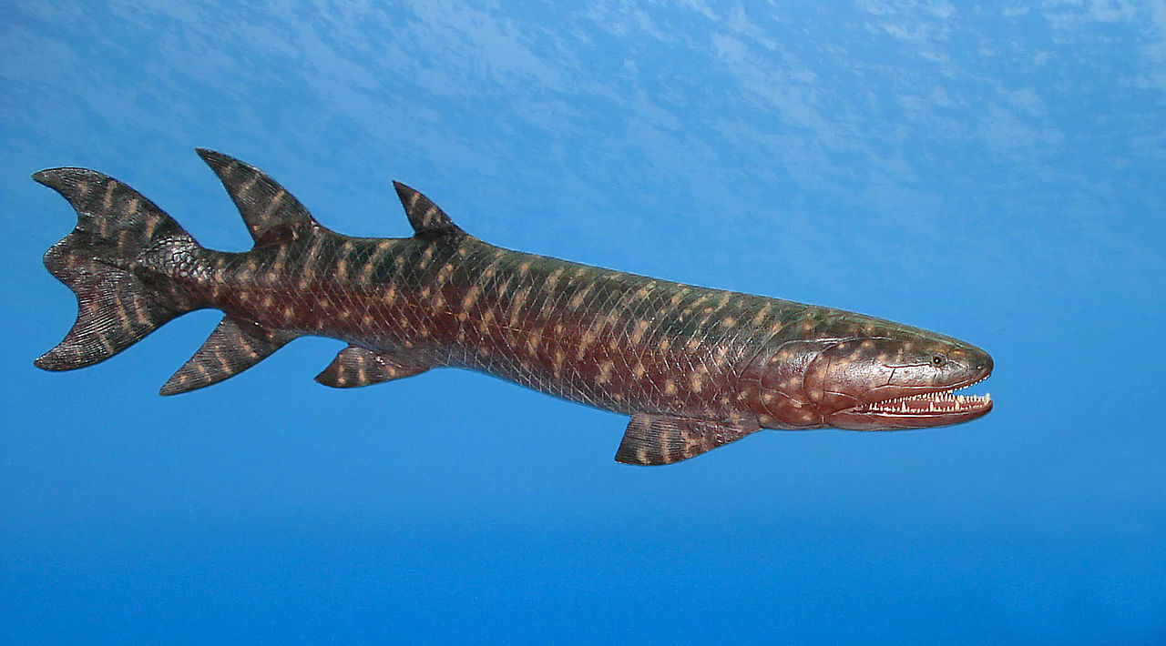
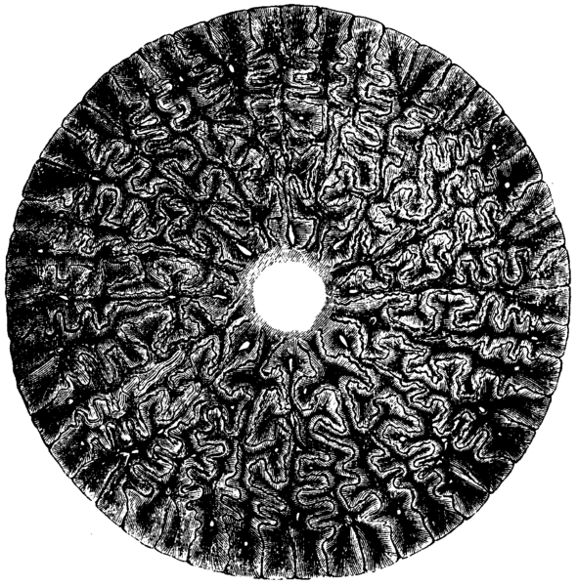
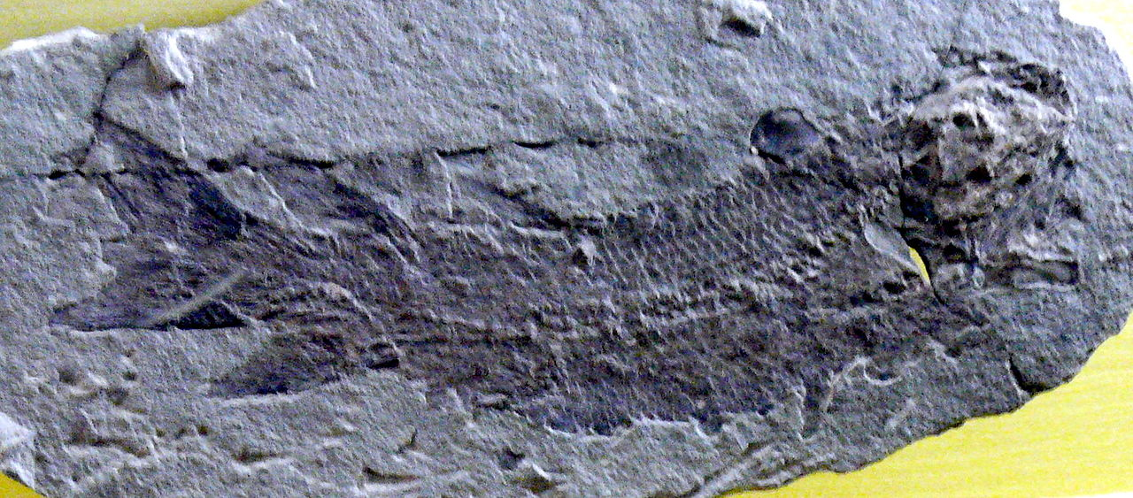
Tetrapodomorpha (infraclass)
Eusthenopteron
Lungs and gills
Scales lost the dentine
Skull bones modified
Unique teeth
Bones of limbs distinct
Internal nostrils!!

Slide 5
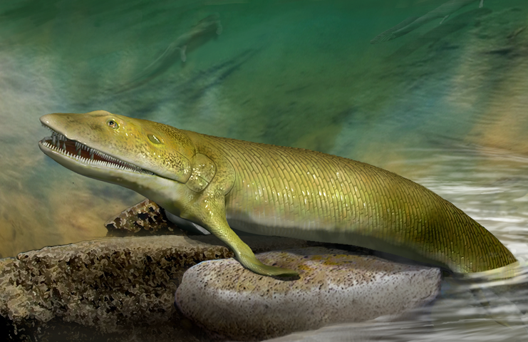
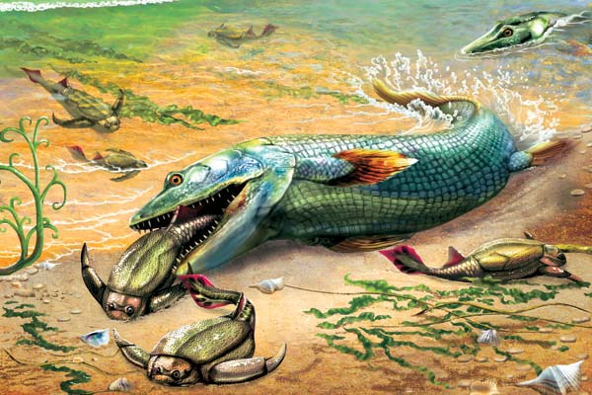
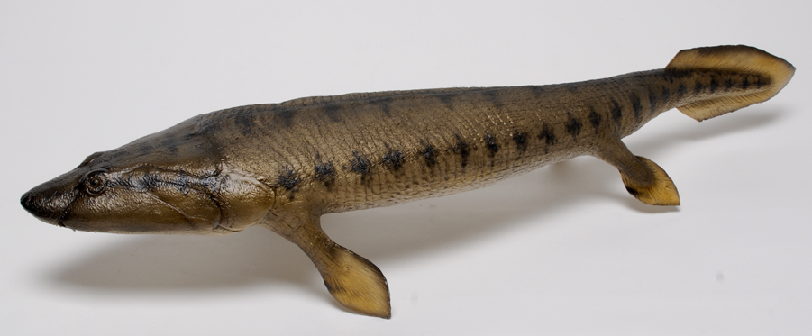
Elpistostegids
Lungs and gills
Paired fins
Lost dorsal/anal fin
Dorsal eyes
Frontal bones more like tetrapods
Labyrinthodont dentition
Fish?
Notes:
An order of fishes that originated approximately 365 mya
Have a unique combination of characters that make them the likely ancestors to modern tetrapods
Possess both lungs and gills (just like the sarcopterigians)
Have paired fins
No dorsal or anal fin
Dorsally positioned eyes
Frontal bones (located between the eyes) in the skull (unlike other fish, but similar to tetrapods)
Labyrinthodont dentition (the dentine (calcified tissue surrounding the pulp cavity of a tooth and comprising the bulk of the tooth) folded in a complex pattern).

Slide 6
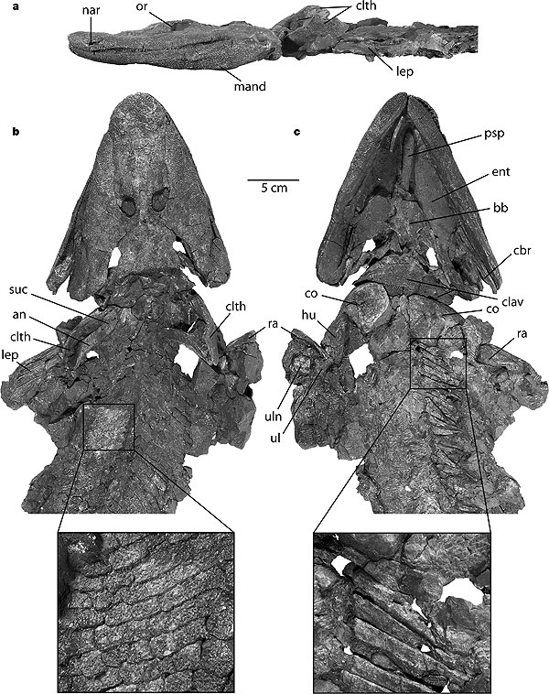
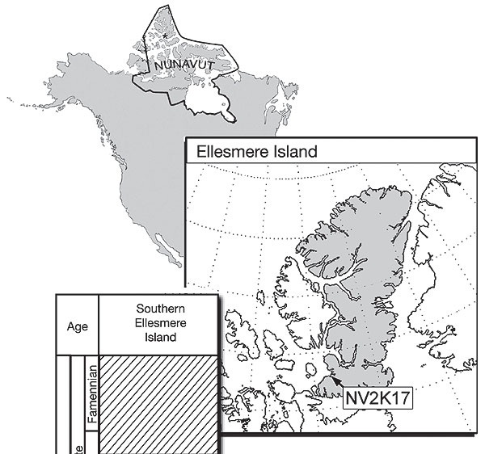
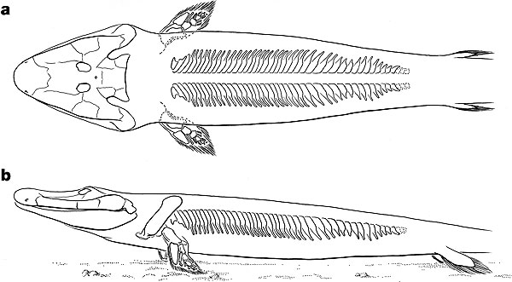
Tiktaalik roseae
Daeschler et al., 2006. Nature
Mix of primitive traits and derived traits
Scales
Fin rays
Lower jaw and palate
Well-dev gills
Short skull
Modified inner ear
Mobile neck
Functional wrist
Habitat?
Notes:
Intermediate between the sarcopterygian fishes like the Elpistostegids and stem tetrapods that have limbs and digits
The body scales, fin rays, lower jaw and palate are comparable to those in more primitive sarcopterygians
Has a shortened skull roof, a modified ear region, a mobile neck, a functional wrist joint, and other features that precursor to tetrapods.
Life in shallow-water, marginal and subaerial habitats.

Slide 7

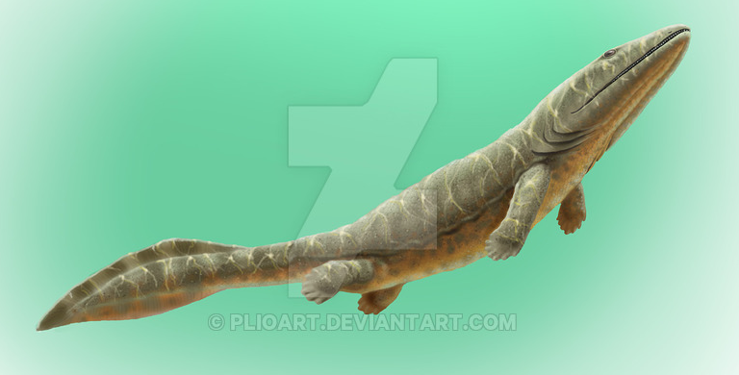
Elginerpeton
Scotland
Missing most bones
Some traits fish-like, others tetrapod-like
NOT CLEAR

Slide 8
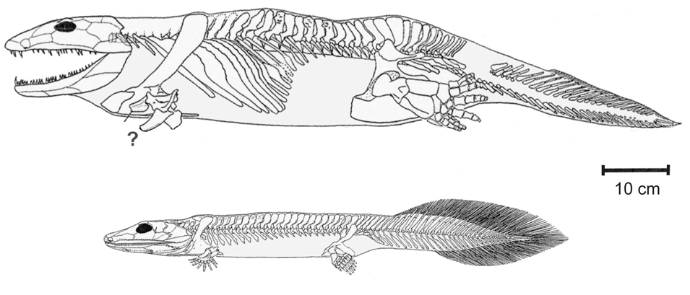
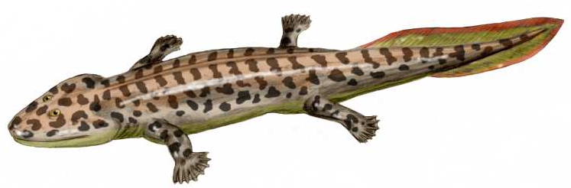
Stegocephali
~360MYA
LIMBS!!!
Polydactyly
Limb bones more robust
Girdles more flexible
Mobile neck
Fish like traits?
Acanthostega
Notes:
Elpistostegids had tetrapod like features, but were definitely fish
Stegocephalians: Tetrapoda + all extinct taxa more closely related to them than to other lobe-fined fishes
Known as stem tetrapods
Had a number features that identify them as tetrapods
weight-bearing LIMBS (not fins)
Polydactyly (many digits), between 6 and 8 per limb
Plus all the features present in elpistostegids
Lungs and gills
Caudal fin
No dorsal or anal fin
Labyrinthodont teeth
Likely semi-aquatic based on the skull morphology (retained fish-like breathing mechanisms – based on palate morphology)
Likely stayed close to the shore
Many other features would have also changed, sensory and hearing structures, but don’t preserve in fossils.

Slide 9
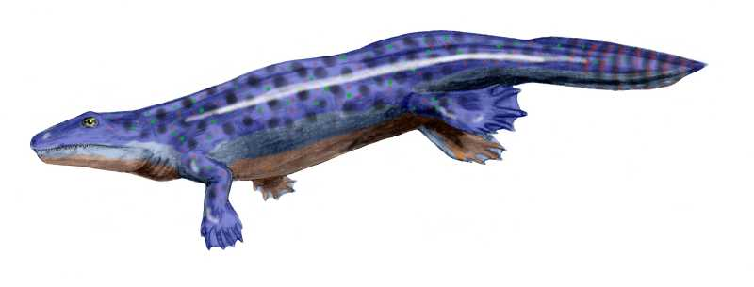
Early Stegocephalians
What has changed relative to Acanthostega?
Ichthyostega
Notes:
Originated approximately 360 mya
Carnivorous
Approximately 20 – 120 cm long
Bones of the limbs (radius, ulna, tibia, fibula) are much more robust than the elpistostegids
Bones in the hands are reorganized in these, likely to faciliate walking, but still more adapted for water than land
Fossils from Greenland, and eastern Europe

Slide 10
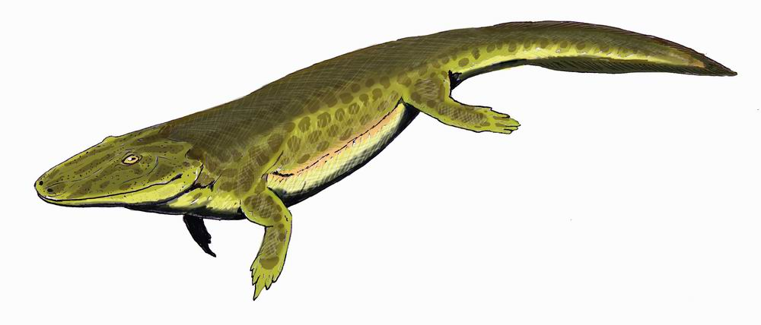
Tulerpeton
6 fingers and toes
More robust limbs and girdles
True neck (head disconnected from girdle)
No gills

Slide 11
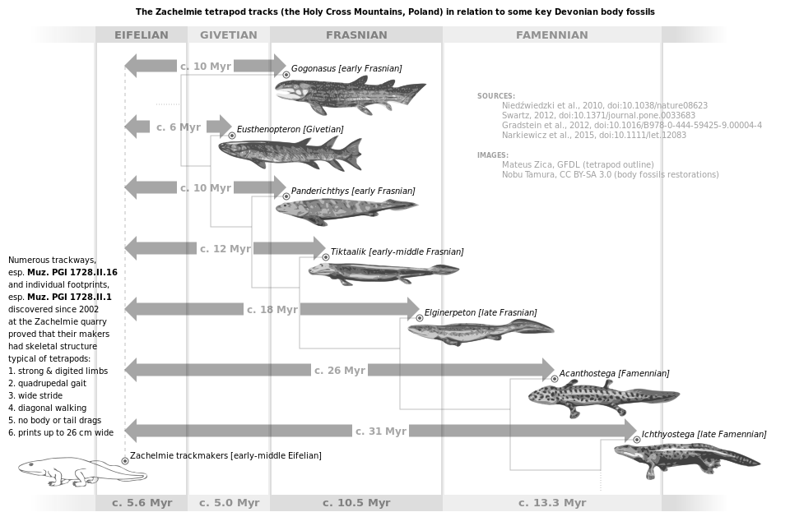

Slide 12
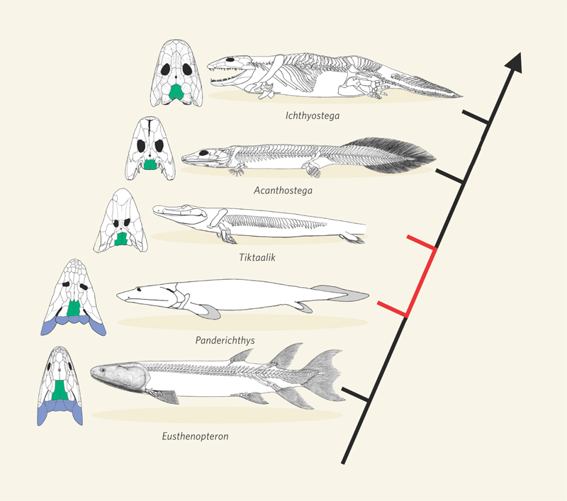
General Phylogeny of Early Tetrapods

Slide 13
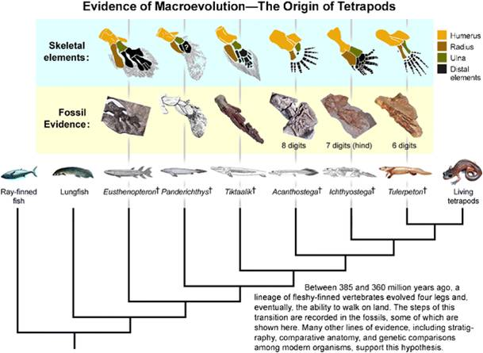

Slide 14
How does a land animal evolve in water?

Slide 15
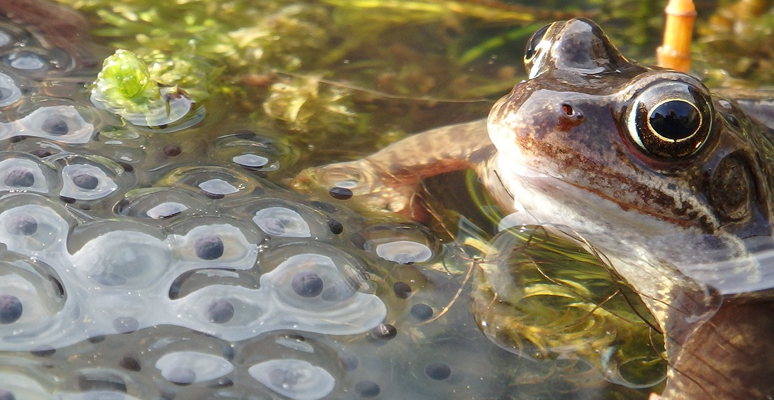
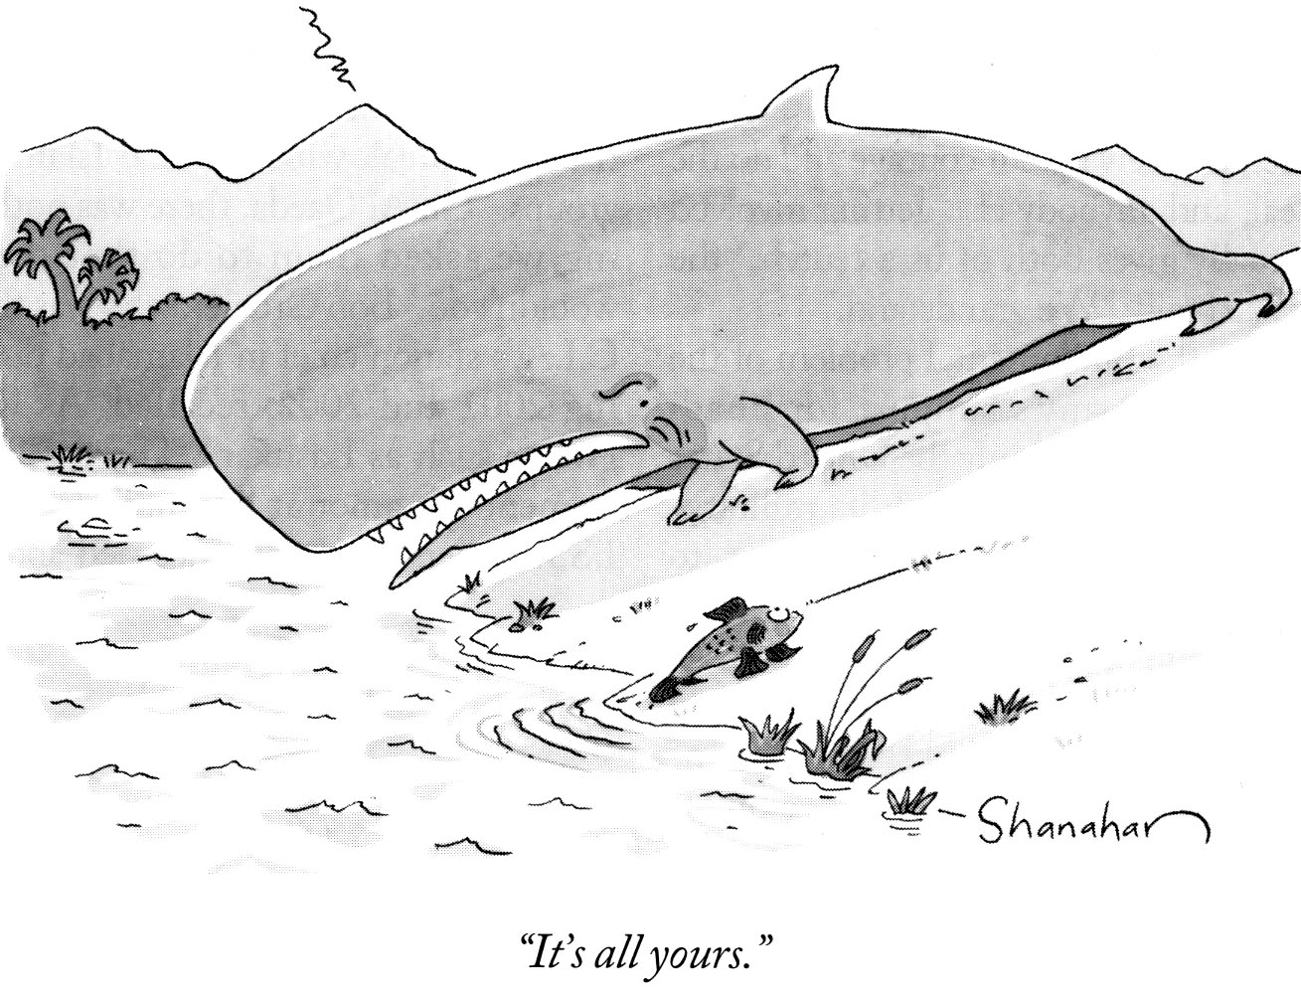
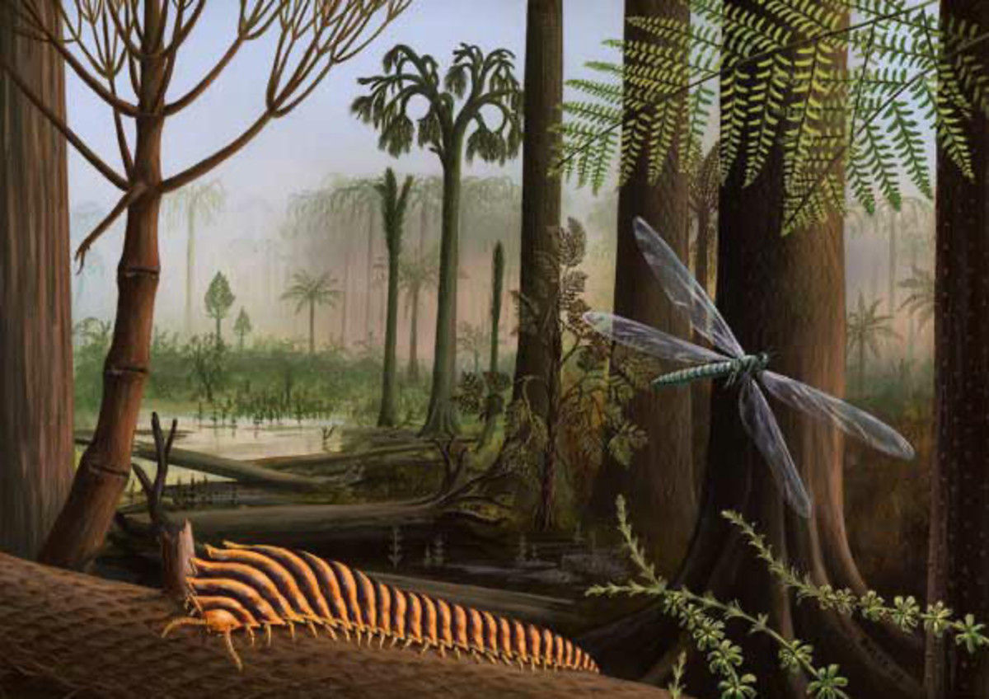
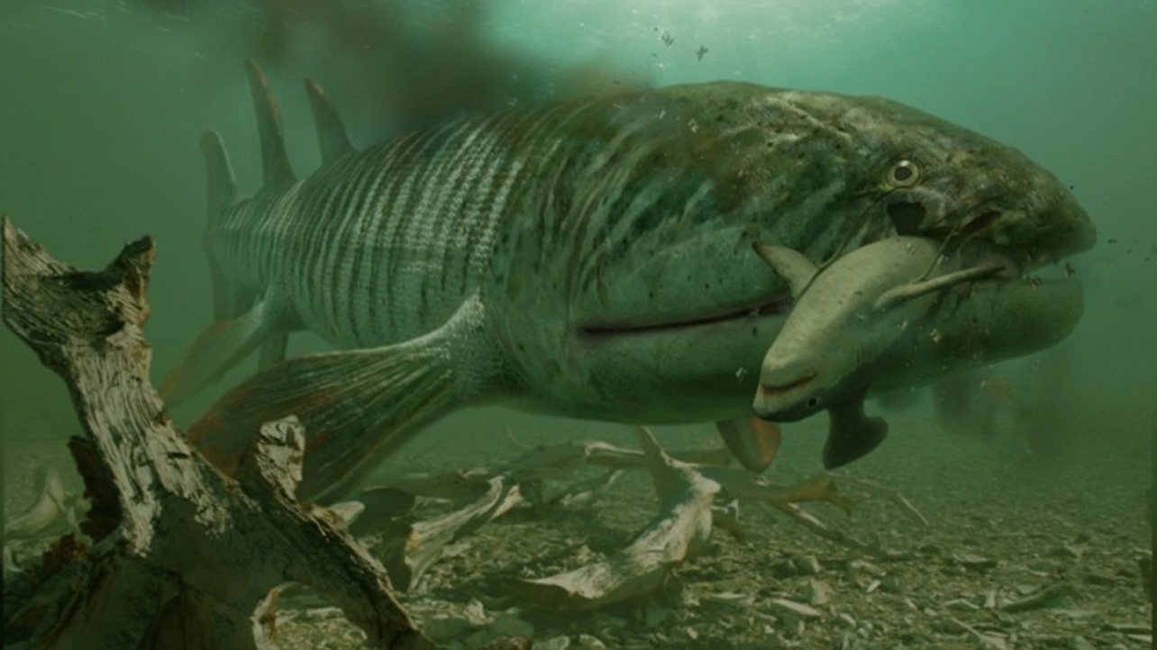
Why the transition to land?
Notes:
Escape predation from aquatic predators
Provided a nursery that was relatively free from predators (giant lobe-fin predators)
Take advantage of terrestrial prey (e.g., insects)
Move between pools in seasonally dry environment

Slide 16
Challenges
Gravity more intense
Water loss
Drastic temperature changes
Sensing environment different
Obtaining oxygen
Reproduction without water
Feeding
Getting rid of waste
Work with people around you and explain how these challenges were met
Notes:
Water is very bouyant and supports body weight – on land must have structures to support weight
Terrestrial environments are dry – must have ways to avoid water loss
Sensory stimuli are very different – air is poor conductor of sound and electricity, lateral line no longer effective

Slide 17
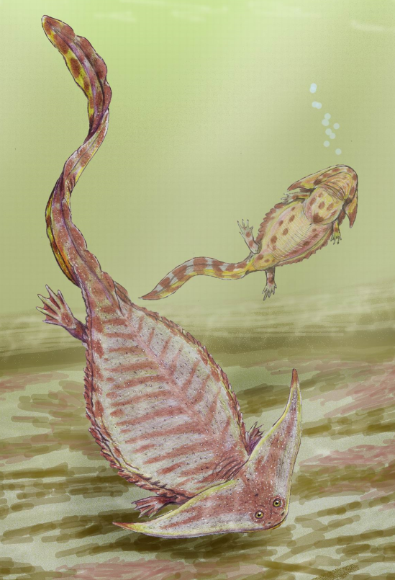
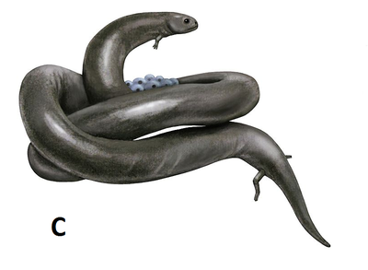
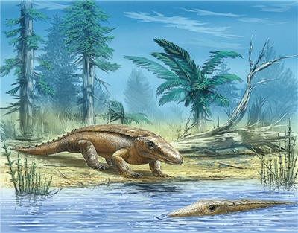
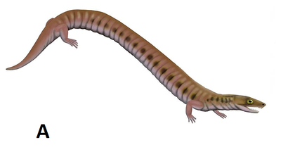
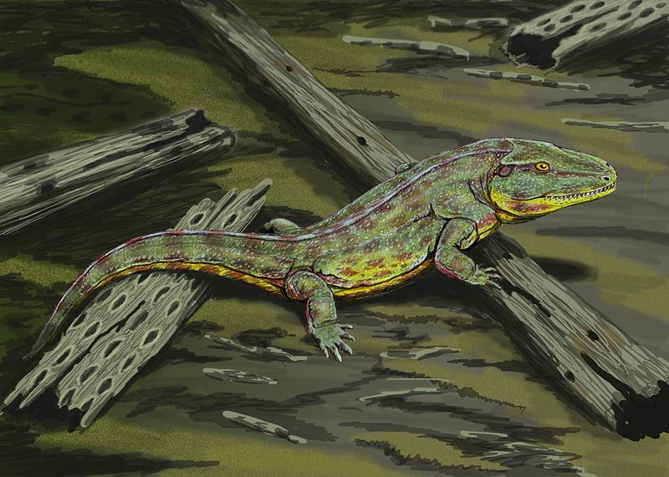
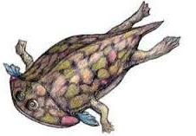
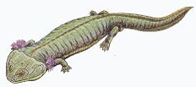
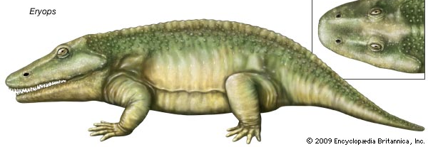
Ancestors of Tetrapods?
Phlegethontia

