Slide 1
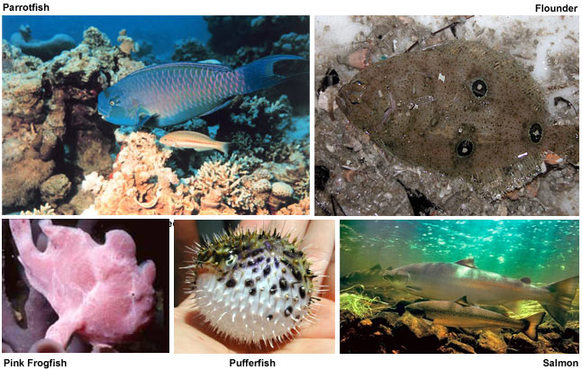
The Bony Fish

Slide 2
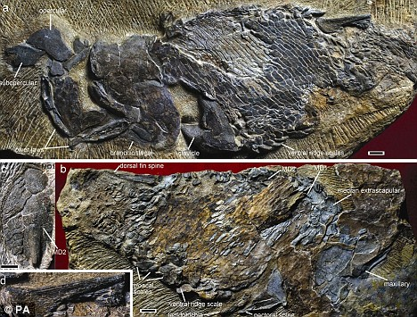
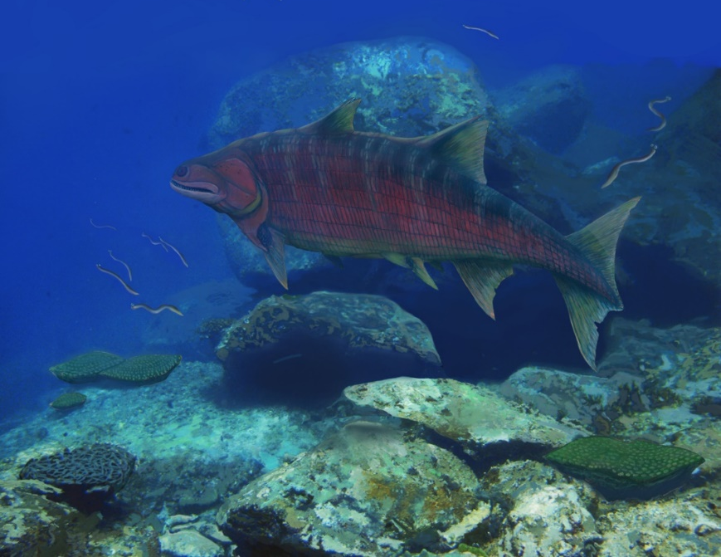
Osteichthyes (superclass)
Most diverse vert group
420 MYA
Ancestral traits:
  Fins have extra bones
  Skull thicker
  Brain small
  Scales still thick
Guiyu oneiros

Slide 3

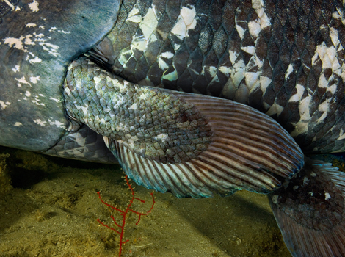
Devonian Fishes
Diversified right after origin
Dominant for >50MY - “Age of Fishes”
2 major radiations

Slide 4
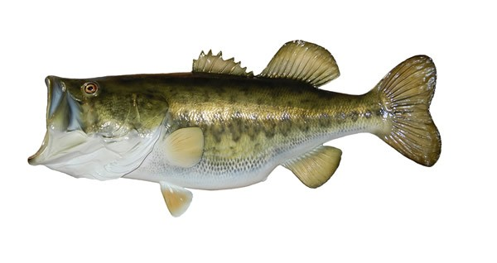
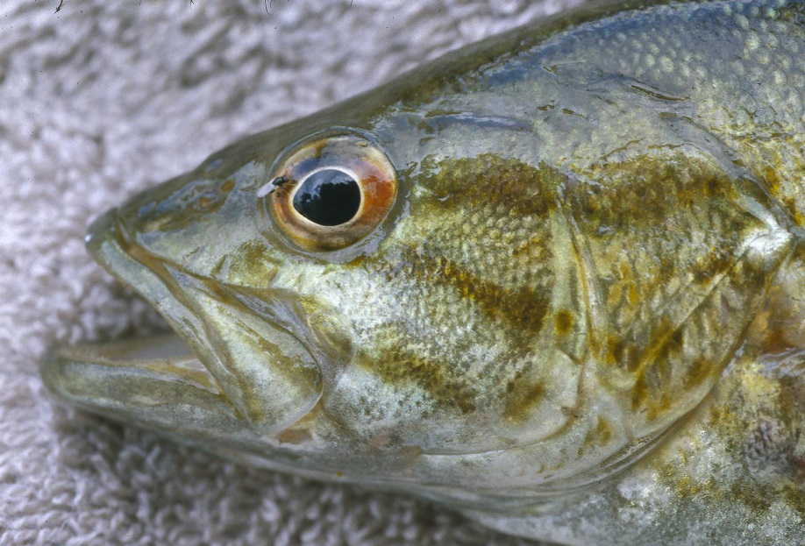
Bony Fish Specializations
https://www.youtube.com/watch?v=fzP3l_XOe6M
https://www.youtube.com/watch?v=VfZCa6rPk6I

Slide 5
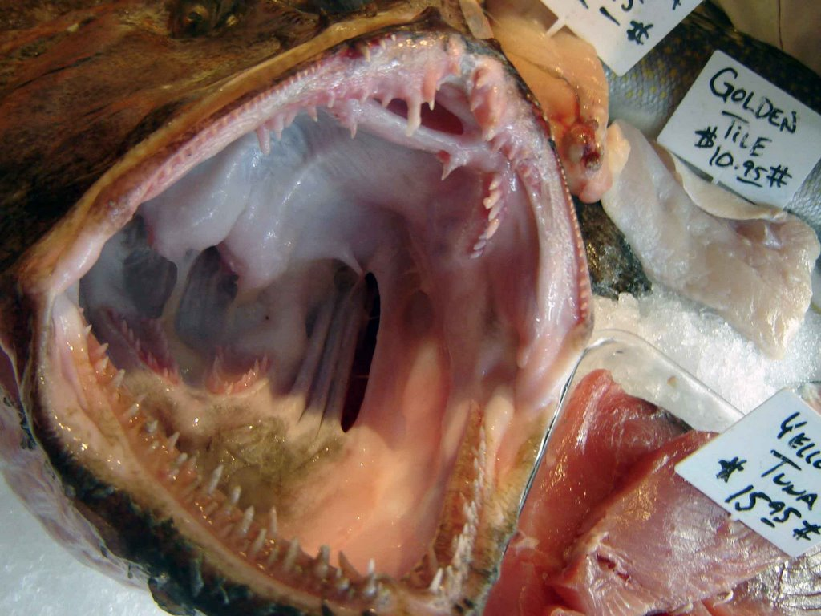
Do you notice anything strange?

Slide 6
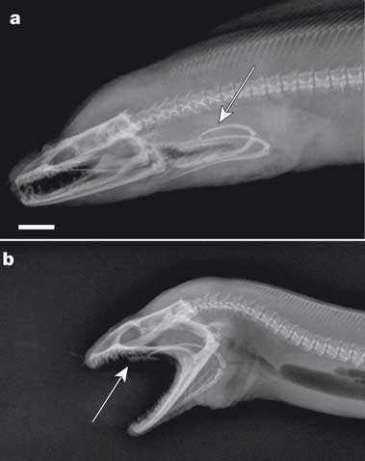
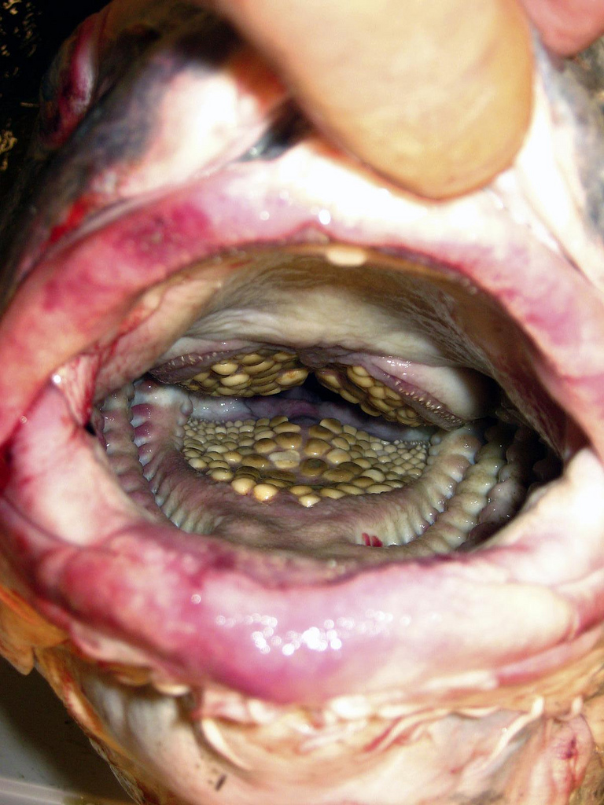
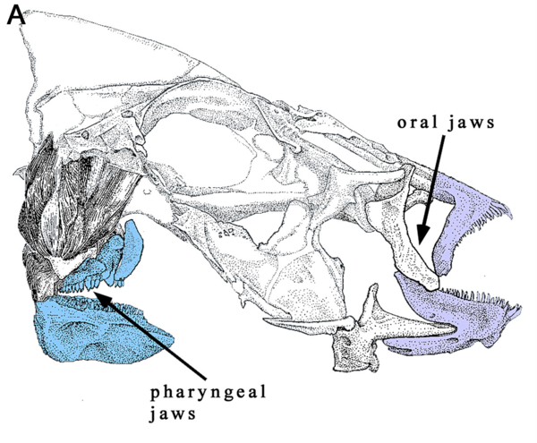
Ancestral: dermal tooth plates
Originally supported gills
Plates fused to each other
Bones associated with plates become mobile (some)
Muscles independent
Versatility in feeding within bony fish
https://www.youtube.com/watch?v=gAO37K7DPQA
https://www.youtube.com/watch?v=mC1UM6eE6eU

Slide 7
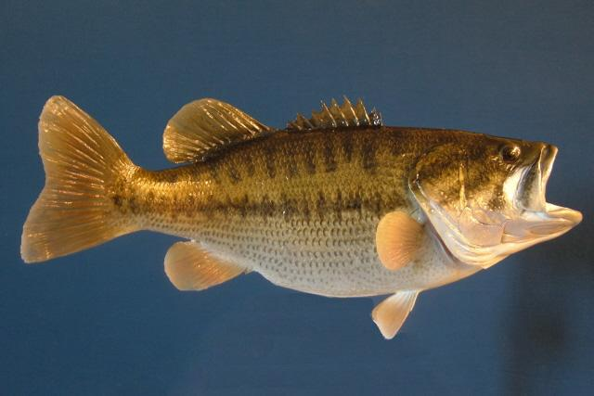
Bony Fish Specializations
Caudal fine bones modified – add support
Caudal fin changed shape

Slide 8
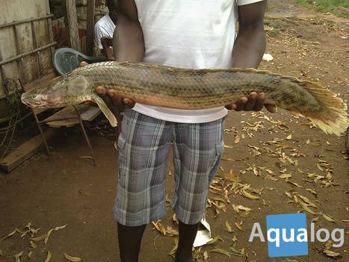
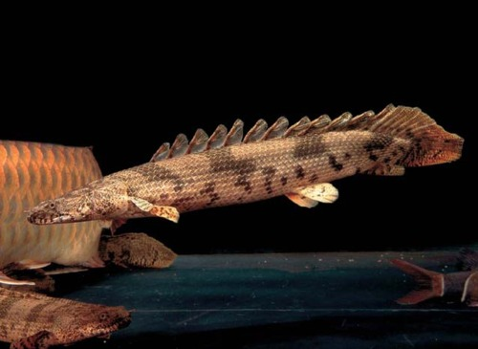
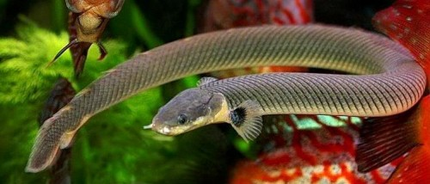
Major Groups of Actinopterygii
Most primitive
15 sp.
Africa
Elongate
Heavy armor

Slide 9
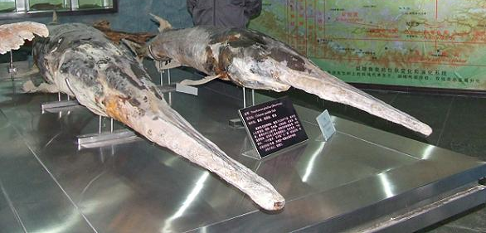
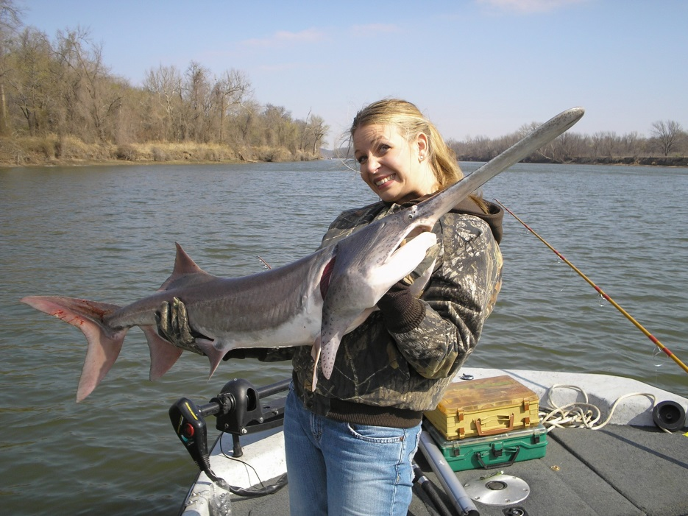
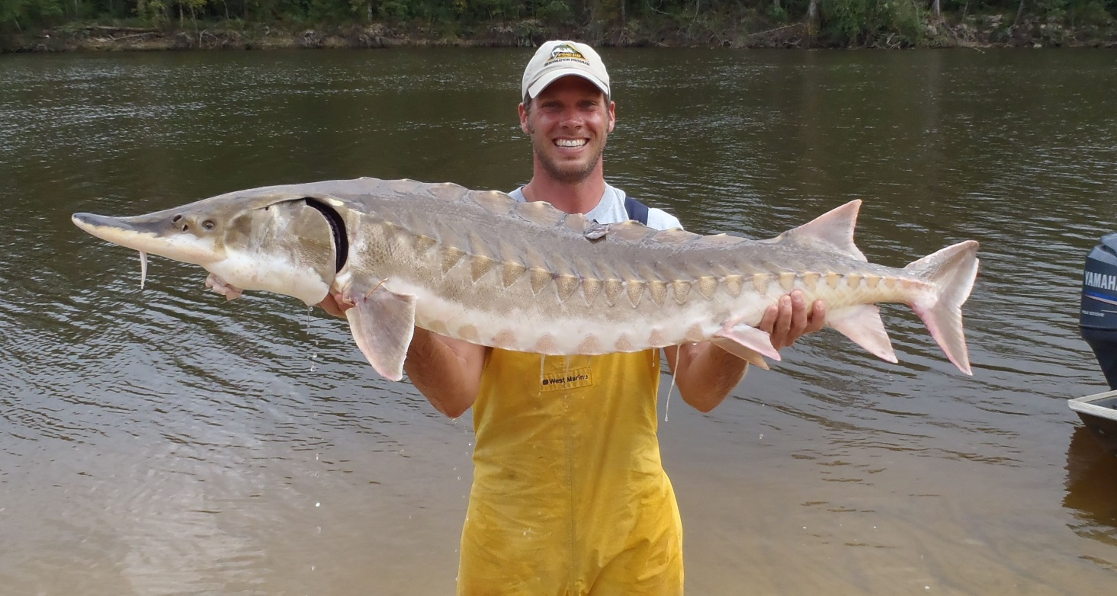
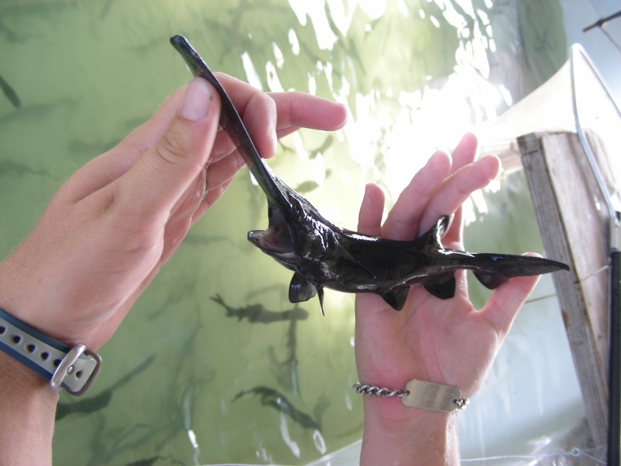
Major Groups of Actinopterygii
https://www.youtube.com/watch?v=M2BZeLEVtak
https://www.youtube.com/watch?v=l3Pi1O9IRD8

Slide 10
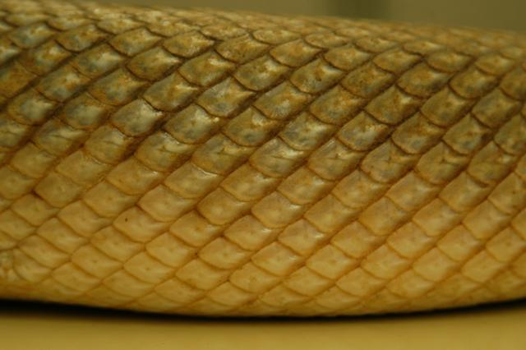
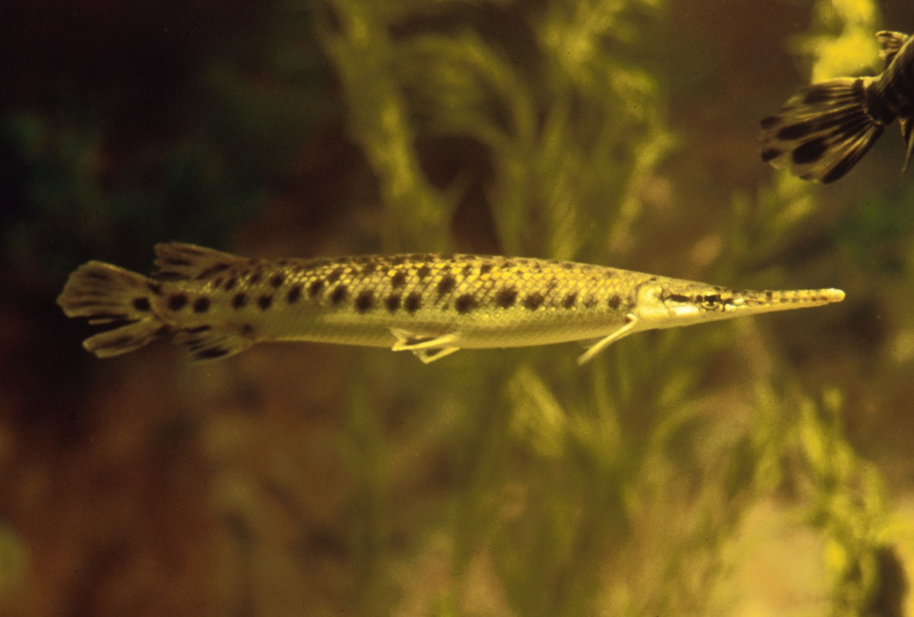
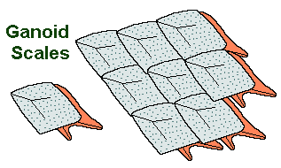
Major Groups of Actinopterygii
North and Central America
1-4m long
Ambush hunters
Interlocking scales
Gas bladder well vascularized
https://www.youtube.com/watch?v=vWuRQJSMj68

Slide 11
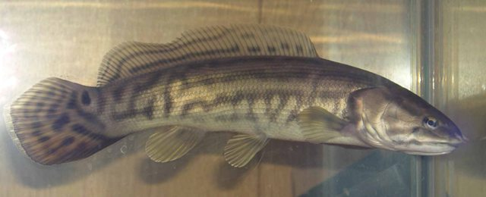
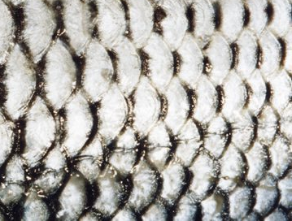
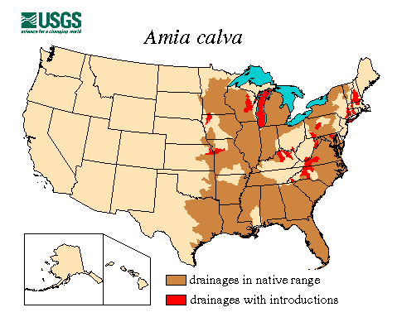
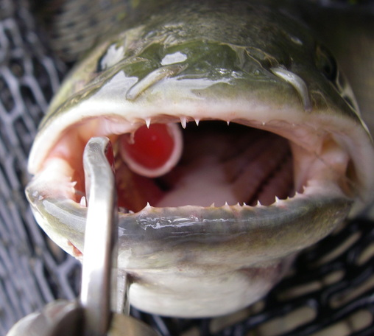
Major Groups of Actinopterygii
Bowfin
Native to US
Scales highly evolved
Asymmetrical caudal fin
Gas bladder well vascularized
Bony gular plate
Not the same as snakehead

Slide 12
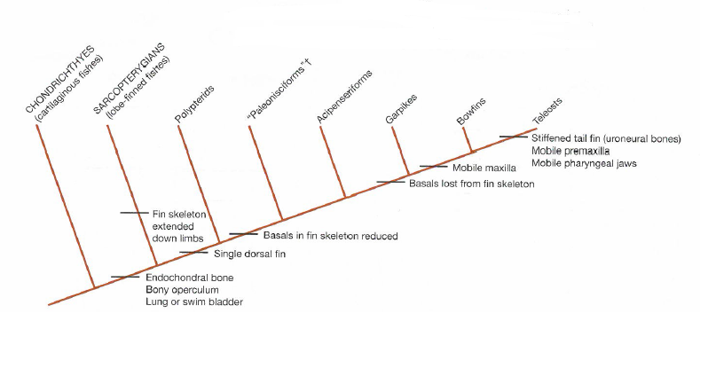
Extinct Order
Sturgeons and Paddlefish
Lepisosteiformes
Amiiformes
Bichirs

Slide 13
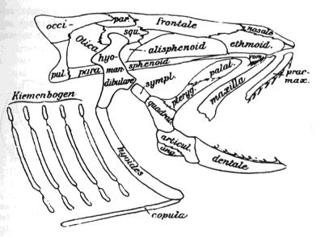
Osteoglossomorpha (superorder)
Tropical freshwater fish
United by single trait
2 orders

Slide 14
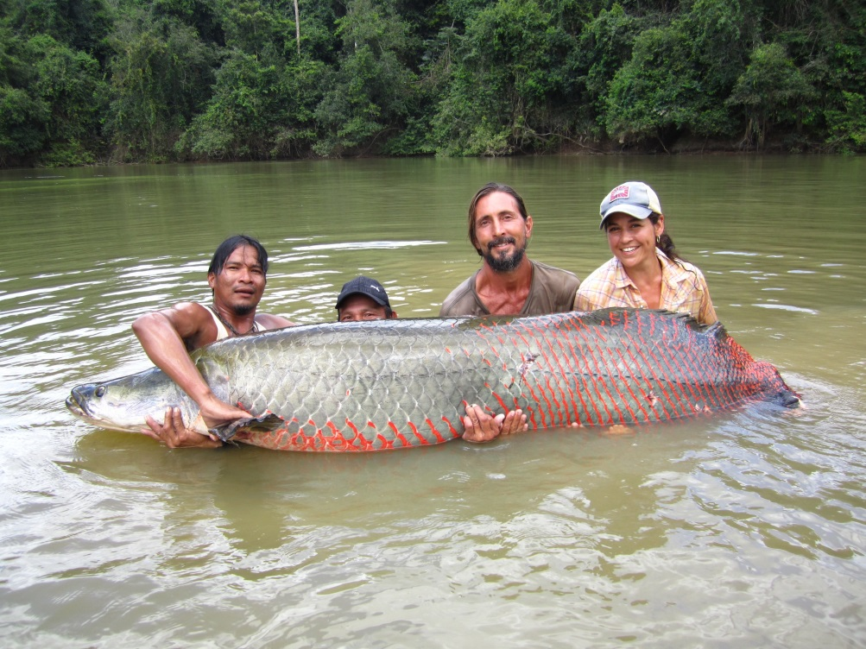
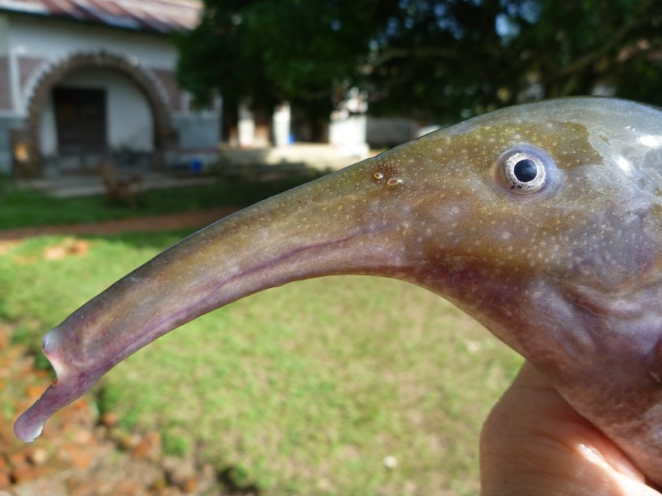
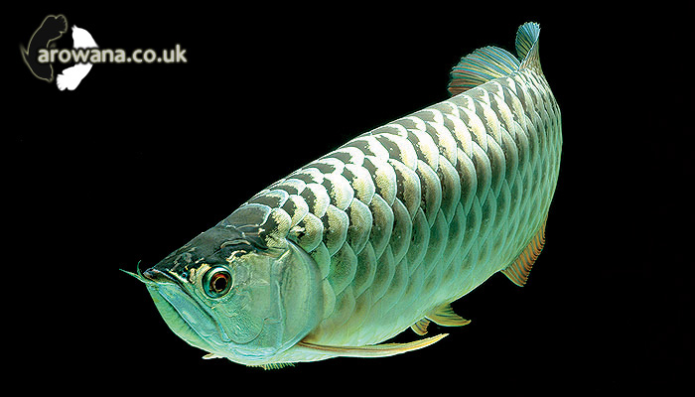
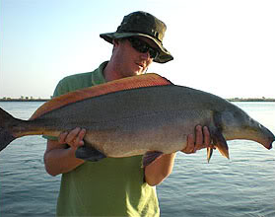
Osteoglossiformes
250 sp.
Tropical freshwater
Southern hemisphere
Well-known fish
  Arapaima
  Arowana
  Elephant fishes

Slide 15
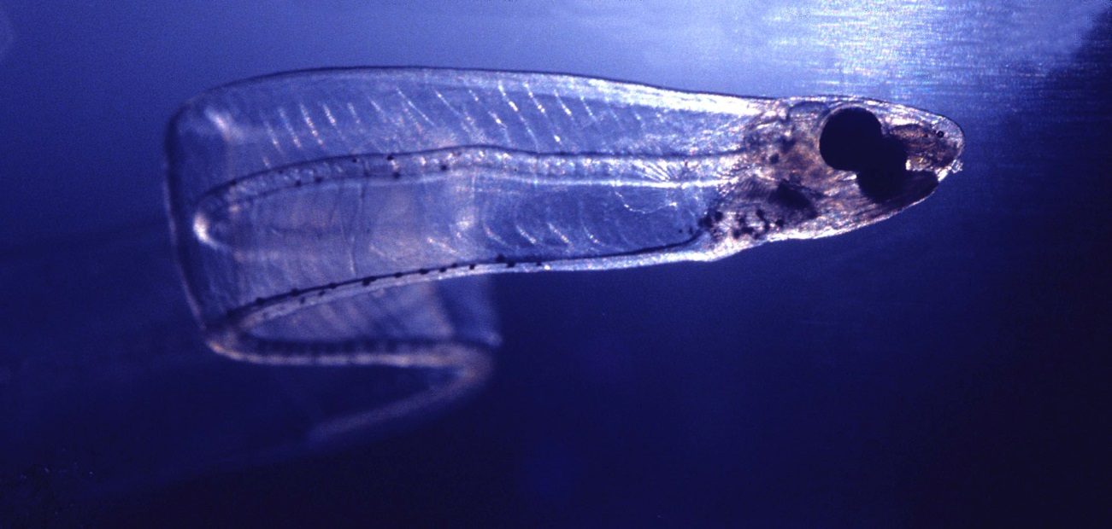
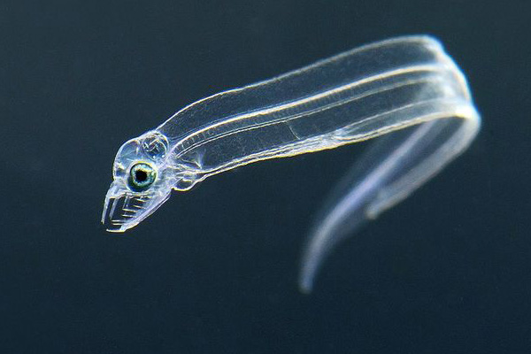
Elapomorpha (superorder)
800 sp.
Marine and eel-like
Single unique characteristic

Slide 16
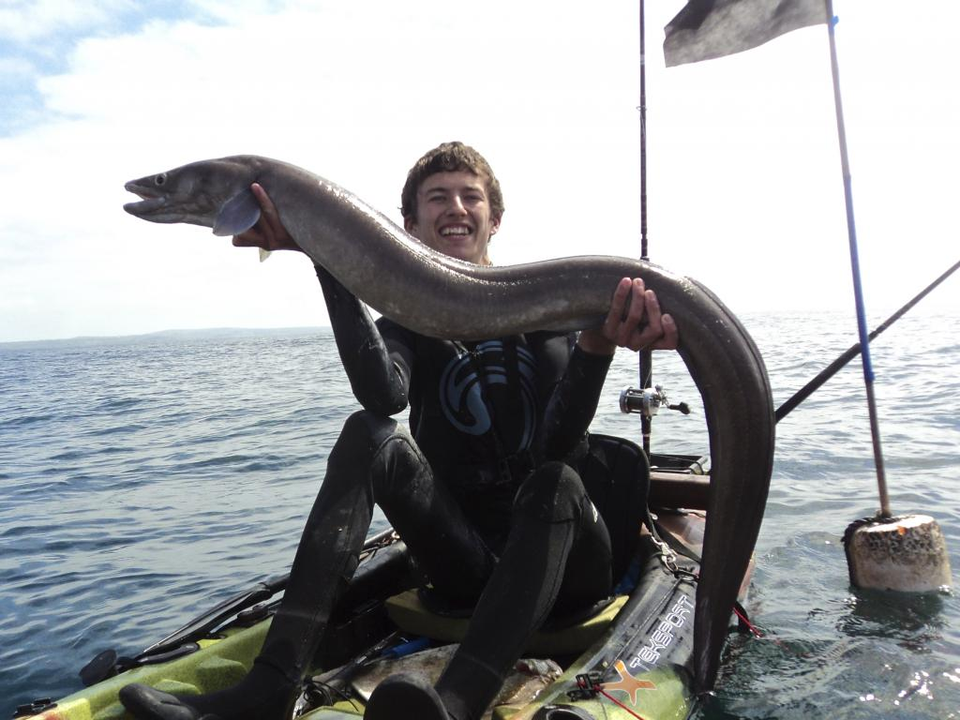
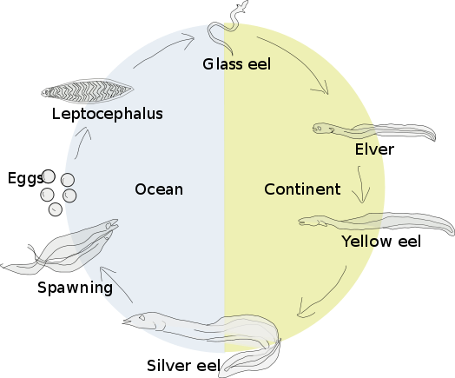
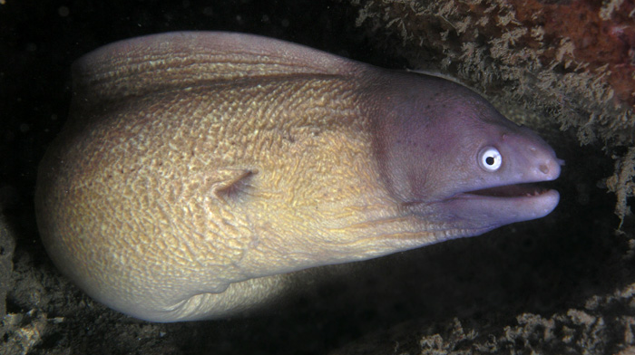
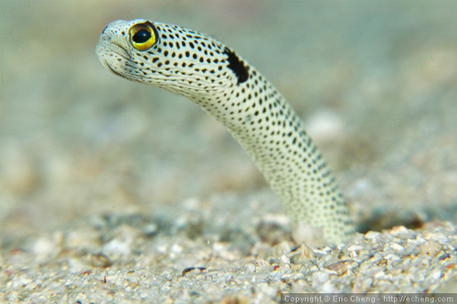
Anguilliformes (the eels)
Shallow water
Burrow (sand, mud, rock crevices)
All predatory
Elongated dorsal fine
https://www.youtube.com/watch?v=ph6R0yY2WzI

Slide 17
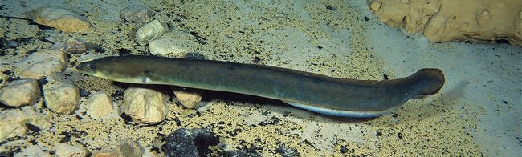
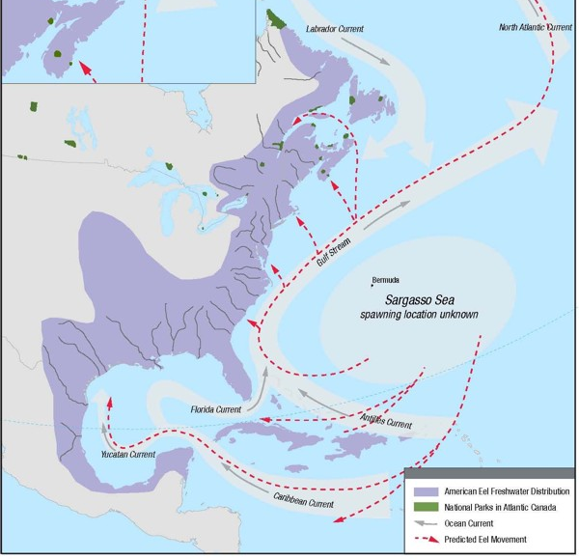
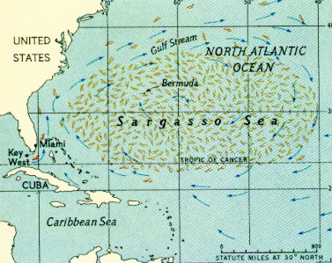
American Eel

Slide 18
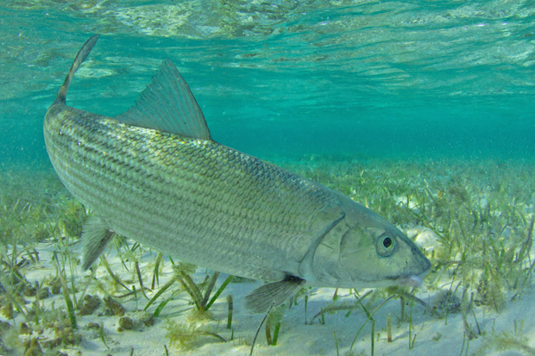
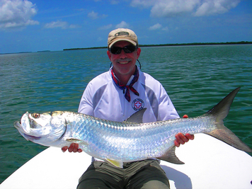
Albuliformes (bonefish)
Major sport fish
Shallow coastal waters
Move to sea grass flats with tide
Swim bladder for respiration

Slide 19
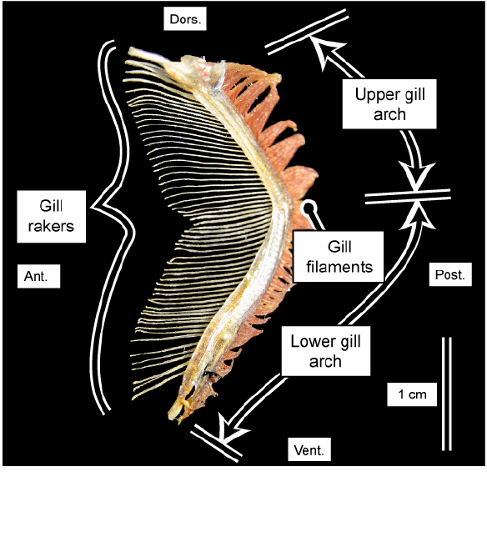
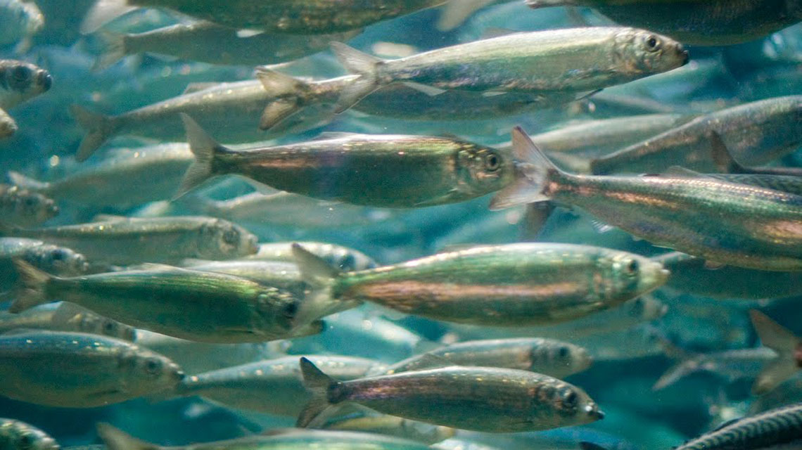
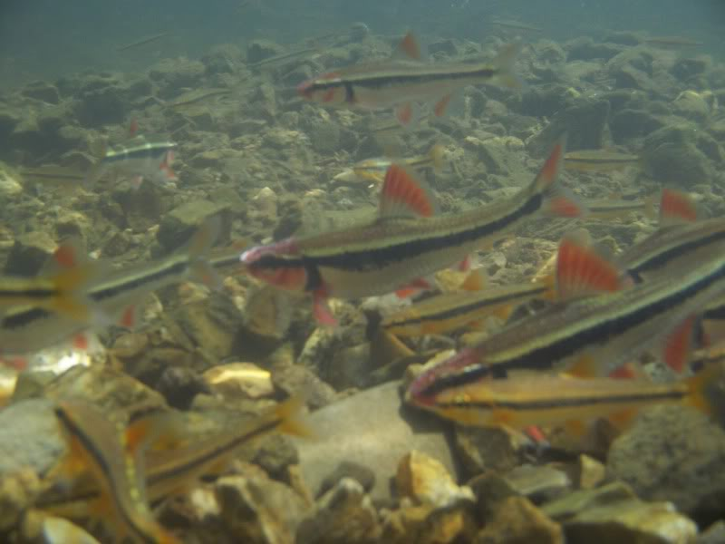
Clupeomorpha (superorder)
Herring, shad, sardines, anchovies
Marine schooling fishes
Specialized feeders

Slide 20
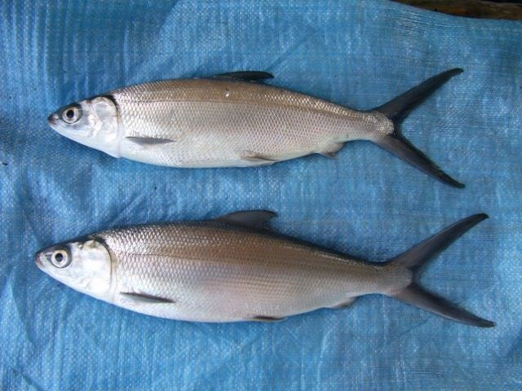
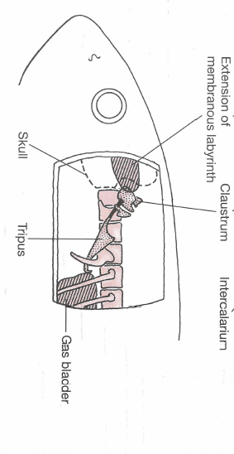
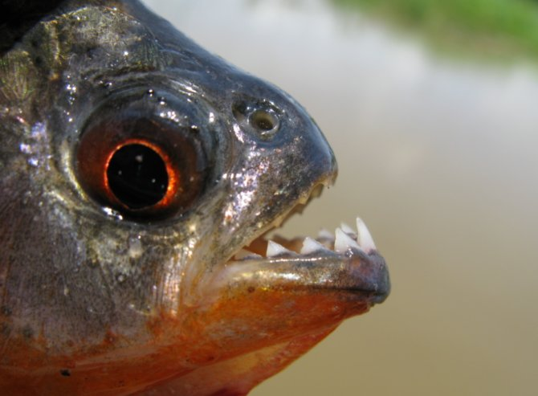
Ostariophysi (superorder)
Most diverse freshwater fishes
2 unique traits
5 orders, 11 families

Slide 21
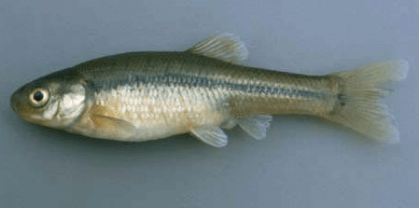
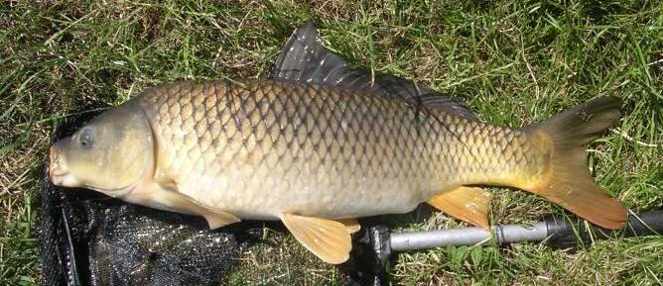



Cypriniformes (order)
Carps and minnows
11 families
Absent Australia and S.A.
Unique traits
Pharyngeal teeth?

Slide 22



Gymnotiformes
(order)
Knifefish
Elongated anal fin
Lack pelvic and dorsal fin (most)
Caudal reduced or absent
https://www.youtube.com/watch?v=V9qjXIId6dQ
https://www.youtube.com/watch?v=GomeIaCmQPw

Slide 23





Siluriformes (order)
Catfish
Barbels around mouth (function?)
Hollow spine on dorsal and pectoral fin
  some w/ venom
Bottom dwellers - negatively buoyant
Shallow flowing water
2 body forms

Slide 24




Catfish of Indiana

Slide 25



Euteleostei (superorder)
Ostariophysi (cypriniformes, siluriformes, etc.)

Slide 26




Esociformes (Order)
Pickerals, pikes, muskie, mudminnows
Ambush predators
Long snout, sharp teeth
2 popular sport fish

Slide 27

Grass pickerel

Slide 28





Salmoniformes (order)
https://www.youtube.com/watch?v=sabk7Khq0kQ
https://www.youtube.com/watch?v=H9wJOAtSk6shttps://www.youtube.com/watch?v=H9wJOAtSk6s
66 sp.
Scales small and thin
Two major lineages?

Slide 29



Perciformes (order)
Largest order
Ctenoid scales
Dorsal and anal fins divided
May be slit into many orders

Slide 30

Let’s summarize scale types

Slide 31


Cichlidae
1800 sp.
Popular aquarium fish
Single synapomorphy
Diverse in Africa & S. America

Slide 32

Toxotidae
Archerfish
7 sp.
SE Asia
Brachish water
https://www.youtube.com/watch?v=4T1SQtavaUM

Slide 33



Percidae
Fresh and brackish water
Common species here in NA
Characteristics:

Slide 34


Scaridae
Parrotfish
Shallow tropical water
Distinct teeth
Food?

Slide 35



Labridae
Wrasses
Marine
Bright coloration
Small but predators on ?

Slide 36




Channidae
40 sp.
Native to Africa and Asia
Major predators
Breath air
2018
2021
2023
https://www.youtube.com/watch?v=UpC-LdHOza0

Slide 37



Centrarchidae
37 sp.
Valuable sport fish
Build nest

Slide 38



Scombriformes (order)
Tropical and subtropical
Marine
Major predators

Slide 39




Tetraodontiformes (order)
350 sp.
Tropical marine (most)
Box or ball shaped (body can not flex)
Scales modified
Jaw bones fused

Slide 40




Scorpaeoniformes (order)
1300 sp.
Characteristics
  Cheekbones
  Spiny head
  Rounded pectoral and caudal fin
Important invasive in US
https://www.youtube.com/watch?v=GzaeYzAC8Ro
Slender rockfish

Slide 41



The Lobe-Finned Fishes
Neoceratodus
Notes:
Osteichthyes – are the bony fishes (as opposed to Chondrichthyes)

Slide 42



Characteristics
Unique scales
Paired fleshy and scaled fins
Fins have bony central axis
2 dorsal fins
Ray-finned fish
Lobe-finned fish

Slide 43

Ancestral Sarcopterygiians
Abundant historically
2 surviving lineages
Why the decline?

Slide 44


Extant Lungfishes
Set by carboniferous
Jaw changes
Fin changes
Lungs and gills
Notes:
Lungfishes: subclass Dipnoi
Three living genera with six species
Possess gills and lungs
Omnivorous – fish, insects, worms, plant matter, almost anything
Can burrow into the mud and estivate through the dry season
Very long-lived
Have fleshy and bony structures at the base of the fin
Believed one of these led to modern tetrapods
Likely occurred in shallow seas or brackish regions where fresh and salt water converge
Provided a nursery relatively free from predators and likely abundant food sources
“Walking” using their fleshy fins provides a very energetically inexpensive form of locomotion
This likely facilitated the transition to land
Many authors still disagree on which group is the ancestors of tetrapods. A recent paper analyzing molecular evidence suggests the lungfishes are the ancestor. But morphological evidence suggests the actinisia, and most authors still view this as correct

Slide 45



Lungfish Lineages
Neoceratodus
Lepidosiren
Protopterus
Notes:
Lungfishes: subclass Dipnoi
Three living genera with six species
Possess gills and lungs
Omnivorous – fish, insects, worms, plant matter, almost anything
Can burrow into the mud and estivate through the dry season
Very long-lived
Have fleshy and bony structures at the base of the fin
Believed one of these led to modern tetrapods
Likely occurred in shallow seas or brackish regions where fresh and salt water converge
Provided a nursery relatively free from predators and likely abundant food sources
“Walking” using their fleshy fins provides a very energetically inexpensive form of locomotion
This likely facilitated the transition to land
Many authors still disagree on which group is the ancestors of tetrapods. A recent paper analyzing molecular evidence suggests the lungfishes are the ancestor. But morphological evidence suggests the actinisia, and most authors still view this as correct

Slide 46


Coelacanths
Appear 408 MYA
2 derived traits
Carboniferous diversity
Extinct 80 MYA

Slide 47


A Living Fossil
https://www.youtube.com/watch?v=8BfnZFo6S_c
https://www.youtube.com/watch?v=XF8gZ2ADfMQ

Slide 48



What we know now
300+ specimens caught
Deep water
Habitat
Feed at night
Major characteristics

Slide 49

A new Coelacanth Discovery
Only 309 observed since 1938
1998 - Grad student in Philippines

Slide 50


A new Coelacanth Discovery
Group of researchers trained fisherman from Africa to collect DNA samples
Sequenced genome
Two crazy findings:
Amemiya et al. 2013. Nature

