Slide 1
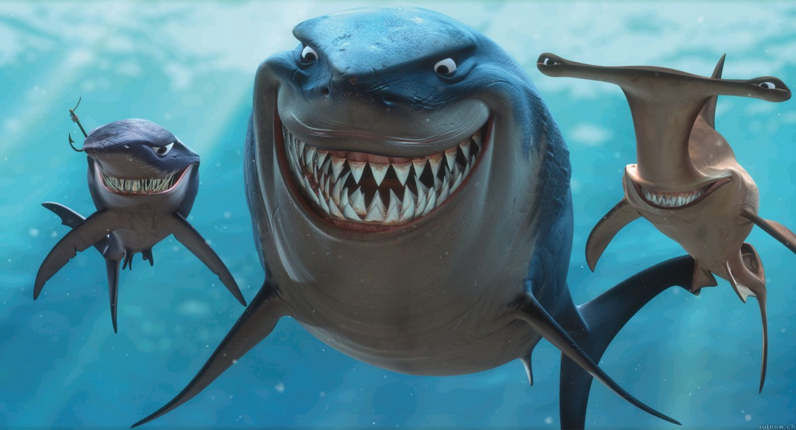
What Class?

Slide 2
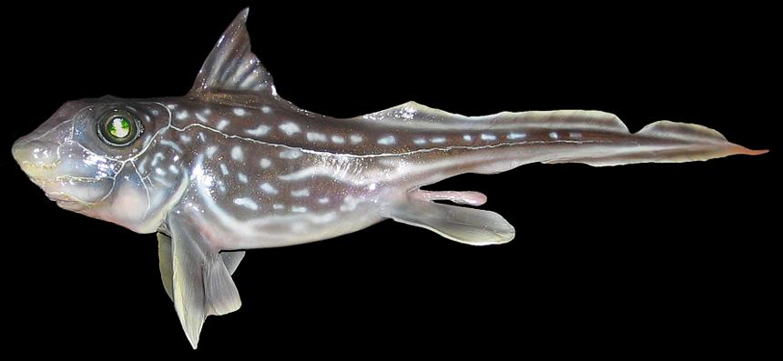
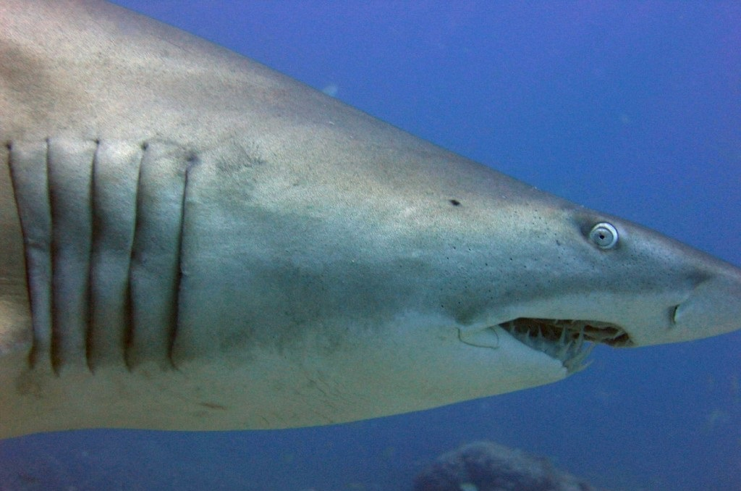
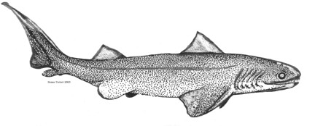
Cartilaginous Fishes
First appear in Devonian
What is strange about the shark fossil below?
Two groups of extant sharks
Doliodus problematicus
Notes:
Phylogeny remains unclear
Parallel evolution among lineages; developed similar modifications in feeding and locomotion
Prismatic calcification: defining synapomorphy of Chondrichthyes
Appear early Devonian (420 MYA)

Slide 3
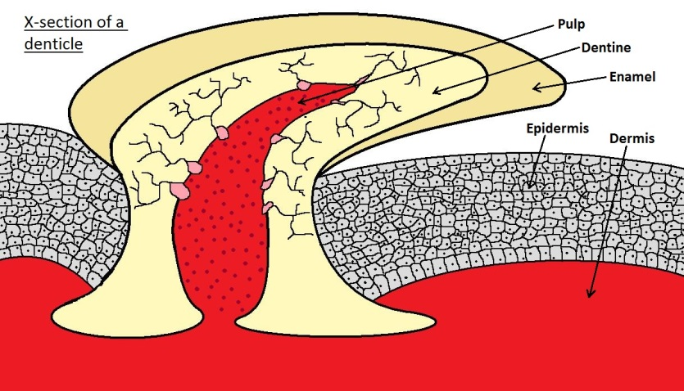
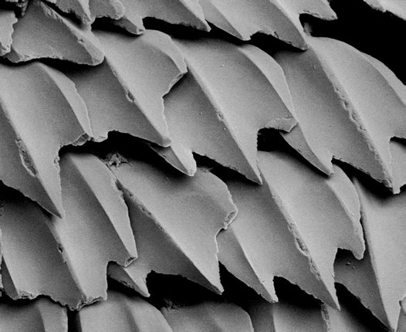
Characteristics of the Chondrichthyans
Cartilaginous endoskeleton
Evolved from bone
Bone retained where?
Why did they evolve cartilaginous endoskeleton?
Is it stronger or weaker than bone?

Slide 4
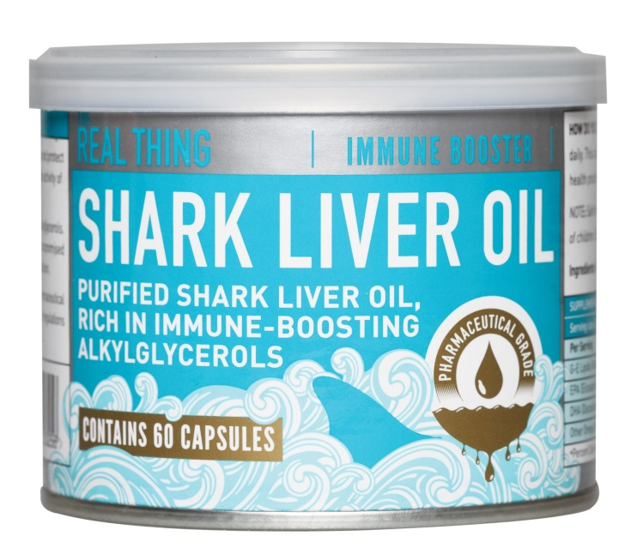
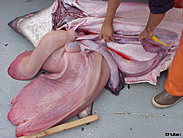
Characteristics of the Chondrichthyans
Lipid filled liver
– why?
– what % of body mass?
This or swim bladder more efficient?

Slide 5
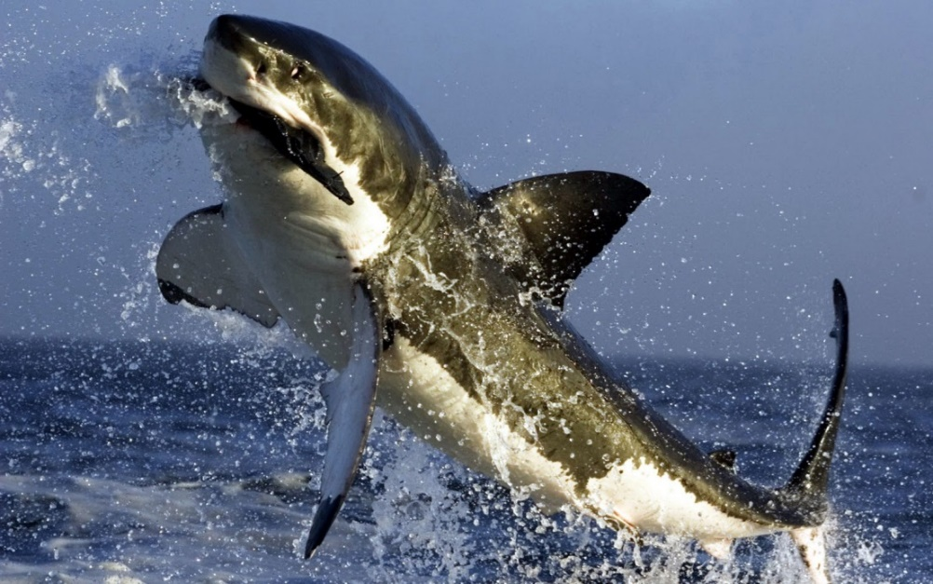
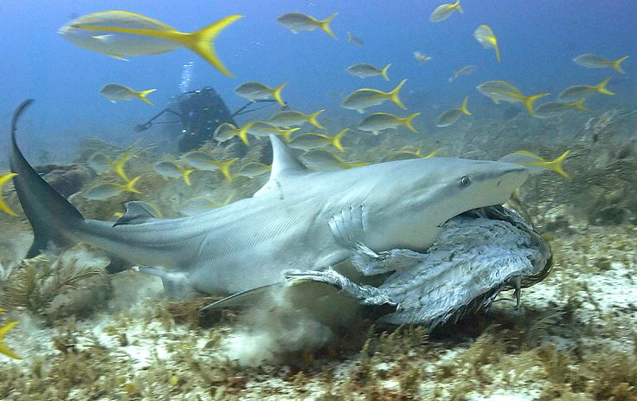
Characteristics of the Chondrichthyans
Blood urea concentration
Why?
Constantly lost & replaced
Recycle ammonia
Absorb ammonia through gills
Convert this to urea
Carried through Rhesus proteins
~1/3 of daily nitrogen needs
Notes:
Rhesus proteins – channels that carry ammonia gas across cell membranes

Slide 6
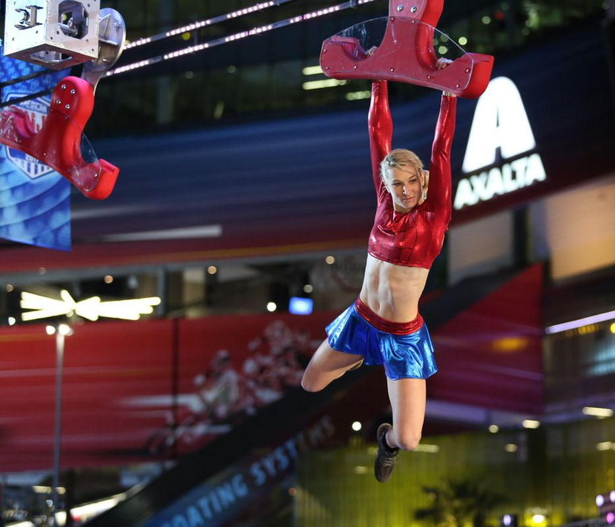
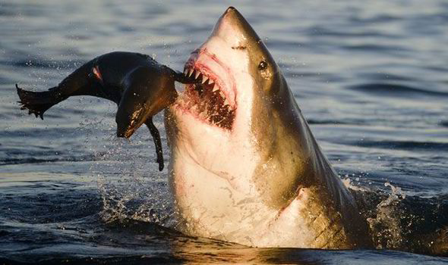
Characteristics of the Chondrichthyans
Most verts oxidize fatty acids during exercise (citric-acid cycle)
Chondrichthyes can’t do this

Slide 7
Let’s link energy metabolism & ion balance in chondrichthyes

Slide 8
Pulling the adaptations together…
Retain urea to save energy and reduce ion gradient
makes osmoregulation more efficient
Urea leaks out the gills – must be replaced
During fasting break down own tissue
Increases amino acid alanine from muscle breakdown
Liver makes urea from alanine
Stored lipids in liver make shark more buoyant
Metabolic byproduct are ketone bodies
Favored shift from fatty acids to ketones

Slide 9
Electrofishing Demonstration
Fill out volunteer form
Wear rubber boots
https://www.youtube.com/watch?v=6aKE_1sGznk
https://www.youtube.com/watch?v=6--pOHoyTdk

Slide 10
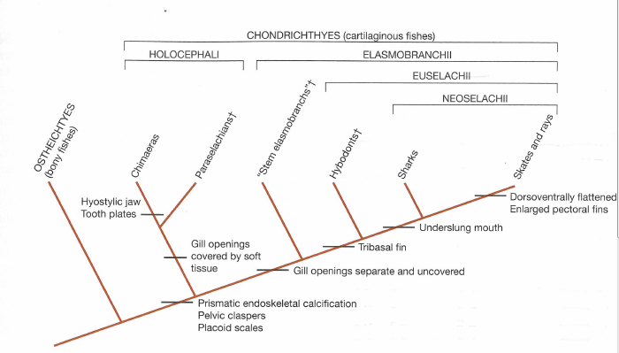
Lineages of Extant Chondrichthyes

Slide 11
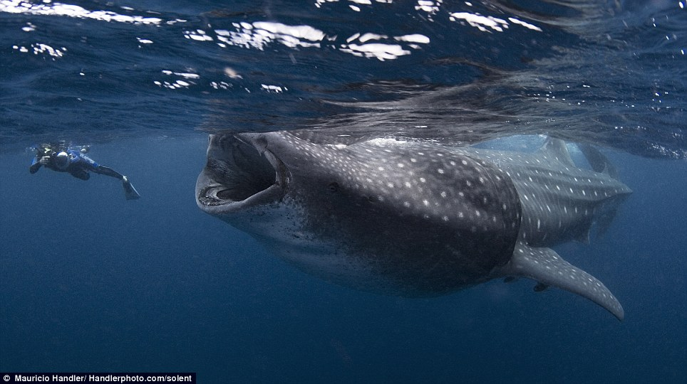
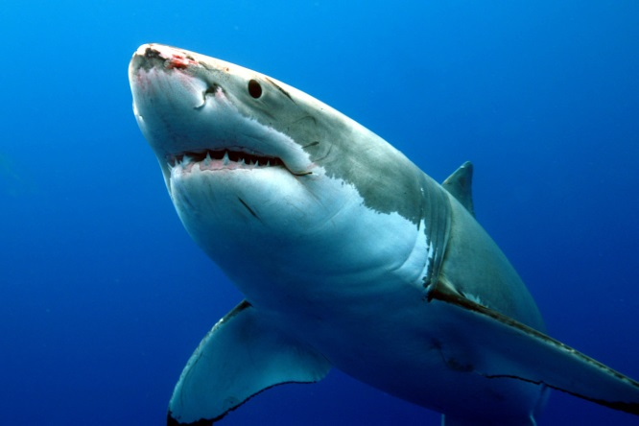
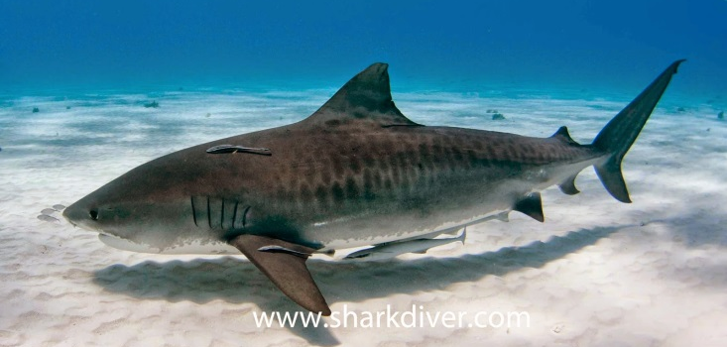
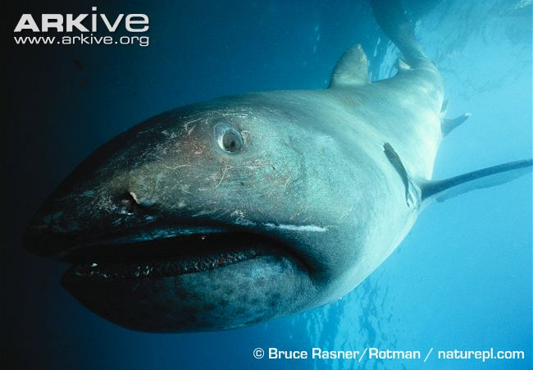
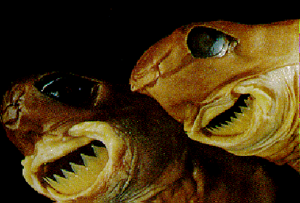
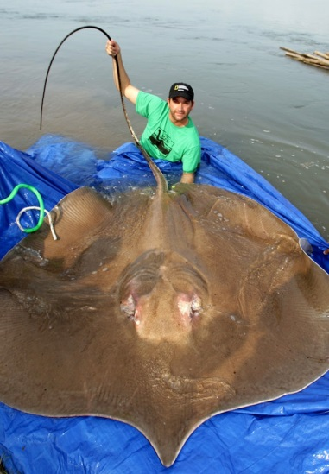
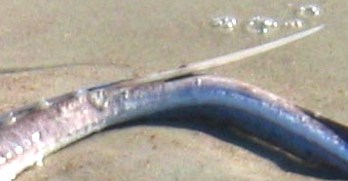
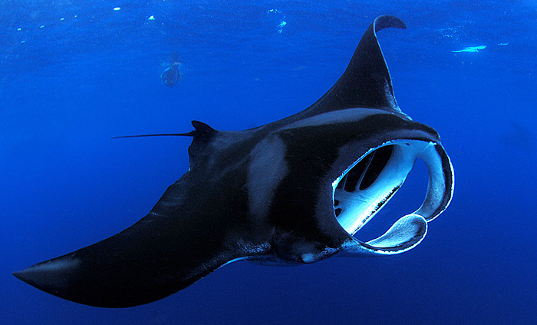
Superorders of the Neoselachii

Slide 12
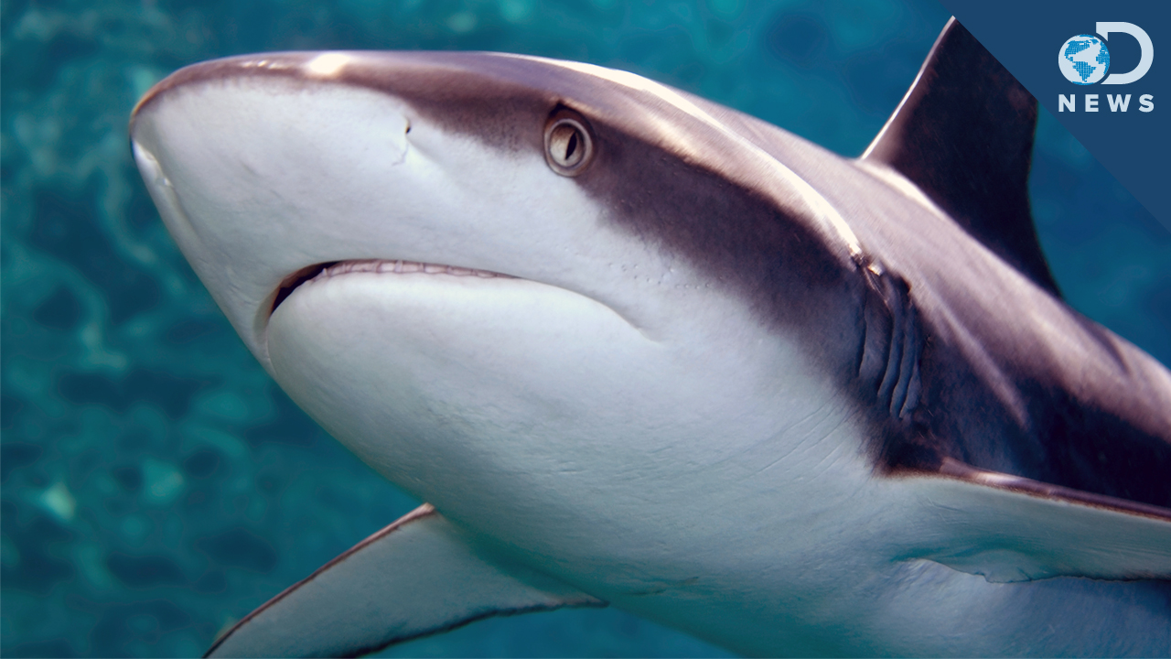
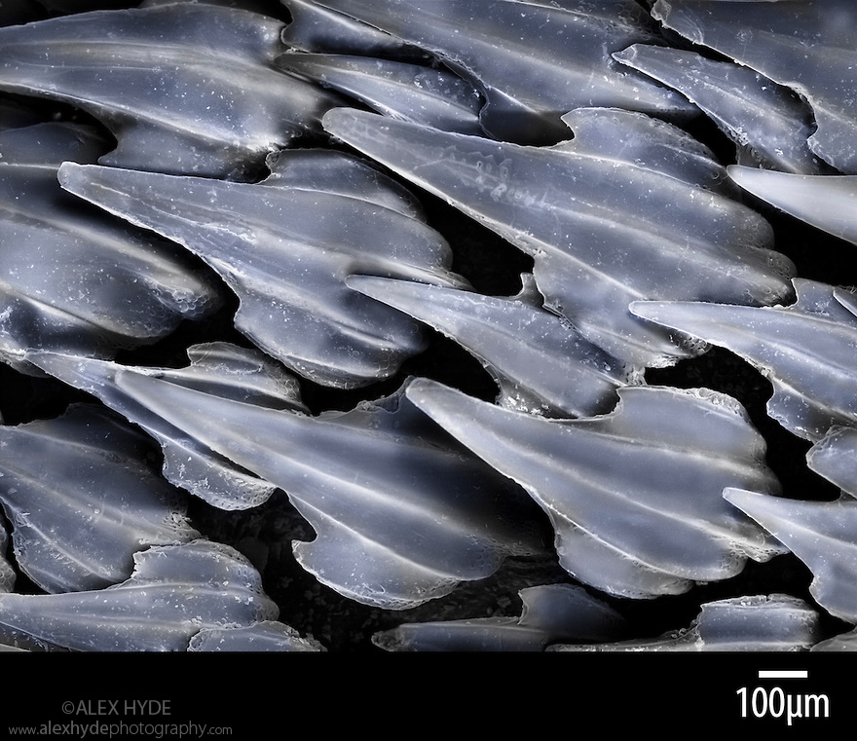
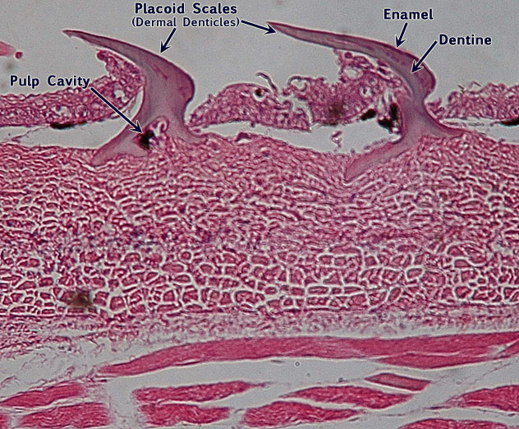
Shark Characteristics: Skin
Do sharks have scales?

Slide 13
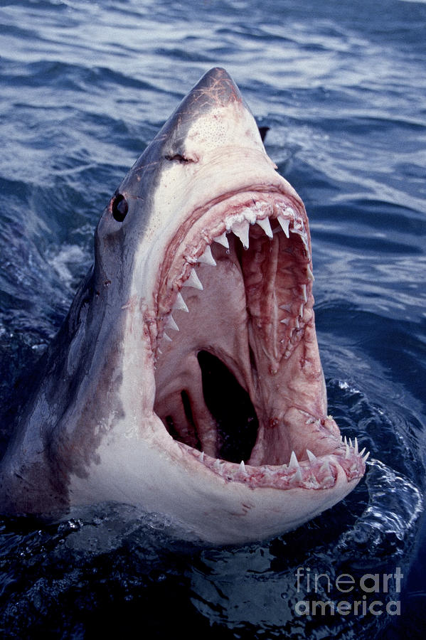
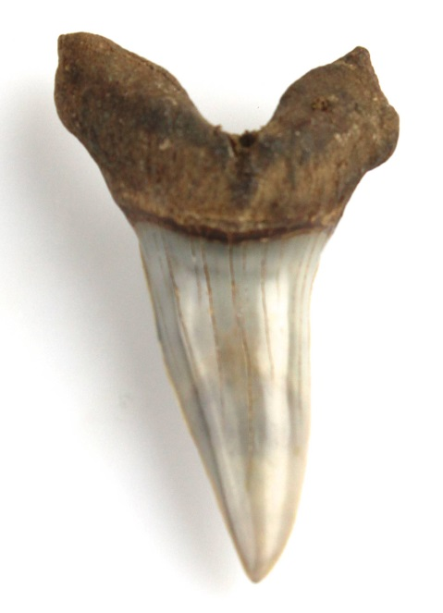
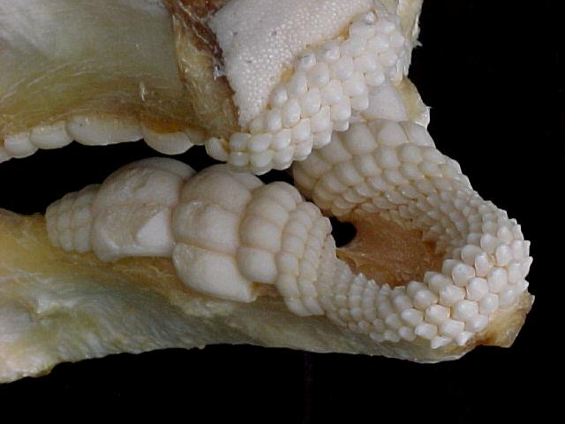
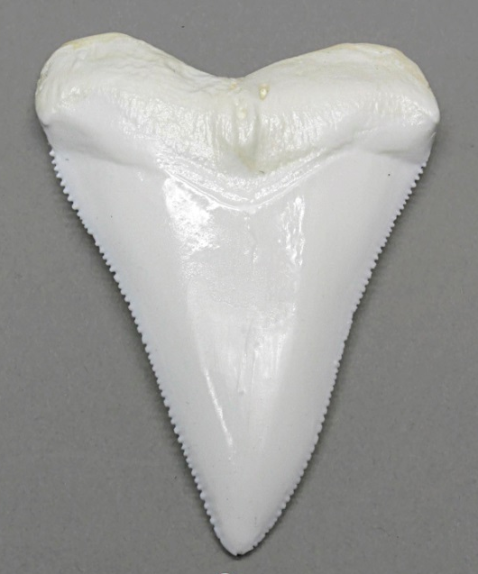
Shark Characteristics: Jaws, Teeth, Feeding

Slide 14
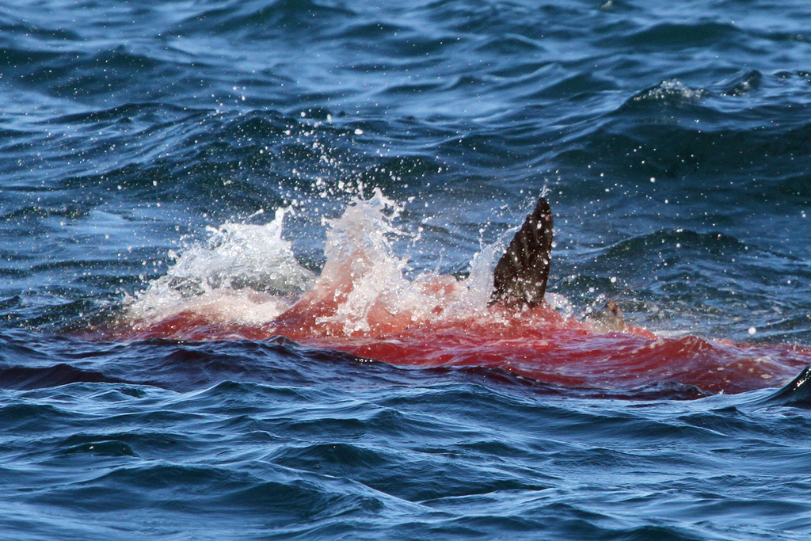
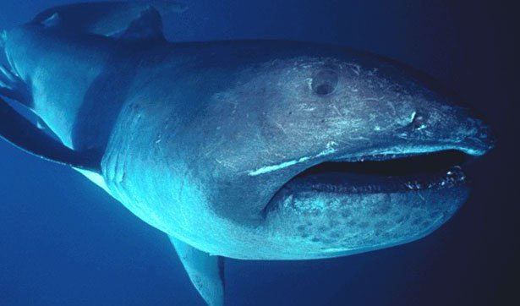
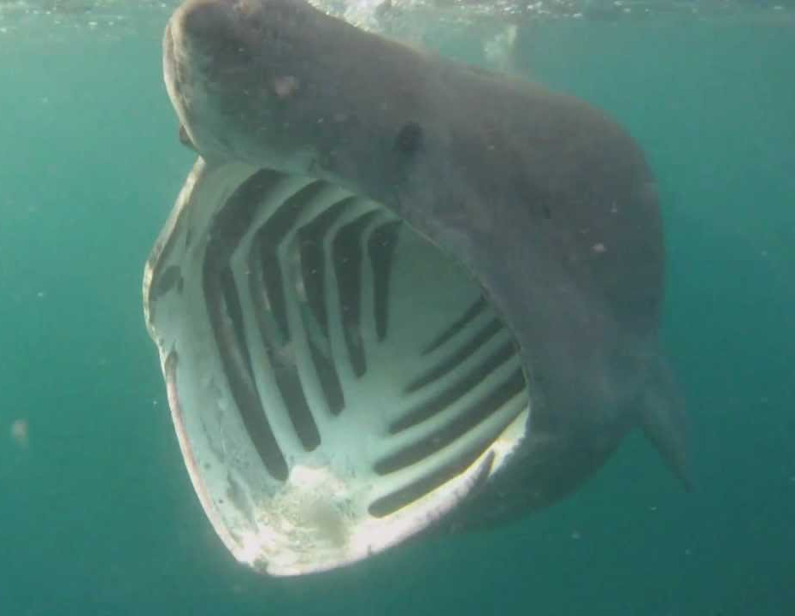
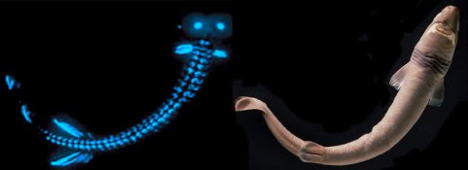
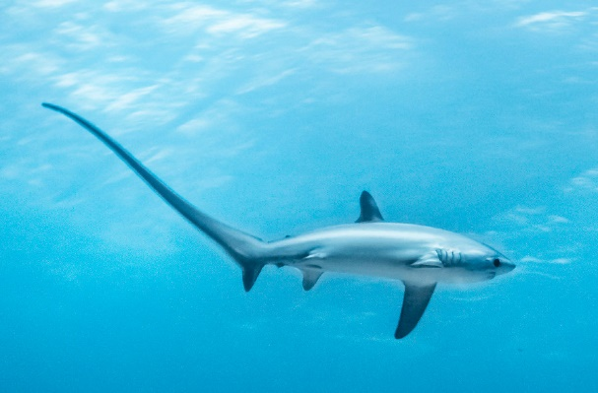
Shark Characteristics: Predation
https://www.youtube.com/watch?v=aQNixrJUk_o
https://www.youtube.com/watch?v=ANjYYXIl_C8

Slide 15
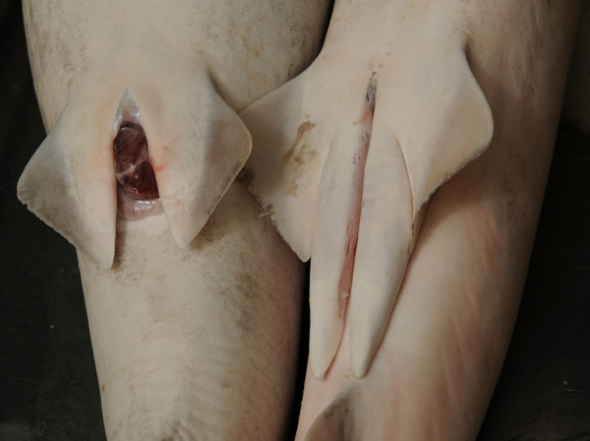
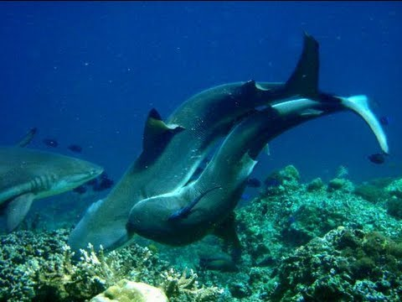
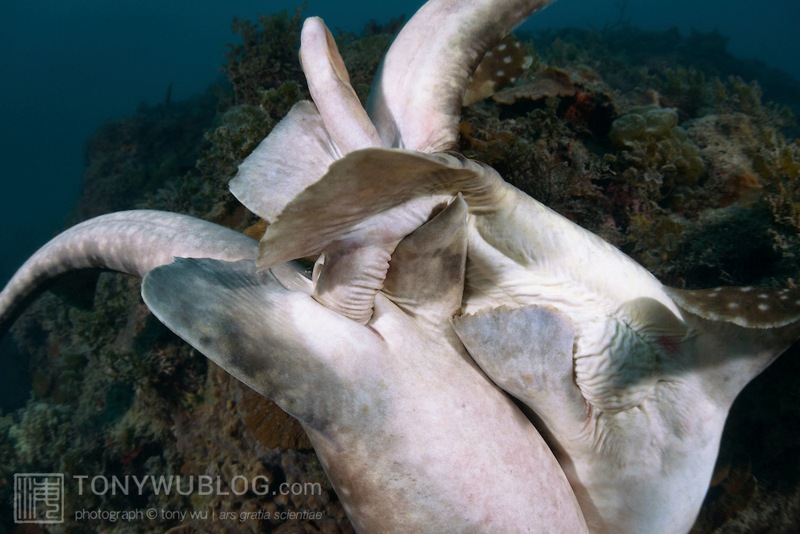
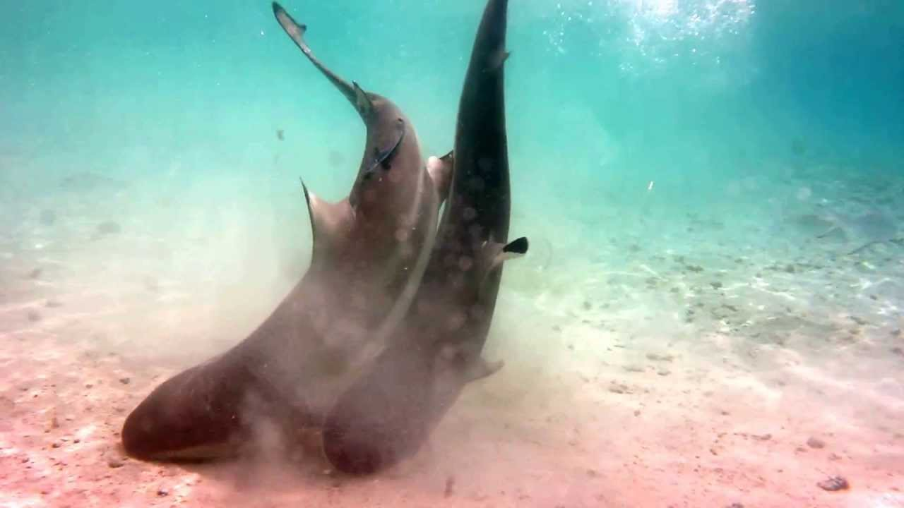
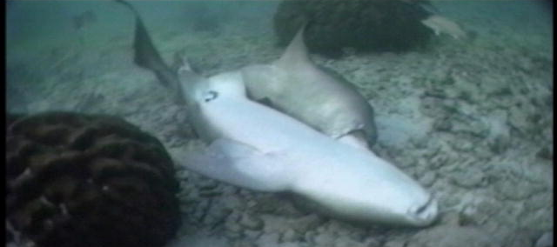
Shark Characteristics: Reproduction

Slide 16
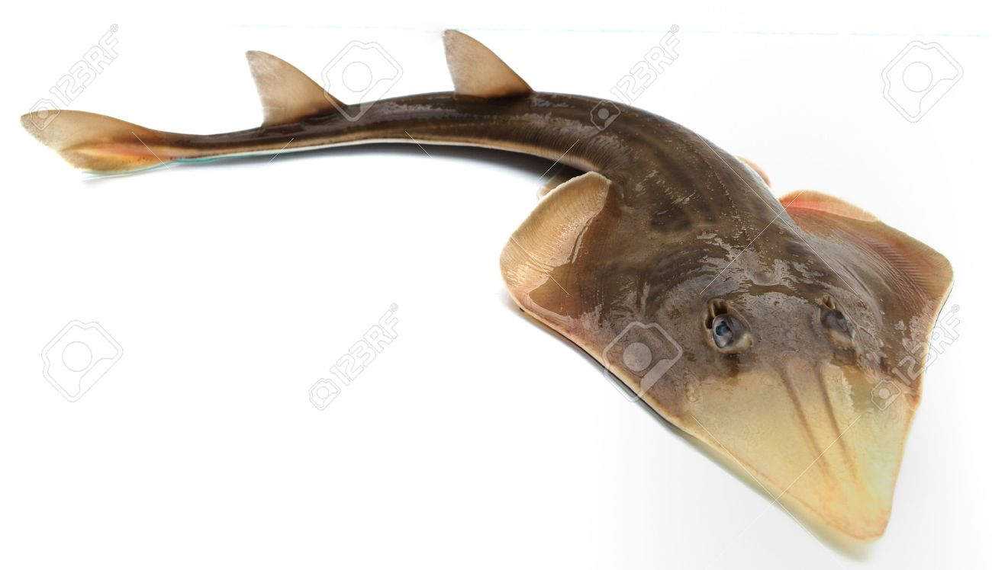
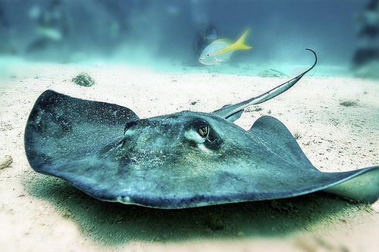
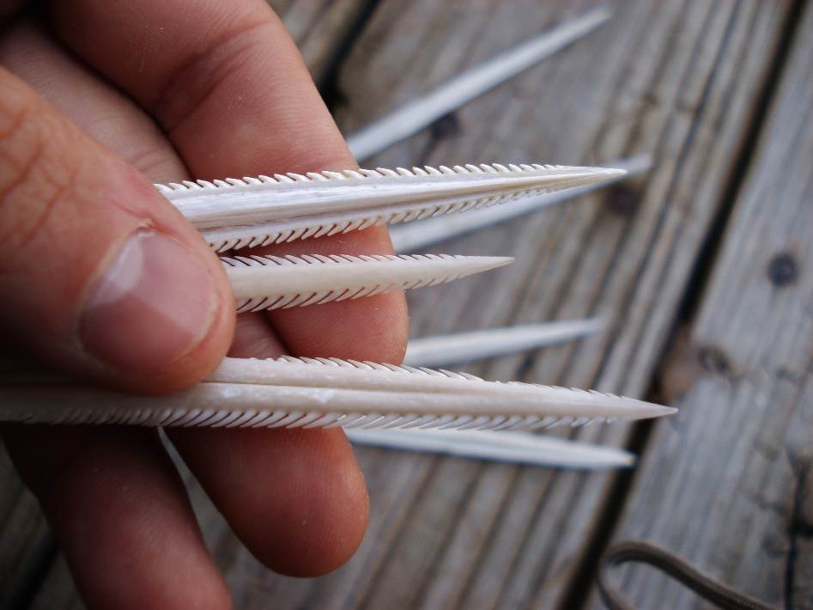
Batoidea: Skates and Rays
Body Form
Dorsoventrally flat
Huge pectoral fins
Swimming
Lack typical scale pattern
What’s the difference between skates and rays?
https://www.youtube.com/watch?v=UIif0dGWMt0

Slide 17
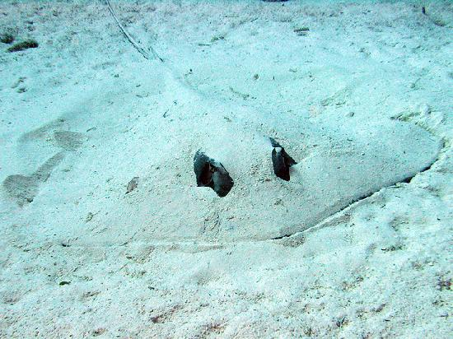
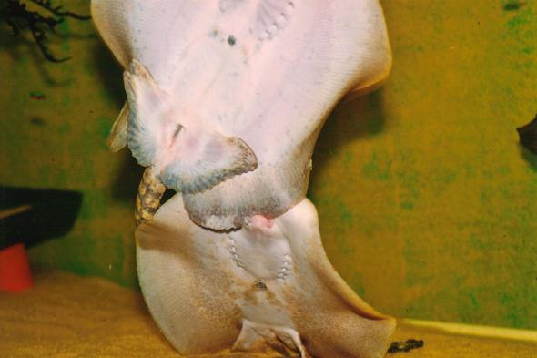
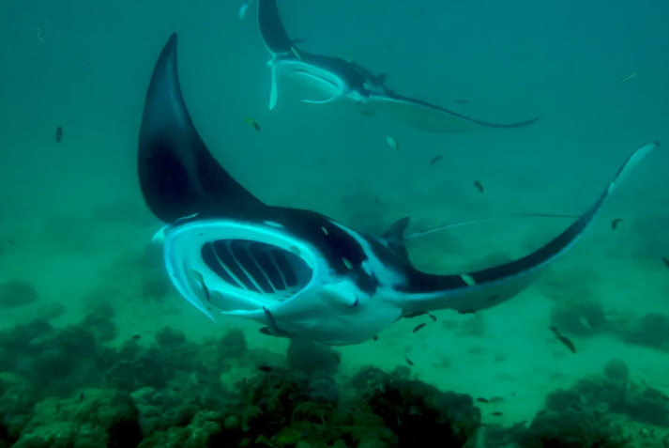
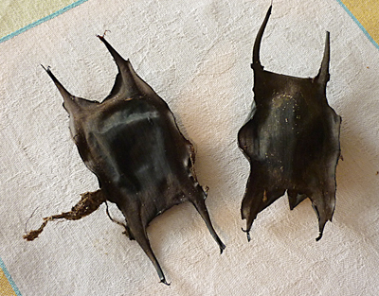
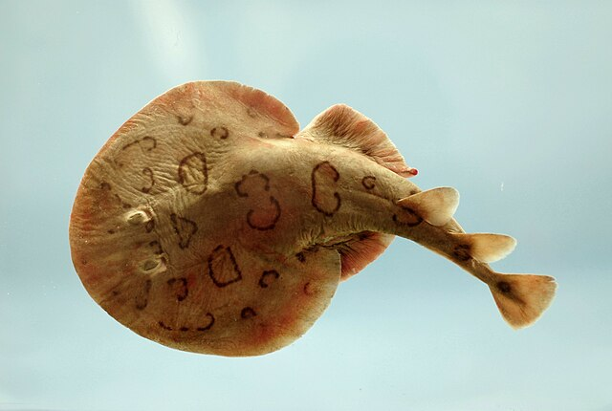
Batoidea: Feeding and Reproduction
https://www.youtube.com/watch?v=bJZxJT1rMyQ

Slide 18
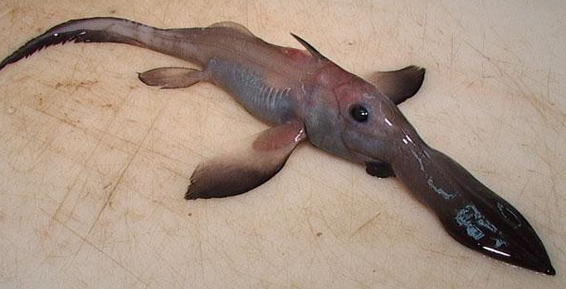
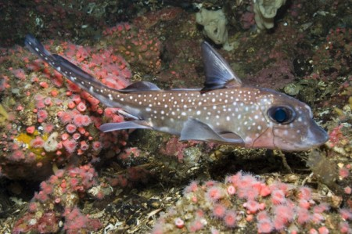
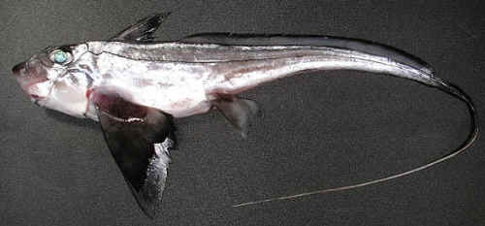
Holocephali (subclass): Chimaeras
Body shape
Range
Reproduction

Slide 19
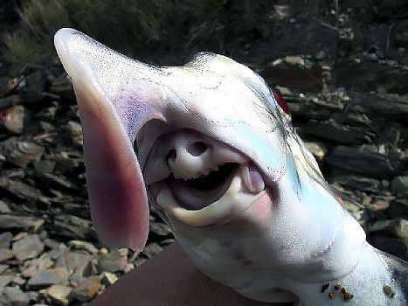
Chimaeras Characteristics
Same shared features of sharks
Unique traits
‘They have this club on the top of their head with spikes. People think it’s used for mating. It’s like a little mace with little spikes and hooks and it fits into their forehead. It’s jointed and it comes out. We’re not sure if it is used to stimulate the female or hold the female closer.”

Slide 20
Chimaeras Food Habits
Subterminal mouth
Feed on inverts, small fish, anemones, jellies
Crushing teeth
Set of dental plates at front

Slide 21
The End

