Slide 1
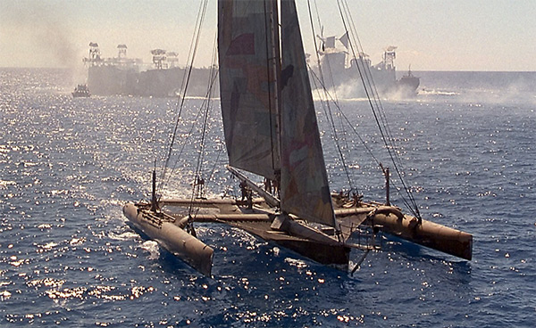
Living in Water: challenges?

Slide 2
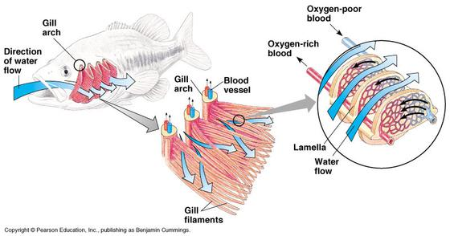
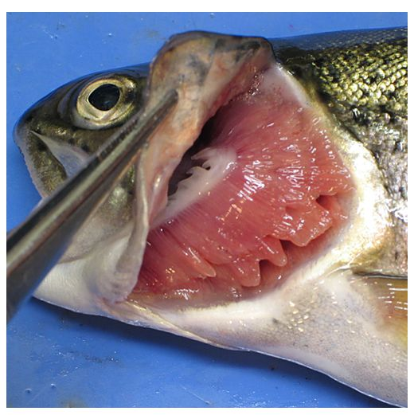
Obtaining Oxygen?
www.arkive.org

Slide 3
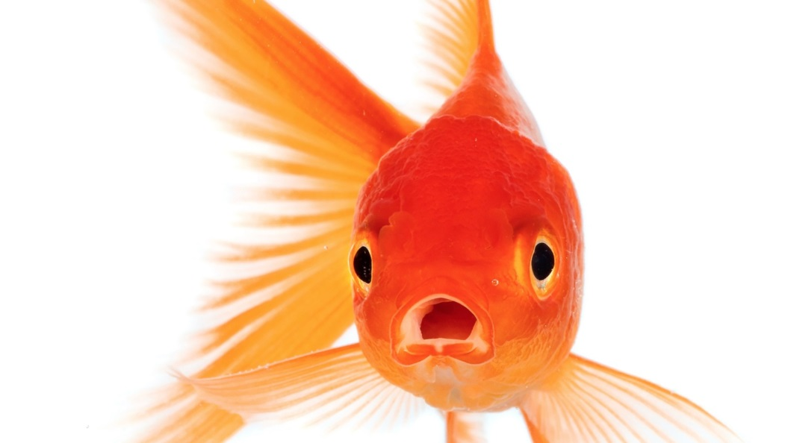
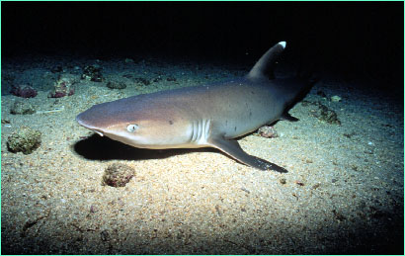
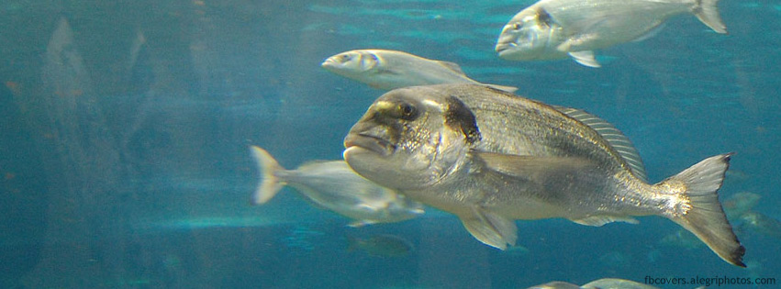
Gill Respiration
Obtaining Oxygen in Water
https://www.youtube.com/watch?v=8bRIuf6EtsA

Slide 4
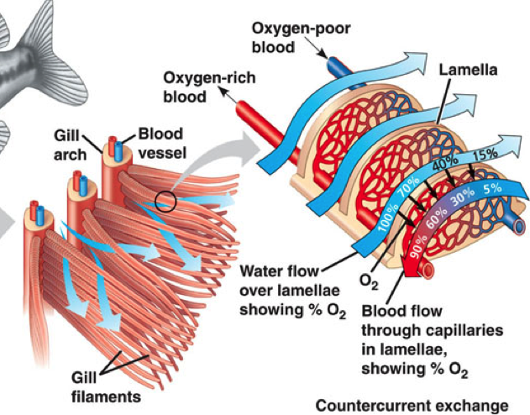
Countercurrent Exchange

Slide 5
In a group of two, re-draw the gills and lamellae and the concentrations of O² if the blood and water flowed in the same direction

Slide 6
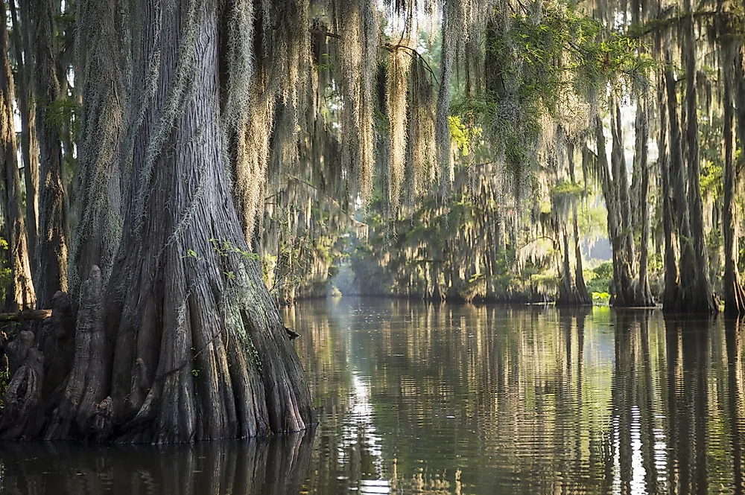
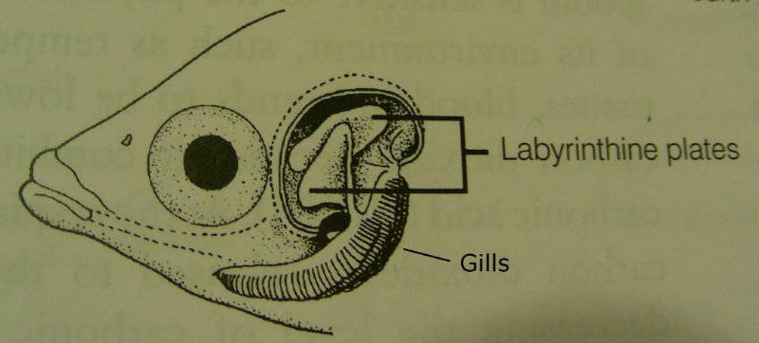
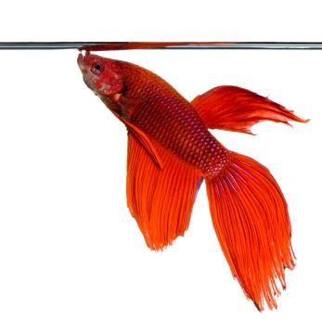
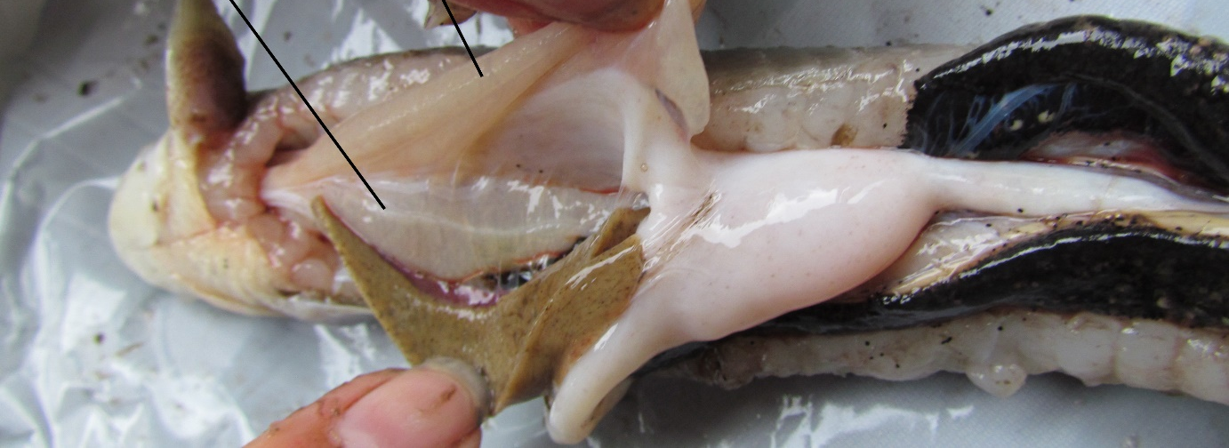
Any fish with lungs?
Notes:
Bottom picture is an African bichir

Slide 7
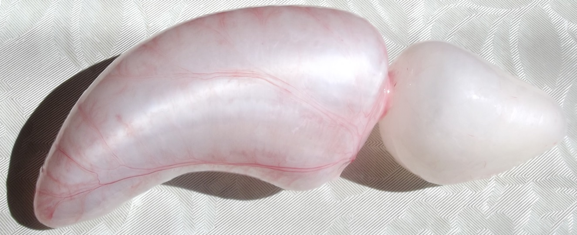
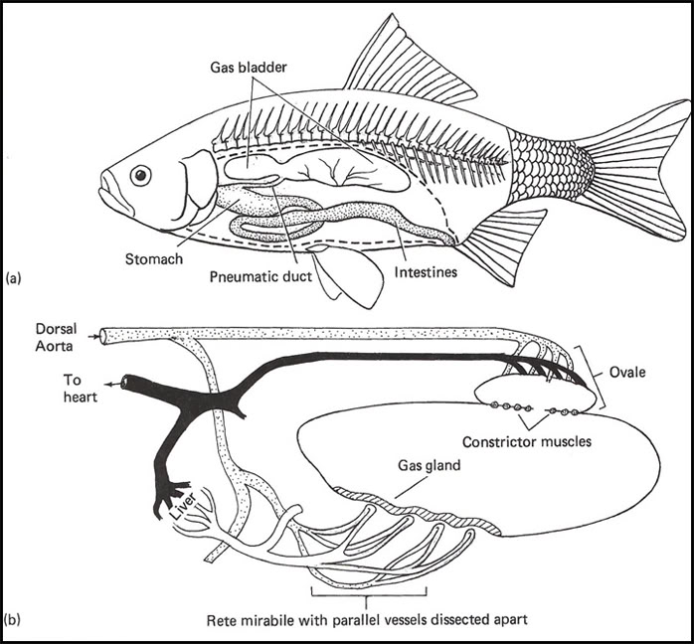
Buoyancy: Bony Fishes
Neutrally buoyant – what does this mean?
Must adjust buoyancy as move up or down in column
Swim bladder
What would happen if fish didn’t adjust the amount of gas in the bladder when moving up or down?

Slide 8
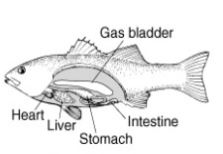
Buoyancy: Bony Fishes
2 types of bladders

Slide 9
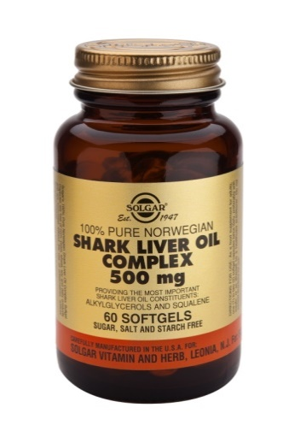
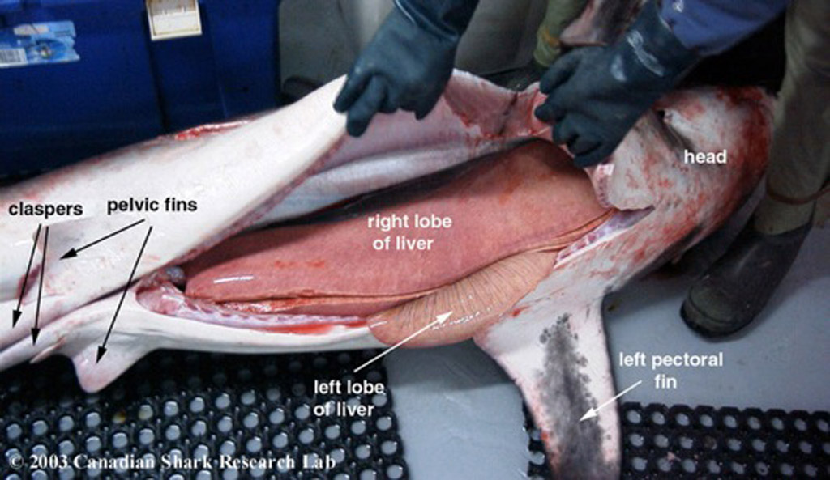
Other Buoyancy Mechanisms
Buoyancy
Cartilaginous Fishes
  Skeleton and muscle heavier than water
  High oil content in liver
  Nitrogen-containing compounds
Notes:
Shark liver oil: alkylglycerols (natural immune booster & cancer treatments to protect from adverse effects of chemotherapy & help inhibit cell proliferation)
Antarctic fish – lipids in intermuscular & subcutaneous sacs

Slide 10
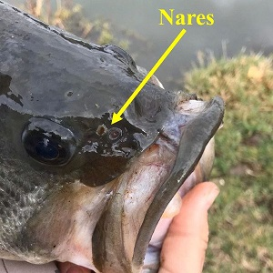
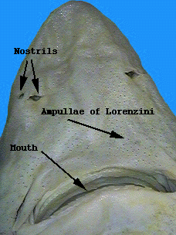
Smelling in water
Notes:
Most fish have two nares on each side of head (4 total)
Front opening leads to a chemosensory sac and then water exits the back opening, not used for respiration
Repositioning the excurrent nare inside the mouth improves respiration when sitting still and better olfactory sampling for sedentary species

Slide 11
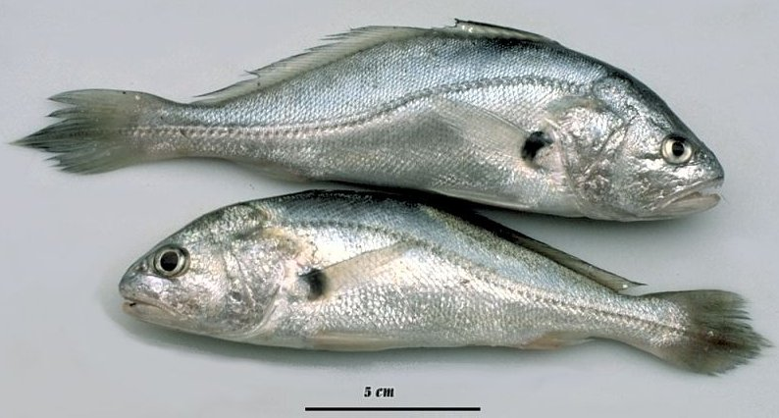
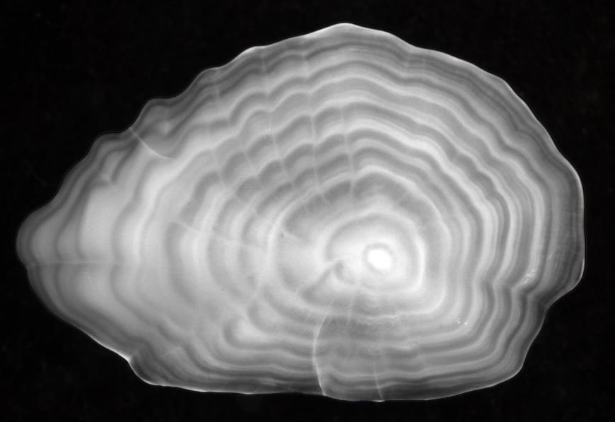
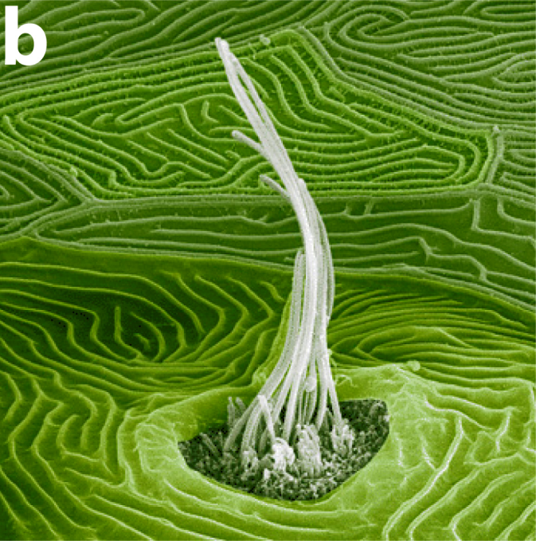
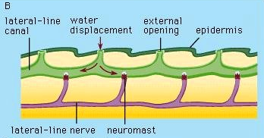
Mechanoreception
Gravity detector
Lateral line system

Slide 12
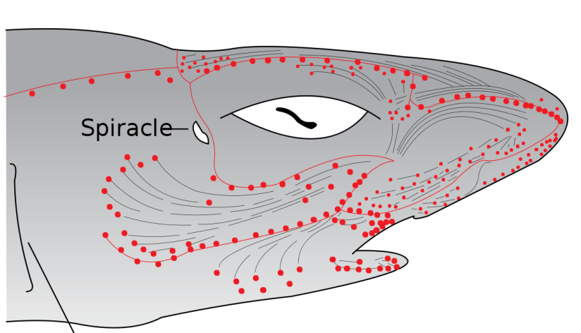
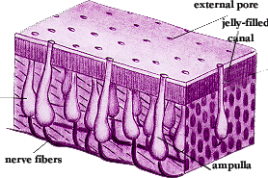
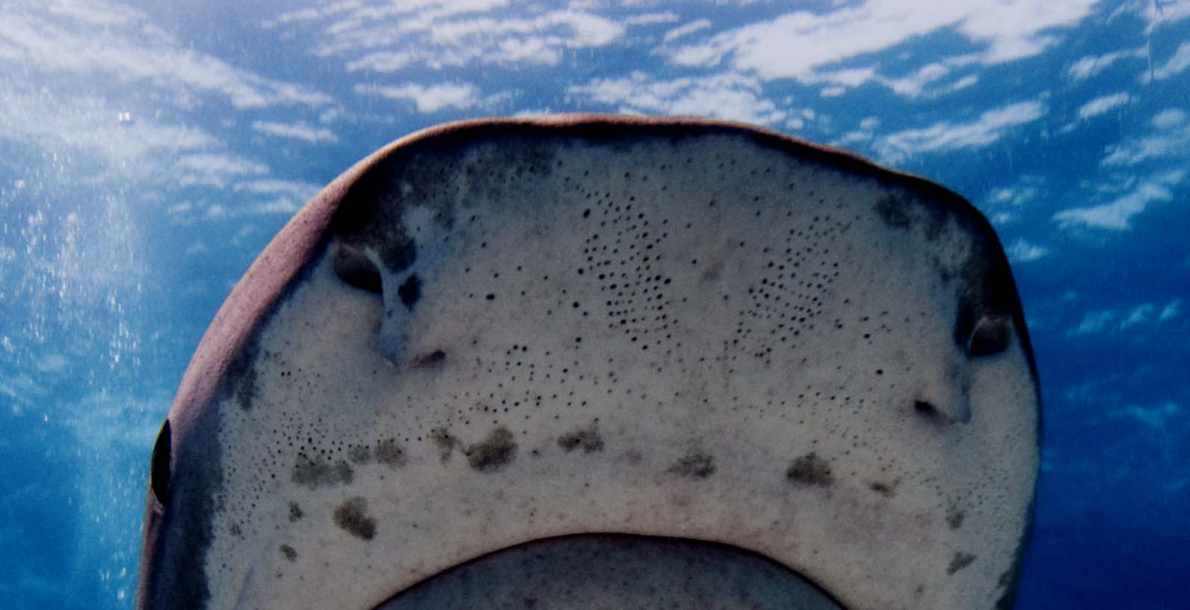
Electroreception
https://www.youtube.com/watch?v=JDPFR6n8tAQ

Slide 13
Internal Environment of Fishes
In general, water and ions move from where to where?
Fish must try to maintain osmotic balance
Freshwater
  Water moves?
  Ions move?
Saltwater
  Water moves?
  Ions move?
What structures are responsible for balancing water and ions?

Slide 14
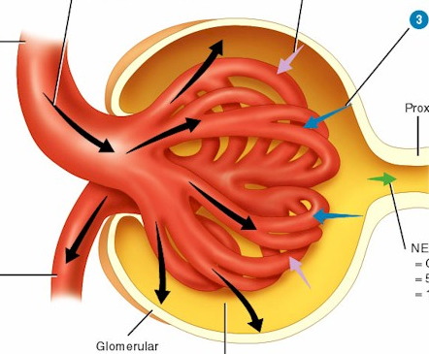
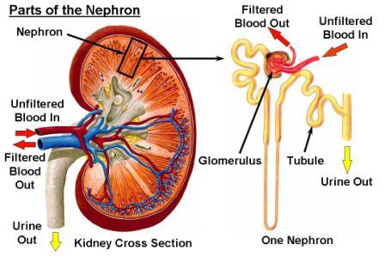
Internal Environment of Fishes
https://www.youtube.com/watch?v=FN3MFhYPWWo

Slide 15
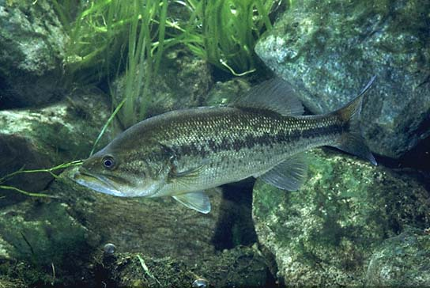
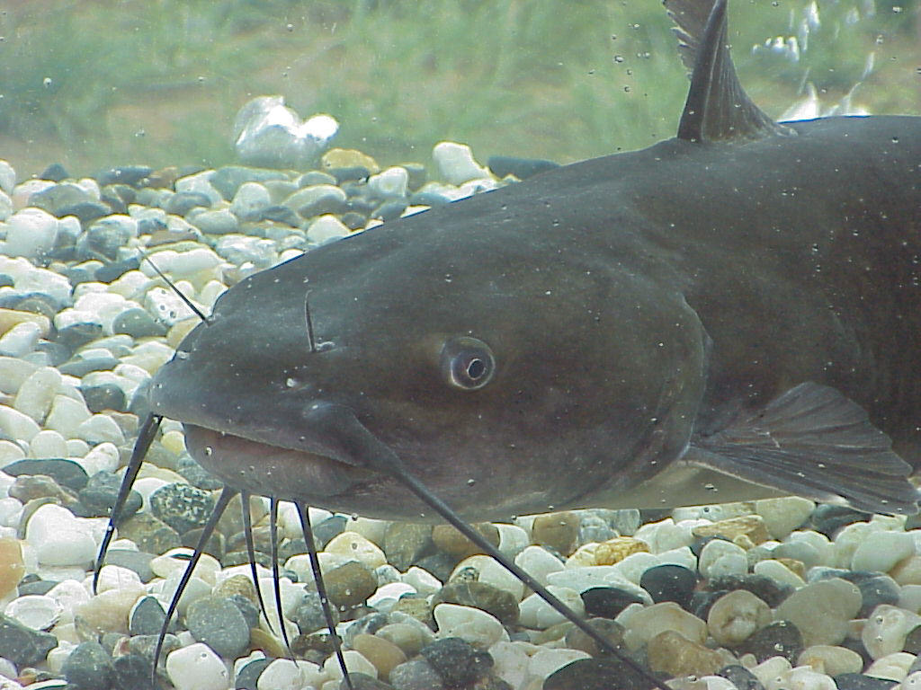
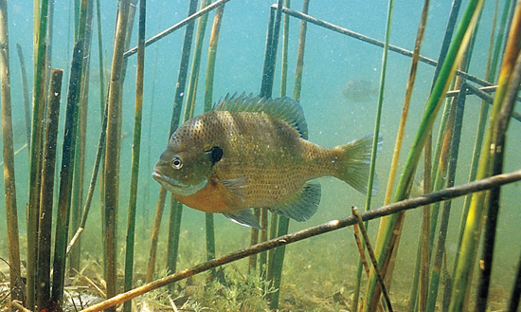
Freshwater Fish
Exchange of Water and Ions
Skin impermeability
Gills – not so much
Influx of ?
  How to compensate?
Out flux of ?
  How to compensate?

Slide 16
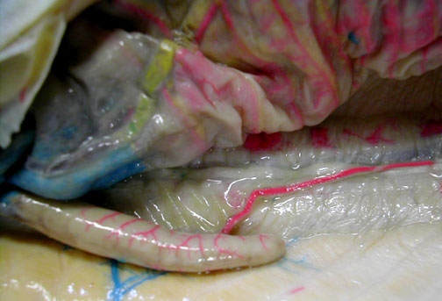
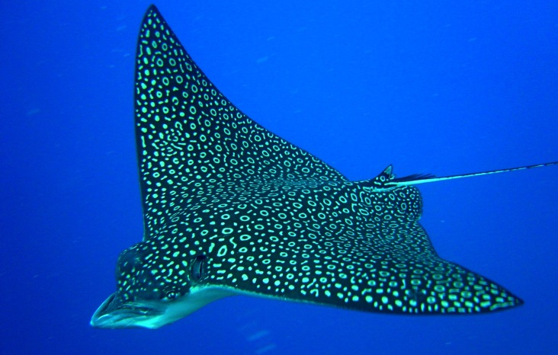
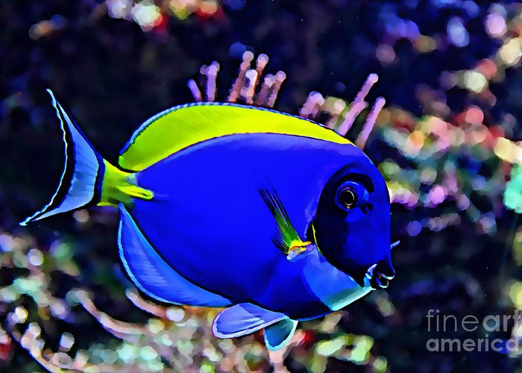
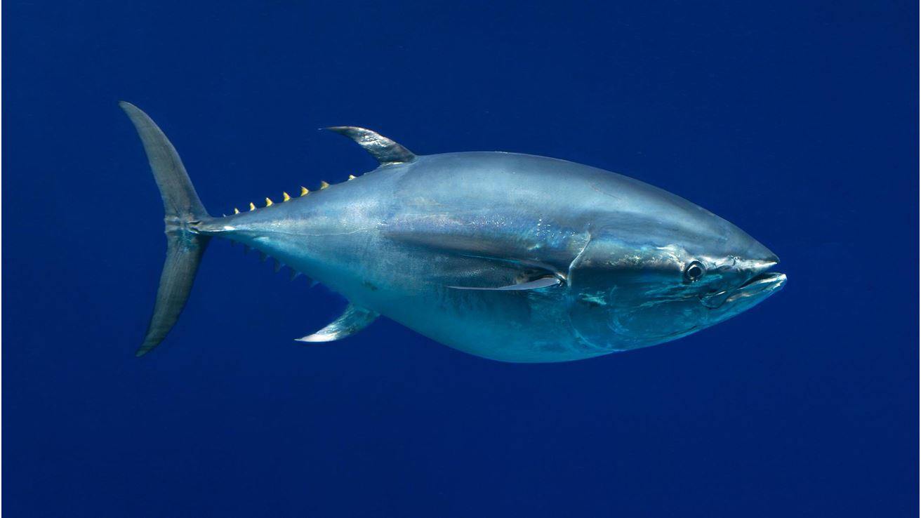
Marine Teleosts
Exchange of Water and Ions
Impermeable integument
Gills – not so much
Cartilaginous fish
  Influx of ?
  Outflow of ?
Bony fish
  Influx of ?
  Outflow of ?

Slide 17
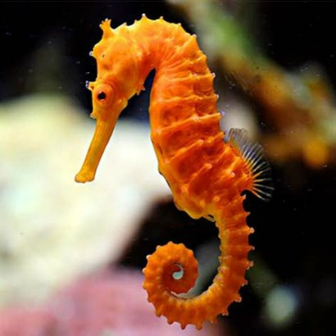
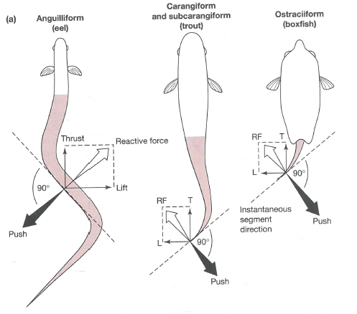
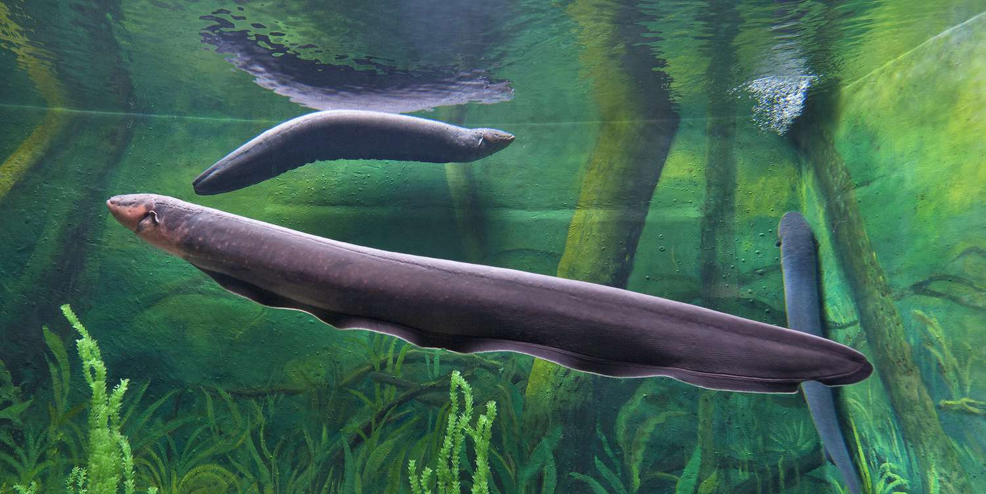
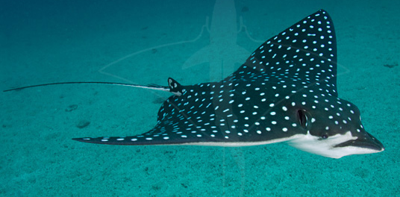
Moving in Water
Swim with anterior to posterior sequential contractions of muscle segments…
https://www.youtube.com/watch?v=cAYpwiOnJrA
https://www.youtube.com/watch?v=cQrEsq19TBY
https://www.youtube.com/watch?v=RgJCxN3ShbY
https://www.youtube.com/watch?v=kYrZw4Jsjh8
https://www.youtube.com/watch?v=peH10oRbX4I

