Slide 1
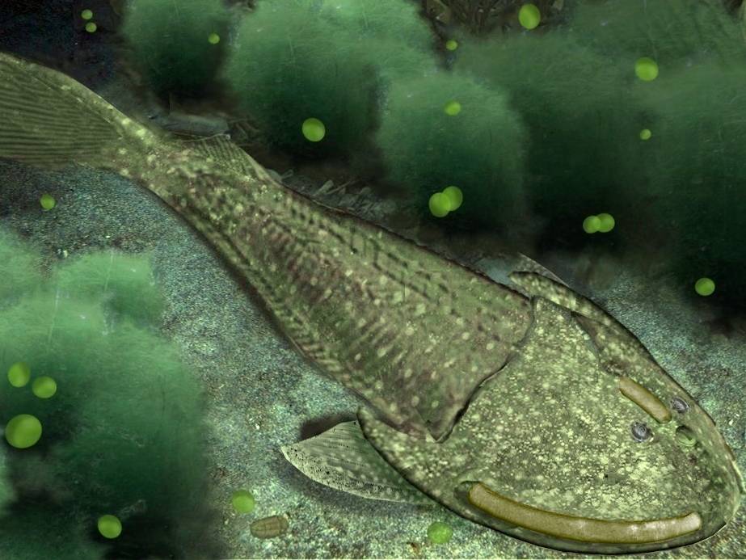
Early Vertebrates
Vertebrate Evolution
Cheyenne Gerdes

Slide 2
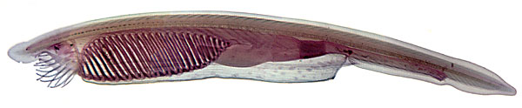
Ancestral “pre” Vertebrate

Slide 3
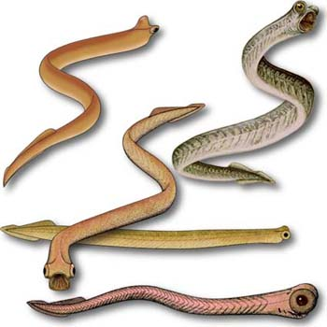
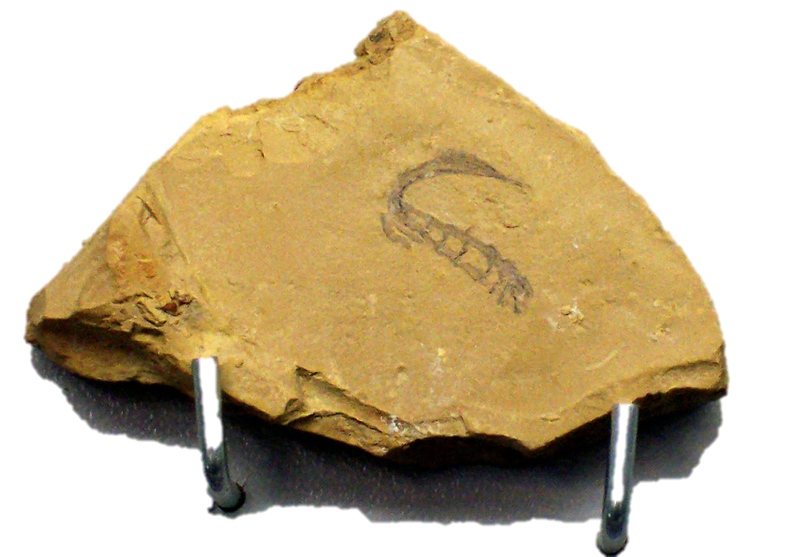
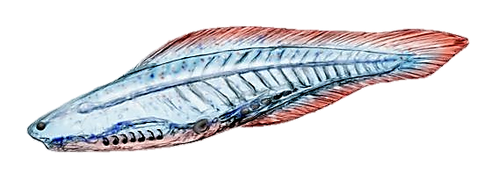
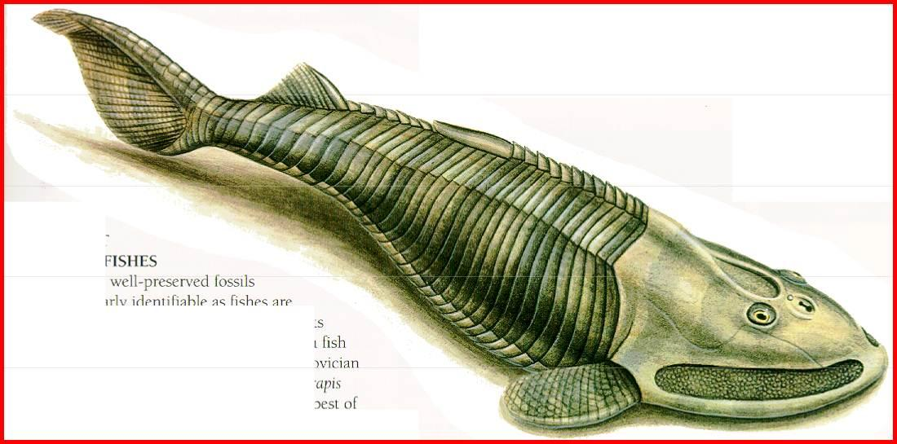
Early Cambrian Vertebrates

Slide 4
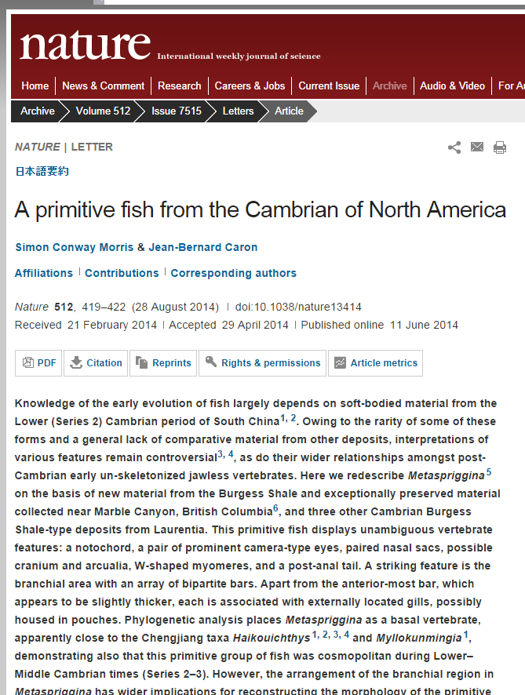
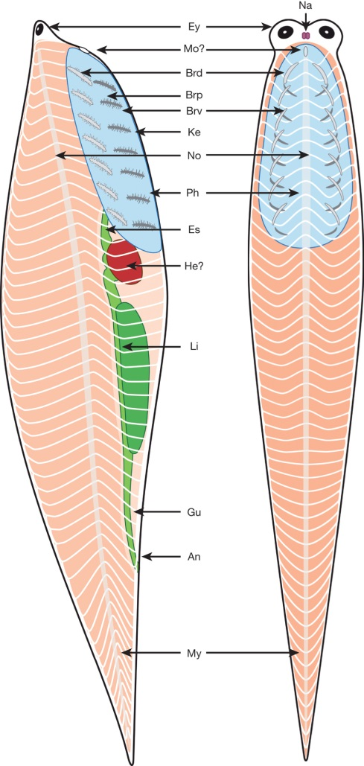
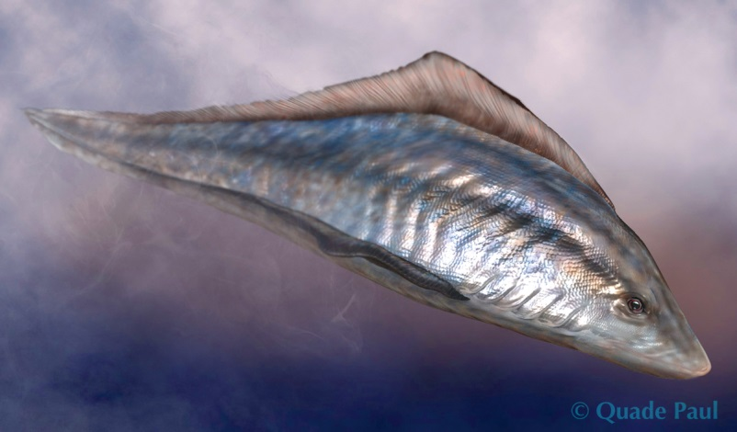
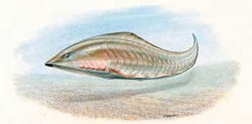
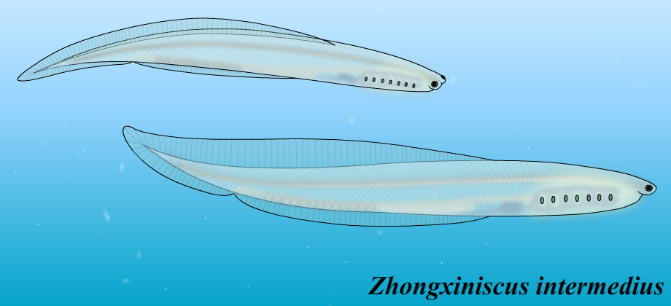
Early (soft bodied) Cambrian fossil vertebrates
Myllokunmingia
Haikouichthys

Slide 5
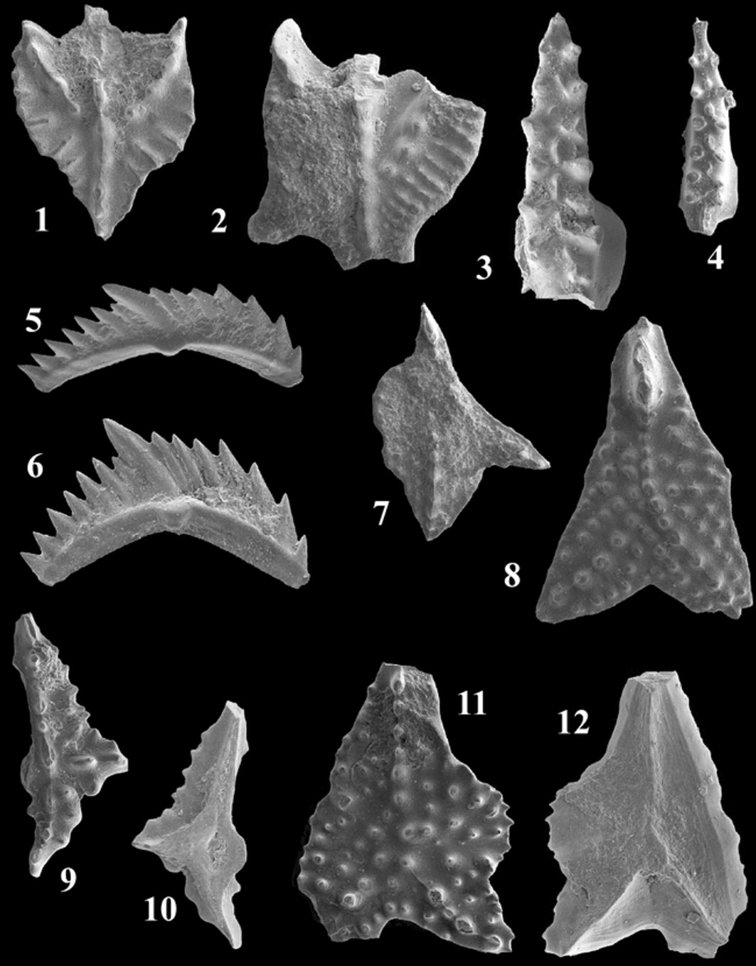
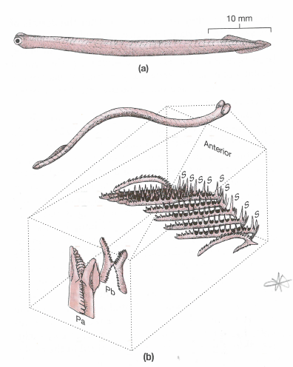
Conodonts (and the origin of bone)
Started with microfossils
First bony elements
Recently whole-body impressions discovered

Slide 6
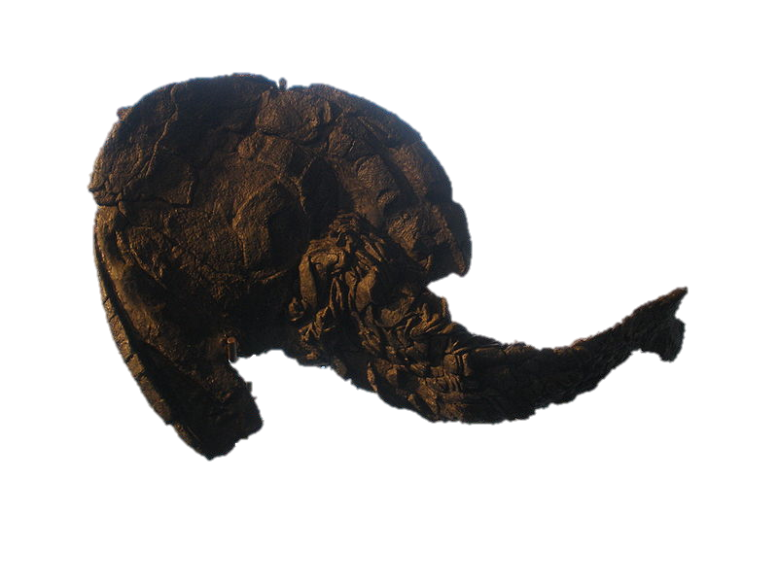
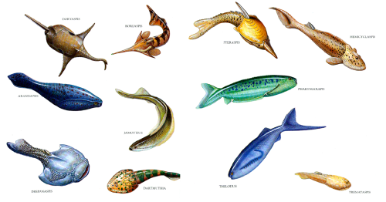
Ostracoderms
First whole-body vert fossils
~490 MYA
Very different from modern verts
Diverse, had gills, pharynx for suction feeding

Slide 7
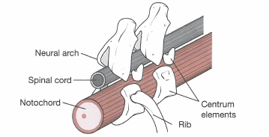
Origin of Vertebrae
What’s function of ribs?

Slide 8
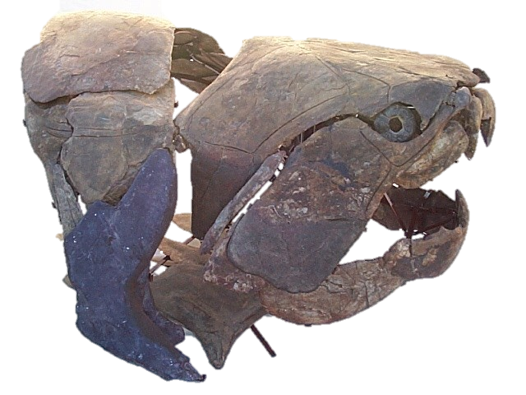
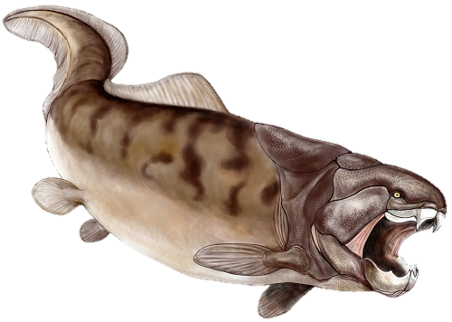
What’s missing???
Approx 450 MYA
Jaws first, then teeth
What ecological benefits?
Another reason?

Slide 9
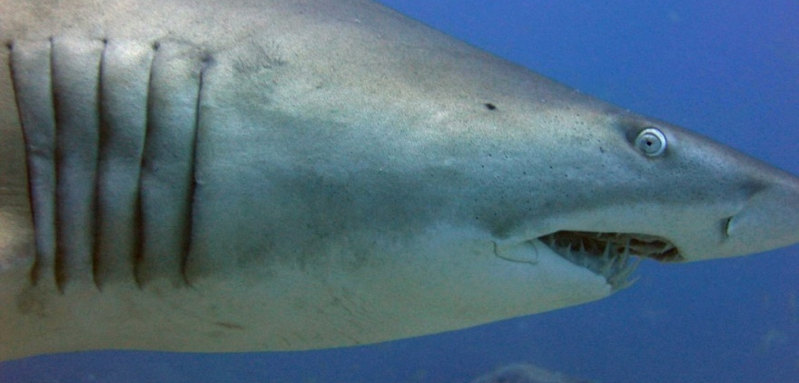
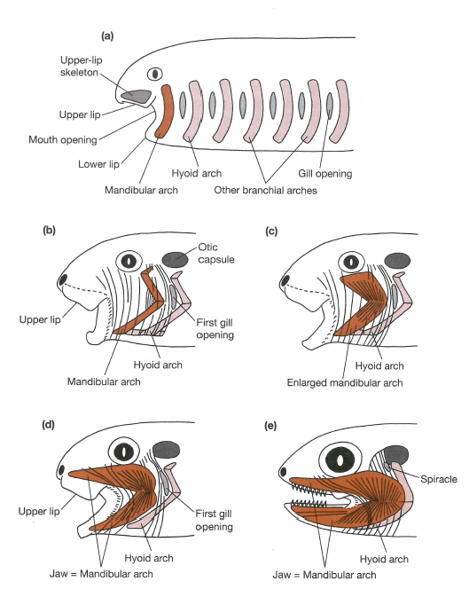
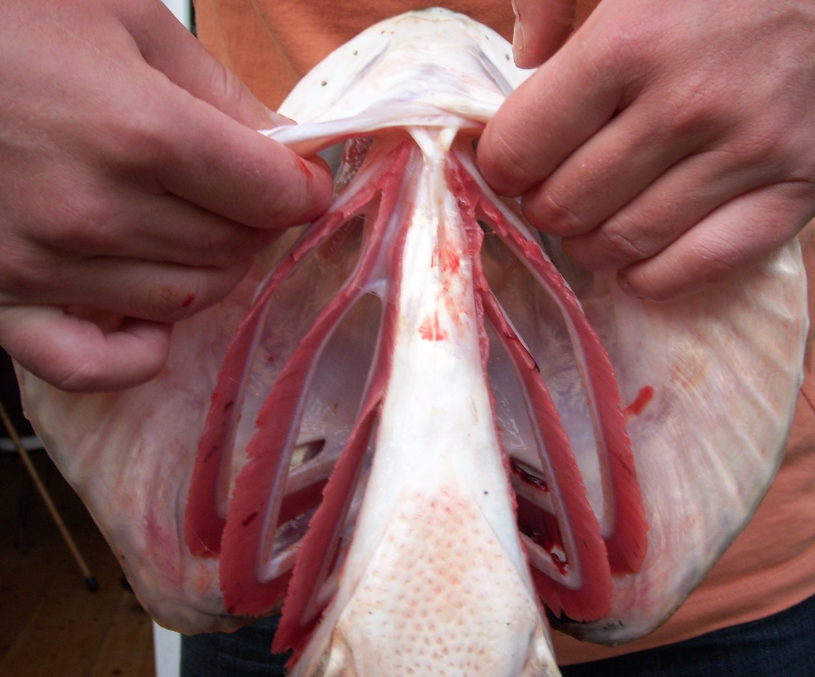
Transition to Jaws
First vertebrates had segmented head
What happened to first branchial arch?
Why make the conversion?
Mallatt 1996. Zoological Journal of the Linnean Society

Slide 10
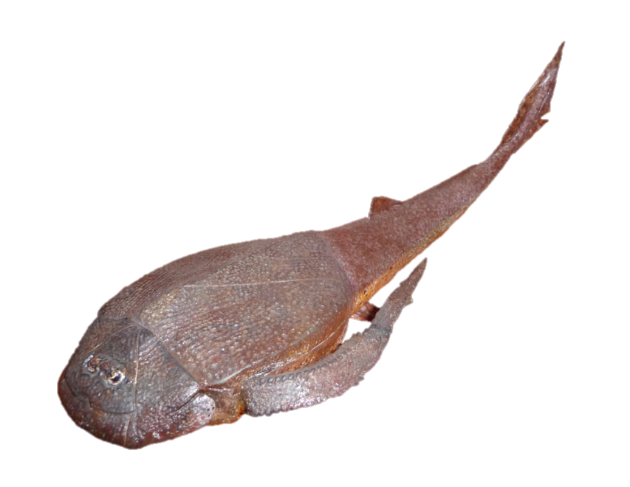
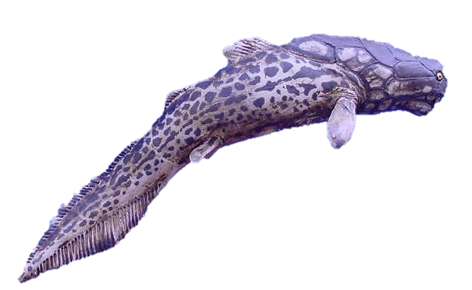
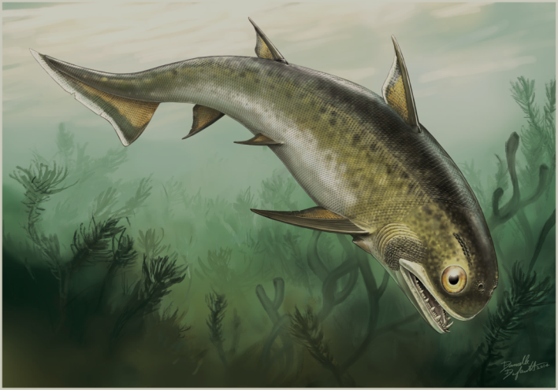
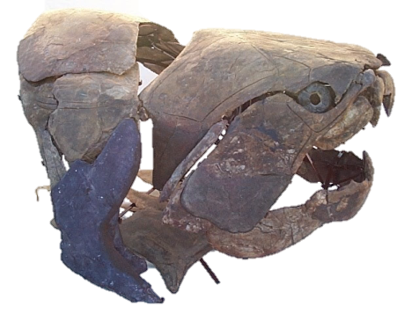
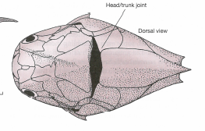
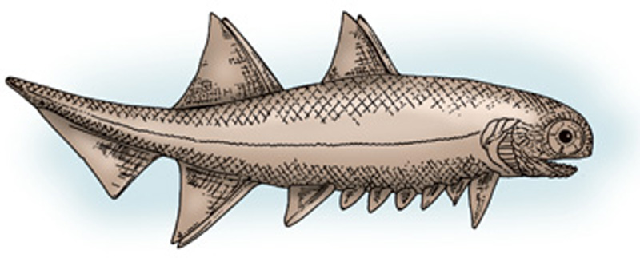
Jawed Fishes
Opened ecological niches
4 major clades

Slide 11
