Slide 1
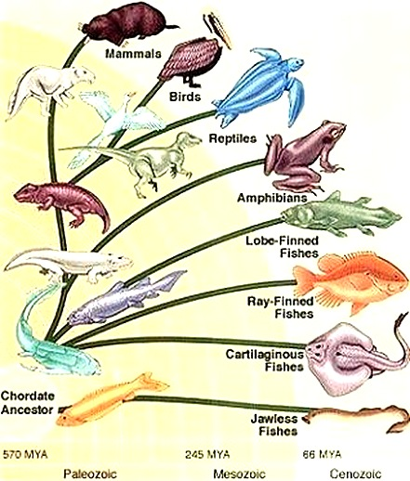
Classification of Vertebrates
(review)

Slide 2
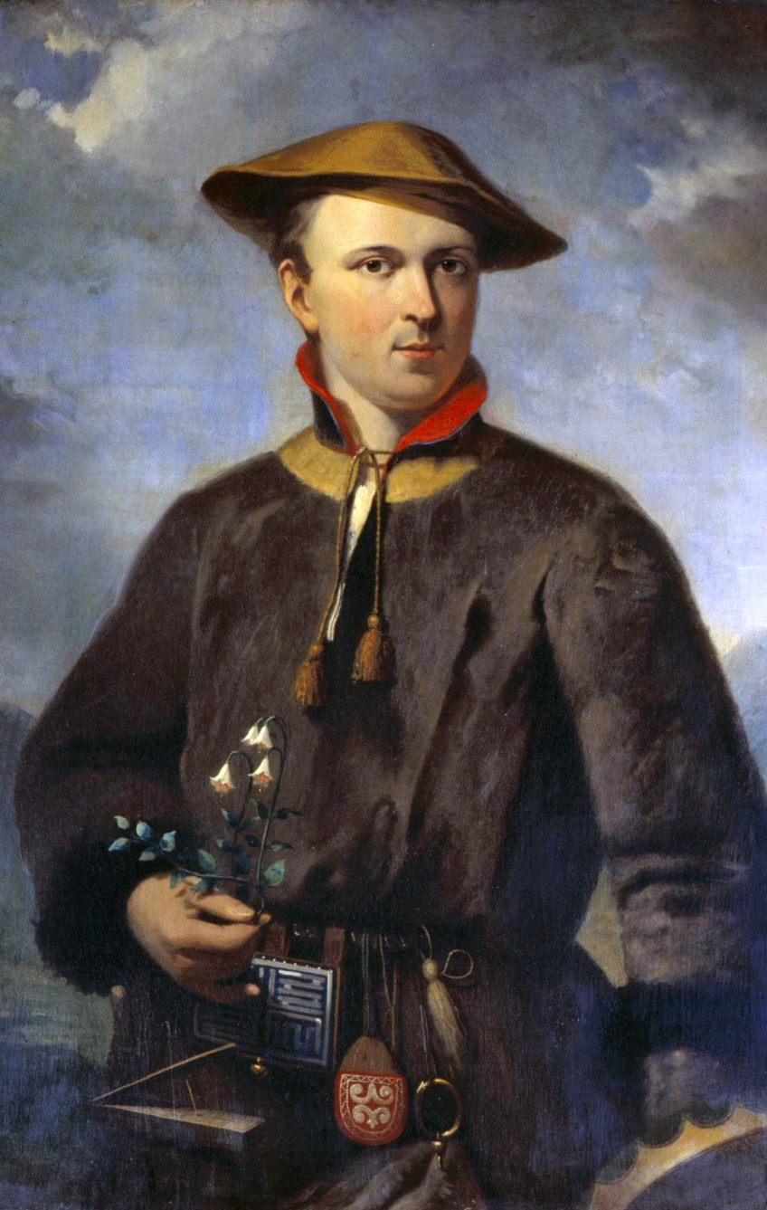
Not this again!
Earliest system to organize life?
Taxonomy is?
Developed by?
Pre or Post Darwin?
What traits were historically used to classify?
What traits are used today?
What is the highest level of classification?
The remaining ranks?
What is binomial nomenclature?
Notes:
Classification system is the same system used in Biodiversity to categorized and organize the diversity of life
Review:

Slide 3
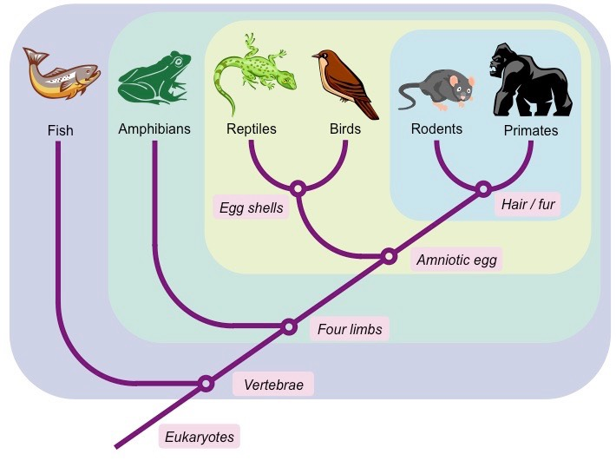
Phylogenetic Systematics
Problems with Taxonomy?
What system came next?
How is it different from taxonomy?
What is a cladogram?
Key terms:
  Synapomorphy?
  Plesiomorphy?
  Others
    Monophyletic?
    Paraphyletic?
    Polyphyletic?
What is a Sister group?
What is an outgroup?
Class Reptilia
Notes:
Phylogenetic Systematics
The second tool used by scientists to organize and group life is:
Systematics or phylogenetic systematics or phylogenetics
Grouping is based on evolutionary relationships
Ignore the Linnaean ranks associated with each species
Try and determine where (as well as the route taken) a species fits on a tree
Trees known as Cladogram or Phylogeny – depicts the evolutionary history of a group
The base is ancestral and tips are the modern representatives
Branching occurs when major evolutionary changes led to a new group
Some general systematics terminology
Sister group – branches that originate at same node and share a common ancestor
Outgroups – lineages outside the clade of interest (used as a control)

Slide 4
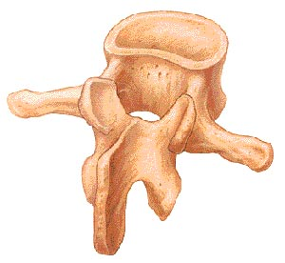
What is the major synapomorphy of all vertebrates?

Slide 5
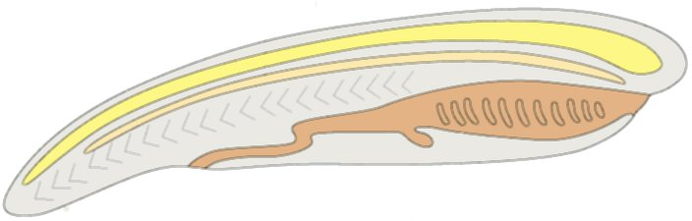
Let's Start Big
What domain are vertebrates in?
What comes after domain?
What comes next?
What synapomorphies do they possess?

Slide 6
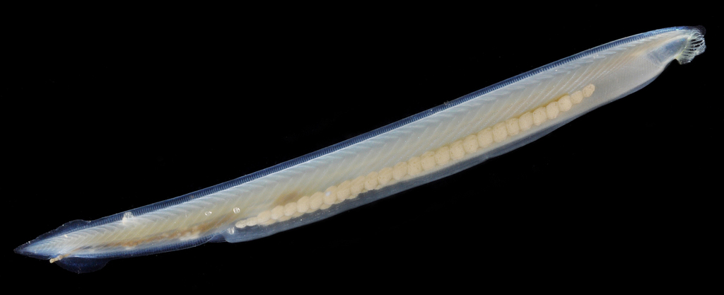
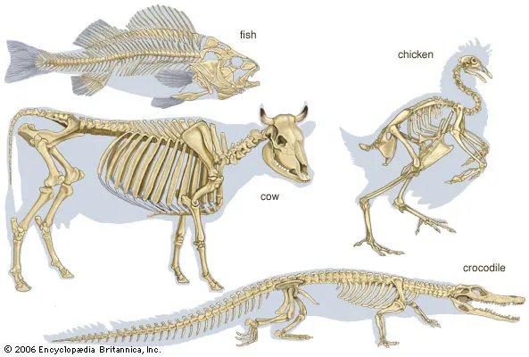
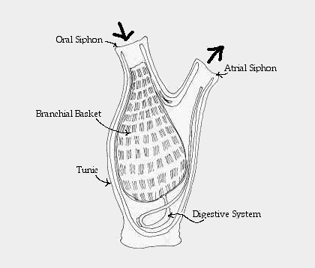
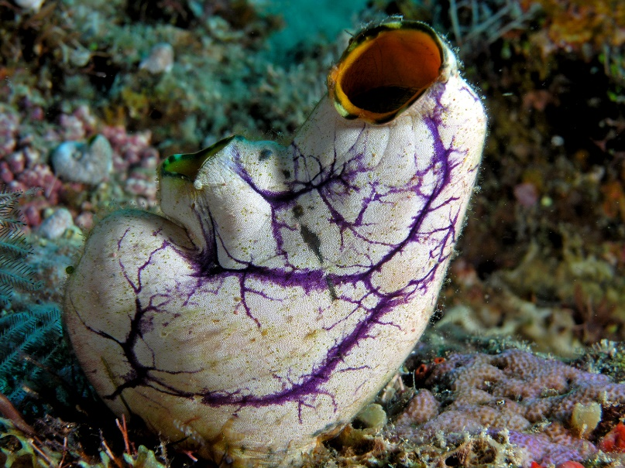
Chordata divided into 3 sub-phyla
Cephalochordata?
Tunicata?
Vertebrata

Slide 7
What Makes a Vertebrate?
back to this
Exceptions?

Slide 8
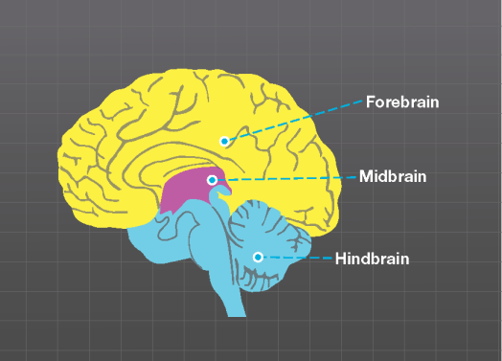
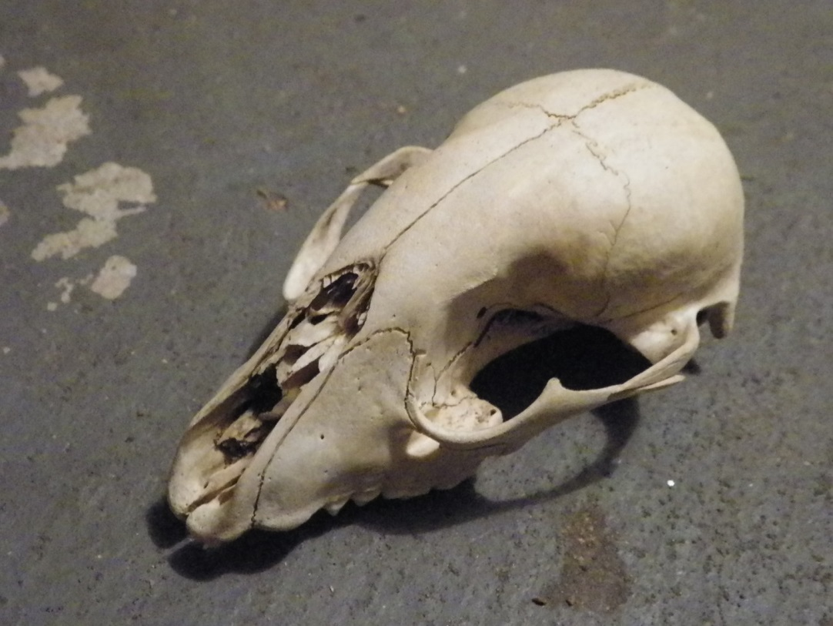
If not all vertebrates have vertebrae, why use the name?

Slide 9
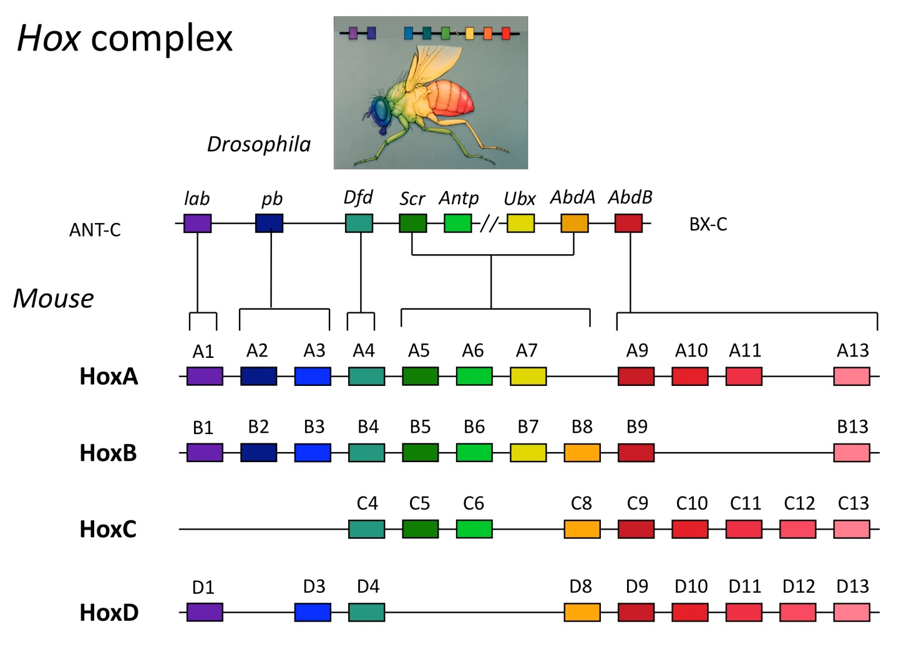
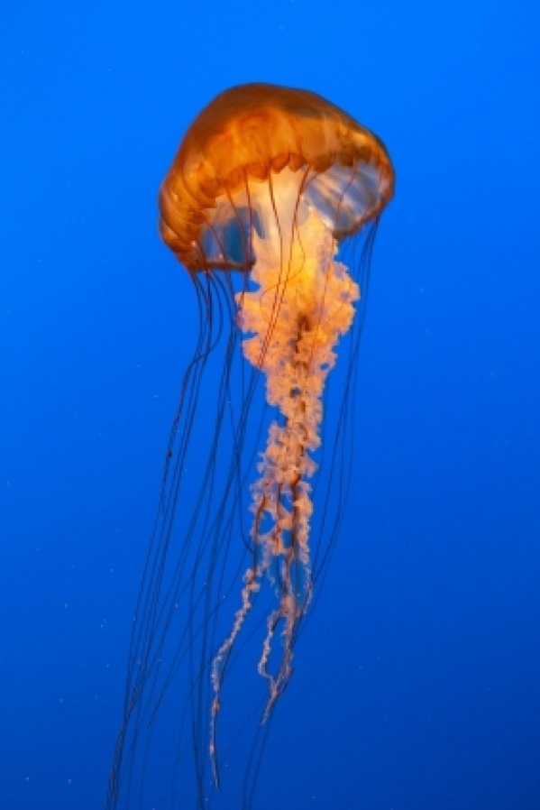
How to make a vertebrate
1-part Hox genes
Double it!

Slide 10
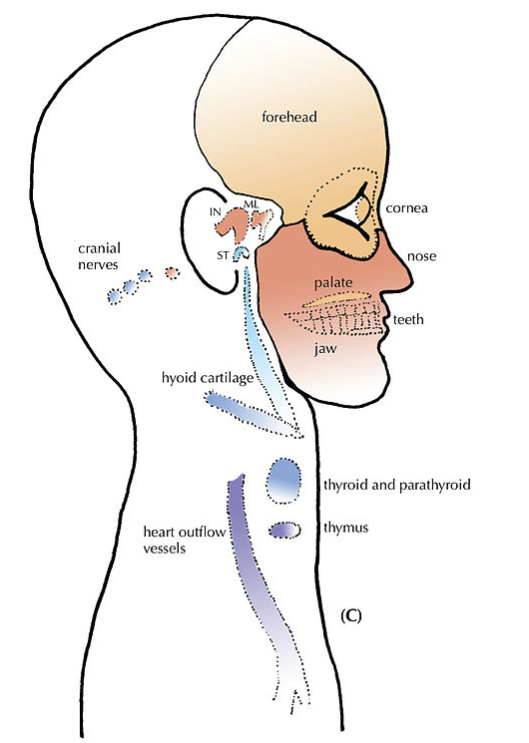
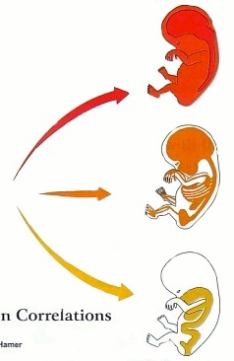
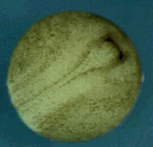
How to make a vertebrate
Review cleavage and gastrulation
https://www.youtube.com/watch?v=dXpAbezdOho

Slide 11
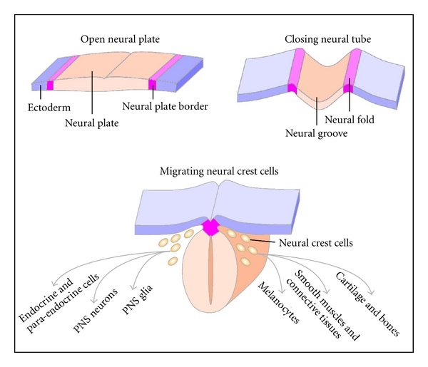

Slide 12
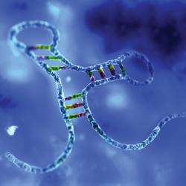
How to make a vertebrate?
MicroRNA (miRNA)
  Non-coding RNA sequences
  Regulate protein synthesis
  Who has them:
https://www.youtube.com/watch?v=t5jroSCBBwk

Slide 13
Summary
3 evolutionary “events” are responsible for producing the structural complexity necessary for vertebrates to evolve
These are ?

Slide 14
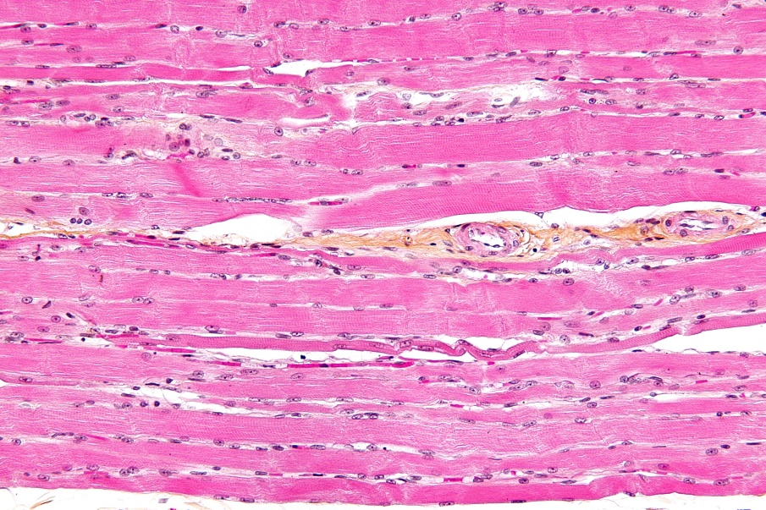
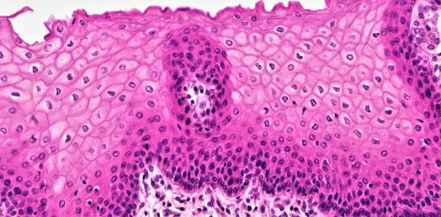
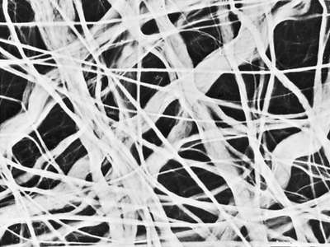
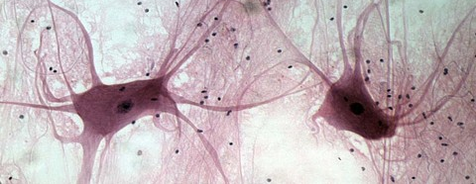
Basic Vertebrate Structure
4 tissue types
Muscle
Epithelial
Nerve
Connective

Slide 15
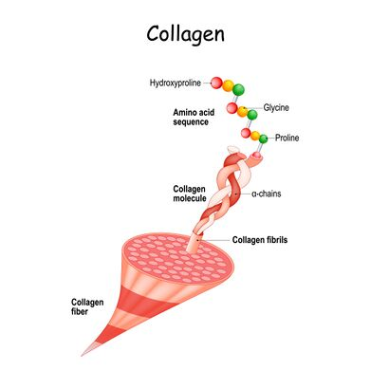
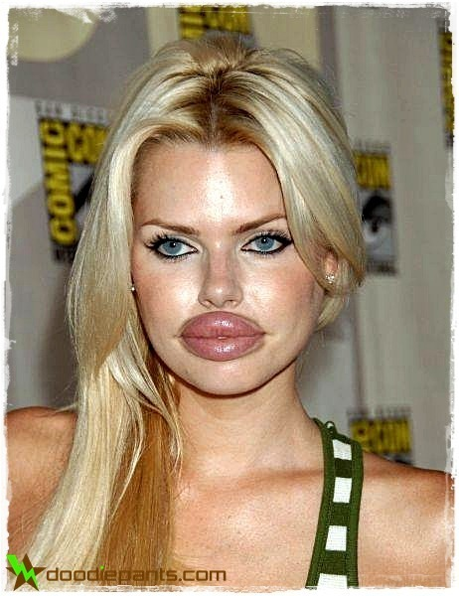
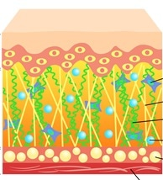
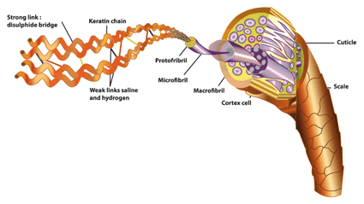
Basic Vertebrate Structure
Collagen
3 key proteins
Elastin
Keratin

Slide 16
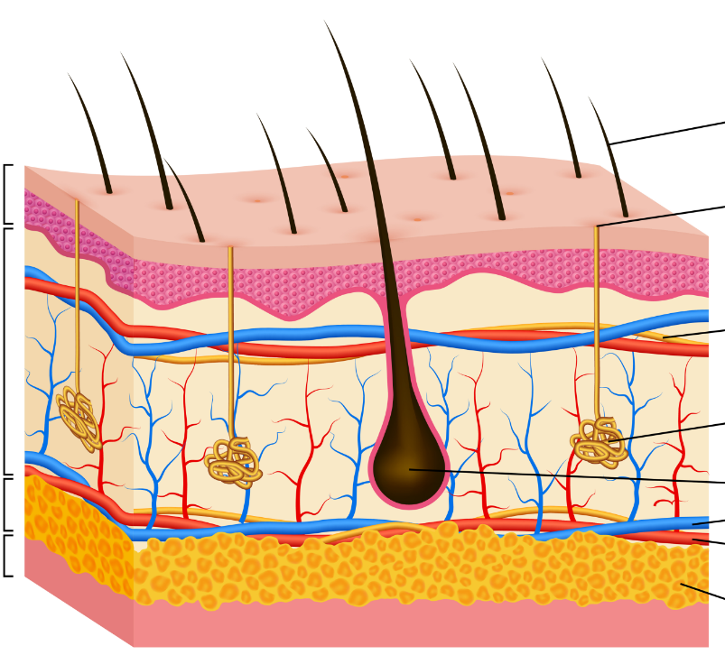
Integument
Outer covering (skin, scales, armor, hair, glands)
Consists of 3 parts

Slide 17
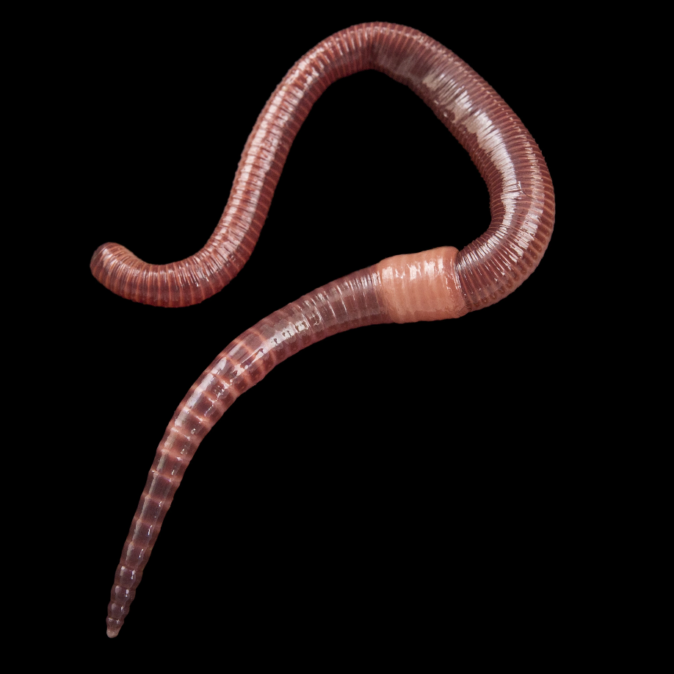
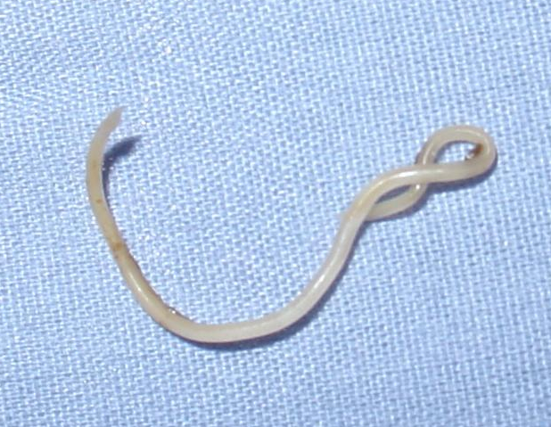
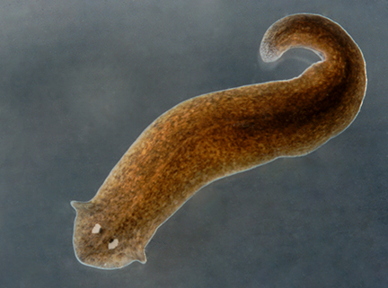
The Vertebrate Body Cavity
All animals can be grouped by body cavity type
What are the 3 types?
What group(s) do verts belong in?

Slide 18
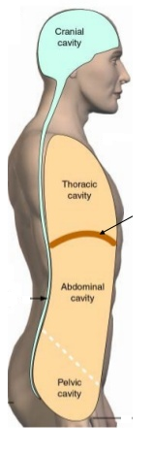
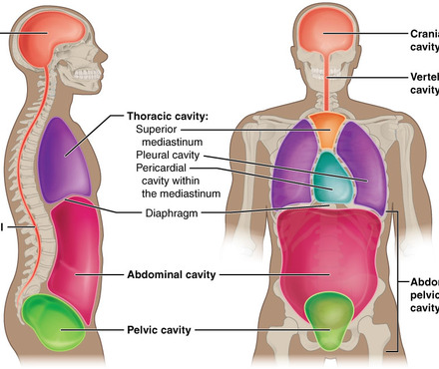
The Vertebrate Body Cavity
Coelom divided into 2 cavity “regions”
Further subdivided

Slide 19
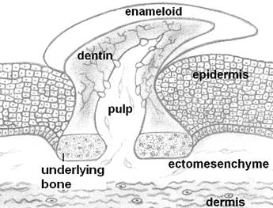
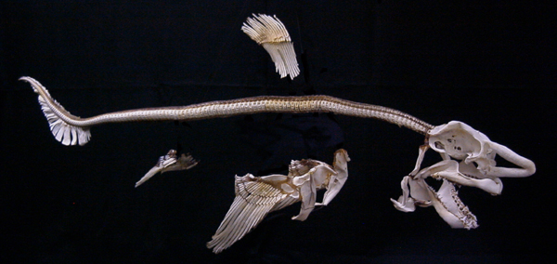
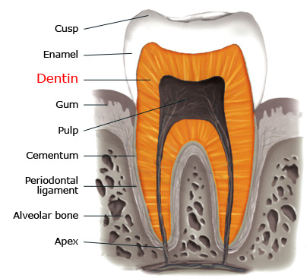
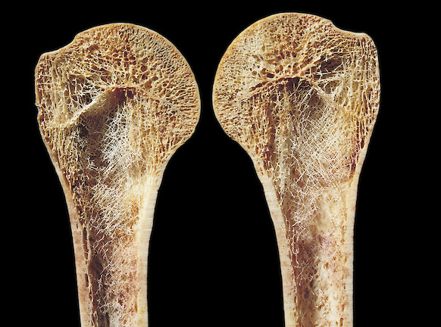
Mineralized Tissues

