Slide 1
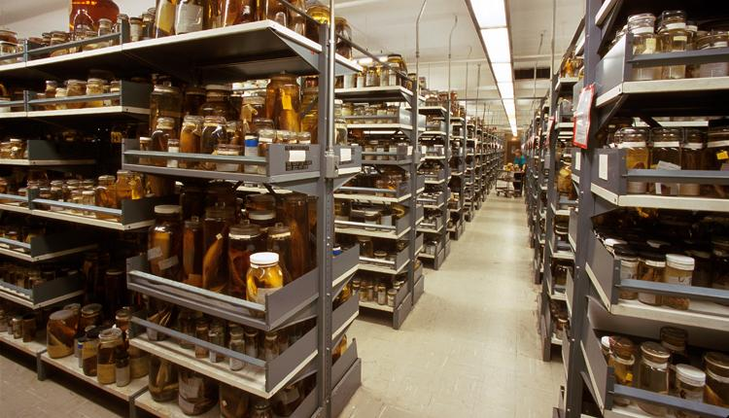
Fish Identification

Slide 2
Important Pages from Fishes of Indiana
XV – List of abbreviations
1 – List of species, associated habitat, drainages they are found in
  Use this as confirmation of species
17 – How to use this guide
54 – Identification of fishes
59 – Methods for counting and measuring fish traits
79 – Key to families
93 – start of the individual family keys
327 – GLOSSARY!

Slide 3
Identification – how to start
Take the fish (or several) and place in dissection tray
Open to the family key
  Even if you think you know the species/family
  DOUBLE CHECK!
Move to the appropriate family
  Look through the list of species
  Quickly flip through the figures and range maps
  Get a feel for how many species you are dealing with
  Start at the top of the dichotomous key
  Make an ID
  Use the range map and table at the beginning to confirm

Slide 4
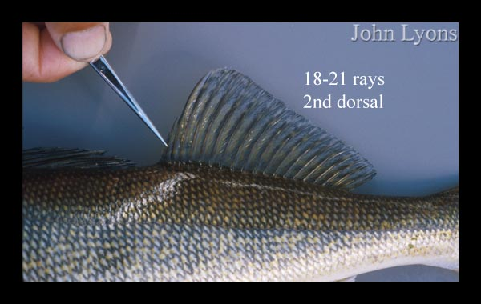
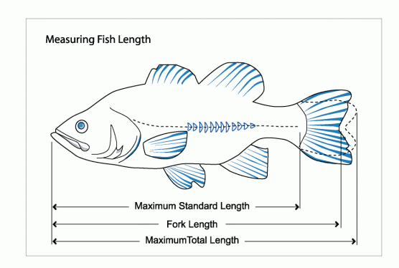
Methods for Measuring Fish Traits
Once you get into the family – hard
Two parts
  Counting (fin rays, scales, etc.)
  Measuring (length, depth, width, etc.)
Variation
  Typically, 3 anal spines, 9 (8) anal rays and 13-14 pectoral rays, 10 dorsal spines and 10-11 dorsal rays
Fish morphology
Adapted from: https://www.koaw.org/lepomid-meristics
Notes:
Meristicis vs morphometrics
https://www.koaw.org/lepomid-meristics
If a number before a characteristic is only a single number, such as the 3 above, then that means the characteristic rarely provides a count of anything different on that species. It is extremely rare to find any lepomid without 3 anal spines. For the dorsal spines, it is less rare but still uncommon to find a green sunfish with more or less than 10 dorsal spines.
If you see two numbers with a hyphen between them, such as the 13-14 above, then both of those counts are the most common and appear with somewhat similar frequency.
If you see a number in parenthesis, such as the 9 (8) above, the first number can usually be counted on that species while the number in parenthesis appears much less but with enough regularity to be considered.

Slide 6
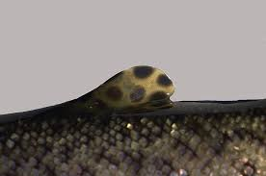
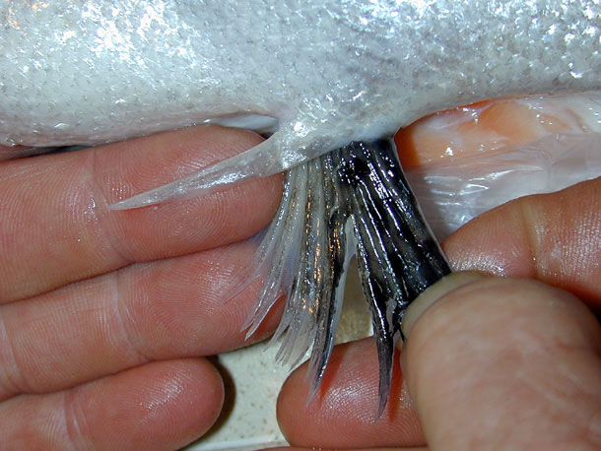
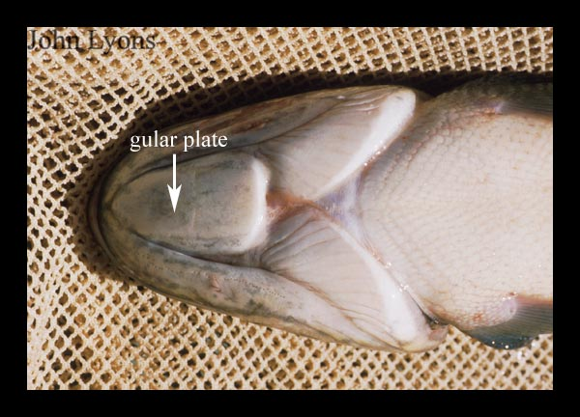
Notes:
Adipose fin - a small, soft, rayless fin located on the back of some fish (e.g. salmon & trout). Located behind the dorsal fin
Axillary process – fleshy or scale-like projection where the pelvic fin attaches to the body. Helps with hydrodynamics (streamlining), may protect fin from damage, or sensory
Gular plate – flat plate-like cartilage or bone located on the chin. Protection for throat and gills, jaw support, maybe streamlining head

Slide 7
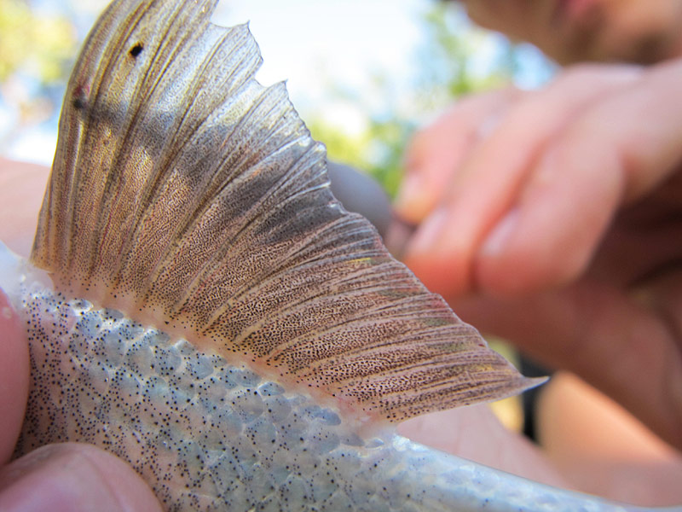
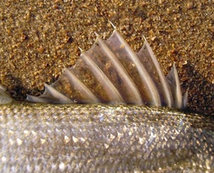
2 types of Fishes
Soft rayed
  Rays are soft, flexible, branched
  Many fishes (minnows, suckers, etc)
  Arabic #’s designate (1, 2, 3…)
Spiny rayed
  Anterior rays spiny and hard
  Dorsal, pelvic, anal fins
  No segmentation (single shaft)
  Roman #’s designate (I, II, III, IV,…)
  Often possess both with any particular fin

Slide 8
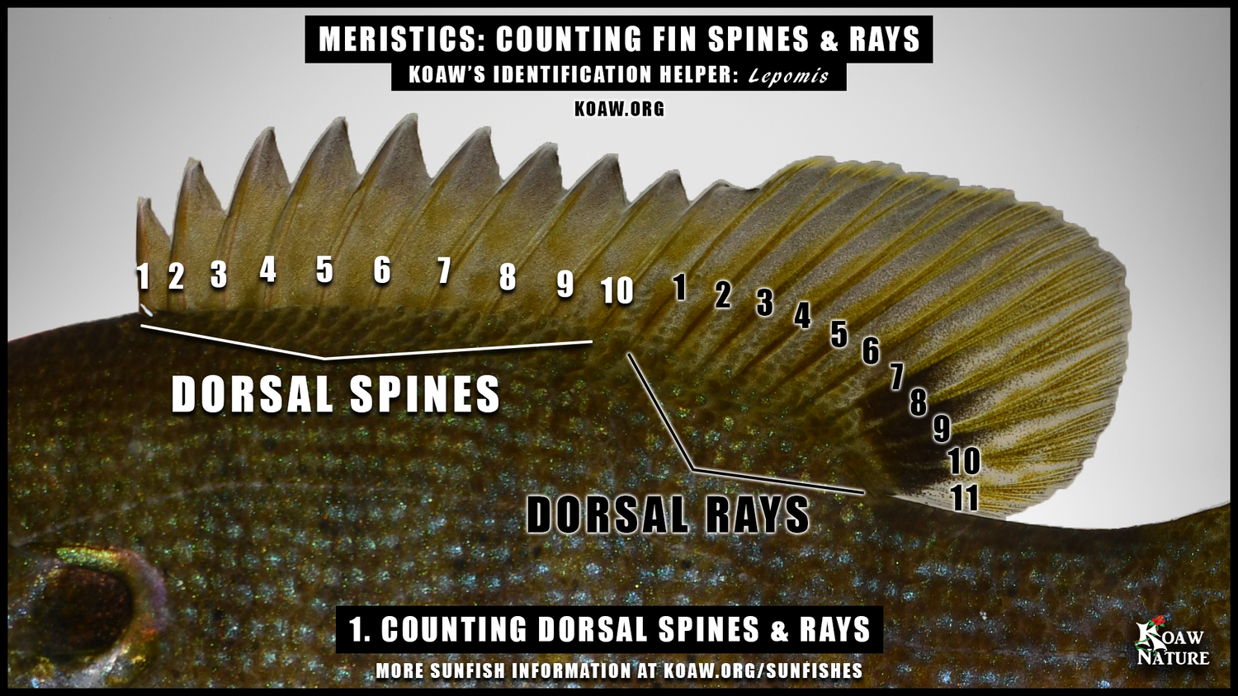
Counting Spiny Rays
Hard thick spines
Typically, first dorsal or first half of dorsal
No segmentation
Count all spines

Slide 9
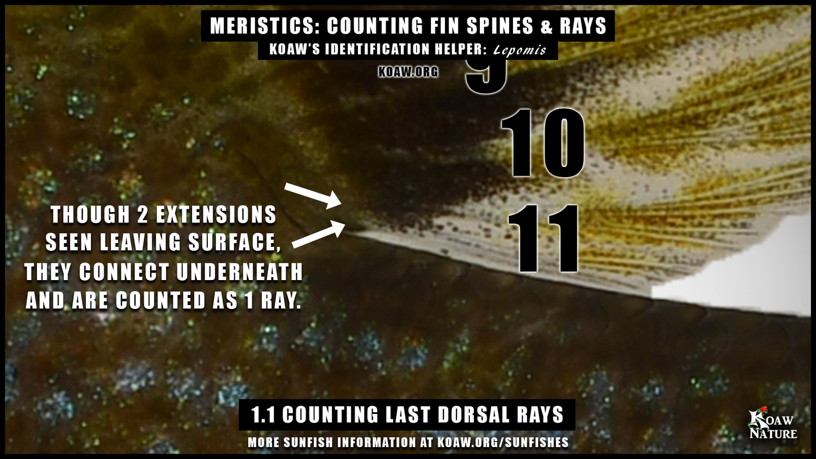
Counting Soft Rays
Branched, flexible, segmented
Usually 2 pieces, equal length
Principle vs secondary rays
Count
  All branched rays
  + 1 unbranched ray (usually front) & reaches fin tip
  Ignore secondary
  Last two count as one (minnows)!
Anal rays - same as above
Pectoral fins
  count all, even small!
  Count at base
Notes:
Often branched, flexible, and segmented
Each ray usually in two pieces (equal)
Principle vs Secondary - Secondary rays (also called accessory rays or procurrent rays in the context of the caudal fin) are smaller, less robust fin rays located at the margins of the fin, typically above or below the principal rays in the caudal fin.
Counting – count only the principle rays (all branched rays +1)
Count from the base
The last two will count as one!
Secondary rays are too difficult
Count from top to middle, and then start over at the middle – caudal fin
Catfish and salmon – count ALL rays, including less developed

Slide 10
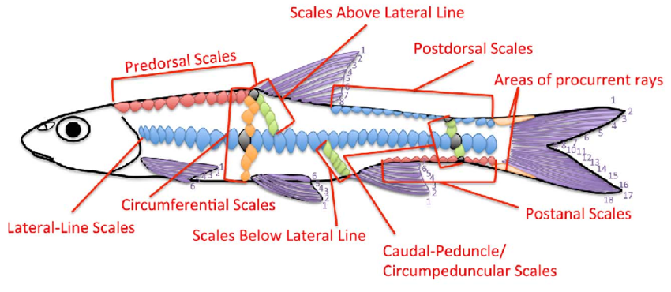
Counting Scales
Never count just one fish!
Lateral line scales
  Start and end
  Pored scales along LL
Scales above LL
Scales below LL
Cheek scales
Notes:
Scale counts – count on several fish (average) – variability present
midline
horizontal
starts at gill cover (may have to lift operculum
ends at caudal peduncal
may have to count from lateral line up to dorsal fin or down to anal fin (diagonal like snake)

Slide 11
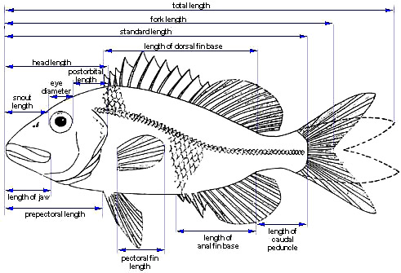
Measurements
Notes:
Head length
Snout Length
Body Depth

Slide 12
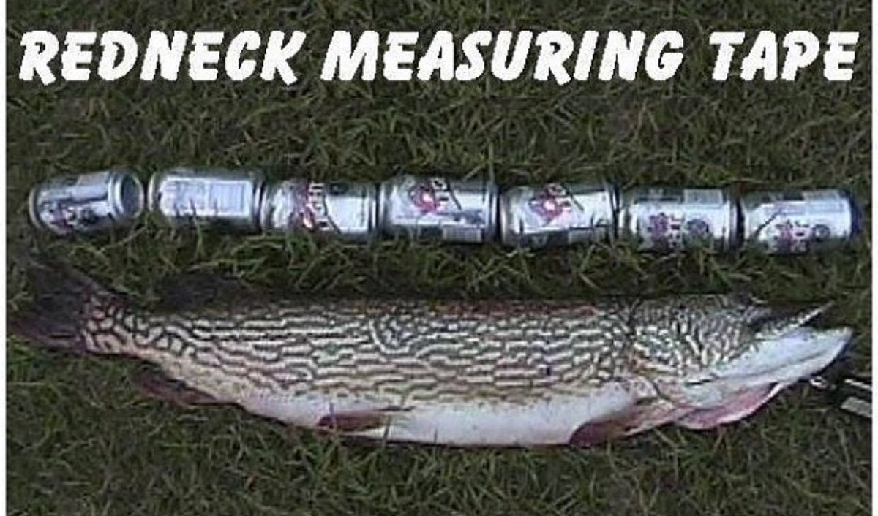
and GO!

