Slide 1
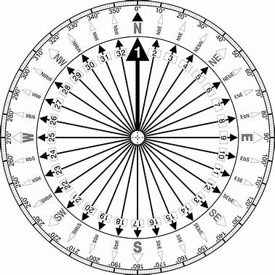
1 m

Slide 2
3 m

