Slide 1
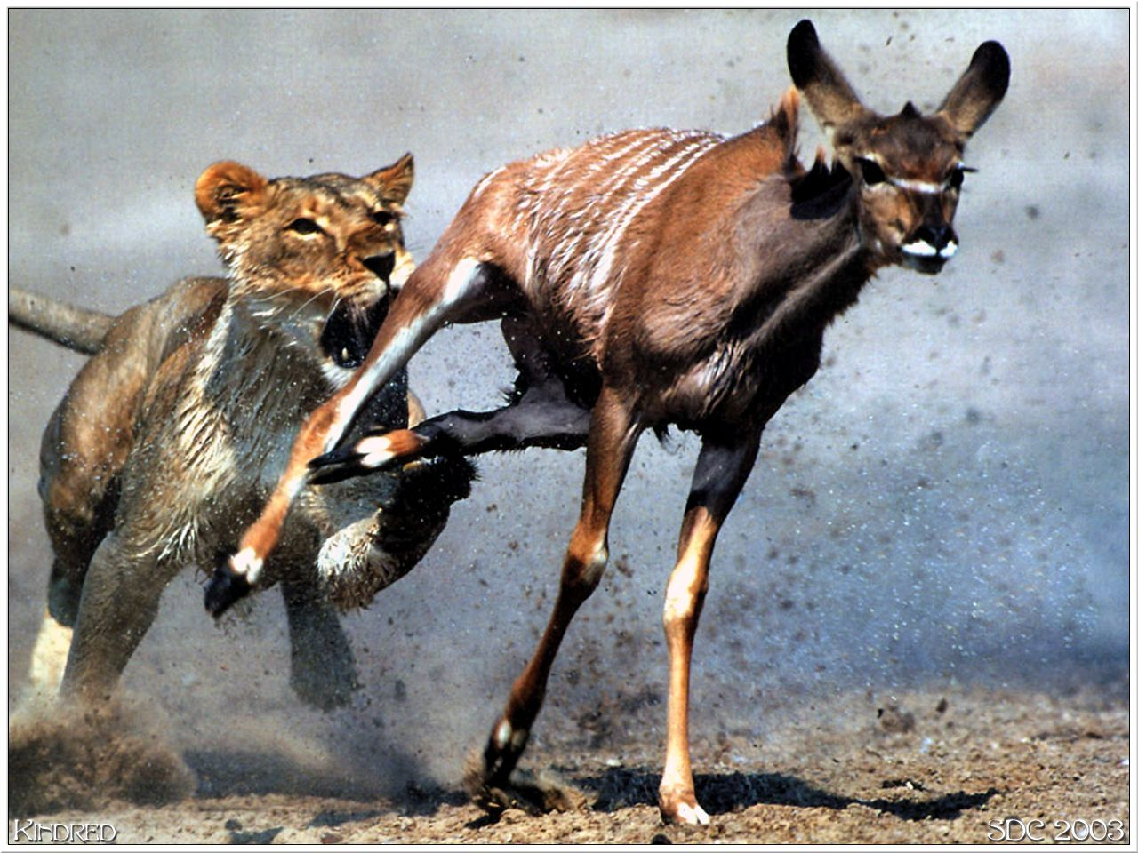
Predator-Prey Interactions

Slide 2
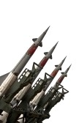

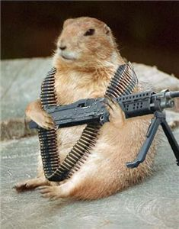
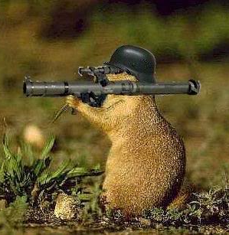
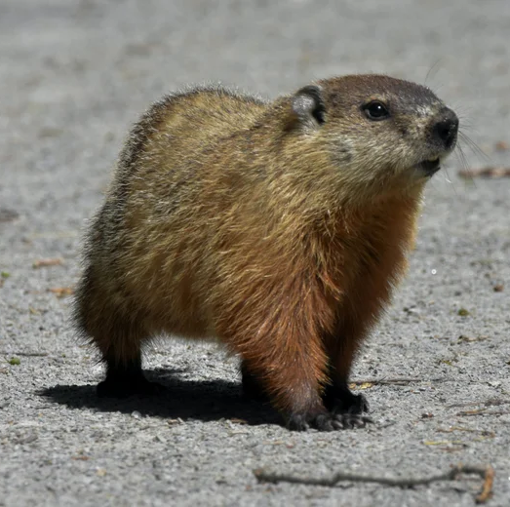
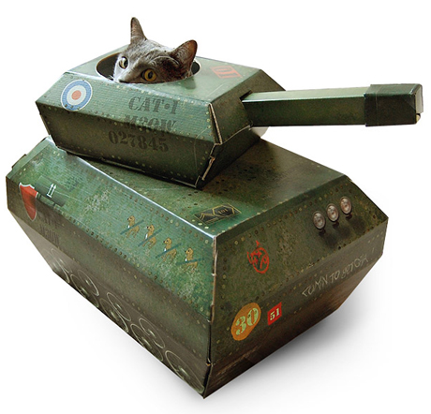
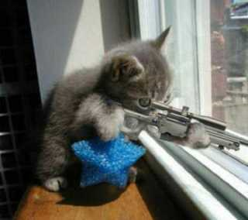
“Arms-Race”

Slide 3
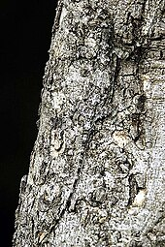
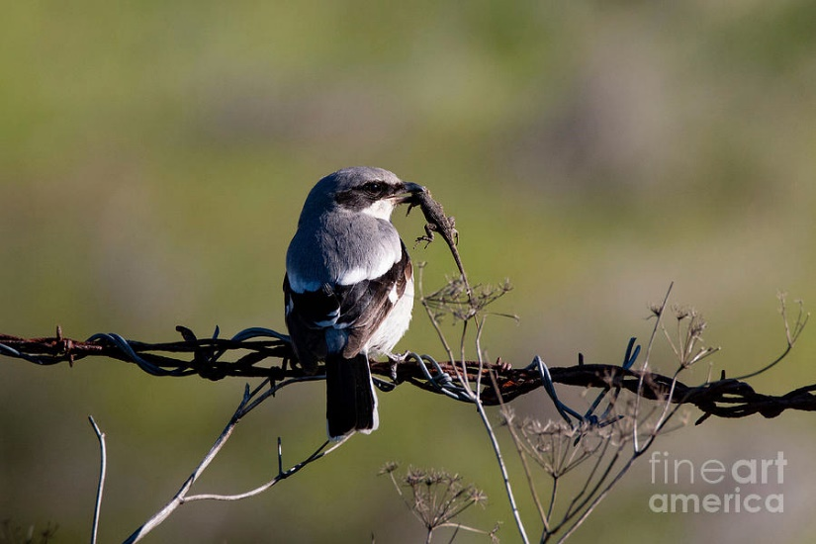
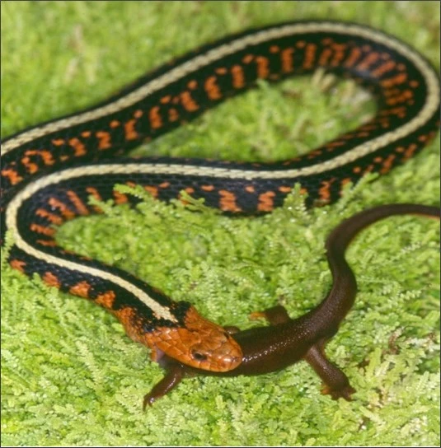
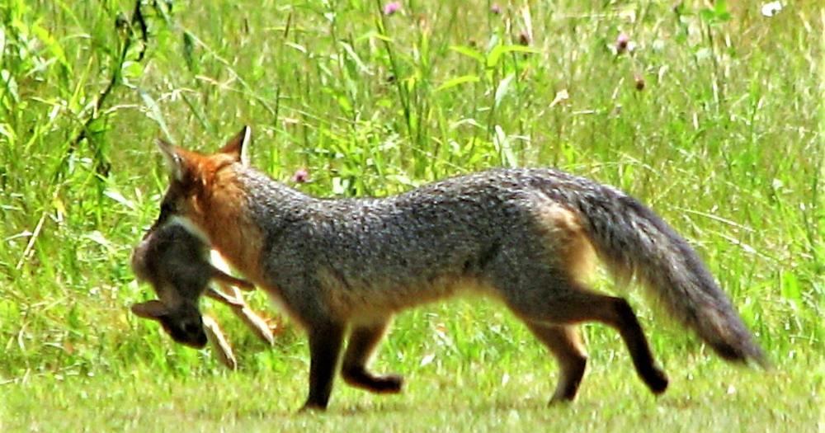

Slide 4
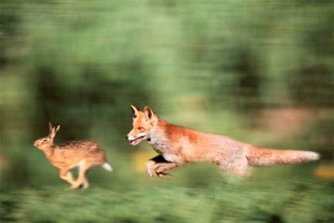
Assumes selection pressure equal on both. Is it?

Slide 5
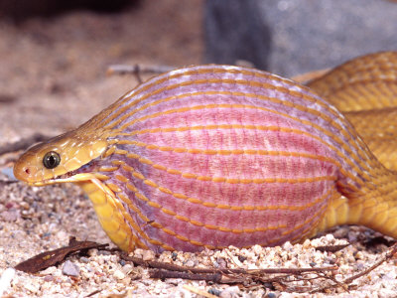
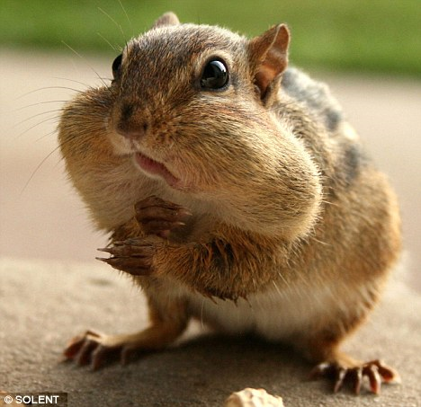
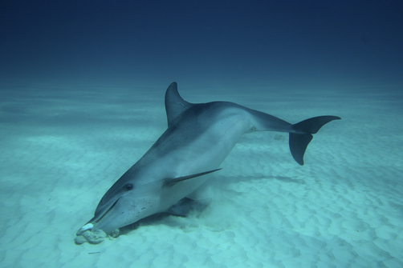
The predator’s view of predation
Predators have a range of foraging choices
  Where to search
  What time to search
  What to eat
  How long to spend eating or trying to eat

Slide 6
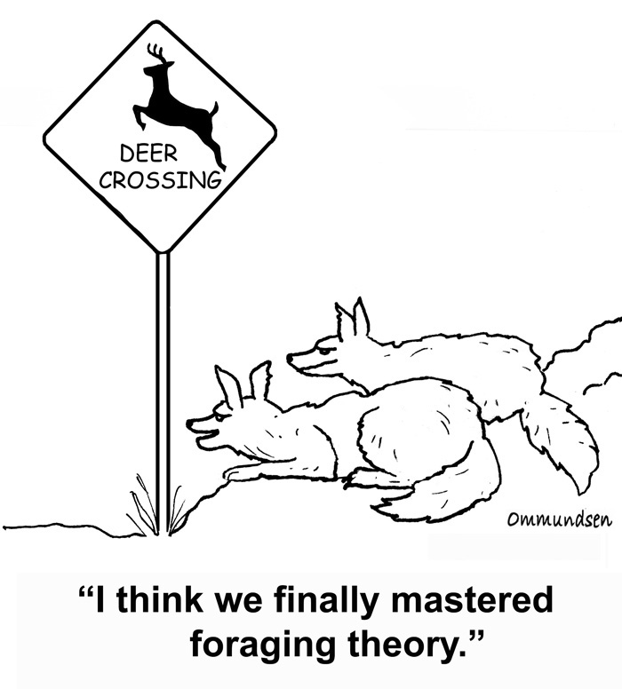
Optimal Foraging Models
  Analyze costs and benefits of foraging decisions
  Goal: predict what foraging “decision” will max fitness
  Frequency-dependent or frequency-independent model?
  How do we typically measure fitness?

Slide 7
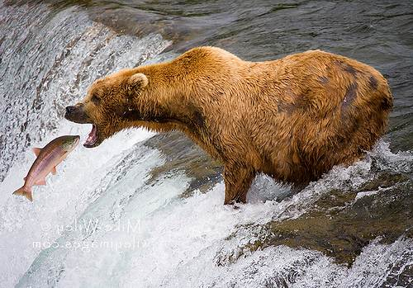
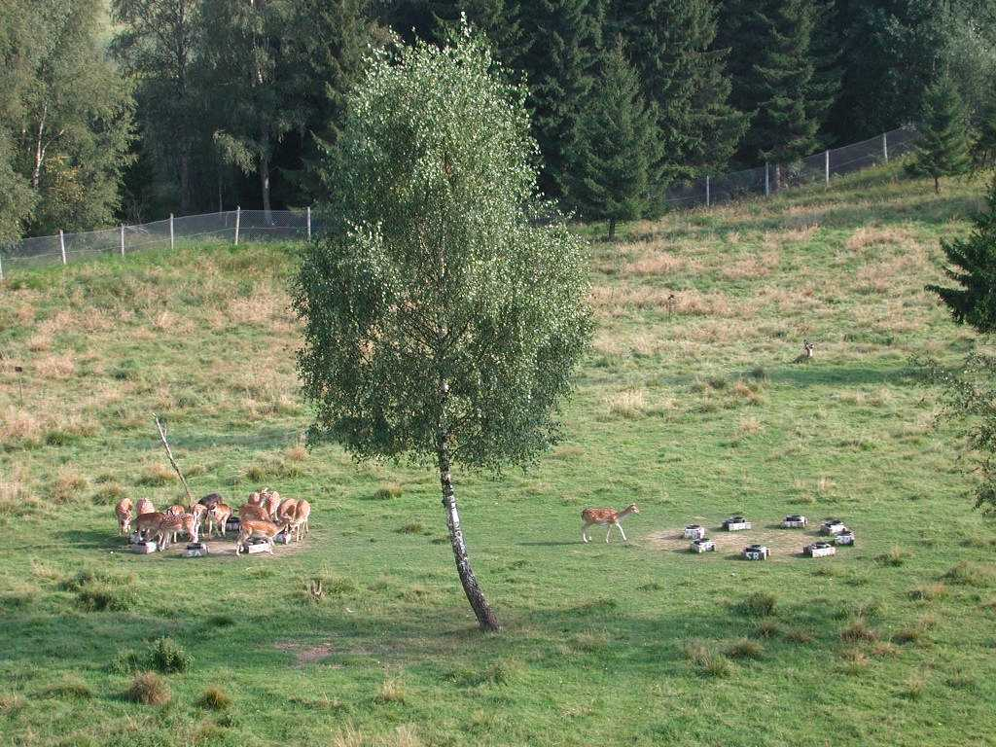
Types of Models
Prey Models
Patch Models

Slide 8
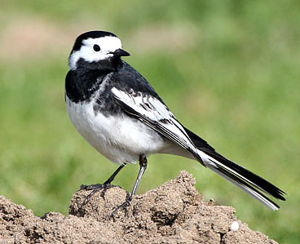
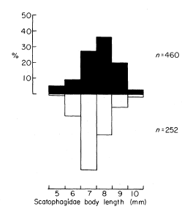
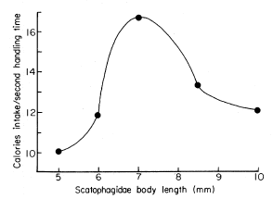
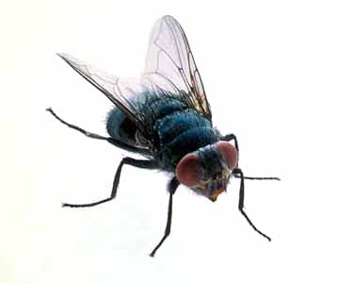
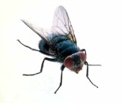
Example: prey model
Davies (1977) on Pied Wagtails
Question: does size of the prey influence foraging decisions
What is calorie payoff relative to fly size?
What would handling time compared to size look like?
When factor in calories/sec handling time…
What do you predict birds will do?

Slide 9
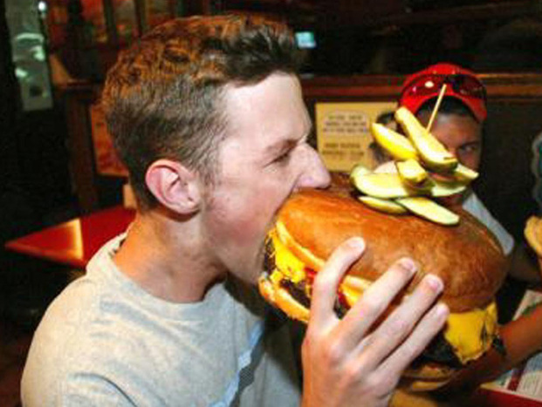
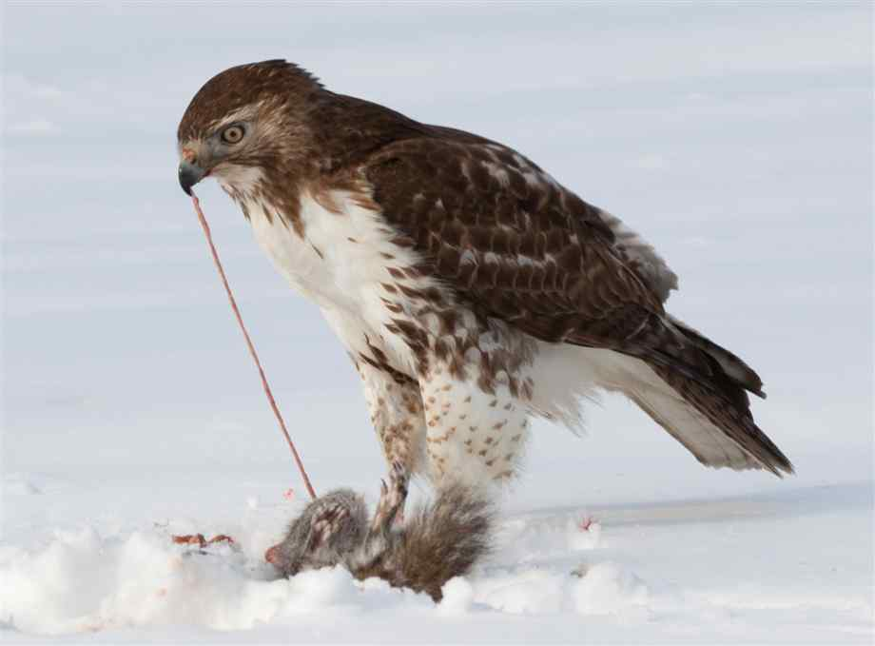
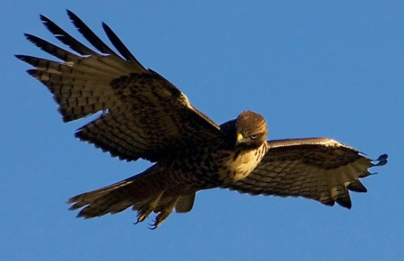
Assumptions
Maximize E gain
Can’t handle & search
Prey recognized instantly
Prey encountered randomly
Handling costs same btw individuals
Travel & searching have equal costs

Slide 10
Patch Model
Question: How long should individual forage in a patch before leaving to find a new one?
Goal: maximize rate of energy gain (most food least time)

Slide 11
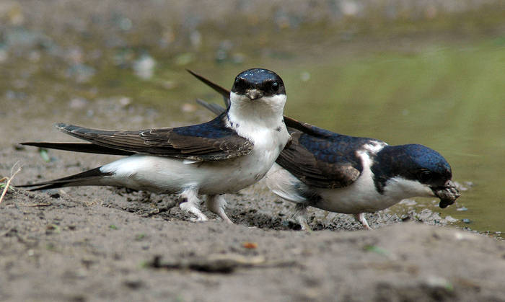
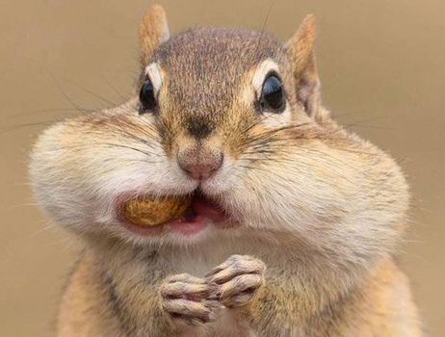
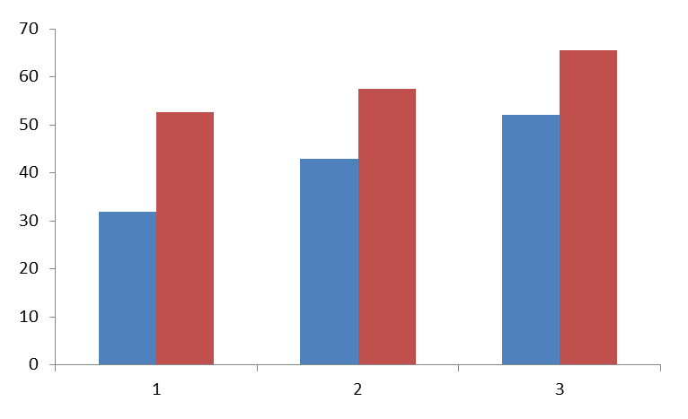
Example: Patch model
Question: How many prey collect before returning to the nest?
Predictions:
Longer travel = ?
Shorter travel = ?
Bryant and Turner, 1982
Number of Prey
0.1
0.45
1.0
Distance from Nest (km)

Slide 12
Ideal despotic distribution

Slide 13
What types of conditions might prevent animals from foraging optimally?

Slide 14
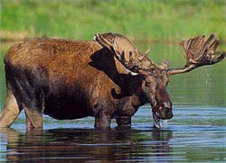
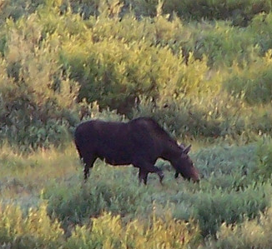
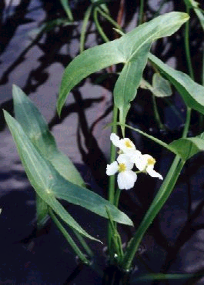
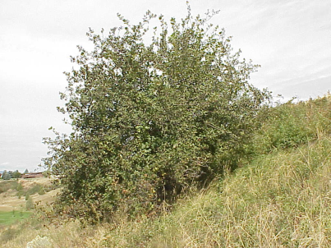
Trade-offs with Foraging
Dietary Constraints
Can only process 32 kg

Slide 15
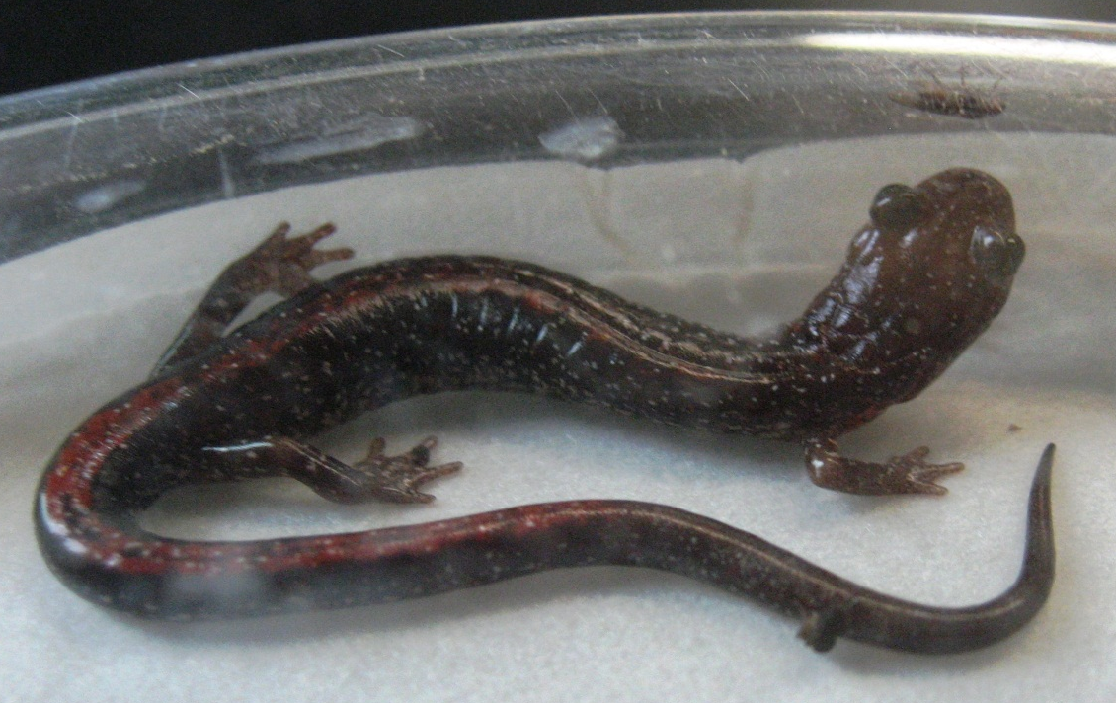
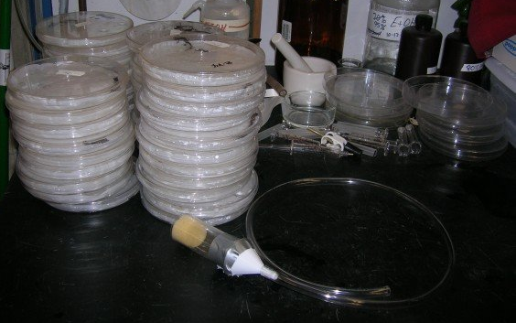
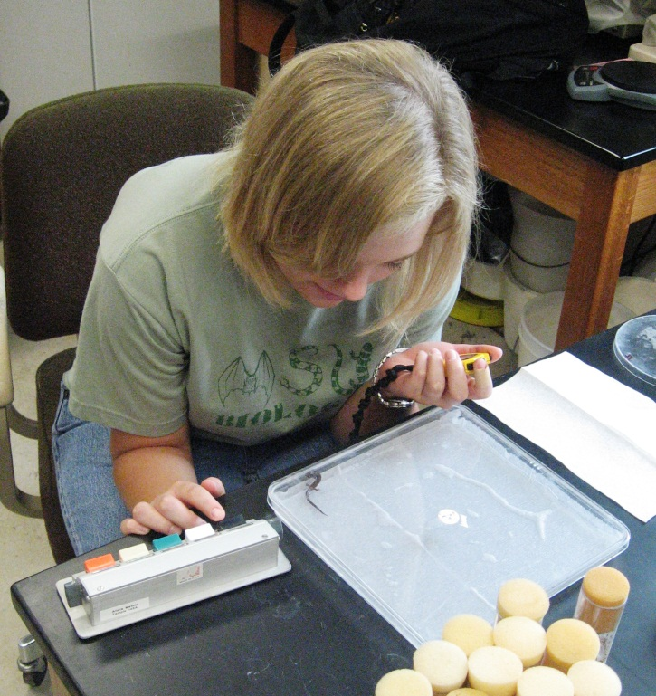
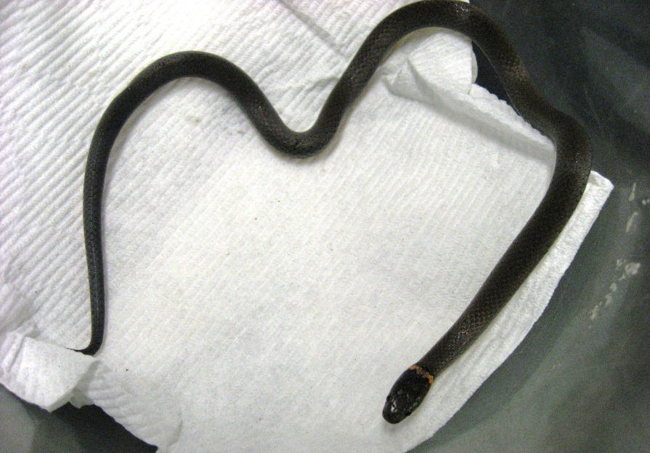
Trade-offs with Foraging
Predation
How will animals modify foraging decisions with risk of predation?
Think about:
Patch choice
Choosing prey
Total time

Slide 16
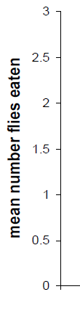
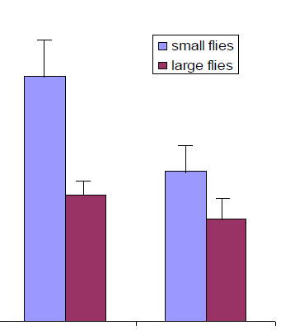

Trade-offs with Foraging
Predation

Slide 17
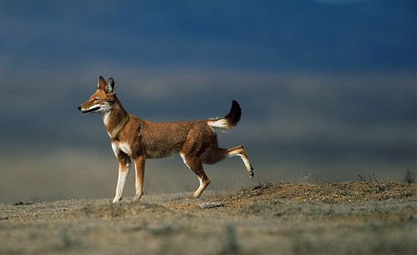
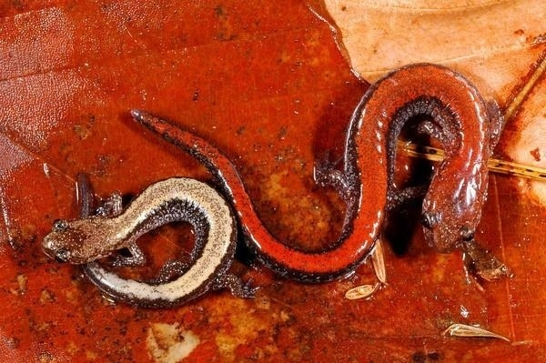
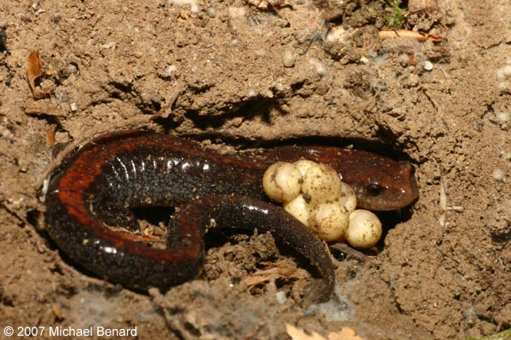
Trade-offs with Foraging
Territorial Defense

Slide 18
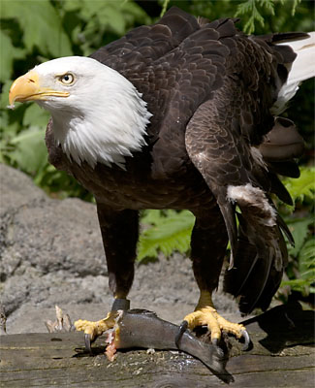
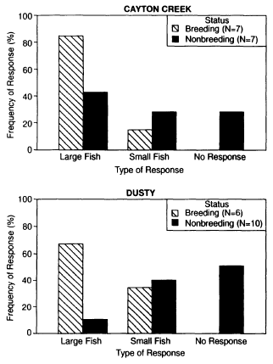
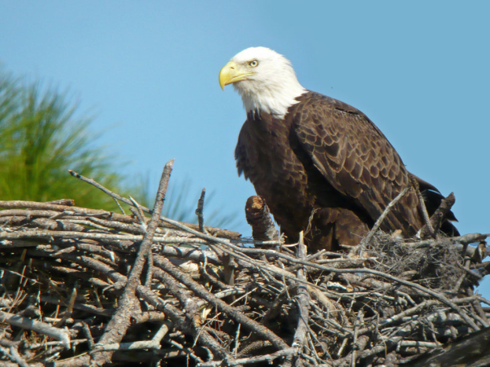
Trade-offs with Foraging
Jackman, 1994. Field experiments on prey selection in bald eagles

Slide 19
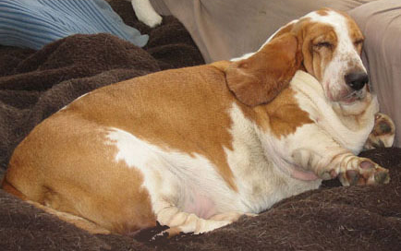
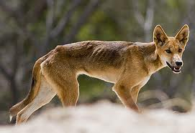
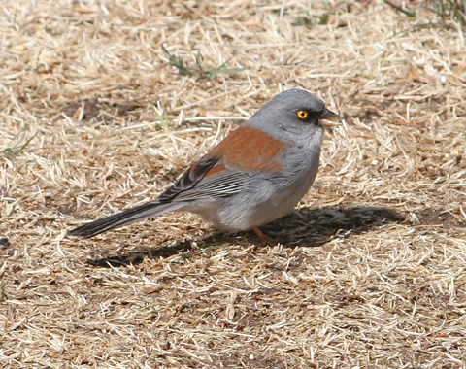
Trade-offs with Foraging
Example: yellow-eyed Junco

Slide 20
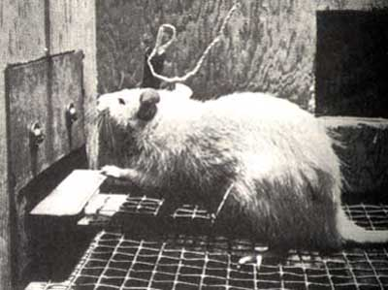
Risk-Sensitive Foraging
Previous examples look at long-term rate of E gain
Animals can also respond to variation in food availability

Slide 21
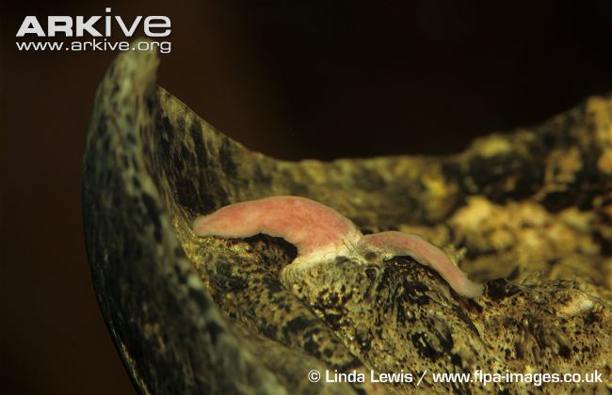



Morphological and Behavioral Adaptations to catch prey
http://www.youtube.com/watch?v=w-aILnSkMXU
Eisner et al. 1978, 1997

Slide 22
Luring
as.vanderbilt.edu//catanialab/research/tentacled-snakes/
youtu.be/9XCPK5Jy8yA
youtu.be/WXtN9PER5UE
youtu.be/t0KT-pec6Cw
youtu.be/BR-GR_dsABQ
youtu.be/3qe2pOD7EH8
https://youtu.be/z_OiBIOkKoU
https://youtu.be/RT-VX031C6I
https://youtu.be/_UCmmmTVeJU
https://youtu.be/txluLEgmbDg
https://youtu.be/c2PVaFWOQAE
https://youtu.be/N2Nf8uMOZ2c
https://youtu.be/oI0IE5iQDZo
https://youtu.be/S1k99sbKQhI
https://youtu.be/JujxVr2immk
https://vimeo.com/2546558

Slide 23





Morphological and Behavioral Adaptations to catch prey
http://www.youtube.com/watch?v=vJvfjiCTvq4
https://www.youtube.com/watch?v=wl120RuhQYg
Earle 1979, Sharpe and Dill 1997

Slide 24


Morphological and Behavioral Adaptations to catch prey
http://www.youtube.com/watch?v=nnYW0jE7-Ik

Slide 25


Slide 26


https://www.youtube.com/watch?v=1-p2AI9uTs0

Slide 27

Predator-Prey Interactions
The Prey’s View
Notes:
People tend to think of predation only in the context of these apex predators

Slide 28




How to avoid predators – part I
Brodie & Brodie (1991)
Developed the theoretical framework behind “choices” animals face when dealing with predators

Slide 29



How to avoid predators – part II

Slide 30


Stages of a Predation Event
1. Describe what happens
- List all of the events that happen between the snow leopard and the goat
2. Work together to break into stages
- Everything doesn’t happen at once
- Some behaviors should group together
- Try and assign discrete categories
https://www.youtube.com/watch?v=KUY9U4Y4SP4
Snow Leopard

Slide 31



Stages of a Predation Event
Detection
a) Shelters or hides
b) Polymorphism
c) Immobility
d) Crypsis
e) Distance and perception effects

Slide 32




Stages of a Predation Event
Identification
a) Masquerade
b) Aposematism
c) Mimicry (see next slide)
Notes:
Identification – is the prey actually edible, is it prey (predator has seen, smelled, felt, etc the “prey” but doesn’t know whether it’s prey yet)
Masquerade – prey resembles something that isn’t edible (leaf and stick mimics, frogs that look like rocks, etc). Take the preserved megophryidae.
Aposematism – advertise that prey are too dangerous to eat (warning color, sound, smell). Smell and sound can be problematic because can have other function (i.e. scare predator into dropping the prey). Can be toxic prey (frogs, monarch butterflies, etc) or dangerous prey (coral snakes, rattle snakes, juvenile pond turtles with stripes), or noxious/distasteful (won’t kill you, just taste bad, skunk, many salamanders)
Mimicry (subset of aposematism) – batesian: unprotected species resembles a dangerous species

Slide 33



Batesian Mimicry
What affects the effectiveness of Batesian mimicry?
https://www.youtube.com/watch?v=Wf-LX1PhPrU
Notes:
Batesian –
Muellerian –

Slide 34



Mullerian Mimicry
Why does this evolve?
Notes:
Batesian –
Muellerian –

Slide 35

Wilson et al. 2012. Nature.

Slide 36


Stages of a Predation Event
Approach
a) Flee
b) Unpredictable behavior
c) Deimatic behavior
d) Advertise unprofitability
Fast start in fish: http://www.youtube.com/watch?v=wfSZt4HG7xM
Springboks stotting:
http://www.youtube.com/watch?NR=1&v=FlddKpKVXV4
Whirligig beetles: http://www.youtube.com/watch?v=Civ1zL3nIzU

Slide 37




Stages of a Predation Event
4. Subjugation
a) Mechanical protection
b) Chemical defense
c) Distress calls
d) Misdirection
Tail autotomy: http://www.youtube.com/watch?v=TsQRzRcQ3dM
Rabbit scream: http://www.youtube.com/watch?v=O-3z-TjnqB4
Kalophrynus

Slide 38




Stages of a Predation Event
Wada et al. 2011. Journal of Biogeography
5. Consumption
Chemicals or spines (immediate release)
Emetic (behavior or chemical)
Survive the trip
https://www.youtube.com/watch?v=kvBi5Wv8-qg
https://rumble.com/vsiwj9-toad-eats-toxic-velvet-ant-and-regrets-it.html

Slide 39

…and if nothing works
The End

Slide 40
Predator avoidance vs antipredator mechanisms
Which are predator avoidance mechanisms, and which are antipredator mechanisms?
Can any of these mechanisms be both?

Slide 41

Antipredator Advantages to Group Living

Slide 42


Mobbing Behavior

Slide 43



Where is risk greatest?
https://www.youtube.com/watch?v=SxEBFheh9Pg

Slide 44


What’s the risk of predation in each herd?

Slide 45


Has anyone duck hunted?
Hogan 2017. Royal Society Open Science
Notes:
https://royalsocietypublishing.org/doi/10.1098/rsos.160564

Slide 46

Unique Predator-Prey Interactions
Tungara Frog (Physalaemus pustulosus)
What was most attractive?
Why don’t males give a lot of long and loud chucks?

Slide 47


Slide 48


Slide 49
https://www.youtube.com/watch?v=UoUL-jGgU1I

Slide 50


Unique Predator-Prey Interactions

Slide 51




African crested rat
Kingdon et al. 2011, Proceedings of the Royal Society B
Notes:
Toxin called ouabain

Slide 52
Q: Is this frog trying to:
(1) Look Bigger
(2) Startle a Predator
(3) Redirect an Attack

Slide 53


Turning the tables
Wisen and Gasith 2011
Adult beetle: http://www.youtube.com/watch?v=2KiT9qbvsIE
Larval beetle: http://www.youtube.com/watch?v=0y1FPm5WNVc

Slide 54


Slide 55


Rib tip

Slide 56
https://www.youtube.com/watch?v=5wFONnzehz4

Slide 57


