Slide 1
Game Theory
http://www.youtube.com/watch?v=rExm2FbY-BE&feature=related
Game theory is a logic-based mathematical tool used to help understand and predict the costs and benefits of different behavioral strategies
Notes:
“Game theory is nothing but﻿ an attempt to turn common sense into a science.”
Youtube quote

Slide 2
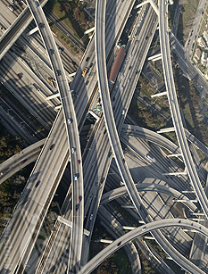
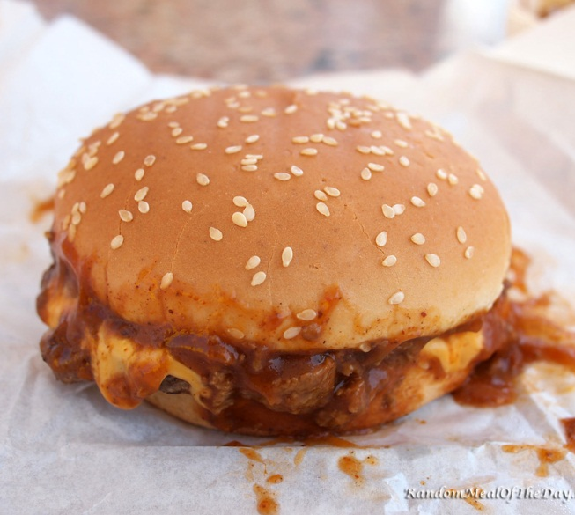
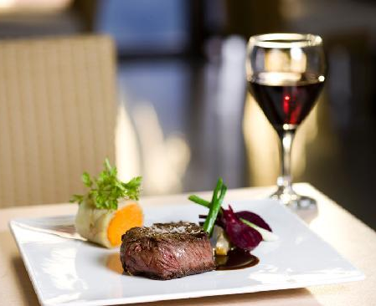
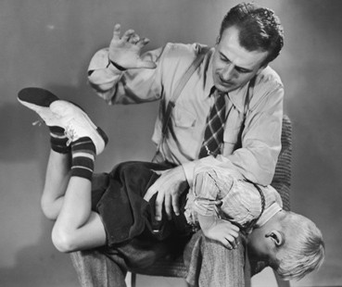

Game Theory

Slide 3
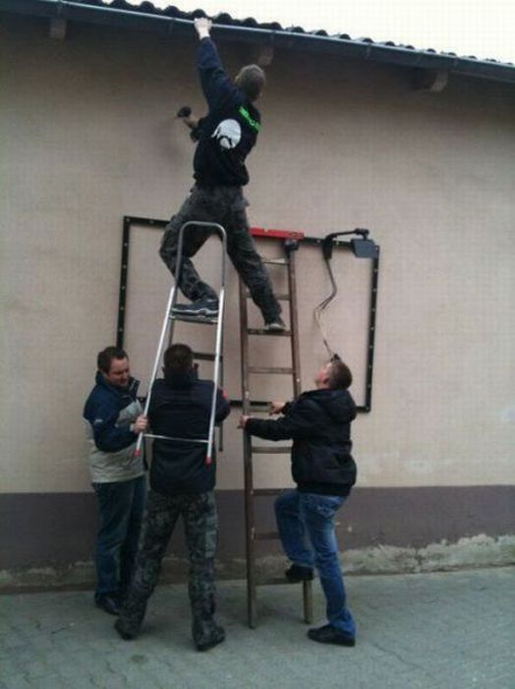
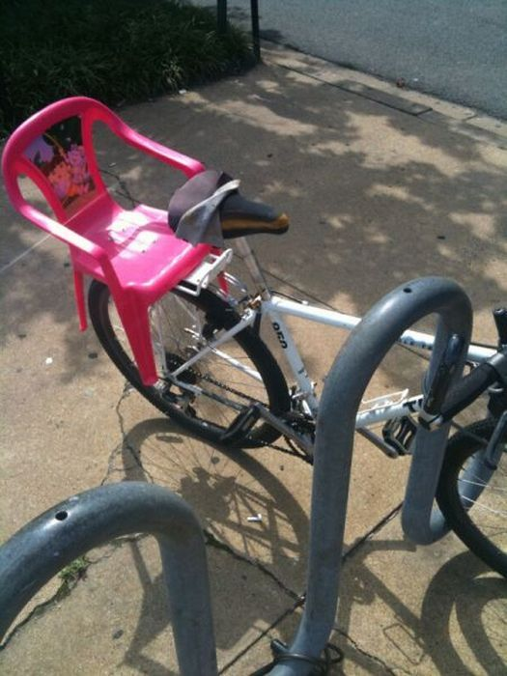
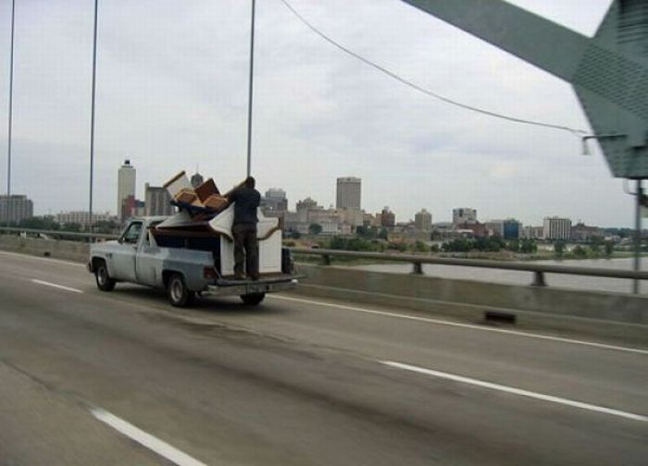
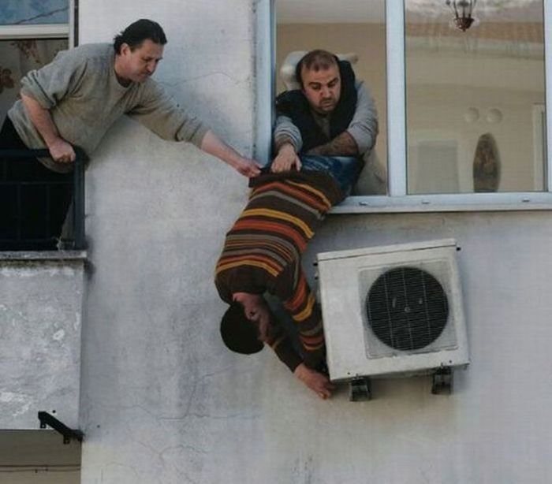
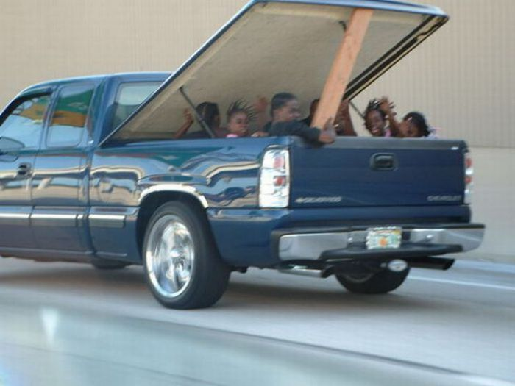

Slide 4
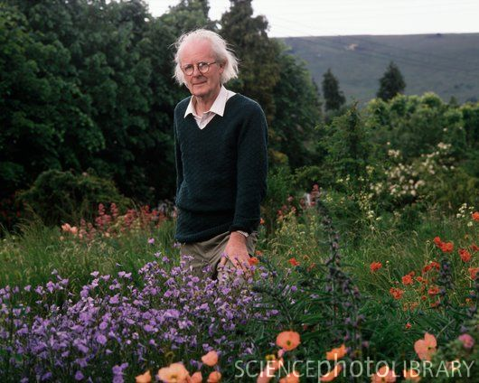
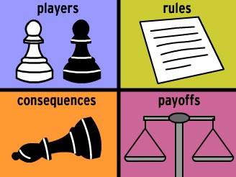
Applied to Evolutionary Biology
Provide hypotheses and predict how/why animals behave
Analyze costs and benefits of “decisions”
  Why can we predict behavior? What are animals trying to do?
Animals are not “conscious” beings – who makes the decisions?
Very successful in biology

Slide 5
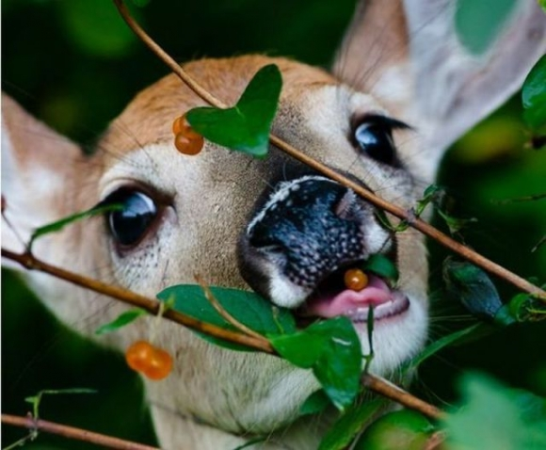
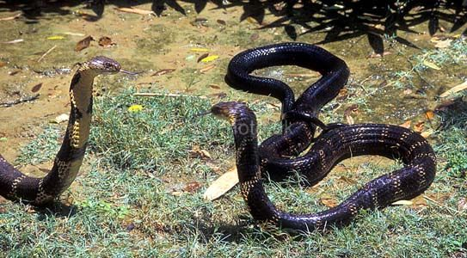
Two Types of Models
“Words such as decision, choice, or strategy are not intended to imply that animals consciously evaluate the costs and benefits of their hypothetical options…” Rubenstein

Slide 6
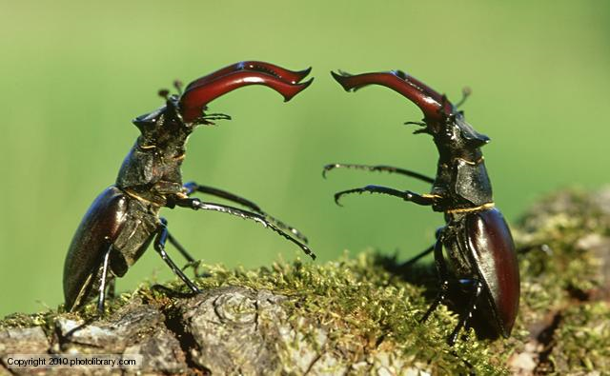
Aggressive Encounter Between Two Individuals
Each player has range of choices
Costs and benefits associated with each choice
Game theory estimates the average “payoff”
Some terms:
  Invasion – new strategy introduced and behavior increases in the population b/c better payoff (fitness)
  Evolutionary Stable Strategy (ESS) – strategy outcompetes others and can not be “invaded” by existing strategies
NOT like playing game for resources - Evolutionary game

Slide 7
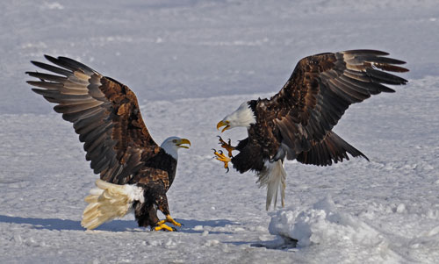
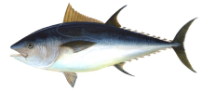
Simple game:
Who has the advantage?
What’s advantage to being dove?
Costs?
Benefits?
Costs?
Benefits?

Slide 8
Payoff Matrix: Hawk-Dove Game

Slide 9
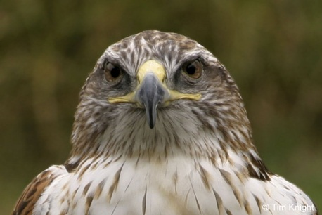



Four potential interactions
What does each player get out of the interaction?
 | Hawk | Dove
Dove

Slide 10
If the benefits are greater than the cost (B > C)…
is either Hawk or Dove an ESS?
Could a hawk invade a pop of doves?
Could a dove invade a pop of hawks?
 | Hawk | Dove
Hawk | ½B – ½C | B
Dove | 0 | ½B

Slide 11
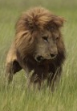
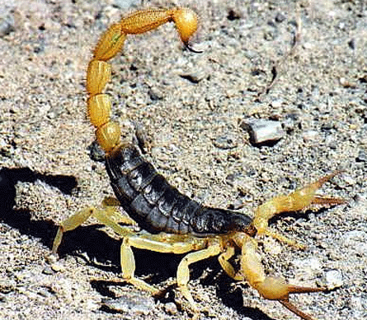
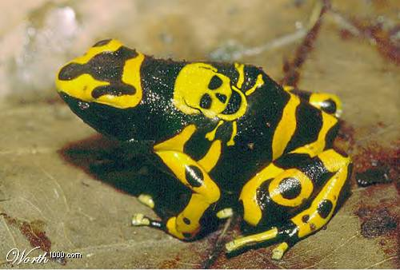
What if the costs are high (C > B)
Poison, sharp claws and teeth, etc.
Could a hawk invade a population of doves?
Could a dove invade a population of hawks?
 | Hawk | Dove
Hawk | ½B – ½C | B
Dove | 0 | ½B

Slide 12
Homework – add cost for wasted time

Slide 13
Mixed ESS

Slide 14
Retaliator

Slide 15
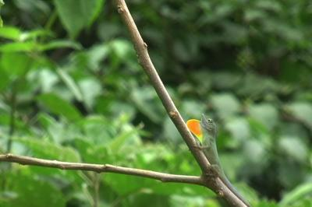
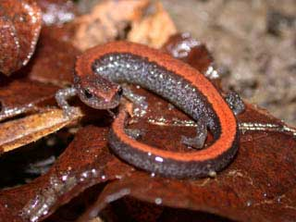
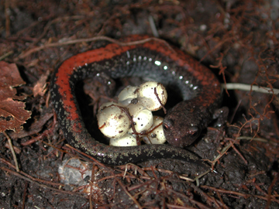
Bourgeois

Slide 16
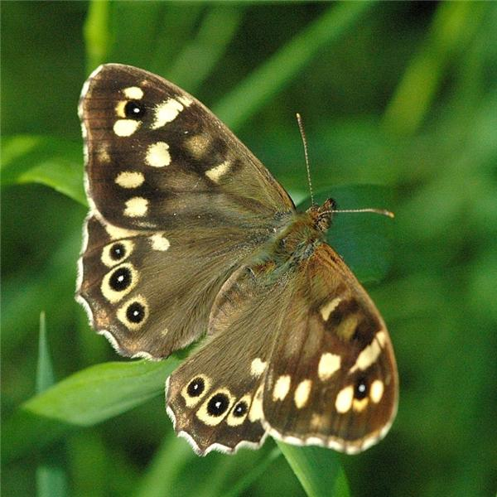
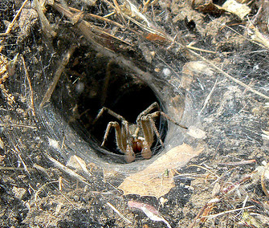
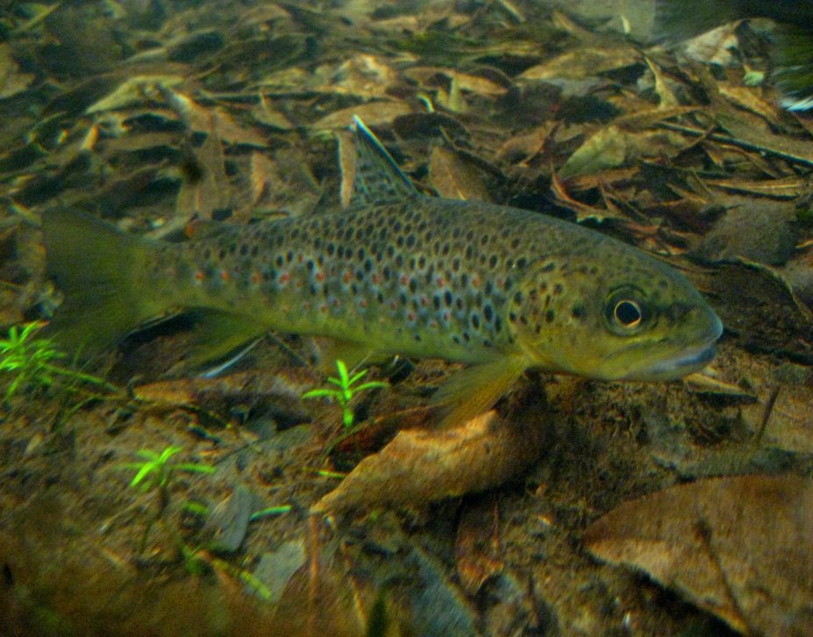
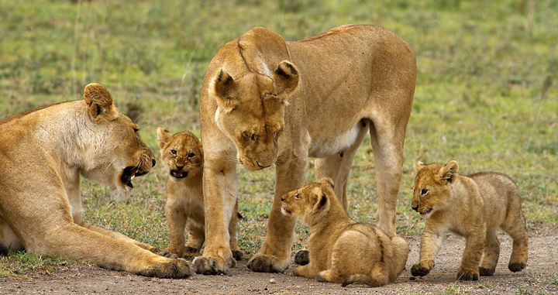
Applications of Game Theory
Territorial behavior
Sex ratio evolution
Evolution of litter size
Parental investment
Altruism
Reproductive behavior

Slide 17
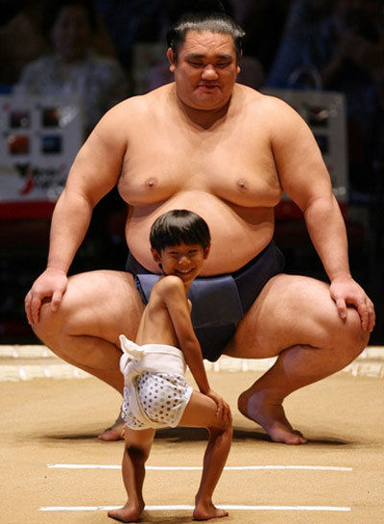
Two Classes of Contests
Symmetrical
Same strategies
Same payoff
Differences (strength, size, etc.) not present or unknown
Are contests between animals in nature likely to be completely symmetrical?

Slide 18
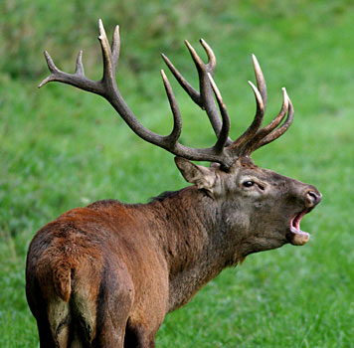
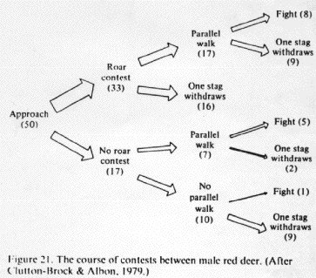
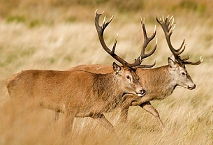
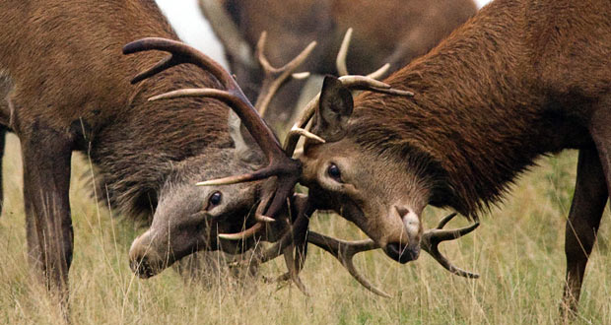
How do animals assess asymmetry?
http://www.youtube.com/watch?v=BPeDsOIhVik

Slide 19
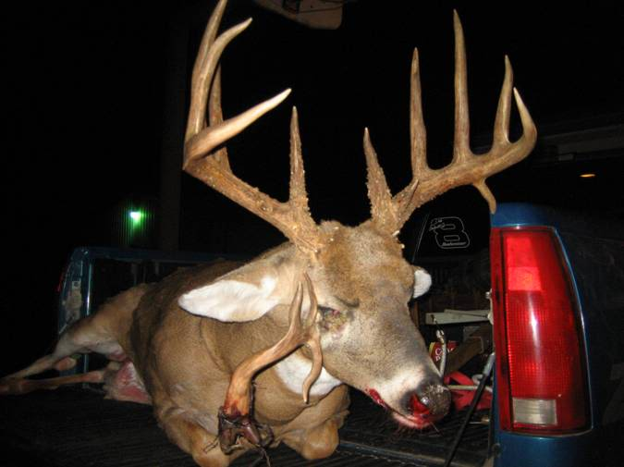
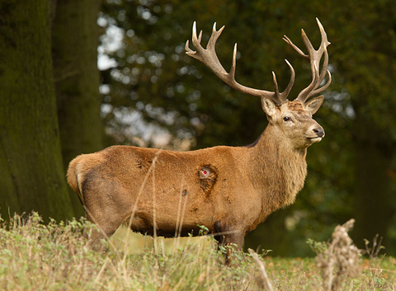
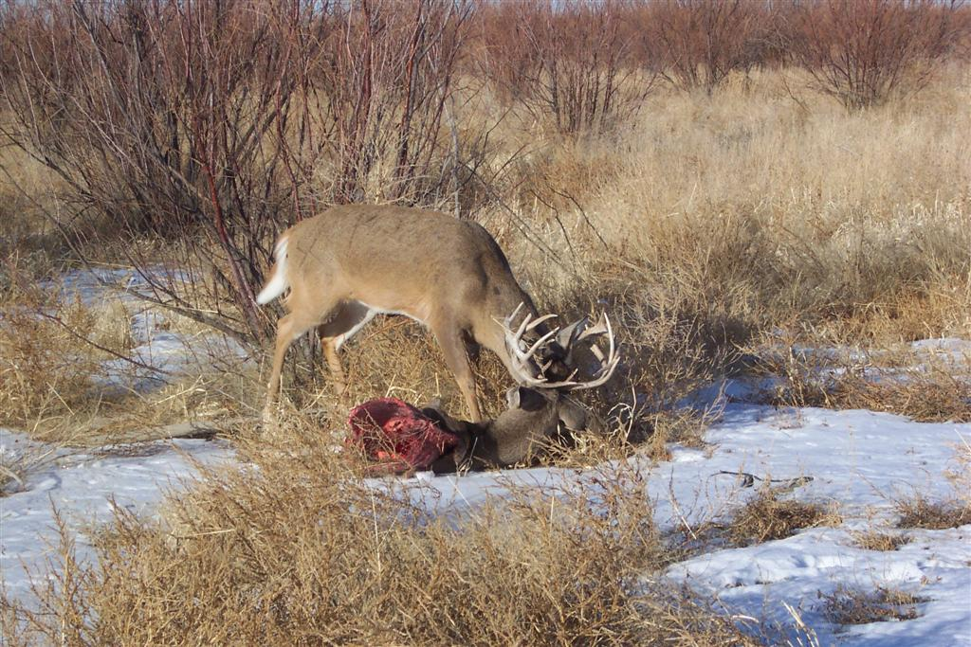
Why do so few contests result in fighting?
https://www.youtube.com/watch?v=_HwR-eFA9sY

Slide 20
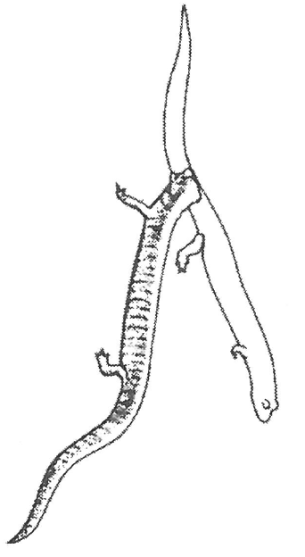
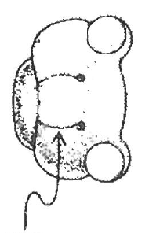
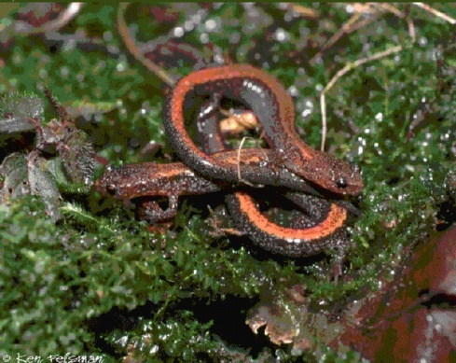
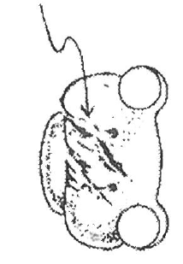
Why do so few contests result in fighting?

Slide 21
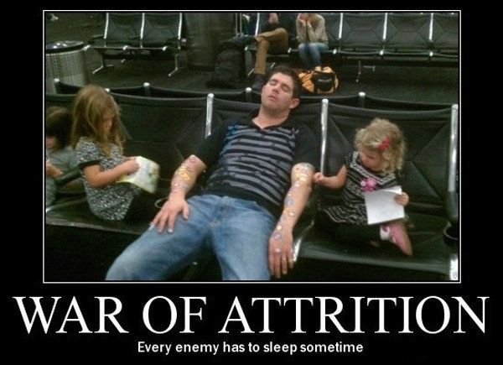
War of Attrition
Prediction:
  In symmetrical contest with mixed ESS
  If cost is a function of time
  Duration of contest is negative exponential

Slide 22
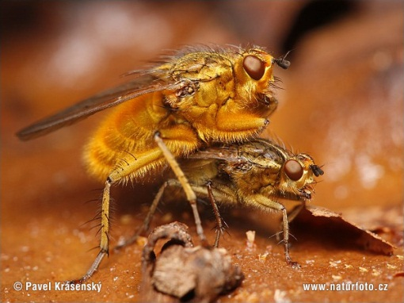
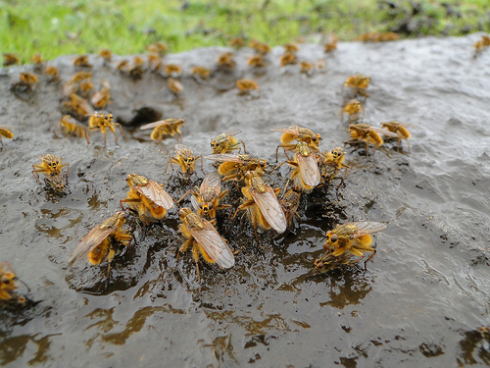
War of Attrition
Provides null test of war of attrition
All individuals must have equal payoff regardless of time invested
How long should a male stay at a cow patty?

Slide 23
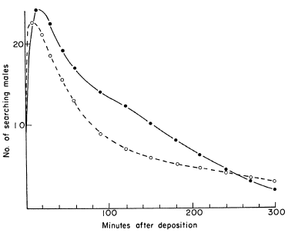
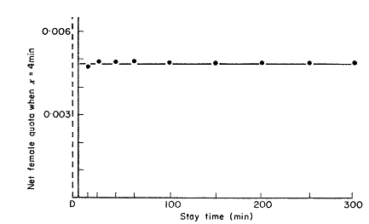
War of Attrition
Number of Males
Time Since Cowpat Laid (min)
Male Mating Success
Time On Cowpat (min)

