Slide 1
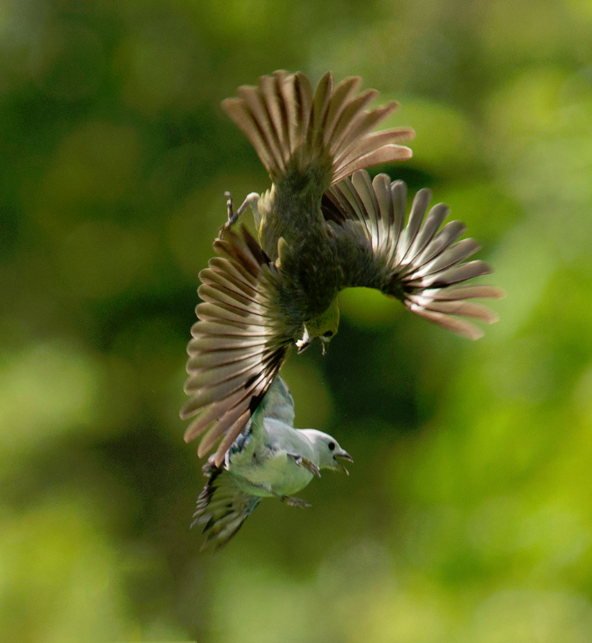
Competition/Territoriality

Slide 2
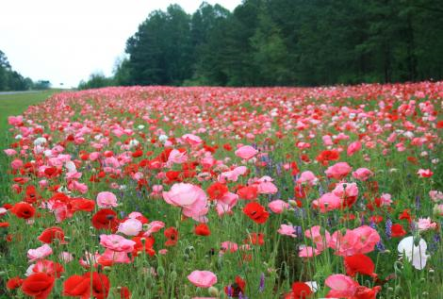
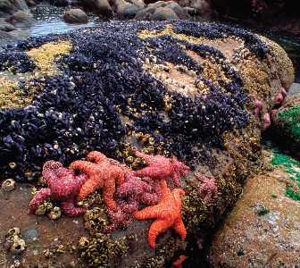
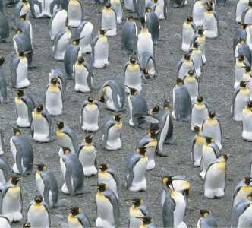
Within a population, animals can be observed to space themselves in a clump, uniformly spaced, or randomly.
What conditions cause those patterns?

Slide 3
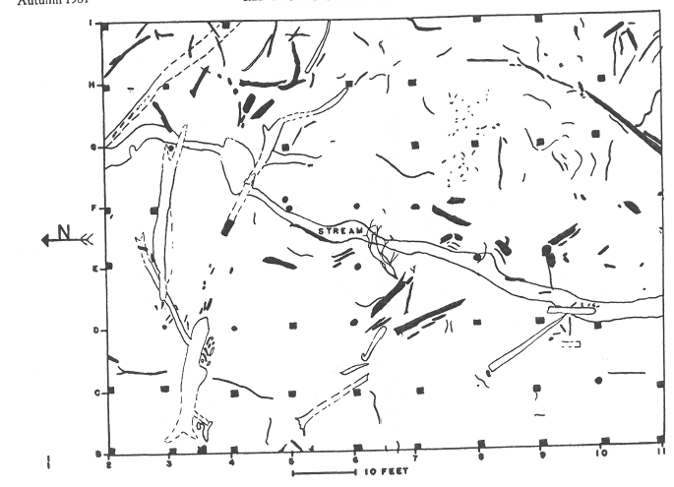
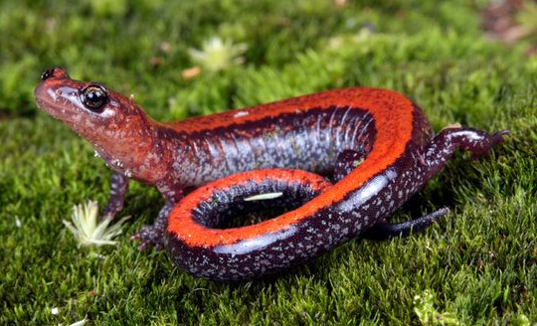
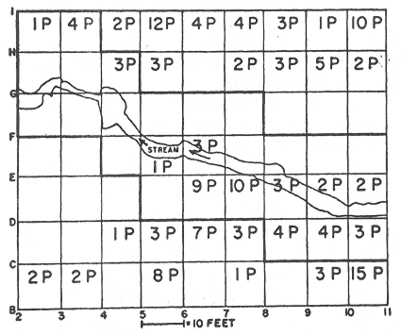
Testing Spacing Patterns
What pattern would this be?
Why?
What if we look at smaller spatial scales?

Slide 4
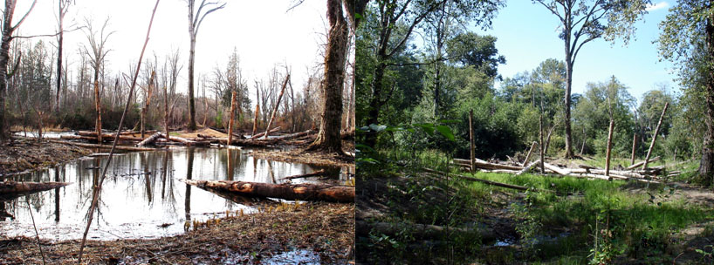
Habitats are variable.
When an animal chooses, must contend with variability
What conditions effect habitat quality?
What would you do if you were an animal and had to find a new place to live?

Slide 5
Choosing the Best Habitat
If you are the initial animal, where would you go?
What happens as more animals move into that good habitat?

Slide 6
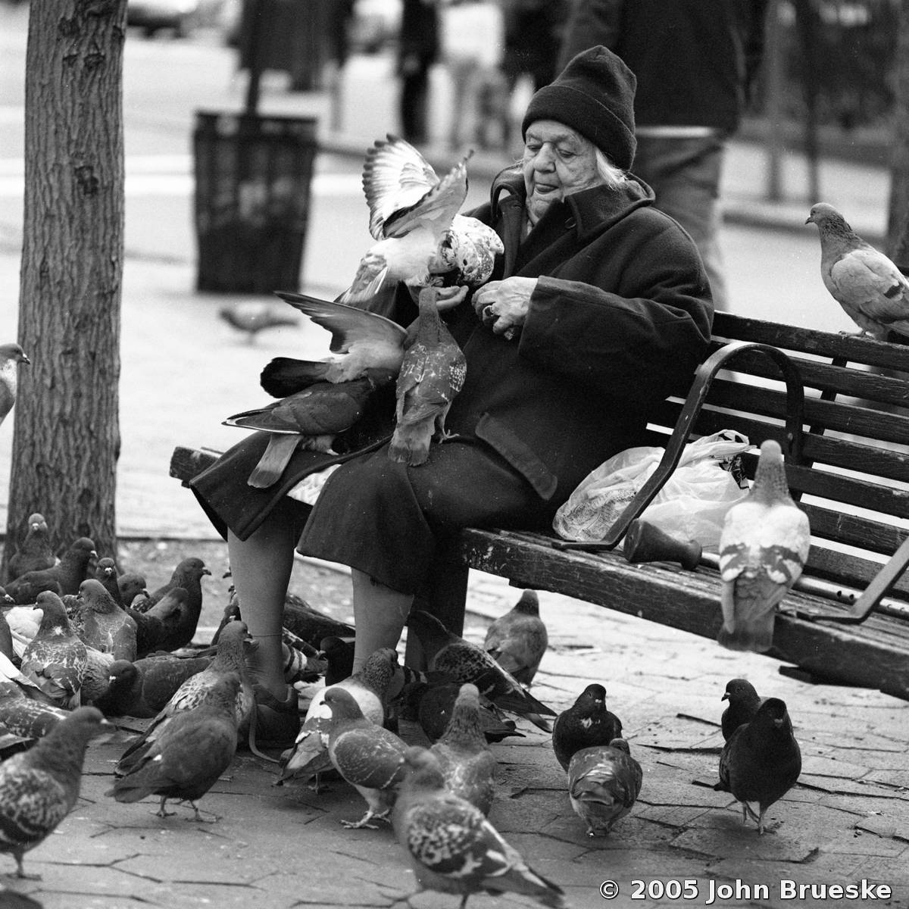
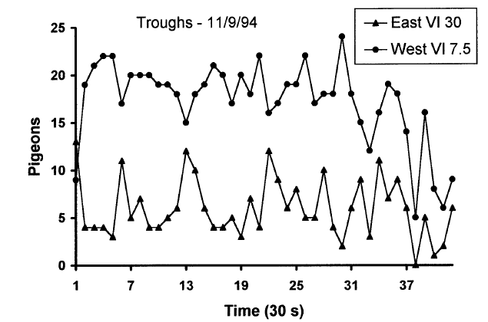
Example of Ideal Free Distribution
Baum and Kraft, 1998
20 Pigeons
All this assumes individuals are competively equal – Likely?
5 Pigeons

Slide 7
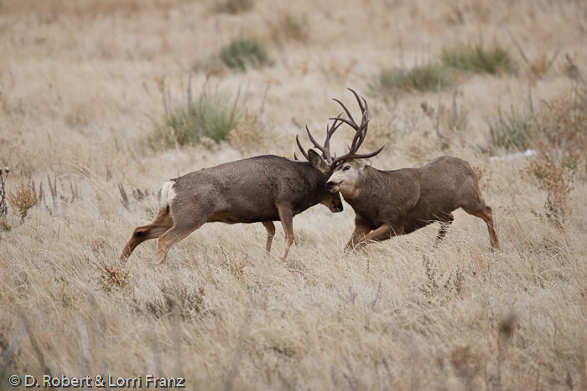
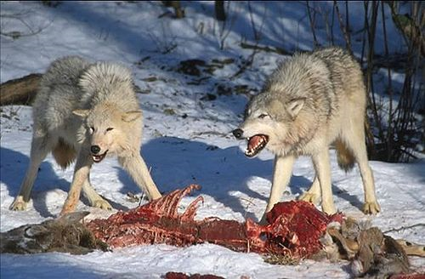
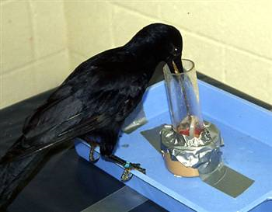
Competition is a major factor effecting where organisms choose to live
What are the fitness consequences for each player that competes?

Slide 8
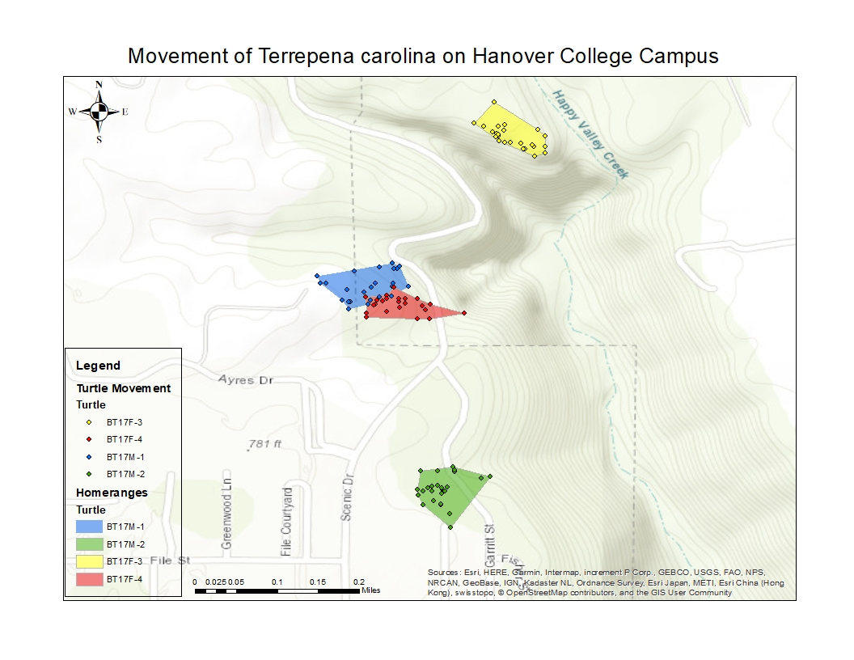
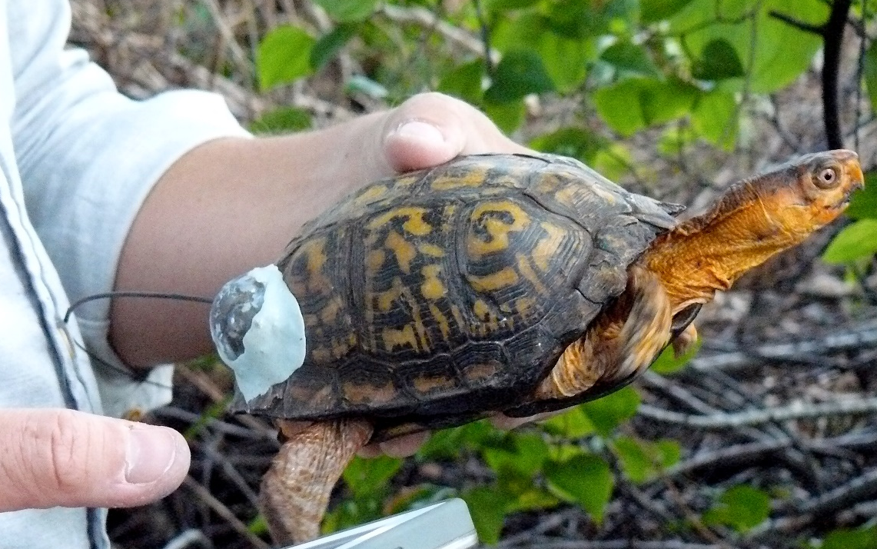
After evaluating quality, most animals will “settle” somewhere

Slide 9
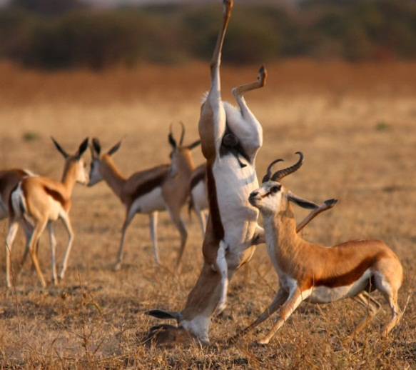
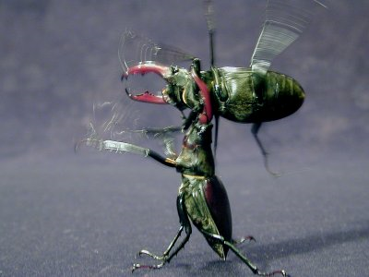
Home range ≠ territory
Let’s determine some properties of territories
  Zombie apocalypse happened
  Each of you work in teams to defend yourself (where? how?) - DETAIL
  If you are not yet zombified – how would you recognize it?

Slide 10
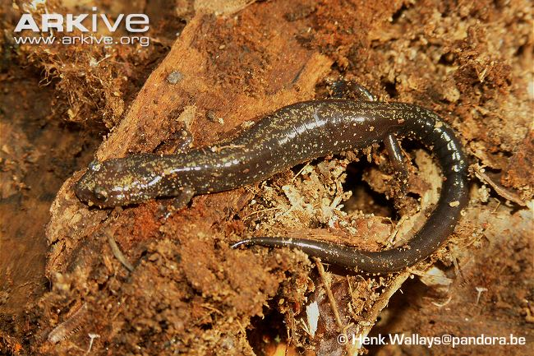
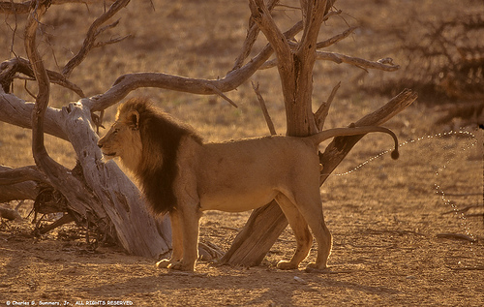
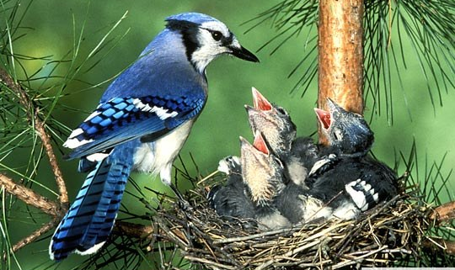
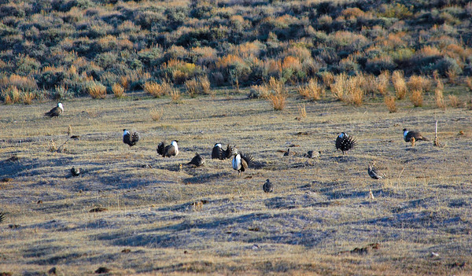
Why be territorial?

Slide 11
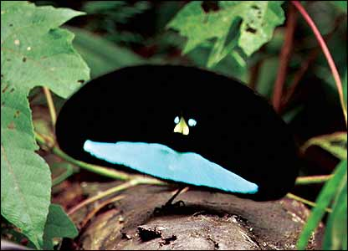
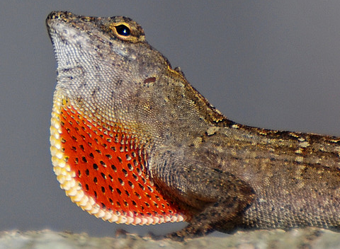
Evolution of Territoriality
Why do some species exhibit territoriality, but others don’t?
i.e. what do we need for territoriality to evolve?
Mathis et al. 1995

Slide 12
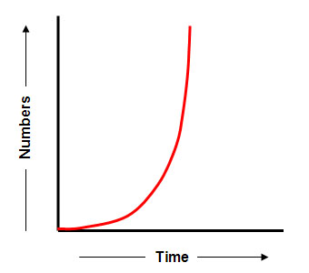
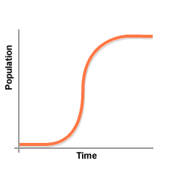
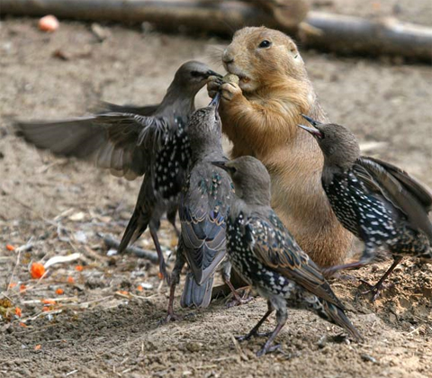
Evolution of Territoriality
Step 1:
Territoriality is a type of competition
Mathis et al. 1995

Slide 13
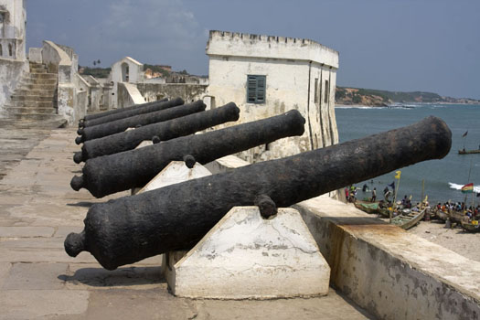
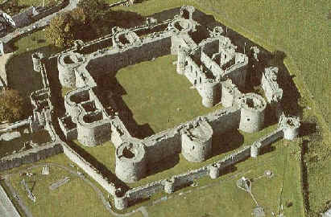
Evolution of Territoriality
Step 2:
Resource must be defended
Physically keep individuals from the resources
Mathis et al. 1995

Slide 14
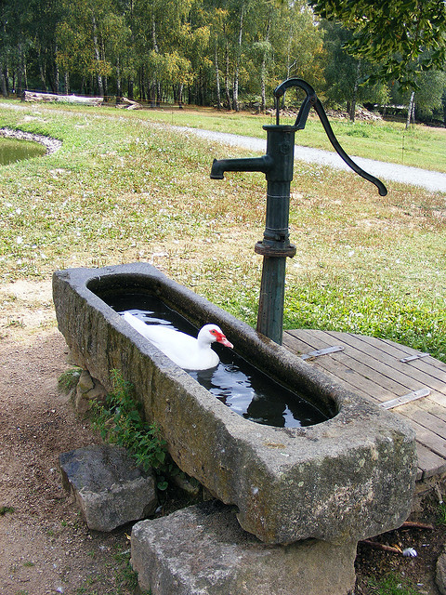
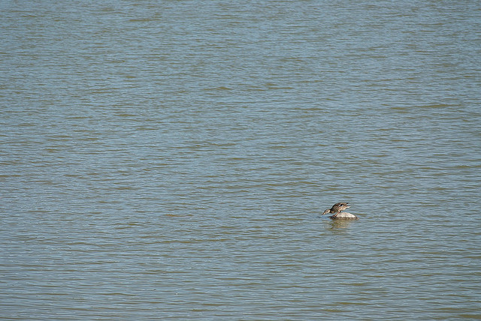
Evolution of Territoriality
Step 3:
Is the resource defendable?
Mathis et al. 1995

Slide 15
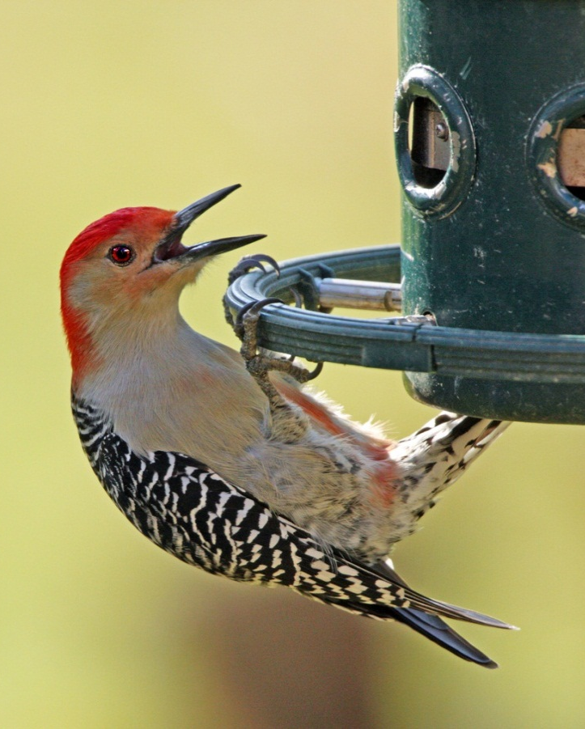
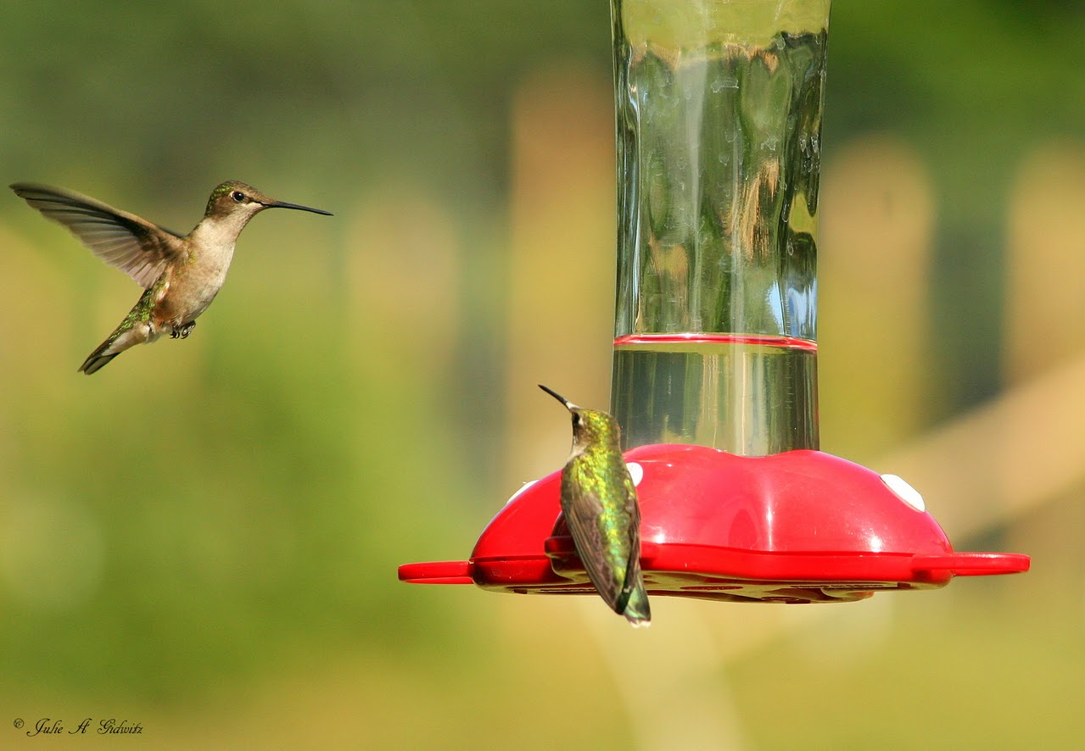
Evolution of Territoriality
Step 4:
Is the resource predictable?
Mathis et al. 1995

Slide 16
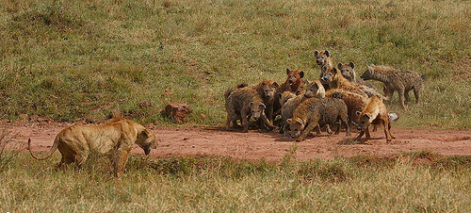
Evolution of Territoriality
Step 5:
Is intruder pressure too high?
Mathis et al. 1995

Slide 17
Evolution of Territoriality
Step 1: Limiting resource
Step 2: Behavior employed
Step 3: Distribution of resources
Step 4: Animal can predict presence
Step 5: Pressure from competitors
Mathis et al. 1995

Slide 18
Flow Diagram
Mathis et al. 1995

Slide 19
Optimality modeling
Critical tool in studying animal behavior
Used to predict optimal behavior under different conditions
What will cost and benefits lines look like?
If costs exceed benefits?
Where on the graph would you predict optimal behavior?
Notes:
Tool used to estimate the costs and benefits of a behavior
Predict the “optimal” behavior under different conditions

Slide 20
How Big of a Territory?
Let’s use optimality modeling to understand how territory size will change based on the following factors:
  Quality
  Body size
  Intruder pressure
  Number of defenders
Think about each scenario and determine whether cost or benefit curve will change (typically not both)
Change the curve
Estimate new territory size
Will territory size go up or down?

Slide 21
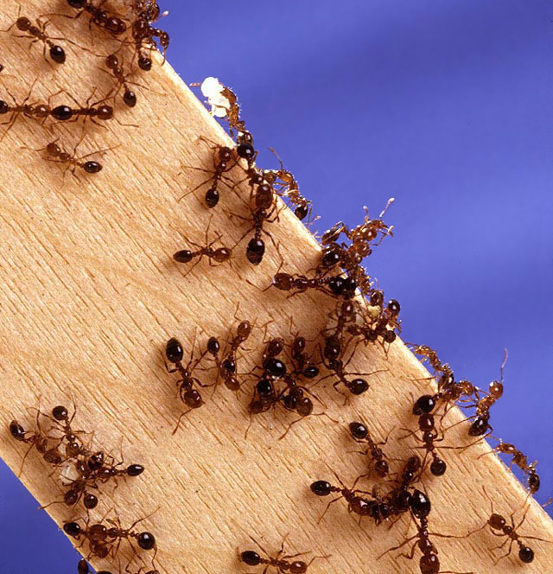
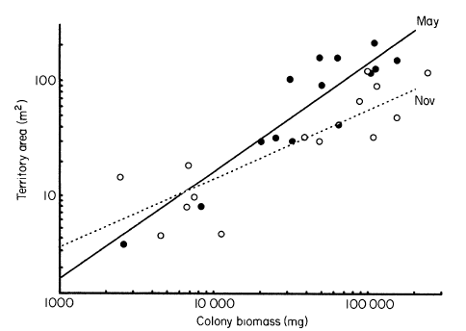
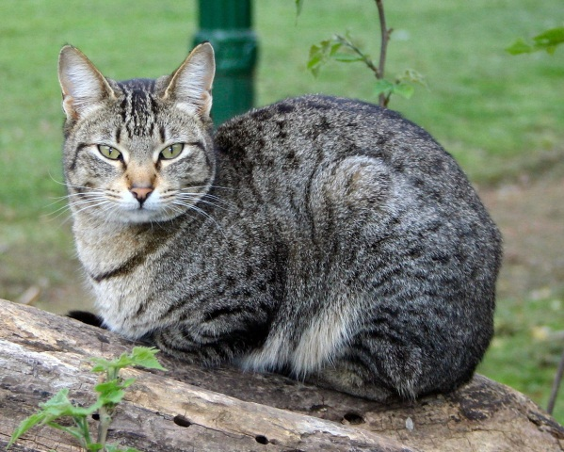
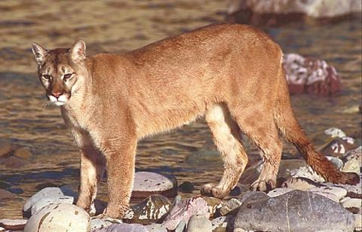
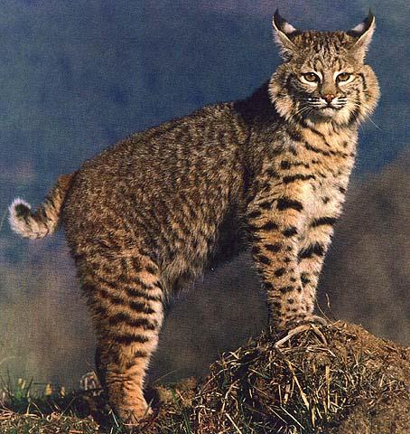
How Big of a Territory?
Domestic cat – 5 to 1000 acres
Bobcat – 6400 acres
Cougar – 64000 acres

Slide 22
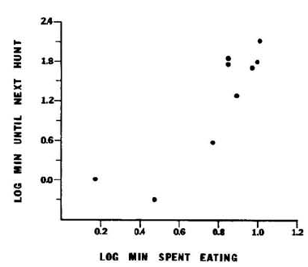
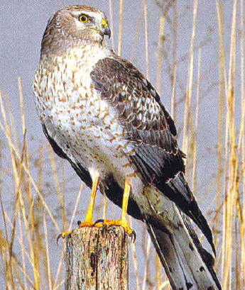
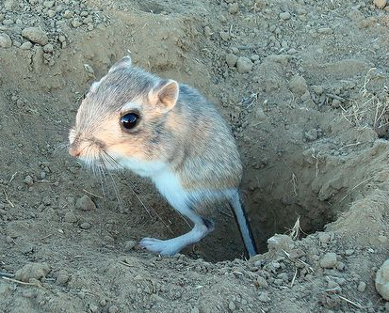
How Big of a Territory?
Effect of foraging constraints
http://www.youtube.com/watch?v=wkJLHnYy_G0

Slide 23
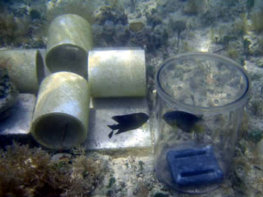
How Big of a Territory?
What will happen to territory size if intruders are eating all the recourses?
What will happen to territory size if intruders cost the owner a lot of time/E to defend?

Slide 24
How Big of a Territory?
Effect of number of defenders
  How would you expect an increasing number of defenders to impact territory size?

Slide 25
How can animals reduce the cost of defense?
Do this by developing a ZSP!
  During class → Zombie outbreak on campus
  Within 48 hrs, outbreak is global
  Where are you going to go? How will you survive?
  Want you to develop a plan to survive both short and long term
  Can’t be a drifter, goal is to develop your own zombie survival territory

Slide 26

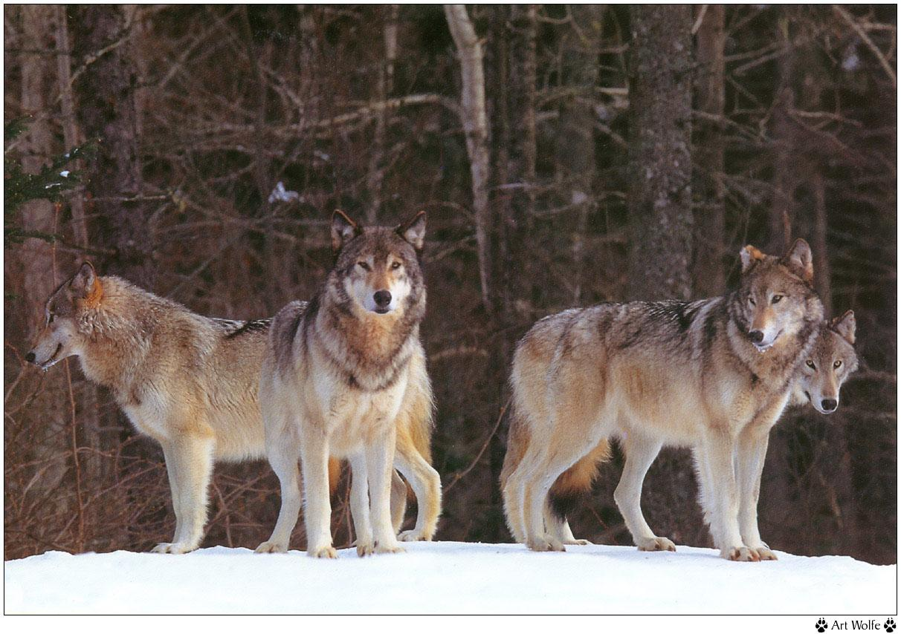
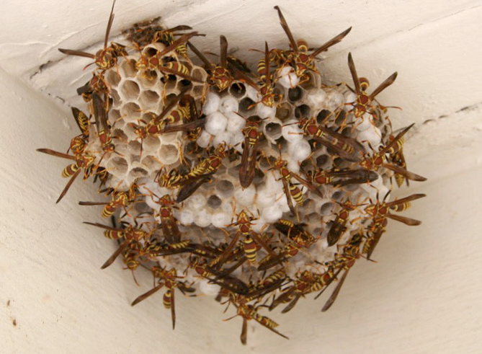
How can animals reduce the cost of defense? – first thing you did?

Slide 27
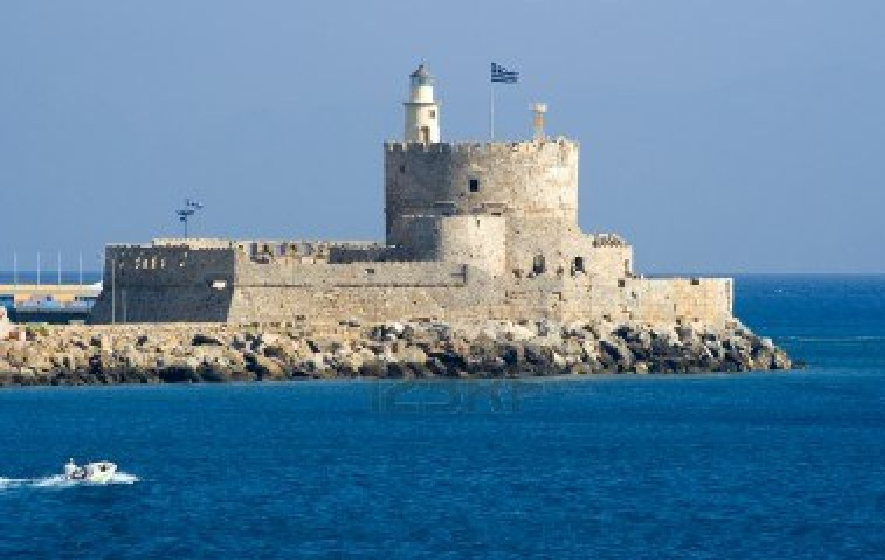
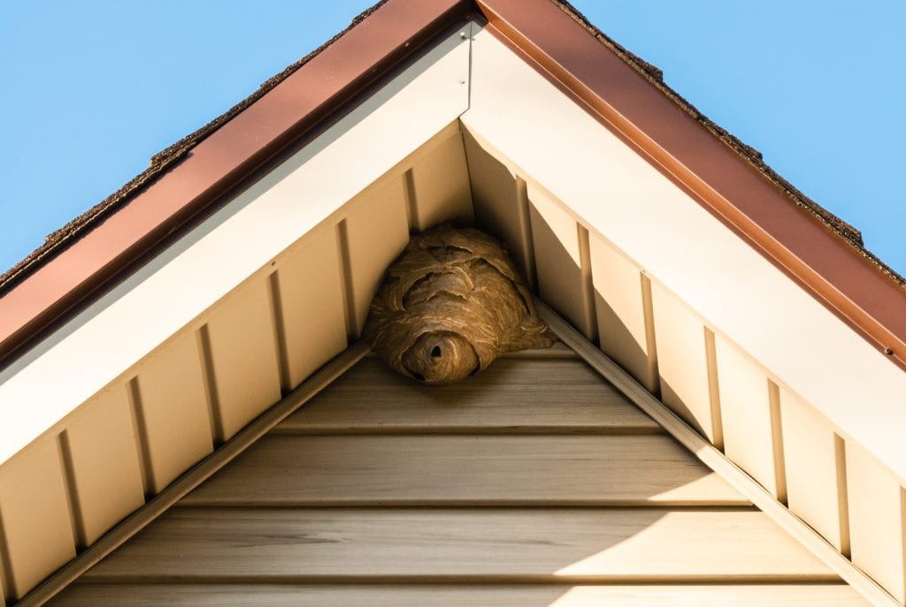
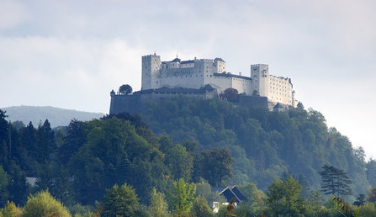
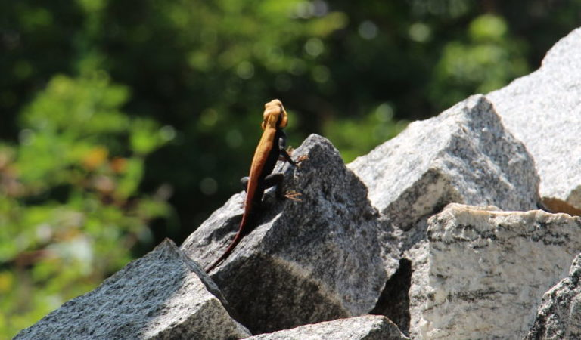
How can animals reduce the cost of defense? – location?

Slide 28


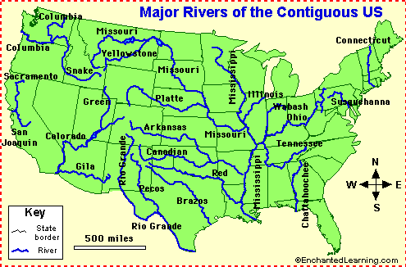
How can animals reduce the cost of defense?
How many states use rivers as part of their border?

Slide 29
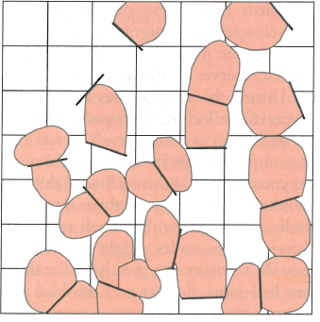



Reducing the Costs of Defense
Eason et al. 1999. Animal Behavior

