Slide 1
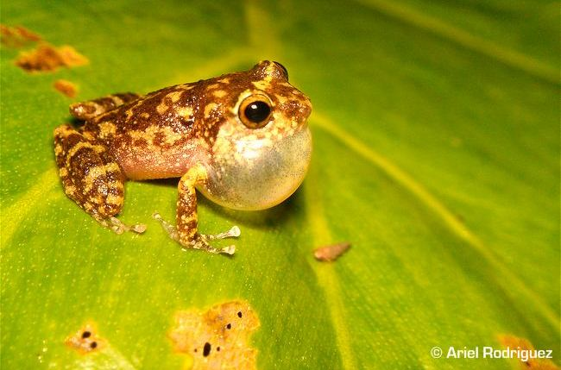
Communication

Slide 2
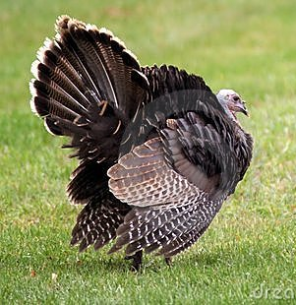
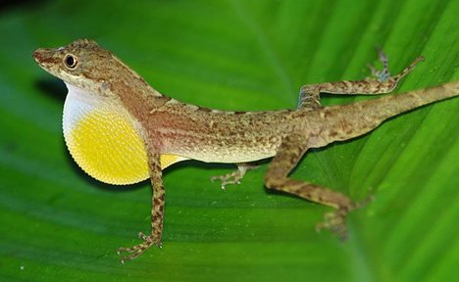
It’s not always this clear cut…
Example

Slide 3
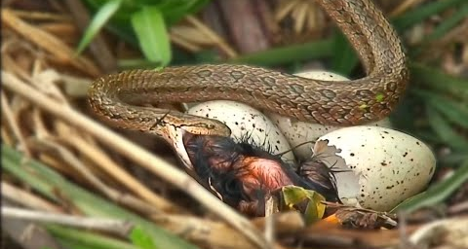
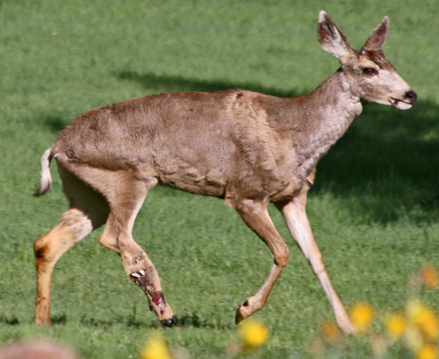
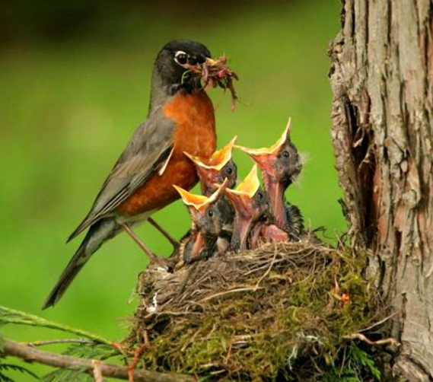
Restricted definition

Slide 4
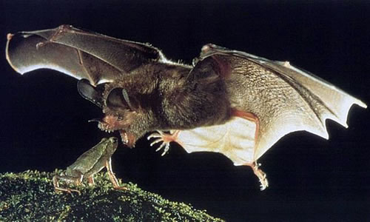
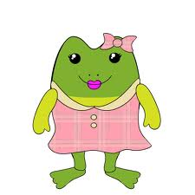
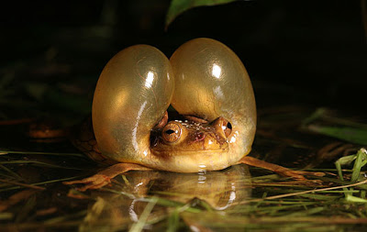
Problems
Difficult to know why behavior evolved
How do you distinguish between benefits that accrue to sender when received by many

Slide 5
So which definition do you buy into?

Slide 6
Cues vs Signals

Slide 7
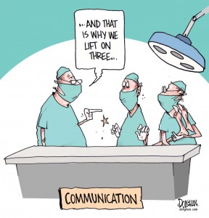
Channels for Communication
Make a table of all types of media for sending signals
Based on properties:
  Effective distance
  Localization of sender
  Goes around obstacles
  Speed of transmission
  Complexity
  Durability/longevity
Determine if have high, med, or low effectiveness
Remember these are relative

Slide 8
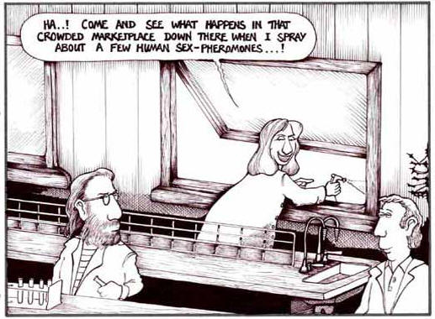
Chemical Communication

Slide 9
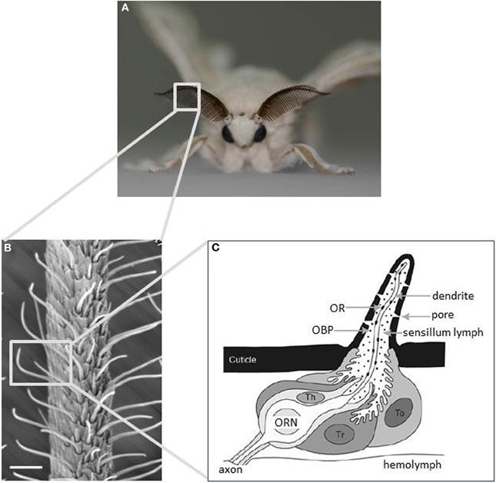
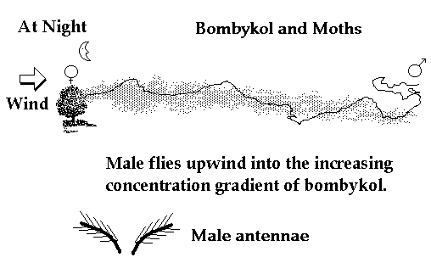
Silk Moth

Slide 10
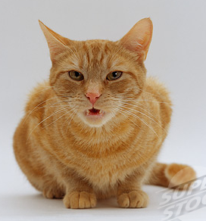
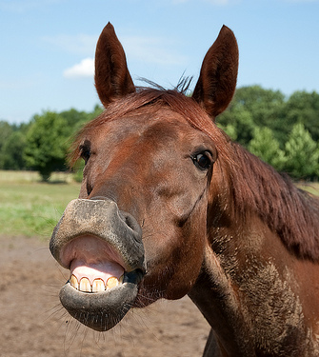
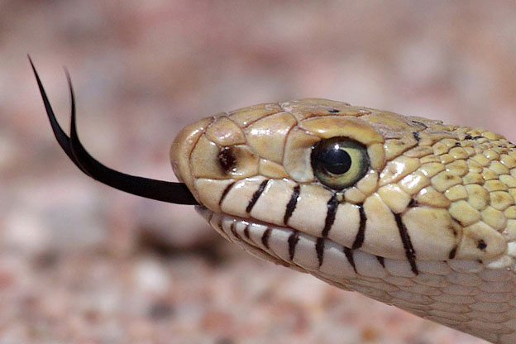
The Vomeronasal Organ
Amphibians, reptiles, and mammals
Functions: mates, parents/offspring, comp
Anatomically separate

Slide 11
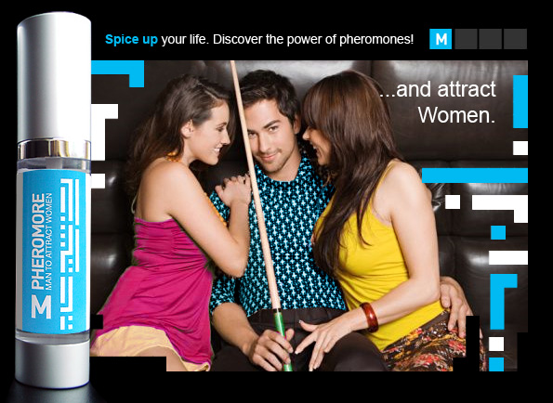
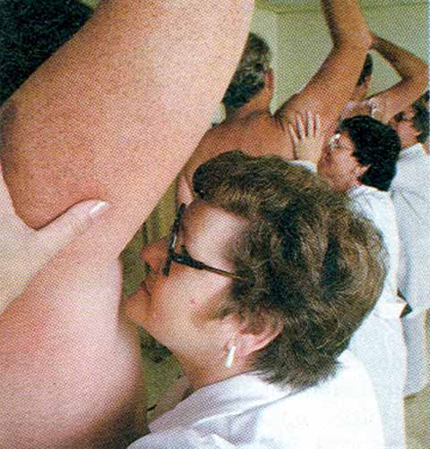
Do humans have pheromones?
https://www.youtube.com/watch?v=-drpViV5LSw

Slide 12
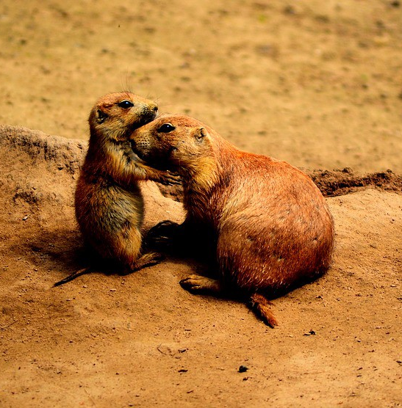
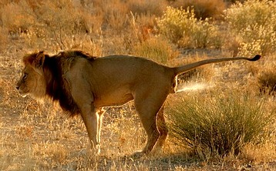
Communication “Pheromones” (now called “cues”)

Slide 13
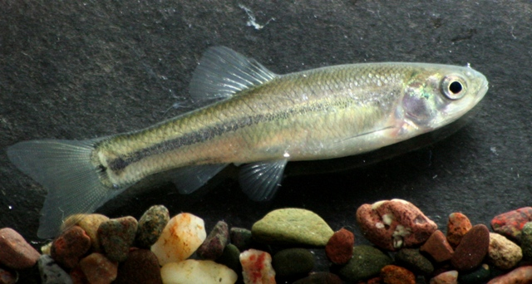
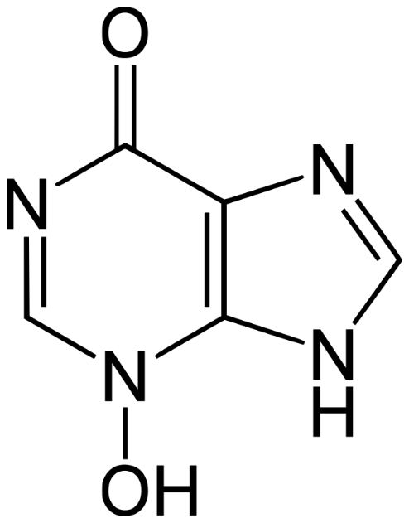
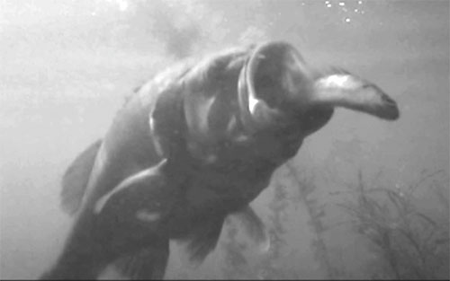
Alarm Cues

Slide 14
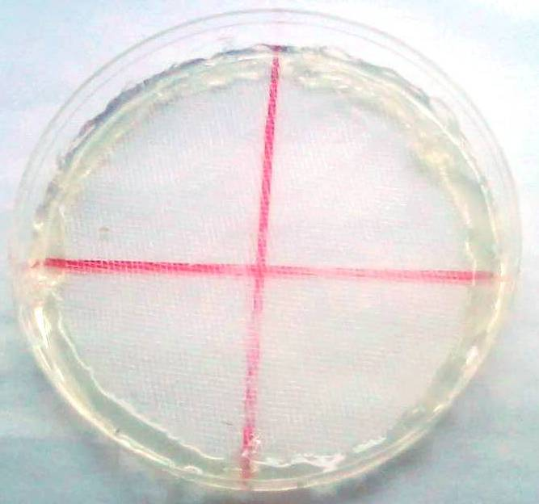
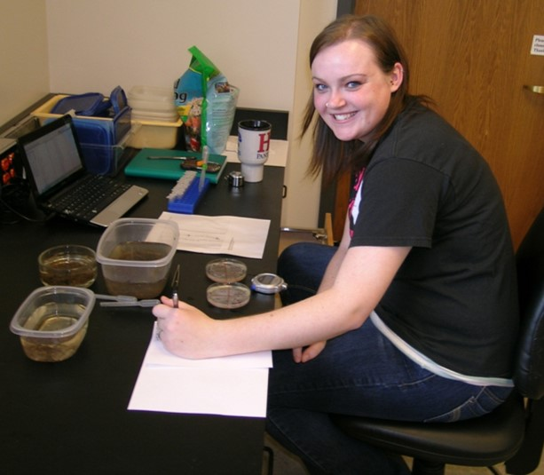
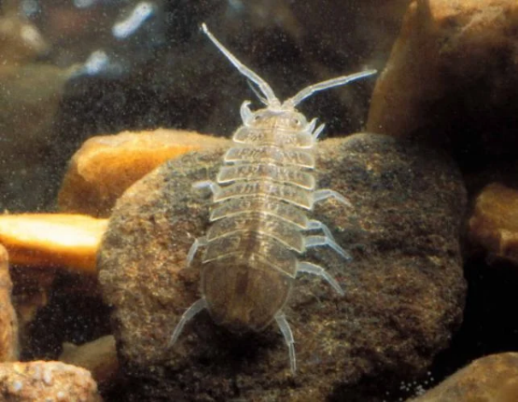
Communication “Pheromones”

Slide 15
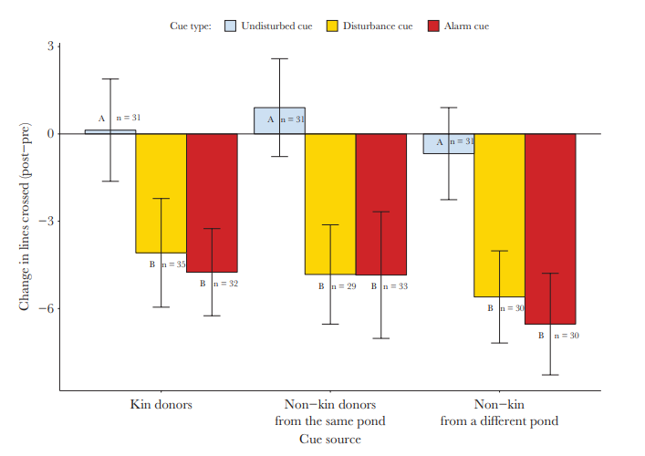
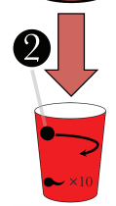
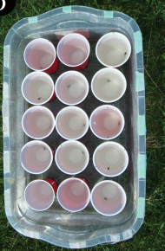
A new class of chemical…
Bairos-Novak et al. 2019. Behavioral Ecology

Slide 16
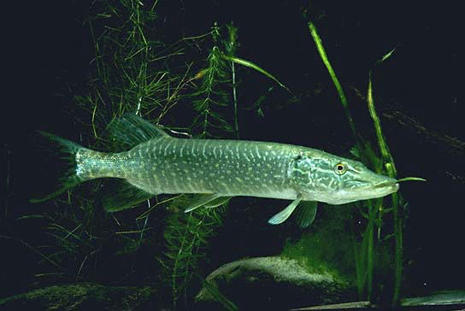
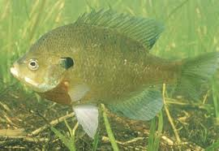
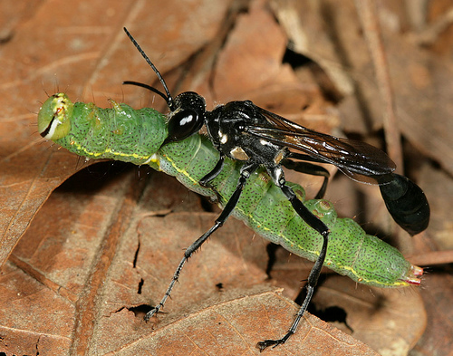
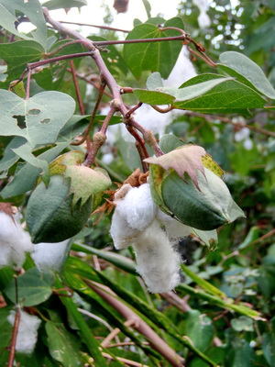
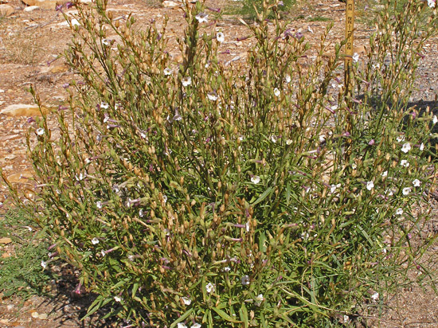
Allochemicals
Allmann & Baldwin. 2010. Science.
Kesler & Baldwin. 2001. Science.
Notes:
Show the data on attracting herbivores predator

Slide 17
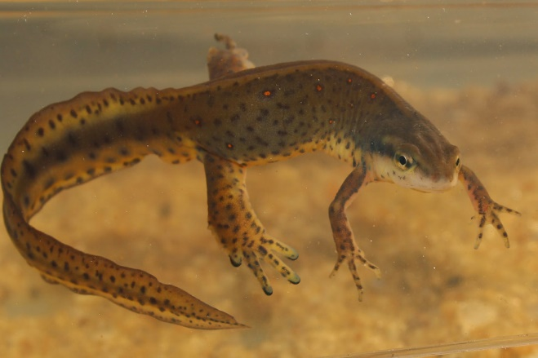

Slide 18
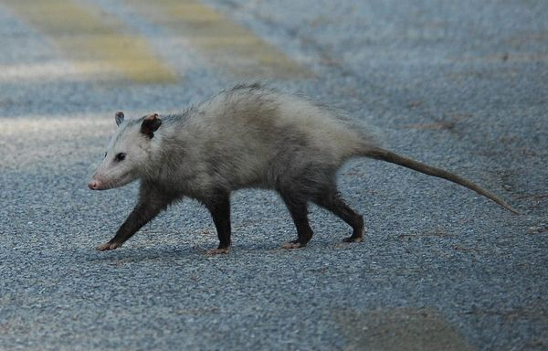
Observation
https://www.youtube.com/watch?v=xIwwo--5meU

Slide 19
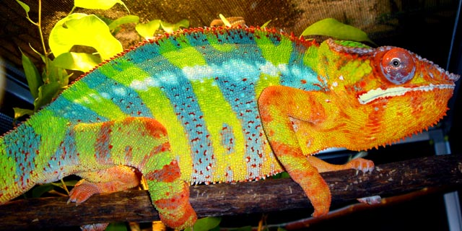
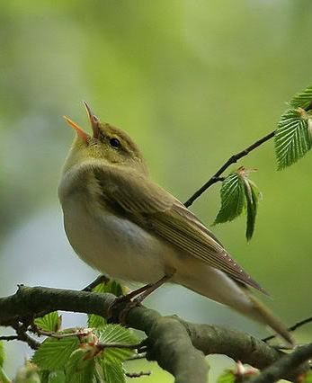
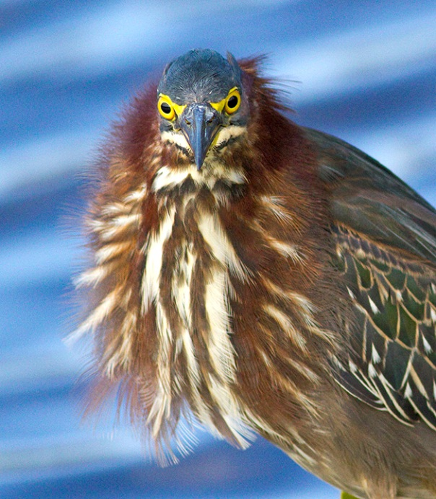
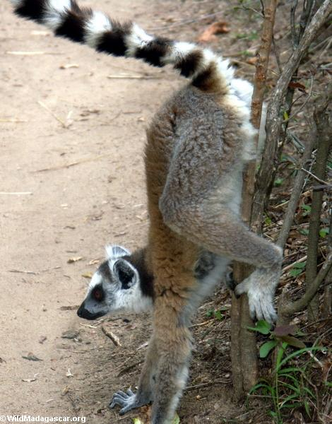
Hypotheses for Origin of Signals

Slide 20
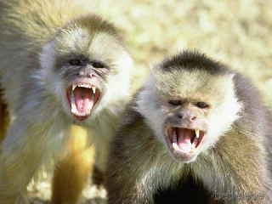
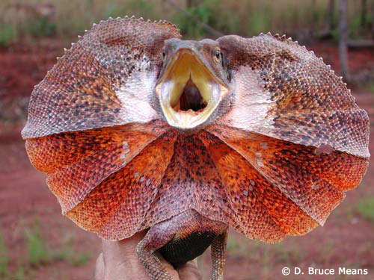
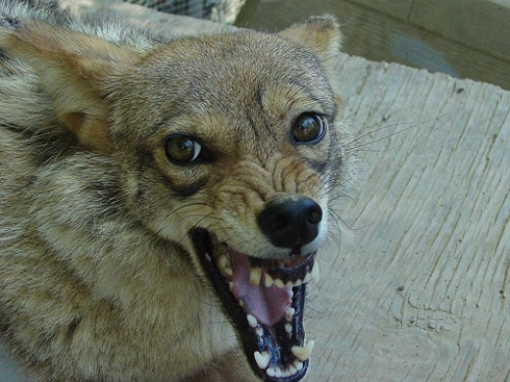
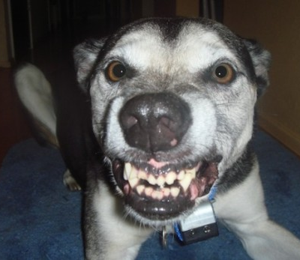
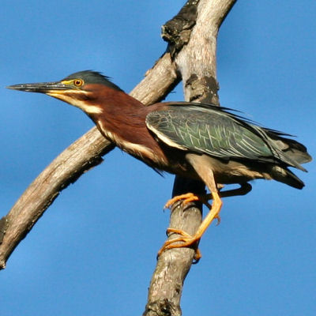
Hypotheses for Origins of Signals

Slide 21
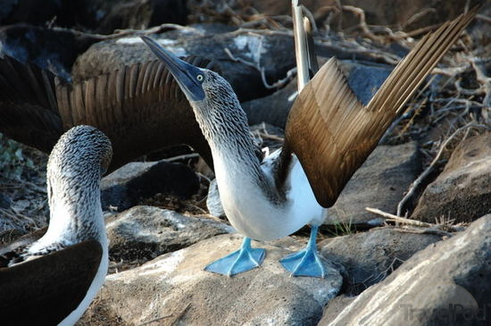
Hypotheses for Origins of Signals

Slide 22
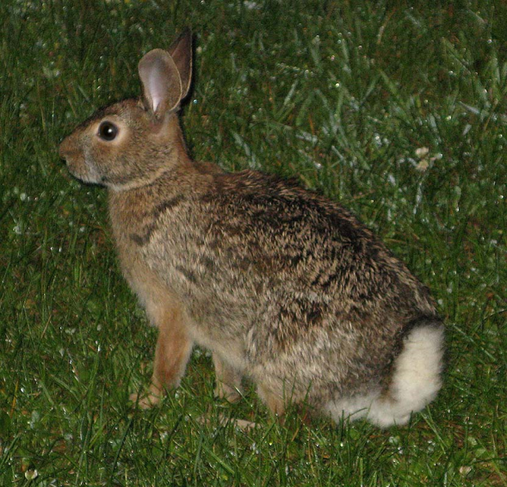
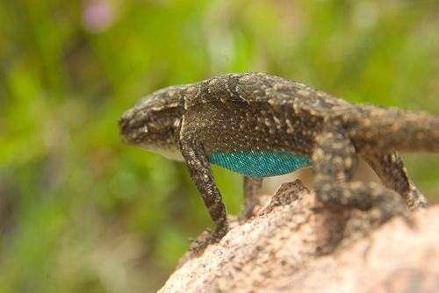
Hypotheses for Origins of Signals
    http://www.youtube.com/watch?v=ng7a9wkeke8
http://www.youtube.com/watch?v=9PanG0VF8pQ&playnext=1&list=PL0CF1F687BB1FDA5D

Slide 23
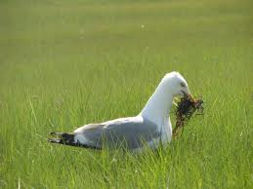
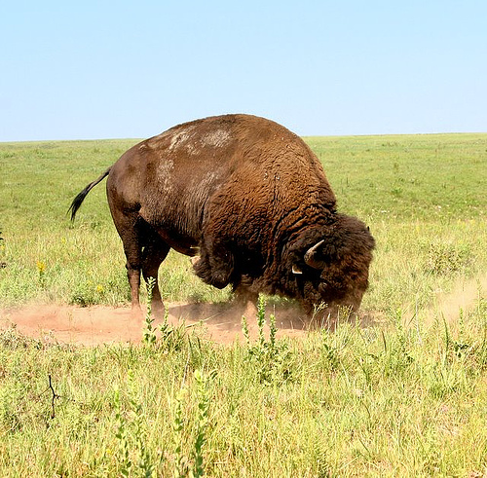

Slide 24



    Agitation increases hormones
      Agitation → adrenal gland → adrenaline → unrelated behavior
Sand digging in sticklebacks
Courtship preening in ducks

Slide 25



Jolles et al. 1979, Novelty and Grooming Behavior in the Rat
Home
Novel

Slide 26



Hypotheses for Origins of Signals
Involuntary responses

Slide 27

Female baboons have open skin that gets increased blood flow when aroused
Domb and Pagel, 2001, Sexual swellings advertise female quality in wild baboons, Nature

Slide 28


Hypotheses for Origins of Signals
Receiver has a pre-existing preference for a particular signal
e.g. female hear a sound better, or see a particular color more easily
That sound or color evolves to be a signal

Slide 29


Tungara Frog
Physalaemus pustulosus
Males call to attract females
Two-part call

Slide 31



Preference?
Frog ear morphology
Papilla vibrate at different frequencies
  Which call should be most attractive?

Slide 32


Slide 33


For this to be sensory exploitation, which has to come first (call or preference)?
Physalaemus coloradorum
Kirpatrick and Ryan, 1991
Notes:
Sonogram of the mating call of male tungara frogs, Physalaemus spp., containing a whine (long horizontal lines) and two chucks (stacked lines at the end). b) The small panel for each species gives the amount of energy in the call over time. The high energy chuck is restricted to the end denoted by brackets. The distribution of female preference and male traits in the phylogeny of tungara frogs: P+ preference present, T+ male chuck present, and T- male chuck absent. Even though the males of the two species considered to be more ancestral, P. coloradorum and P. pustulatus, do not use a chuck in their calls, females of these species appear to have an ancestral bias or pre-existing predisposition for males with the chuck. Thus, the existence of a chuck in the derived calls of P. petersi and P. pustulosus are thought to have originated because the hypothetical common ancestor at the root of the tree had females with the pre-existing preference. (from (Kirkpatrick and Ryan 1991).

Slide 34



Swordtails

Slide 35


Slide 36






Ritualization of Signals
Once established often become elaborate (stereotyped, repetitive, exaggerated

Slide 37

http://www.youtube.com/watch?v=A1FWQvaBoRg

Slide 38





Hypotheses for Ritualization
Kitano 2008, Behaviour

Slide 39


Hypotheses for Ritualization
  Once signal established, males exploit the preference until signal becomes very elaborate
  Examples
    Tungura frogs
    Guppies
    Water mites

Slide 40



Hypotheses for Ritualization
http://www.youtube.com/watch?v=UNIExML05K0
http://www.youtube.com/watch?v=4EJbxKnDvaA

Slide 41


Hypotheses for Ritualization

Slide 42




When to expect honest signals
If senders and receivers share overlapping goals
Signal is tied to a physical characteristic and cannot be faked
Notes:
Signals that are difficult or that can’t be copied
Called the handicap hypothesis (or principle): exaggerated ornaments signal high viability because only good condition males can put the energy into those signals.

Slide 43


Orange as an Honest Signal In Guppies
Made by plants
Benefits:
  Vitamin A
  Antioxidants
  Immune enhancement
  Cancer inhibition
Females prefer orange
If an animal has more orange, what does this tell the female?
ORANGE acts as an HONEST signal

Slide 44




Ornamentation in Birds
Walther and Clayton. 2005. Proc Royal Soc London

Slide 45


Roaring in Red Deer
Europes “elk”
Roaring rate correlated with fighting ability and mating success
Only large, strong and healthy males can roar enough to attract females
http://www.youtube.com/watch?v=DqBk2-W9E_c
McComb. 1991. Animal Behavior

Slide 46





Why can’t animals fake a signal?
- Immunocompetence Hypothesis
Notes:
Signals that are difficult or that can’t be copied
Called the handicap hypothesis (or principle): exaggerated ornaments signal high viability because only good condition males can put the energy into those signals.

Slide 47


When to Expect Honest signals
c) If dishonest signalers can be identified
  May be sender one minute & receiver the next
  May be identifiable and punished
Notes:
Signals that are difficult or that can’t be copied
Called the handicap hypothesis (or principle): exaggerated ornaments signal high viability because only good condition males can put the energy into those signals.

Slide 48


Does (signal) cheating ever happen?
Under what conditions can it be maintained?
http://www.youtube.com/watch?v=T8cnEXIwjWA
Notes:
Pregnant females may copulate with new males to prevent infanticide
False alarm calls in birds

Slide 49



Development of Elaborate Displays: comparative evidence

Slide 50

Honeybee Communication
http://www.youtube.com/watch?v=-7ijI-g4jHg

Slide 51
Bee Foraging Exercise

Slide 52



How could this evolve?
Incredibly complex
Ancestor
Trigona perform excited movements and “hum”
Intermediate
Trigona marks path to food with pheromone
Complex
Melipona fly in direction of food and make sound pulses to convey distance
Very Complex
Apis florea dances on horizontal surface
Trigona
Honeybee
Melipona

Slide 53


Lindauer’s Evolutionary Scenario
Distance
  Started with agitation
  Workers stimulated to leave
  Movements became standardized
Direction
  Started with leading
  Evolved to pointing
  Pointing with zigzag dance
  Converted to sun compass

