Slide 1
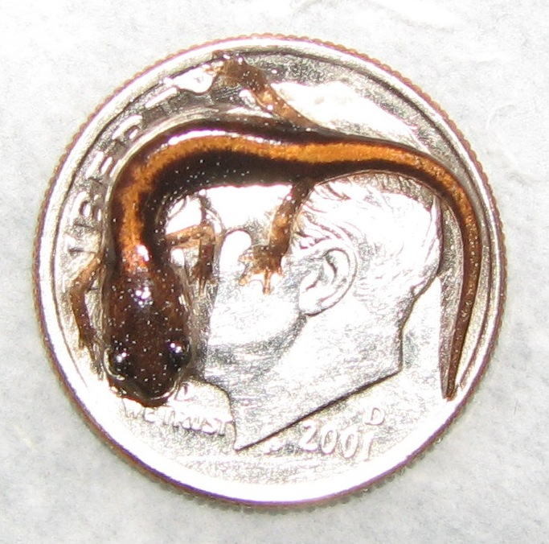
Developmental effects
Instincts and learning
Genes and behavior

Slide 2
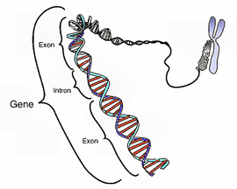
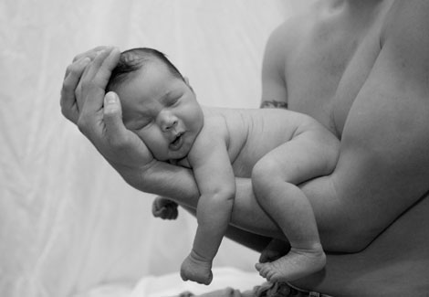
Development of Behavior
Notes:
Nature – genetically determined traits
Nurture – Environmentally determined traits
Deeply rooted in animal behaviors – instincts are said to be controlled by genes whereas learning is controlled by environmental factors

Slide 3
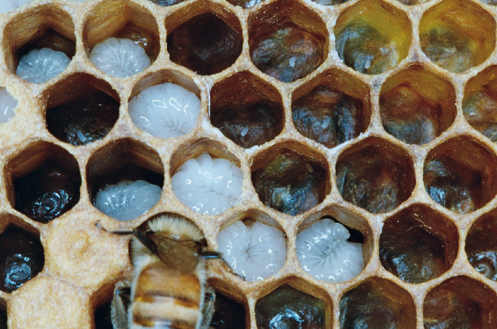
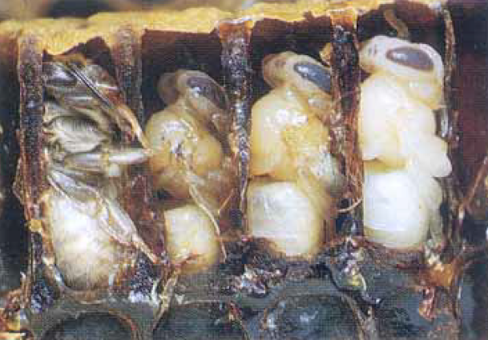
Nature vs. Nurture in Bees

Slide 4
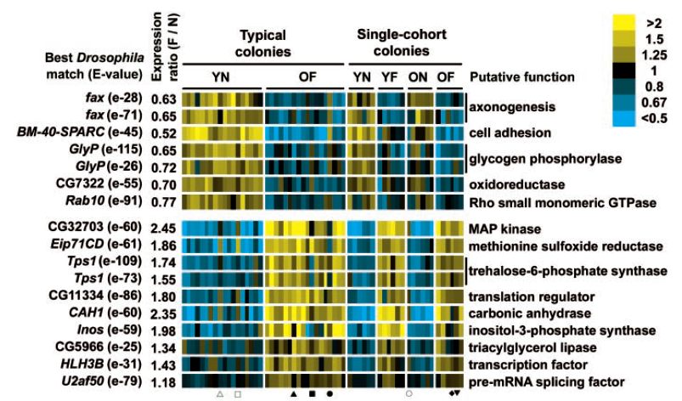
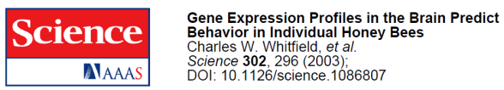
What cause these dramatic shifts?
Whitfield (2004)
  Used microarrays
  Compared brain of workers & foragers
  Different protein output in 2000 genes
  Changes are correlated with changes in behavior
YN = young nurse
OF = old forager
YF = young forager
ON = old nurse

Slide 5
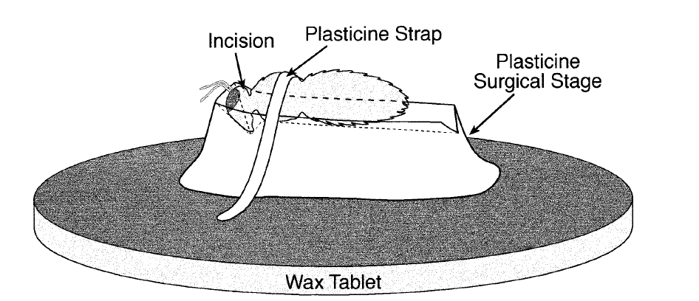
Nature vs. Nurture in Bees
Gene activation doesn’t explain everything
What is responsible for shift in gene expression?
Three different environmental factors influence behavior of bees
Sullivan et al. 2000

Slide 6
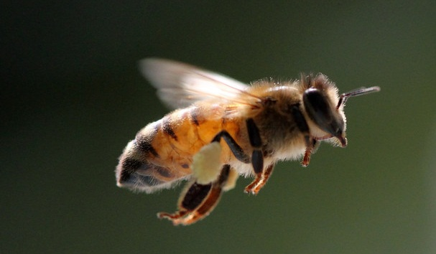
Which is it, nature or nurture?

Slide 7
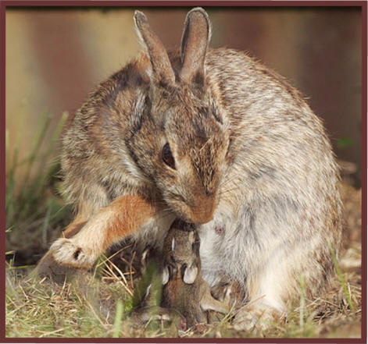
We know behavior changes over time
Ontogeny
Tinbergen’s second question
Can experiences before birth impact behavior?

Slide 8
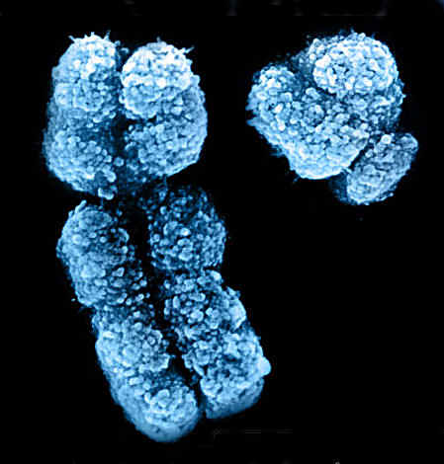

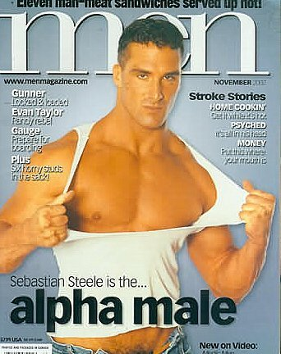
Hormones
In mammals, what determines the sex of offspring?
Determines phenotype
Hint

Slide 9
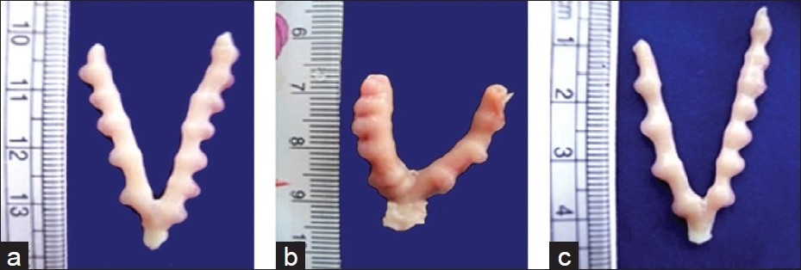

Slide 10
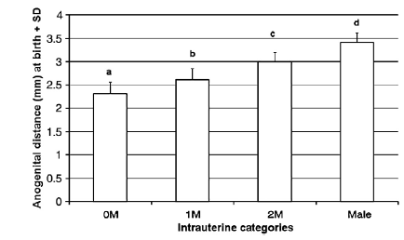
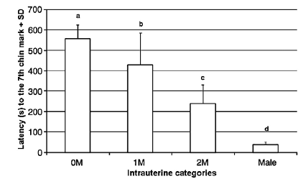
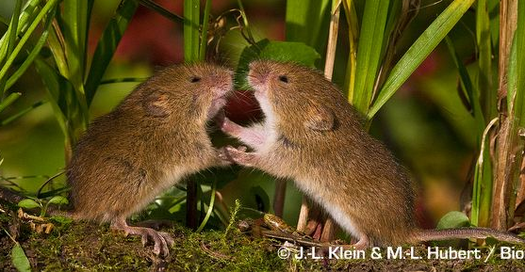
Cool, does it matter?
Anogenital distance
Less “attractive”
Time to sexual maturity?
Number of litters?
Territorial behavior?
Aggression
Ryan 2002. Neuroscience and Biobehavioral Reviews

Slide 11
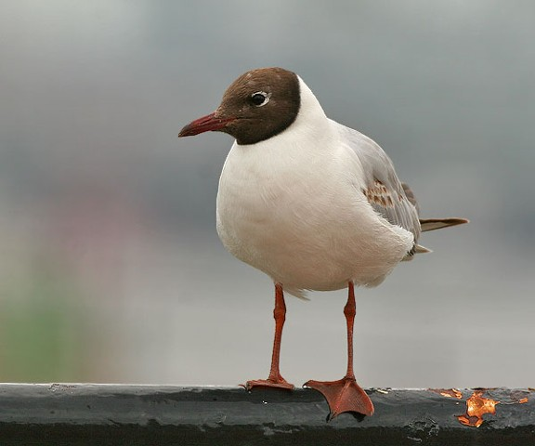
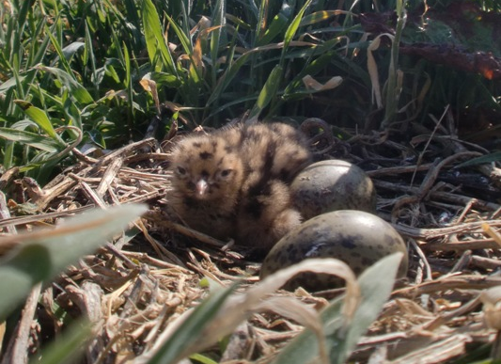
Embryonic effects in birds
Testosterone invested in egg yolk
Females can manipulate levels
Experimental manipulations:
  Hatch earlier
  Higher growth rate
  Better competitor
  Suppressed immune system
  More aggression and courtship
  Lower survival

Slide 12
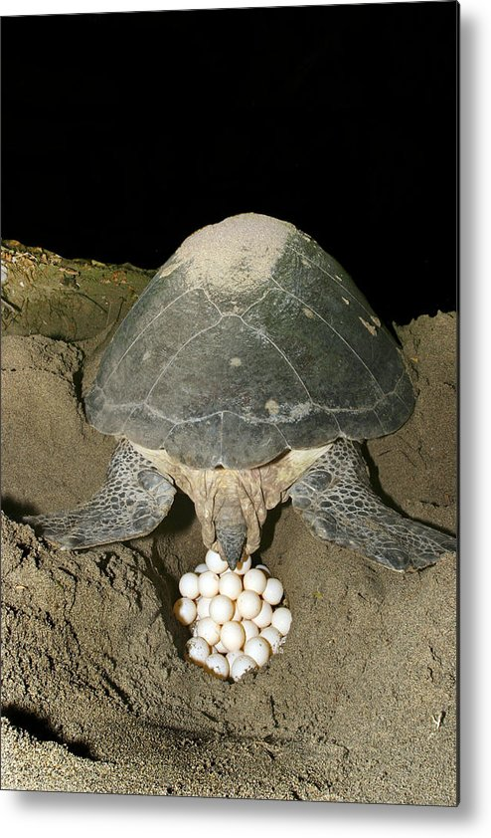
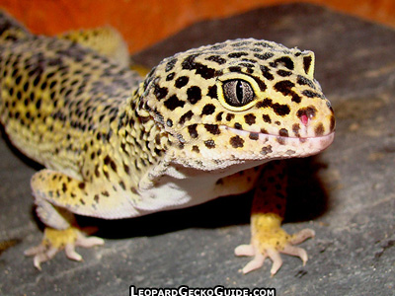
Temperature
What’s the adaptive value?
Putz and Crews. 2005. Developmental psychobiology
Notes:
Sib avoidance
Difference in offspring quality based on rearing temp

Slide 13
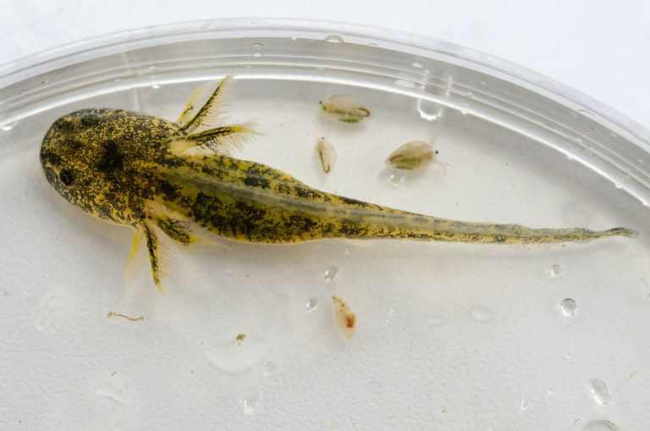
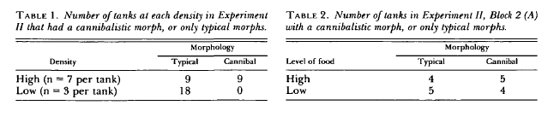
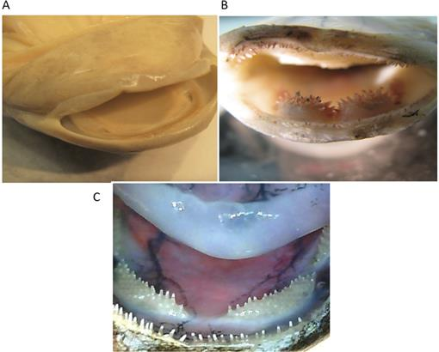
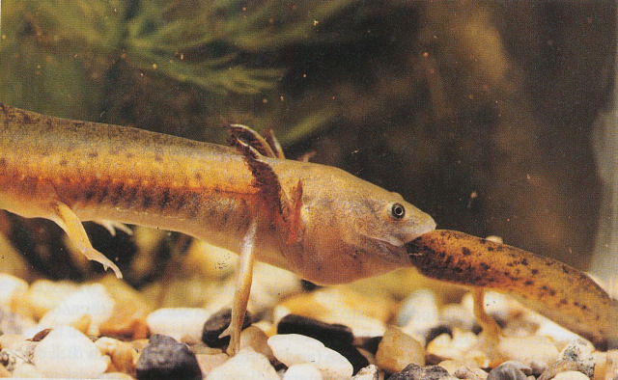
Competition
Collins and Cheek 1983.

Slide 14
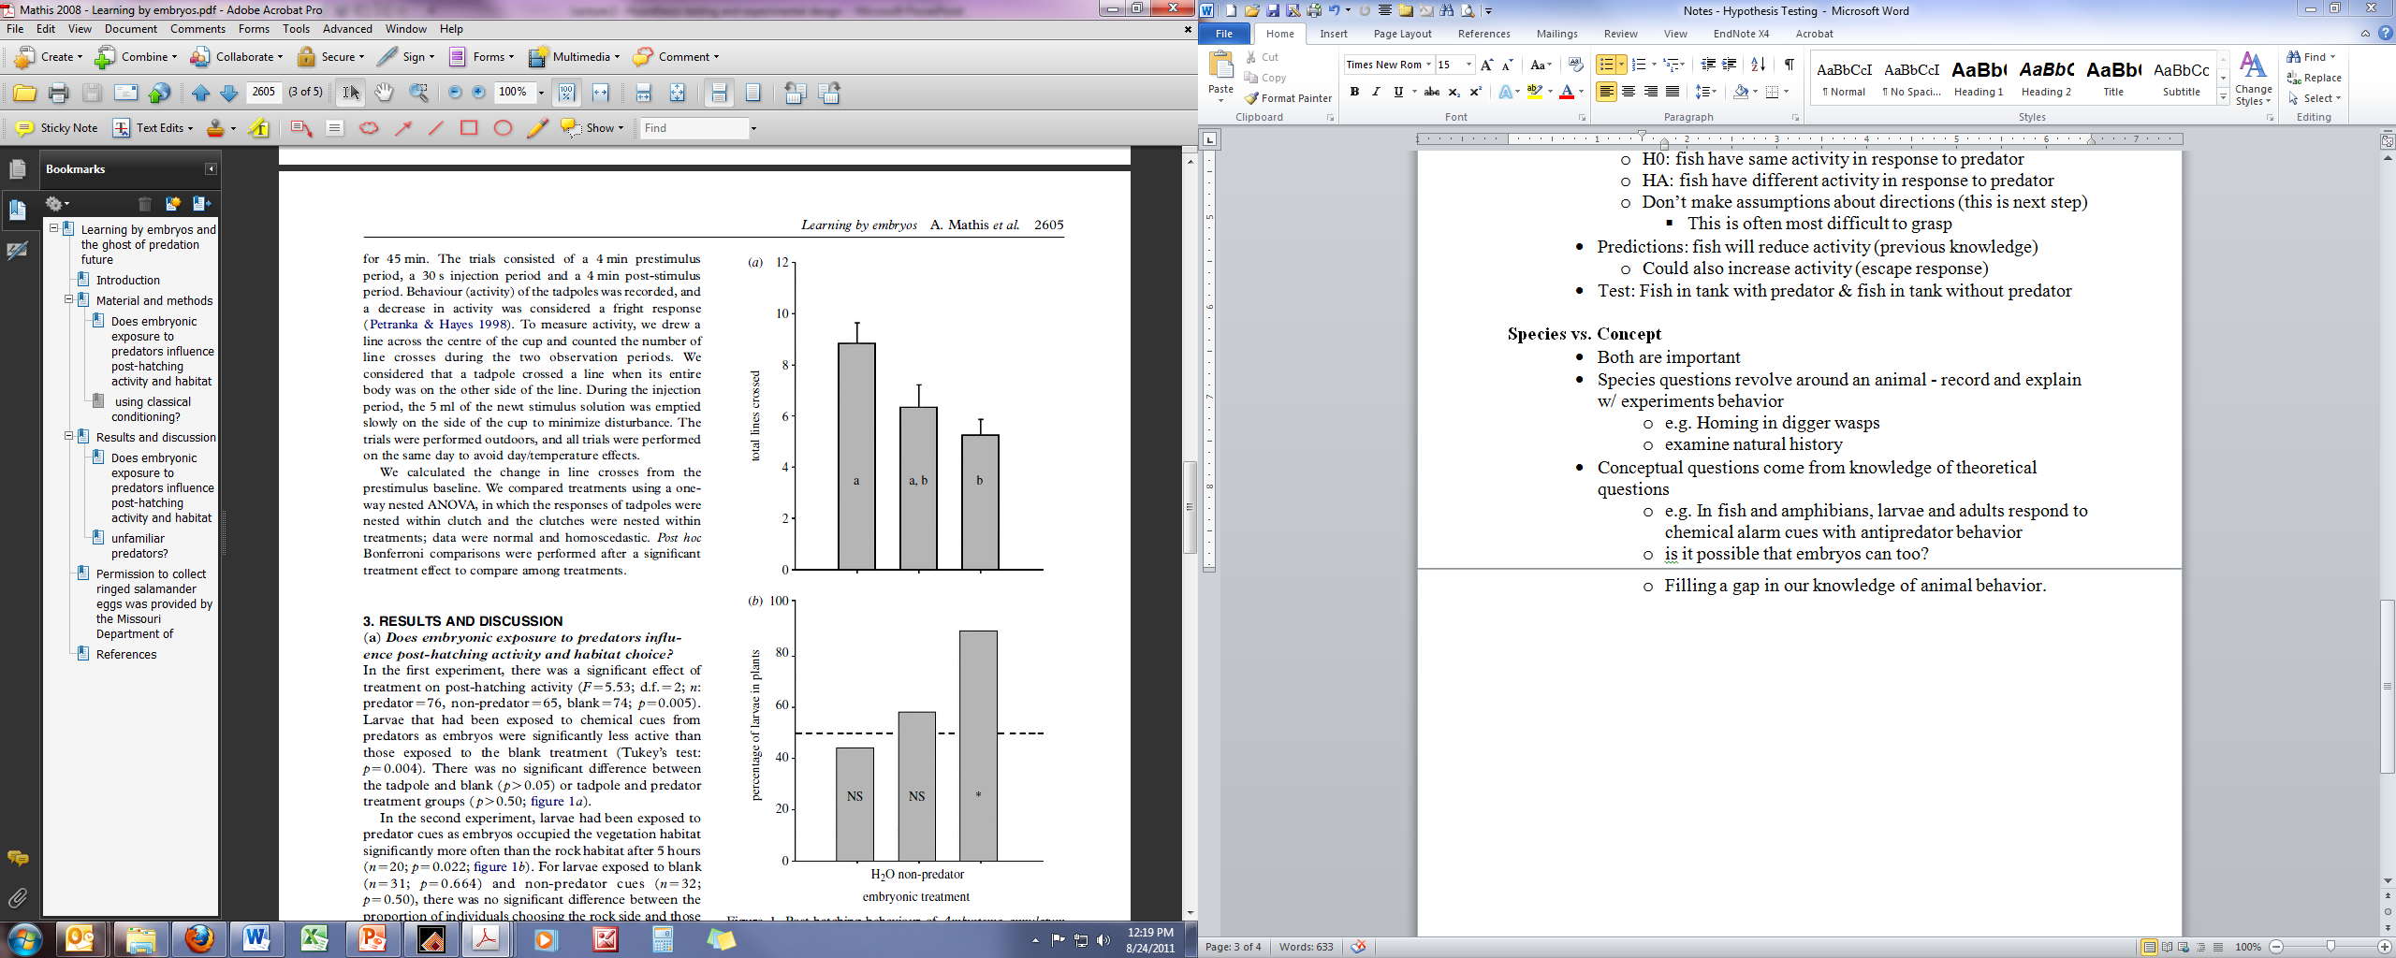
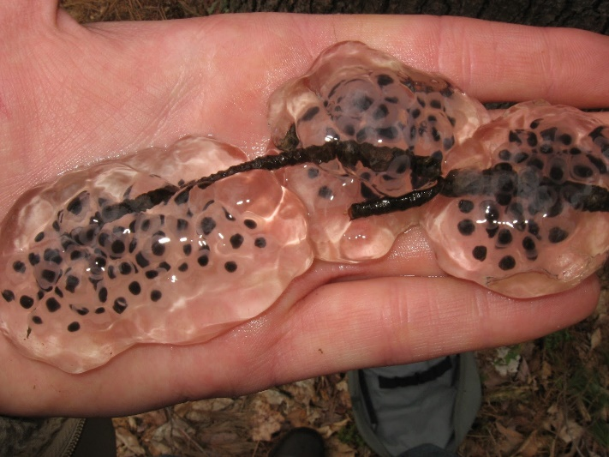
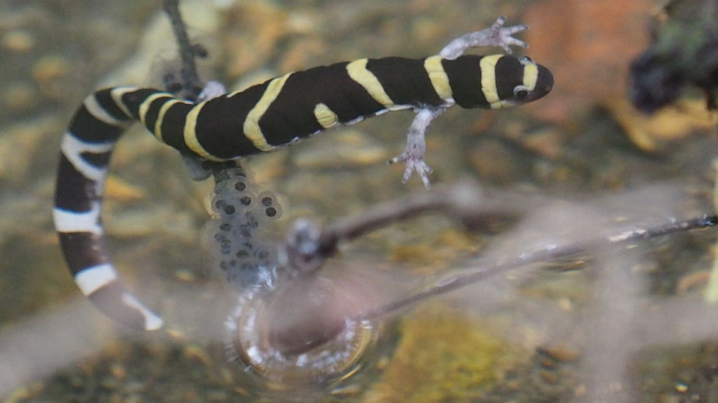
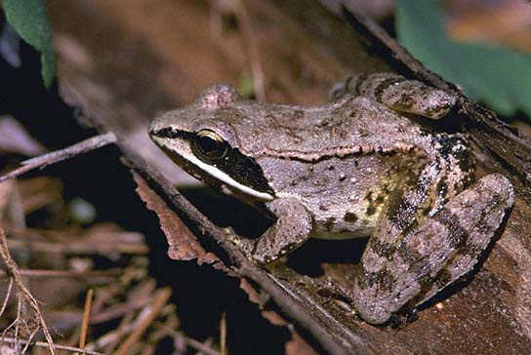

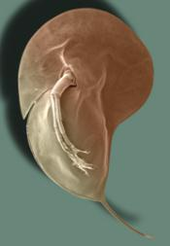
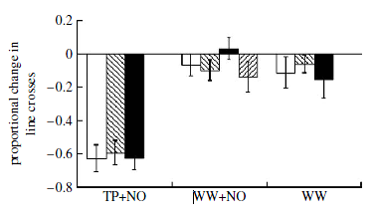

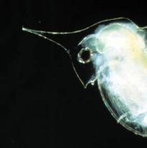
Predation
water
nonpredator
predator
Mathis et al. 2008. Learning by embryos and the ghost of predation future. Proc Royal Soc B

Slide 15
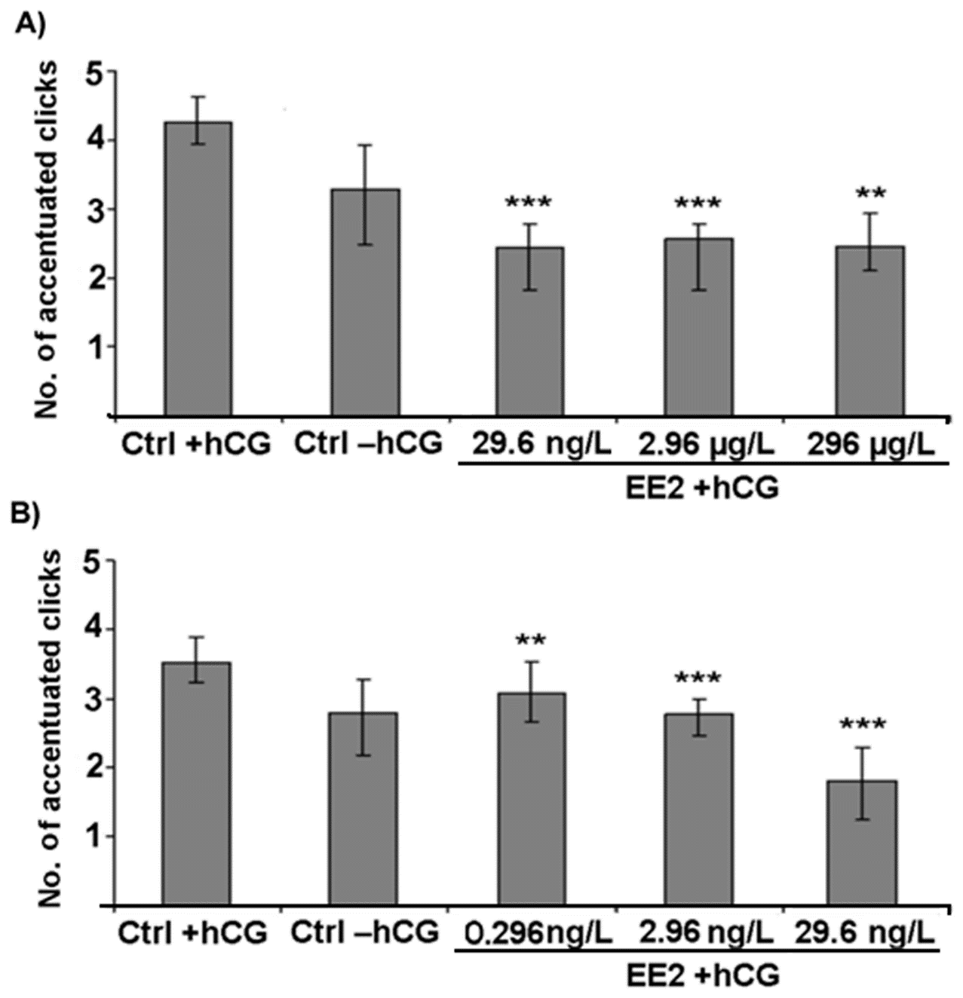
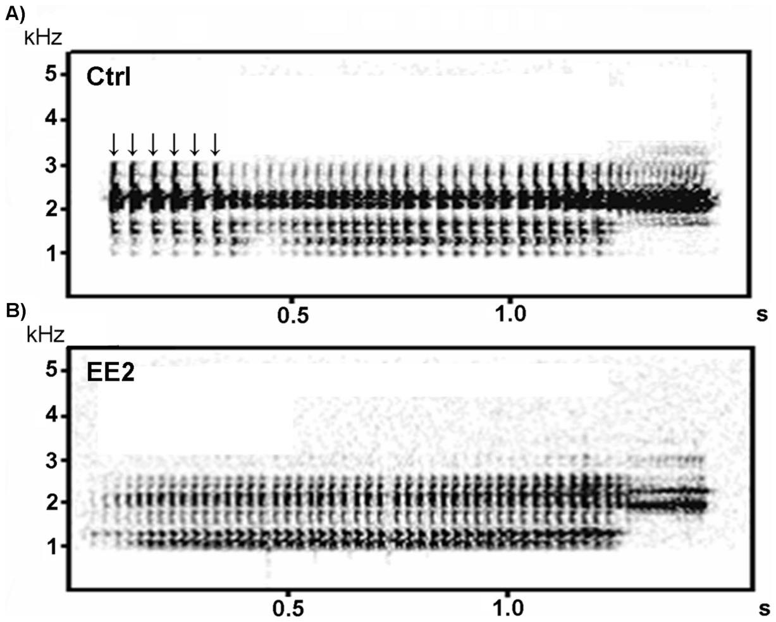
Anthropogenic Chemicals
7α-ethinylestradiol (EE2)
Mating behavior of frogs
5 concentrations
Mating call
Non-mating call
Hoffmann & Kloas 2012
Notes:
Synthetic estrogen in birth control
Looked at 5 concentrations on mating behavior
Lowered sexual arousal – fewer advertisement calls, changed call type to
Exposed males are lower attractiveness to females

Slide 16
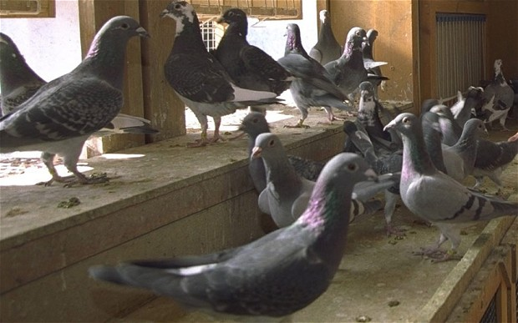
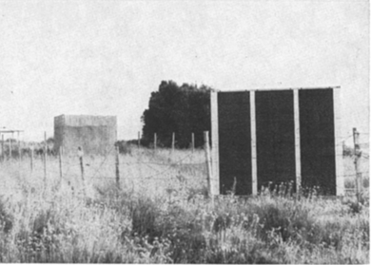
Pigeons – well known homing ability
Papi’s Experiments on Pigeon Homing
Reared in open (control) cages
  Oriented home
Closed (experimental) cages
  Random orientation
Cut olfactory nerve
  Random orientation
But see Gould 2009. Animal Navigation: A wake up call for homing
What will orientation be like in each of these conditions?

Slide 17
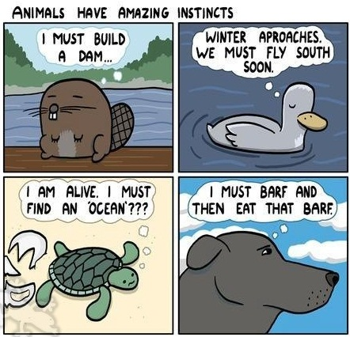
How Behavior is Acquired

Slide 18
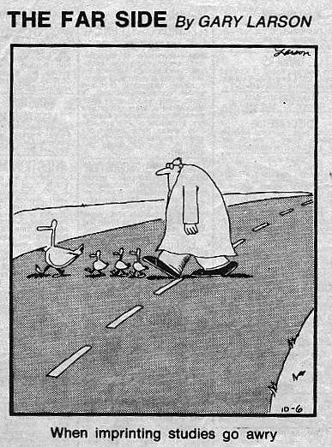
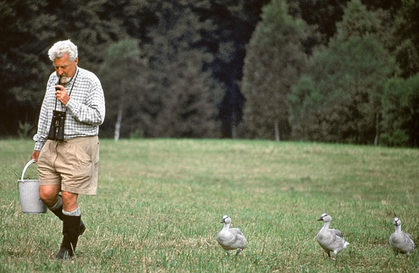
Notes:
Imprinting – when exposed to an object during social interactions in the early stages of development, attachment formed with the object

Slide 19
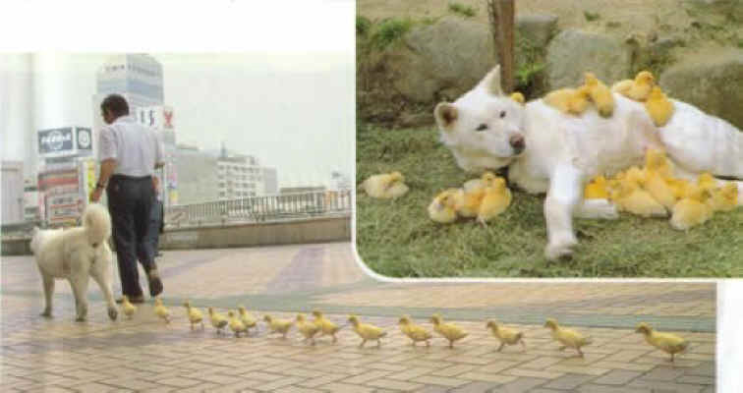
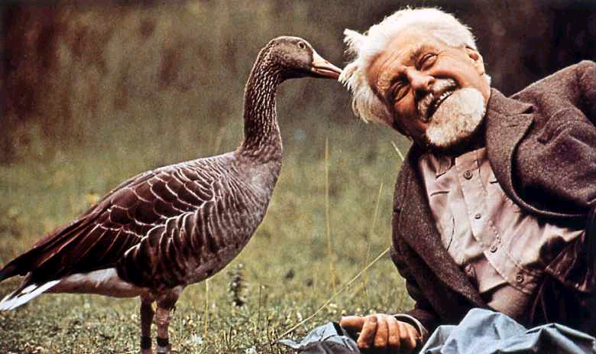
Why does this occur?
Why is imprinting during early stages so important?
Notes:
Animals are learning what constitutes a parent. Sexual imprinting occurs when organism associates something as a sexual partner, etc.
NS selects animals that make the correct decisions about who to associate with

Slide 20
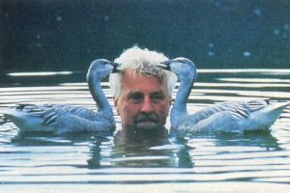
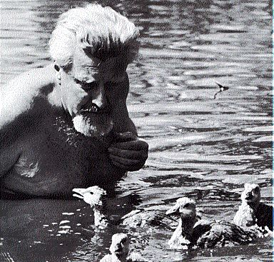
Another form of imprinting

Slide 21
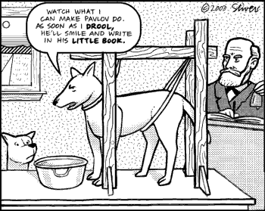
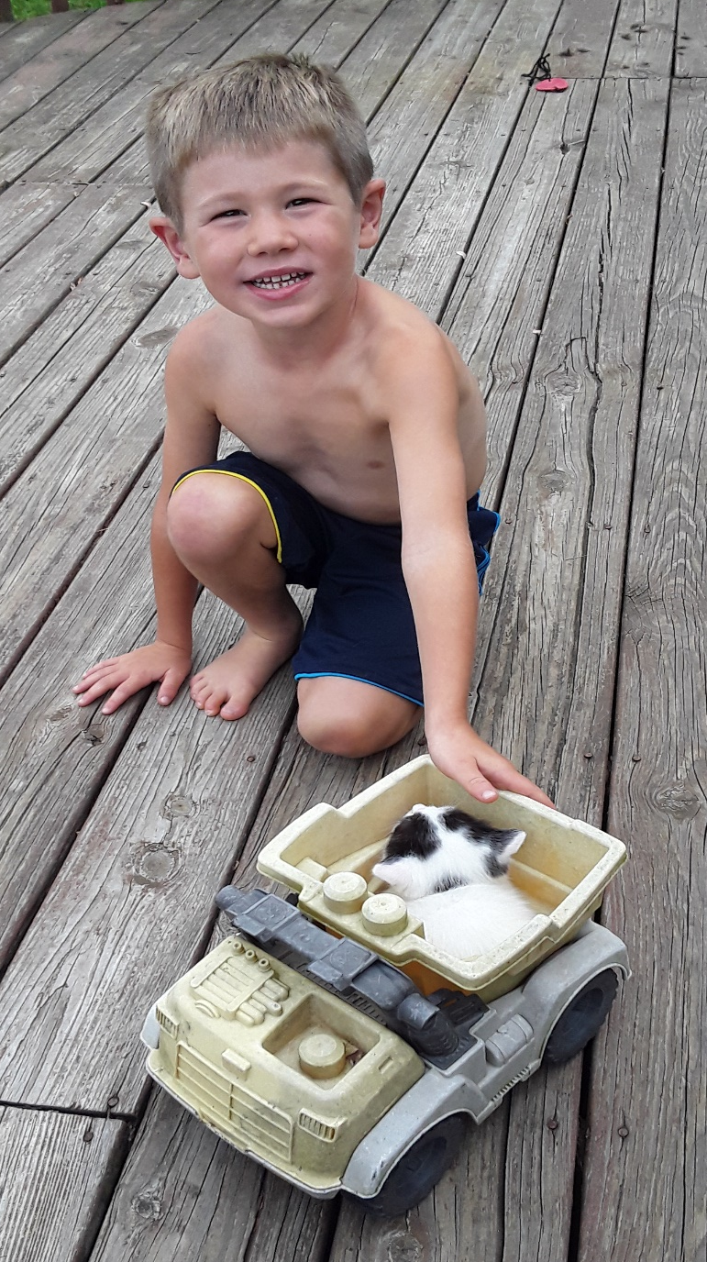
Acquired Information
This is a tricky term – examples

Slide 22
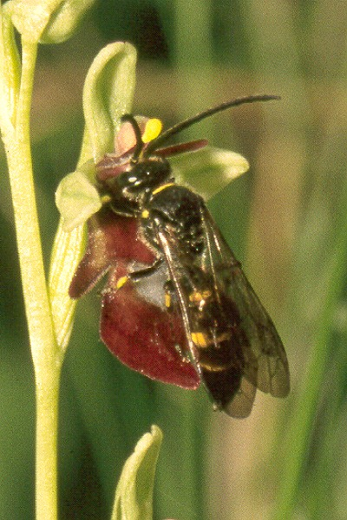
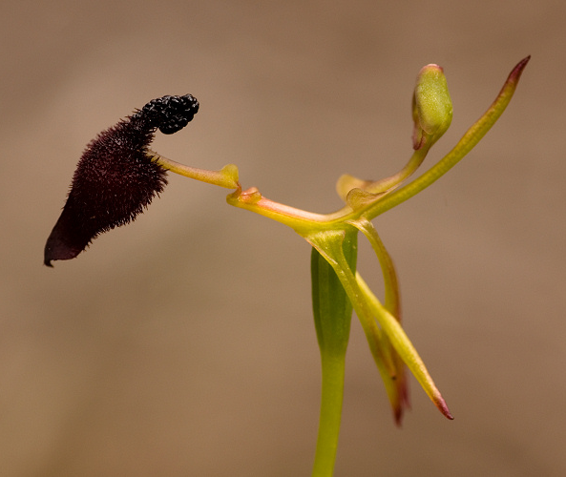
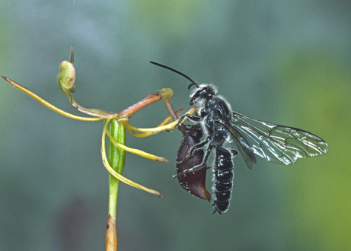
http://www.youtube.com/watch?v=-h8I3cqpgnA

Slide 23
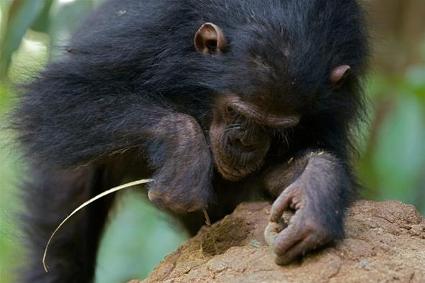
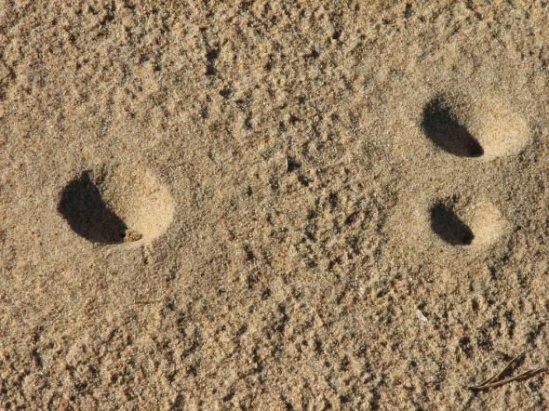
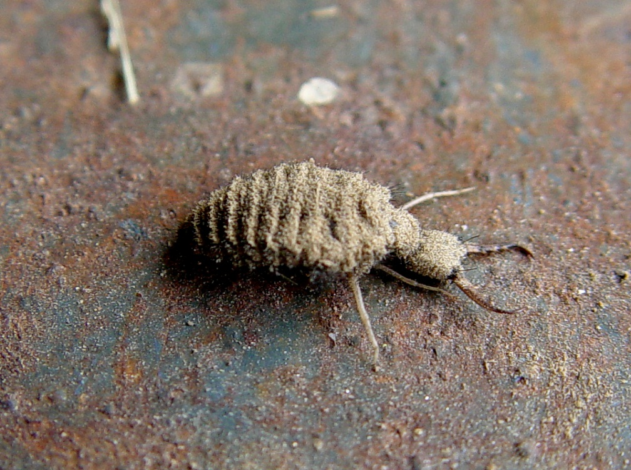
Learning
http://www.youtube.com/watch?v=SI9vgrc5yVo
http://www.youtube.com/watch?v=CWkfAyfBDHE

Slide 24




Learning NOT to Respond
Seagull
Why would it be harmful to respond too frequently?
Duck
Songbird
https://www.youtube.com/watch?v=ebJpoLs7AQs
Schleidt et al. 2011. J of Comp. Psy.
Hawk

Slide 25



Slide 26
http://www.youtube.com/watch?v=hhqumfpxuzI

Slide 27


Pavlov’s Experiments on Humans
https://www.youtube.com/watch?v=N5rXSjId0q4

Slide 28






How does it work in Nature?
+

Slide 29
+
Work in groups and determine what each of the following are:
Smell of pike (before learning)
Alarm cues
Smell of pike after
Hiding (before)
Hiding (after)

Slide 30




Slide 31


Operant Conditioning
http://www.youtube.com/watch?v=teLoNYvOf90
Thorndike
Skinner
https://www.youtube.com/watch?v=fanm--WyQJo
https://www.youtube.com/watch?v=yhvaSEJtOV8
http://www.youtube.com/watch?v=TtfQlkGwE2U&feature=related
http://www.youtube.com/watch?NR=1&v=vGazyH6fQQ4

Slide 32





Slide 33

Example from Nature?
Notes:
Monarch butterflies are specialist herbivores on milkweeds (Family: Asclepiadaceae)
The larvae sequester toxic steroids, known as cardenolides

Slide 34




How it works
What type of stimulus is changing the behavior?
Notes:
Monarch butterflies are specialist herbivores on milkweeds (Family: Asclepiadaceae)
The larvae sequester toxic steroids, known as cardenolides

Slide 35
Clicker Training
Bring 3 unique items to class on Friday
Everyday items you have with you do not count

Slide 36

Clicker Training

Slide 37


Slide 38

Why not just reward the behavior?

Slide 39
Loading the clicker
http://www.youtube.com/watch?v=y5z1dFx_jfs

Slide 40

Timing

Slide 41

“Catching” a behavior

Slide 42

Shaping

Slide 43
Class Exercise

Slide 44


Spatial Learning
Design a simple experiment to test:
Do digger wasps use landmark learning to locate nest?
Supplies:
40 nests (and females)
Anything from natural environment
Nest
Determine:
Experimental approach
What will you manipulate?
What will you measure?
Develop graph for each response variable (hand draw)
Present the results

Slide 45

Spatial Learning
Nest

Slide 46




Landmark Learning in Amphibians
Crane and Mathis 2011. Current Zoology.

Slide 47


Compass Learning

Slide 48


Social Learning
Very powerful
Requires some part of life-history to be social
Three sub-types:
Notes:
In the late 1920's in Southampton, Blue tits learned to remove the caps of milk bottles and drink from the bottle. This was to get at the cream at the top of the bottle. It's not the milk they were after. The tits lack the enzyme to digest lactose. Drinking milk in fact causes tits to suffer diarrhoea! The milk (full milk) had cream at the top. This cream has no lactose. It is digestible and is very energy rich. The habit spread to London in 1935. Many's a blue tit fell into the bottle and met it's end! With the introduction of semi-skinned and fat free milk and with the decrease of doorstep milk deliveries, this delightful activity of the blue tits has become a part of folklore.

Slide 49
Local Enhancement in Amphibians
Design and experiment to test whether tadpoles exhibit local enhancement
You have access to the following supplies
If you would like additional supplies, you must justify the need to me
You have 10 minutes
Notes:
In the late 1920's in Southampton, Blue tits learned to remove the caps of milk bottles and drink from the bottle. This was to get at the cream at the top of the bottle. It's not the milk they were after. The tits lack the enzyme to digest lactose. Drinking milk in fact causes tits to suffer diarrhoea! The milk (full milk) had cream at the top. This cream has no lactose. It is digestible and is very energy rich. The habit spread to London in 1935. Many's a blue tit fell into the bottle and met it's end! With the introduction of semi-skinned and fat free milk and with the decrease of doorstep milk deliveries, this delightful activity of the blue tits has become a part of folklore.

Slide 50



Local Enhancement in Amphibians
When are animals likely to do this in nature?
Chapman et al. 2014. Ethology
Notes:
In the late 1920's in Southampton, Blue tits learned to remove the caps of milk bottles and drink from the bottle. This was to get at the cream at the top of the bottle. It's not the milk they were after. The tits lack the enzyme to digest lactose. Drinking milk in fact causes tits to suffer diarrhoea! The milk (full milk) had cream at the top. This cream has no lactose. It is digestible and is very energy rich. The habit spread to London in 1935. Many's a blue tit fell into the bottle and met it's end! With the introduction of semi-skinned and fat free milk and with the decrease of doorstep milk deliveries, this delightful activity of the blue tits has become a part of folklore.

Slide 51

Do you see a problem with this design?

Slide 52
Why the difference between species?

Slide 53
Stimulus Enhancement
Design and experiment to test whether octopuses exhibit stimulus enhancement
You have access to the following supplies
If you would like additional supplies, you must justify the need to me
You have 10 minutes

Slide 54


Stimulus Enhancement
Does it have to be visual?

Slide 55

Social Facilitation
Notes:
In the late 1920's in Southampton, Blue tits learned to remove the caps of milk bottles and drink from the bottle. This was to get at the cream at the top of the bottle. It's not the milk they were after. The tits lack the enzyme to digest lactose. Drinking milk in fact causes tits to suffer diarrhoea! The milk (full milk) had cream at the top. This cream has no lactose. It is digestible and is very energy rich. The habit spread to London in 1935. Many a blue tit fell into the bottle and met their end! With the introduction of semi-skinned and fat free milk and with the decrease of doorstep milk deliveries, this delightful activity of the blue tits has become a part of folklore.

Slide 56

Notes:
In the late 1920's in Southampton, Blue tits learned to remove the caps of milk bottles and drink from the bottle. This was to get at the cream at the top of the bottle. It's not the milk they were after. The tits lack the enzyme to digest lactose. Drinking milk in fact causes tits to suffer diarrhoea! The milk (full milk) had cream at the top. This cream has no lactose. It is digestible and is very energy rich. The habit spread to London in 1935. Many a blue tit fell into the bottle and met their end! With the introduction of semi-skinned and fat free milk and with the decrease of doorstep milk deliveries, this delightful activity of the blue tits has become a part of folklore.

Slide 57

Let's think about the evolution of learning
Two scenarios:
  Innate response to a predator
  Learned response to a predator
What are pros and cons with each mechanism?
Is there a context when learning is more important than innate responses (or vice versa)?

Slide 58

Does the basis for learning have a genetic component?

Slide 59

Gene-Environment Interactions
To be influenced by natural selection, variation in behavior must have a genetic component

Slide 60


Determining what is Environmental vs. Genetic

Slide 61


Human Twins Reared Apart
Separated after 5 days
Raised in middle-class Jewish homes
Reconnected at 32
Gerald Levy & Mark Newman

Slide 62

Human Twins Reared Apart
Separated 4 weeks after birth
Reunited at 39
Jim Springer & Jim Lewis

Slide 63



Guppies
How do you think each will behave?

Slide 64


Guppy Results

Slide 65




Garter Snake Prey Preference
http://www.youtube.com/watch?v=JbKXNjbgvqc

Slide 66

Garter Snake Results
Brought females into lab
Babies not fed until testing

Slide 67
Quantitative Genetics

Slide 68


Example of Quantitative Genetics
Female field crickets mate many times
Is the # matings env or genetic?
Mothers that mated many times have daughters that mate many times
  Slope 0.345
What is the heritability of this trait?
Solymar and Cade, Behavioral Ecology and Sociobiology

Slide 69



Slide 70

Mendelian Genetics
Do crosses between individuals with different behaviors result in recognizable patterns of heritability?
Foraging strategies of fruit flies
Why is the sitter allele not eliminated from the gene pool?
Could it ever be beneficial?

Slide 71




Jim Springer & Jim Lewis
Brown et al., 1996. Cell

Slide 72


Galah and Cockatoo
Nest in same season
Nest in same place

Slide 73




Galah and Cockatoo
Cockatoo
Cross-fostered
Galah
Galah

