Slide 1
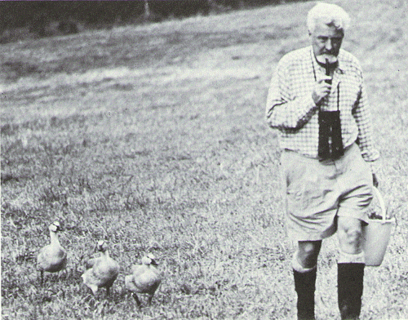
Introduction to Animal Behavior

Slide 2
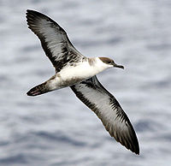
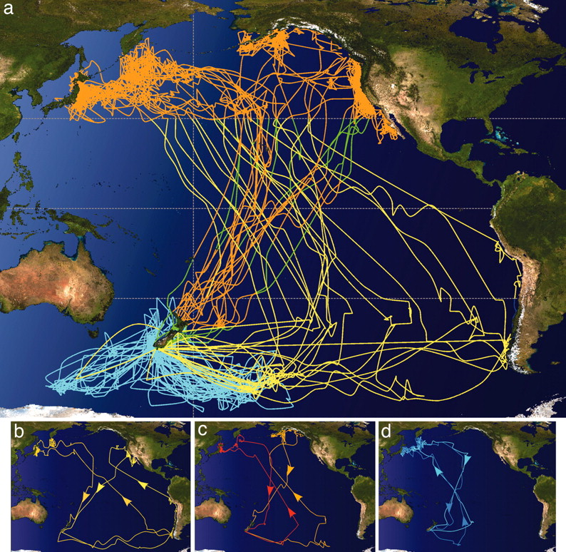
Shearwater migrations
Shaffer S A et al. PNAS 2006;103:12799-12802

Slide 3
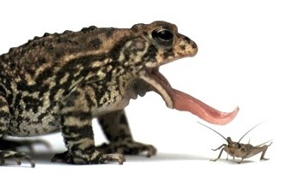
Behavior is driven by two causes

Slide 4
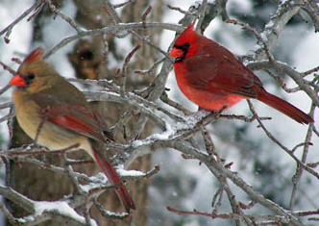
Another example
Proximate mechanisms
One male produces stronger signal
  vocal, visual, etc.
Elevation in sex hormones
  progesterone, estrogen
Increase in epinephrine and serotonin
Leads to copulatory behavior
Ultimate mechanisms
  Females that display a preference for particular males
      Produce more offspring
      Have healthier offspring
      Have larger offspring – maybe feed more as babies
      Their offspring are simply more attractive

Slide 5
Why do birds migrate?
Shearwater
Actual reason?
Shaffer S A et al. PNAS 2006;103:12799-12802

Slide 6
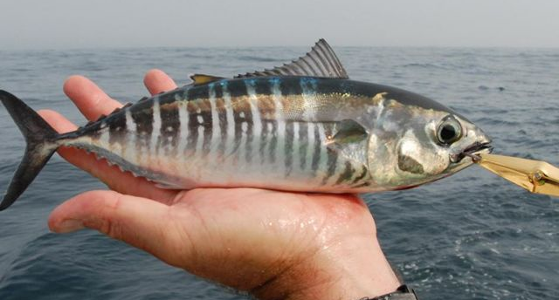
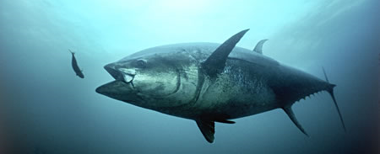
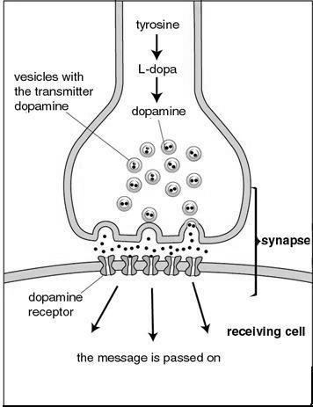
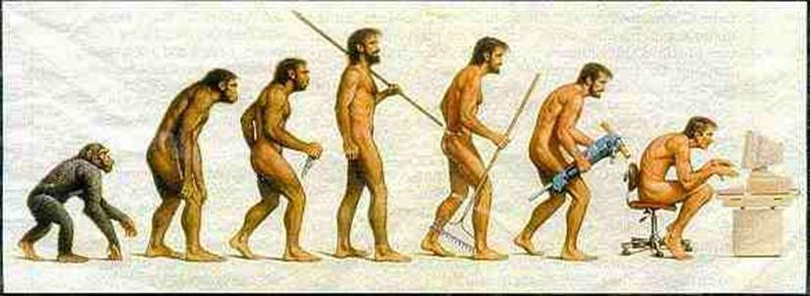
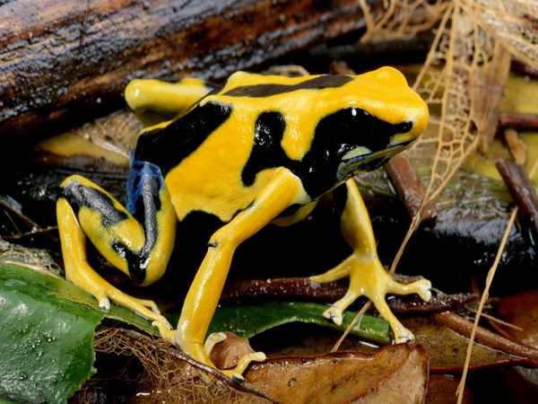
What are the mechanisms that cause behavior?
How does the behavior develop?
Tinbergen believed = attention should be given to these…has that happened?
What is the survival value of the behavior?
How did the behavior evolve?

Slide 7
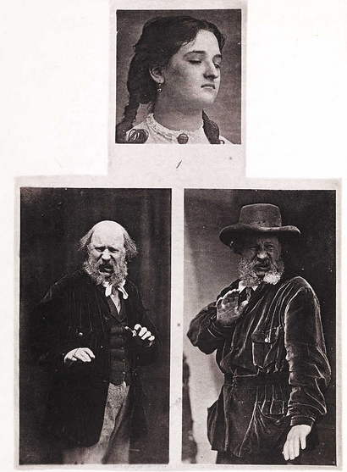
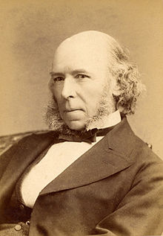
History of Ethology
Herbert Spencer (1855)
Contempt

Slide 8
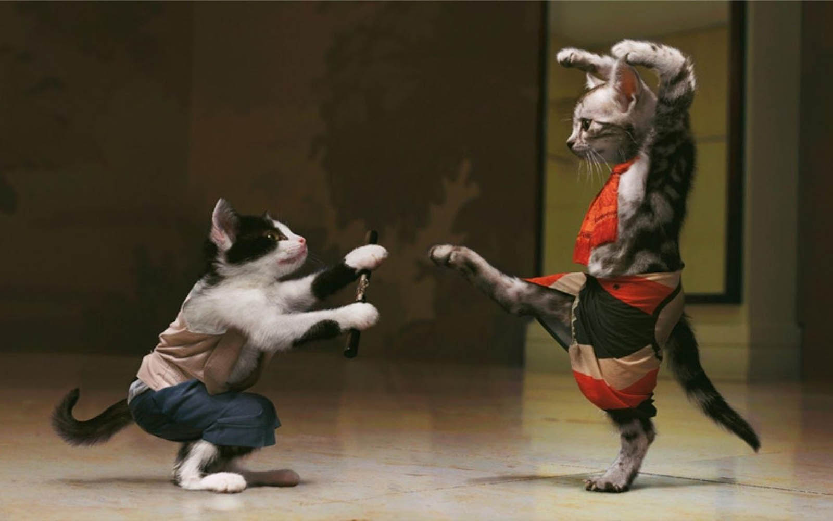
By early 1900’s, we got…

Slide 9
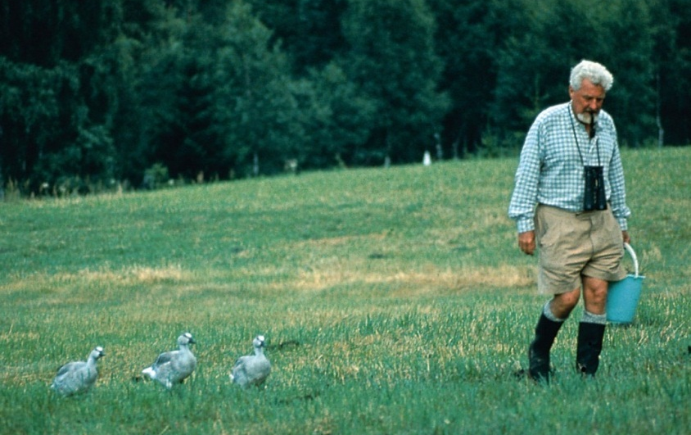
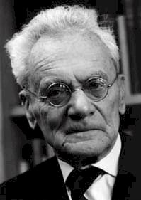
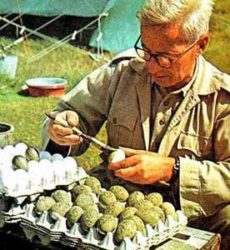
Schools of Behavior
Nikolas Tinbergen
Gerard Baerends
Miles Keenleyside
Jan Smith
Alicia Mathis
Brian Gall
YOU!

Slide 10
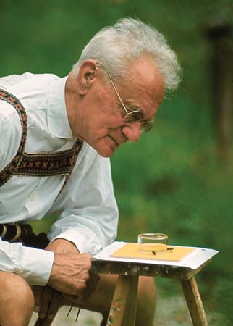
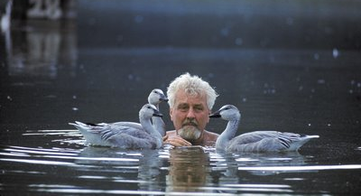
Classical Ethology
Observation in natural habitat
Generate hypotheses
No manipulation (except?)
  how answer questions?
Comparative approach

Slide 11
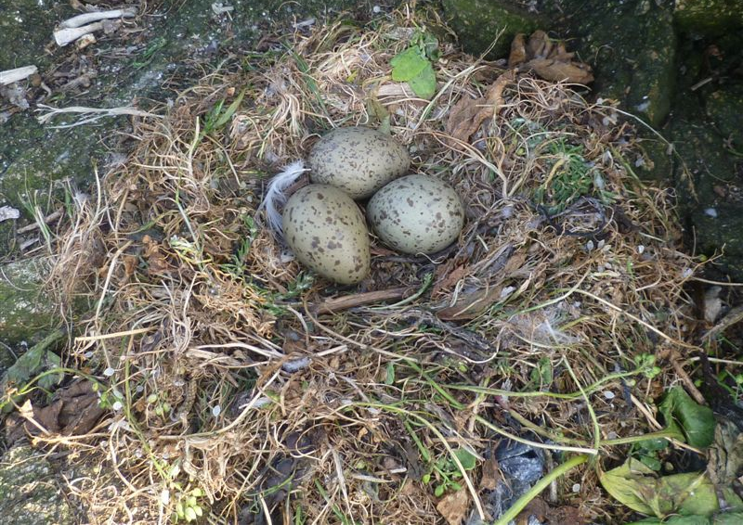
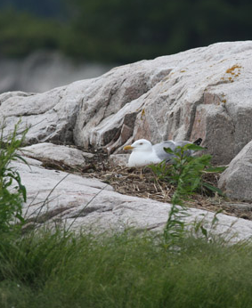
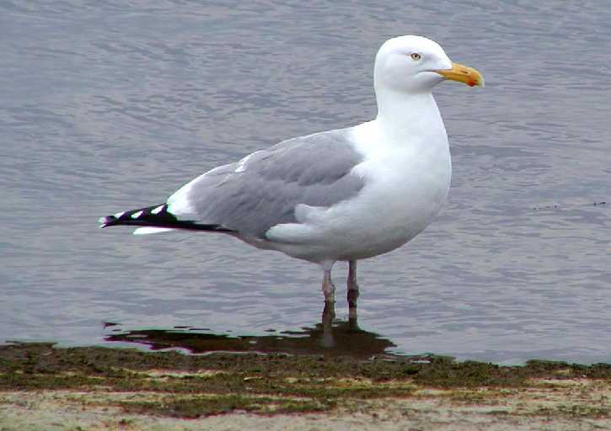
Example of the classical ethology and comparative approach in early AB
http://www.youtube.com/watch?v=OvA2WO9wMgU
Let’s develop hypotheses to explain this behavior

Slide 12
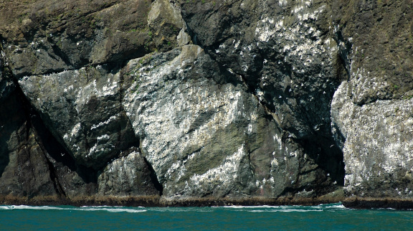
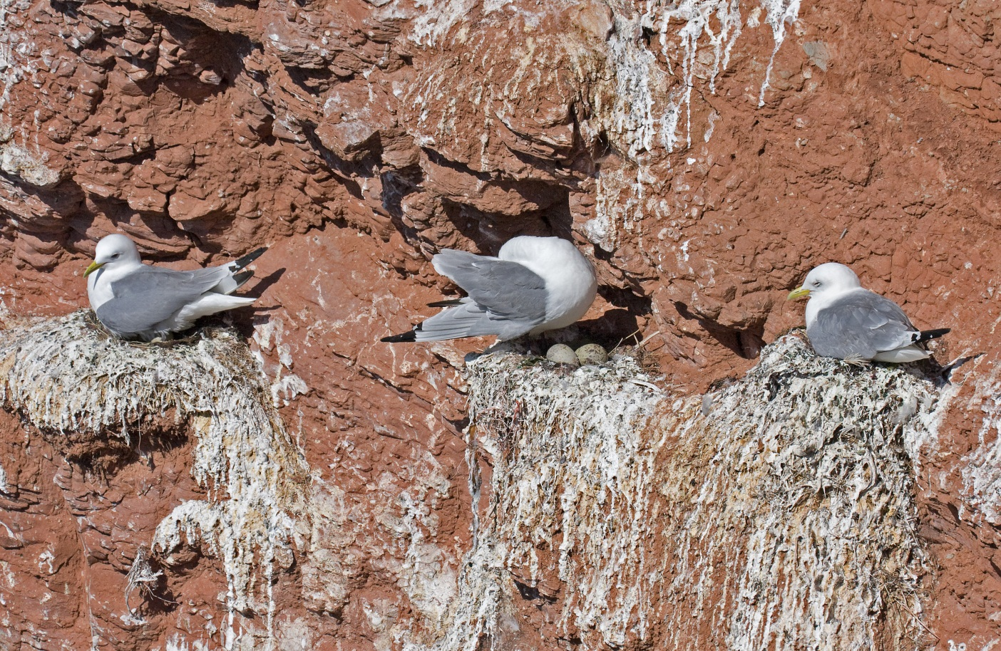
Enter the Kittiwake…

Slide 13
Design an experiment to ask: Do gulls remove egg shells to protect chicks from predation?
Break into 2 groups
Starting supplies:
  40 (independent) gull nests
  No adults/no live chicks (why?)
  Unlimited number of eggs (chicken)
Design and describe every detail of the experiment (Where, When, How)
Put together a PowerPoint with pictures, diagrams, and details for how you will implement your experiment and what you will do
May be more than one way to test question
ANY resource may be used, except students that have taken AB previously
Present the experiments on Monday
Team with the best design gets?

Slide 14
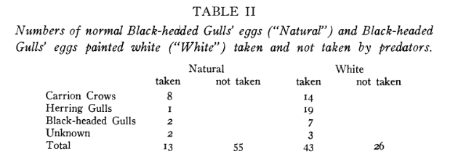
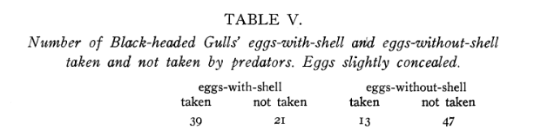
Tinbergen’s Experiments

Slide 15
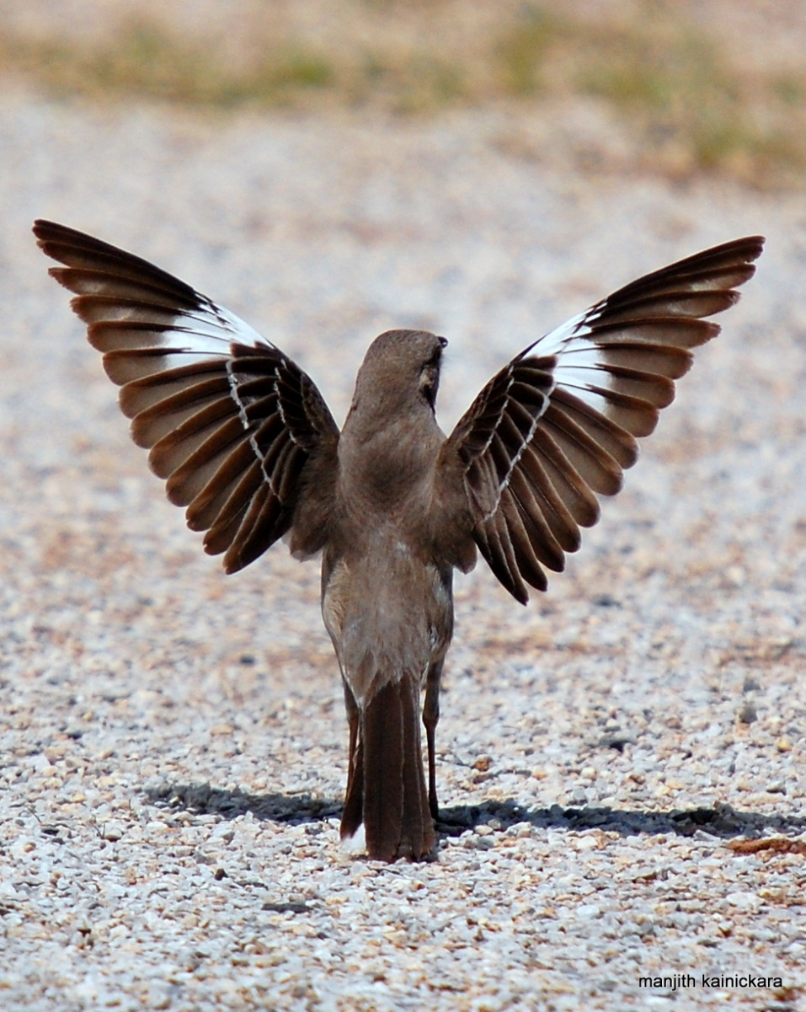
Stereotypic Behavior
  Whitman and Heinroth
  Motor response (i.e. behavior) initiated by environmental stimulus and continues to completion even if stimulus is removed
  What initiates the behavior?

Slide 16
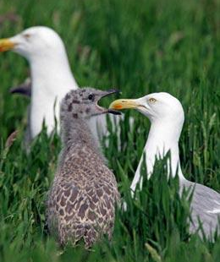
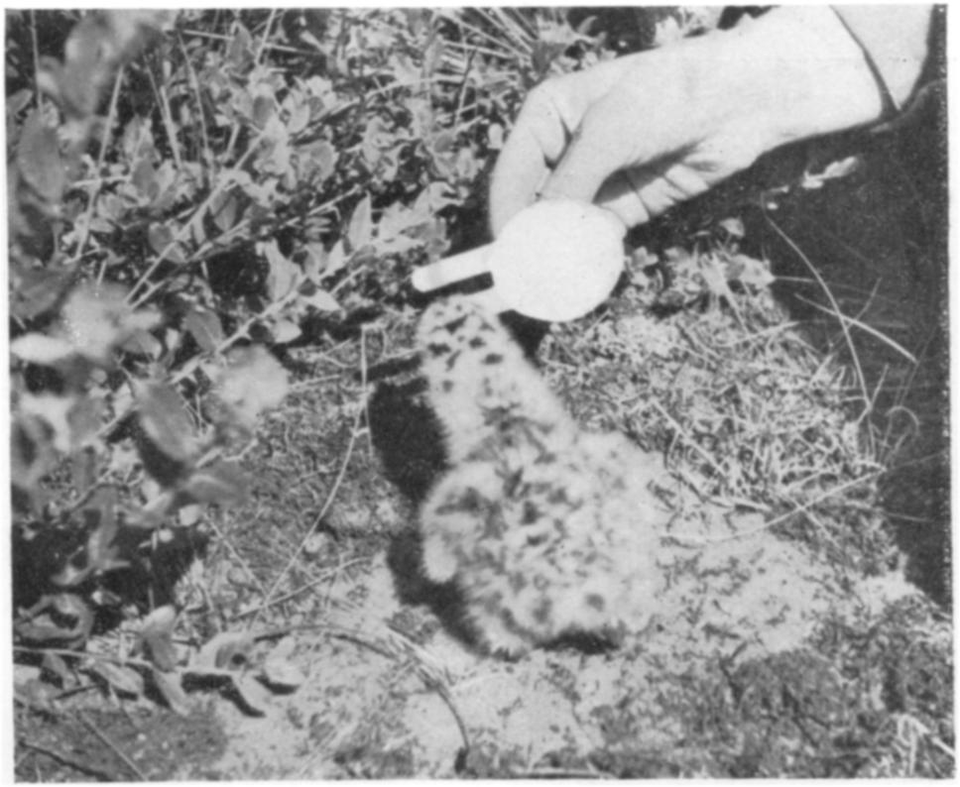
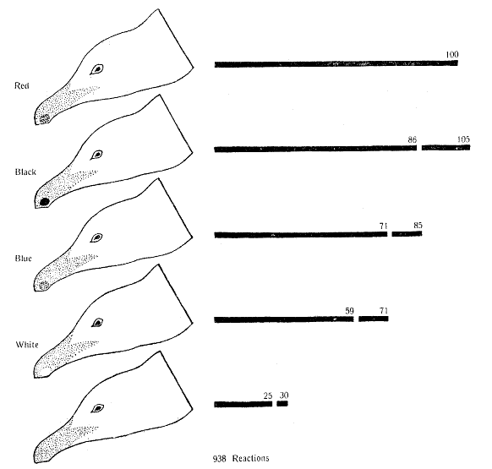
Begging in Herring Gulls
What’s the FAP?
http://www.youtube.com/watch?v=qkKSV15ddgE
Tinbergen, 1950

Slide 17
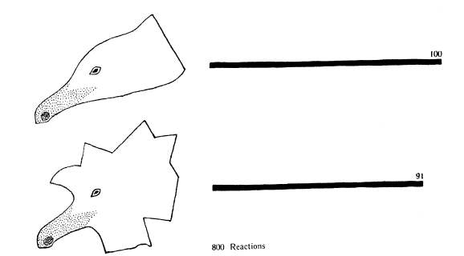
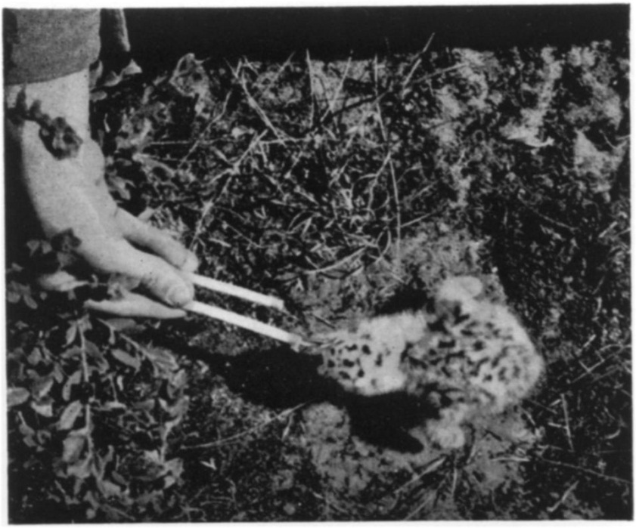
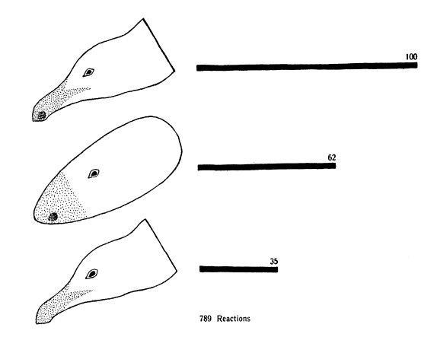
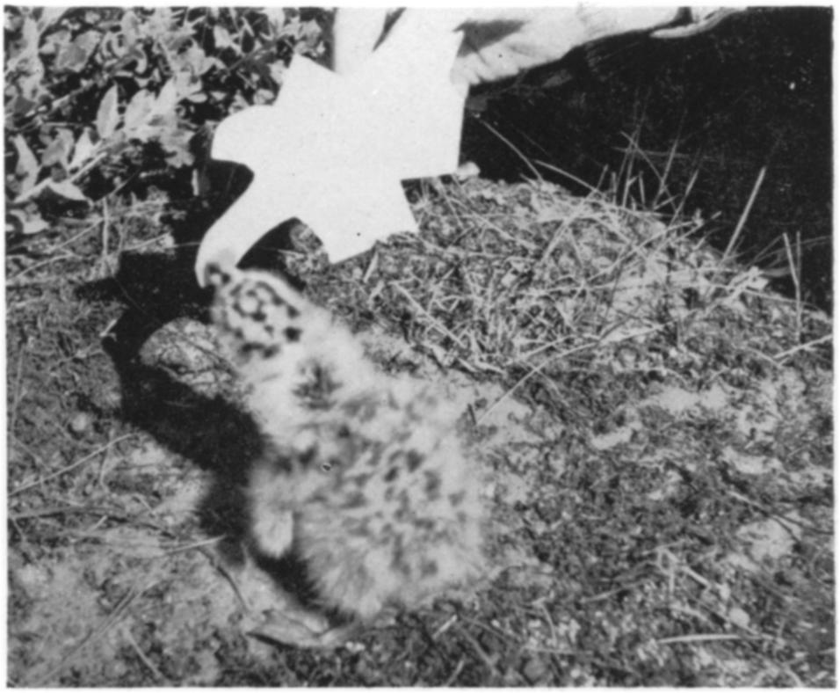

Slide 18
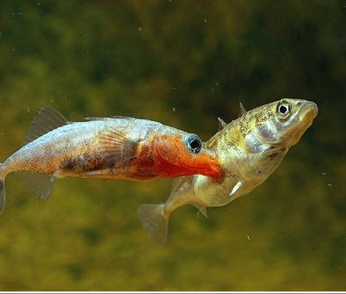
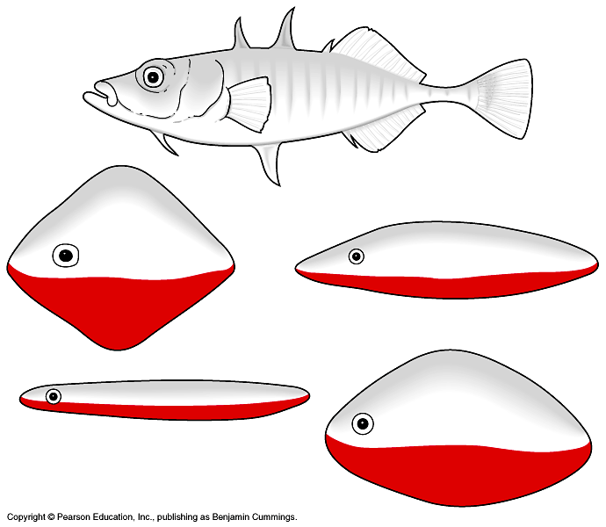
FAP’s in Stickleback
What is the fixed action pattern?
What is the sign-stimulus?
http://www.youtube.com/watch?v=ZfcGZCGdGVE&NR=1&feature=endscreen
Tinbergen 1951

Slide 19
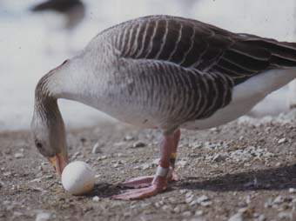
Goose Egg Retrieval
What is the fixed action pattern?
What is the sign-stimulus?
Lorenz and Tinbergen, 1938
http://www.youtube.com/watch?v=vUNZv-ByPkU

Slide 20
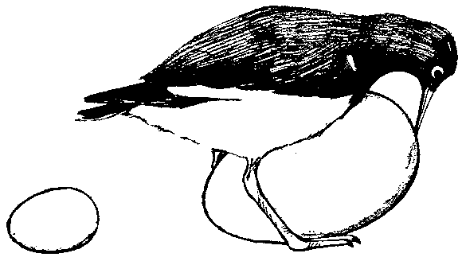
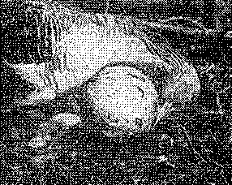
What do you think will happen if you provide a greater intensity sign-stimuli?

Slide 21
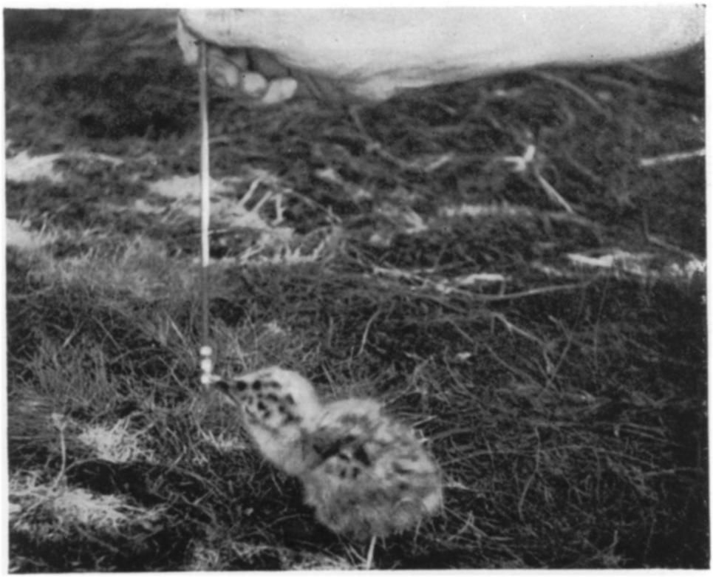
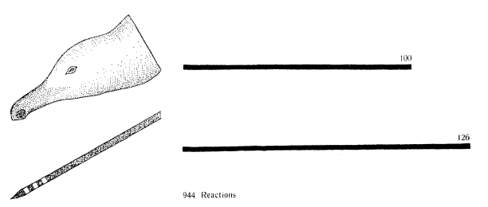
Supernormal Stimuli in hatching gulls
Why?

Slide 22
Criticisms of FAPs
What will happen if I expose a female goose to an egg out of the nest every 15 min for 3 days?
How about a baby gull expose to gull head with red dot all day every day?

