Slide 1
Today’s Lab
Review editing notes
Discuss pieces of scientific papers
Finish your ethogram
  Include functional and descriptive definitions
  Present the ethogram as a table in your manuscript
Peer edit drafts
Continue writing/editing methods
Manuscript due 14 Sept

Slide 2
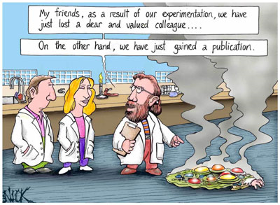

Slide 3
My version of the “doing science” flow chart

Slide 4
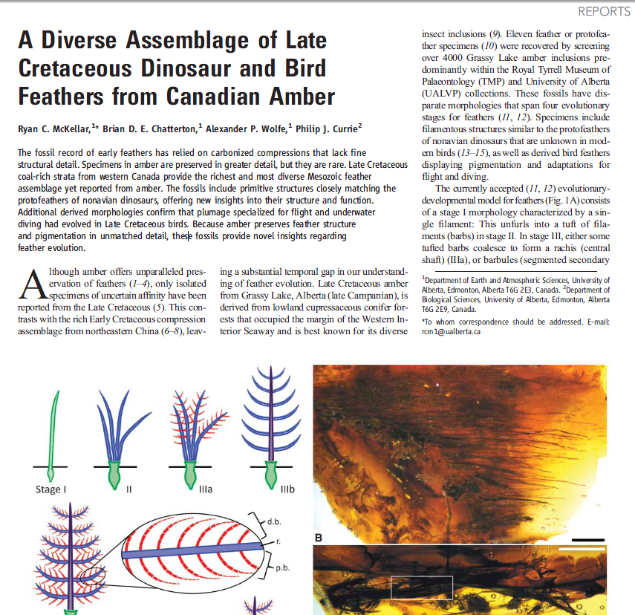

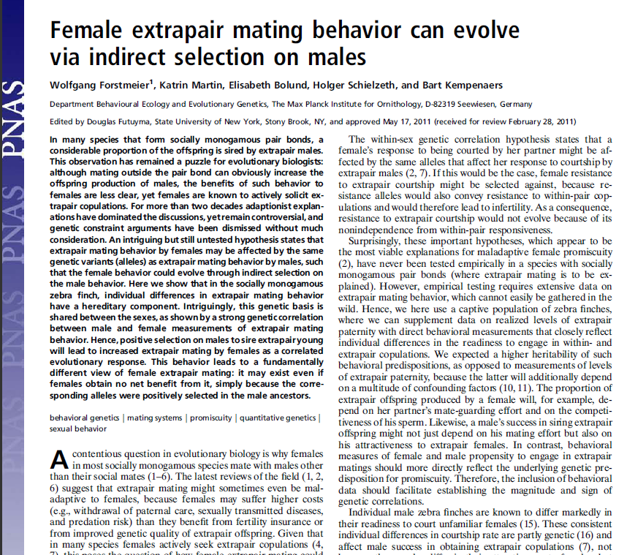
Building a Manuscript

Slide 5
Why Publish?
**Disseminate New knowledge**
Get feedback on work
Advancement (academia)
Bragging rights?

Slide 6

Purpose of a Publication?
Inform other scientists
Document the approach (replication)
Interpret and place in context:
  Explain motivation
  Meaning of results
  Place in context of past literature (how does it change scientific knowledge?)

Slide 7

What is scientific writing style?
Clear and concise
NO BS!!
Quality of writing still important
“At present it widely accepted that TTX possibly be an exogenous source via food chain or symbiosis in case of marine animals, whereas in amphibians it be having an endogenous origin.”

Slide 8
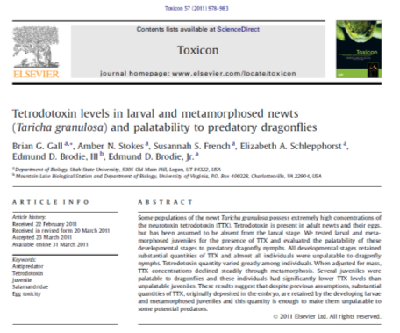
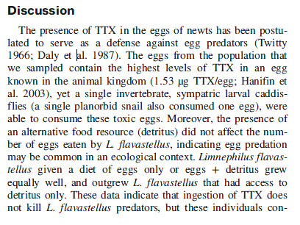
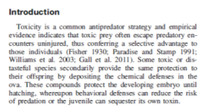
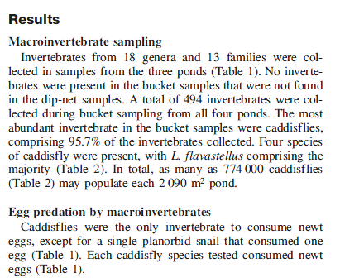
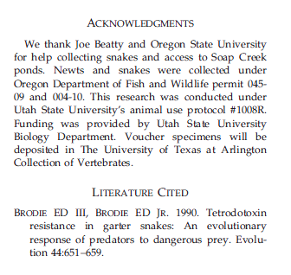
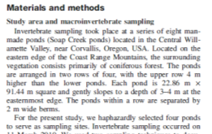
What are the pieces?

Slide 9
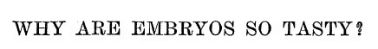
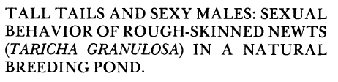
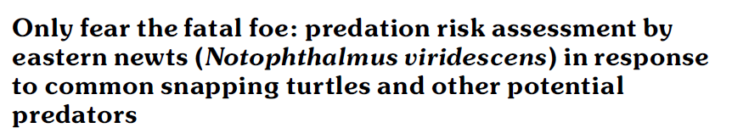
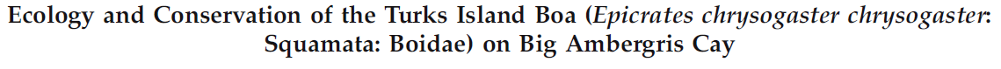
Why is the title the most important part of your paper?
Land Ho! Polarized Light Serves as a Visual Signal for Landward Orientation in Displaced Spiders
Long-jawed orb weavers (Tetragnathus elongatus) use visual signals and polarized light to find riparian habitat

Slide 10
Title should do the following:
Describe what was “done” OR “found”
Catch attention and interest
Contain important or relevant words (why?)
Your titles…

Slide 11
Introduction
Sets up your paper and put in context
Discuss:
  Conclusions of previous literature
  Holes in current knowledge
  Justification for why these questions relevant/important
General structure:
Start with an outline

Slide 12
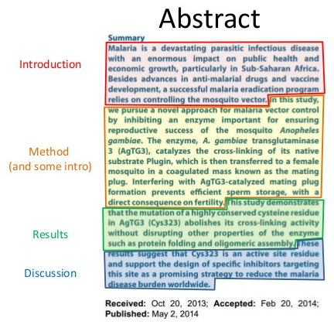
Abstract
Second most important part (what’s first?)
Mini version of paper
Should include?
  Objectives
  How
  Results
  Significance
Short and sweet
WRITE LAST

Slide 13
Let’s develop an outline for our alarm cue paper

Slide 14
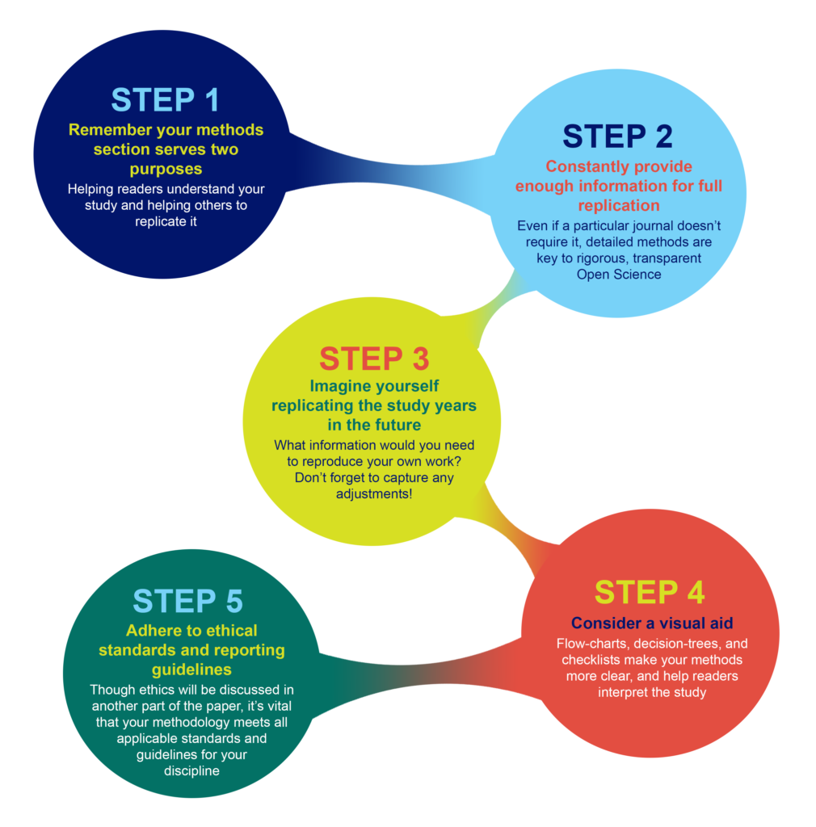
Methods
Tell a story (IN ORDER!)
General info
  Provide details
  Duplicable
  Assume other scientists have skills
    Not a list of instructions
    Example:
Paragraphs should outline various stages (examples)
Split methods into subsections:

Slide 15
The Stats Analysis Section (in the methods)
Structure is critical
  Start with what test was done
  Then say what the test does
  What variables?
  Then say who it was tested on
  Finally say your treatments or what the experiment was testing

Slide 16
For spiders…
T-test on Time to Shore
T-test on Number Orientation Behaviors
V-test for circular statistics – 1 m
V-test for circular statistics – 3 m

Slide 17
Results
Present the results of your experiments
DO NOT INTERPERET
Common mistake – discussing results
Things to include
  Test statistic (t, F, X²)
  DF or N
  P-value
  Mean and SD/SE in text (or table/figure!!!)
  Do not present raw data!!!!!!!!!!!!!!!!!!!!!!!!

Slide 18
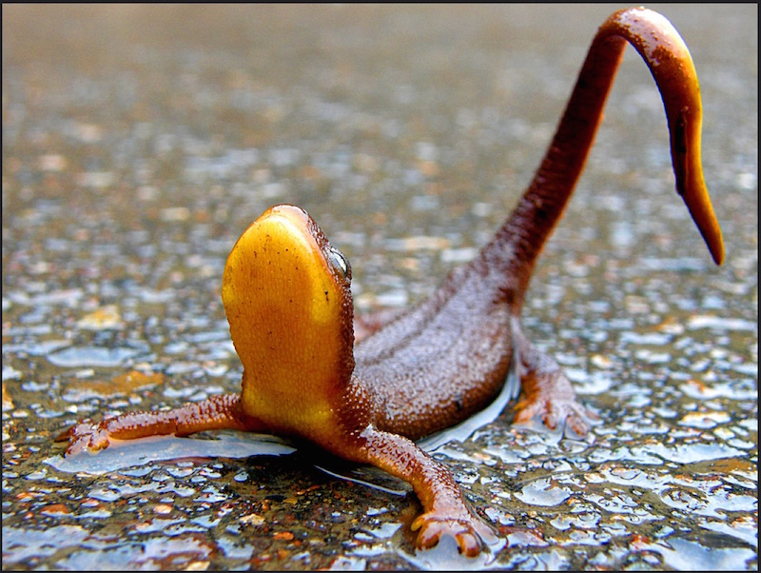
Set up
N = 14 per treatment, t = 2.47, P = 0.02
Start by determining the following:
  What type of test?
  What was found?
      Significant difference
      Non-significant difference
      Positive relationship
      Negative relationship
      No relationship
      Etc.
  What’s the response variable?
  Who is the subject of the study?
  What were the subjects exposed to (list treatments)?
  Stats report (test statistic, n, p-value)

Slide 19
What next?
Combine all these components, in order, into a fluid sentence
Let’s do this for one of the response variables
Robotic – follow it up with the MOM sentence (if significant)

Slide 20
Now you do this for the remaining response variables
  Type of test:
  Finding:
  Response variable:
  Who is the subject:
  Subjects exposed to:
  Stats report (test statistic, n, p-value)
  FOLLOW WITH MOM SENTENCE (if significant)

Slide 21
Discussion
Interpret your results
WHY are results important, what do they mean for the organism
WHY are they different from other studies
Don’t make statements too broad
  Example:
Review previous studies and explain how your results fit with this body of knowledge
Hardest section to write!
TELL A STORY
READ DISCUSSIONS

Slide 22
Discussion
General Structure
First paragraph – most important result
Next paragraphs:
  supporting ideas/information (e.g. less significant but still relevant results)
  Review and cite relevant literature
  Examples of your finding in other species
Final paragraph – summarize your conclusions
Start by making a bulleted outline

Slide 23

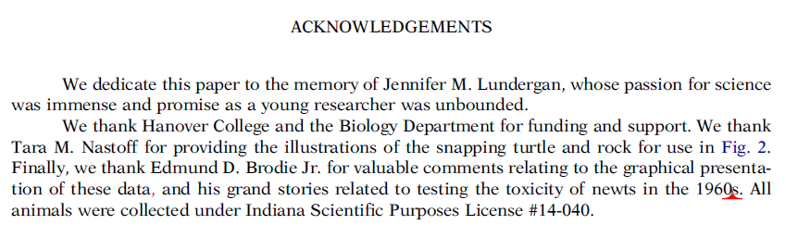

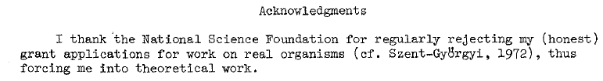
Acknowledgements
Thank people
Site funding
Completely free

Slide 24
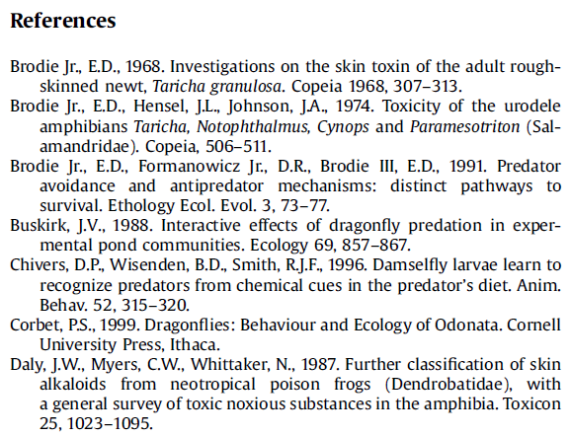
Literature Cited
Last full section
Alphabetical list of all articles
Structure
  In text:
  Lit cited:
Endnote
Google Scholar

Slide 25
Tables and figures
When is a table vs. figure appropriate? What’s the point of each?
Accuracy = table
To make a statement = figure
Each should stand alone (what does this mean?)

Slide 26
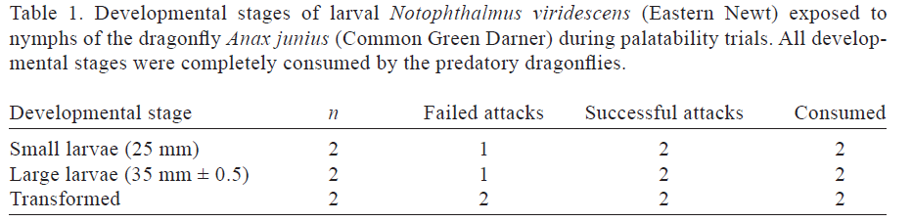
Table Rules
Table heading goes above
Horizontal line
Top row is the column headings
Another horizontal line
Summary data below headings
One line at bottom delineates end of table

Slide 27
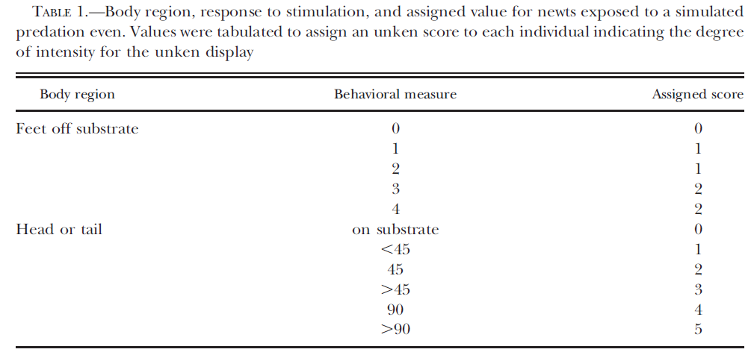

Slide 28
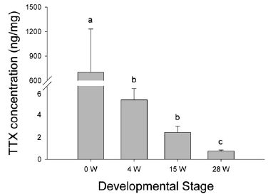
Figure Rules
Figure legend goes below
Never show individual data (means!)
Must have axis labels
Explain all symbols
NO TITLE
NO HORIZONTAL LINES
NO LEGEND (unless grouped bars)
Figure 1. Mean (± SE) ttx concentration (ng/mg) in newt larvae from four developmental stages. 0 W = larvae that had recently hatched, 4 W = four week old larvae, 15 W = fifteen week old larvae, 28 W = larvae that had recently completed metamorphosis. Different letters indicate significant differences between treatments (P < 0.015).

Slide 29
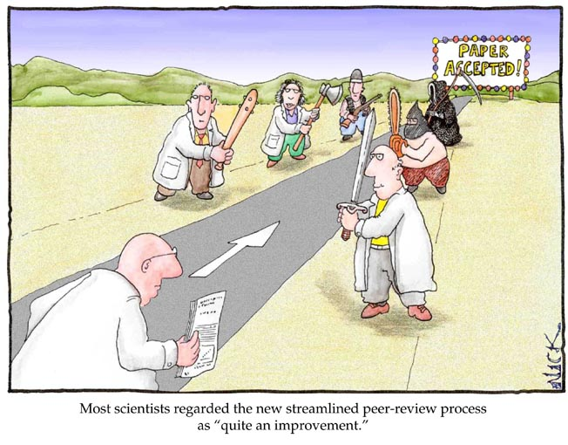
After the pieces are together?

Slide 30

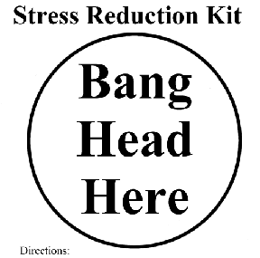
After the pieces are together?
Formatting
Submission
Review
Revisions
Acceptance/start over
Publication

Slide 31
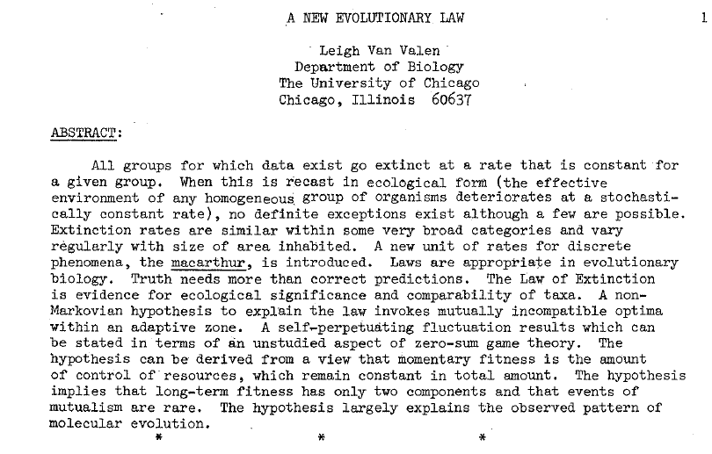
If all else fails….

