Slide 1
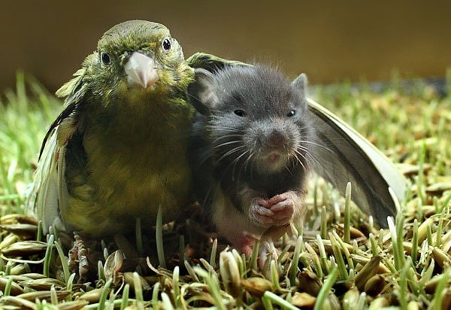
A behavior will spread through population when…?

Slide 2
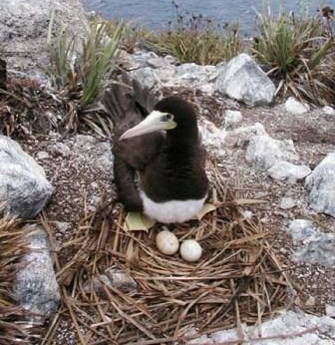
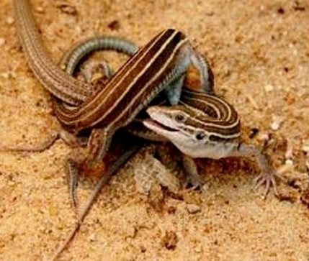
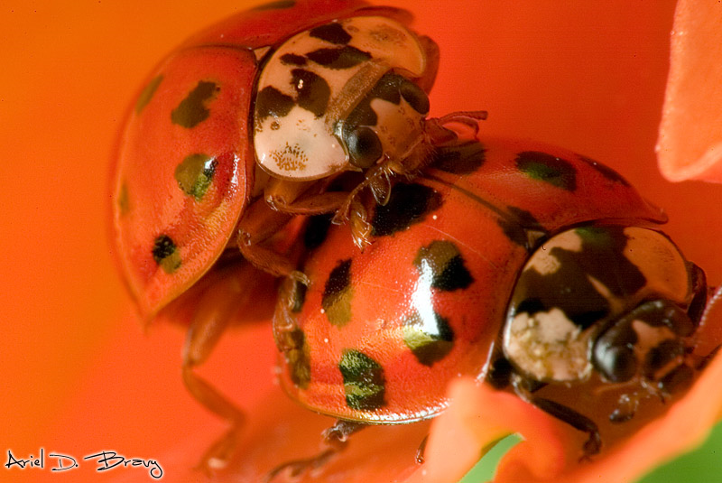
What's the point of reproduction?
Two ways to pass on your genes

Slide 3
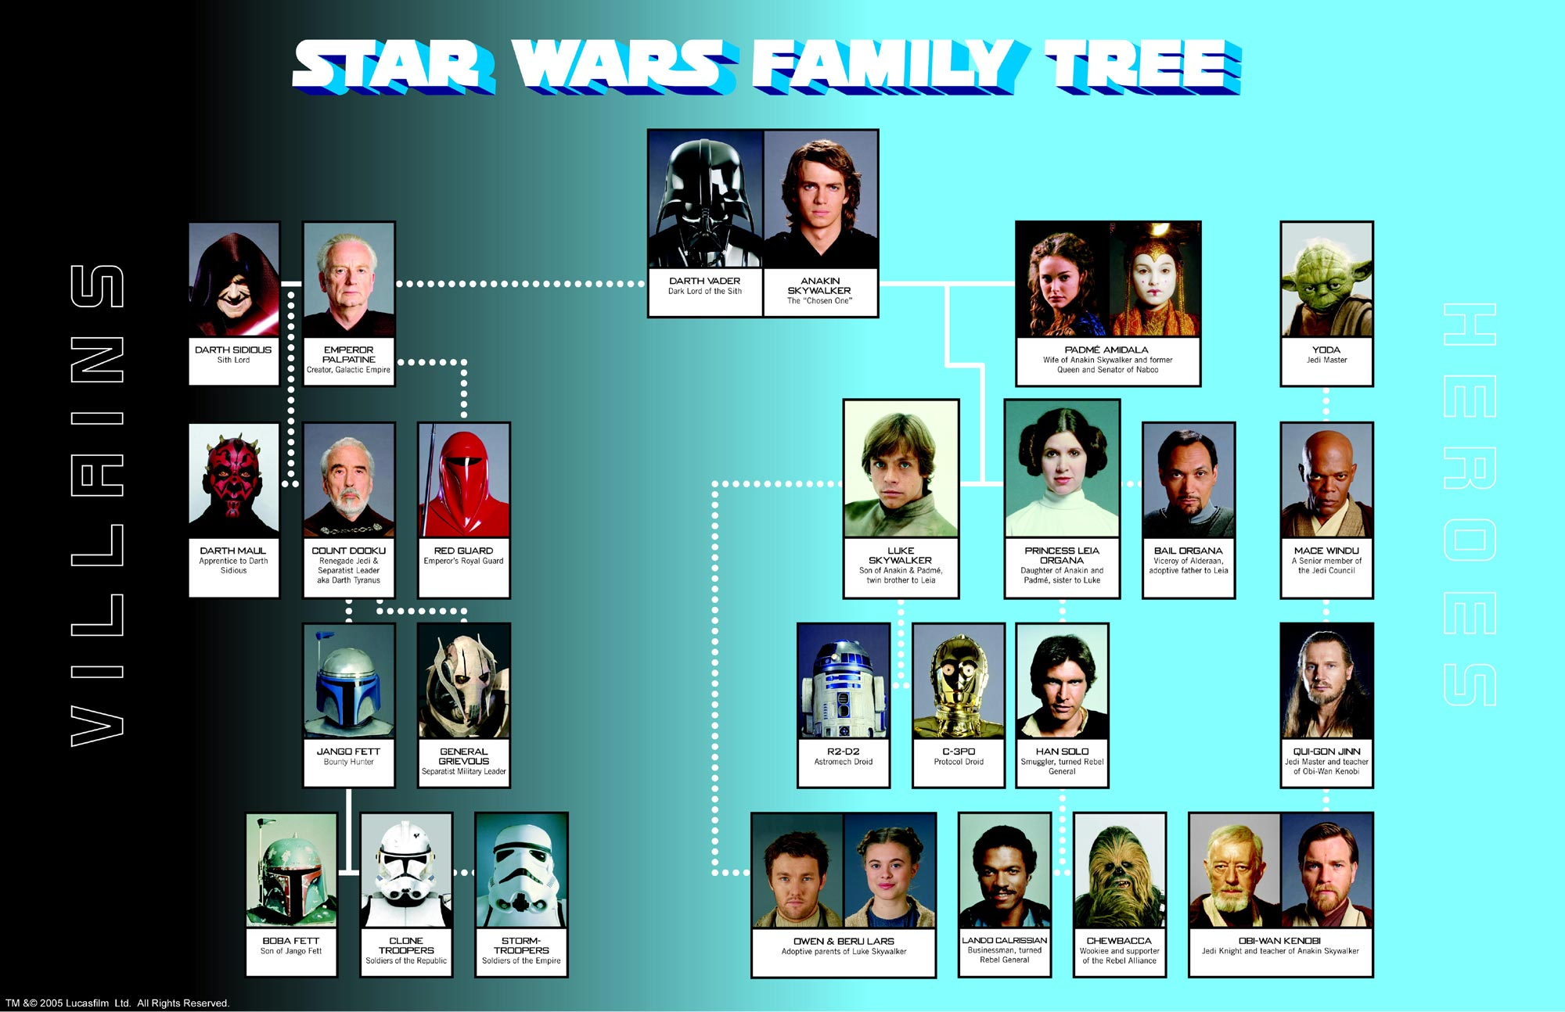

Slide 4
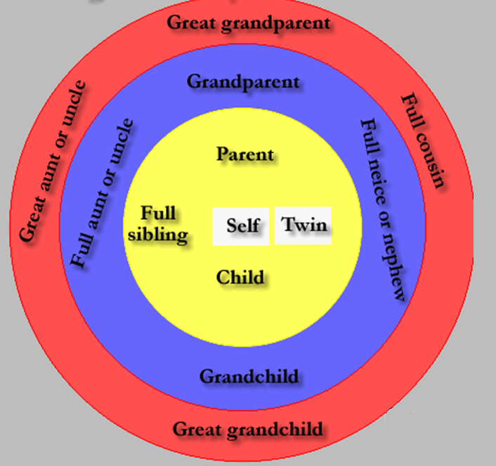
You share a proportion of your genes with your relatives – Let’s figure out how much?
1.0
0.5
0.25
0.125

Slide 5
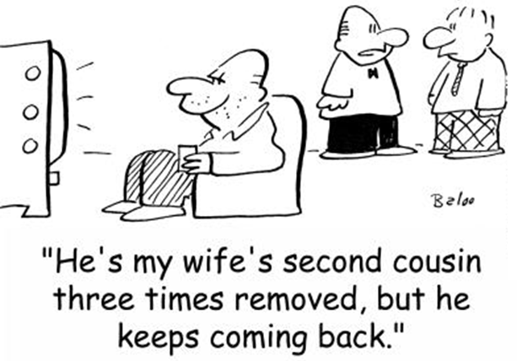
We can measure an animal’s contribution to future generations
(direct selection + indirect selection)

Slide 6
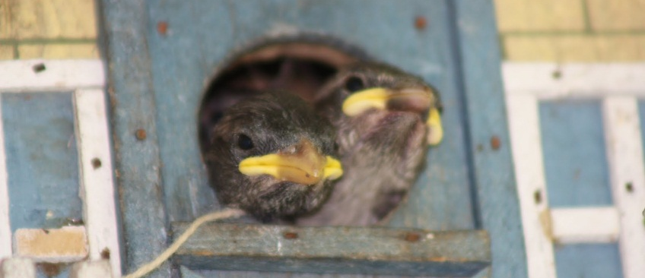
Calculating Inclusive Fitness

Slide 7
Calculate an animal’s inclusive fitness based on:
Bird has 2 offspring, helps no relatives
Mouse abandons personal reproduction and invests heavily in 3 siblings
4 offspring + abandoned at birth and don’t have relatives
0 offspring + help rear 7 brothers and sisters
1 offspring + help rear 1 sister and 3 grandchildren

Slide 8
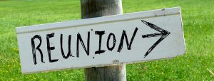
Idea of relatedness impacting fitness – WD Hamilton (1964)
Kin selection - evolutionary strategy that focuses on the family level rather than the individual level

Slide 9
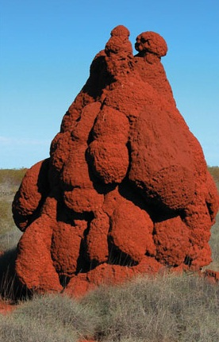
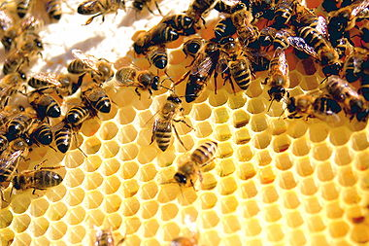
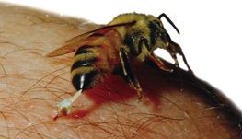
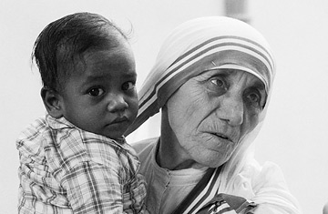
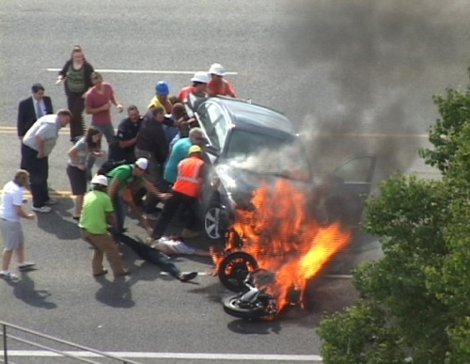
Altruism
Helping others survive and reproduce at a cost to self

Slide 10
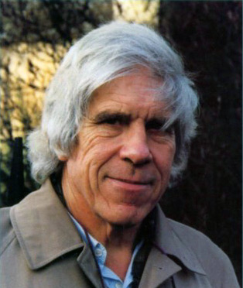
Altruism
Hamilton made connection between altruism and individual
Altruism is possible because individuals are related
Hamilton’s Rule
When should altruism occur or not occur (e.g. between whom)?

Slide 11
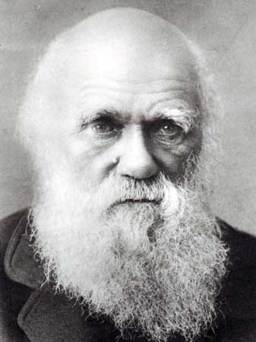
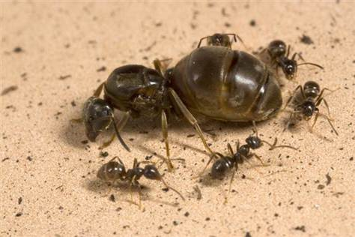
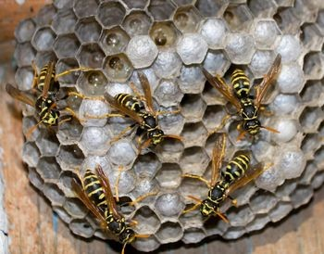
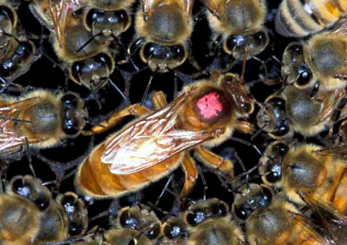
Eusociality
"one special difficulty, which at first appeared to me insuperable, and actually fatal to my theory.“
Female biased social system
One female reproduces
Others support her
Examples of Kin Selection and Altruism in Nature

Slide 12
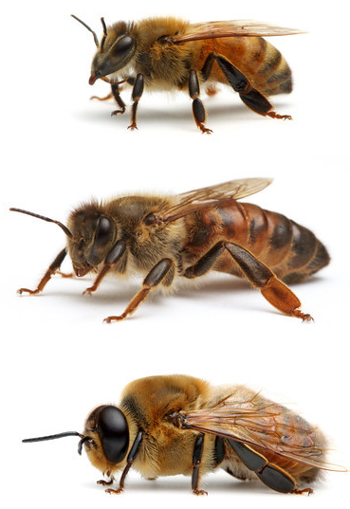
Haplo-Diploidy
Sex-determination System
Worker
Queen
Weird genetics
What is the coefficient of relatedness for the following:
Daughter – father
Daughter – mother
Son – mother
Sister – sister
Male
Why does Eusociality evolve?
What are the implications?

Slide 13
Haplodiploidy Example
Worker
Queen
Male

Slide 14
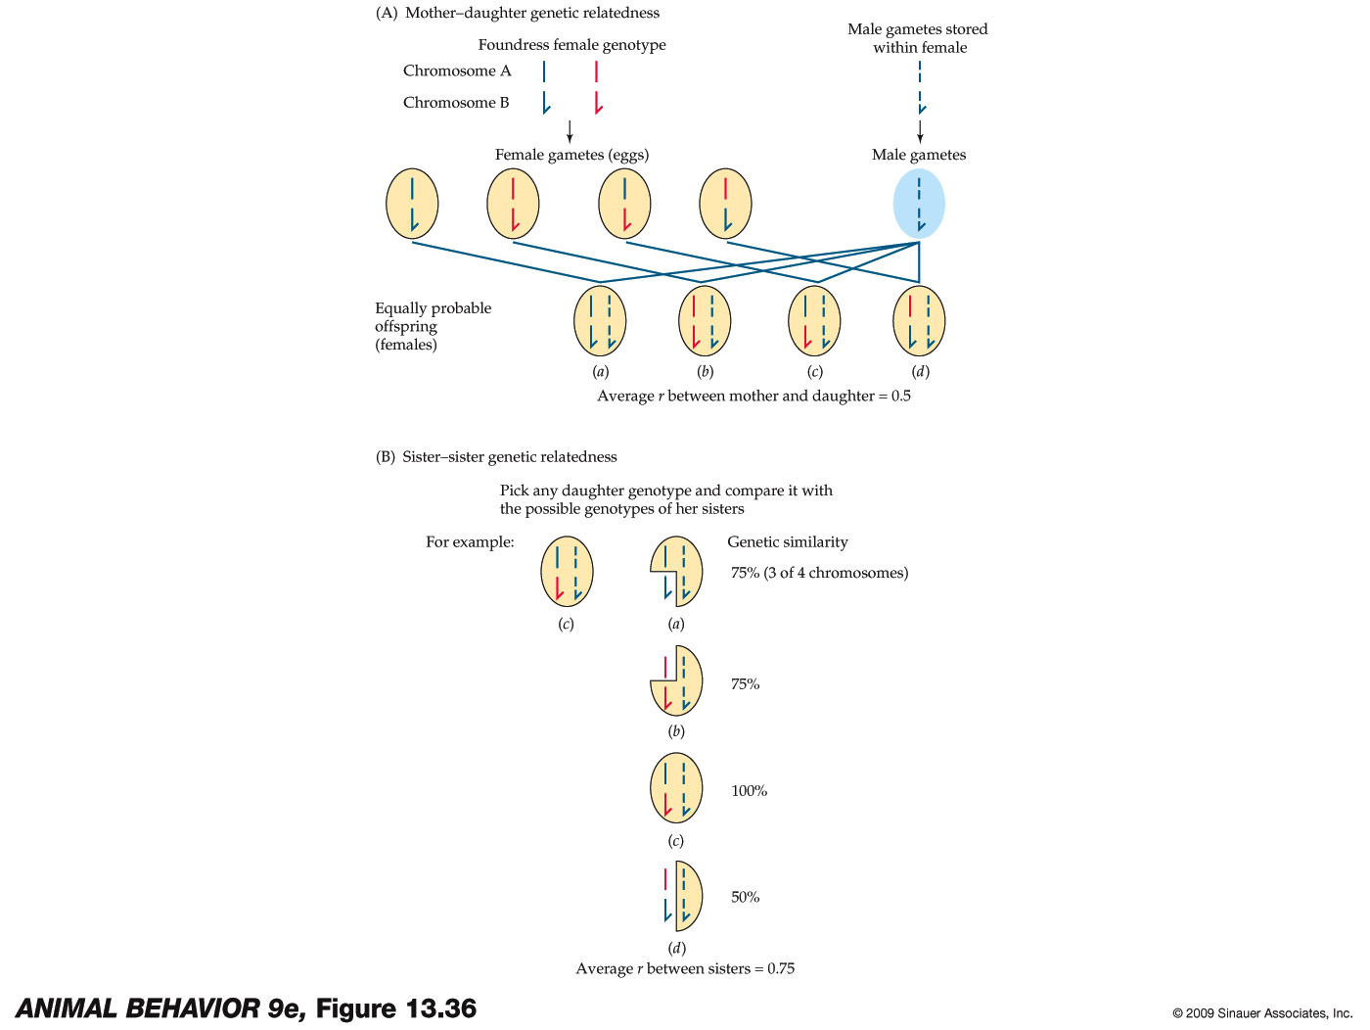

Haplodiploidy
Alcock has an excellent description of the relatedness between individuals exhibiting haplodiploidy

Slide 15
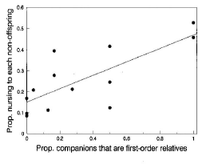
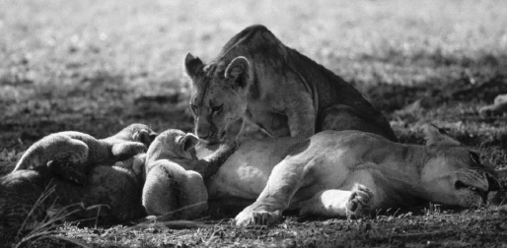
Proportion Time Nursing
Examples of Kin Selection and Altruism in Nature
Proportion Relatives
Pusey and Packer, 1994. Behavioral Ecology

Slide 16
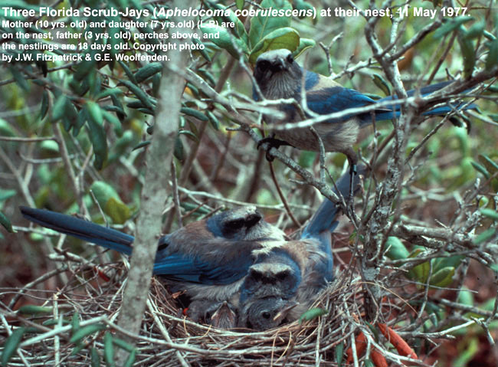
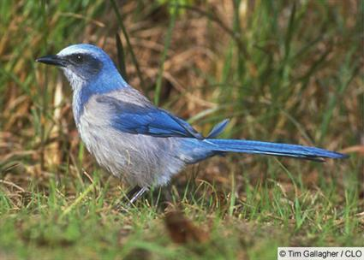
Florida Scrub Jay
Habitat saturated with birds
Unlikely to gain territory
May inherit territory
Young birds stay and help raise siblings
Father (3 yrs)
Mother (10 yrs)
Daughter (7 yrs)

Slide 17
Final Design Challenge
central Florida
Sandy pine and oak habitat (Archbold Biological Station)
Given field site with access to 30 nests
Each nest has the following:
  One parental male and female
  Various former sib helpers (sons and daughters) – 2 to 6 (max)
Question: Do altruistic helpers influence reproductive success in Florida Scrub Jays?
Father (3 yrs)
Mother (10 yrs)
Daughter (7 yrs)

Slide 18
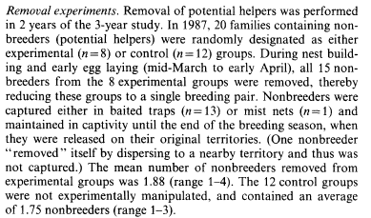
Design an experimental study to answer the question
Father (3 yrs)
Mother (10 yrs)
Daughter (7 yrs)
Mumme (1992) Beh Eco Sociobio

Slide 19
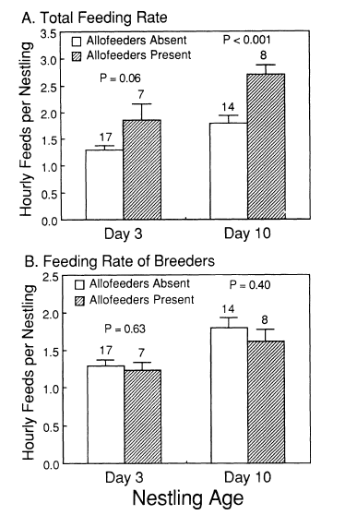
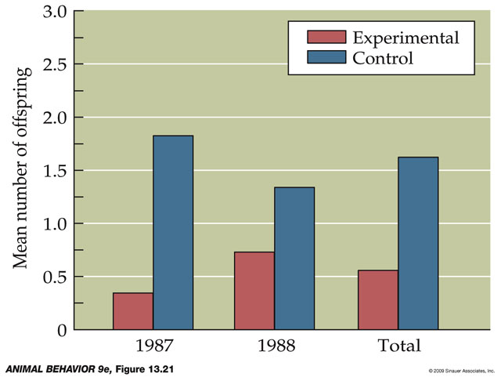
Results
No effect on
  Breeder survival
  First egg date
  Nesting attempts
  Clutch size
  Hatching success
# Offspring surviving to day 60
*Fledging at day 20*
Helpers removed
Helpers left at nest

Slide 20
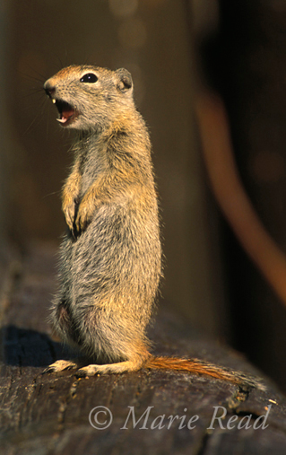
Alarm Calls in Ground Squirrels
http://www.youtube.com/watch?v=1bY8ZsPVgZY
observed
Examples of Kin Selection and Altruism in Nature
expected
Number Individuals Giving Alarm Call
Spring
Summer
Dunford, 1977. American Naturalist

Slide 21
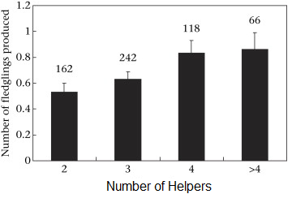
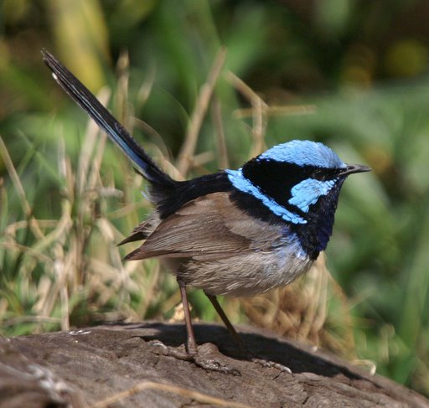
Impact of Helpers
Father (3 yrs)
Mother (10 yrs)
Daughter (7 yrs)

Slide 22
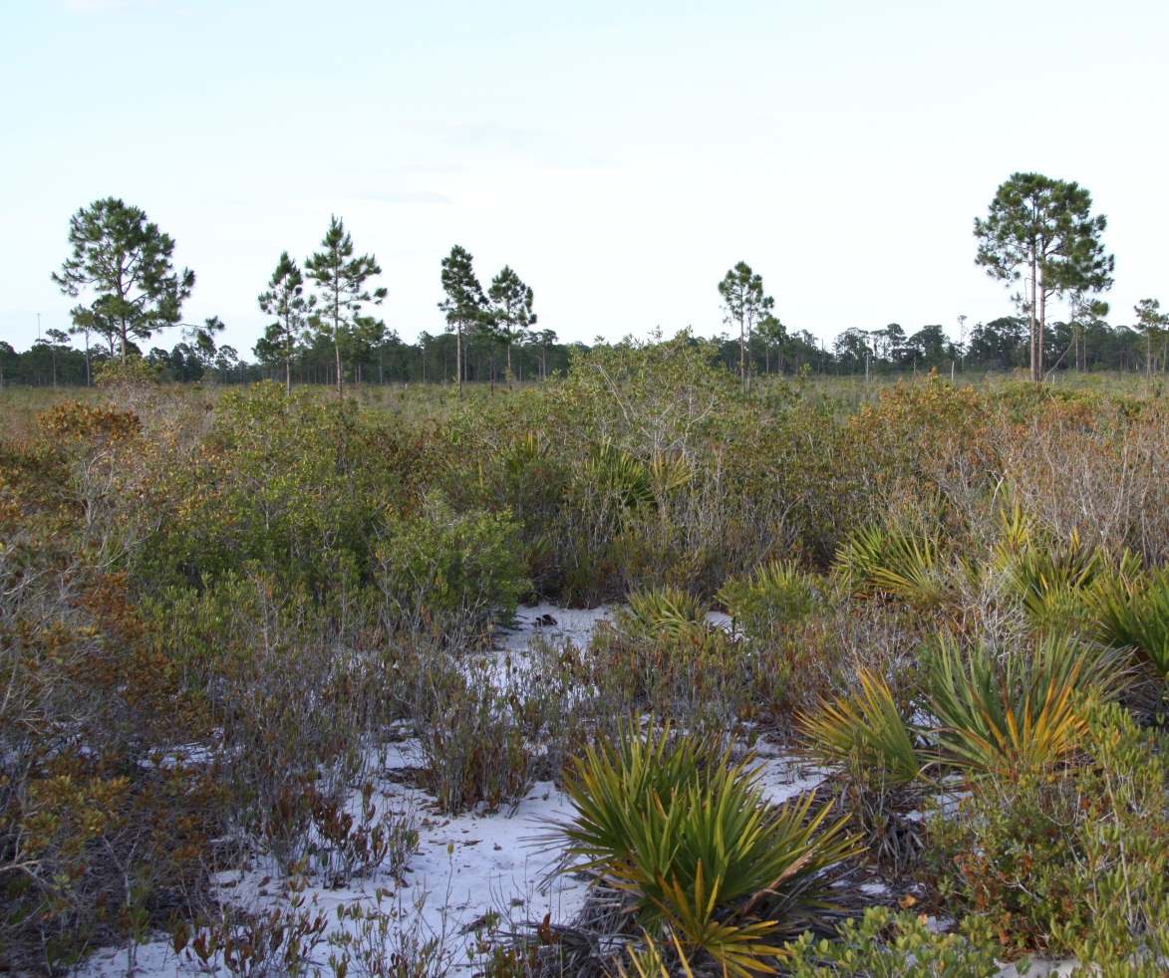
Why don’t helpers breed
Other than inclusive fitness benefits…

Slide 23
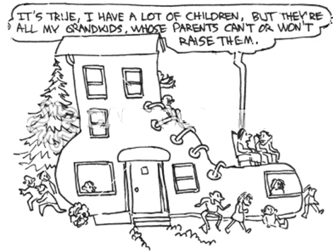
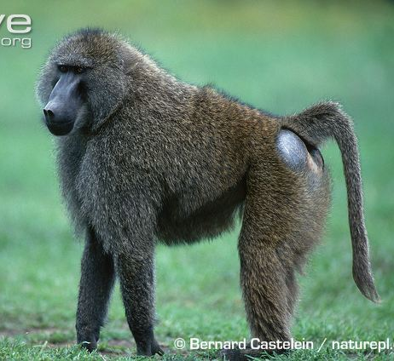
Benefits to helpers
Olive Baboon
Future Territory Owner

Slide 24
Kin selection and inclusive fitness explain altruism between _____________.
Should animals help non-kin?

Slide 25
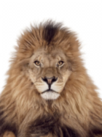
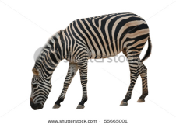



Cooperation Between Non-Kin
X
**Selfish genes will always spread through a population of altruists**
What’s a problem with this mechanism?

Slide 26
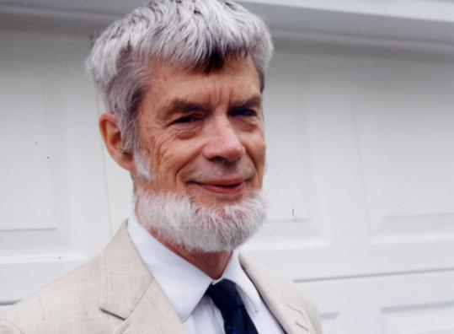
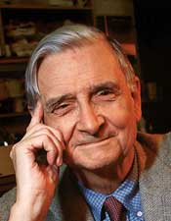
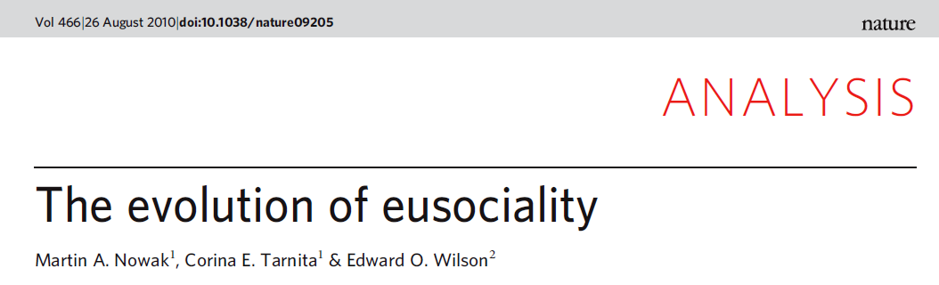
Problems with Group Selection

Slide 27
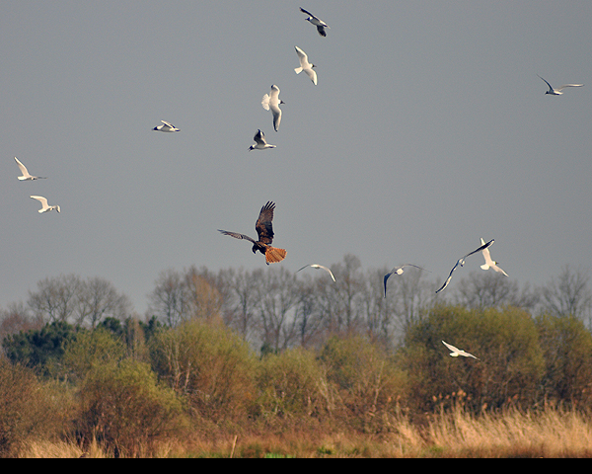
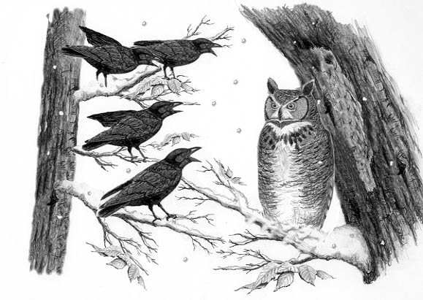
Is it ever possible to benefit from helping non-kin?
Remember: these are not kin (no inclusive fitness)
Altruist: cost to self + benefit to others
Direct benefit of altruism: may be hidden benefit

Slide 28
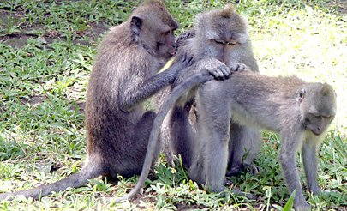
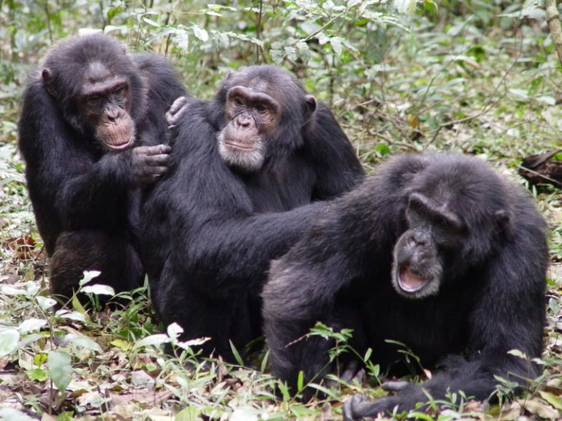
Direct Benefits to Self
Two Characteristics:

Slide 29
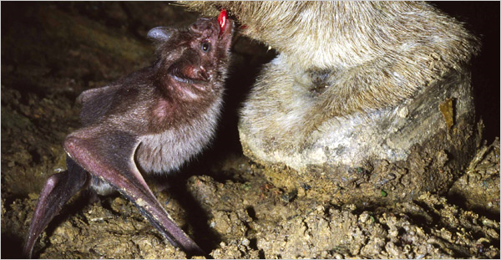
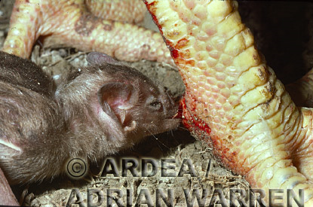
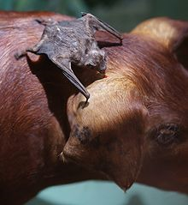
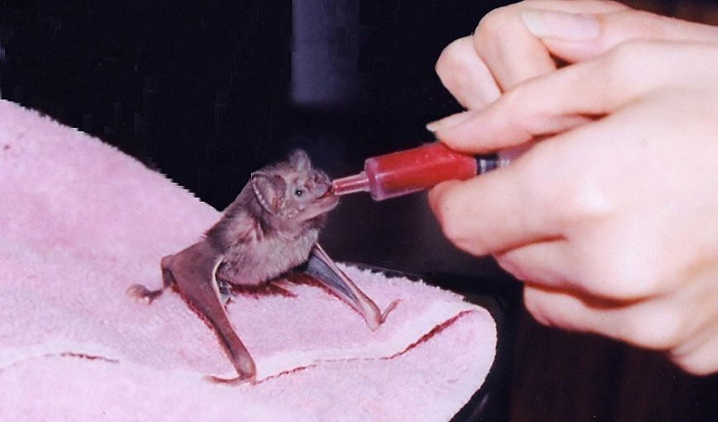
https://www.youtube.com/watch?v=iLp-ls8AoaU

Slide 30
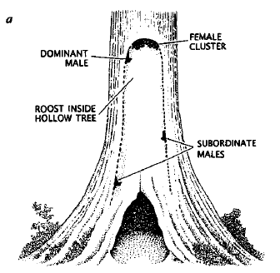
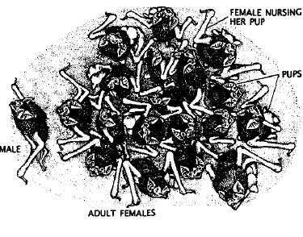
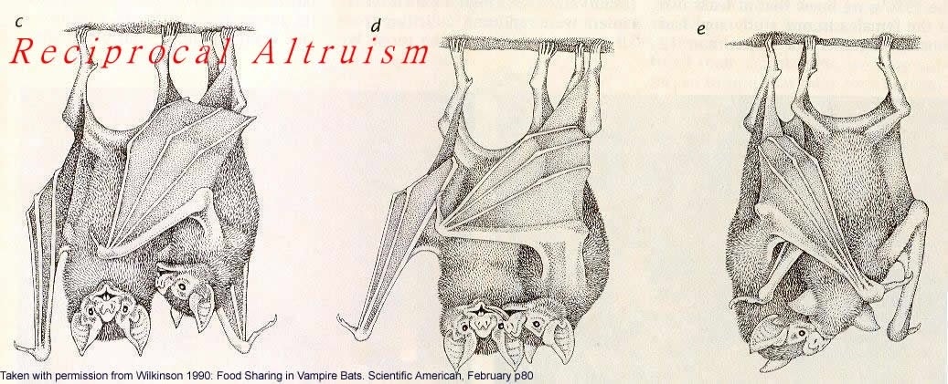
Social groups of kin and non-kin
Stable
30% young, 10% old fail to feed
Random within those groups
> 60 hours = death

Slide 31

To maintain altruism:
Low cost to helping (–C)
Large benefit later (B_{s})
Should also see:
  Good chance of repayment in future
  Roles switch often
  More likely to help altruistic individuals

Slide 32


Slide 33

Model of non-kin cooperation

Slide 34
Prisoners Dilemma
Worked well with partner so get back together after the sentence
Axelrod & W. D. Hamilton
Characteristics of winning IPD game:
  Nice strategy
  Retaliatory
  Forgiving
Axelrod discovered
  When encounters repeated, greedy strategies did poorly while altruistic strategies did better
  Possible mechanism for evolution of altruistic behavior

Slide 35
Do you think Reciprocal Selection can explain some altruism in Humans?

Slide 36

Other hypotheses
Indirect reciprocity hypothesis
Nothing to do with max fitness
  Arbitrary culture evolution
  Cultural evolution theory

Slide 37


