Slide 1
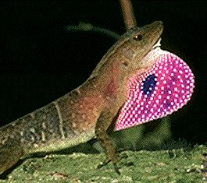
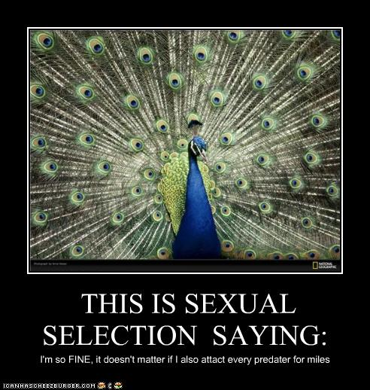

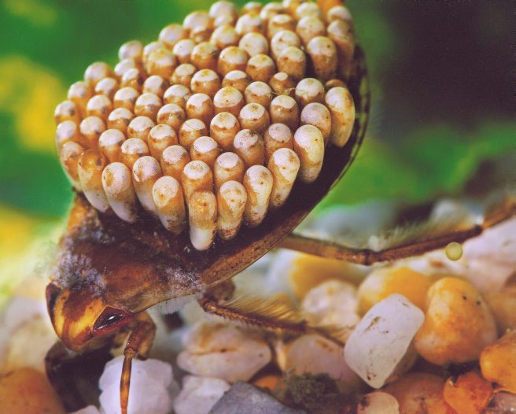
Sexual Selection
Parental Investment
Mating Tactics

Slide 2


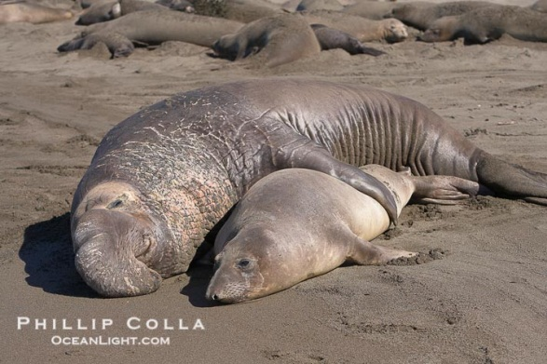
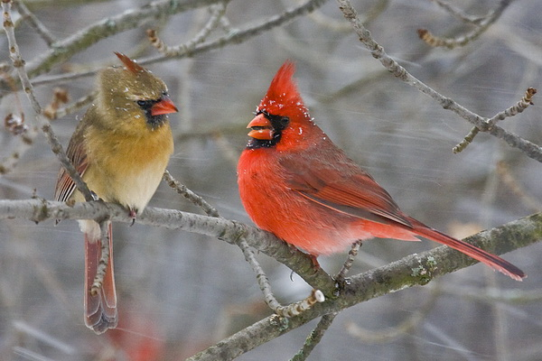
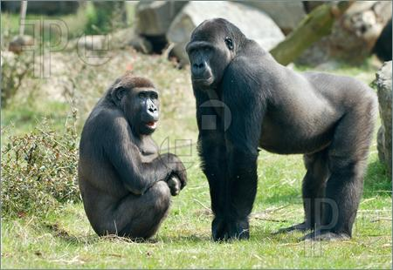
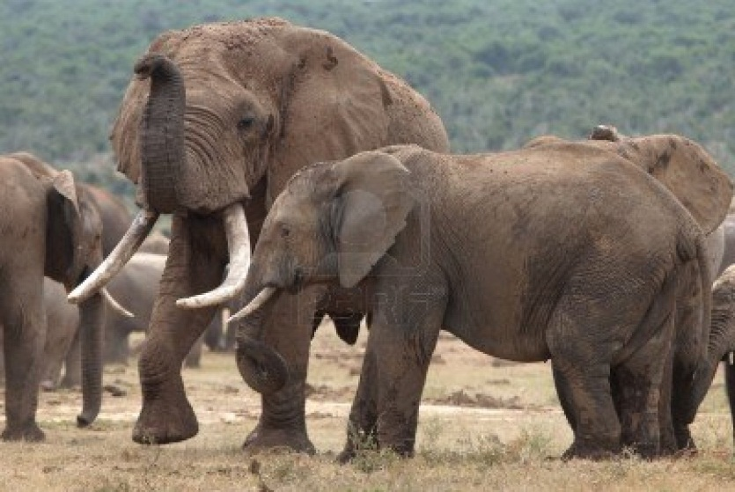
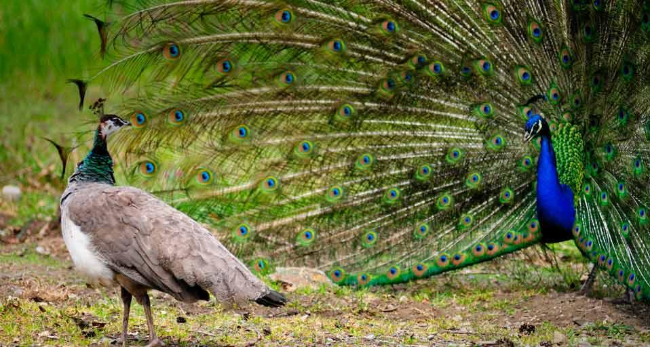
What distinguishes from
Why are there differences?
Why do these patterns routinely appear and result in these differences?

Slide 3
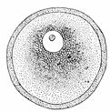

What Distinguishes from
At the most basic level…
Egg is 10 million X volume of sperm

Slide 4
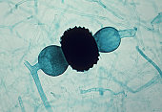
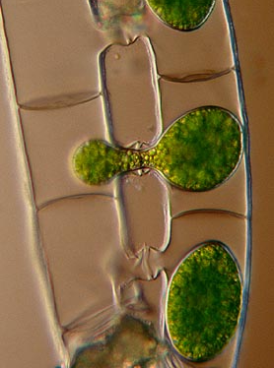
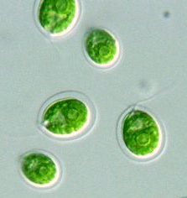
Evolution of different gametes
How and why do we see pressure to move to different sized gametes?

Slide 5
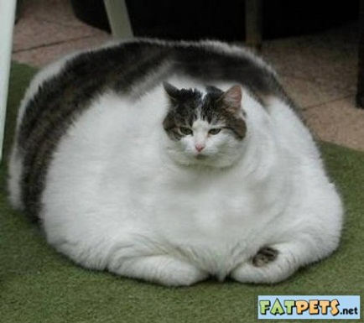
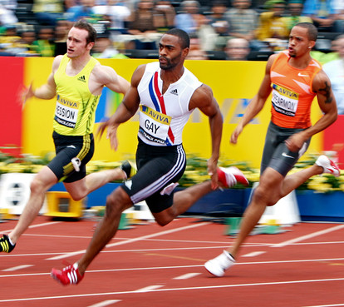
Two Strategies
If gametes are similar size, two ways (hypotheses) for how organisms can increase reproductive success

Slide 6
What does this mean in terms of investment for the animal with the “big” gamete versus the one with the “little” gamete?

Slide 7
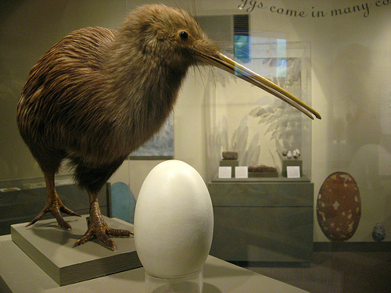
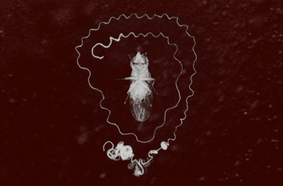
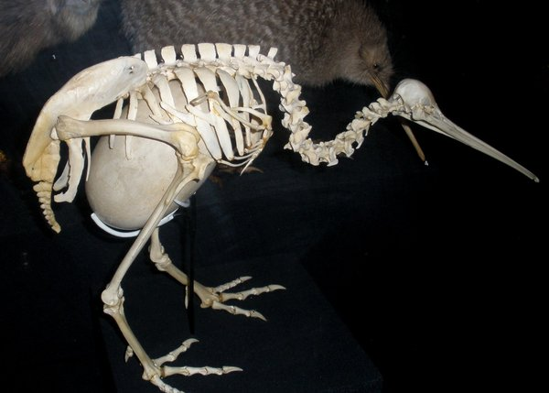
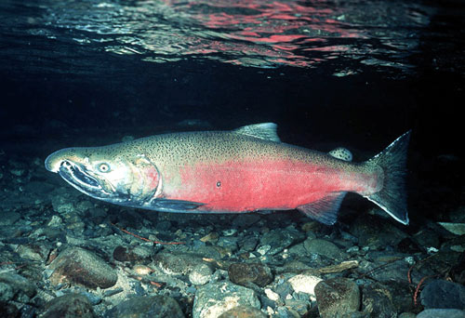
Differential Investment
Sperm are cheap
  Just big enough for DNA and little energy
Single bird egg = 15-30% female mass
Single male may have 8 billion sperm in testes
Coho salmon (100 billion sperm/3500 eggs)
Humans?

Slide 8
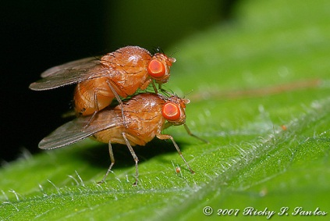
Differences in investment set the stage for competition
    Bateman
    Can we estimate number of offspring as a function of number of mates?
    Do this for both males and females

Slide 9
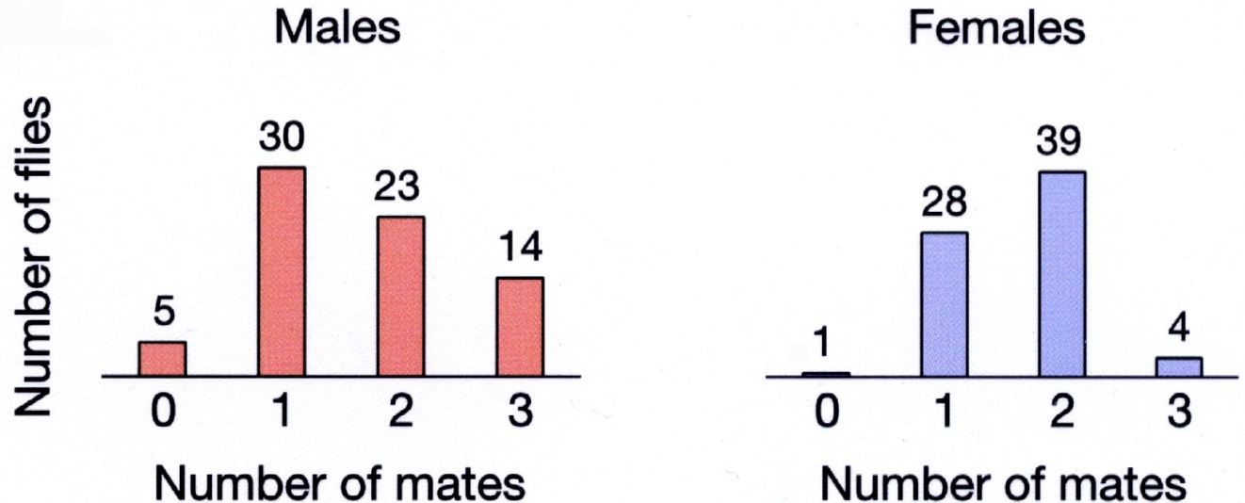
Sets Stage for Competition
    Results:
    Males: some never mated, others 3+ (20%)
    Females: All mated 1-2 times
    Conclusions:
    Sex with little investment will have large variation in reproductive success → COMPETE
    Sex with lots investment will all be successful (no competition)
    How should each sex maximize reproductive success?

Slide 10
Why do we see consistent patterns related to body size, weaponry, etc.?

Slide 11
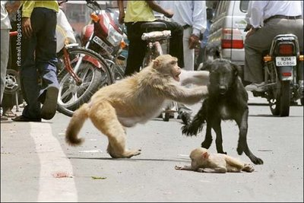
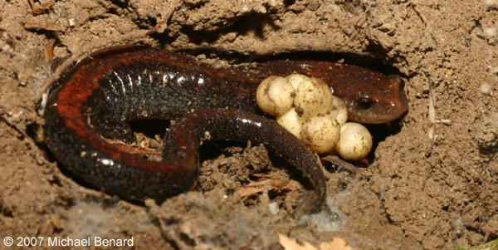
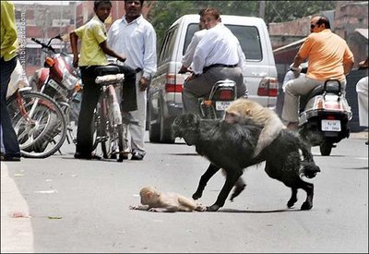
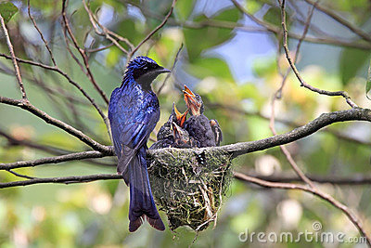
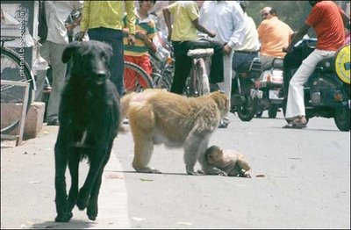
Parental Investment

Slide 12
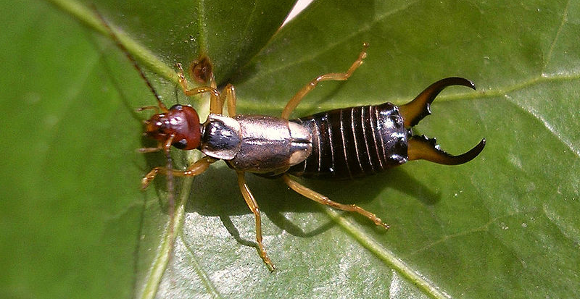
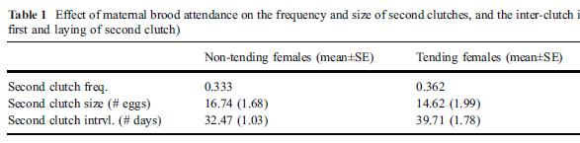
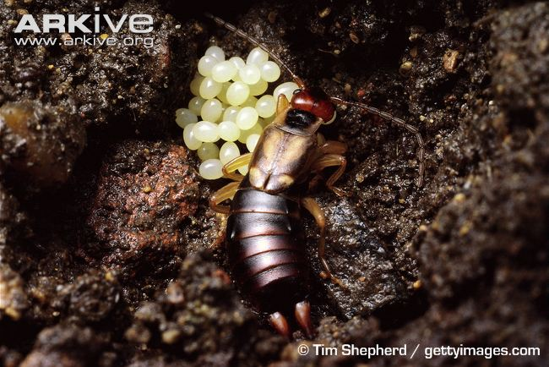
Does this trade-off really exist?
European earwig
**
Kolliker 2007. Behav Ecol Sociobiol.

Slide 13
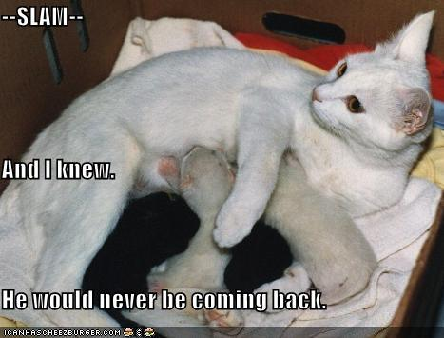
Is one sex more likely to exhibit parental care?

Slide 14
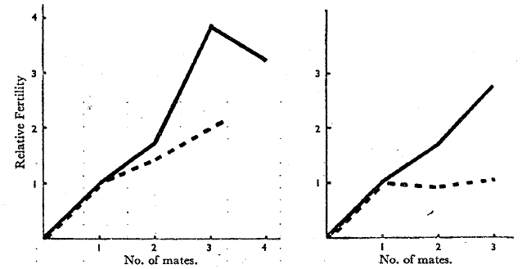
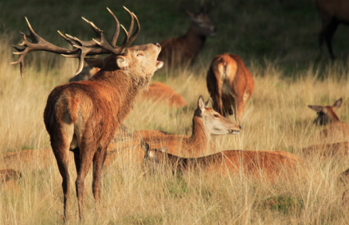
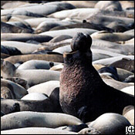
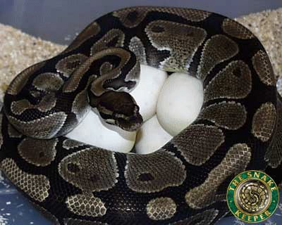
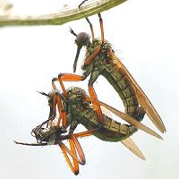
Lets tie everything together…
How much do males invest in reproduction (gametes and parental care)?
What limits male reproductive success?
What should the males strategy be?
Males
Females
How much do females invest in reproduction (gametes and parental care)?
What limits female reproductive success?
What should the females strategy be?

Slide 15
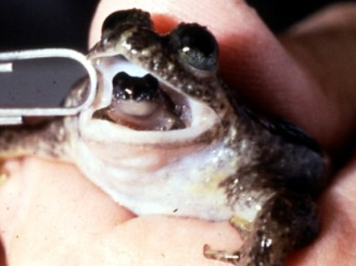
Extreme examples of Parental Investment

Slide 16
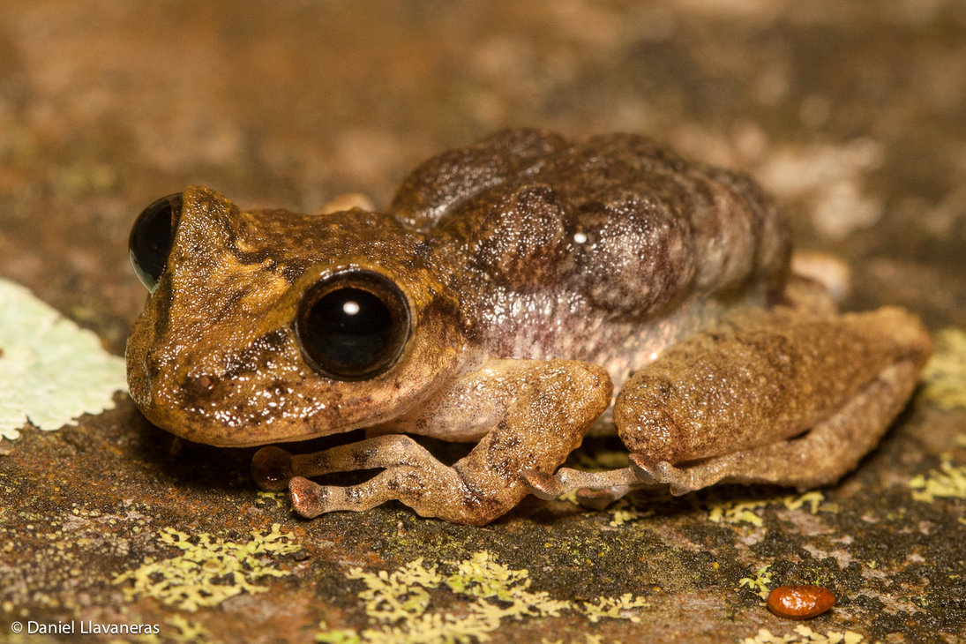
Extreme examples of Parental Investment

Slide 17
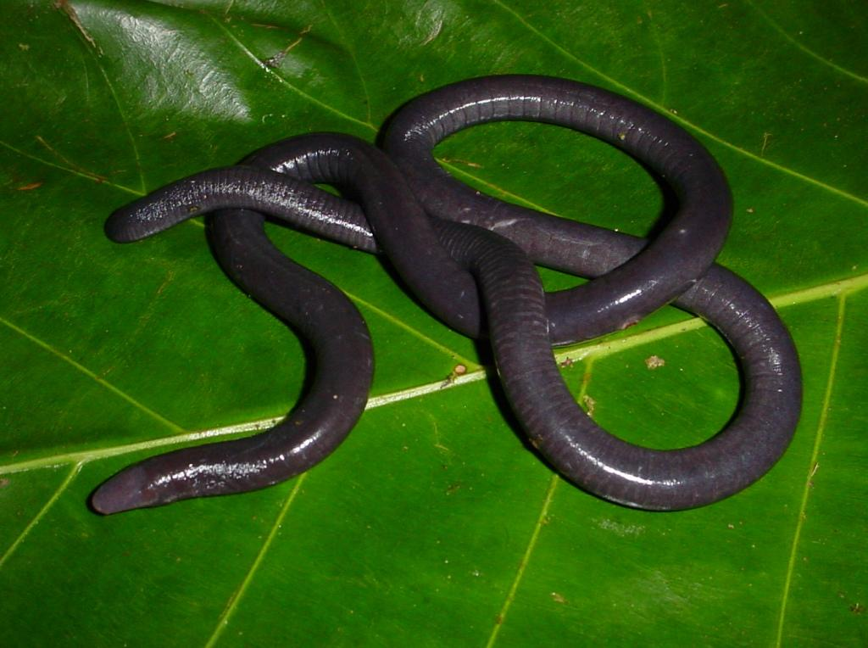
Extreme examples of Parental Investment
https://www.youtube.com/watch?v=6K6szXrBHwM&nohtml5=False

Slide 18
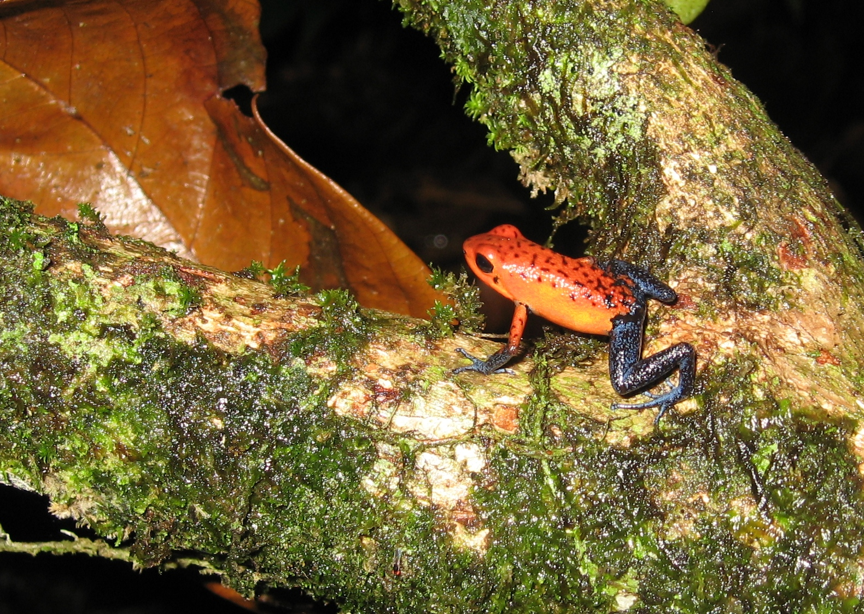
Extreme examples of Parental Investment
http://www.youtube.com/watch?v=PTd_Z9a78FU

Slide 19
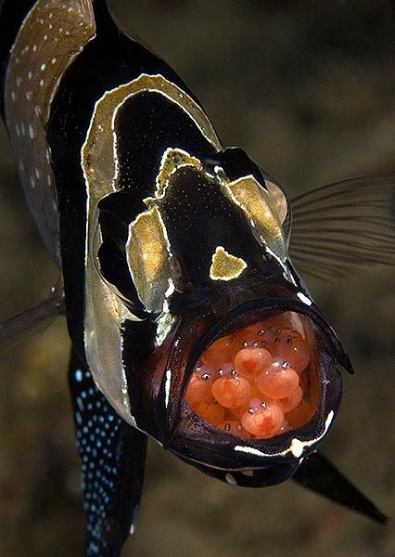
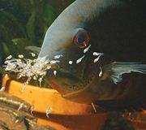
Extreme examples of Parental Investment
http://www.youtube.com/watch?v=9KsWGj_0k7s
http://www.youtube.com/watch?v=vJE1wwwTGwQ

Slide 20
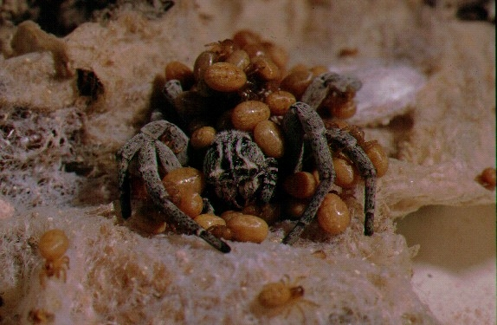
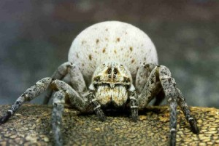
Extreme examples of Parental Investment
Stegodyphus lineatus
Salomon et al. 2010. Maternal nutrition affects offspring performance via maternal care in a subsocial spider Behavioral Ecology and Sociobiology

Slide 21
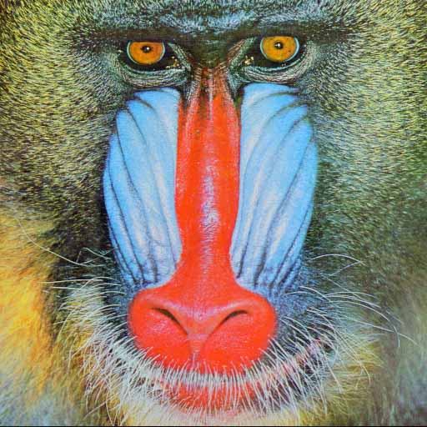
Sexual Selection
Darwin’s view of sexual selection
What I have called Sexual Selection… depends not on a struggle for existence in relation to other organic beings or to external conditions, but on a struggle between individuals of one sex, generally the males for the possession of the other sex. When the males and females…have the same general habits but differ in structure, color, or ornament, such differences have been mainly caused by sexual selection.
Darwin, The Origin Of Species

Slide 22
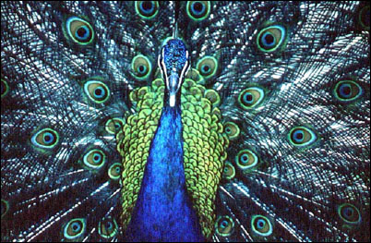
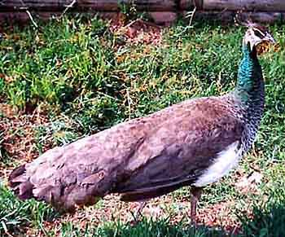
The asymmetric nature of sexual selection leads to dramatic sexual dimorphism in characters directly related to male-male competition and/or female choice.
Peacock
Peahen

Slide 23
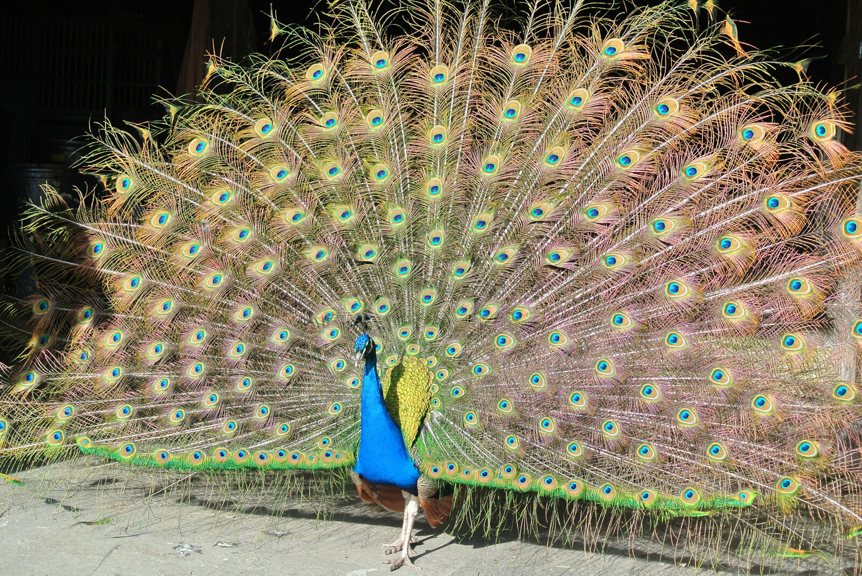
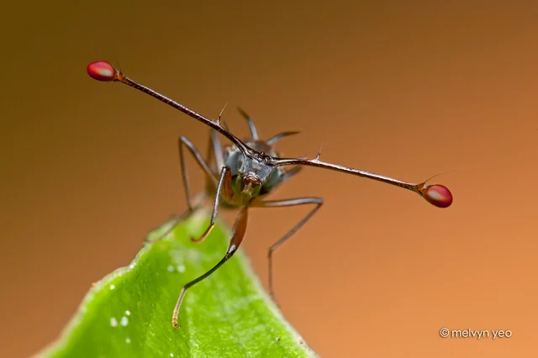
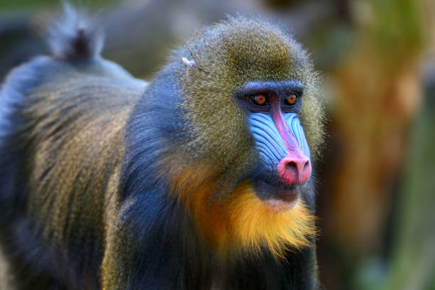
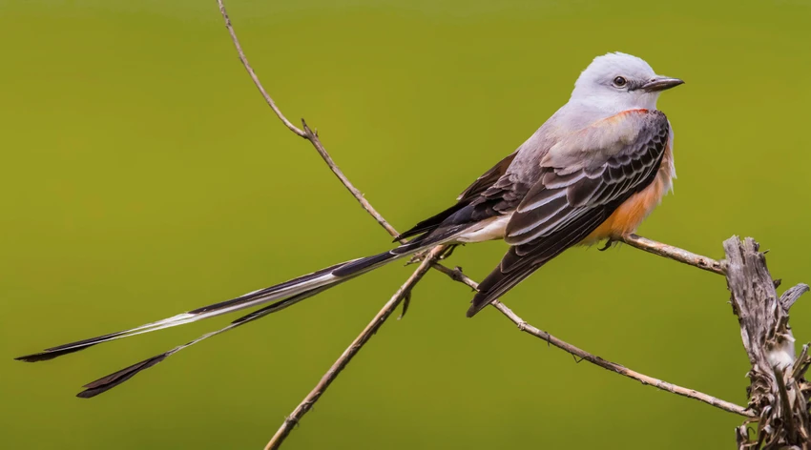
Sexual Selection

Slide 24
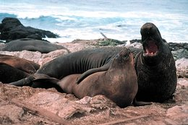




First (of 2) mechanism of sexual selection
Definition
Who is the limited sex?
Who is competing?
What characters are affected by this mechanism?

Slide 25






Slide 26




Slide 27




Signals to attract females
Sensory systems to detect females

Slide 28




Mechanisms to enhance sperm success
Decrease success of others
Increase success of your own

Slide 29



Role of the female in intrasexual selection?

Slide 30




Second (of 2) mechanism of sexual selection
Definition
Two mechanisms

Slide 31


Female Bush Cricket
Example: Direct Benefits

Slide 32
Intersexual Selection
Indirect selection: can be difficult to quantify

Slide 33


Indirect Benefits:
Runaway Sexual Selection
How it works:
Imagine a bird pop where females choose randomly
Males (and fem) with longer tails have advantage
Preference evolves – why?
Gene for female choosiness favored
  (i.e. long tail = better surv = sexier)
Spreads through population
At this point, female preference and trait correlated
Female preference may drive evolution of even longer tails
Selection advantage for long tail reversed
Only benefit is sons inherit most attractive trait
100%
*Selection advantage lost

Slide 34




Indirect Benefits:
Runaway Sexual Selection
Short Stalk
Long Stalk
Experiments by Gerald Wilkinson et al.

Slide 35




Slide 36
Indirect Benefits: Good Genes
Males differ in quality
Differences are genetically based and heritable
4 hypotheses
  Paternal genetic effect – catch-all for situations we don’t understand
  Parasite hypothesis – Characteristics signal parasite resistance, females chose the trait that is correlated with strongest immune system
  Handicap hypothesis – Ornaments are costly to produce, ornaments signal quality
  Optimal outbreeding – avoid mates whose genes are too similar or too different
Notes:
Major histocompatibility complex (MHC) is a cell surface molecule encoded by a large genomic region or gene family found in most vertebrates. Because on surface of cell organisms able to

Slide 37



Indirect Benefits: Good Genes
Gray tree frogs
Females prefer males with long calls
DOT NOT: defend call sites, provide nuptial gift, provide parental care, no difference in fertilization
Welch et al. 1998. Science

Slide 38

Indirect Benefits: Good Genes
Females choose traits that advertise parasite resistance
Offspring inherit traits correlated with resistance

Slide 39


Indirect Benefits: Good Genes
Exaggerated male ornaments signal high viability
Traits honest signals, only quality males can maintain them
Allen and Levinton (2007)

Slide 40

Indirect Benefits: Good Genes
Optimal outbreeding
Major Histocompatability Complex (mammal immune sys)
  Mice
  Humans
“Sweaty T-shirt" experiment
Claus Wedekind
Why?

Slide 41


The sex whose parental investment is greater than the opposite sex will be the limiting resource for that sex
How do we test this?

Slide 42

Test of Parental Investment Theory
https://www.youtube.com/watch?v=XwLPAKDJNqU
Birth:
http://www.youtube.com/watch?v=uKrkXXaRMUI

Slide 43


Test of Parental Investment Theory
Mattle and Wilson. 2009. Beh Ecol Sociobiol

Slide 44
Test of Parental Investment Theory

Slide 45


Test of Parental Investment Theory

Slide 46



Slide 47


Heterozygote advantage
Heterozygote has higher fitness than either of the homozygote conditions
Kruger et al. 2001. Maladaptive mate choice maintained by heterozygote advantage. Evolution

Slide 48
How could an alternative strategy evolve?
What is the difference in payoff between these two?
What are the costs of each strategy?
What might the payoff be relative to being territorial whole life?

Slide 49



Example
Bluegill sunfish
“Parental” males or “cuckolder” males
Gross and Charnov. 1980. PNAS

Slide 50


Extreme Example
https://www.youtube.com/watch?v=xsD_d016gAE

Slide 51

Mixed ESS
Equilibrium where individuals playing both strategies have equal fitness

Slide 52

Example
http://www.youtube.com/watch?v=byrZx2s6Y7M
Sockeye salmon have two male mating tactics
These tactics are heritable
What is the payoff for these two strategies?

Slide 53

Dispensing with parental Care

Slide 54

Brood Parasitism
Lay eggs in nest of other birds and leave all parental care to the “host” parents
Two types:

Slide 55



Slide 56




Interspecific Brood Parasitism
http://www.youtube.com/watch?v=cMSjmDk4GK0

Slide 57

Mating Systems
The “ideal relationship” depends on the sex
Both maximizing reproductive success
Mating systems:
Why would male be monogamous?!

Slide 58


How is monogamy maintained?
Bi-parental care may be necessary for offspring survival
 | Pup Survival (%)
Conditions | Father Present | Father Absent
Laboratory
Cold Temps | 90 | 55
Parents run for food | 83 | 45
Field | 81 | 26
Gubernick 2000

Slide 59


How is monogamy maintained?
Males that guard female may have higher fitness than if try and find additional mates
Baeza (2008)

Slide 60


How is monogamy maintained?
Females may refuse to mate with already mated males
Female punishing male
Prosen et al. 2004. Sexual coercion in a territorial salamander: females punish socially polygynous male partners. Animal Behavior.

Slide 61


Two types of monogamy
Few animals truly monogamous
Differentiate between two types of monogamy

Slide 62

Additional Mating Opportunities
What are the costs and benefits for EPC’s for both males and females?
Species level frequency of EPC in birds
Male
Female

Slide 63

Promiscuity
Everybody is mating!

Slide 64

Polyandry
Female associates with several males
Herold never suspected the cost of moving in with the colony

Slide 65
Polygyny
Males mate with more than one female
Classic paper by Emlen and Oring (1977)
“the extent to which a male can monopolize mating opportunities depends on social and ecological factors that affect the distribution of females”

Slide 66



Types of Polygyny

Slide 67


Types of Polygyny
Females are not clustered
Males defend clumped resources that females need
Scorpionflies

Slide 68



Types of Polygyny
Males defend calling or display sites that do not contain resources
Females visit, select mate, copulate, leave the lek
Males compete in two ways

Slide 69


Types of Polygyny
Neither females, nor resources are defendable
Females not choosy (no reason to gather)

Slide 70



Why mate with already paired male?

