Slide 1
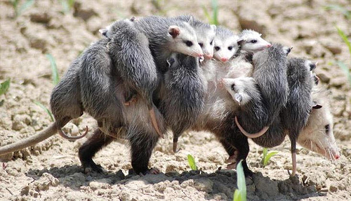
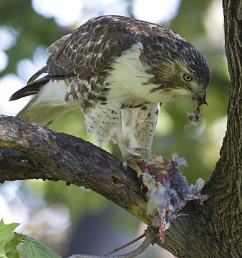
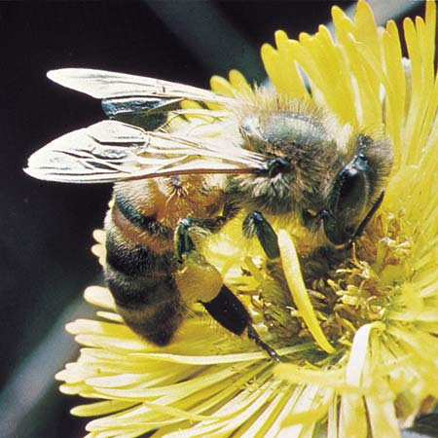
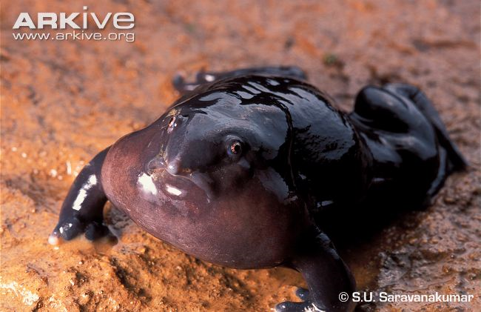
Animal Behavior
Dr. Brian Gall
When: MWF 12:00-1:10pm
Where: SCC 245

Slide 2
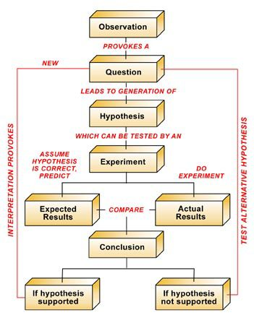
Major Goals in this Course
Introduction to animal behavior
“Doing science”
Learn to write and read scientifically

Slide 3
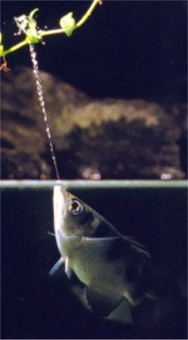
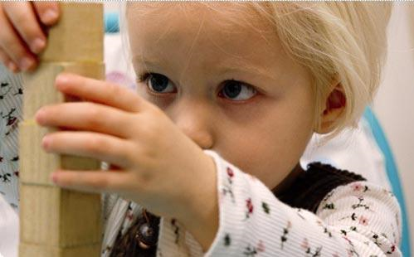
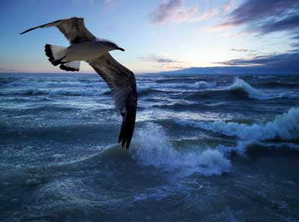
Why Animal Behavior Important?
Used to understand other aspects of biology
  conservation & evolution
Medical research (direct human benefits)
Models for processes (learning, limits, mates)
Learn about human behavior

Slide 4
Why do I do Animal Behavior?
"People cannot foresee the future well enough to predict what's going to develop from basic research. If we only did applied research, we would still be making better spears.“
--George Smoot (2006 Nobel laureate)

Slide 5

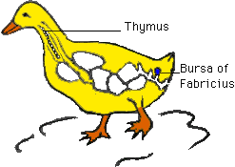
2018 winner:
  Goose butt gland advancing immunology
The purpose of the “Golden Goose” award is to demonstrate the human and economic benefits of federally funded research by highlighting examples of seemingly obscure studies that have led to major breakthroughs and resulted in significant societal impact

