Slide 1
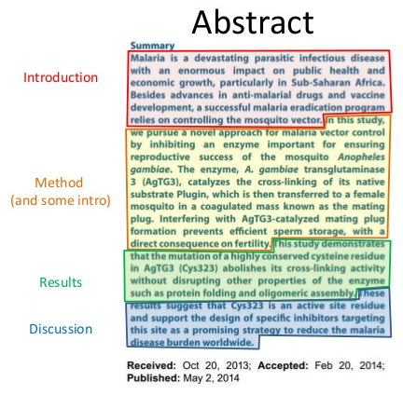
Abstract
Second most important part
Shortened version of paper
Should include:
  Objectives
  How
  Results
  Significance
Short and sweet

Slide 2
Introduction
Sets up your paper and put in context
Discuss:
  Results and conclusions of previous literature
  Holes in current knowledge
Structure:
How to write:

