Slide 1
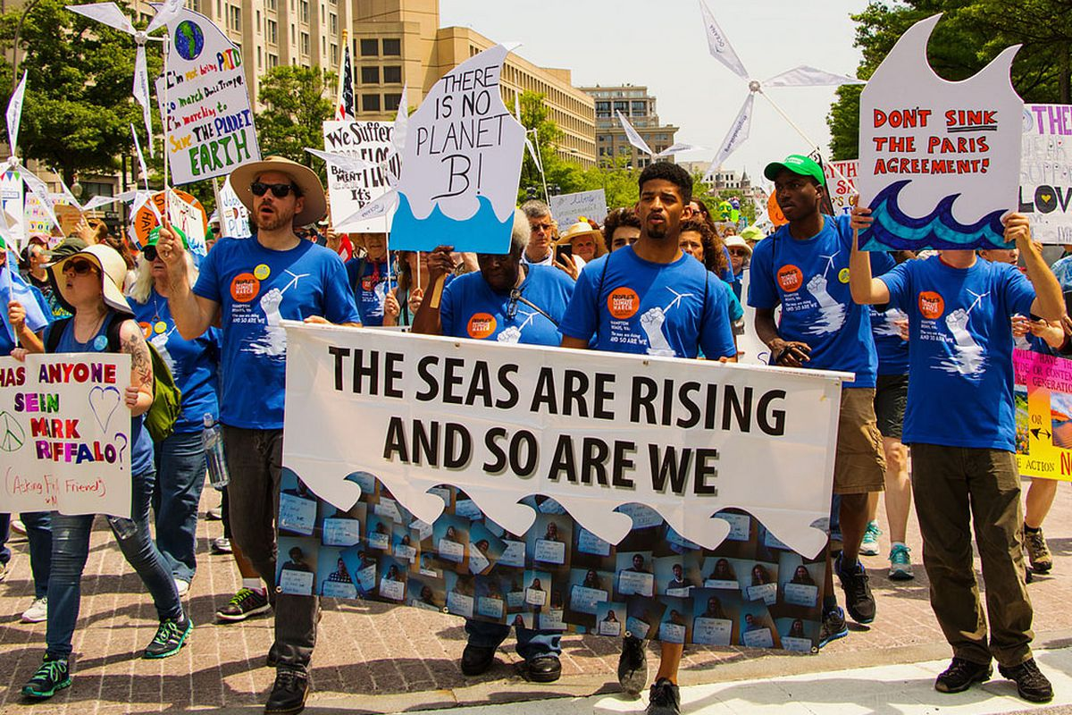

Talk Title: Presentation Template ENV260
NAME

Slide 2
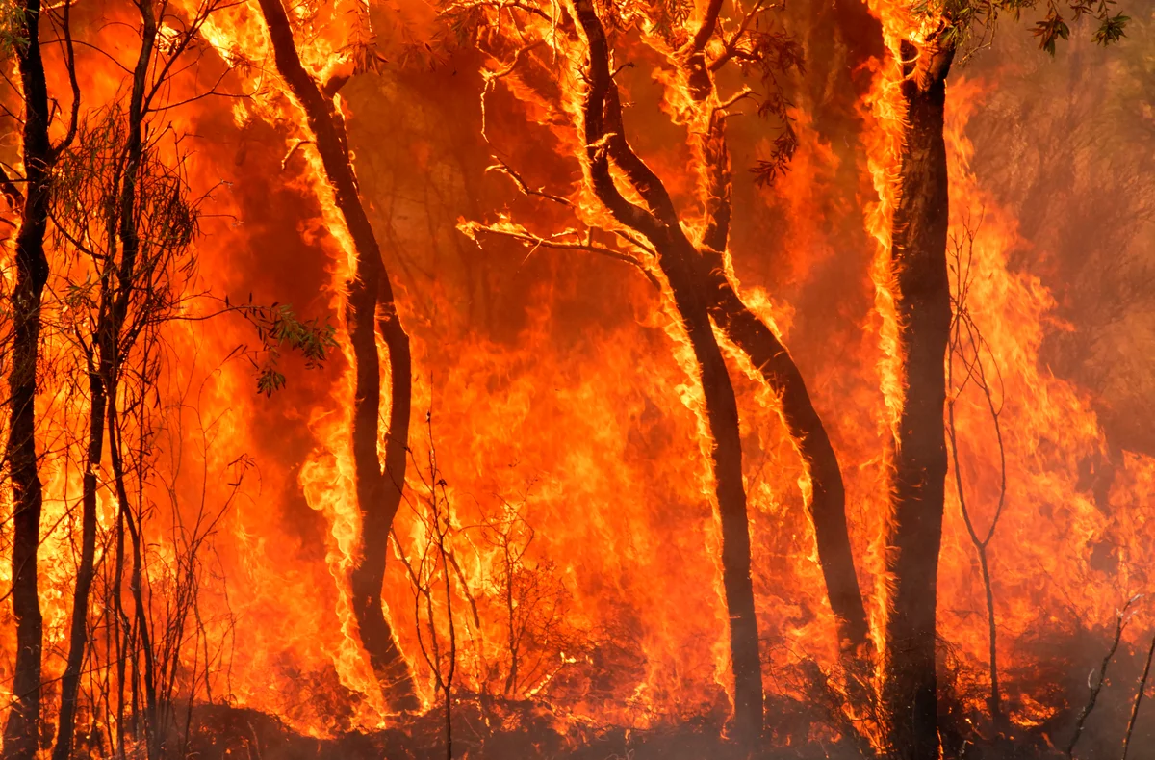
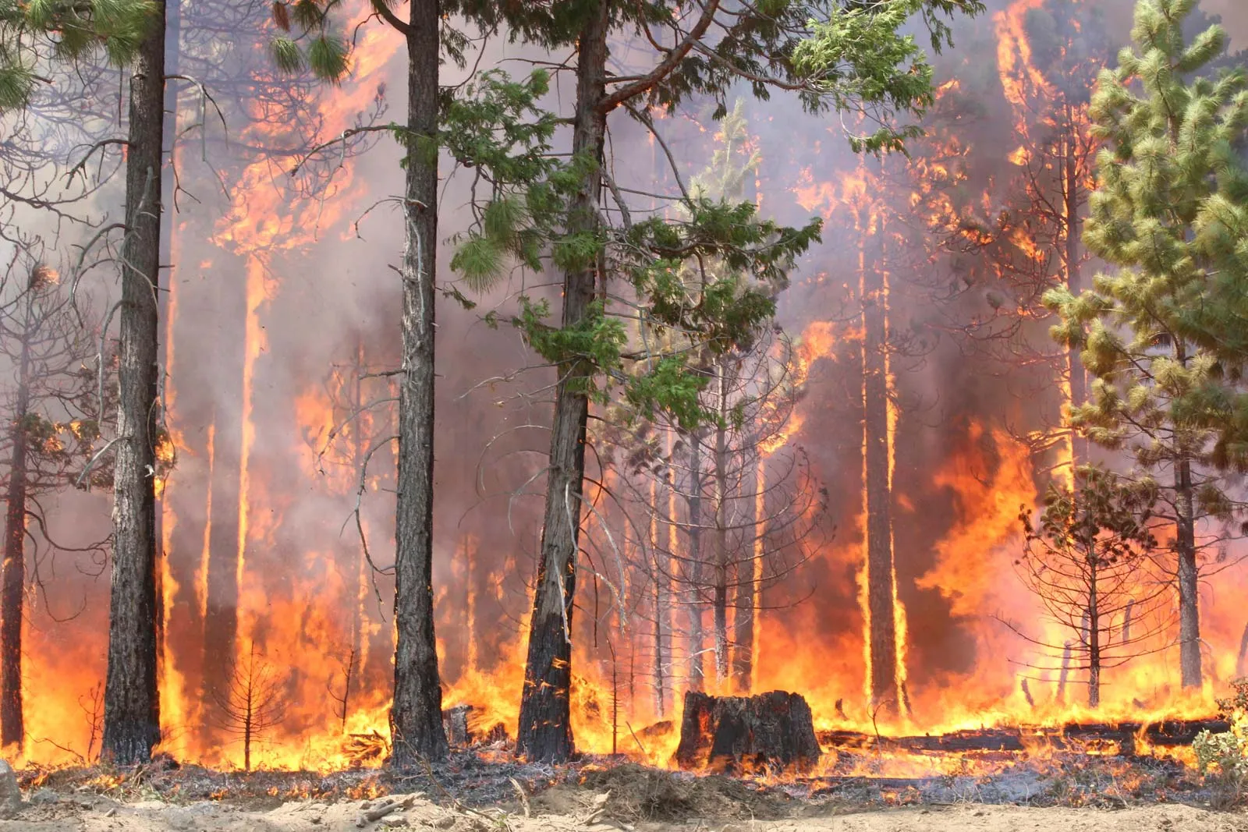
Overview

Slide 3
What are forest fires
What are they
Causes
  Anthropogenic
  Natural
Pictures should fill the empty space and help link to the ideas you have listed in bullets

Slide 4
Potential Responses
No response (let it burn!)
Control
Extinguish

Slide 5
Factors influencing fire intensity
Temperature
Wind
Tinder
Etc.

Slide 6
Link to climate change
The claim:
Evidence

