Slide 1
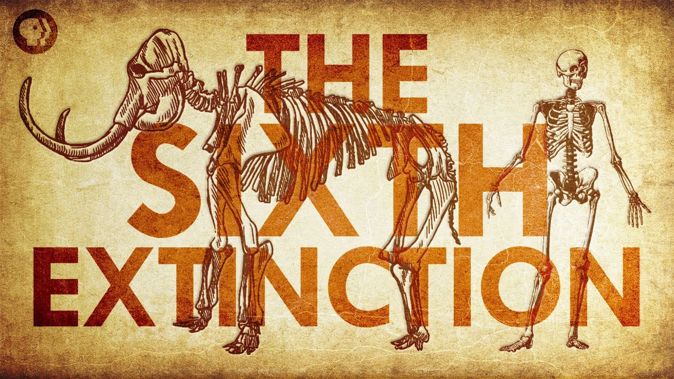

Slide 2
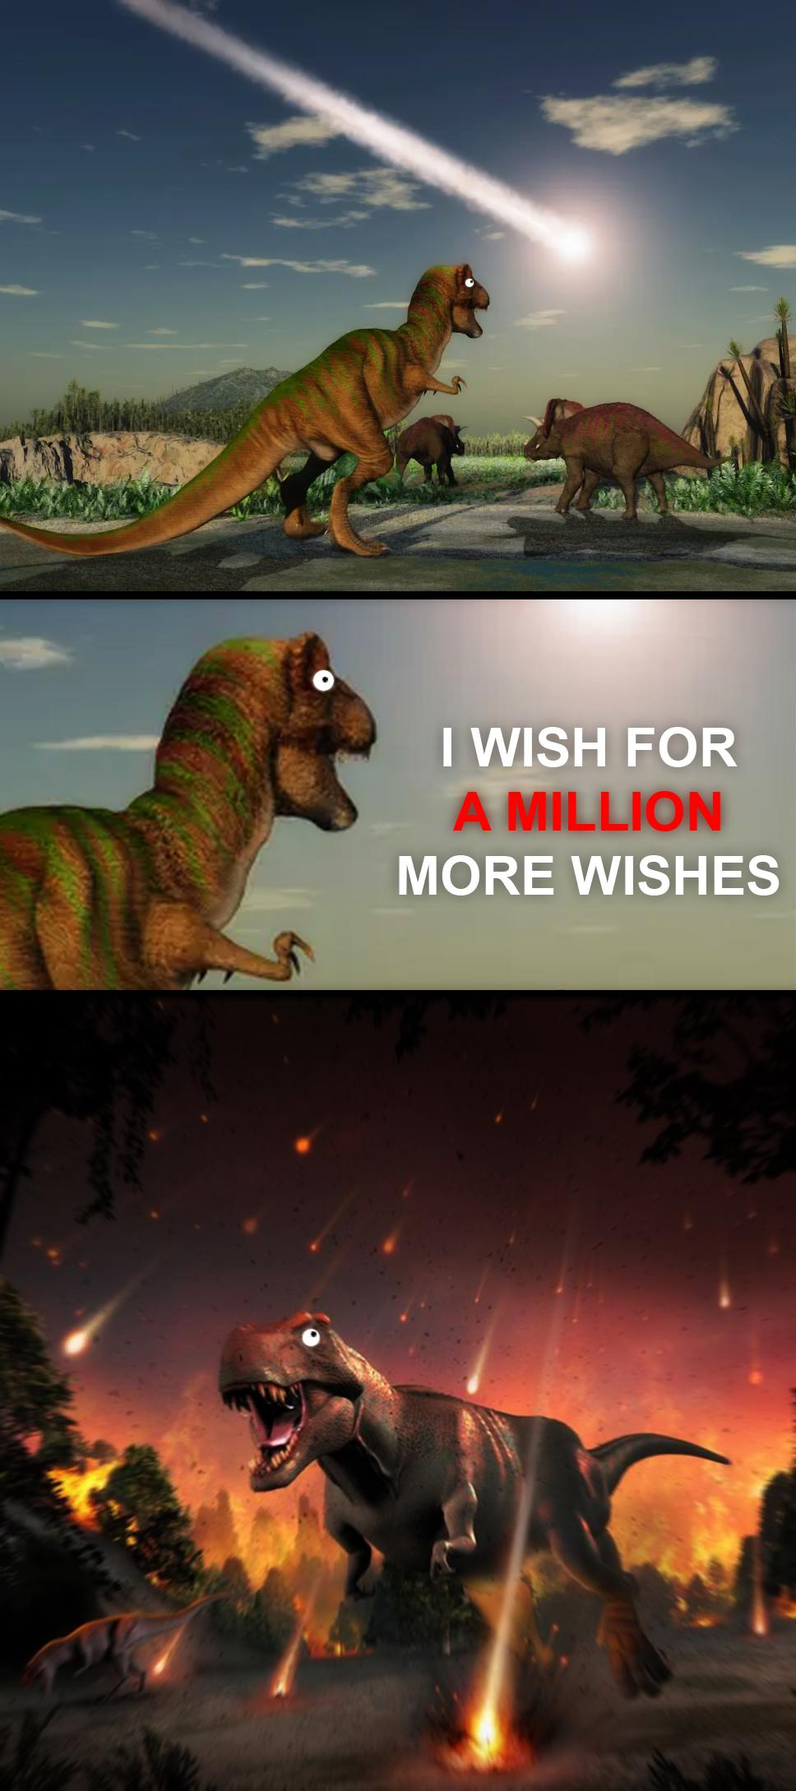
What is a mass extinction?
I wish for a million wishes!
Background rate
  10% lost per million years
  65% lost per 100 million
Species extinction balanced by speciation
Allows us to identify periods when the extinction rate is much higher
Mass extinction
  75% of species
  Short (geological) period
Notes:
Mass extinction defined by magnitude and rate

Slide 3
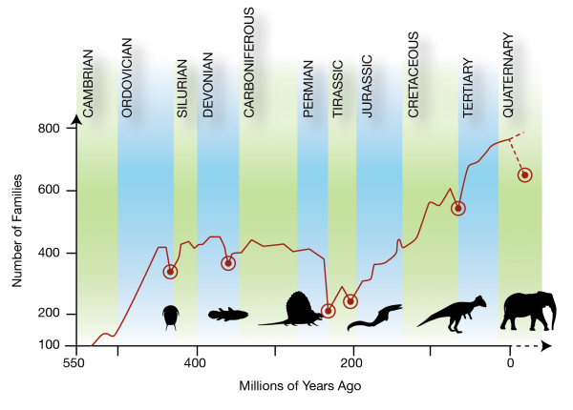
Clarifying Questions
How many mass extinctions in Earth’s history?
Do you know anything about them?
Causes?
?
Notes:
All associated with post-Cambrian period (why nothing before this?)
- end Ordovician (444 MYA) – intense glacial periods, wild sea level swings
- Devonian (360 MYA) – land plant explosion generated rapid global cooling
- Permian (250 MYA) – volcanic activity in Siberia
- Triassic (200 MYA) – volcanic activity in Atlantic, changed ocean chemistry and caused global warming
- Cretaceous (65 MYA) - Asteroid

Slide 4
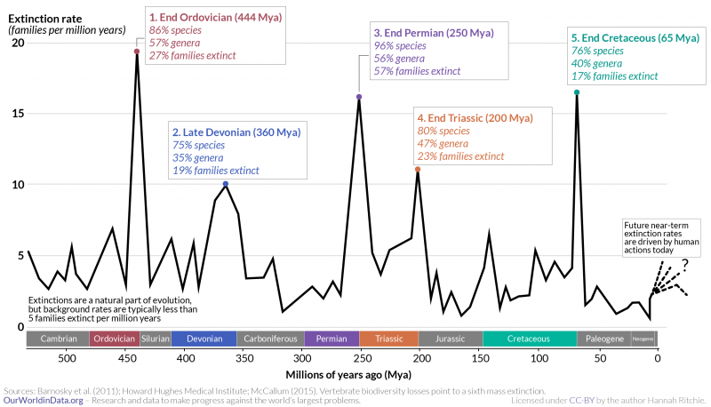
Notes:
Background rate is loss of 5 families per million years

Slide 5
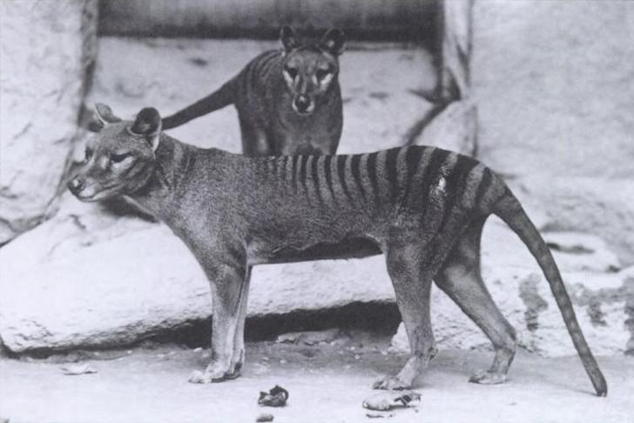
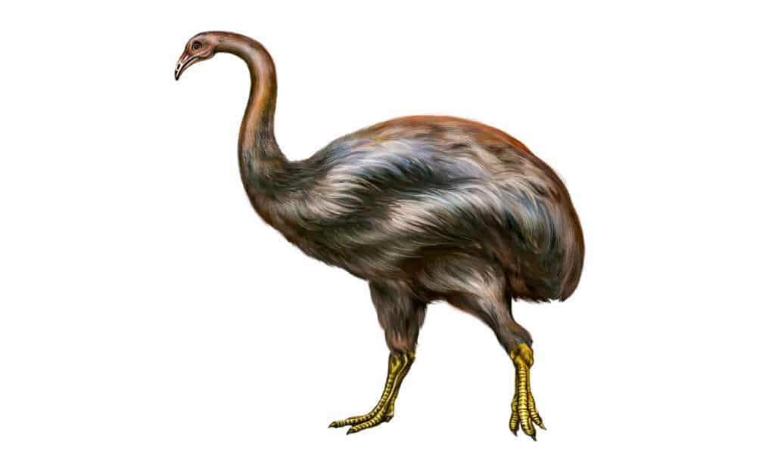
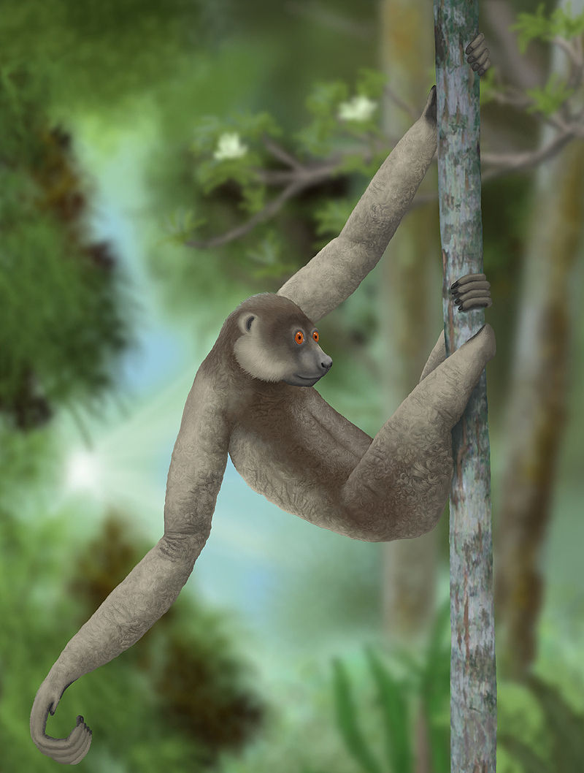
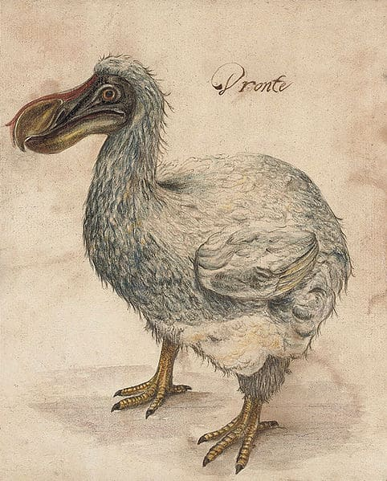
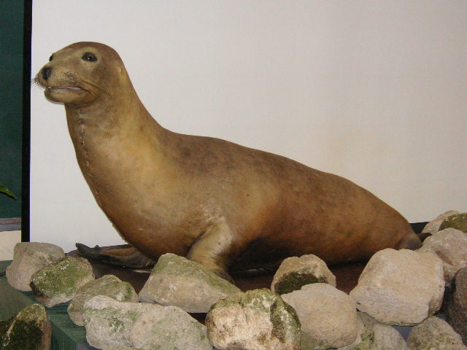
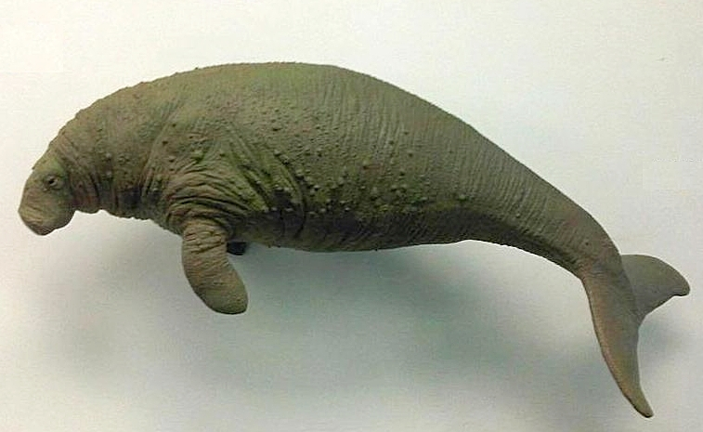
A sixth extinction?
Extinctions since 1500?
Undocumented and prior to this?
  65% large mammals
  35% counting large and medium mammals
Timing of these early extinctions?
Causes?
Notes:
DOCUMENTED: 700 animal species, 600 plant species since roughly 1500AD
-Japanese sea lion (1970’s)
-Stellars sea cow (
Tasmanian tiger(1930’s)
Madagascan lemurs (~by 1500)
PRIOR – documented to be involved in extinctions going back 50,000 years – especially ~12,000 years ago
- mammoths, mastodons, camels, saber-toothed cats, giant ground sloths, giant armodillos, giant kangaroos, giant wombats
NUMBERS – 65% of megafauna, 35% counting large and medium
TRIED SO HARD TO GET THIS AS A % of TOTAL – NOTHING – ON PURPOSE?
America’s – 12,000 yrs ago
Africa – n/a
Eurasia – n/a
Australia – 45,000 yrs ago
Climate Change – climate change dramatically 12,000 years ago. Vegetation changed. Warmed considerably and still in that period. Megafauna could not adapt as quickly as needed
Overkill Hypothesis – human hunters pushed large mammals to extinctions. First megafauna extinction and arrival of Clovis peoples coincide

Slide 6
A Sixth Extinction?
Notes:
Tiing of extinctions varies (12,000 years ago N & S America, 41,000 years ago Australia)
Africa and Europe/Asia experienced little extinction
CAUSE
2

Slide 7

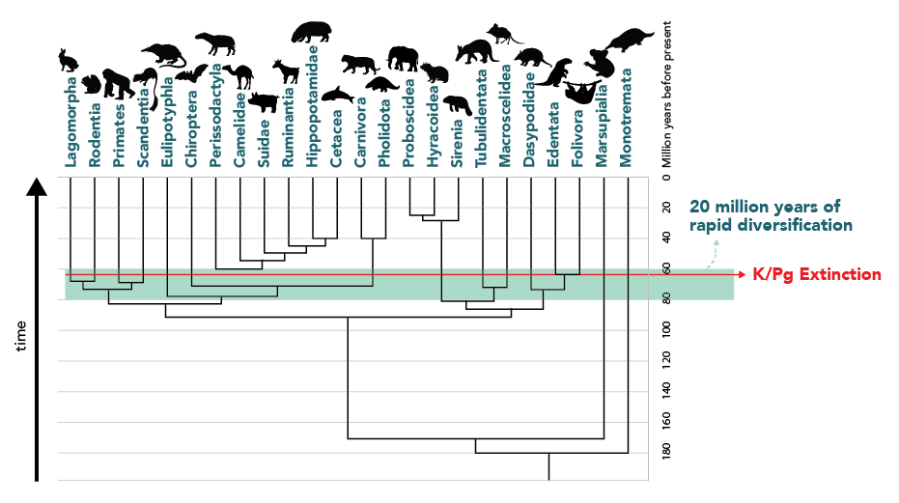
IUCN
Shellenberger’s stats
  0.8% of 112,432 extinct since 1500
  Only includes species that have been assessed
  Massive diversification last 100 MY
150,000 species on IUCN Red List (10%)
44,000 species at risk of extinction (2.9%)

Slide 8
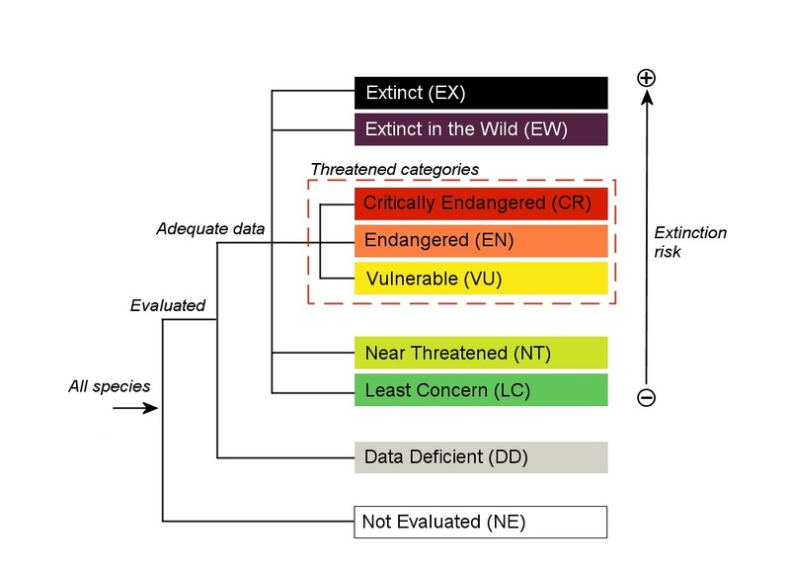
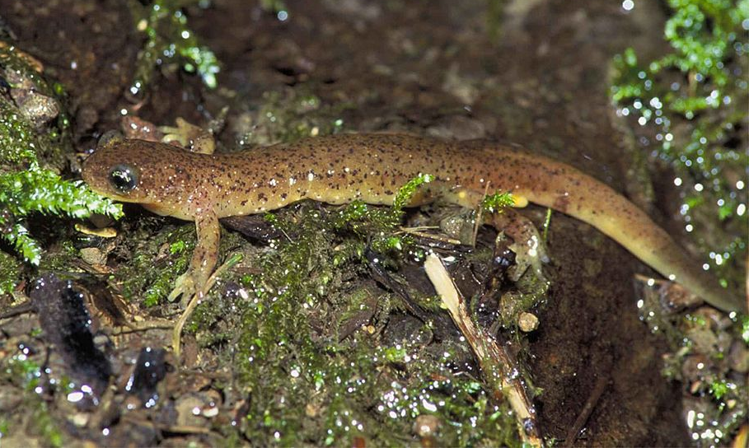
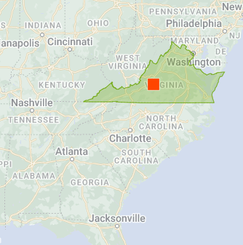
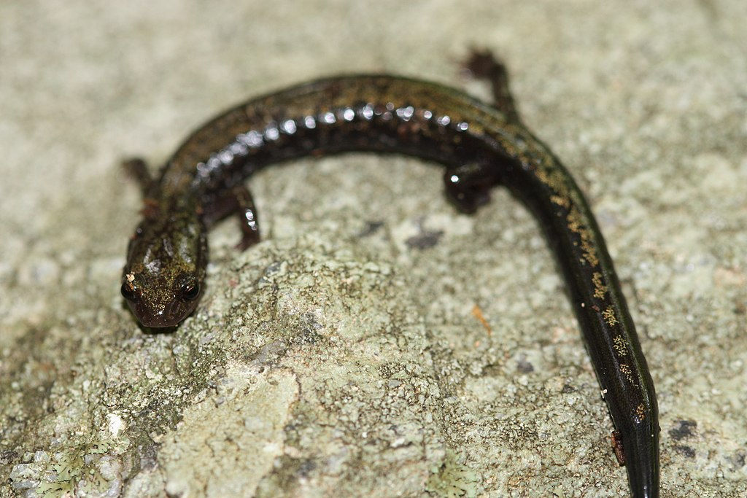
Categories
Problematic
Notes:
Plethodon hubricti
Ryacotriton olympicus

Slide 9
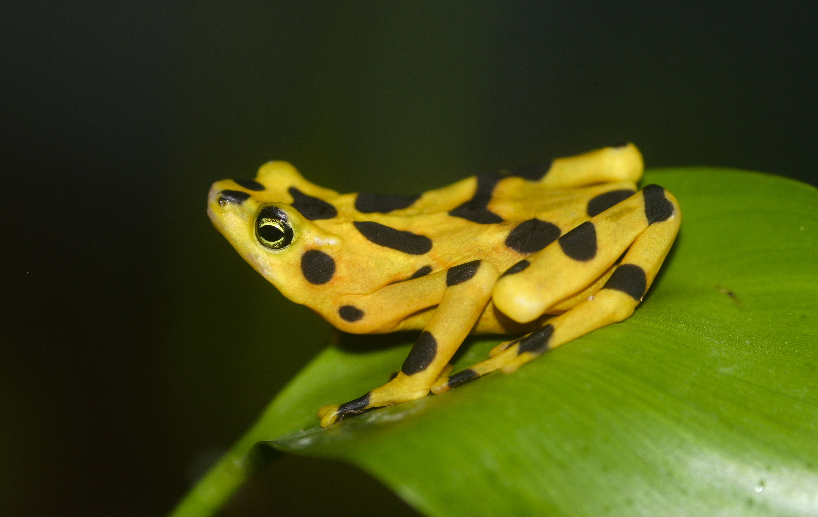
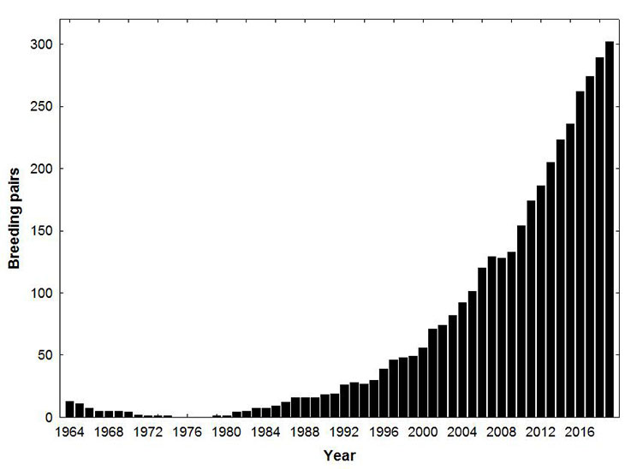
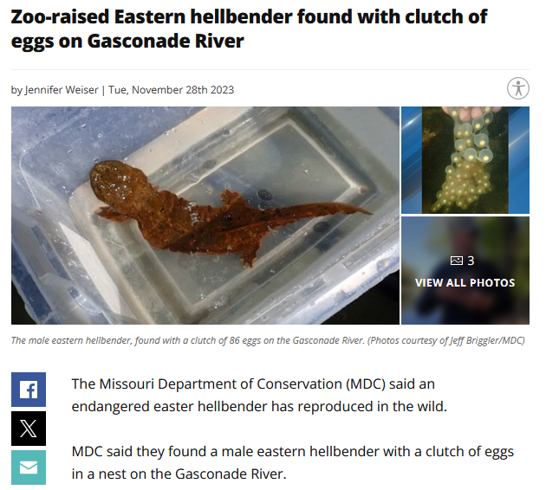
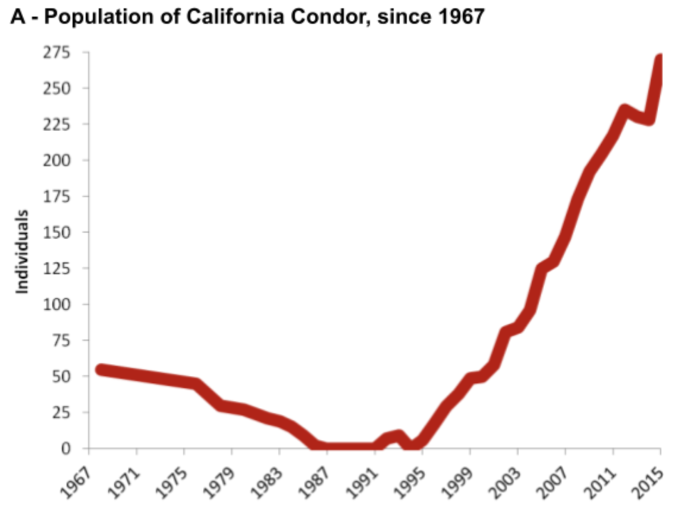
Conclusions
Current rate of extinction is massively below the threshold to qualify for a mass extinction
  2.9 % - counting vulnerable
Even factoring in vulnerable species or extinctions over last 10,000 years – WAY below
Many species at risk (islands)
We are very good at rehabbing species
  Eagles
  Condors
  Golden frogs
  Hellbenders
Notes:
Bald eagle population growth

