Slide 1
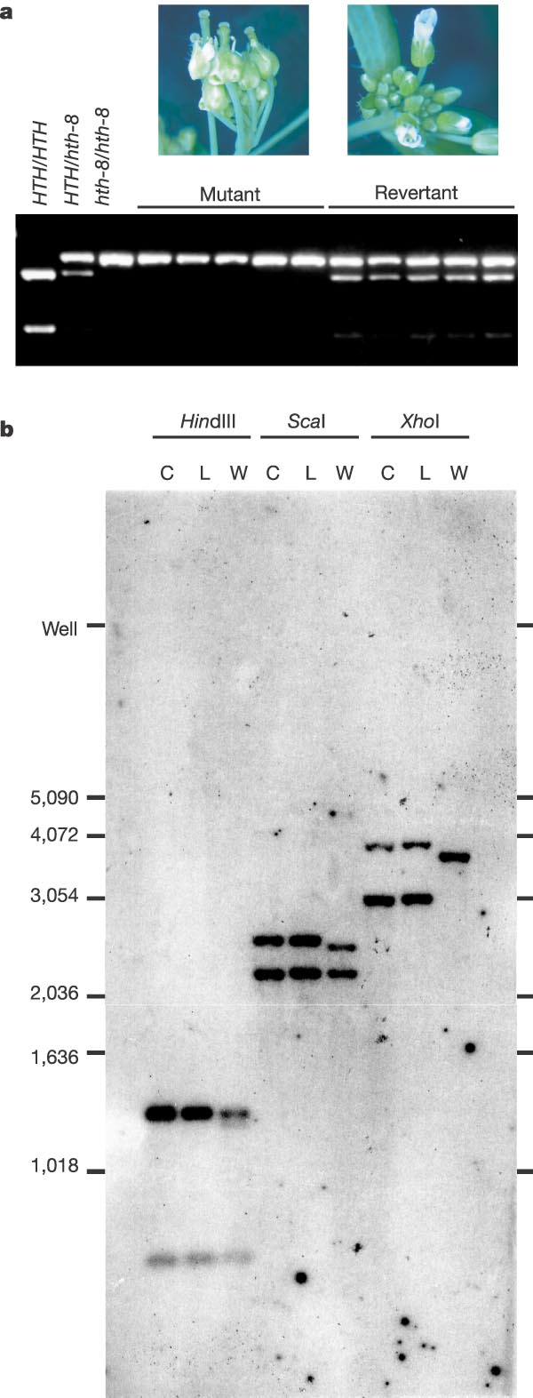
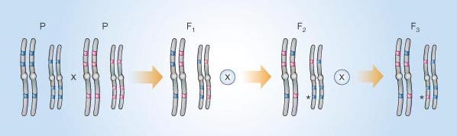
Genome-wide non-mendelian inheritance of extra-genomic information in Arabidopsis
LOLLE et al. Nature 2005
A previously unknown way of reversing genome-wide sequence changes in DNA has been revealed by an analysis of plants carrying mutations in a gene called HOTHEAD. The mechanism remains a mystery.
Figure 1 Reversion in hothead plants. Two parents (P) with different DNA sequence variants at several positions (colour-coded) in the genome are crossed. In subsequent generations (F1 and F2), plants are allowed to self-fertilize (indicated by a circled cross). In the F3 generation, there is reversion (asterisk) to a sequence originally present in the grandparent, but not in the immediate parent. This has been observed for several sites at surprisingly high frequency in the hothead mutant.

Slide 2
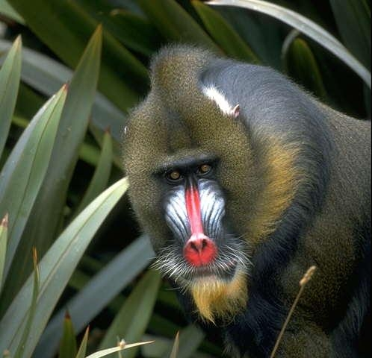

Slide 3
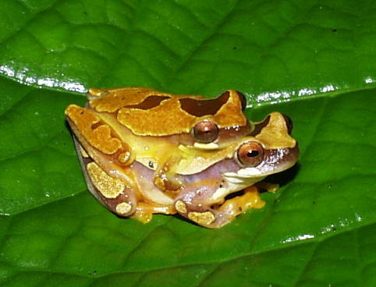
SEXUAL SELECTION
What I have called Sexual
Selection…depends not on a
struggle for existence in
relation to other organic beings
or to external conditions, but
on a struggle between individuals
of one sex, generally the males for the possession of the other sex… When the males and females…have the same general habits but differ in structure, colour, or ornament, such differences have been mainly caused by sexual selection.
Darwin, The Origin Of Species

Slide 4
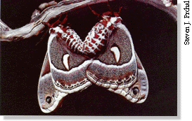
SEXUAL SELECTION
A special form of selection that accounts for many elaborated traits and behaviors in organisms.
Arises from differences in the ability to find and mate with members of the opposite sex.
Only occurs when access to one or the other sex is limiting, i. e., when there is competition for mates or offspring.

Slide 5
Sexual selection is non-random variance in reproductive success.
Two forms of sexual selection:
Intrasexual selection: direct competition for mates between members of the same sex, usually male-male competition.
Intersexual selection: differences in attractiveness to the opposite sex, usually non-random mate choice by females.

Slide 6
The form of Sexual Selection is directly related to the relative investment in offspring production.
The sex that invests more in offspring production has fewer reproductive opportunities.
As a result they,
Should be more discriminating (choosier).
Become a limiting resource for the opposite sex.

Slide 7
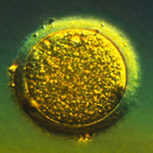
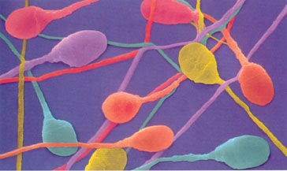
ANISOGAMY
FEMALES: Sex that produces few, well-provisioned gametes (eggs)
MALES: Sex that produces many, “cheap” gametes (sperm)

Slide 8
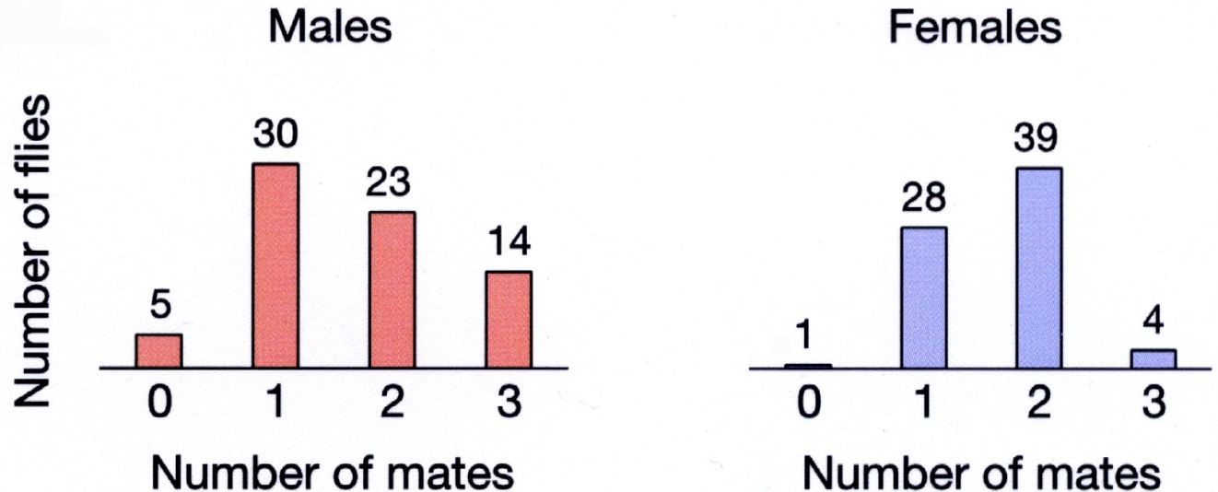
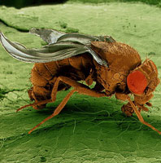
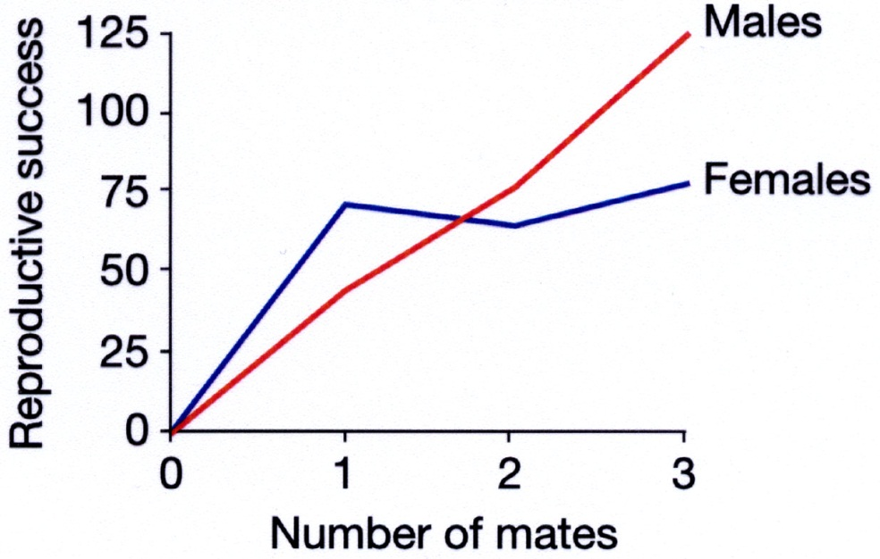
Bateman’s Principle: greater variance in reproductive success among males than females
Since male gametes are not (as) limiting, male reproductive success increases linearly with increasing number of mates.
When this is true, sexual selection is higher on males.

Slide 9
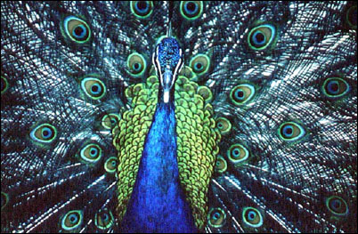
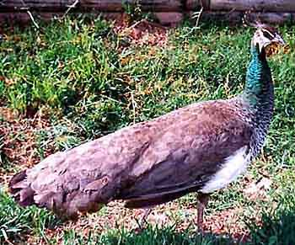
The asymmetric nature of sexual selection often leads to dramatic sexual dimorphism in characters directly related to male-male competition and/or female choice.
Peacock
Peahen

Slide 10
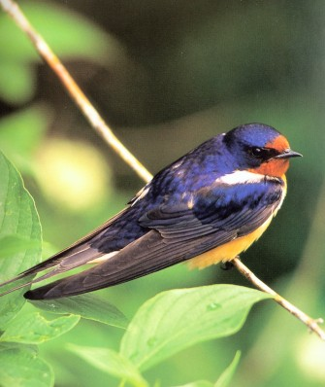
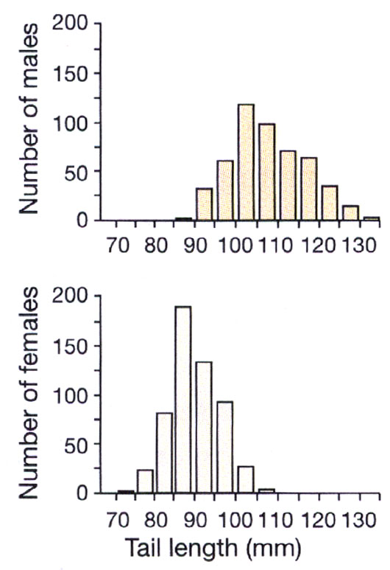
SEXUAL DIMORPHISM IN TAIL LENGTH IN BARN SWALLOWS

Slide 11
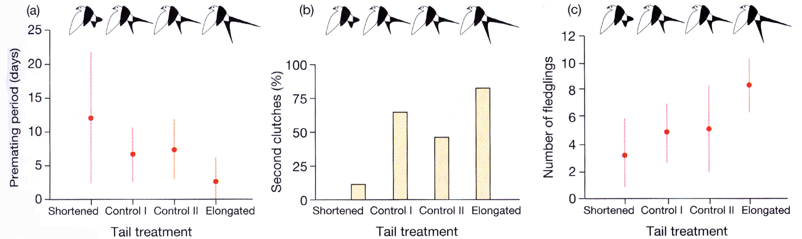
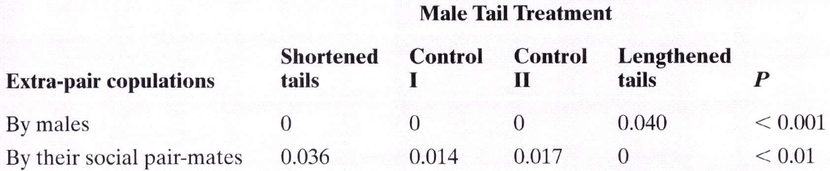
NON-RANDOM VARIANCE IN MATING SUCCESS RELATED TO TAIL LENGTH

Slide 12
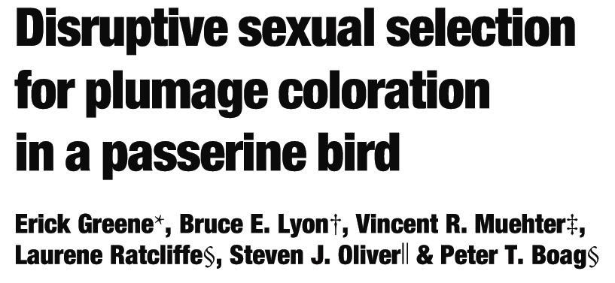
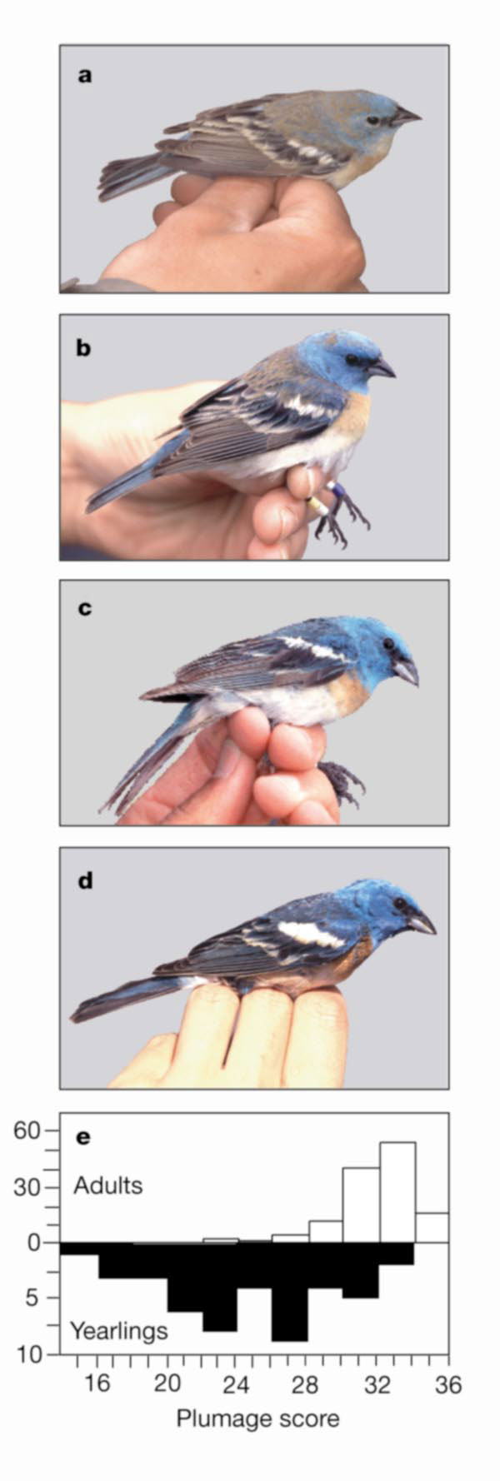
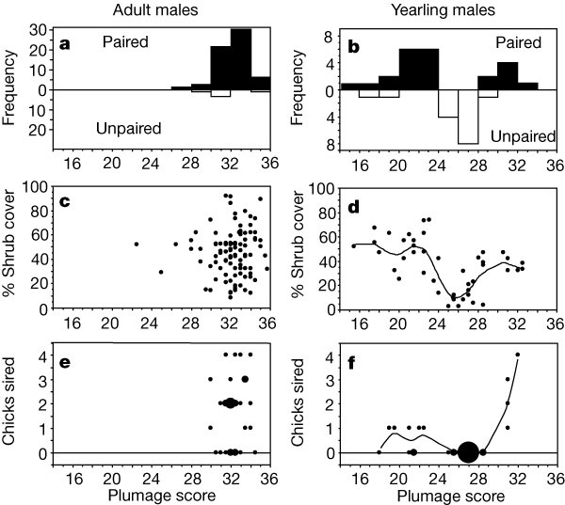
Nature (2000) 407:1000-1003

Slide 13
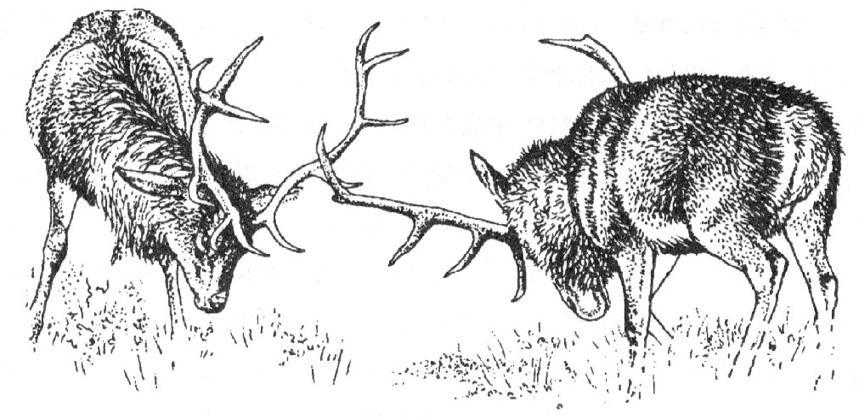
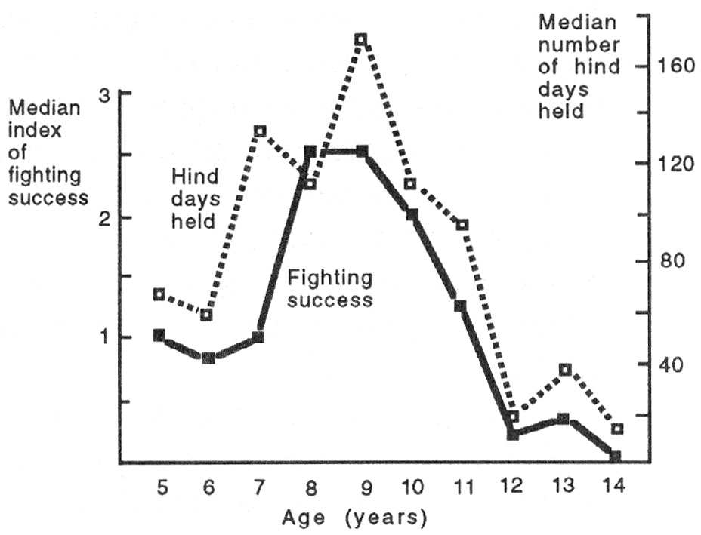
MALE-MALE
COMPETITION
Male Red Deer with the greatest success in combat are able to retain females for longer periods.

Slide 14
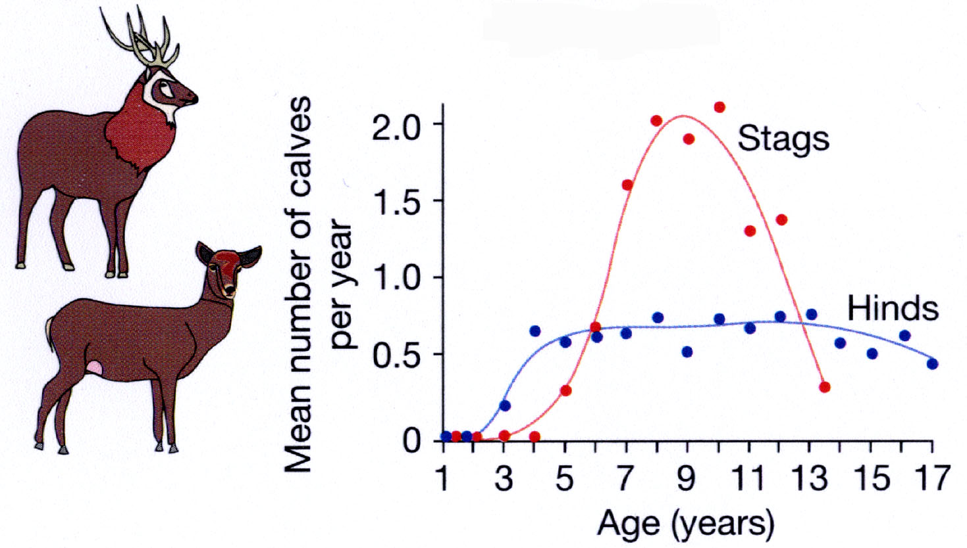
Male Red Deer who retain females longer have higher reproductive success.
Stags have higher variance in reproductive success than Hinds.

Slide 15
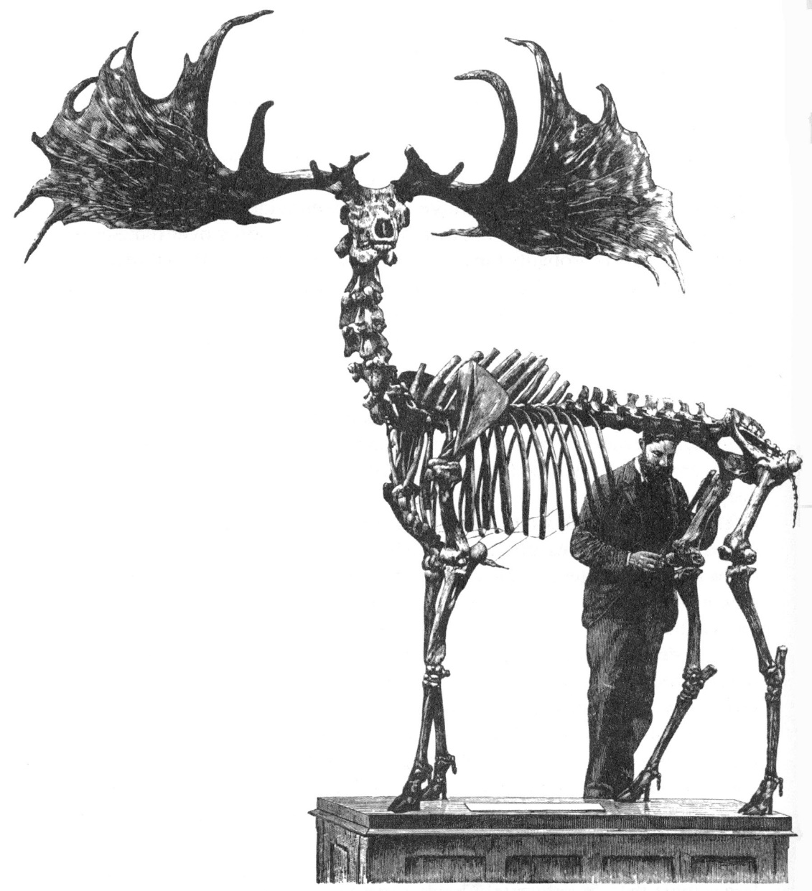
Sexual selection can be very strong and often opposes natural selection.
This can lead to exaggerated and sometimes maladaptive development of male traits.

Slide 16
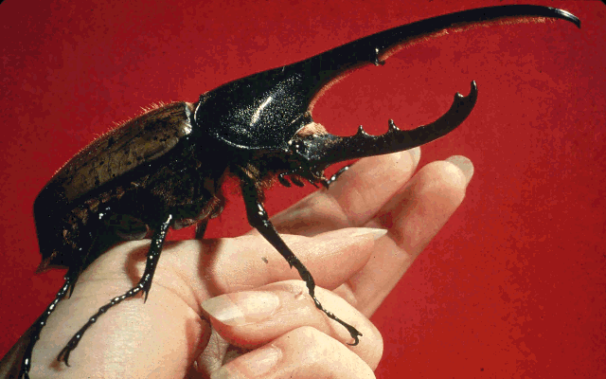
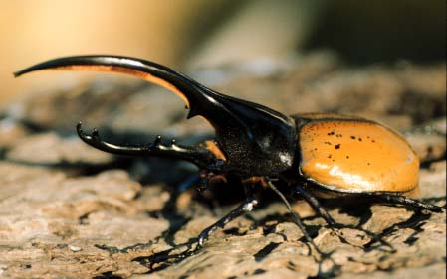
Male-male competition can explain the evolution of many morphological and behavioral traits
Hercules beetles engage in titanic jousting matches using their elaborate horns to displace rival males.
This competition has lead to an exaggeration of body size and horn size…

Slide 17
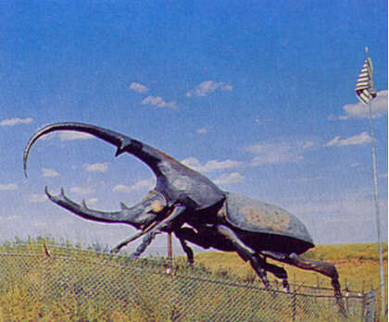
The Colorado Horned Beetle,
Largest Known Beetle Species

Slide 18
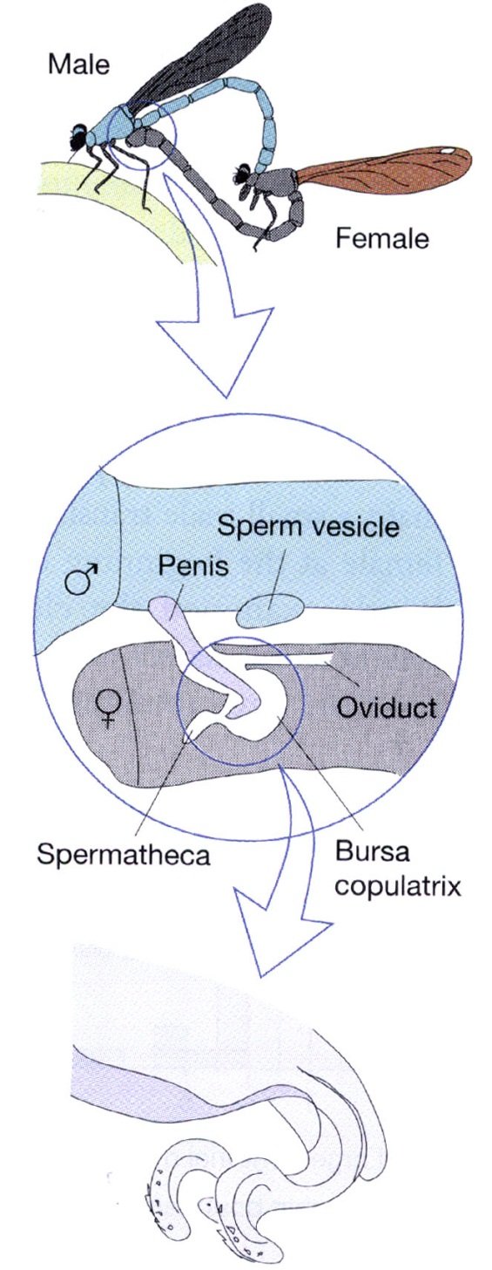
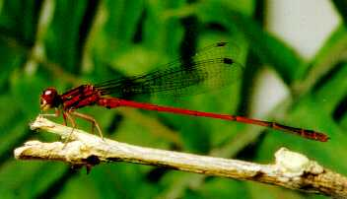
Male-Male competition often does not stop with successful mating. There is often post-copulatory competition.
This type of intrasexual competition is called,
SPERM COMPETITION
DAMSELFLY

Slide 19
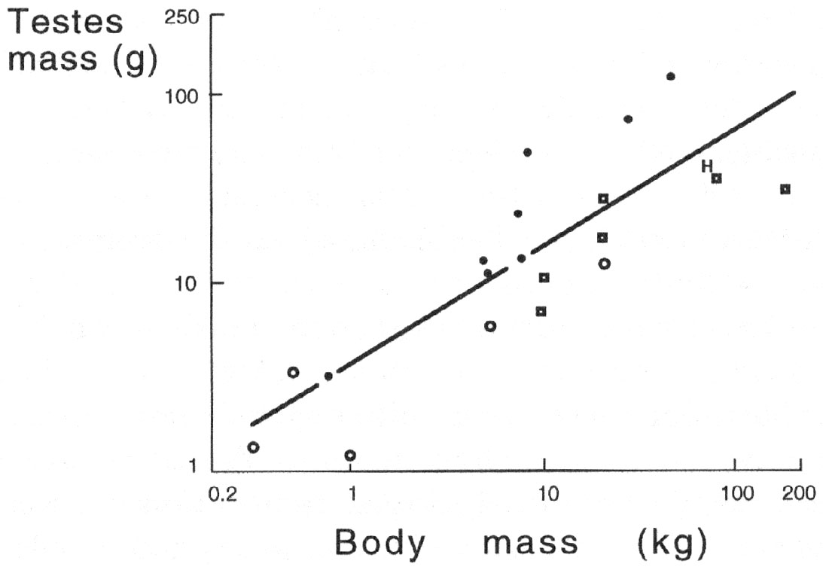
EVIDENCE FOR SPERM COMPETITION IN PRIMATES
HUMANS
MONOGAMOUS
MULTI-MALE GROUPS
SINGLE-MALE HAREMS
AFTER: Harcourt et al. 1981

Slide 20
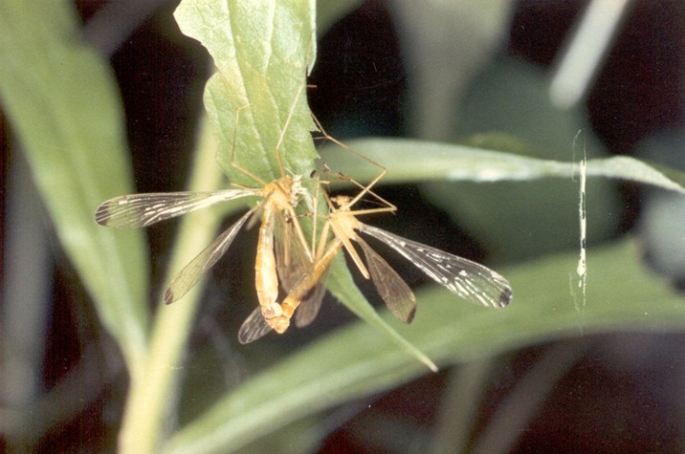
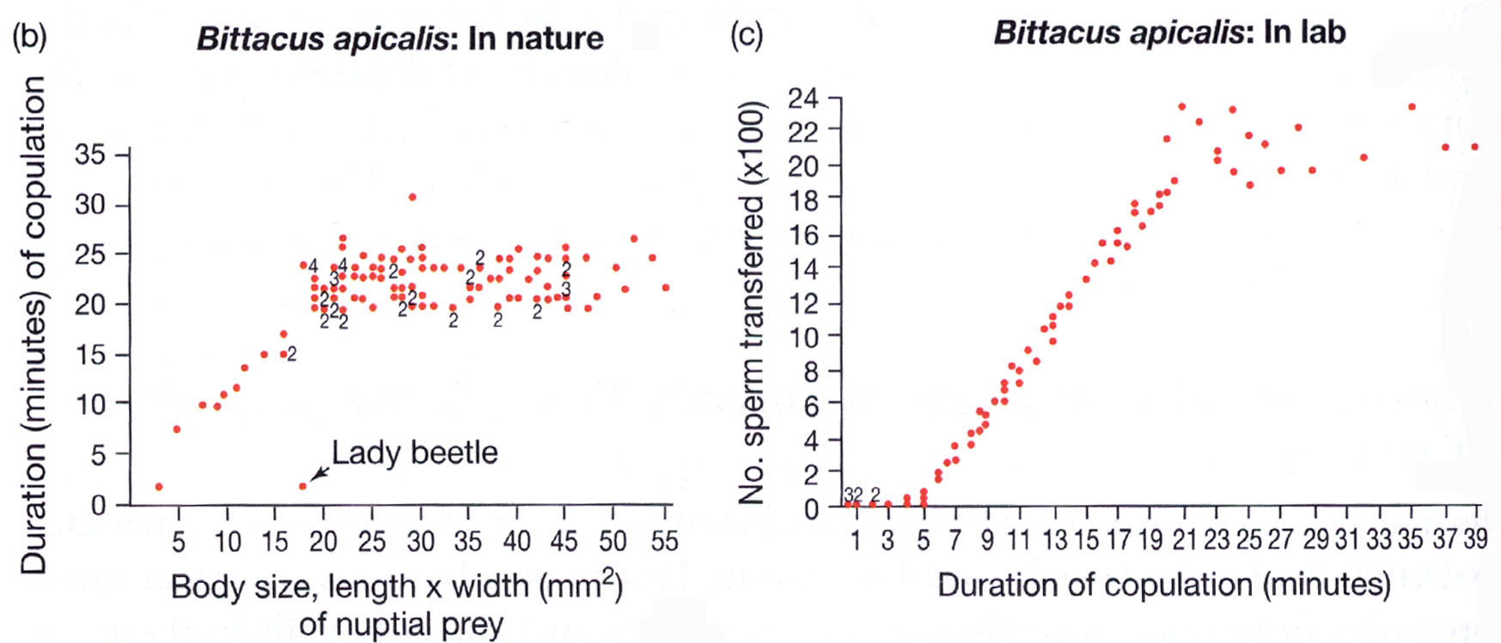
Nuptial Gifts:
Male Hanging Flies present their female partners with insect food items. The size of the gift is correlated with the duration of copulation and the number of sperm transferred.
HANGING FLIES

Slide 21
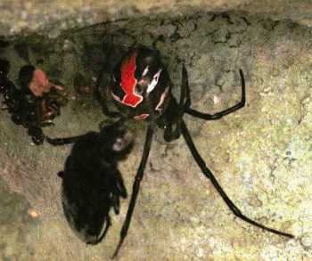
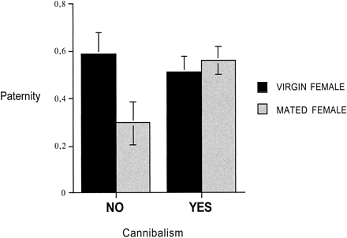
Some times mate provisioning can go a little too far…
Australian Red-backed Spider
Second males who are eaten have increased reproductive success.
FROM: M. C. B. Andrade. 2001.

Slide 22
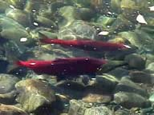
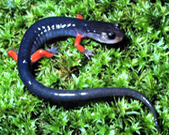
ALTERNATIVE REPRODUCTIVE STRATEGIES
If you can’t beat them… Fool them!
Many species have polymorphic male mating strategies.
Sneakers: males not directly
engaging in competition for
mates may gain extra-pair
copulations.
(e.g., small “Jack” salmon)
Female mimicry: one way to
distract or interrupt a competitor.
Plethodontid salamanders

Slide 23
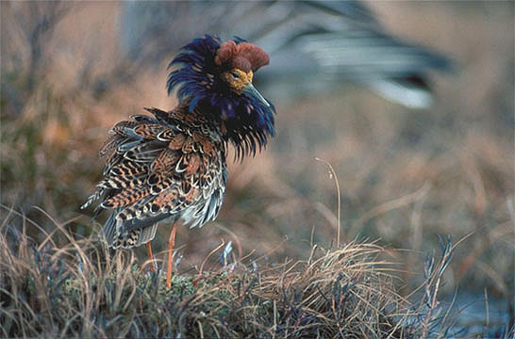
ELABORATE TRAITS CAN ALSO BE THE RESULT OF FEMALE PREFERENCE

Slide 24
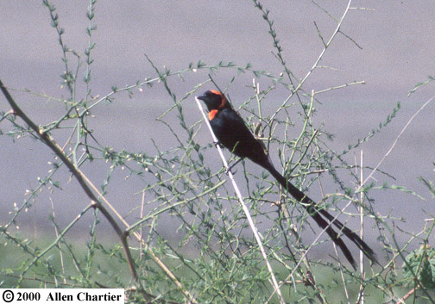
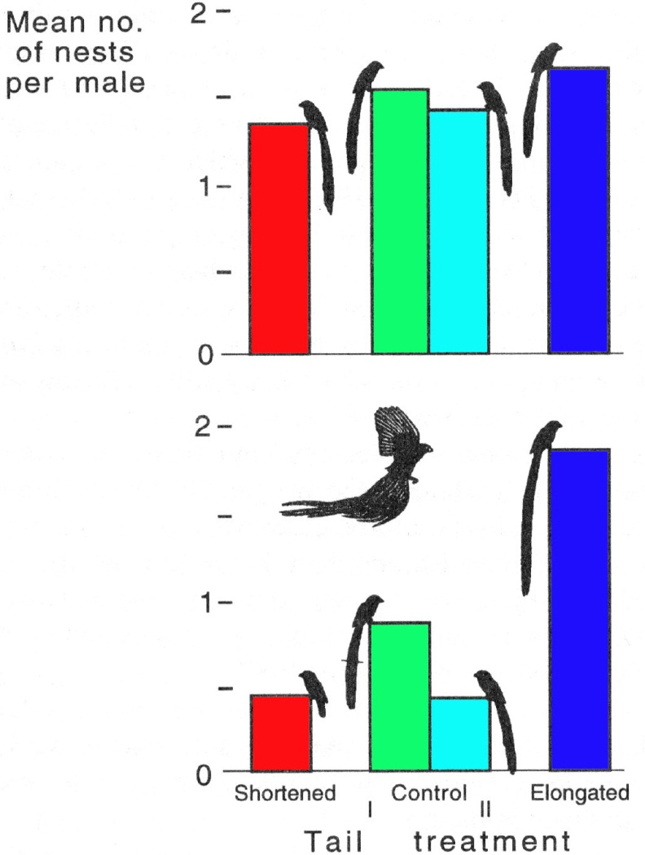
FEMALE PREFERENCE FOR TAIL LENGTH IN WIDOWBIRDS
Nesting success before experimental manipulation
Nesting success after experimental manipulation

Slide 25
REASONS FOR FEMALE CHOICE OR PREFERENCE
Direct Benefits:
Females may benefit from increased nutrition, provisioning, or paternal care that increases their reproductive output or the quality of their offspring.
Indirect benefits:
Good Genes Hypothesis: Genetically superior mates produce fitter offspring.
Sexy Son Hypothesis: Females that mate with preferred fathers produce sons that will have high mating success.

Slide 26
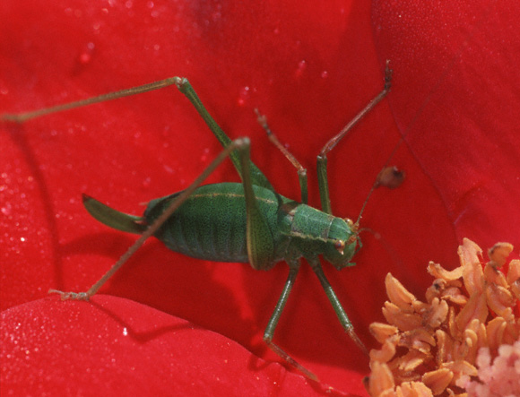
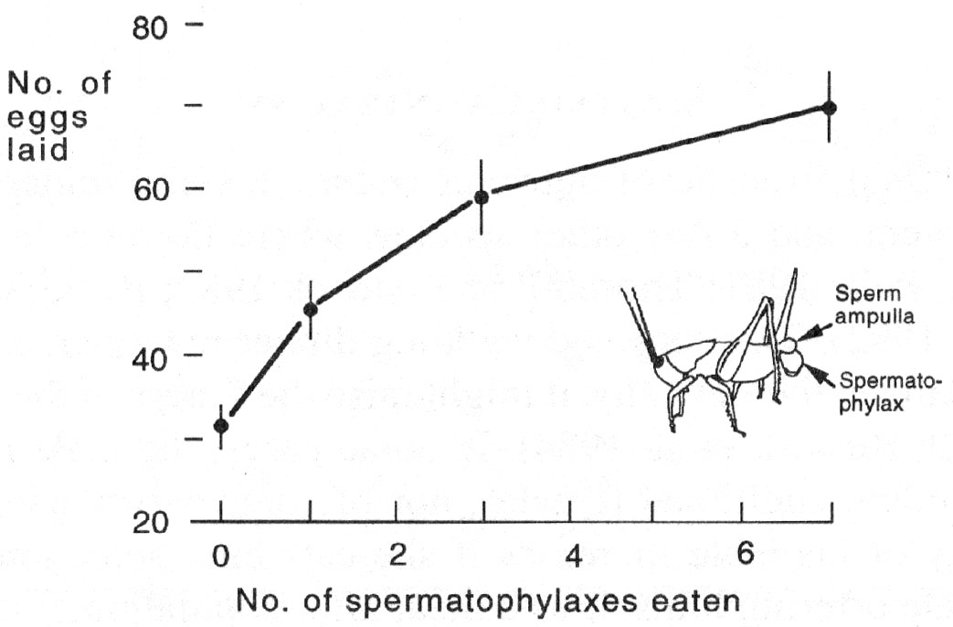
Many female insects gain direct benefits by consuming a portion of the spermatophore presented to them by males.
Female Bush Cricket
Male Bush Cricket

Slide 27
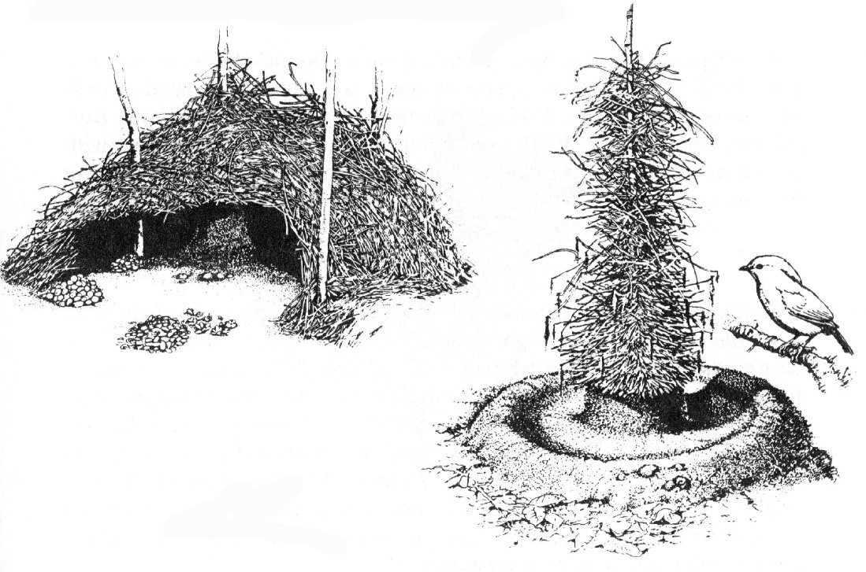
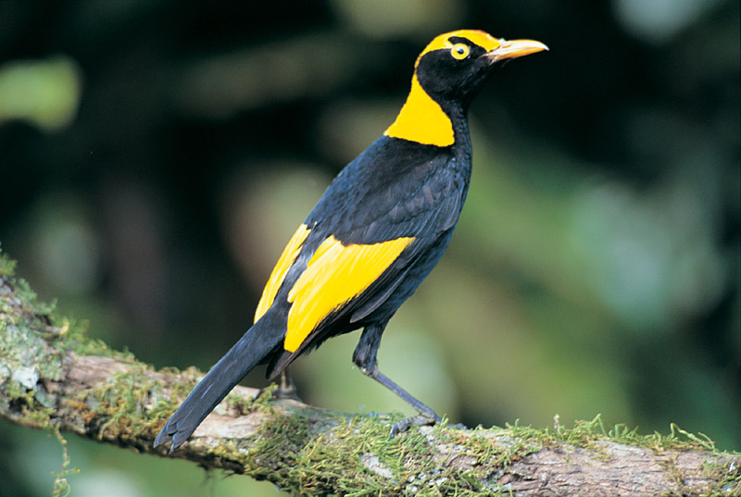
How can we explain female preferences when there are no direct benefits?
REGAL BOWER BIRD

Slide 28
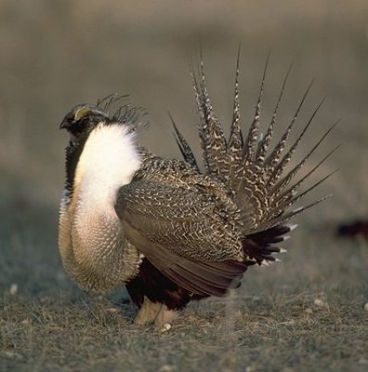
GOOD GENES MODEL
ELABORATED MALE TRAITS MAY BE INDICATORS OF HERITABLE GENETIC QUALITY (I.E. FITNESS).
The Handicap Principle (Zahavi 1975)
Some males may have a heritable trait that reduces viability.
Only males with “Good Genes” can survive despite the handicap.
Females that mate with these males will have offspring with higher fitness

Slide 29
HANDICAP PRINCIPLE
The bigger the handicap, the higher the genetic quality of the male carrying the trait.
Female choice evolves and the handicap spreads and becomes elaborated.
This is an example of an honest signal since there is a true cost to the elaborated trait that prevents “cheaters”.

Slide 30
FISHERIAN RUNAWAY SEXUAL SELECTION
An alternative to the “Good Genes” Hypothesis:
Assortative mating within a population between males with the most exaggerated trait and females with the strongest preference can lead to a genetic correlation between trait genes and preference genes. The female preference genes will “hitchhike” onto the successful male genes.

Slide 31
FISHERIAN RUNAWAY SEXUAL SELECTION
Suppose that males with longer tails are preferred at first because they have higher viability (Good Genes).
The increased reproductive success of these males increases the frequency of trait and preference genes and reinforces assortative mating since offspring carry genes for both exaggerated tail length and strong preference.
When there is a genetic correlation between the male trait and female preference then the process becomes self-reinforcing.

Slide 32
FISHERIAN RUNAWAY CAN LEAD TO MALADAPTIVE TRAITS
When the trait and the preference are genetically correlated, then the trait can evolve way beyond the point where it indicates overall genetic quality.
Runaway of the male trait can proceed to a point of exaggeration where it actually decreases male fitness.
The runaway process leads to a situation where the only benefit to female choice is that her sons inherit the most attractive state of the trait. This is in direct contrast to the “Good Genes” Hypothesis and has been referred to as the “Sexy-son” Hypothesis.

Slide 33
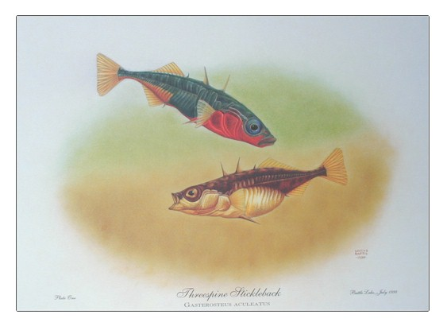
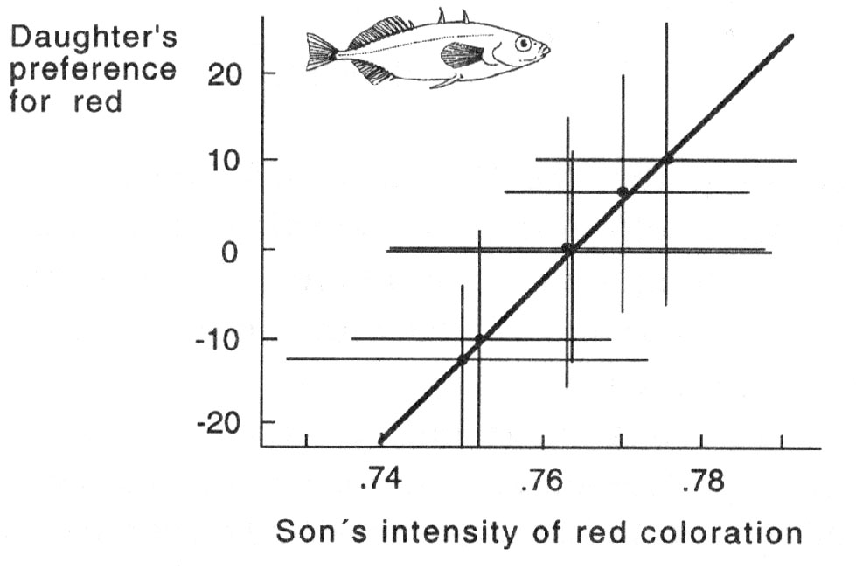
Evidence for a genetic correlation between trait and preference from Three-spine Sticklebacks.

Slide 34
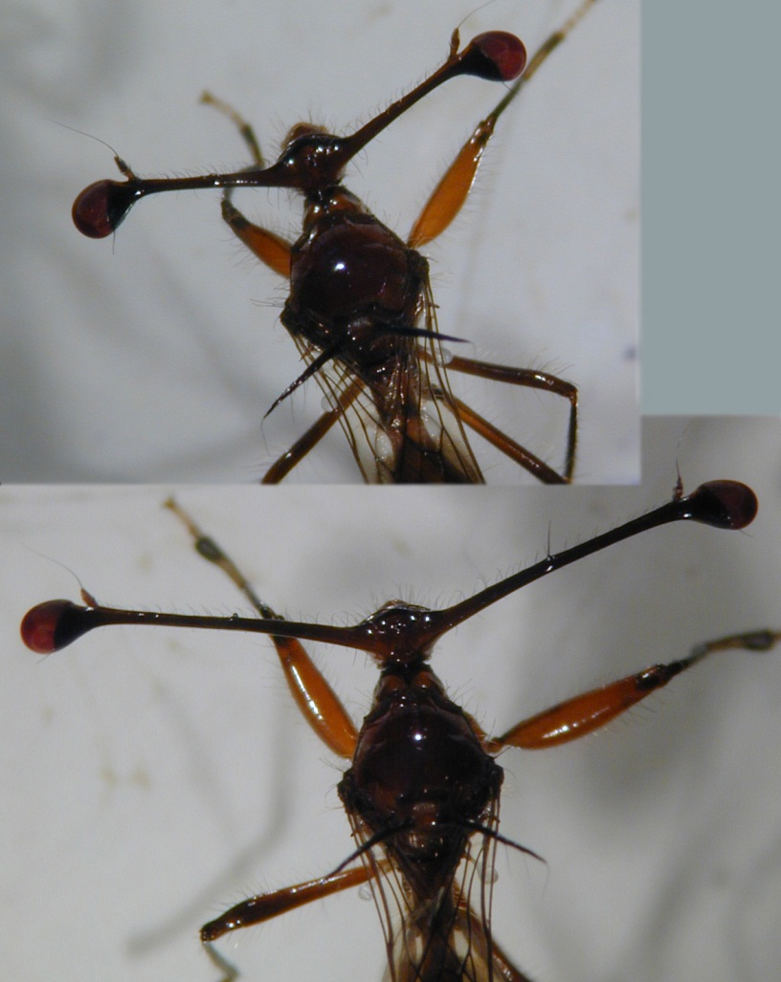
EXPERIMENTAL EVIDENCE FOR FISHER’S RUNAWAY PROCESS
Stalk-eyed Flies have heritable variation for the distance between eyes in males and for female preference for stalk length
AFTER: Wilkinson et al.
Short Stalk
Long Stalk

Slide 35
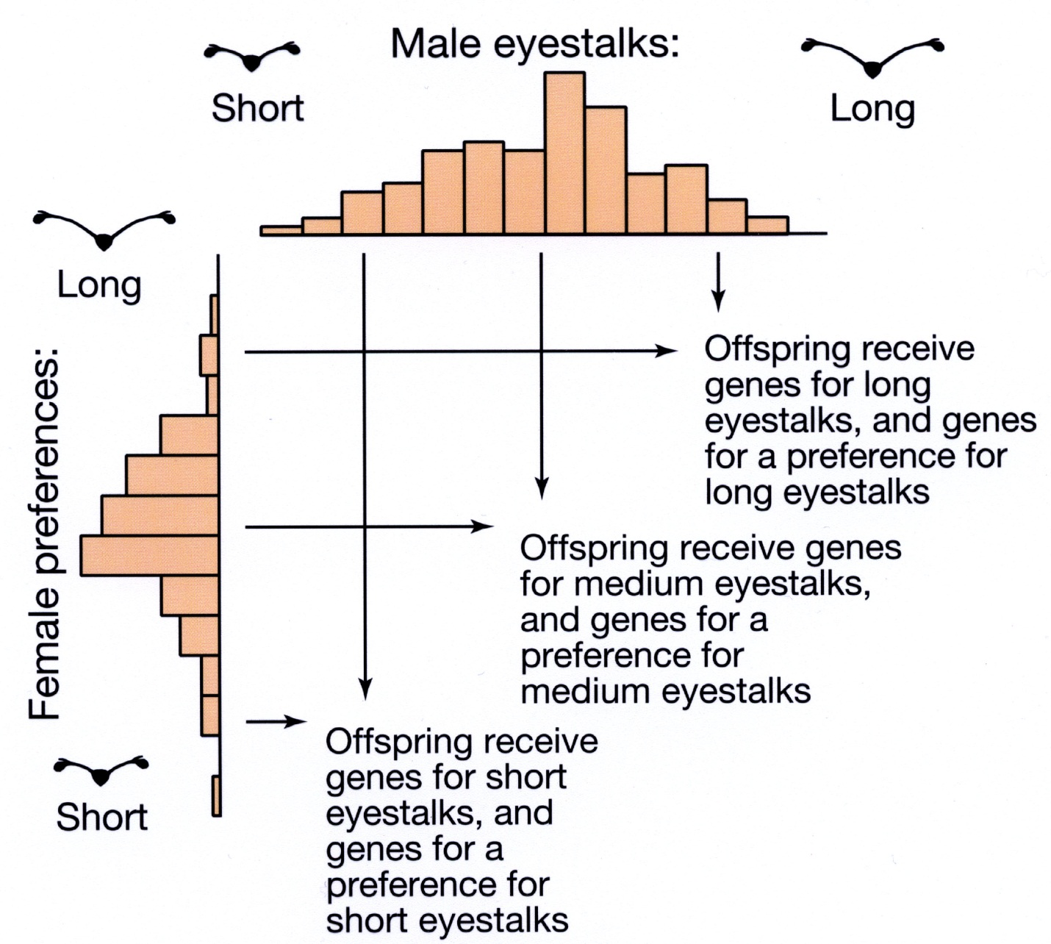
ASSORTATIVE MATING AND THE DEVELOPMENT OF A GENETIC CORRELATION BETWEEN TRAIT AND PREFERENCE

Slide 36
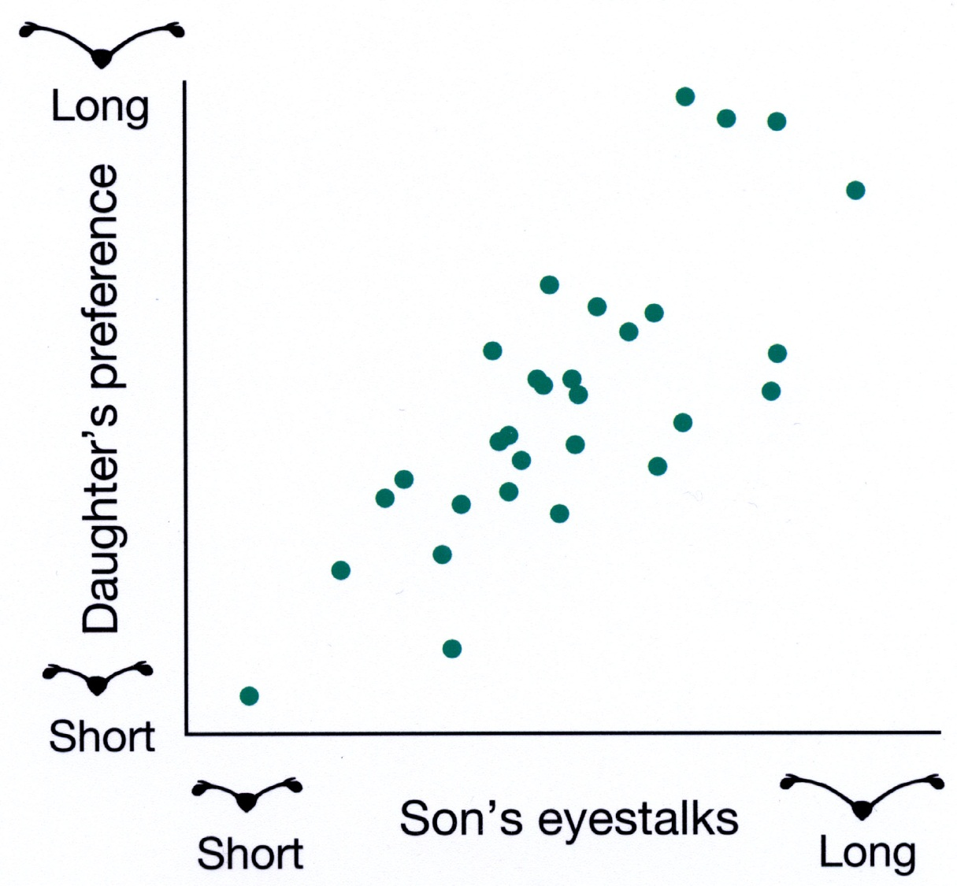
EVIDENCE FOR A GENETIC CORRELATION BEWEEN TRAIT AND PREFERENCE

Slide 37
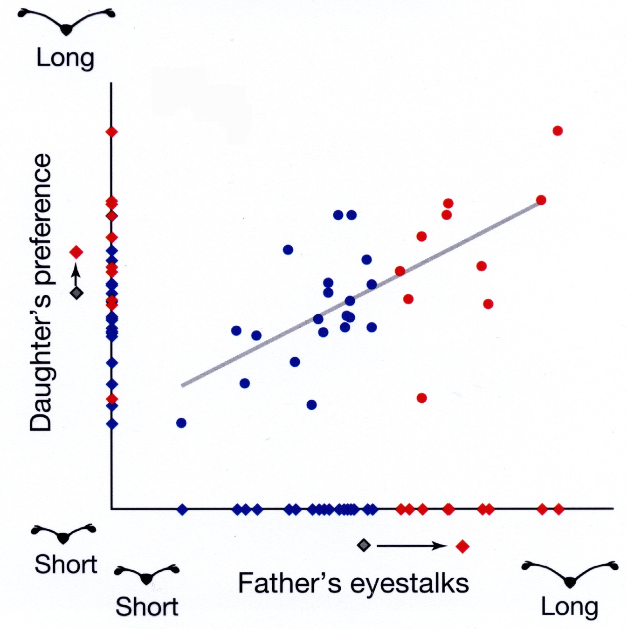
RESULTS OF SELECTION EXPERIMENTS

Slide 38
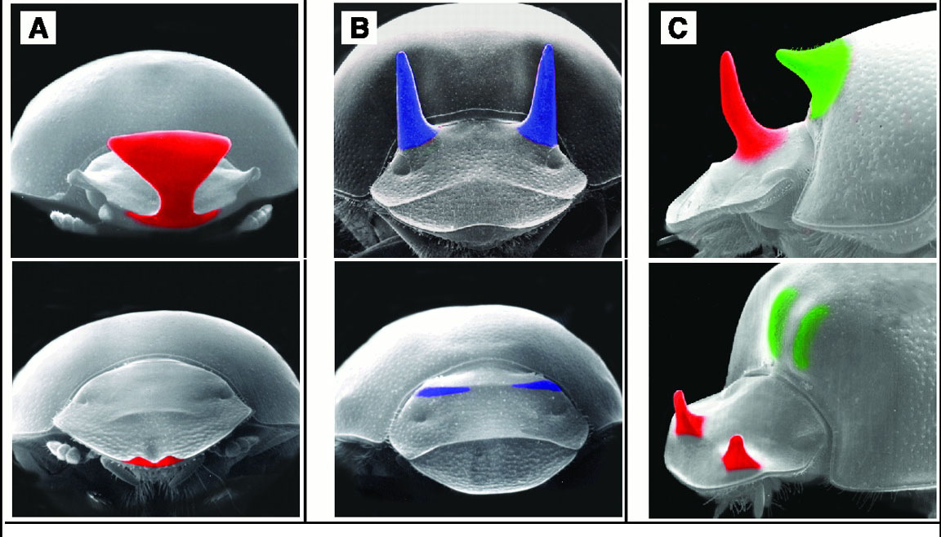
EVIDENCE THAT MALE TRAITS ARE LIMITED BY NATURAL SELECTION
MALE HORNS
FEMALE HORNS
FROM:Emlen Science 2001

Slide 39

DEVELOPMENT OF MALE TRAITS CAN BE ECOLOGICALLY DEPENDENT
FROM:Emlen Science 2001

Slide 40

Immune Activation Rapidly Mirrored in a Secondary Sexual Trait
A crucial assumption underlying most models of sexual selection is that sexual advertisements honestly reflect the phenotypic and/or genetic quality of their bearers (1). Here we show that experimental activation of the immune system is rapidly mirrored in the expression of a carotenoid-based secondary sexual trait in male blackbirds (Turdus merula).
FROM: Faivre et al. Science. April 4, 2003

Slide 41


Carotenoid Modulation of Immune Function and Sexual Attractiveness in Zebra Finches
Blount et al.
One hypothesis for why females in many animal species frequently prefer to mate with the most elaborately ornamented males predicts that availability of carotenoid pigments is a potentially limiting factor for both ornament expression and immune function. An implicit assumption of this hypothesis is that males that can afford to produce more elaborate carotenoid-dependent displays must be healthier individuals with superior immunocompetence… In this study, we show that manipulation of dietary carotenoid supply invokes parallel changes in cell-mediated immune function and sexual attractiveness in male zebra finches (Taeniopygia guttata).
Experimental Group
Control Group
SCIENCE, April 4, 2003

Slide 42

ALTERNATIVE HYPOTHESIS FOR THE ORIGIN OF FEMALE PREFERENCE
Sensory Bias (Ryan)
Preexisting preferences for certain traits may be hardwired in females and lead to the development of exaggerated traits in males.

Slide 43


EXAMPLE OF SENSORY BIAS IN TRINIDAD GUPPIES
Female guppies are attracted to ORANGE. This response may be due to feeding behavior selecting for the ability to locate ripe fruit.
Sexual selection then favors males with lots of orange working on a preference that is already in place.

Slide 44
PHYLOGENETIC PREDICTIONS OF THE OF SENSORY BIAS HYPOTHESIS
P⁺/T⁺
P⁺/T⁺
P⁺/T⁻
P⁻/T⁻
MALE TRAIT
FEMALE PREFERENCE
Female preference should evolve first, followed by the evolution of the male trait.

Slide 45


Phylogeny of Species in the genus Xiphoporus
FROM: Meyer et al. 1994 Nature

Slide 46

EVIDENCE FOR SENSORY BIAS
Swordtail
Females of species in the genus Xiphoporus in which males do not have swords PREFER males with swords.
The primitive condition is for male to have no swords.

Slide 47


MALE PARENTAL CARE INCREASES MALE INVESTMENT IN OFFSPRING PRODUCTION
Male Dendrobatid Frog carrying a tadpole
Male Giant Water Bug guarding a clutch of eggs

Slide 48


MALE “PREGNANCY” IN SEAHORSES AND PIPEFISH CAN LEAD TO SEXUAL DIMORPHISM:
Stronger sexual selection on females leads to the expression of secondary sexual characters in females NOT males.

Slide 49


BATEMAN’S GRADIENT AND SEX-ROLE REVERSAL
MALE
FEMALE
Bateman’s Flies
Reproductive Success
Pipefish
# of Mates
FROM: Jones et al. 2000. Proc. R. Soc. Lond. B 267:677-680

Slide 50



Jones et al. (2002) used highly polymorphic microsatellite loci to genotype an entire population of rough-skinned newts to get a direct estimate of mating success and offspring production. From these data they were able to assess the relative strength of sexual selection on males and females.

Slide 51
FACTORS THAT CONTRIBUTE TO THE STRENGTH OF SEXUAL SELECTION
Mating systems:
Monogamy: Pair fidelity
Polygyny: Male promiscuity
Polyandry: Female promiscuity
Monogamy Polygyny/Polyandry
Increasing intensity of sexual selection

Slide 52
POLYANDRY IS MORE COMMON THAN WE THOUGHT
Recent advances in molecular techniques (e.g.,DNA fingerprinting and Microsatellites) allow the direct assessment of paternity.
The emerging evidence suggests that polyandry (females mating with more than one male) is far more common in nature than was assumed based on behavioral observations.
For example, in apparently monogamous birds 15 – 20% of offspring are sired through extra-pair copulations.
This observation indicates that sexual selection may operate even in monogamous species.

Slide 53
ECOLOGICAL DETERMINANTS OF THE INTENSITY OF SEXUAL SELECTION
The opportunity for sexual selection is influenced by the Breeding Sex Ratio (BSR), ratio of receptive females to sexually active males which varies with the particular ecological setting.
Intensity can vary between closely related species, among populations, or within a population over time.

Slide 54

SEXUAL DIMORPHISM IN HUMANS

Slide 55

TALL MEN HAVE HIGHER REPRODUCTIVE SUCCESS
FROM: Pawlowski et al. 2000. Nature 403:156

Slide 56




MALE ORNAMENTATION:

Slide 57


FEMALE ORNAMENTATION:

Slide 58


IS SEXUAL SELECTION STRONGER IN MEN OR WOMEN?

Slide 59
KEY ELEMENTS OF SEXUAL SELECTION
Parental
Investment
Relationship Between Mating
Success and Reproductive Success
(Sexual Selection Gradient)
Potential
Reproductive
Rates
Variance
in Mating
Success
(Number of
Mates)
Variance in
Reproductive
Success (Number
of Offspring
= Fitness)
Competition
for Access
to Mates
Operational
Sex Ratio
Ecological
Factors

Slide 60


PNAS (2003) 100:5858-5862

Slide 61




QTL mapping identifies a single region associated with the OB color
Molecular Ecology (2003) 12:2465-2471

Slide 62




EVOLUTION OF SEXUAL REPRODUCTION

Slide 63
Three questions:
When did recombination evolve?
Why did recombination evolve?
How is recombination maintained in natural populations?

Slide 64

Divergence dates of the 3 major domains based on ribosomal RNA genes
1.2 BYA
2.8 BYA
2.7 BYA
2.7 BYA
FROM: Knoll 1999 Science

Slide 65
0.002
Ancestral humans
Diversification of mammals
0.6
Diversification of insects and plants
Diversification of animals
Cell-cell
communication
1.0
Origin of the major
eukaryotic groups
1.9
Eukaryotic cells abundant
Origin of the nucleus
Acquisition of organelles
Evolution of sex (meiosis & recombination)
2.8
Atmospheric oxygen plentiful
3.6
Simple cells abundant
3.8
Origin of life
Stabilization of the earth
4.6
Origin of the earth
BYA

Slide 66
EVOLUTION AND DIVERSIFICATION OF THE EUKARYOTES
What factors contributed to the rapid diversification of eukaryotic lineages?
  Increased atmospheric O₂ concentration – switch to aerobic respiration?
  Global climate change – Major ice age around 2.7 BYA?
  Evolution of sexual reproduction?

Slide 67


Haploid Circular Chromosome
Diploid Linear Chromosomes
Prokaryote
Eukaryote

Slide 68


Primitive Eukaryote:
Giardia lamblia
Giardia has two haploid nuclei
No mitochondria (???)

Slide 69

GENOME SIZE IN PROKARYOTES

Slide 70

GENOME SIZE IN EUKARYOTES

Slide 71

INCREASE IN GENOME SIZE
From: Gregory (2005) The Evolution of the Genome, Elsevier Press

Slide 72

COMPOSITION OF THE HUMAN GENOME
~1.5% of the genome consists of protein-coding sequences
~45% is composed of transposable elements
~15% is composed of repetitive elements
~24% is composed of introns
Data from the International Human Genome Sequencing consortium Nature (2001) 860-921

Slide 73

WHY SEX???
What factors favor the evolution and maintenance of sexual reproduction?
Is there an advantage or cost to asexual reproduction?

Slide 74
What is Sexual Reproduction?
Asexual Lineage
Sexual Lineage

Slide 75
What are some costs of sexual reproduction relative to asexual reproduction?
Asexual Lineage
Sexual Lineage

Slide 76

OK, so WHY SEX?
Asexual Population
Sexual Population

Slide 77
What do we know about new mutations?

Slide 78

This a major problem for asexual lineages!
H. J. Muller and the X-ray machine with which he did his Nobel Prize-winning experiments at the University of Texas

Slide 79

DELETERIOUS MUTATIONS IN ASEXUAL POPULATIONS
H. J. Muller and the X-ray machine with which he did his Nobel Prize-winning experiments at the University of Texas

Slide 80
Meltdown
Ratchet advances slowly
Fitness continues to decline
Eventually mutational load is too great

Slide 81


HUMAN Y CHROMOSOME
1500 genes
Now 50
Y exposed to high mutation rate – why?
Y chromosome will self-destruct in 10 MY
What happens then?
Mole Vole
Japanese spinous country rats

Slide 82
Mice with fewer genes
Healthy baby mice have been artificially produced with sperm with just two genes from the Y chromosome
http://www.nature.com/news/mice-with-just-two-male-genes-father-babies-1.14219

Slide 83


ARE WE ACCELERATING THE DECAY IN HUMAN Y CHROMOSOMES WITH MODERN IN VITRO FERTILIZATION TECHNIQUES?
Many sperm abnormalities and infertility disorders are associated with defects on the Y chromosome.

Slide 84
THE BIG BENEFIT OF SEX
Mechanism for genomic repair, eliminating deleterious mutations (*).
PARENT GAMETES
A * A A * *
B * B * * B
* C C * C *

Slide 85
SEXUAL REPRODUCTION CONTRIBUTES TO VARIATION
Example – A Line Cross Experiment
Consider 2 diploid individuals with 3 loci and 2 alleles,
Parents: aabbcc x AABBCC
F₁ progeny: AaBbCc
F₂ progeny:
AABBCC AABBCc AABBcc
AABbCC AABbCc AABbcc
AAbbCC AAbbCc AAbbcc
AaBBCC AaBBCc AaBBcc
AaBbCC AaBbCc AaBbcc
AabbCC AabbCc Aabbcc
aaBBCC aaBBCc aaBBcc
aaBbCC aaBbCc aaBbcc
aabbCC aabbCc aabbcc
27
COMBINIATIONS

Slide 86

AN “OUTBREAK OF VARIATION”
Cross between a Dachshund and a French Bulldog
Parental Generation
F₁ Progeny
F₂ Generation
FROM: C. R. Stockard. 1941. The Genetic and Endocrine Basis for Differences in Form and Behavior. Wistar Inst. Anat. Biol., Philadelphia, PA

Slide 87


asexual strains in the benign environment
sexual in the benign environment
asexual in the harsh environment
sexual in the harsh environment.
Many modern theories that provide an explanation for the advantage of sex incorporate an idea originally proposed by Weismann more than 100 years ago: sex allows natural selection to proceed more effectively because it increases genetic variation.
Sex increases the efficacy of natural selection in experimental yeast populations
Goddard et al. Nature 2005

Slide 88


SEXUAL REPRODUCTION ALLOWS POPULATIONS TO STAY ONE-STEP AHEAD OF THEIR PARASITES
FREQUENCY OF FEMALE ( ) AND MALE ( ) SNAILS IN NEW ZEALAND
FROM: Lively (1992)

Slide 89
ADVANTAGES TO ASEXUALITY

Slide 90
Advantages and Disadvantages TO ASEXUALITY

Slide 91

MOST ASEXUAL LINEAGES ARE EVOLUTIONARILY “YOUNG”
SEXUAL
ASEXUAL
Cnemidophorus

Slide 92


Bdelloid Rotifers: an ancient asexual lineage
One of the strongest candidates for ancient asexuals, bdelloid rotifers date back at least 40 million years. That's the age of the oldest bdelloid recovered from amber. Despite bdelloids' asexuality, they've diversified into ~360 species.
Bdelloid homologous chromosomes have diverged to the point that most genes have only one functional copy ( ). Now, they are locked into asexuality.
After Welsh & Meselson. Science 2000

Slide 93
SUMMARY OF THE EVOLUTION OF SEX
Sexual reproduction (recombination) is a unique feature of eukaryotes and likely originated early in the history of this domain around ~2.7 BYA.
Increases in genome size and the proliferation of genome “parasites” may have favored the early evolution of recombination.
Asexuality avoids the “2-fold” cost of sex. Asexual lineages have both a genetic and demographic advantage over sexual lineages.
The effects of mutation accumulation in asexual lineages may offset these costs.
In stable environments, asexuality preserves well adapted genotypes and may be favored.
In contrast, in variable environments, sexual lineages may be capable of rapid adaptation and sex may be favored.

