Slide 1
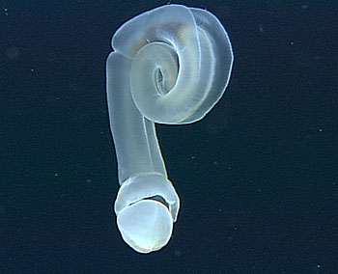
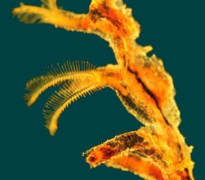
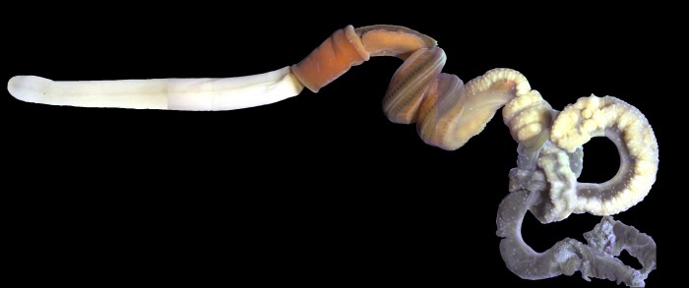
Phylum Hemichordata
2 classes (Enteroptnuestea & Pterobranchia)
“half-chordate”
Bottom dwellers
All filter feeders
Globally distributed
Acorn worm

Slide 2
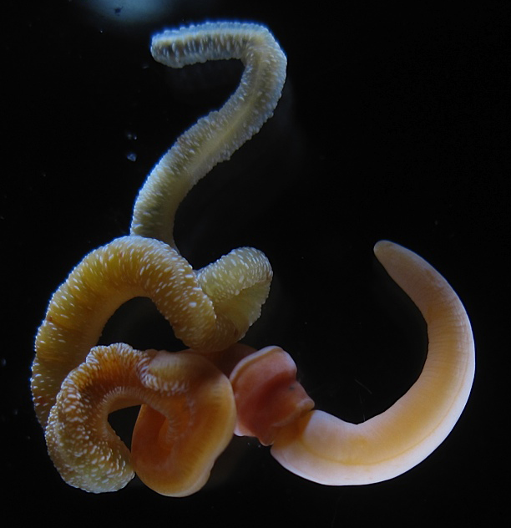
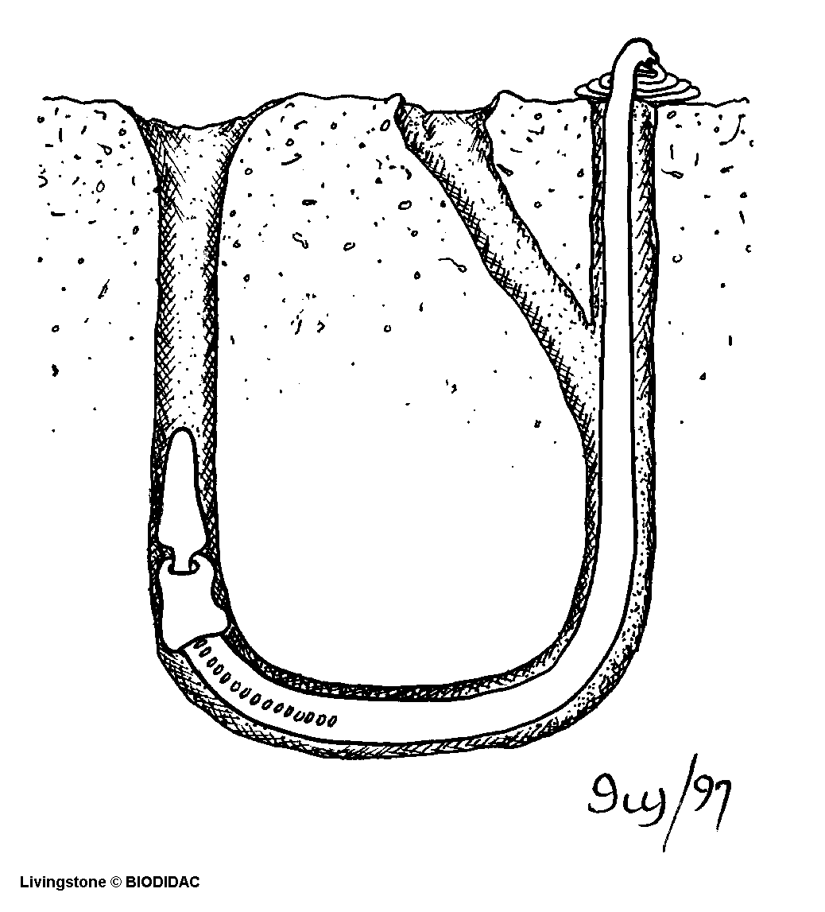
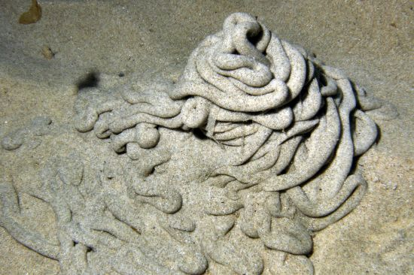
Phylum Hemichordata
Class Enteropneusta (acorn worms)
75 sp.
Sluggish and “worm-like”
3 body regions
20mm to 2.5m long
Burrowers in mud and sand-flats

Slide 3
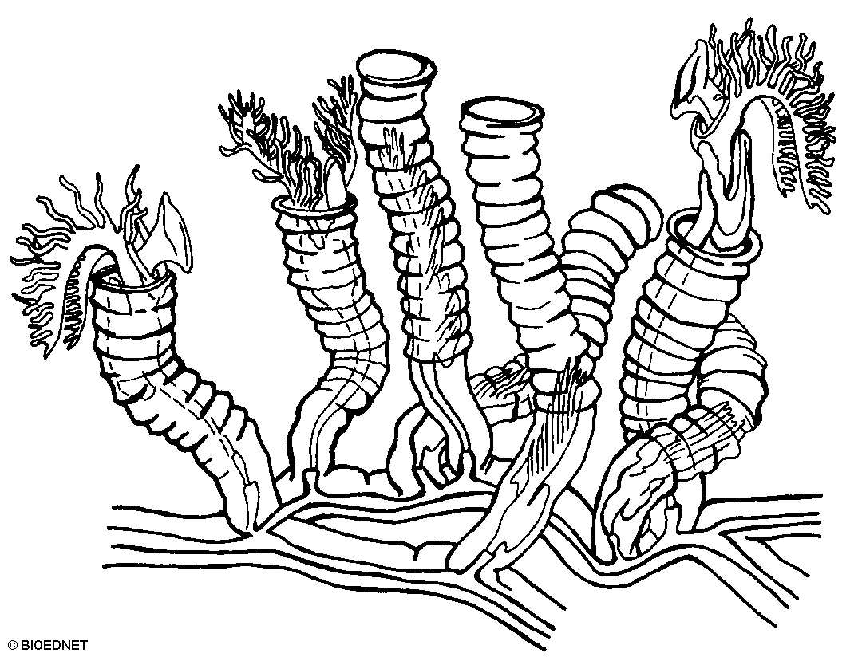
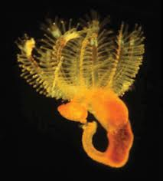
Phylum Hemichordata
Class Pterobranchia
30 species
Deep water
Similar structure as acorn worm
  Crown of tentacles filter feed
  Proboscis shield shaped
Many form colonies

Slide 4
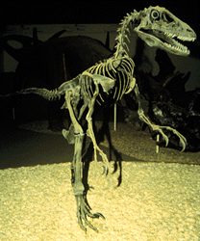
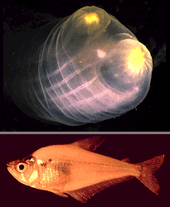
Phylum Chordata
Home at Last
2700 min of class
~2.3% of all species
Less than 62 minutes!

Slide 5
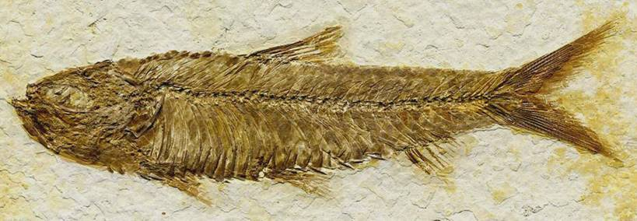
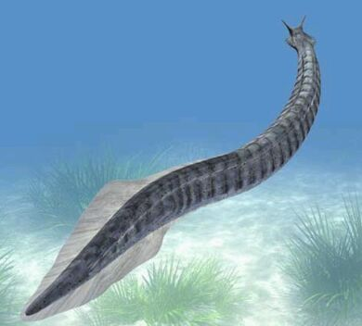
The Chordates
Characteristics & Synapomorphies
  Muscles arranged in segmented blocks
  Internal skeleton (most)
  4 major synapomorphies

Slide 6
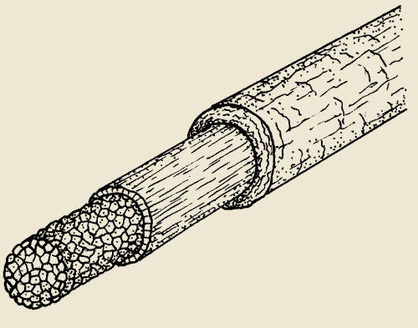
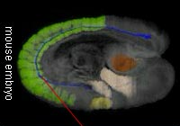
Notochord
Flexible rod (first “backbone”)
Surrounded by fibrous sheeth
Function?
What happens to it in verts?
Notes:
Flexible rod-like structure down body (blue line in mouse embryo)
First part of endoskeleton to appear in embryos
Provides site for muscle attachment
Present throughout life in all but vertebrates
In verts, replaced by vertebrate during embryo development

Slide 7
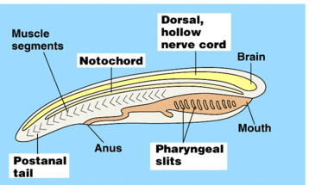
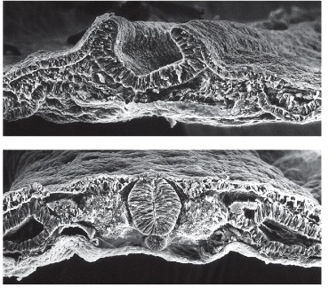
Dorsal Hollow Nerve Cord
Tube located above notochord (becomes spinal cord)
Anterior end becomes?
Forms from in-folding of ectoderm
https://www.youtube.com/watch?v=dXpAbezdOho
Notes:
Tube above the digestive track and notochord
Produced from infolding of ectoderm cells
Anterior end enlarges to become the brain, rest comes the spinal cord

Slide 8
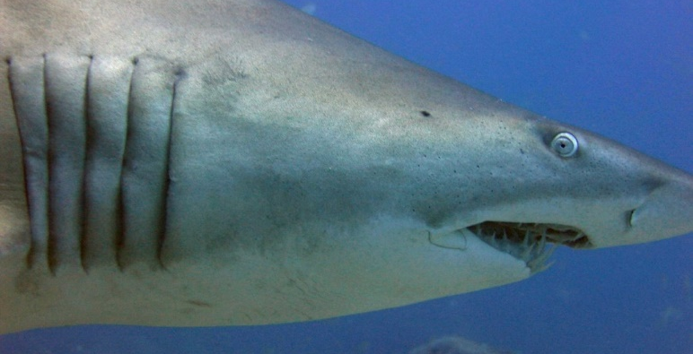
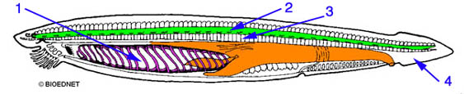
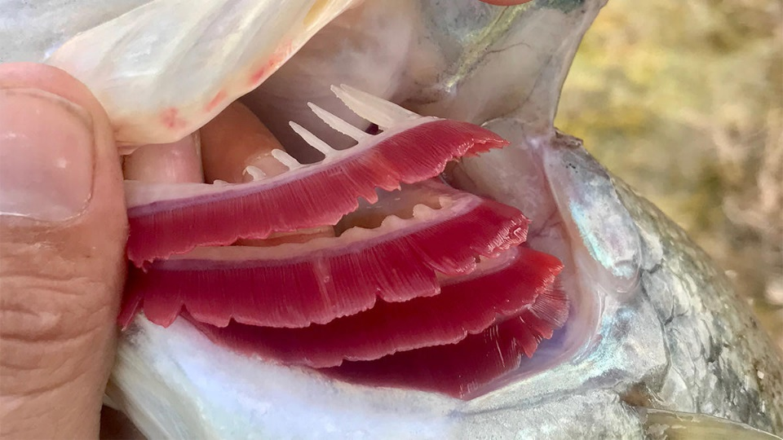
Pharyngeal Slits
Openings between pharynx and outside
Aquatic organisms – become ?
Terrestrial organisms?
Originally evolved for?
Notes:
Openings that lead from pharyngeal cavity to outside of animal
Originally evolved for filter feeding
Evolved a network of capillaries for gas exchange in many species
Many chordates – pockets form but weak

Slide 9
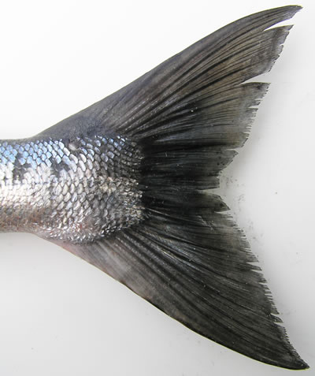
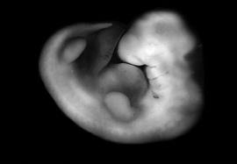
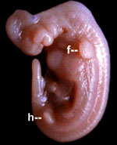
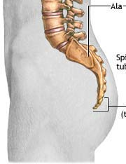
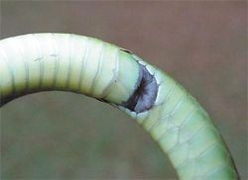
Postanal tail
Notes:
Tail!
When combined with muscle + notochord = mobility
Add tail fin increases efficiency

Slide 10
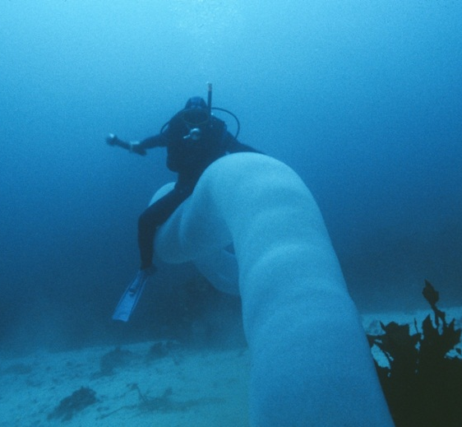
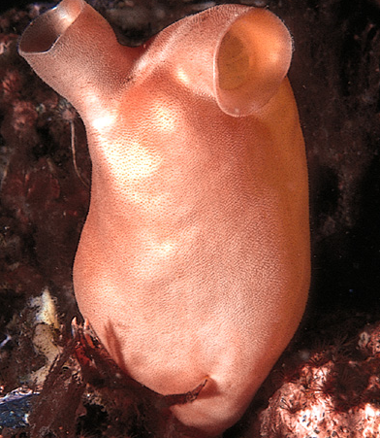
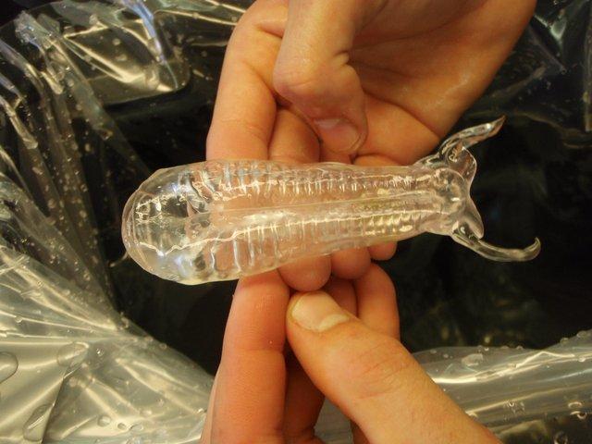
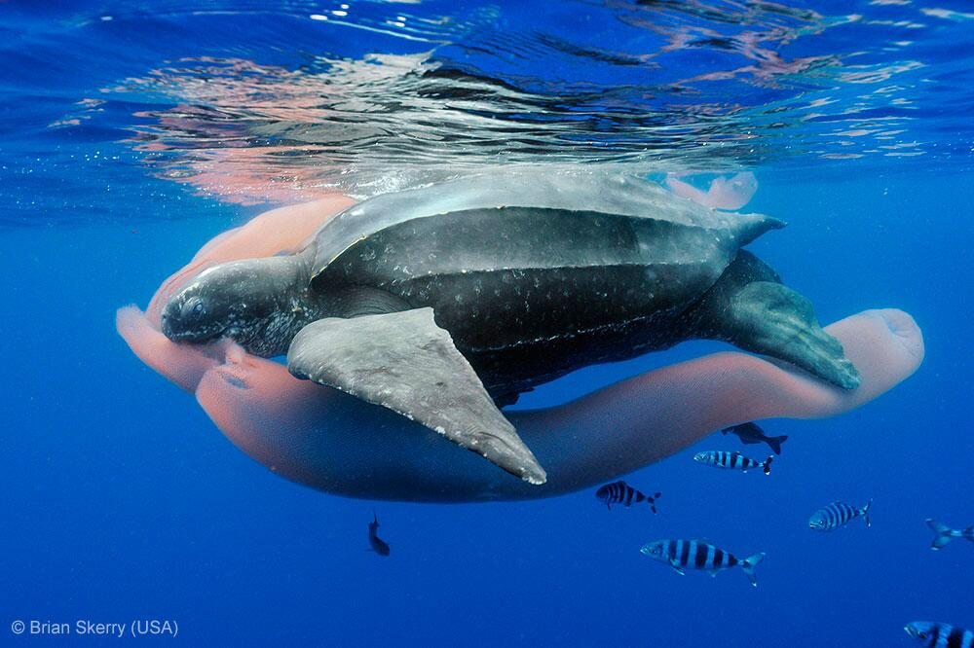
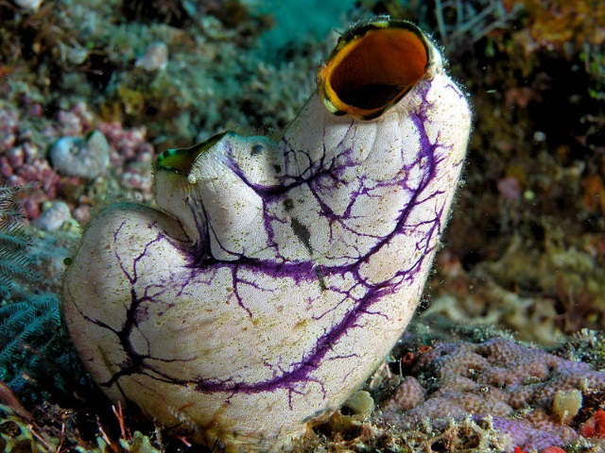
Phylum Chordata
Subphylum Urochordata
VERY strange organisms
All are ciliary filter-feeders
Class Thaliacea (Salps & Pyrosomes)
Class Ascidea (tunicates)
2000 sp.
Marine
Sessile as adults
Free-swimming larvae
Hard cellulose lined shell - tunic
Filter feed
1 of “Big 4”?
Tropical and subtropics
Siphons at opposite ends
Used for food and locomotion
Often form colonies
https://www.youtube.com/watch?v=5EQGA_4BZ5s
http://www.youtube.com/watch?v=e8jM94pNssc
DRAW: Preserved sea squirt (pg 462)

Slide 11
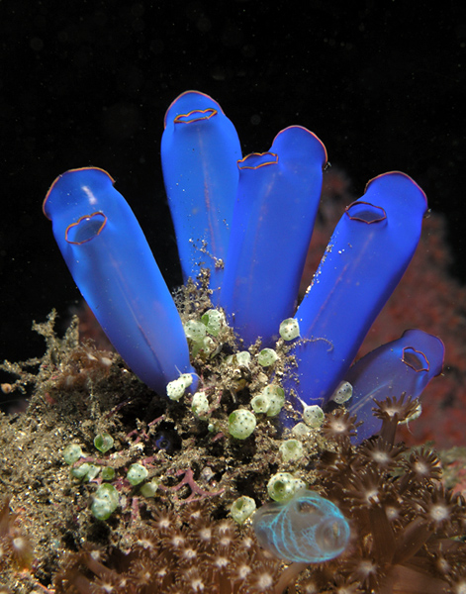
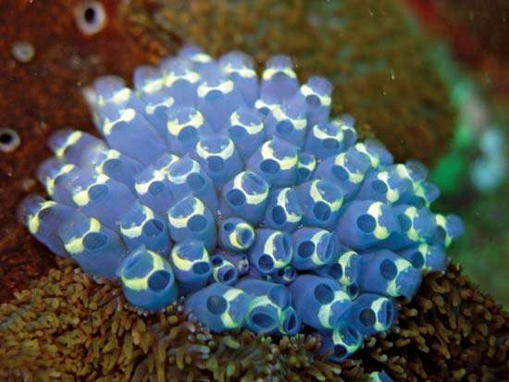
Subphylum Urochordata
Class Ascidea (tunicates)
2000 sp.
Marine
Sessile as adults
Free-swimming larvae
Hard cellulose lined shell - tunic
Filter feed (incurrent & excurrent siphon)
1 of “Big 4”?
DRAW: Preserved sea squirt (pg 462)

Slide 12
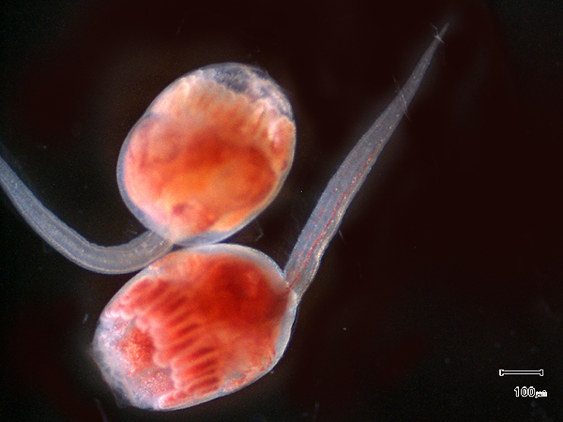

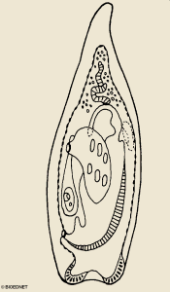
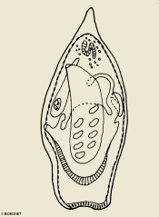
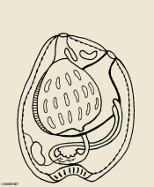
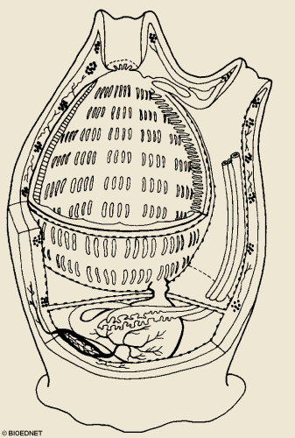
Urochordate metamorphosis

Slide 13
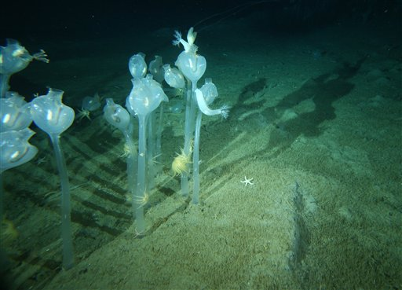
http://www.youtube.com/watch?v=e8jM94pNssc

Slide 14
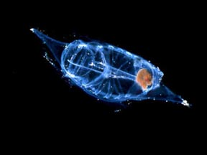
Subphylum Urochordata
Class Thaliacea (Salps & Pyrosomes)
Tropical and subtropics
Siphons at opposite ends
Used for food and locomotion
Often form colonies
Pyrosomes
https://www.youtube.com/watch?v=5EQGA_4BZ5s

Slide 15
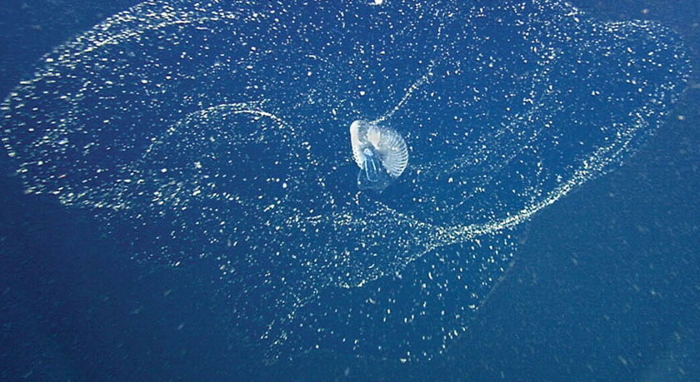
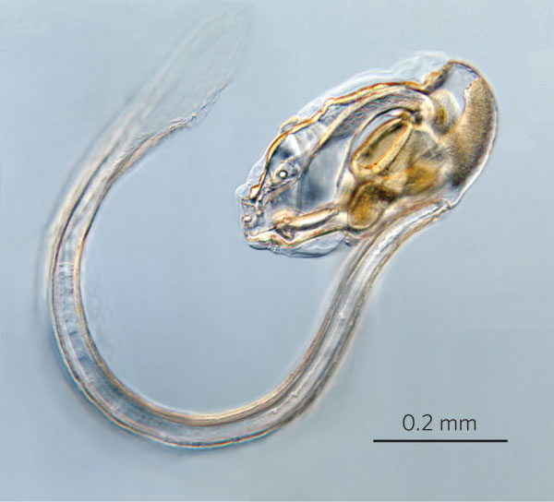
Subphylum Urochordata
Class Larvacea
Shaped like bent tadpole
Pelagic
Build a transparent hollow sphere of mucous
Floating detritus collects on mucous and is eaten

Slide 16
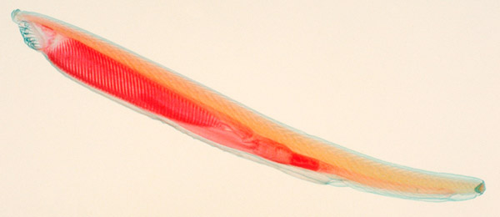
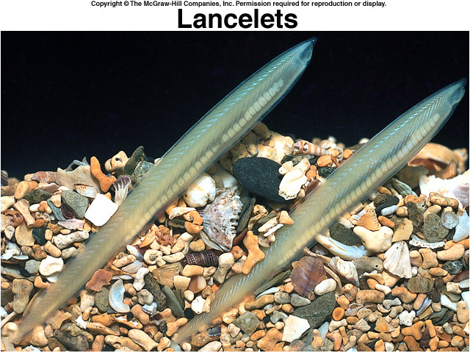
Subphylum Cephalochordata
25 sp.
Scale-less, fish-like marine animals
Burrow into sand of coastal waters
Obtain food?
DRAW: Preserved lancelet (pg 462) – look for all 4 chordate synapomorphies

Slide 17
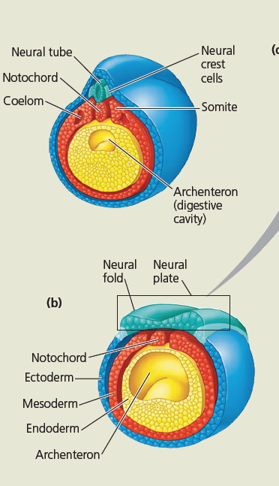
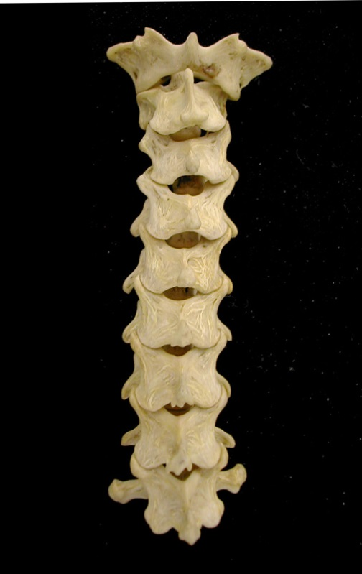
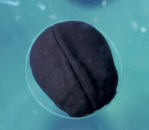
Subphylum Vertebrata
Notochord replaced by?
Distinct head (cranium)
Jaws (most)
Endoskeleton made of ?
Neural crest tissue – very important

Slide 18
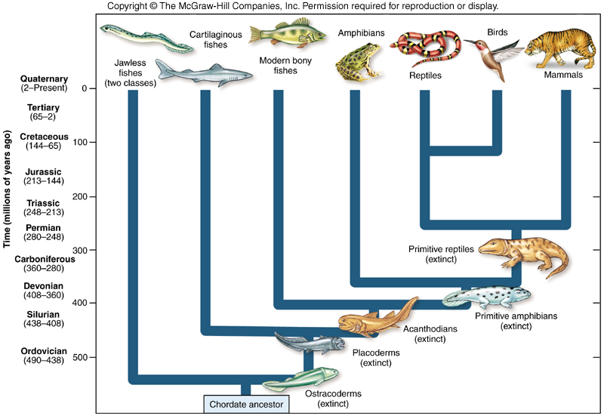
9 classes of Vertebrates

Slide 19
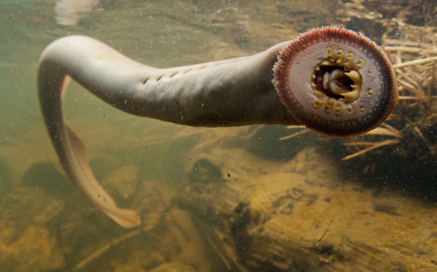
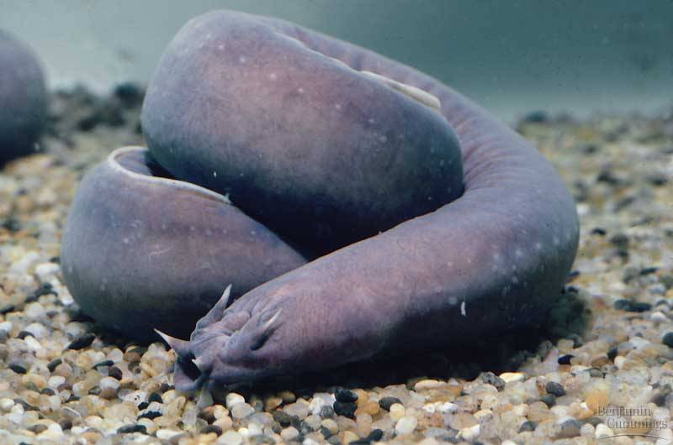
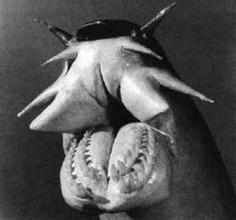
The Living Jawless Fish
Hagfish & Lampreys
Traditionally, not verts
Now recognize as Vertebrata
  Included b/c brain and skull

Slide 20
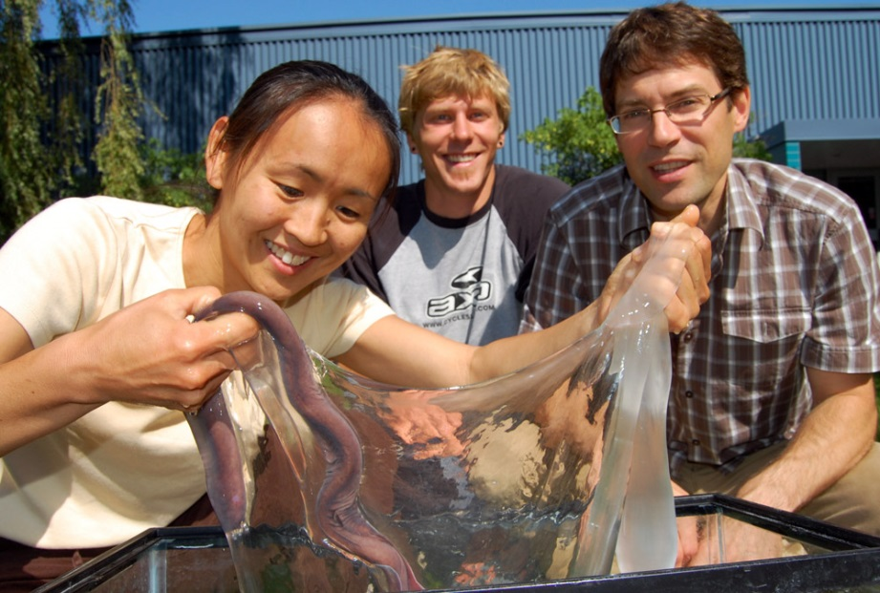

Class Myxini (hagfishes)
65 species
Marine
No vertebrae - ?
Feed on annelids, molluscs, crustaceans, anything else
Important scavengers
Reproduction unknown
http://www.youtube.com/watch?v=tKTRv3hx1s0
https://www.youtube.com/watch?v=_8FVpj0p-iU

Slide 21




Hagfish

Slide 22

Hagfish feeding
Notes:
Copy and paste URL to link to original images at BIODIDAC
http://biodidac.bio.uottawa.ca/thumbnails/filedet.htm?File_name=Agna009b&File_type=GIF

Slide 23

http://www.youtube.com/watch?v=t5PGZRxhAyU
http://www.youtube.com/watch?v=5kS64P-o5mU
Hagfish slime

Slide 24

Hagfish feeding on whale carcass
http://www.youtube.com/watch?v=tKTRv3hx1s0
Hagfish: Marine, deep-sea, cold water. Important scavengers. Reach incredible population densities.

Slide 25



Class Cephalospidomorphi (Lamprey)
Freshwater and marine
Simple vertebrae
Ascend freshwater streams to breed
Males build nest
Sucker disk for mouth
Parasitic and non-parasitic sp.

Slide 26




Parasitic Lamprey

Slide 27



Slide 28
Lamprey Management
  Release of sterile males
  Killing females
  Lampricides
  Electric fences
  Use of larval chemical cues

Slide 29


Not all parasitic
DRAW: Preserved hagfish OR preserved lamprey

Slide 30




Subphylum Vertebrata
Class Chondrichtheyes (Cartilaginous Fish)
850 species
Cartilage skeleton
Perceive electrical signals
Placoid scales
Replace teeth
Liver oils for buoyancy
Diverse reproductive modes
Mermaids purse
DRAW: Shark external and internal anatomy

Slide 31


Subclass Holocephali (chimaeras)
Ratfish, rabbitfish, spookfish, etc.
Weird teeth!
Seaweed, mollusks, echinoderms, crustaceans, fishes

Slide 32
Osteichthyes: Bony Fish
Two classes:
  Actinopterygii: Ray-finned Bony Fish
    Chondrostei
    Neopterygii
      Bowfin and gar
      Teleostia
  Sarcopterygii: Lobefin fishes
    Actinistia: Coelacanth
    Dipnoi: Lungfish

Slide 33


History of the Fishes
Bony fishes dominate
Evolved same time as sharks
Evolved in fresh water
Characteristics
  Highly mobile fins
  Bony scales
  Bony plate over gills
  Swim bladder

Slide 34




Class Actinopterygii (Ray-fined fish)
Modern bony fishes
96% of all living fishes
Every conceivable habitat
Characteristics:
  Replaced armored scales
  Highly mobile fins
  Jaw modified for suction
  Swim bladder

Slide 35



12 superorders
45 orders

Slide 36



Class Sarcoptyrgii (Lobe-fin Fishes)
https://www.youtube.com/watch?v=yz1oTHXvbHg
8 sp.

Slide 37




Tetrapoda (4 legs)
Amphibia
  Moist skin
  Short ribs
Reptilia
  Keratinized scaly skin
  Leathery or calcified egg
Aves
  Feathers and flight
  Loss of teeth, beak
Mammalia
  Hair
  Mammary glands

Slide 38



History of the Amphibians
Adaptations for the Invasion of Land
  Legs
  Lungs
  Redesigned 3-chamber heart to drive new respiratory system
  Physiological changes to prevent desiccation
    Skin thickening
    Amniotic egg
  Changes in sensory systems

Slide 39



Class Amphibia
  Three orders (salamanders, frogs, caecilians)
  Moist, granular skin
  Unique respiration (remember their toes!)
  Lungs (positive pressure)
  Short straight ribs
  Aquatic larval stage
  No nails or claws

Slide 40


Amniotes
First amniotes appear 300 MYA
Amniotic egg
Dry keratinized skin
Thoracic breathing
Reorganized heart

Slide 41




Order Testudines
  External skeleton (shell)
    Bone covered with keratinized scutes
  Vertebrae and ribs fused to the shell
  No teeth
  Terrestrial, aquatic, marine

Slide 42




Order Crocodilia
  Ancient
  Heavily armored
  Temperature Sex Determination
  Numerous sensory organs
  Adaptations for aquatic lifestyle

Slide 43





Order Squamata
  Lizards (Lepidosauria), snakes (Serpentes), & amphisbaenia
  Skin shedding
  2 Penises!
  Tail autotomy
  Highly reduced and movable jaw
  Limb reduction common
http://www.youtube.com/watch?v=TsQRzRcQ3dM

Slide 44




Class Aves
  “Glorified Reptiles”
  Split 150-200 MYA
  Forelimbs modified for flying
    Feathers
    Skeleton
    Other physiology changes (lungs)
    No tail
  10,000 species - 25 orders
Super
Simplified!
Notes:
Feathers – modified scales
Skeleton – ossified but hollow with air pockets
Other physiology changes – unidirectional airflow, efficient circulation (changes to heart), endothermy

Slide 45



Class Mammalia
  5,000 sp.
  Body covered with hair
  Glands!!
  Diphyodont teeth
  Moveable eyelids, fleshy external ears
  Mammary glands – nourish young
  Three groups?
Notes:
Feathers – modified scales
Skeleton – ossified but hollow with air pockets
Other physiology changes – unidirectional airflow, efficient circulation (changes to heart), endothermy

Slide 46


4,600 sp.

Slide 47

DRAW 4
Explore the collection and select 4 organisms from 4 different lineages to draw

