Slide 1
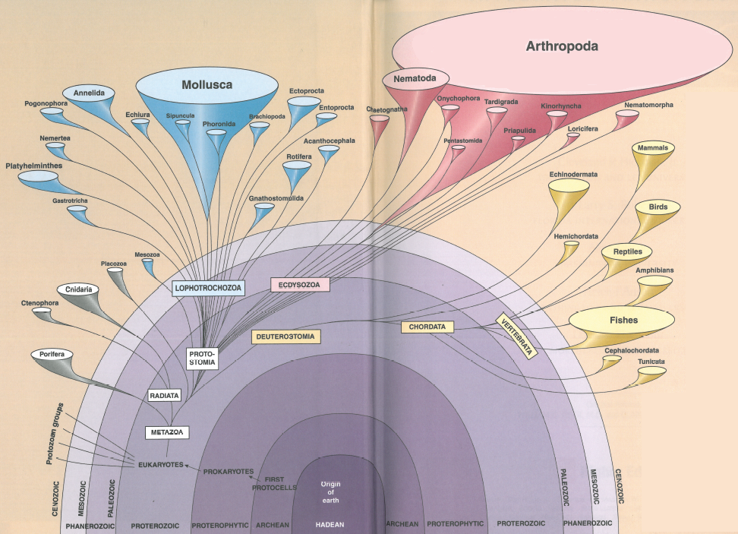

Slide 2
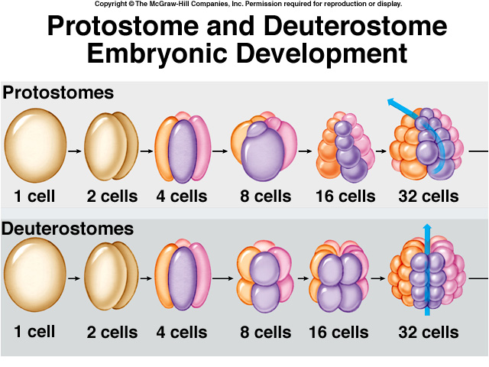

Slide 3
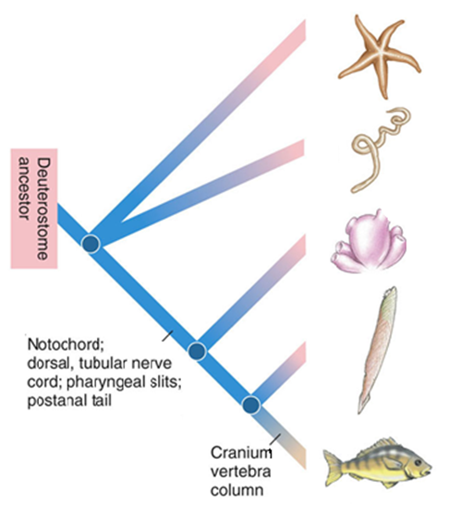
Notes:
Figure 31.3: Evolutionary relationships of the chordates.
This cladogram shows possible phylogenetic relationships among deuterostomes, including chordates (tan region), based on structural and DNA data.

Slide 4
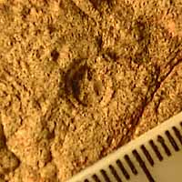
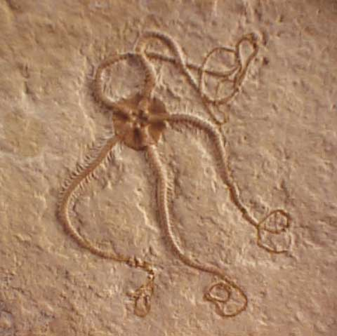
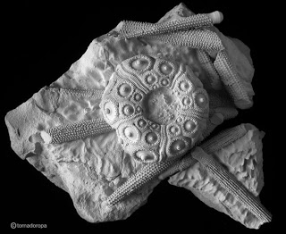
Deuterostome Evolution
First Deuterostomes - early Cambrian
First echinoderm fossil from 560 mya
Arkarua

Slide 5
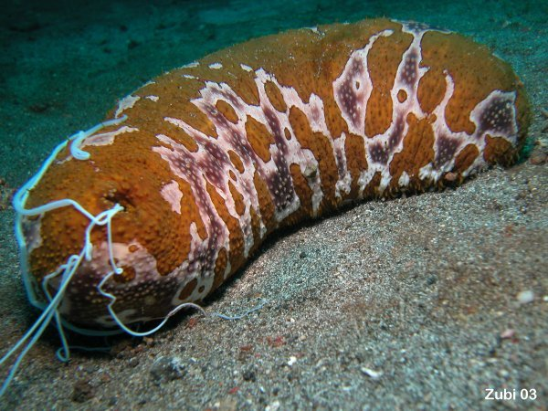
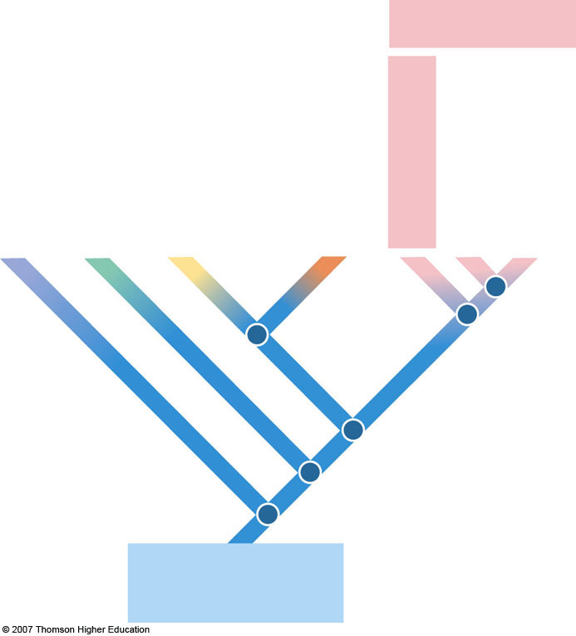
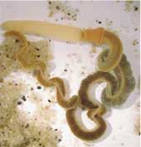
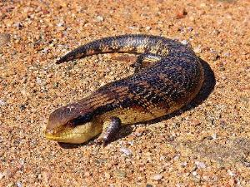
Deuterostomia Phylogeny
3 Phyla
3 Subphyla
Parazoa
Radiata
Ecdysozoa
Choanoflagellate ancestor
Lophotrochozoa
Deuterostomia
Notes:
Figure 31.1: Echinoderms.

Slide 6
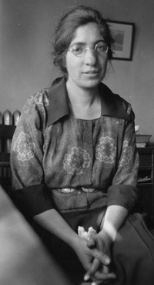
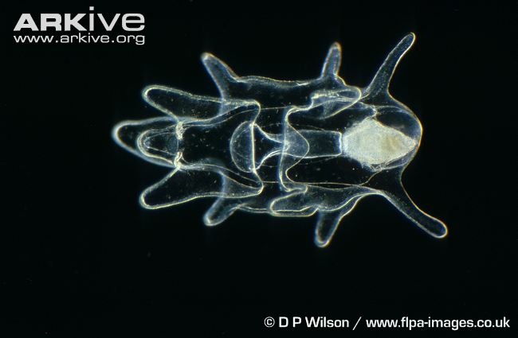
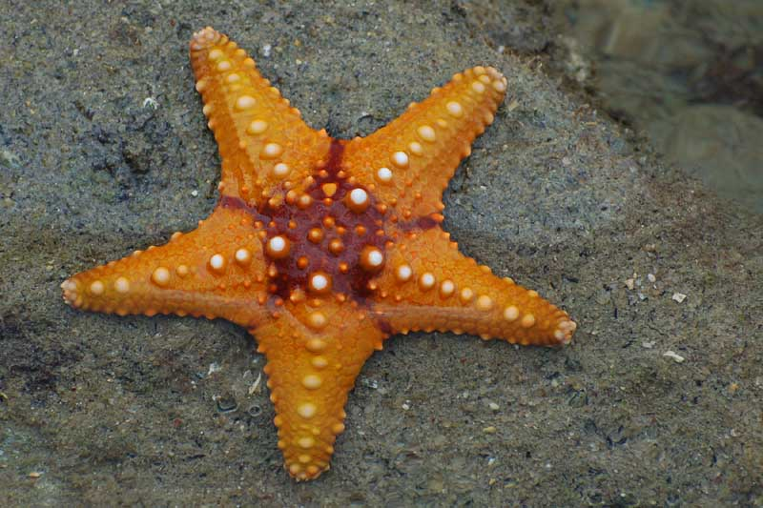
“a noble group especially designed to puzzle the zoologist”
Zoologist
Libbie Hyman
When is bilateral symmetry beneficial?
When is radial symmetry beneficial?
Radial symmetry secondarily derived
  Larvae bilateral
  Adults penta-radially symmetrical

Slide 7
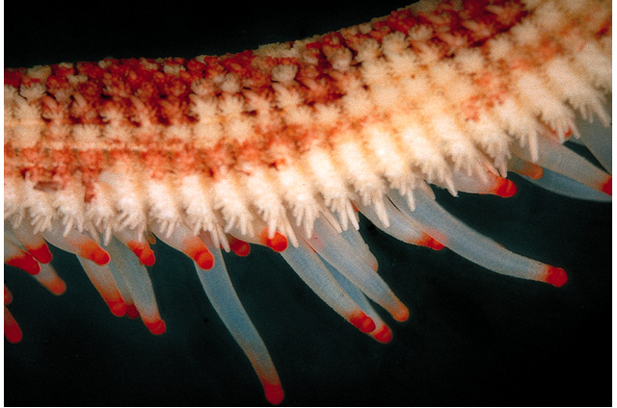
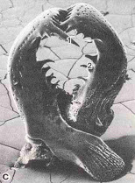
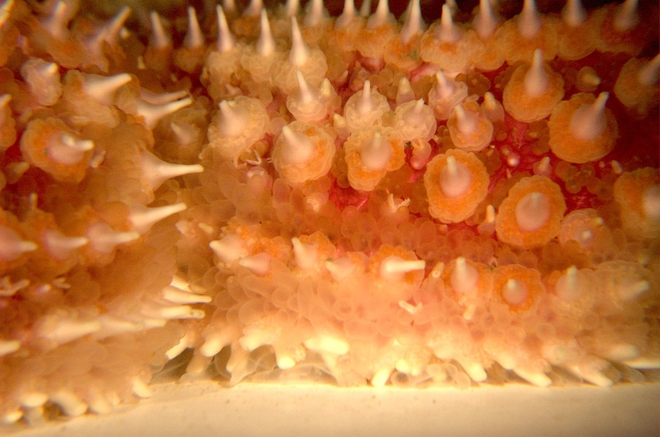
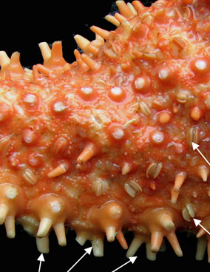
Echinoderm Body Plan
Endoskeleton
Dermal branchiae – function?
Pedicellariae – function?
Water-vascular system – function?
No head / brain
Complete digestive system
Regeneration
Get a dissection tray and sea star

Slide 8
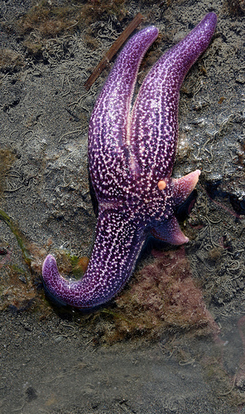
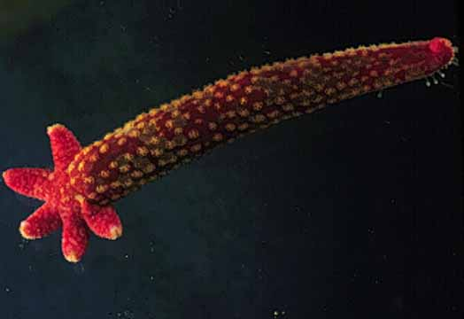
Regeneration

Slide 9
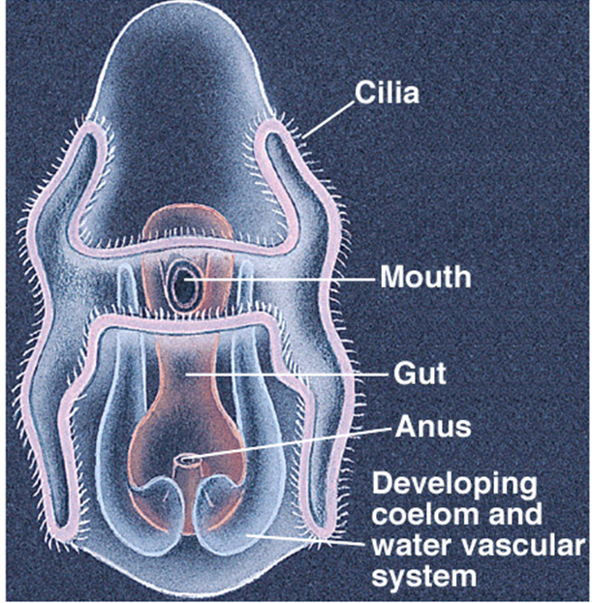
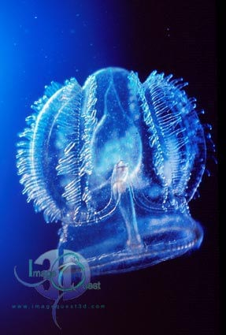

Slide 10
Phylum Echinodermata
  Class Concentricycloidea
  Class Ophiuroidea
  Class Echinoidea
  Class Holothuroidea
  Class Crinoidea
  Class Asteroidea

Slide 11
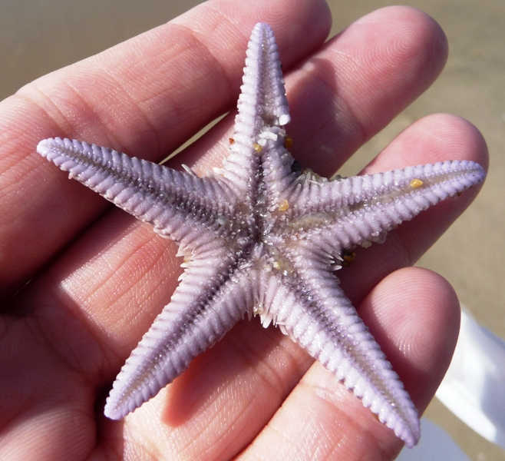
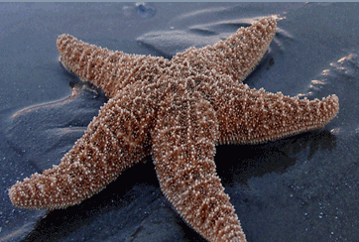
Phylum Echinodermata
Class Asteroidea (sea stars)
2000 species
Central disc and 5 arms
Endoskeleton with ossicles
Grove along bottom of each arm
Predatory - secrete digestive enzymes and digests soft tissues
DRAW: External anatomy Sea star (40.1)
DRAW: Sea Star dissection (40.2)

Slide 12
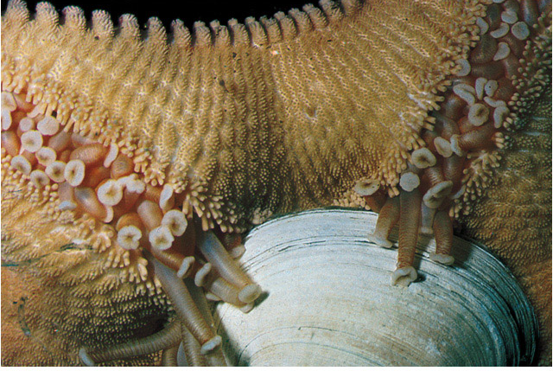
https://www.youtube.com/watch?v=2DFXGafpGkQ
Feeding

Slide 13
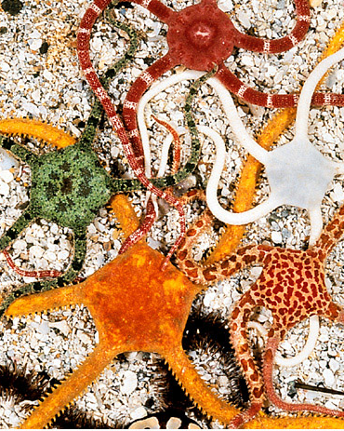
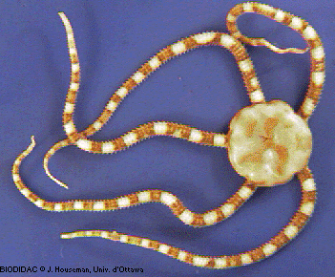
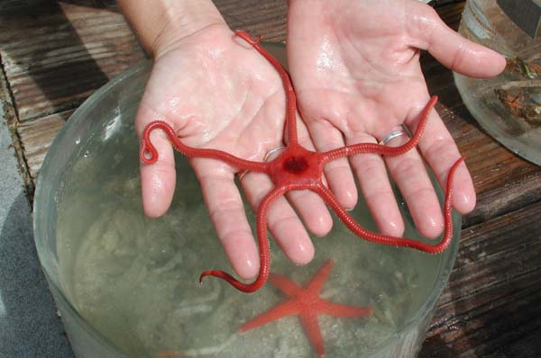
Phylum Echinodermata
Class Ophiuroidea
2000 species
Arms slender, groove closed, covered with ossicles
Capture plankton and detritus with tube feet
Tube feet but no suckers
https://www.youtube.com/watch?v=ADH792NZEiA
DRAW: Live or Preserved brittle star (pg 455)

Slide 14
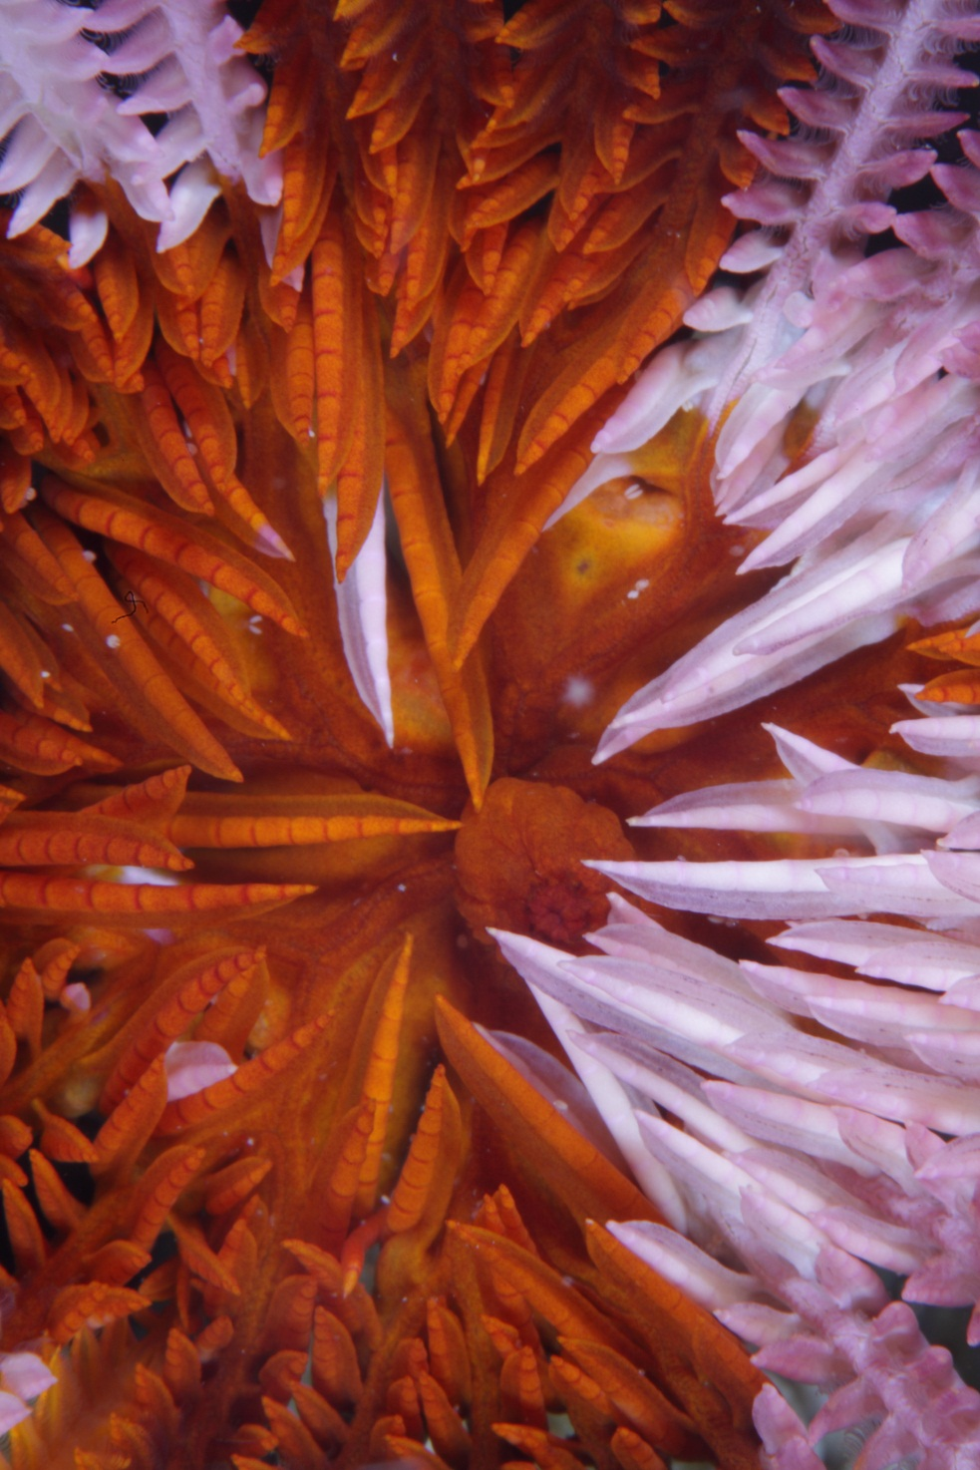
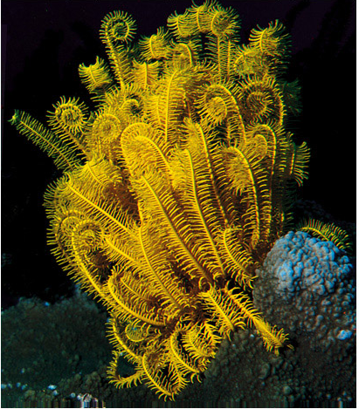
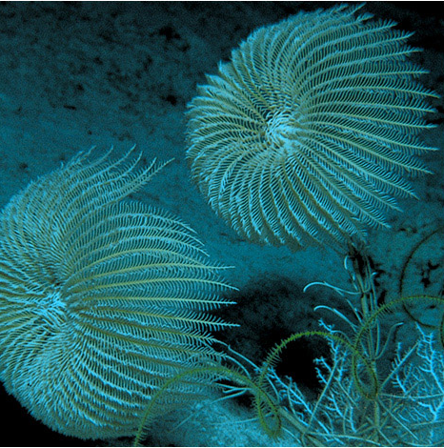
Phylum Echinodermata
Class Crinoidea
Anus
(raised cone)
Mouth
600 species
Historically abundant
U-shaped digestive tract
Use arms to filter feed
No medroporite, spines, pedicellariae
https://www.youtube.com/watch?v=OyketlthVWg
HW: Crinoid fossil collection (pg 458)

Slide 15
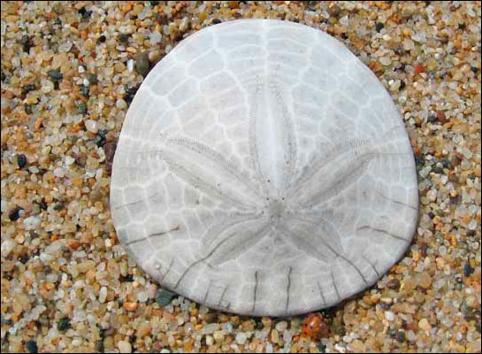
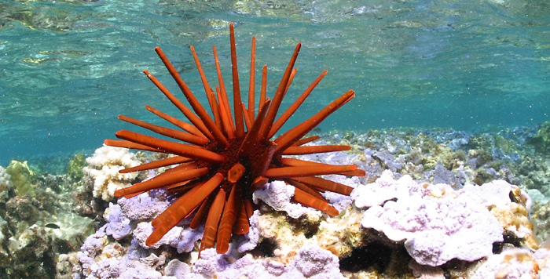
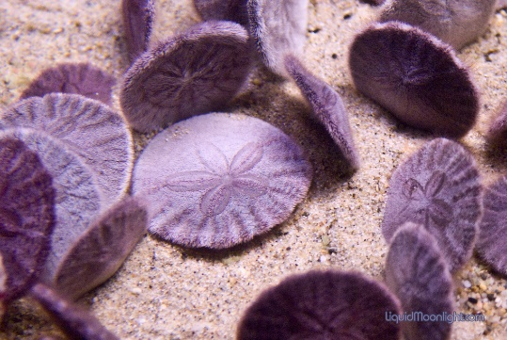
Phylum Echinodermata
Class Echinoidea
1000 species
Ossicles tightly fitting
Lack distinct arms – retain pentaradial symmetry
Walk on tube feet or movable spines
Feed with Aristotle's lantern

Slide 16
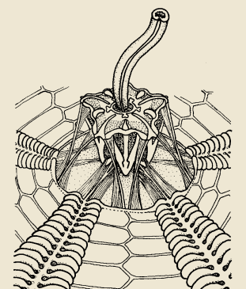
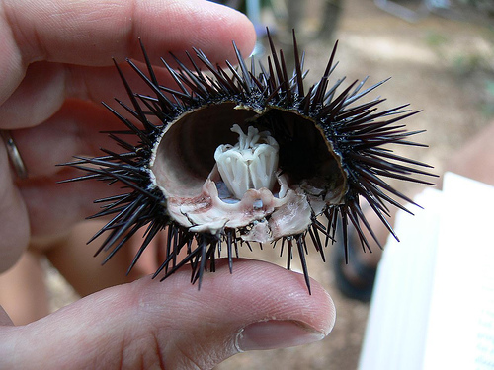
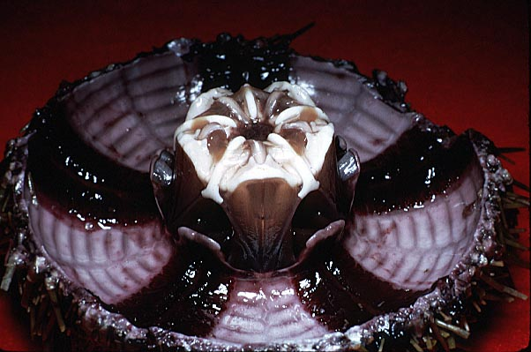
Aristotle’s lantern
DRAW: Sea urchin OR sand dollar (pg 458)
EXTRA CREDIT: Sea urchin dissection (on own time)

Slide 17
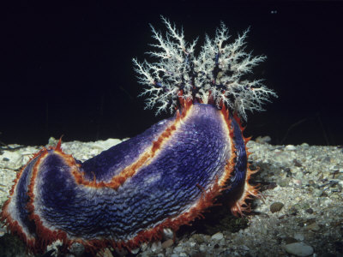
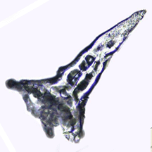
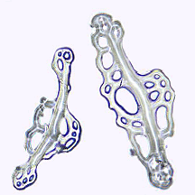
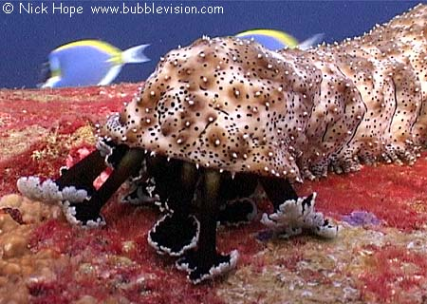
Phylum Echinodermata
Class Holothuroidea
1200 species
Slug-like, reduced endoskeleton
Mouth surrounded by modified tube feet (“tentacles”)
Filter feeders or sediment feeders
Respiratory tree
DRAW: preserved sea cucumber (pg 460)

Slide 18
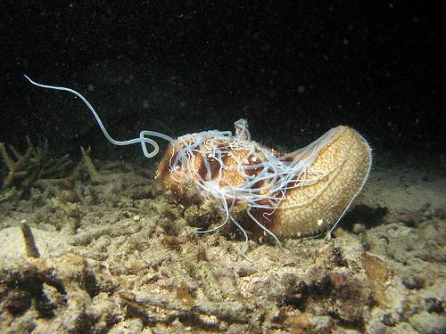
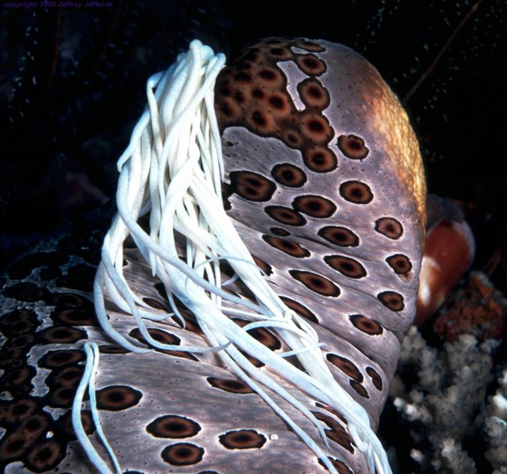
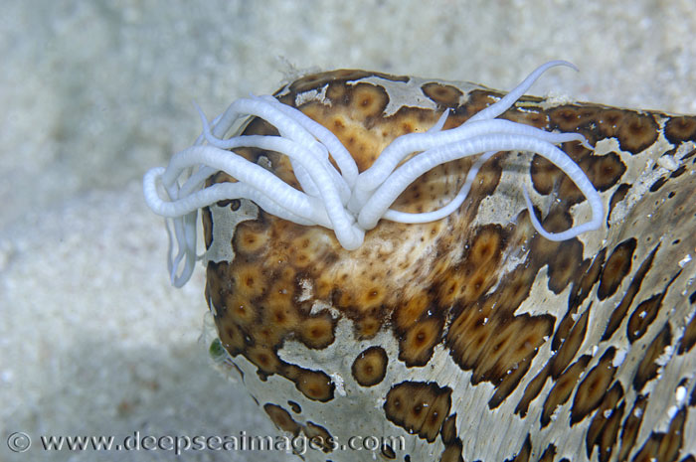
Defensive Behavior
https://www.youtube.com/watch?v=wXf_YodWw40

Slide 19
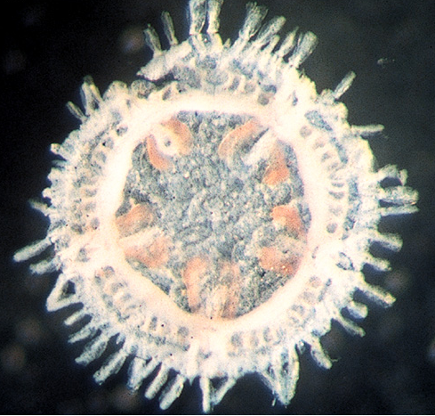
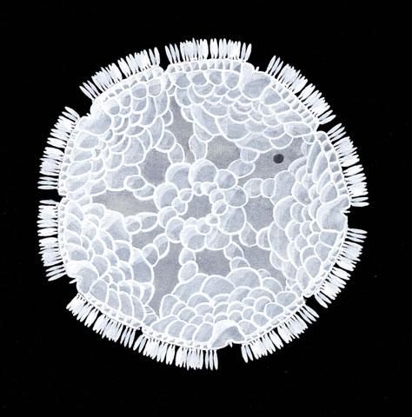
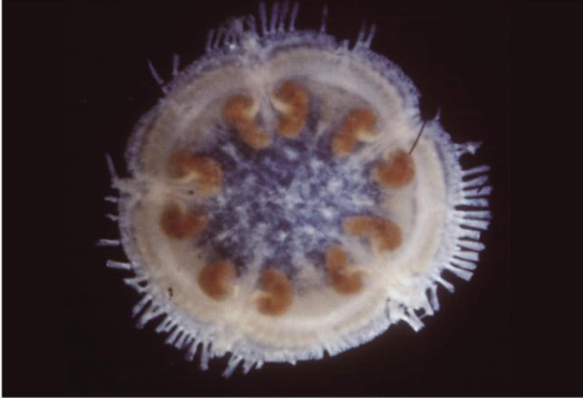
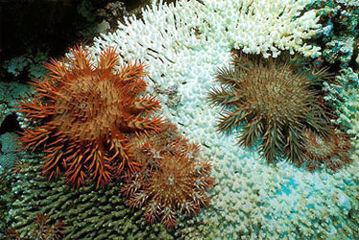
Class Concentricycloidea
2 species
  < 1 cm
  Pentaradial symmetry
    No arms
  Simple digestive tract
  Class?

