Slide 1
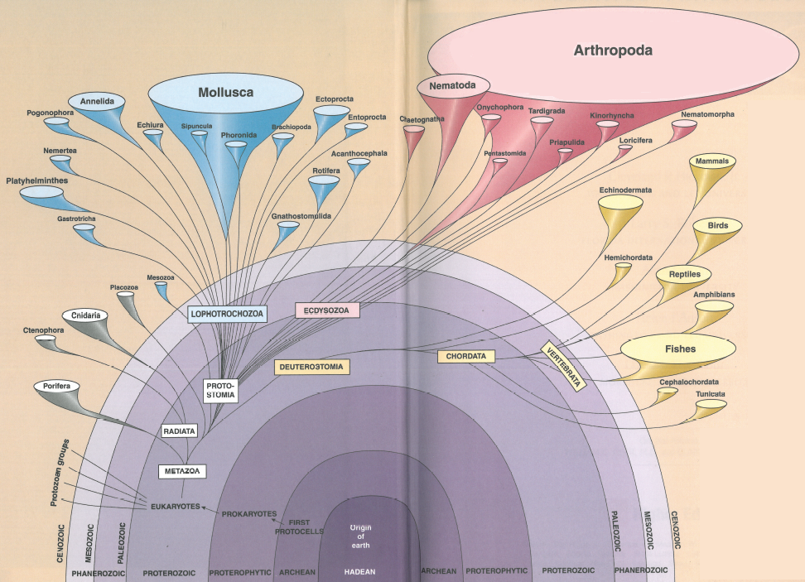
Protostomes: Ecdyzoans

Slide 2
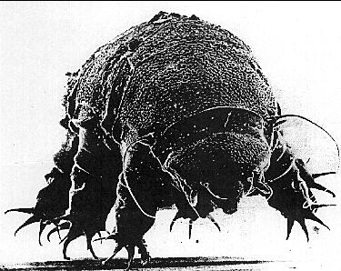
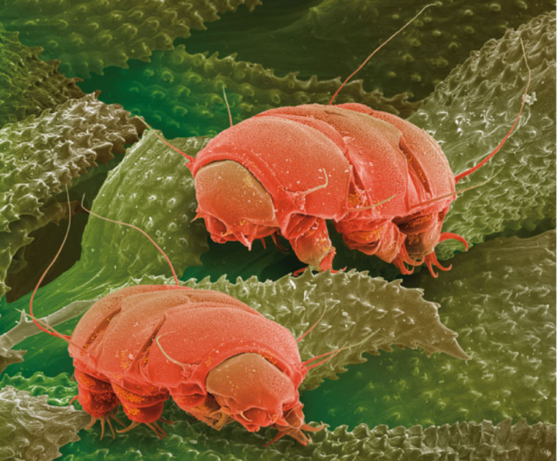
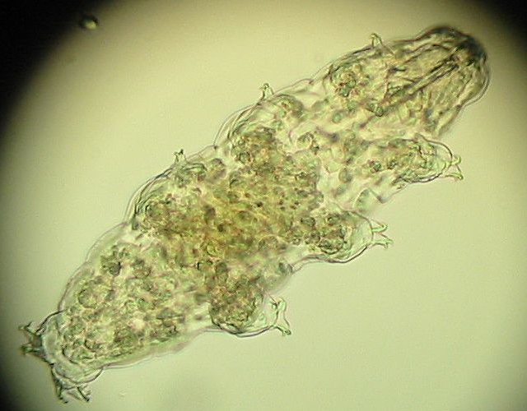
Phylum Tardigrada water bears
Small (<1 mm)
Water film of lichens and mosses
Also freshwater and marine
Coelomate
Piercing mouthparts
Remarkable cryptobiosis

Slide 4
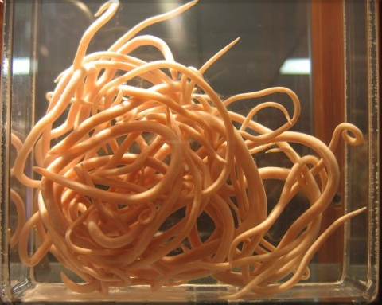
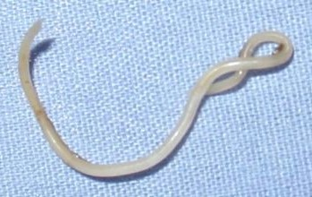
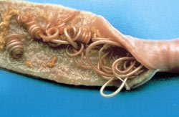
Phylum Nematoda
Roundworms
Arthropoda
Mollusca
Chordata
50,000 sp. – probably 10x
Pseudocoelomate – means?
Covered by thick cuticle – helps evade?
No segmentation
Move by hydrostatic skeleton – efficient?
Important human parasites
Anatomy
Platyhelminthes
Nematoda
Annelida
Porifera
Echinodermata
Other
Other protozoans
Apicomplexa
Ciliophora

Slide 5
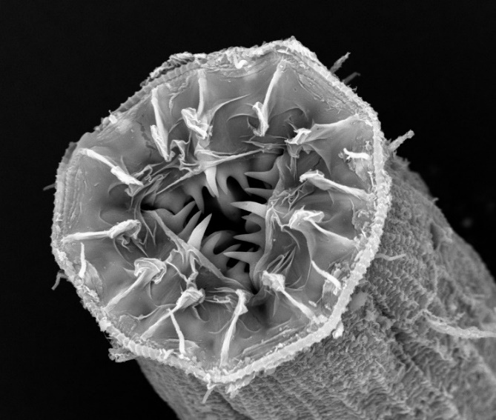
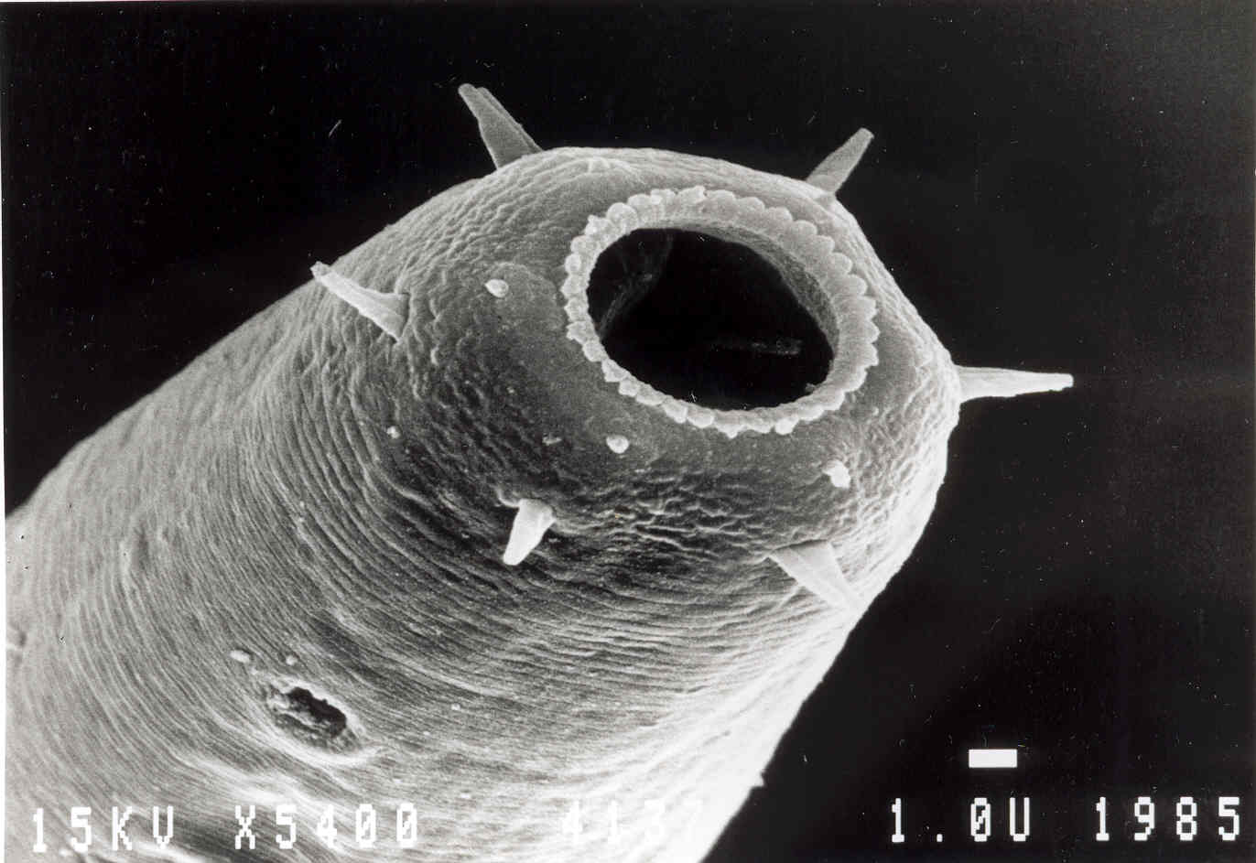
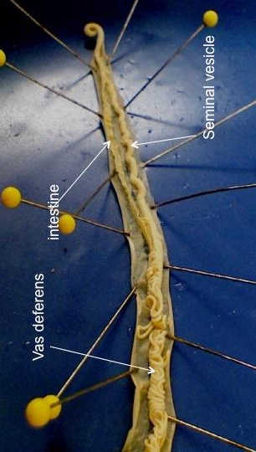
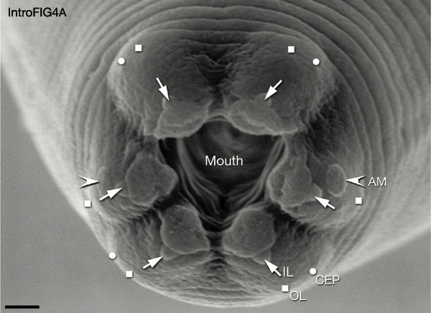
Nematode Anatomy
DRAW: Live vinegar roundworms (37.2) - wetmount
DRAW: Nematode dissection (37.3 or 38.7)

Slide 6
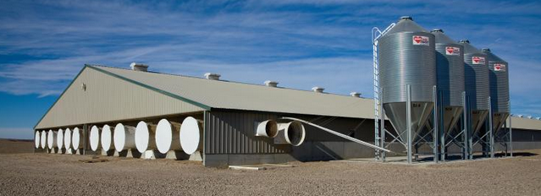
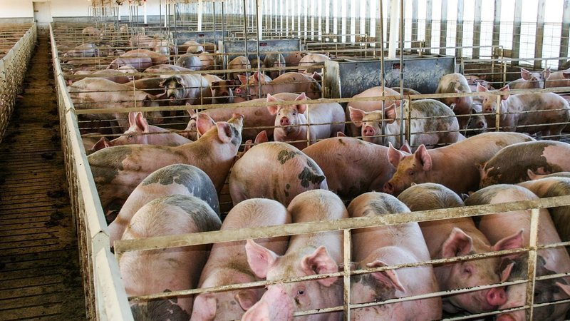
Write down 3 words that come to mind when seeing these pictures
Why are they grown like this?

Slide 7
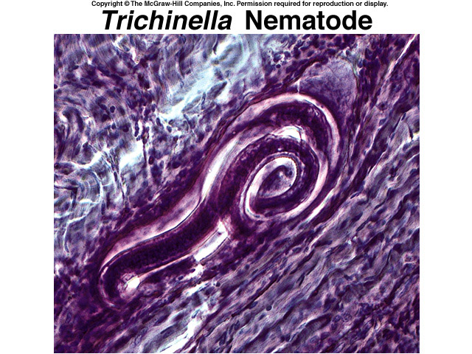
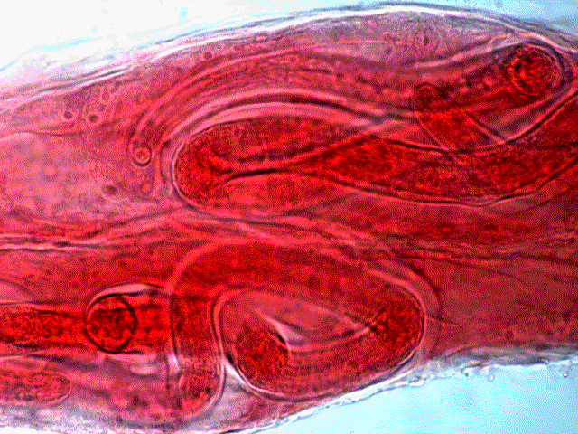

Slide 8
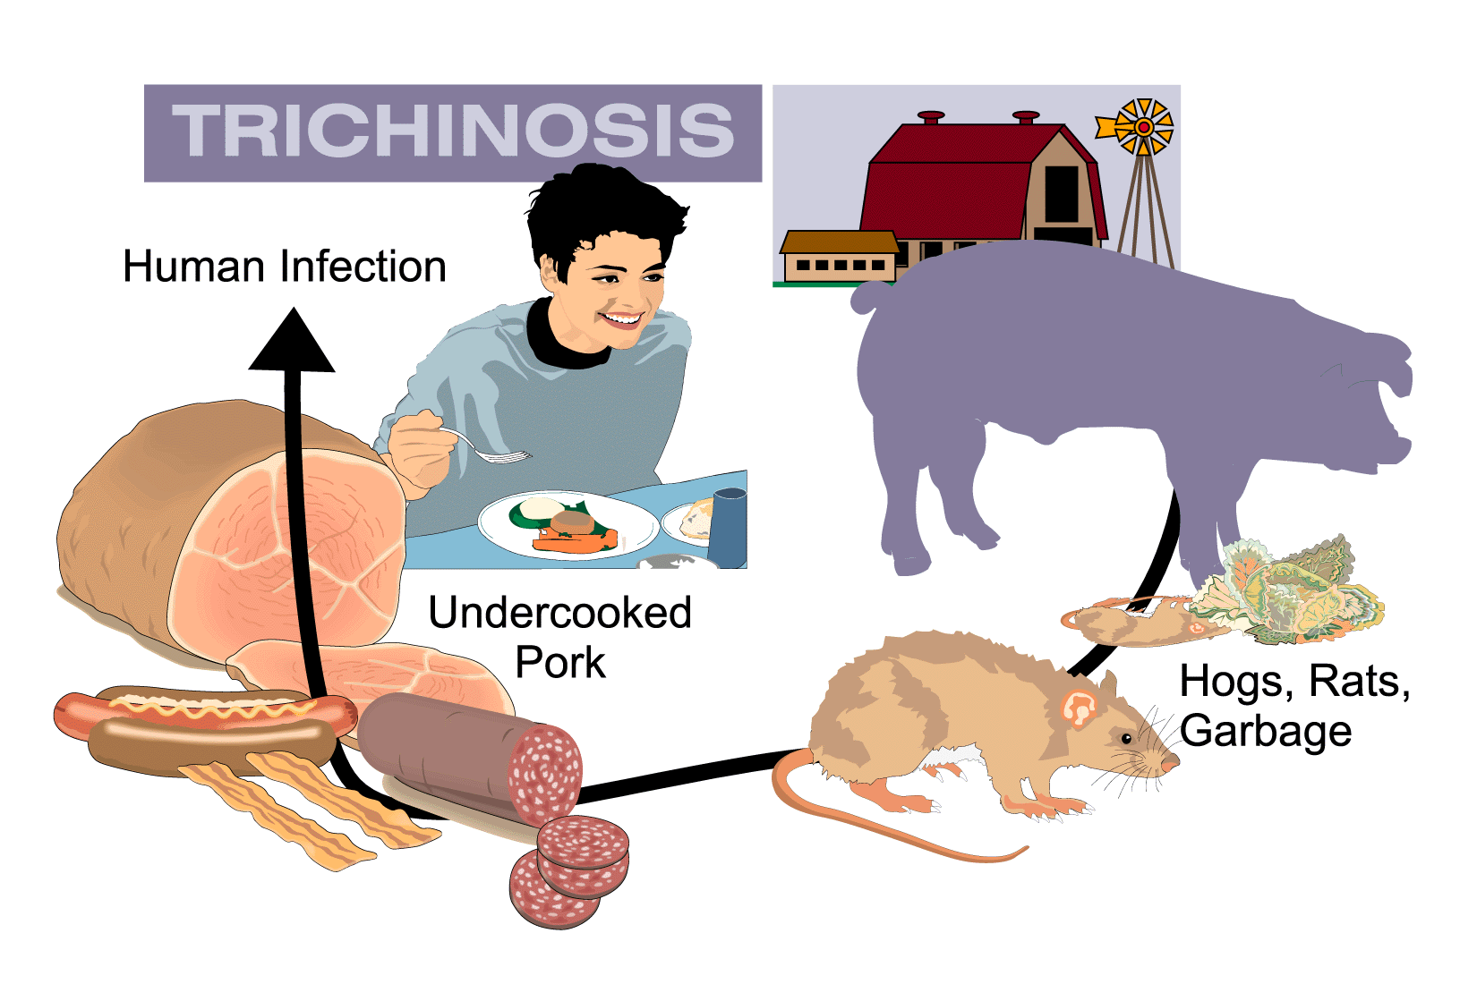

Slide 9
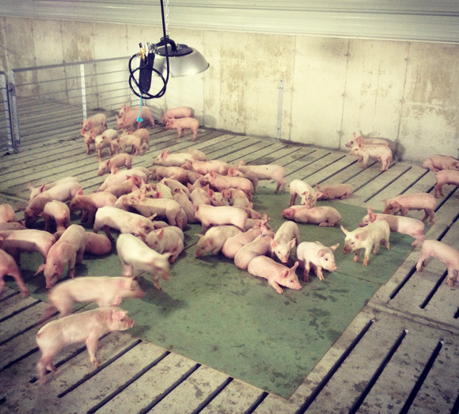

Slide 10
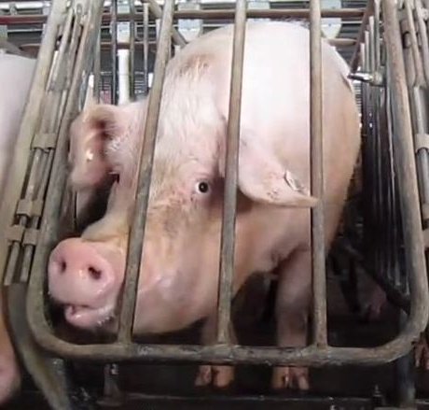
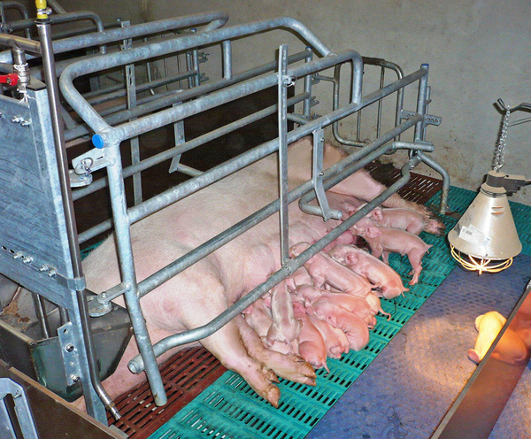
DRAW: Trichenella (37.4)

Slide 11
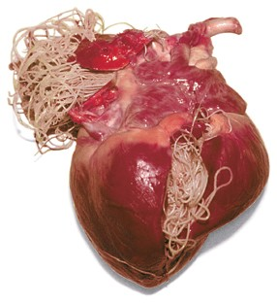
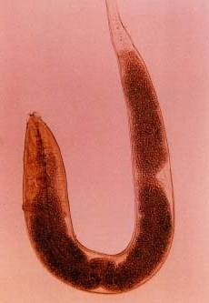
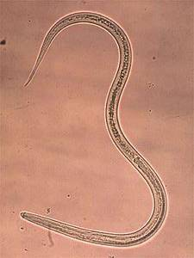
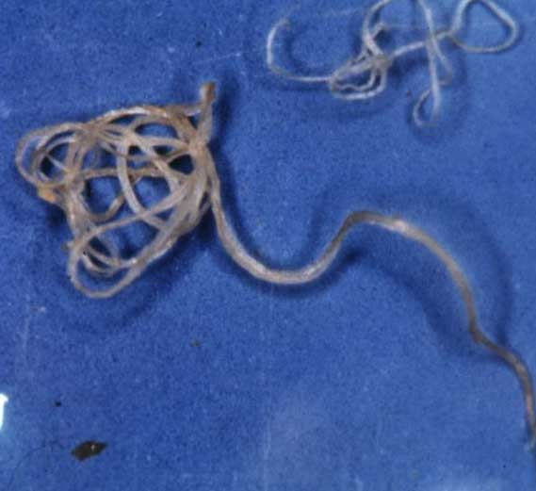
Other Nematode Parasites
HW: Pick 2 slides of nematode parasites, draw them, and incorporate a paragraph on the biology of each.

Slide 12
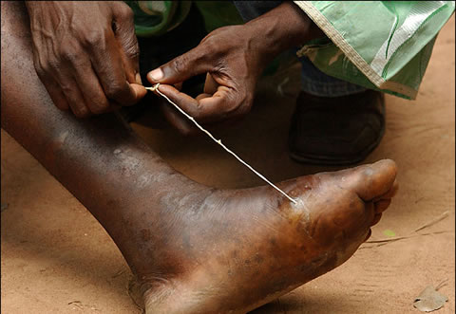
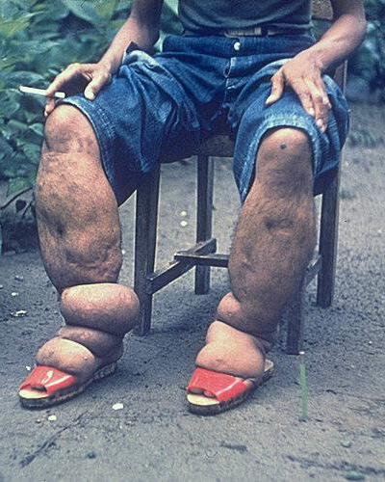
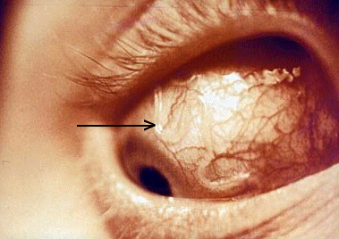
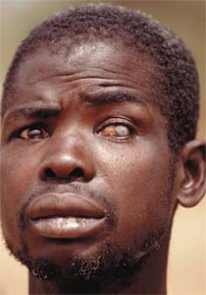
Wuchereria bancrofti
(elephantiasis)
Loa loa
(eye worm)
Onchocerca volvulus
(river blindness)
Filarial Nematodes
Matchstick Worm (Dracunculus)
https://www.youtube.com/watch?v=phCod-0tfkE

Slide 13
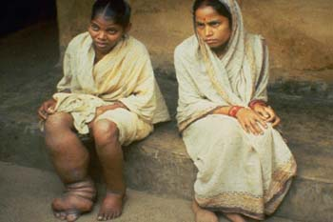
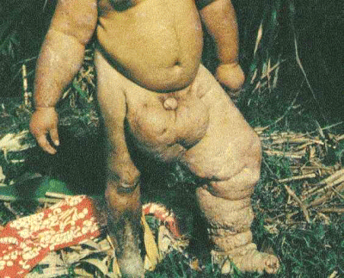
Elephantiasis
Lymphatic system is blocked by the nematodes
Fluid from organs collect, causing tissues to swell
Nematodes prefer lymph nodes in lower abdominal cavity and legs

Slide 14
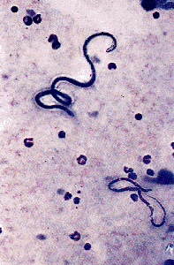
Loa Loa
Often referred to as “eye worm”
Causes loaisis
Found in subcutaneous tissues of the body, not just in the eye
The deer fly, Chrysops, is a vector

Slide 15
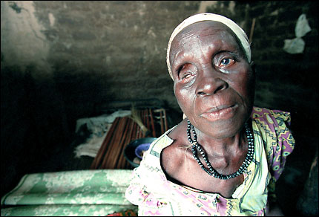
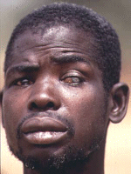
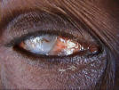
River Blindness (Onchocerciasis)
Affects more than 30 million people
Develops when the microfilariae enter the eye and die, causing inflammation leading to cataract type blindness
Named because the vector, black fly, breeds near rivers
Areas where the endemic strikes can cause an infection of 30-40% of adult population

Slide 17
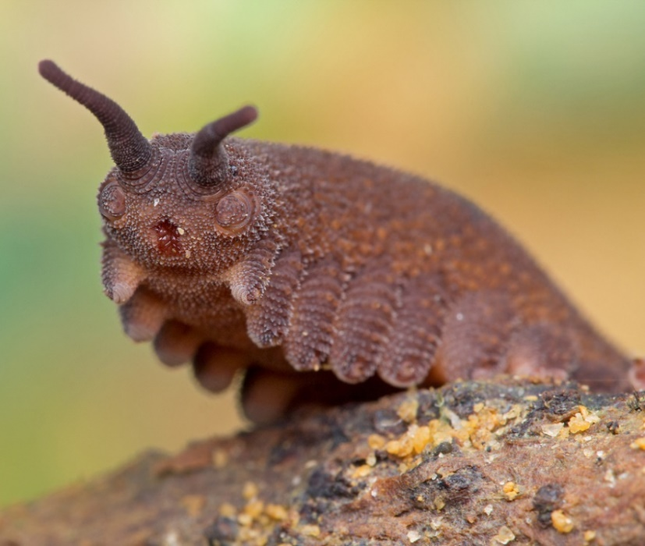
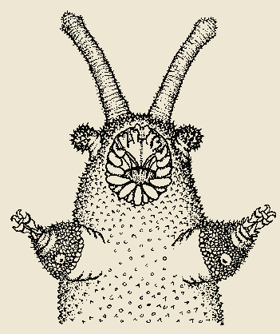
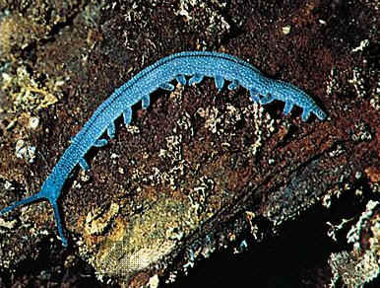
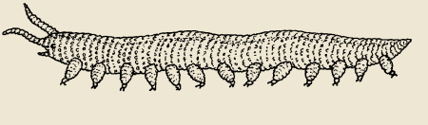
Phylum Onychophora
Velvet worms
110 sp.
Resemble catapillar
No segmentation
Soft and flexible cuticle
Paired “appendages” with hooks
http://www.youtube.com/watch?v=mrL2A7my1fc

Slide 19
Number of species
Mollusca
Arthropoda
Chordata
Platyhelminthes
Nematoda
Porifera
Annelida
Echinodermata
Sarcomastigophora
Apicomplex
Ciliophora

Slide 20
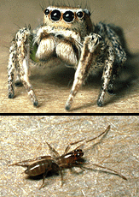
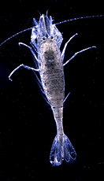
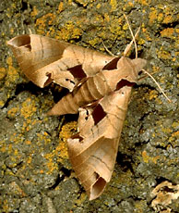
Arthropod Importance
Important group for:
  Biodiversity, evolution, economically
Niches?
Impact on humans?

Slide 21
Get a
Dissection tray
Preserved crayfish
Preserved grasshopper

Slide 22
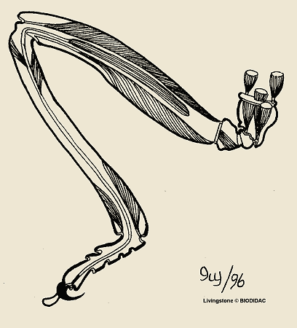
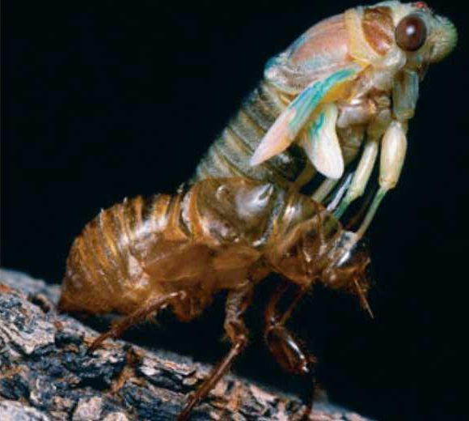
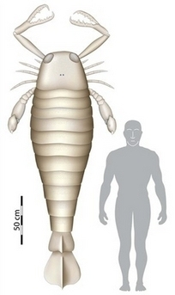
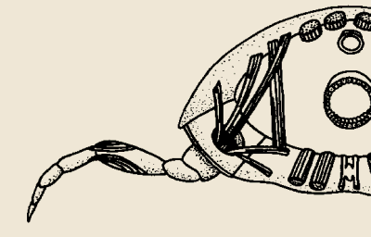
Why are arthropods successful?
Benefits?
Costs?
What’s the largest arthropod you’ve ever seen?

Slide 23
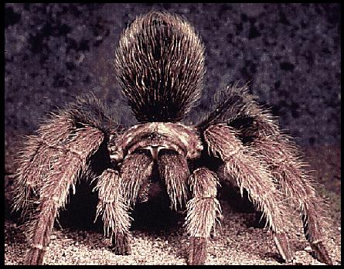
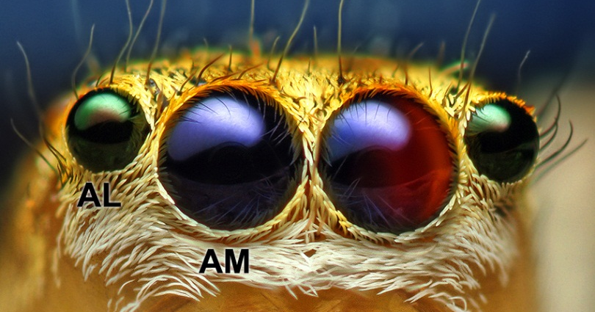
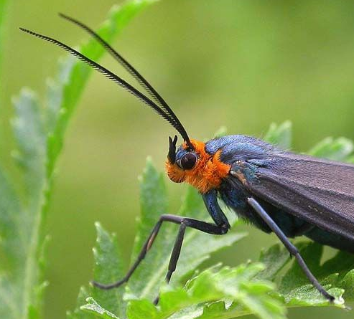

Slide 24
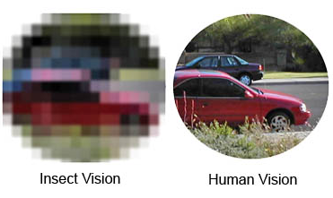
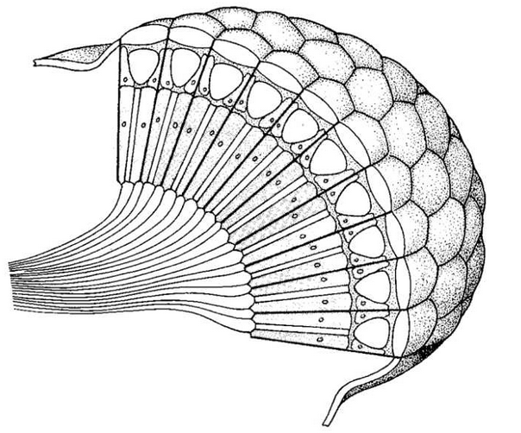
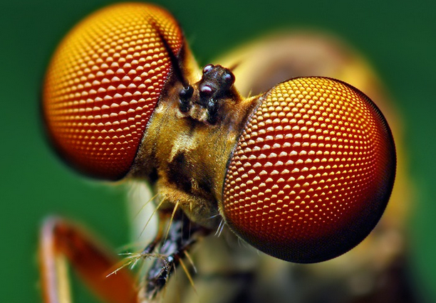
The Compound Eye
Arthropods - type of eye variable
Compound eye ancestral
Made up of repeating units
Forms a composite

Slide 25





Why does a distinct larval stage make them successful?

Slide 26




Other General Characteristics
3 body regions (ancestral)
Open circulatory system
Nervous system
Respiratory system
Excretory system
White structures are malpighian tubes

Slide 27







Classification of the Arthropods
Trilobitomorpha (extinct)
Chelicerata (spiders, scorpions, ticks, horseshoe crab)
Crustacea (crabs, shrimp, barnacles)
Myriapoda (millipedes & centipedes)
Hexapoda (insects)

Slide 28


Subphylum Trilobitomorpha
Earliest arthropod
Extinct during Permian extinction
25,000 sp.
All ecologies (predator, scavenger, filter feeder, planktonic)
Distinct, 3-part exoskeleton
HOMEWORK: draw fossil trilobite from museum collection

Slide 29




Subphylum Chelicerata: Class Arachnida
80,000 sp.
Lots of appendages
(almost) all carnivorous
No antennae or compound eye
Body fused into 2 sections

Slide 30


Subphylum Chelicerata: Class Arachnida
Order Scorpiones: Scorpions
90 sp. in US
Ancient (1st terrestrial)
Mainly warm climates
Live birth
Long lived

Slide 31


https://www.youtube.com/watch?v=ZM96828jmQk

Slide 32


Subphylum Chelicerata: Class Arachnida
Order Opiliones: daddy longlegs
6500 sp.
Single body segment
Predators and scavengers
Venomous?
Glands that secrete noxious compounds

Slide 33



Subphylum Chelicerata: Class Arachnida
Order Araneae: spiders
40,000 species
All (but 1) active predators
4-8 eyes
Chelicerae?
How eat?
Many have silk glands leading to spinnerets on abdomen

Slide 34


Slide 35


Subphylum Chelicerata: Class Arachnida
Order Acari: mites and ticks
50,000 sp.
Parasitic (ticks)
Mites?
Cephalothorax & abdomen fused
Major disease vectors (2nd to?)

Slide 36
DRAW 2 now, remaining 2 HW (PG 442)
Preserved scorpion (identify cephalothorax & abdomen)
Preserved daddy longleg
Preserved spider (look for pedipalps & chelicerae)
Preserved tick

Slide 37


Subphylum Chelicerata: Class Merostomata (Horseshoe crabs)
https://www.youtube.com/watch?v=90LTtKIFY8U
  Ancient Group (possible trilobite relatives?)
  Covered by carapace
  Predators on?
  Mate in spring – where and how?
  Females dig burrows, lay eggs
  Long-lived (15+ yrs)
DRAW: Preserved horseshoe crab (pg 441)

Slide 38




Subphylum Crustacea (crustaceans)
80,000 sp.
This + insects = 80% arthropods
Habitat?
Synapomorphies
  Biramous appendages
  Two pair antennae
  Legs modified for chewing
  Segmented, each with pair appendage
  Nauplius larval stage
“What insects are to land, crustaceans are to sea”
Nauplius

Slide 39
Subphylum Crustacea
Class Remipedia
Class Cephalocarida
Class Branchiopoda (fairy shrimp & water fleas)
Class Ostracoda (ostracods)
Class Malacostraca (isopods, amphipods, krill, crab, shrimp)
Class Maxillopoda (copepods, barnacles)

Slide 40




Subphylum Crustacea: Class Branchiopoda
Order Diplostraca: water fleas
Order Anostraca: fairy shrimp
Water fleas
Freshwater
Legs used for suspension feeding
Critical link in food webs
Parthenogenic
Morphological plasticity
Fairy shrimp
Vernal pools
Swim upside down
Filter or scrape algae

Slide 41



Subphylum Crustacea: Class Ostracoda
  Seed shrimp
  Small (mm) and laterally flattened
  Resemble bivalves
  Antennae used to swim
  Feed on?
  Prominent in stagnant water

Slide 42




Subphylum Crustacea: Class Malacostraca
Order Decopoda
  Name “Ten footed” (10 pairs)
  3 anterior modified for feeding
    Exoskeleton reinforced with calcium carbonate
    Head/thorax fused - cephalothorax (covered by carapace)
    Ancestral biramous appendage highly modified
      Locomotion, feeding, respiration, sensory
Antenna
Mandible
Maxilla
Uropod
DRAW: Crayfish dissection (pg 443, 39.1, 39.2)
Swimmerets
Maxillipeds
Walking
legs
Cheliped

Slide 43





Crabs
Abdomen short and hidden
Thick exoskeleton
Terrestrial, freshwater, marine
Single pair of claws
900 sp.
Lobster & Crayfish
Paraphyletic
Long body, thick muscular tail
5 pairs of walking legs, 3 with claws
Commercially important food
Long life-span
Rocky ocean floors – to continental shelf
Freshwater/terrestrial
Omnivorous
Shrimp/Prawns
Elongate bodies
Elongate and muscular tail
Legs weak, swim with swimmerets
Terrestrial, freshwater, marine
Several thousand sp.
Krill
Resemble small shrimp
Feed on phytoplankton
Critical link in food web
Vertical migrations to feed?

Slide 44


I can’t make this up…
hyperlink

Slide 45
DRAW 1, other 2 HW:
Live crayfish (put in container with water)
Preserved Crab
Preserved Shrimp

Slide 46



Subphylum Crustacea: Class Malacostraca
Order Isopoda: Isopods
Order Amphipoda: amphipods
  Isopods
  Freshwater, marine and terrestrial
  Dorso-ventrally flattened
  Segmented exoskeleton
  Detritivores
  Amphipods
  Freshwater and marine
  Laterally flattened
  Detritivores
Sowbugs & Pillbugs
DRAW: freshwater or terrestrial isopod

Slide 47



Subphylum Crustacea: Class Maxillopoda
Order Cirripedia: barnacles
  Adults sessile
  Mantle-like tissue
  Long legs with setae
  Hermaphrodites, rarely self-fertilize?
  How mate?
http://www.youtube.com/watch?v=v1SW-pl2gYs
DRAW: preserved barnacle or shell remnant

Slide 48


Subphylum Crustacea: Class Maxillopoda
Order Copepoda: copepods
  Small 1-2mm
  Freshwater and marine
  Single compound eye
  No circulatory system
  Feed on phytoplankton

Slide 49
  Subphylum Myriapoda
  Class Chilopoda
  Class Diplopoda

Slide 50



Subphylum Myriapoda:
Classes
Chilopoda (centipedes)
  30+ legs
  1 leg per segment
  Carnivorous
  Legs attached laterally
Millipoda (millipedes)
  60+ legs
  2 legs per segment
  Legs attached ventrally
  Herbivorous

Slide 51


Centipede Feeding
DRAW ONE, HW OTHER
Live centipede (pg 446)
Live millipede (pg 446)

Slide 52
  Subphylum Hexapoda
  Class Entognatha
  Class Insecta

Slide 53


Subphylum Hexapoda: Class Entognatha
Order Collembola: springtails
https://www.youtube.com/watch?v=OwOL-MHcQ1w
https://www.youtube.com/watch?v=jWcmy84P__0
  Closely related to insects
  Extremely abundant in damp soil
  Direct development
  Springing organ folded under the abdomen

Slide 54

Subphylum Hexapoda: Class Insecta
Largest group of organisms on earth
  ~1 million named species
    1 ha rainforest - 41,000 sp.
    Reasons for success?
      Small size
      Waterproof exoskeleton
      Metamorphosis
      Reproductive potential
      Evolution of flight
Copyright © McGraw-Hill Companies Permission required for reproduction or display

Slide 55


Subphylum Hexapoda: Class Insecta
Synapomorphies
  3 body segments
  3 pairs of legs
    1 pair antennae
      4 mouthparts, highly modified
      2 pair wings (NOT APPENDAGES)

Slide 56



Insect Life Histories
Separate sexes (dioecious)
Internal or external fertilization?
2 forms of metamorphosis:

Slide 57
Major Insect Orders
Coleoptera - beetles
Diptera - true flies
Lepidoptera - butterflies & moths
Hymenoptera - ants, bees, wasps
Collembola - springtails
Hemiptera - true bugs
Ephemeroptera - mayflies
Odonata - dragonflies & damselflies
Plecoptera - stoneflies
Orthoptera - grasshoppers and crickets
Isoptera - termites
Homoptera - cicadas, aphids, leafhoppers
Neuropter - lacewings
Trichoptera - caddisflies
Dermaptera - earwigs
Embioptera - web spinners
Thysanura - silverfish
Psocoptera - bark and book Lice
Mallophaga - chewing Lice
Anoplura - sucking lice
Thysanoptera - thrips
Strepsiptera - twisted wing parasites
Siphonaptera - fleas
This is not everything (26 total)!

Slide 58




Subphylum Hexapoda: Class Insecta
Order Coleoptera: Beetles
  500,000+ described species
  Front wings thick and hard
  Mouthparts biting or chewing

Slide 59




Subphylum Hexapoda: Class Insecta
Order Diptera: true flies
  Second largest order
  Single pair of flight wings
  Second set reduced (balancers)
  Mouthparts highly modified
Crane fly

Slide 60




Subphylum Hexapoda: Class Insecta
Order Lepidoptera: butterflies & moths
  Wings covered with scales
  Wings coupled or overlapping
  Mouthparts a sucking tube – Proboscis
  Larvae:
    Silk glands
    Chewing mandibles
http://www.youtube.com/watch?v=K5qijI--v9E

Slide 61



Subphylum Hexapoda: Class Insecta
Order Hymenoptera: bees, ants, wasps
  100,000 species
  Ovipositor may be modified into a stinger
  Social and solitary species
  Many haplo-diploid sex determination
    Males haploid, Females diploid

Slide 62


Subphylum Hexapoda: Class Insecta
Order Orthoptera: grasshoppers, crickets, locusts
  20,000 sp.
  Incomplete metamorphosis
  Cylindrical body with elongated rear legs (jumping)
  Produce sound – rub wings together or against legs
  Chewing mouthparts
  Hindwings fold up
DRAW: grasshopper dissection (39.3 & 39.4)

Slide 63




Subphylum Hexapoda: Class Insecta
Order Trichoptera: caddisflies
  Adults look like a moth
  Larvae are aquatic & build case
  Produce silk
  Breed in summer/fall

Slide 64



Subphylum Hexapoda: Class Insecta
Order Hemiptera: true bugs
  Only insects you can call “bugs”
  Piercing and sucking mouth
  Wings may be present or absent

Slide 65
HOMEWORK:
Find and collect 3 adult insects
Put them in the freezer
Figure out what order they belong to (page 451)
Draw them

