Slide 1
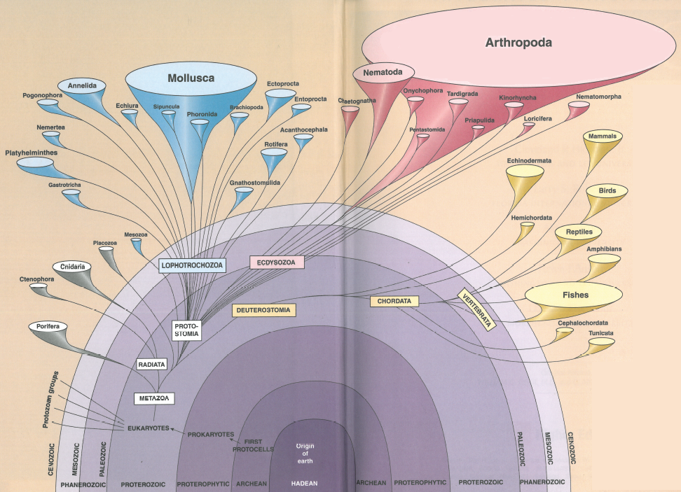

Slide 2
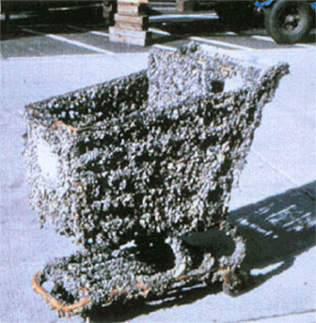
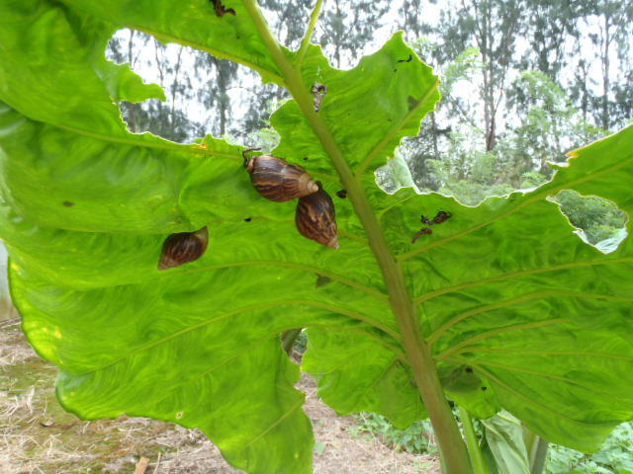
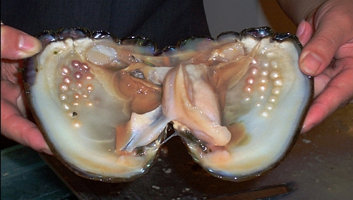
Phylum Mollusca
chitons, clams, squids, octopus, snails, slugs
Extremely diverse, ~100,000 sp.
All coelomic
Open circulatory system
Massive economic & environmental significance - ?
Open circulatory system
Synapomorphies
  Two body sections
  Mantle
  Shells – function?
  Radula

Slide 3
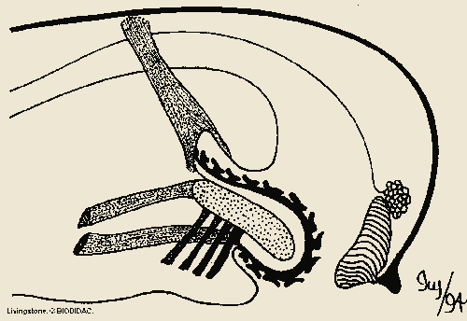
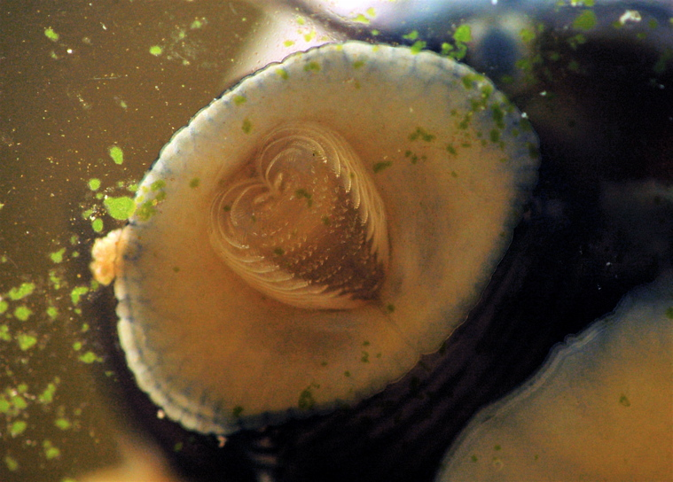
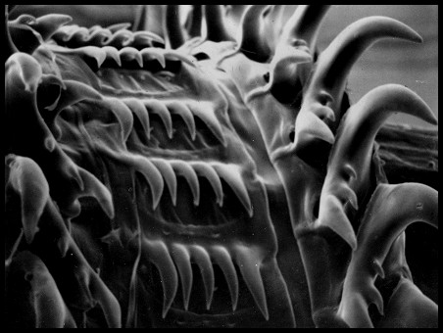
Radula
Radula
https://www.youtube.com/watch?v=mLVDwlrSq5U
Odontophore
Mouth
Odontophore muscles
Notes:
Radula of a snail

Slide 4
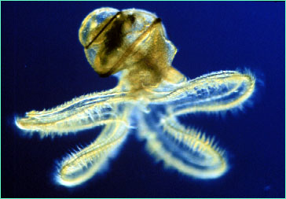
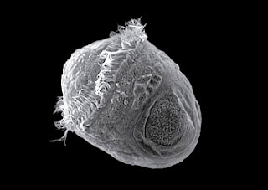
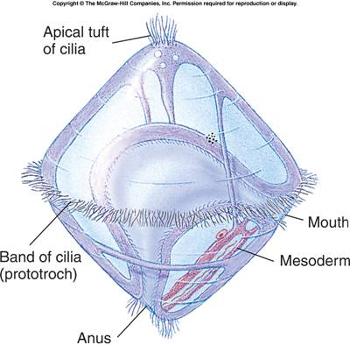
Reproduction in Mollusks
Most dioecious
Five life-history stages
Veliger
Trochophore
trochophore

Slide 5
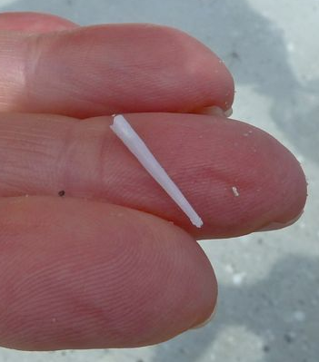
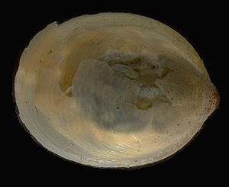
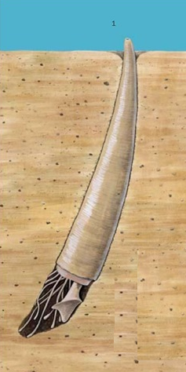
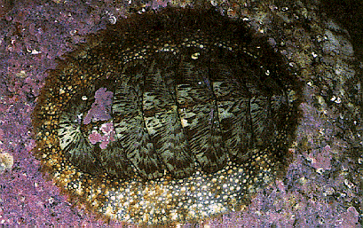
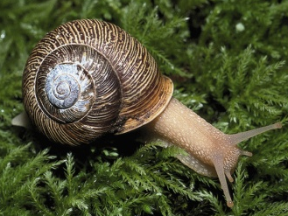
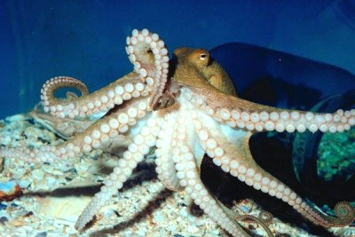
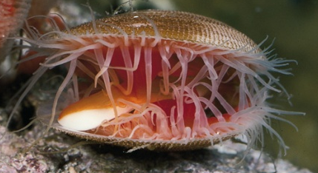
Classes within Phylum Mollusca
Class Caudofoveata
Class Solenogastres
Class Scaphopod
Class Monoplacophora
Class Polyplacophora
Class Gastropoda
Class Bivalvia
Class Cephalopoda

Slide 6
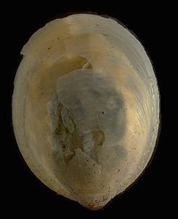
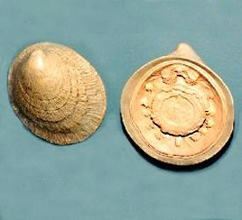
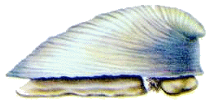
Phylum Mollusca
Class Monoplacophora
Discovered in 1952
Superficially resemble gastropods
25 species

Slide 7
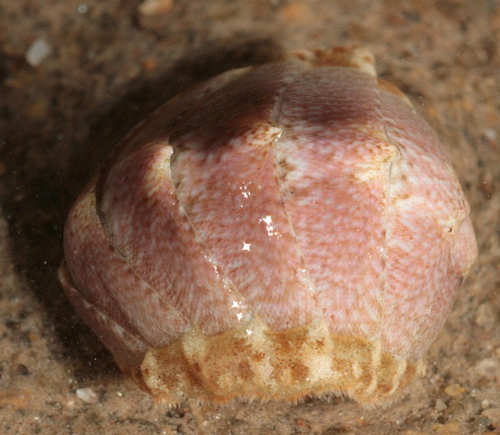
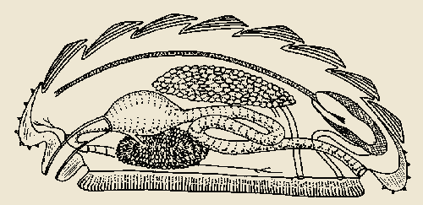
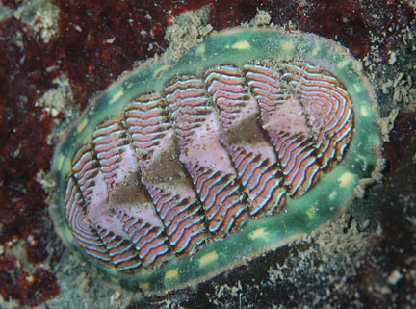
Phylum Mollusca
Class Polyplacophora
https://www.youtube.com/watch?v=hNDCdIQlY8M
1000 sp.
Oval body, 8 overlapping plates
Marine grazers
Can roll into a ball if dislodged
No mantle cavity or gills
DRAW: Preserved Chiton (pg 427)

Slide 8

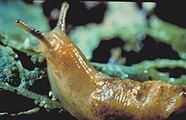
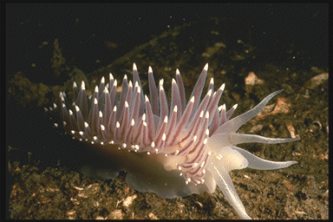
Phylum Mollusca
Class Gastropoda
80,000 sp.
Snails, slugs, limpets, conch, sea slugs
All aquatic environments & damp terrestrial
With or w/o shell (slugs)
Synapomorphies
  Single piece shell
  Torsion

Slide 9
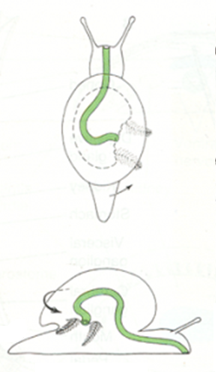
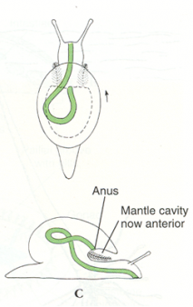
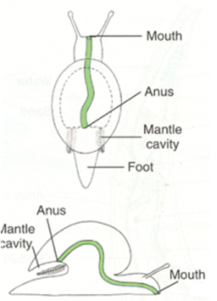
Torsion

Slide 10
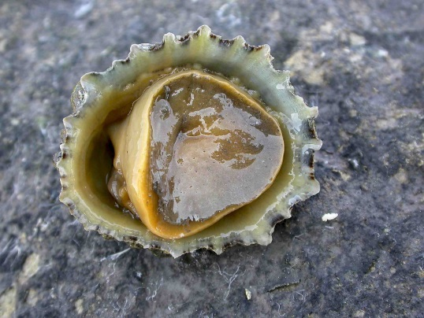
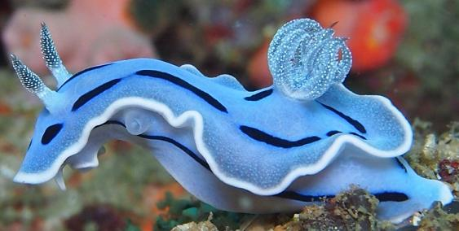
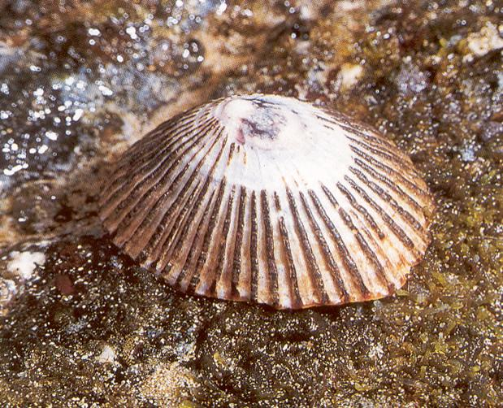
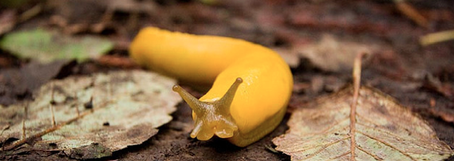
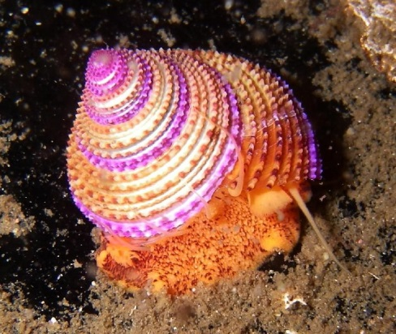
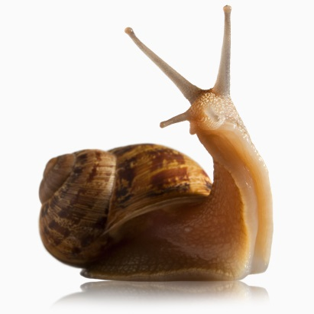
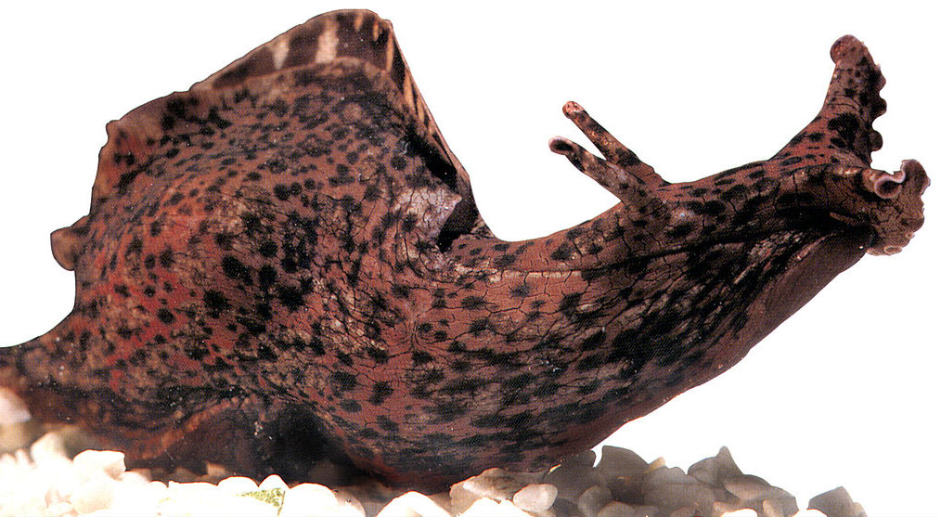
4 major gastropod groups
Slugs
No shell
Marine (sea slugs) or terrestrial
Limpets
No coil in shell
https://www.sciencenews.org/article/cone-snail-venom-sea-worms-pheromones
Sea Hares
Eat seaweed
Internal protein shell
2 chemosensory stalks
Snails
Single coiled shell
All habitats
https://www.youtube.com/watch?v=EFAdts1xUMc
HW: Live snail (pg 427)
OBSERVE: Gastropod Shell Collection

Slide 11
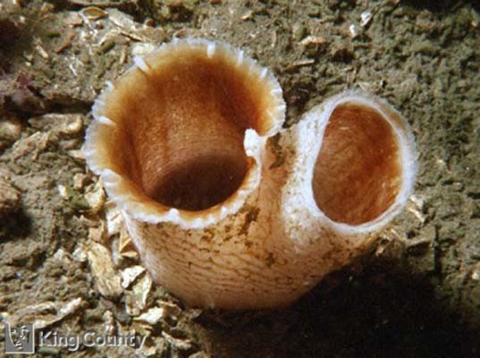
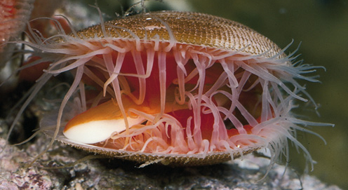
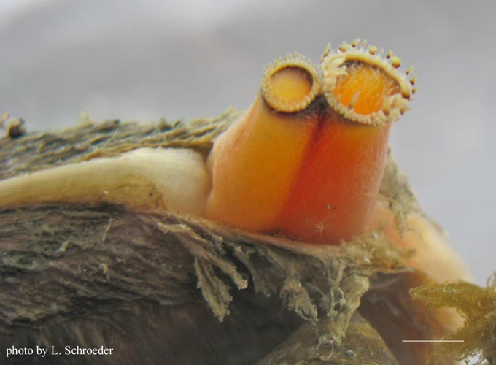
Phylum Mollusca
Class Bivalvia
10,000 sp.
Clams, scallops, mussels, oysters
Two lateral shells
Sessile filter feeders
Incurrent and excurrent siphon
Parasitic larvae (freshwater)
https://www.youtube.com/watch?v=DxEpyjWDB6I
DRAW: Mussel dissection (38.1)

Slide 12
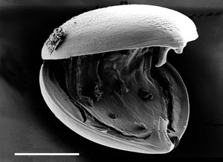
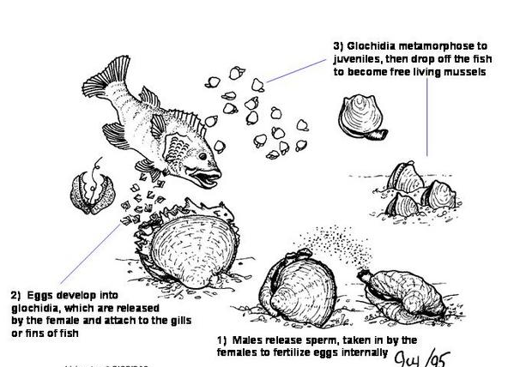
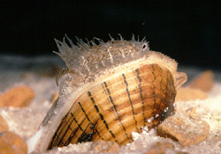
Freshwater clams
http://www.youtube.com/watch?v=I0YTBj0WHkU
HW: Mussel glochidia (NIB)
DRAW: Mussel glochidia (no pg)

Slide 13
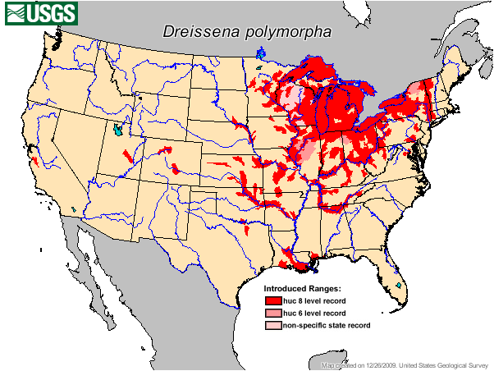
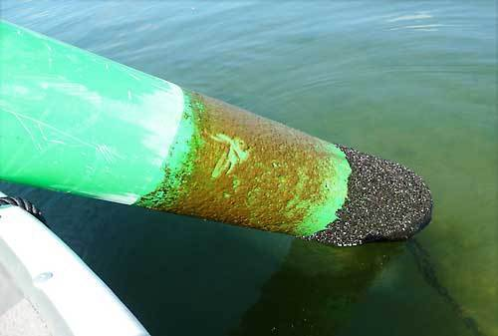
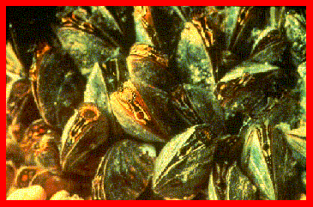
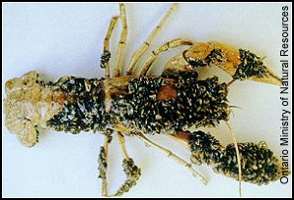
Zebra Mussels
Notes:
https://www.youtube.com/watch?v=abImqGDzXBo

Slide 14
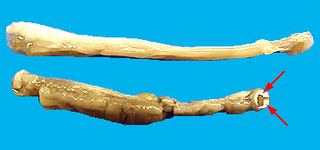
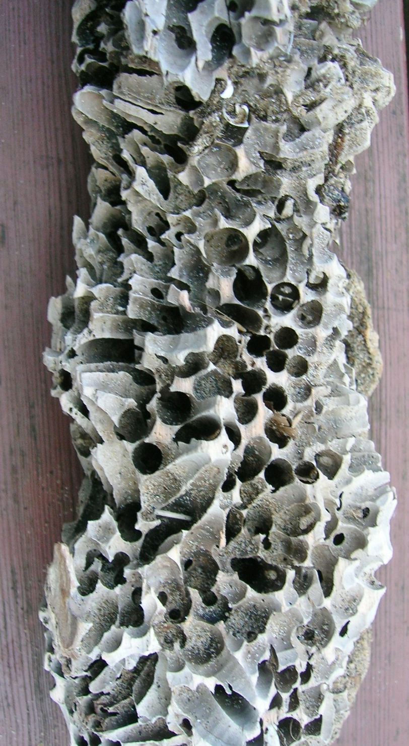
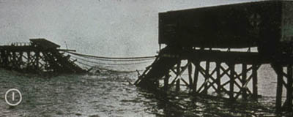
Teredo Shipworms

Slide 15
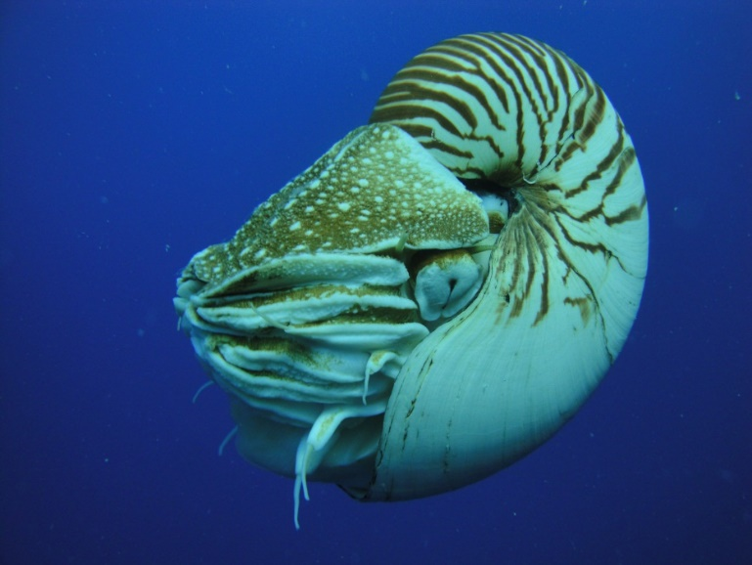
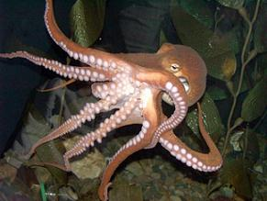


Phylum Mollusca
Class Cephalopoda
800 sp.
Octopus, squid, nautilus, cuttlefish
Most intelligent invertebrate
Active predators
  Large eyes
  Closed circ system
  Efficient respiration
  Highly developed nervous sys
Foot → 2 tentacles
Series of arms
Suckers on arms and tentacles

Slide 16



Cephalopod shell
Robust – nautilus
Reduced – squid
Absent – octopus

Slide 17


Locomotion
Expel water from mantel cavity
Use funnel to aim
Ink – defense
Color change - defense
http://www.youtube.com/watch?v=aPWXOlCiEgg

Slide 18



Nautiloids and Ammonoids
First lineage to evolve
3 living species, many extinct
Spiral, chambered shell
Tentacles grab suspended particulates
Ammonite
https://www.youtube.com/watch?v=YBCsF8hQK1M

Slide 19




Squid
300 sp.
8 arms, 2 tentacles
Lateral fins used to swim
External shell lost (internal pen)
DRAW: Squid dissection (pg 430)

Slide 20


Octopuses
300 sp.
8 arms – use to pull along substrate
Lost all remnants of shell
Short life-span
https://www.youtube.com/watch?v=4fkQZrfeYXQ
https://www.youtube.com/watch?v=t-LTWFnGmeg

Slide 21


Cuttlefish
~120 sp.
Internal shell - cuttlebone
Lateral fins wrap all around body
https://www.youtube.com/watch?v=E-zodF-XrSE

Slide 22
HW DRAW:
Cuttlefish
Nautilus
Octopus

